Slide 1
Discover Biology FIFTH EDITION
Anu Singh-Cundy • Michael L. Cain
CHAPTER 25
Global Change
© 2012 W. W. Norton & Company, Inc.

Slide 2
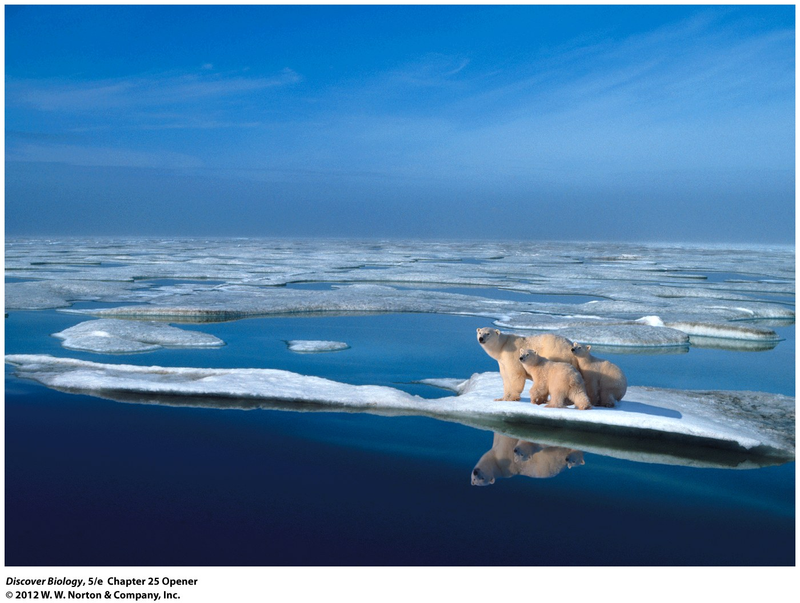
Notes:
Top of the Food Chain, Top of the World.
As global warming melts the Arctic ice cap, receding summer ice is increasingly leaving polar bears stranded on land or ice floes. Some bears are moving south into Canada and Alaska, but global warming may also affect the bears in a surprising way—by damaging marine food chains from the bottom up.

Slide 3
Is the Cupboard Bare?
Ecologists report that global populations of tiny organisms called phytoplankton, an integral part of the marine food web, have declined by 40 percent since the 1950s
With the stress of warmer temperatures and the decrease in phytoplankton, polar bears are facing unprecedented challenges
The expanding human population is dramatically affecting the biosphere in many ways

Slide 4
On Land and Sea and Sky, Our World Is Changing
We know with certainty that global change, a worldwide change in the environment, is occurring
Worldwide evidence of a decline in biodiversity has been documented and pollution has altered ecosystems throughout the world
Climate change is a large-scale and long-term alteration in Earth’s climate, much of which is caused by human activities

Slide 5
Land and Water Transformation
The physical and biotic changes that people make to the land surface of Earth are referred to as land transformation or land-use change
Land transformation includes the destruction of natural habitat to allow for resource use, agriculture, or urban growth
Water transformation refers to physical and biotic changes that people make to the waters of our planet
The local effects of land and water transformation add up to have a global impact

Slide 6
There Is Ample Evidence of Land and Water Transformation
Aerial photos, satellite data, changing urban boundaries, and local instances of the destruction of natural habitats illustrate that land and water transformation are being caused by human actions and are global in scope
The destruction of tropical rainforests and the conversion of grasslands into cropland illustrate human effects on ecosystems
Estuaries, saltwater marshes, mangrove swamps, and coastal shelf waters are among the most productive ecosystems on Earth yet are severely threatened by urban development, sewage, nutrient runoff, pollution, and overfishing

Slide 7
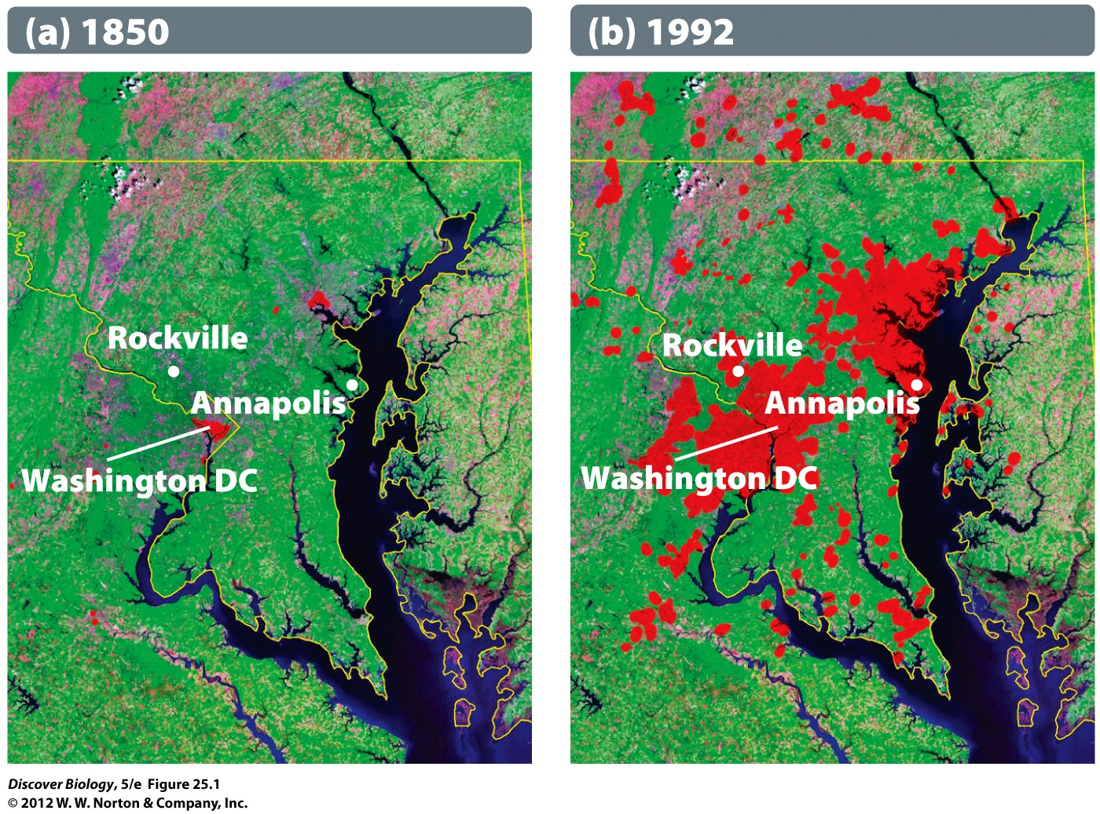
Notes:
Figure 25.1 Land Transformation
Change in the boundaries (in red) of urban regions near Washington, DC, between 1850 (a) and 1992 (b).

Slide 8
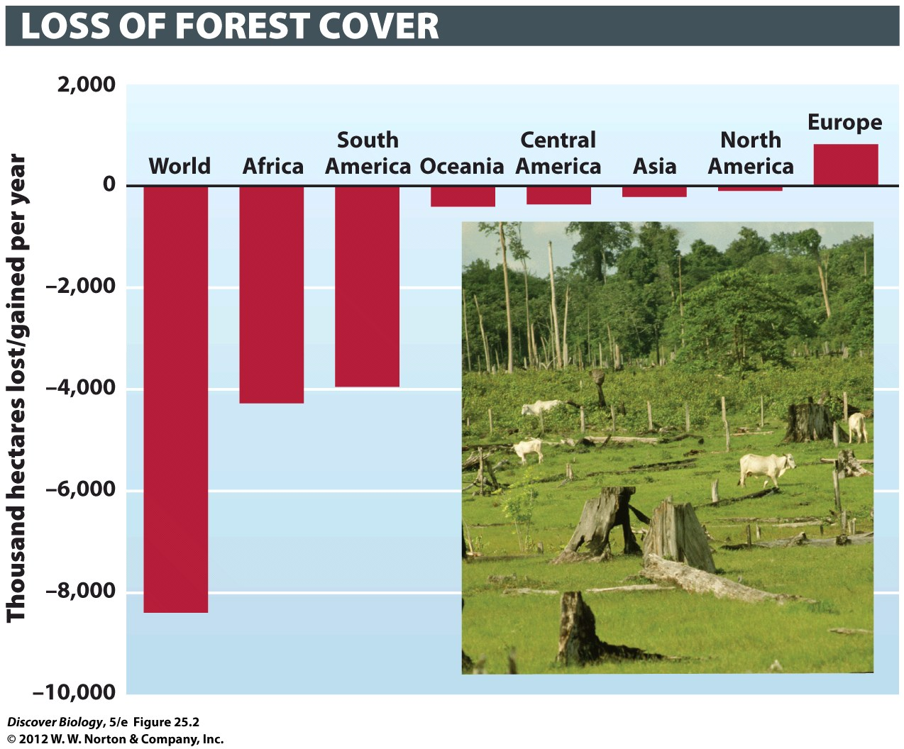
Notes:
Figure 25.2 Disappearing Forests
This graph, based on data from the United Nations Food and Agriculture Organization (FAO), shows that forest cover has shrunk in most regions of the world, except Europe. Asia’s relatively good standing is due largely to extensive reforestation efforts in China over the past few years. The inset shows cattle grazing on land previously covered by Amazonian rainforest, in Para, Brazil.

Slide 9
Land and Water Transformation Have Important Consequences
Humans now control roughly 30–35 percent of the world’s NPP, thereby reducing the amount of land and resources available to other species
Overfishing and pollution can affect the abundances and types of species found in the world’s aquatic ecosystems
The transformation of land and water can also affect local climates in ways that may not be reversible

Slide 10
Changes in the Chemistry of Earth
Life on Earth depends on, and is heavily influenced by, the cycling of nutrients in ecosystems
Naturally occurring chemicals, such as nitrogen and phosphorus, are important in the production of NPP in ecosystems

Slide 11
Bioaccumulation Concentrates Pollutants up the Food Chain
Chemicals released by humans can accumulate in an organism at concentrations higher than in the surrounding abiotic environment, a process called bioaccumulation
Long-lived organic molecules of synthetic origin that bioaccumulate in organisms and can have harmful effects are classified as persistent organic pollutants (POPs)

Slide 12
Bioaccumulation Concentrates Pollutants up the Food Chain
Biomagnification is the increase in tissue concentrations of a chemical as organic matter is passed up successively higher trophic levels in a food chain
Chemicals that show biomagnification are not easily excreted by animals because they bind to macromolecules such as proteins or fats
Organisms at the top of the food chain usually have the highest tissue concentration of biomagnified chemicals

Slide 13
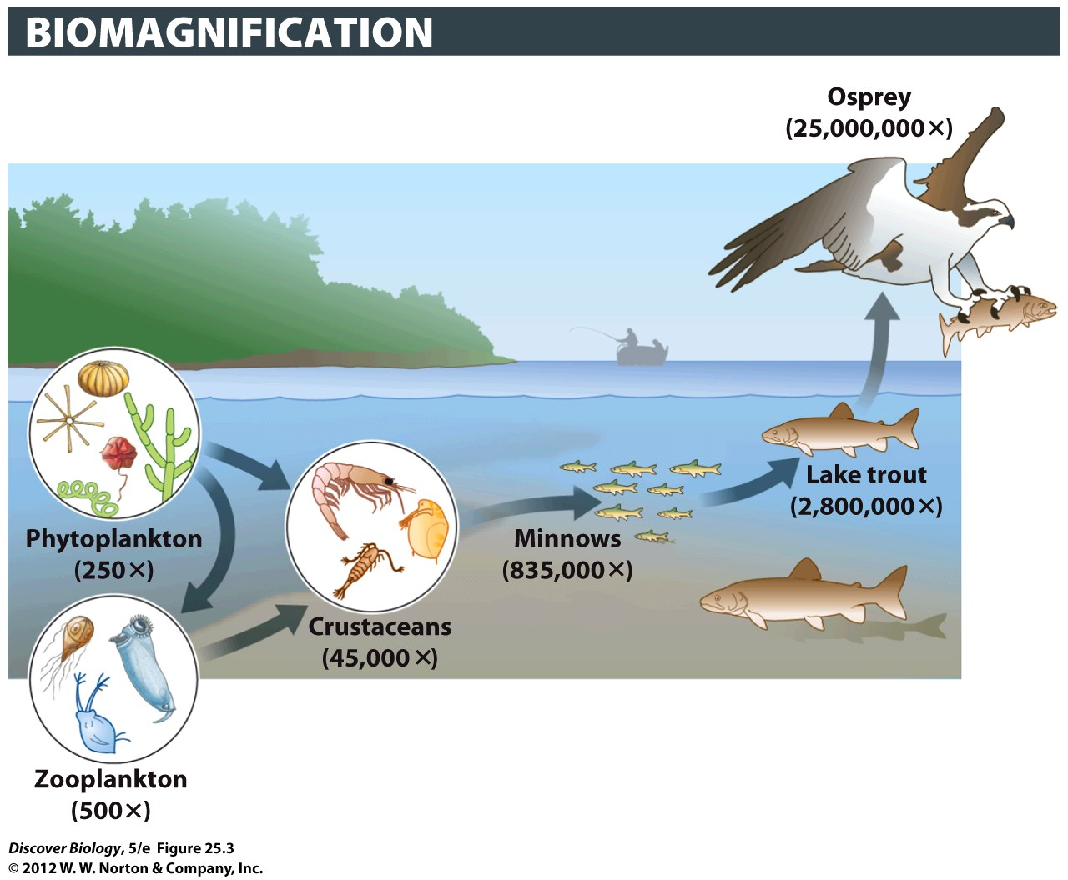
Notes:
Figure 25.3 PCB Levels Become More Concentrated in Consumers Higher in the Food Chain

Slide 14
Many Pollutants Cause Changes in the Biosphere
Chlorofluorocarbons (CFCs) have caused a decrease in the thickness of the atmospheric ozone layer across the globe and contributed to the ozone hole above Antarctica
Fortunately, a worldwide response to this issue has led to a ban on CFCs in many countries and the beginning of a recovery in the ozone layer

Slide 15
Changes in Global Nutrient Cycles
All humans have had a hand in changing the world’s nutrient cycles to some extent
Carbon dioxide, nitrogen, phosphorus, and sulfur are the chemicals we add to our environment in the largest quantities

Slide 16
Humans Use Technology to Fix Nitrogen
In nature, certain bacteria convert atmospheric nitrogen gas into an organic form through the process of nitrogen fixation
The amount of nitrogen fixed by human activities, mainly as a result of the industrial production of fertilizers, far exceeds the amount fixed by all natural processes combined
When nitrogen is added to land, NPP usually increases but the number of species often decreases because the species best able to use the extra nitrogen outcompete the others

Slide 17
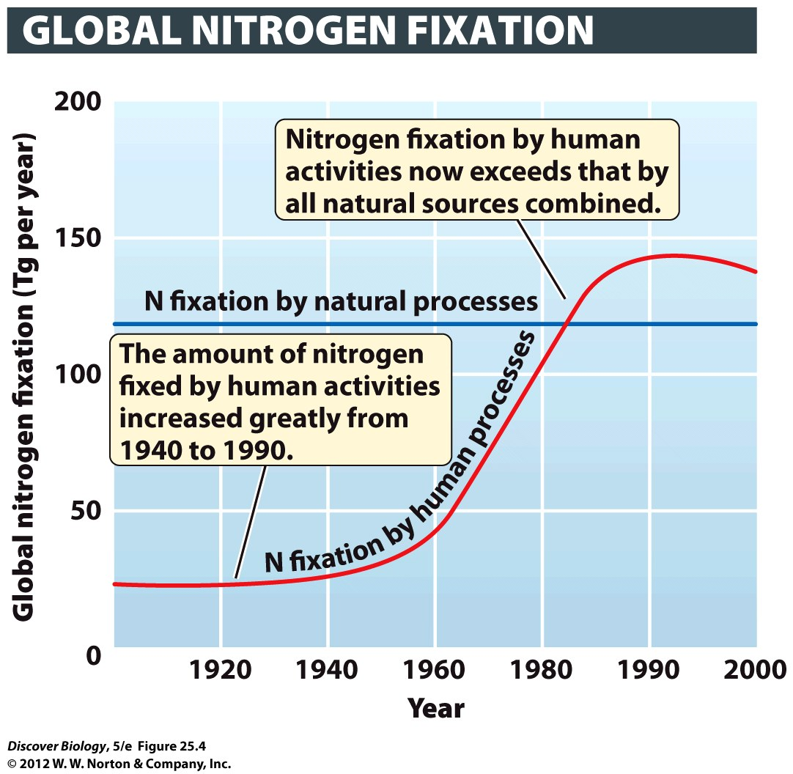
Notes:
Figure 25.4 Human Impact on the Global Nitrogen Cycle
Nitrogen is fixed naturally by bacteria and by lightning at a rate of about 130 teragrams (Tg) per year (1 Tg = 1,012 grams, or 1.1 million tons). Human activities such as the production of fertilizers now fix more nitrogen than do all natural sources combined.

Slide 18
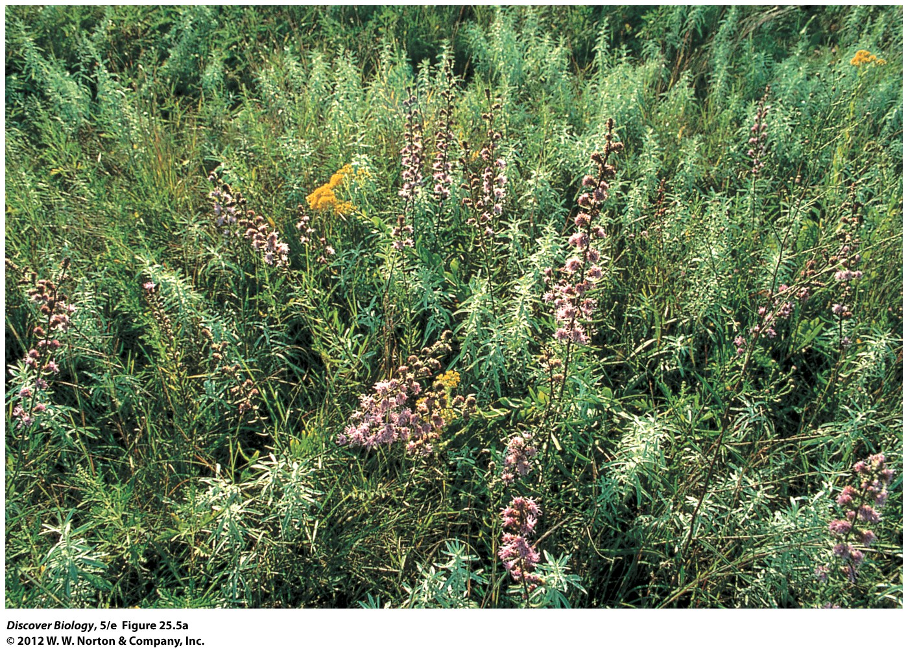
Notes:
Figure 25.5a A Nitrogen Addition Experiment
Native grasslands in Minnesota often have 20–30 plant species per square meter. (a) No nitrogen was added to this control plot, and it lost no species between 1984 and 1994.

Slide 19
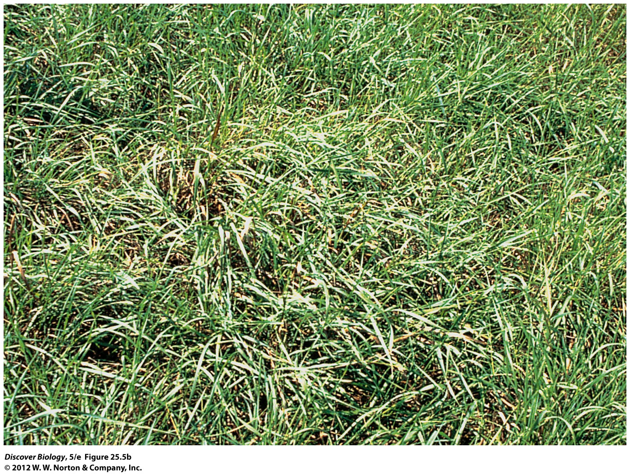
Notes:
Figure 25.5b A Nitrogen Addition Experiment
Native grasslands in Minnesota often have 20–30 plant species per square meter. (b) Researchers added nitrogen to this nearby experimental plot during the same time period. Most of the native species disappeared from this plot, and an introduced species, European quack grass, became dominant.

Slide 20
Atmospheric Carbon Dioxide Levels Have Risen Dramatically
CO₂ is an atmospheric gas essential for photosynthesis; however, it also contributes to the global warming process
CO₂ levels have risen greatly over the past 200 years and most significantly in recent years
The dramatic rise in CO₂ in recent years is due to the burning of fossil fuels (75 percent), the logging and burning of forests (nearly 25 percent), and industrial processes (a small percentage)

Slide 21
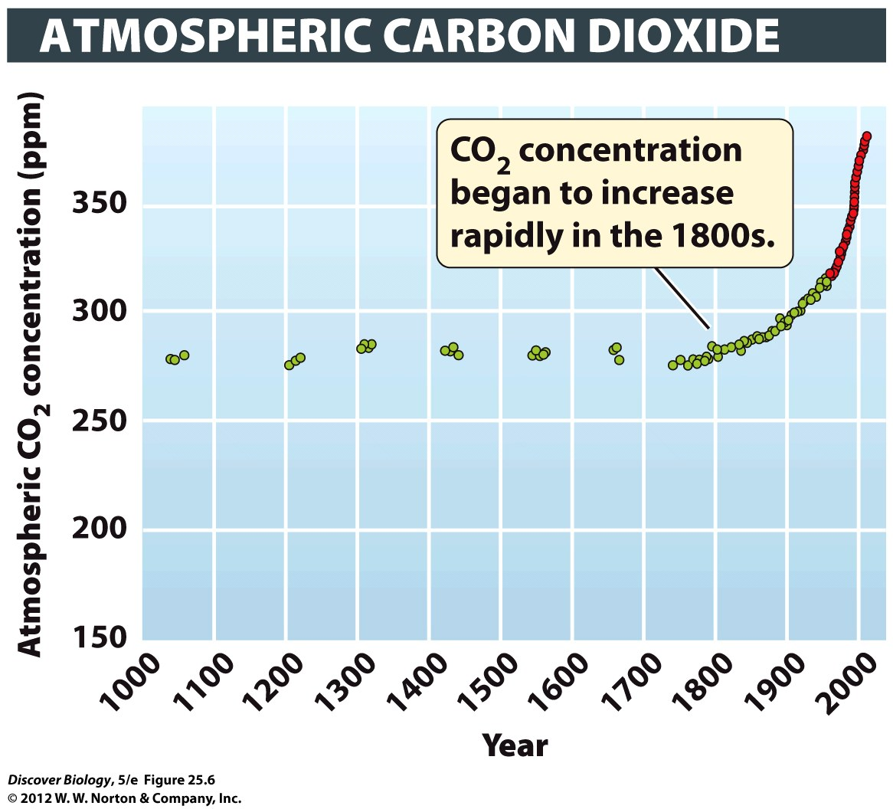
Notes:
Figure 25.6 Atmospheric CO₂ Levels Are Rising Rapidly
Atmospheric CO₂ levels (measured in parts per million, or ppm) have increased greatly in the past 200 years. The red circles are direct measurements at the Mauna Loa Observatory in Hawaii, at 11,135 feet above sea level. The green circles indicate CO₂ levels measured from bubbles of air trapped in ice that formed many hundreds of years ago.

Slide 22
Increased Carbon Dioxide Concentrations Have Many Biological Effects
Many plants increase their rate of photosynthesis, and therefore grow more rapidly, when more CO₂ is available
Species that maintain rapid growth at high CO₂ levels may outcompete other species in their current ecological communities
Differences in how individual species respond to higher CO₂ levels may cause changes to entire communities

Slide 23
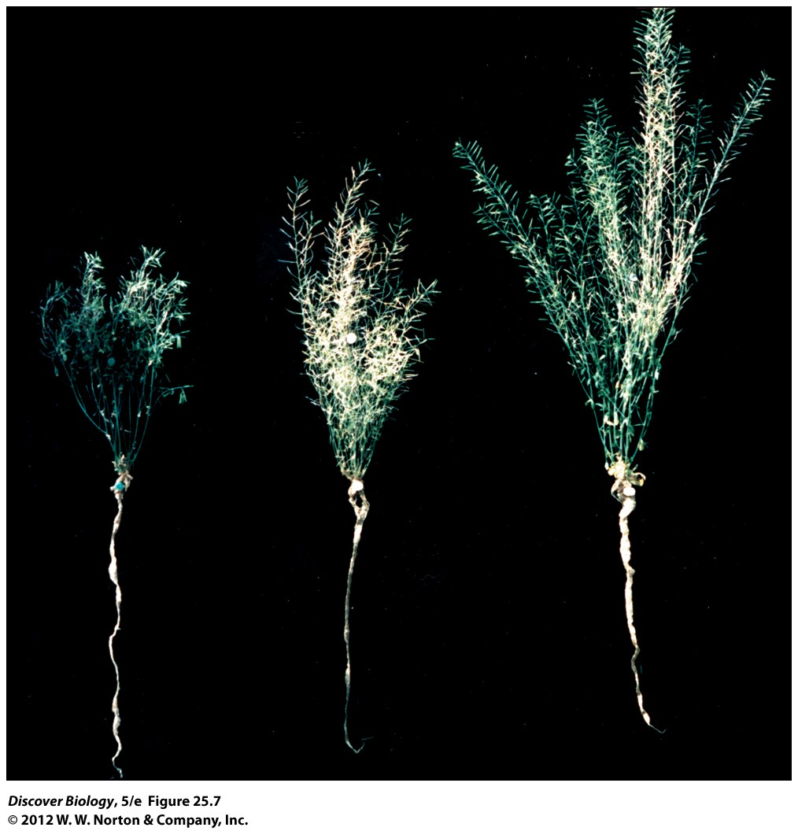
Notes:
Figure 25.7 High CO₂ Levels Can Increase Plant Size
These three Arabidopsis thaliana plants all have the same genotype but were grown under different CO₂ concentrations: (a) 200 ppm, a level similar to that found roughly 20,000 years ago; (b) 350 ppm, the level found in 1988; and (c) 700 ppm, a predicted future level. Notice that plants grew larger at higher

Slide 24
Climate Change
Greenhouse gases, such as carbon dioxide, water vapor, methane, and nitrous oxide, let sunlight into Earth’s atmosphere but trap heat, causing the greenhouse effect
Once trapped, heat absorbed by greenhouse gasses cannot escape into outer space
As the concentration of greenhouse gases in the atmosphere increases, more heat is trapped, raising temperatures on Earth

Slide 25
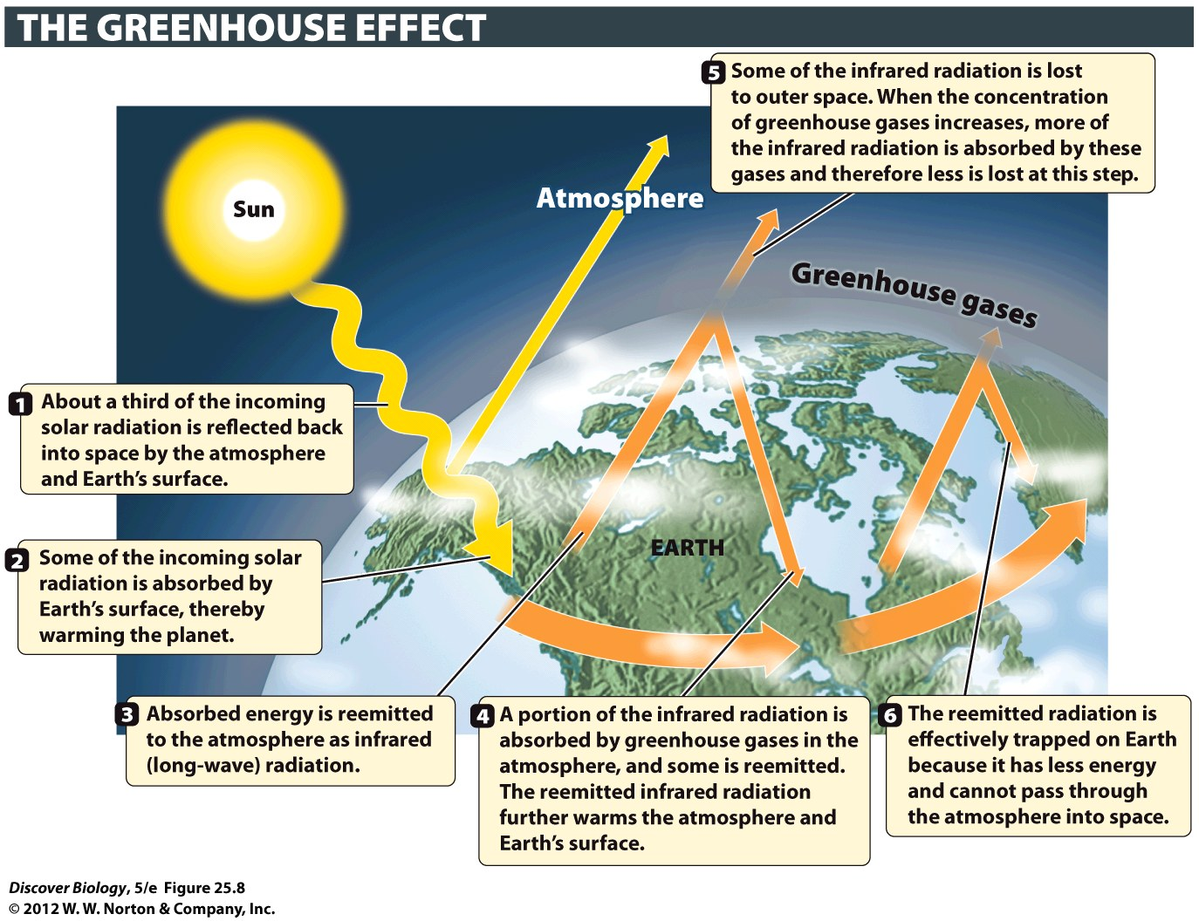
Notes:
Figure 25.8 How Greenhouse Gases Warm the Surface of Earth

Slide 26
Global Temperatures Are Rising
Global warming describes the warming trend in Earth’s climate, which increased an average of 0.75°C between 1906 and 2005
Most scientists agree global warming is the result of human-caused increases in the concentration of CO2 and other greenhouse gases in the atmosphere

Slide 27
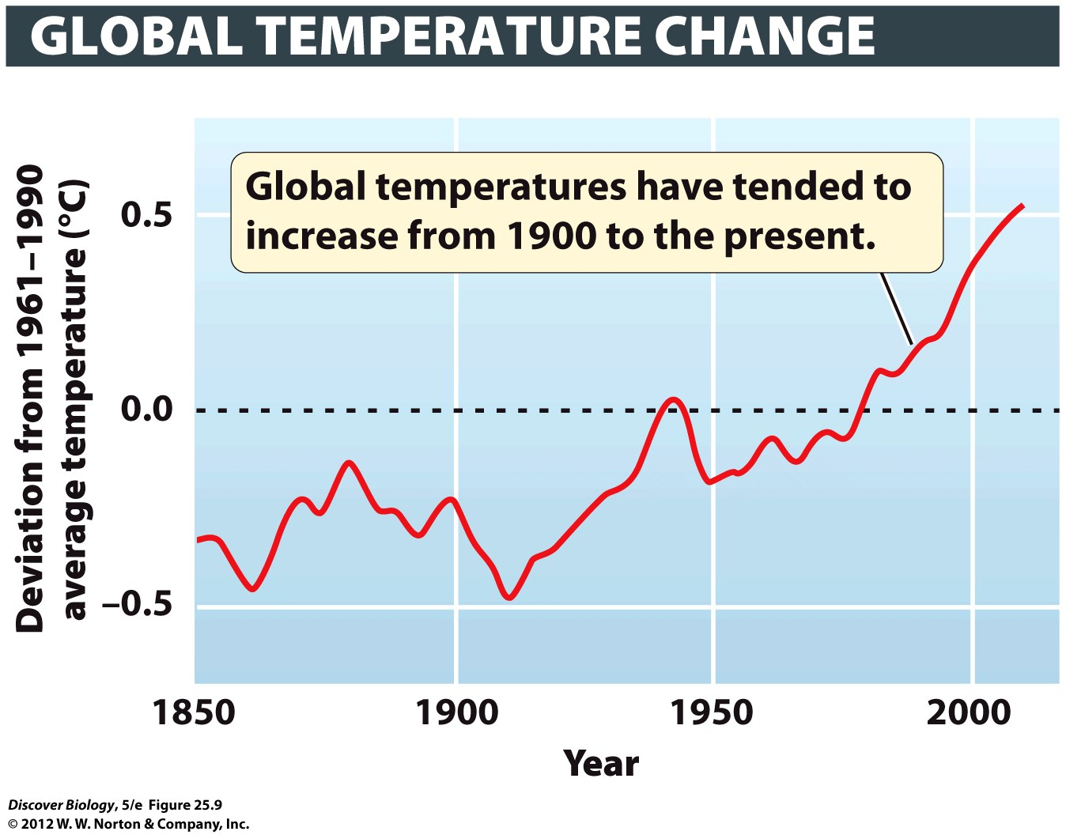
Notes:
Figure 25.9 Global Temperatures Are on the Rise
Global air temperatures are plotted relative to the average temperature between 1961 and 1990 (dashed line). Portions of the curve below and above the dashed line represent lower-than average and higher-than-average temperatures, respectively.

Slide 28
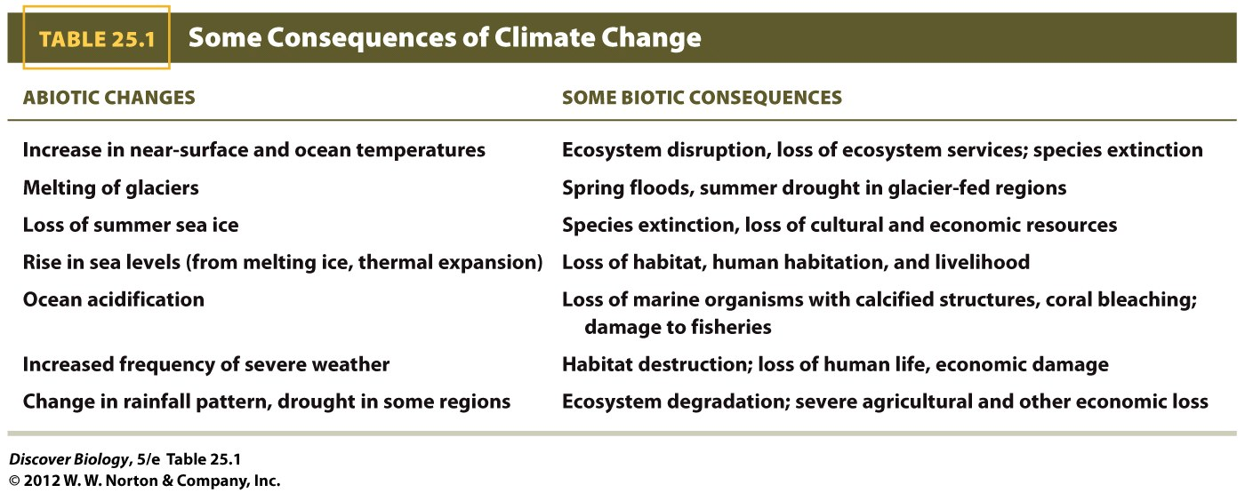

Slide 29
Some Predicted Consequences of Climate Change Are Now Being Seen
Long-term and large-scale changes in the state of Earth’s climate are broadly known as climate change
As a result of climate change, satellite images show that Arctic sea ice has been declining by 2.7 percent per decade since 1978, sea levels have been rising, and the pH of the world’s oceans has declined from an average value of about 8.25 to 8.14
The additional heat energy trapped in Earth’s atmosphere has led, and will continue to lead, to an increase in the frequency of severe weather

Slide 30
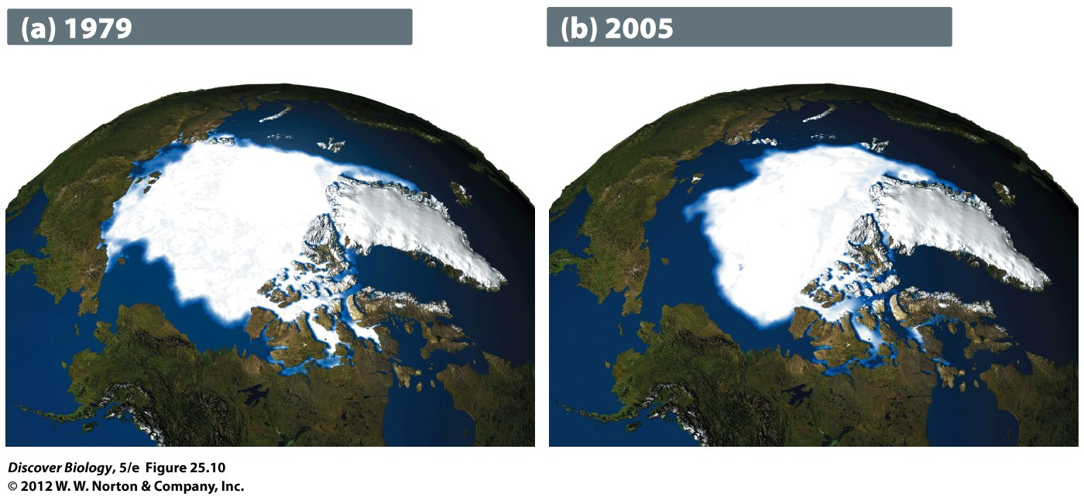
Notes:
Figure 25.10 The Extent of Polar Sea Ice Has Declined Sharply
Summer sea ice in the Arctic has declined by almost 25 percent compared to preindustrial levels. Climate change has affected wind and ocean currents in different ways across the globe, which explains why the Antarctic ice sheet is relatively stable. The satellite-based illustrations show the extent of the polar ice cap in the Arctic and the ice sheet on Greenland in the summer of 1979 (a) and the summer of 2005 (b). Courtesy NASA.

Slide 31
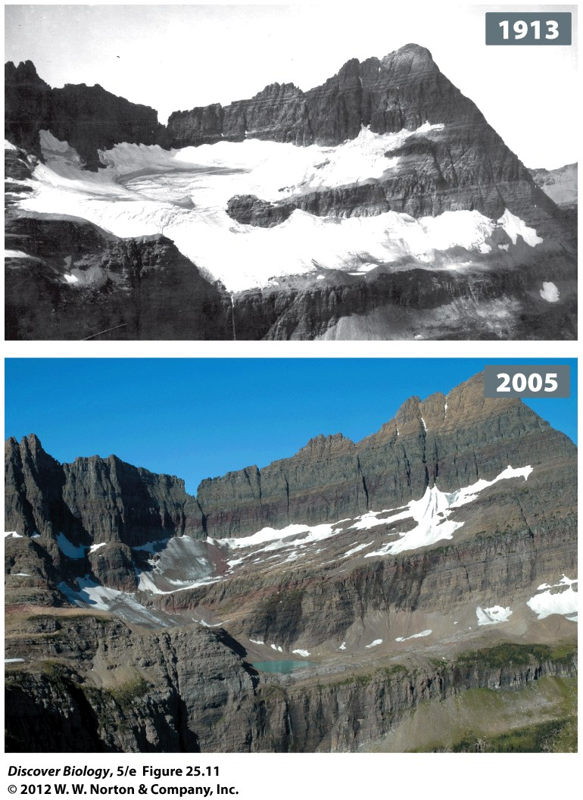
Notes:
Figure 25.11 Many Glaciers Are in Retreat
The photos compare the extent of Shepard Glacier over time in Glacier National Park, Montana. Most of the world’s glaciers are in retreat, although some, especially in parts of South America and Central Asia, are either stable or growing slightly.

Slide 32
Climate Change Has Brought Many Species to the Brink
The temperature increases have also changed the biotic component of some ecosystems
Many northern ecosystems are shifting poleward and some are running out of room to migrate
About a third of the tropical coral reefs have been destroyed in the last few decades by coral bleaching, pollution, and physical damage from severe storms

Slide 33
Climate Change Has Brought Many Species to the Brink
Species with specialized habitat requirements, like those in the tropics, are most vulnerable to climate changes
Organisms that have broader tolerances and can live in a variety of habitats, such as weeds and pests, are most likely to survive and even expand their range

Slide 34
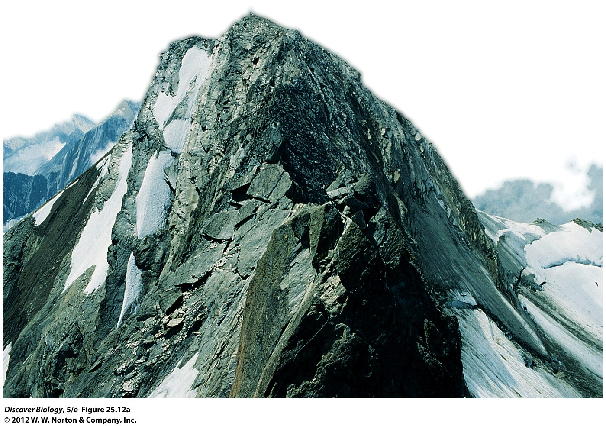
Notes:
Figure 25.12a Running Out of Altitude
Alpine species such as the mountain androsace (a) and pika (b) are adapted to cold, high-elevation habitats. These species have been increasing their range upslope in the past few decades, but scientists fear that they will soon run out of options as they reach the tops of mountain peaks. Pikas live in boulder-strewn talus slopes in the highest reaches of the alpine zone. With their dense fur, these rodents suffer heat stress at temperatures that we would consider cool.

Slide 35
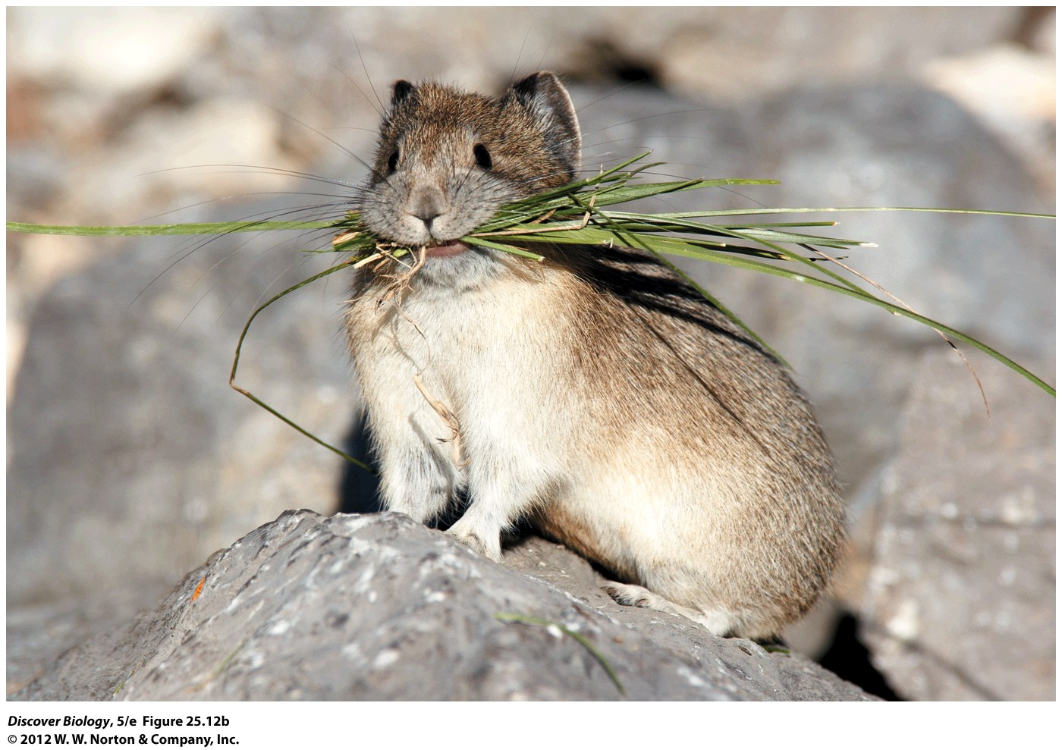
Notes:
Figure 25.12b Running Out of Altitude
Alpine species such as the mountain androsace (a) and pika (b) are adapted to cold, high-elevation habitats. These species have been increasing their range upslope in the past few decades, but scientists fear that they will soon run out of options as they reach the tops of mountain peaks. Pikas live in boulder-strewn talus slopes in the highest reaches of the alpine zone. With their dense fur, these rodents suffer heat stress at temperatures that we would consider cool.

Slide 36
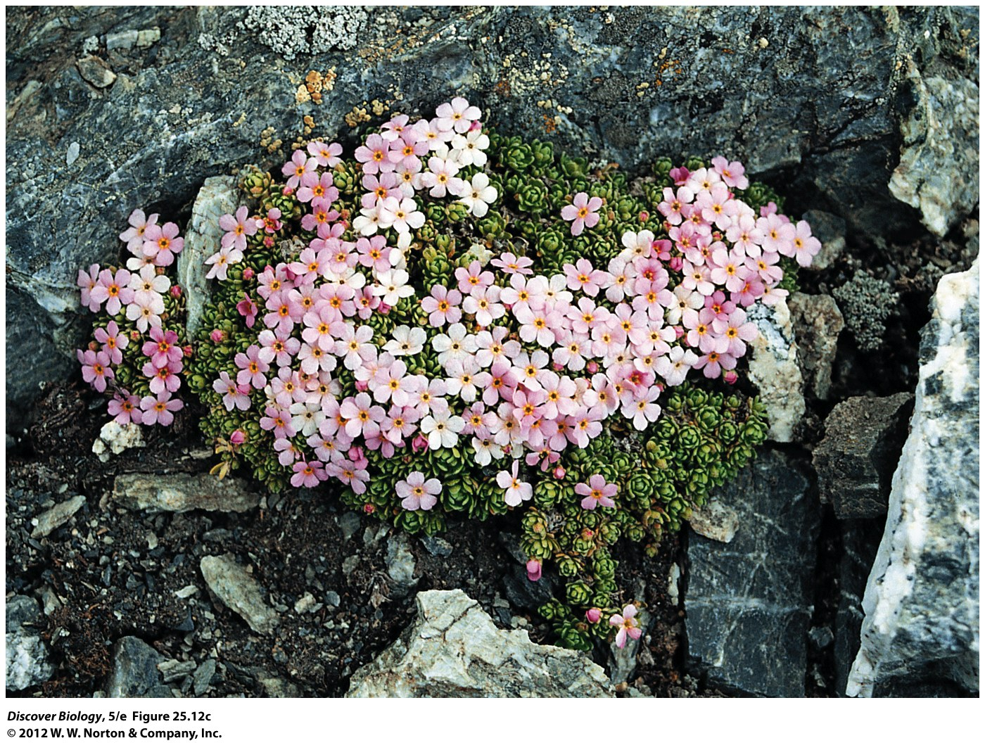
Notes:
Figure 25.12 (inset) Running Out of Altitude
Alpine species such as the mountain androsace (a) and pika (b) are adapted to cold, high-elevation habitats. These species have been increasing their range upslope in the past few decades, but scientists fear that they will soon run out of options as they reach the tops of mountain peaks. Pikas live in boulder-strewn talus slopes in the highest reaches of the alpine zone. With their dense fur, these rodents suffer heat stress at temperatures that we would consider cool.

Slide 37
Climate Change Will Likely Have Severe Consequences
The current trend of increasing global temperatures seems likely to continue and the effects will depend on how much, and how fast, global warming occurs
Scientists predict average temperatures on Earth will have risen by anywhere from 1.1°C to 6.4°C (2°–11.5°F) by the end of the twenty-first century
By the end of the century, summer sea ice in the Arctic is likely to have disappeared, severe weather is expected to become more common, and many species will probably have become extinct

Slide 38
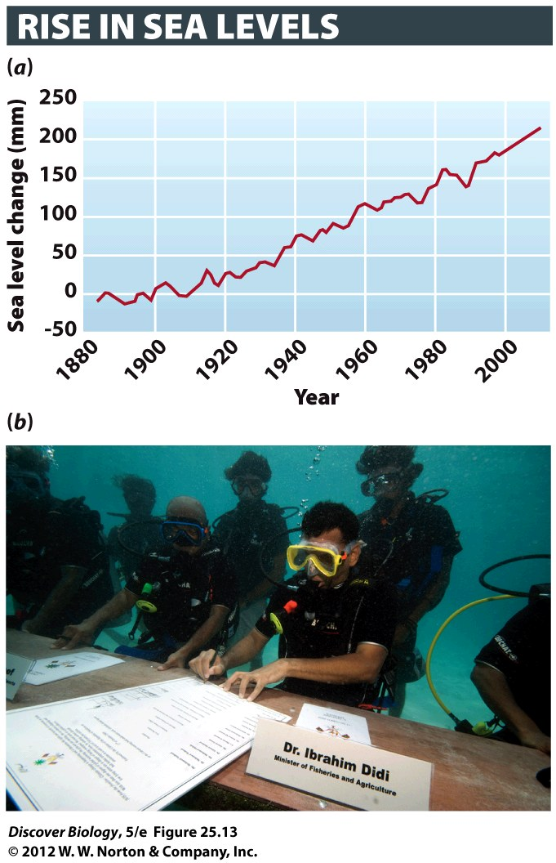
Notes:
Figure 25.13 Thermal Expansion Combined with Ice Melt Has Raised Sea Levels
(a) Average sea levels have risen by about 200 millimeters since the start of the industrial revolution in 1880. By 2100, sea levels are expected to be between 500 and 1,400 millimeters higher than preindustrial levels. (b) The prime minister of the Maldives held an underwater cabinet meeting in 2009 to draw international attention to the threat that climate change presents to his island nation. The Maldive Islands, an archipelago of atolls and islets in the Indian Ocean, are so low-lying that they are likely to be submerged by 2100 if sea levels continue to rise at their current rate.

Slide 39
Timely Action Can Avert the Worst-Case Scenarios
Experts say the worst-case scenarios can be averted by timely action using technology that is already available
The keys to minimizing climate changes are:
Reduced use of fossil fuels
Increased energy efficiency
Increased reliance on renewable energy

Slide 40
Bye-Bye, Food Chain?
Every organism on Earth depends on the work of phytoplankton, which supply all of the energy for marine food chains and about half of all newly generated oxygen
Scientists agree that phytoplankton populations have declined and that the decline is related to global warming and ocean acidification; however, they disagree as to the extent of the decline

Slide 41
Clicker Questions
CHAPTER 25
Global Change

Slide 42
Concept Quiz
Fertilizers help plants grow, but why can they be considered bad?
The plant growth being measured is usually a single species and many other species may be harmed by the effects of the fertilizer.
The nitrogen-fixing bacteria will lose their essential role and will be lost.
They can be made into bombs.
Notes:
The correct answer is A because one must consider the ecological impact of as many different species as possible. Simply improving the growth of one plant may be detrimental to other species important for the ecosystem.
Answer B: Human introduction of converted nitrogen is hurting the balance of many other species, but the nitrogen-fixing bacteria will continue to play an important role in the Earth’s natural nitrogen cycle.
Answer C: It is true that truckloads of fertilizer have been used as a nitrogen source for explosions. However, that is not the direct environmental impact which is the focus of this chapter.

Slide 43
Concept Quiz
If the Earth is experiencing global warming, then why is it so cold in Duluth, Minnesota, in January?
Greenhouse gases do not affect the air currents of the northern hemisphere.
Global warming is measured over long periods of time on a much larger scale.
Global warming only applies to the increased infrared heat which enters through the ozone holes over Antarctica.
Notes:
The correct answer is B. It can still be cold in the northern climates. However, even those areas are showing signs of an overall warmer average temperature. Warm climate insects are moving into otherwise disease-free Boreal forests. Vegetation changes in tundra regions of the Arctic over a 40 year period indicate warmer temperatures. Animal migrations have changed over the years to accommodate warmer climates.
Answer A: The greenhouse gases trap radiant heat which normally leaves the Earth’s atmosphere. It is not necessarily a measurement of air currents in specific areas of the atmosphere.
Answer C: Do not confuse the issue of ozone holes caused by chemicals such as CFCs which lead to increased ultraviolet radiation with the greenhouse effect caused by gases trapping infrared heat in the Earth’s atmosphere. And by the way, ozone holes are not a solution for releasing the trapped infrared heat!

Slide 44
Concept Quiz
Plants need CO₂ for photosynthetic processes. Isn’t it beneficial for plants to have more CO₂ emissions?
Yes
No
Yes, but…
Notes:
The correct answer is C. Although certain plants may benefit, overall it changes the ecological balance which was achieved with “normal” levels of carbon dioxide emissions prior to the burning of fossil fuels and the change in the Earth’s forest populations.
Answer A is incorrect, because many plants will increase photosynthetic activity as a result of higher carbon dioxide levels but that may lead to an imbalance in plant growth as not all plants respond to same.
Answer B is incorrect. Individually it might be better for a plant to have higher levels, but one must balance the impact on all species.

Slide 45
Relevant Art from Other Chapters
All art files from the book are available in JPEG and PPT formats online and on the Instructor Resource Disc

Slide 46
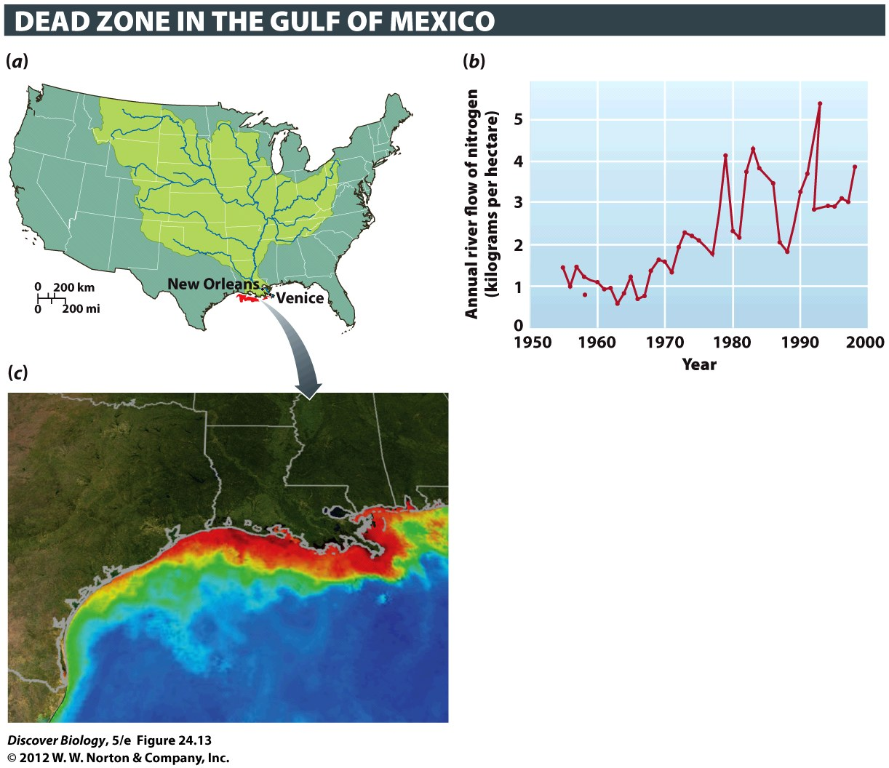
Notes:
Figure 24.13 Nutrient Loading Can Deplete Oxygen in Aquatic Ecosystems
The Mississippi and Atchafalaya river basins drain nearly 40 percent of U.S. land area (a). Since the 1970s, large amounts of nitrogen (N) from fertilizer, sewage, and industrial by-products have entered waters within these watersheds. The resulting nutrient addition can be measured as the amount of nitrogen flowing past particular points on the Mississippi per year (b). This nitrogen then drains into the Gulf of Mexico, where each summer the extra nutrients create a large dead zone (c) in which virtually all animals are killed. The image, based on satellite photos from NASA, shows ocean turbidity and chlorophyll concentrations. Red and orange represent high concentrations of phytoplankton and river sediment.

Slide 47
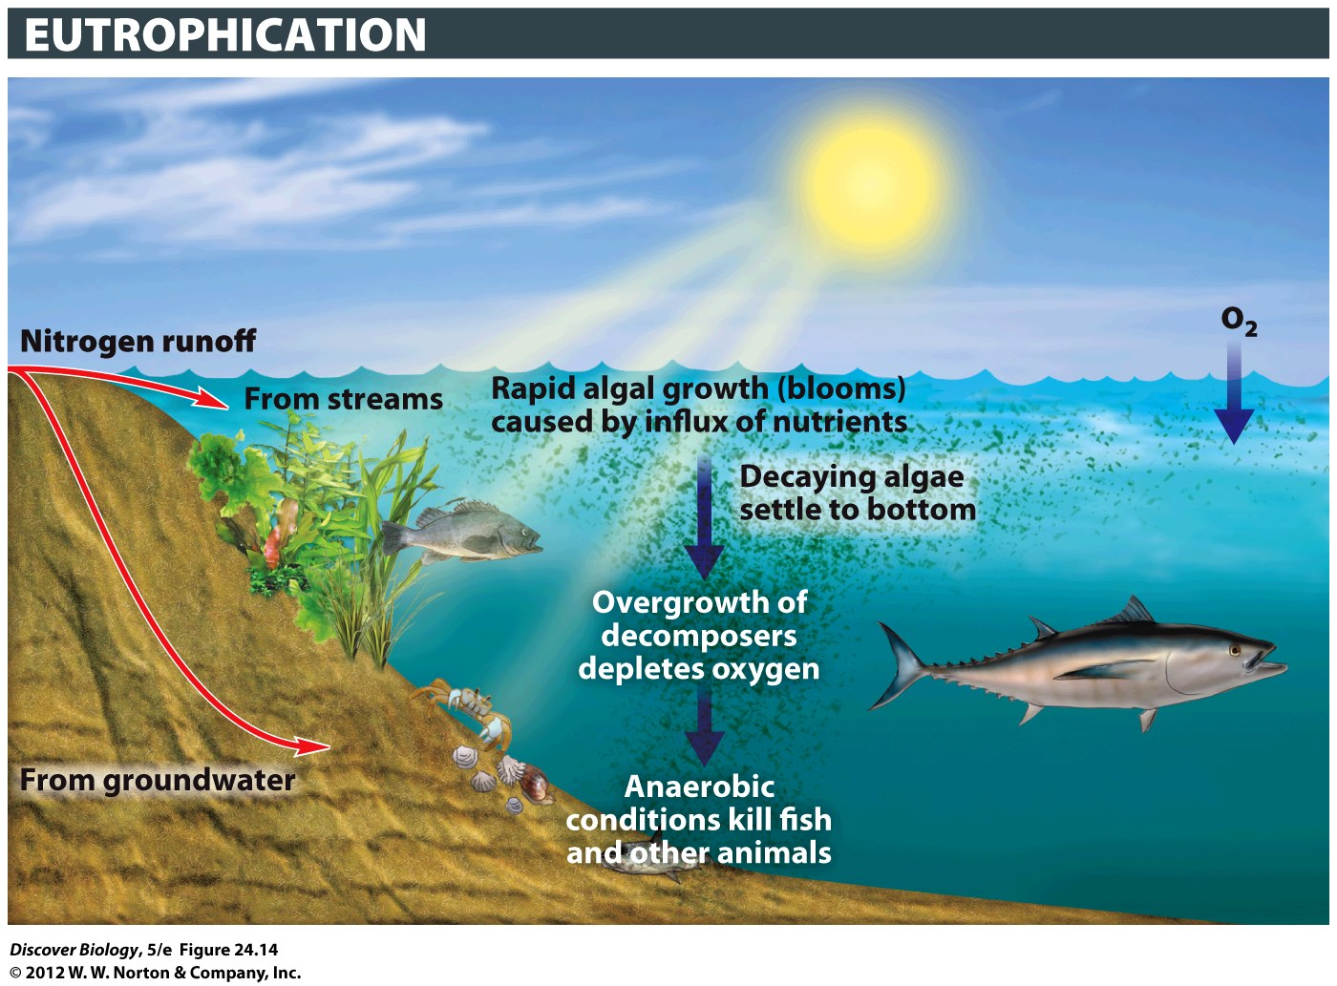
Notes:
Figure 24.14 Eutrophication Can Be Too Much of a Good Thing
Large inputs of nutrients such as nitrogen and phosphorus can cause a population boom in photosynthetic plankton (algae). Dying algae in turn trigger explosive growth of oxygen-consuming decomposers, choking off the oxygen supply for animals.

Slide 48
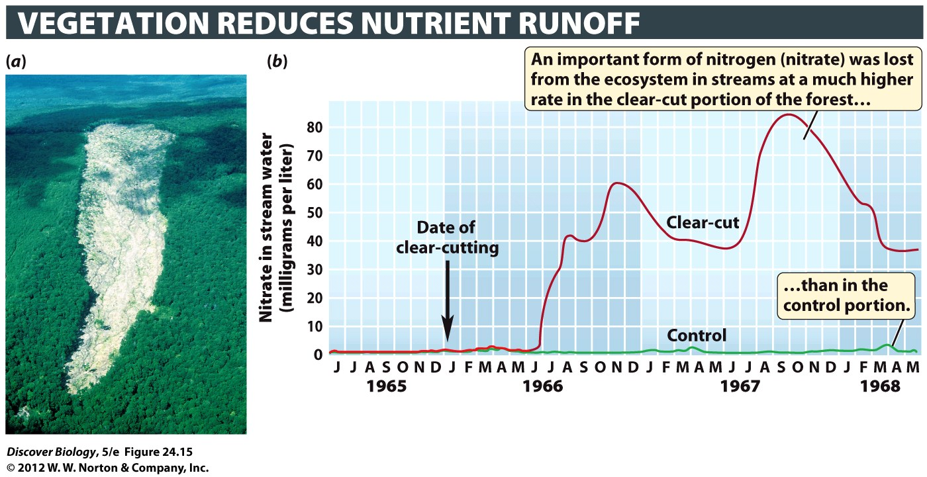
Notes:
Figure 24.15 Altering Nutrient Cycles in a Forest Ecosystem
(a) This portion of the Hubbard Brook Experimental Forest in New Hampshire has been clearcut. (b) A portion of the forest was first clear-cut and then sprayed with herbicides for 3 years to prevent regrowth. A second portion of the forest was not clear-cut or sprayed and served as a control plot. Nitrate, a form of nitrogen that is important to plants, was lost from the ecosystem in streams at a much higher rate in the clear-cut portion of the forest than in the control portion. (The loss of nitrate was measured in milligrams of nitrate in the stream per liter of water.)

Slide 49
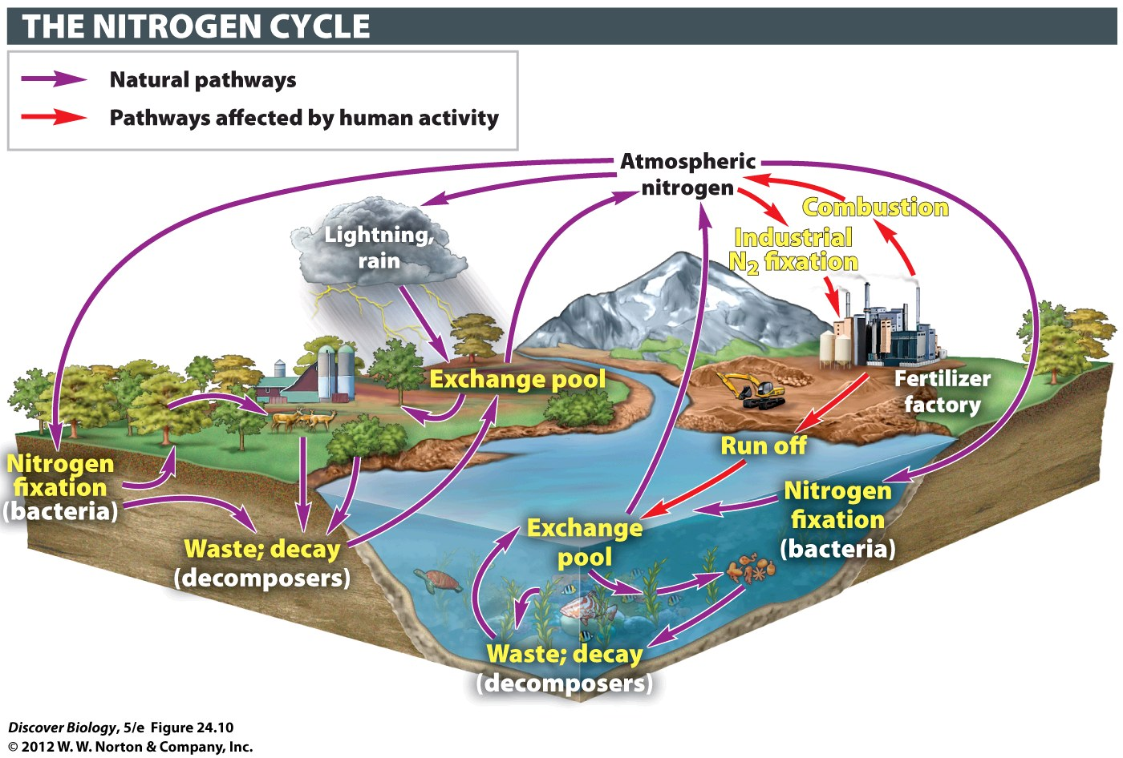
Notes:
Figure 24.10 The Nitrogen Cycle

Slide 50
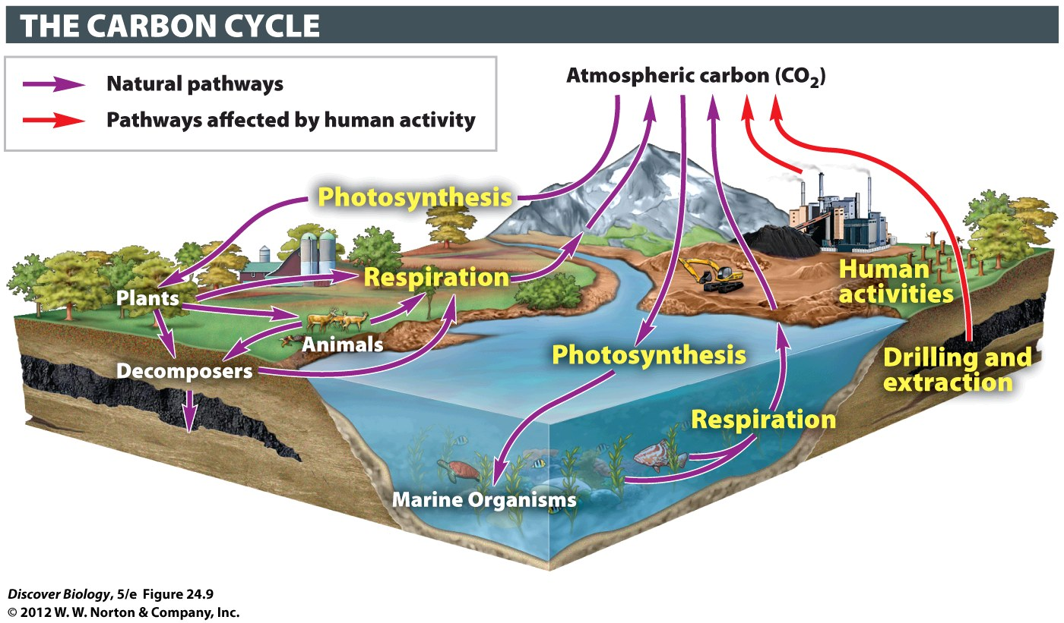
Notes:
Figure 24.9 The Carbon Cycle

