Slide 1
Discover Biology FIFTH EDITION
Anu Singh-Cundy • Michael L. Cain
CHAPTER 24
Ecosystems
© 2012 W. W. Norton & Company, Inc.

Slide 2
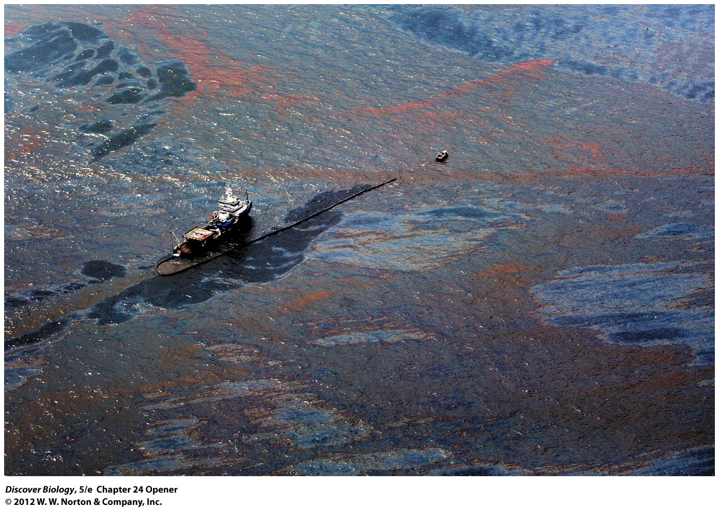
Notes:
A Massive Oil Slick.
In 2010, an explosion at the BP Deepwater Horizon deep-sea oil-drilling rig in the Gulf of Mexico resulted in a gigantic oil spill that coated thousands of square miles of ocean and destroyed marine life throughout the northern Gulf of Mexico and along 125 miles of coastline.

Slide 3
Deepwater Horizon: Death of an Ecosystem?
In 2010, the Deepwater Horizon oil-drilling rig exploded, releasing 5 billion barrels of crude oil into the Gulf of Mexico in a plume that stretched 22 miles under the ocean’s surface
Ecologists predicted unprecedented damage to the Gulf ecosystem food chains similar to the long-term effects of the Exxon Valdez oil spill in Alaska

Slide 4
To Survive, All Organisms Need Energy
Most organisms depend directly or indirectly on solar energy as well as carbon, hydrogen, oxygen, and other organic elements in order to maintain life
Ecosystem ecology is the study of how energy and materials are used in natural systems

Slide 5
How Ecosystems Function: An Overview
An ecosystem consists of communities of organisms and the physical environment they share
The biotic portion of an ecosystem refers to the interacting living organisms: prokaryotes, protists, animals, fungi, and plants
The abiotic portion of an ecosystem is the physical environment that surrounds the biotic community: the atmosphere, water, and Earth’s crust

Slide 6
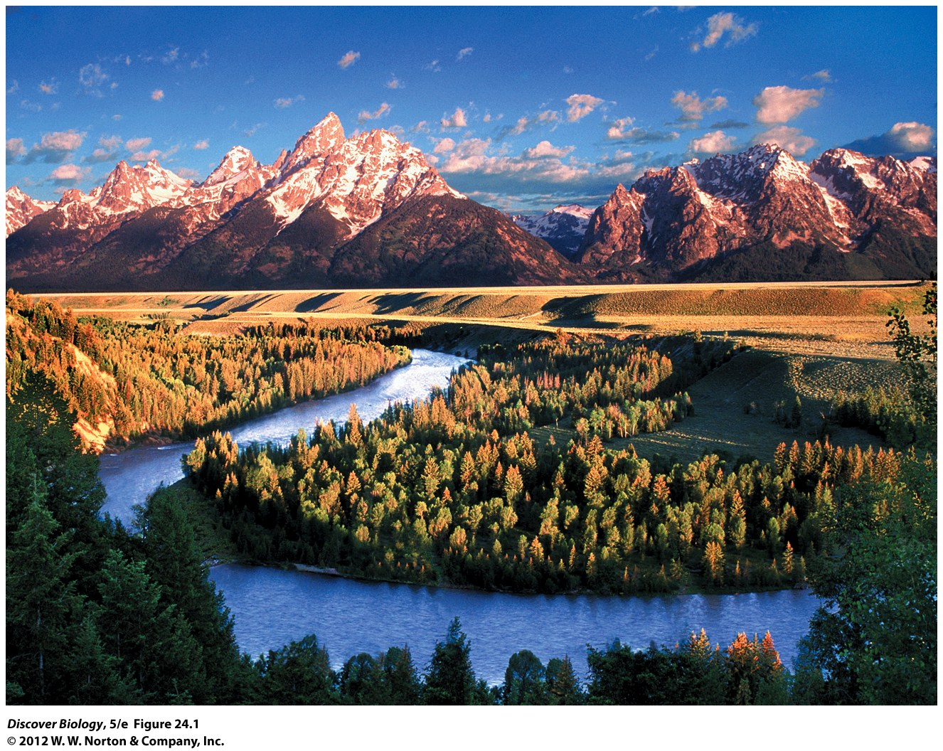
Notes:
Figure 24.1 Ecosystems in the Snake River valley, near Jackson Hole, Wyoming
How many ecosystems can you discern in this photo? What is the energy base in each of these ecosystems? Name some abiotic factors that are likely to affect the organisms living in the ecosystems you identified.

Slide 7
How Ecosystems Function: An Overview
Ecologists define ecosystems mainly by the means through which energy is acquired by the biotic community
At each step in a food web, a portion of the energy captured by producers is lost as metabolic heat
Energy flows in only one direction through ecosystems

Slide 8
How Ecosystems Function: An Overview
Nutrients are chemical elements required by living organisms and are largely recycled between living organisms and the physical environment
Earth has a finite amount of nutrients that are absorbed from the environment by producers, cycled among different types of consumers for varying lengths of time, and eventually returned to the environment
The physical, chemical, and biological processes that link the biotic and abiotic worlds in an ecosystem are known as ecosystem processes

Slide 9
Notes:
Figure 24.2 How Ecosystems Work
At each step in a food chain, a portion of the energy captured by producers is lost as metabolic heat (indicated by the red arrows). Therefore, energy flows through the ecosystem in a single direction and is not recycled (yellow, orange, and red arrows). In contrast, nutrients such as carbon and nitrogen cycle between organisms and the physical environment (blue arrows).

Slide 10
Energy Capture in Ecosystems
With few exceptions, life on Earth depends directly or indirectly on the capture of solar energy by producers
The sun is the main source of energy in most terrestrial and aquatic ecosystems

Slide 11
Ecosystems Depend on Energy Captured by Producers
Plants and other photosynthetic organisms store energy captured from the sun in chemical compounds such as carbohydrates
The overall amount of energy captured by producers influences the amount of food available to other organisms in the ecosystem

Slide 12
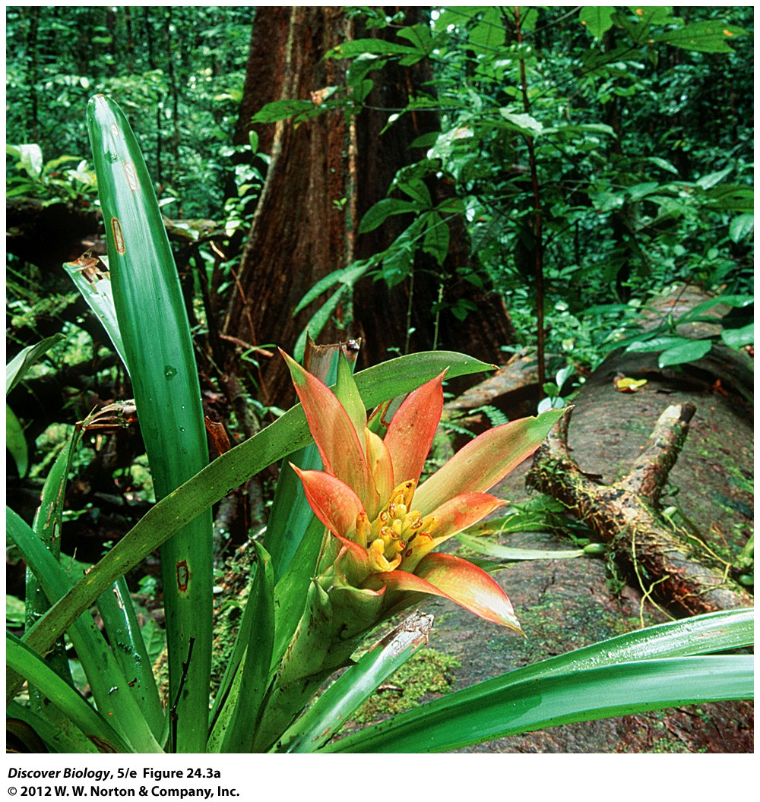
Notes:
Figure 24.3a Producers Are the Energy Base in an Ecosystem
(a) In tropical rainforests, the abundant producers (plants) store a lot of chemical energy, which in turn is available to consumers.

Slide 13
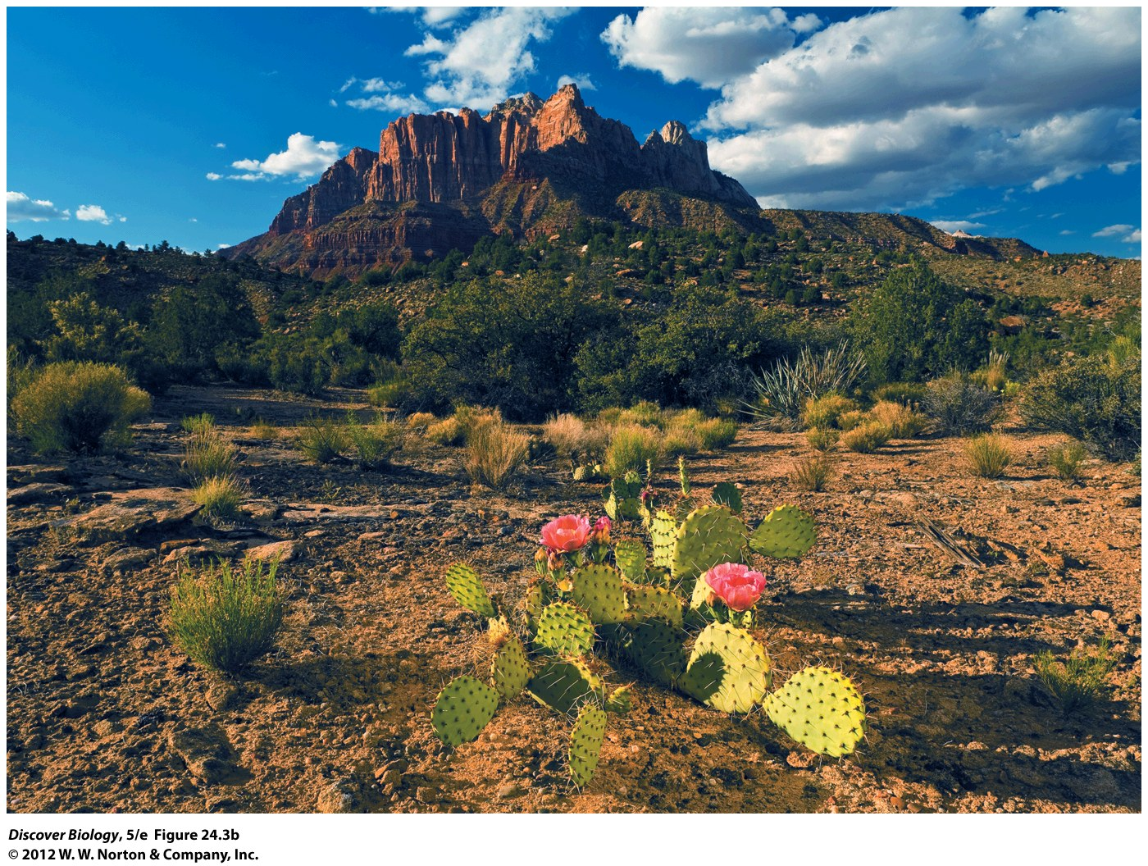
Notes:
Figure 24.3b Producers Are the Energy Base in an Ecosystem
(b) In deserts, because of the sparse plant life, relatively little chemical energy is available for consumers.

Slide 14
The Rate of Energy Capture Varies across the Globe
Net primary productivity is the amount of energy acquired through photosynthesis that is available for growth and reproduction
The NPP can be estimated by the amount of new biomass produced in a given area during a specified period of time
NPP decreases as the amount of solar radiation decreases from the equator to the poles
In terrestrial ecosystems, water, sunlight, temperature, and nutrients affect NPP

Slide 15
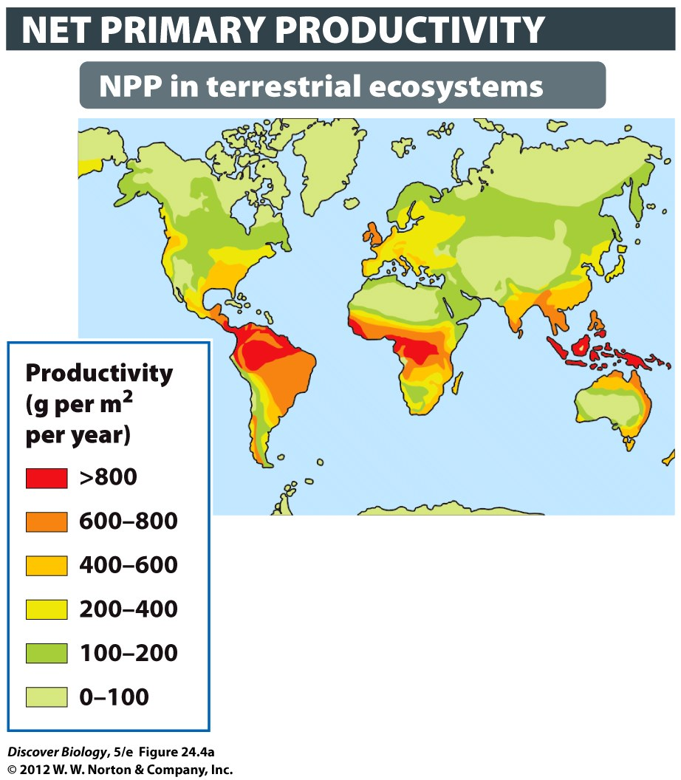
Notes:
Figure 24.4 (Part 1) Net Primary Productivity Varies Greatly in Both Terrestrial and Marine Ecosystems
NPP is commonly measured as grams of new biomass made by plants or other producers each year in a square meter of area.

Slide 16
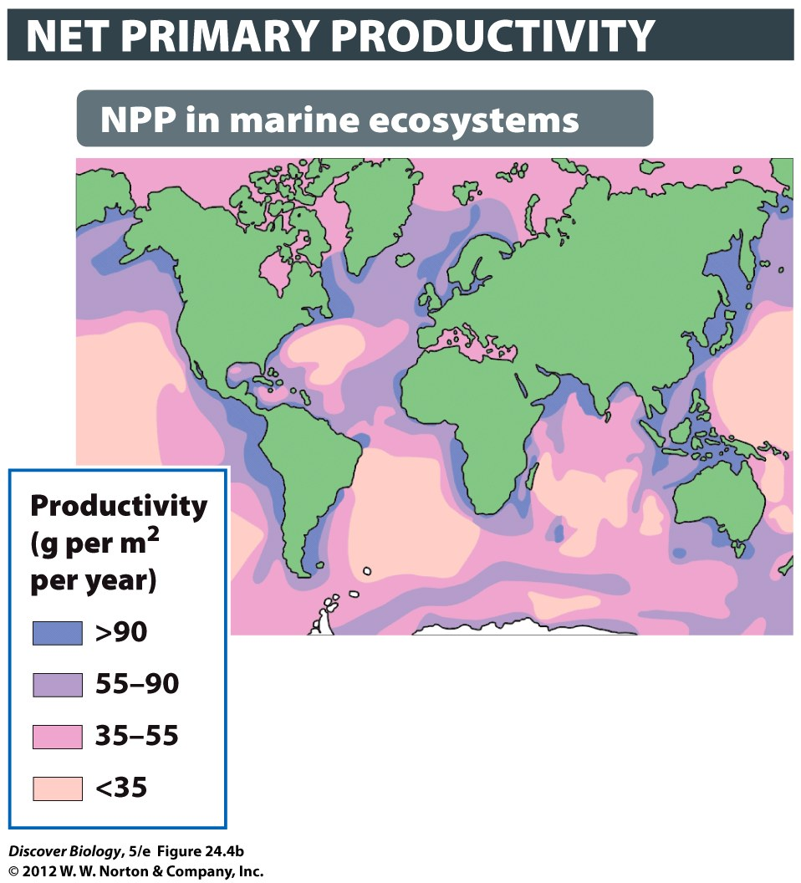
Notes:
Figure 24.4 (Part 2) Net Primary Productivity Varies Greatly in Both Terrestrial and Marine Ecosystems
NPP is commonly measured as grams of new biomass made by plants or other producers each year in a square meter of area.

Slide 17
The Rate of Energy Capture Varies across the Globe
The NPP in marine ecosystems is often high in ocean regions close to land but relatively low in the open ocean
Nutrients drained off the land stimulate the growth of producers, especially in estuaries, which form the foundation of aquatic food webs
As on land, the NPP in aquatic ecosystems can be strongly limited by sunlight

Slide 18
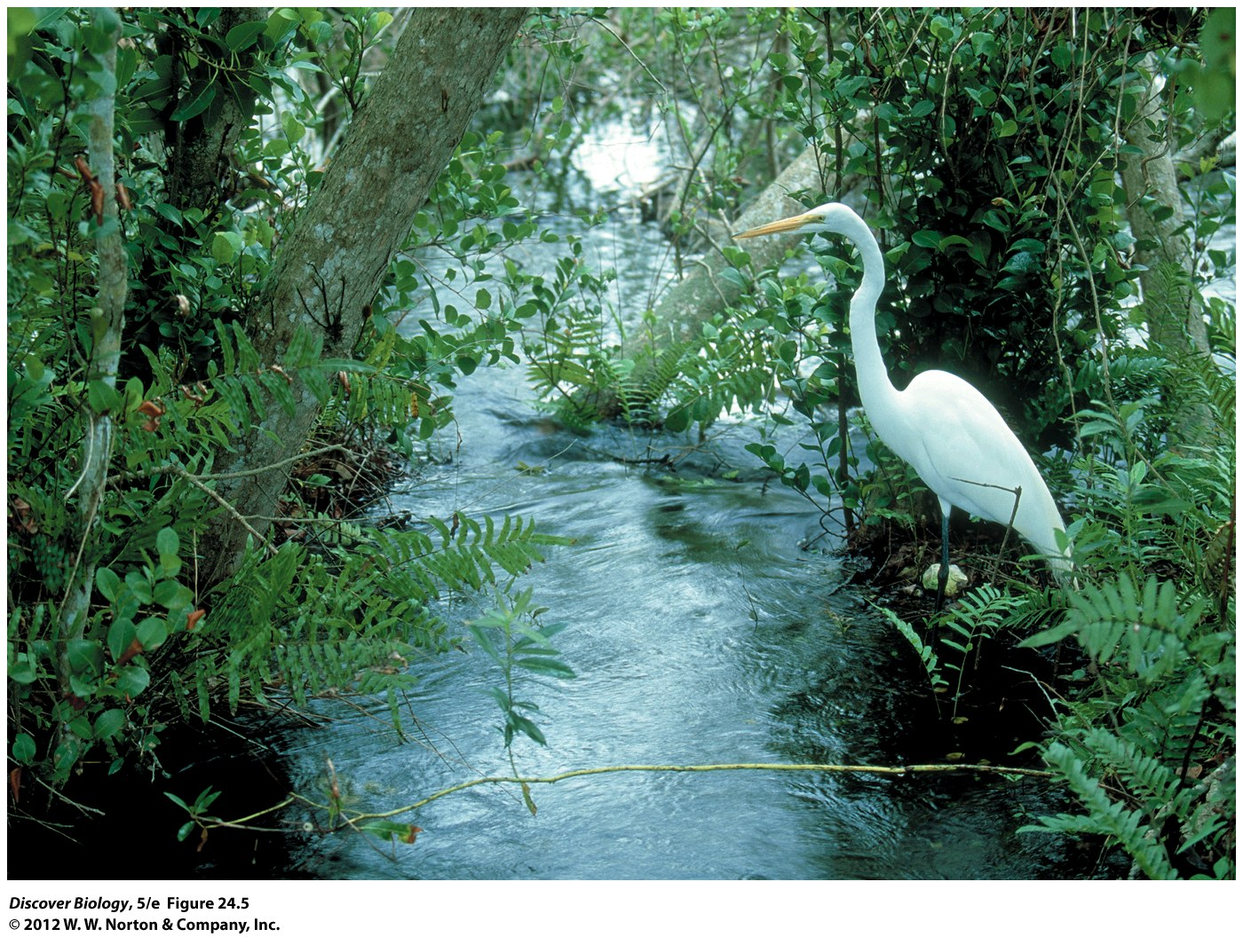
Notes:
Figure 24.5 The Most Productive Ecosystems
Wetlands like this estuary in Virginia can harness energy from sunlight and oxygen and translate it into high net primary productivity on a par with terrestrial systems like tropical forests and agricultural fields.

Slide 19
Energy Flow through Ecosystems
Producers get their energy from abiotic sources
Consumers extract energy from the biomass of other organisms

Slide 20
An Energy Pyramid Shows the Amount of Energy Transferred up a Food Chain
Energy cannot be recycled within an ecosystem because all energy captured by producers is lost from the biotic part of the ecosystem as heat
As biomass is transferred along a food chain, the available energy declines
The amounts of energy available to organisms in an ecosystem can be represented in an energy pyramid made up of trophic levels that represent each level of the food chain

Slide 21
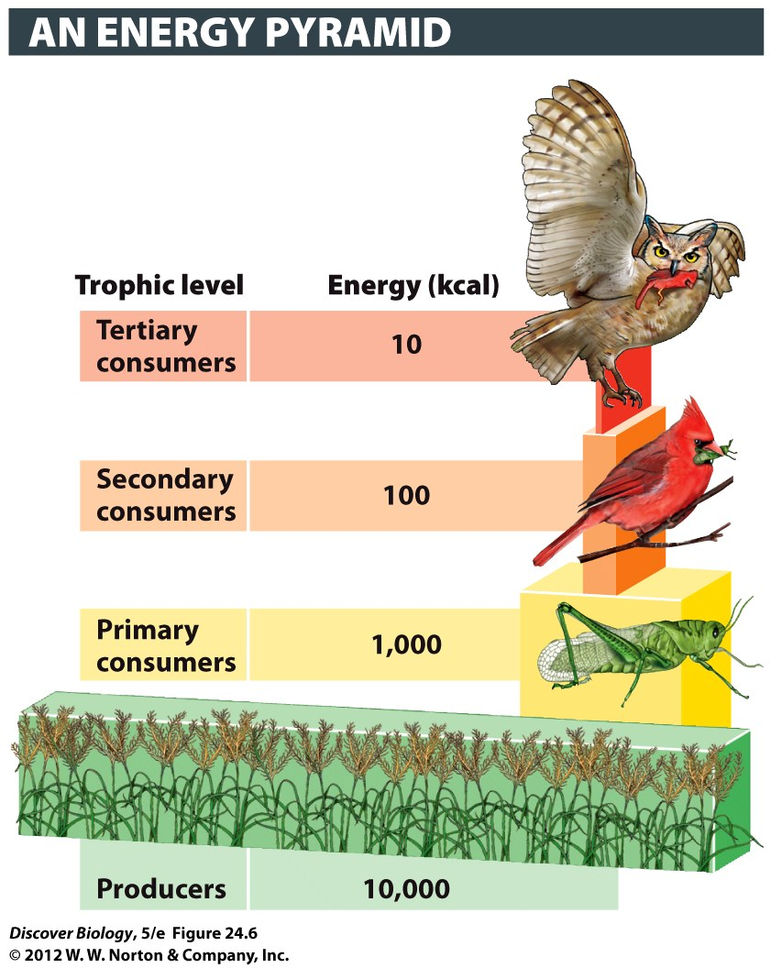
Notes:
Figure 24.6 Trophic Levels
Of each 10,000 kilocalories (kcal; 1 kilocalorie = 1,000 calories) of energy from the sun captured by producers, primary consumers store only about 10 percent. Roughly 10 percent of the energy at each trophic level is then transferred to the next trophic level.

Slide 22
Secondary Productivity Is Highest in Areas of High NPP
Secondary productivity is the rate of new biomass production by consumers and is highest in ecosystems with high net primary productivity
Eventually, all biomass made by producers, herbivores, predators, and parasites is consumed by decomposers

Slide 23
Notes:
Figure 24.7 Give Thanks to the Decomposers
Without decomposers, not only would nature’s waste pile up, but the soil would become devoid of nutrients. Decomposers such as bacteria and fungi recycle more than 50 percent of net primary productivity in ecosystems of all types. In the forest represented here, 80 percent of NPP is used directly by decomposers, and the remaining 20 percent is used by other consumers (such as herbivores and predators).

Slide 24
Biogeochemical Cycles
Producers obtain nutrients needed for growth from the soil, water, or air
Consumers obtain nutrients needed for growth by eating producers or other consumers
Nutrients are transferred between organisms and the physical environment in cyclical patterns called nutrient cycles or biogeochemical cycles

Slide 25
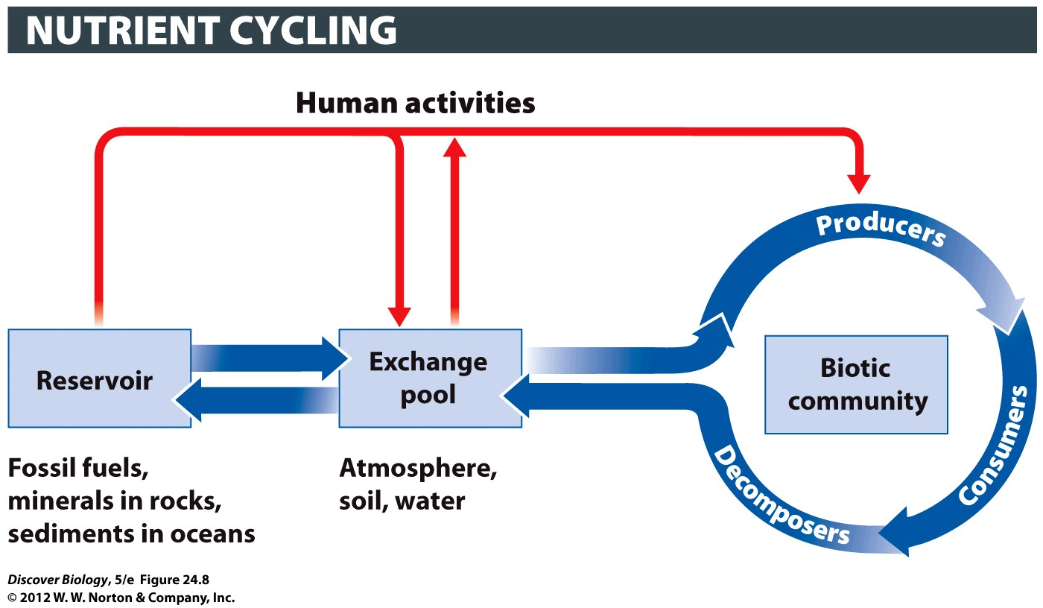
Notes:
Figure 24.8 Nutrient Cycling
Nutrients cycle among reservoirs inaccessible to producers, exchange pools available to producers, and living organisms. Human activities, such as fossil fuel use and fertilizer synthesis, can move nutrients between reservoirs and exchange pools, altering their availability to producers and changing nutrient cycles.

Slide 26
Biogeochemical Cycles
Once captured by producers, nutrients can be passed from the producer along the food chain, where decomposers eventually break down once-living tissues into simple chemical components, thereby returning nutrients to the physical environment
The type of nutrient and the abiotic conditions influence the length of time it takes for a nutrient to cycle from the biotic community to the exchange pool and back

Slide 27
Biogeochemical Cycles
Nutrients that exist as a gas under natural conditions have an atmospheric cycle, which means they can be released into or absorbed from the atmosphere
A few nutrients, including phosphorus, are said to have a sedimentary cycle because they are not commonly found as a gas under natural conditions and move mostly through land and water rather than the atmosphere

Slide 28
Carbon Cycling between the Biotic and Abiotic Worlds Is Driven by Photosynthesis and Respiration
The transfer of carbon within communities, between living organisms and their physical surroundings, and within the abiotic world is known as the global carbon cycle
Living organisms acquire carbon mainly through photosynthesis and convert it into biomass
Decomposers are responsible for releasing the carbon contained in the dead organisms back into the carbon cycle

Slide 29
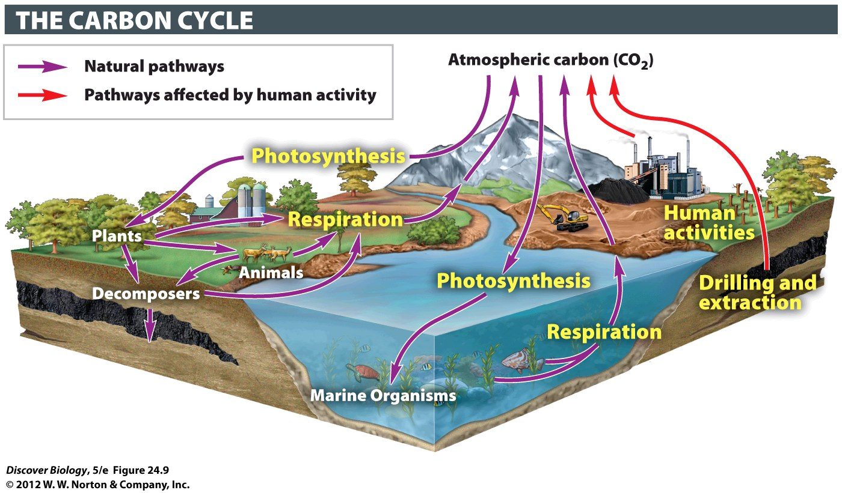
Notes:
Figure 24.9 The Carbon Cycle

Slide 30
Biological Nitrogen Fixation Is the Most Important Source of Nitrogen for Biotic Communities
Nitrogen is not naturally abundant in soil and water and therefore limits the growth of producers in most ecosystems that are unaltered by humans
Nitrogen found in soil and water originates from a process called nitrogen fixation that is carried out by certain prokaryotes
Nitrogen fixed by bacteria is added to soil or water when these organisms and any host produce waste or die and decompose
Consumers acquire nitrogen when they eat plants that have acquired nitrogen from the soil or through their association with nitrogen-fixing bacteria

Slide 31
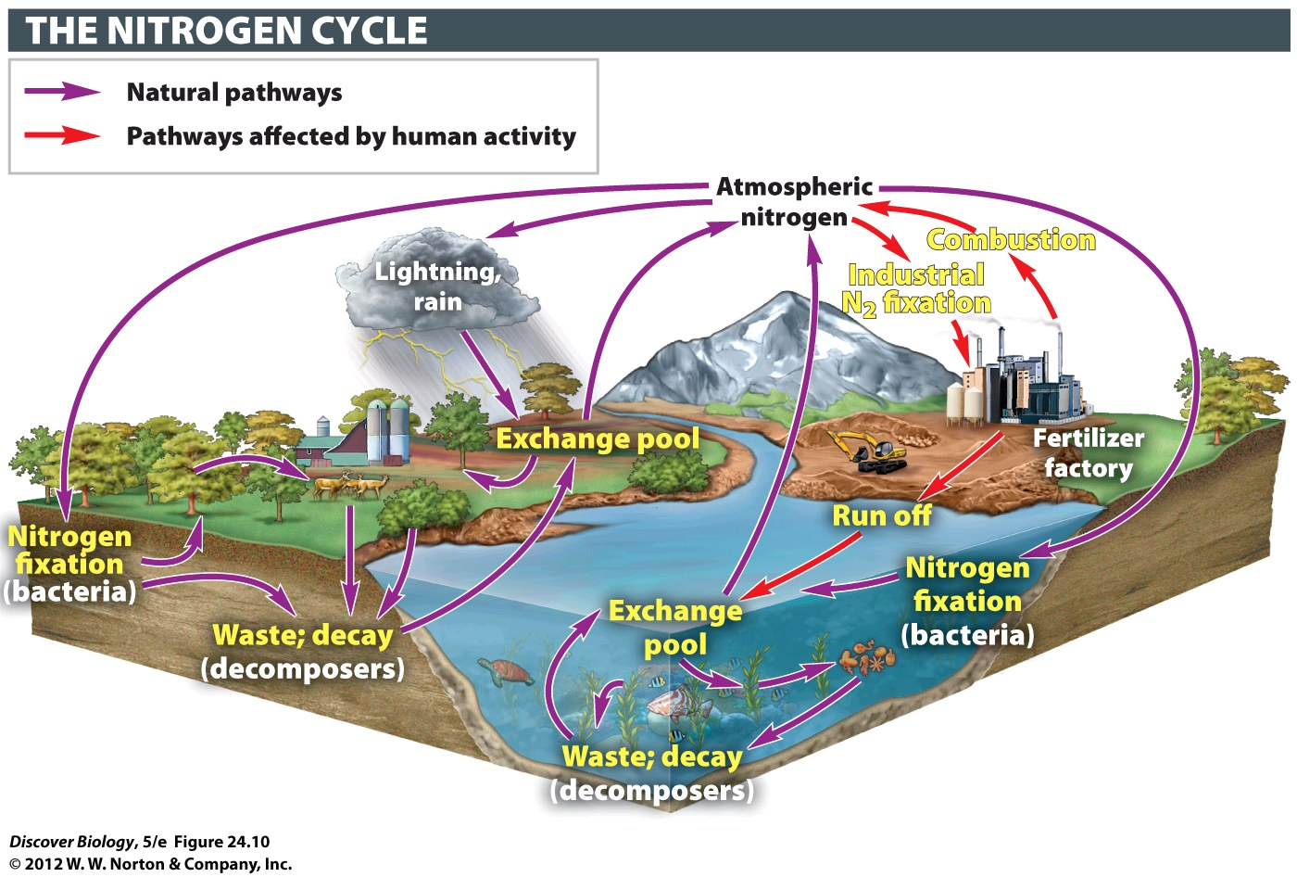
Notes:
Figure 24.10 The Nitrogen Cycle

Slide 32
Sulfur Is One of Several Important Nutrients with an Atmospheric Cycle
About 95 percent of the sulfur that enters the atmosphere comes from the world’s oceans in the form of sea spray
Like most other nutrients with atmospheric cycles, sulfur cycles through terrestrial and aquatic ecosystems relatively quickly

Slide 33
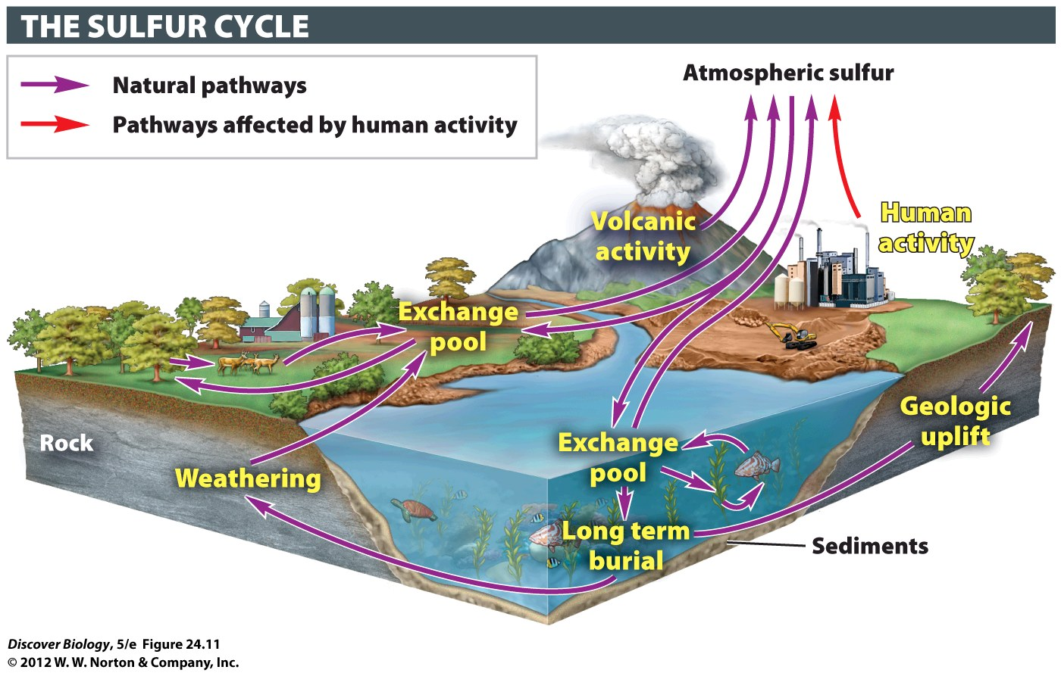
Notes:
Figure 24.11 The Sulfur Cycle

Slide 34
Phosphorus Is the Only Major Nutrient with a Sedimentary Cycle
Among the major nutrients that cycle within ecosystems, phosphorus is the only nutrient with a sedimentary cycle, and it has a large impact on NPP
Phosphorus first cycles within terrestrial and aquatic ecosystems for variable periods of time and is eventually deposited as sediment on the ocean floor, where it remains for many years

Slide 35
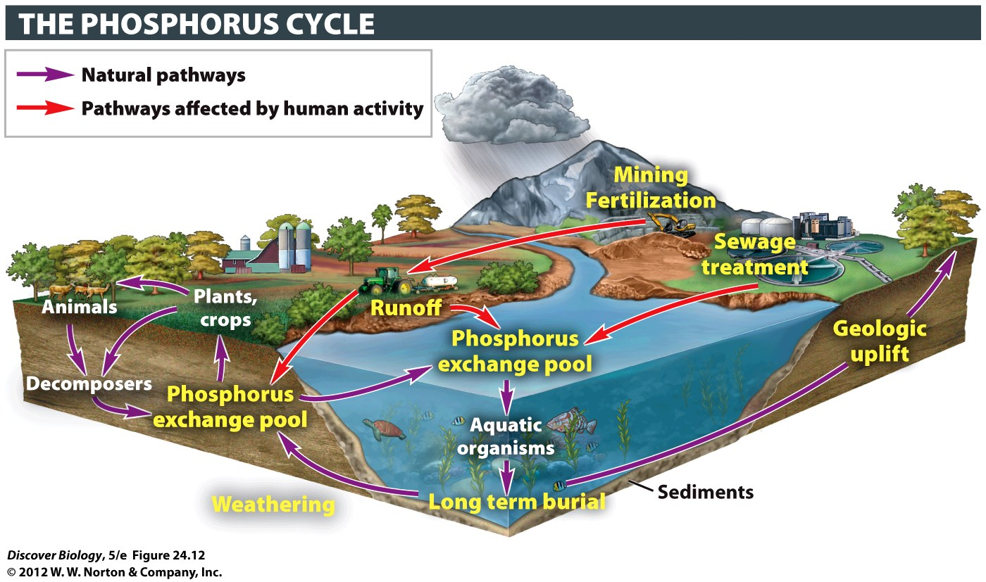
Notes:
Figure 24.12 The Phosphorous Cycle

Slide 36
Human Actions Can Alter Ecosystem Processes
Humans have been disrupting ecological communities for many hundreds of years with often-tragic consequences
The past 200 years have brought about large-scale ecological changes that we are only beginning to understand

Slide 37
Human Activities Can Increase or Decrease NPP
The addition of extra nutrients to lakes, streams, or offshore waters from farmland runoff leads to eutrophication, or overfeeding
Eutrophication causes algae to be more abundant, thereby increasing the NPP
Increased NPP can causes undesirable changes in a body of water, leading to a decrease or elimination of fish and other animals
Scientists estimate a net there has been a 5 percent decrease in NPP on land as a result of logging and fire

Slide 38
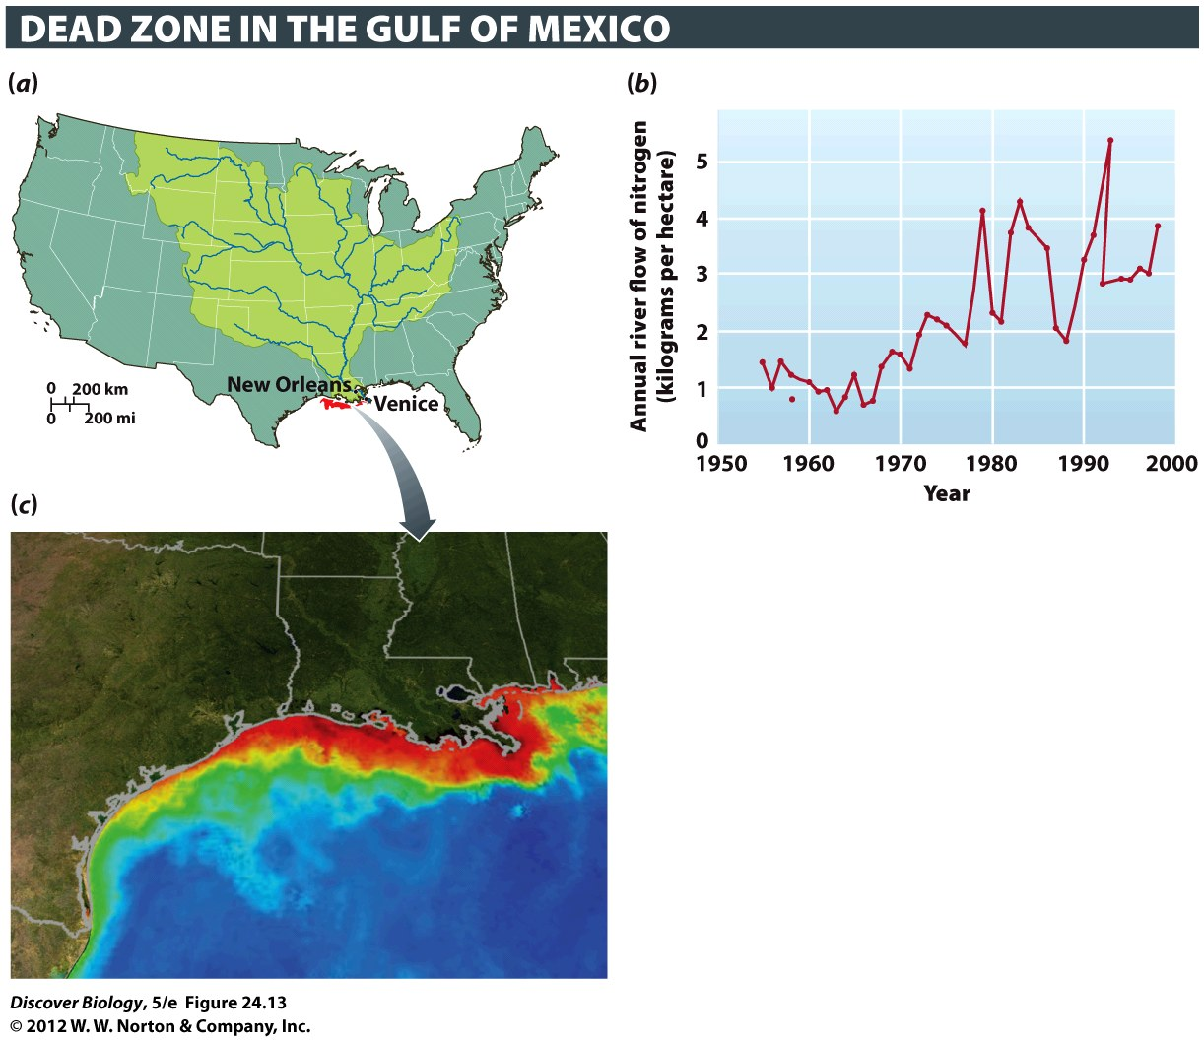
Notes:
Figure 24.13 Nutrient Loading Can Deplete Oxygen in Aquatic Ecosystems
The Mississippi and Atchafalaya river basins drain nearly 40 percent of U.S. land area (a). Since the 1970s, large amounts of nitrogen (N) from fertilizer, sewage, and industrial by-products have entered waters within these watersheds. The resulting nutrient addition can be measured as the amount of nitrogen flowing past particular points on the Mississippi per year (b). This nitrogen then drains into the Gulf of Mexico, where each summer the extra nutrients create a large dead zone (c) in which virtually all animals are killed. The image, based on satellite photos from NASA, shows ocean turbidity and chlorophyll concentrations. Red and orange represent high concentrations of phytoplankton and river sediment.

Slide 39
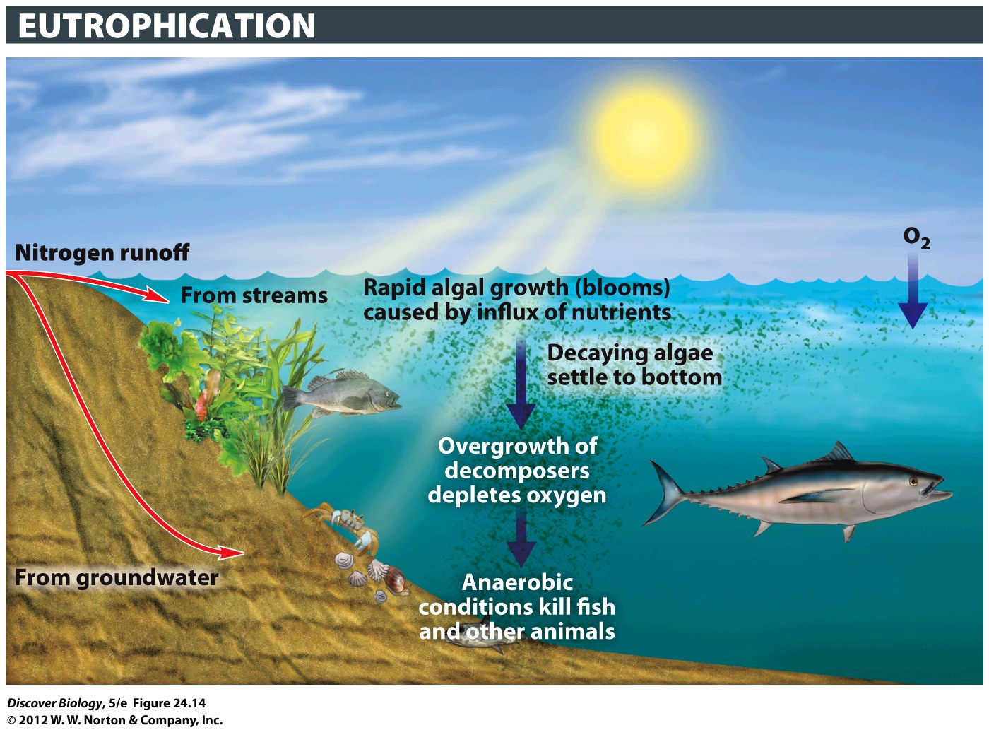
Notes:
Figure 24.14 Eutrophication Can Be Too Much of a Good Thing
Large inputs of nutrients such as nitrogen and phosphorus can cause a population boom in photosynthetic plankton (algae). Dying algae in turn trigger explosive growth of oxygen-consuming decomposers, choking off the oxygen supply for animals.

Slide 40
Human Activities Can Alter Nutrient Cycles
When people alter nutrient cycles, the effects can be seen throughout the world
Acid rain is rain with a decreased pH that results from the burning of fossil fuel
Acid rain has drastically reduced fish populations in thousands of Scandinavian and Canadian lakes and damaged many acres of forest in North America and Europe

Slide 41
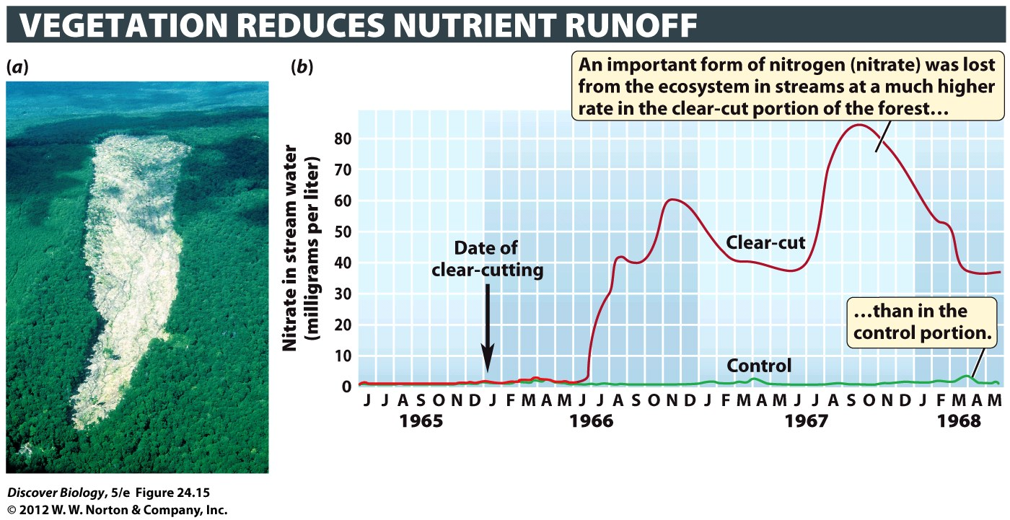
Notes:
Figure 24.15 Altering Nutrient Cycles in a Forest Ecosystem
(a) This portion of the Hubbard Brook Experimental Forest in New Hampshire has been clearcut. (b) A portion of the forest was first clear-cut and then sprayed with herbicides for 3 years to prevent regrowth. A second portion of the forest was not clear-cut or sprayed and served as a control plot. Nitrate, a form of nitrogen that is important to plants, was lost from the ecosystem in streams at a much higher rate in the clear-cut portion of the forest than in the control portion. (The loss of nitrate was measured in milligrams of nitrate in the stream per liter of water.)

Slide 42
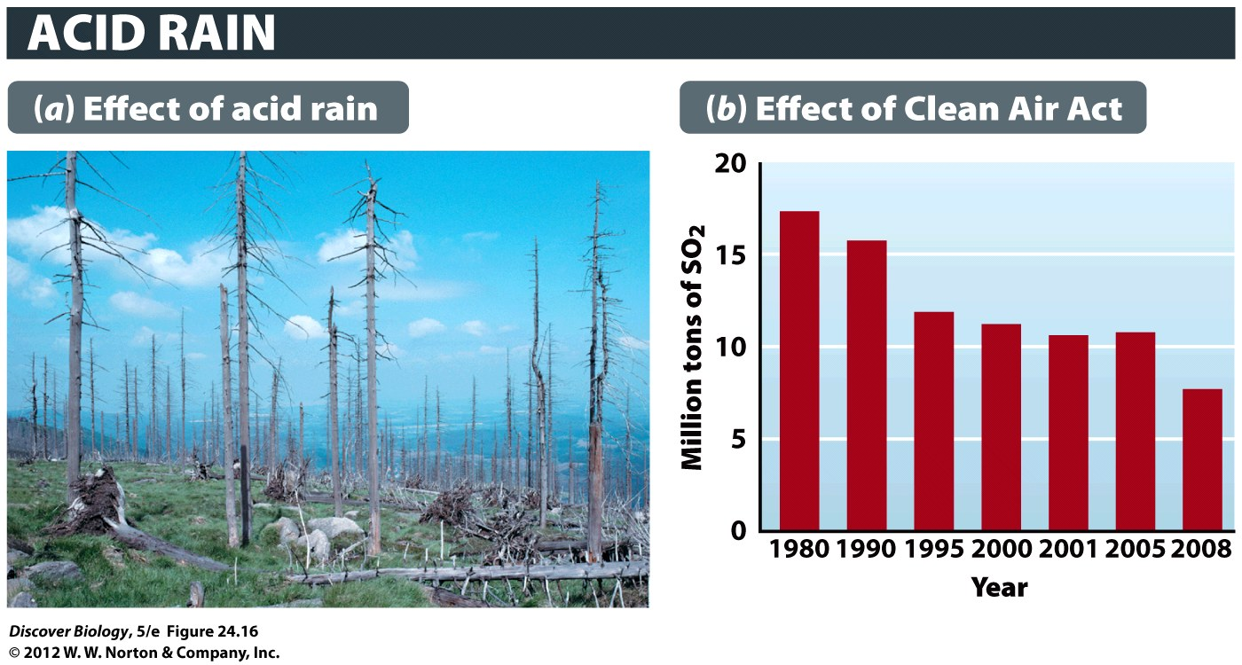
Notes:
Figure 24.16 Acid Rain Can Damage Many Ecosystems
(a) This spruce forest in the Jizerské Mountains of the Czech Republic was killed by acid rain. (b) Thanks to regulations imposed by the 1990 Clean Air Act, the amount of sulfur dioxide, a major contributor to acid rain, emitted into the atmosphere each year in the United States has fallen by more than 50 percent since 1980.

Slide 43
What Happens When the Worst Happens?
A year after the disastrous oil spill, scientists held mixed opinions on the recovery of the Gulf of Mexico
Most agreed the disaster could have had more far-reaching effects, but others were closely monitoring the food chain for evidence of damage

Slide 44
Clicker Questions
CHAPTER 24
Ecosystems

Slide 45
Concept Quiz
Which is the correct pathway of energy flow
in an ecosystem?
Sun → producers → consumers → decomposers
Sun → consumers → producers → decomposers
Sun → producers → decomposers → consumers
Notes:
The correct answer is A.
Energy flow must begin with an abiotic (non-living) source. On Earth, the sun is the major source of energy.
Producers can make their own food from this abiotic source.
Consumers eat producers (or other consumers).
Decomposers break down the dead matter from all other living things so that nutrients can be recycled.

Slide 46
Concept Quiz
What is NPP?
Net productivity of phosphorus
The amount of available nitrogen for plants
The amount of energy captured minus metabolic heat loss
Notes:
The correct answer is C.
NPP stands for Net Primary Productivity.
NPP is calculated by measuring the amount of energy captured by producers and then subtracting the amount of heat loss as energy flows through an ecosystem.
The amount of nitrogen available for plants does affect NPP, but alone does not determine the NPP. NPP values are due to many factors.
The net productivity of phosphorus is not a real measured value.

Slide 47
Concept Quiz
Which of the following is not a major type of
nutrient cycling?
Nitrogen
Sedimentary
Atmospheric
Notes:
The correct answer is A. The nitrogen cycle is a type of atmospheric cycle. Other examples of atmospheric cycles are carbon, hydrogen, oxygen, and sulfur.
Sedimentary cycles are the second major type of cycle. Phosphorus is the only major sedimentary cycle.

