Slide 1
Discover Biology FIFTH EDITION
Anu Singh-Cundy • Michael L. Cain
CHAPTER 23
Ecological Communities
© 2012 W. W. Norton & Company, Inc.

Slide 2
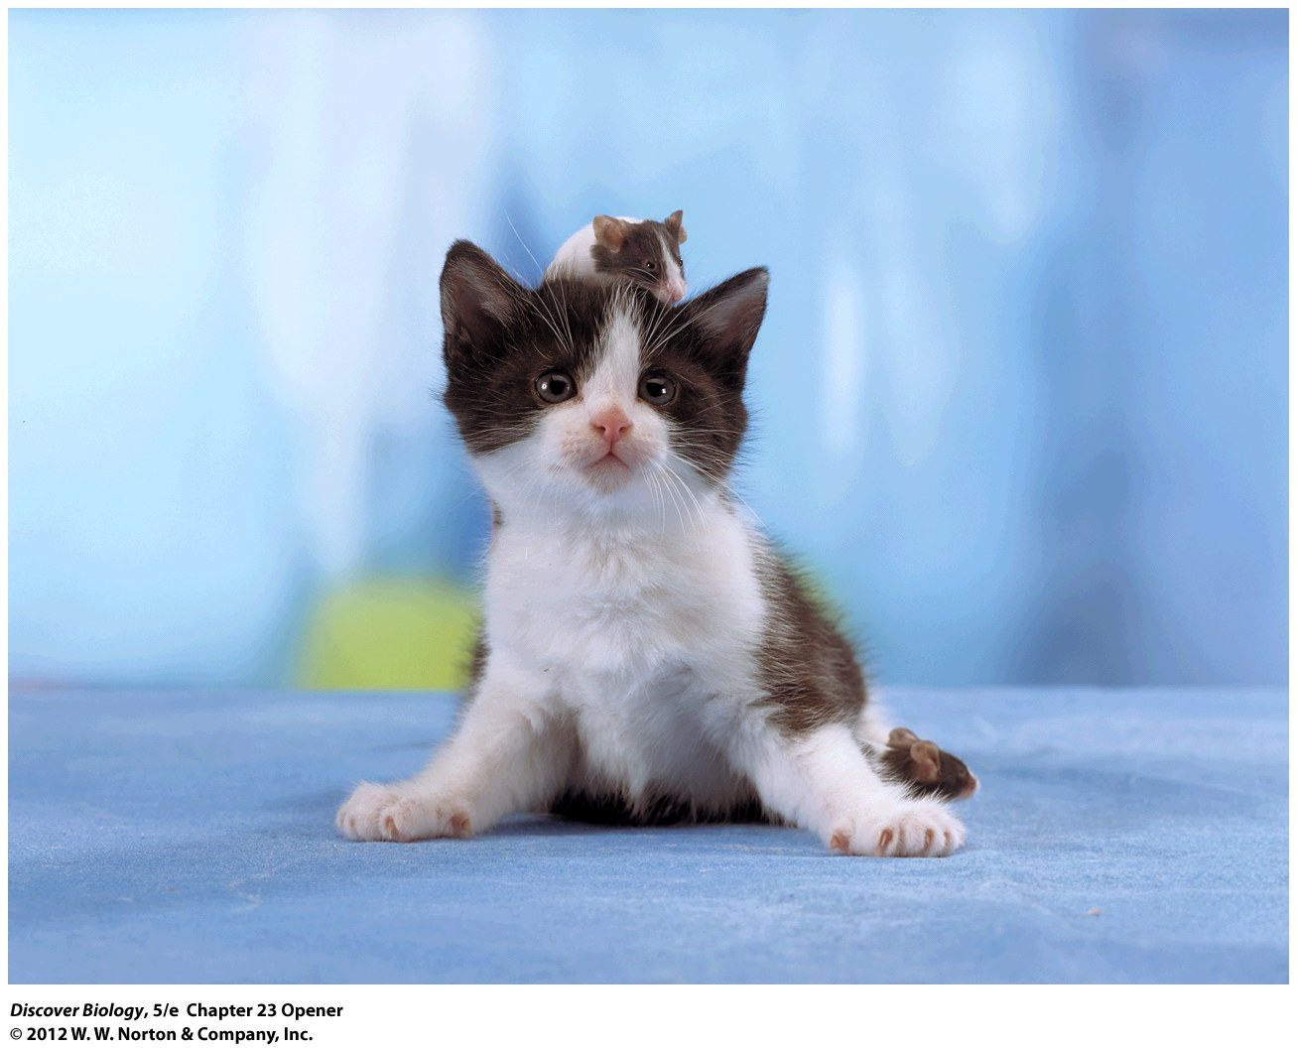
Notes:
A Baby Rat Sits Atop a Kitten’s Head.
When the parasite Toxoplasma gondii infects a rat, the rat loses its natural fear of cats and will readily approach a cat. The cat eats the rat and itself becomes infected by the parasite. Very young animals like the ones in this photo tend to be less fearful than adults; these two are probably not infected.

Slide 3
Fatal Feline Attraction
Toxoplasma gondii is a single-celled parasite, most often contracted from raw meat, that alters the brain activity of rodents
The species that make up a community interact in all kinds of ways

Slide 4
An Association of Different Species
An ecological community is an association of different species that live in the same area
Communities vary greatly in size and complexity and can be characterized by their species composition, or diversity
The diversity of a community has two components:
Species richness
Relative species abundance

Slide 5
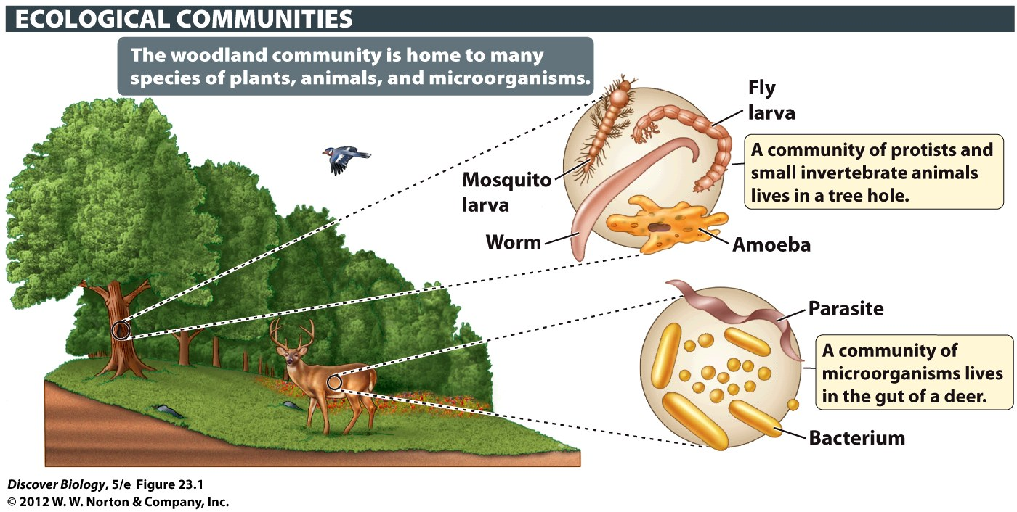
Notes:
Figure 23.1 Temperate Forests in North America Contain Many Types of Woodland Communities
Smaller communities can be nested within a larger community. This beech-maple woodland community contains the community of a temporary pool of water in a tree hole and the community of a deer’s gut, among others.

Slide 6
An Association of Different Species
Species richness refers to the total number of different species that live in the community
Relative species abundance describes how common individuals of a species are compared to individuals of other species in the community
Interactions among organisms have huge effects on natural communities

Slide 7
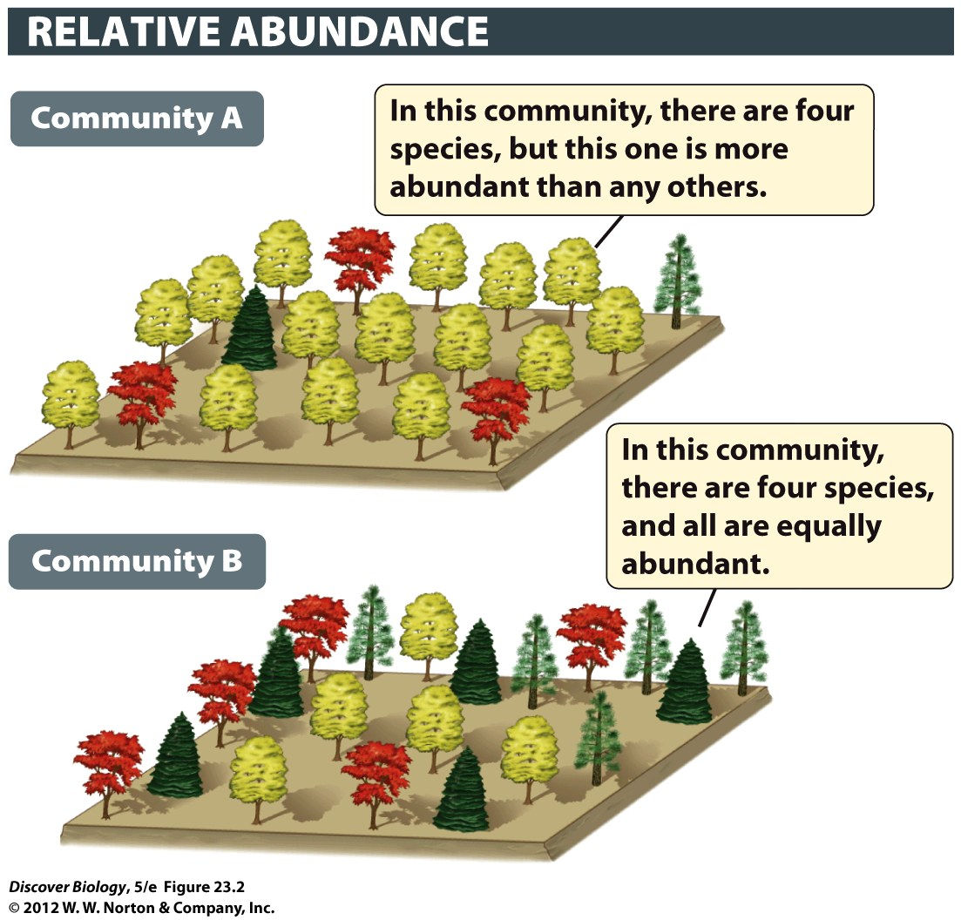
Notes:
Figure 23.2 Which Community Has Greater Diversity?
Community A is dominated by a single species; in community B, all four species are equally represented. Therefore, ecologists consider community A less diverse than community B.

Slide 8
Species Interactions
Interactions among organisms can be divided into four categories:
Mutualism: interactions in which both species benefit
Commensalism: interactions in which one species benefits at no cost to the other
Exploitation: interactions in which one species benefits and the other is harmed
Competition: interactions in which both species may be harmed

Slide 9
There Are Many Types of Mutualism
Mutualism is an association between two species in which both species benefit by increasing the survival and reproduction of both of the interacting species
Two or more organisms of different species living together and benefiting each other is called symbiosis
There are many types of mutualism, including gut inhabitant mutualism, behavioral mutualism, seed dispersal mutualism, and pollinator mutualism

Slide 10
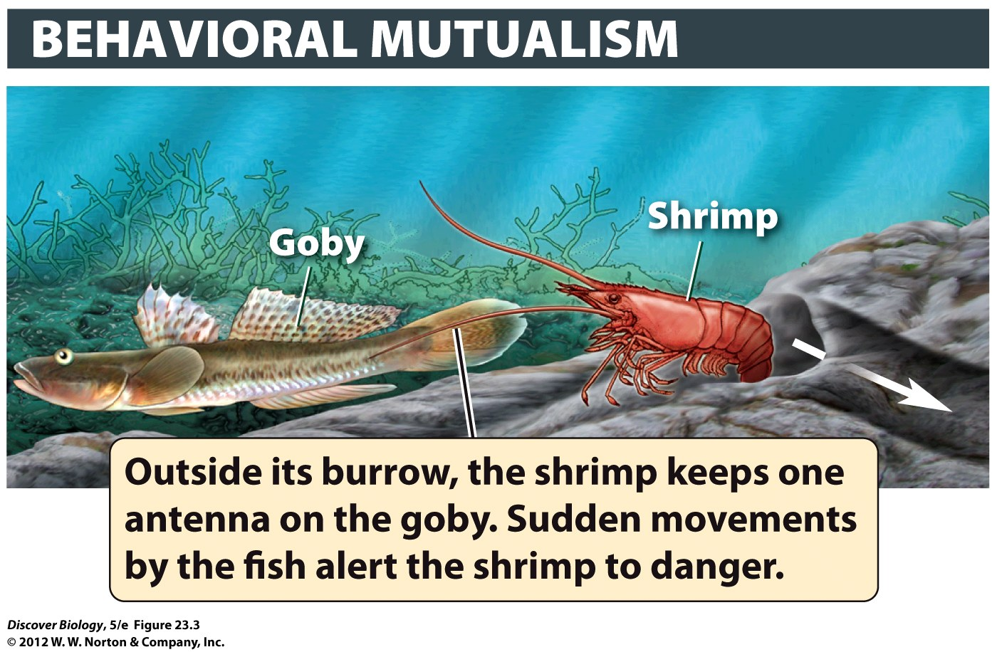
Notes:
Figure 23.3 Friends in Need
Each Alpheus shrimp builds a burrow for shelter, which it shares with a goby fish. The fish provides an early-warning system to the nearly blind shrimp when the shrimp leaves the burrow to feed.

Slide 11
Mutualists Are in It for Themselves
In a mutualistic relationship, what is good for one species may come at a cost to the other
Mutualism evolves when the benefits of the interaction outweigh the costs for both species
Organisms in a mutualism have reached an evolutionary compromise that is cost-effective for the individuals involved

Slide 12
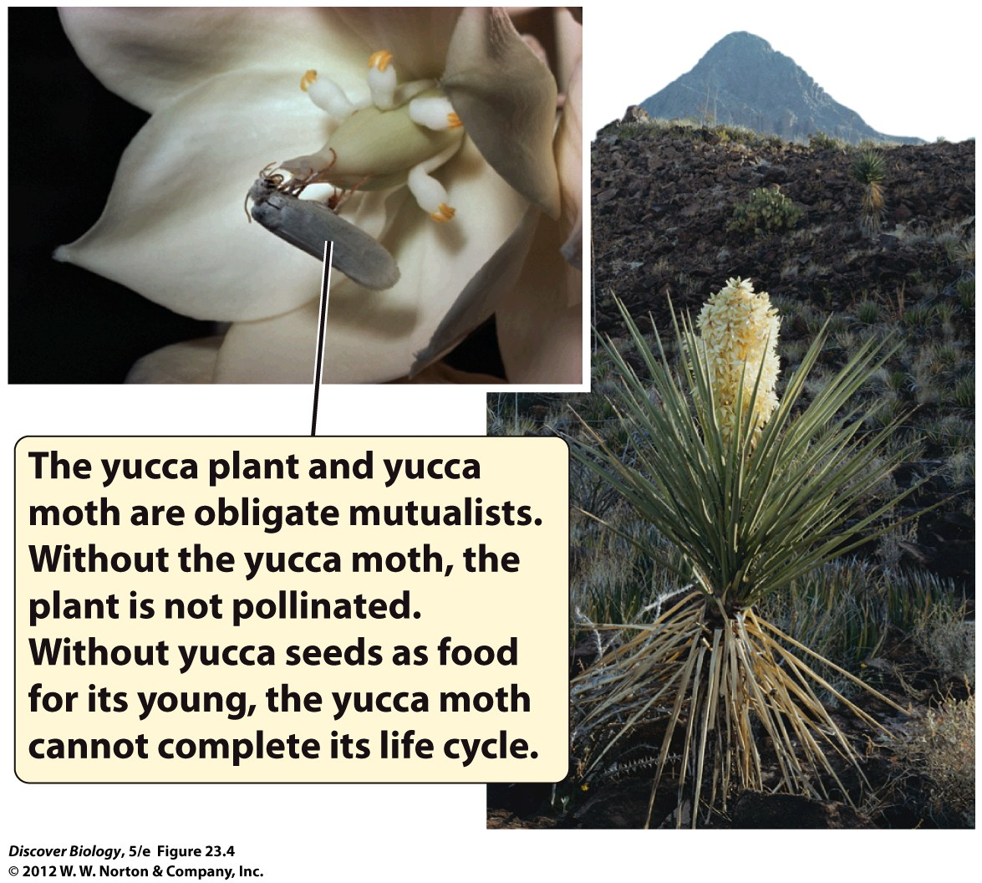
Notes:
Figure 23.4 Pollinator Mutualism
In the inset photo, a yucca moth (Tegeticula yuccasella) is moving pollen from the anthers (orange) to the pistil of the yucca plant (Yucca torreyi) seen in the larger photo.

Slide 13
Mutualism Can Determine the Distribution and Abundance of Species
Mutualism can affect species distribution, the geographic area over which a species is found
Species abundance is the number of individuals of a species in a defined habitat and can also be affected by mutualism
Mutualism can have indirect effects on the distribution and abundance of species that are not part of the mutualism

Slide 14
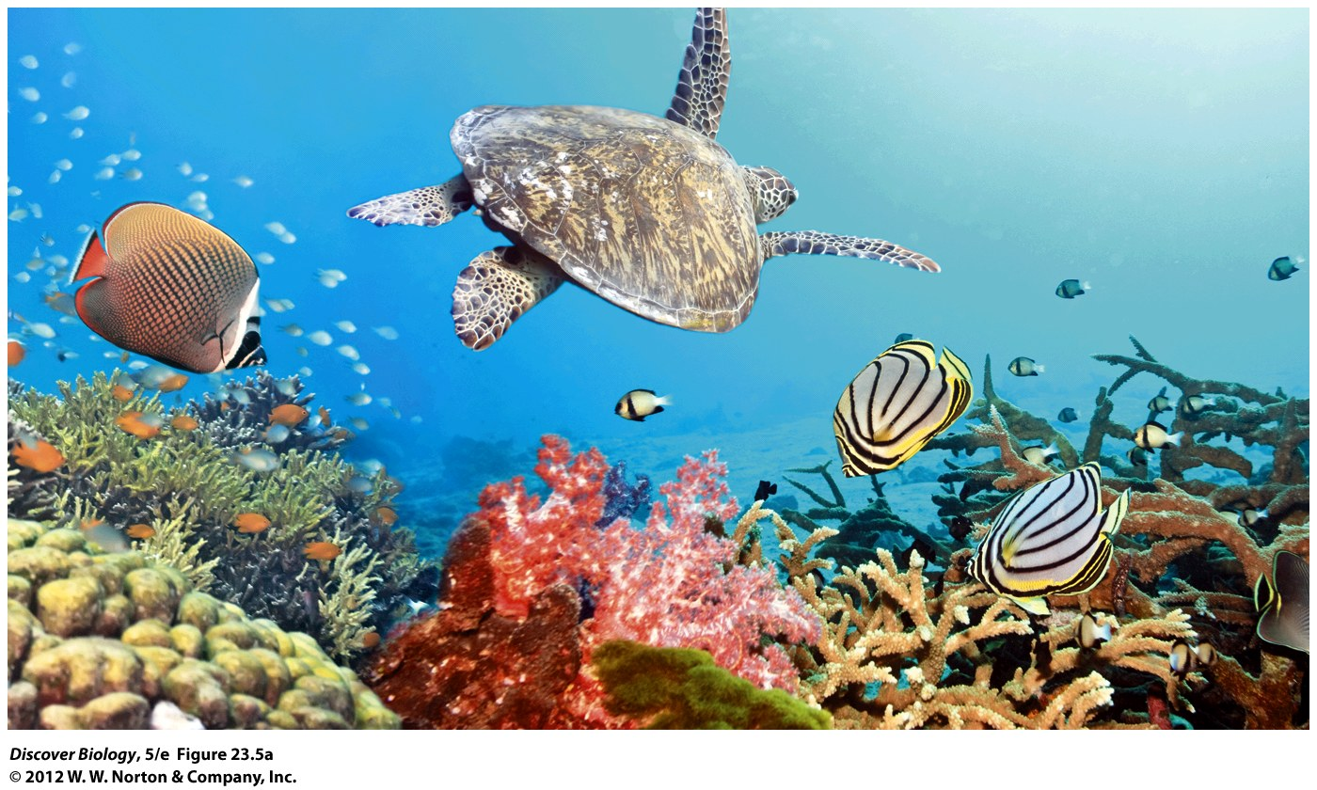
Notes:
Figure 23.5a The Home a Mutualism Built
The great diversity of life in tropical reefs depends on corals, many of which benefit from mutualistic associations with algae. The clownfish sheltering within their host sea anemone (photo on right) gain protection from predators repelled by the stinging cells on the sea anemone’s tentacles. The clownfish are unharmed by the stinging cells because their bodies are coated with a thick mucus. The anemone uses nutrients from waste excreted by the fish. Also, the clownfish eat or chase away grazers that would otherwise nibble on the anemone.

Slide 15
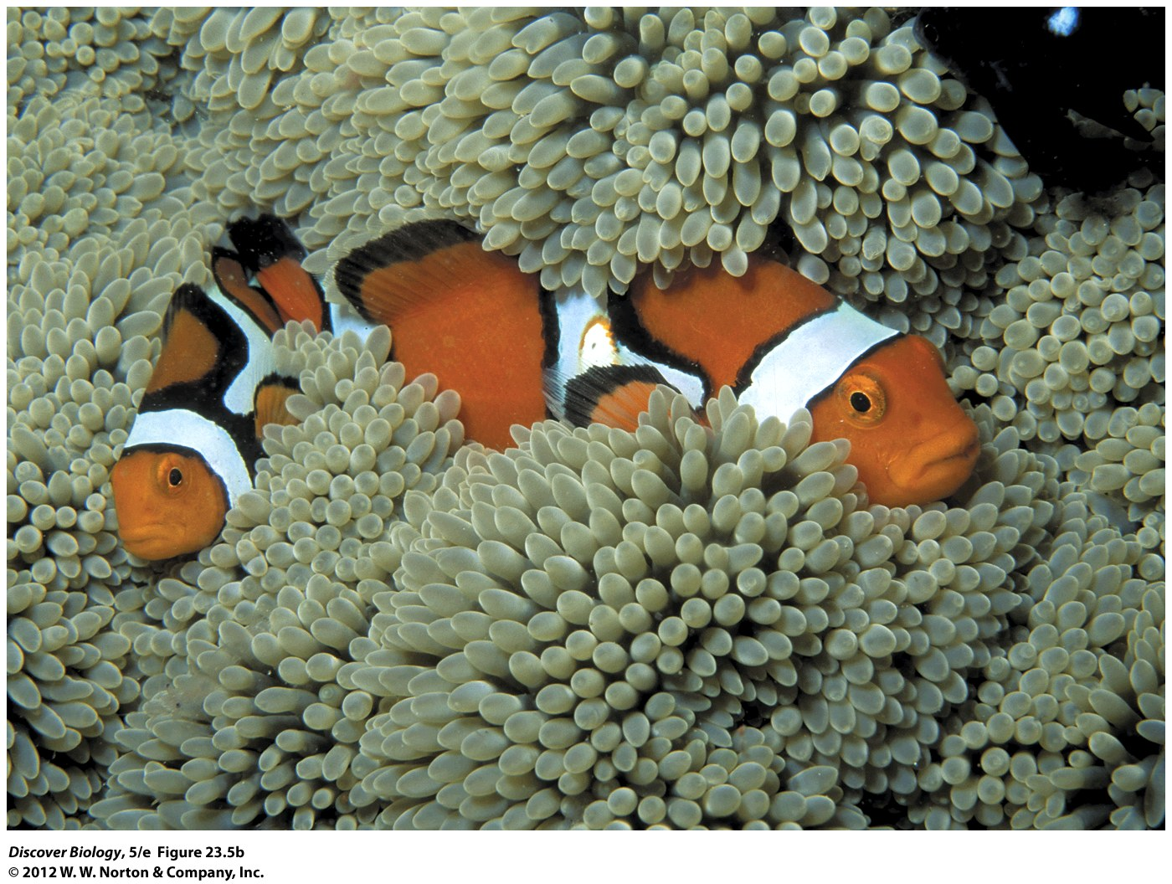
Notes:
Figure 23.5b The Home a Mutualism Built
The great diversity of life in tropical reefs depends on corals, many of which benefit from mutualistic associations with algae. The clownfish sheltering within their host sea anemone (photo on right) gain protection from predators repelled by the stinging cells on the sea anemone’s tentacles. The clownfish are unharmed by the stinging cells because their bodies are coated with a thick mucus. The anemone uses nutrients from waste excreted by the fish. Also, the clownfish eat or chase away grazers that would otherwise nibble on the anemone.

Slide 16
Only One Partner Benefits in Commensalism
A relationship in which one partner benefits while the other is neither helped nor harmed is called commensalism
Barnacles that attach themselves to whales are an example of commensalism

Slide 17
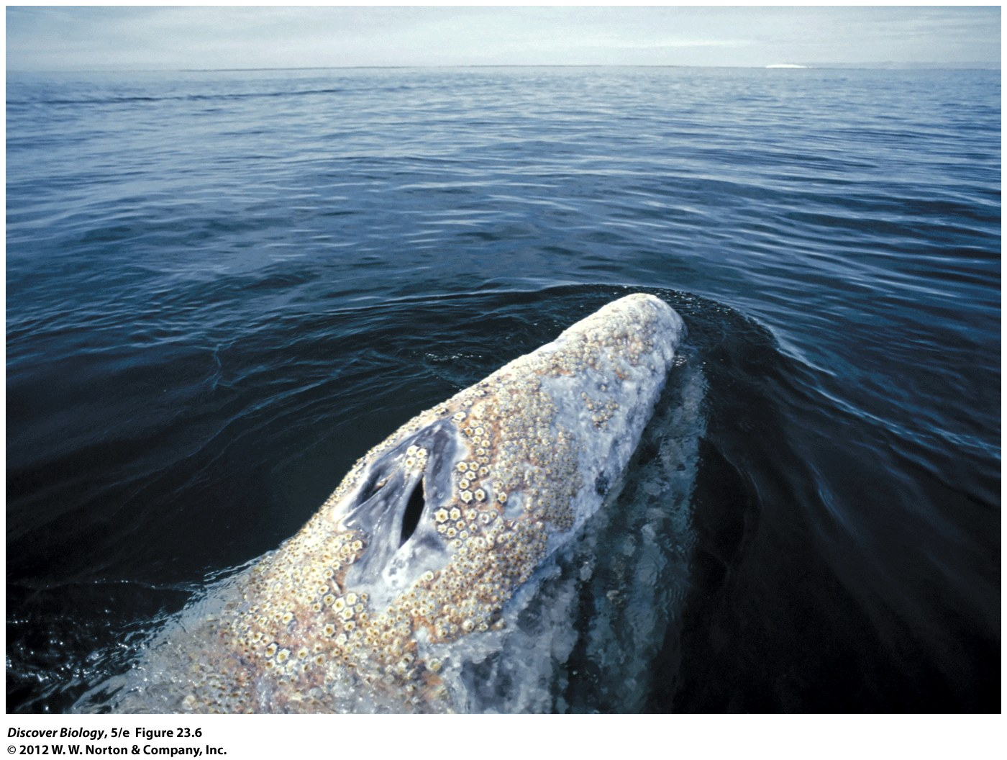
Notes:
Figure 23.6 Commensalism
This gray whale’s rostrum (snout) is covered in barnacles.

Slide 18
In Exploitation, One Member Benefits While Another Is Harmed
Exploitation encompasses a variety of interactions in which one species benefits and the other is harmed
Exploiters are generally consumers falling into three main categories:
Herbivores are consumers that eat plants or plant parts
Predators are animals that kill other animals for food
Parasites are consumers that live in or on the organisms they eat

Slide 19
Consumers and Their Food Organisms Can Exert Strong Selection Pressure on Each Other
The presence of consumers in an environment has caused many species to evolve elaborate strategies to avoid being consumed
Induced defenses are responses from certain plants that are directly stimulated by an attack from herbivores
Warning coloration is used by prey organisms to warn potential predators that they are heavily defended

Slide 20
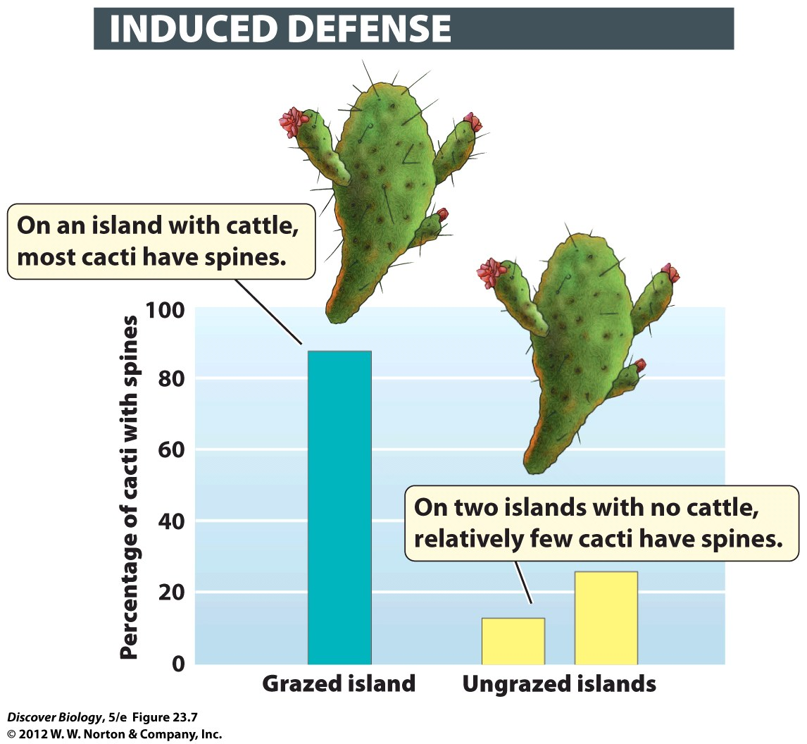
Notes:
Figure 23.7 Spines on Some Cacti Are an Induced Defense
On three islands off the coast of Australia, the percentage of cacti with spines is higher on the island that has cattle than on the two islands that do not. Field and laboratory experiments show that grazing by cattle directly stimulates the production of spines in this species of cactus.

Slide 21
Consumers and Their Food Organisms Can Exert Strong Selection Pressure on Each Other
Mimicry is a type of adaptation arising from predator-prey interactions in which a species evolves to imitate the appearance of something unappealing to its would-be predator
Coevolution occurs when two species that interact trigger evolutionary change in each other as a consequence of their interactions

Slide 22
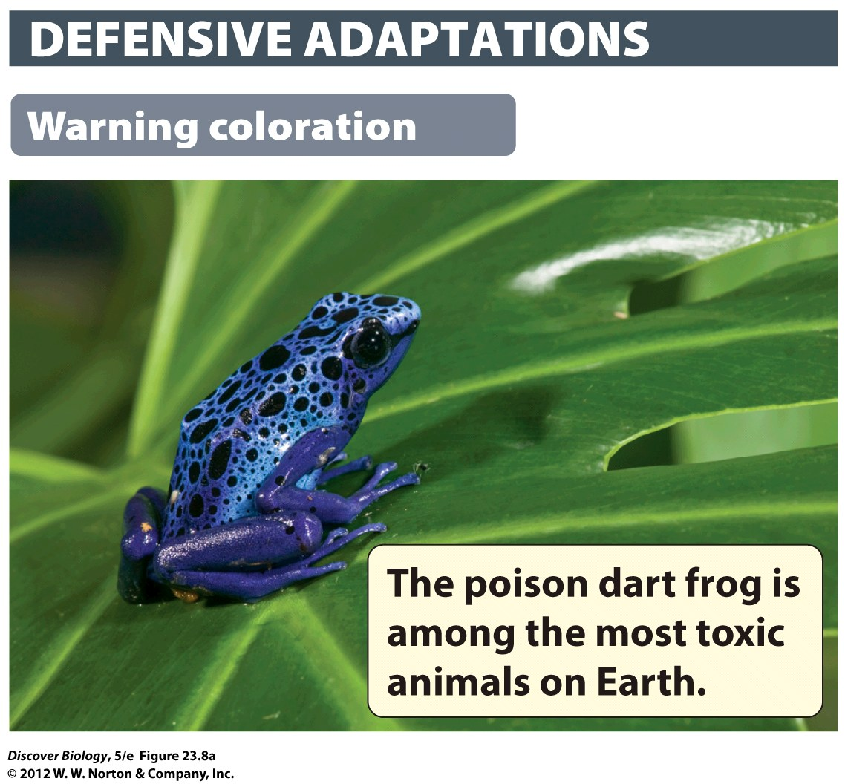
Notes:
Figure 23.8a Adaptive Responses to Predation
(a) The bright colors of this poison dart frog warn potential predators of the deadly chemicals contained in its tissues.

Slide 23
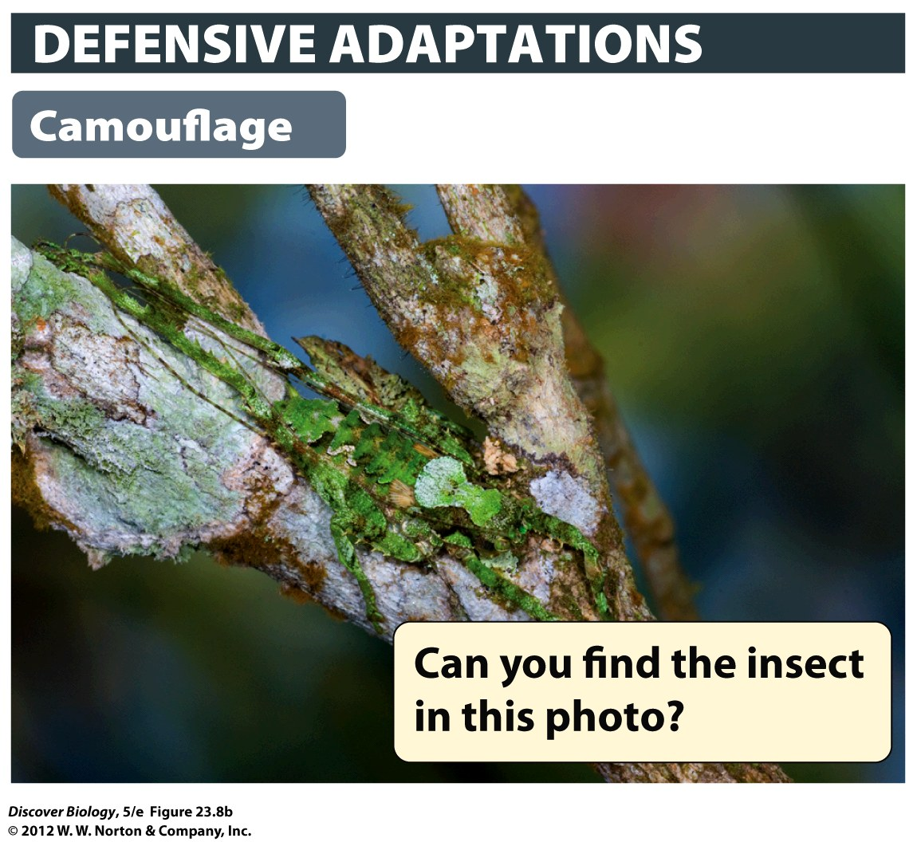
Notes:
Figure 23.8b Adaptive Responses to Predation
(b) With its long legs outstretched, this lichen-mimic katydid lies motionless on lichen-covered branches to escape detection in daytime by lizards, birds, and other predators. A relative of the cricket, the katydid forages at night.

Slide 24
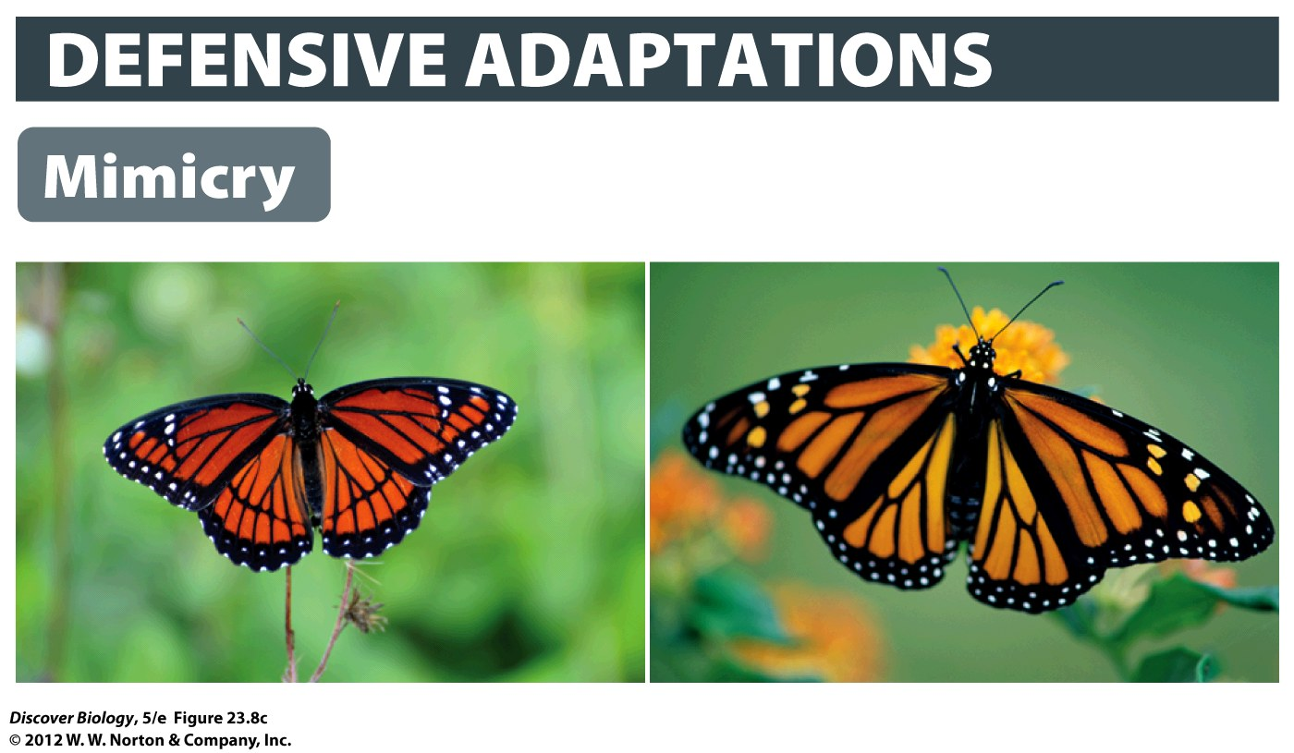
Notes:
Figure 23.8c Adaptive Responses to Predation
(c) The viceroy butterfly (left) mimics the color and pattern of the monarch butterfly (right), which contains toxic compounds. Confusing it with the monarch, predators tend to leave the viceroy alone.

Slide 25
Consumers Can Alter the Behavior of Exploited Organisms
The behaviors of animals who live or feed in groups likely evolved as a response to predation
Many parasites cause behaviors in host organisms that benefit the parasite

Slide 26
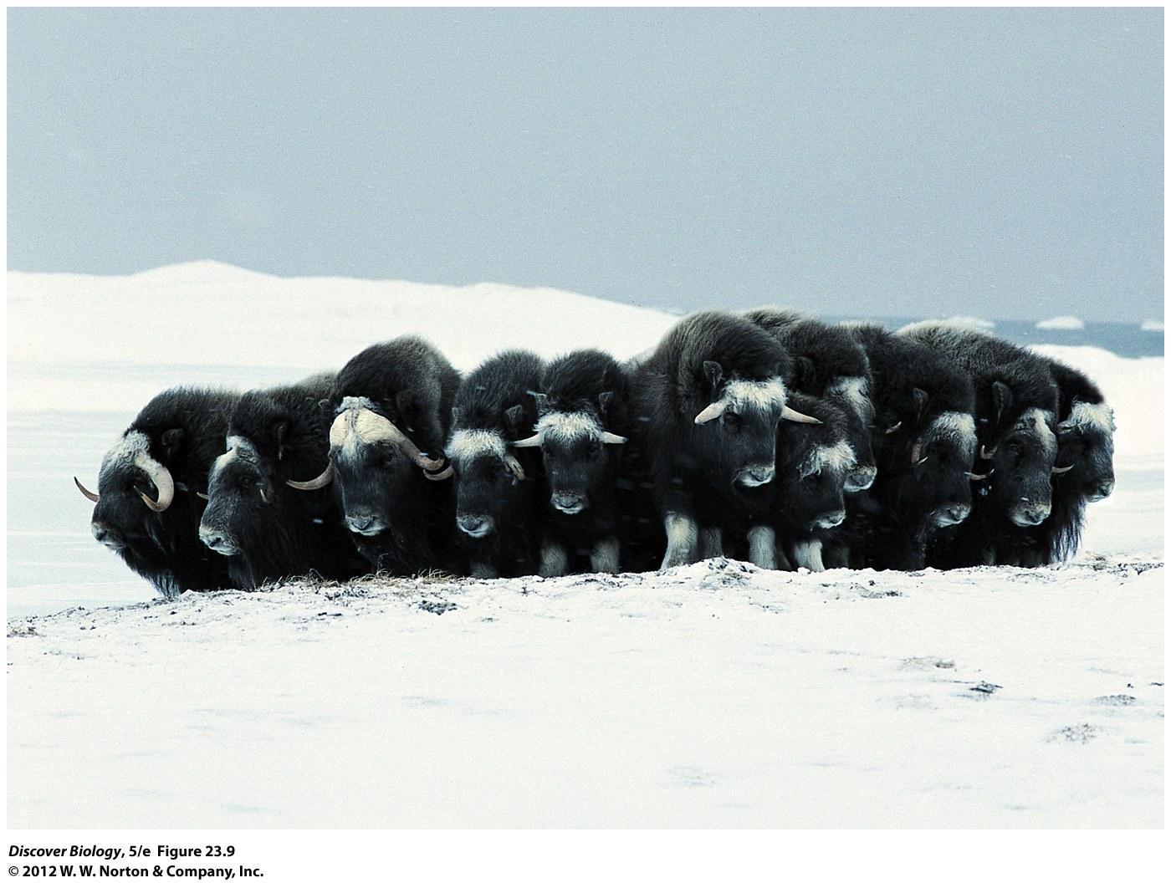
Notes:
Figure 23.9 Come and Get Us
Although a single musk ox may be vulnerable to predators such as wolves, a group that forms a circle makes a difficult target.

Slide 27
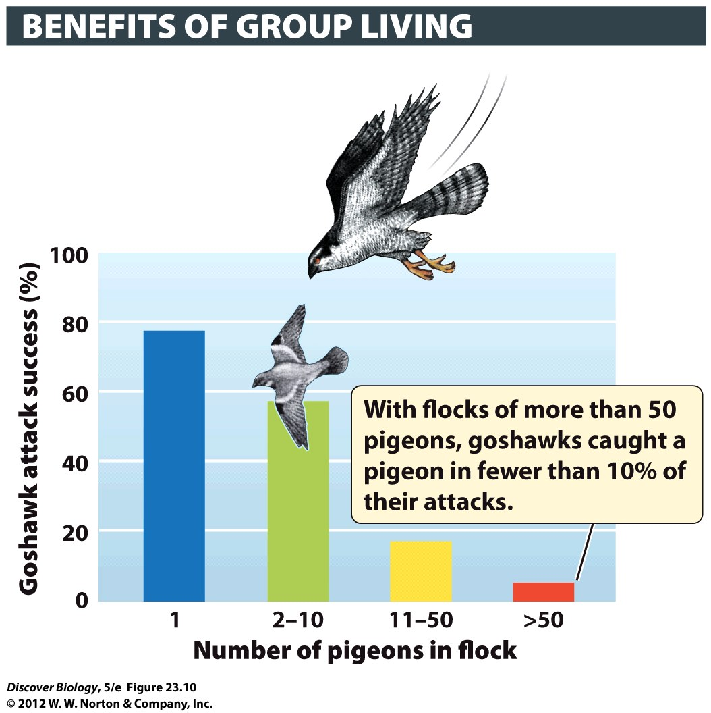
Notes:
Figure 23.10 Safety in Numbers
The success of goshawk attacks on wood pigeons decreases greatly when there are many pigeons in a flock.

Slide 28
Consumers Can Restrict the Distribution and Abundance of Their Food Organisms
Nonnative species introduced by people to new regions sometimes disrupt the ecological communities there
Some species multiply rapidly when introduced to new areas due to lack of predation and fewer parasites than in their original home

Slide 29
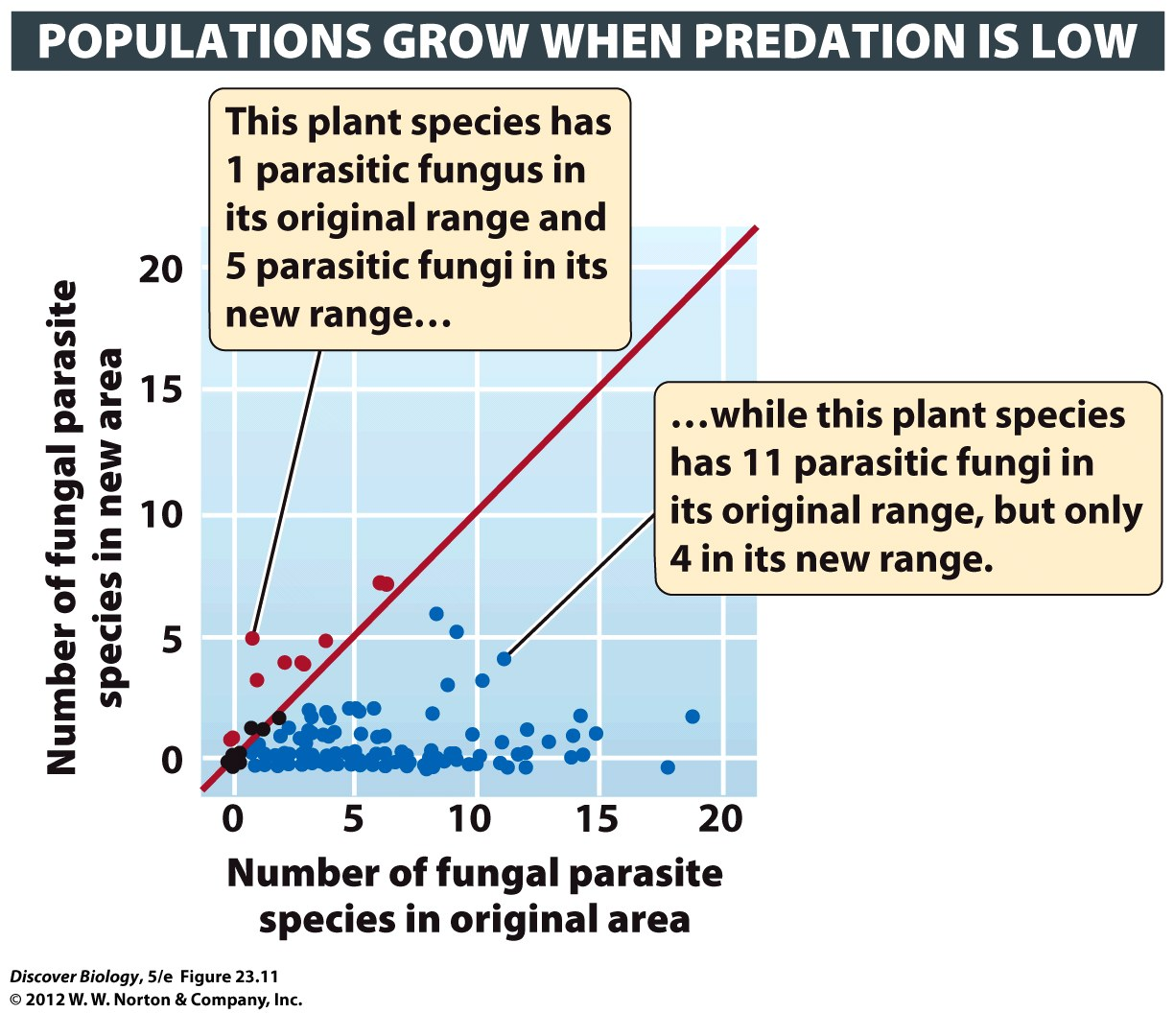
Notes:
Figure 23.11 Nonnative Species Leave Their Predators at Home
Generally, nonnative species have fewer parasites and other predators in their new homes than in their original homes. Each point on the graph represents a different plant species that has been introduced to a new area. Points below the diagonal line represent plants with fewer fungal parasites in their new home than in their old home; points above the diagonal line represent the opposite. Points falling on the diagonal line indicate plants showing no difference in the number of fungal parasite species between their new and old ranges.

Slide 30
Consumers Can Drive Their Food Organisms to Extinction
Exploitation can drive food organisms to extinction
Once an organism becomes extinct, the exploiter must either locate a new population of food organisms or go extinct itself

Slide 31
In Competition, Both Species Are Negatively Affected
Interspecific (interspecies) competition is most likely when two species share an important resource that is limited
An ecological niche is the sum total of the conditions and resources a species or population needs in order to survive and reproduce successfully in its particular habitat
When two or more species compete, each has a negative effect on the other because each uses resources needed by its competitor

Slide 32
In Competition, Both Species Are Negatively Affected
Competitive exclusion occurs when one species uses all the resources needed by another and that species becomes extinct
There are two main types of competition:
Interference competition: one organism directly excludes another from the use of a resource
Exploitative competition: species compete indirectly for a shared resource, each reducing the amount of the resource available to the other

Slide 33
Competition Can Limit the Distribution and Abundance of Species
Competition between species is important in evolution and can limit the distribution and abundance of species that share resources or space
Niche partitioning occurs when natural selection leads competing organisms to use their common niche in different ways as a method of reducing competition

Slide 34
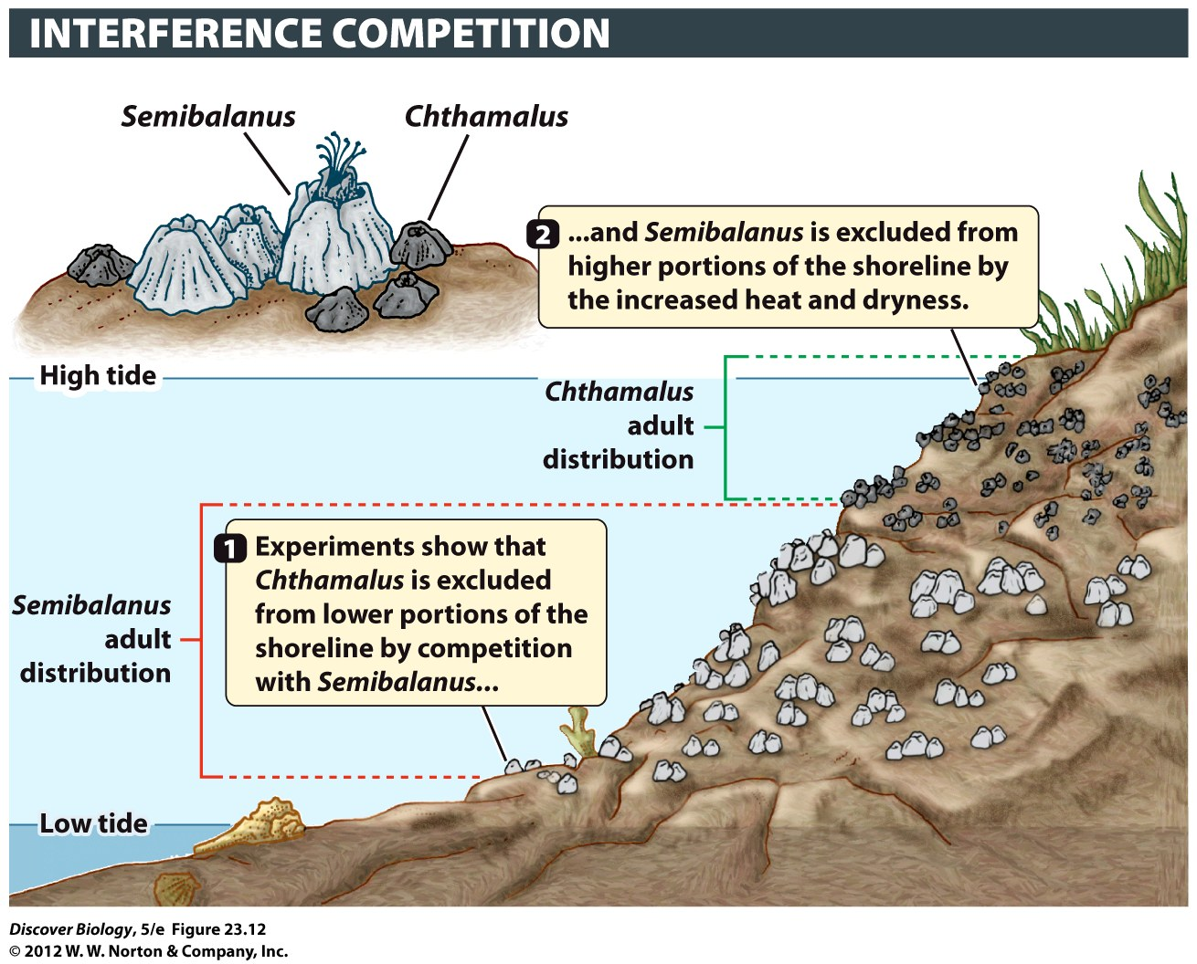
Notes:
Figure 23.12 What Keeps Them Apart?
On the rocky coast of Scotland, the larvae of Semibalanus and Chthamalus barnacles settle on rocks on both high and low portions of the shoreline. However, adult Semibalanus barnacles are not found on high portions of the shoreline, and adult Chthamalus individuals are not found on low portions.

Slide 35
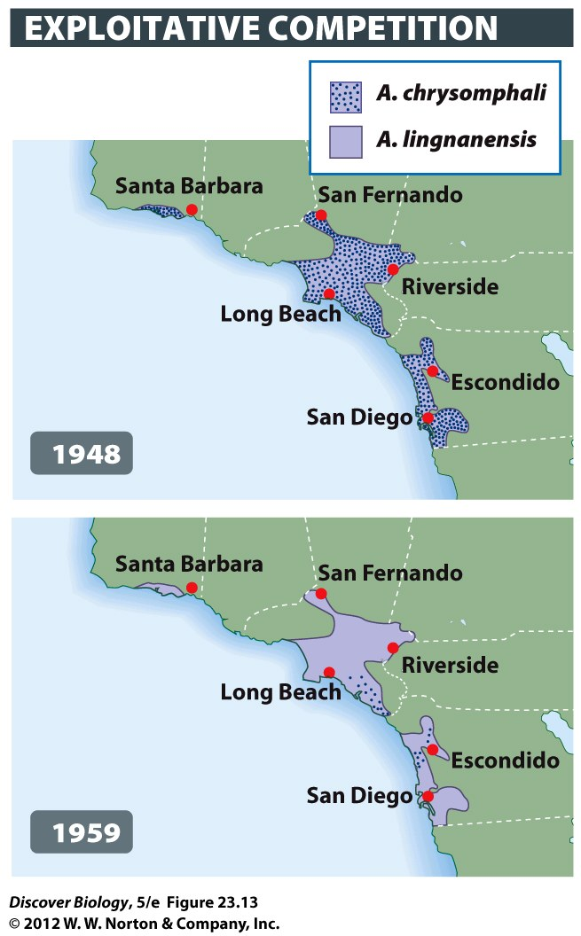
Notes:
Figure 23.13 A Superior Competitor Moves In
After being introduced to southern California in 1948, the wasp Aphytis lingnanensis rapidly drove its competitor, A. chrysomphali, extinct in most locations. Both species of wasps prey on scale insects that damage citrus crops (such as lemons and oranges).

Slide 36
Competition Can Increase the Differences between Species
Competition between species can be intense when the two species are very similar in form
Character displacement occurs when intense competition between species causes them to evolve to become more different over time

Slide 37
How Species Interactions Shape Communities
Interactions among organisms can impact the communities and ecosystems in which those organisms live
Human actions, such as urbanization, and natural causes, such as fire, affect a species’ chances of survival
Any changes in species diversity in a community will have a ripple effect throughout the community

Slide 38
Food Chains Transfer Nutrients through the Community
A food chain describes a linear sequence of who eats whom in a community
A food web is made up of interconnected and overlapping food chains and shows the movement of energy and nutrients throughout a community
The foundation of all food webs consists of producers, organisms that produce their own food, such as plants and phytoplanktons

Slide 39
Food Chains Transfer Nutrients through the Community
Consumers are organisms that obtain energy by eating all or parts of other organisms or their remains
Primary consumers are organisms that eat producers, while secondary consumers are organisms such as humans that feed on primary consumers as part or all of their diet
As the food chain extends, secondary consumers can be further categorized as tertiary consumers or quaternary consumers

Slide 40
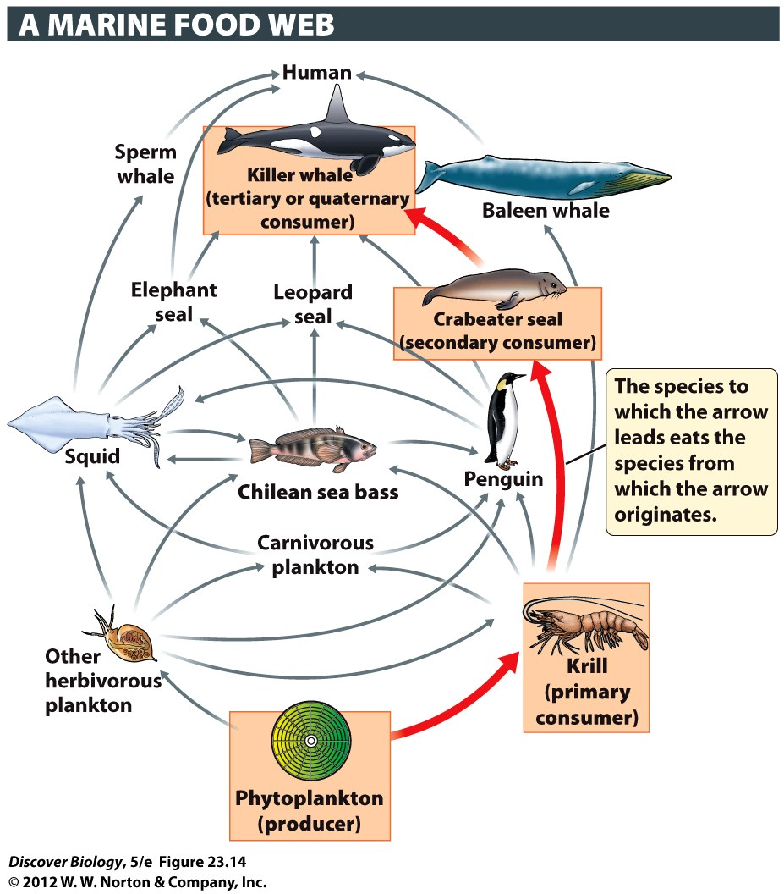
Notes:
Figure 23.14 Food Webs Summarize the Movement of Food through a Community
Food webs are composed of many specific sequences, known as food chains, that show one species eating another. To make it easier to follow a single sequence of feeding relationships, one of the food chains in this food web is highlighted with red arrows and orange boxes.

Slide 41
Keystone Species Have Profound Effects on Communities
Keystone species have a disproportionately large effect, relative to their own abundance, on the types and abundances of the other species in a community
Keystone species can include any producer or consumer of relatively low abundance that has a large influence on its community, and they are usually only noticed when they are removed or disappear from an ecosystem

Slide 42
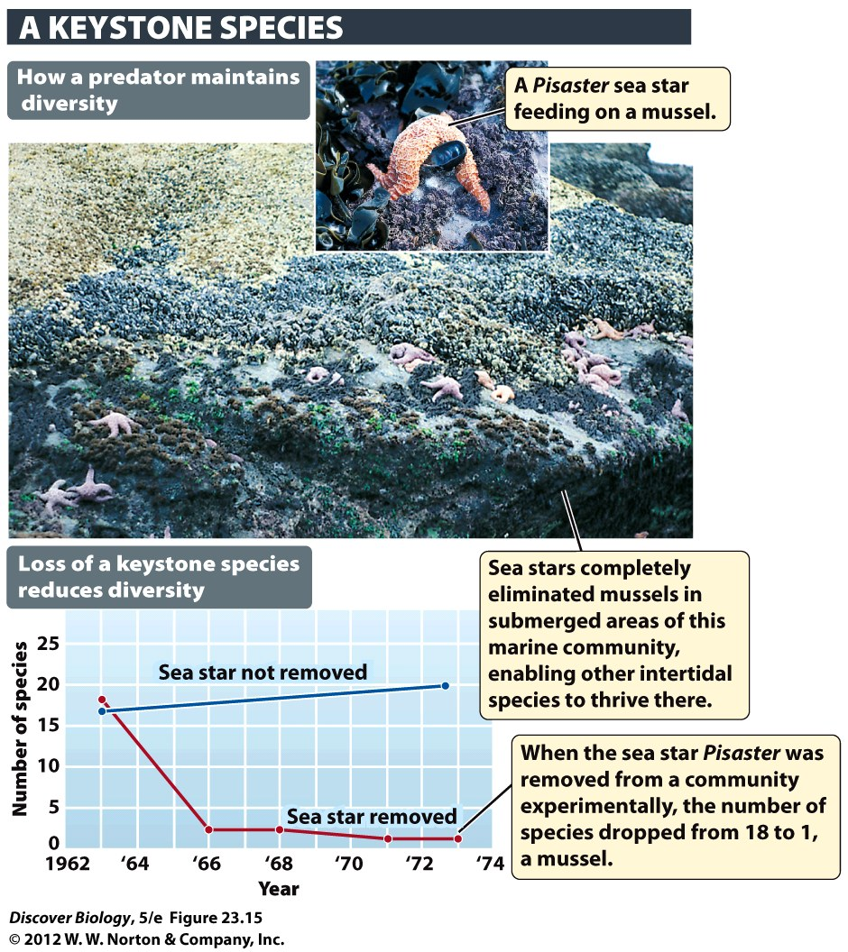
Notes:
Figure 23.15 The Star of the Community
The sea star Pisaster ochraceus is a predator that feeds on mussels and thereby prevents the mussels from crowding out other species in their community.

Slide 43
How Communities Change over Time
The number of individuals of different species in a community often changes as the seasons or the years change
Communities also undergo broad directional changes in species composition over longer periods of time

Slide 44
Succession Establishes New Communities and Replaces Disturbed Communities
The process by which species in a community are replaced over time is called succession
The process of succession ends when the species composition of a community remains stable over a long period of time, resulting in a mature community
Most ecological communities never reach maturity because of frequent disturbances such as fires or windstorms

Slide 45
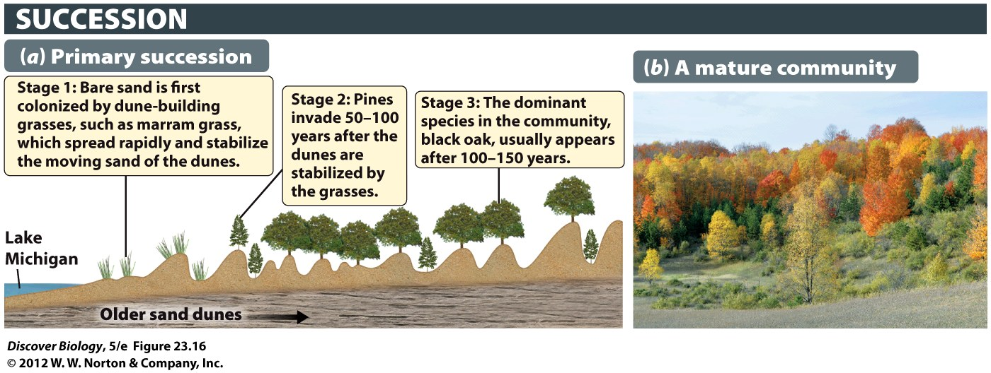
Notes:
Figure 23.16 Sand Becomes Woodland
When strong winds cause sand dunes to form at the southern end of Lake Michigan, succession often leads to a community dominated by black oak. Succession on such dunes occurs in three stages and forms communities of black oak that have lasted up to 12,000 years. Under different local environmental conditions, succession on Michigan sand dunes (a) can lead to the establishment of stable communities as different as grasslands, swamps, and sugar maple forests (b).

Slide 46
Succession Establishes New Communities and Replaces Disturbed Communities
Primary succession occurs in newly created habitat when a few species that are able to grow and reproduce under the challenging conditions begin to colonize the area
The first species to colonize the area may alter the habitat in ways that cause later-arriving species to thrive or fail
Secondary succession is the process by which communities regain the successional state that existed before a disturbance

Slide 47
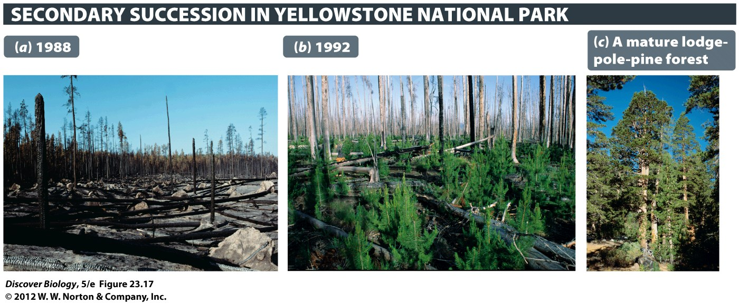
Notes:
Figure 23.17 The Slow but Steady Regrowth of Lodgepole-Pine Forest in Yellowstone National Park
These photographs, taken in different locations, show the regrowth of lodgepole-pine forest following the large fire that struck Yellowstone National Park in 1988 (a, b), compared to unburned, mature forest (c).

Slide 48
Communities Change as Climate Changes
The climate at a given location can change over time as a result of either global climate change or continental drift
The change in the global climate causes slow but dramatic changes in the location and diversity of plant and animal species in an ecosystem
Human activities are now accelerating the natural changes in the global climate
As the continents move slowly over time, their climates change, causing large changes in their communities

Slide 49
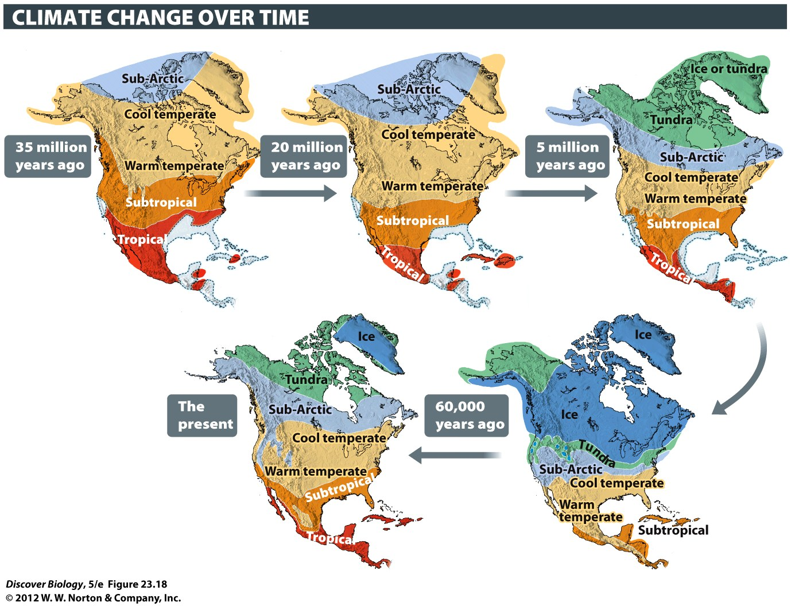
Notes:
Figure 23.18 Climates Change, Communities Change
The climate of North America has changed greatly during the past 35 million years. As the climate has changed, the communities found in particular places have changed as well. The white regions surrounded by dotted lines were below sea level at the time indicated.

Slide 50
Human Impacts on Community Structure
Ecological communities are subject to many natural forms of disturbance, from which secondary succession can reestablish the previously existing community over time
Human actions can alter the frequency of an otherwise natural form of disturbance

Slide 51
Communities Can Reassemble after Some Human-Caused Disturbances
Some communities, such as cleared farmland, can recover from a human disturbance
The sizes and abundances of species in a community are different after a disturbance, and there may be fewer species

Slide 52
People Can Cause Long-Term Damage to Communities
Ecological interactions brought about by humans, such as logging or overgrazing by cattle, can permanently affect natural communities
Some communities may take hundreds to thousands of years to recover; others may never recover

Slide 53
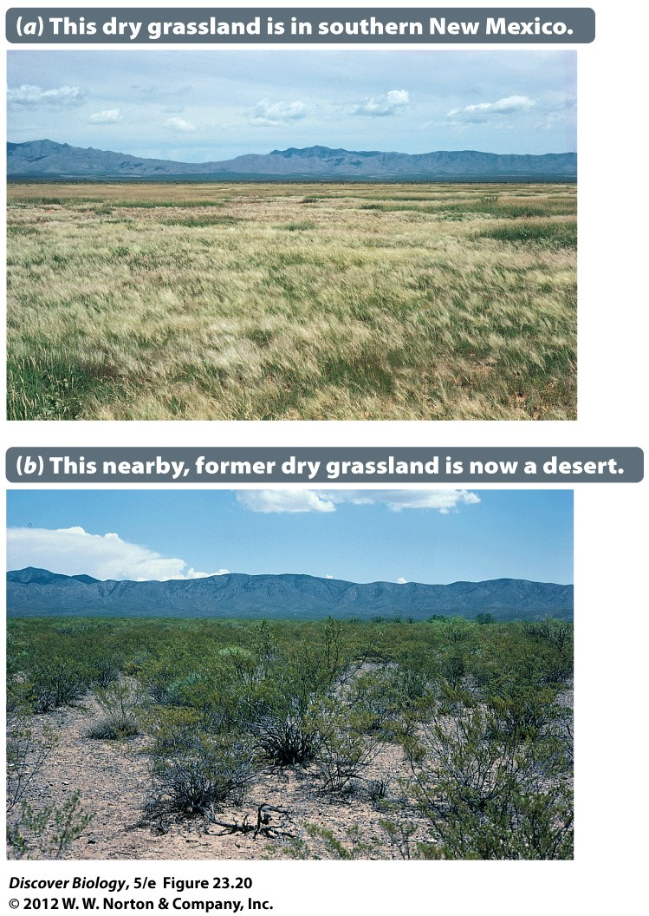
Notes:
Figure 23.19 Overgrazing Can Convert Grasslands into Deserts
(a) More than 200 years ago, large regions of the American Southwest were covered with dry grasslands. (b) Most of these grasslands have been converted into desert shrublands, in large part because of overgrazing by cattle.

Slide 54
How a Parasite Can Hijack Your Brain
T. gondii improves its chances of spreading to cats by changing the behavior of infected rats
Studies indicate T. gondii infections in humans also alter behavior but have not determined whether the effect on humans is just a side effect that fails to help the parasite or if in our evolutionary past it made us take risks

Slide 55
Clicker Questions
CHAPTER 23
Ecological Communities

Slide 56
Concept Quiz
The type of interaction where one species
benefits at the other’s expense is known as
Mutualism
Exploitation
Competition
Notes:
The correct answer is B. Exploitation is when one species benefits from the interaction, and the other species is harmed.
Mutualism is where both species benefit from the interaction.
Competition is when both species are harmed from the relationship; they do not reach their full potential.

Slide 57
Concept Quiz
Which of the following is not a major type of
exploitation?
Herbivores
Parasites
Induced defenses
Notes:
The correct answer is C.
Both herbivores and parasites are major types of exploitation.
Induced defenses are a result of exploitation.

Slide 58
Concept Quiz
Two species of insects feed on nectar of different
flowers when they live in the same habitat. When
the insect species live in different habitats, they
feed on the same species of flower nectar. This is
an example of
Pollinator mutualism
Character displacement
Exploitative competition
Notes:
The correct answer is B. Character displacement keeps species apart when they occur in the same habitat. These insects are forced to find alternative food sources when they occur together.
Pollinator mutualism benefits the insect (pollinator) because it receives a food reward and benefits the plant by distributing pollen. Although this is a situation of feeding on nectar, the question does not focus on the act of pollination.
Exploitative competition is indirect competition for a resource. In this situation, there is direct competition for food. Competition for the same food source has pushed the species apart to find a new source.

Slide 59
Concept Quiz
Organisms that must survive by eating other
organisms are called
Producers
Consumers
Herbivores
Notes:
The correct answer is B because the question is asking about any organism that consumes food. Carnivores also fall into this category. Consumer is the answer that applies to all situations.
Producers are organisms that can make their own food.
Although herbivores eat other organisms, the term only includes organisms that eat producers.

Slide 60
Concept Quiz
The retreat of a glacier exposing a new
patch of habitat is considered
Primary succession
Secondary succession
Climate change
Notes:
The correct answer is A. Primary succession occurs when a brand new patch of land becomes available in the environment.
Secondary succession occurs when species are replaced by other species, such as after a fire.
Climate change is the climate of a community changing. This has nothing to do with available land.

Slide 61
Concept Quiz
The study of the interactions of many
food chains is called a
Succession
Competition
Food web
Notes:
The correct answer is C. A food web is composed of many food chains and the study of how those food chains interact.
Succession is how a community develops over time through species replacement.
Competition is when two species are competing for the same resource.

Slide 62
Relevant Art from Other Chapters
All art files from the book are available in JPEG and PPT formats online and on the Instructor Resource Disc

Slide 63
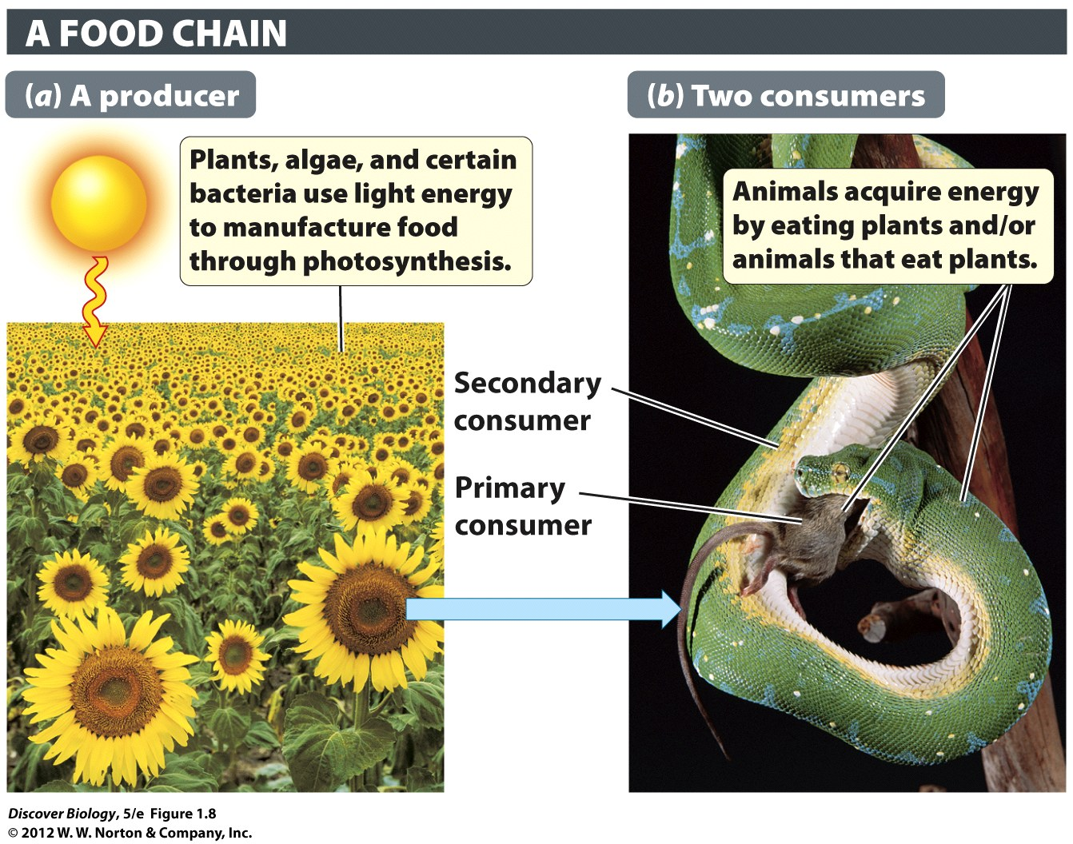
Notes:
Figure 1.8 Energy Capture by Organisms
Whereas plants can capture energy from sunlight through photosynthesis (a), animals must get their energy by eating other organisms (b). The green tree python pictured in (b) is ingesting a source of energy (a rat) that itself derived energy from eating plants.

