Slide 1
Discover Biology FIFTH EDITION
Anu Singh-Cundy • Michael L. Cain
CHAPTER 22
Growth of Populations
© 2012 W. W. Norton & Company, Inc.

Slide 2
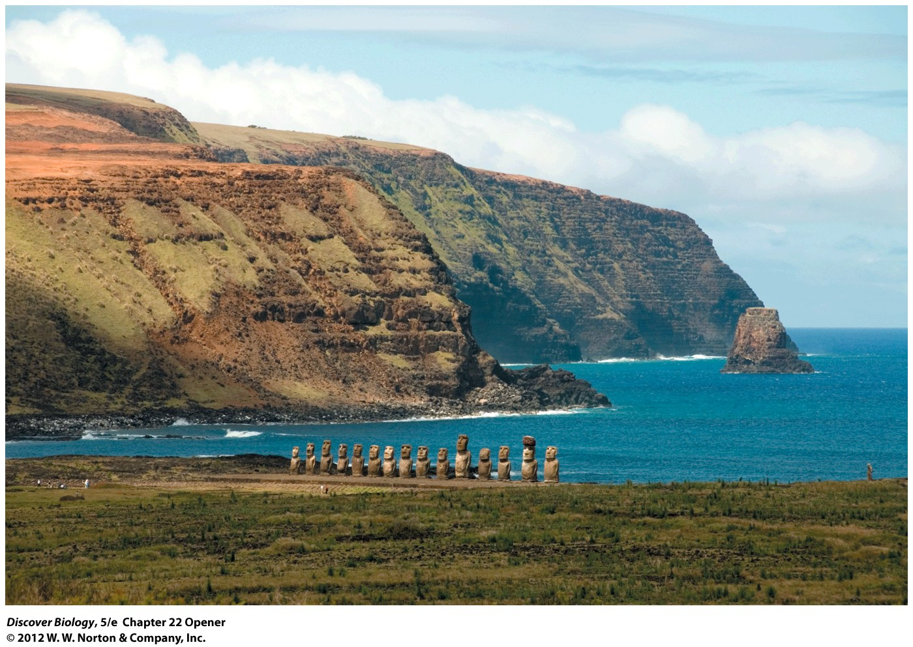
Notes:
Easter Island Was Once Covered by a Lush Forest.
Long ago the Rapanui people cut down all the trees on Easter Island—to build houses, to fuel cooking fires, and to move giant stone statues, visible in this photograph. The unsustainable use of resources led to an ecosystem collapse, and the island could no longer support the thousands of Rapanui who once lived there.

Slide 3
The Tragedy of Easter Island
Easter Island, once home to a diverse group of species including humans, is now a barren grassland
Easter Island is a example of what happens when humans use more resources than the biosphere can support

Slide 4
How Many Organisms Live in a Particular Environment, and Why?
Population ecology is the study of the number of organisms in a particular place
Population ecology is essential for solving real-world problems, such as protecting endangered species or controlling pest species

Slide 5
What Is a Population?
A population is a group of interacting individuals of a single species located within a particular area
Population size refers to the total number of individuals in the population
Population density refers to the number of individuals per unit of area
The area appropriate for defining a particular population depends on the questions being asked and the biology of the organism of interest

Slide 6
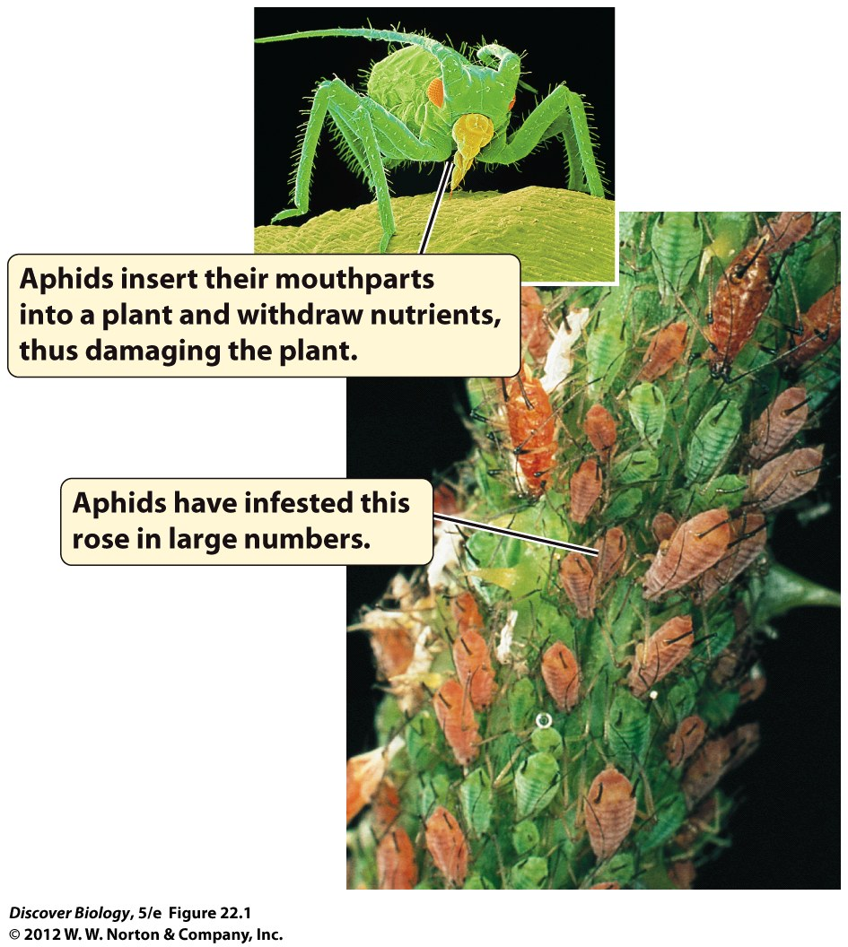
Notes:
Figure 22.1 Populations of Aphids Can Cause Extensive Crop Damage
Aphids are small insects with sucking mouthparts. They are pests on many plant species, which they infest in such large numbers that they can be difficult to count.

Slide 7
Changes in Population Size
Whether a population increases or decreases in size depends on the birth and death rates and immigration and emigration rates
A population increases in size whenever the number of individuals entering is greater than the number of individuals leaving
Birth and death rates and immigration and emigration rates are all affected by environmental factors

Slide 8
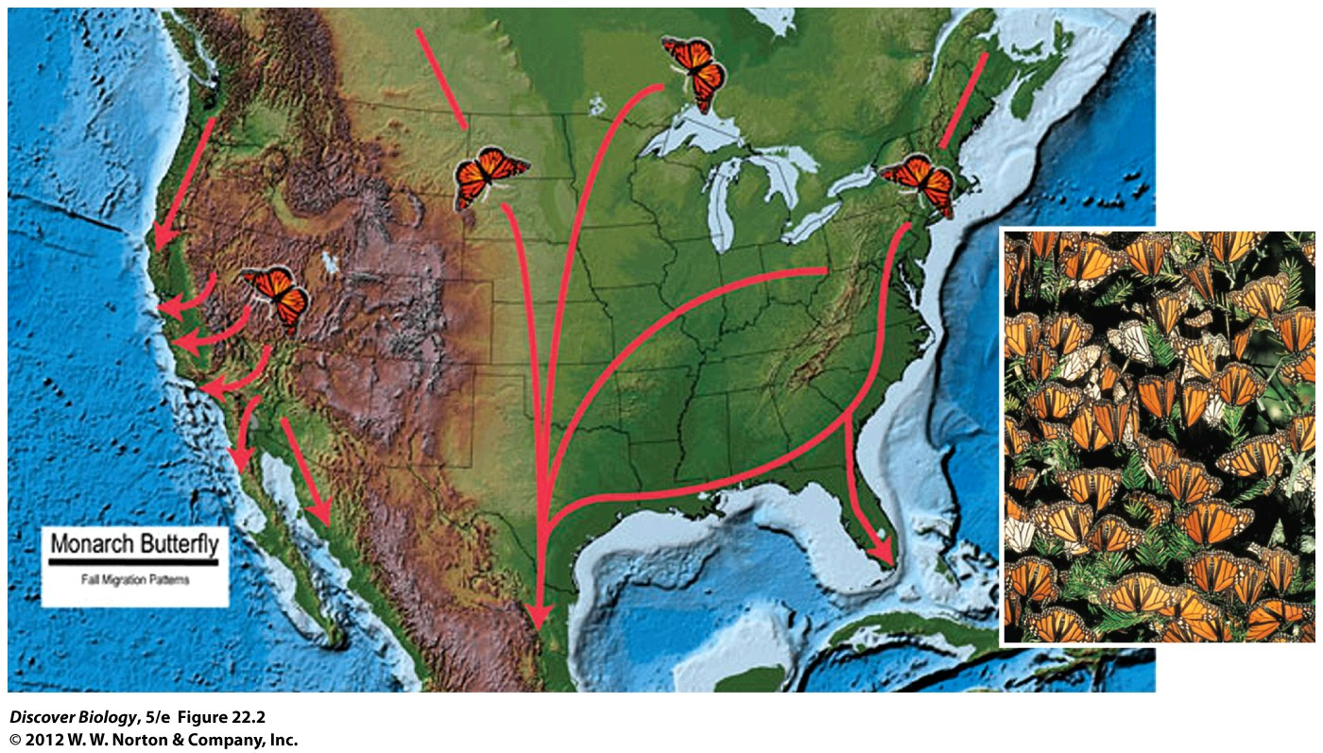
Notes:
Figure 22.2 Before the Crash
Huge numbers of monarch butterflies overwinter in mountains west of Mexico City and then migrate each spring to eastern North America. In 2002, 70–80 percent of the overwintering butterflies died in an unusual winter storm.

Slide 9
Exponential Growth
An important type of rapid population growth, exponential growth, occurs when a population increases by a constant proportion over a constant time interval
The time it takes a population to double in size is called the doubling time and can be used as a measure of how fast the population is growing
Endless exponential growth of a population is limited by the availability of resources and is not seen under natural conditions

Slide 10
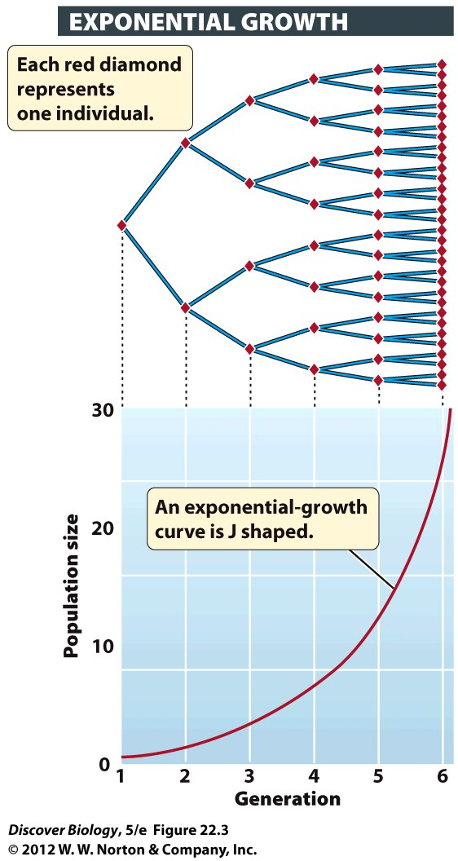
Notes:
Figure 22.3 The Size of a Population That Is Growing Exponentially Increases at a Constant Rate
In this hypothetical population, each individual produces two offspring, so the population increases by a constant rate: it doubles with each generation. The number of individuals added to the population increases each generation, resulting in the J-shaped curve that is characteristic of exponential growth. Exponential-growth curves are always J shaped, but the curve’s steepness varies depending on the rate of increase.

Slide 11
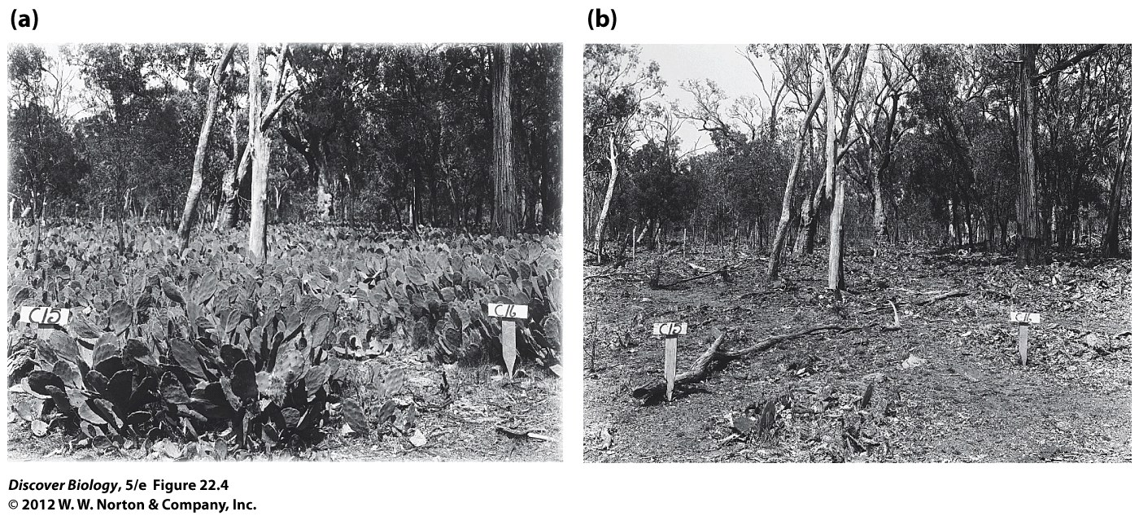
Notes:
Figure 22.4 Blasting a Troublesome Cactus
In Australia, the moth Cactoblastis cactorum was introduced in 1925 to halt the exponential growth of populations of an introduced cactus species. (a) Two months before release of the moth, Opuntia cacti were growing in a dense stand. (b) Three years after introduction of the moth, the same stand had been almost completely eliminated.

Slide 12
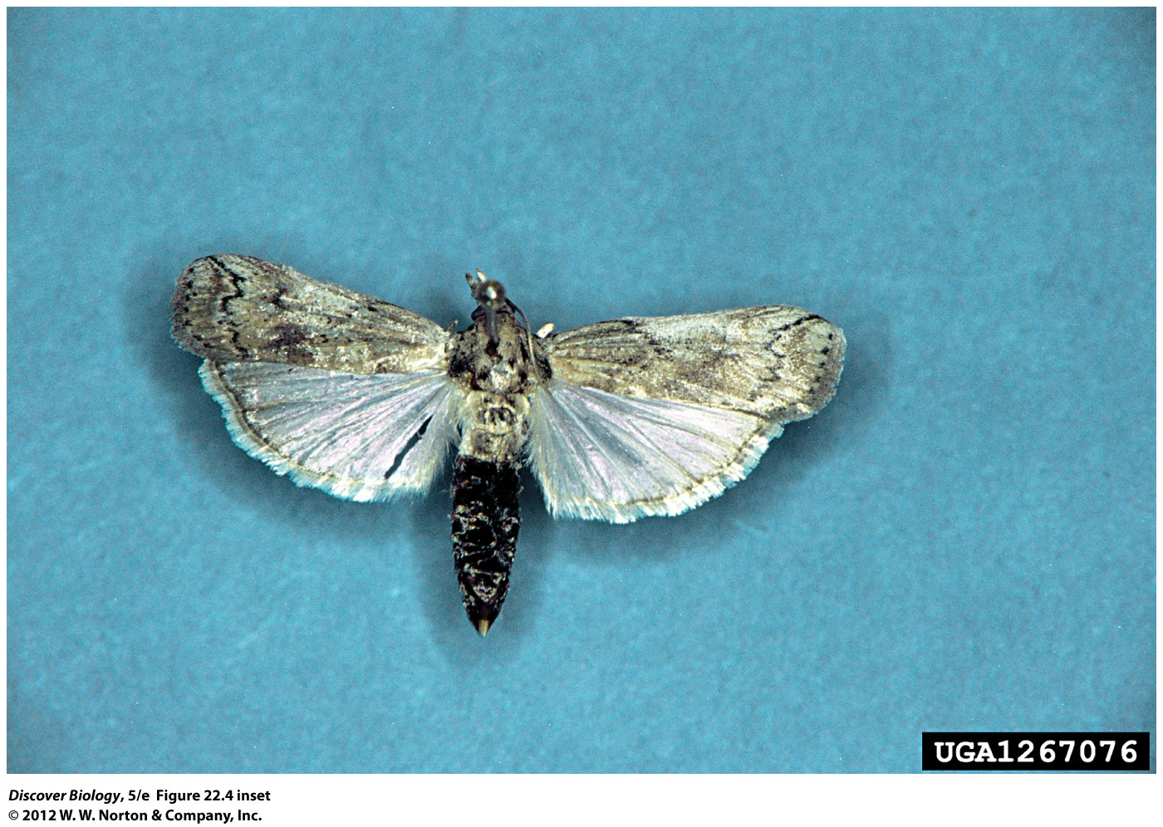
Notes:
Figure 22.4 Blasting a Troublesome Cactus
The moth Cactoblastis cactorum .

Slide 13
Logistic Growth and the Limits on Population Size
Populations cannot increase in size indefinitely—limits exist

Slide 14
Growth Is Limited by Essential Resources and Other Environmental Factors
Space and nutrients are important limiting factors in the population growth of an organism
Habitat is the type of environment in which an organism lives and is an environmental factor that limits population growth

Slide 15
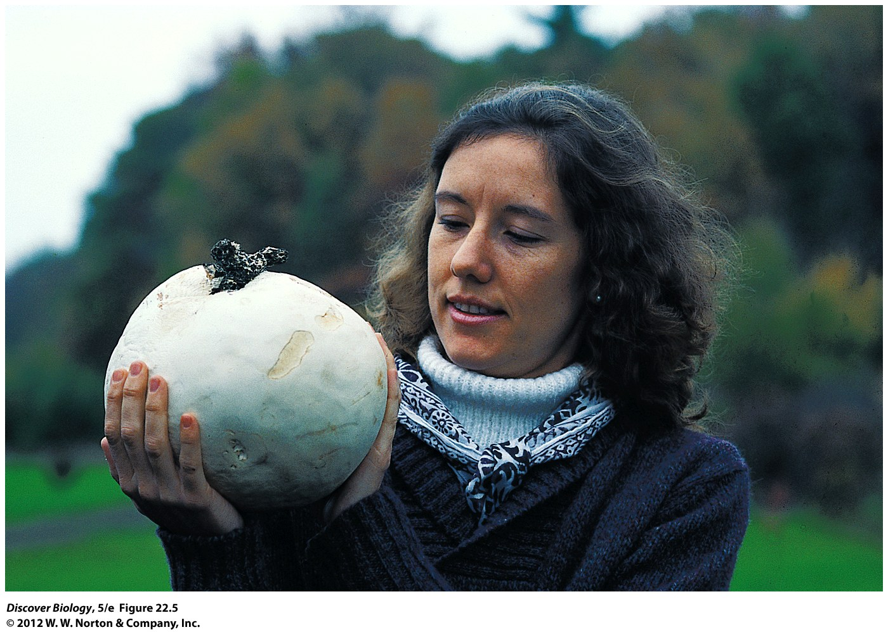
Notes:
Figure 22.5 Will They Overrun Earth?
Given the number of spores it produces, a giant puffball mushroom has the potential to produce 7 trillion offspring in a single generation. However, relatively few of those spores land in a habitat suited for their growth. Large giant puffballs weigh 40–50 kilograms each; a medium-sized example is shown here.

Slide 16
Logistic Population Growth Is the Norm in the Real World
Logistic growth is represented by an S-shaped curve; it takes into consideration changes in growth rates that occur as resources become limited
The maximum population size that can be sustained in a given environment is known as the carrying capacity
At the carrying capacity, the population growth rate is zero

Slide 17
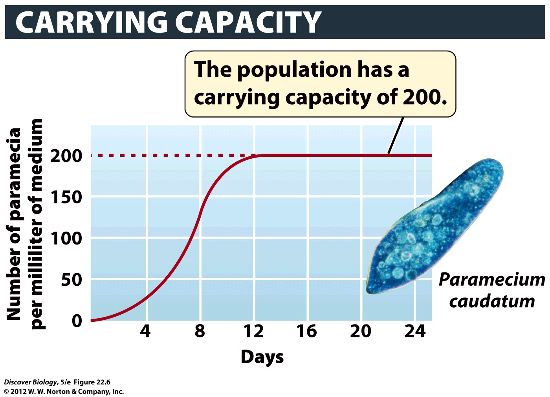
Notes:
Figure 22.6 Carrying Capacity Is the Maximum Population Size a Particular Environment Can Sustain
A laboratory population of the single-celled protist Paramecium caudatum increases rapidly at first and then stabilizes at the maximum population size that can be supported indefinitely by its environment—that is, at its carrying capacity. This growth pattern can be graphed as an S-shaped curve.

Slide 18
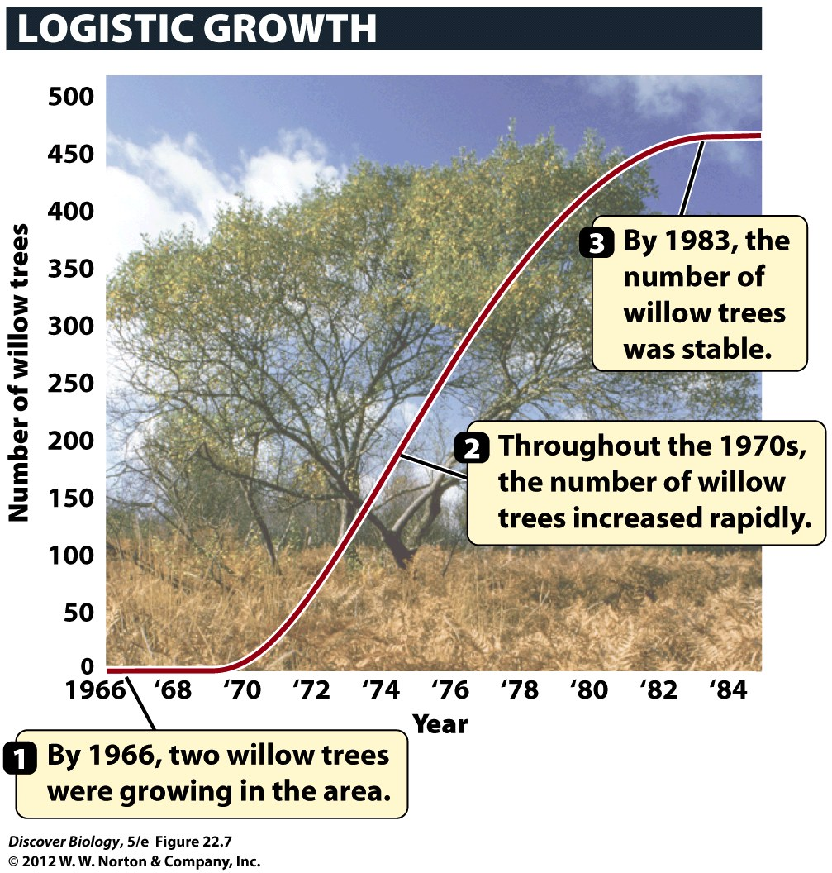
Notes:
Figure 22.7 A Logistic Curve in a Natural Population
At a site in Australia, rabbits heavily grazed young willow trees, preventing willows from growing in the area. The rabbits were removed in 1954. By 1966, two willows had taken root in the area, presumably from seed blown in or carried in by animals. They increased rapidly in number, and the population then leveled off at about 475 trees.

Slide 19
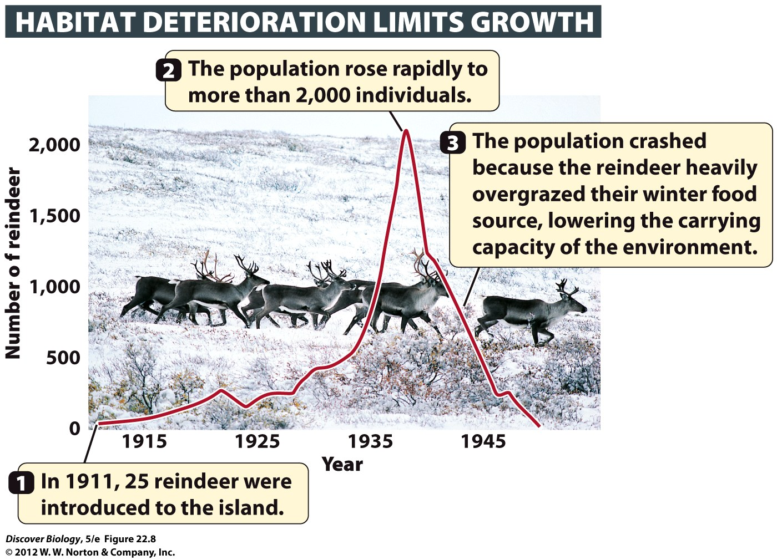
Notes:
Figure 22.8 Boom and Bust
When reindeer were introduced to Saint Paul Island, off the coast of Alaska, in 1911, their population increased rapidly at first and then crashed. By 1950, only eight reindeer remained.

Slide 20
Some Growth-Limiting Factors Depend on Population Density; Others Do Not
Birth rates and death rates are density-dependent because they change as the density of the population changes
Density-independent factors are not related to the density of the population
Weather, natural disasters, and the effects of environmental pollutants are examples of density-independent factors

Slide 21
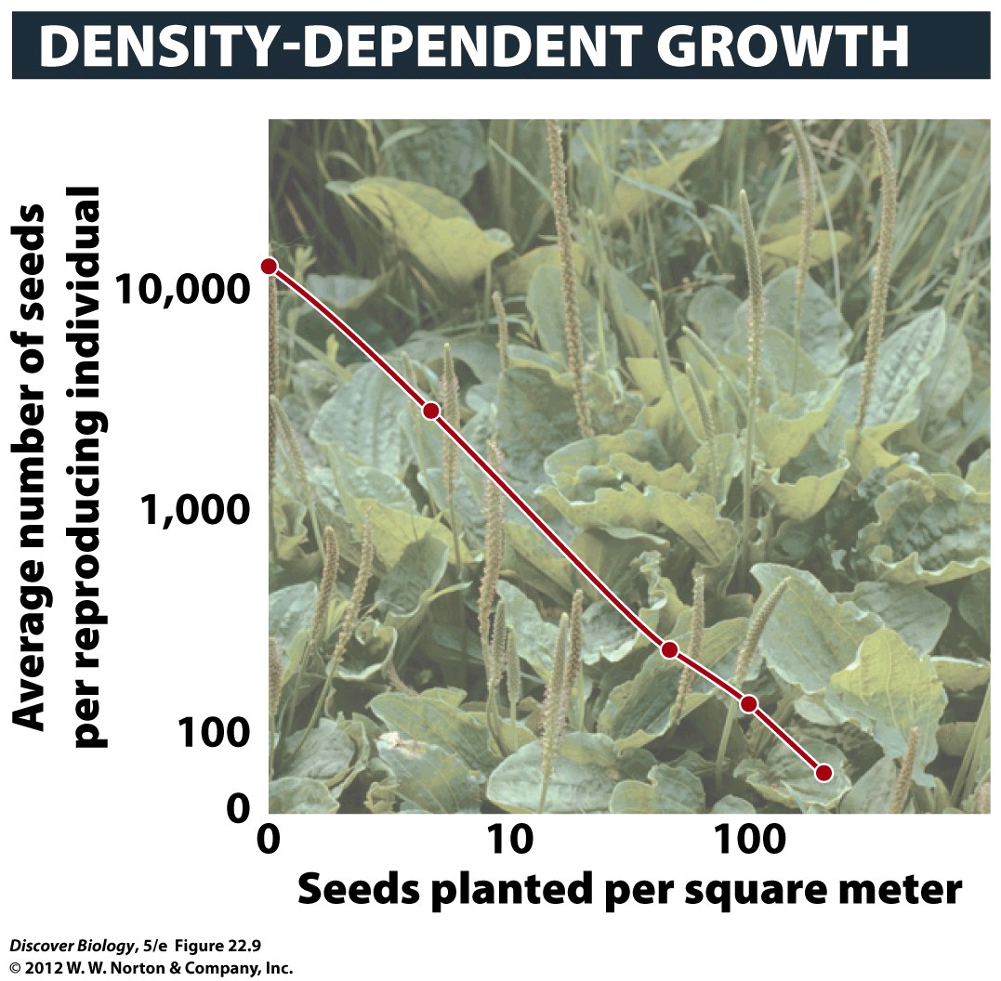
Notes:
Figure 22.9 The Effects of Overcrowding in Plantain Weed, Plantago major
The number of seeds produced per plant drops dramatically under increasingly crowded conditions in plantain, a small herbaceous plant.

Slide 22
Patterns of Population Growth
J-shaped growth patterns indicate rapid population growth, which can only continue until all resources are depleted
In the logistic S-shaped growth pattern, the rate of population growth slows as the population size nears the carrying capacity
In a population cycle, the population sizes of two or more species change together because at least one of the two is influenced by the other

Slide 23
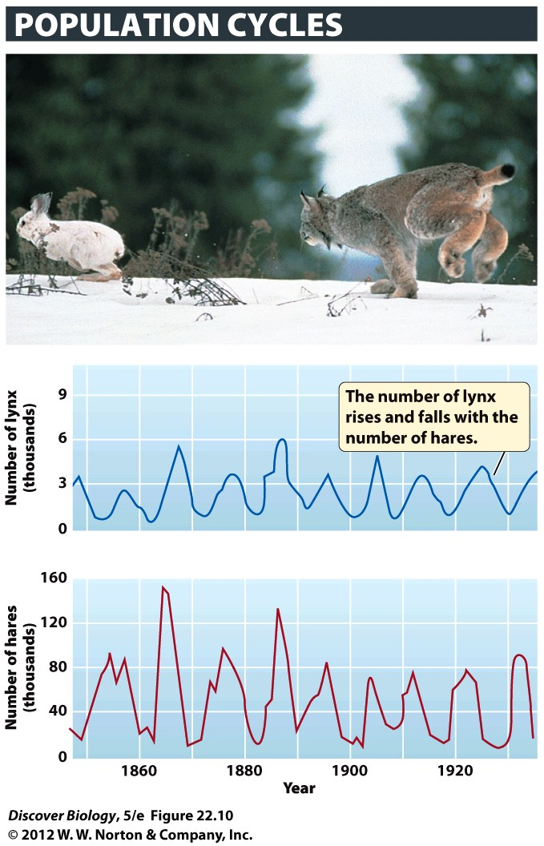
Notes:
Figure 22.10 Populations of Two Species Occasionally Increase and Decrease Together
The Canadian lynx depends on the snowshoe hare for food, so the number of lynx is strongly influenced by the number of hares. Experiments conducted in the early twentieth century indicate that hare populations are limited by their food supply and by their lynx predators. (The researchers supplemented their observations with population estimates based on the numbers of hare and lynx pelts sold by trappers to the Hudson’s Bay Company, Canada.)

Slide 24
Patterns of Population Growth
Populations change in size over time, and most experience irregular fluctuations
Populations of the same species may experience different patterns of growth

Slide 25
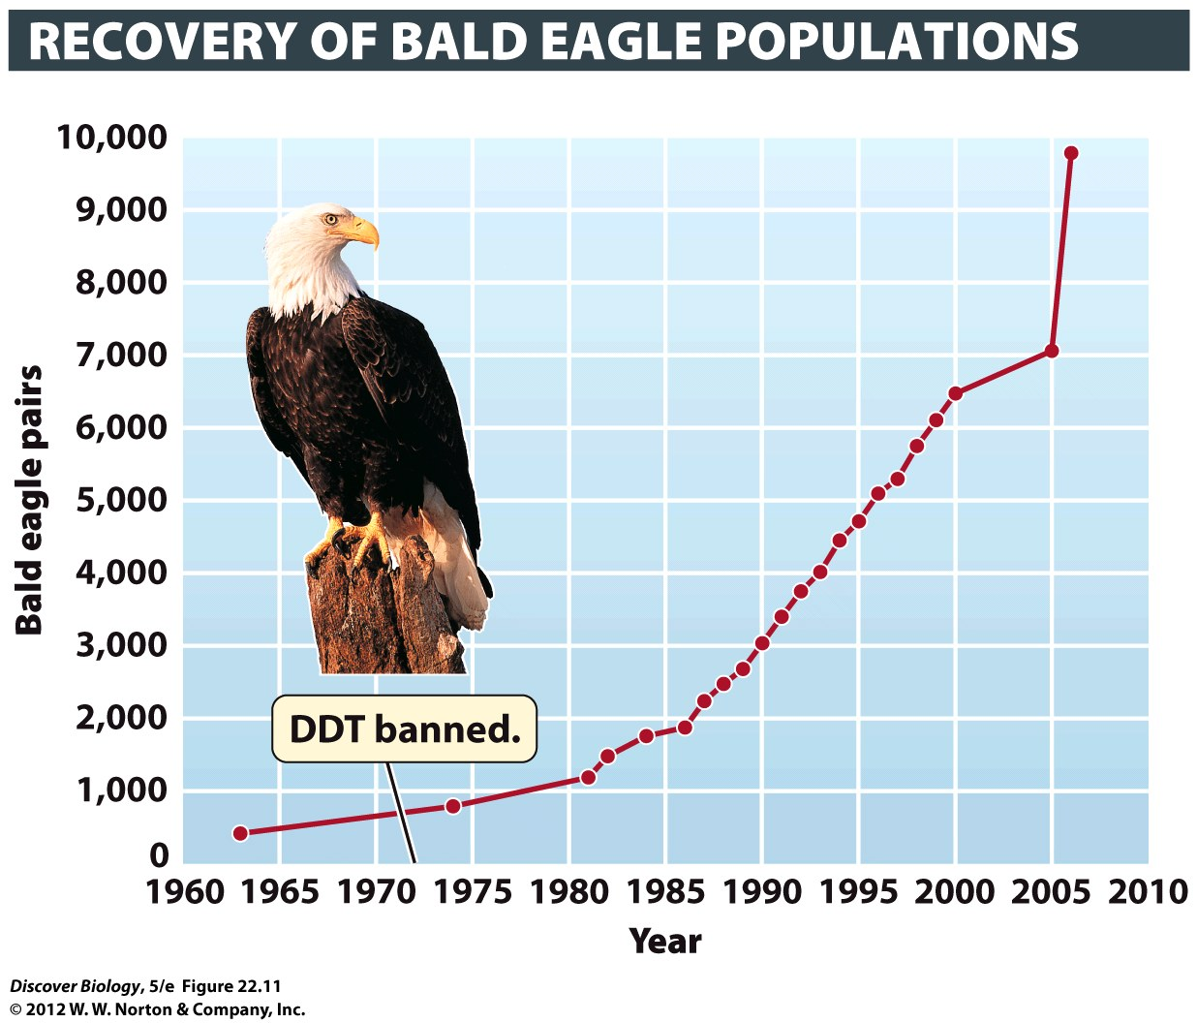
Notes:
Figure 22.11 Bald Eagle Populations Increased After DDT Was Banned
Bald eagles are relatively easy to count: they have large, conspicuous nests to which they return year after year. By the early 1960s, population counts indicated that only 417 breeding pairs of eagles remained in the lower 48 states—a huge drop from the estimated 100,000 breeding pairs present in 1800. It was determined that DDT poisoning was directly responsible for declining eagle populations, which prompted a ban on DDT in 1972.

Slide 26
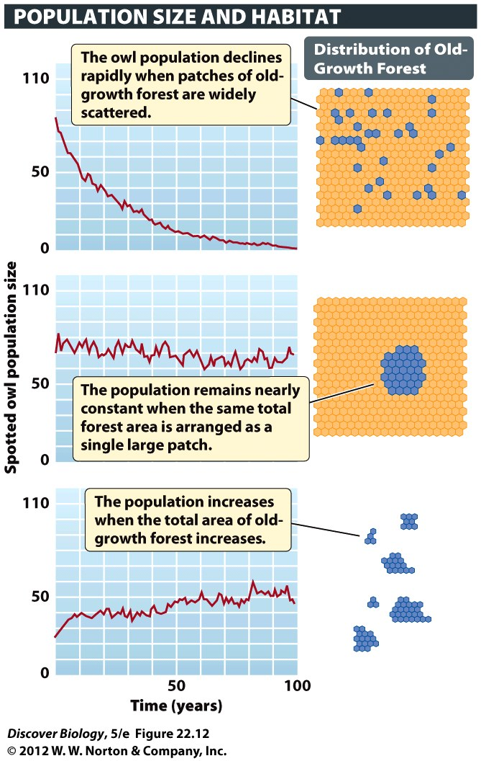
Notes:
Figure 22.12 Same Species, Different Outcomes
Different populations of the endangered spotted owl are predicted to show different patterns of growth over time, depending on the arrangement and area of their preferred habitat: old-growth forest. Patches of old-growth forest are shown in blue in the diagrams on the right.

Slide 27
What Does the Future Hold?
A combination of rapid population growth and habitat destruction led to the extinction of major groups of plants and animals and a human population crash on Easter Island
Easter Island is an example of the problems facing humans today, including excess population growth and destruction of the environment
All the evidence suggests that the current human impact on Earth is unsustainable

Slide 28
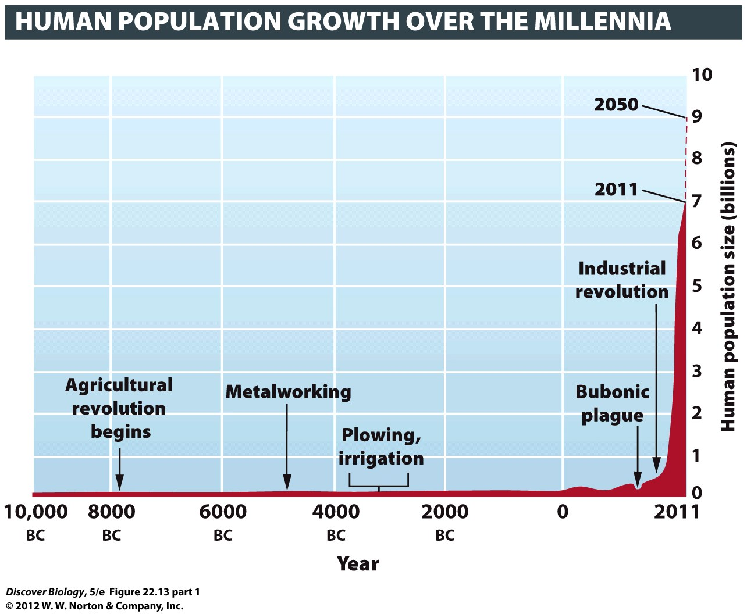
Notes:
Figure 22.13 (Part 1) Rapid Growth of the Human Population
An indication of our growing numbers on Earth, this image from space shows the planet brightly lit by its most populous cities’ lights. The brightness correlates well with population densities in industrialized countries but underrepresents population densities in countries such as China and India, which have sizable populations with poor access to modern amenities. The image was created by researchers at NASA using satellite image data.

Slide 29
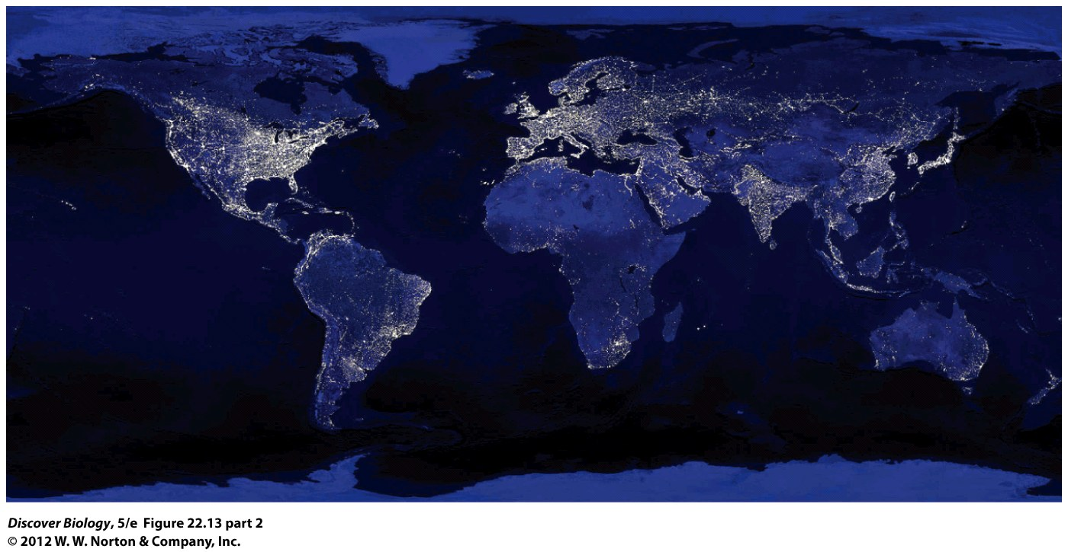
Notes:
Figure 22.13 (Part 2) Rapid Growth of the Human Population
An indication of our growing numbers on Earth, this image from space shows the planet brightly lit by its most populous cities’ lights. The brightness correlates well with population densities in industrialized countries but underrepresents population densities in countries such as China and India, which have sizable populations with poor access to modern amenities. The image was created by researchers at NASA using satellite image data.

Slide 30
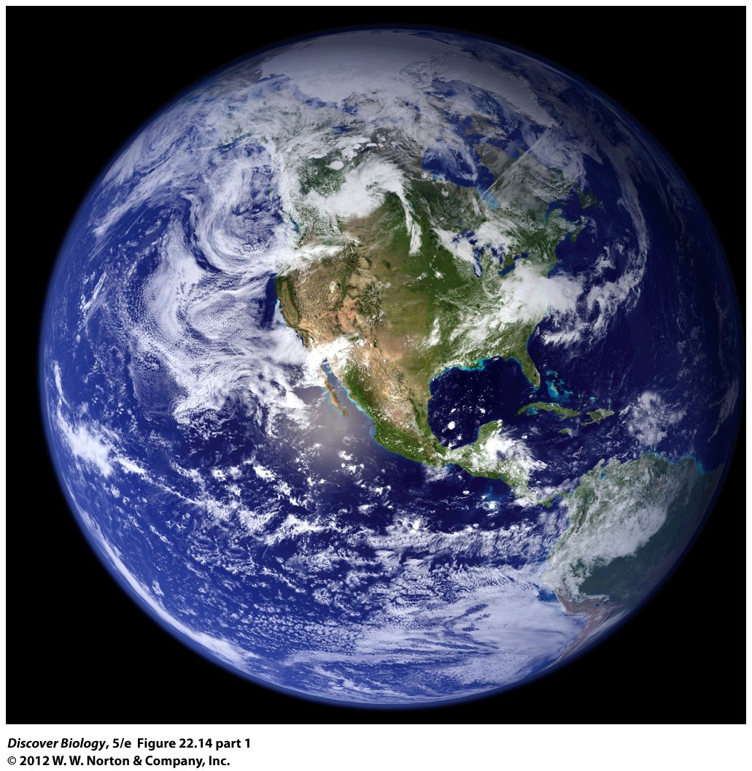
Notes:
Figure 22.14 (Part 1) Our Rising Ecological Impact
The global ecological impact of people has increased steadily. This graph compares human demands on the biosphere in each year between 1961 and 1999 with the capacity of the biosphere to regenerate itself. Human demand has exceeded the biosphere’s entire regenerative capacity since the late 1970s.

Slide 31
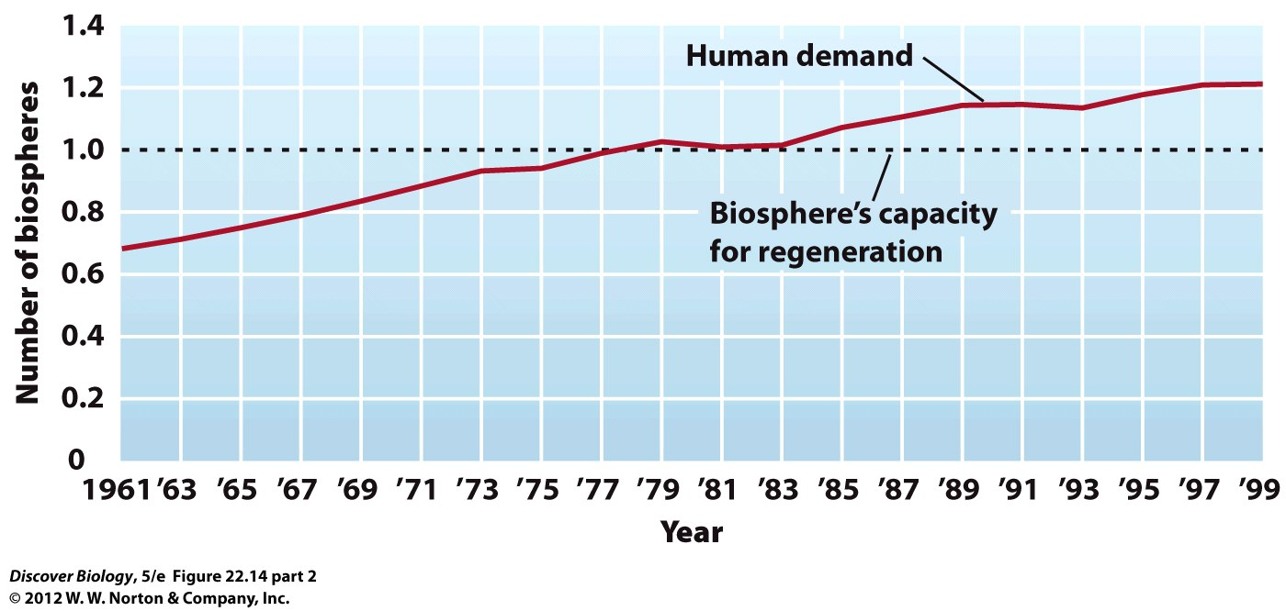
Notes:
Figure 22.14 (Part 2) Our Rising Ecological Impact
The global ecological impact of people has increased steadily. This graph compares human demands on the biosphere in each year between 1961 and 1999 with the capacity of the biosphere to regenerate itself. Human demand has exceeded the biosphere’s entire regenerative capacity since the late 1970s.

Slide 32
Clicker Questions
CHAPTER 22
Growth of Populations

Slide 33
Concept Quiz
In an exponentially growing population, the
rate of growth (λ) is 1.5. If there are 100
organisms this year, what will the population
size be after 2 years?
150
175
225
Notes:
The correct answer is C.
The rate of the growth is constant at 1.5.
In the first generation, there will be 150 individuals (1.5 x 100).
To calculate the second generation, multiply the total of the first generation (150) by the rate (1.5).
1.5 x 150 = 225

Slide 34
Concept Quiz
What type of organism
would most likely show
the growth pattern seen
here?
Elephants
Bacteria
Bears
© 2009 W.W. Norton & Company, Inc. DISCOVER BIOLOGY 4/e
Notes:
The correct answer is B. Bacteria generally show an explosive exponential growth pattern.
Elephants and bears produce fewer offspring at a time and would show an S-shaped growth curve.

Slide 35
Concept Quiz
Which of the following is not a density-
independent factor?
Weather conditions
Food availability
Flooding
Notes:
The correct answer is B.
Both weather conditions and flooding will have the same affect on a population where the population is dense or sparse.
Food availability directly influences population size, especially in a population that is dense. The denser the population, the more drastic effect the shortage of food will have on that population.

Slide 36
Relevant Art from Other Chapters
All art files from the book are available in JPEG and PPT formats online and on the Instructor Resource Disc

Slide 37
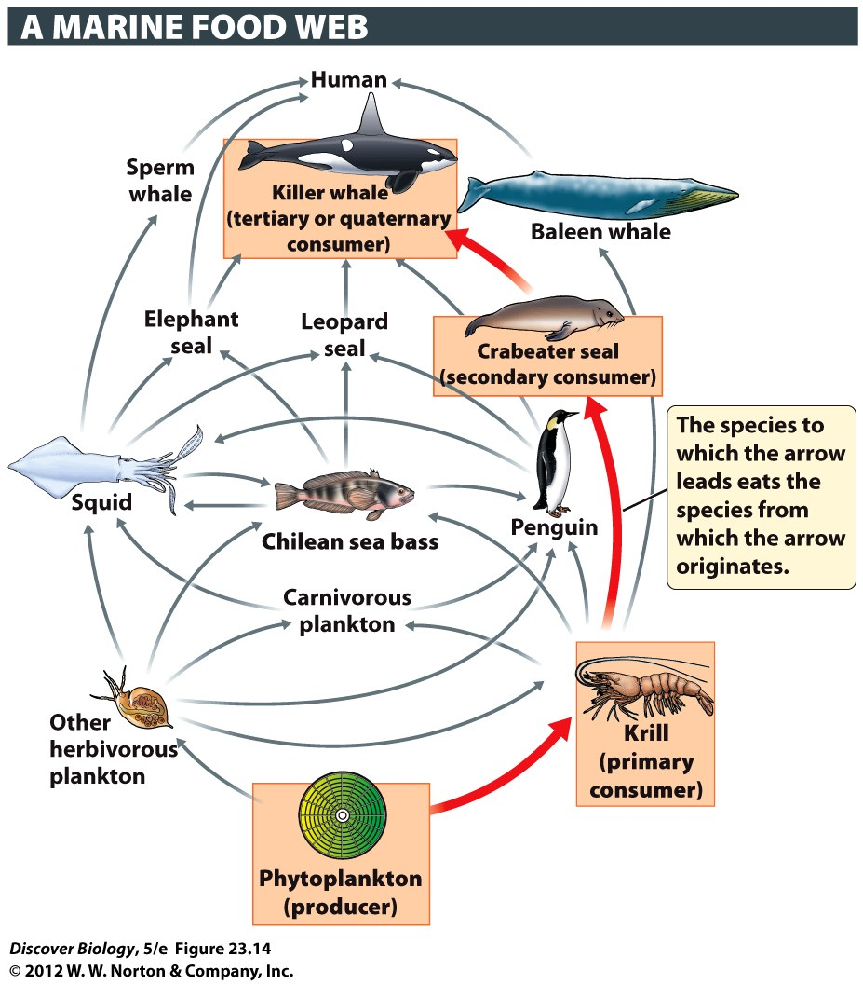
Notes:
Figure 23.14 Food Webs Summarize the Movement of Food through a Community
Food webs are composed of many specific sequences, known as food chains, that show one species eating another. To make it easier to follow a single sequence of feeding relationships, one of the food chains in this food web is highlighted with red arrows and orange boxes.

Slide 38
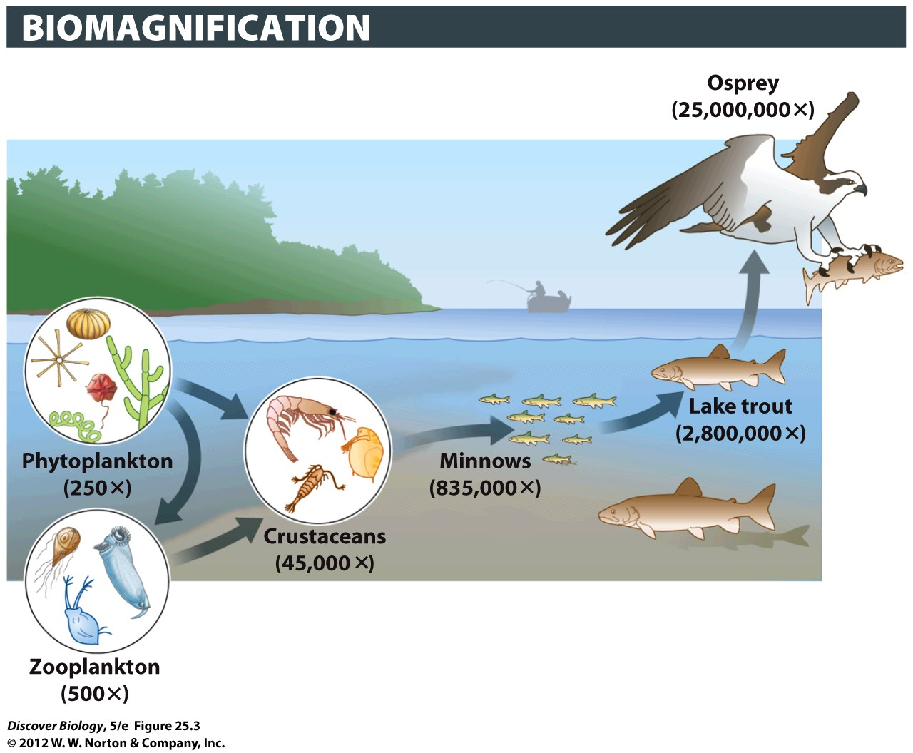
Notes:
Figure 25.3 PCB Levels Become More Concentrated in Consumers Higher in the Food Chain

