Slide 1
Discover Biology
FIFTH EDITION
Anu Singh-Cundy • Michael L. Cain
CHAPTER 21
The Biosphere
© 2012 W. W. Norton & Company, Inc.

Slide 2
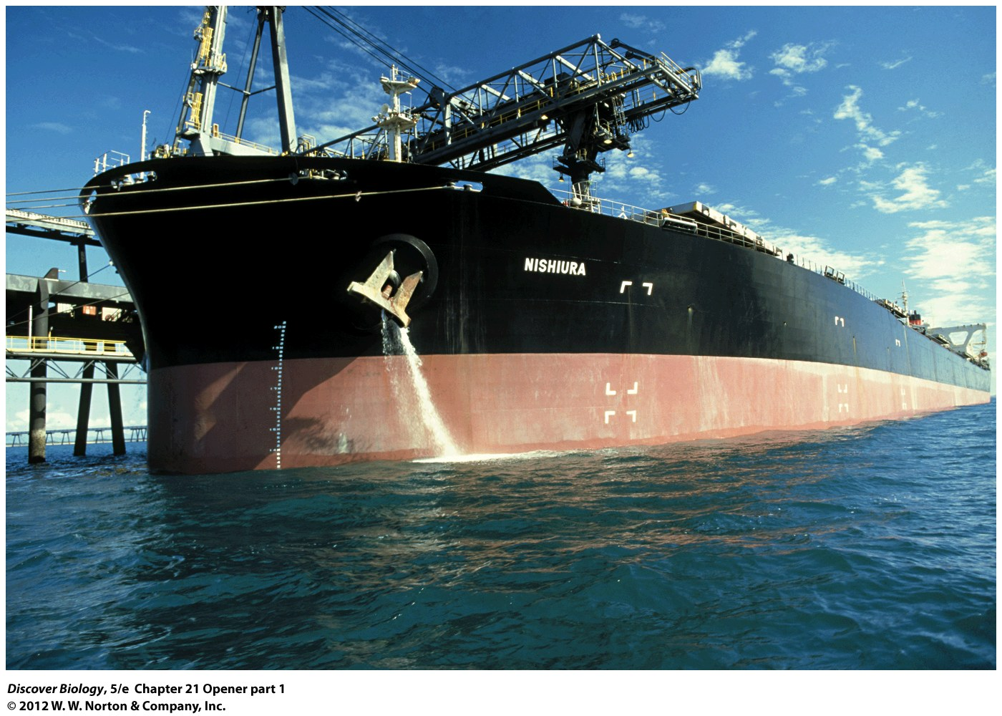
Notes:
A Cargo Ship Pumps Ballast Water.
This ship in Queensland, Australia, pumps ballast water while being loaded with coal bound for Japan. Dumping ballast water into local waters introduces aquatic species from other parts of the world. Zebra mussels are one of the most economically destructive invasive species in North America. Today, most ships replace ballast water while still at sea, where the saltiness of the ocean seawater kills most freshwater stowaways.

Slide 3
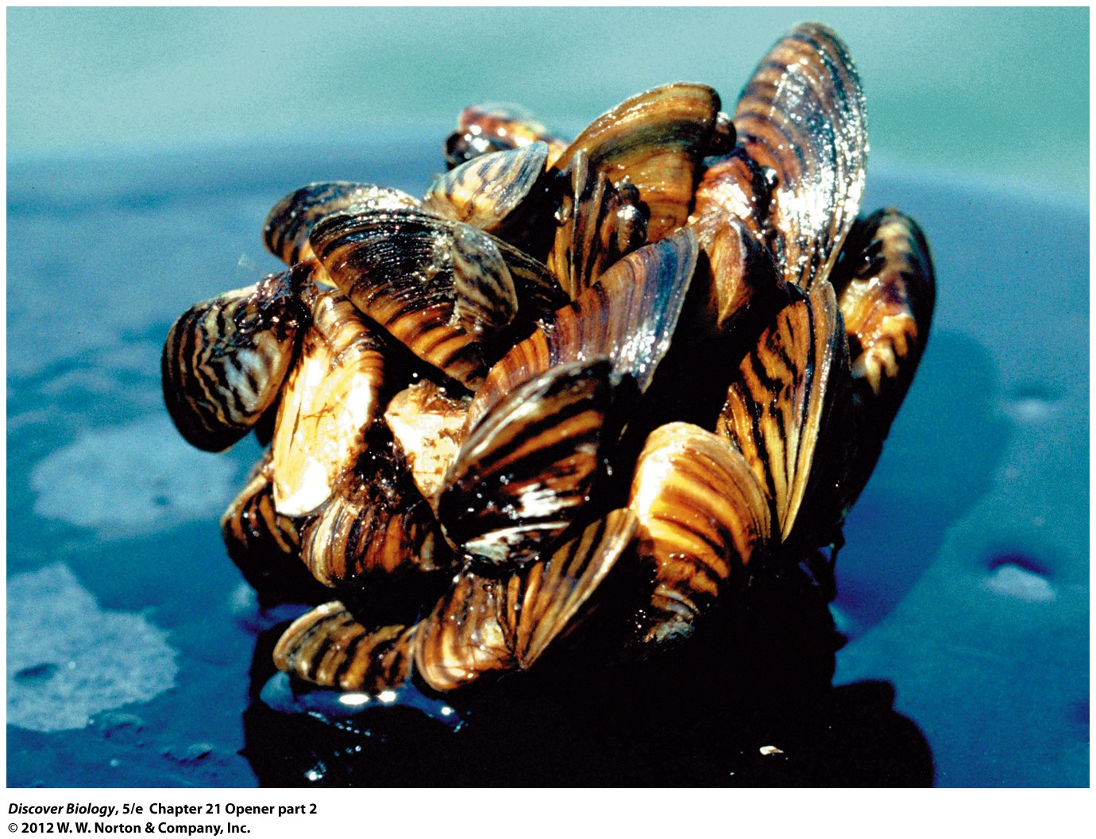
Notes:
A Cargo Ship Pumps Ballast Water.
This ship in Queensland, Australia, pumps ballast water while being loaded with coal bound for Japan. Dumping ballast water into local waters introduces aquatic species from other parts of the world. Zebra mussels are one of the most economically destructive invasive species in North America. Today, most ships replace ballast water while still at sea, where the saltiness of the ocean seawater kills most freshwater stowaways.

Slide 4
Invasion of the Zebra Mussels
Every organism, including humans, is part of Earth’s biosphere
Humans can have an enormous impact on the biosphere
The invasion of the zebra mussels into the great lakes and North America is an example of the impact humans can have on the biosphere

Slide 5
A View of Earth from Space
The biosphere includes all the organisms on Earth, together with the physical environments in which they live
Ecology is the scientific study of interactions between organisms and their biotic (living) and abiotic (nonliving) environment

Slide 6
Ecology: Understanding the
Interconnected Web
The organisms and physical environments of the biosphere can be thought of as forming a web of interconnected relationships
Studying the interconnected relationships between organisms and their environments helps us understand our natural world and the impact we have on it

Slide 7
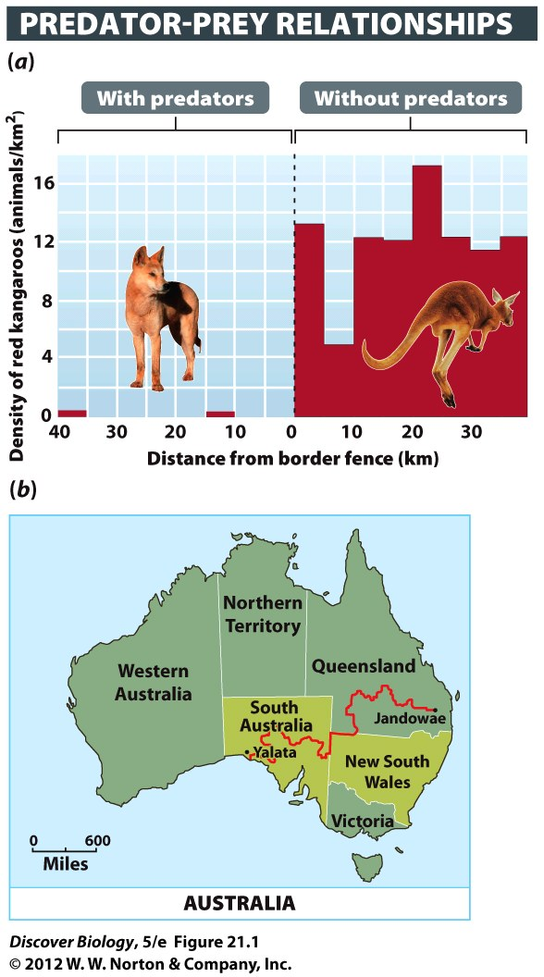
Notes:
Figure 21.1 An Explosion in Numbers
(a) Red kangaroo numbers increased by a factor of 166 when their dingo predators were removed from the Australian rangelands located south of (b) the world’s longest fence (red line).

Slide 8
Climate’s Large Effect on the Biosphere
Climate is defined as the prevailing weather conditions experienced in a region over relatively long periods of time
Organisms are more strongly influenced by climate than by any other feature of their environment

Slide 9
Incoming Solar Radiation
Shapes Climate
The angle at which the sun strikes Earth influences Earth’s different climates
The increased solar energy at the equator and the surrounding tropical regions promotes photosynthesis, which increases the productivity of plants and other light-dependent producers, resulting in more biomass
Consumers depend on the productivity of producers

Slide 10
Wind and Water Currents
Affect Climate
Earth has four giant convection cells in which warm, moist air rises and cool, dry air sinks, generating relatively consistent wind patterns
When cool, dry air from the polar regions collides with warm, moist air moving north, precipitation results in the temperate regions
Winds usually blow from a consistent direction in a given location and are called prevailing winds

Slide 11
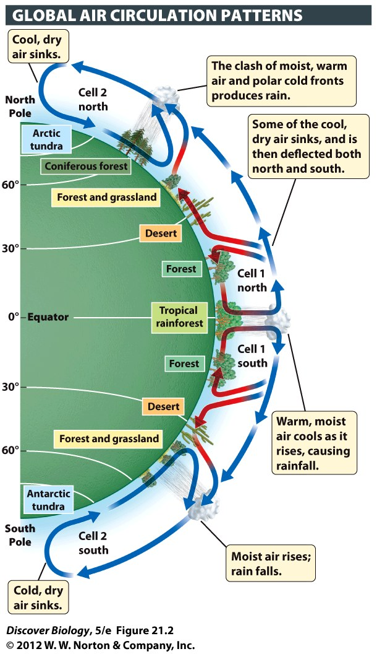
Notes:
Figure 21.2 Earth Has Four Giant Convection Cells
Two giant convection cells are located in the Northern Hemisphere and two in the Southern Hemisphere. In each convection cell, relatively warm, moist air rises, cools, and then releases moisture as rain or snow.

Slide 12
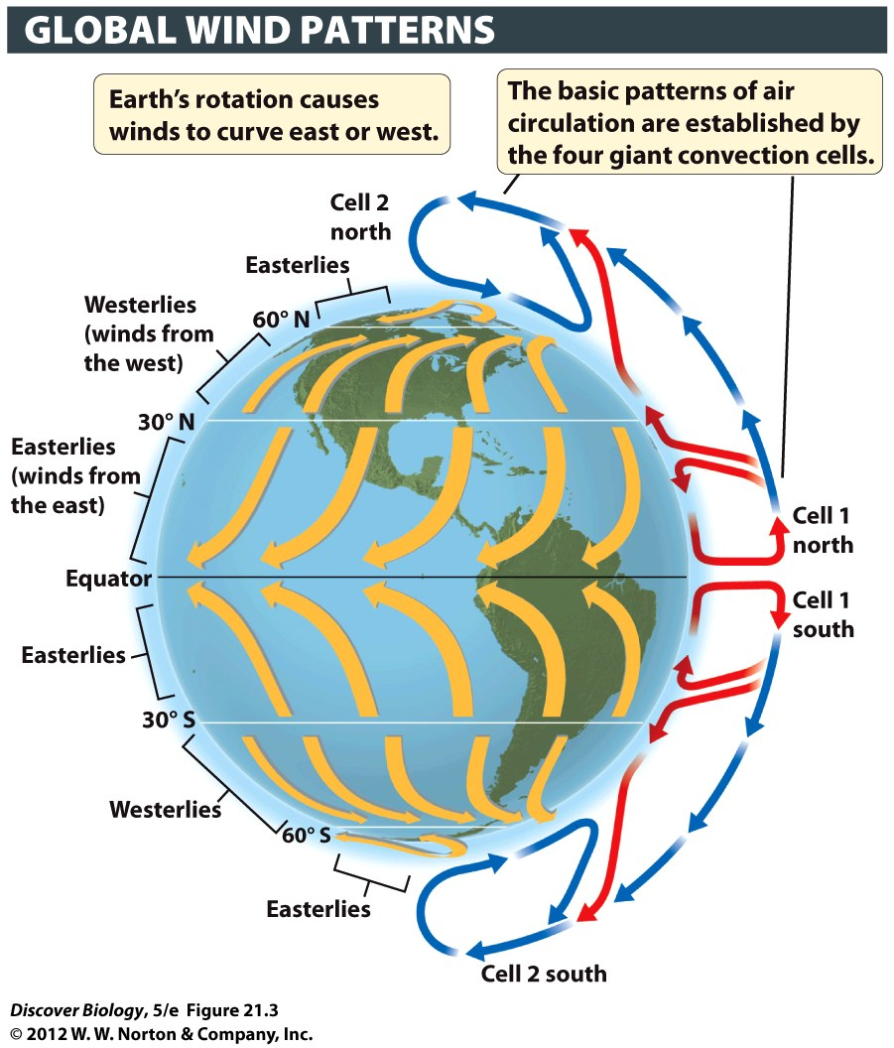
Notes:
Figure 21.3 Prevailing Winds Are Determined by Global Patterns of Air Circulation
Earth’s rotation causes winds to curve to the east or west. The direction in which they curve depends on their latitude, but for most regions on Earth, the seasonal winds blow from a consistent direction.

Slide 13
Wind and Water Currents
Affect Climate
The rotation of Earth, differences in water temperature between the poles and the tropics, and the directions of prevailing winds all contribute to the formation of ocean currents
Without the warming effect of the water carried by currents such as the Gulf Stream, climates around the world would be much different than they are today

Slide 14
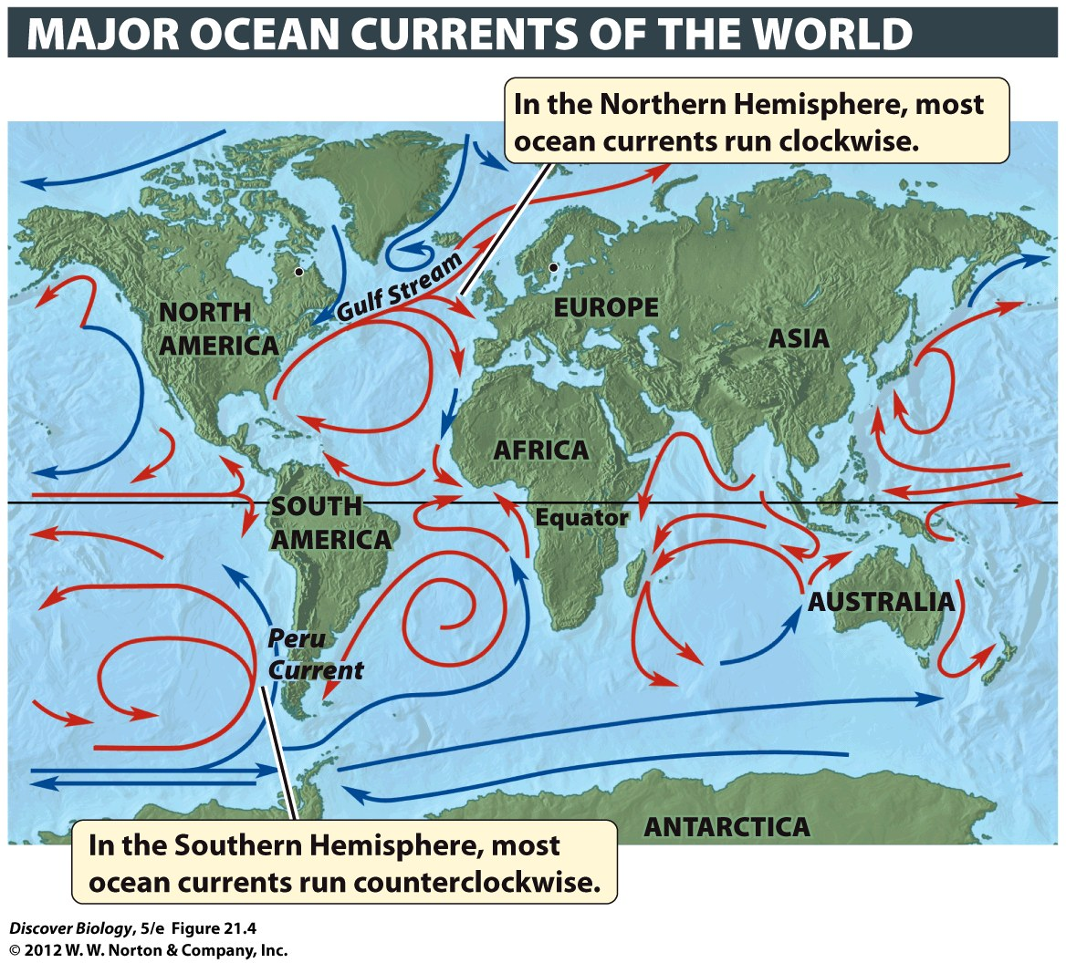
Notes:
Figure 21.4 Why Do Ocean Temperatures Vary?
Ocean currents can be cold (blue) or warm (red), depending on a combination of factors, including water depth and latitude.

Slide 15
The Major Features of Earth’s
Surface Also Shape Climate
The climate of a place may also be affected by the presence of large lakes, the ocean, and mountain ranges
Large bodies of water absorb and release heat more slowly, creating a milder climate
Mountains often produce a rain shadow effect, in which little precipitation falls on the side of the mountain that faces away from the prevailing winds

Slide 16
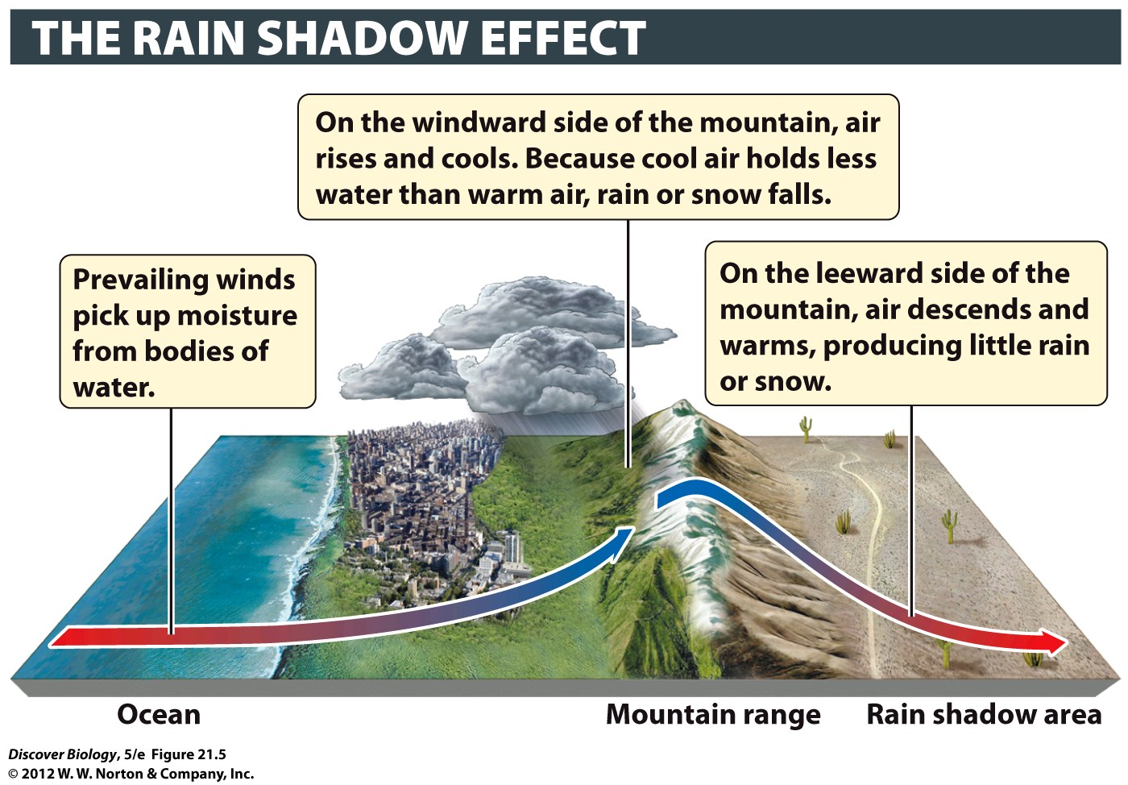
Notes:
Figure 21.5 The Leeward Side of a Mountain Is Usually Dry
The side of a high mountain that faces the prevailing winds (the windward side) receives more precipitation than the side of the mountain that faces away from the prevailing winds (the leeward side). The leeward side is therefore said to be in a rain shadow.

Slide 17
Terrestrial Biomes
Biomes can be categorized based on the unique climatic and ecological features of each such region
Terrestrial biomes are land biomes and are usually named after the dominant vegetation in the area
Aquatic biomes are found in water and are classified on the basis of physical and chemical features, such as salt content

Slide 18
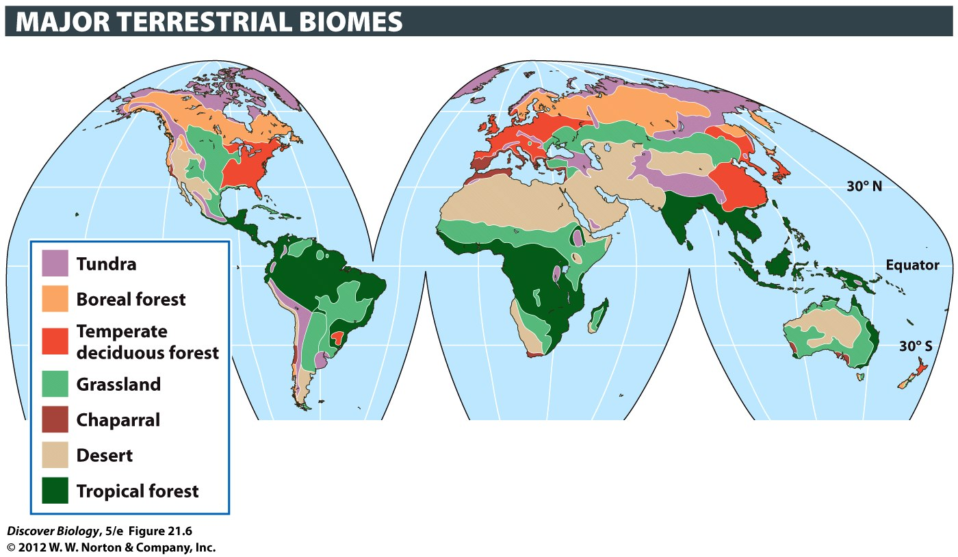
Notes:
Figure 21.6 The Distribution of Biomes Is Affected by Climate, Latitude, and Disturbance
Biomes do not begin and end abruptly. Instead, they generally transition into one another. Disturbances such as storms, fires, and human activities can alter biomes.

Slide 19
The Location of Terrestrial Biomes
Is Determined by Climate
Climate, especially the temperature and precipitation, is the most important factor controlling the location of natural terrestrial biomes
The effects of temperature and moisture on different species cause particular biomes to be found under a consistent set of conditions
The extent and distribution of biomes that exist today are very strongly influenced by humans

Slide 20
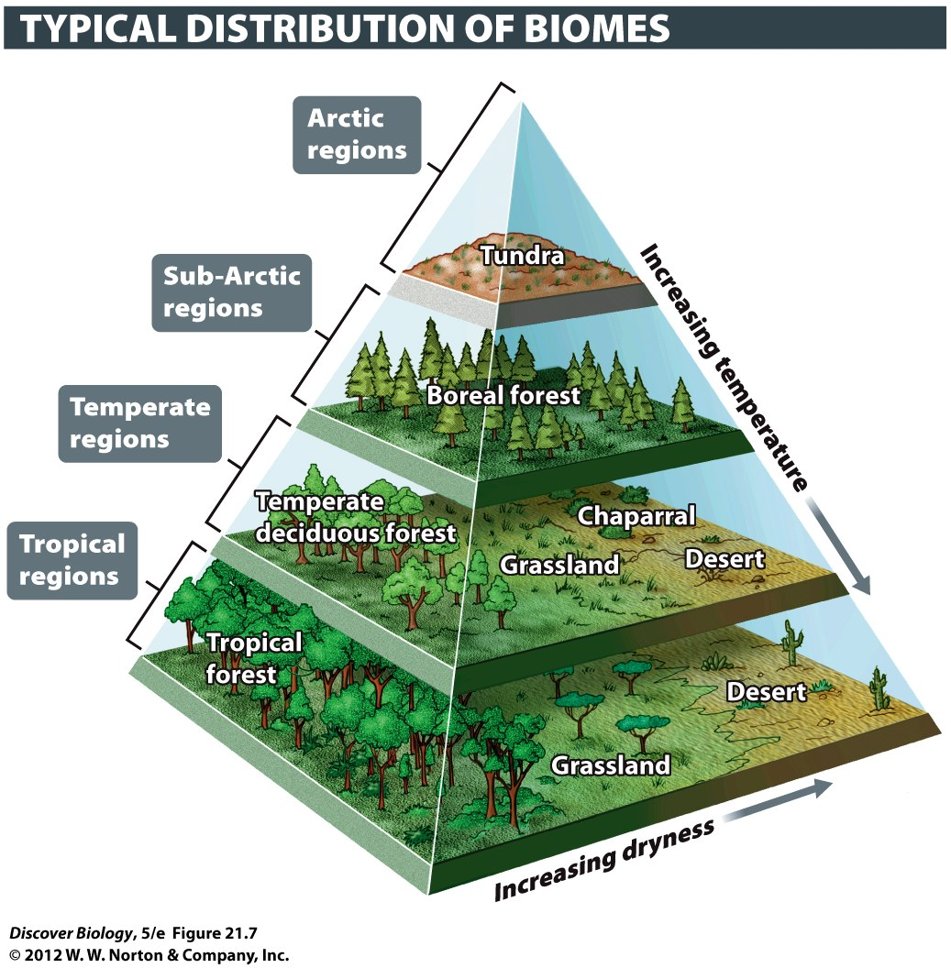
Notes:
Figure 21.7 The Location of Terrestrial Biomes Depends on Temperature, Precipitation, and Altitude

Slide 21
The Tundra Is Marked by Cold
Winters and a Short Growing Season
The Arctic tundra covers nearly one-fourth of Earth’s land surface; it is frozen ten months of the year and receives less precipitation than many of the world’s deserts
Permafrost is permanently frozen soil found below the surface layers of the tundra
Trees are scarce in the tundra, which is dominated by low-growing flowering plants, such as grasses, sedges, moss, and lichens

Slide 22
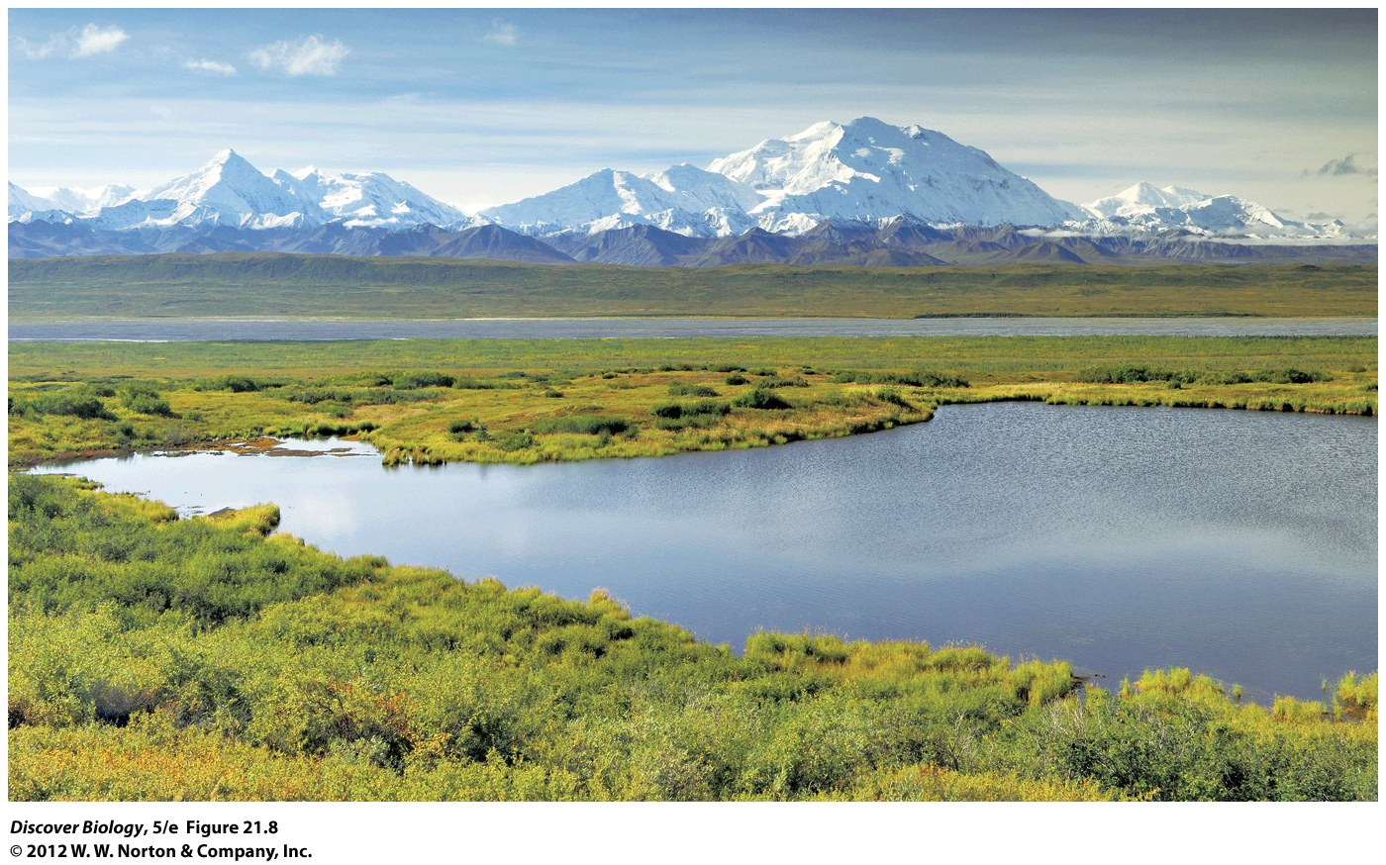
Notes:
Figure 21.8 Tundra: Denali National Park, Alaska
Tundra is found at high latitudes and high elevations, and it is dominated by low-growing shrubs and nonwoody plants that can cope with a short growing season.

Slide 23
A Few Coniferous Species
Dominate in the Boreal Forest
The boreal forest is the largest terrestrial biome and includes the sub-Arctic landmass immediately south of the tundra
The soil in boreal forests is thin and nutrient-poor and rainfall is low
Plant diversity is relatively low and conifers, which are cone-bearing trees with needlelike leaves, dominate the boreal forest vegetation

Slide 24
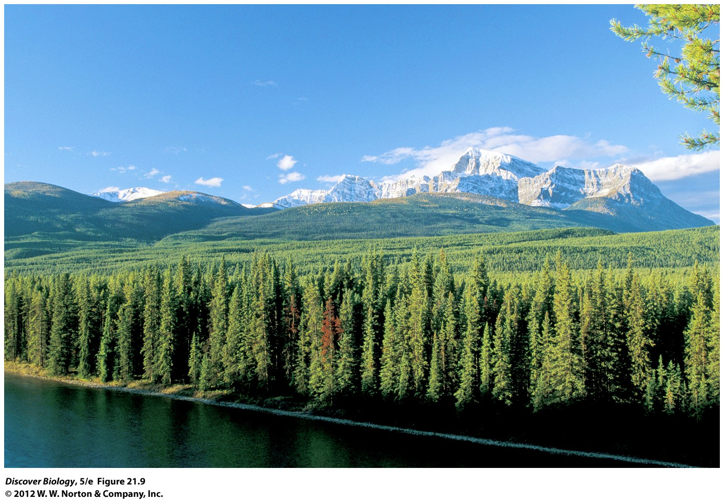
Notes:
Figure 21.9 Boreal Forest: Banff National Park, Alberta
Boreal forests are dominated by coniferous (cone-bearing) trees that grow in northern or high-altitude regions with cold, dry winters and mild summers.

Slide 25
Temperate Deciduous Forests Have Fertile Soils and Relatively Mild Winters
Temperate deciduous forests occur in regions with a distinct winter that lasts 4–5 months and precipitation that is distributed evenly through much of the year
There is greater species diversity in both plants and animals than in the tundra and boreal biomes, and many types of deciduous trees are the dominant vegetation

Slide 26
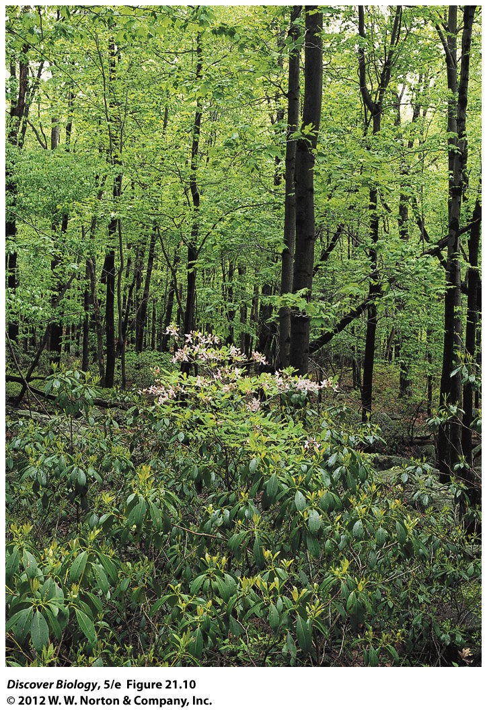
Notes:
Figure 21.10 Temperate Deciduous Forest: Pocono Mountains, Pennsylvania
Temperate deciduous forests are dominated by trees and shrubs adapted to relatively rich soil, snowy winters, and moist, warm summers.

Slide 27
Grasslands Appear in Regions with Good Soil but Relatively Little Moisture
The grassland biome is found in both temperate and tropical latitudes
Grasslands receive 25–100 centimeters of precipitation annually, which is insufficient for vigorous tree growth
The soils in some grasslands are exceptionally deep and fertile, and as a result, most of these areas have been converted to agriculture

Slide 28
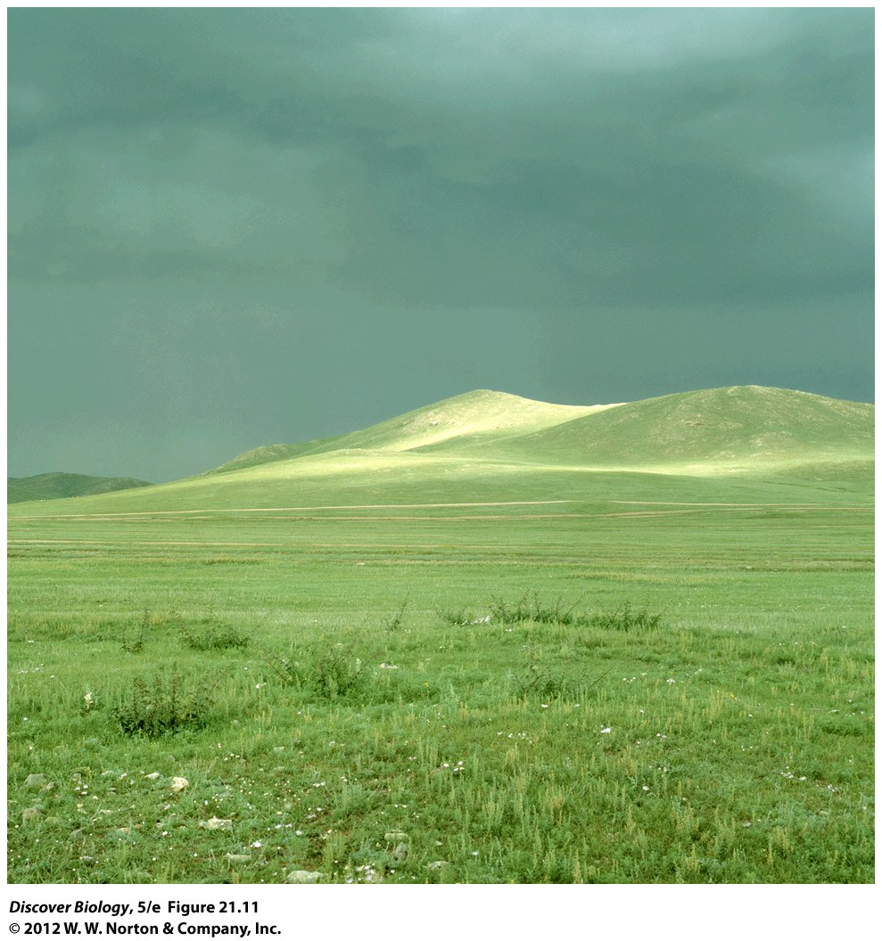
Notes:
Figure 21.11 Grassland: Eastern Colorado
Grasslands are common throughout the world and are dominated by grasses, although scattered trees are found in some, such as the tropical grasslands known as the savanna. Pictured here is buffalo grass (Buchloe dactyloides) in a short grassland.

Slide 29
Chaparral Is Characteristic of Regions with Wet Winters and Hot, Dry Summers
The chaparral is a shrubland biome characterized by cool, rainy winters and hot, dry summers and dominated by dense growths of scrub oak and other drought-resistant plants
The soil is relatively poor in these habitats, and most species are adapted to hot, dry conditions

Slide 30
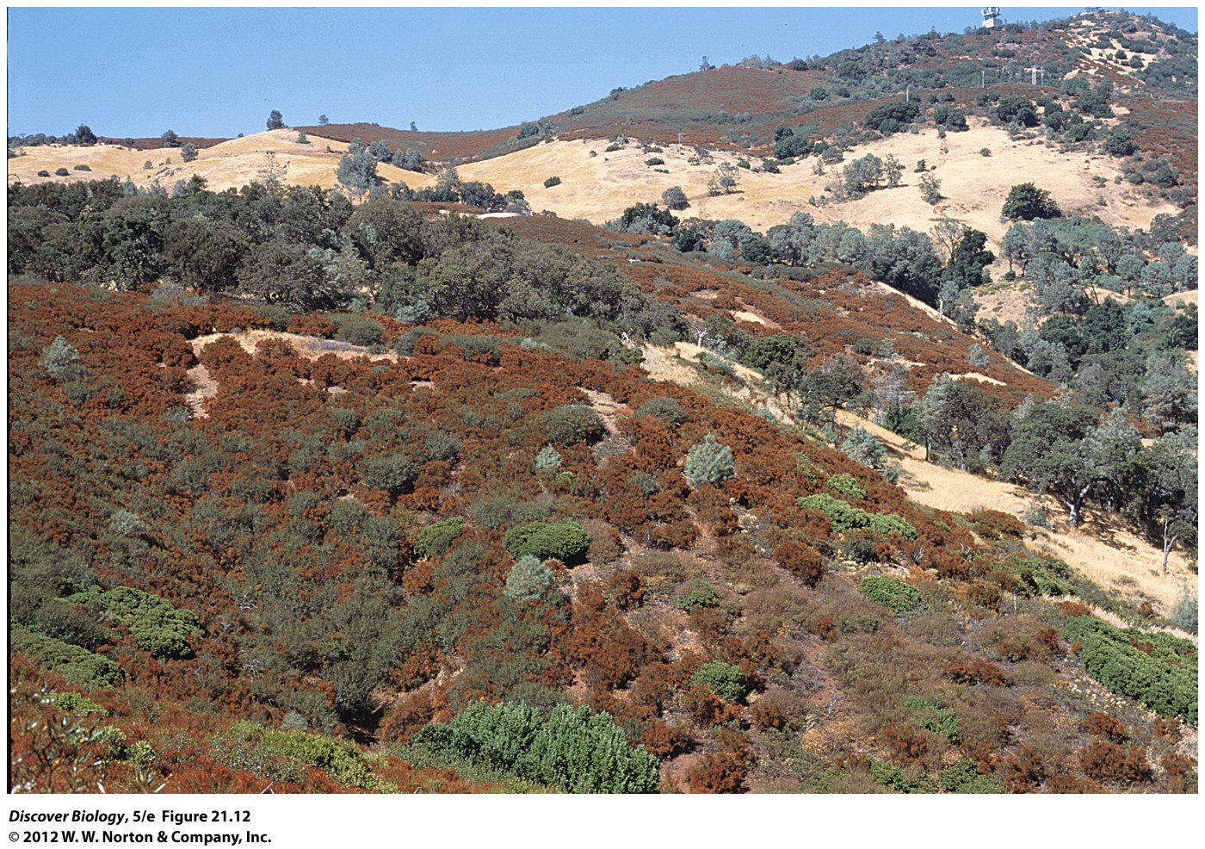
Notes:
Figure 21.12 Chaparral: North of San Francisco, California
Chaparral is characterized by shrubs and small, nonwoody plants that grow in regions with cool, rainy winters and hot, dry summers.

Slide 31
The Scarcity of Moisture
Shapes Life in the Desert
The desert biome makes up one-third of Earth’s land surface and is defined by its lack of precipitation
Desert air lacks moisture and, in turn, cannot moderate daily temperature fluctuations
Desert plants have small leaves and some produce enormously long tap-roots
A majority of the desert biome’s animal species are nocturnal

Slide 32
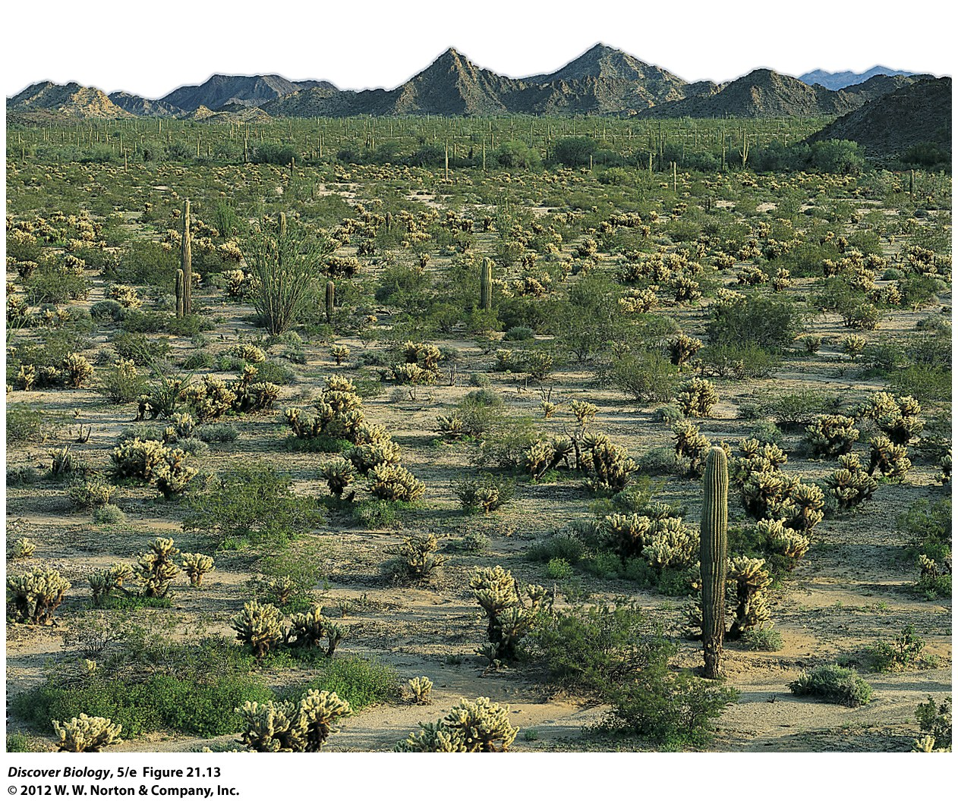
Notes:
Figure 21.13 Desert: Near Phoenix, Arizona
Deserts form in regions with low precipitation, usually 25 centimeters (10 inches) per year or less. The photo shows saguaro cacti (tall green columns) and other plants in the Sonoran Desert.

Slide 33
Tropical Forests Have High
Species Diversity
The tropical forest biome is characterized by warm temperatures and about 12 hours of daylight year-round
The abundance of sunshine and moisture makes tropical rainforests the most biodiverse biome, and they are home to almost 50% of Earth’s plant and animal species
Today, more than half the original tropical rainforest has been lost to logging and agriculture

Slide 34
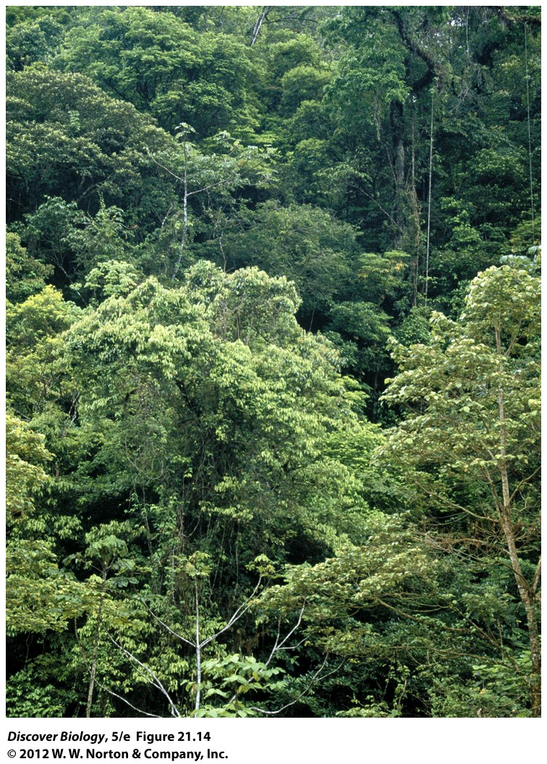
Notes:
Figure 21.14 Tropical Forest: El Yunque National Forest, Puerto Rico
Tropical forests form in warm regions with either seasonally heavy rains or year-round rain. Tropical rainforests, which receive abundant moisture throughout the year, are some of the most productive ecosystems on Earth. They have a rich diversity of trees, vines, and shrubs.

Slide 35
Aquatic Biomes
Aquatic ecosystems cover about 75 percent of Earth’s surface
The salt content, water temperature, water depth, and speed of water flow are all defining characteristics of aquatic biomes
Two main types of aquatic biomes can be distinguished on the basis of salt content:
  Freshwater biome
  Marine biome

Slide 36
Aquatic Biomes Are Influenced by
Terrestrial Biomes and Climate
Aquatic biomes are heavily influenced by the terrestrial biomes they border or through which their water flows
Water drains from terrestrial biomes into aquatic biomes such as rivers and streams, which in turn carry nutrients from the terrestrial environments to the ocean
Aquatic biomes also are strongly influenced by climate, which helps determine factors like the temperature, depth, and salt content of the oceans

Slide 37
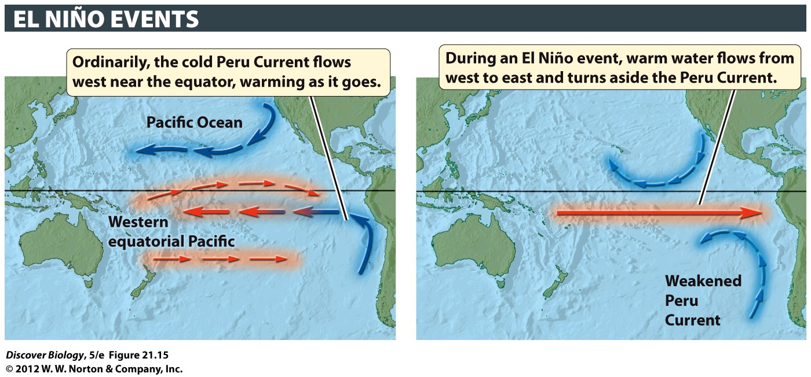
Notes:
Figure 21.15 Ocean Currents Change during El Niño Events
During an El Niño event, winds from the west push warm surface water from the western Pacific to the eastern Pacific. The resulting changes in sea surface temperatures cause changes in ocean currents (shown here in blue for cold, red for warm). El Niño events cause many additional changes (not shown here), altering wind patterns, sea levels, and patterns of precipitation throughout the world.

Slide 38
Aquatic Biomes Are Also
Influenced by Human Activity
Wetlands and estuaries are often destroyed by humans to allow for development projects, while other aquatic biomes are negatively affected by pollution
Aquatic biomes also suffer when humans destroy or modify the terrestrial biomes they occupy

Slide 39
Lakes, Rivers, and Wetlands Are
Part of the Freshwater Biome
Lakes are standing bodies of water that are surrounded by land and at least 2 hectares (5 acres) in size
The productivity of a lake, and the abundance and distribution of its life-forms, is strongly influenced by:
  Nutrient concentrations
  Water depth
  The extent to which the lake water is mixed

Slide 40
Lakes, Rivers, and Wetlands Are
Part of the Freshwater Biome
Rivers are bodies of fresh water whose physical characteristics tend to change along their length and that move continuously in a single direction
Wetlands are characterized by standing water shallow enough that rooted plants emerge above the water surface
Bogs are stagnant wetlands whose productivity and species diversity are low; marshes and swamps are highly productive wetlands

Slide 41
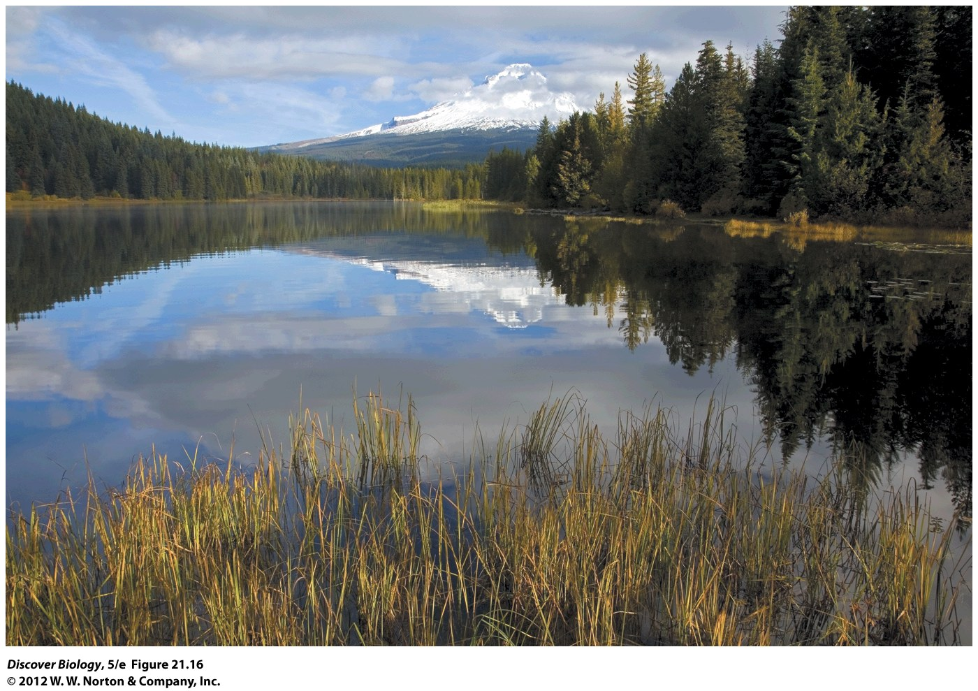
Notes:
Figure 21.16 Lakes, Rivers, and Wetlands
Lakes are land-locked bodies of standing water. They vary in size from one-fiftieth of a square kilometer (5 acres) to thousands of square kilometers. In contrast, rivers are bodies of fresh water that move continuously in a single direction, and wetlands are characterized by shallow waters that flow slowly over lands that border rivers, lakes, or ocean waters.

Slide 42
Estuaries and Coastal Regions Are Highly Productive Parts of the Marine Biome
An estuary is a region where a river empties into the sea and is the shallowest of the marine ecosystems
The abundance and diversity of life make estuaries one of the most productive ecosystems on our planet
The coastal region is the underwater area that stretches from the shoreline to the edge of the continental shelf and is among the most productive marine ecosystems

Slide 43
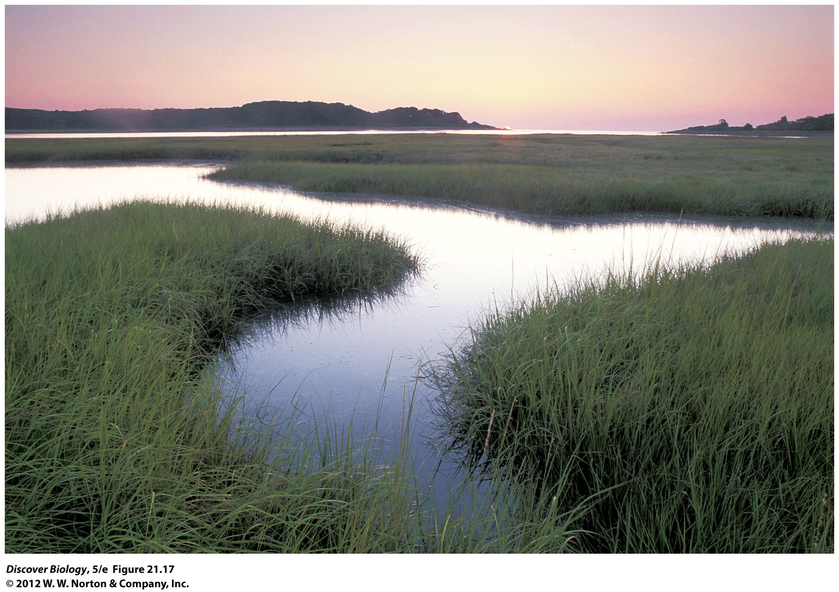
Notes:
Figure 21.17 Estuaries
Estuaries are tidal ecosystems where rivers flow into the ocean. They are usually classified as part of the marine biome. This photo shows a salt marsh at sunrise in Rachel Carson National Wildlife Refuge, Maine.

Slide 44
Estuaries and Coastal Regions Are Highly Productive Parts of the Marine Biome
The intertidal zone is the part of the coast that is closest to the shore and extends from the highest tide mark to the lowest tide mark
The coastal benthic zone may lie as deep as 200 meters (656 feet) below the water surface; it is a relatively stable habitat and is rich in sediments containing the dead and decaying remains of organisms (detritus)

Slide 45
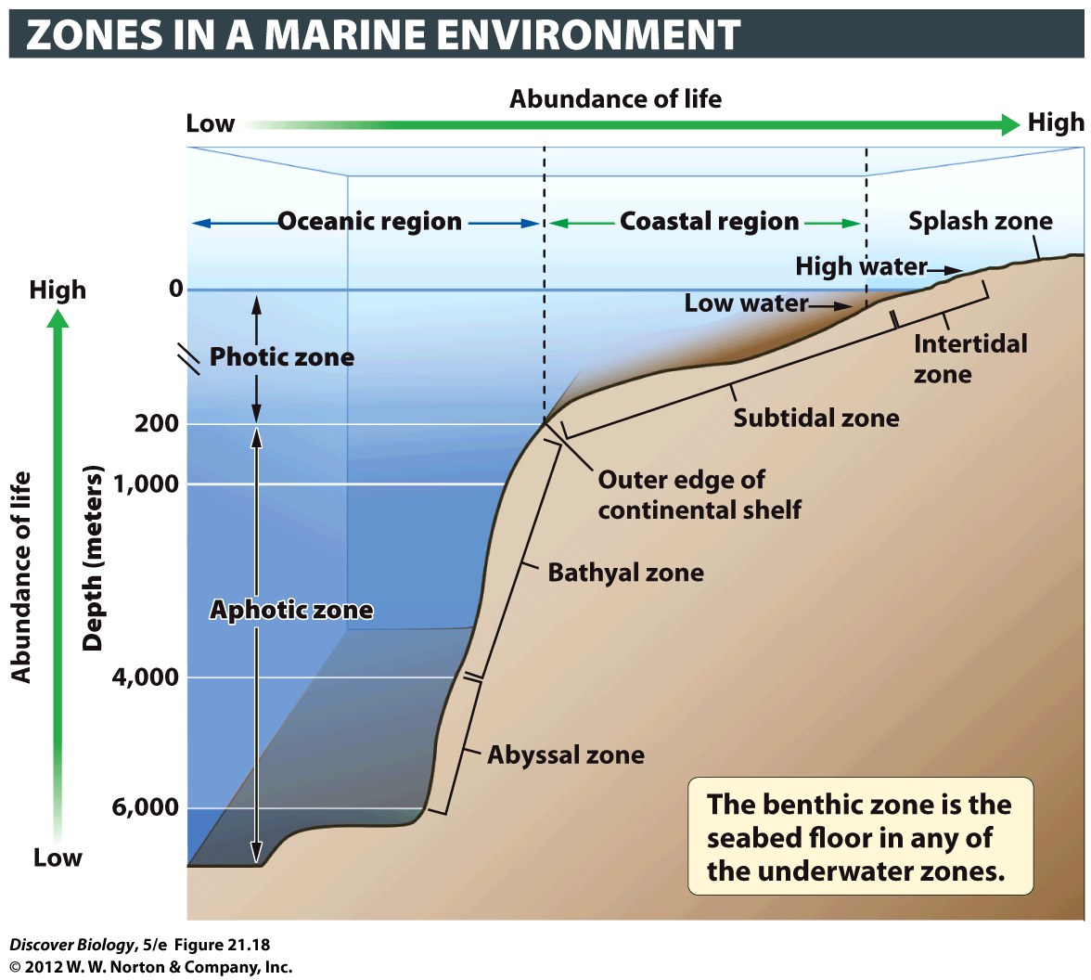
Notes:
Figure 21.18 Ecological Zones in the Marine Biome
This diagram depicts a cross-sectional view of the land and water, progressing from the shoreline toward the open ocean (oceanic region). The coastal region stretches out to sea as far as the continental shelf, which is the underwater extension of a continent’s rim. Productivity, and the abundance of life-forms, declines with increasing water depth because sunlight, which producers need for photosynthesis, diminishes with depth. The sunlit zone, or photic zone, extends to a depth of 200 meters (656 feet). The waters are dimly lit up to 1,000 meters but lie in complete darkness at greater depths. Productivity also decreases with distance away from the shore because nutrient levels typically decline farther out to sea. The well-lit waters of the open ocean are less productive than the well-lit regions of coastal areas, and the deepest layers of the ocean (the abyssal zone) are typically the least productive of all aquatic habitats.

Slide 46
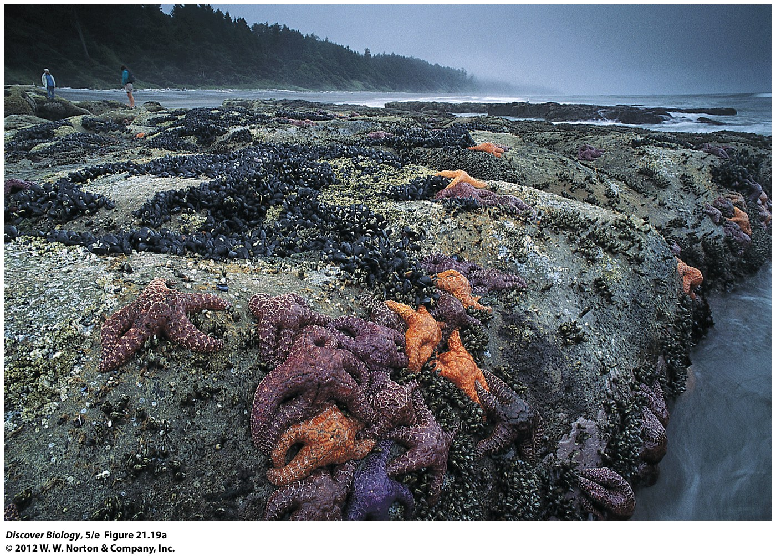
Notes:
Figure 21.19a The Marine Biome
(a) Intertidal zones are found in coastal regions where the tides rise and fall on a daily basis, periodically submerging a portion of the shore.

Slide 47
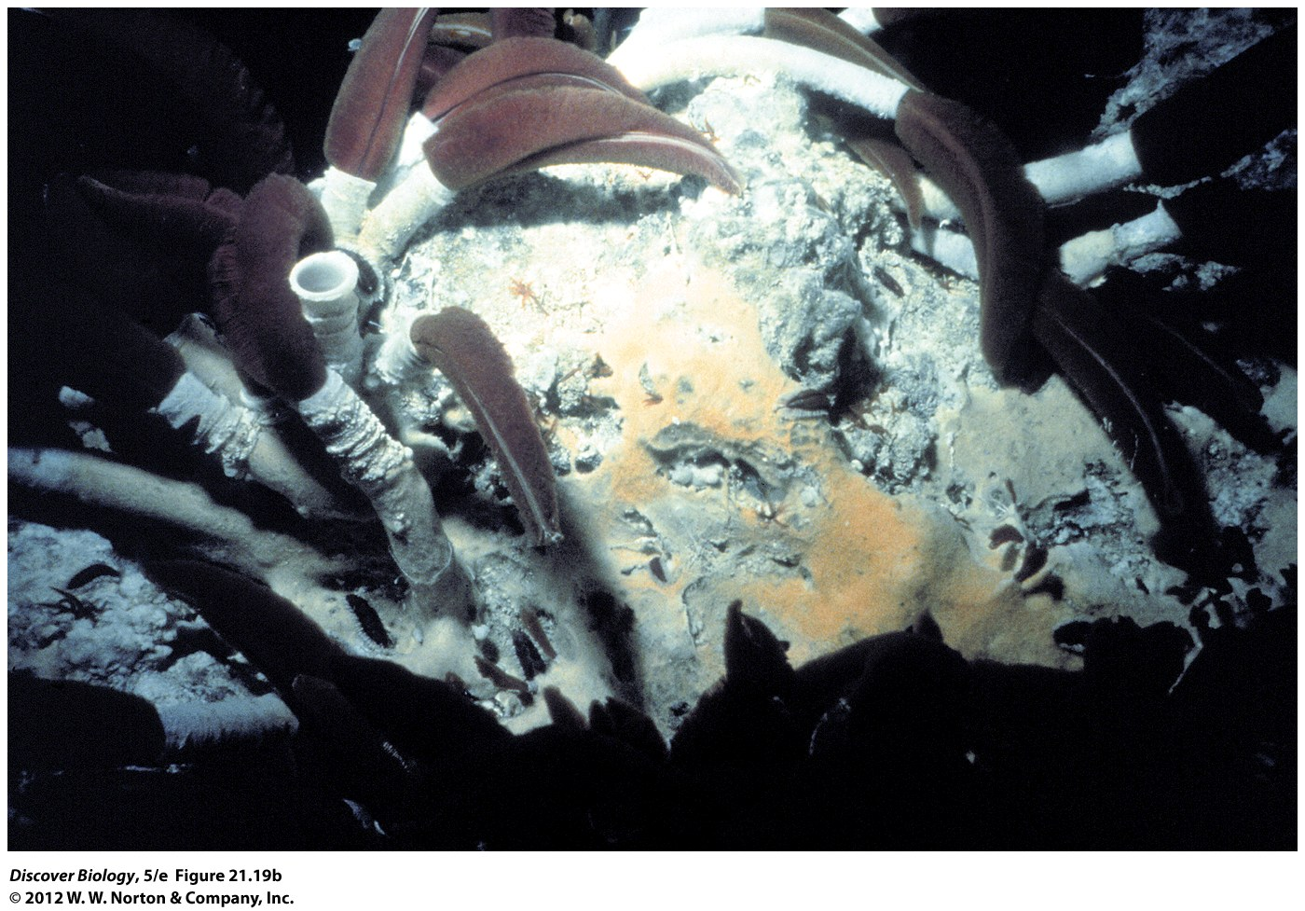
Notes:
Figure 21.19b The Marine Biome
(b) Benthic zones, located on the bottom surfaces of lakes, rivers, wetlands, estuaries, coastal regions, and oceanic regions, are home to a variety of consumers, many of which feed on dead organisms drifting down from the upper, better-lit zones.

Slide 48
Productivity in the Oceanic Region
Is Limited by Nutrient Availability
The oceanic region begins about 40 miles offshore and is relatively nutrient-poor
The abyssal zone begins where the continental shelf ends and the seafloor drops to a depth of approximately 6,000 meters (almost 20,000 feet)

Slide 49
How Invasive Mussels Can Harm
Whole Ecosystems
Any introduced species that becomes a major pest in a new environment is called an invasive species
The Eurasian zebra mussel is an invasive species that has driven native mussels out of the Great Lakes and left little for other aquatic species to eat
The biosphere is an interconnected web of relations among different species and ecosystems

Slide 50
Notes:
A Cargo Ship Pumps Ballast Water.
This ship in Queensland, Australia, pumps ballast water while being loaded with coal bound for Japan. Dumping ballast water into local waters introduces aquatic species from other parts of the world. Zebra mussels are one of the most economically destructive invasive species in North America. Today, most ships replace ballast water while still at sea, where the saltiness of the ocean seawater kills most freshwater stowaways.

Slide 51
Clicker Questions
CHAPTER 21
The Biosphere

Slide 52
Concept Quiz
Following dingo eradication in Australia, what was the effect of this eradication on the sheep?
  The sheep overgrew their environment.
  The price of sheep went down.
  The kangaroos competed with sheep for food.
Notes:
The correct answer is C. Dingoes keep the kangaroo population in check. Lacking the predator, the kangaroos increased in numbers and thereby competed with the sheep for food and eventually killed essential foraging crops because of their ability to dig plants up by the roots.
Answer A: Eliminating the predator of a domestic livestock does not impact their population numbers since the ranchers control the number of animals they keep.
Answer B: Although many changes in the ecological balance will have significant economic impacts, the price of sheep was not a factor in the interactions following the killing of the dingoes.

Slide 53
Concept Quiz
Why is it possible to see tundra in Alaska as well as a high mountain meadow in Colorado?
  Both have climates which are similar.
  The high elevation has less oxygen as does the northern latitudes.
  The decreased filtering of ultraviolet rays in high altitudes leads to stunted growth of plants making it look like tundra.
Notes:
Answer A is correct .
Answer B: Oxygen levels are not a factor in differentiating where tundra biomes exist. The temperature and precipitation similarities are what make the conditions favorable for tundra growth.
Answer C: Ultraviolet rays are not the contributing factor to the similarities of high altitude and high latitude climates.

Slide 54
Concept Quiz
Because estuaries are found where rivers empty into oceans, all estuaries also intertidal zones.
  True
  False
Notes:
The answer is false because not all estuaries are found where the tide levels change enough to have daily submerging of portions of the shore.

Slide 55
Relevant Art from Other Chapters
All art files from the book are available in JPEG and PPT formats online and on the Instructor Resource Disc

Slide 56
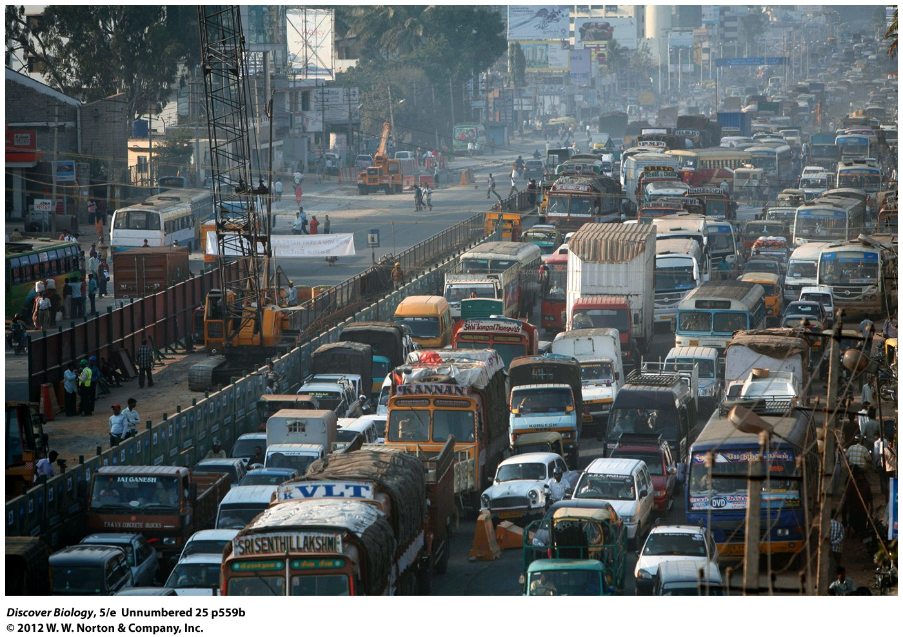
Notes:
Figure 2 The Most Inconvenient Truth: Climate Change Is Caused by Overpopulation and Overconsumption

Slide 57
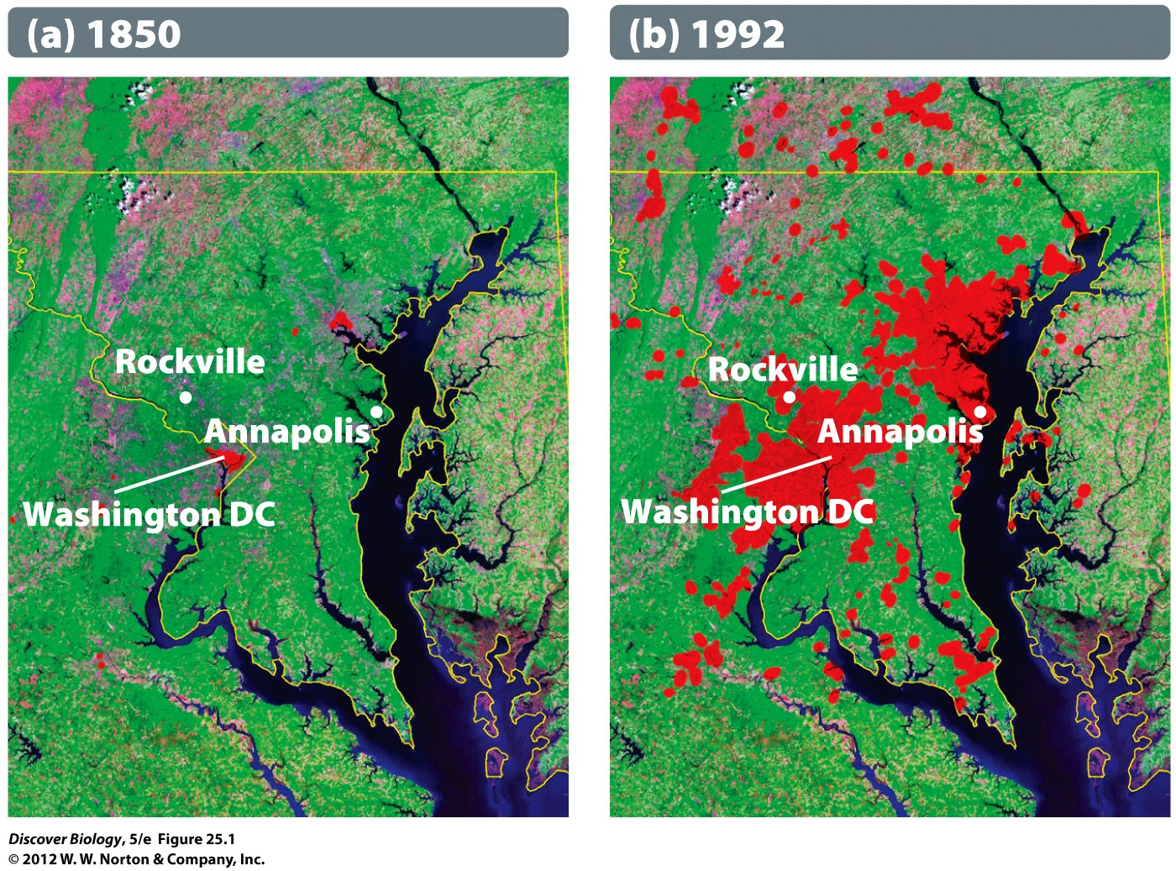
Notes:
Figure 25.1 Land Transformation
Change in the boundaries (in red) of urban regions near Washington, DC, between 1850 (a) and 1992 (b).

Slide 58
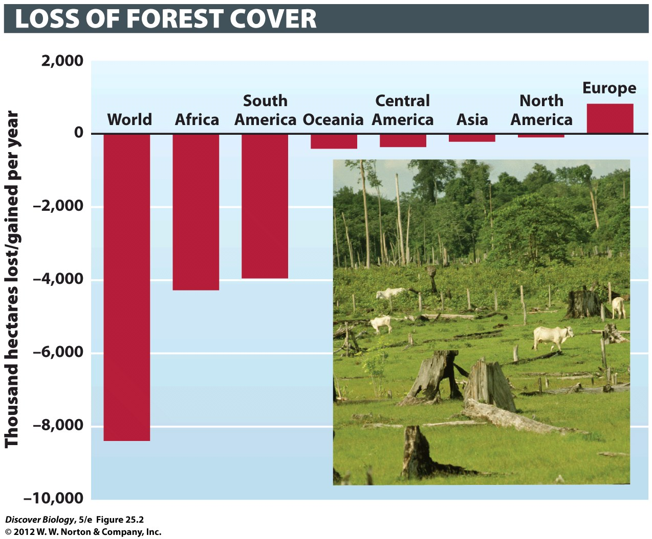
Notes:
Figure 25.2 Disappearing Forests
This graph, based on data from the United Nations Food and Agriculture Organization (FAO), shows that forest cover has shrunk in most regions of the world, except Europe. Asia’s relatively good standing is due largely to extensive reforestation efforts in China over the past few years. The inset shows cattle grazing on land previously covered by Amazonian rainforest, in Para, Brazil.

