Slide 1
Discover Biology
FIFTH EDITION
Anu Singh-Cundy • Michael L. Cain
CHAPTER 20
The Evolutionary History of Life
© 2012 W. W. Norton & Company, Inc.

Slide 2
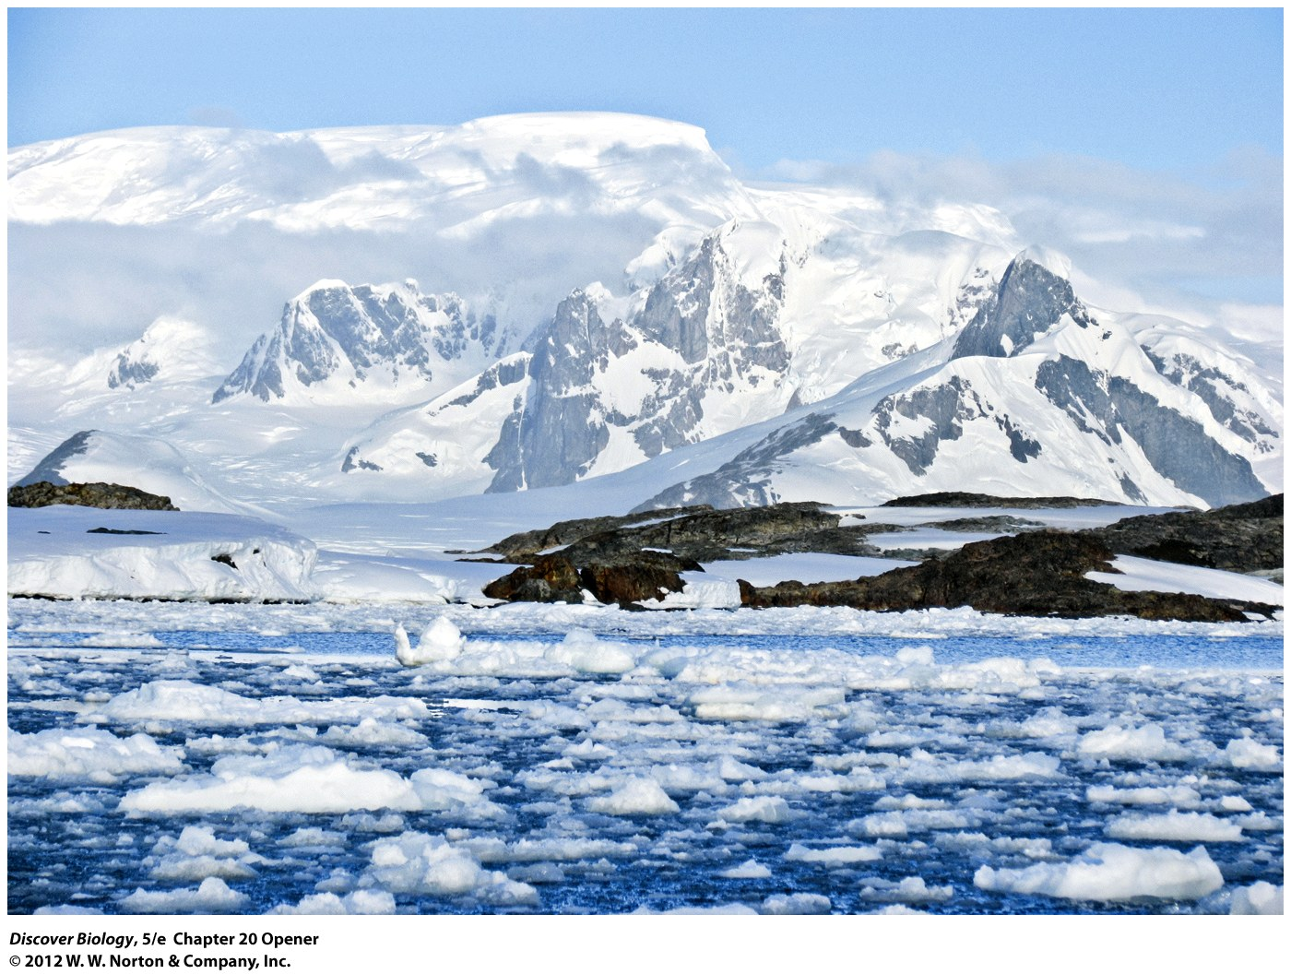
Notes:
The Ross Ice Shelf, Antarctica.
The Antarctic continent is so cold and dry that few organisms can survive here on land year-round. And yet, millions of years ago the continent supported an ecosystem with giant ferns, amphibians, dinosaurs, and flightless birds

Slide 3
Puzzling Fossils in a Frozen Wasteland
Modern Antarctica is devoid of almost all life; however, that was not always the case
Paleontologists have uncovered signs indicating that life in Antarctica once included dinosaurs and other reptiles, mammals and flightless birds, ferns and enormous trees, amphibians, freshwater fishes, and aquatic beetles

Slide 4
Earth Abounds with Life
About 1.7 million species have been described and cataloged by biologists around the world, and millions more await discovery
The species alive today are thought to represent far less than 1 percent of all the species that have ever lived on Earth

Slide 5
The Fossil Record:
A Guide to the Past
Fossils are the preserved remains or impressions of individual organisms that lived in the past, and are often found in sedimentary rock
Fossils provide evidence that past organisms were unlike organisms alive today and that life has evolved through time
The ages of fossils correspond to their order in the fossil record

Slide 6
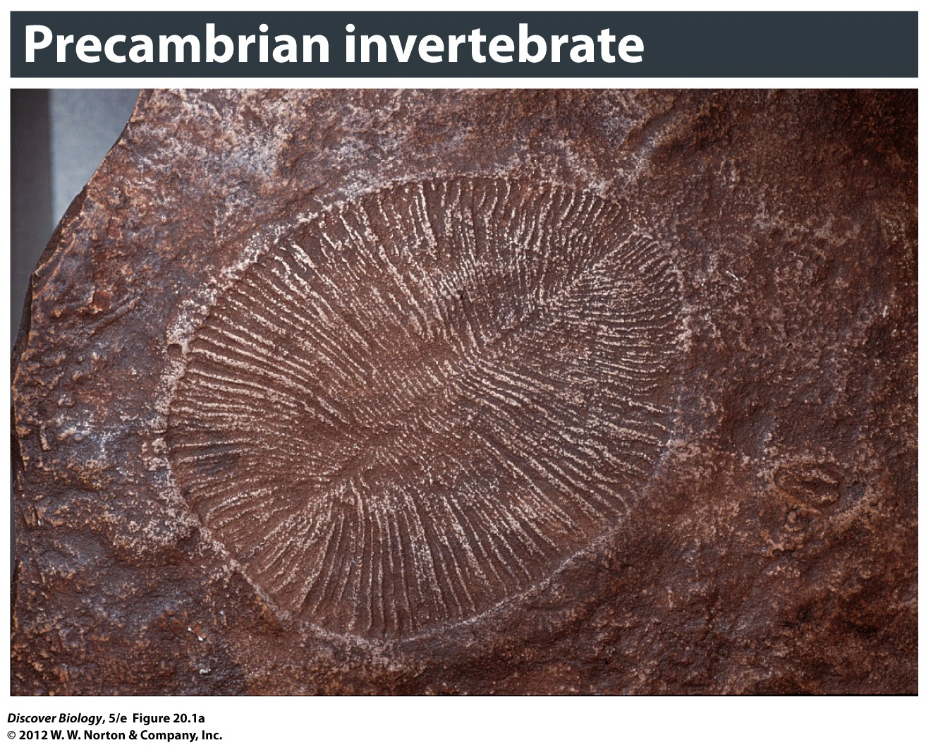
Notes:
Figure 20.1a Fossils through the Ages
(a) Soft-bodied animals such as this one dominated life on Earth 600 million years ago (mya).

Slide 7
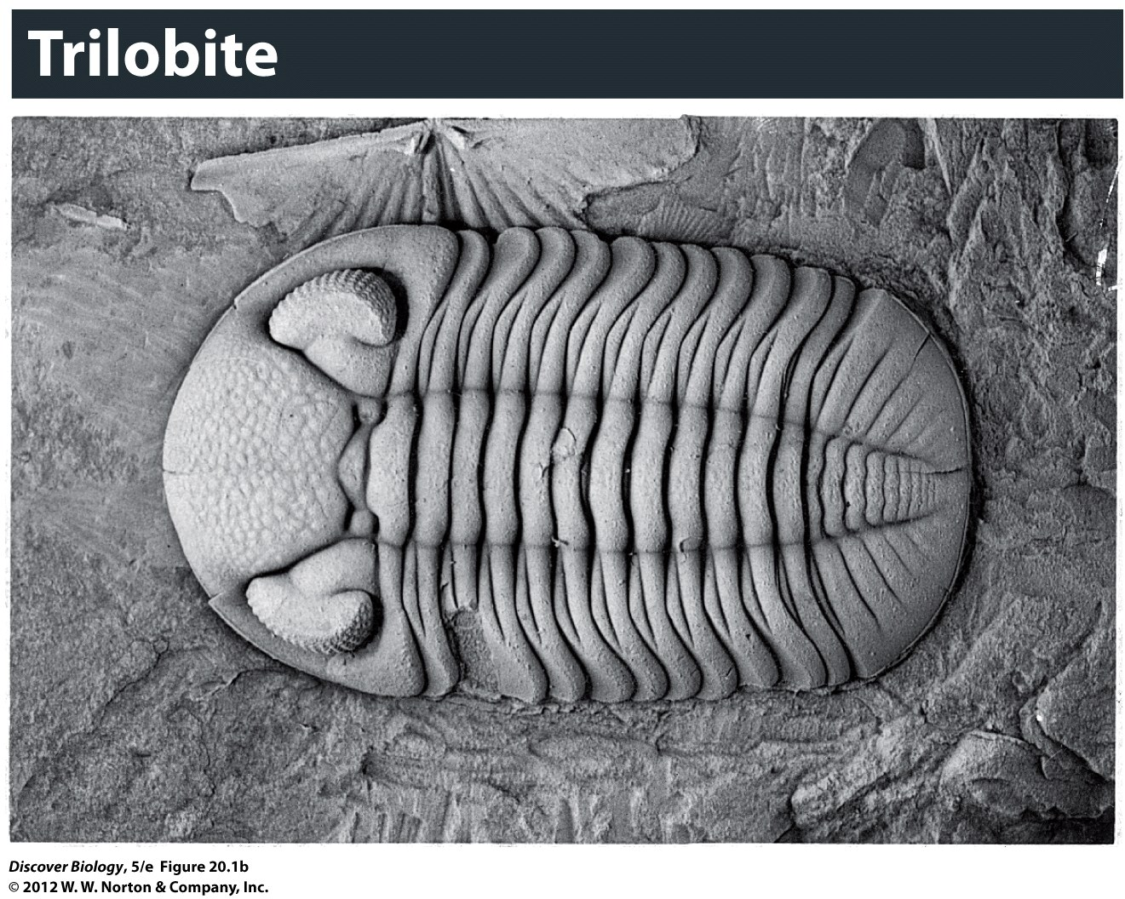
Notes:
Figure 20.1b Fossils through the Ages
(b) A fossil of a trilobite [trye-loh-byte] that lived in the Devonian period (410–355 mya). Note the furrow-like rows of lenses on each of the two large eyes.

Slide 8
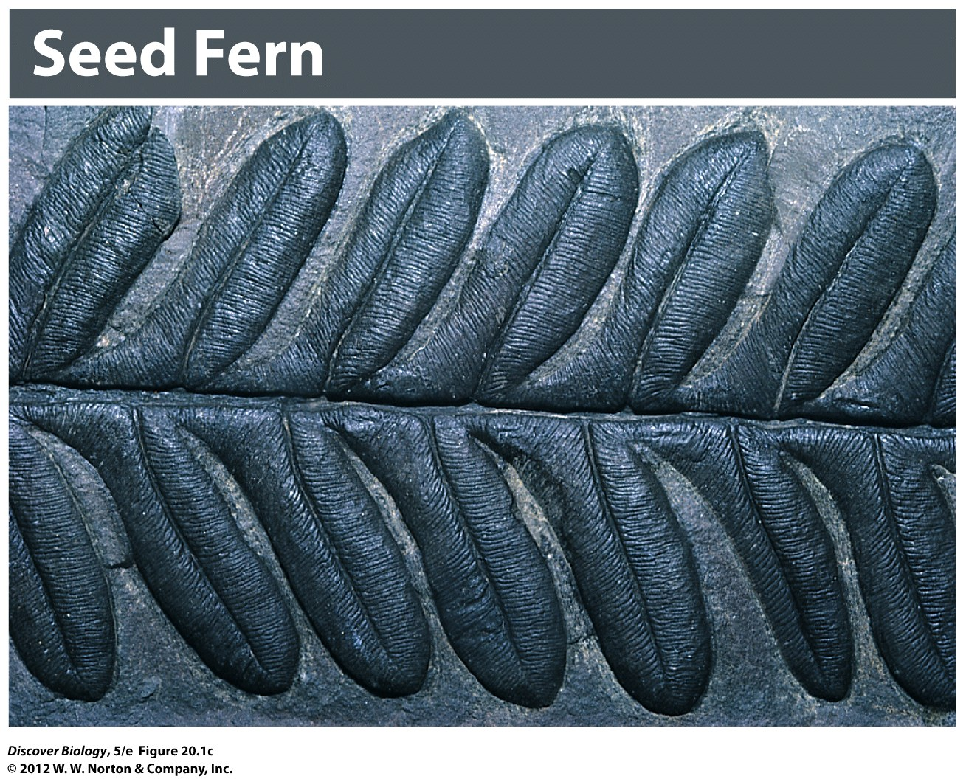
Notes:
Figure 20.1c Fossils through the Ages
(c) Leaf of a 300-million-year-old seed fern found near Washington, DC. The fossil formed during the Carboniferous [kahr-buh-nif-er-us] period (355–290 mya). The great forests of this period led to formation of the fossil fuels (oil, coal, and natural gas) that we use today as sources of energy.

Slide 9
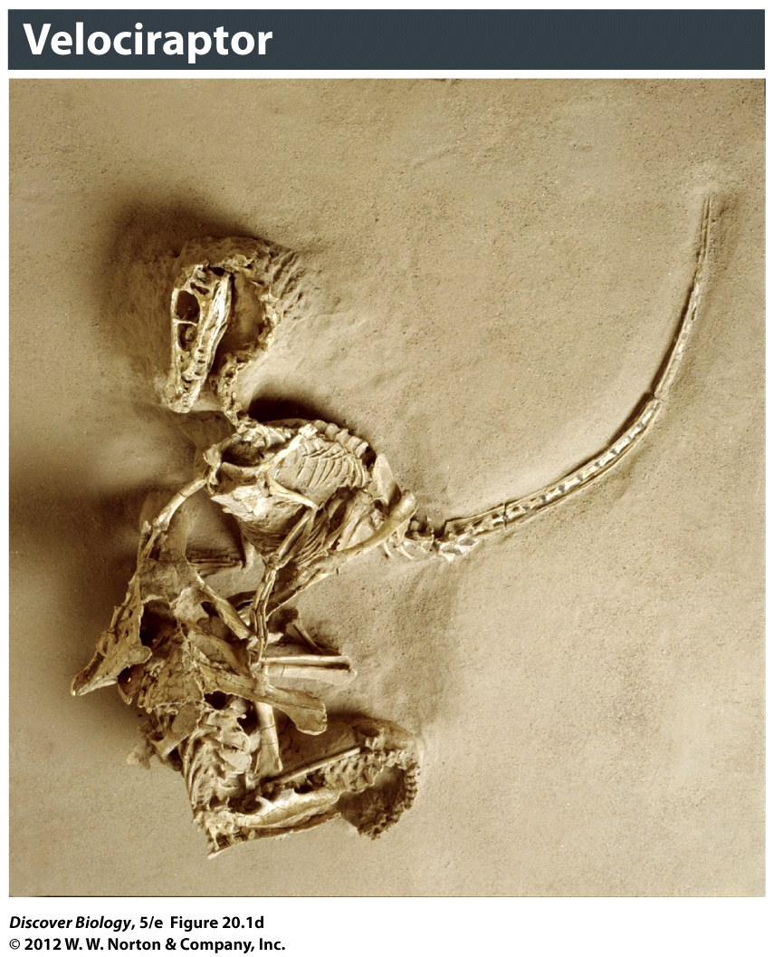
Notes:
Figure 20.1d Fossils through the Ages
(d) This 20-million-year-old termite is preserved in amber, the fossilized resin of a tree.

Slide 10
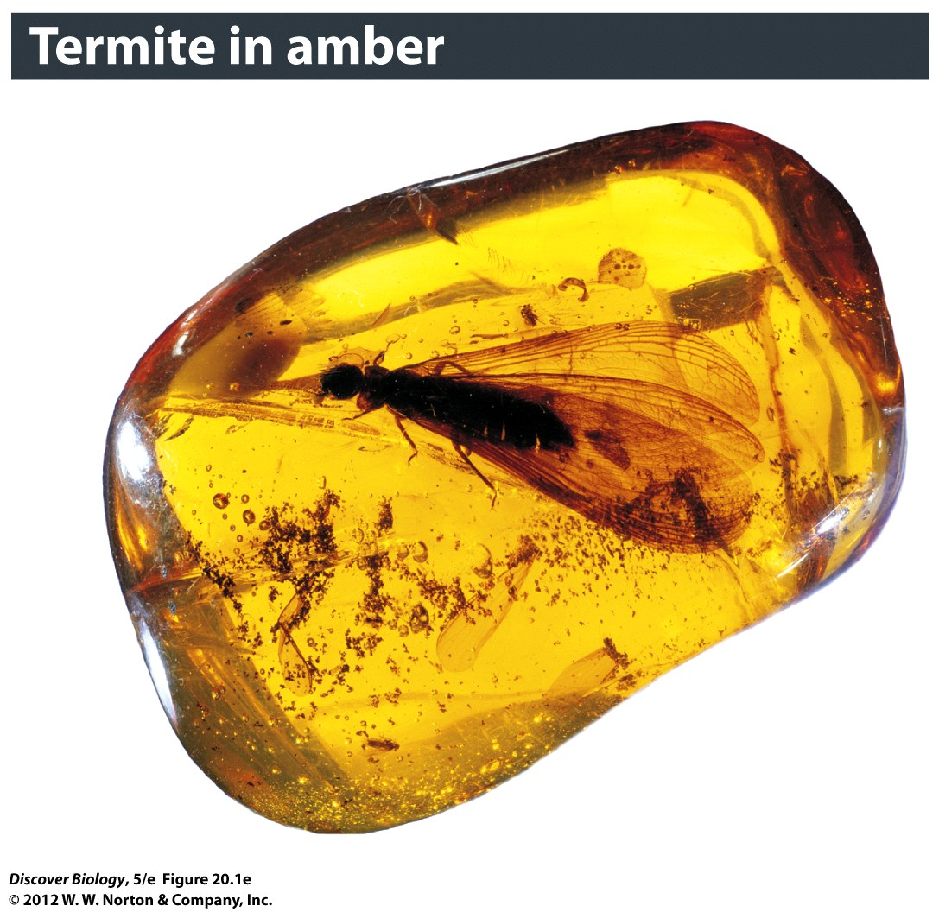
Notes:
Figure 20.1e Fossils through the Ages
(e) A fossil of a Velociraptor entangled with a Protoceratops, which bit down on the predator’s claw, locking both in a death grip.

Slide 11
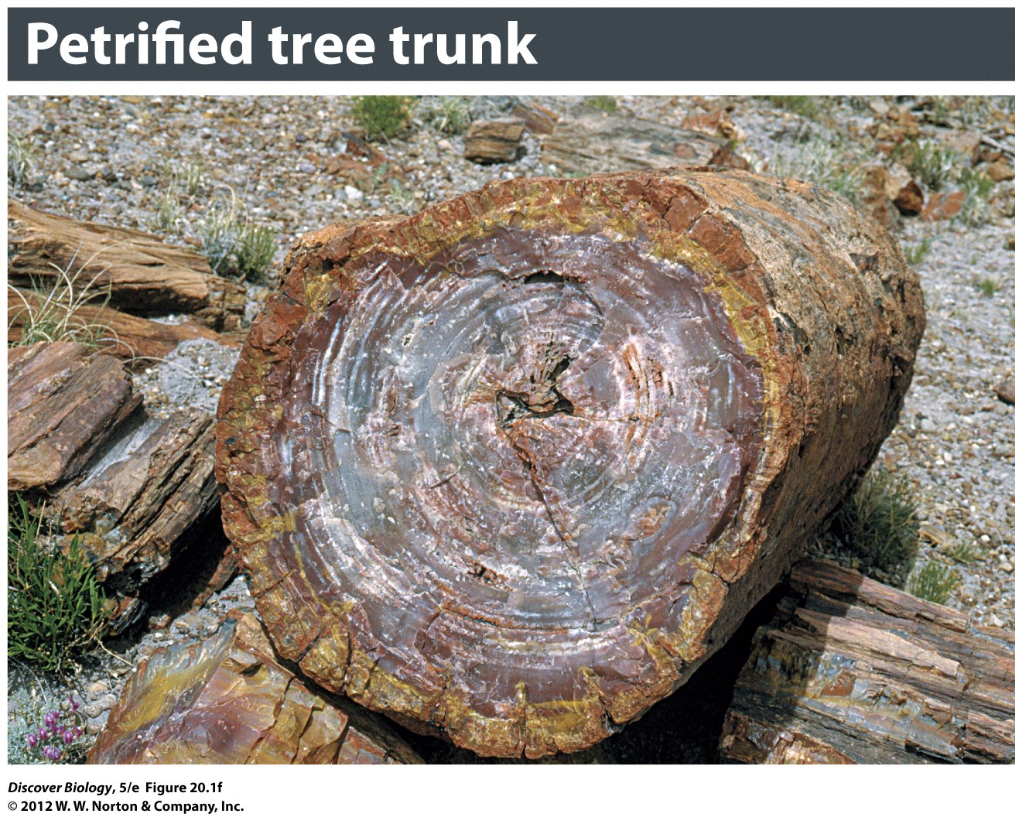
Notes:
Figure 20.1f Fossils through the Ages
(f) Petrified wood. Here we see how what was once solid wood has fossilized into solid rock.

Slide 12
The Fossil Record:
A Guide to the Past
More accurate fossil dating can be determined by measuring radioisotopes present in the fossil
Radioisotopes, such as carbon-14 and uranium-235, are unstable, isotopic forms of elements that decay to more stable forms over time
Radioisotopes can also be used to date rock above and below a fossil that does not contain radioisotopes of its own

Slide 13
The Fossil Record Is Not Complete
Most organisms decompose rapidly after death and do not form fossils
Those fossils that are formed can be destroyed by common geologic processes such as erosion and extreme heat or pressure
The unique set of circumstance required to form, preserve, and then discover fossils creates large gaps in the fossil record

Slide 14
Fossils Reveal That Whales Are Closely Related to a Group of Hoofed Mammals
Genetic analysis of recently discovered fossils confirms that whales are most closely related to artiodactyls, which are even-toed, hoofed land mammals
Morphological analysis of recently discovered fossils showing the ankle bones of early whales indicates the relationship to the artiodactyls

Slide 15
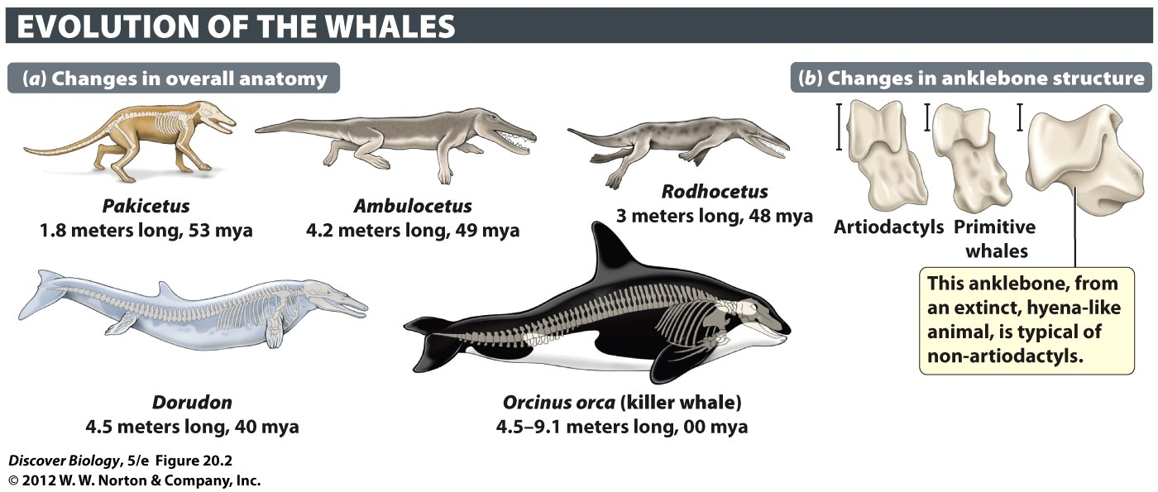
Notes:
Figure 20.2 Shape-Shifters
(a) It took roughly 15 million years for whale ancestors to make the transition from life on land to life in water. The oldest whale ancestor shown here, Pakicetus, lived on land 53 million years ago. Ambulocetus [am-byoo-loh-see-tus] had strong, well-developed legs and probably was semiaquatic, living at the water’s edge and hunting in much the same way that a crocodile does today. In Rodhocetus, the body was more streamlined and the front legs were shaped more like flippers. By 40 mya, Dorudon was fully aquatic. These drawings are based on reconstructed fossil skeletons, which are superimposed on two of the whale ancestors. Compare the whale ancestors in this sequence with Orcinus, a modern toothed whale. (b) The ankle-bones of two whale ancestors—Pakicetus (shown here) and Rodhocetus (not shown)—are similar in shape to those of artiodactyls (hoofed mammals), but very different from those found in most other mammals. Each scale bar represents 1 centimeter.

Slide 16
The History of Life on Earth
The study of life on Earth focuses on three main events:
  The origin of cellular organisms
  The beginning of multicellular life
  The colonization of land

Slide 17
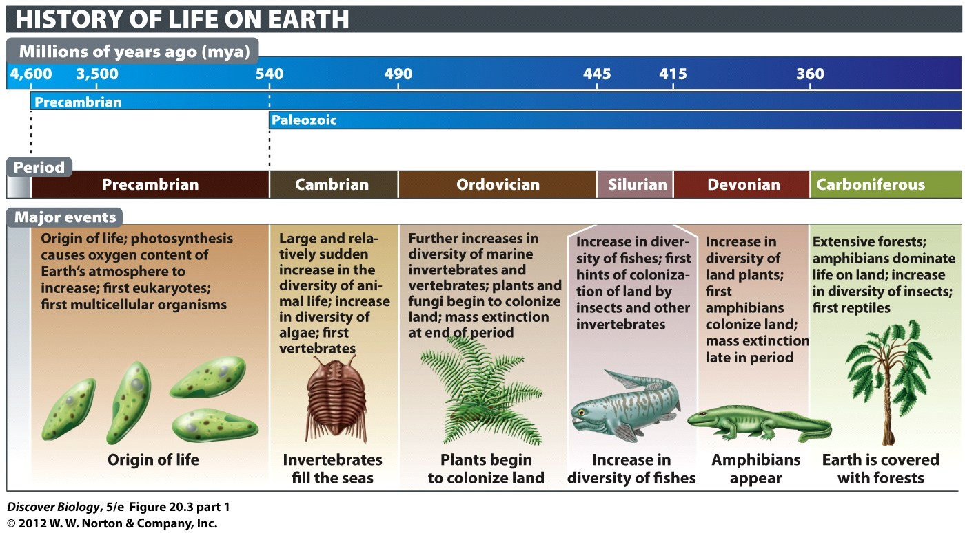
Notes:
Figure 20.3 (Part 1) The Geologic Timescale and the Major Events in the History of Life
The history of life can be divided into 12 major geologic time periods, beginning with the Precambrian (4,600–540 mya) and extending to the Quaternary (1.8 mya to the present). This timescale is not drawn to scale; to do so while including the Precambrian would require extending the diagram off the book page to the left by more than 5 feet.

Slide 18
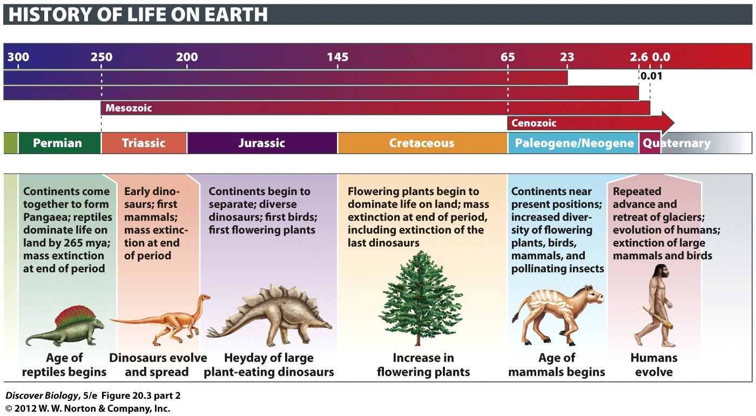
Notes:
Figure 20.3 (Part 2) The Geologic Timescale and the Major Events in the History of Life
The history of life can be divided into 12 major geologic time periods, beginning with the Precambrian (4,600–540 mya) and extending to the Quaternary (1.8 mya to the present). This timescale is not drawn to scale; to do so while including the Precambrian would require extending the diagram off the book page to the left by more than 5 feet.

Slide 19
The First Single-Celled Organisms
Arose at Least 3.5 Billion Years Ago
The earliest hints of life were cell-like structures that can be found in stromatolites, layered mounds formed 3.5 billion years ago
Eukaryotes first appeared 2.1 billion years ago, over a billion years after the first prokaryotes
The evolution of eukaryotes coincides with increased oxygen levels in the atmosphere, one of the most important events in the history of life on Earth

Slide 20
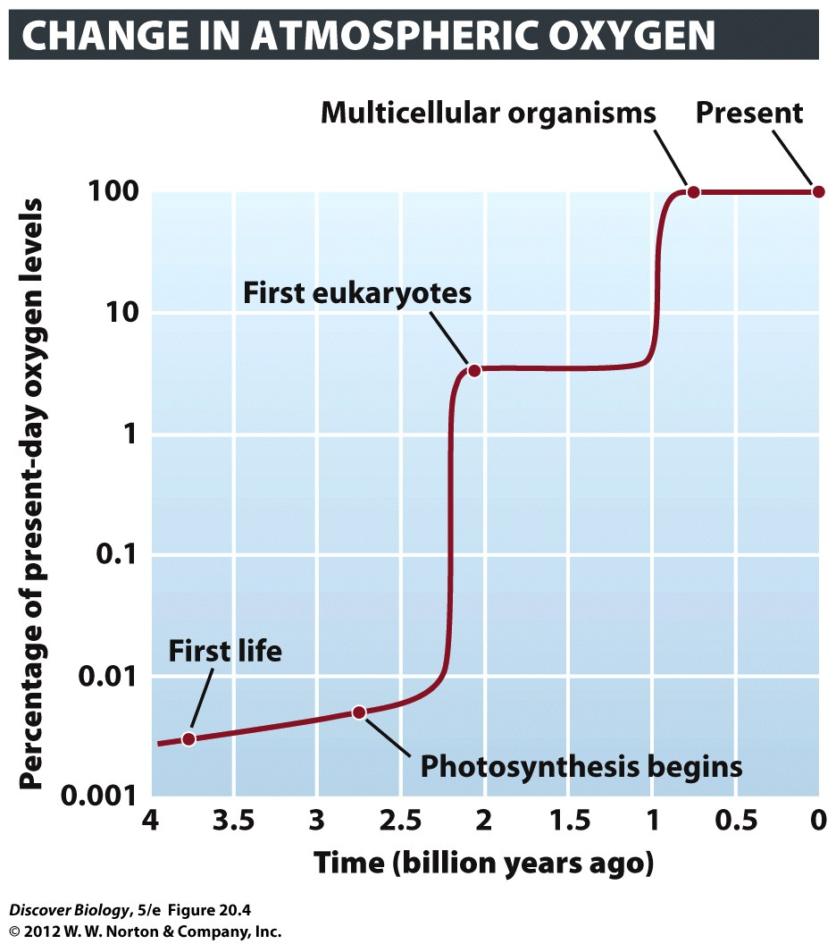
Notes:
Figure 20.4 Oxygen on the Rise
The release of oxygen as a waste product by photosynthetic organisms caused its concentration in Earth’s atmosphere to increase greatly over the last 3–4 billion years, facilitating the evolution of eukaryotes and multicellular organisms. Shown here are the hypothesized levels of oxygen at key points in the history of life, but much is still unknown about the dynamics of the rise of oxygen over time.

Slide 21
Multicellular Life Evolved about 650 Million Years Ago
Early forms of life evolved in the shallow seas that covered the Earth during the Precambrian period, about 650 mya
During the early to middle Cambrian period, 530 mya, there was a dramatic increase in the diversity of life, known as the Cambrian explosion, which lasted only 5–10 million years
The presence of new predators is thought to have sped up the evolution of Cambrian herbivores

Slide 22
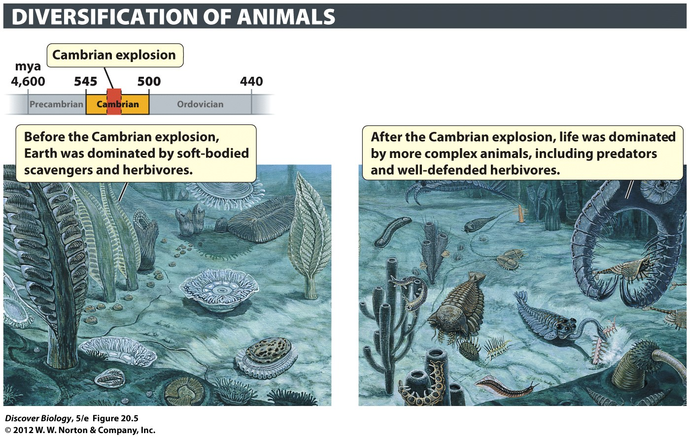
Notes:
Figure 20.5 The Cambrian Explosion Transformed the History of Life on Earth

Slide 23
Colonization of Land Followed the Cambrian Explosion
Descendants of green algae were the first organisms to colonize land and diversify, approximately 500 mya
Plants covered Earth by the end of the Devonian period, 360 mya
To meet the challenges of life on land, plants developed several key innovations, including:
  A waterproof cuticle
  Vascular systems
  Structural support tissues (wood)

Slide 24
Colonization of Land Followed the Cambrian Explosion
The first definite fossils of terrestrial animals are of spiders and millipedes and date from about 410 mya
The first vertebrates to colonize land were amphibians, which are thought to have descended from lobe-finned fishes about 365 mya
Reptiles later evolved from amphibians and were the first to evolve the amniotic egg, a major event in the history of life

Slide 25
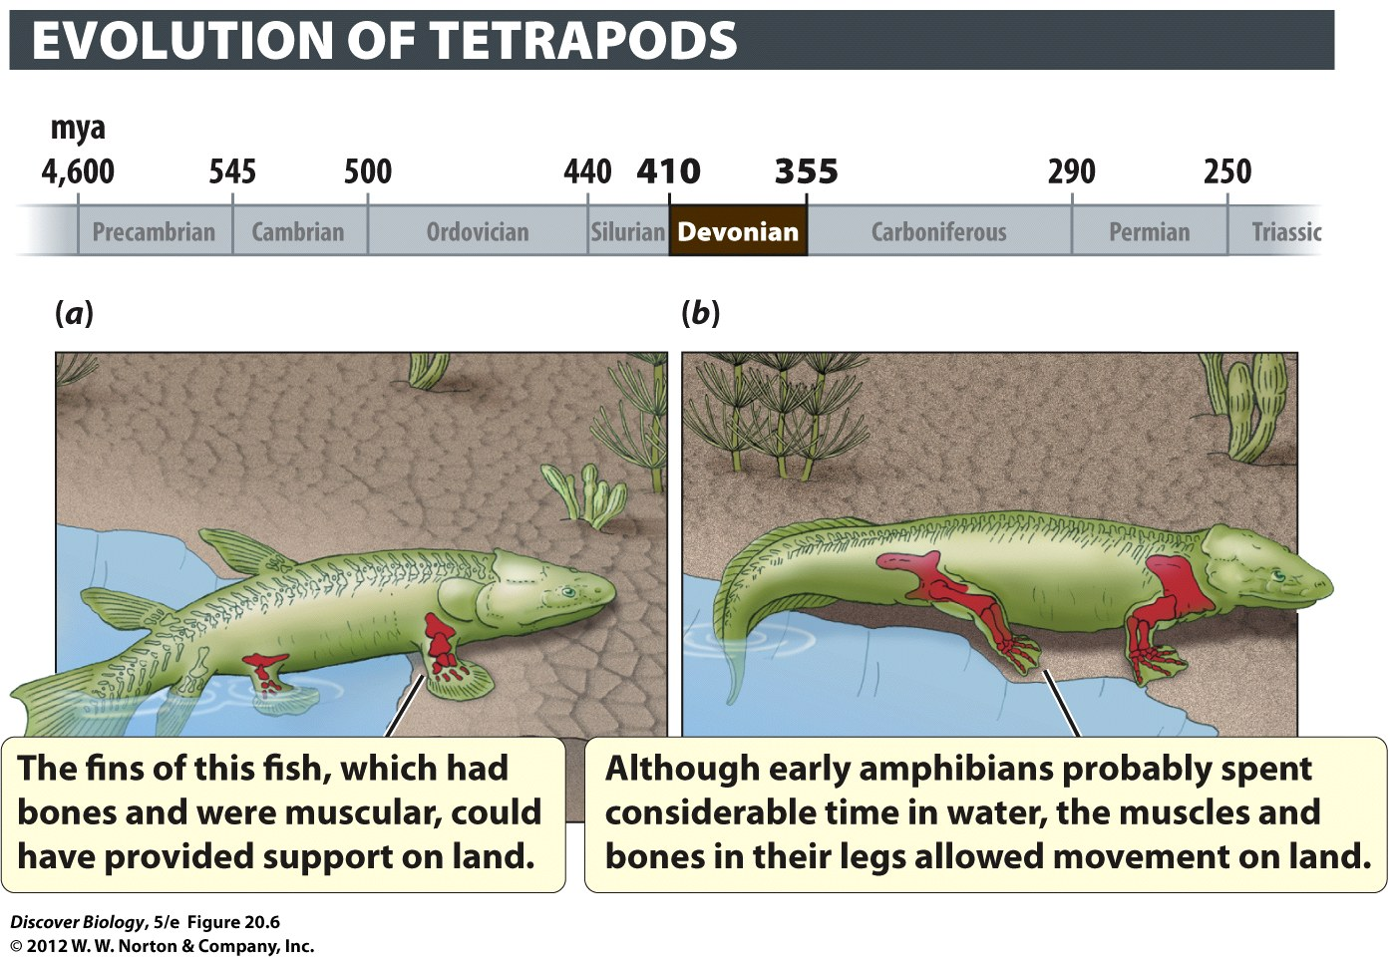
Notes:
Figure 20.6 The First Amphibians
(a) Amphibians probably evolved over long periods of evolutionary time from a lobe-finned fish ancestor like the one shown here. (b) This early amphibian was reconstructed from a 365-million-year-old (late Devonian) fossil.

Slide 26
The Effects of Plate Tectonics
The slow movement of the continents over time relative to one another is called plate tectonics or continental drift
Continental drift can be caused by spreading of the sea floor or the collision and subsequent sinking of two plates
The movement of Earth’s plates has had a dramatic effect on speciation and climate

Slide 27
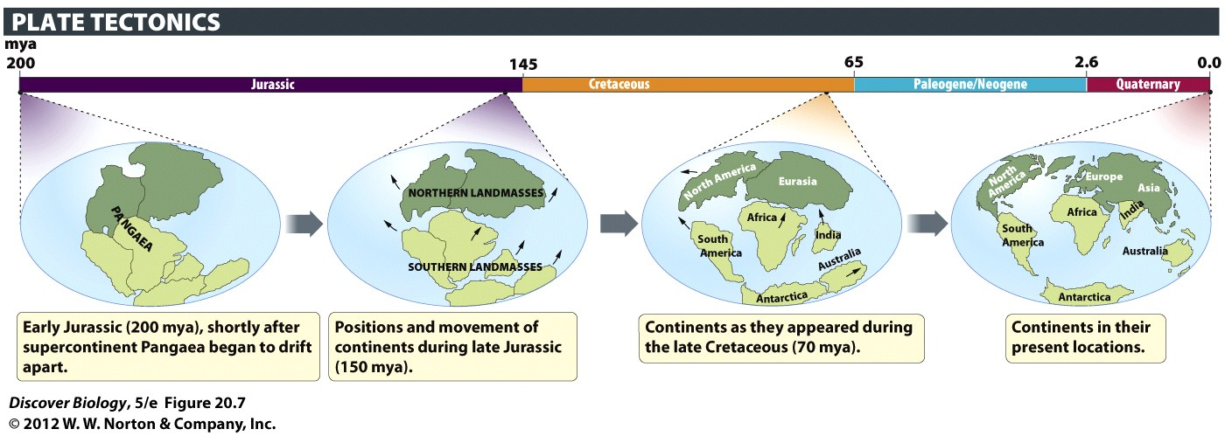
Notes:
Figure 20.7 Movement of the Continents over Time
The continents move over time, as shown by these “snapshots” illustrating the breakup of the supercontinent Pangaea. Earlier movements of the continents led to the gradual formation of Pangaea, a process that was complete by 250 mya.

Slide 28
Mass Extinctions: Worldwide
Losses of Species
The fossil record shows that there have been five mass extinctions, periods of time during which great numbers of species went extinct throughout most of Earth
The mass extinctions are thought to have been caused by such things as climate change, massive volcanic eruptions, and asteroid impacts
The extinction of one or more groups of organisms can provide new ecological and evolutionary opportunities for other groups of organisms

Slide 29
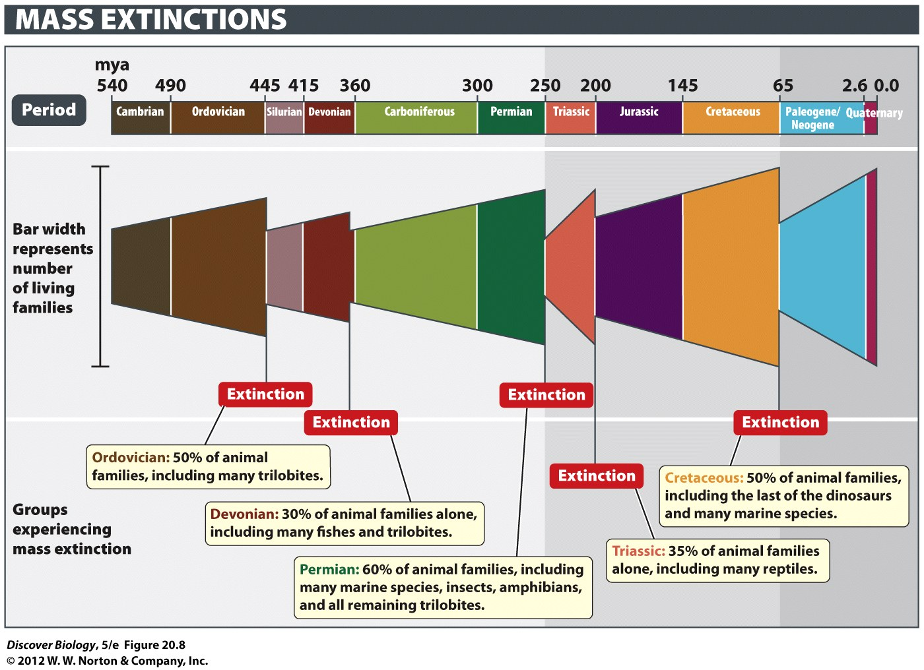
Notes:
Figure 20.8 The Five Mass Extinctions Drastically Reduced the Diversity of Animals
In addition to both marine and terrestrial animals, plant groups (not shown) were severely affected by the five mass extinctions that have occurred in Earth’s history. After each extinction, life again diversified.

Slide 30
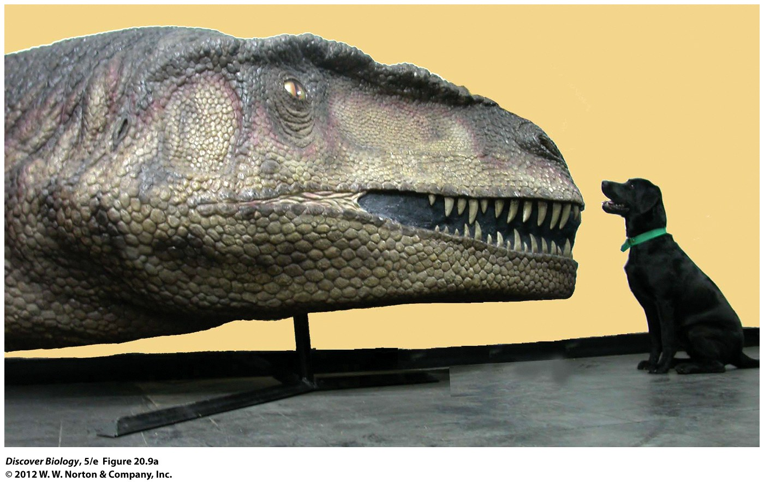
Notes:
Figure 20.9a Gone for Good
(a) A dog sits next to a reconstruction of the head of a Mapusaurus dinosaur—what may have been the largest carnivore ever to walk the Earth.

Slide 31
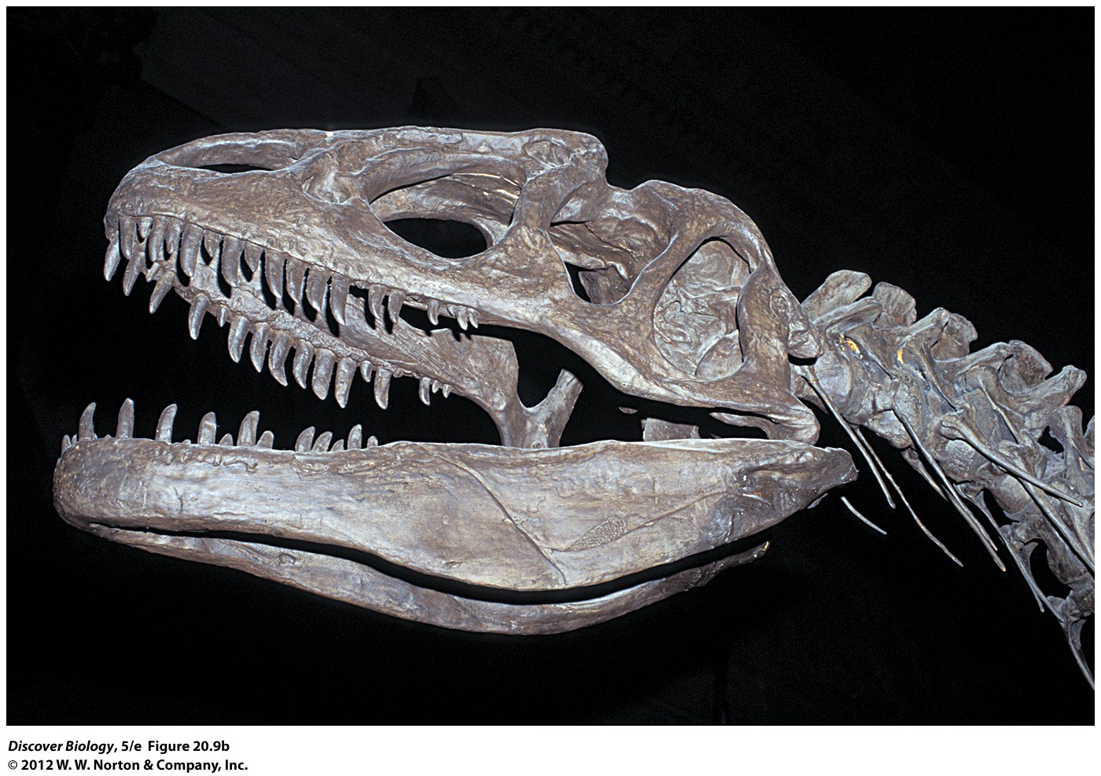
Notes:
Figure 20.9b Gone for Good
(b) This Allosaurus skeleton reveals how sharp, pointed, large, and numerous a dinosaur’s teeth could be.

Slide 32
Adaptive Radiations: Increases in the Diversity of Life
When a group of organisms expands to take on new ecological roles and to form new species and higher taxonomic groups, that group is said to have undergone an adaptive radiation
Adaptive radiations may be caused by the reduction in competition after a dominant group of organisms goes extinct or after a group of organisms has acquired a new adaptation that enables it to use its environment in new ways

Slide 33
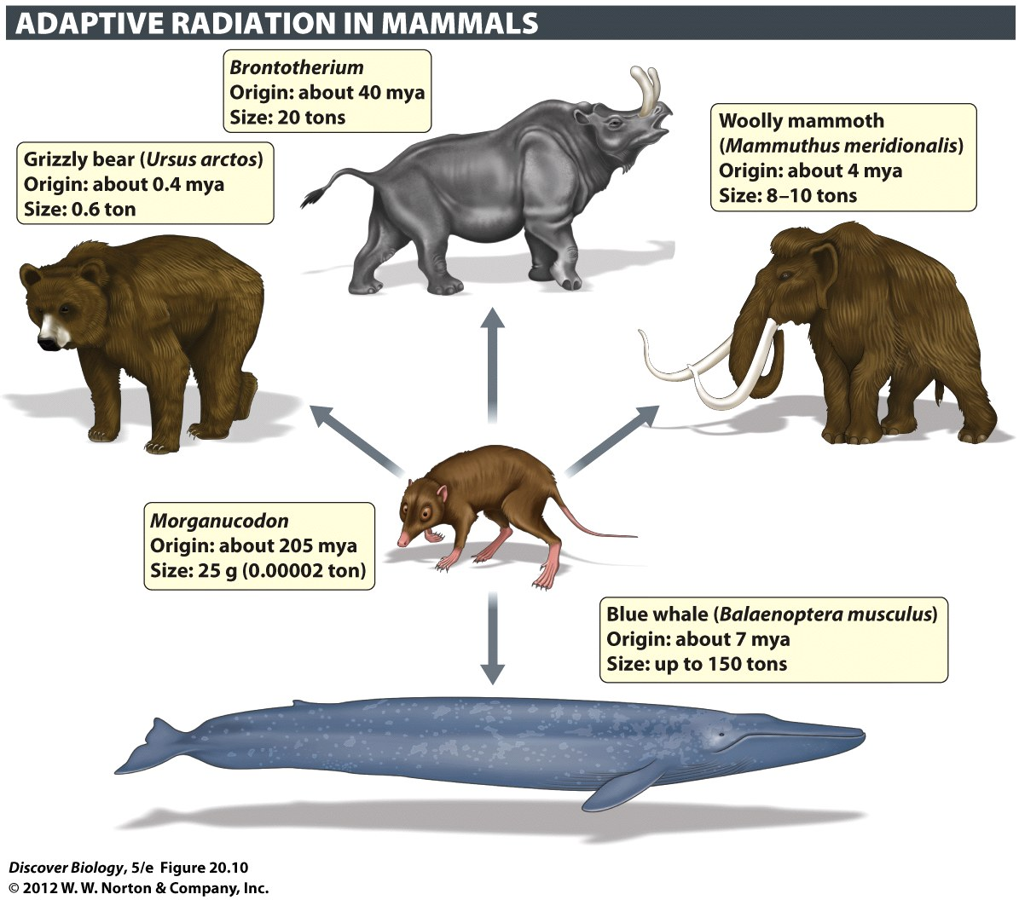
Notes:
Figure 20.10 They Became Giants
Early mammals (such as Morganucodon [mohr-guh-nookuh- dahn]) were small and are thought to have been nocturnal. Following the extinction of the dinosaurs, the diversity and size of mammals increased to include large forms such as those shown here. Because of the huge range in size between the smallest (Morganucodon, about the size of a shrew) and the largest (the blue whale, which can reach 25–30 meters long), none of these animals are drawn to scale.

Slide 34
The Origin and Adaptive
Radiation of Mammals
It is well documented that mammals evolved from reptiles; however, it is difficult to draw the line between mammals and reptiles in the fossil record
Fossils displaying features of both reptiles and mammals illustrate an evolutionary shift from one major group of organisms to another

Slide 35
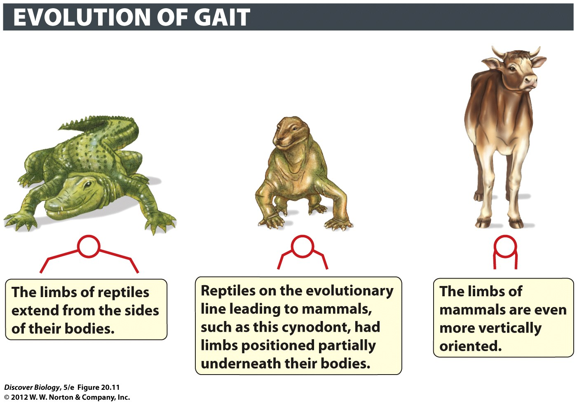
Notes:
Figure 20.11 A Gradual Change in the Way Animals Move
The legs of most living reptiles stick out to the sides of their bodies, giving them a sprawling gait. Over time, the legs of mammal-like reptiles became positioned under the body, leading eventually to the vertical orientation of the legs and the upright gait of living mammals.

Slide 36
The Mammalian Jaw and Teeth Evolved from Reptilian Forms in Three Stages
Compared with reptiles’ simple snap-shut jaws and uniform teeth, mammals have complex teeth and jaws that can be precisely controlled
The fossil record indicates a gradual change in jaw size and structure punctuated by three key steps

Slide 37
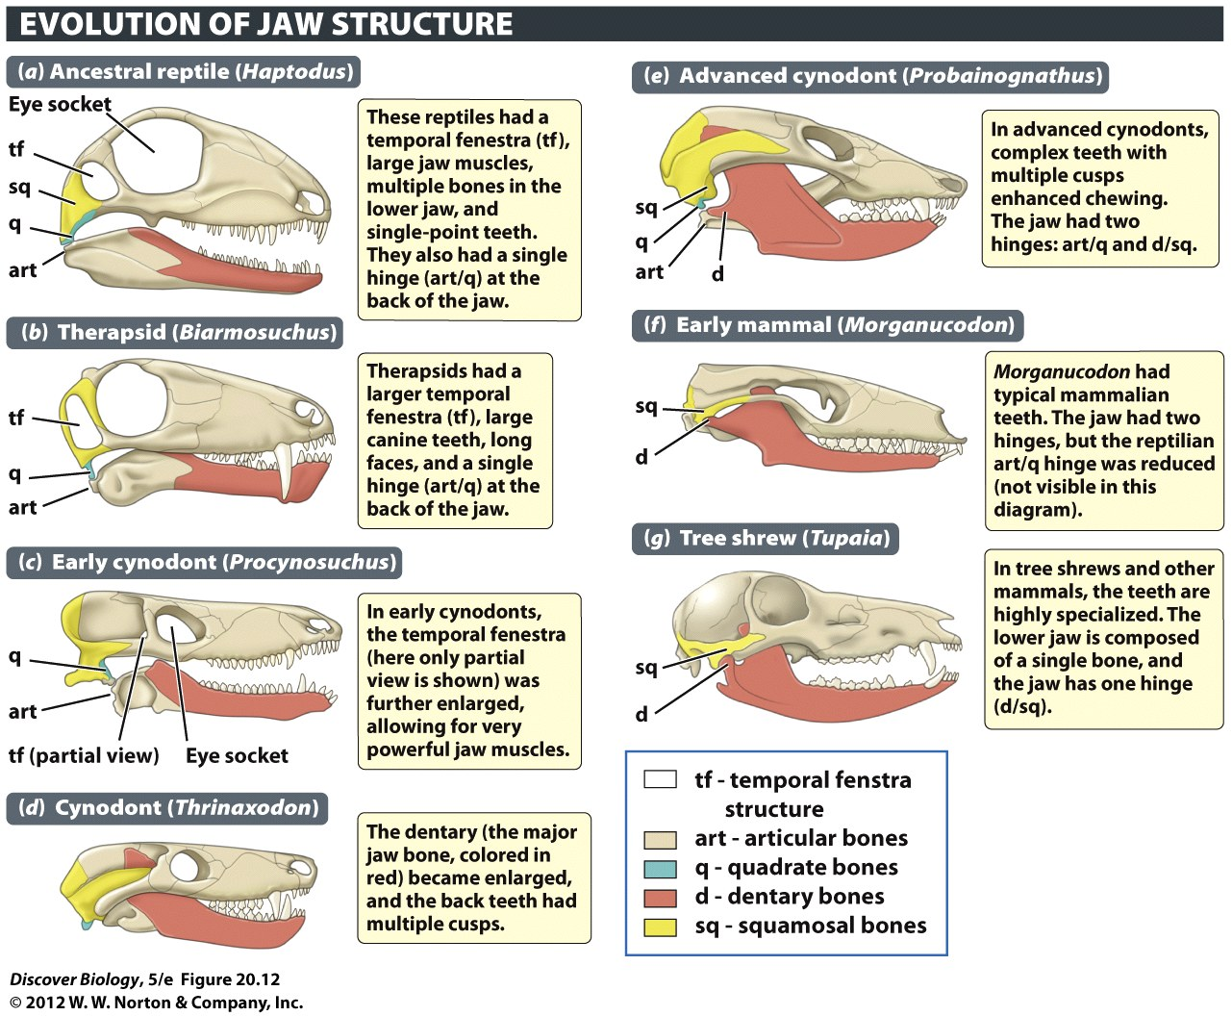
Notes:
Figure 20.12 From Reptile to Mammal
Over an 80-million-year period, the jaws and teeth of the reptilian ancestors of mammals gradually changed to resemble those of living mammals. In addition to those shown here, there are dozens of other fossil species of mammal-like reptiles— species with features that are intermediate to those of reptiles and mammals. When fossils from all of these species are lined up next to one another, the transition from reptile to mammal appears very smooth. Here, red shows the size and position of the dentary bone, which ultimately formed the entire lower jaw in mammals. The muscles that close the jaw pass through an opening called the temporal fenestra (tf); a larger temporal fenestra allows for larger and more powerful jaw muscles. In reptiles (a), the hinge of the jaw is formed by the articular/quadrate (art/q) bones; in mammals (g), the hinge is formed by two entirely different bones: the dentary/squamosal (d/sq) bones. Advanced cynodonts and early mammals had two hinges: the reptilian (art/q) hinge and the mammalian (d/sq) hinge.

Slide 38
Mammals Increased in Size after the Extinction of the Dinosaurs
The earliest mammals were small, rodent-sized organisms that evolved about 220 mya and remained small until the extinction of the dinosaurs
After the dinosaurs became extinct, mammals radiated greatly to include many new forms

Slide 39
Human Evolution
Humans belong to the order primates because we have flexible shoulder and elbow joints, five functional fingers and toes, and thumbs that can be placed opposite other fingers, or are opposable
Genetic analyses and fossil evidence have led scientists to believe that the human lineage diverged from our closest relatives, the chimpanzees, about 5–7 million years ago

Slide 40
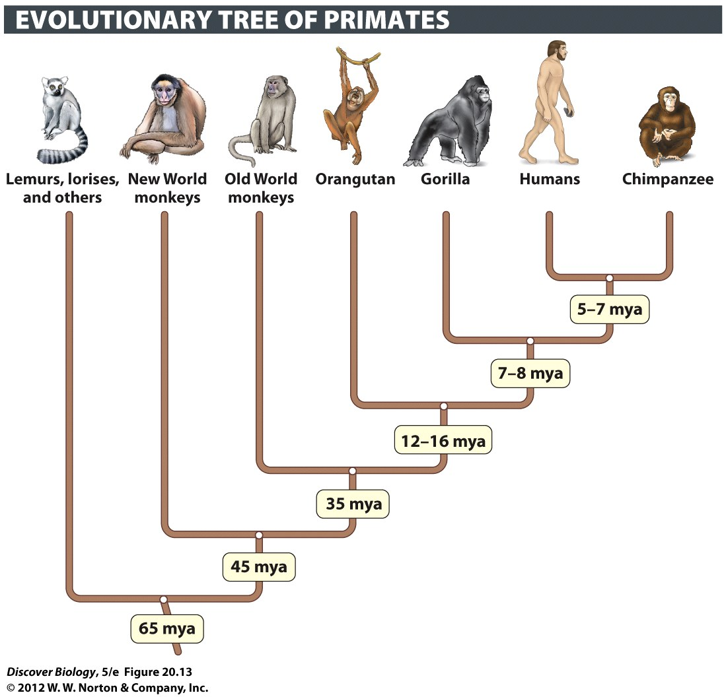
Notes:
Figure 20.13 The Primates Include Lemurs, Monkeys, and Apes

Slide 41
Walking Upright Was a Big
Step in Hominin Evolution
The first primate fossils are 56 million years old and resemble modern-day lemurs
The earliest fossil hominins display a mix of chimpanzee and human-like anatomical features
Many skeletal changes accompanied the switch to walking upright, or being bipedal, which provided several advantages for living on the ground

Slide 42
Notes:
Figure 20.13 The Primates Include Lemurs, Monkeys, and Apes

Slide 43
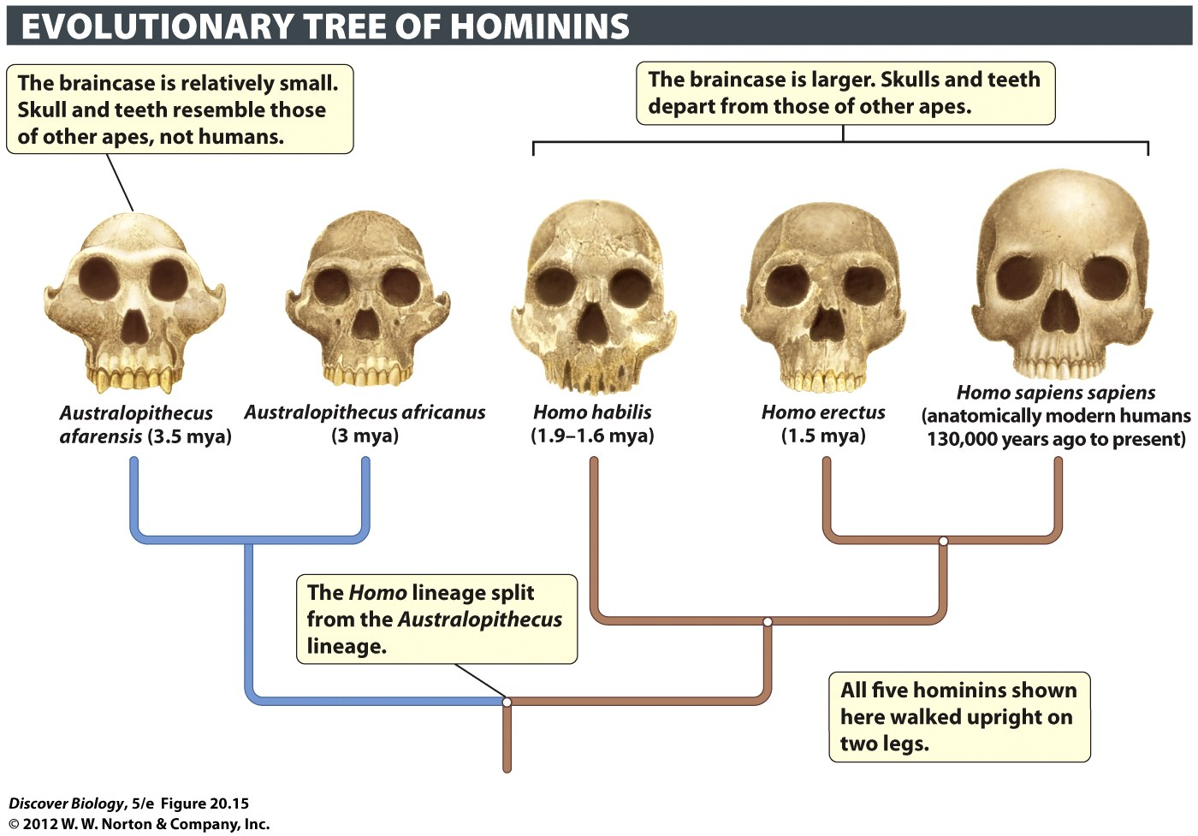
Notes:
Figure 20.15 A Gallery of Hominin Skulls
This tree shows the evolutionary relationships and the skulls of five of the many hominin species. A more complete evolutionary tree of hominins would be “bushier,” with multiple side branches emerging at different times.

Slide 44
A Larger Brain Is the Hallmark of the Human Genus, Homo
Fossil records suggest that the earliest members of the genus Homo originated in Africa 2–3 mya
Skull shape and size can used to identify intermediate species in the evolutionary shift from ancestral hominin characteristics to more recent ones
H. erectus or an earlier form of Homo migrated from Africa about 2 mya and had a larger brain and a skull more like that of modern humans
Research indicates that there may have been more species of Homo than was once thought, and that several of these species existed in the same places and times

Slide 45
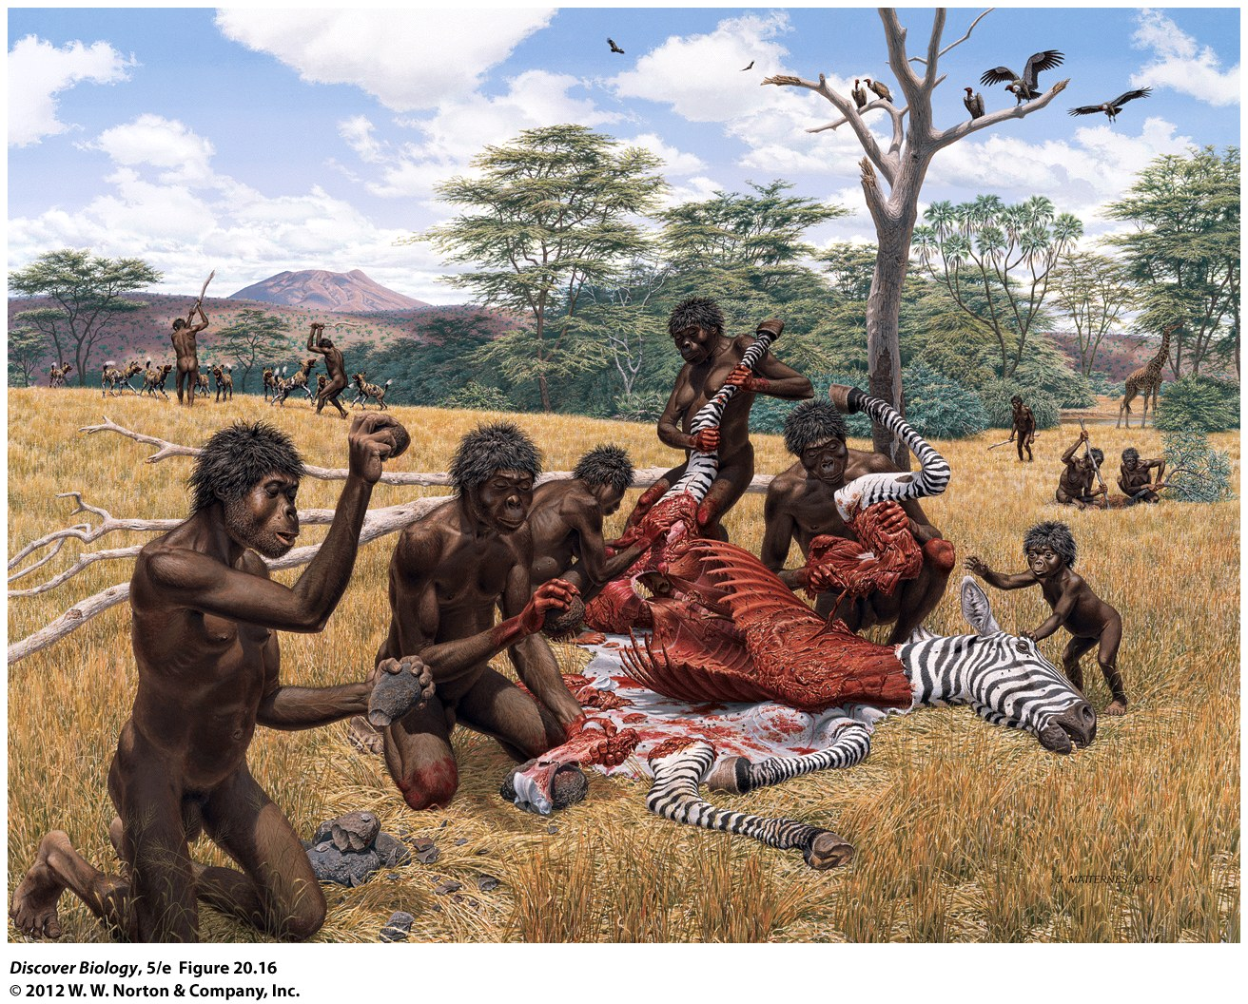
Notes:
Figure 20.16 Tool Use and Social Organization in Hominins
Both Homo habilis and Homo erectus likely worked in groups using stone tools when dealing with large kills.

Slide 46
Modern Humans Spread Out of Africa to Populate the Rest of the World
We are all “anatomically modern humans,” also known as Homo sapiens sapiens, a group that arose some 130,000 years ago
There are two conflicting hypotheses as to how anatomically modern humans arose from archaic H. sapiens

Slide 47
Modern Humans Spread Out of Africa to Populate the Rest of the World
The out-of-Africa hypothesis states that modern humans first evolved in Africa and then spread from Africa to the rest of the world, completely replacing all other Homo populations
The multiregional hypothesis states that modern humans evolved over time from H. erectus populations located throughout the world
Currently, both fossil evidence and DNA analysis support the out-of-Africa hypothesis

Slide 48
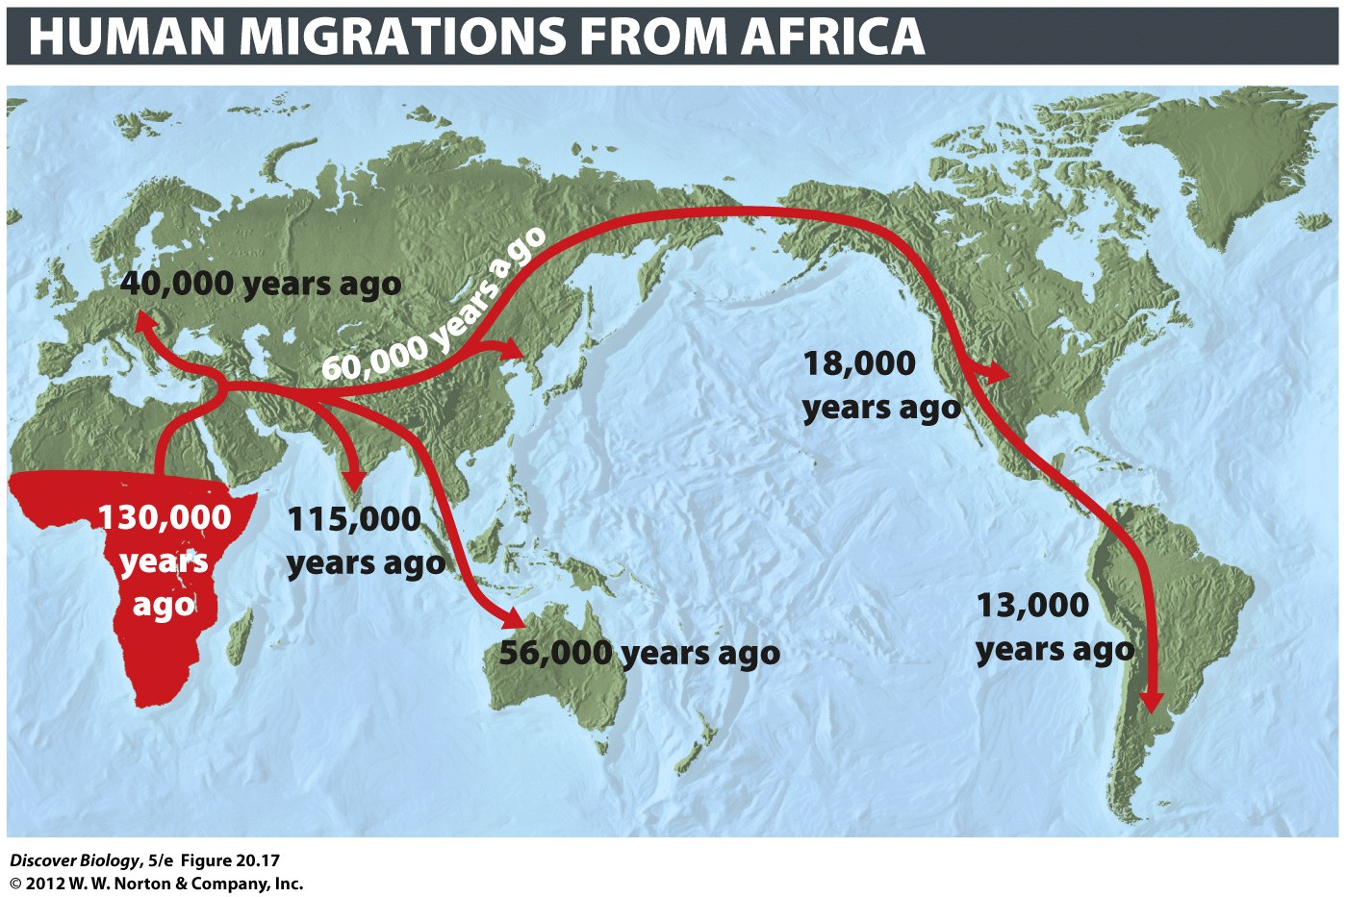
Notes:
Figure 20.17 Anatomically Modern Humans Evolved in Africa
The earliest known fossil and archaeological specimens of Homo sapiens sapiens, the first anatomically modern humans, come from Africa. The dates provided give the age of the earliest evidence that anatomically modern humans lived in different regions of the world. These dates are continually challenged by new evidence that scientists must then work to confirm.

Slide 49
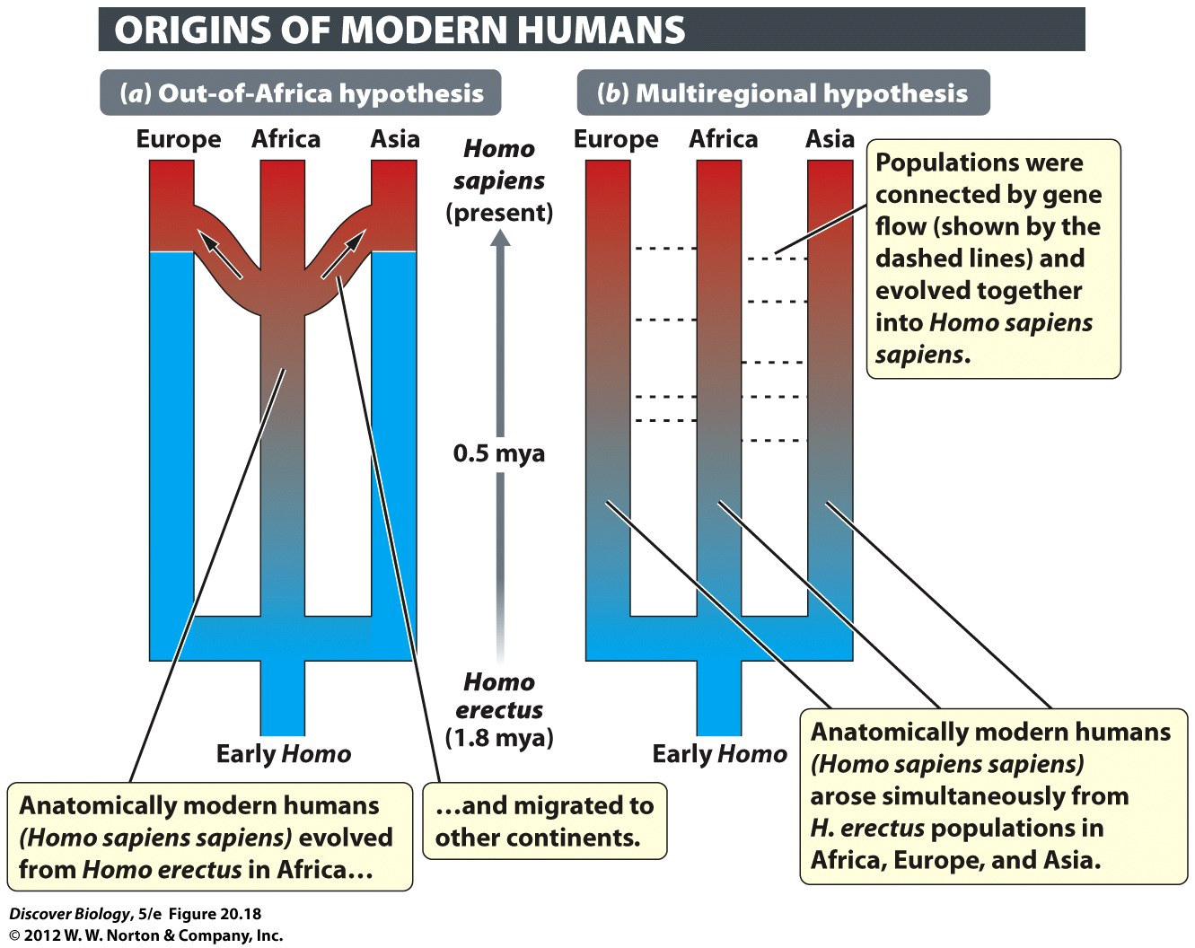
Notes:
Figure 20.18 Two Competing Hypotheses about the Origins of Anatomically Modern Humans
(a) The out-of-Africa hypothesis: Homo sapiens sapiens, or anatomically modern humans (red), originated in Africa within the past 200,000 years and then migrated to Europe and Asia, replacing Homo erectus (blue) and archaic H. sapiens populations. (b) The multiregional hypothesis: Populations of H. erectus in Africa, Asia, and Europe evolved simultaneously into anatomically modern humans (H. sapiens sapiens).

Slide 50
When Antarctica Was Green
Antarctic fossils of dinosaurs, forests, and tropical marine organisms are a vivid testimony to our dynamic world
The Antarctic fossil record also reveals the striking contrast between the diverse life-forms that once lived in Antarctica and the few that live there today

Slide 51
Clicker Questions
CHAPTER 20
The Evolutionary History of Life

Slide 52
Concept Quiz
The largest extinction on Earth was during
which period?
Permian
Devonian
Cretaceous
Notes:
The correct answer is A. During the Permian period, almost 95% of all species became extinct.
The Cretaceous period was the most recent, eliminating dinosaurs.

Slide 53
Concept Quiz
Which characteristic of reptiles is the major
reason they are more successful on land
than amphibians?
More efficient jaw
Teeth
Shelled egg
Notes:
The correct answer is C.
Reptiles do have a stronger jaw and more well developed teeth compared to amphibians.
However, the evolution of the amniotic egg is the primary reason reptiles are more successful on land.

Slide 54
Concept Quiz
Which of the following was present on Earth
3.5 billion years ago?
Anaerobic bacteria
Oxygen gas
Photosynthesizing prokaryotes
Notes:
The correct answer is A.
Three and a half mya, photosynthesis had not evolved. Without photosynthesis, oxygen gas was not present.

Slide 55
Relevant Art from Other Chapters
All art files from the book are available in JPEG and PPT formats online and on the Instructor Resource Disc

Slide 56
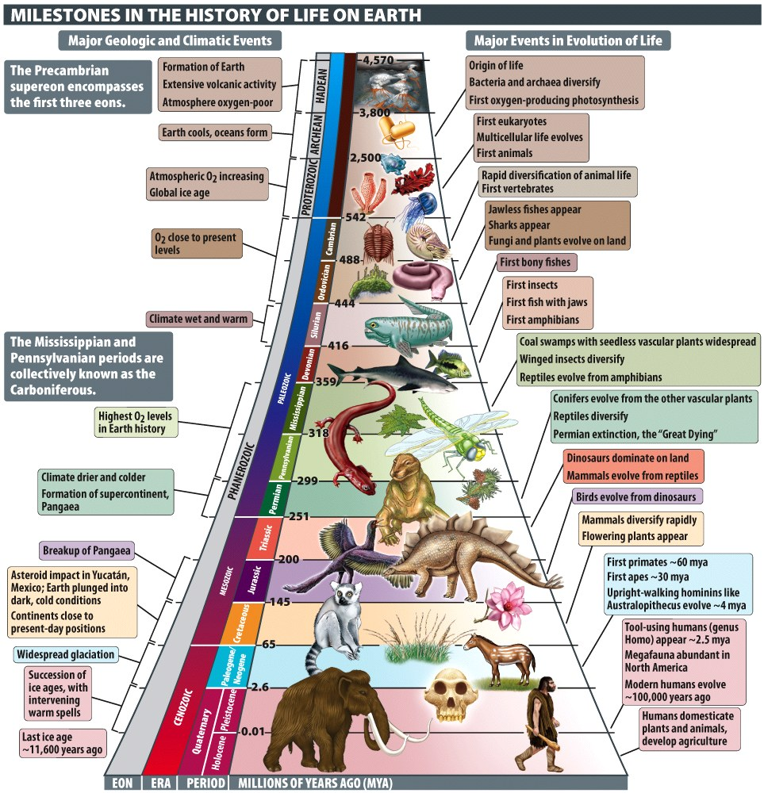
Notes:
Milestones in the History of Life on Earth

Slide 57
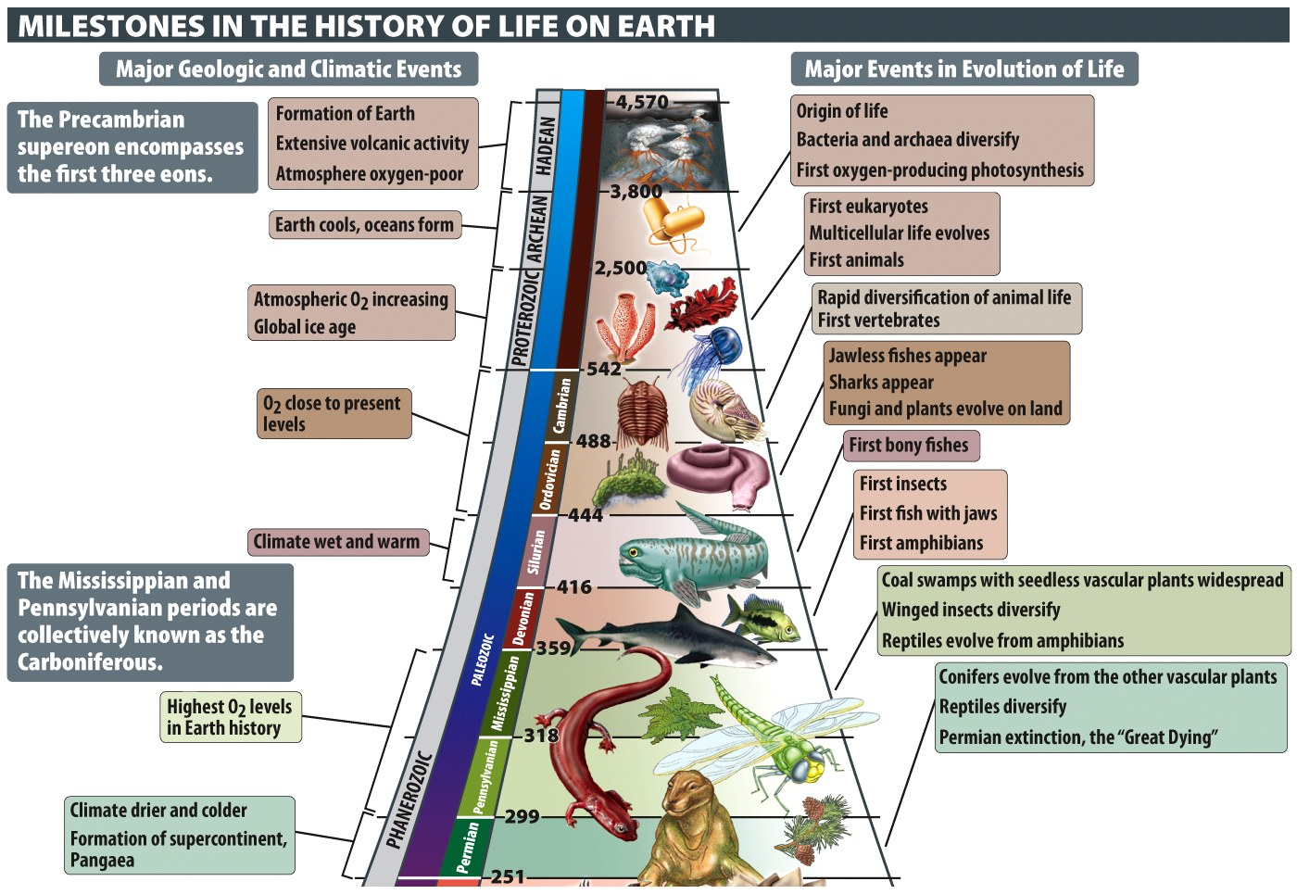
Notes:
Milestones in the History of Life on Earth

Slide 58
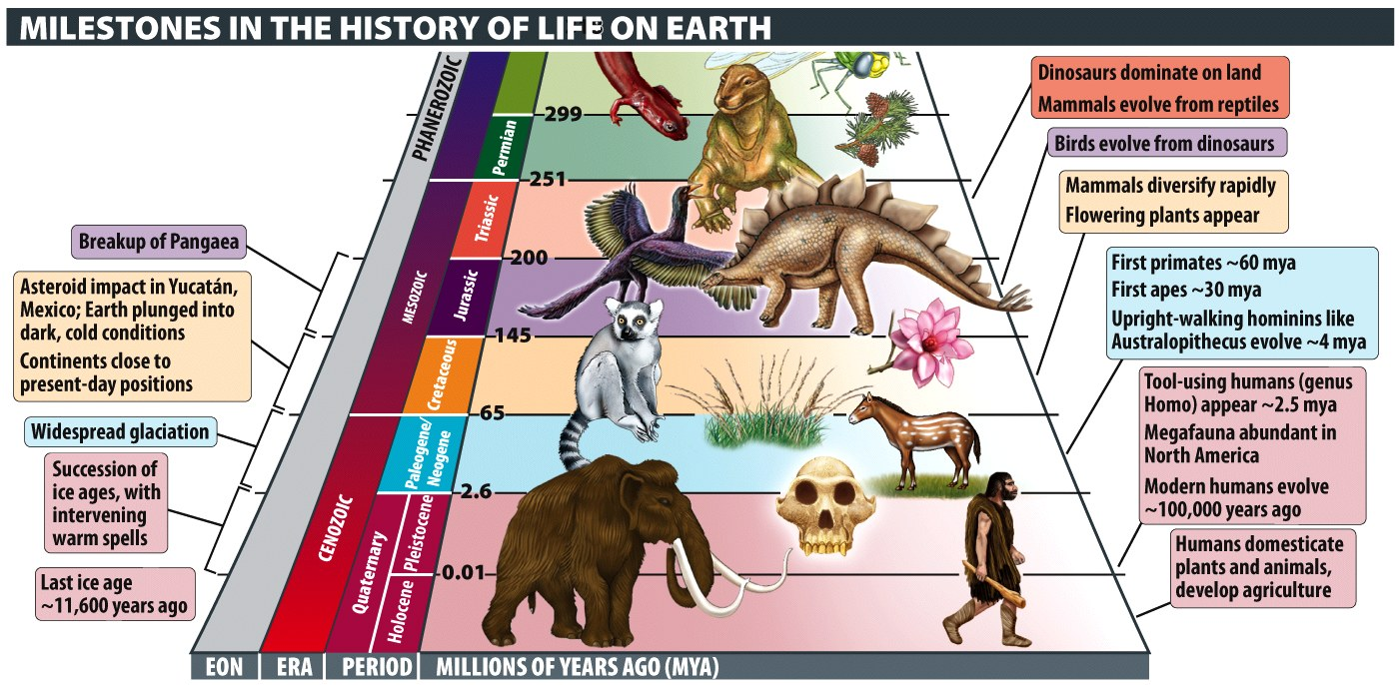
Notes:
Milestones in the History of Life on Earth

Slide 59
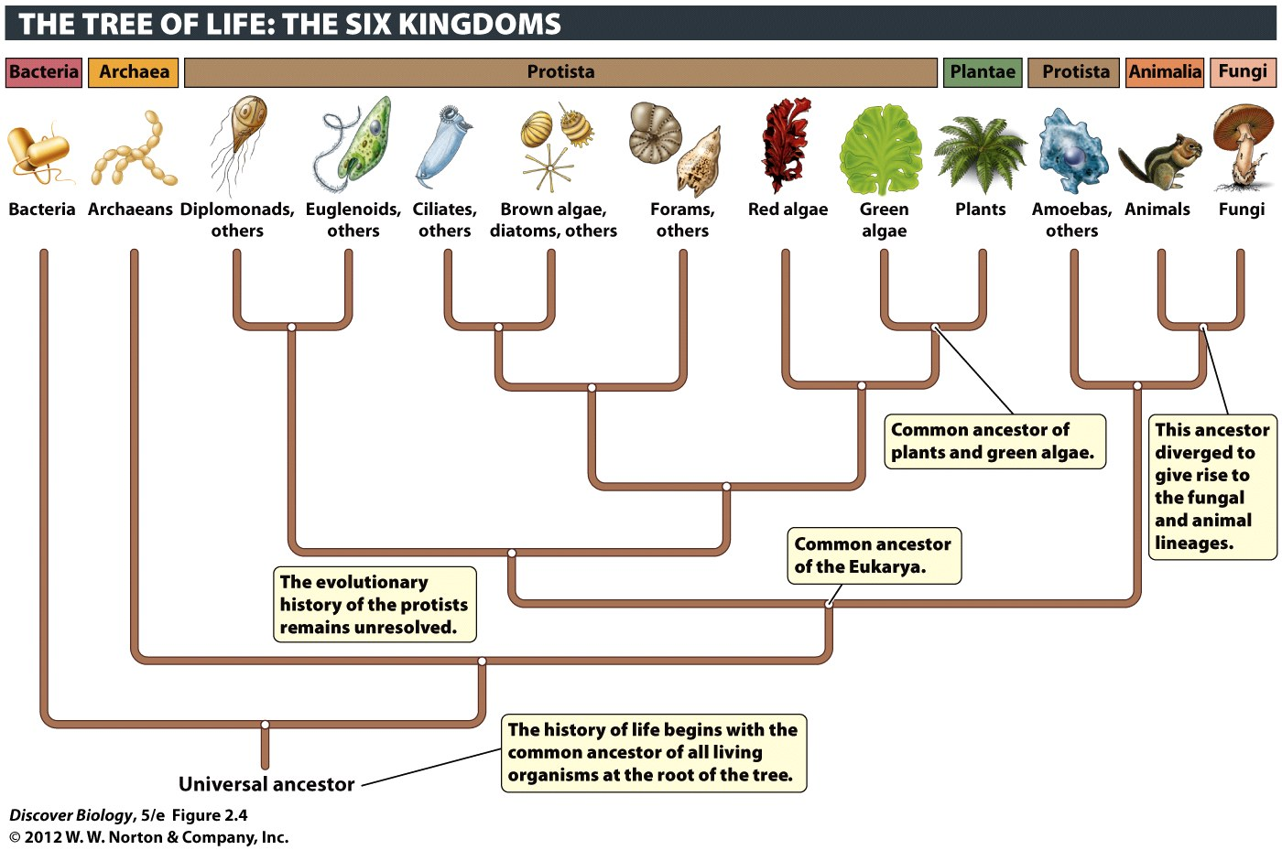
Notes:
Figure 2.4 The Three Domains and Six Kingdoms of Life
This evolutionary tree shows the hypothesized relationships among the six kingdoms, as well as the three domains. Each group branching off the tree can be thought of as a cluster of close relatives, or clade.

Slide 60
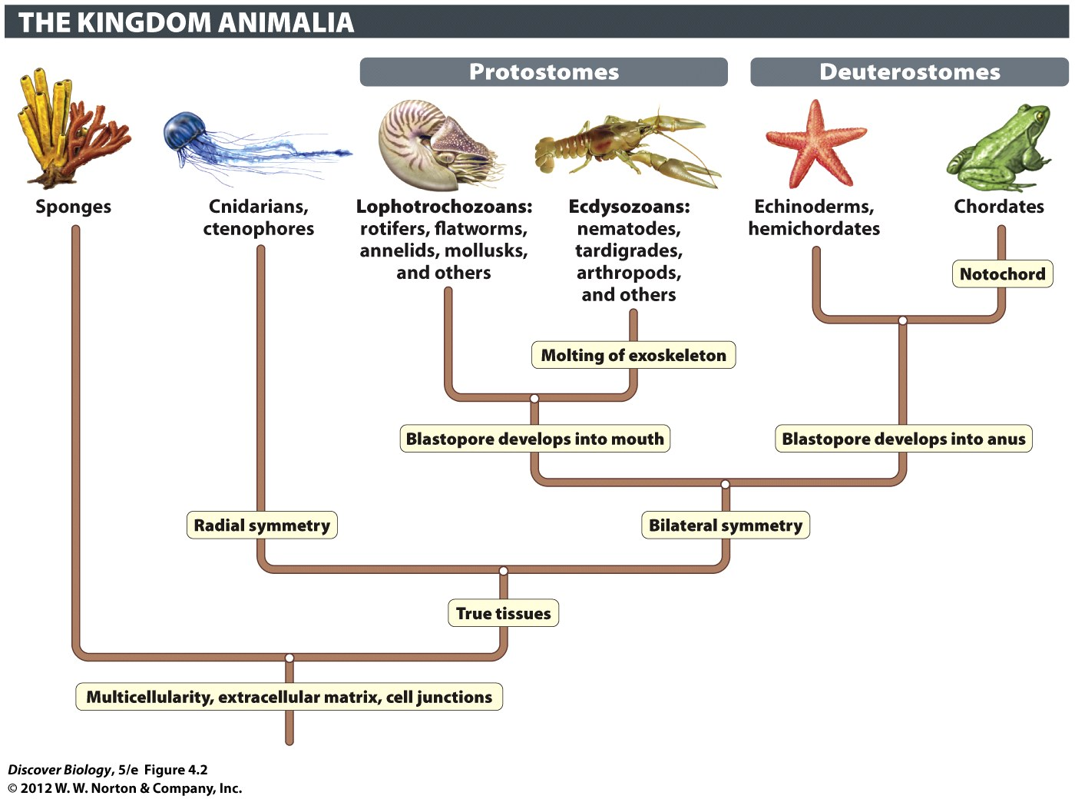
Notes:
Figure 4.2 Evolutionary Tree of the Animalia
The unique evolutionary innovations of each lineage are shown with boxed labels.

Slide 61
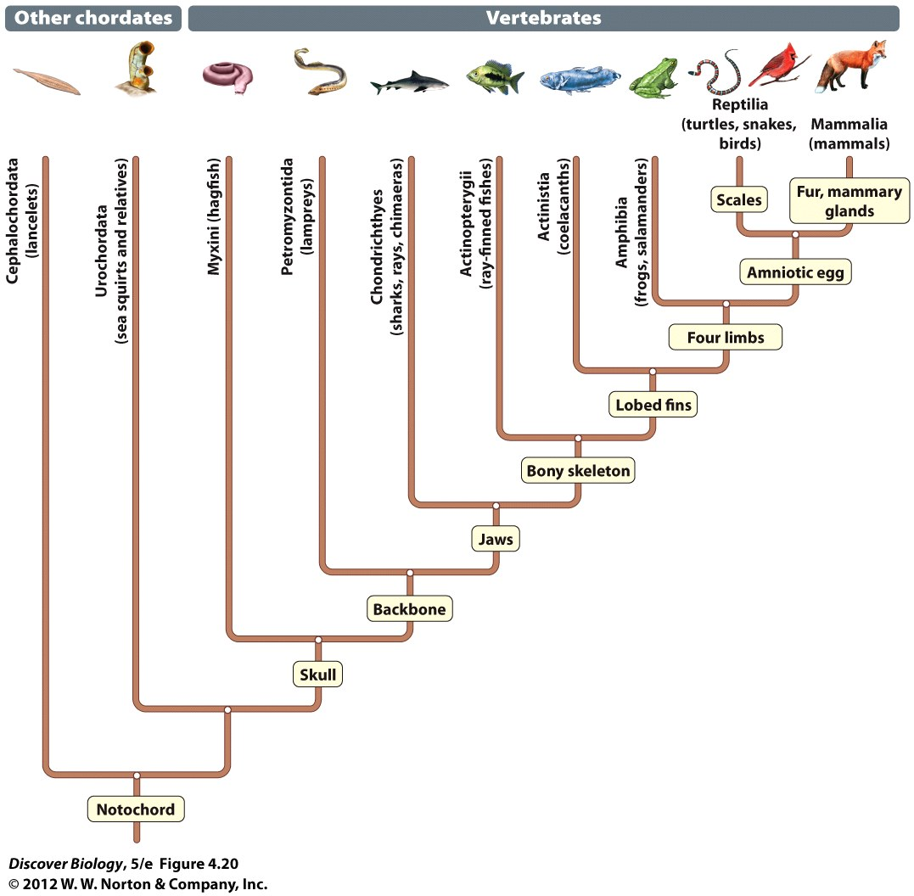
Notes:
Figure 4.20 Evolutionary Tree of the Vertebrates

Slide 62
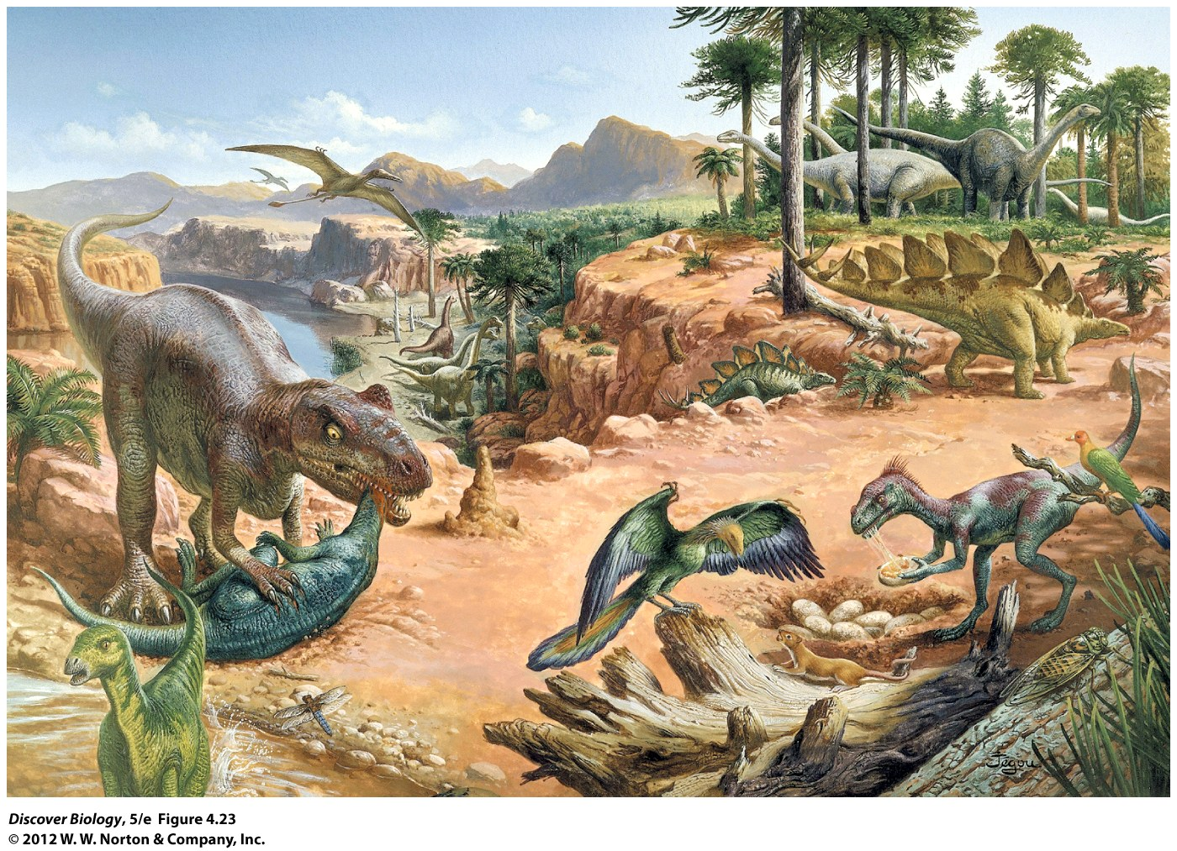
Notes:
Figure 4.23 Jurassic Park
Dinosaurs reached the height of their dominance during the Jurassic, the middle period of the Mesozoic era.

Slide 63
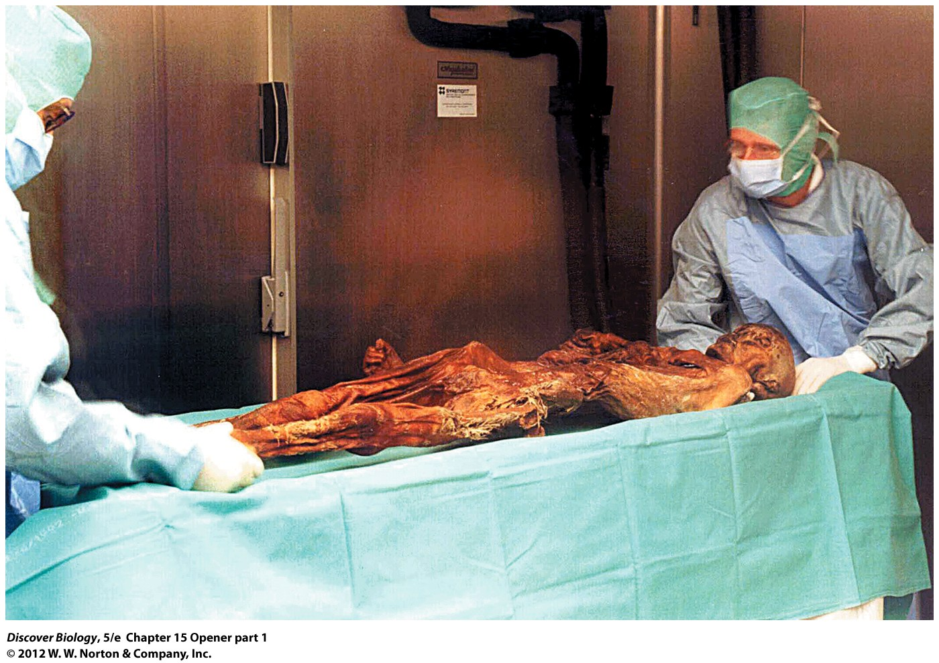
Notes:
Ötzi, the Iceman.
In 1991, hikers discovered the body of a man who lived thousands of years ago, lying at the base of a melting glacier. Long-frozen DNA sequences revealed how he was related to modern Europeans and how he may have died.

Slide 64
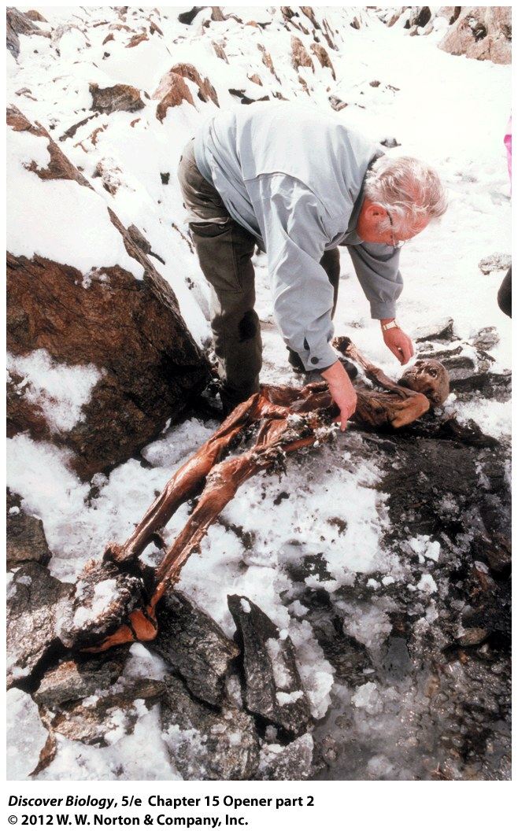
Notes:
Ötzi, the Iceman.
In 1991, hikers discovered the body of a man who lived thousands of years ago, lying at the base of a melting glacier. Long-frozen DNA sequences revealed how he was related to modern Europeans and how he may have died.

Slide 65
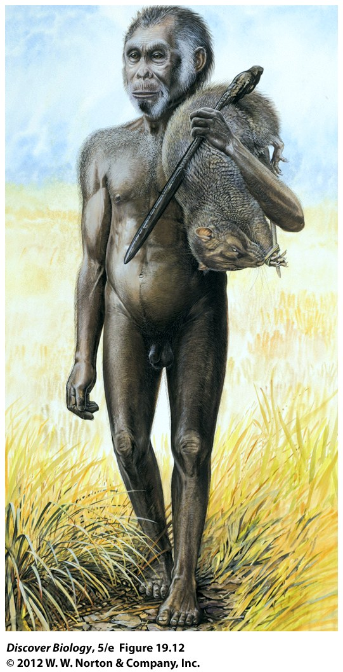
Notes:
Figure 19.12 Island Isolation May Have Driven the Evolution of Homo floresiensis
The foot structure and other anatomical features suggest that H. floresiensis was a distinctly different species, not a scaled-down version of H. erectus or H. sapiens.

