Slide 1
Discover Biology
FIFTH EDITION
Anu Singh-Cundy • Michael L. Cain
CHAPTER 19
Speciation and the Origins
Of Biological Diversity
© 2012 W. W. Norton & Company, Inc.

Slide 2
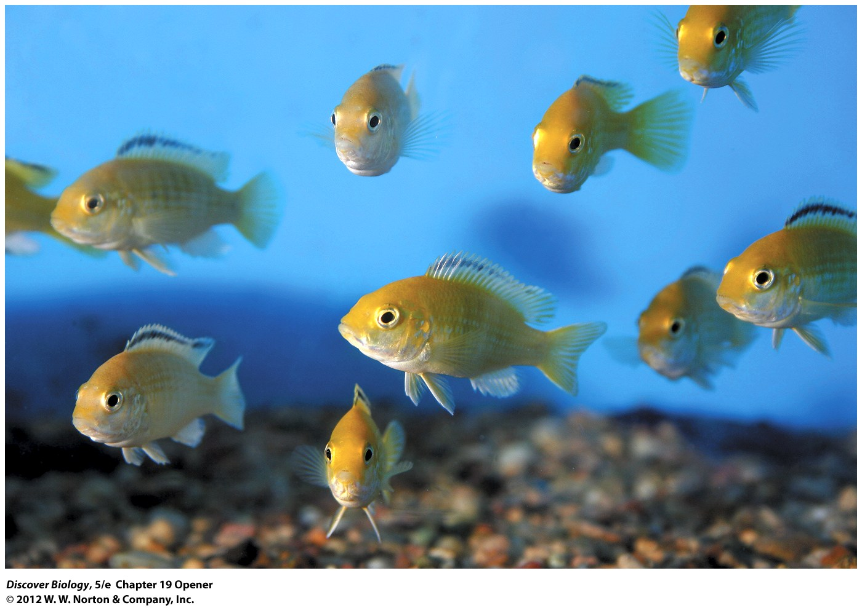
Notes:
Electric-Yellow Cichlids.
This particular cichlid species is native to Lake Malawi in East Africa. Africa alone is believed to have at least 1,600 species of cichlids. Hundreds more have evolved in other parts of the world, from Madagascar, India, and Syria to Central America, Mexico, and the southern United States.

Slide 3
Cichlid Mysteries
Earth’s changes separate populations of organisms, alter the environments in which they live, and set the stage for evolution
Until the 1970s, Lake Victoria was home to more than 500 species of cichlids, which descended from just 2 different ancestor species
Environmental influences have decreased the number of cichlid species; this process may lead to accelerated evolutionary change

Slide 4
Knowing That Populations and Species Can
Evolve Explains Adaptation
Knowing that populations and species can evolve explains adaptation, the diversity of life, and the shared characteristics of life
Natural selection causes adaptive traits to accumulate in a population, leading to speciation

Slide 5
Adaptation: Adjusting to Environmental Challenges
Adaptive traits are inherited characteristics that enable an individual to function well in its particular environment
Individuals with adaptive traits have greater reproductive fitness and pass those traits on to their offspring
An adaptation is an adaptive trait that is advantageous to an individual or a species
Adaptation can also refer to the process of evolution through natural selection

Slide 6
Adaptations Can Take
Many Different Forms
Natural selection can produce complex behavioral or reproductive adaptations
Coevolution occurs when the evolution of an adaptation in one species causes a reciprocal adaptation in another species

Slide 7
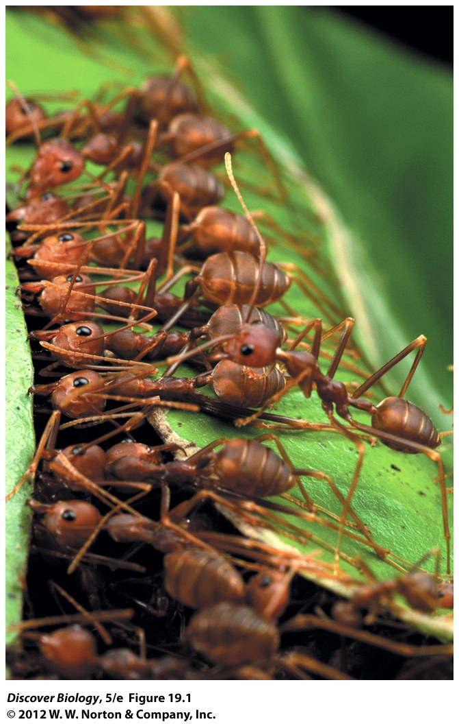
Notes:
Figure 19.1 Behavioral Adaptations in Weaver Ants Benefit All Members of the Colony
Weaver ants collaborate to pull nest leaves together.

Slide 8
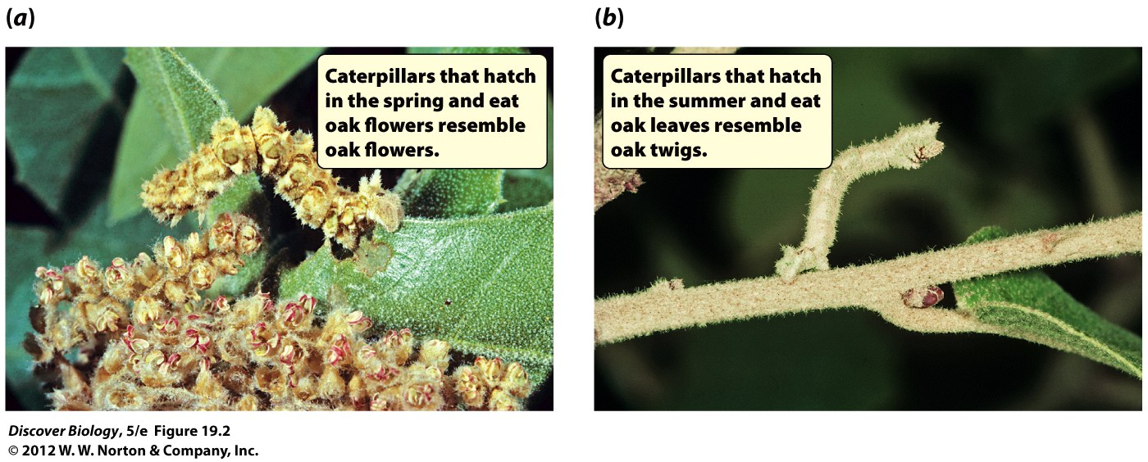
Notes:
Figure 19.2 An Adaptation That Offers Protection from Predators
Although they do not look alike, the two caterpillars shown here are the same species of moth: Nemoria arizonaria [nee-mohr-ee-uh air-ih-zoh-nair-ee-uh]. N. arizonaria caterpillars differ in appearance depending on what they feed on—the flowers or leaves of oak trees. Experiments have demonstrated that chemicals in the leaves control the switch that determines whether the caterpillars will mimic flowers (a) or twigs (b).

Slide 9
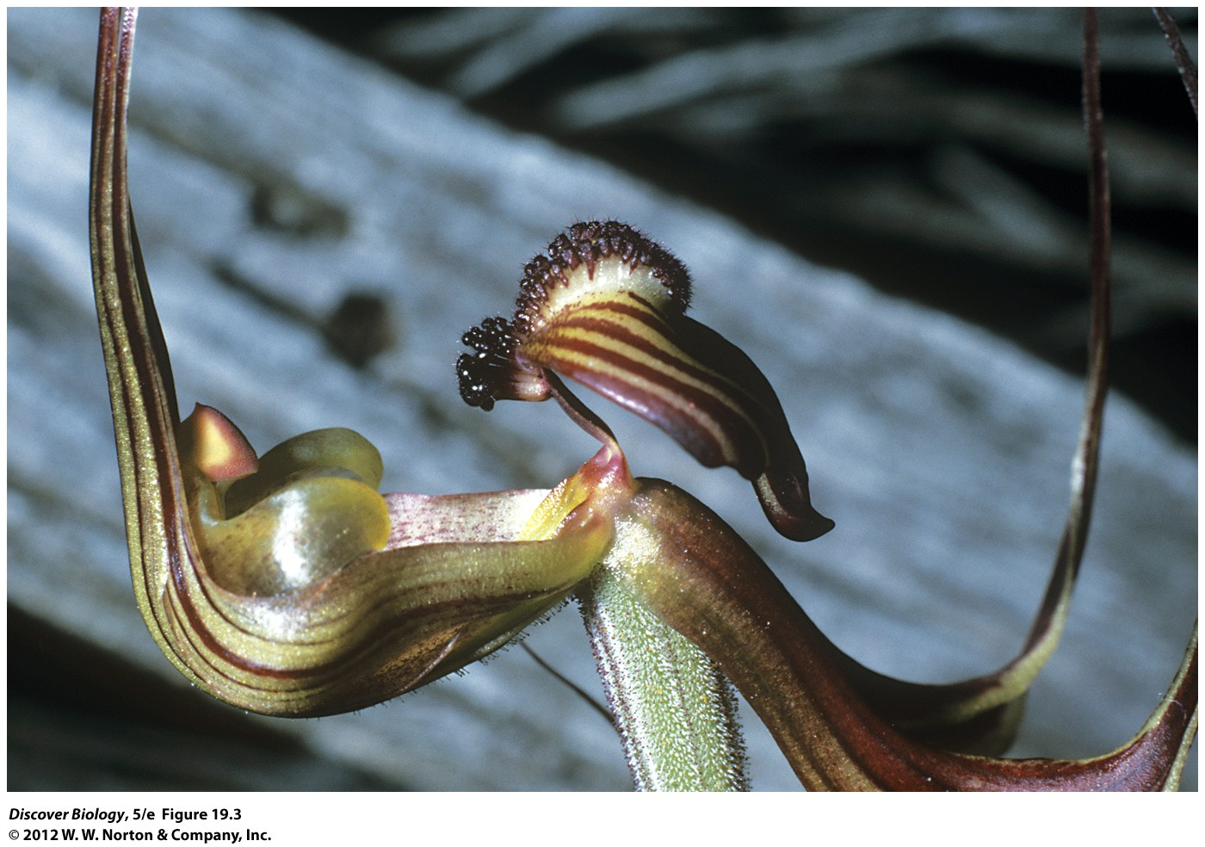
Notes:
Figure 19.3 An Adaptation That Facilitates Reproduction
The flowers of this orchid have evolved to look strikingly like the females of a wasp species that can be found flying in the area. The match is so good that the orchids are able to achieve pollination by being “mated” by a fooled male wasp.

Slide 10
All Adaptations Share Certain
Key Characteristics
All adaptations share common characteristics:
  Adaptations show a close match between organism and environment
  Adaptations are often complex
  Adaptations help the organism accomplish important functions

Slide 11
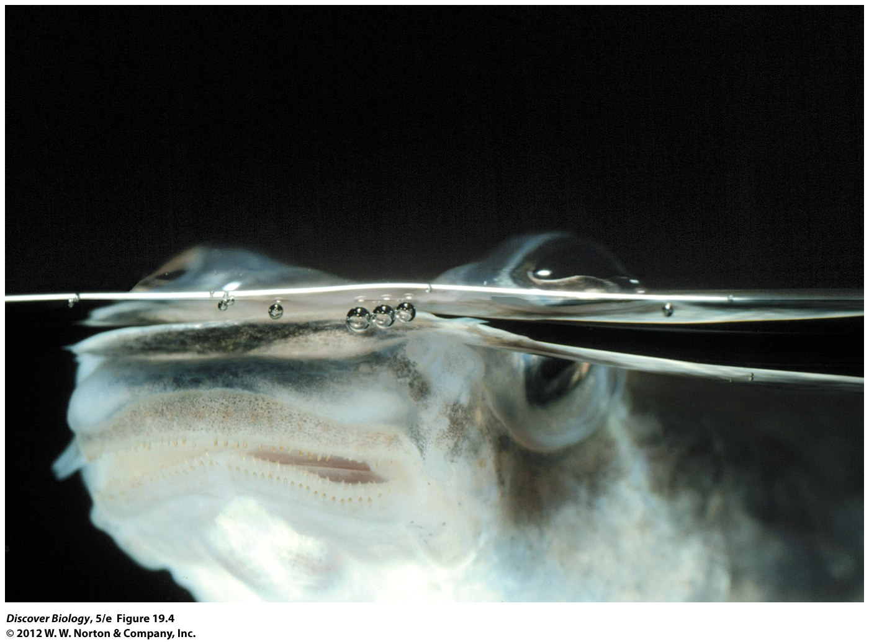
Notes:
Figure 19.4 A Fish with Four Eyes?
The four-eyed fish (Anableps anableps) really has only two eyes, but each eye has a special design that lets it see clearly both in air and in water.

Slide 12
Populations Can Adjust Rapidly to Environmental Change
Organisms have the ability to evolve rapidly in response to changing environmental conditions
Changes such as an increase in predators or a drought can influence adaptive evolution or natural selection

Slide 13
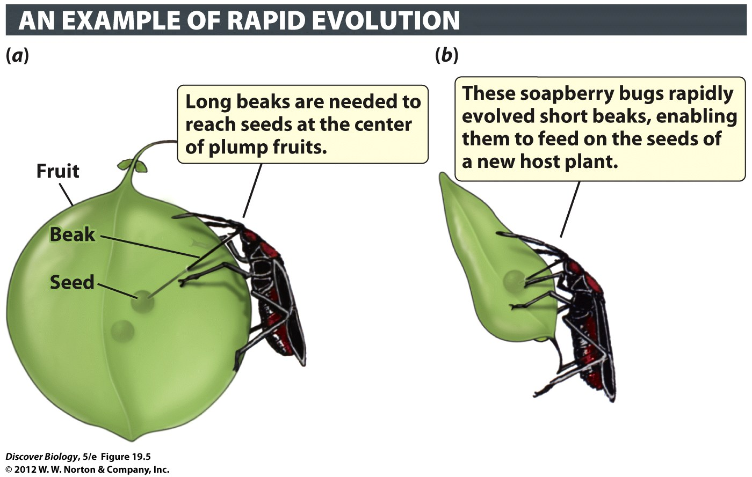
Notes:
Figure 19.5 Soapberry Bugs Have Rapidly Adapted to Changes in the Fruits They Eat
(a) In Florida, soapberry bugs traditionally fed on seeds of a native plant species, the balloon vine. The bugs had to pierce to the center of the balloon vine’s fruit to reach the seeds at the center. (b) Over the past 30–50 years, some populations of soapberry bugs have evolved short beaks, enabling them to feed on seeds within the narrower fruit of an introduced species, the golden rain tree.

Slide 14
Adaptation Does Not
Craft Perfect Organisms
Genetic constraints, developmental constraints, or ecological trade-offs can prevent organisms from adequately adapting to their changing environment
Extinction is the result of a species’s inability to adapt to adverse changes in the environment

Slide 15
Lack of Genetic Variation
Can Limit Adaptation
There must be genetic variation for traits that can enhance the match between the organism and its environment
Without genetic variation, there is a limit on the ability of natural selection to generate adaptation in descendant populations

Slide 16
The Varied Effects of Developmental Genes Can Limit Adaptation
The multiple effects of developmental genes can limit the ability of the organism to evolve in certain directions
The expression of a gene that has a negative effect at a certain stage of the organism’s life is likely to be repressed

Slide 17
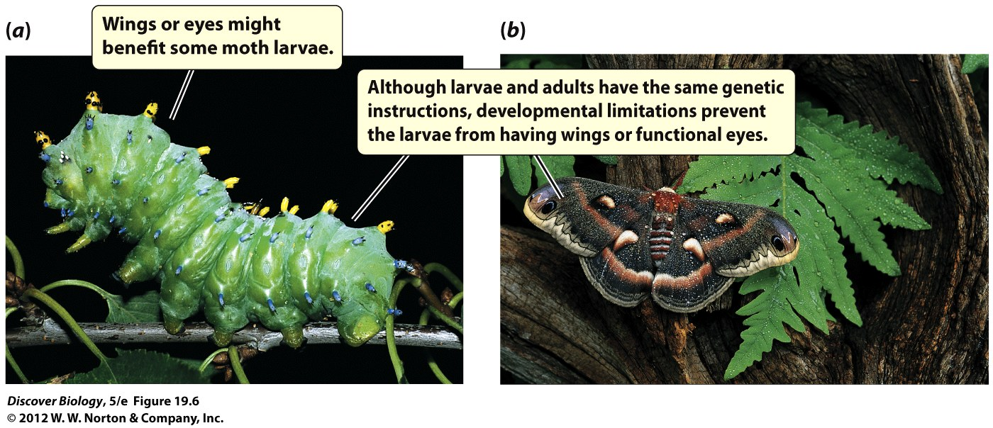
Notes:
Figure 19.6 A Developmental Limitation
The larval form (a) of this moth does not have wings or functional eyes, two important adaptations that are found in the adult form (b).

Slide 18
Ecological Trade-offs Can
Limit Adaptation
To survive and reproduce, organisms must survive the challenges posed by the physical environment
Conflicting environmental demands that organisms face may compromise their ability to perform important functions
Trade-offs exist between reproduction and other important functions

Slide 19
What Are Species?
There are several ways to define a species
Biologists have proposed various species concepts to help us understand what defines a species

Slide 20
Species Are Often
Morphologically Distinct
The morphological species concept is based on the notion that most species can be identified as a separate and distinct group of organisms by the unique set of morphological characteristics
The morphological species concept is limited because distinct and separate species can have the same morphological characteristics

Slide 21
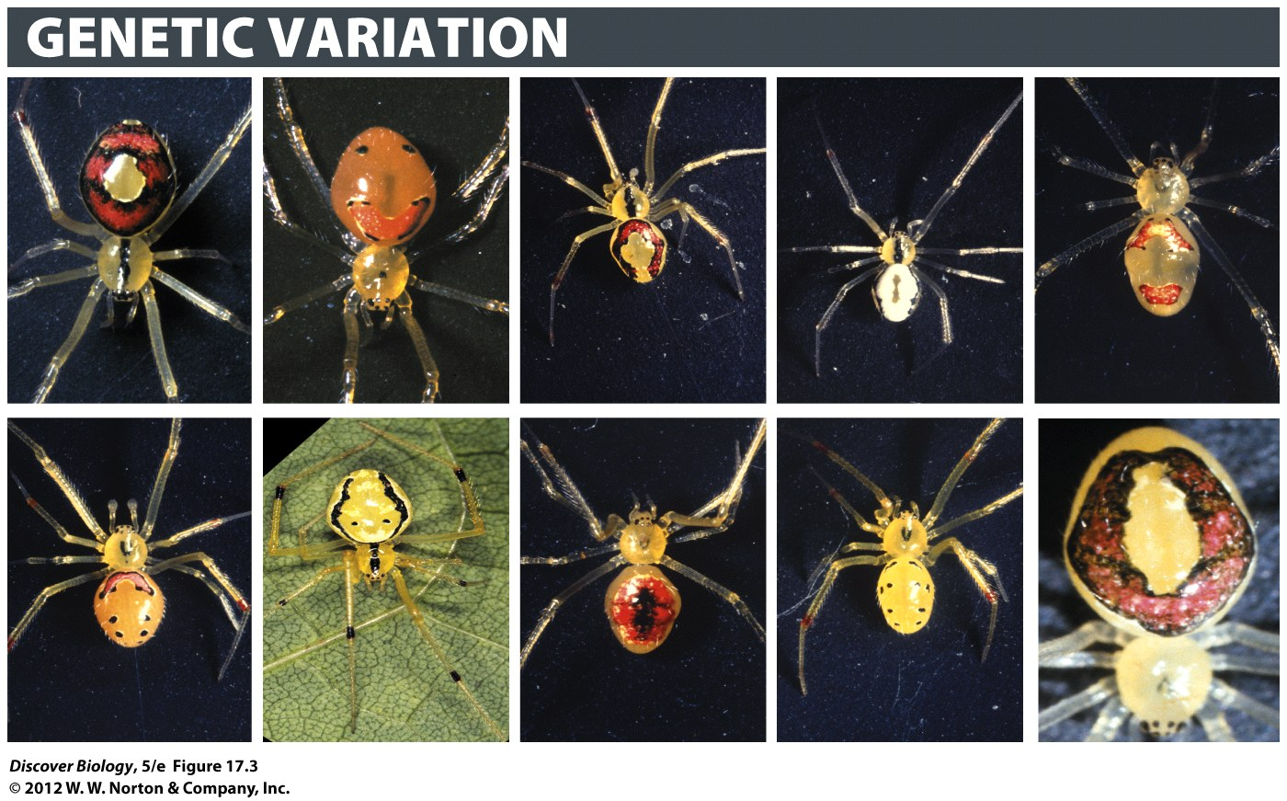
Notes:
Figure 17.3 Genetic Variation in Happy-Face Spiders
Markings on the backs of happy-face spiders, which inhabit four of the Hawaiian Islands.

Slide 22
Species Are Reproductively
Isolated from One Another
Members of different species cannot reproduce with each other under natural conditions and are said to be reproductively isolated
Barriers to reproduction are often divided into two categories:
  Prezygotic barriers prevent a male gamete and female gamete from fusing to form a zygote
  Postzygotic barriers prevent zygotes from developing into healthy and fertile offspring

Slide 23
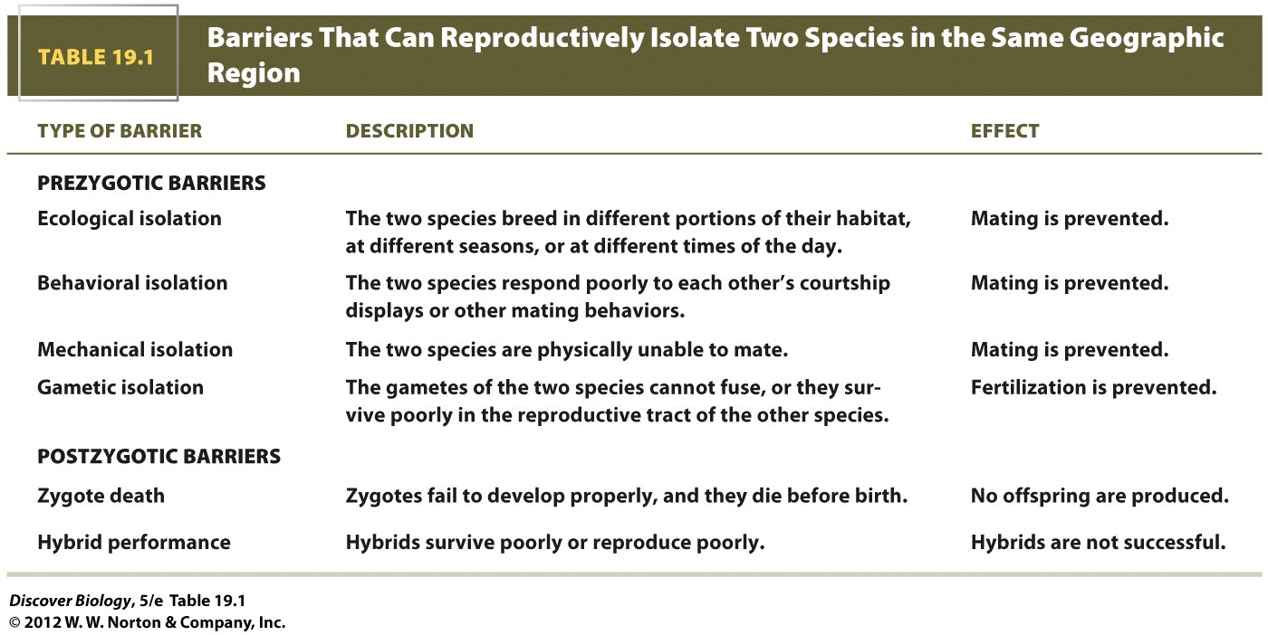

Slide 24
Species Are Reproductively
Isolated from One Another
A wide variety of cellular, anatomical, physiological, or behavioral mechanisms generate barriers to reproduction
The biological species concept defines a species as a group of natural populations that can interbreed to produce fertile offspring but that are reproductively isolated from other such groups
Distinct species that are able to interbreed in nature are said to hybridize, and their offspring are called hybrids

Slide 25
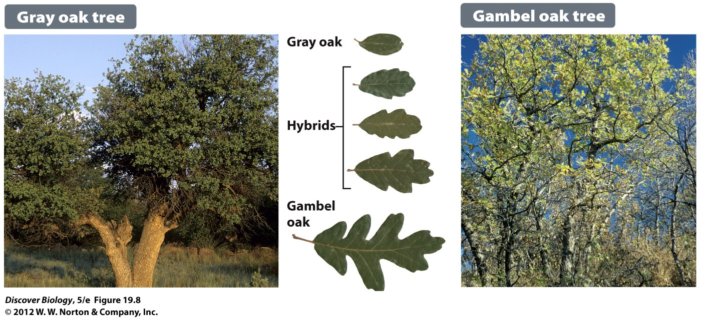
Notes:
Figure 19.8 Some Species Interbreed yet Remain Distinct
The gray oak and the Gambel oak can mate to produce fertile hybrids in regions where they co-occur. However, the gene flow in nature is limited enough that overall the two species remain phenotypically distinct.

Slide 26
Speciation: Generating
Biodiversity
Speciation is the process in which one species splits to form two or more species that are reproductively isolated from one another
Speciation has led to the tremendous diversity of life on Earth
The crucial event in the formation of new species is the evolution of reproductive isolation

Slide 27
Speciation Can Be Explained by the Same Mechanisms That Cause the Evolution of Populations
Populations evolve genetic differences from one another because of mutation, genetic drift, or natural selection, and these genetic differences sometimes result in reproductive isolation
Reproductive isolation can evolve as a by-product of other evolutionary changes
Gene flow limits the genetic divergence of populations; therefore, the factors that promote speciation must have a greater effect than the amount of ongoing gene flow

Slide 28
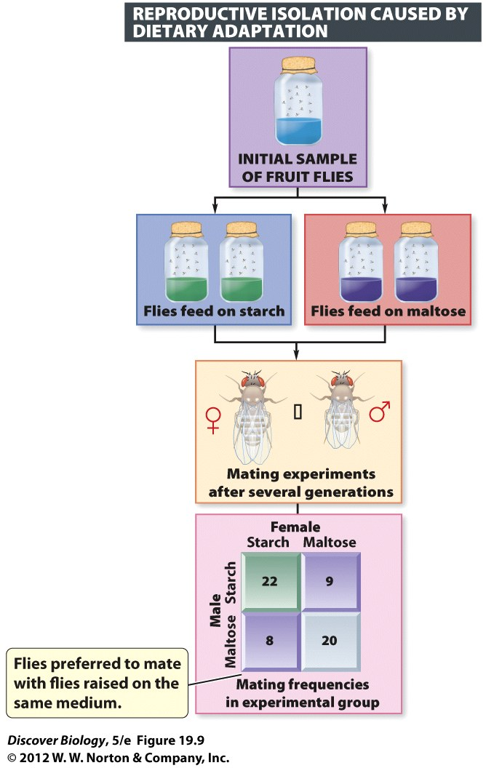
Notes:
Figure 19.9 When What You Eat Affects Who You Love
Fruit flies in an initial sample were separated into four populations and raised on two different kinds of food (starch or maltose) for several generations. In the experimental group, flies from the populations that had become adapted to feed on starch were then given the opportunity to mate with other flies that had adapted to feed on starch or with flies adapted to feed on maltose. As the mating frequencies show, scientists found that flies adapted to feed on starch preferred mating with other flies adapted to starch. Flies adapted to maltose likewise preferred other flies adapted to maltose. These preferences are the early stages of reproductive isolation that can eventually lead to speciation.

Slide 29
Speciation Can Result from
Geographic Isolation
Geographic isolation can occur when populations of a single species become separated, or geographically isolated, from one another
The distance required for geographic isolation to occur varies from species to species depending on how easily the species can travel across any given barrier
The formation of new species from geographically isolated populations is called allopatric speciation

Slide 30
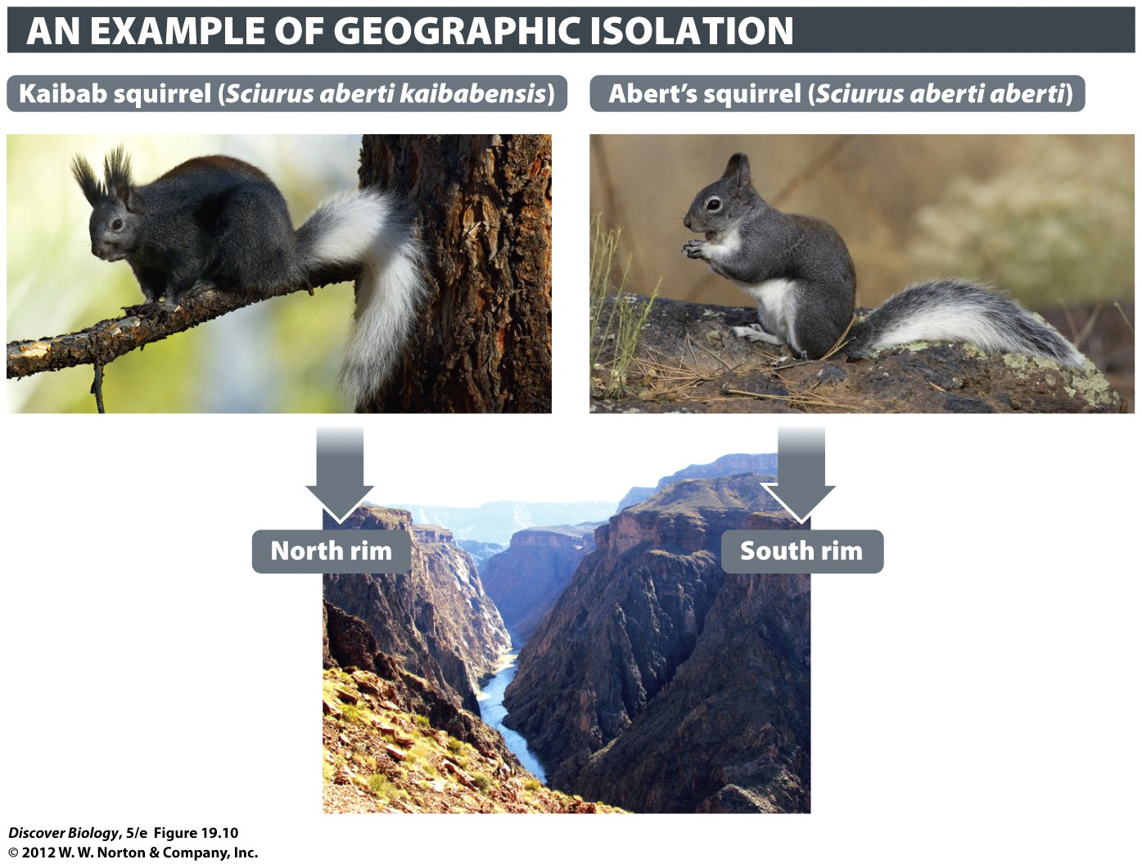
Notes:
Figure 19.10 The Grand Canyon Is a Geographic Barrier for Squirrels
The Kaibab squirrel is confined to the ponderosa pine forests on the north rim of the Grand Canyon. Abert’s squirrel lives on the south rim and also farther south on the Colorado Plateau and in the southern Rocky Mountains to Mexico. The Kaibab population became isolated from the Abert’s squirrels when the Colorado River cut a canyon—as deep as 6,000 feet in some places. With gene flow between them blocked, probably beginning about 5 million years ago, the Kaibab population diverged from the ancestral Abert’s squirrel. The two squirrels used to be considered separate species, but now most experts classify them as subspecies of the Abert’s squirrel, Sciurus aberti.

Slide 31
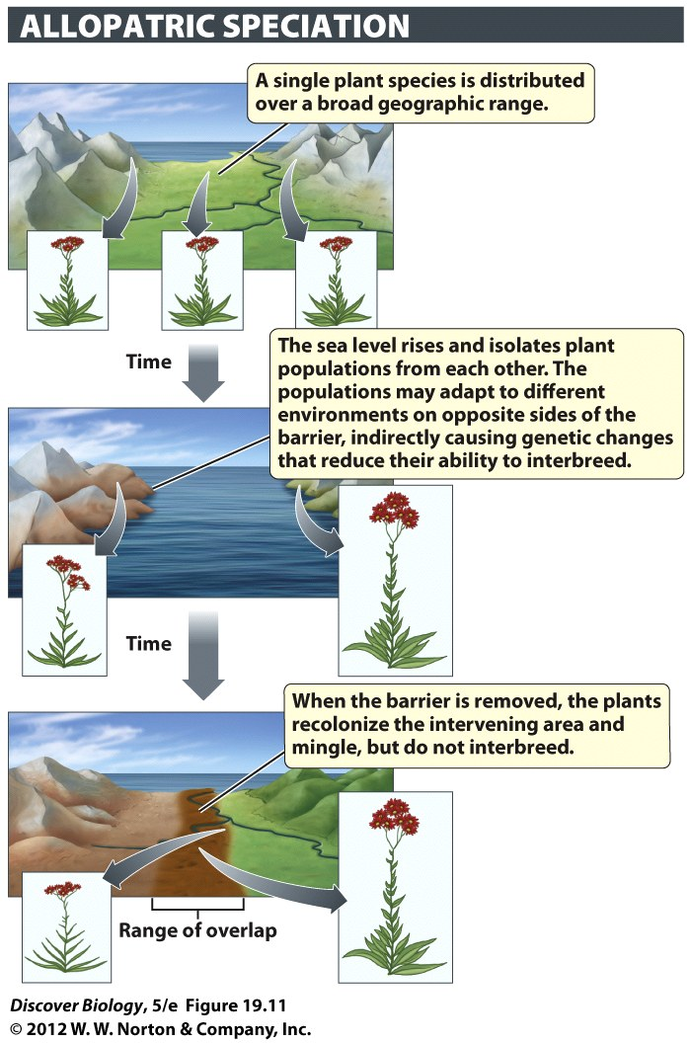
Notes:
Figure 19.11 Physical Barriers Can Produce Speciation by Blocking Gene Flow
New species can form when populations are separated by a geographic barrier, such as a rising sea.

Slide 32
Speciation Can Result from
Geographic Isolation
Ring species can develop when populations loop around a geographic barrier in which populations at the two ends of the loop are in contact with one another, yet individuals from these populations cannot interbreed
Ring species are a result of geographic isolation

Slide 33
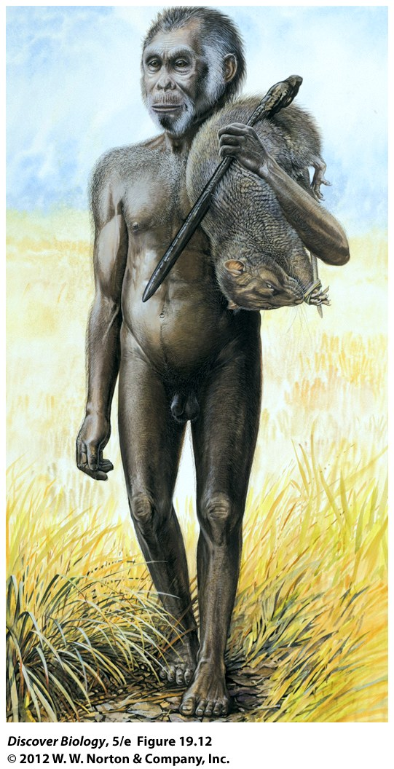
Notes:
Figure 19.12 Island Isolation May Have Driven the Evolution of Homo floresiensis
The foot structure and other anatomical features suggest that H. floresiensis was a distinctly different species, not a scaled-down version of H. erectus or H. sapiens.

Slide 34
Speciation Can Occur without
Geographic Isolation
The formation of new species in the absence of geographic isolation is called sympatric speciation
New plant species can form in a single generation as a result of polyploidy, a condition in which an individual has more than two sets of chromosomes
Sympatric speciation has also been observed in a few animal species

Slide 35
Rates of Speciation
Rapid chromosomal changes, such as in polyploidy, can form a new species in a single generation; however, DNA evidence suggests that in most plants and animals, speciation occurs more slowly
Some populations can be geographically isolated for a long time without evolving reproductive isolation

Slide 36
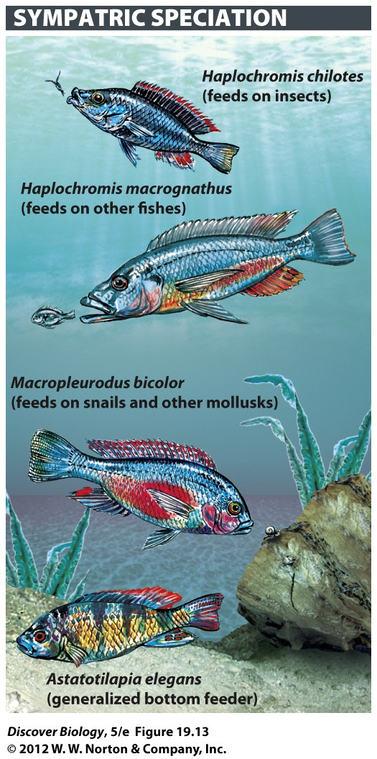
Notes:
Figure 19.13 Food Preferences and Female Mate Preferences May Have Driven Speciation Among Lake Victoria Cichlids
The four species shown here illustrate some of the differences in feeding behavior and morphology among Lake Victoria cichlids.

Slide 37
Lake Victoria: Center of Speciation
Cichlids in Lake Victoria have diversified into hundreds of new species over the past 400,000 years, in a classic example of adaptive radiation
Researcher speculated that a combination of the cichlid’s specialized color vision and the range of light color in the water helps to reproductively isolate each cichlid species
Recently, the pollution in Lake Victoria has led to an increase in cross-breeding and hybridization, possibly the first step in adaptive radiation

Slide 38
Notes:
Electric-Yellow Cichlids.
This particular cichlid species is native to Lake Malawi in East Africa. Africa alone is believed to have at least 1,600 species of cichlids. Hundreds more have evolved in other parts of the world, from Madagascar, India, and Syria to Central America, Mexico, and the southern United States.

Slide 39
Clicker Questions
CHAPTER 19
Speciation and the Origins
Of Biological Diversity

Slide 40
Concept Quiz
Which of the following is not a true
example of an adaptation?
Bats wanting to fly and developing wings
Spots on a leopard for camouflage
Long tongues in frogs for catching flies
Notes:
Answer A is not true. Organisms cannot willingly change their bodies to the current or future environment.
Adaptations are the result of natural selection; they are not random.

Slide 41
Concept Quiz
One species of frog in a pond splits into two
species because males develop two different
mating calls. This is an example of:
Ecological isolation
Polyploidy
Behavioral isolation
Notes:
Answer C is correct.
The frogs live in the same pond but demonstrate different behaviors by their mating calls. Because they live in the same pond, ecological isolation is incorrect.

Slide 42
Concept Quiz
Which of the following is not a reproductive
isolation mechanism?
Hybrid fertility
Zygote death
Gametic isolation
Notes:
The correct answer is A.
Hybrids being fertile does not keep species separated; it allows them to mix.

Slide 43
Relevant Art from Other Chapters
All art files from the book are available in JPEG and PPT formats online and on the Instructor Resource Disc

Slide 44
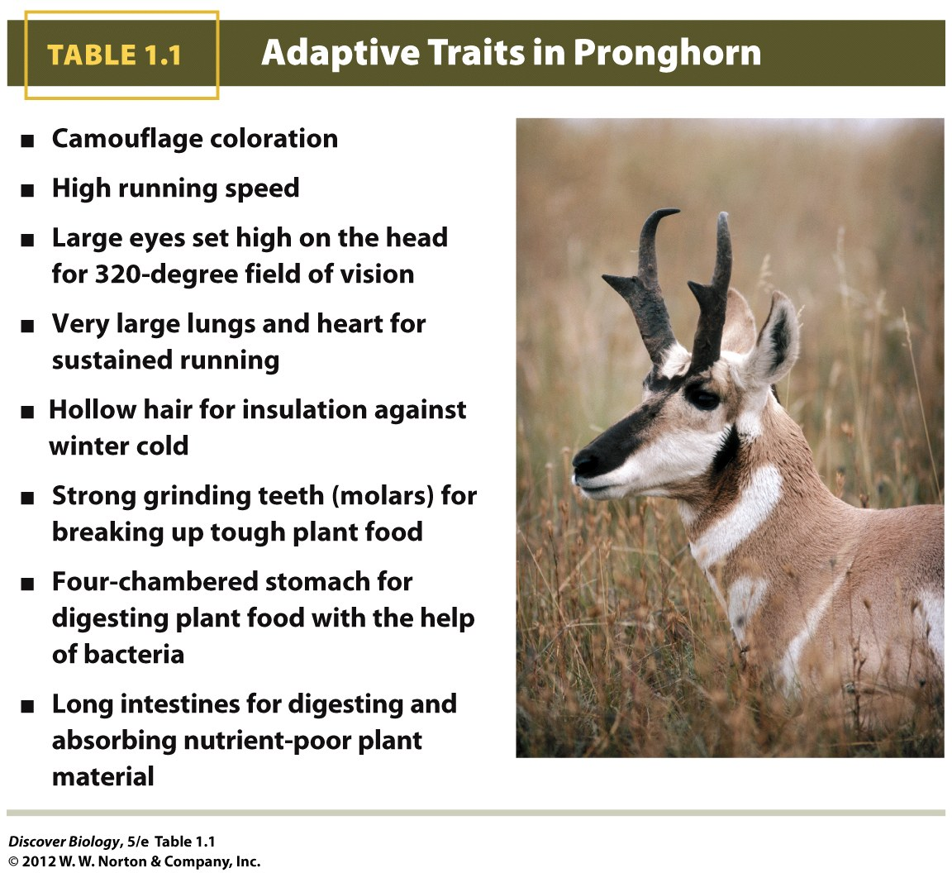
Notes:
Table 1.1 Adaptive Traits in Pronghorn

