Slide 1
Discover Biology
FIFTH EDITION
Anu Singh-Cundy • Michael L. Cain
CHAPTER 18
Evolution of Populations
© 2012 W. W. Norton & Company, Inc.

Slide 2
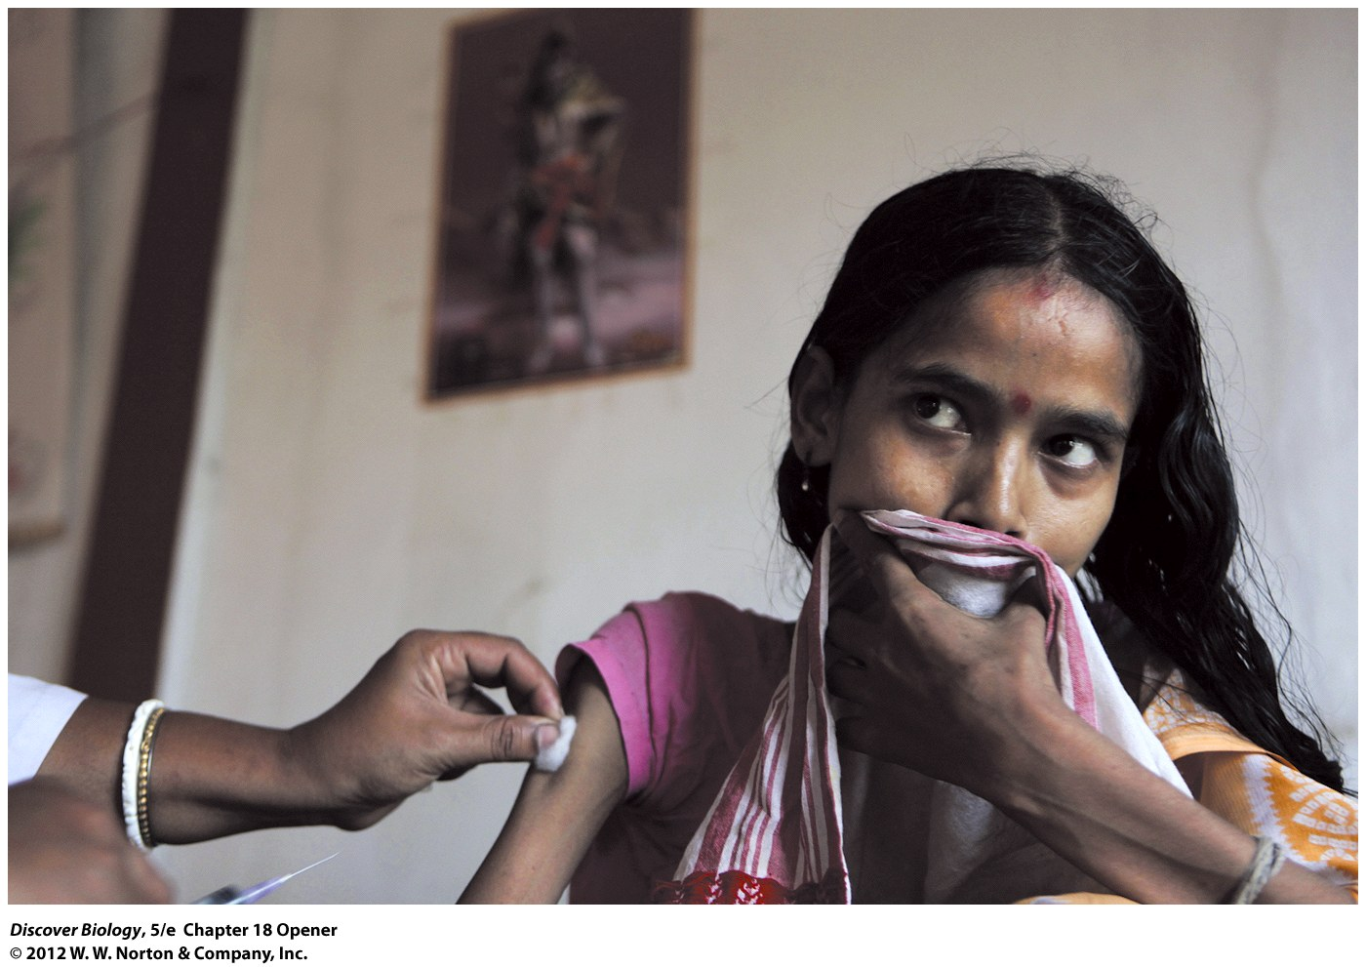
Notes:
A Woman with Tuberculosis.
One-third of the world’s population may be infected with tuberculosis (TB), a “mycobacterium.” As the rate of TB infection has increased, so has the number of cases of antibiotic-resistant TB, a result of natural selection.

Slide 3
Evolution of Resistance
The discovery of antibiotics has helped millions of people fight deadly bacterial infections since the 1940s
Bacteria have the ability to adapt to antibiotics in their environment, leading to antibiotic-resistant strains

Slide 4
Is Evolution Too Slow to Be Observed?
The evolution of populations can occur at different rates
A population is the smallest scale at which evolution can occur
Evolution is the change in allele frequencies in a population from generation to generation
A change in allele frequencies in a population over successive generations is called microevolution

Slide 5
Alleles and Genotypes
The percentage of a population that carries a certain allele is called the allele frequency
Genotype frequency refers to the proportion of a population with a particular genotype
When calculating genotypes, the total number should always add up to 1.0

Slide 6
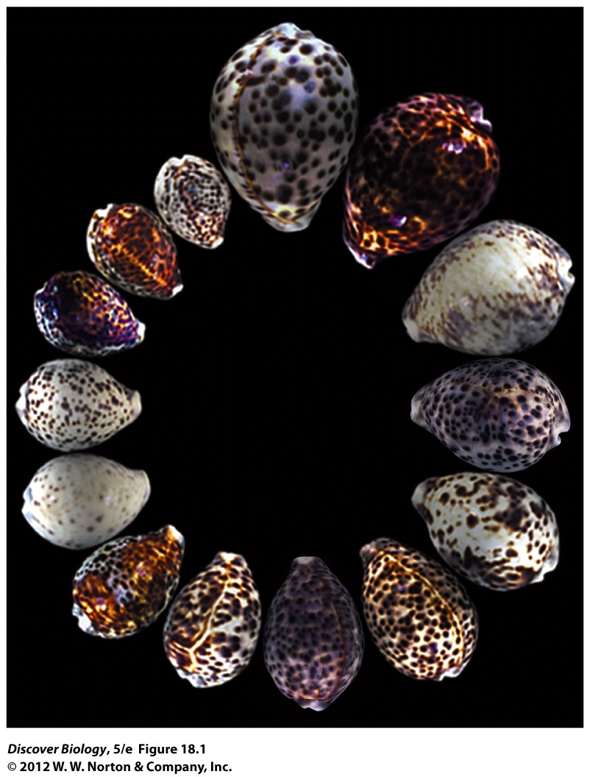
Notes:
Figure 18.1 Morphological Variation in Tiger Cowries, Cypraea tigris
The individuals within a population often vary greatly in many morphological traits, just as these tiger cowries do in their size and color patterns. These snails are widespread throughout the Pacific and Indian oceans, from Hawaii to the eastern shores of Africa.

Slide 7
Four Mechanisms That Cause Populations to Evolve
There are four methods of microevolution:
  Mutation
  Gene flow
  Genetic drift
  Natural selection
The Hardy-Weinberg equation can test whether evolution is taking place in a population

Slide 8
Mutation: The Source of Genetic Variation
Mutations that occur in the gene sequence of germ-line cells provide the raw material for all evolutionary change
Mutations cause a relatively small change in the allele frequency of a population
The effect of a single mutation depends on environmental influences

Slide 9
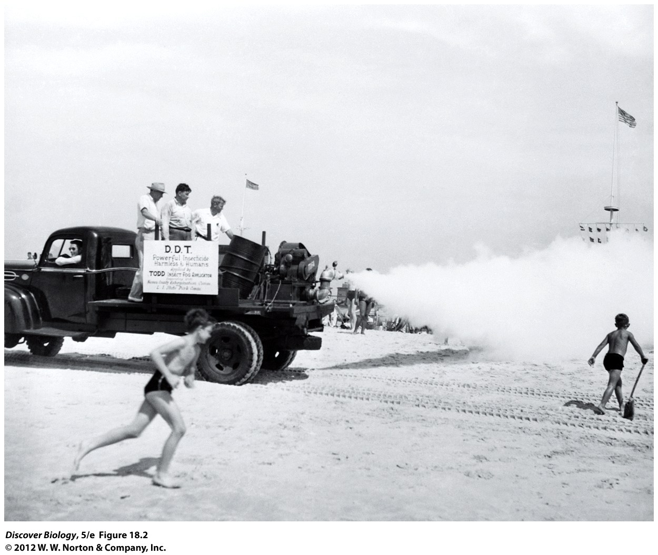
Notes:
Figure 18.2 DDT Was Initially Described as a “Benefactor of All Humanity”
Developed as the first of the modern insecticides early in World War II, DDT was initially used with great effect to combat malaria, typhus, and the other insect-borne human diseases. Often termed the “miracle” pesticide, DDT came into wide agricultural and commercial use. The photo shows DDT fogging machines spraying DDT at Jones Beach in New York in the 1940s. By 1972, however, the Environmental Protection Agency had banned DDT because of the devastating side effects of extensive DDT use, including insect resistance and adverse environmental impacts.

Slide 10
Gene Flow: Exchanging Alleles between Populations
Gene flow occurs when individuals move from one population to another and exchange alleles
Gametes can move from one population to another, causing gene flow
Two-way gene flow tends to make the genetic composition of different populations more similar
Gene flow can counteract the effects of other evolutionary mechanisms

Slide 11
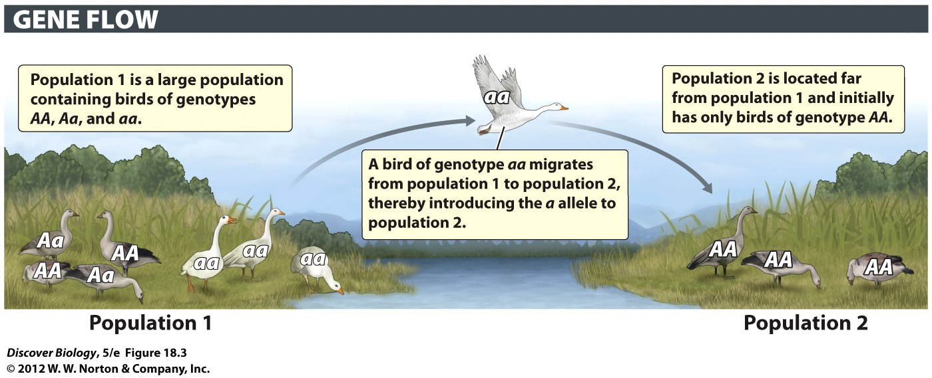
Notes:
Figure 18.3 Migrants Can Move Alleles from One Population to Another

Slide 12
Genetic Drift: The Effects of Chance
A change in allele frequencies because of random differences in survival and reproduction from one generation to the next is called genetic drift
Chance events determine which individuals contribute offspring to the next generation

Slide 13
Genetic Drift Affects Small Populations
Chance events that cause change in allele frequencies are much more noticeable in small populations than in large populations
A source of genetic drift is the random alignment of alleles during gamete formation and chance events associated with the survival and reproduction of individuals
When the frequency of an allele reaches 100 percent in a population, it is fixed

Slide 14
Genetic Drift Affects Small Populations
Genetic drift can affect the evolution of small populations by eventually causing one allele to reach fixation
Genetic drift can lead to fixation of alleles that are neutral, harmful, or beneficial

Slide 15
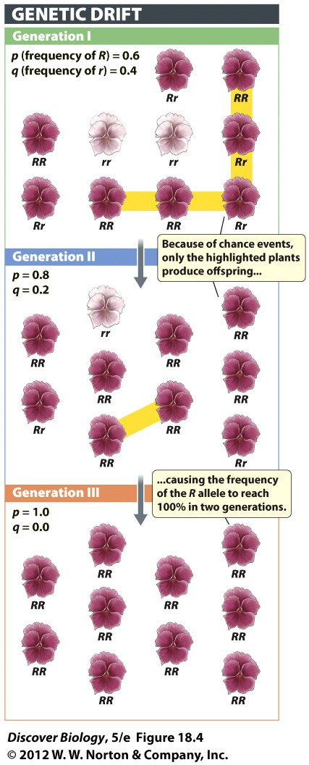
Notes:
Figure 18.4 Genetic Drift Occurs by Chance
In this small population of wildflowers, chance events determine which plants leave offspring, without regard to which individuals are better equipped for survival or reproduction. Here, chance events cause the frequency of the R allele to increase from 60 percent to 100 percent in two generations. Note that this particular outcome is just one of many ways that genetic drift could have caused allele frequencies to change at random over time.

Slide 16
Genetic Bottlenecks Can Threaten the Survival of Populations
Genetic drift can hasten the extinction of endangered species
The loss of genetic variation in a small population is called a genetic bottleneck
The founder effect is a type of genetic bottleneck created when a small group of individuals established a new population far from existing populations

Slide 17
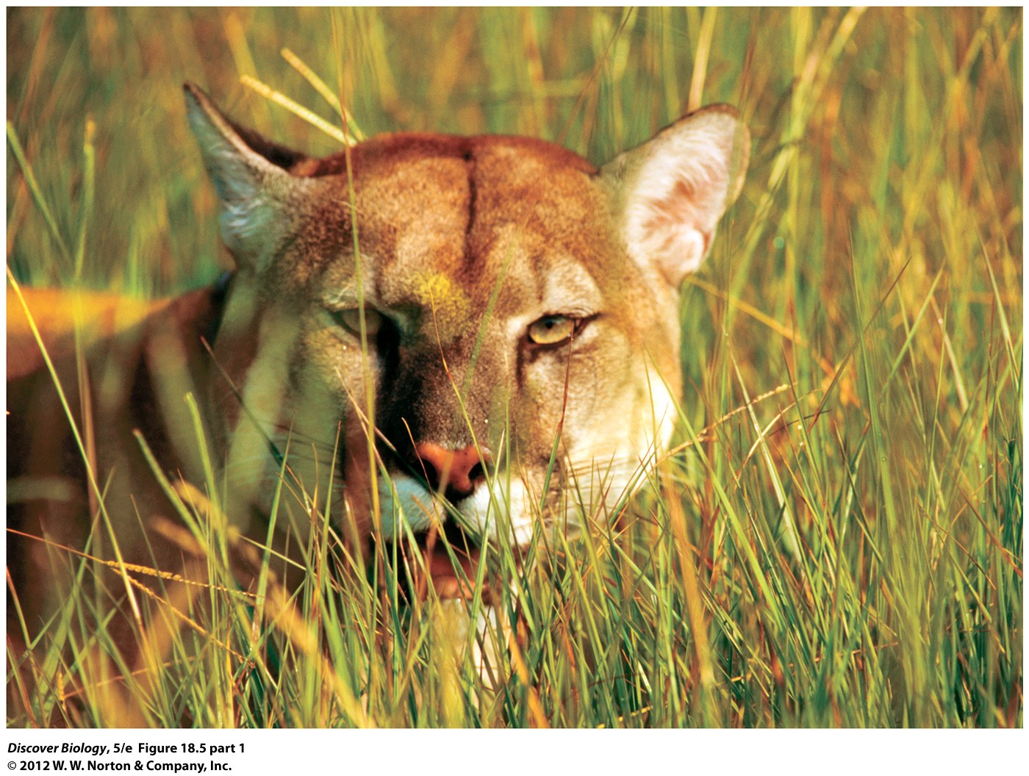
Notes:
Figure 18.5 (Part 1) Abnormally Shaped Sperm in the Rare Florida Panther
Florida panthers have more abnormal sperm than do cats from other cougar populations—a possible effect of the fixation of harmful alleles.

Slide 18
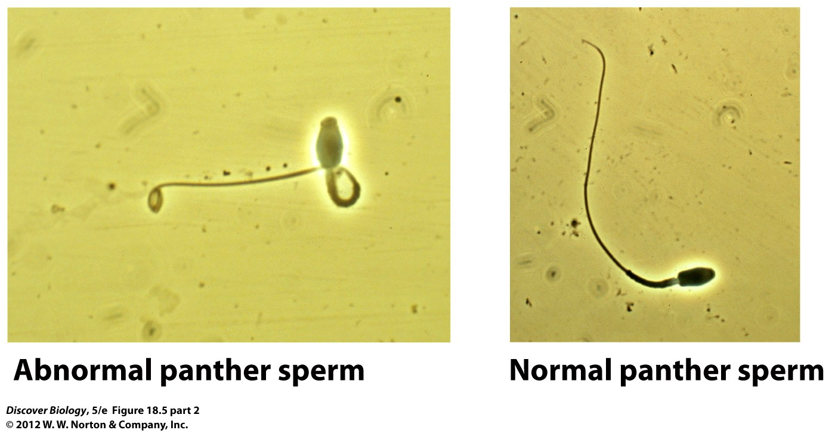
Notes:
Figure 18.5 (Part 2) Abnormally Shaped Sperm in the Rare Florida Panther
Abnormal sperm and normal sperm, for comparison.

Slide 19
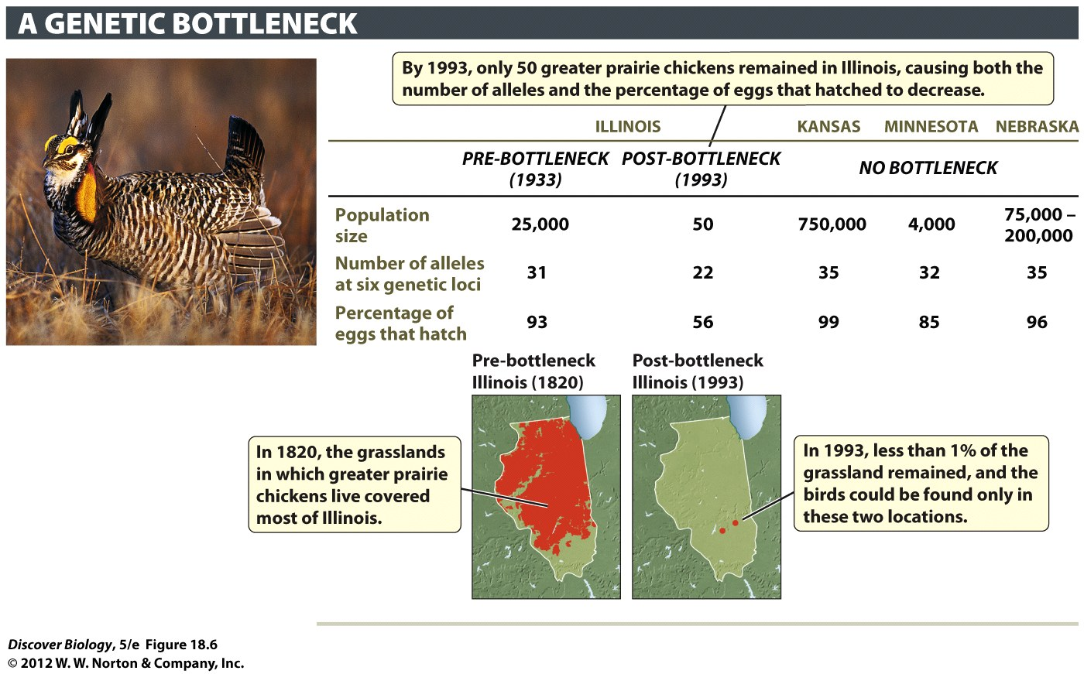
Notes:
Figure 18.6 A Genetic Bottleneck Can Cause a Population to Crash
The Illinois population of greater prairie chickens dropped from 25,000 birds in 1933 to only 50 birds in 1993. This drop in population size caused a loss of genetic variation and a drop in the percentage of eggs that hatched. Here, the modern, post-bottleneck Illinois population is compared with the 1933 pre-bottleneck Illinois population, as well as with populations in Kansas, Minnesota, and Nebraska that never experienced a bottleneck.

Slide 20
Natural Selection: The Effects of Advantageous Alleles
Natural selection occurs when individuals with particular inherited characteristics survive and reproduce at a higher rate than other individuals in a population because those phenotypes are favored over others
Natural selection acts on the phenotype of a population but affects the genotype as well

Slide 21
Even Natural Selection Does Not Always Lead to Evolutionary Change
Natural selection is the only mechanism that consistently improves the reproductive success of the organism in its environment
In order for natural selection to take place, there must be genetic variation and beneficial mutations in the population

Slide 22
There Are Three Types of
Natural Selection
Individuals with certain forms of an inherited phenotypic trait tend to have better survival rates and to produce more offspring than do individuals with other forms of that trait in all three types of natural selection:
  Directional selection
  Stabilizing selection
  Disruptive selection

Slide 23
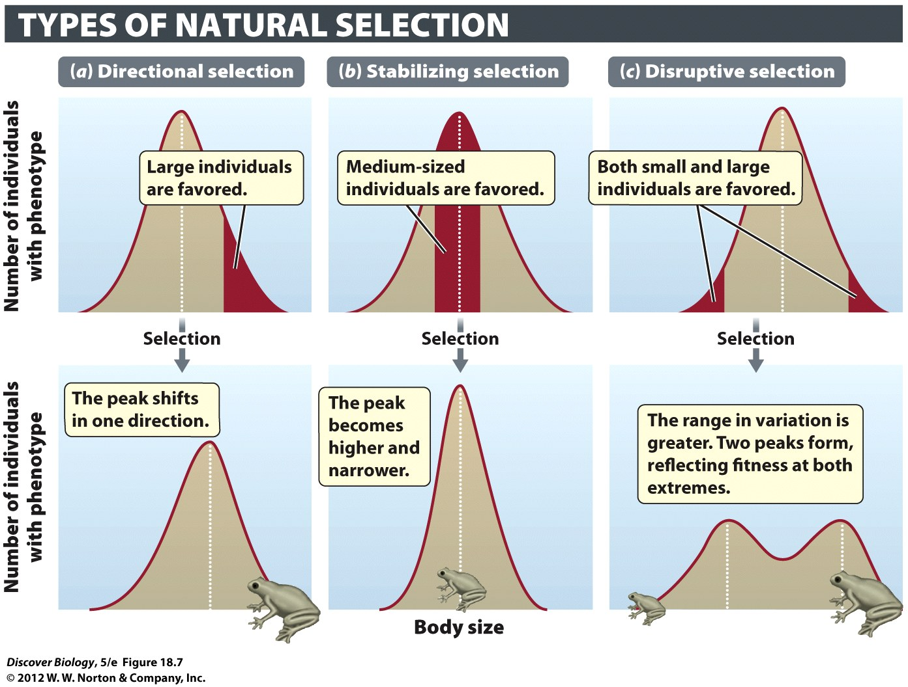
Notes:
Figure 18.7 Directional, Stabilizing, and Disruptive Selection Affect Phenotypic Traits Differently
The graphs in the top row show the relative numbers of individuals with different body sizes in a population before selection. The phenotypes favored by selection are shown in yellow. The graphs in the bottom row show how each type of natural selection affects the distribution of body size in the population.

Slide 24
There Are Three Types of
Natural Selection
When individuals at one extreme of an inherited phenotypic trait have an advantage over other individuals in the population, they exhibit directional selection
When individuals with intermediate values of an inherited phenotypic trait have an advantage over other individuals in the population, they exhibit stabilizing selection

Slide 25
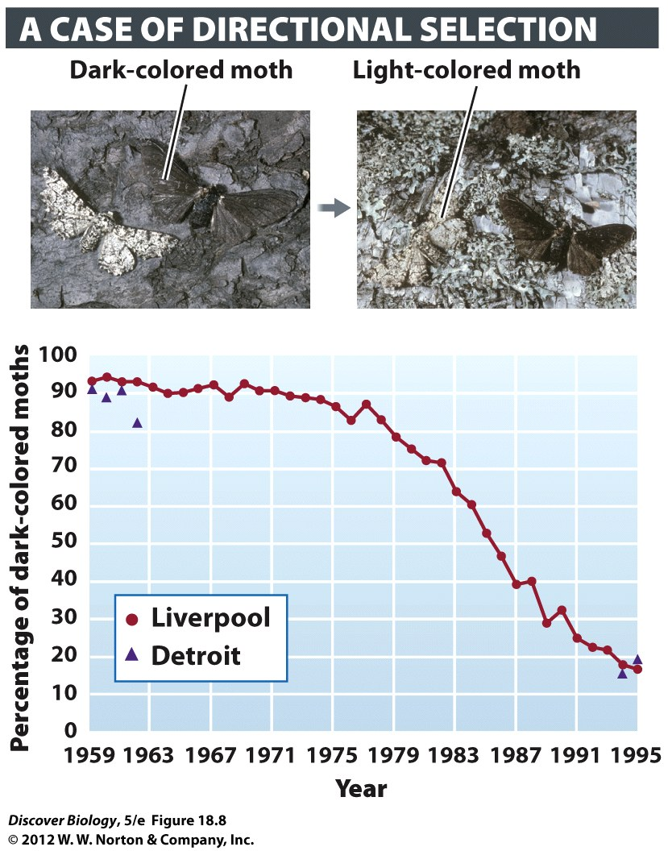
Notes:
Figure 18.8 Directional Selection in the Peppered Moth
The frequency of dark-colored peppered moths declined dramatically from 1959 to 1995 in regions near Liverpool, England, and Detroit, Michigan. Before 1959, dark-colored moths had risen in frequency in both England and the United States after industrial pollution had blackened the bark of trees, causing dark-colored moths to be harder for bird predators to find than light-colored moths. A reduction in air pollution following clean-air legislation enacted in 1956 in England and in 1963 in the United States apparently removed this advantage, leading the dark-colored moths to decline in a similar way in the two regions. (No data were collected in Detroit for the 30-year period 1963–1993.)

Slide 26
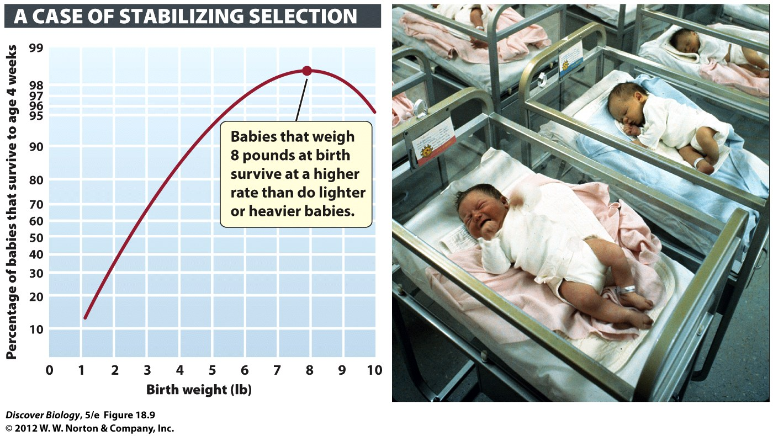
Notes:
Figure 18.9 Stabilizing Selection for Human Birth Weight
This graph is based on data for 13,700 babies born from 1935 to 1946 in a hospital in London. In countries that can afford intensive medical care for newborns, the strength of stabilizing selection has been reduced in recent years: because of recent improvements in the care of premature babies and increases in the number of cesarean deliveries of large babies, a graph of such data collected today would be flatter (less rounded) at its peak than the graph shown here.

Slide 27
There Are Three Types of
Natural Selection
When individuals with either extreme of an inherited phenotypic trait have an advantage over individuals with an intermediate phenotype, they exhibit disruptive selection
Disruptive selection is fairly uncommon

Slide 28
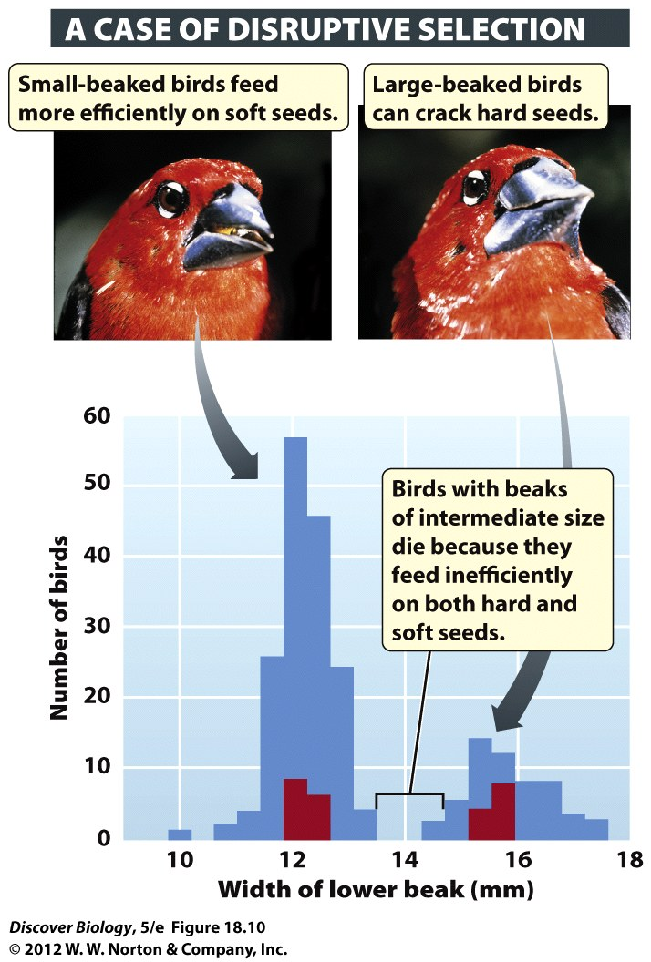
Notes:
Figure 18.10 Disruptive Selection for Beak Size
In African seed crackers, differences in feeding efficiencies may cause differences in survival. Among a group of young birds hatched in one year, only those with a small or large beak size survived the dry season, when seeds were scarce; all the birds with intermediate beak sizes died. Therefore, natural selection favored both large-beaked and small-beaked birds over birds with intermediate beak sizes. Red bars indicate the beak sizes of young birds that survived the dry season; blue bars indicate the beak sizes of young birds that died.

Slide 29
Sexual Selection: Where Sex and Natural Selection Meet
When individuals differ in inherited characteristics that affect their ability to get mates, they exhibit sexual selection
Sexual selection favors individuals that are more fit for mating
Sexual selection can lead to sexual dimorphism, which means that males and females are distinctly different in appearance

Slide 30
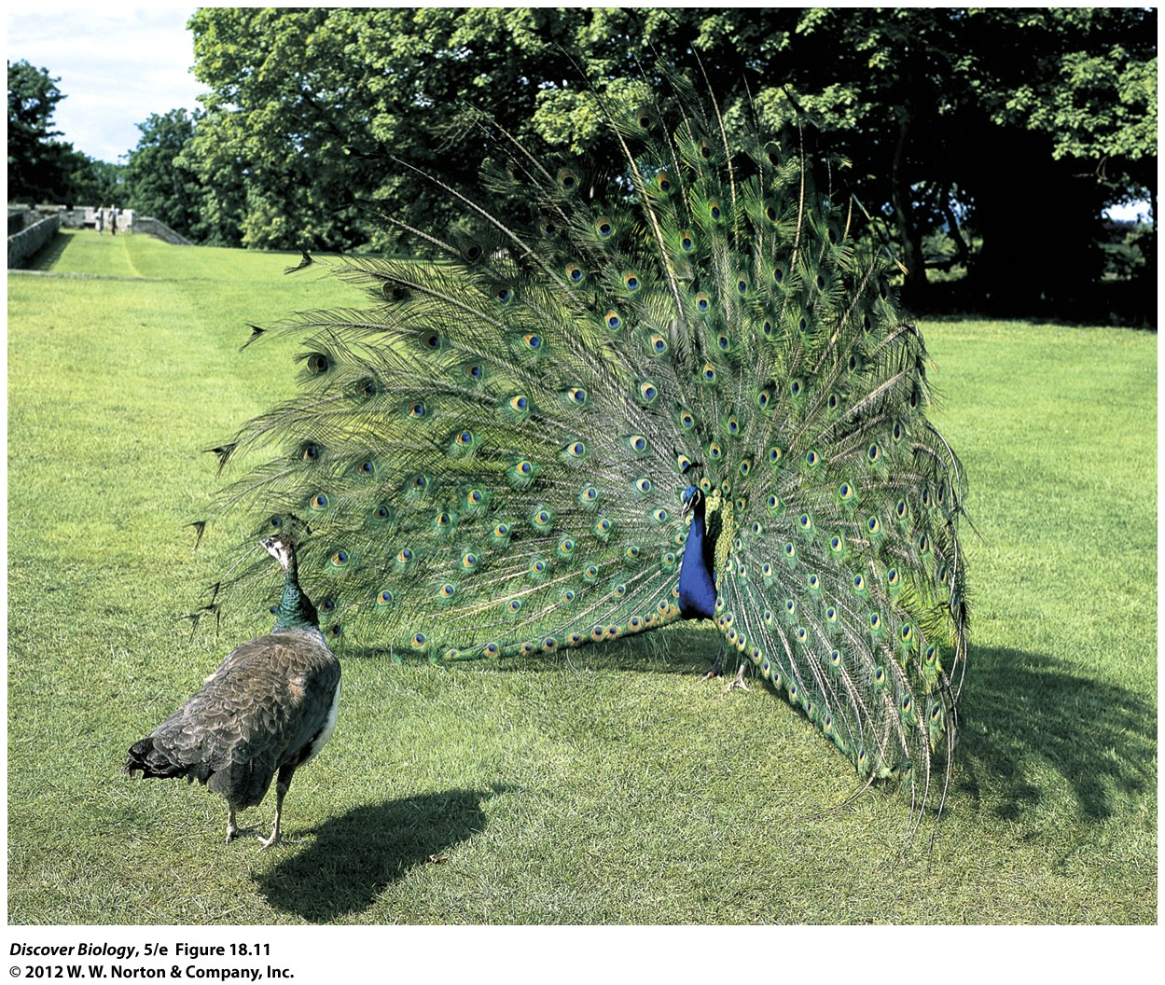
Notes:
Figure 18.11 Elaborate Male Courtship Displays Influence Mate Choice
Male peacocks with larger eyespots on their tails are thought to produce offspring with better survival rates.

Slide 31
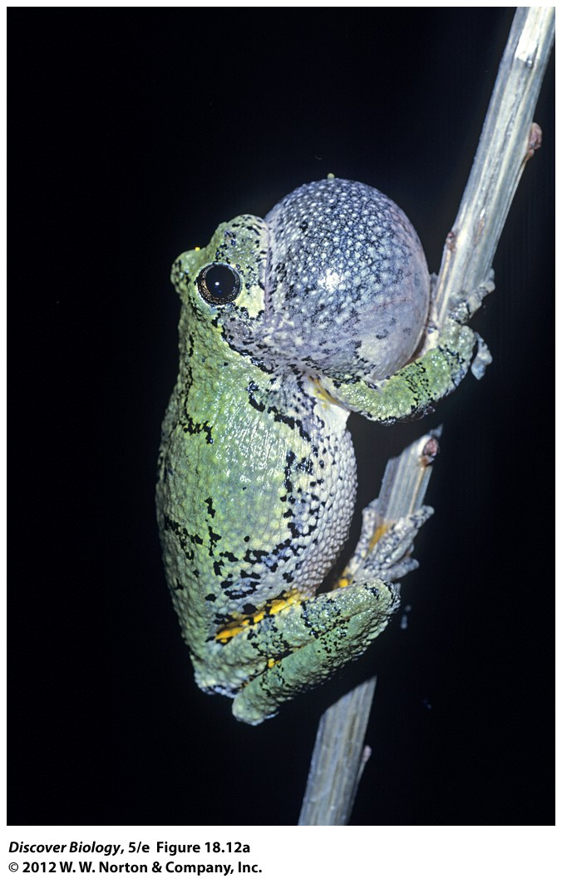
Notes:
Figure 18.12a Competing for a Mate Can Be Hazardous
(a) The call that this male gray tree frog issues to attack a mate can be emulated by predators to attract their prey.

Slide 32
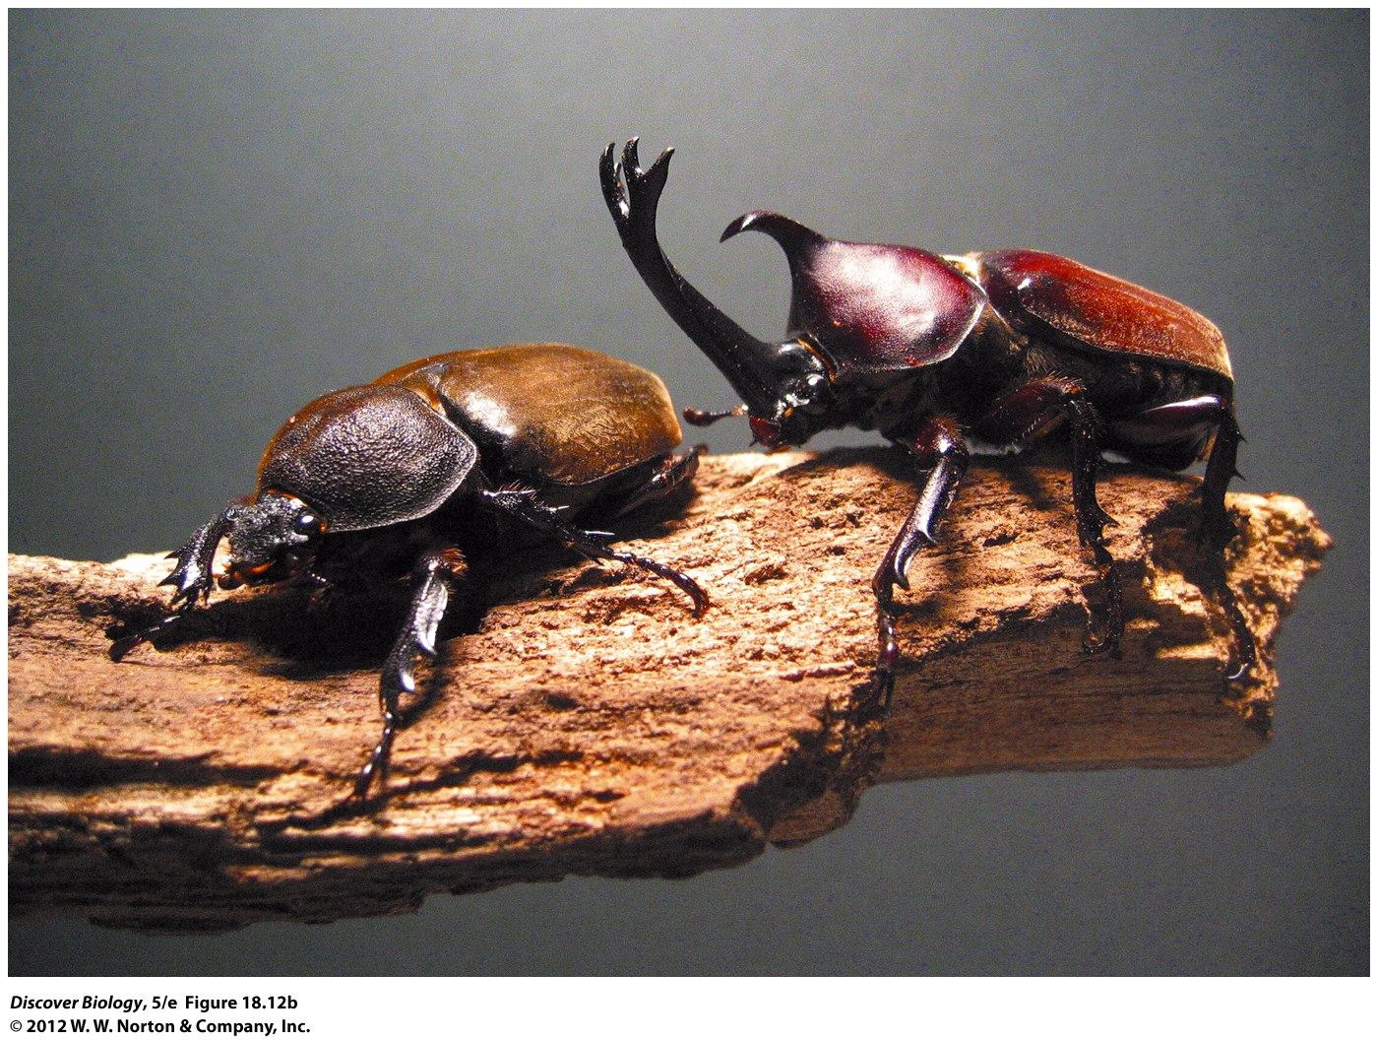
Notes:
Figure 18.12b Competing for a Mate Can Be Hazardous
(b) Only the male staghorn beetle sports the large horn, which it uses to joust with other males. In most cases, the beetle with the longer horn wins more jousts, fertilizes more females, and therefore leaves more descendants. However, jousting carries the risk of serious injury or death.

Slide 33
Flesh-Eating Bacteria and
Antibiotic Resistance
Methicillin-resistant Staphylococcus aureus (MRSA) is a strain of staphylococcus that carries genes that make it resistant to most antibiotics
MRSA kills 20 percent of those who are infected
MRSA is common in medical settings where antibiotics are used frequently; they select for antibiotic resistance

Slide 34
Flesh-Eating Bacteria and
Antibiotic Resistance
Antibiotic-resistant genes can come from common mutations
Antibiotic-resistant genes can be transferred from other strains of bacteria, called plasmids, in a process called lateral gene transfer

Slide 35
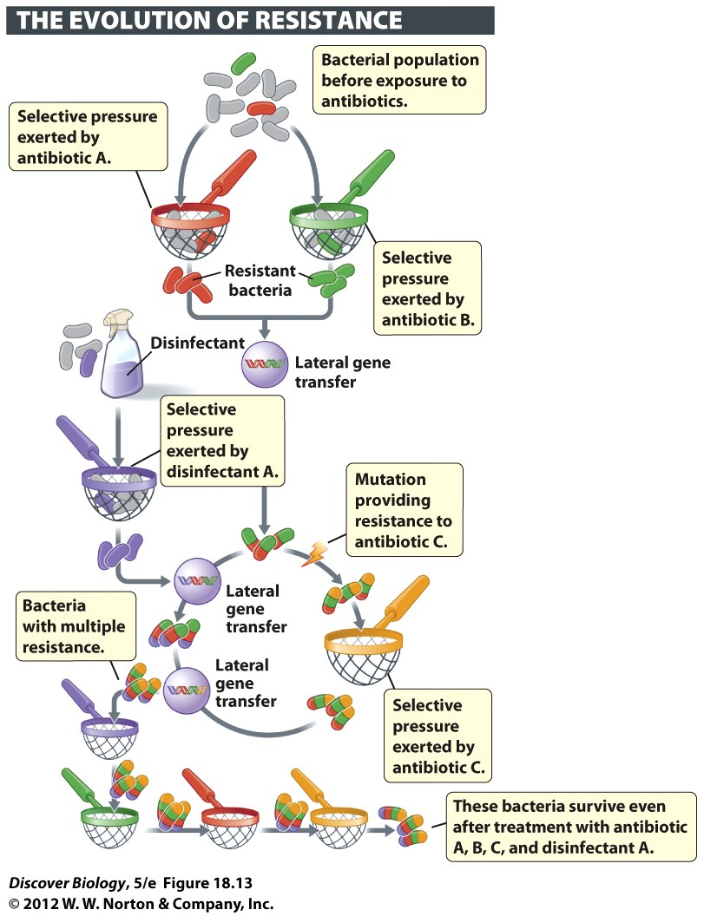
Notes:
Figure 18.13 Natural Selection Results in Resistance to Antibiotics
Before antibiotic use was common, most bacteria could be killed by antibiotics. Early use of antibiotics selected those few individuals that were resistant. Over time, new mutations and repeated episodes of selection—by the use of either antibiotics (represented here by sieves) or disinfectants—caused the frequency of resistant individuals to increase. In addition, transfer of genes within and among bacterial species allowed some bacteria to develop resistance to multiple antibiotics.

Slide 36
Clicker Questions
CHAPTER 18
Evolution of Populations

Slide 37
Concept Quiz
The average litter size for a squirrel is three.
Above and below three is not favored. What
type of selection is occurring?
Disruptive selection
Stabilizing selection
Directional selection
Notes:
Answer B is correct.
If a squirrel has more than 3 pups in a littler, she has too many mouths to feed and their survival is in jeopardy.
Having less than three pups in a litter may be an advantage to the single pup, but the mother will not be passing on as many of her genes compared to other mothers in the population.

Slide 38
Concept Quiz
A population of slugs has 230 individuals that are
AA, 570 that are Aa, and 200 that are aa. What is
the frequency of the A allele?
0.50 or 50%
0.65 or 65%
0.52 or 52%
Notes:
Answer C is correct.
There are 1,000 total individuals in the population.
Each individual has 2 alleles; there are 2,000 alleles in the population.
2 x 230 (AA) + 570 (Aa) + 0 (aa) = 1,030/2,000 = .52

Slide 39
Concept Quiz
A few birds manage to start their own
population on a new island. What best
describes this situation?
Genetic drift
Gene flow
Natural selection
Notes:
Answer A is correct.
When a few individuals start their own population, this is known as the founder effect.
The founder effect is a type of genetic drift.
The birds that made it to the island are not necessarily better flyers; this is a random event. Therefore, natural selection is incorrect.
Gene flow occurs when there is exchange of genes between two populations.

