Slide 1
Discover Biology
FIFTH EDITION
Anu Singh-Cundy • Michael L. Cain
CHAPTER 17
How Evolution Works
© 2012 W. W. Norton & Company, Inc.

Slide 2
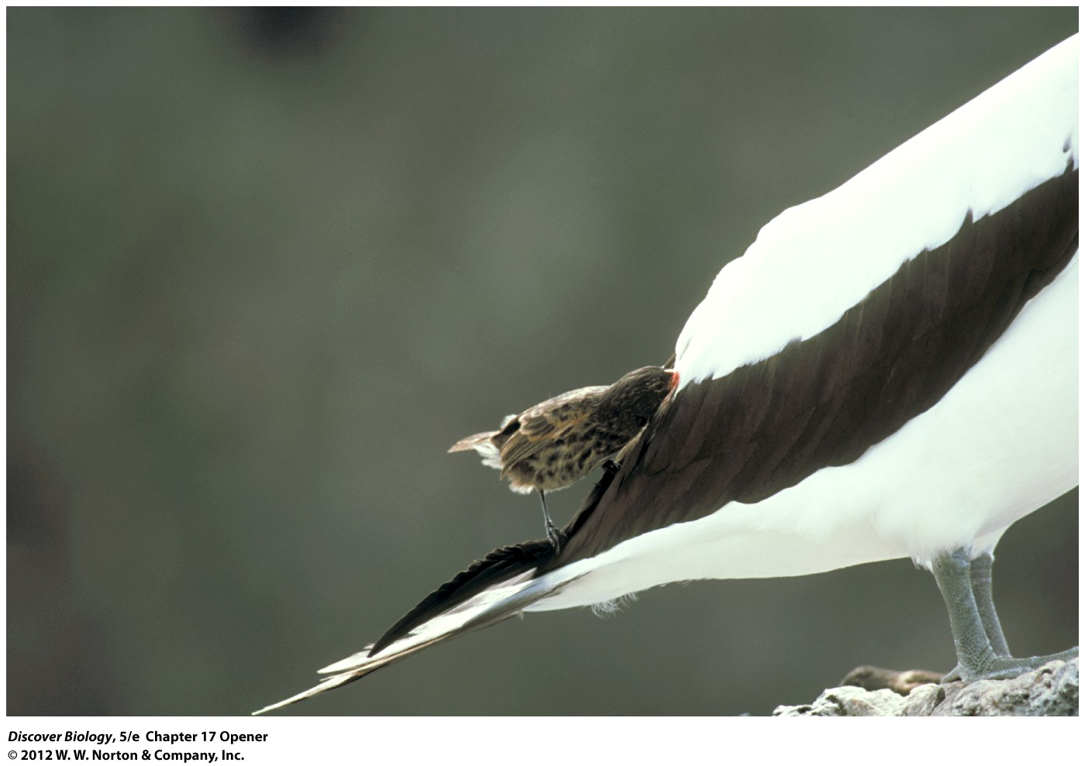
Notes:
Vampire finch.
This subspecies of the sharp-billed ground finch lives on two of the Galápagos Islands. In addition to eating insects, the birds drink nectar from flowers, the contents of eggs, and sometimes, the blood of other birds. Scientists speculate that the strange diet may be driven by the scarcity of fresh water on the islands inhabited by this subspecies.

Slide 3
Finches Feasting on Blood
Vampire finches found on the Galapagos Islands have been observed feasting on the blood of large seabirds
Charles Darwin, a naturalist aboard the HMS Beagle, was the first to observe that many of the species on the Galapagos Islands were found nowhere else, thus sparking his study of what we now know as evolution

Slide 4
Earth Teems with Living Things
The many organisms that inhibit our planet are perfectly fitted to their environment as a result of evolution
Evolution leads to diversity among organisms

Slide 5
Descent with Modification
The Aristotelian view of nature dominated for hundreds of years and was backed by Judeo-Christian views about the origins of life
James Ussher, a seventeenth-century archbishop, claimed to know the exact date that all life was created: October 23, 4004 BC

Slide 6
With the Industrial Revolution Came Doubts about the Constancy of the World
During the industrial revolution in the second half of the eighteenth century, people began questioning previously held beliefs about life on Earth
Scottish geologist Charles Lyell published the Principles of Geology, a text that greatly influenced both Charles Darwin and Alfred Wallace

Slide 7
Darwin Offers a Unifying Explanation: Descent with Modification
After his 5 years aboard the HMS Beagle, Darwin made a bold proposal: that species descended with modification from ancestor species
Charles Darwin and Alfred Wallace both proposed a mechanism of evolution called natural selection
Natural selection can be defined as a nonrandom evolutionary process that adapts a population to its environment

Slide 8
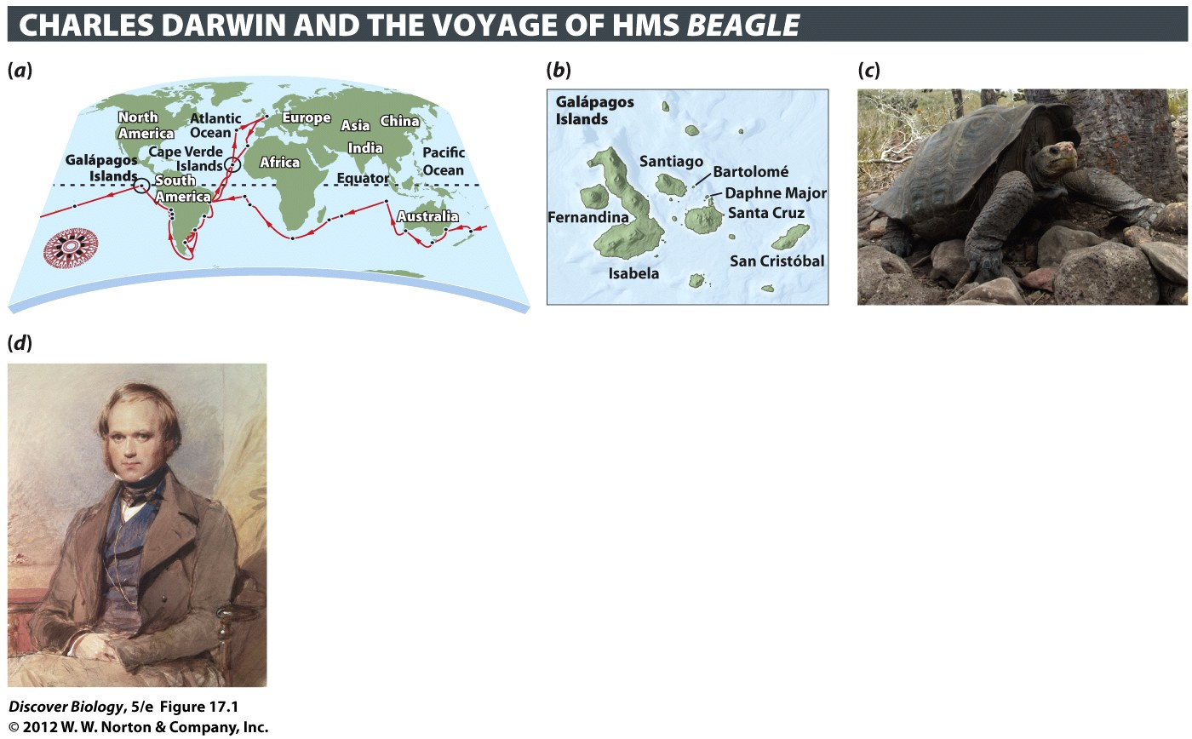
Notes:
Figure 17.1 Charles Darwin Was Ship’s Naturalist on the HMS Beagle
(a) The course sailed by the Beagle. (b) The Galápagos Islands, located 1,000 kilometers to the west of Ecuador. (c) A giant Galápagos tortoise. (d ) Charles Darwin.

Slide 9
Darwin Offers a Unifying Explanation: Descent with Modification
Darwin has received credit for the theory of evolution based on his book, published in 1859, called the On the Origin of Species, in which he provides extensive support for the theory of evolution
Groups of organisms evolve when natural selection favors individuals with advantageous inherited characteristics

Slide 10
Darwin Offers a Unifying Explanation: Descent with Modification
Darwin further observed that when natural selection acts differently on two populations, they may emerge as two new species descended from one ancestral population
Microevolution focuses on evolutionary changes that occur over relatively short periods of time
Macroevolution studies the history of life from the perspective of the formation and extinction of species and other large-scale consequences of population-level changes

Slide 11
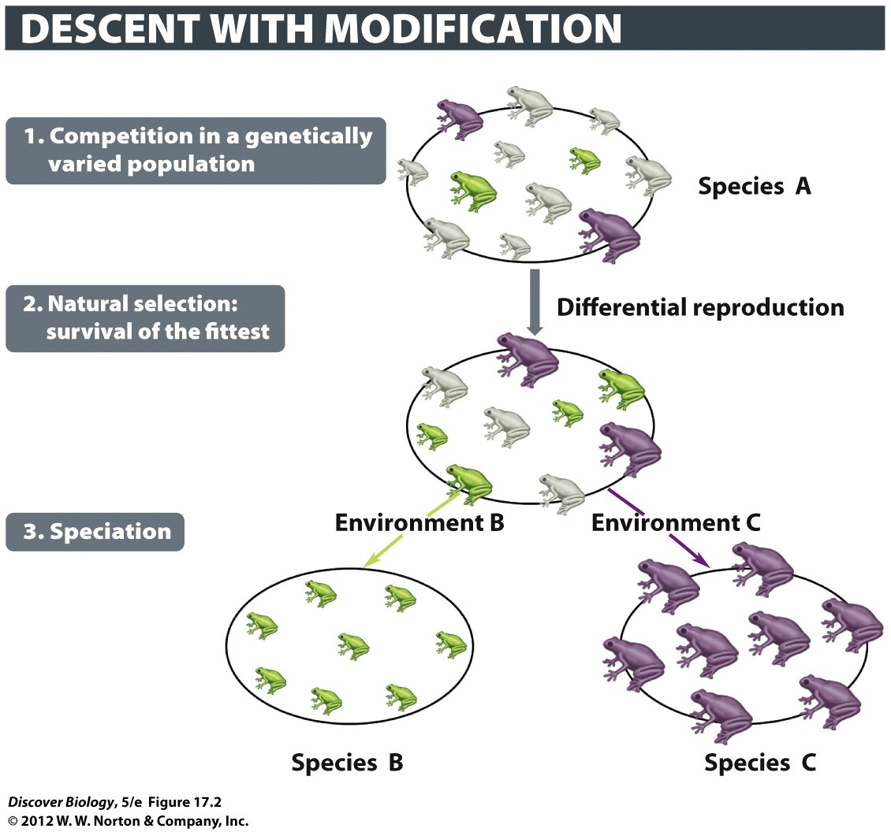
Notes:
Figure 17.2 Darwin Proposed Natural Selection as the Mechanism behind Species Formation

Slide 12
Mechanisms of Evolution
Evolution occurs at the level of the population, not at the level of the individual
The gene pool, the sum of all the genetic information carried by all the individuals in a population, can be influenced by four mechanisms:
  Mutation
  Gene flow
  Genetic drift
  Natural selection

Slide 13
Mutations Introduce Genetic
Variation in a Population
DNA-based differences in observable traits make up genetic variation in a population
Mutations are the source of all genetic variation and are the result of random changes in DNA sequences
DNA variants produced by mutation are known as alleles and make up the genotype of an individual
New mutations that are inherited change the overall genetic composition of a population, resulting in evolution

Slide 14
Mutations Introduce Genetic
Variation in a Population
Gene mutations are caused by various accidents such as:
  Mistakes in DNA replication
  Collisions of the DNA molecule with other molecules
  Damage from heat or chemical agents
Only mutations that occur in an organism’s gametes can be inherited

Slide 15
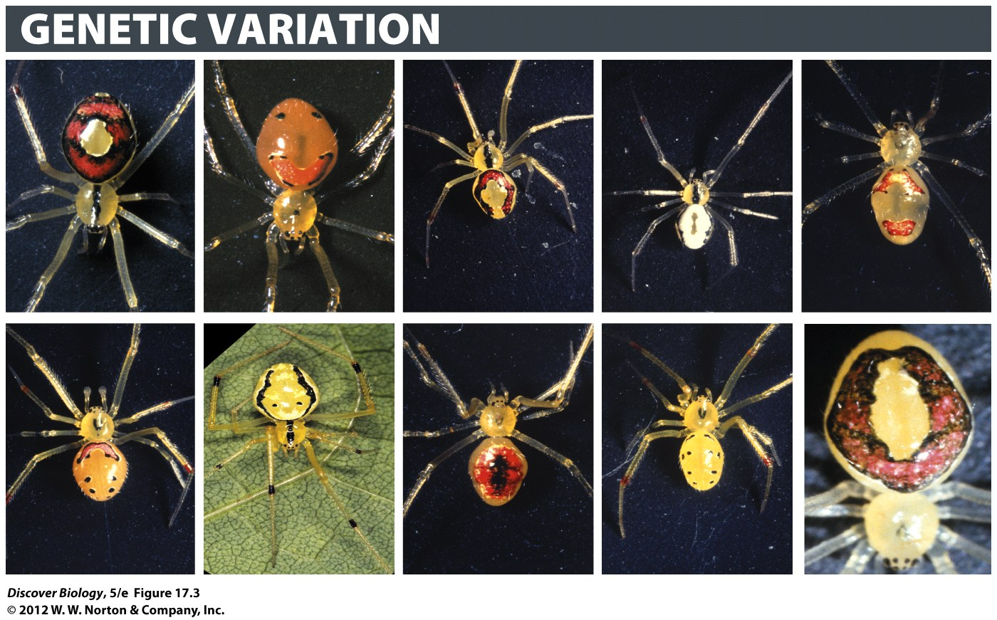
Notes:
Figure 17.3 Genetic Variation in Happy-Face Spiders
Markings on the backs of happy-face spiders, which inhabit four of the Hawaiian Islands.

Slide 16
Gene Flow Moves Genes between Populations
Gene flow is the movement of genes from one population to another
A population evolves when there is a change in the gene pool through migration or out-migration

Slide 17
Genetic Drift Generates Differential Reproduction through Accidental Events
Genetic drift is a random process that can cause the gene pool of a population to fluctuate randomly over time
Genetic drift may cause individuals with a unique set of characteristics to die off while allowing individuals with different characteristics to survive and reproduce
Genetic drift is more likely to alter the gene pool of a small population than that of a large population

Slide 18
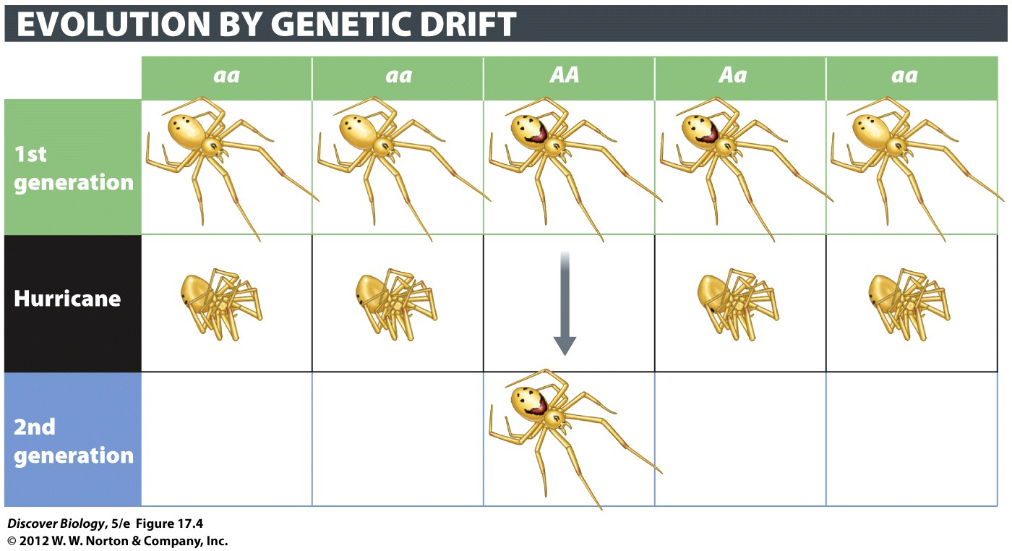
Notes:
Figure 17.4 Genetic Drift Can Drastically Alter the Genetic Makeup of a Population
Chance events can determine which individuals survive and reproduce. Here, a hurricane destroys most of the spiders on a small island. By chance alone, nearly all the surviving spiders have two A alleles (genotype AA), causing the proportion of A alleles in the population to change from 30 percent to 100 percent in a single generation.

Slide 19
Natural Selection Generates
Adaptation in a Population
Natural selection is a nonrandom, directional process that shifts the genetic characteristics of a population in one direction that leads to adaptation over successive generations
Individuals in a natural population must compete for resources, such as food, mates, and living space, that help them survive long enough to reproduce

Slide 20
Natural Selection Generates
Adaptation in a Population
An inherited characteristic that enables an individual to function better than others in that habitat makes that individual more likely to survive and reproduce and to pass those characteristics on
Adaptive traits are genetic characteristics that enable the individuals to function well in a competitive environment
The evolutionary process by which a population as a whole becomes better matched to its habitat over successive generations is known as adaptation

Slide 21
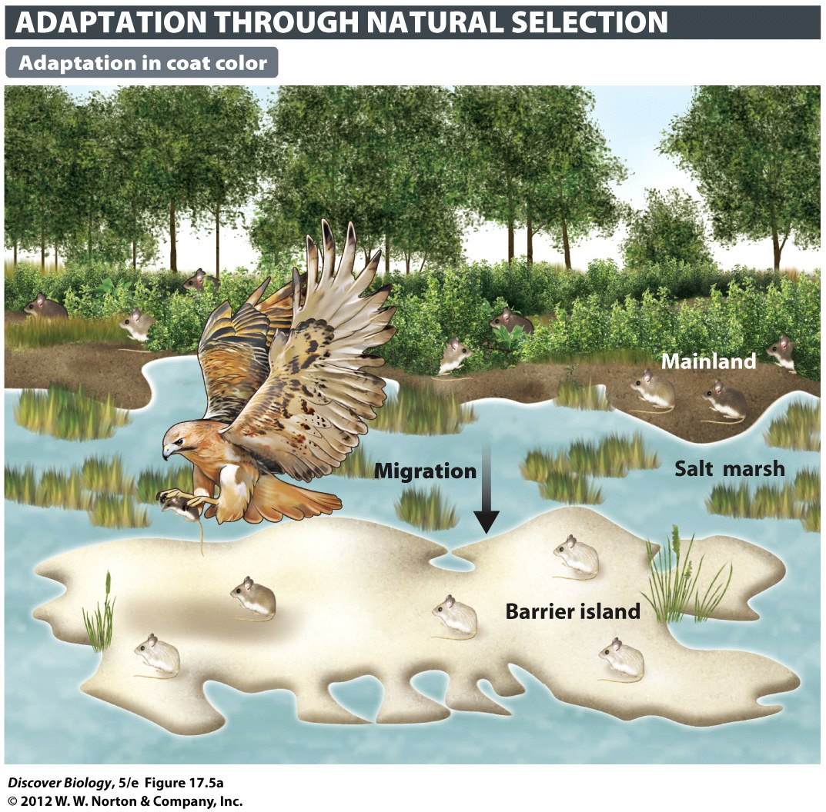
Notes:
Figure 17.5a Natural Selection Adapts a Population to Its Environment
Researchers studied subspecies of a deer mouse (Peromyscus polionotus) that inhabit each of eight barrier islands off the coast of Florida. Darker and more extensive areas of pigmentation are most common among the mainland subspecies (called the oldfield mouse). (a) The barrier island subspecies, known as beach mice, tend to have paler coats and reduced areas of pigmentation on the back.

Slide 22
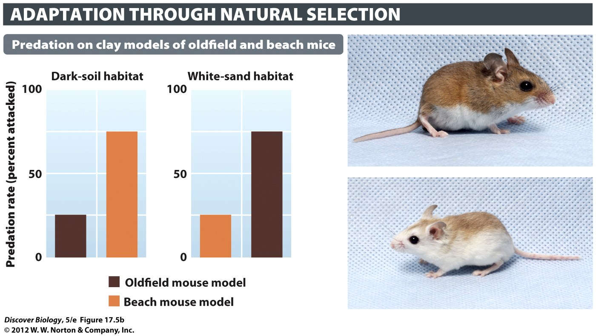
Notes:
Figure 17.5b Natural Selection Adapts a Population to Its Environment
Researchers studied subspecies of a deer mouse (Peromyscus polionotus) that inhabit each of eight barrier islands off the coast of Florida. Darker and more extensive areas of pigmentation are most common among the mainland subspecies (called the oldfield mouse). (b) Researchers used clay models of oldfield mice and beach mice to test the hypothesis that predators will see and attack coat patterns that contrast with their background.

Slide 23
Evolution Can Explain the Unity and Diversity of Life
The evolution of life on Earth can explain how it is that many characteristics are shared by very different organisms
The evolution of life can also explain the diversity of organisms on Earth

Slide 24
Organisms Share Characteristics as a Result of Common Descent
Similarities among organisms can explain the fact that organisms that share similar characteristics evolved from a common ancestor
Vestigial organs are reduced or degenerate parts whose function is no longer needed
Features of organisms related to one another through common descent are said to be homologous

Slide 25
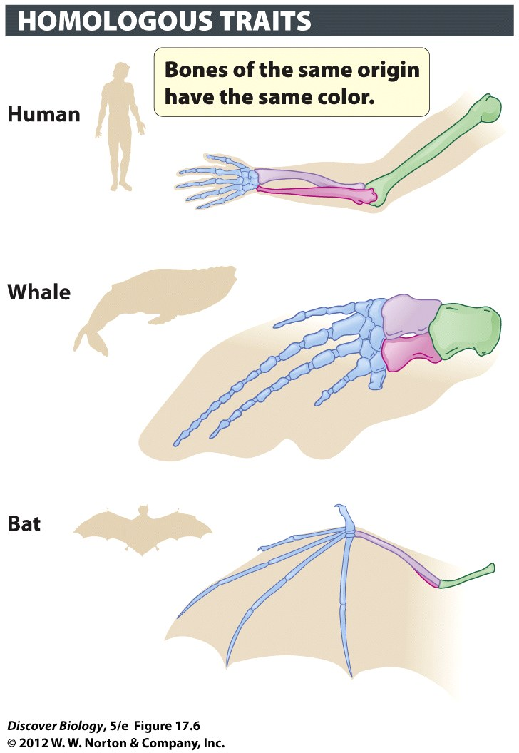
Notes:
Figure 17.6 Shared Characteristics
The human arm, the whale flipper, and the bat wing are homologous structures, all of which have what are essentially a matching set of five digits and a matching set of arm bones that have been altered by evolution for different functions.

Slide 26
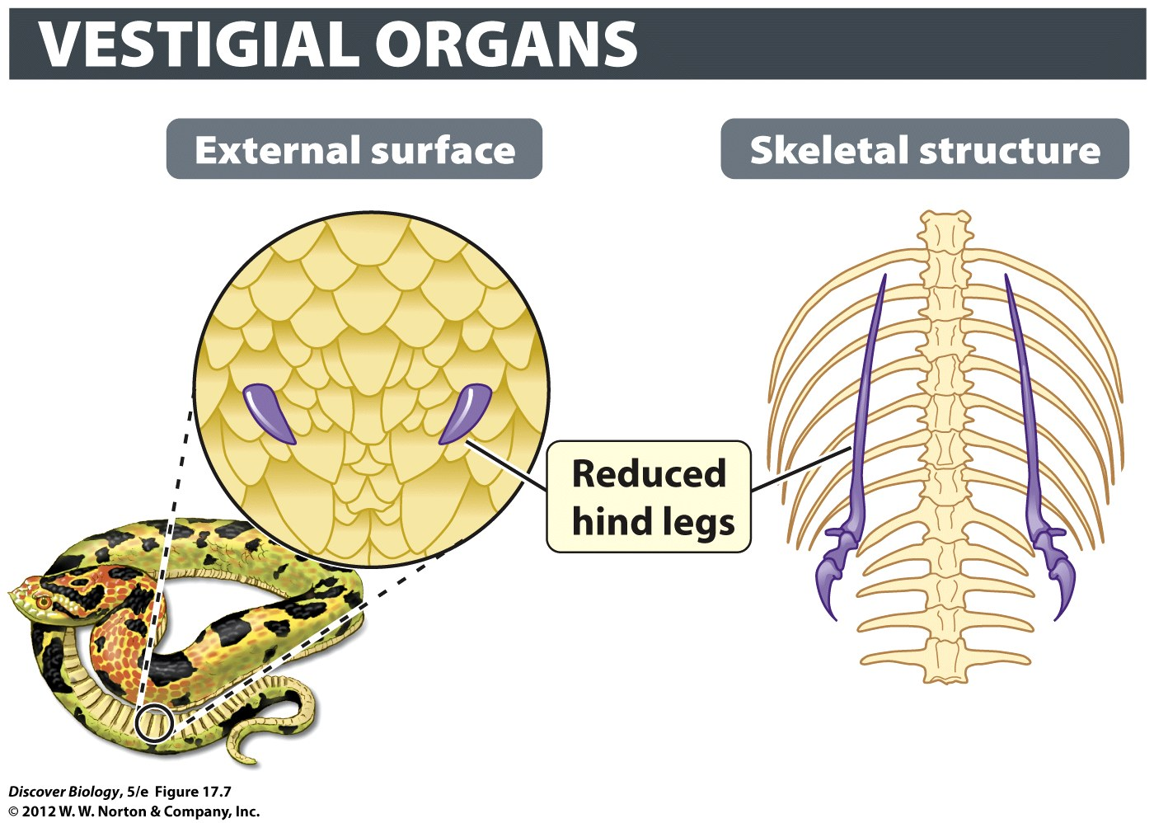
Notes:
Figure 17.7 A Python Has Rudimentary Hind Legs Visible Externally and Internally

Slide 27
Organisms Share Characteristics as a Result of Common Descent
Convergent evolution occurs when natural selection causes distantly related organisms to evolve similar structures in response to similar environmental challenges
Characteristics that result from convergent evolution are said to be analogous

Slide 28
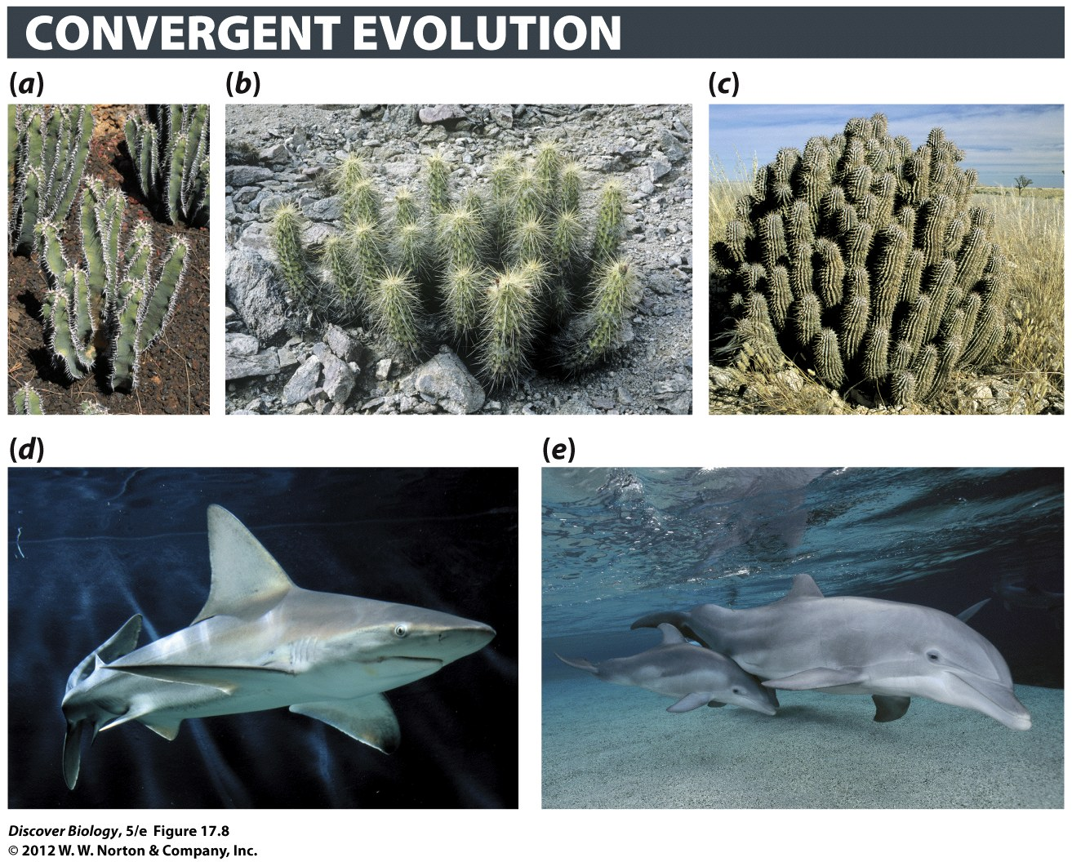
Notes:
Figure 17.8 The Power of Natural Selection
(a–c) These three plants evolved from very different groups of leafy plants. They resemble one another because of convergent evolution: each was similarly driven by natural selection to adapt to life in a desert. Their shared structures (fleshy stems, spines, reduced leaves) are therefore analogous, not homologous. (a) Euphorbia [yoo-fohr-bee-uh] belongs to the spurge family and can be found in Africa. (b) Echinocereus [ee-kye-noh-seer-ee-us] is a cactus found in North America. (c) Hoodia, a fleshy milkweed, can be found in Africa. (d,e) Convergent evolution can be a powerful force shaping animals as well. Here we see how natural selection has caused two distantly related animals—sharks (d) and dolphins (e)—to look very similar. Sharks are a kind of fish; dolphins are mammals.

Slide 29
The Diversity of Life Results from the Splitting of One Species into Two or More Species
Speciation is the process of splitting one species into two or more species; it results in the diversity of life Earth
Speciation can be caused by geographic separation, also called geographic isolation
Over time the separated populations may accumulate so many genetic changes that they are no longer able to reproduce with each other

Slide 30
The Evidence for
Biological Evolution
The vast majority of scientists of all nations, races, and creeds believe the evidence for evolution is very strong
Six lines of evidence provide compelling support for biological evolution:
  Fossils
  Traces of evolutionary history in existing organisms
  Similarities and divergences in DNA
  Direct observations of genetic change in populations
  Continental drift
  The present-day formation of new species

Slide 31
Evolution Is Strongly Supported by the Fossil Record
Fossils are the preserved remains, or their impressions, of formerly living organisms, which enable biologists to reconstruct the history of life on Earth
The fossil record shows many intermediate species that exhibit some similarities to the ancestral group and some similarities to the descendant species

Slide 32
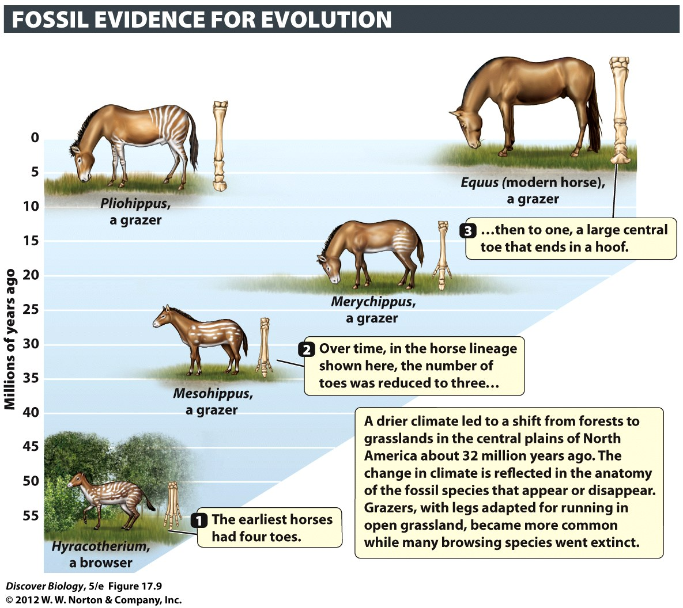
Notes:
Figure 17.9 Fossils Reveal Descent with Modification in Horse Lineages
The evolutionary tree of the horse family (Equidae) is highly branched, as deduced from the fossil remains of more than 200 different species. Progressive changes in the anatomy, especially of the leg bones and teeth, are seen in some lineages.

Slide 33
Organisms Contain Evidence of Their Evolutionary History
Patterns of growth in the very earliest stages of life can provide evidence of an organism’s evolutionary past
The manner in which an embryo develops, especially at the early stages, may mirror early developmental stages of ancestral forms

Slide 34
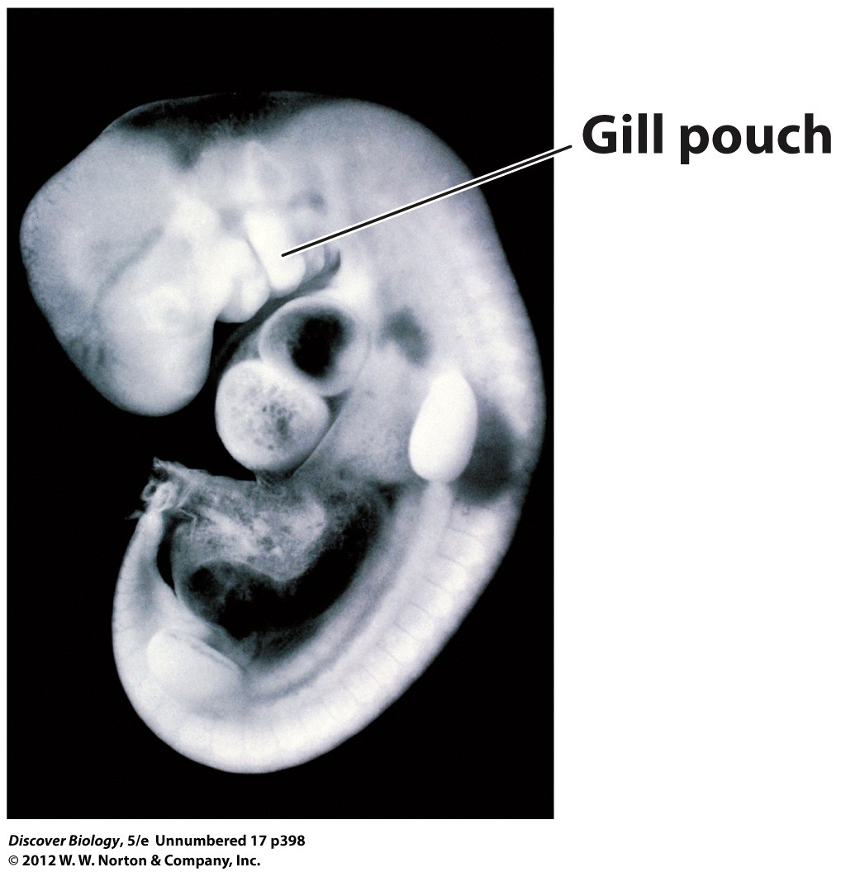
Notes:
Human embryo, about 30 days after fertilization

Slide 35
DNA Evidence Provides Some of the Most Compelling Evidence for Evolution
All living organisms contain DNA and use the same genetic code
These similarities are further evidence that the great diversity of living things descended, or evolved, from a common ancestor
DNA sequences and protein sequences of organisms that share a more recent common ancestor should be more similar than those that share a common ancestor further back in time

Slide 36
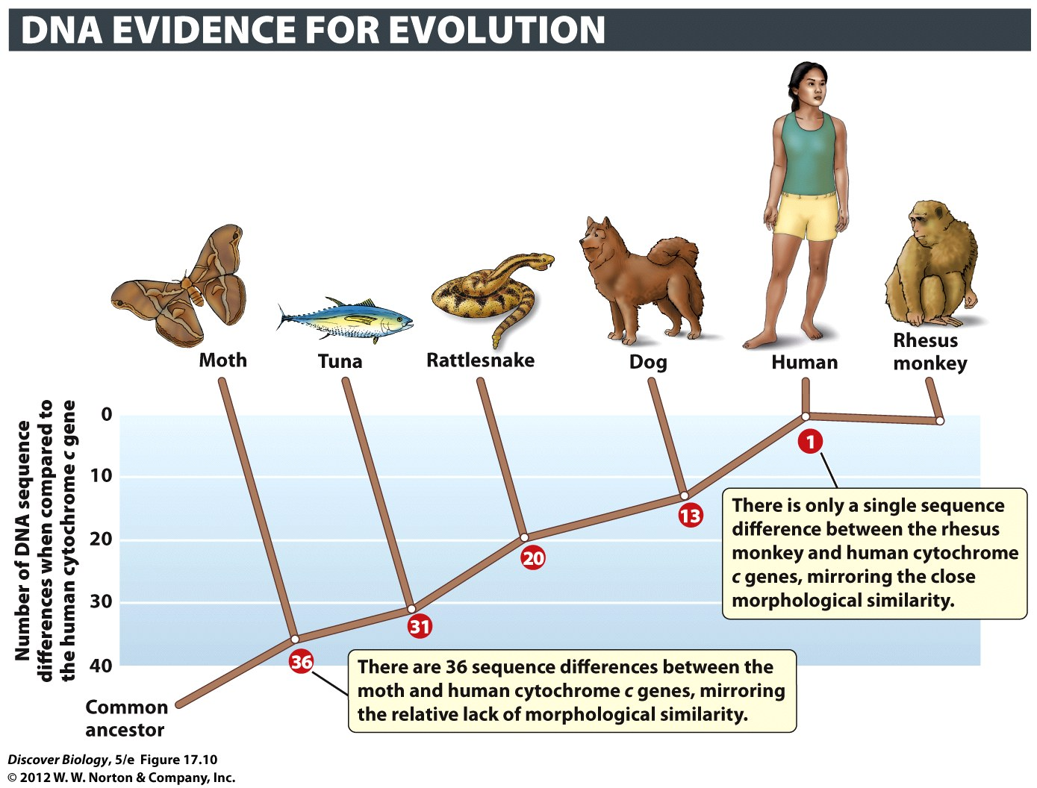
Notes:
Figure 17.10 Independent Lines of Evidence Yield the Same Result
Cytochrome c is an enzyme that functions in aerobic respiration and is found in all eukaryotes. A pattern of evolutionary relationships among animals is based on the number of DNA sequence differences between the cytochrome c gene found in humans and other organisms. The pattern of evolutionary relationships shown here, in which humans are most closely related to rhesus monkeys and least closely related to moths, matches the pattern derived independently from anatomical features.

Slide 37
Direct Observation Reveals
Genetic Changes within Species
Artificial selection is the process by which only individuals with certain inherited characteristics are allowed to breed
The variation that humans have produced within dogs, ornamental flowers, and many other species illustrates the power of artificial selection to bring about evolutionary change

Slide 38
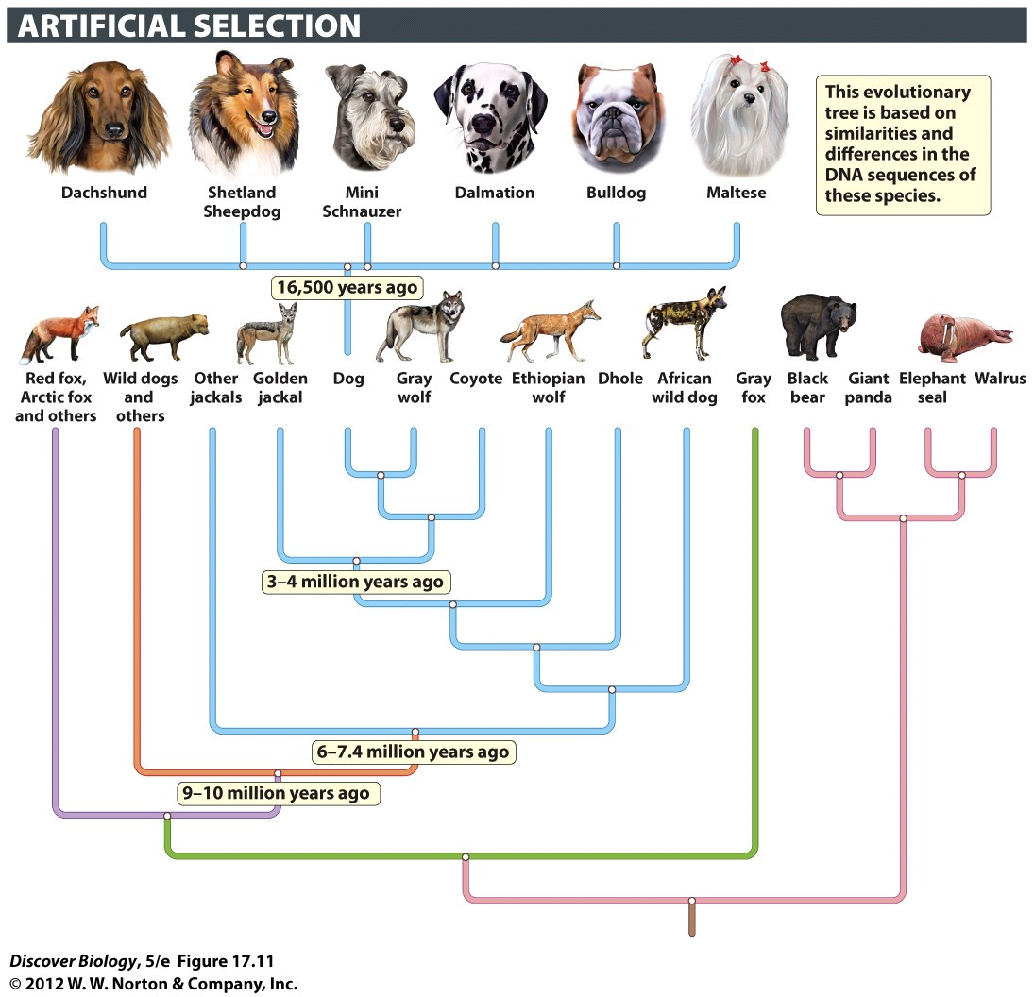
Notes:
Figure 17.11 Artificial Selection Produces Genetic Change
Humans have directed the evolution of the gray wolf to produce the many breeds of dogs. Despite the dramatic differences exhibited by the gray wolf, the Chihuahua, and the Great Dane, all three are members of the same species: Canis lupus. Selective breeding for specific genetic characteristics is responsible for the difference in form and behavior among the dog breeds.

Slide 39
Continental Drift and Evolution Explain the Geographic Locations of Fossils
The slow movement of the Earth’s continents over time is called continental drift, or plate tectonics
By measuring continental drift, scientists can predict the geographic location of fossils, providing another important line of evidence for evolution

Slide 40
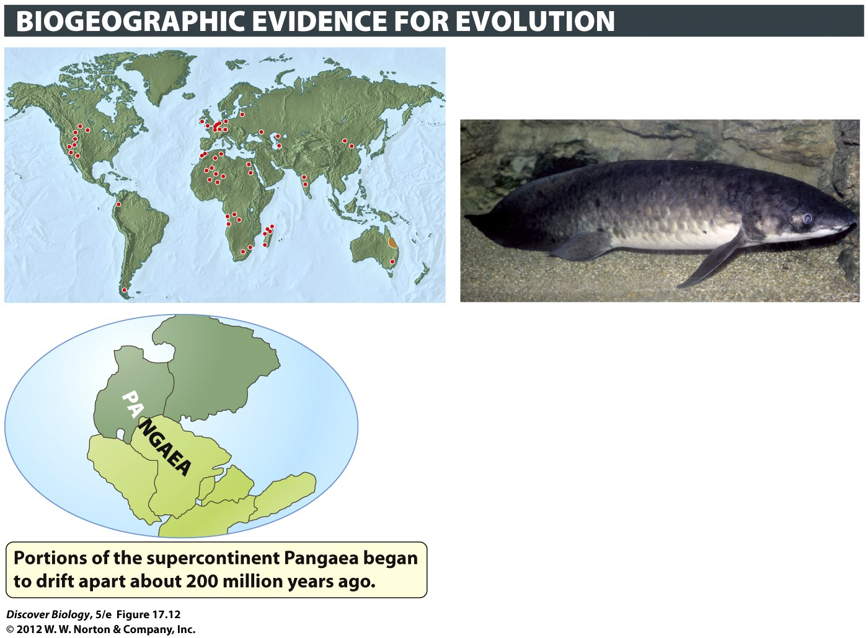
Notes:
Figure 17.12 The Biogeography of a Lungfish Reflects Its Evolutionary Past
Ancestors of the freshwater lungfish Neoceratodus fosteri (inset) lived during the time of Pangaea. N. fosteri fossils have been found on all continents except Antarctica. Currently found only in the orange-shaded region of northeastern Australia, this species is the only surviving member of its family. Red dots indicate places where fossils of N. fosteri’s ancestors have been found.

Slide 41
Formation of New Species Can Be Observed in Nature and Produced Experimentally
Scientists can produce new species through experiments such as the one that created the primrose in the early 1900s
Scientists have also directly observed new species forming in nature

Slide 42
The Impact of
Evolutionary Thought
Evolutionary thought revolutionized biology and had a profound effects on other fields, ranging from literature to philosophy to economics
Today most religious leaders and most scientists view evolution and religion as compatible but distinct fields of inquiry

Slide 43
Darwin’s Finches: Evolution in Action
After returning to England, Darwin concluded that all the finches in the Galápagos Islands were descended from a single species from the mainland that had split into a dozen new species
The Galápagos Islands serve as a natural laboratory for studying evolution, with the 14 species of finches found there serving as one good example

Slide 44
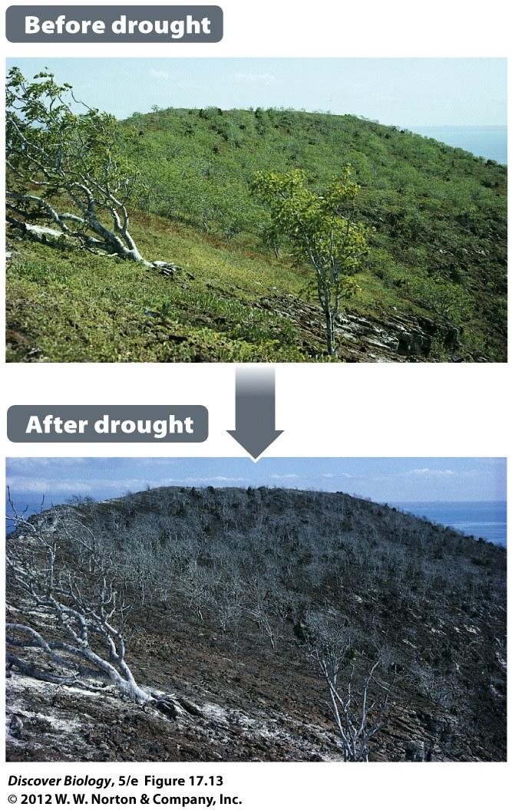
Notes:
Figure 17.13 A Drought Results in Rapid Evolutionary Change
The 1977 drought on Daphne Major in the Galápagos Islands had a dramatic effect on the plant life there, setting the stage for natural selection to cause rapid evolutionary change in birds that depended on the plants for food.

Slide 45
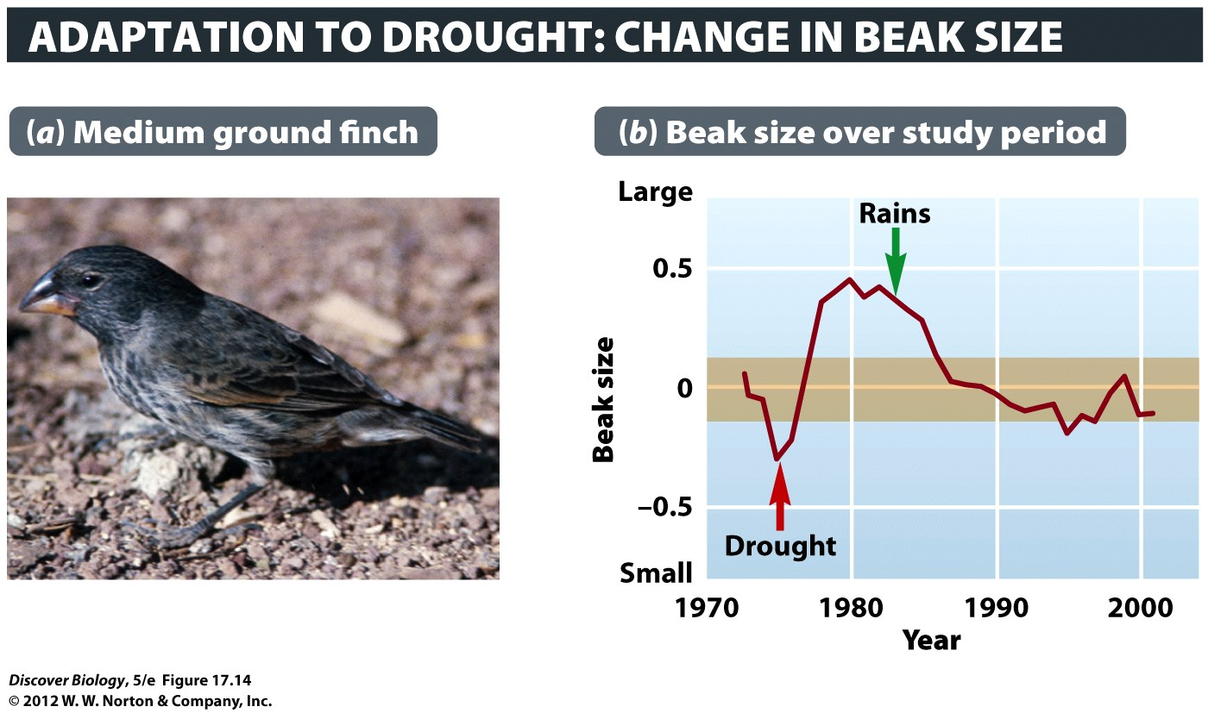
Notes:
Figure 17.14 Evolutionary Change within a Species
Scientists have been studying the medium ground finch (a) on the Galápagos island Daphne Major for more than 30 years. Average beak size increased in the population after a severe drought in 1977. When rainfall resumed, natural selection drove the evolution of smaller beaks (b). The orange-colored band indicates the range of values that would be expected without evolutionary change.

Slide 46
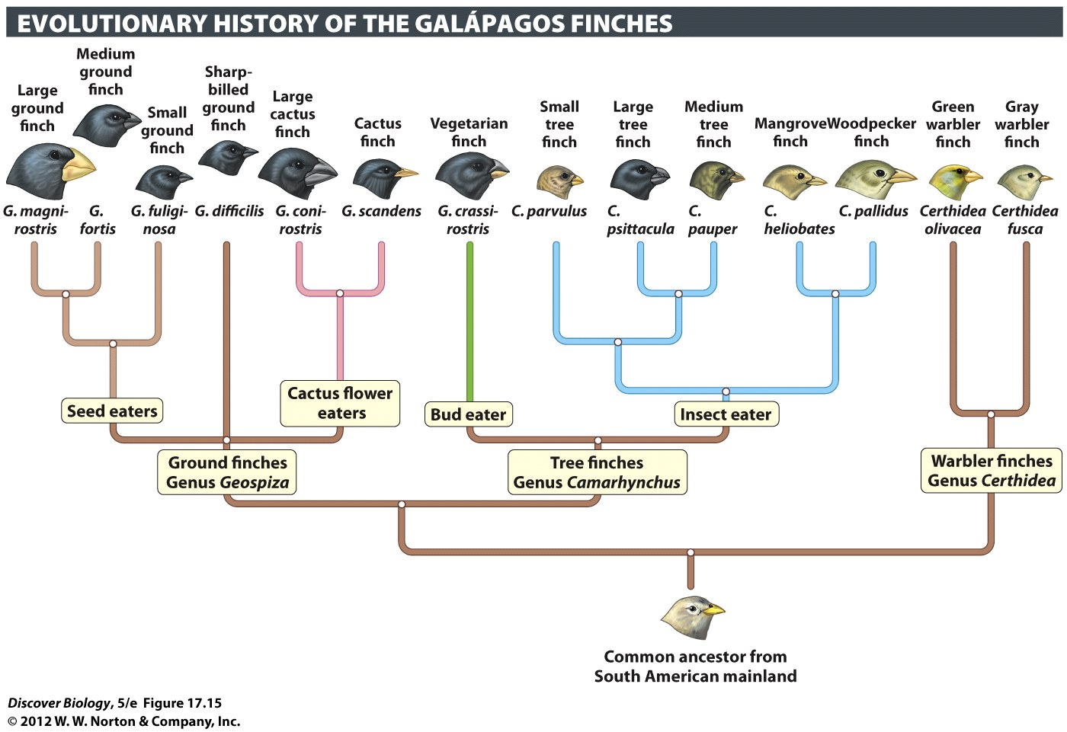
Notes:
Figure 17.15 Unique Species of Finches Evolved in the Galápagos Islands
This evolutionary tree is based on comparison of DNA sequences from each of the 14 species. The descendants of the ancestral form diverged into different evolutionary lineages as they adapted to diverse environments and different diets.

Slide 47
Clicker Questions
CHAPTER 17
How Evolution Works

Slide 48
Concept Quiz
Of the following situations that pertain to
evolution, which one is false?
Organisms inherit traits from their parents.
Organisms can adapt to prepare their offspring for future events.
Evolution can happen by chance.
Notes:
The correct answer is B.
Students may feel compelled to answer choice C; evolution can happen by chance.
Remind them that evolution can happen in two ways: natural selection and genetic drift. Genetic drift is a random event.

Slide 49
Concept Quiz
Evolution is the change that occurs in
__________ over time.
A population
An organism
The environment
Notes:
The correct answer is A.
Populations can evolve over time, but an individual organism cannot evolve because its genes are mostly fixed at the time of conception.

Slide 50
Concept Quiz
Of the following, which term or phrase best
describes the process of natural selection?
Genetic drift
Differential reproductive success
Speciation
Notes:
The correct answer is B.
Natural selection is often described as the “survival of the fittest”.
The best adapted organisms have a better chance at a longer life, which gives them a better chance at reproduction.
Genetic drift is a random process and is evolution without natural selection.
Speciation may be the result of natural selection, but does not describe the process.

Slide 51
Relevant Art from Other Chapters
All art files from the book are available in JPEG and PPT formats online and on the Instructor Resource Disc

Slide 52
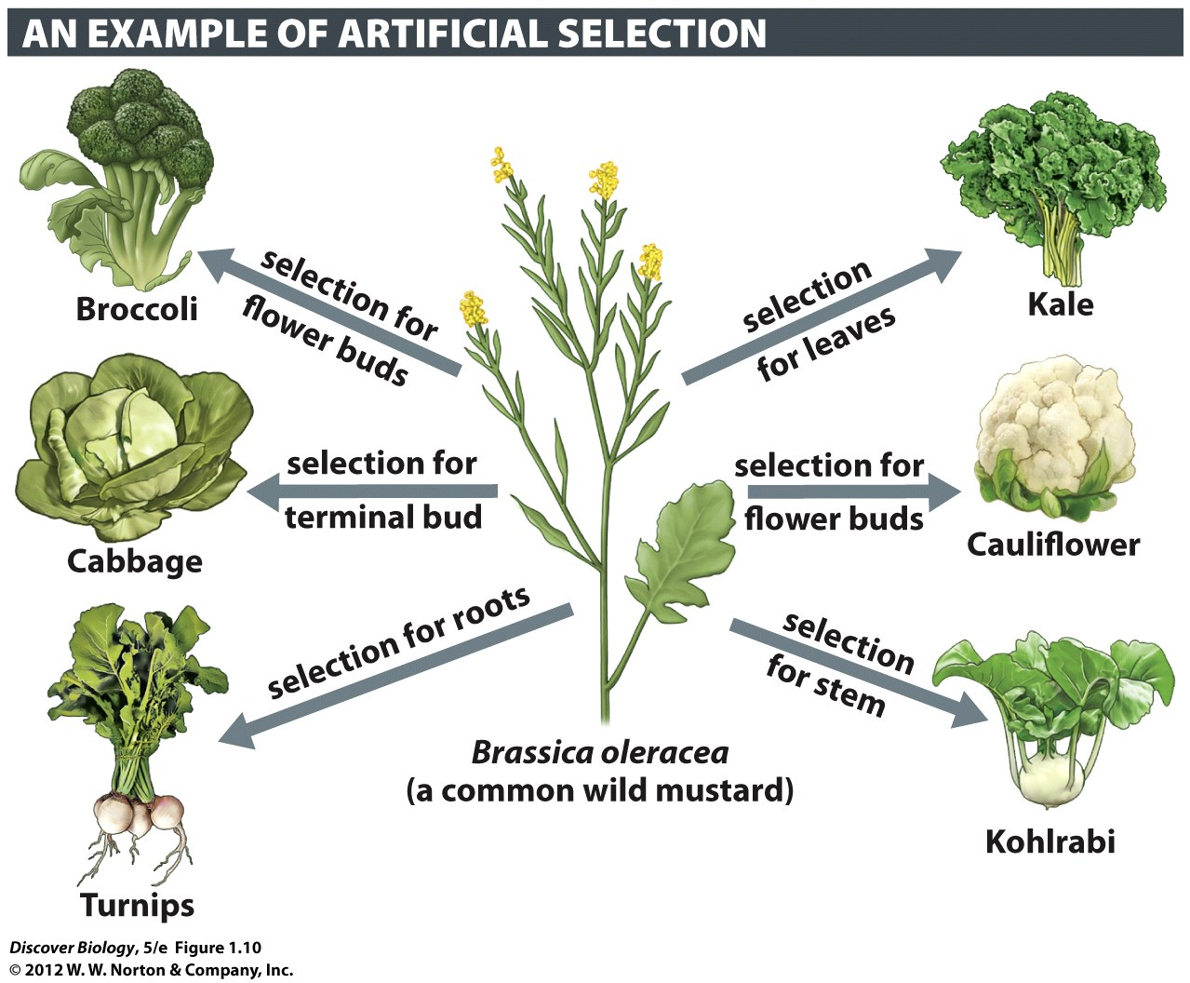
Notes:
Figure 1.10 Evolution of Wild Mustard through Domestication
In artificial selection, humans are the selective agents. The many different varieties of cruciferous plants were created by humans through selective breeding of genetically varied wild mustard plants. Individuals with desired genetic characteristics were bred with each other until their descendants became distinctly different from the ancestor, the wild mustard.

Slide 53
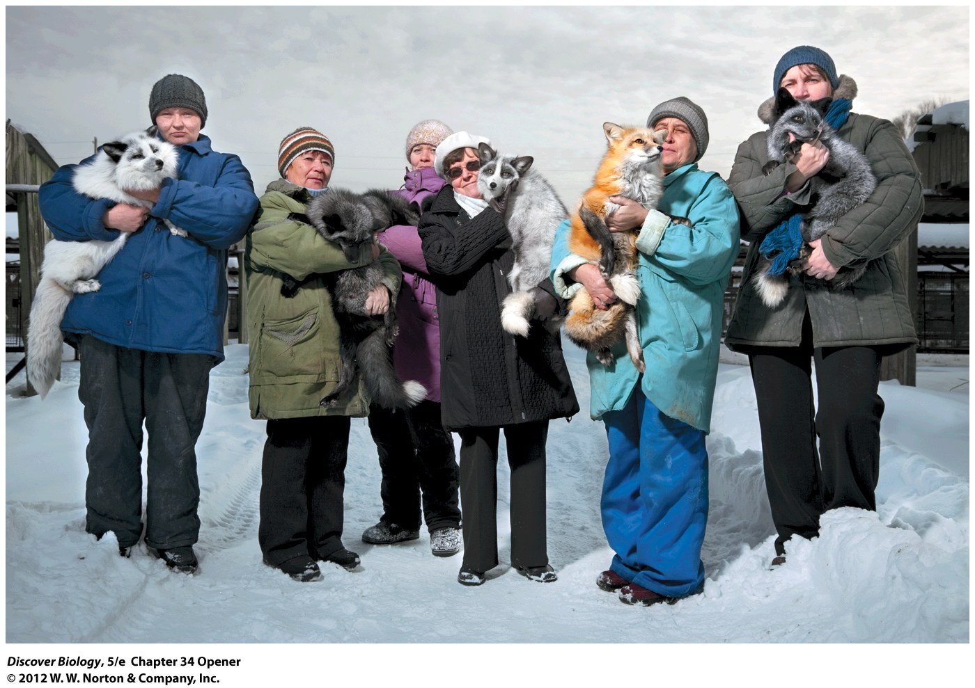
Notes:
Domesticated Siberian Silver Foxes. Not just hand-raised descendants of wild foxes, these foxes have been bred since 1959 only to respond positively to humans. In the process of genetic domestication, the foxes also evolved multicolored coats, curly tails, broader heads, and other traits typical of domesticated animals. Domesticated foxes, unlike their wild cousins, make great pets.

Slide 54
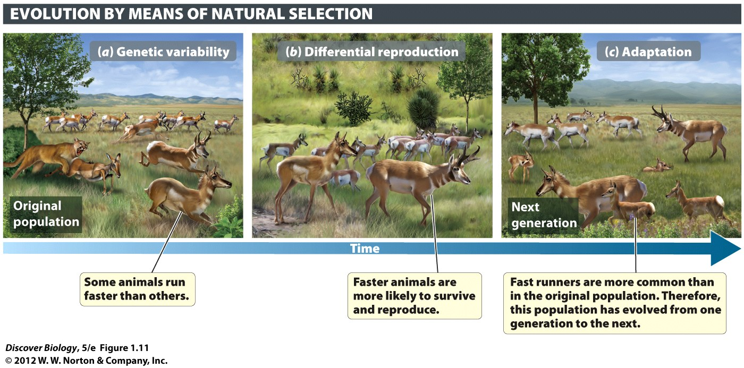
Notes:
Figure 1.11 Groups of Living Organisms Can Evolve
Natural selection, exerted through predators looking for a meal, favors the survival and reproduction of fast pronghorn over the slower animals in the population. The next generation of pronghorn has evolved, and is better adapted to the presence of predators, because it contains many more fast runners than the previous generation had.

Slide 55
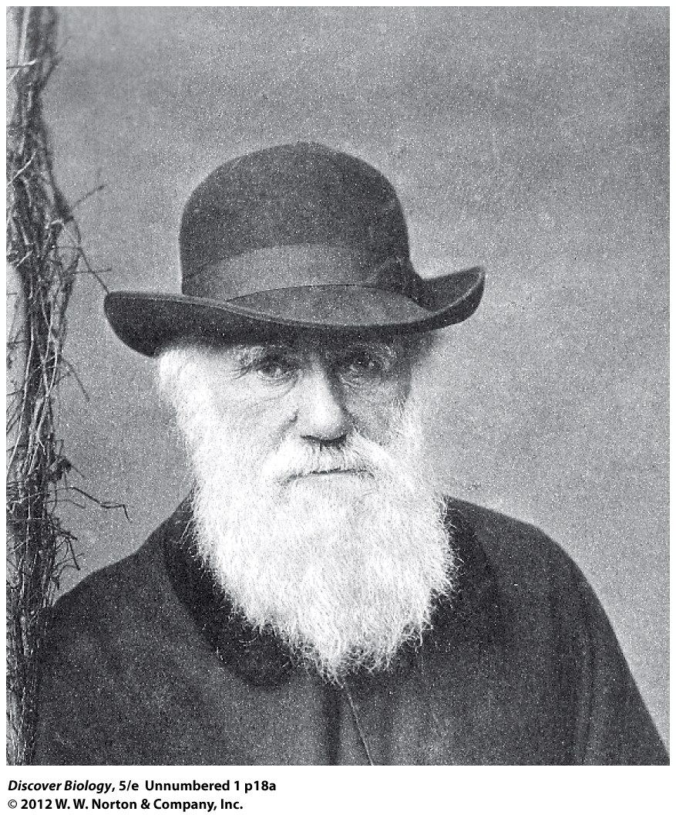
Notes:
Charles Darwin
(1809–1882)

Slide 56
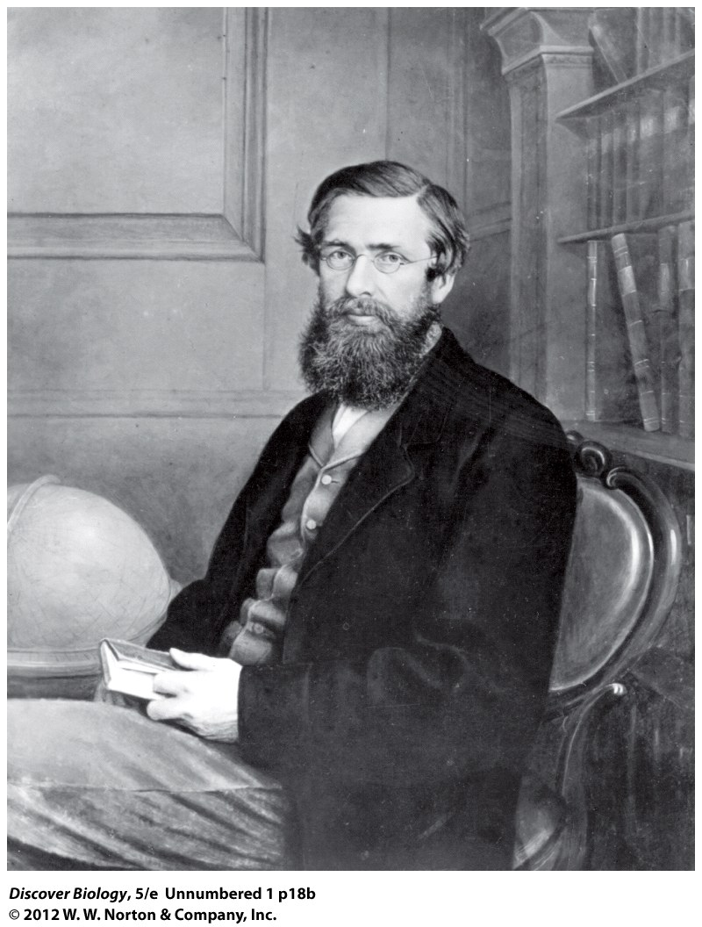
Notes:
Alfred Wallace
(1823–1913)

Slide 57
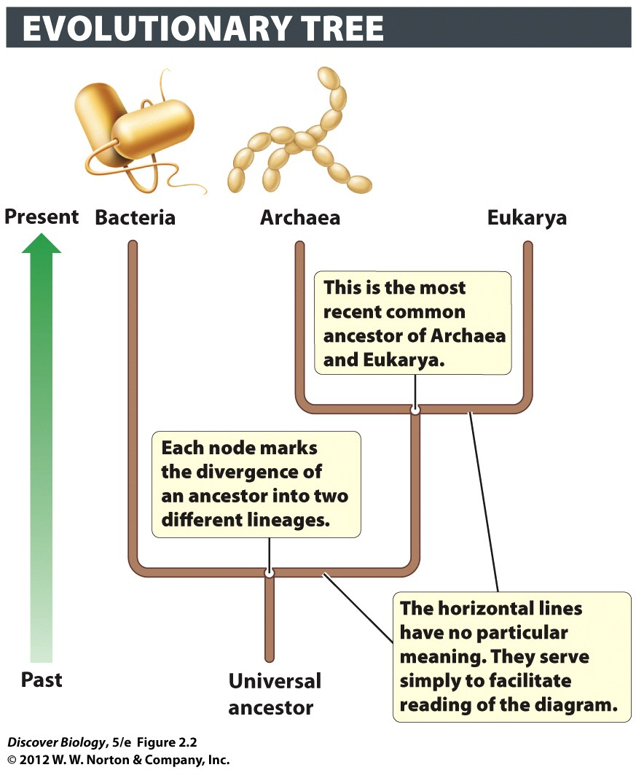
Notes:
Figure 2.2 Evolutionary Tree of Domains
This tree shows one model of the relationships of the three domains. At the root of the tree is the universal ancestor, from which all living things descended. Of the three surviving lineages, the first split came between the Bacteria and the lineage that would give rise to the Archaea and Eukarya. The next split was between the Archaea and the Eukarya, making Archaea and Eukarya more closely related to each other than either group is to Bacteria.

Slide 58
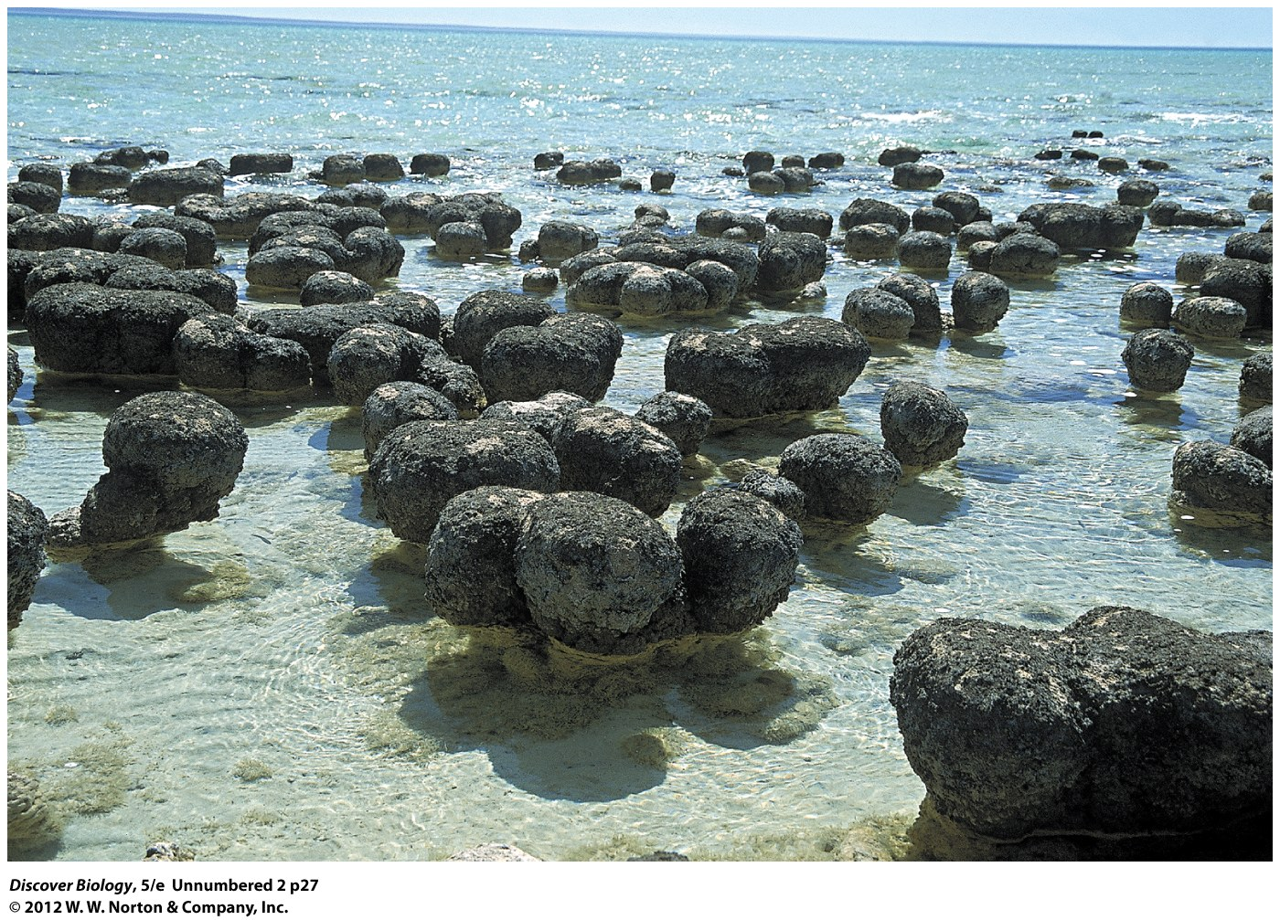
Notes:
Bacteria-like shapes have been found in stromatolites 3.4 billion years old. However, some researchers say the preservation is too poor for reliable identification. Stromatolites, such as these modern-day forms in Shark Bay, Western Australia, are pillowlike deposits of sediments that can trap bacterial biofilms.

Slide 59
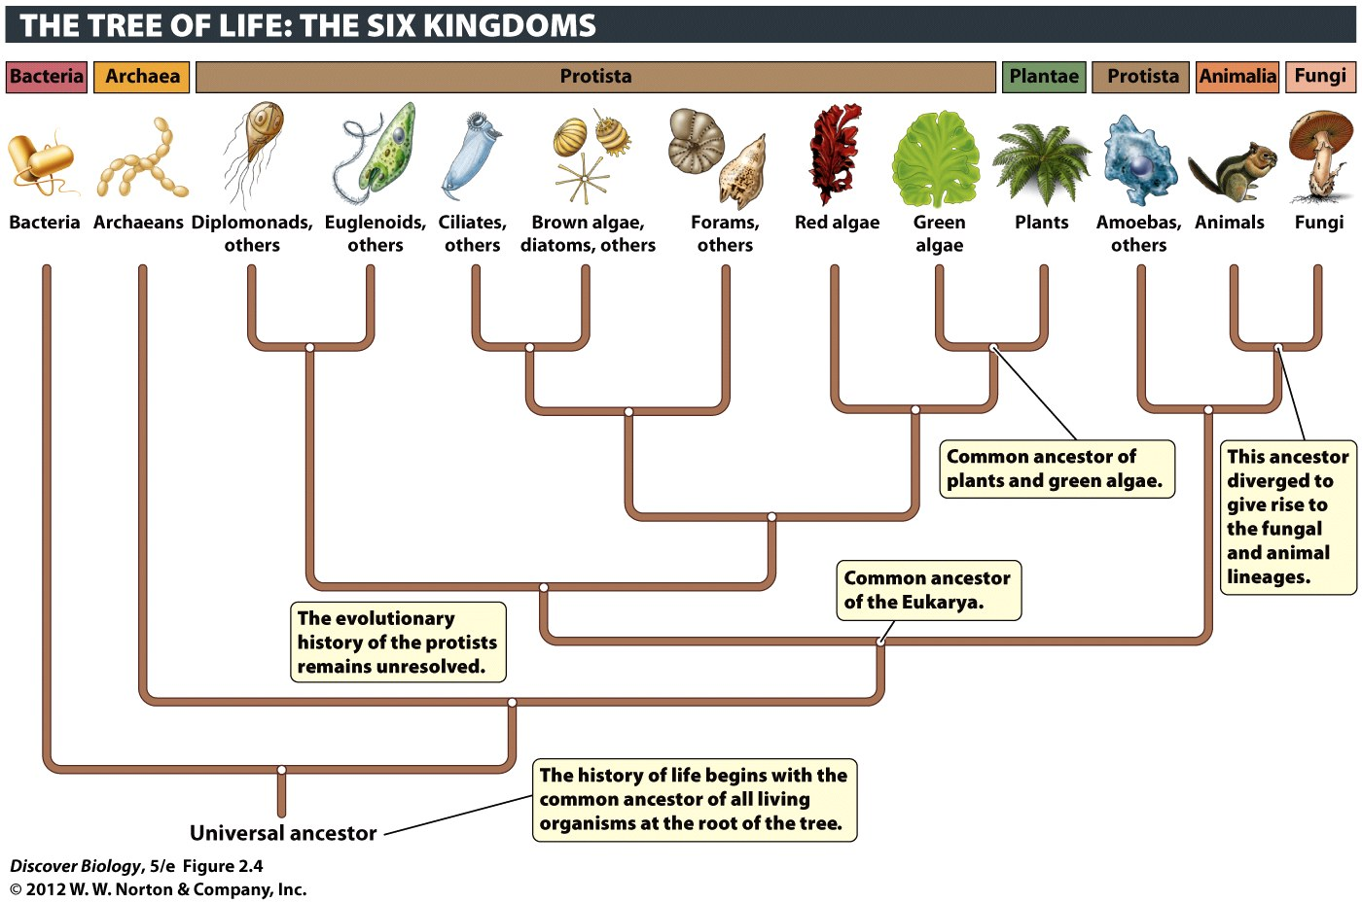
Notes:
Figure 2.4 The Three Domains and Six Kingdoms of Life
This evolutionary tree shows the hypothesized relationships among the six kingdoms, as well as the three domains. Each group branching off the tree can be thought of as a cluster of close relatives, or clade.

Slide 60
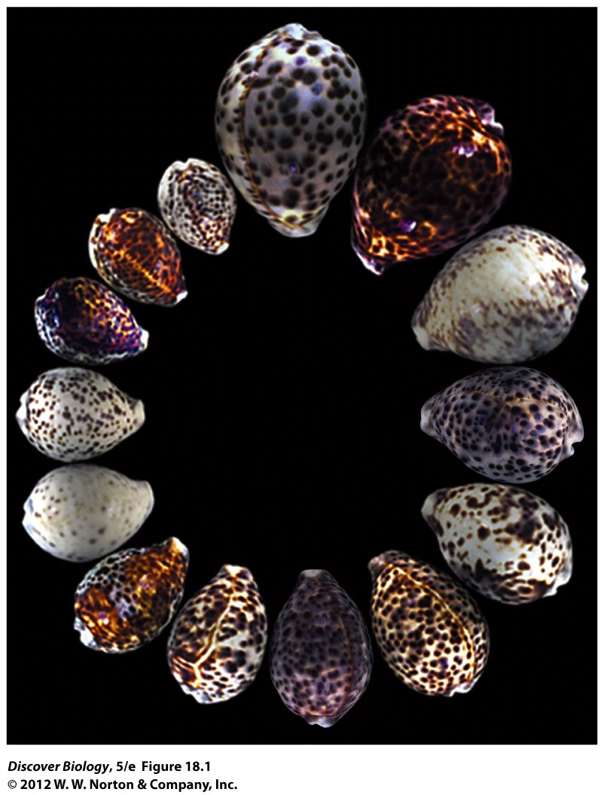
Notes:
Figure 18.1 Morphological Variation in Tiger Cowries, Cypraea tigris
The individuals within a population often vary greatly in many morphological traits, just as these tiger cowries do in their size and color patterns. These snails are widespread throughout the Pacific and Indian oceans, from Hawaii to the eastern shores of Africa.

Slide 61
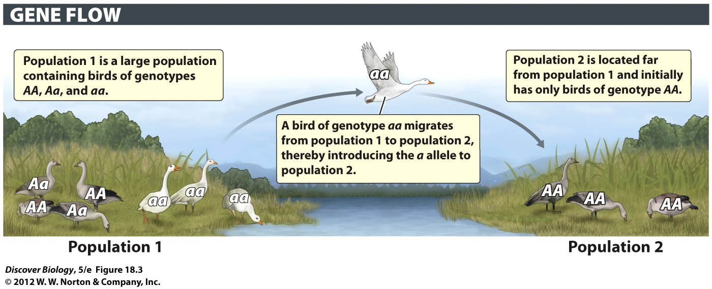
Notes:
Figure 18.3 Migrants Can Move Alleles from One Population to Another

Slide 62
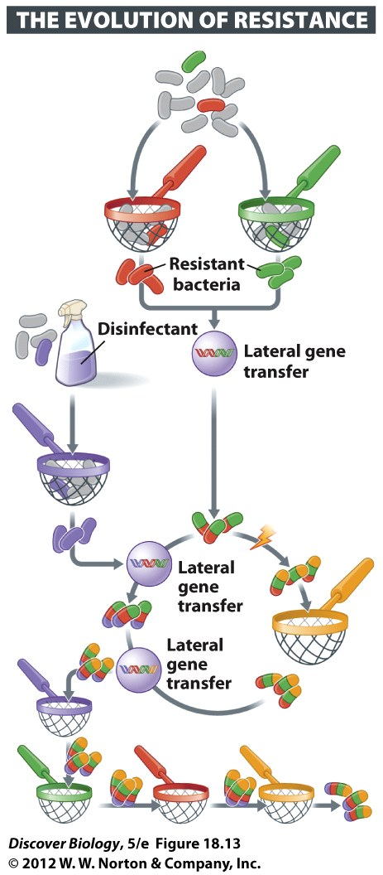
Notes:
Figure 18.13 Natural Selection Results in Resistance to Antibiotics
Before antibiotic use was common, most bacteria could be killed by antibiotics. Early use of antibiotics selected those few individuals that were resistant. Over time, new mutations and repeated episodes of selection—by the use of either antibiotics (represented here by sieves) or disinfectants—caused the frequency of resistant individuals to increase. In addition, transfer of genes within and among bacterial species allowed some bacteria to develop resistance to multiple antibiotics.

Slide 63
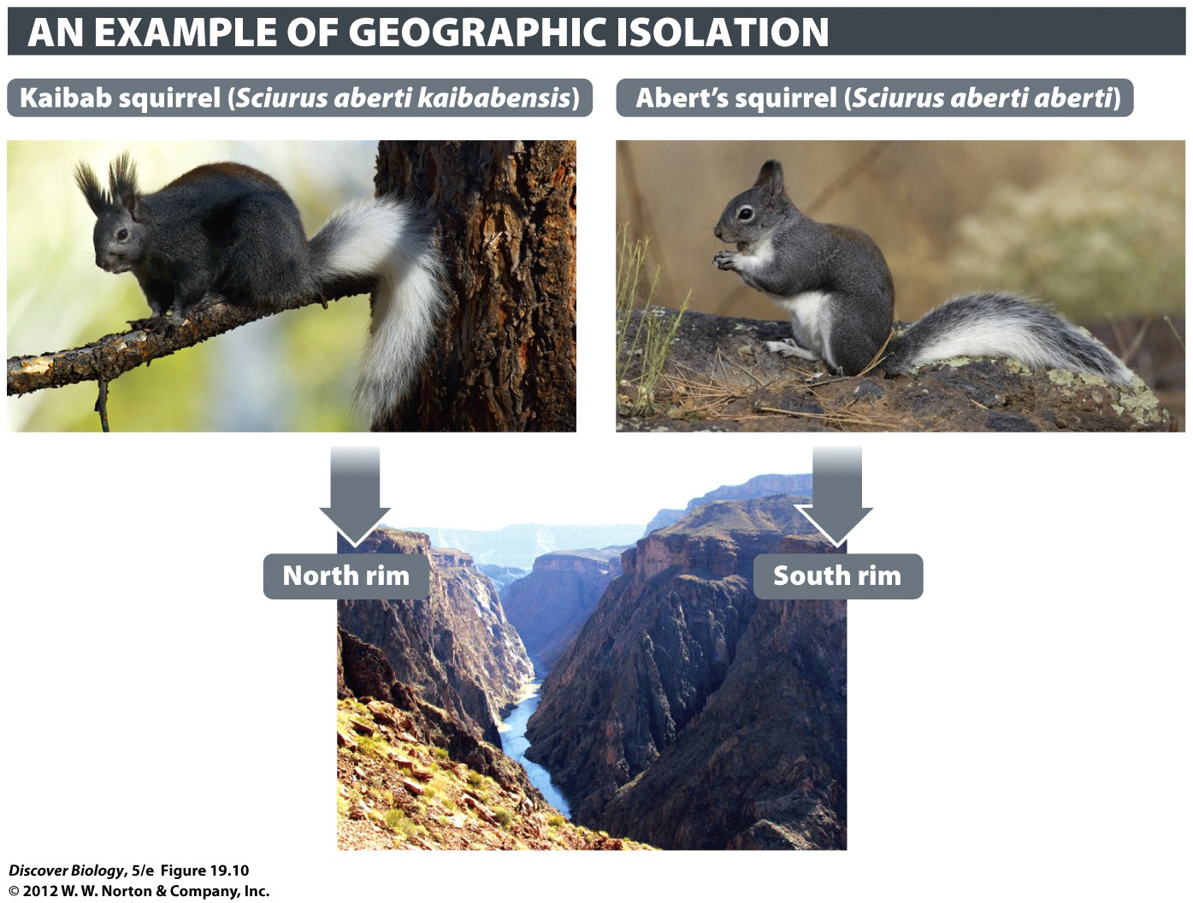
Notes:
Figure 19.10 The Grand Canyon Is a Geographic Barrier for Squirrels
The Kaibab squirrel is confined to the ponderosa pine forests on the north rim of the Grand Canyon. Abert’s squirrel lives on the south rim and also farther south on the Colorado Plateau and in the southern Rocky Mountains to Mexico. The Kaibab population became isolated from the Abert’s squirrels when the Colorado River cut a canyon—as deep as 6,000 feet in some places. With gene flow between them blocked, probably beginning about 5 million years ago, the Kaibab population diverged from the ancestral Abert’s squirrel. The two squirrels used to be considered separate species, but now most experts classify them as subspecies of the Abert’s squirrel, Sciurus aberti.

