Slide 1
Discover Biology
FIFTH EDITION
Anu Singh-Cundy • Michael L. Cain
CHAPTER 16
DNA Technology
© 2012 W. W. Norton & Company, Inc.

Slide 2
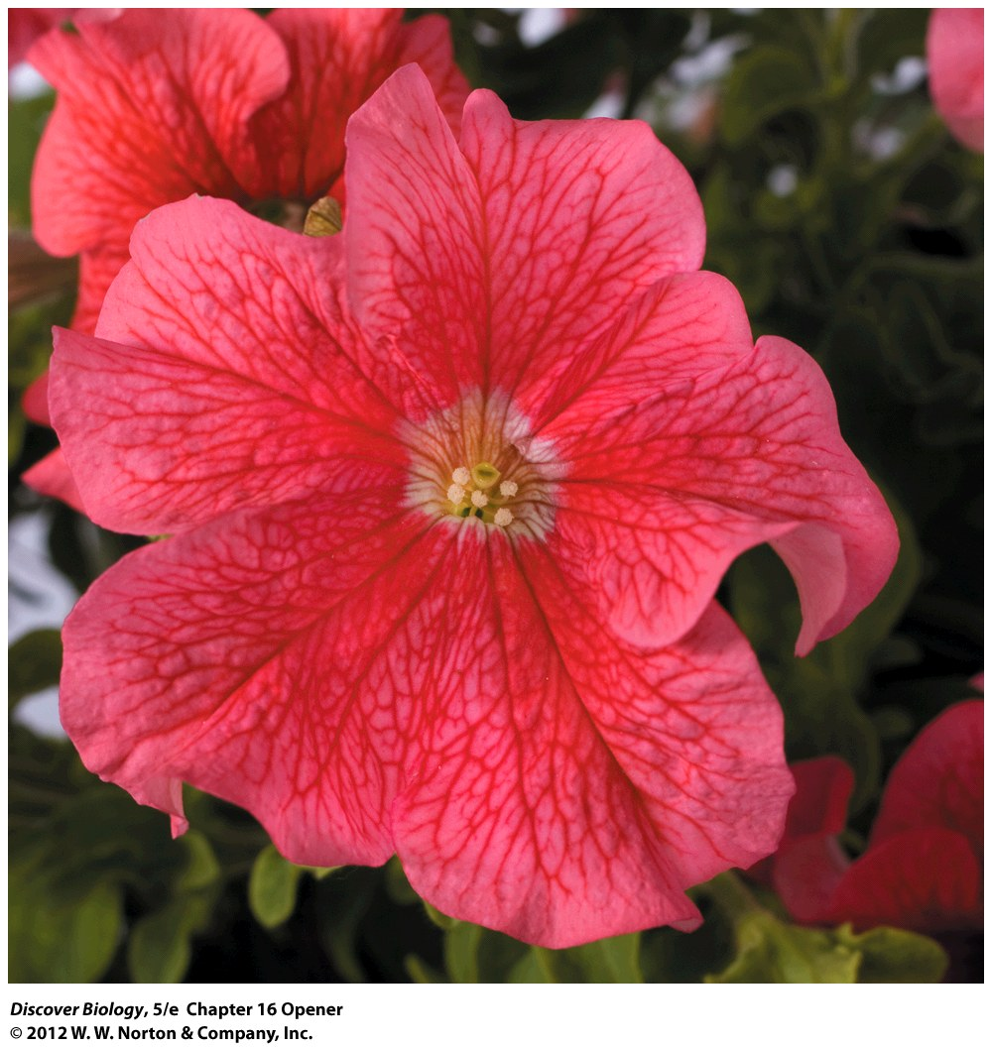
Notes:
The Edunia.
This transgenic petunia, part plant and part human, carries a gene for a human antibody extracted from the cells of artist Eduardo Kac. Kac created the “Edunia” to express some of his ideas about biotechnology.

Slide 3
Eduardo Kac’s “Plantimal”
Eduardo Kac’s interest in biotechnology led him to create a petunia that expresses one of his own genes
Creation of this “plantimal” was possible because plants and animals share a common ancestor, and as a result they use the same processes to translate and transcribe genes into proteins

Slide 4
People Have Been Manipulating the Genetic Material of Other Organisms for Thousands of Years
Humans have been manipulating the genetic characteristics of organisms through selective breeding for many years
Genetic manipulation has increased in speed and efficiency over the past 40 years

Slide 5
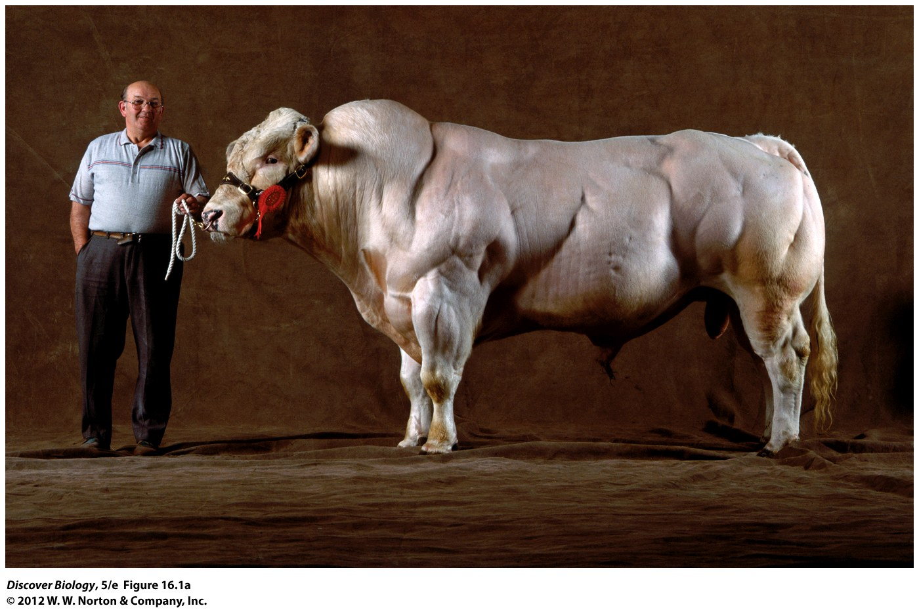
Notes:
Figure 16.1a Traditional Breeding versus Direct DNA Manipulation
When it comes to strange appearances, conventional breeding methods and DNA technology can both generate some extraordinary phenotypes. (a) This British Belgian Blue bull was developed through conventional selective breeding practices for heavily muscled, low-fat meat.

Slide 6
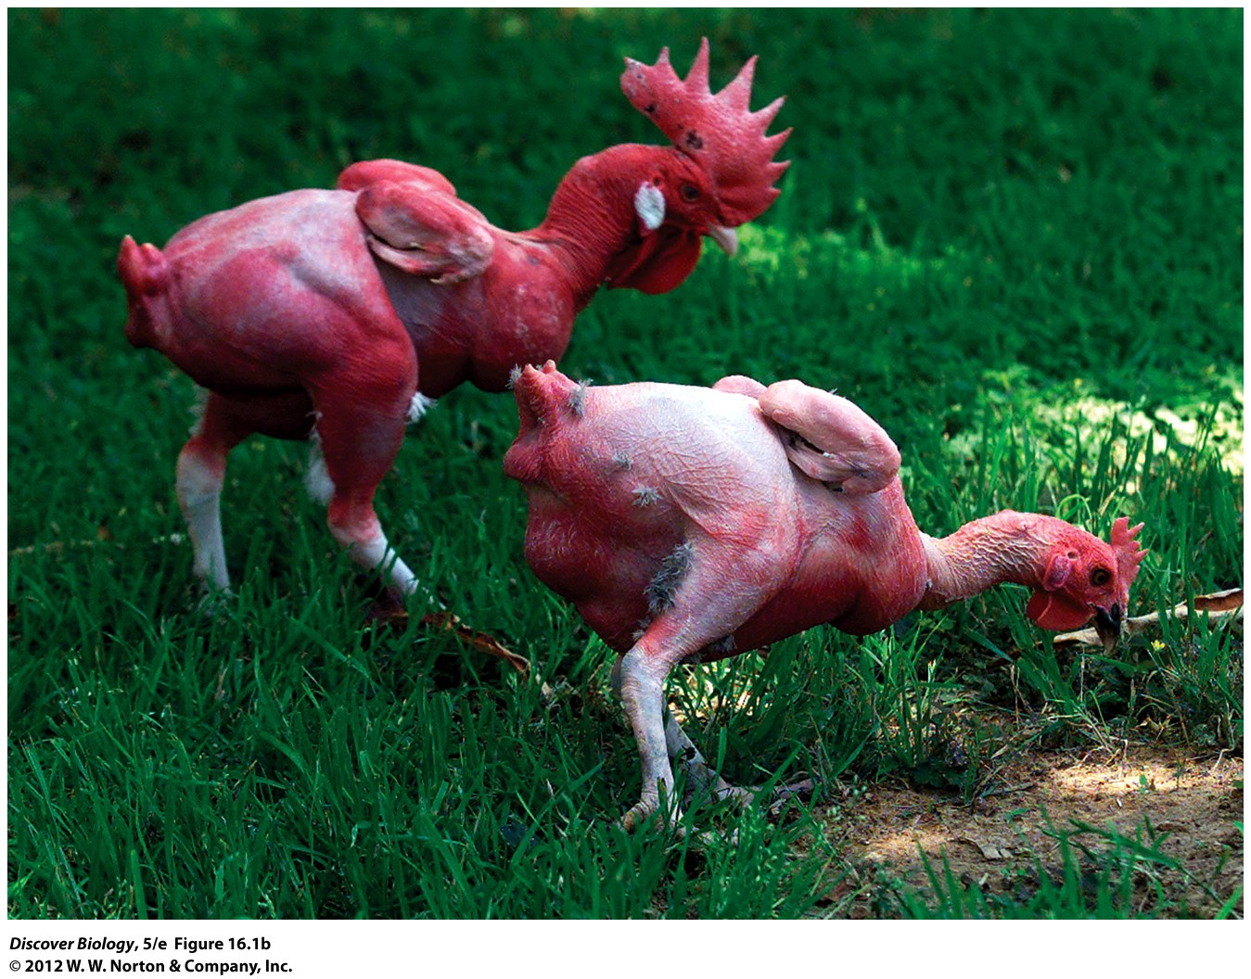
Notes:
Figure 16.1b Traditional Breeding versus Direct DNA Manipulation
When it comes to strange appearances, conventional breeding methods and DNA technology can both generate some extraordinary phenotypes. (b) These “naked” chickens were genetically altered using the tools of DNA technology. The goal of the research project was to develop low-fat poultry that would be cheap and environmentally friendly, in part because there would be no feathers to remove and dispose of.

Slide 7
The Brave New World of
DNA Technology
DNA technology began in the 1970s and has applications in our daily life, from the foods we eat to the medical care we receive
Scientists began by deciphering the way DNA is modified and replicated within cells, especially bacteria and viruses

Slide 8
Revolutionary Techniques Are the
Foundation of DNA Technology
The strategies and techniques that scientists use to analyze and manipulate DNA are known as DNA technology
Consistency in the chemical structure of DNA means that similar laboratory techniques can be used to isolate and analyze DNA from different species
Extracted DNA can be cut into smaller fragments with certain enzymes and then amplified, creating billions of copies

Slide 9
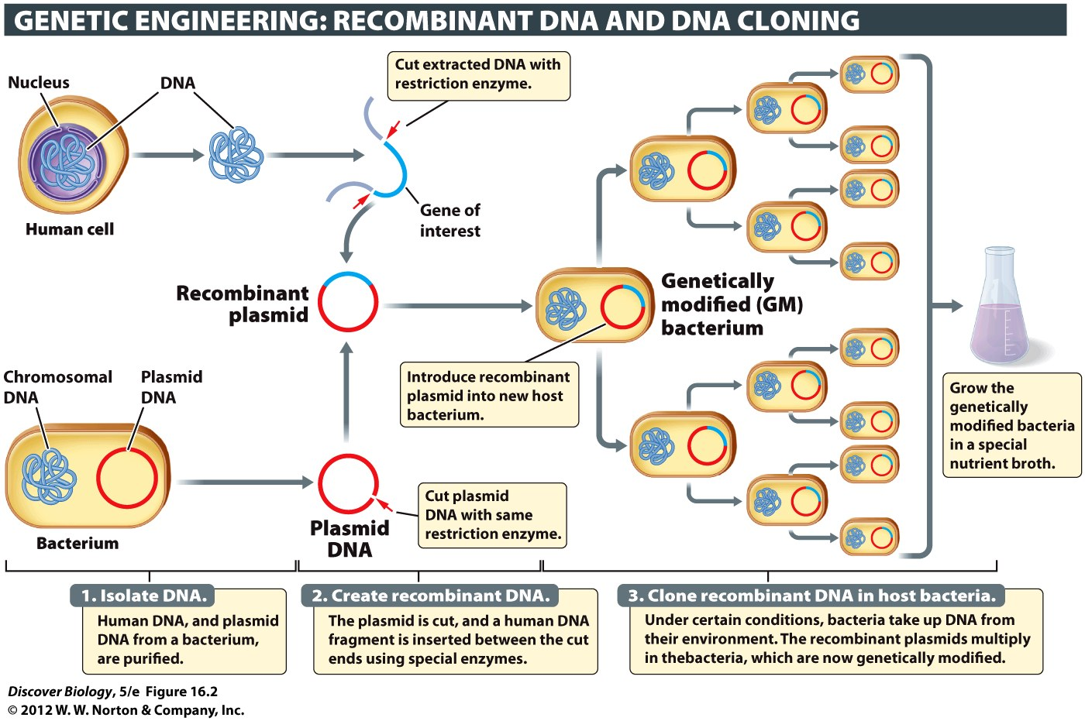
Notes:
Figure 16.2 Recombinant DNA Can Be Propagated in Bacteria
This diagram illustrates the general scheme for genetic engineering, using the introduction of a human gene into a bacterium as an example. Once a recombinant plasmid has been created, it can be introduced into a desired strain of bacterium in a number of different ways. The bacterium makes many copies of the recombinant plasmid, which are inherited by the daughter cells every time the bacterium divides. DNA cloning is the propagation of foreign DNA in a suitable host, such as a bacterium.

Slide 10
Revolutionary Techniques Are the
Foundation of DNA Technology
Recombinant DNA: fragments of DNA can be joined together with the help of special enzymes, creating an artificial assembly of genetic material
DNA cloning is the introduction of recombinant DNA into a host cell, followed by the copying and propagation of the introduced DNA in the cells of the host and all of its offspring

Slide 11
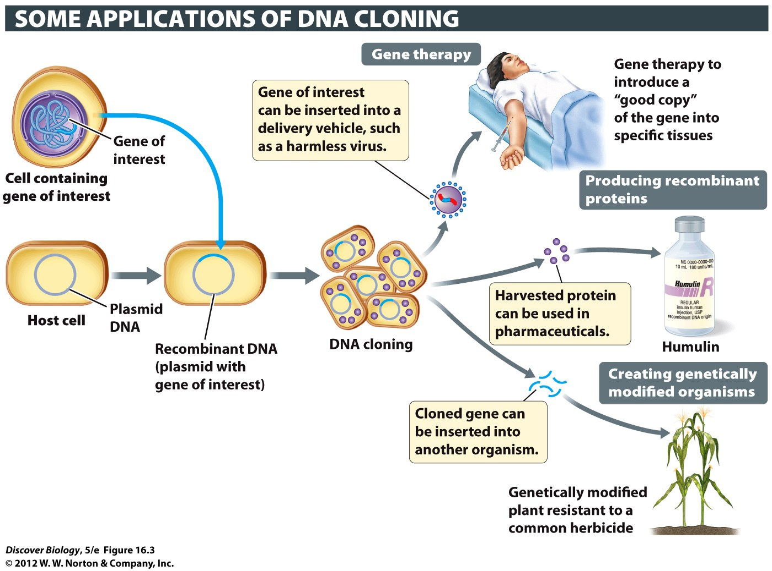
Notes:
Figure 16.3 Cloned DNA Serves Many Purposes

Slide 12
DNA Technology Has
Transformed Our World
DNA technology is used in forensics and to help diagnose genetic disorders and infectious diseases
DNA microarrays have made it possible to understand which sets of genes are expressed in specific cell types under certain conditions; as a result, doctors have begun to practice personalized medicine

Slide 13
DNA Technology Has
Transformed Our World
The permanent introduction of one or more genes into a cell, tissue, or whole organism, leading to a change in at least one genetic characteristic in the recipient, is called genetic engineering
Organisms that have been genetically engineered are called genetically modified organisms (GMOs)
Doctors use gene therapy to treat serious genetic disorders or diseases

Slide 14
DNA Fingerprinting
DNA fingerprinting is the process of identifying DNA unique to a species or individual and is especially important in forensic science
Scientists examine certain regions of the human genome that are known to vary greatly from one person to the next, such as introns and spacer DNA

Slide 15
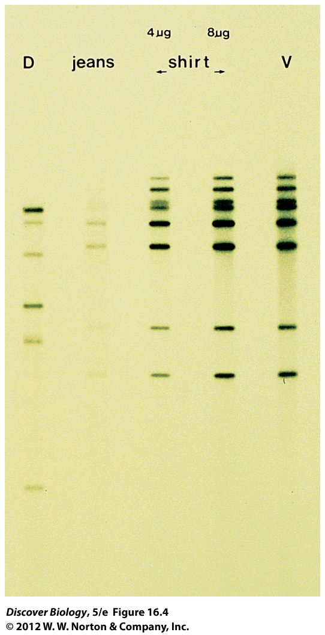
Notes:
Figure 16.4 DNA Fingerprinting Can Be Used to Identify Criminals
The DNA profile on the far left is that of the defendant (D) in a murder trial. The profile on the far right is that of the victim (V). The defendant’s jeans and shirt were splattered with blood. The fingerprint of the DNA extracted from the blood splatters is an exact match with the victim’s DNA profile.

Slide 16
Reproductive Cloning of Animals
Reproductive cloning of animals is used to produce offspring that are genetically identical to an organism that has useful characteristics
Cloning is a three-step process that begins with removing the nucleus from an egg and then fusing the enucleated egg with a somatic cell from a nuclear donor
The new embryo is then implanted in a surrogate mother to develop

Slide 17
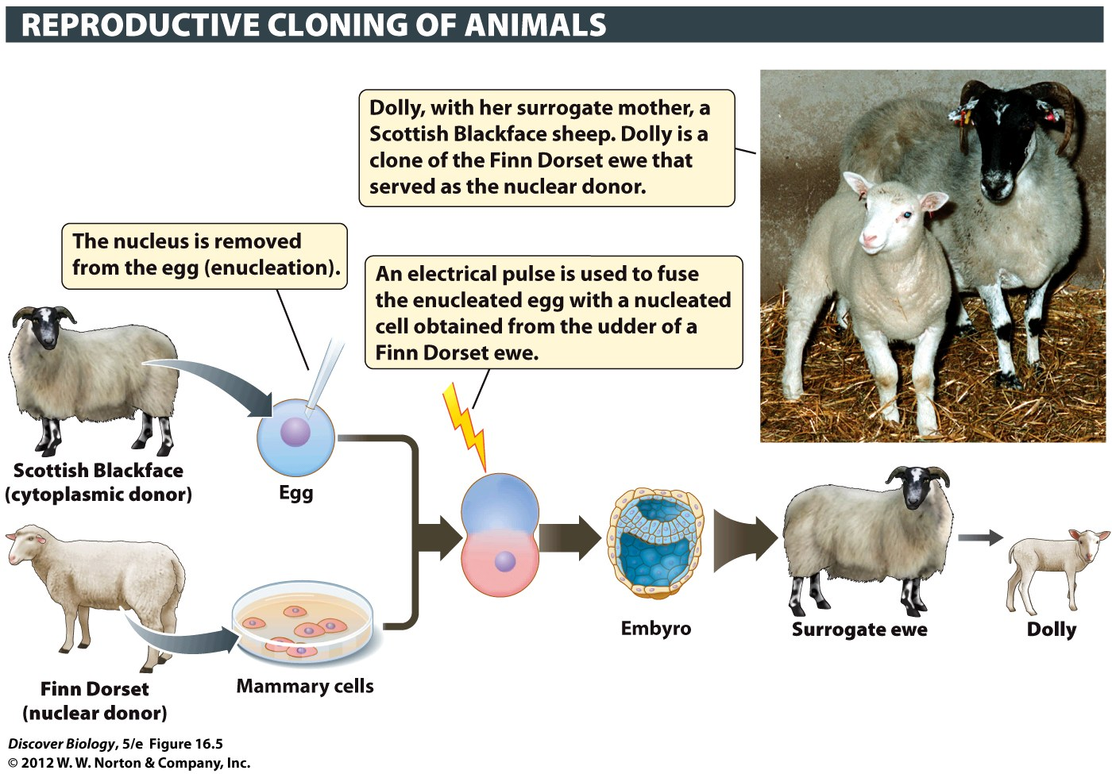
Notes:
Figure 16.5 Cloning Sheep: How Dolly Came to Be

Slide 18
Genetic Engineering
A gene that is introduced into a GMO is called a transgene; therefore, GMO individuals are known as transgenic organisms
Scientists have been able to track gene expression using a light-producing protein known as green fluorescent protein (GFP), which is extracted from jellyfish
New genes can be introduced into a cell in many different ways:
  Plasmids
  Viruses
  Gene guns

Slide 19
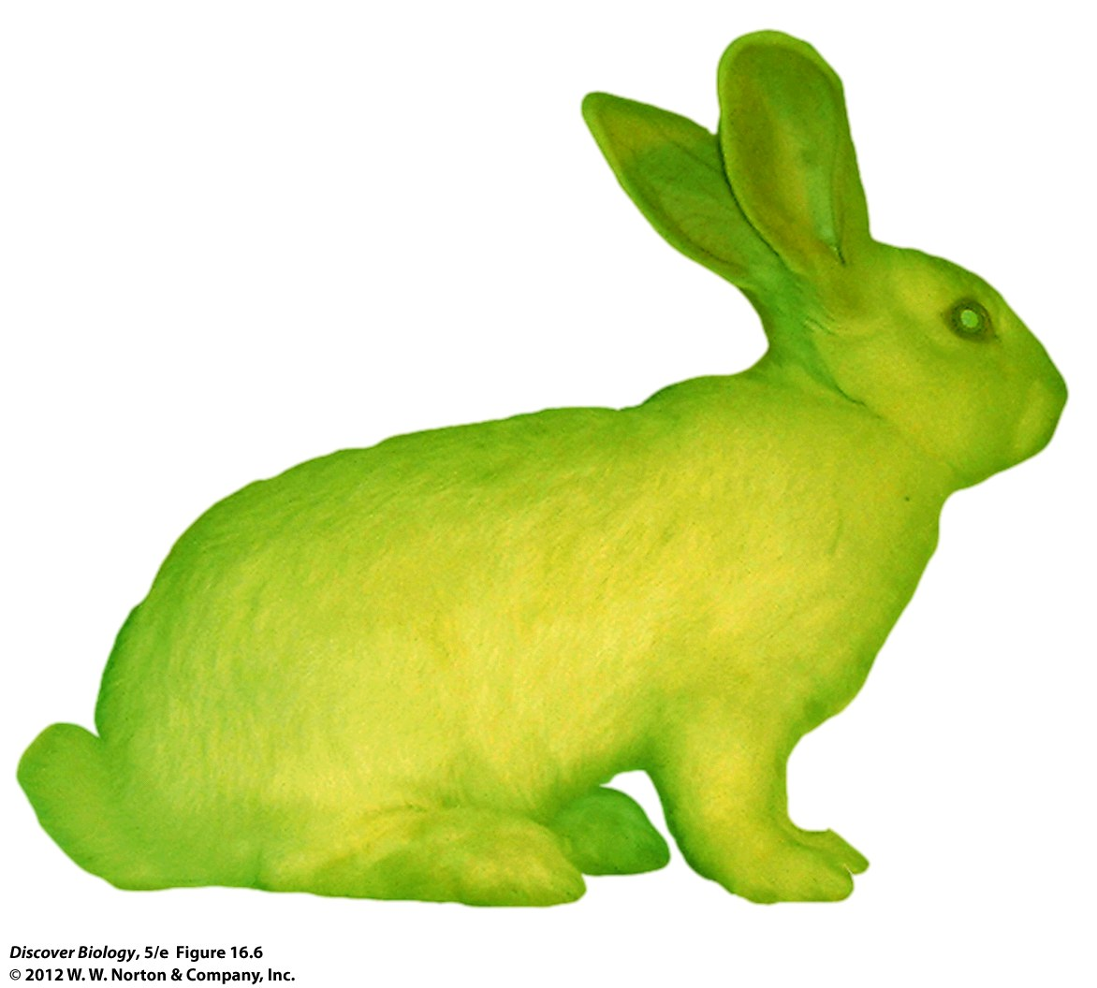
Notes:
Figure 16.6 Alba, a White Rabbit Genetically Modified to Glow
A gene coding for a jellyfish protein called green fluorescent protein (GFP) was introduced into the fertilized egg from which this rabbit developed. Attaching this gene to genes that encode small components of the cell that would otherwise be very difficult to visualize has led to tremendous advances in our understanding of basic cell biology. The three scientists who contributed to the discovery and use of GFP in biology and biomedicine shared the 2008 Nobel Prize in Chemistry.

Slide 20
Genetic Engineering
Genetic engineering is commonly used to alter the genetic characteristics of the recipient organism in order to increase productivity or performance
Genetic engineering is also used to produce large amounts of a gene product, usually one with therapeutic or commercial value

Slide 21
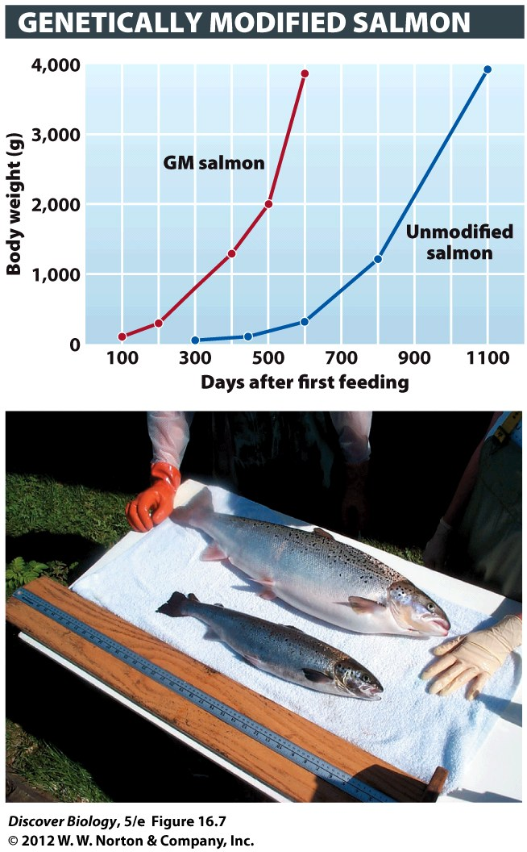
Notes:
Figure 16.7 Genetically Modified Organisms—Good or Bad?
Genetically modified salmon eat more food and grow more rapidly compared to unmodified fish.

Slide 22
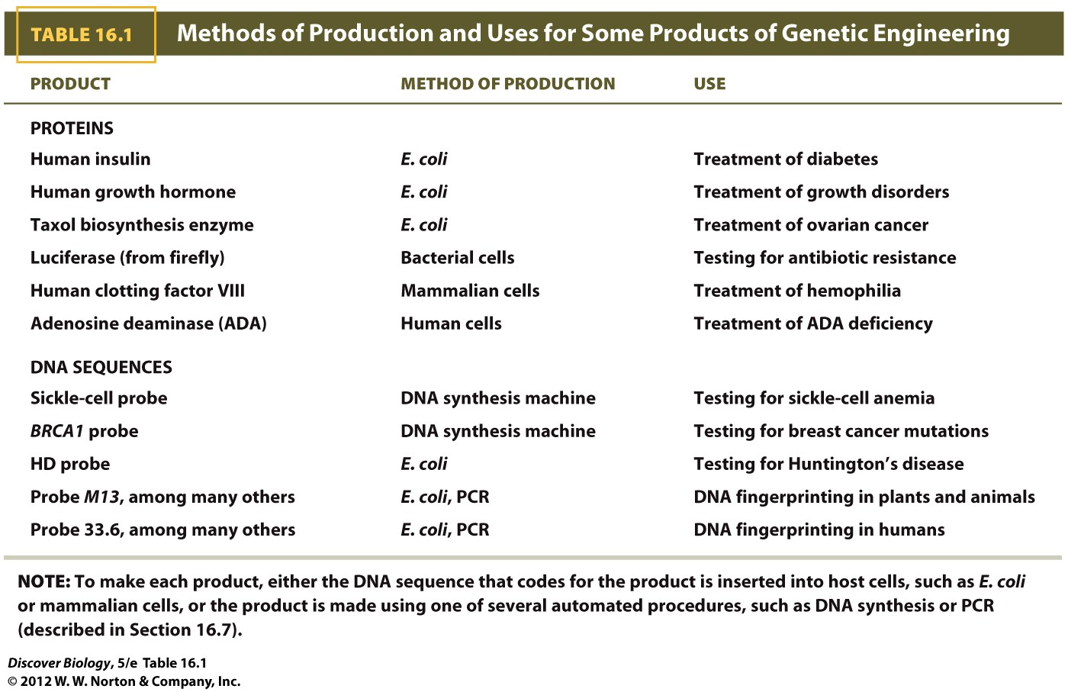

Slide 23
Human Gene Therapy
Gene therapy seeks to correct genetic disorders by altering gene function
In 1990, Ashanthi DeSilva was the first human to receive gene therapy when she was the recipient of genetically modified versions of her own white blood cells
Gene therapy is a controversial field of study with risks as well as benefits
RNA interference (RNAi) is a relatively new mechanism that selectively blocks the expression of a given gene and may increase the success of gene therapy

Slide 24
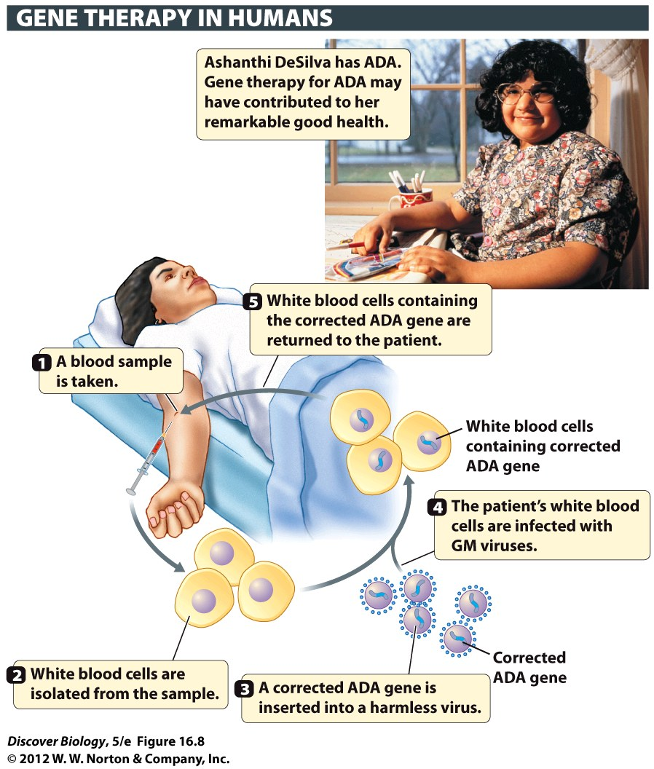
Notes:
Figure 16.8 Gene Therapy Has Been Used to Treat ADA Deficiency

Slide 25
Ethical and Social Dimensions of DNA Technology
Genetic engineering raises ethical concerns in the minds of some who ask how we can assume we have the right to alter the DNA of other species
Some see no ethical conflict in altering the DNA of a bacterium or a virus but object to changing the genome of a food plant or an animal like a dog or a chimpanzee

Slide 26
Ethical and Social Dimensions of DNA
Technology
Genetically modified bacteria produce such things as insulin, blood-clotting proteins for hemophiliacs, and clot-dissolving enzymes for stroke victims
Some environmentalists worry that engineering crops can have harmful effects on soil, water, and other animals
Environmentalists and conservationists worry that genetically modified organisms will threaten the integrity of wild populations
The debate over genetically modified organisms (GMOs) tends to center on political and socioeconomic issues as well as biological ones

Slide 27
A Closer Look at Some Tools of DNA Technology
Scientists use a collection of enzymes “borrowed” from cells and viruses to strip away other macromolecules until just the DNA remains
Most of the methods used by scientists to produce genetically modified organisms have come from nature and have been honed by evolutionary processes

Slide 28
Enzymes Are Used to Cut and Join DNA
Once DNA is extracted, it must be split into more manageable pieces by restriction enzymes, which cut the DNA at highly specific sites
DNA ligase is an enzyme used to insert one piece of DNA into another molecule, creating a recombinant DNA molecule

Slide 29
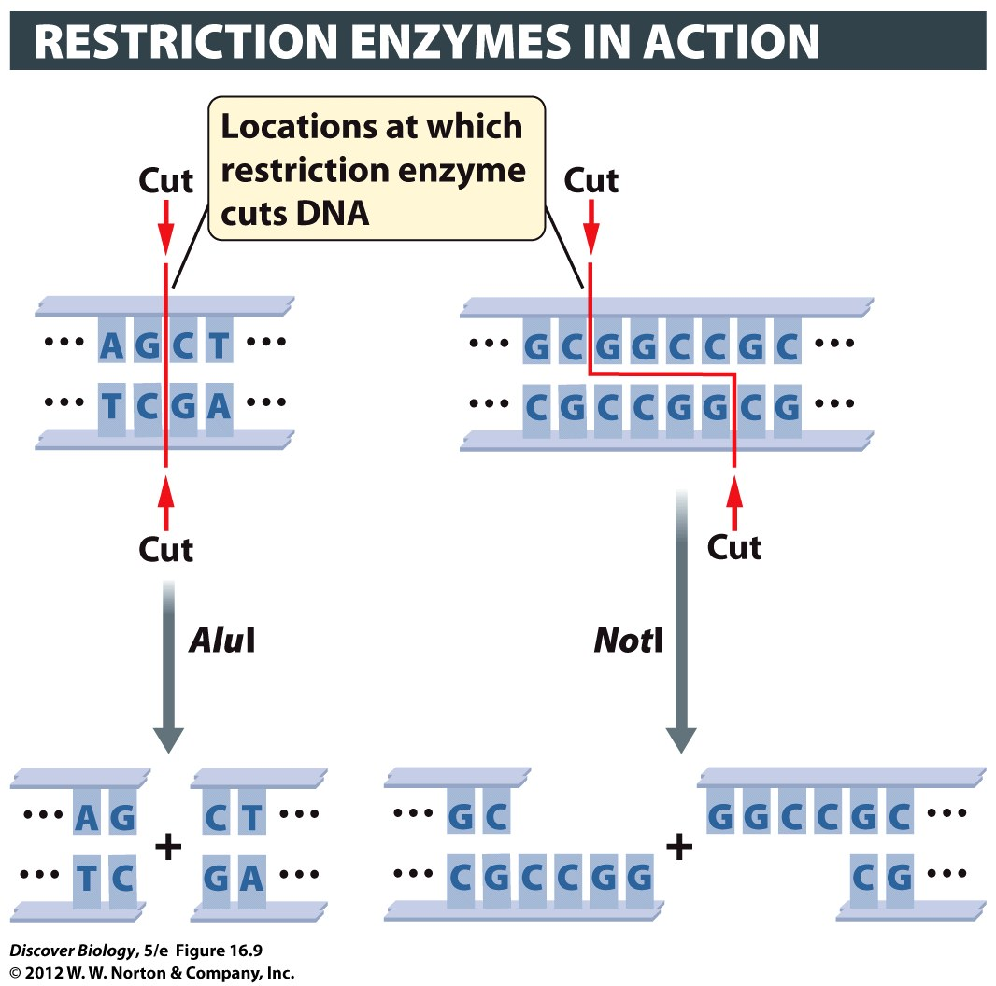
Notes:
Figure 16.9 Restriction Enzymes Cut DNA at Specific Places
The restriction enzyme AluI specifically binds to and then cuts the DNA molecule wherever the sequence AGCT occurs. Another restriction enzyme, NotI, specifically binds to and cuts the DNA sequence GCGGCCGC. Each enzyme binds to and cuts its own special target sequence, and no other.

Slide 30
Gel Electrophoresis Sorts
DNA Fragments by Size
Gel electrophoresis allows scientists to see and analyze DNA fragments
With the help of an electrical current, DNA is passed through a special gel that sorts the fragments based on size, allowing scientists to examine differences in DNA sequences

Slide 31
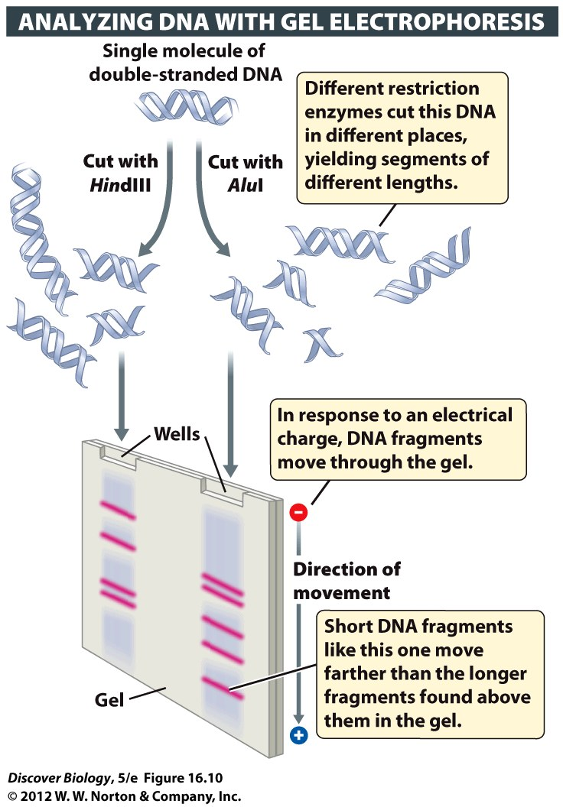
Notes:
Figure 16.10 DNA Fragments Can Be Separated by Gel Electrophoresis
Gel electrophoresis is used to separate and visualize biomolecules. When subjected to an electrical current, DNA fragments move through a gel at different rates, depending on their size. Larger molecules move slowly, while smaller molecules move quickly. To enable visualization of the DNA, the gel is commonly stained with a DNA-binding dye ethidium bromide that glows pink when exposed to ultraviolet light.

Slide 32
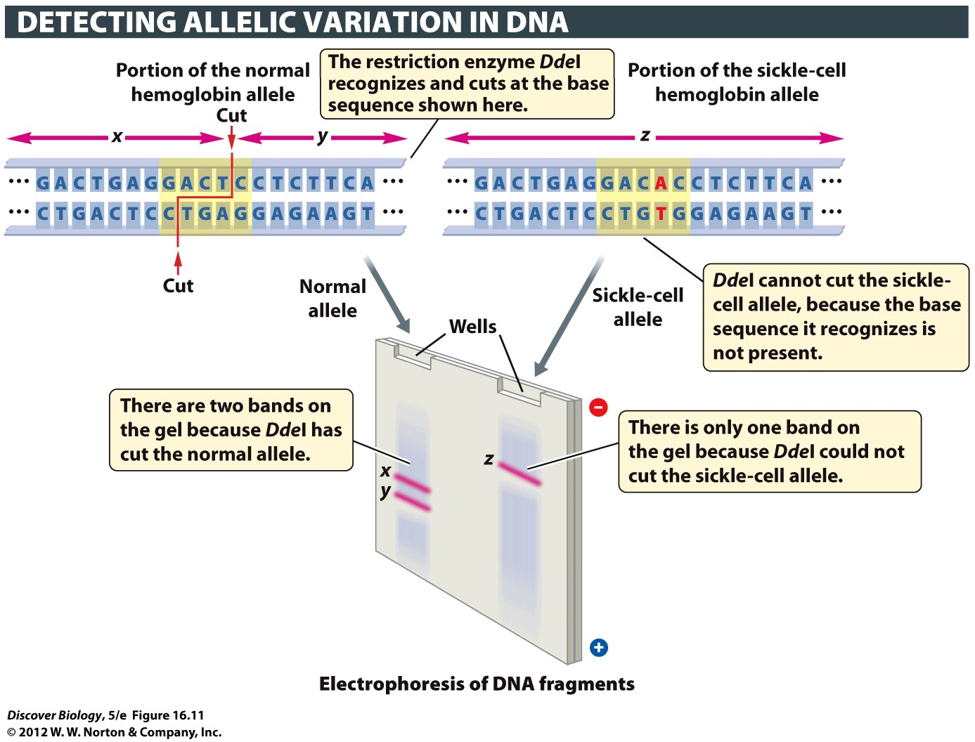
Notes:
Figure 16.11 Restriction Enzymes and Gel Electrophoresis Can Be Used to Identify the Sickle-Cell Allele
The restriction enzyme DdeI cuts DNA wherever it encounters the sequence GACTC (shown in yellow in the top panels). Only one such sequence occurs in the normal allele of the hemoglobin gene. A single base pair mutation (in which T-A becomes A-T) causes sickle-cell anemia; this mutation occurs in the GACTC sequence, and changes the sequence to GACAC. Since DdeI cannot recognize the mutant sequence GACAC, it does not cut the DNA at this location. As a result, the sickle-cell allele produces only one band on the gel, whereas the normal hemoglobin allele shows up as two bands on the gel, representing two fragments of different sizes.

Slide 33
DNA Sequencing and DNA Synthesis Are Key Tools in Biotechnology
DNA sequencing enables researchers to identify the sequence of nucleotides in a DNA fragment, a gene, or an entire organism
Automated sequencing machines can quickly identify over a million bases per day, making it possible to determine the sequence of entire genomes relatively quickly
Proteomics is a new field of study focused on the full set of proteins encoded by genes

Slide 34
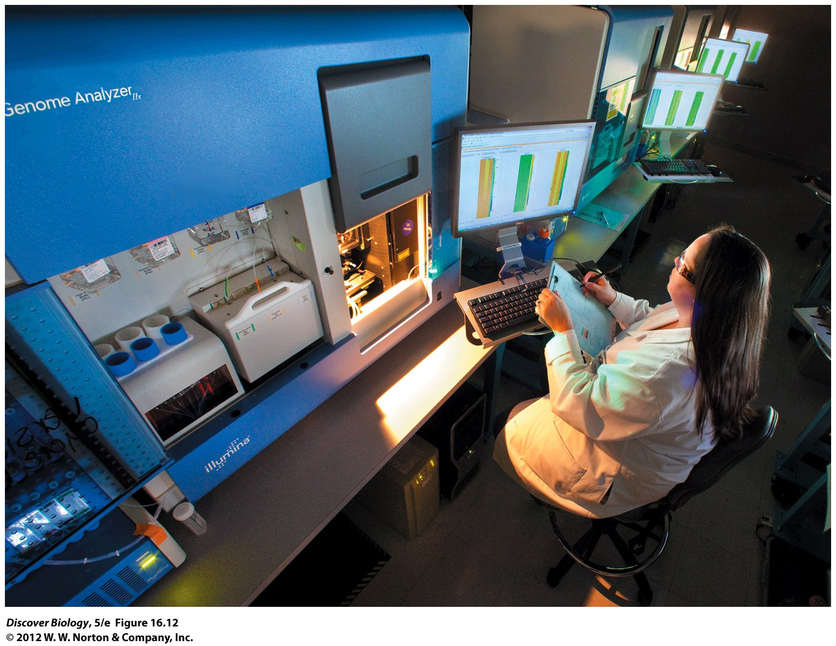
Notes:
Figure 16.12 Machines Can Sequence DNA
Automated DNA sequencing machines can rapidly determine the nucleotide (base) sequence of a DNA fragment. Here a scientist examines a computer display showing part of an automated DNA sequencing gel. Each of the four chemical bases in DNA is represented by a different color (red, green blue, or yellow).

Slide 35
DNA Sequencing and DNA Synthesis Are Key Tools in Biotechnology
DNA probes are single-stranded DNA segments that are synthesized in a lab and can be used to help find a gene of interest in a sample of DNA under investigation
In DNA hybridization, the target DNA is cut into fragments by restriction enzymes and converted to a single-stranded form
When the single-stranded probe encounters a complementary sequence of single-stranded DNA in the target, it will bind to it in a process called hybridization

Slide 36
PCR Is Used to Amplify Small
Quantities of Target DNA
A polymerase chain reaction (PCR) uses a special type of DNA polymerase to quickly make billions of copies of a targeted sequence of DNA
Two short segments of synthetic DNA, called DNA primers, bind to each end of the DNA segment, initiating replication
PCR is used in diverse fields such as medical diagnostics, forensics, paternity testing, and paleoanthropology to amplify the DNA collected from only a few cells

Slide 37
DNA Cloning Is a Means of
Propagating Recombinant DNA
Biologists generally clone a DNA fragment by linking it to other DNA fragments to create a recombinant molecule
The molecule is then introduced into a host cell, which will make many identical copies of it
DNA cloning is a key step in the study of genes that cause inherited genetic disorders and cancers

Slide 38
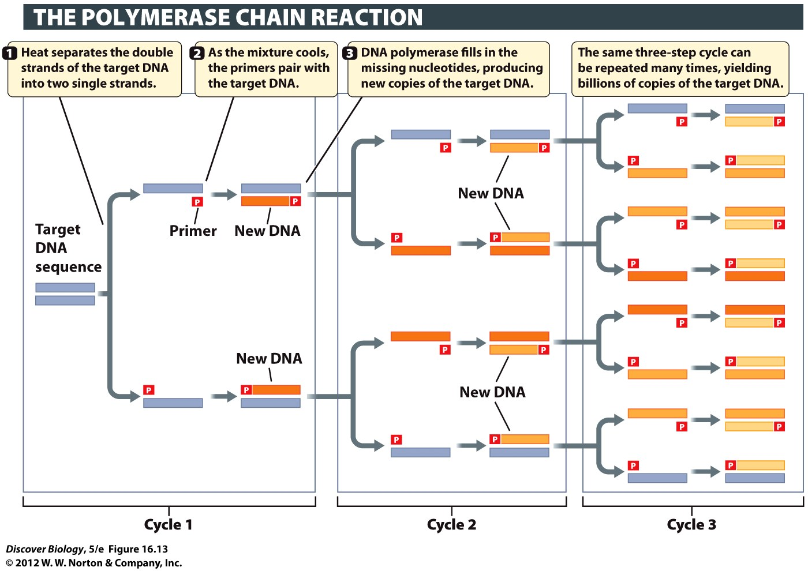
Notes:
Figure 16.13 Small Amounts of DNA Can Be Amplified More than a Million-fold through PCR
Short primers (red) that can pair with the two ends of a gene of interest (bluish gray) are mixed in a test tube with a sample of the target DNA, the enzyme DNA polymerase, and all four nucleotides (A, C, G, and T). A machine then processes the mixture through the three steps shown, in which the temperature is first raised and then lowered, to double the number of double-stranded versions of the template sequence. The doubling process can be repeated many times (only three cycles are shown here). For clarity, color coding is used to identify the template DNA sequence in the first cycle (bluish gray), the DNA that is newly made in each cycle (shades of orange), and the primers (red).

Slide 39
How to Make a Plantimal, How to Make a Little Girl Well
Kac’s plantimal was created using recombinant plasmids, which infected the bacteria, which in turn infected the plant cells and carried the genetically modified plasmid into the plant cells
Gene therapy can only treat genetic diseases, not cure them, and must be repeated to keep the person healthy

Slide 40
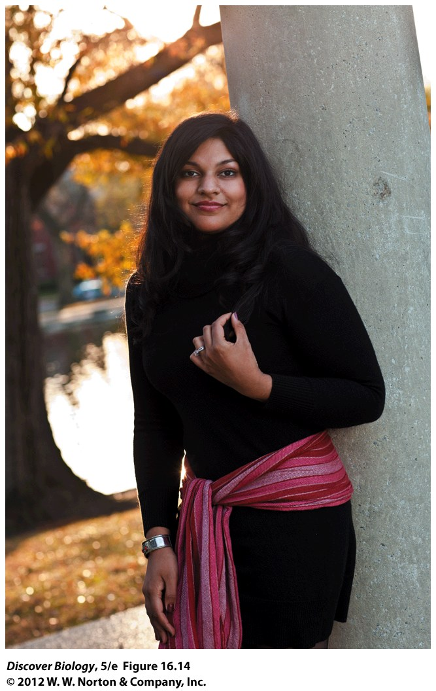
Notes:
Figure 16.14 Ashanthi DeSilva
In 1990, when Ashanthi DeSilva was 4 years old, researchers tried an experimental treatment, injecting her with cells that had been genetically modified to make a critical enzyme that her own cells were unable to make. Today, DeSilva is a healthy young woman with a career in international development.

Slide 41
Clicker Questions
CHAPTER 16
DNA Technology

Slide 42
Concept Quiz
What is an advantage of restriction enzymes?
They cut DNA into manageable pieces.
They cut at a specific sequence and, therefore, give consistent results.
They leave sticky ends, which can be used in cloning.
All of the above
Notes:
The correct answer is D. These are all advantages of restriction enzymes.
A and B are useful during cloning.
C is useful for DNA fingerprinting.

Slide 43
Concept Quiz
The purpose of a DNA library is to
Store DNA.
Isolate specific genes.
Access DNA sequence information.
Genetically modify E. coli.
Notes:
The correct answer is B.
DNA is not stored in a library.
DNA sequence information can be derived once a clone has been isolated, but not directly from a DNA library.
The E. coli do become genetically modified, but this is not the reason for doing this.

Slide 44
Concept Quiz
RFLP analysis
Is one method of DNA fingerprinting.
Provides 100% accurate positive results.
Is used in diagnosis of human diseases.
All of the above
Notes:
The correct answer is A.
A positive result in RFLP provides a probability that a match has been made, not 100% certainty. This probability is between 1 in 100,000 and 1 in one billion, depending on how many markers are used.
RFPL is used for forensic and paternity identification, not disease diagnosis.

