Slide 1
Discover Biology FIFTH EDITION
Anu Singh-Cundy • Michael L. Cain
CHAPTER 15
From Gene to Protein
© 2012 W. W. Norton & Company, Inc.

Slide 2
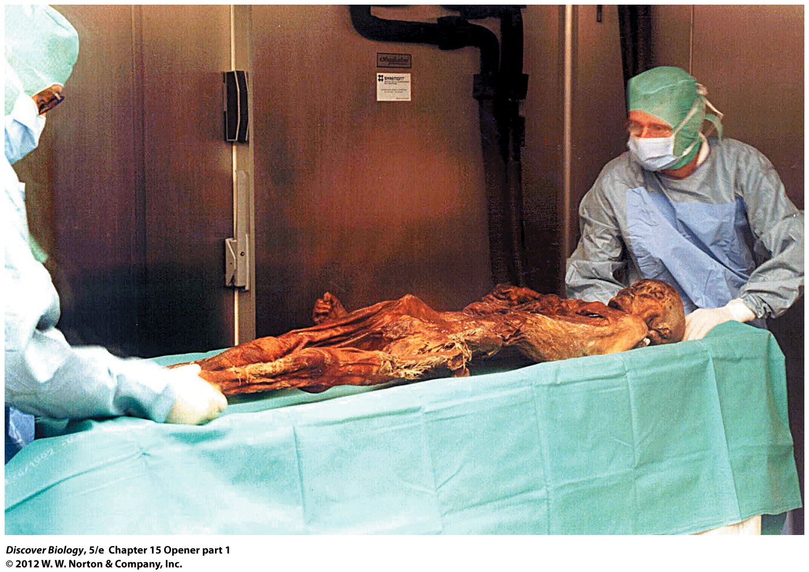
Notes:
Ötzi, the Iceman.
In 1991, hikers discovered the body of a man who lived thousands of years ago, lying at the base of a melting glacier. Long-frozen DNA sequences revealed how he was related to modern Europeans and how he may have died.

Slide 3
The Man from the Copper Age
In 1991, hikers discovered a well-preserved mummy in the Italian Alps
Scientists estimated the mummy was from the Copper Age and proceeded to use DNA to accurately date the incredible discovery

Slide 4
How Do Genes Store the Information Needed to Build RNA and Proteins?
Scientists work to understand how gene mutations produce new phenotypes, including disease phenotypes
Genetic information is encoded in genes and is then used to build proteins as directed

Slide 5
How Genes Work
Proteins, especially enzymes, are essential to all life
Enzymes, along with the internal and external environment, are the key determinants of an organism’s phenotype
In the early twentieth century, scientists hypothesized that genes were responsible for enzyme production and that metabolic disorders were caused by enzyme deficiencies

Slide 6
Genes Contain Information for Building RNA Molecules
A gene is any DNA sequence that is transcribed into RNA
DNA molecules are double-stranded nucleic acids, while RNA molecules are single-stranded
DNA strands form a double helix, while RNA molecules can assume a variety of three-dimensional shapes
DNA and RNA also differ in the type of sugar used, and RNA uses the base uracil in place of thymine on the DNA molecule

Slide 7
Notes:
Figure 15.1 RNA Is a Single-Stranded Chain of Nucleotides

Slide 8
Three Types of RNA Assist in the Manufacture of Proteins
Cells use three main types of RNA molecules to construct proteins:
Messenger RNA (mRNA)
Ribosomal RNA (rRNA)
Transfer RNA (tRNA)

Slide 9
How Genes Guide the Manufacture of Proteins
A complementary mRNA sequence is made using the information in the DNA sequence of that gene during the process of transcription
During translation, amino acids are covalently linked in the sequence dictated by the base sequence of the mRNA
Translation requires other types of RNA, called rRNA and tRNA, to carry out the process

Slide 10
How Genes Guide the Manufacture of Proteins
The base sequence of the mRNA molecule dictates which tRNAs are bound, and therefore which amino acids are delivered at the ribosomes
The ribosomes use the mRNA, tRNA, and amino acids to synthesize a protein, with the exact correct sequence of amino acids determined by the base sequence of mRNA

Slide 11
Notes:
Figure 15.2 Genetic Information Flows from DNA to RNA to Protein during Transcription and Translation
The transcription of a protein-coding gene produces an mRNA molecule, which is then transported to the cytoplasm, where translation occurs and the protein is made with the help of ribosomes. Different amino acids in the protein being constructed at the ribosome are represented here by different colors and shapes.

Slide 12
Transcription: Information Flow from DNA to RNA
RNA polymerase is the key enzyme in the transcription of a gene
Only a small portion of the chromosome is copied into RNA during transcription
Transcription begins when RNA polymerase binds to a segment of DNA called a promoter, which is easily recognized and begins to unwind the DNA

Slide 13
Transcription: Information Flow from DNA to RNA
One strand of the DNA is used as a template strand to build an mRNA molecule
The position of the promoter specifies which DNA strand will serve as the template
Transcription stops when RNA polymerase reaches a sequence of bases called a terminator

Slide 14
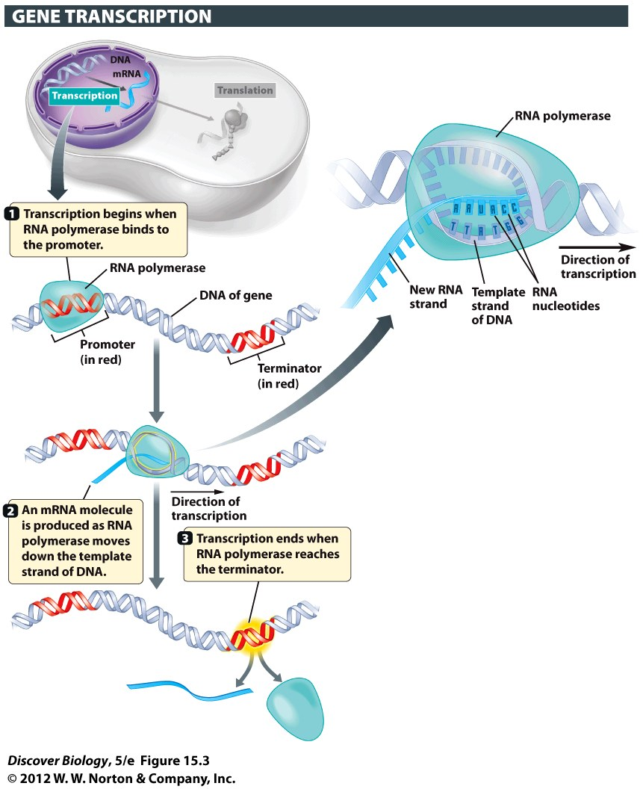
Notes:
Figure 15.3 RNA Polymerase Transcribes DNA-Based Information into RNA-Based Information

Slide 15
Transcription: Information Flow from DNA to RNA
Transcription in eukaryotes also includes chemical modification of both ends of the mRNA
The newly formed mRNA undergoes RNA splicing, which removes the introns, and is then allowed to leave the nucleus through the nuclear pore

Slide 16
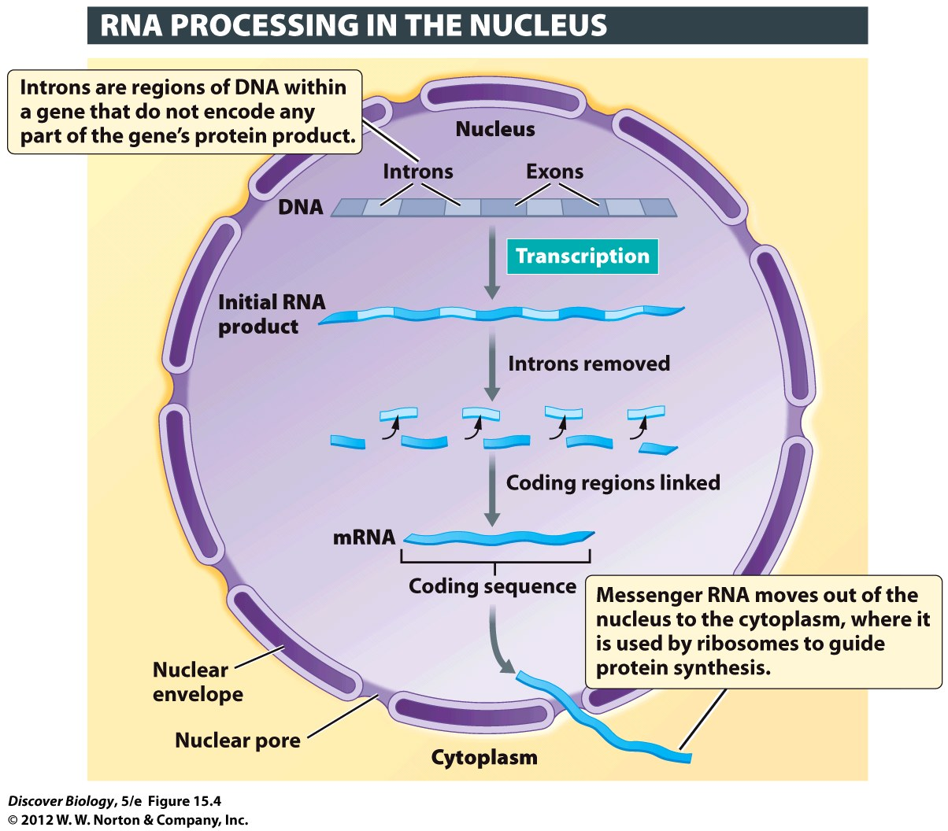
Notes:
Figure 15.4 In Eukaryotes, Introns Must Be Removed Before an mRNA Leaves the Nucleus
Most eukaryotic genes contain both coding sequences (exons) and noncoding sequences (introns). Before the mRNA transcribed from such genes can be exported to the cytoplasm, enzymes in the nucleus must remove the introns and link the remaining exons.

Slide 17
The Genetic Code
Each unique sequence of three bases is called a codon
There are 64 codons that make up the information in the genetic code
When reading the code, the cell begins at the start codon, AUG, and ends at one of three stop codons, UAA, UAG, or UGA

Slide 18
The Genetic Code
The genetic code has several distinct characteristics:
It is unambiguous
It is redundant
It is virtually universal

Slide 19
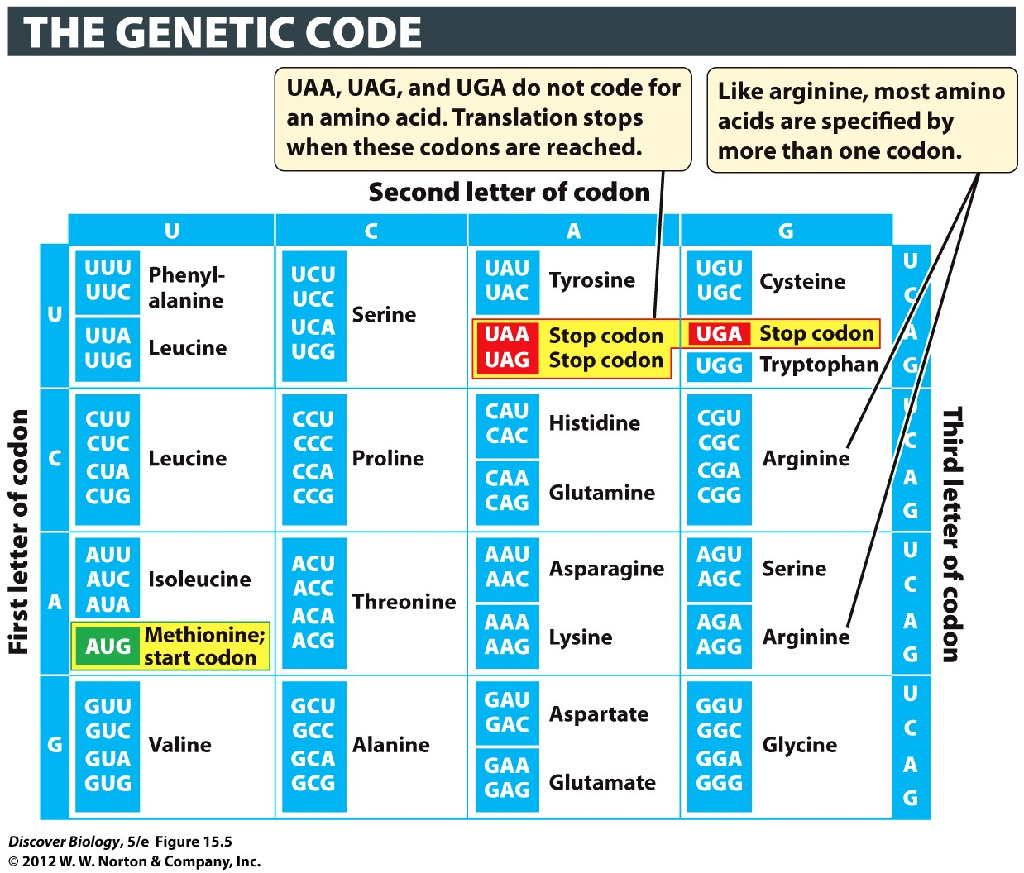
Notes:
Figure 15.5 The 64 Possible Codons Specify Amino Acids or Signals That Start or Stop Translation

Slide 20
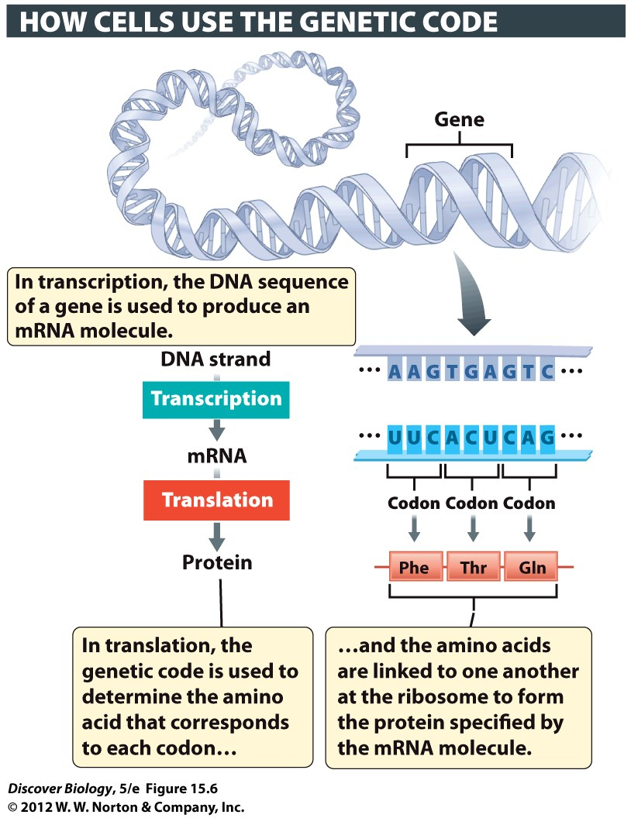
Notes:
Figure 15.6 The Genetic Code Is Read in Sets of Three Bases, Each Set Constituting a Codon

Slide 21
Translation: Information Flow from mRNA to Protein
Translation is the process of converting a sequence of bases in mRNA to a sequence of amino acids in a protein
Translation occurs at the ribosomes, which are made up of proteins and rRNA
The tRNA specializes in binding to one specific amino acid, and it recognizes and pairs with specific codons in the mRNA

Slide 22
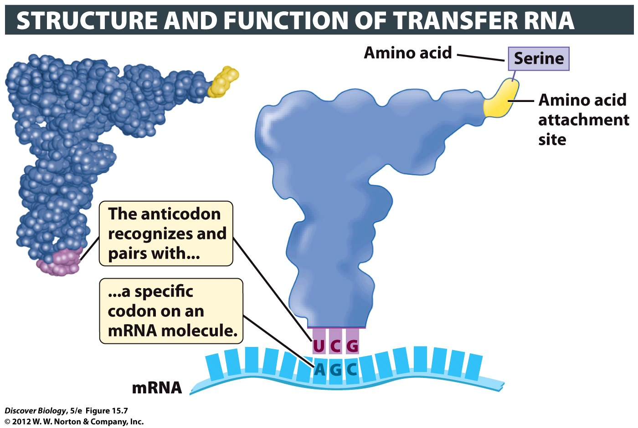
Notes:
Figure 15.7 Transfer RNA Delivers Amino Acids Specified by mRNA Codons
A space-filling-model (left) and a diagrammatic version (right) illustrate the general structure of all tRNA molecules. Similar regions in the space-filling model and on the diagram are shown in matching colors. Each tRNA carries a specific amino acid (serine in this example) and has a specific anticodon sequence (UCG in this example) that binds to a complementary three-base sequence (the codon) in the mRNA.

Slide 23
Translation: Information Flow from mRNA to Protein
An anticodon is a three-base sequence that determines which codons on the mRNA can be recognized by the tRNA
Translation begins when the tRNA molecule recognizes and pairs with the AUG of the start codon
Each codon on the mRNA is recognized by a specific tRNA, and the ribosome adds the amino acid delivered by this tRNA to the growing amino acid chain
The process continues until a stop codon is reached and the mRNA and the completed amino acid chain both separate from the ribosome

Slide 24
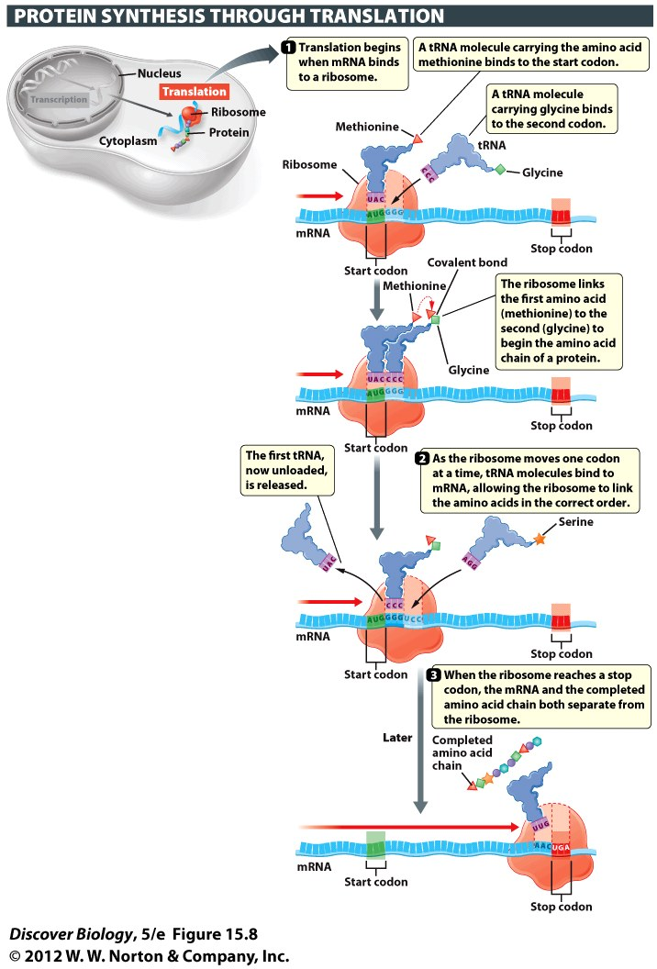
Notes:
Figure 15.8 In Translation, Information Coded in mRNA Directs the Synthesis of a Protein That Has a Particular Amino Acid Sequence

Slide 25
The Effects of Mutations on Protein Synthesis
A mutations is a change in the base sequence of an organism’s DNA
Mutations can range from a change in the identity of a single base pair to the deletion of one or more whole chromosomes

Slide 26
Mutations Can Alter One or Many Bases in a Gene’s DNA Sequence
There are three major types of mutations:
Substitutions
Insertions
Deletions
Mutations in which a single base is altered are called point mutations
A substitution mutation occurs when one base is substituted for another in a DNA sequence

Slide 27
Mutations Can Alter One or Many Bases in a Gene’s DNA Sequence
Insertion or deletion mutations occur when a base is inserted into or deleted from a DNA sequence
Unlike a substitution mutation, an insertion or deletion mutation causes a genetic frameshift, which changes the sequence of amino acids
In most cases, frameshift mutations alter the resulting protein so severely that it fails to function

Slide 28
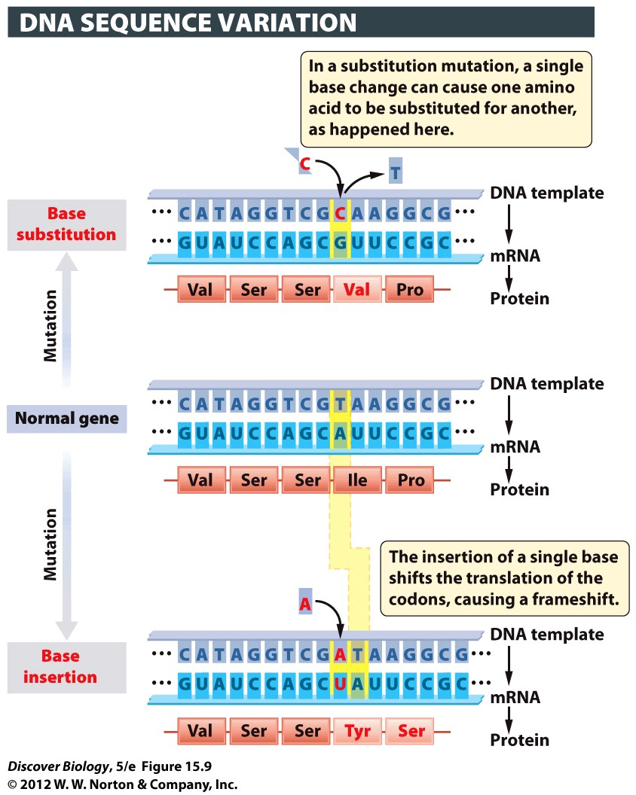
Notes:
Figure 15.9 A Change in the DNA Sequence Translates into a Change in the Amino Acid Sequence of the Protein
Two kinds of mutations are shown here: a substitution and an insertion. In each case, the mutation and its effects on transcription and translation are shown in red.

Slide 29
Mutations Can Cause a Change in Protein Function
Frameshift mutations stop protein synthesis before it is complete or alter the identity of many amino acids in a protein
A silent mutation causes no change in the structure of the protein, and therefore no change in the phenotype of the organism
Some mutations can be beneficial and improve the efficiency or functionality of a protein

Slide 30
Putting It All Together: From Gene to Protein to Phenotype
Transcription and translation are the two major steps in the synthesis of a protein from the information in its corresponding gene
Proteins encoded by genes are essential to life, and a mutation in a gene can alter the sequence of amino acids in the gene’s protein product

Slide 31
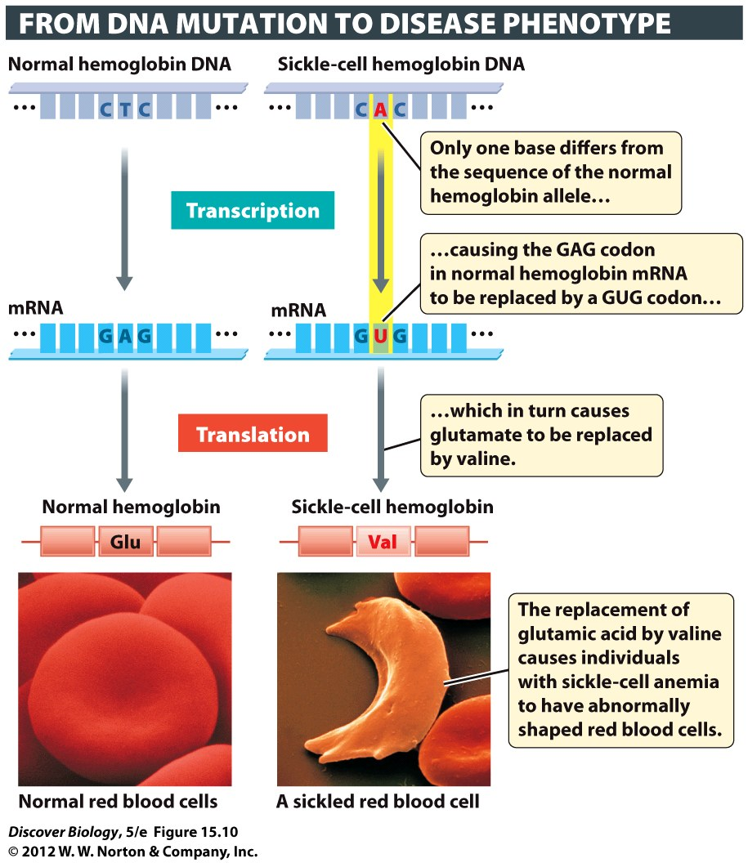
Notes:
Figure 15.10 Mutations in a Single Base in the Hemoglobin Gene Can Lead to Sickle-Cell Anemia

Slide 32
CSI: Copper Age
Through DNA analysis and DNA fingerprinting, scientists were able to determine, not only the age of the Iceman, but also where he lived and how he died, and even to analyze the blood on his weapons
DNA evidence revealed that the Iceman carried the K gene, which is found in 6% of ethnic Europeans

Slide 33
Clicker Questions
CHAPTER 15
From Gene to Protein

Slide 34
Concept Quiz
Which of the following is true?
Transcription occurs in the cytoplasm and produces RNA.
Transcription occurs in the nucleus and produces proteins.
Translation occurs in the cytoplasm and produces proteins.
Translation occurs in the nucleus and produces RNA.
Notes:
The correct answer is C.
Students often confuse transcription and translation because they sound similar.
Translation occurs in the cytoplasm and produces proteins.
Transcription occurs in the nucleus and produces RNA.

Slide 35
Concept Quiz
Which of the following is not true about the genetic code?
It is based on three base codons.
There are 64 possible codons.
Amino acids can have more than one codon.
Every codon has a corresponding amino acid.
Notes:
The correct answer is D. Every codon doesn’t have an amino acid; three codons have no amino acids and are STOP codons.
Answers A, B, and C all contain true information about the genetic code.

Slide 36
Concept Quiz
Frameshift mutations
Occur when part of a chromosome is missing
Occur when one base is changed to another
Don’t change the structure of the protein
Include insertion and deletion mutants
Notes:
The correct answer is D.
Answer A is incorrect, because this is a chromosomal break.
Answer B is incorrect, because this is a substitution mutation.
Answer C is incorrect, because frameshifts usually destroy the function of a protein.

Slide 37
Relevant Art from Other Chapters
All art files from the book are available in JPEG and PPT formats online and on the Instructor Resource Disc

Slide 38
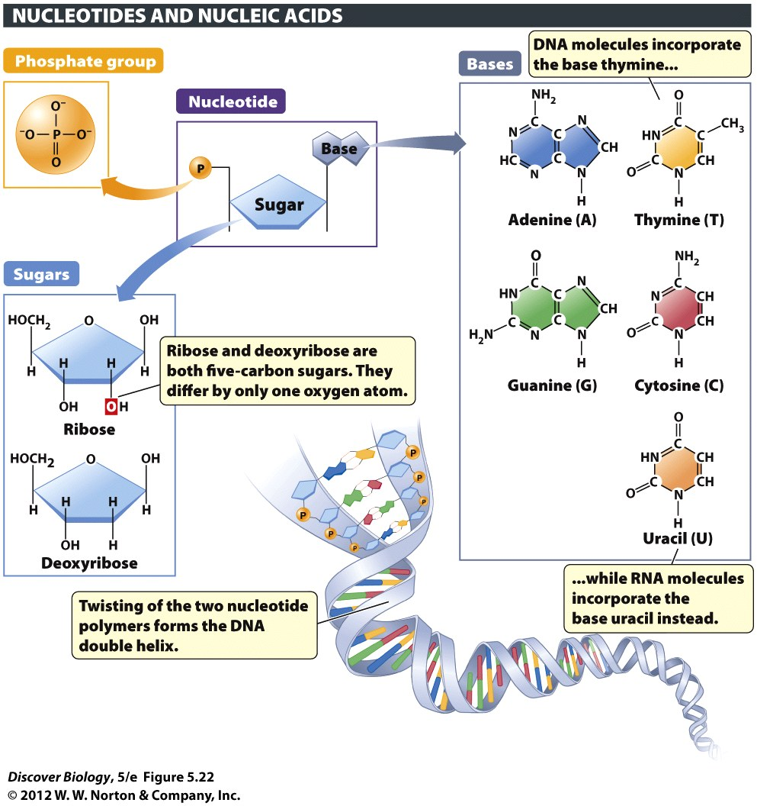
Notes:
Figure 5.22 Nucleotides Are the Building Blocks of Nucleic Acids
Each nucleotide consists of a fivecarbon sugar linked to a nitrogenous base and one or more phosphate groups. The bases adenine, guanine, cytosine, and thymine, when linked to the sugar deoxyribose, form the building blocks of DNA. The bases adenine, guanine, cytosine, and uracil, when linked to the sugar ribose, form the building blocks of RNA.

Slide 39
Notes:
Figure 14.3 The DNA Double Helix and Its Building Blocks
A nucleotide consists of three types of chemical groups: a phosphate, a sugar, and a nitrogen-containing base. DNA contains four types of nucleotides, varying only in the type of base found in them. DNA consists of two complementary strands of nucleotides that are twisted into a spiral around an imaginary axis, rather like the winding of a spiral staircase. The two strands are held together by hydrogen bonds between their complementary bases. (Inset) James Watson (left) and Francis Crick, with a model of the DNA double helix.

Slide 40
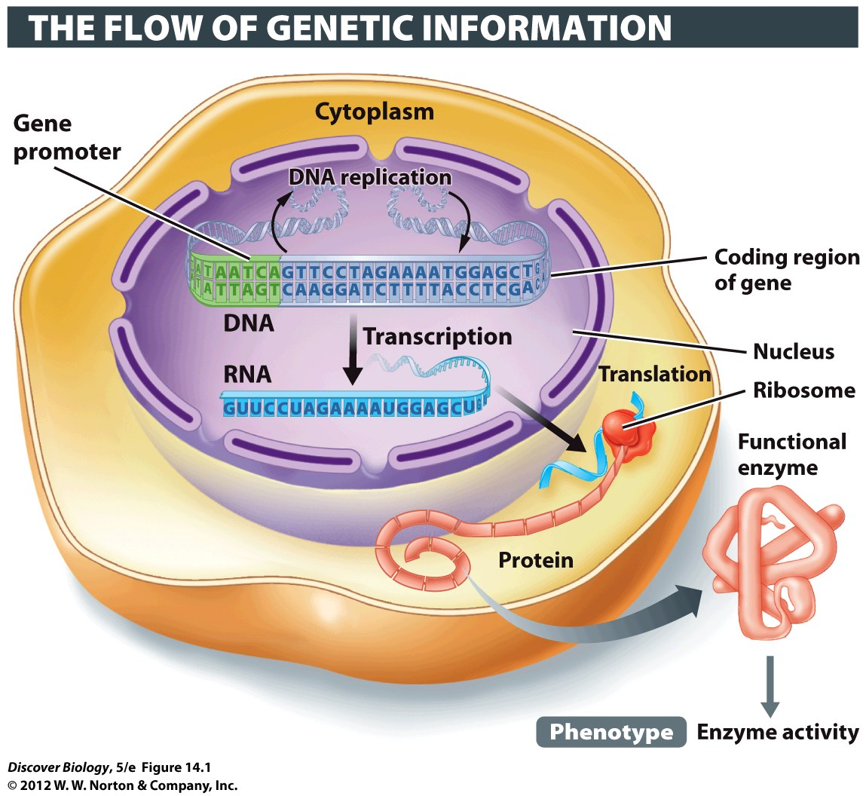
Notes:
Figure 14.1 From Gene to Phenotype at the Molecular Level
The readout of information coded in DNA produces the phenotype, such as the activity of lactase enzyme in the small intestine of humans.

Slide 41
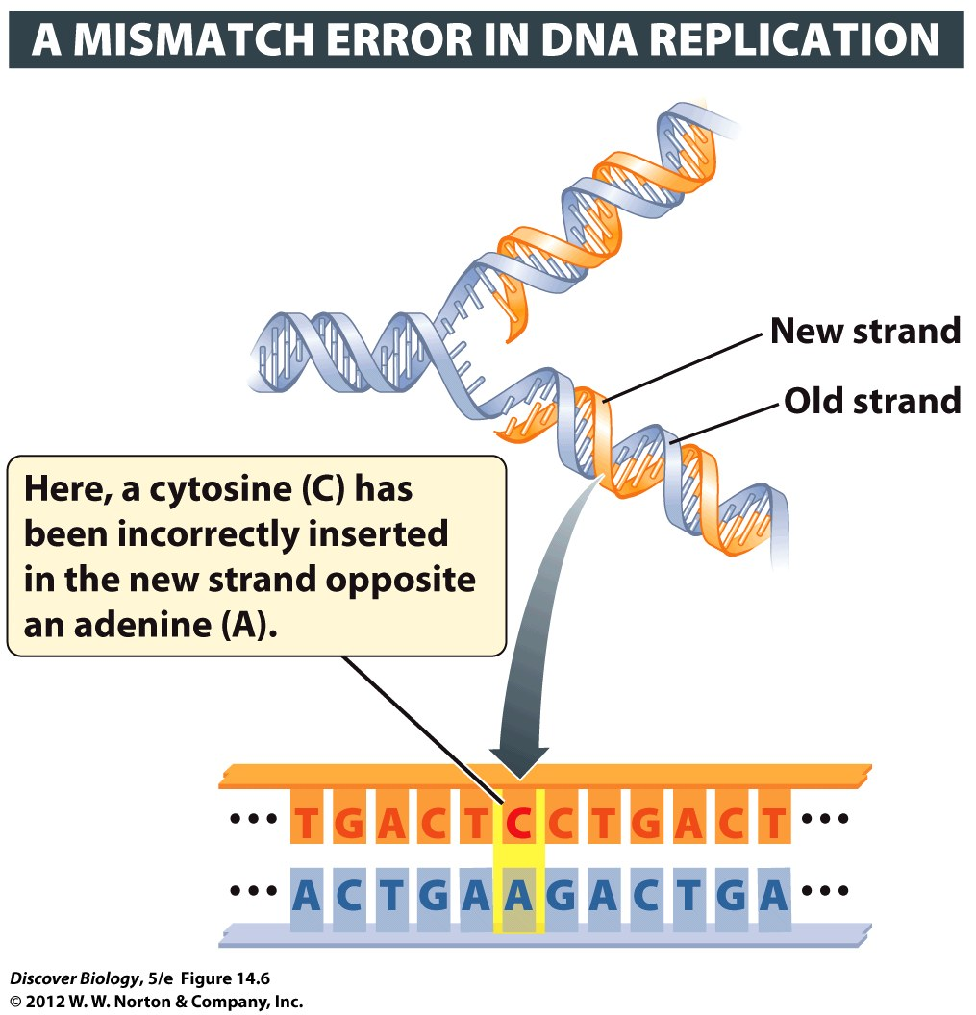
Notes:
Figure 14.6 Mistakes in DNA Replication May Lead to Mutations
DNA repair enzymes usually detect and fix mismatch errors such as the one shown here before the cell’s DNA is replicated again. If the mismatch is not repaired before the next round of DNA replication, half the daughter helices made by this DNA will have a C-G base pair in place of the original A-T base pair. Such a change in the DNA sequence constitutes a mutation.

