Slide 1
Discover Biology FIFTH EDITION
Anu Singh-Cundy • Michael L. Cain
CHAPTER 14
DNA and Genes
© 2012 W. W. Norton & Company, Inc.

Slide 2
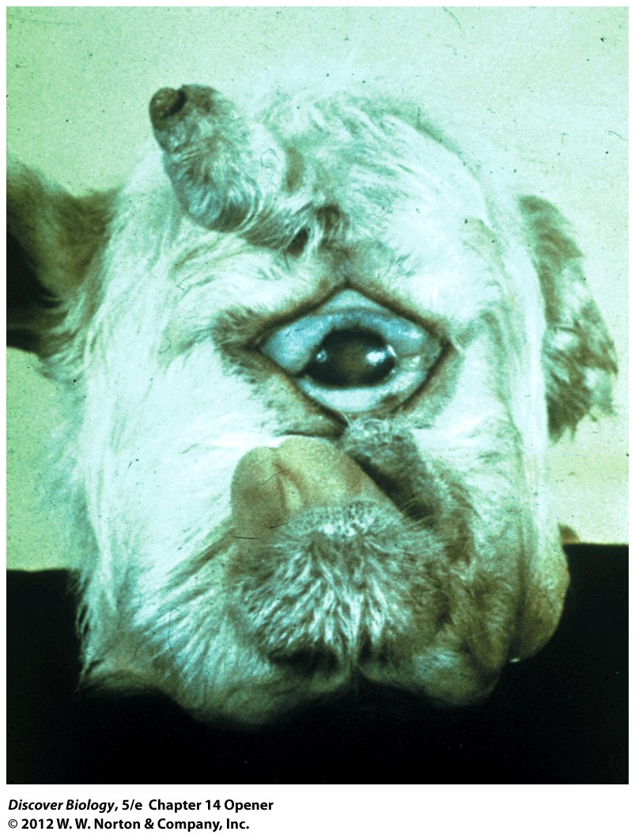
Notes:
Head of a Lamb with Cycl opia.
This lamb suffered severe birth defects, including a single large eye and a fused, malformed brain, because its mother ate a wild plant called corn lily early in pregnancy. Corn lilies make a compound that shuts down the expression of certain genes.

Slide 3
Greek Myths and One-Eyed Sheep
Cyclopia can occur in vertebrates, including sharks, fishes, amphibians, and birds, as well as mammals
Changes in the sequence of gene expression can lead to improper embryo development, causing cyclopia and other genetic defects

Slide 4
Genes Control the Inheritance of Traits
Genes control the inheritance of traits and are located on chromosomes
DNA is the genetic material that makes up genes and, therefore, chromosomes and the genotype and phenotype of an individual

Slide 5
An Overview of DNA and Genes
In the early part of the 1900s, scientists were unsure if the genetic material contained in genes was the protein or the DNA
By 1952, through a series of experiments with bacteria, biologists determined that the genetic material was DNA

Slide 6
DNA Stores Genetic Information as a Sequence of Nucleotides
DNA is a nucleic acid composed of two strands of polynucleotides twisted to form a double helix
Four different nucleotides make up polynucleotides and can be found in the DNA of all cells
All the DNA-based information in the nucleoid or nucleus of an organism is called the genome
Each species has a unique genome

Slide 7
Most Genes Code for Proteins, Which Generate Phenotypes
A gene is a segment of DNA that codes for at least one distinct genetic trait
RNA is a single-stranded nucleic acid similar to DNA
Messenger RNA (mRNA) delivers the genetic information, or instructions, from DNA to the ribosomes, where proteins are made
The conversion of a DNA-based sequence of nucleotides in a gene to an RNA-based sequence is called transcription

Slide 8
Most Genes Code for Proteins, Which Generate Phenotypes
The process by which ribosomes convert the genetic information in mRNA into proteins is known as translation
Each protein has a unique amino acid sequence, which gives it a unique function
Gene expression is the manifestation of the information encoded in a gene as a specific trait

Slide 9
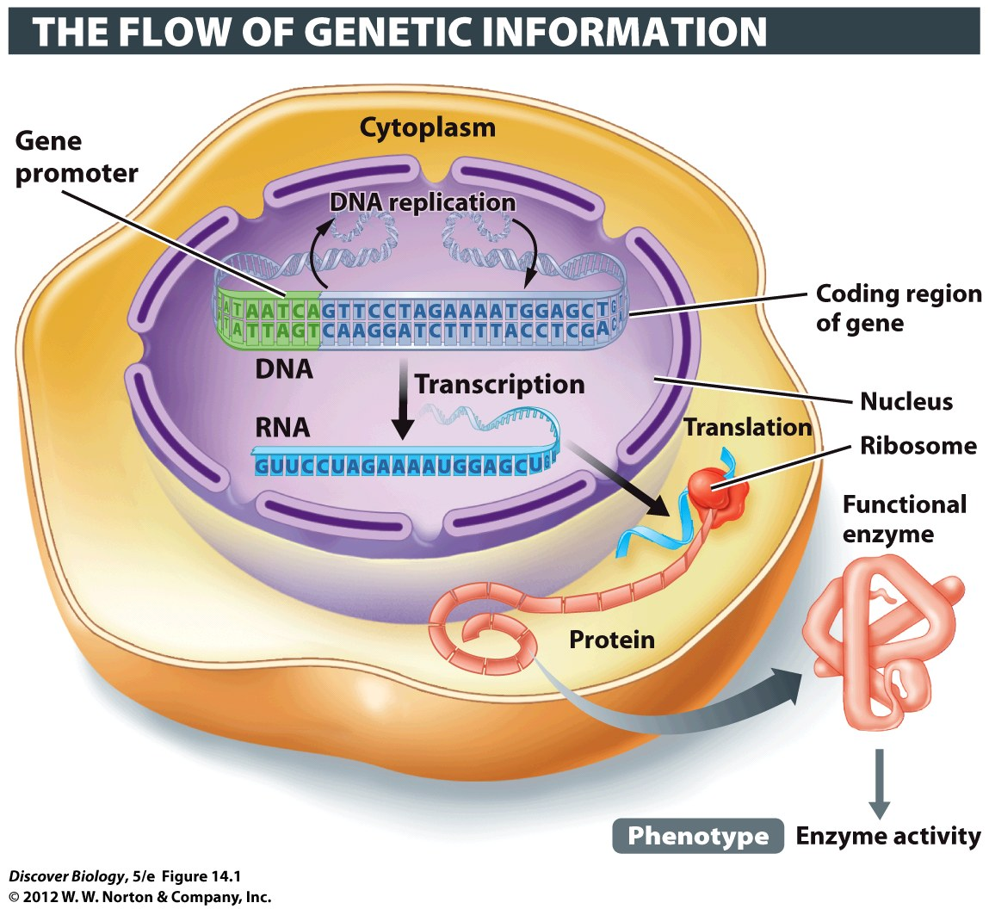
Notes:
Figure 14.1 From Gene to Phenotype at the Molecular Level
The readout of information coded in DNA produces the phenotype, such as the activity of lactase enzyme in the small intestine of humans.

Slide 10
Different Sets of Genes Are Expressed in Different Cell Types
All cells in a multicellular individual have essentially the same DNA-based information; however, not all cells express all genes
Gene promoters are sections of a gene that function as an on/off switch for transcription
The expression of developmentally regulated genes changes as an organism develops

Slide 11
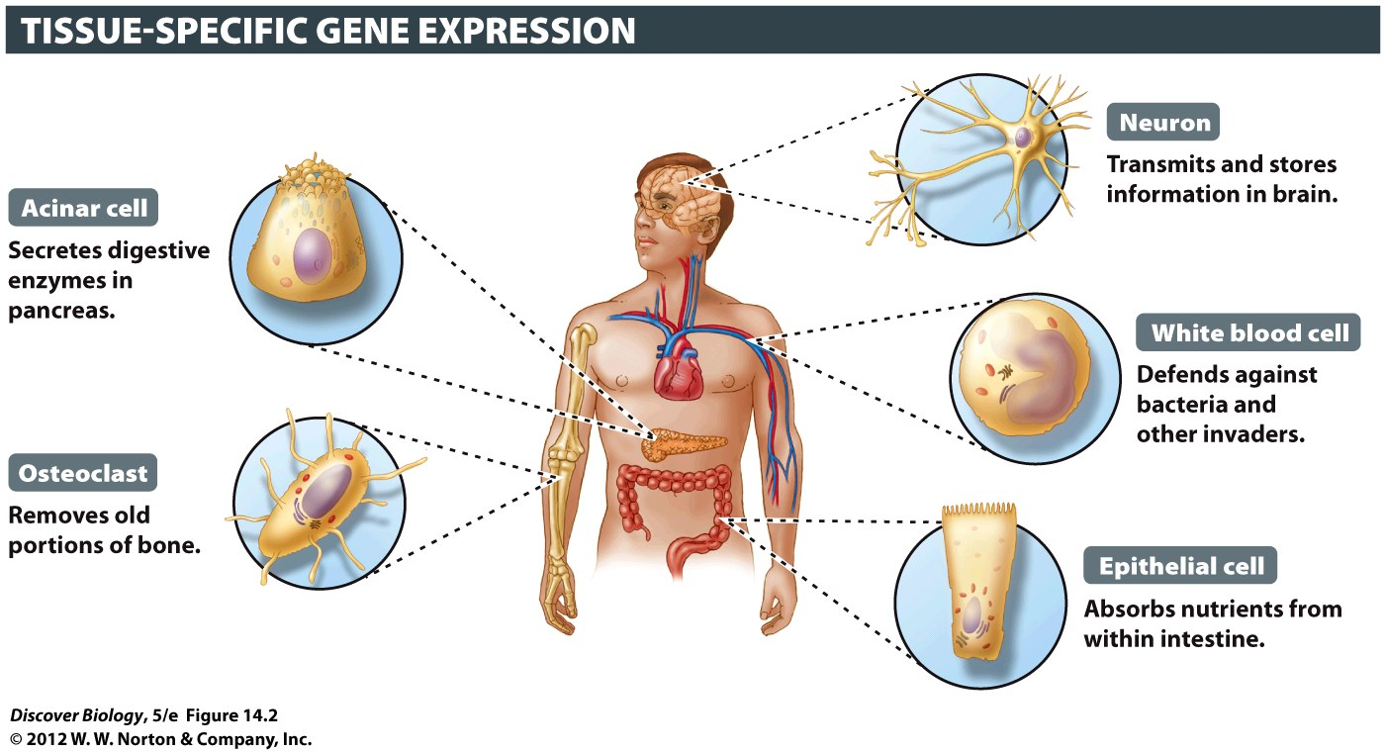
Notes:
Figure 14.2 Different Cell Types Have the Same Genes
Although all cells within a multicellular organism have the same genes, these cells can differ greatly in structure and function because different genes are active in different types of cells.

Slide 12
The Three-Dimensional Structure of DNA
James Watson and Francis Crick deciphered the physical structure of DNA in 1953
Watson and Crick won the Nobel Prize for discovering that DNA was shaped in a double helix

Slide 13
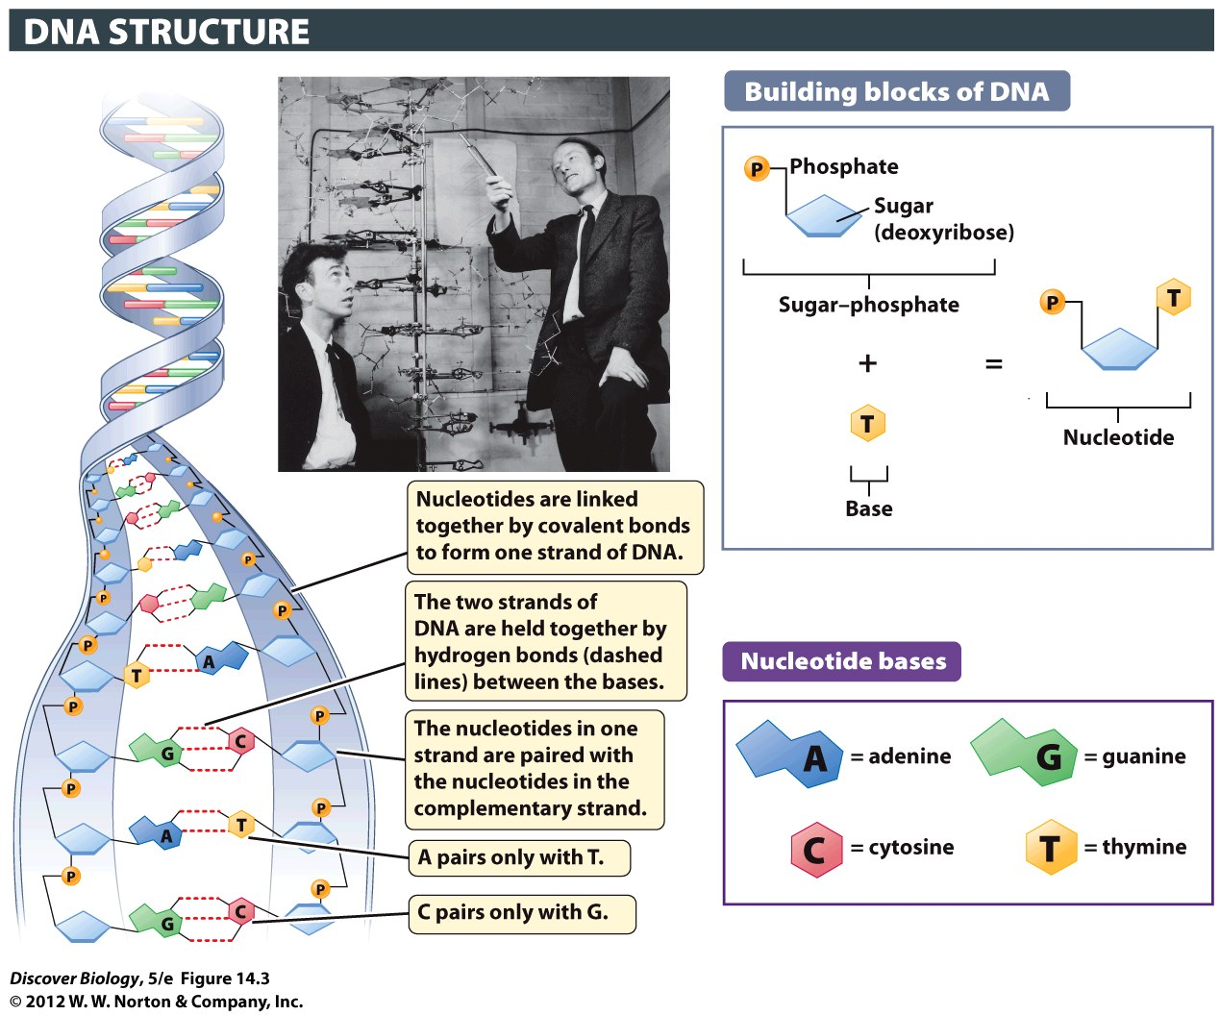
Notes:
Figure 14.3 The DNA Double Helix and Its Building Blocks
A nucleotide consists of three types of chemical groups: a phosphate, a sugar, and a nitrogen-containing base. DNA contains four types of nucleotides, varying only in the type of base found in them. DNA consists of two complementary strands of nucleotides that are twisted into a spiral around an imaginary axis, rather like the winding of a spiral staircase. The two strands are held together by hydrogen bonds between their complementary bases. (Inset) James Watson (left) and Francis Crick, with a model of the DNA double helix.

Slide 14
DNA Is Built from Two Helically Wound Polynucleotides
DNA is composed of two parallel strands of nucleotides
Each nucleotide is made up of a sugar, a phosphate group, and one of four nitrogenous bases
Adenine
Cytosine
Guanine
Thymine

Slide 15
DNA Is Built from Two Helically Wound Polynucleotides
Base pair is the term for two bases held together by hydrogen bonds in a DNA molecule
Base-pairing rules, first proposed by Watson and Crick, state that a base on one strand of DNA pairs exclusively with a corresponding base on the other strand, resulting in two complementary stands of DNA

Slide 16
DNA’s Structure Explains Its Function
A DNA sequence can store a tremendous amount of information in the order of the bases along the DNA molecule
Each species, and each individual within the species, has a different sequence of bases in their DNA
Differences in DNA sequences account for genetic variation

Slide 17
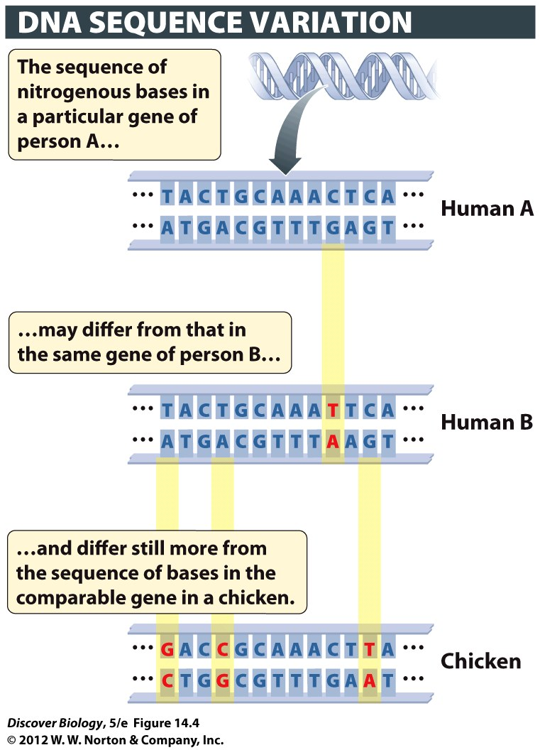
Notes:
Figure 14.4 The Sequence of Bases in DNA Differs among Species and among Individuals within a Species
Here the sequence of bases in a hypothetical gene is compared for two humans (A and B) and a chicken. Base pairs highlighted in yellow are variant; that is, they differ between the genes of persons A and B, and between the comparable human and chicken genes.

Slide 18
How DNA Is Replicated
DNA replication involves unwinding a DNA double helix and using each strand as a template for a new, complementary strand
DNA polymerase and over a dozen other enzymes and proteins are required to successfully replicate a single strand of DNA

Slide 19
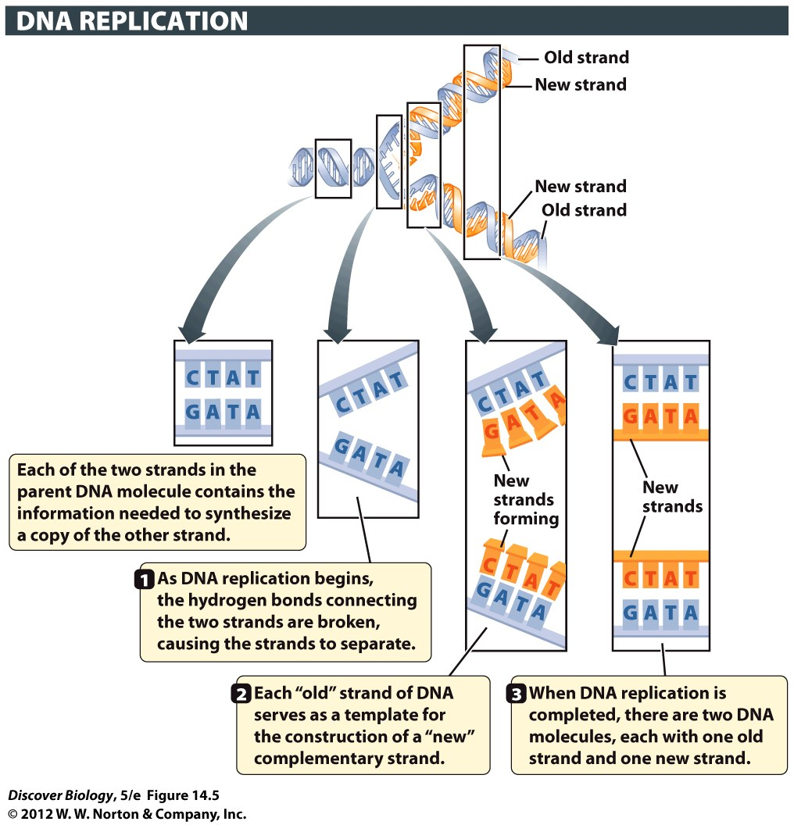
Notes:
Figure 14.5 The Replication of DNA Is Semiconservative
In this overview of DNA replication, the template DNA strands are blue, and the newly synthesized strands are orange. One strand (blue) from the parent double helix is conserved in each newly made daughter double helix (blue and orange).

Slide 20
Repairing Replication Errors and Damaged DNA
Six billion base pairs of template DNA must be copied each time a human diploid cell divides
Replication errors and damage to the DNA can lead to the death of cells or the entire organism

Slide 21
Few Mistakes Are Made in DNA Replication
DNA polymerase acts as a proofreader as it bonds base pairs during DNA replication
Cells contain special proteins that correct 99% of any base pair mismatches not caught by DNA polymerase
A change to the sequence of bases in an organism’s DNA that is not corrected is called a mutation

Slide 22
Few Mistakes Are Made in DNA Replication
Mutagens are substances or energy sources that can cause mutations
Most genetic mutations are either neutral or harmful, and harmful mutations can cause diseases such as cancer and Huntington’s disease

Slide 23
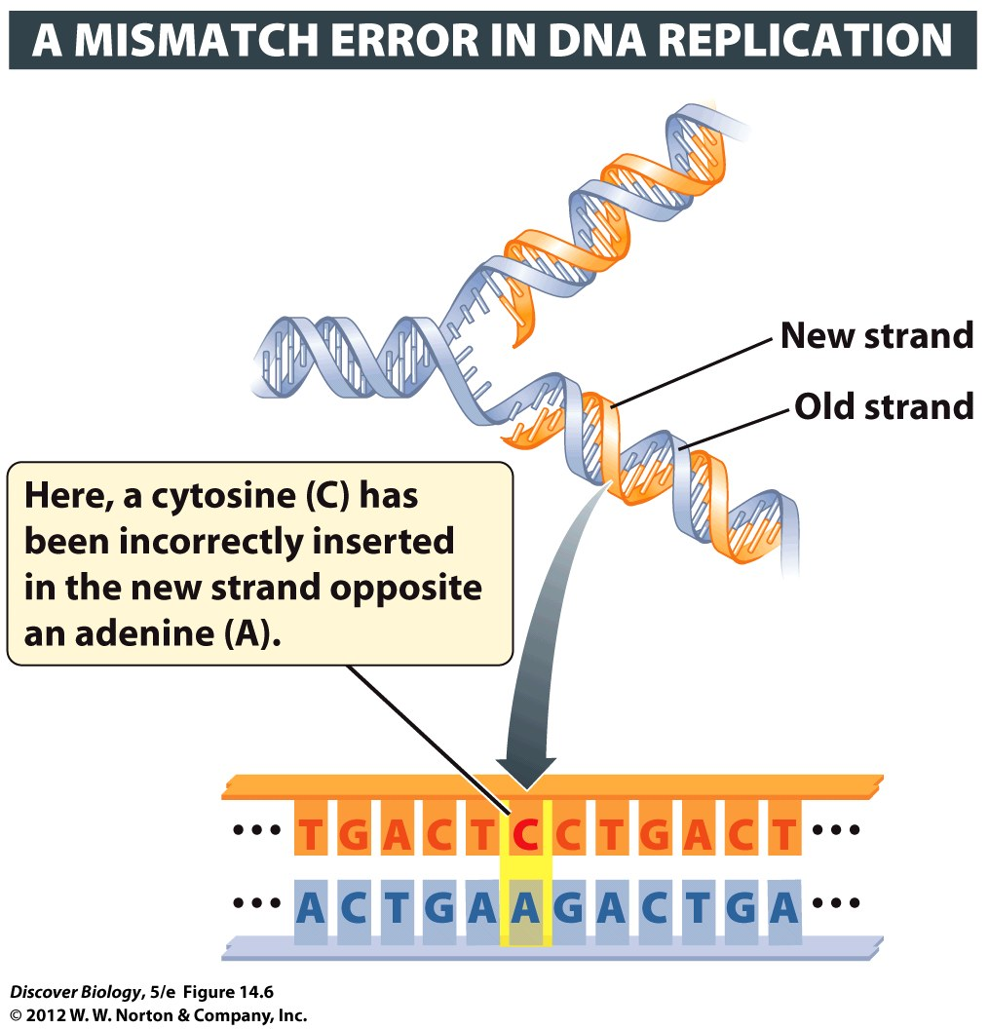
Notes:
Figure 14.6 Mistakes in DNA Replication May Lead to Mutations
DNA repair enzymes usually detect and fix mismatch errors such as the one shown here before the cell’s DNA is replicated again. If the mismatch is not repaired before the next round of DNA replication, half the daughter helices made by this DNA will have a C-G base pair in place of the original A-T base pair. Such a change in the DNA sequence constitutes a mutation.

Slide 24
Normal Gene Function Depends on DNA Repair
DNA repair requires a three-step process:
Recognition
Removal
Replacement
Each step requires different sets of repair proteins using specialized enzymes to identify, remove, and replace the damaged DNA

Slide 25
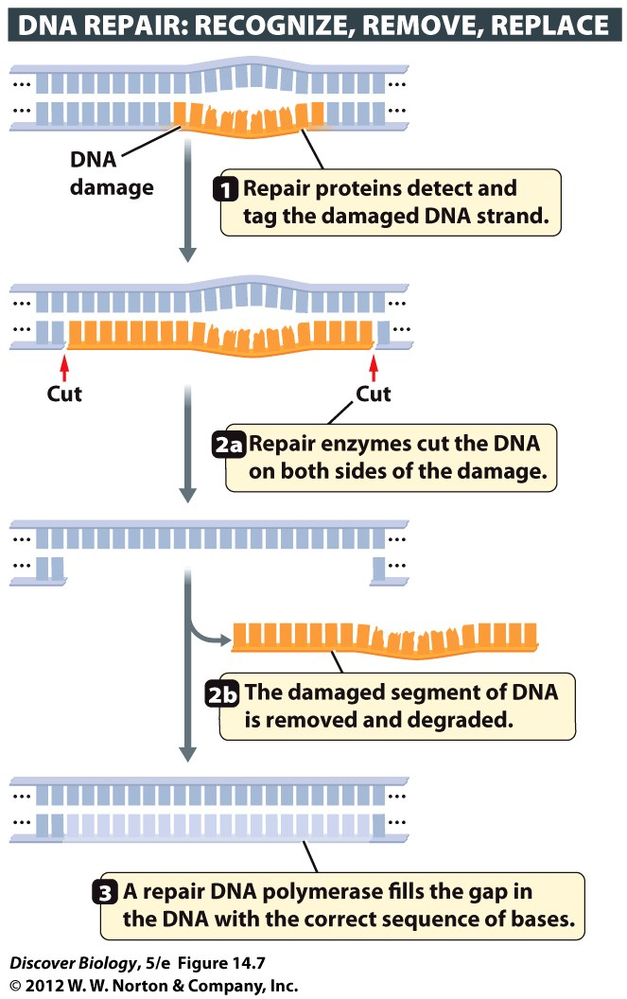
Notes:
Figure 14.7 Repair Proteins Fix DNA Damage
Large complexes of DNA repair proteins work together to fix damaged DNA. They (1) recognize DNA damage, (2) remove the segment of DNA strand that is damaged, and (3) replace the missing segment through new DNA synthesis.

Slide 26
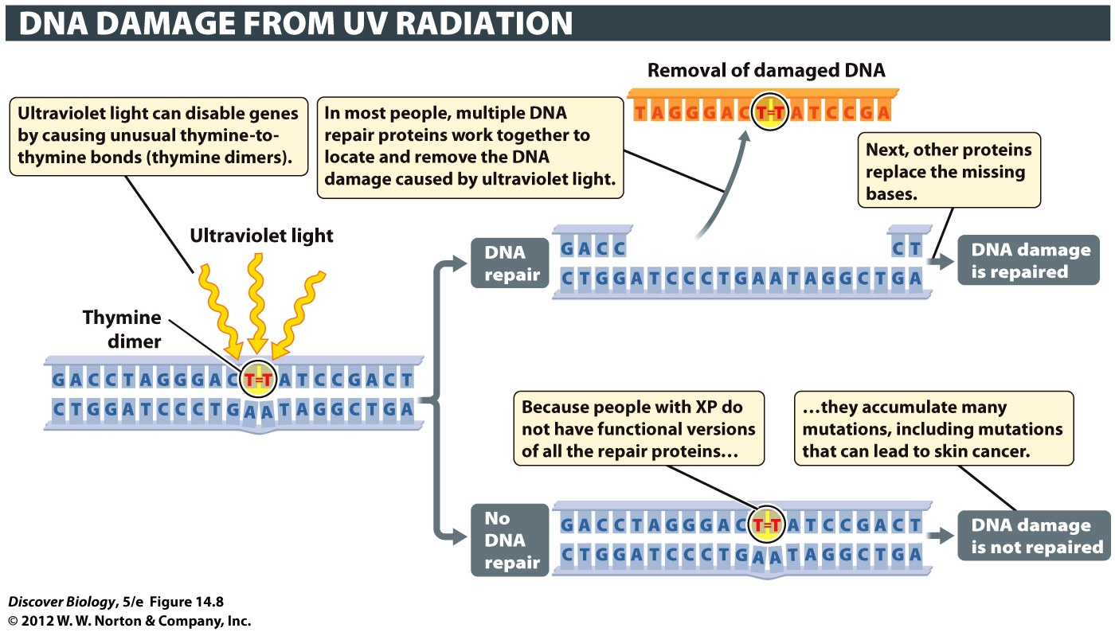
Notes:
Figure 14.8 The Importance of DNA Repair Mechanisms
When DNA repair mechanisms fail to work properly, the consequences can be severe, as illustrated by the high frequency of skin cancers in people who have xeroderma pigmentosum (XP), a recessive genetic disorder in which cells are unable to make a protein used to repair DNA damage caused by ultraviolet light.

Slide 27
Genome Organization
A bacterium contains one chromosome made up of several million base pairs of DNA
Eukaryote DNA contains large amounts of noncoding DNA; prokaryotes rarely contain noncoding DNA
Prokaryotic genes tend to be organized by function

Slide 28
Eukaryotes Have More DNA per Cell Than Most Prokaryotes Have
Eukaryotes in general are structurally and behaviorally more complex than prokaryotes and have larger genomes
The genome of a prokaryote is typically contained in a single chromosome

Slide 29
Genes Constitute Only a Small Percentage of the DNA in Most Eukaryotes
Noncoding DNA is DNA that does not code for any kind of functional RNA
Noncoding sections of DNA are called introns; exons are the coding segments of DNA
Noncoding DNA that separates one gene from another is called spacer DNA
Transposons are sequences that can move from one position on a chromosome to another, or even from one chromosome to another, and may disrupt a gene’s function in the process

Slide 30
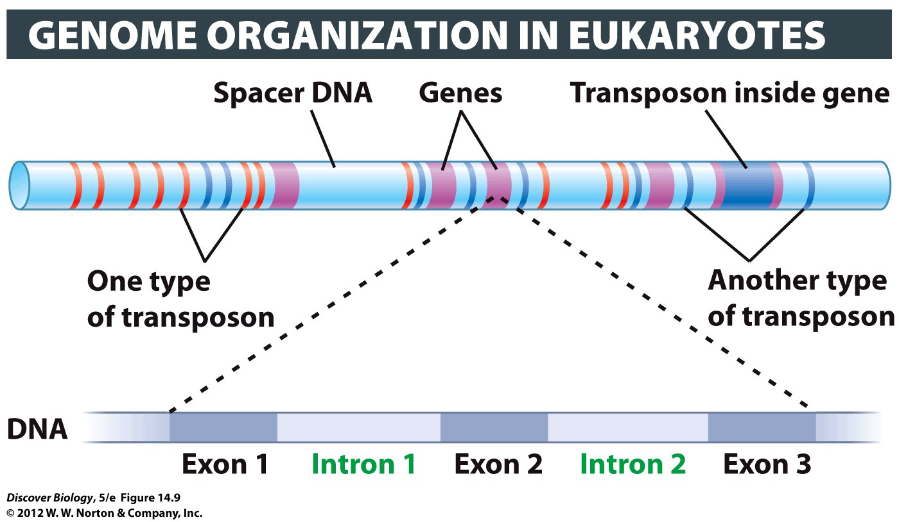
Notes:
Figure 14.9 Eukaryotic Genomes Contain Both Coding and Noncoding DNA
Eukaryotic genomes contain a small proportion of genes (purple) interspersed with a large amount of spacer DNA (light blue) and transposons (red and dark blue). Each of the two different types of transposons shown here is found in many copies throughout the human genome. Note that one transposon (dark blue) has inserted itself into one of the five genes. Most eukaryotic genes consist of coding regions (exons) interspersed with noncoding regions called introns.

Slide 31
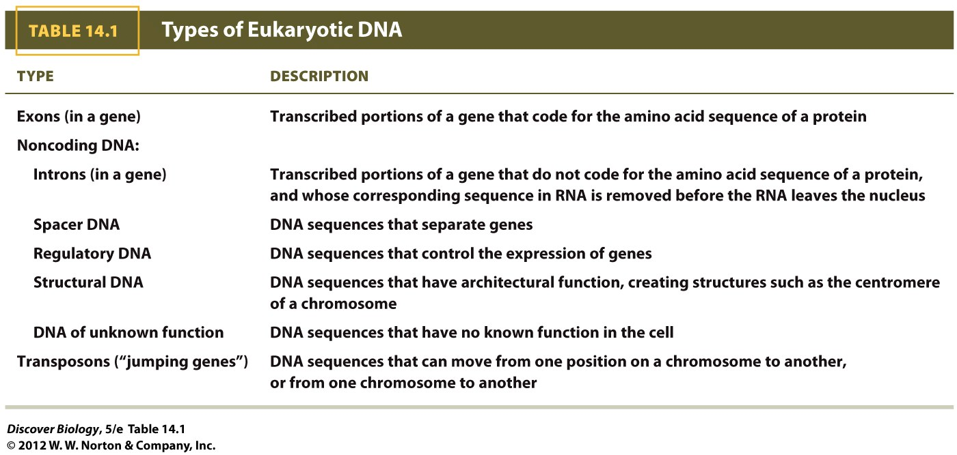

Slide 32
DNA Packing in Eukaryotes
Eukaryotic cells must use packaging proteins to compress a large amount of genetic information into a chromosome
Short lengths of DNA are wound around histone proteins to create a bead-on-a-string structure that is further compressed into a looped, 30-nanometer fiber
During cell division, DNA condenses into shorter, thicker chromosomes, the highest level of packing a chromosome can acquire

Slide 33
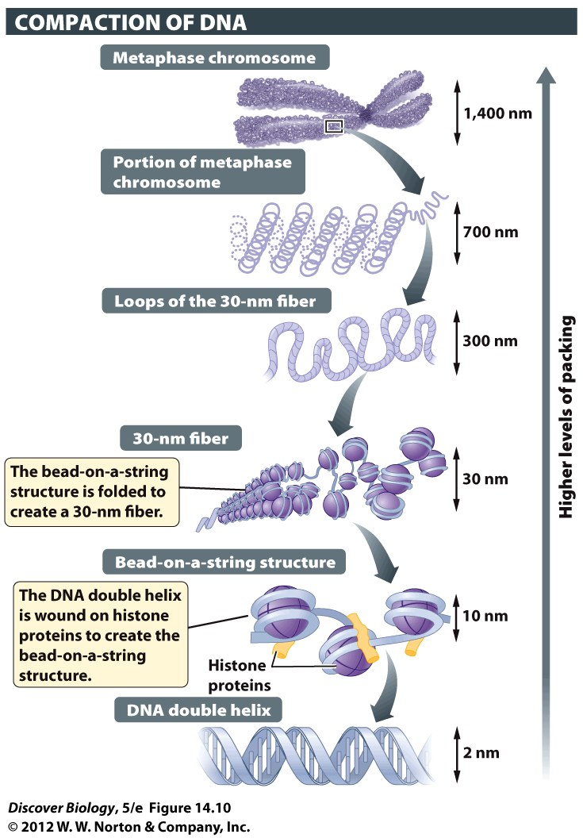
Notes:
Figure 14.10 DNA Packing in Eukaryotes
The DNA of eukaryotes is highly organized by a complex packing system. Increasingly higher levels of DNA packing are illustrated, with the chromosome at metaphase representing the stage of the cell cycle at which DNA is most tightly packed.

Slide 34
Patterns of Gene Expression
Gene expression is the means by which genes influence the structure and function of a cell or organism
Patterns of gene expression, even within a cell, can change over time

Slide 35
Organisms Can Turn Genes On or Off in Response to Environmental Cues
Bacteria have the ability to reorganize gene expression to match the food resources available
By producing only the enzymes needed when a particular food is available, bacteria avoid wasting energy and cellular resources
Multicellular organisms can change which genes are expressed in response to internal and external signals

Slide 36
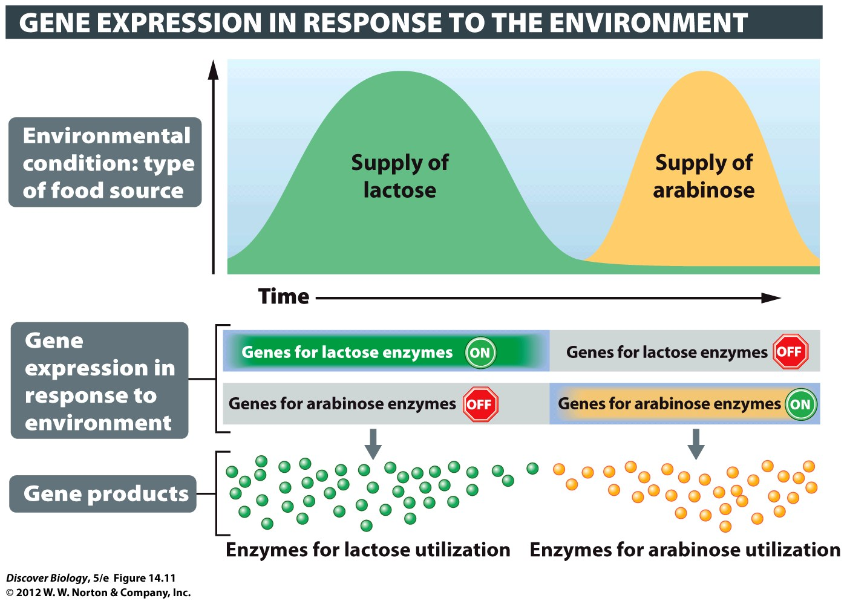
Notes:
Figure 14.11 Bacteria Express Different Genes as Food Availability Changes
The sugars lactose and arabinose are not always available, but both can serve as food for the bacterium E. coli. The presence of the sugar triggers expression of the gene that codes for enzymes needed to metabolize that sugar.

Slide 37
Different Cells in Eukaryotes Express Different Genes
Different types of cells express different sets of genes depending on whether that gene function is needed under the current conditions
Housekeeping genes play an essential role in the maintenance of cellular activities in all kinds of cells and have been highly conserved in evolutionary history

Slide 38
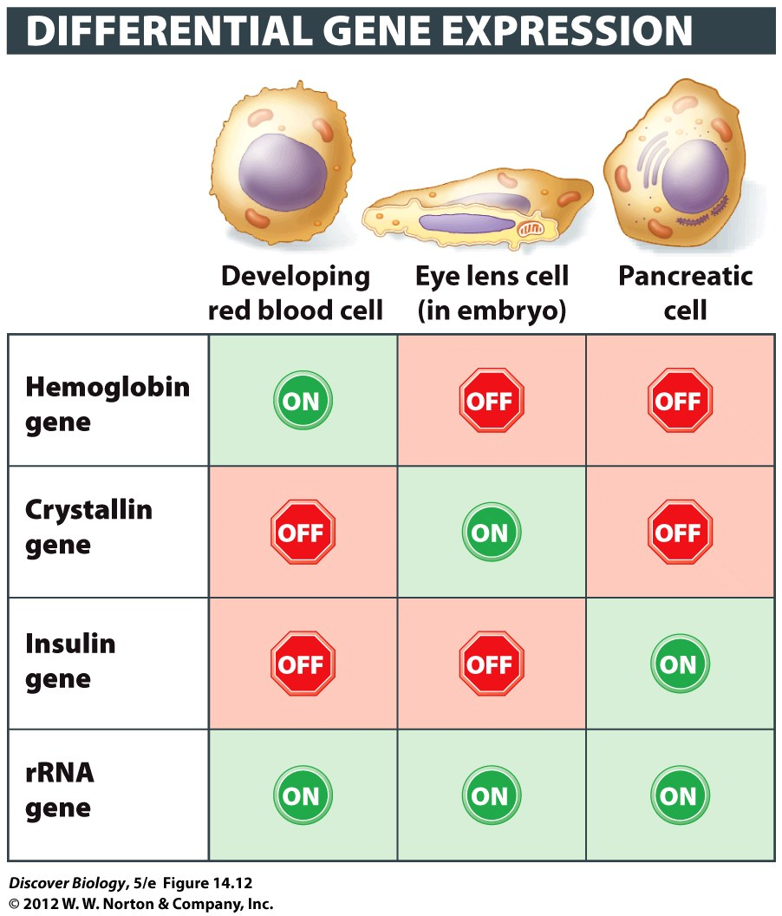
Notes:
Figure 14.12 Different Types of Cells Express Different Genes
Some genes, such as those encoding hemoglobin, crystallin, and insulin, are active (“on”) only in the types of cells that use or produce the protein encoded by the gene. Housekeeping genes, such as the rRNA gene, are active in most types of cells.

Slide 39
How Cells Control Gene Expression
Cells process information from a variety of signals and use that information to determine which genes to express
Internal and external signals as well as cell-to-cell signals all work to control gene expression within a cell

Slide 40
Most Genes Are Controlled at the Transcriptional Level
Cells generally control gene expression by regulating the transcription of the gene
Regulatory DNA activates or inactivates gene transcription and gene regulatory proteins
Gene regulatory proteins, also called transcription factors, interact with signals from the environment and regulatory DNA to control gene expression

Slide 41
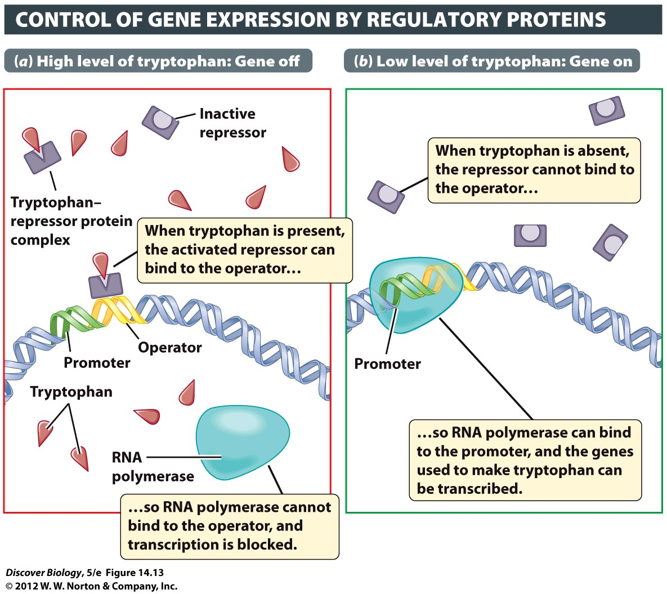
Notes:
Figure 14.13 Repressor Proteins Turn Genes Off
In the bacterium E. coli, a repressor protein interacts with an operator to control the transcription of a group of genes that encode the enzymes needed to make tryptophan. (a) When tryptophan is present, it binds to a repressor protein; this tryptophan–repressor protein complex then turns the genes off by binding to the operator. (b) On its own (that is, when tryptophan is absent), the repressor protein cannot bind to the operator, but RNA polymerase can bind to the promoter, which turns on the genes for tryptophan synthesis.

Slide 42
Gene Expression Can Be Regulated at Several Levels
Tight packing of DNA prevents access to its gene regulatory DNA ,making that segment of DNA transcriptionally inactive
Regulation of transcription enables the cell to conserve resources when it does not need a particular gene product
By limiting the life span of many types of mRNA, a cell prevents the wasteful synthesis of proteins

Slide 43
Gene Expression Can Be Regulated at Several Levels
Regulation of translation keeps mRNA ready to direct rapid protein synthesis when needed
Proteins can be directly regulated by modification following translation
Regulation of protein breakdown conserves resources and prevents damage

Slide 44
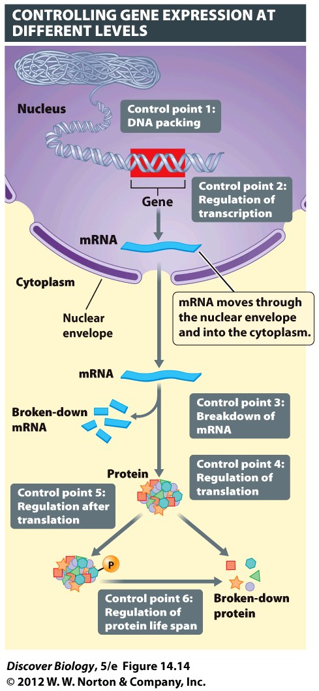
Notes:
Figure 14.14 Steps at Which Gene Expression Can Be Regulated in Eukaryotes
Each point in the pathway from gene to protein provides an opportunity for cells to regulate the production or activity of proteins.

Slide 45
From Gene Expression to Cyclops
Environmental influences, such as ingestion of the corn lily by a pregnant animal, can cause gene expression to be altered, resulting in abnormalities such as cyclopia

Slide 46
Clicker Questions
CHAPTER 14
DNA and Genes

Slide 47
Concept Quiz
The Griffith experiment showed that
Something heritable was being passed between the bacterial strains.
DNA was the genetic material.
Protein was the genetic material.
Strain S was lethal to mice.
Notes:
The correct answer is A. The importance of the Griffith experiment was that it provided an assay system to probe what the genetic material was. The experiment showed that genetic material was passed form one strain to the other.
Answers B and C: The experiments by Avery, McLeod & McCarty and Hershey & Chase addressed the protein vs. DNA issue.
Answer D: It was known that strain S was lethal before this experiment was performed.

Slide 48
Concept Quiz
Watson and Crick showed that
A binds to T and G binds to C.
One strand is a template for the other strand.
The DNA molecule can be easily replicated.
All of the above
Notes:
The correct answer is D. These were all important discoveries based on the structure of the DNA molecule.

Slide 49
Concept Quiz
DNA repair is
Important only during replication.
Found in some species.
Vital to maintaining DNA’s integrity.
An inherited disorder.
Notes:
The correct answer is C. DNA repair is vital to maintaining the integrity of DNA.
DNA repair is also important to correct changes made by environmental mutagens.
DNA repair is important to all species.
The lack of DNA repair is an inherited disorder.

Slide 50
Concept Quiz
One difference between prokaryotic and eukaryotic genes is that
Prokaryotic genes are made with different bases.
Related genes are grouped in eukaryotes.
Prokaryotes have many more genes.
Eukaryotic genes have noncoding regions.
Notes:
The correct answer is D.
Answer A: All DNA is made with the same 4 bases.
Answer B: Related genes are grouped in prokaryotes but seldom in eukaryotes.
Answer C: Eukaryotes have many more genes.

Slide 51
Concept Quiz
The function of homeotic genes is to
Act as a master switch, turning on a gene cascade.
Activate a gene in response to lactose.
Respond to changes in the environment.
Cause the development of the eye in fruit flies.
Notes:
The correct answer is A .
Answer B: This is a specific example of gene control in prokaryotes.
Answer C: Homeotic genes are active in development, not in response to the environment.
Answer D: This is one example of development due to homeotic genes, but this class of genes has a wide array of effects.

Slide 52
Concept Quiz
In prokaryotic gene control, the role of the operator is to
Bind to tryptophan.
Bind to the DNA.
Bind the repressor.
Activate transcription.
Notes:
The correct answer is C.
Answer A: This is the role of a specific repressor.
Answer B: The operator is a part of the DNA of a gene, not separate from it.
Answer D: The operator inhibits transcription when the repressor is bound to it.

Slide 53
Relevant Art from Other Chapters
All art files from the book are available in JPEG and PPT formats online and on the Instructor Resource Disc

Slide 54
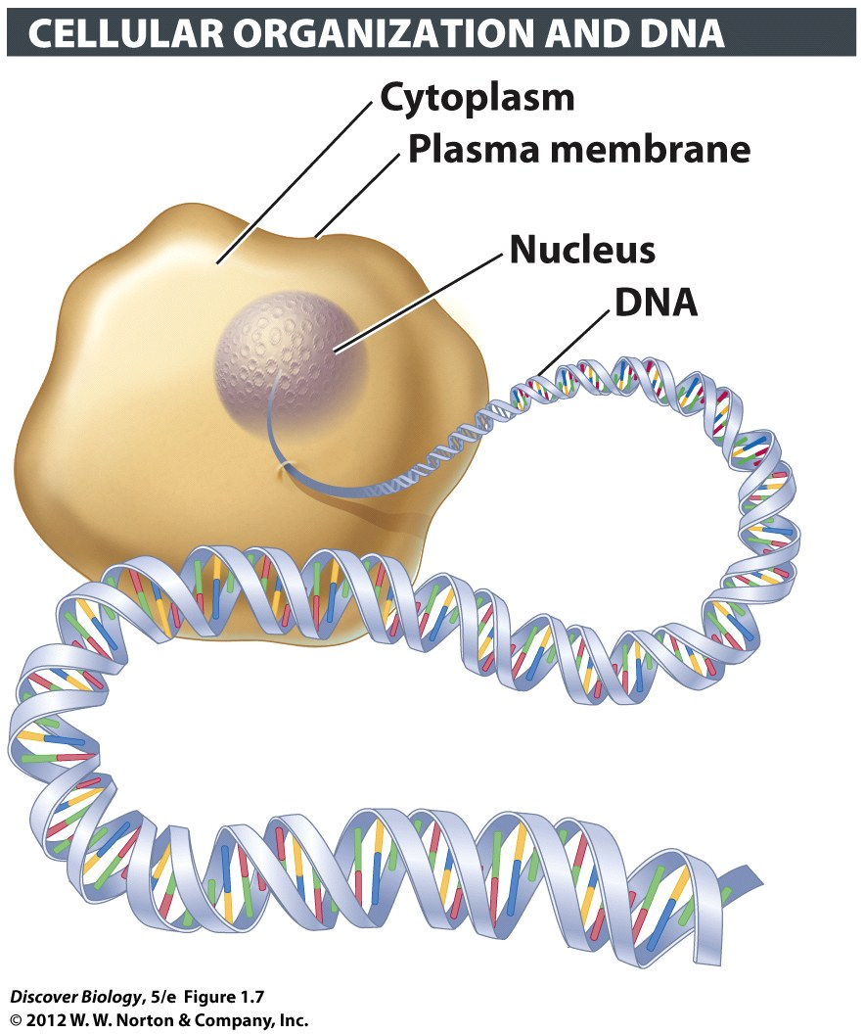
Notes:
Figure 1.7 DNA Is an Information-Storing Molecule
Organisms pass genetic information to their young by transferring copies of DNA to their offspring.

Slide 55
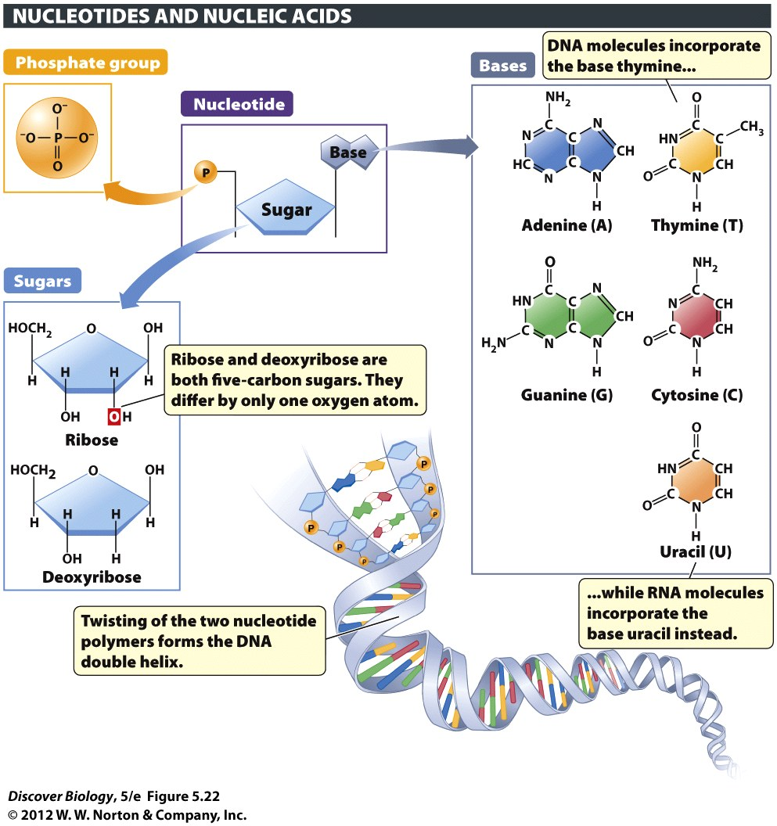
Notes:
Figure 5.22 Nucleotides Are the Building Blocks of Nucleic Acids
Each nucleotide consists of a fivecarbon sugar linked to a nitrogenous base and one or more phosphate groups. The bases adenine, guanine, cytosine, and thymine, when linked to the sugar deoxyribose, form the building blocks of DNA. The bases adenine, guanine, cytosine, and uracil, when linked to the sugar ribose, form the building blocks of RNA.

Slide 56
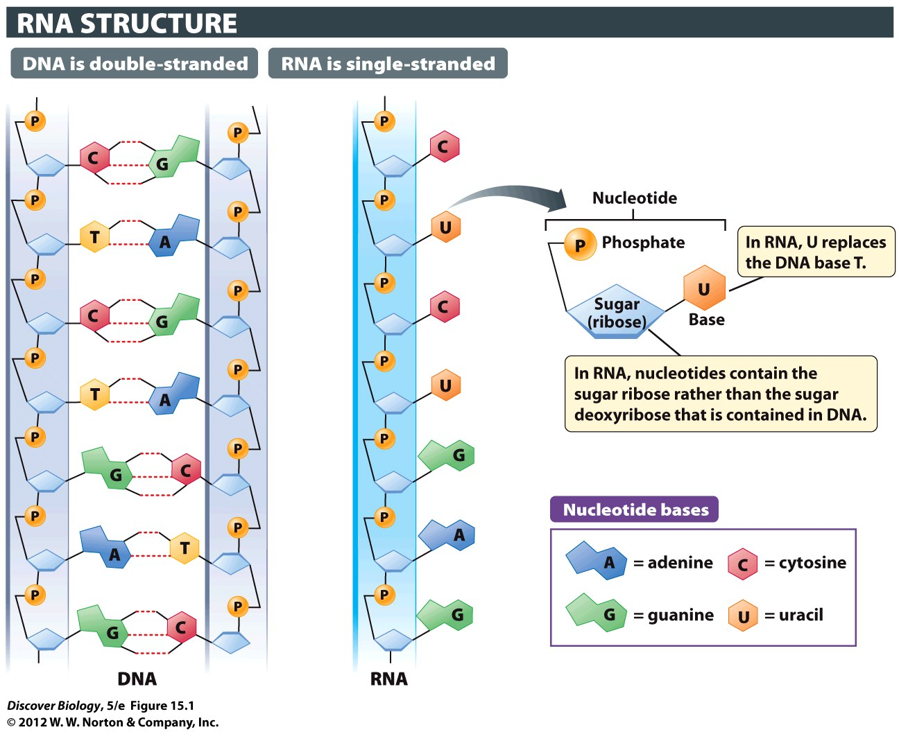
Notes:
Figure 15.1 RNA Is a Single-Stranded Chain of Nucleotides

Slide 57
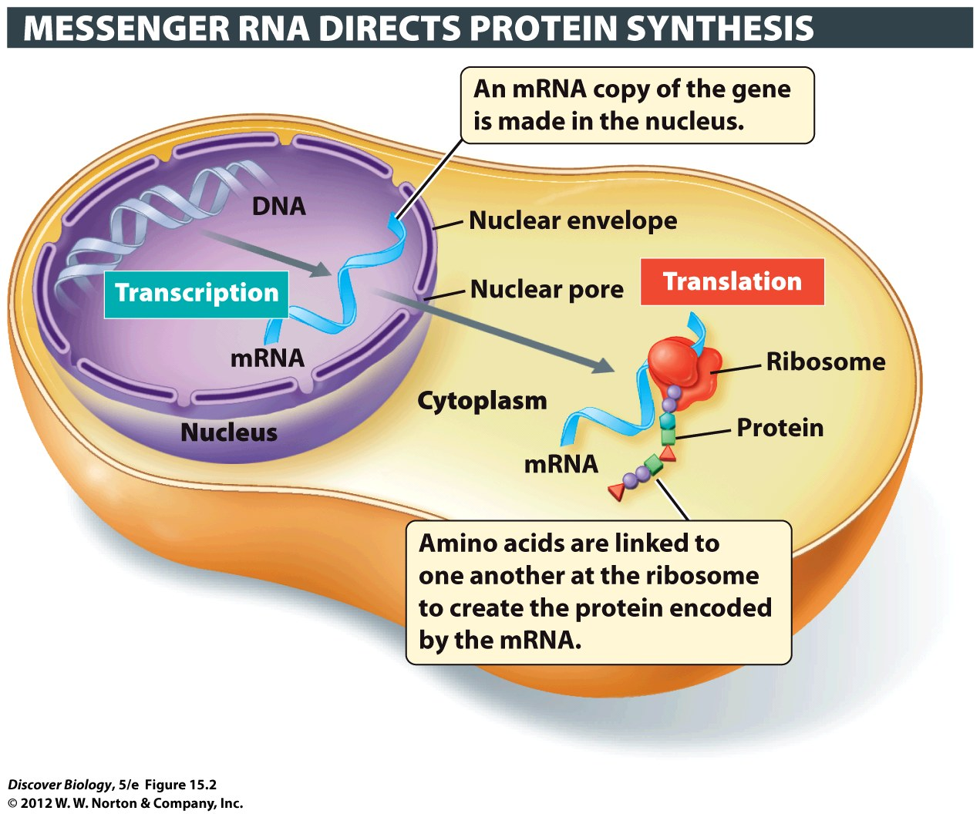
Notes:
Figure 15.2 Genetic Information Flows from DNA to RNA to Protein during Transcription and Translation
The transcription of a protein-coding gene produces an mRNA molecule, which is then transported to the cytoplasm, where translation occurs and the protein is made with the help of ribosomes. Different amino acids in the protein being constructed at the ribosome are represented here by different colors and shapes.

Slide 58
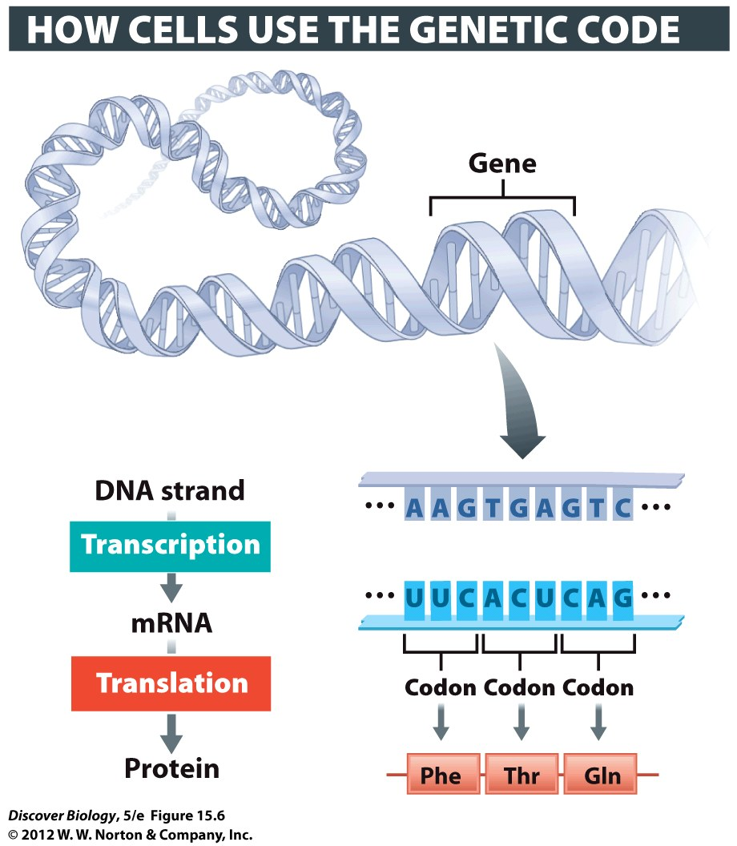
Notes:
Figure 15.6 The Genetic Code Is Read in Sets of Three Bases, Each Set Constituting a Codon

Slide 59
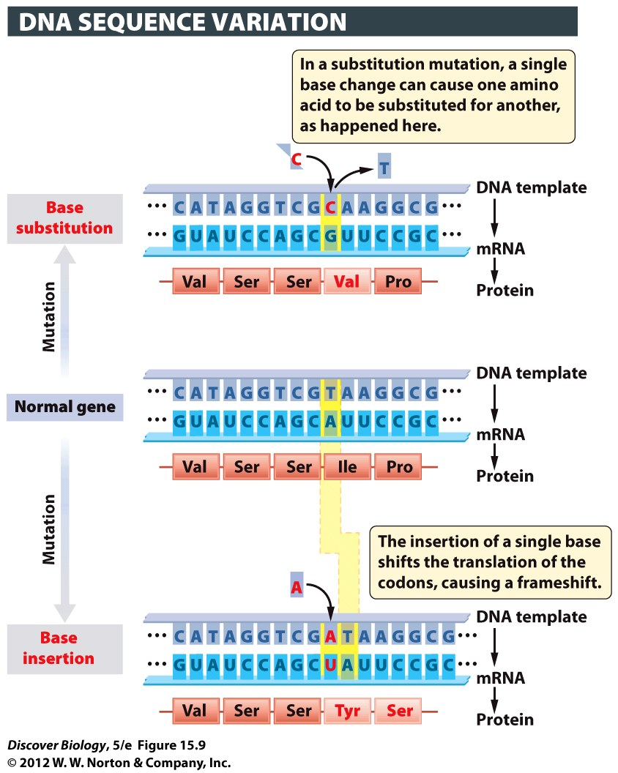
Notes:
Figure 15.9 A Change in the DNA Sequence Translates into a Change in the Amino Acid Sequence of the Protein
Two kinds of mutations are shown here: a substitution and an insertion. In each case, the mutation and its effects on transcription and translation are shown in red.

Slide 60
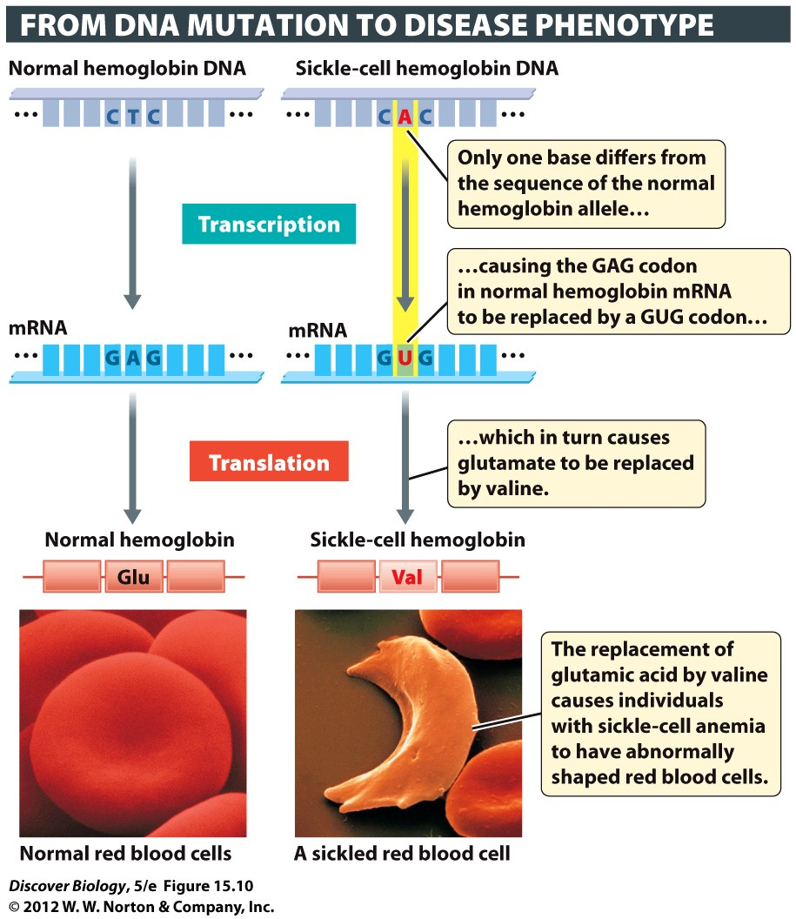
Notes:
Figure 15.10 Mutations in a Single Base in the Hemoglobin Gene Can Lead to Sickle-Cell Anemia

