Slide 1
Discover Biology FIFTH EDITION
Anu Singh-Cundy • Michael L. Cain
CHAPTER 13
Chromosomes and Human
Genetics
© 2012 W. W. Norton & Company, Inc.

Slide 2
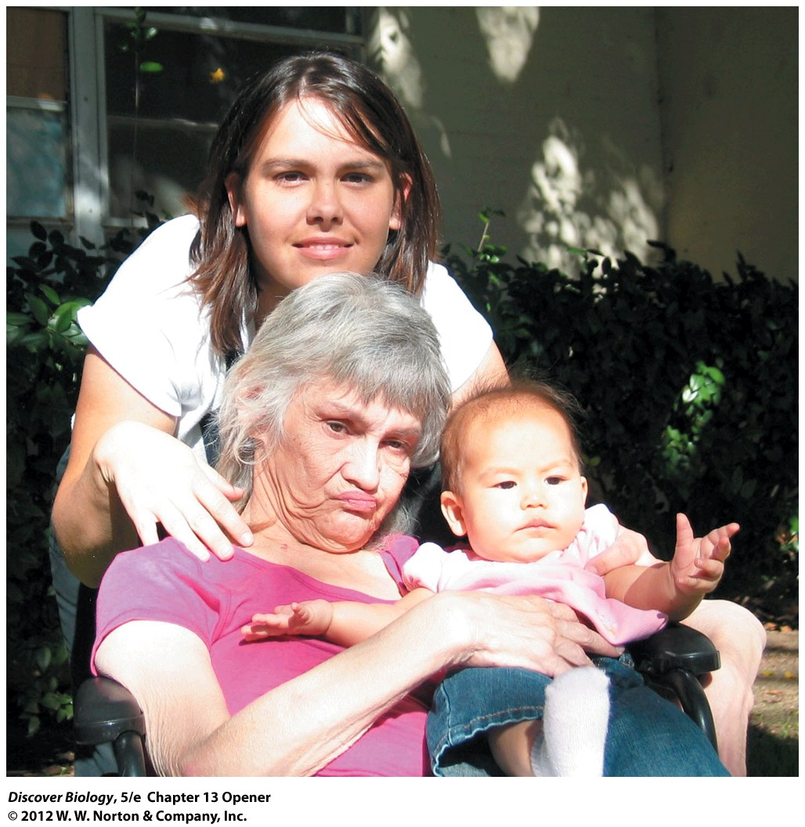
Notes:
Misty Oto with Her Mother and Daughter.
Misty Oto’s mother, Rosie Shaw, died of Huntington’s disease, a genetic disease passed through families on a single dominant allele. Oto, who works to educate people about Huntington’s disease, has lost several family members to the disease. When her daughter was born, Oto did not know whether she or her daughter carried the disease gene.

Slide 3
Kith and Kin
The gene for Huntington’s disease was located in 1993 and a genetic test to identify carriers was developed soon after
People with a history of Huntington’s disease in their family struggle with whether to be tested for this as-yet incurable disease

Slide 4
Over a Hundred Years Ago . . .
Gregor Mendel deduced that inherited traits are governed by discrete hereditary units
The chromosome theory of inheritance, along with Mendel’s laws, forms the foundation of modern genetics

Slide 5
The Role of Chromosomes in Inheritance
In 1882, scientists were able to use microscopes to indentify threadlike structures, now known as chromosomes, inside dividing cells
August Weismann first hypothesized that the number of chromosomes was first reduced by half during the formation of gametes and then restored to its full number during fertilization
Weismann also suggested that hereditary material was located on the chromosomes

Slide 6
Genes Are Located on Chromosomes
The chromosome theory of inheritance states that all genes are located on chromosomes
Each chromosome consists of a single long DNA molecule attached to many bundles of packaging proteins
Each gene is a small region of the DNA molecule
Humans have an estimated 25,000 genes located on 23 pairs of chromosomes

Slide 7
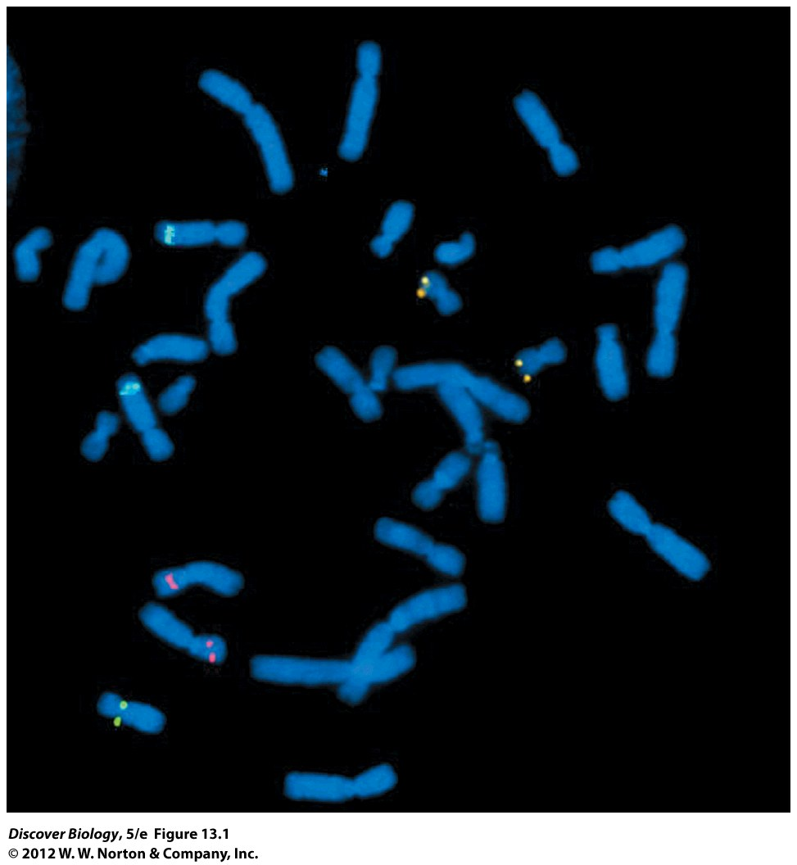
Notes:
Figure 13.1 Genes Are Located on Chromosomes
A technique called fluorescence in situ hybridization (FISH) was used to show the location of three different genes on these chromosomes prepared from tumor cells in mitosis. Each of the three genes (HER2, green; p16, pink; znk217, gold) is known to be involved in cancer.

Slide 8
Genes Are Located on Chromosomes
The physical location of a gene on a chromosome is called a locus
A diploid cell that has two different alleles at a given genetic locus has a heterozygous genotype for the gene at that locus
A diploid cell that has two identical alleles at a given genetic locus is homozygous for the gene at that locus
The inheritance of various genes can be affected by how close or far apart they are on the chromosome and whether it is a sex chromosome or an autosome

Slide 9
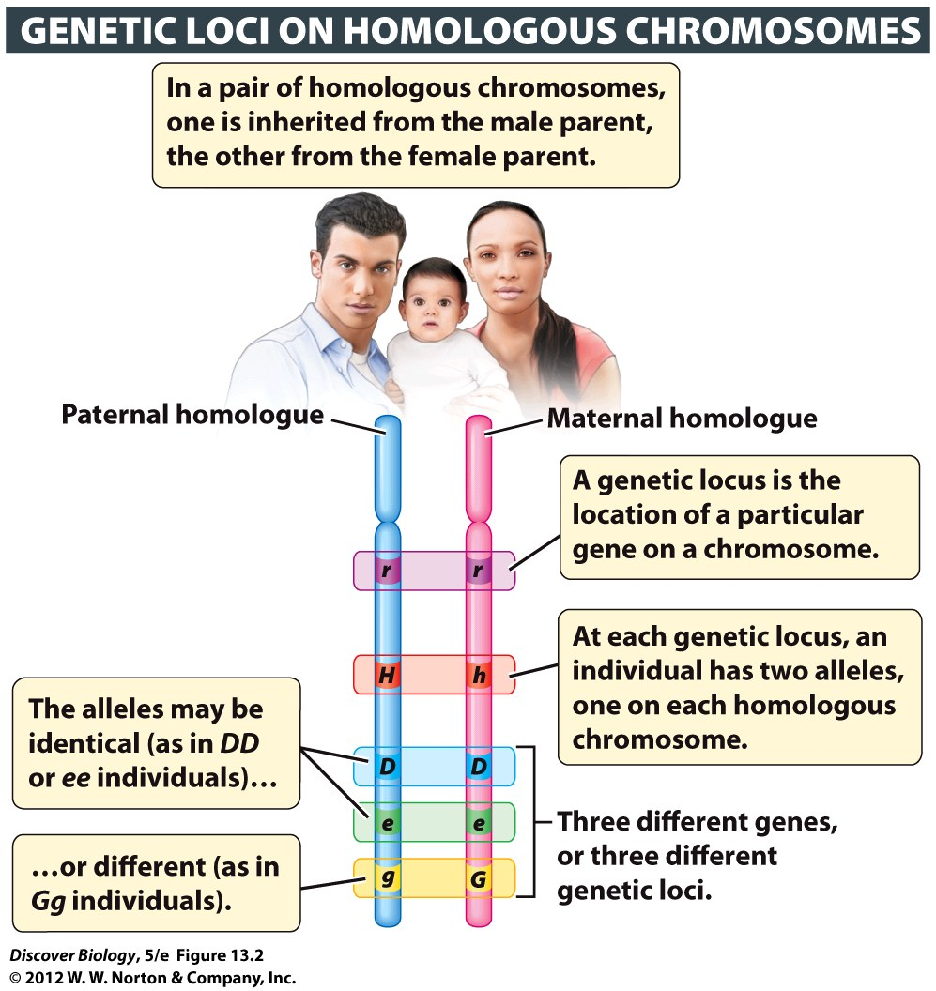
Notes:
Figure 13.2 Genes Are Located on Chromosomes
The genes shown here take up a larger portion of the chromosome than they would if they were drawn to scale. The average human chromosome has more than a thousand different genes interspersed with large stretches of noncoding DNA.

Slide 10
Autosomes Differ from Sex Chromosomes
Chromosomes that determine sex are called sex chromosomes; all other chromosomes are called autosomes
In humans, males have one X chromosome and one Y chromosome and females have two X chromosomes
Human males have only one copy of each gene that is unique to either the X or the Y chromosome

Slide 11
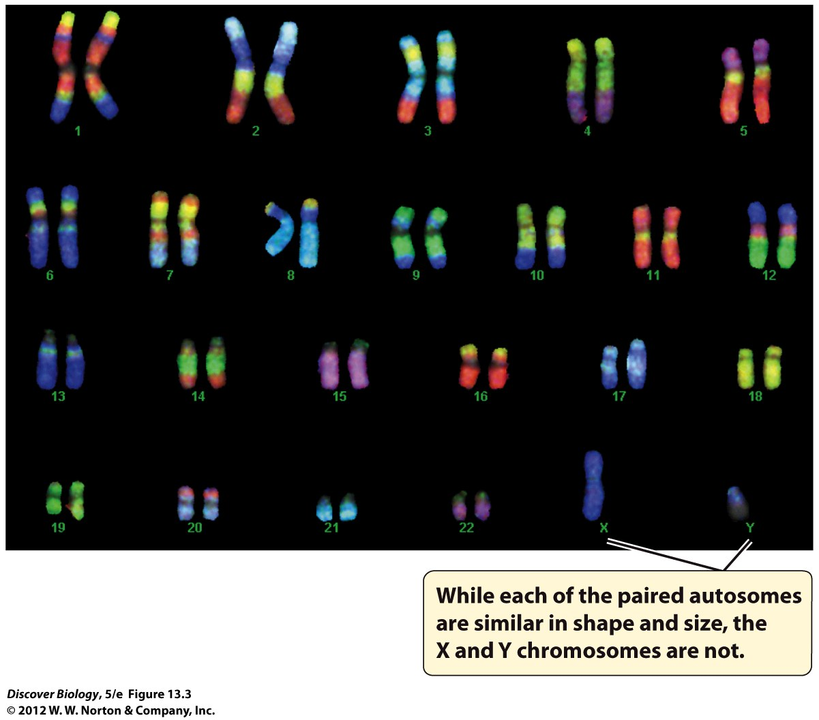
Notes:
Figure 13.3 Autosomes and Sex Chromosomes
These chromosomes have been stained using a technique called FISH (fluorescence in situ hybridization).

Slide 12
In Humans, Maleness Is Specified by the Y Chromosome
In humans, female gametes all contain an X chromosome; male gametes contain either an X or a Y chromosome
The sex chromosome carried by the sperm determines the sex of the offspring
The Y chromosome carries the SRY gene, which causes the other genes to produce male sexual characteristics; without the SRY gene, the embryo develops as a female

Slide 13
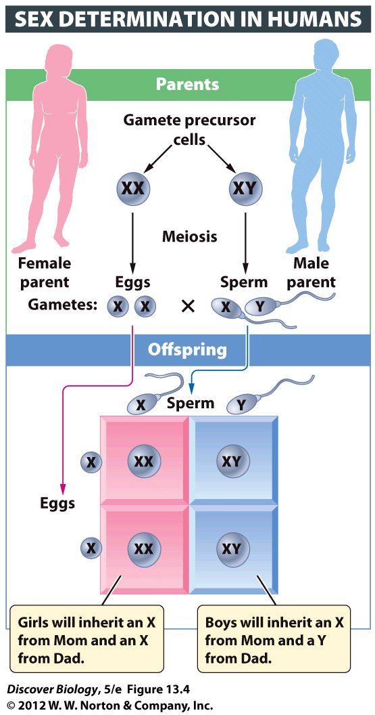
Notes:
Figure 13.4 Dad’s Chromosomes Determine Baby’s Gender
Human females have two X chromosomes, while human males have one X and one Y chromosome. If a baby receives an X chromosome from the father, it’s a girl! If the baby receives a Y chromosome from Dad, it’s a boy! Because a man’s X and Y chromosomes segregate into different gametes during meiosis, the odds are 50 percent that a given sperm cell will contain an X or Y chromosome.

Slide 14
Origins of Genetic Differences between Individuals
Genetic differences among offspring provide the genetic variation on which evolution can act
Alleles are arranged in new combinations by one of three methods:
Crossing-over
Independent assortment of chromosomes
Fertilization

Slide 15
Origins of Genetic Differences between Individuals
Crossing-over is a reciprocal exchange of segments of nonsister chromatids in prophase I of meiosis, which produces chromosomes with new combinations of alleles
Crossing-over causes offspring to have a genotype that differs from the genotype of either parent and their siblings

Slide 16
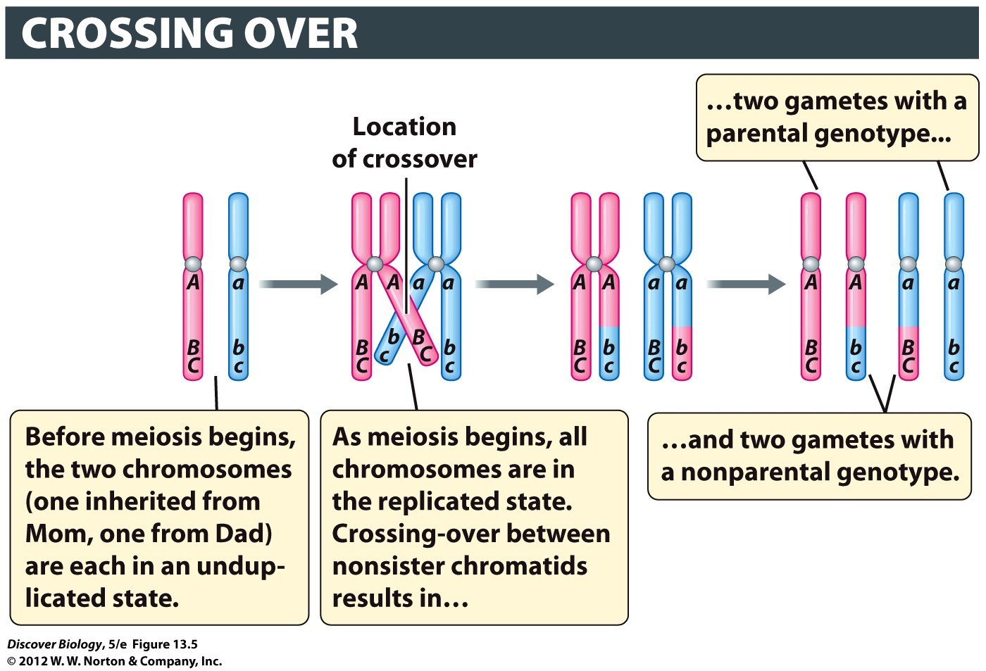
Notes:
Figure 13.5 Segments of Chromosomes Are Exchanged in Crossing-Over
Crossing-over takes place during prophase I. As a result of crossover between A/a and B/b, half of the gametes have a parental genotype (ABC or abc), while the other half have a nonparental genotype (Abc or aBC). In this example, there is no crossing-over between B/b and C/c.

Slide 17
Origins of Genetic Differences between Individuals
The independent assortment of chromosomes creates new combinations of alleles through the random distribution of maternal and paternal chromosomes into gametes during meiosis
The independent assortment of chromosomes can generate gametes with new allele combinations not seen in either parent

Slide 18
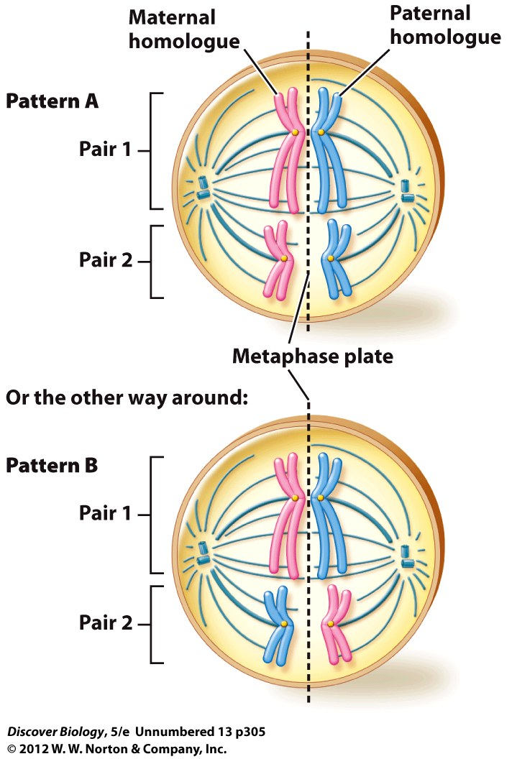

Slide 19
Genetic Linkage and Crossing-Over
Mendel’s law of independent assortment states that the two copies of one gene are separated into gametes independently of the two copies of other genes
This law was challenged in the early 20th century when studies showed that certain genes were often inherited together

Slide 20
Linked Genes Are Located on the Same Chromosome
Genes that are inherited together are said to be genetically linked
Genetic loci that are neighbors or positioned close to each other on the same chromosome tend to be genetically linked
Genes cannot be genetically linked if they are located on different chromosomes

Slide 21
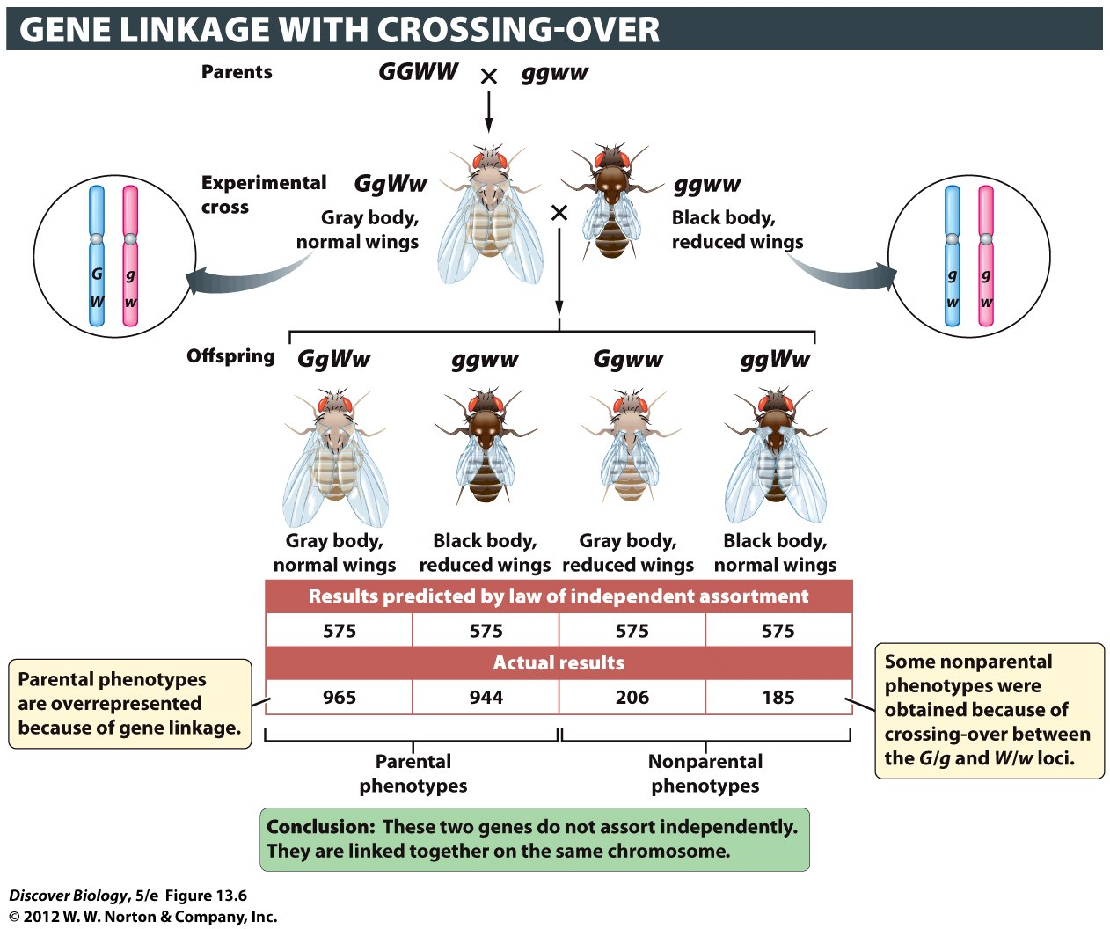
Notes:
Figure 13.6 Genes on the Same Chromosome May Not Assort Independently
By crossing flies of genotype GgWw with flies of genotype ggww, Morgan found that the gene for body color (dominant allele G for gray, recessive allele g for black) is linked to the gene for wing length (dominant allele W for normal length, recessive allele w for reduced length). The parental genotypes are overrepresented because the G and W genes are linked to each other: the two genes are located relatively close to each other on the same chromosome.

Slide 22
Crossing-Over Reduces Genetic Linkage
Crossing-over can occur between homologous chromosomes during meiosis, even in linked genes
Genetic loci that are far apart on a chromosome are more likely to be separated by crossing-over

Slide 23
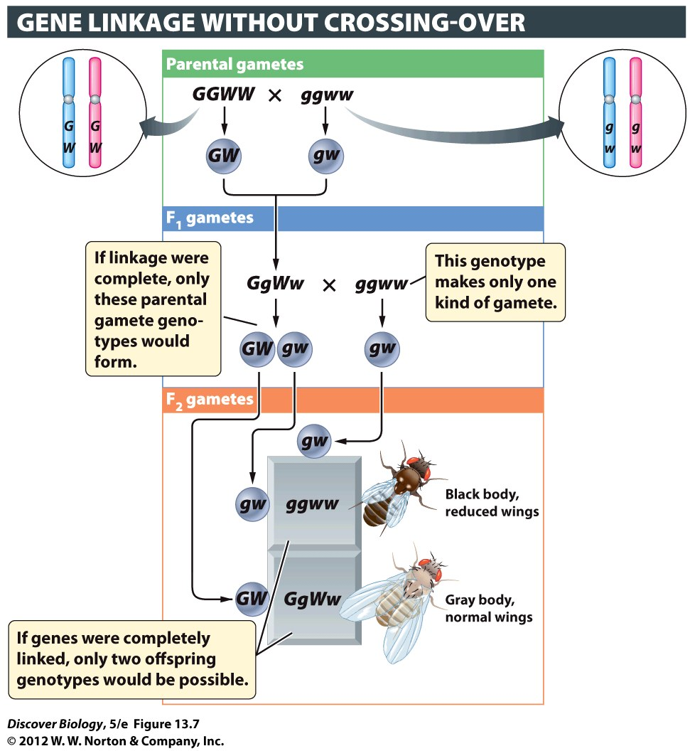
Notes:
Figure 13.7 Without Crossing-Over, Genes on the Same Chromosome Would Be Completely Linked
If genes were completely linked, the F₂ progeny in Morgan’s experiment would all have had exactly the same genotype as the parents: GgWw or ggww. But Morgan’s experiment (see Figure 13.6) did not produce this result, indicating that there was some recombination between the two genetic loci.

Slide 24
Human Genetic Disorders
Studying genetics and genetic disorders can lead to the prevention or cure of many human genetic diseases
Studying human genetic disorders is challenging due to the long generation time and the variables in mate selection and family size

Slide 25
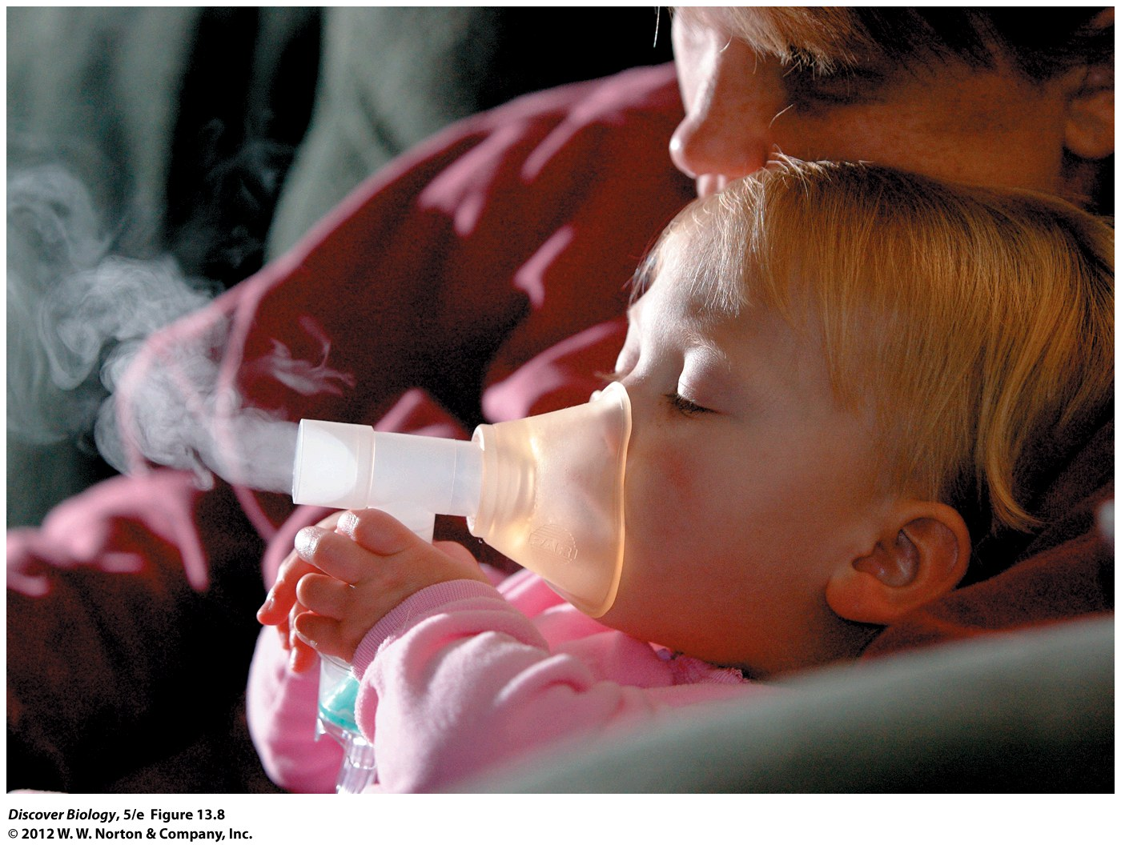
Notes:
Figure 13.8 Living with a Genetic Disorder
A toddler with cystic fibrosis inhales medication into her lungs with the help of a nebulizer, which turns the medicine into a fine spray. Cystic fibrosis is a recessive genetic disorder in which mucus builds up in the lungs, digestive tract, and pancreas, causing chronic bronchitis, poor absorption of nutrients, and recurrent bacterial infections, often leading to death before the age of 35.

Slide 26
Pedigrees Are a Useful Way to Study Human Genetic Disorders
A pedigree is a chart that shows genetic relationships among family members over two or more generations of a family’s history
Geneticists use pedigrees to analyze data and study patterns of inheritance

Slide 27
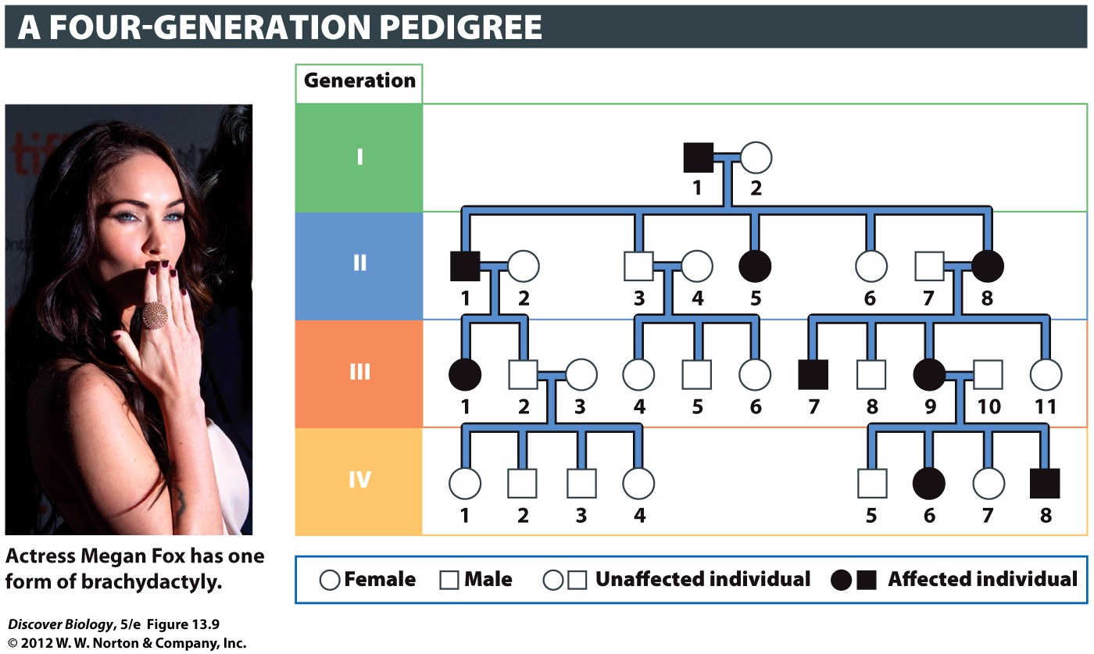
Notes:
Figure 13.9 Patterns of Inheritance Can Be Analyzed in Family Pedigrees
The pedigree shown here illustrates symbols commonly used by geneticists. The Roman numerals at left identify different generations. Numbers listed below the symbols identify individuals of a given generation. This pedigree charts the inheritance of brachydactyly, a dominant condition marked by short or clubbed fingers and toes. Brachydactyly was the first genetic condition to be analyzed, in 1903, by following pedigrees.

Slide 28
Some Genetic Disorders Are Inherited
Somatic mutations occur in non-sex cells and are not passed down to offspring
Mutations present in gametes can be passed on to offspring
Inherited genetic disorders can come from two sources:
Mutations in individual genes
Abnormalities in chromosome number or structure

Slide 29
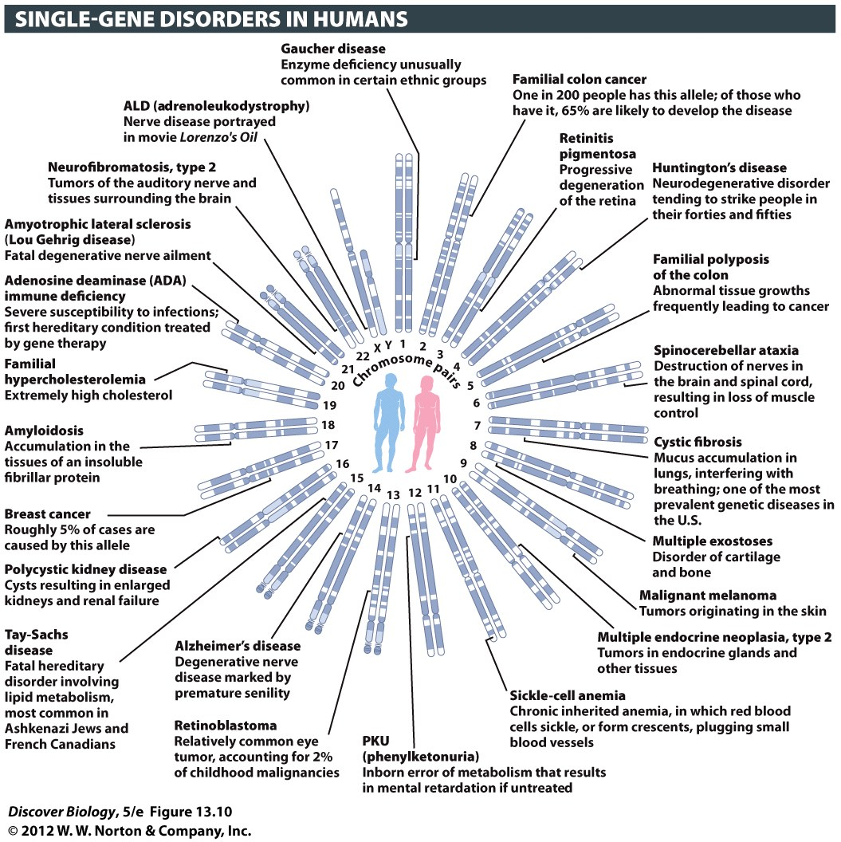
Notes:
Figure 13.10 Genes Known to be Associated with Inherited Genetic Disorders in Humans
About 2,000 Mendelian traits are known, and each has been mapped to one of the 23 pairs of human chromosomes. Mutations of single genes that lead to genetic disorders are found on the X chromosome and on each of the 22 autosomes in humans. For clarity, we show only one such genetic disorder per chromosome.

Slide 30
Autosomal Inheritance of Single-Gene Mutations
Single-gene genetic disorders can be organized based on whether the gene is located on an autosome or a sex chromosome
Autosomal disorders can be organized by whether the disease-causing allele is recessive or dominant

Slide 31
Autosomal Recessive Genetic Disorders Are Common
There are several thousand human genetic disorders that are inherited as recessive traits
Offspring that inherit a recessive genetic disorder inherit two copies of the defective allele, one from each heterozygous parent
Individuals that are heterozygous for a recessive disorder are said to be genetic carriers of the disorder

Slide 32
Autosomal Recessive Genetic Disorders Are Common
Recessive disorders often skip a generation because the offspring of two carriers have a 75% chance of not displaying any symptoms
Lethal recessive disorders can persist in the human population because carriers are not harmed by the disorder

Slide 33
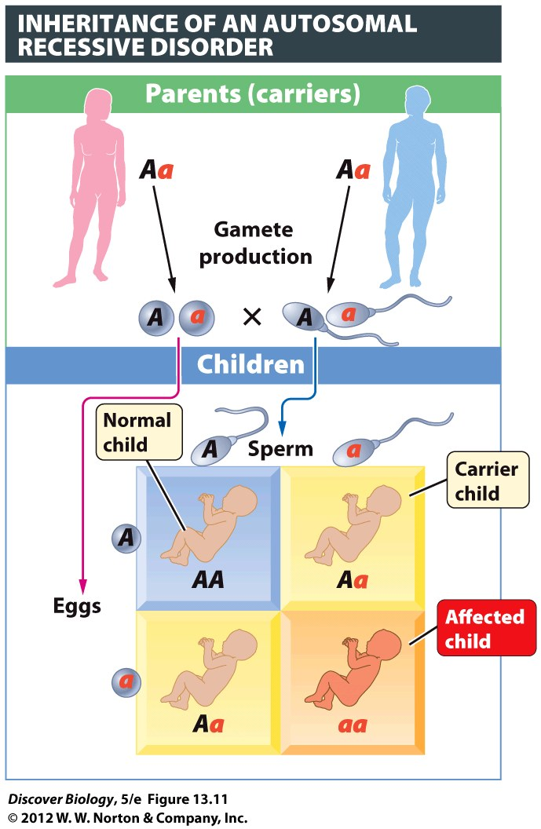
Notes:
Figure 13.11 Genetic Carriers Transmit an Autosomal Recessive Condition without Displaying It Themselves
The patterns of inheritance for a human autosomal recessive genetic disorder are the same as for any other recessive trait (compare this figure with the pattern shown by Mendel’s pea plants in Figure 12.7). Recessive disorder alleles are colored red and denoted a. Dominant, normal alleles are black and denoted A. Here, the parents are a carrier male (genotype Aa) and a carrier female (genotype Aa).

Slide 34
Serious Dominant Genetic Disorders Are Less Common
A parent that has a dominant genetic disorder has a 50% chance of passing it on to the children
Dominant genetic disorders that prevent a sufferer from reproducing are uncommon in a population and most often appear as the result of new mutations
Huntington’s disease is a dominant genetic disorder that expresses its effects after childbearing age

Slide 35
Sex-Linked Inheritance of Single-Gene Mutations
Genes found only on the X or Y chromosome are said to be sex-linked
Males receive one copy of each sex-linked gene while females receive two copies of genes on the X chromosome and no copies of genes on the Y chromosome
There are about 50 human Y-linked genes and approximately 1,100 human X-linked genes

Slide 36
Sex-Linked Inheritance of Single-Gene Mutations
Males cannot be heterozygous for any X-linked genes because the Y chromosome does not have a copy of those genes; therefore, the effects of a recessive X-linked disorder cannot be masked by a dominant allele
Males are more likely to get recessive X-linked disorders
Females must inherit two copies of the allele for the disorder in order to be affected

Slide 37
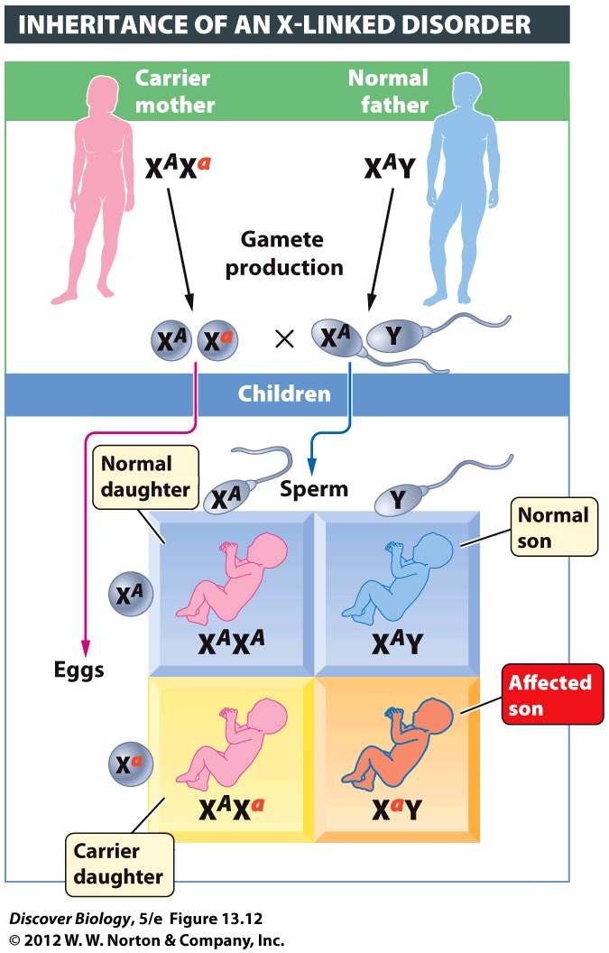
Notes:
Figure 13.12 X-Linked Recessive Conditions Tend to Be More Common in Males Than in Females
The recessive disorder allele (a) is located on the X chromosome and is denoted by Xª. The dominant normal allele (A) on the X chromosome is denoted by X^{A}.

Slide 38
Inherited Chromosomal Abnormalities
A change in the number or structure of chromosomes is considered a chromosomal abnormality
Chromosomal abnormalities that occur in gametes or gamete-producing cells can be passed to offspring
Very few genetic disorders are caused by inherited chromosomal abnormalities, probably because most large changes in the chromosomes cause death in the developing embryo

Slide 39
The Structure of Chromosomes Can Change in Several Ways
Changes occur most often when chromosomes are being aligned or separated during cell division
Deletion occurs when a piece of a chromosome breaks off and is lost
Inversion occurs when a fragment of a chromosome breaks off and returns to the correct place on the original chromosome, but with the genetic loci in reverse order

Slide 40
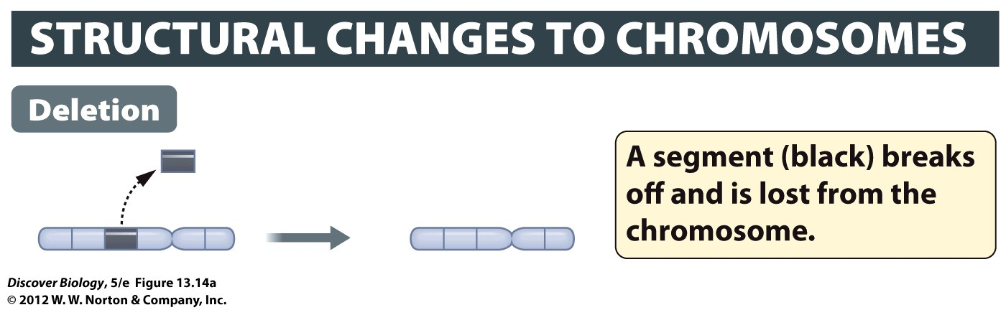
Notes:
Figure 13.14a Chromosome Rearrangements Can Cause Serious Genetic Disorders

Slide 41
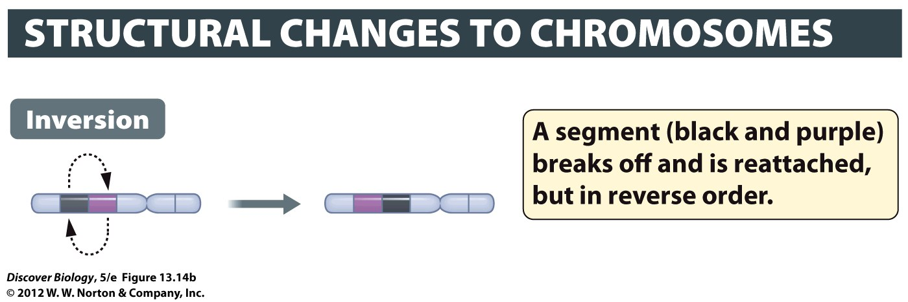
Notes:
Figure 13.14b Chromosome Rearrangements Can Cause Serious Genetic Disorders

Slide 42
The Structure of Chromosomes Can Change in Several Ways
A translocation occurs when a broken piece from one chromosome becomes attached to a different, nonhomologous chromosome
Duplication is a type of chromosomal abnormality in which a chromosome becomes longer because it ends up with two copies of a particular chromosome fragment

Slide 43
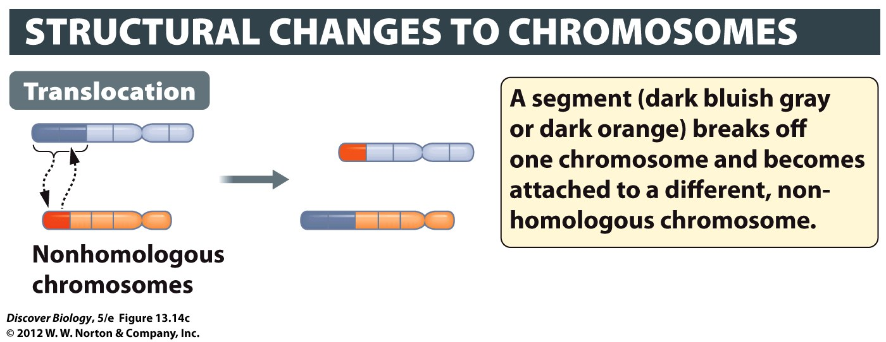
Notes:
Figure 13.14c Chromosome Rearrangements Can Cause Serious Genetic Disorders

Slide 44
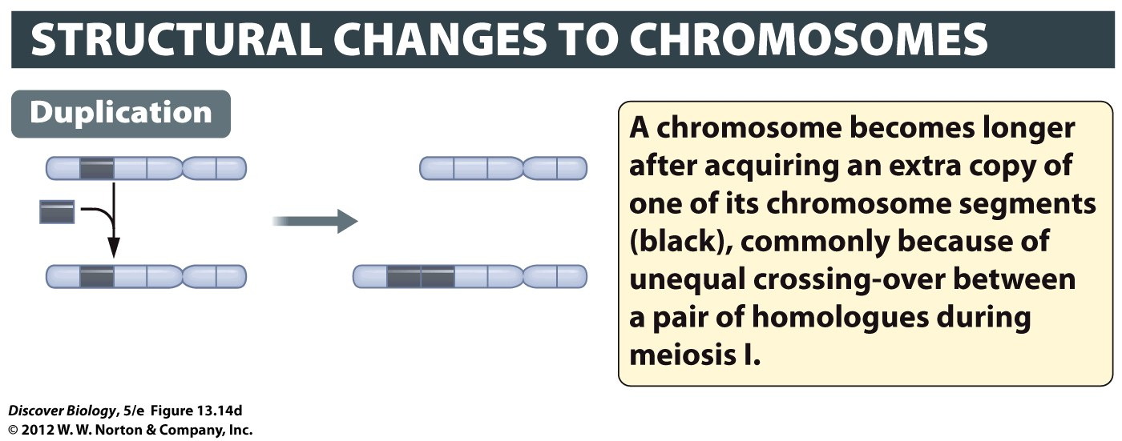
Notes:
Figure 13.14d Chromosome Rearrangements Can Cause Serious Genetic Disorders

Slide 45
Changes in Chromosome Number Are Often Fatal
Unusual numbers of chromosomes can result when chromosomes fail to separate properly during meiosis
Down syndrome results when a person inherits three copies, or a trisomy, of chromosome 21
Changes in the number of sex chromosomes have more minor effects

Slide 46
Testing for Huntington’s Disease
Huntington’s disease (HD) is caused by a dominant allele; therefore, each child of a parent with Huntington’s has a 50% chance of developing the disease
Scientists have developed a test for the HD gene and are working on a cure
Genetic testing and counseling can help reduce the number of people with genetic diseases

Slide 47
Clicker Questions
CHAPTER 13
Chromosomes and Human
Genetics

Slide 48
Concept Quiz
Which of the following is not true of homologous chromosomes?
They contain the same alleles.
They contain the same genes.
One came from each parent.
Each is duplicated during replication.
Notes:
The correct answer is A; they don’t necessarily carry the same alleles
This stresses the difference between genes and alleles, which is confusing to students; alleles are what create genetic diversity, so there must be differences between maternal and paternal alleles
Answer B is true, unless there is a chromosomal abnormality
Answer C is true; this is the result of fertilization
Answer D is true; students often confuse sister chromatids with homologous chromosomes; Stress that homologous means “similar” not identical

Slide 49
Concept Quiz
Genes that are linked on the same chromosome always segregate together.
True
False
Notes:
False. While linked genes usually segregate together (which means that they don’t obey the Law of Independent Assortment), crossing over can cause them to act as if they aren’t linked.

Slide 50
Concept Quiz
Autosomal‑dominant disorders
Are carried on the X chromosome.
Often express late in life.
Are spread by carriers (heterozygotes) mating.
Are more common than recessive disorders.
Notes:
The correct answer is B. Autosomal dominant disorders are rare because affected individuals usually die before mating and passing the gene on. The exception is autosomal dominant disorders that express late in life, like Huntington’s Disease.
Sex-linked diseases are associated with the X chromosome (although the X and Y share 18 genes and these act as autosomal genes).
Since the is dominant, people with one gene are affected. There are no carriers.
Recessive disorders are more common because they are spread by carriers.

Slide 51
Relevant Art from Other Chapters
All art files from the book are available in JPEG and PPT formats online and on the Instructor Resource Disc

Slide 52
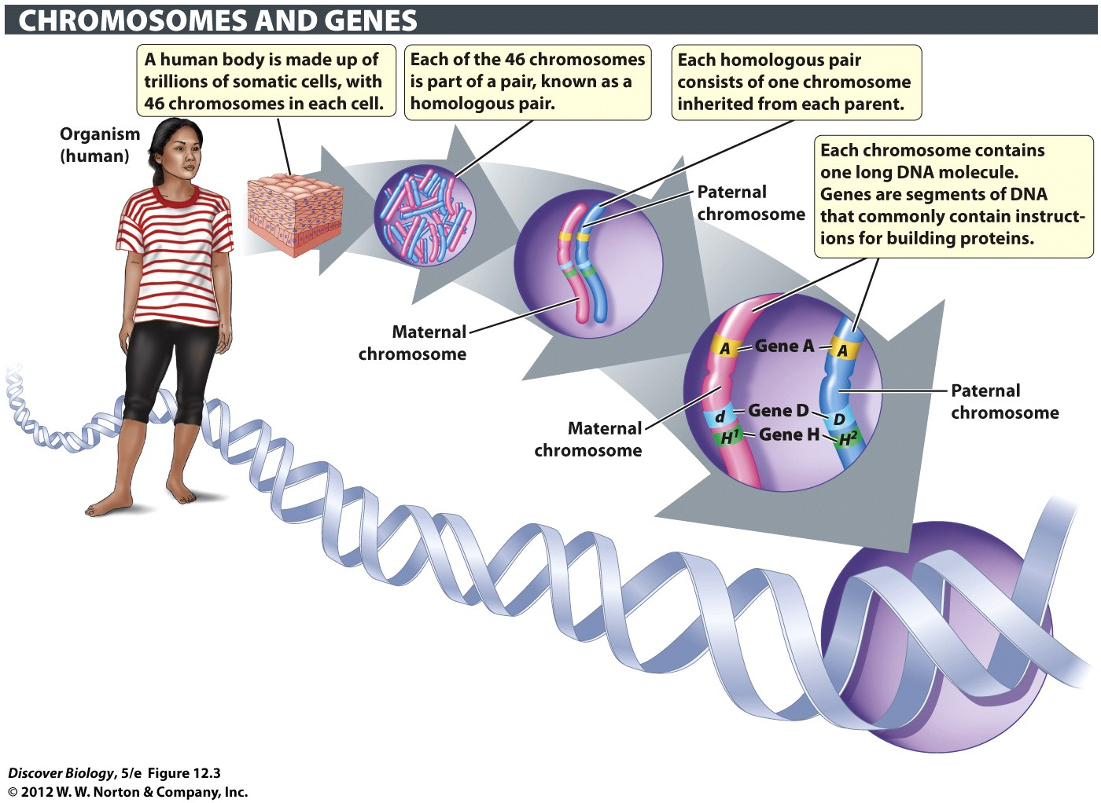
Notes:
Figure 12.3 Somatic Cells Have Two Copies of Most Genes
Somatic cells make up the large majority of cells in the body of a multicellular organism. Somatic cells in plants and animals are diploid: each type of chromosome occurs as a pair, known as a homologous pair. Alternative versions of a gene are known as alleles. In a matched pair of homologous chromosomes, a given gene is found at the same location on each chromosome, but the paternal and maternal homologues may carry different alleles of that gene.

Slide 53
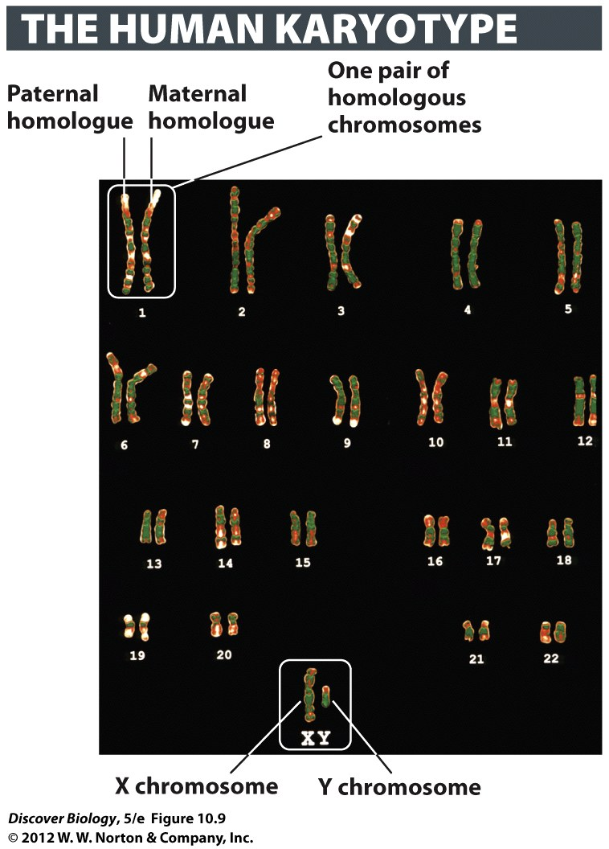
Notes:
Figure 10.9 The Karyotype Identifies All the Chromosomes of a Species
The 46 chromosomes in this micrograph represent the karyotype of a human male. With the help of computer graphics, photos of the chromosomes have been aligned so that the two members of each homologous pair are placed next to each other. The non–sex chromosomes (known as autosomes) are numbered. The sex chromosomes are represented by letters (XY, in the case of this individual, a male).

Slide 54
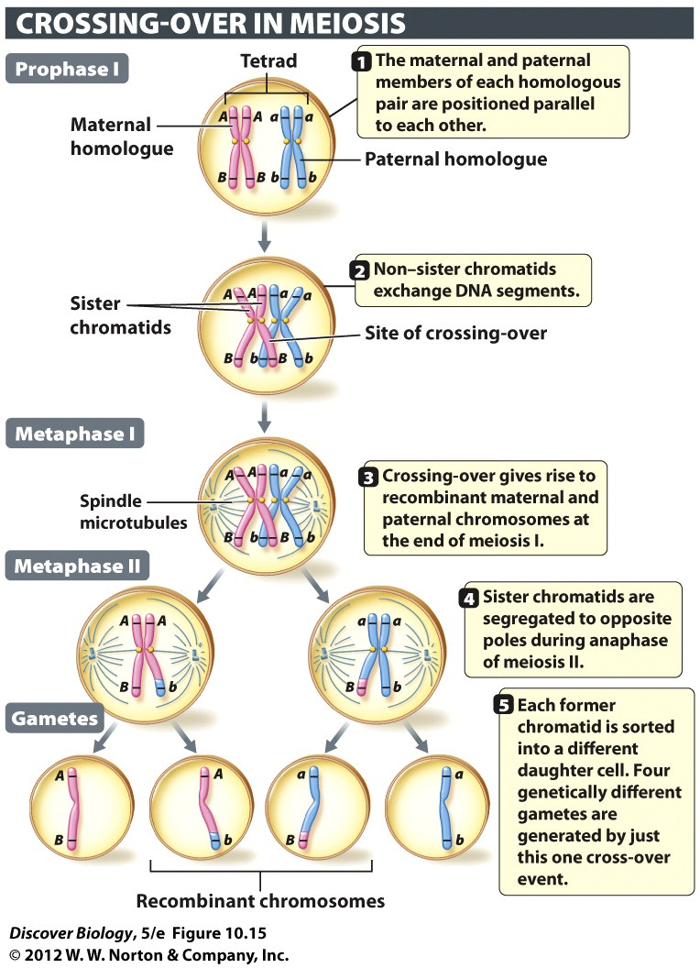
Notes:
Figure 10.15 Crossing-over Produces Recombinant Chromosomes
Crossing-over is the physical exchange of corresponding segments between the non–sister chromatids in a pair of homologous chromosomes that are aligned parallel to each other during prophase I. For clarity, only one maternal and one paternal chromatid are depicted here as exchanging segments. In human cells undergoing meiosis, most tetrads have one to three crossover sites, with longer chromosomes more likely to have multiple crossovers. A crossover site can be located at any point along the length of the paired homologues (tetrad), not just at the tips of the chromatids. The letters (A/a and B/b) represent alternative alleles of two genes, A and B. Note that the parental combinations of these alleles have been shuffled in the recombinant chromosomes.

Slide 55
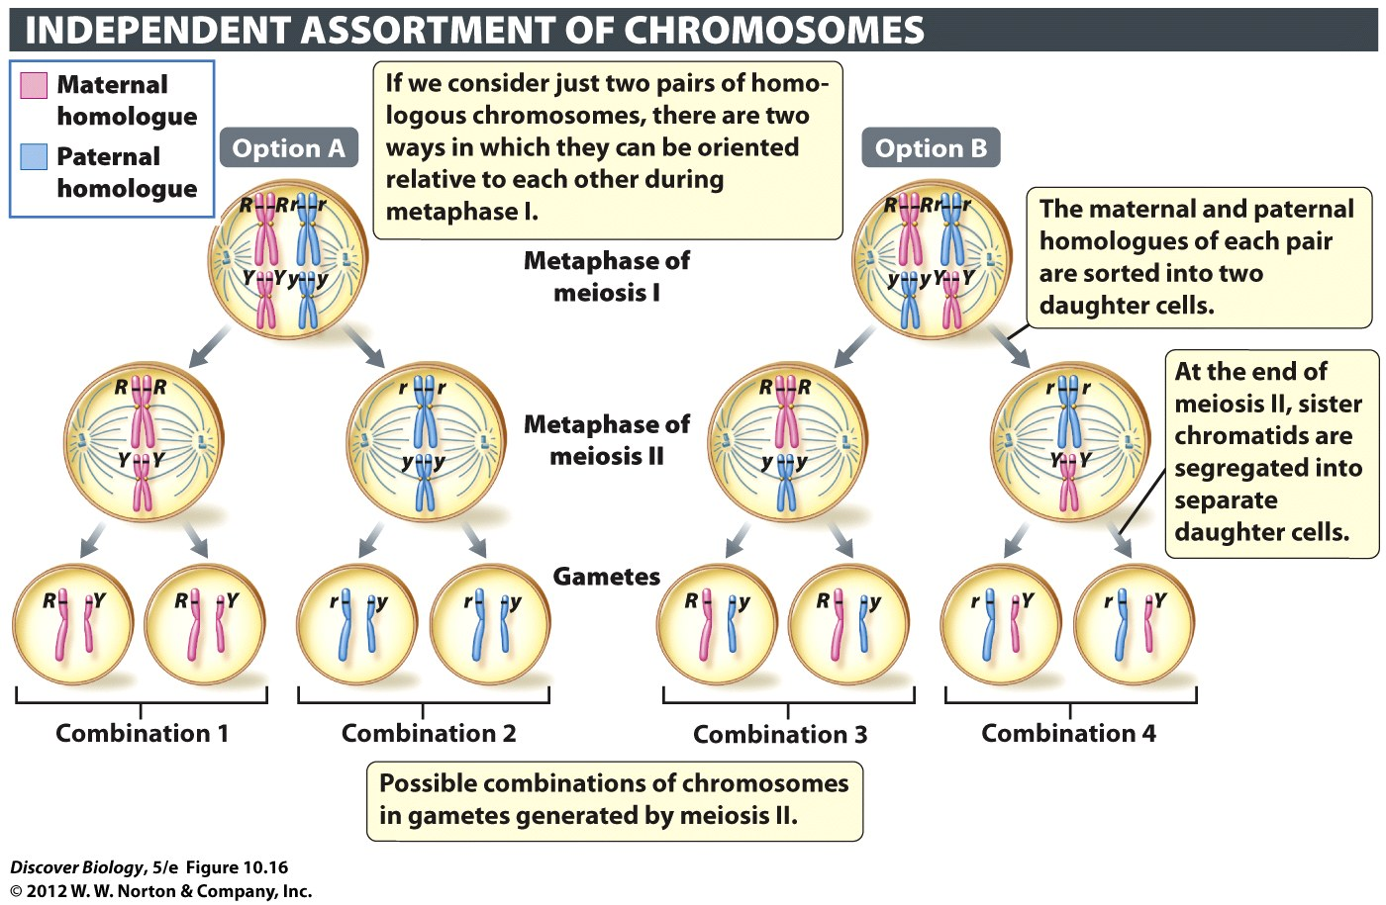
Notes:
Figure 10.16 The Random Assortment of Homologous Chromosomes Generates Chromosomal Diversity among Gametes

