Slide 1
Discover Biology FIFTH EDITION
Anu Singh-Cundy • Michael L. Cain
CHAPTER 12
Patterns of Inheritance
© 2012 W. W. Norton & Company, Inc.

Slide 2
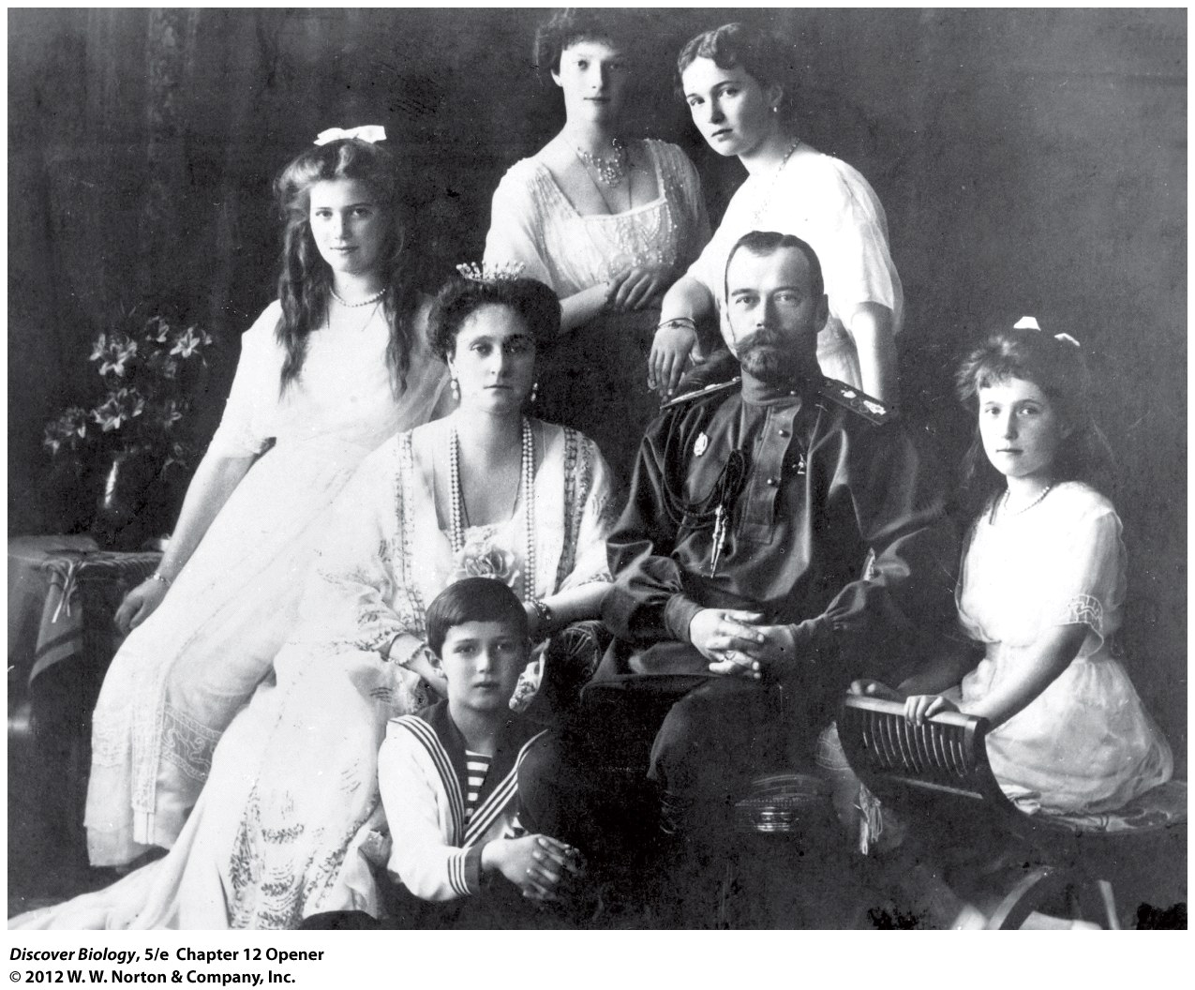
Notes:
A Royal Mystery.
Czar Nicholas II, seen here with the czarina and their five children, was the last czar of Russia. His youngest daughter, Princess Anastasia, is on the right in this 1910 photo.

Slide 3
The Lost Princess
The last Russian czar and his family were executed in 1918
Rumors that one of his daughters escaped were disproved through genetic testing

Slide 4
Humans Have Used the Principles of Inheritance for Thousands of Years
The field of genetics originated in 1866 after Gregor Mendel published a paper on inheritance in pea plants
Mendel used mathematics to analyze the inheritance of seven genetic traits in pea plants
Mendel’s work was largely ignored for 30 years before it was adopted as the foundation for modern genetics

Slide 5
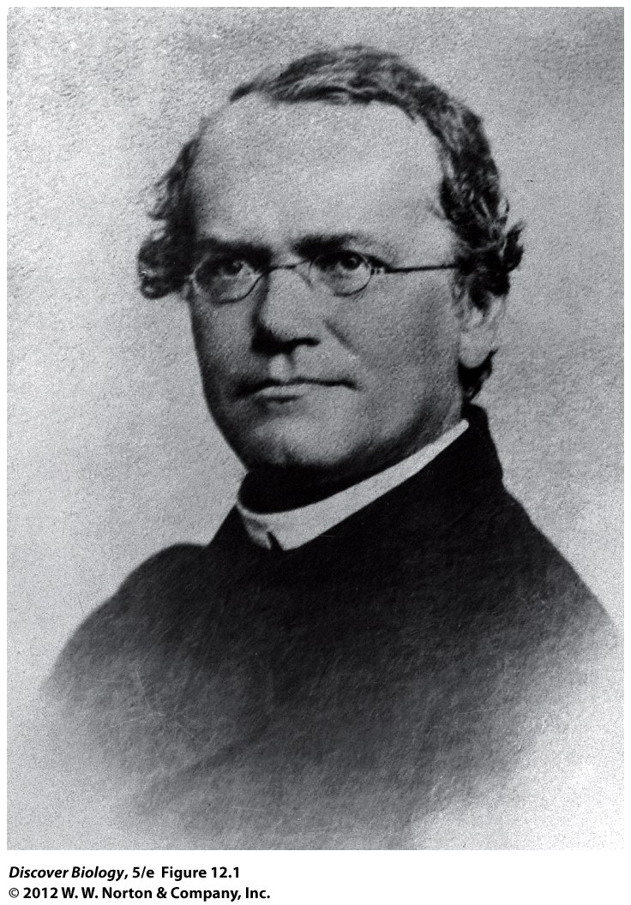
Notes:
Figure 12.1 Gregor Mendel (1822-1884)

Slide 6
Essential Terms in Genetics
A genetic trait is any inherited characteristic of an organism that can be observed or detected
Invariant genetic traits are the same in all individuals in a population
The display of a particular version of a genetic trait in a specific individual is the phenotype

Slide 7
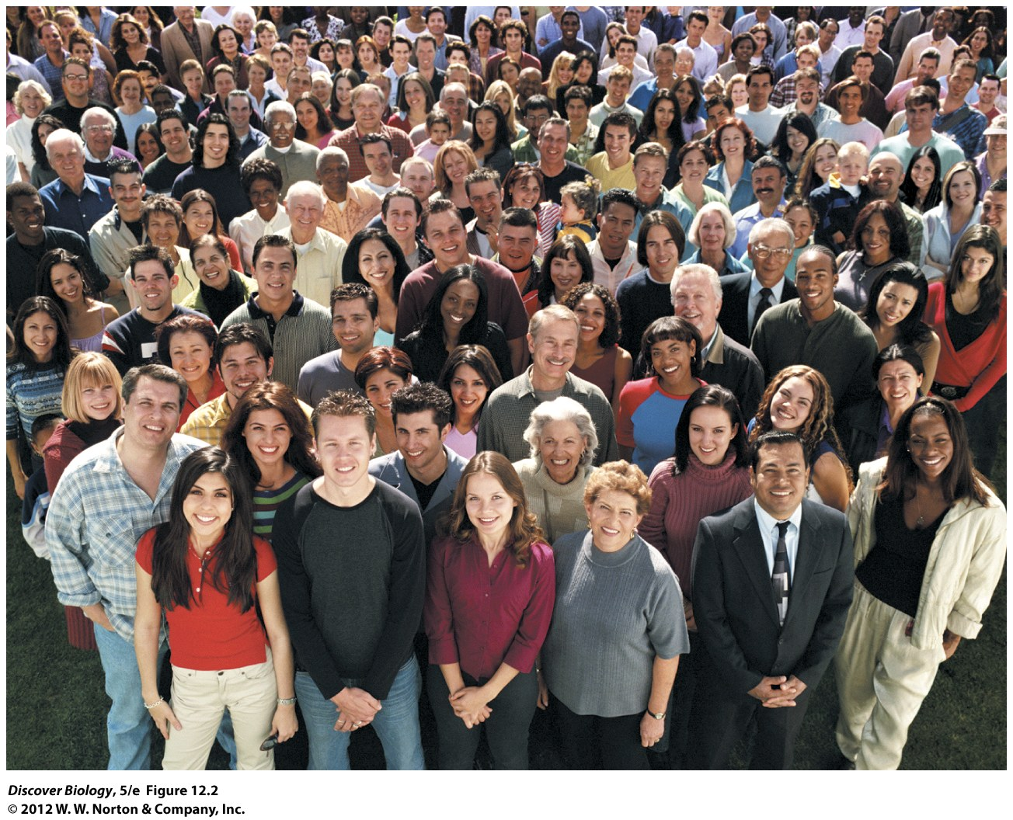
Notes:
Figure 12.2 Genetic Traits in Humans
How many genetic traits can you identify in this crowd? Are the traits discrete, falling into clear-cut categories, or do they vary by degree in different people (the way height does)? Do you suppose that the traits you have identified are controlled by genes exclusively, or might they be influenced by environmental factors also?

Slide 8
Diploid Cells Have Two Copies of Every Gene
Somatic cells of plants and animals are diploid, meaning that they contain two copies of each type of chromosome and make up a homologous pair
Each homologous pair contains one paternal homologue and one maternal homologue
Humans have 23 pairs of homologous chromosomes, making a total of 46 chromosomes
Gametes are created through meiosis and are haploid, meaning they have only one set of chromosomes

Slide 9
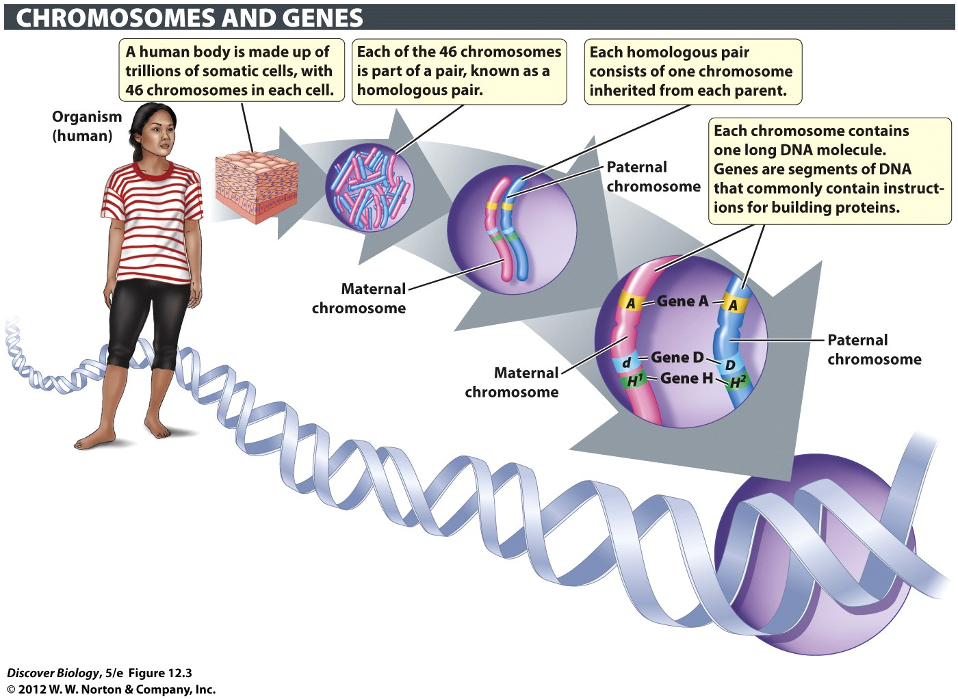
Notes:
Figure 12.3 Somatic Cells Have Two Copies of Most Genes
Somatic cells make up the large majority of cells in the body of a multicellular organism. Somatic cells in plants and animals are diploid: each type of chromosome occurs as a pair, known as a homologous pair. Alternative versions of a gene are known as alleles. In a matched pair of homologous chromosomes, a given gene is found at the same location on each chromosome, but the paternal and maternal homologues may carry different alleles of that gene.

Slide 10
Genotype Directs Phenotype
Alleles are different versions of a given gene
Genetic diversity is the result of the many different alleles of each gene in a population
The genotype of an individual is the allelic makeup of that individual with respect to a specific genetic trait
The phenotype is the result of an individual’s genotype

Slide 11
Genotype Directs Phenotype
An individual who carries two copies of the same allele is said to be homozygous for that gene
An individual whose genotype consists of two different alleles for a given phenotype is said to be heterozygous for that gene

Slide 12
Some Phenotypes Are Controlled by Dominant Alleles
The allele that exerts a controlling influence on the phenotype is said to be dominant
An allele that has no effect on the phenotype when paired with a dominant allele is said to be recessive
Some traits are controlled by more than one gene, whereas others are not controlled by any one set of genes

Slide 13
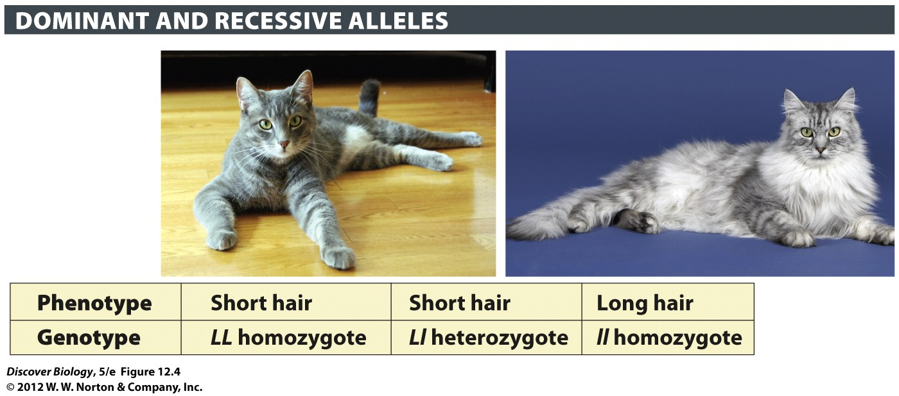
Notes:
Figure 12.4 In Cats, Short Hair Is Dominant over Long Hair
The L allele is dominant over the l allele and therefore confers short hair in both the homozygous and heterozygous states (LL and Ll). The long-hair phenotype, controlled by the l allele, is manifested only when unmasked in the ll homozygote.

Slide 14
Gene Mutations Are the Source of New Alleles
A mutation is a change in the DNA making up a gene that creates new alleles, leading to genetic diversity in a population
Harmful mutations are often recessive and therefore masked by the dominant allele yet are passed along to offspring by heterozygotes

Slide 15
Gene Mutations Are the Source of New Alleles
Mutations are often neutral or, on the rare occasion, beneficial to the individual
Gene mutations occur at random
Only mutations that occur in the gametes or the cells that produce gametes can be passed to offspring

Slide 16
Controlled Crosses Help Us Understand Patterns of Inheritance
A genetic cross is a controlled mating experiment performed to examine how a particular trait is inherited
The parents, or P generation, are crossed to produce offspring, called the F₁ generation
Two individuals from the F₁ generation are then crossed to produce the F₂ generation

Slide 17
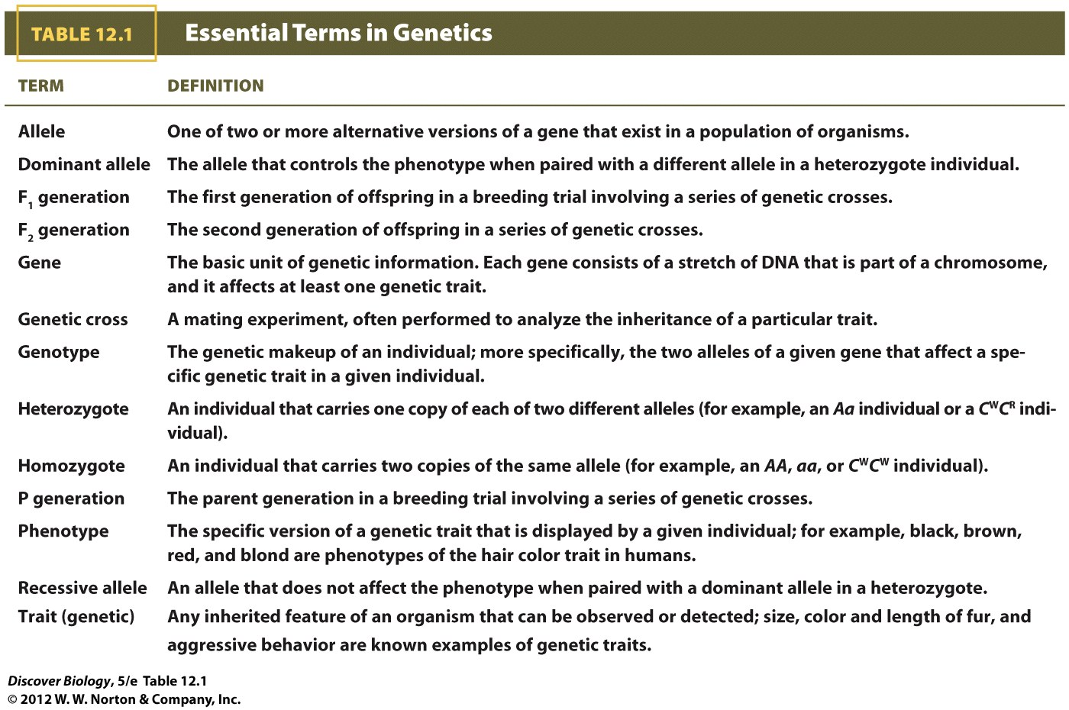
Notes:
Table 12.1 Essential Terms in Genetics

Slide 18
Basic Patterns of Inheritance
Prior to Mendel’s work, it was believed that offspring were a blend of parental traits that produced an intermediate (“in-between”) phenotype, meaning that lost traits could not appear in later generations
Mendel analyzed inheritance in pea plants and proposed that offspring inherit two separate units of genetic information, now known as genes, with one from each parent

Slide 19
Mendel’s Genetic Experiments Began with True-Breeding Pea Plants
Mendel used true-breeding varieties of pea plants to conduct highly controlled experiments
True-breeding, or purebred, individuals have a homogenous genotype
Mendel crossed two lines of pure-breeding plants to produce two generations of hybrid plants and recorded the phenotypic data

Slide 20
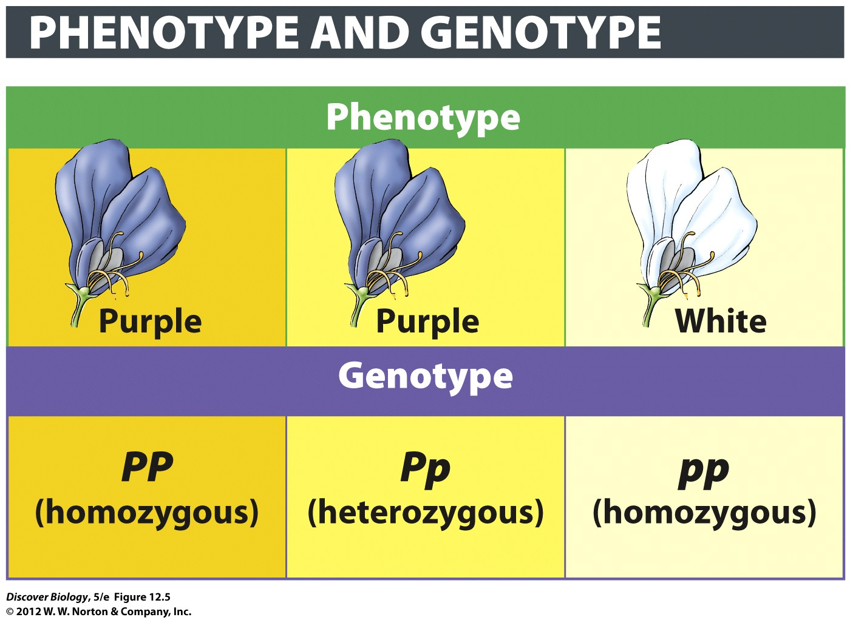
Notes:
Figure 12.5 True-Breeding Traits Have a Homozygous Genotype
Flower color in peas is controlled by a gene with two alleles (P and p). Although there are three genotypes (PP, Pp, and pp), there are only two phenotypes (purple flowers and white flowers). There are fewer phenotypes because genotypes PP and Pp both produce purple flowers, while pp produces white flowers.

Slide 21
Mendel Inferred That Inherited Traits Are Determined by Genes
Mendel repeatedly observed a 3:1 ratio of dominant to recessive phenotypes
The basis of Mendel’s work can be summarized as in five points:
Alternative versions of genes cause variation in inherited traits
Offspring inherit one copy of a gene from each parent

Slide 22
Mendel Inferred That Inherited Traits Are Determined by Genes
The basis of Mendel’s work can be summarized in five points (cont’d):
An allele is dominant if, when paired with a different allele, it has exclusive control over an individual’s phenotype
The two copies (alleles) of a gene segregate during meiosis and end up in different gametes
Gametes fuse randomly, without regard to the particular alleles they carry

Slide 23
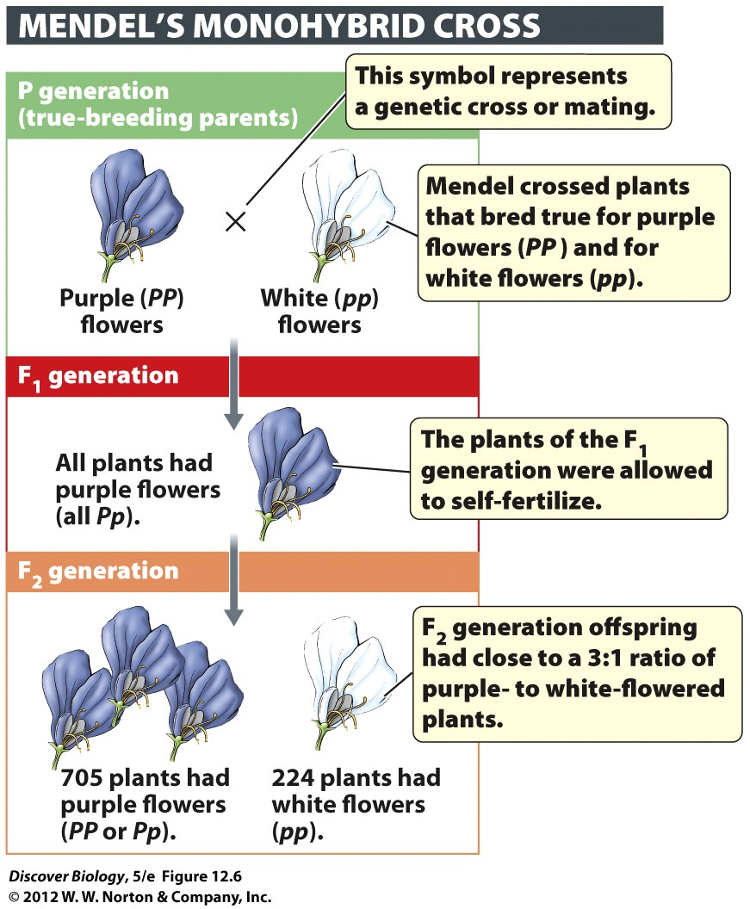
Notes:
Figure 12.6 Inheritance of a Single Trait over Three Generations
Mendel crossed parent plants that were true-breeding (homozygous) for two discrete phenotypes (purple or white) of a particular trait (flower color). Such breeding trials are described as monohybrid crosses because the F₁ plants are hybrid (heterozygous) for a single trait (flower color).

Slide 24
Mendel’s Laws of Inheritance
Mendel deduced the law of segregation from breeding experiments in which he tracked a single trait
The law of independent assortment was based on two-trait breeding experiments that Mendel conducted, in which he tracked two completely different traits at the same time

Slide 25
Mendel’s Single-Trait Crosses Revealed the Law of Segregation
The law of segregation states that the two copies of a gene are separated during meiosis and end up in different gametes
The law of segregation can be used to predict how a single trait will be inherited
A Punnett square can be used to show all the possible ways in which two alleles can recombine through fertilization

Slide 26
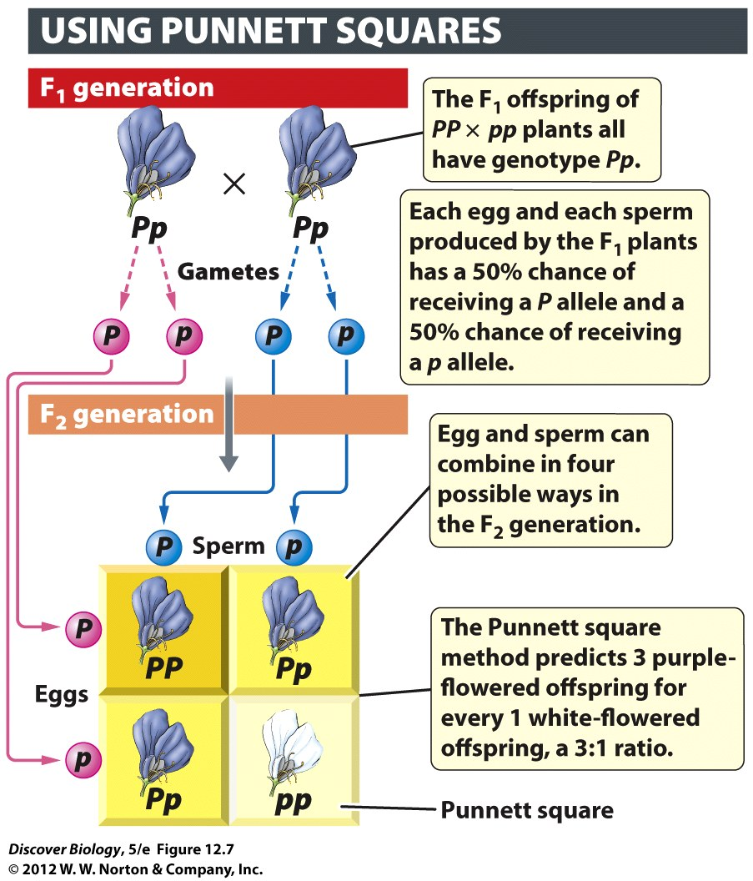
Notes:
Figure 12.7 The Punnett Square Method Is Used to Predict All Possible Outcomes of a Genetic Cross
Punnett squares chart the segregation (separation) of alleles into gametes and all the possible ways in which the alleles borne by these gametes can be combined to produce offspring.

Slide 27
Mendel’s Two-Trait Experiments Led to the Law of Independent Assortment
Mendel crossed dihybrids, individuals that are heterozygous for two traits, to determine if the inheritance of one allele was dependent on the inheritance of another allele
The law of independent assortment states that when gametes form, the two copies of any given allele segregate during meiosis, independently of any two alleles of other genes
The law of independent assortment applies to the inheritance of two genes that are physically separated on different chromosomes

Slide 28
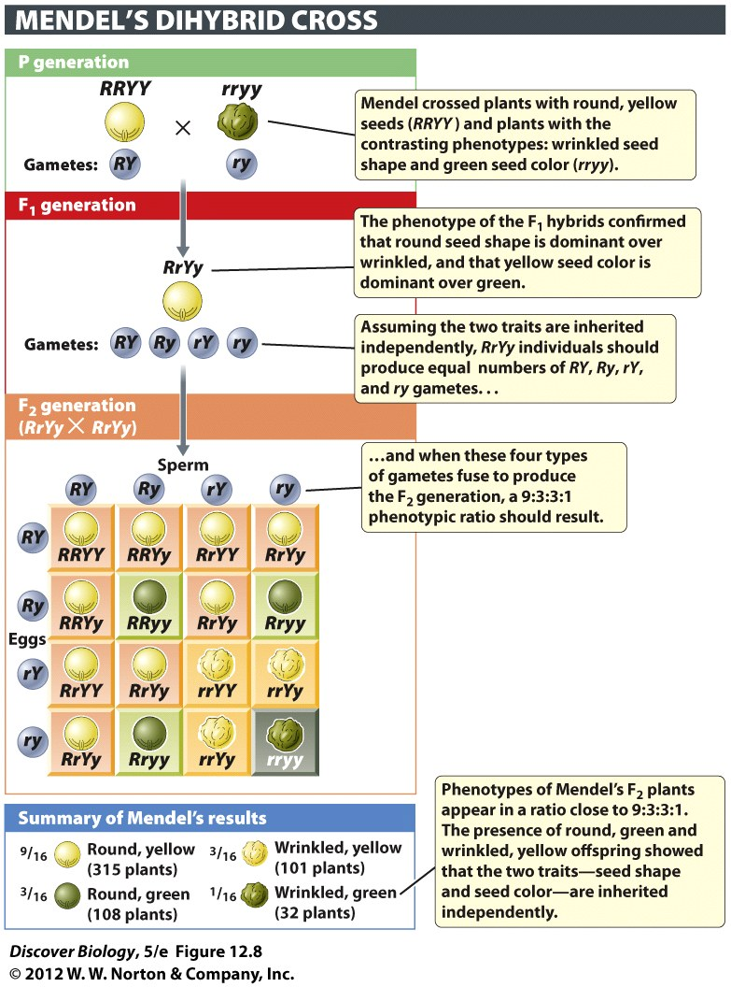
Notes:
Figure 12.8 Inheritance of Two Traits over Three Generations
Mendel used two-trait breeding experiments to test the hypothesis that the alleles of two different genes are inherited independently from each other. In one set of experiments, illustrated here, Mendel tracked the seed shape trait controlled by the R/r alleles and the seed color trait controlled by the Y/y alleles. The real test of the hypothesis came when Mendel examined the phenotypes of the offspring produced by crossing the heterozygous F₁ plants (RrYy). As predicted by the hypothesis, two new phenotypic combinations were found among the F₂ offspring: plants that made round, green seeds (R-yy) and plants that made wrinkled, yellow seeds (rrY-). The bottom panel summarizes the ratio of the two parental phenotypes and the two novel, nonparental phenotypes. A two-trait breeding experiment in which the F₁ plants are double heterozygotes (heterozygous for both traits) is called a dihybrid cross.

Slide 29
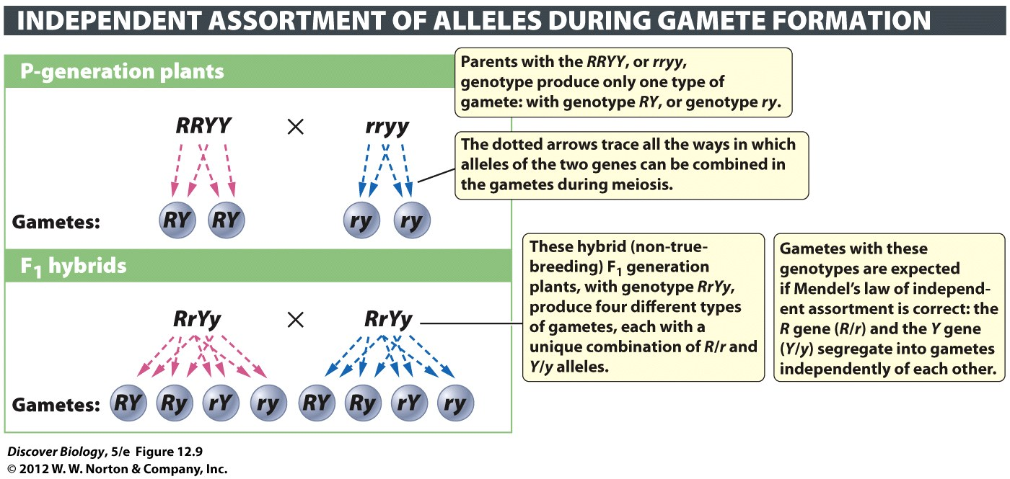
Notes:
Figure 12.9 The Alleles of Two Genes Are Sorted into Gametes Independently
The 9:3:3:1 phenotypic ratios in the F₂ generation of Mendel’s dihybrid cross are best explained by the law of independent assortment, according to which the alleles of the R gene segregate independently of the alleles of the Y gene during meiosis.

Slide 30
Mendel’s Insights Rested on a Sound Understanding of Probability
To deduce the patterns of inheritance, Mendel used probability to analyze the data he collected from the offspring of the genetic crosses
We can predict the probability that a particular offspring will have a certain phenotype or genotype, but we cannot predict the actual phenotype or genotype of an individual
The probability that a particular offspring will display a specific phenotype is completely unaffected by the number of offspring

Slide 31
Extensions of Mendel’s Laws
Mendel’s work was based on genetic traits controlled by a single gene with a dominant and a recessive allele
Mendel’s laws have been expanded to help explain the more complex patterns of inheritance

Slide 32
Many Alleles Display Incomplete Dominance
Incomplete dominance is the situation in which no single allele completely dominates the other when the two are paired in a heterozygote
In cases where neither allele is able to exert its full effect, heterozygotes display an intermediate phenotype

Slide 33
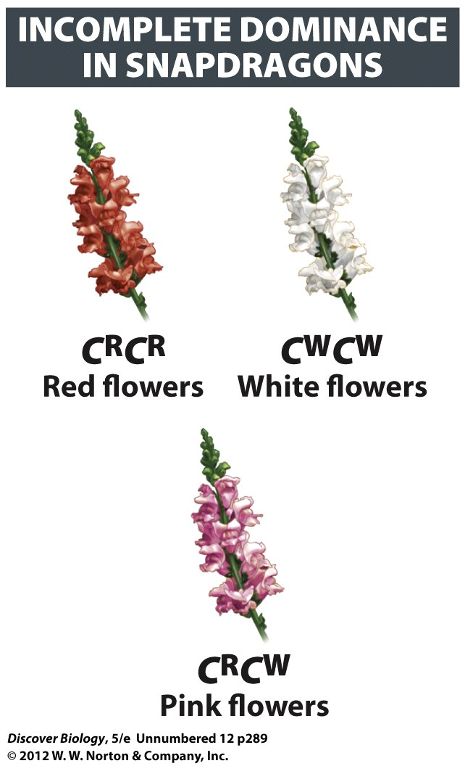

Slide 34
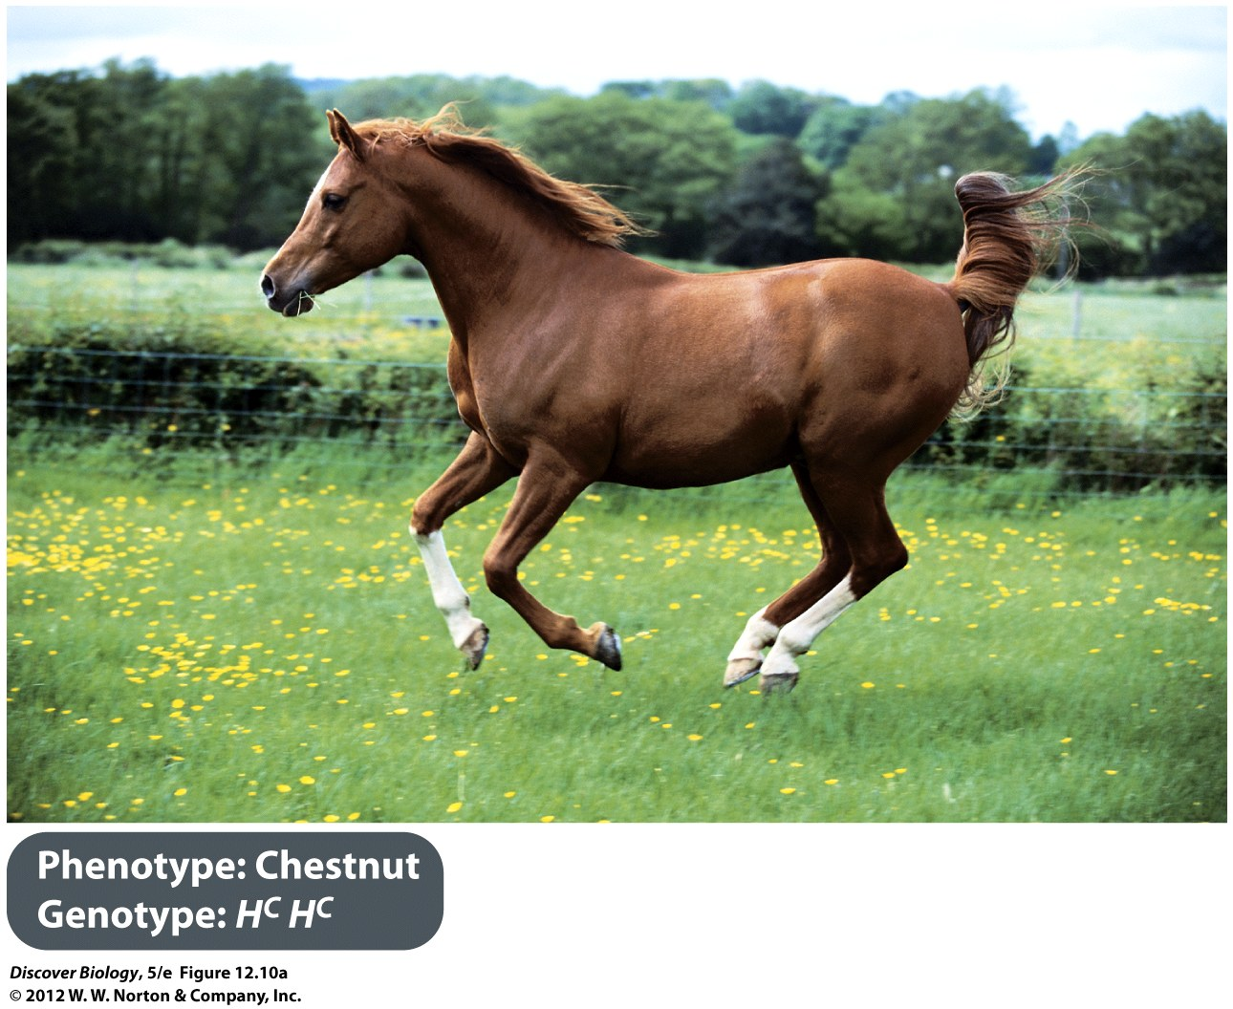
Notes:
Figure 12.10 Incomplete Dominance in Horses
Palominos (heterozygous genotype H^{C}H^{Cr}) are intermediate in color to chestnuts (H^{C}H^{C}) and cremellos (H^{Cr}H^{Cr}) because in the heterozygote, the H^{Cr} allele “dilutes” the effect of the H^{C} allele to produce the intermediate phenotype.

Slide 35
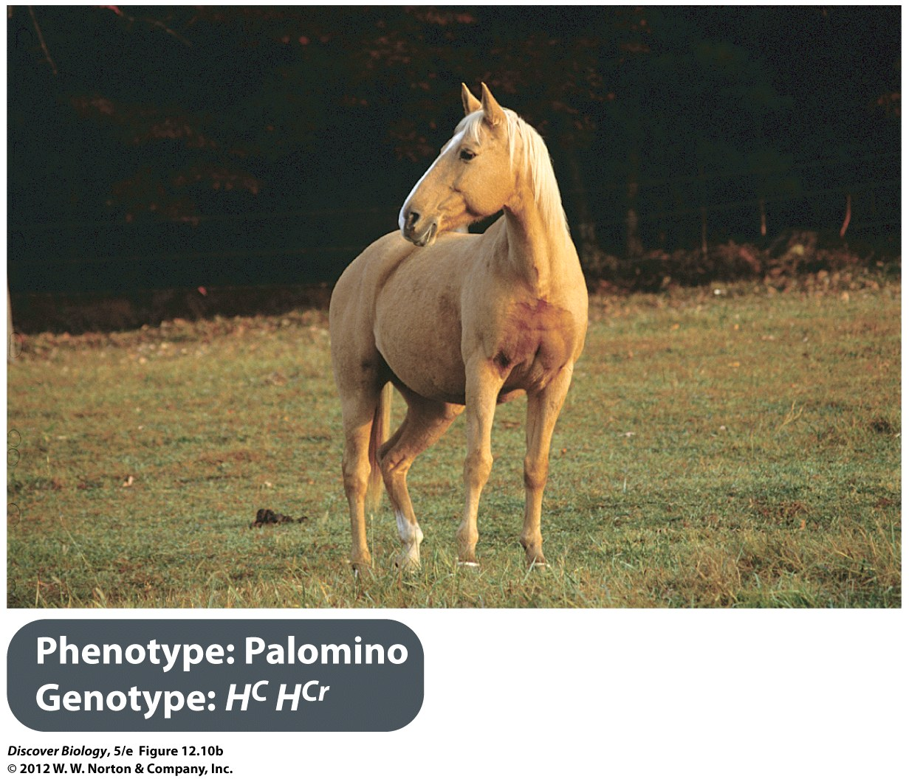
Notes:
Figure 12.10 Incomplete Dominance in Horses
Palominos (heterozygous genotype H^{C}H^{Cr}) are intermediate in color to chestnuts (H^{C}H^{C}) and cremellos (H^{Cr}H^{Cr}) because in the heterozygote, the H^{Cr} allele “dilutes” the effect of the H^{C} allele to produce the intermediate phenotype.

Slide 36
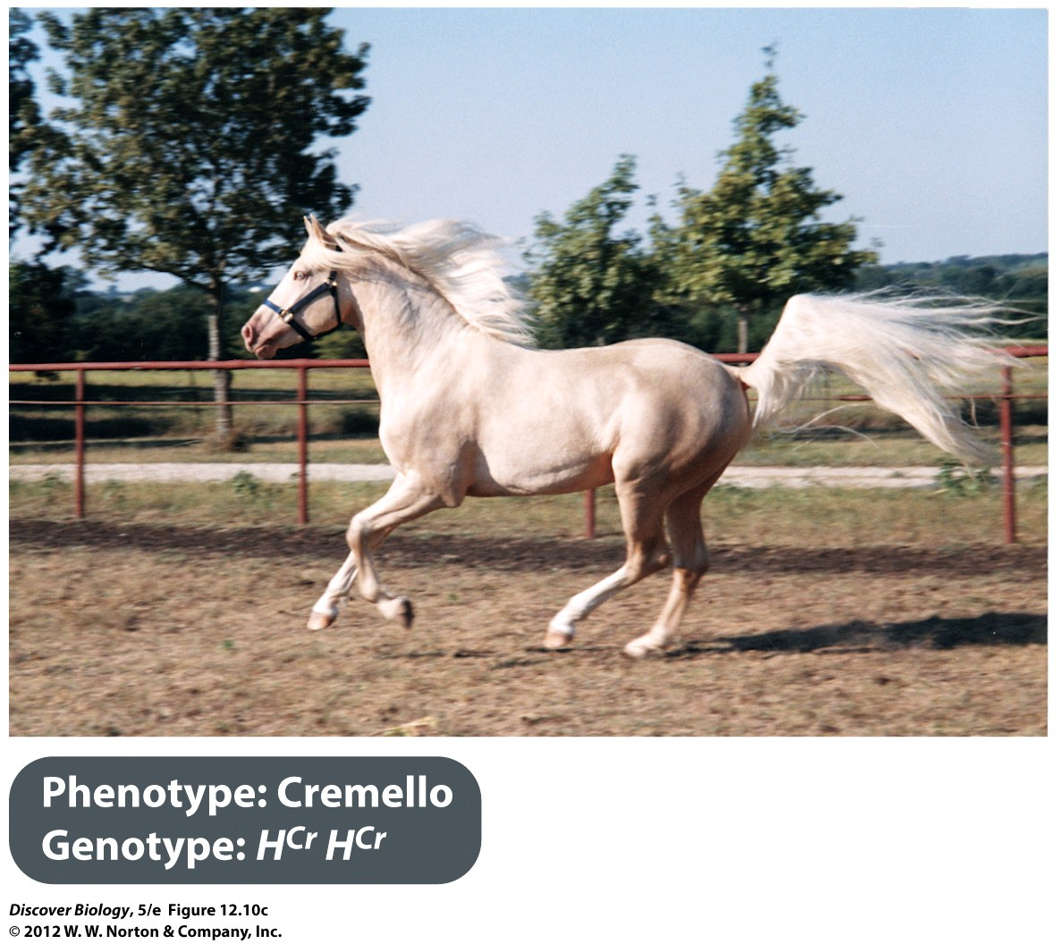
Notes:
Figure 12.10 Incomplete Dominance in Horses
Palominos (heterozygous genotype H^{C}H^{Cr}) are intermediate in color to chestnuts (H^{C}H^{C}) and cremellos (H^{Cr}H^{Cr}) because in the heterozygote, the H^{Cr} allele “dilutes” the effect of the H^{C} allele to produce the intermediate phenotype.

Slide 37
The Alleles of Some Genes Are Codominant
Codominance occurs when the effect of both alleles is equally visible in the phenotype of the heterozygote
Neither allele is diminished or diluted in a heterozygote that displays codominance
The AB blood type is an example of codominance

Slide 38
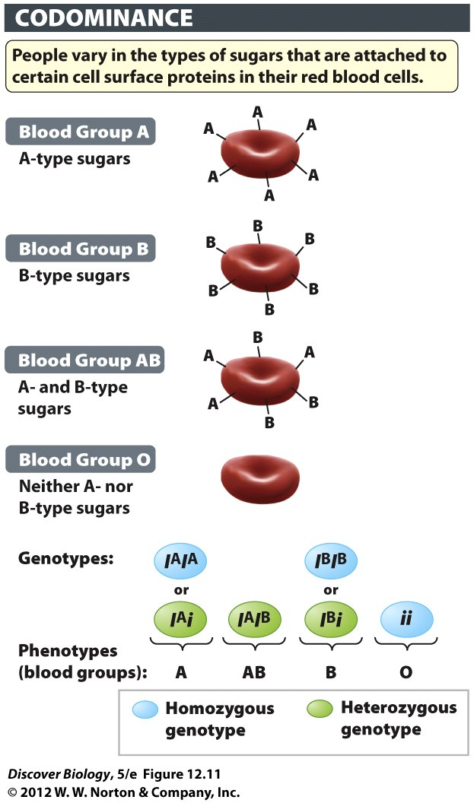
Notes:
Figure 12.11 Genetic Basis of the ABO Blood Types in Humans
The ABO blood types are determined by chains of sugars covalently attached to certain cell surface proteins on red blood cells. Type A red blood cells have a distinctive “A type” of sugar (chemically, N-acetylgalactosamine), whereas type B blood cells have a “B type” of sugar (galactose) at the end of the chain. The AB blood type reflects codominance: the red blood cells in type AB blood have about equal amounts of A-type sugars and B-type sugars on their cell surface. The I gene encodes an enzyme that comes in at least two allelic forms: the form encoded by the A allele adds A-type sugars to red blood cell surfaces, and the form encoded by the B allele adds B-type sugars. The i allele codes for a nonfunctional version of the enzyme that cannot attach any sugar to the cell surface protein. People who have two copies of the i allele (homozygotes) are said to have blood type O.

Slide 39
A Pleiotropic Gene Affects Multiple Traits
The situation in which a single gene influences two or more distinctly different traits is called pleiotropy
A mutation in a pleiotropic gene can cause changes in many different traits
Albinism is an example of a pleiotropic disorder

Slide 40
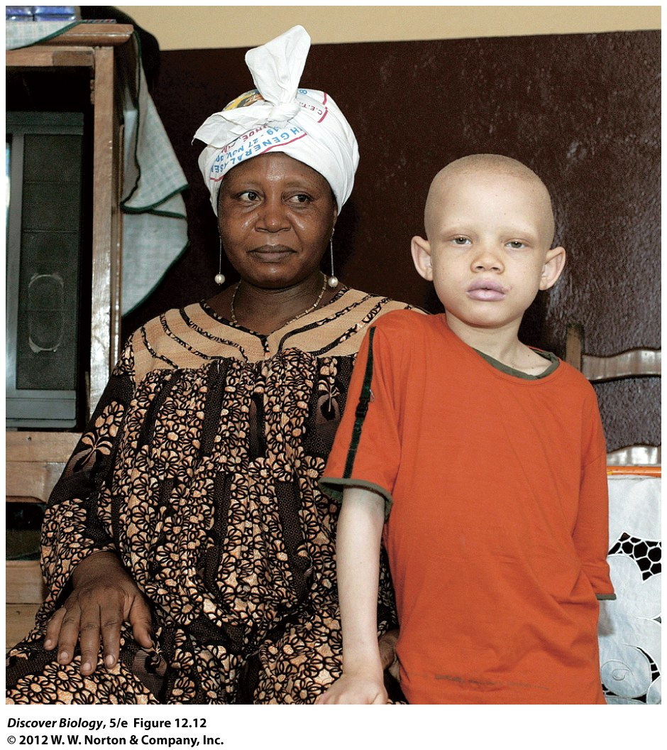
Notes:
Figure 12.12 A Child with Albinism
A mother and her son, who has albinism, in their living room in Douala, Cameroon, Africa. Because it affects eyesight as well as pigmentation in skin, eyes, and hair, albinism is an example of a pleiotropic condition.

Slide 41
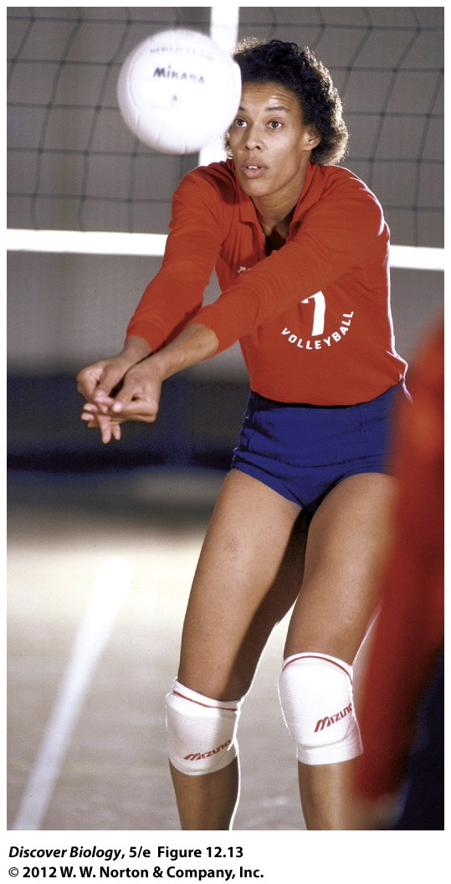
Notes:
Figure 12.13 Flo Hyman
U.S. Olympic volleyball silver medalist Flora Jean (“Flo”) Hyman, shown during practice in 1984. Complications from Marfan syndrome, a pleiotropic genetic disorder, contributed to her death in 1986.

Slide 42
Alleles for One Gene Can Alter the Effects of Another Gene
The term epistasis applies when the phenotypic effect of the alleles of one gene depends on the presence of certain alleles for another, independently inherited gene
Epistasis can be seen in the coat color of numerous animals, whose many genes code for enzymes that convert the amino acid tyrosine into melanin in a multistep pathway

Slide 43
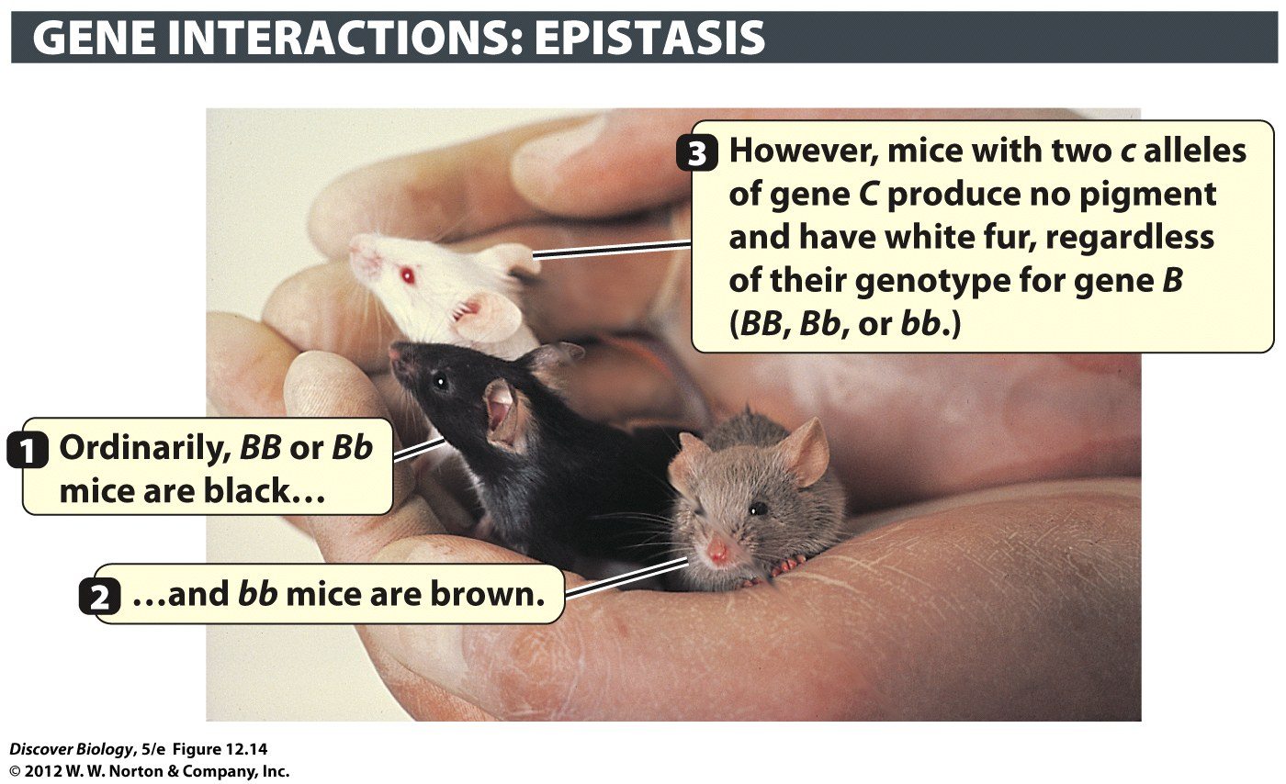
Notes:
Figure 12.14 Alleles of One Gene May Affect the Phenotype Produced by Alleles of Another Gene
In this example the c allele of gene C masks the alleles of another gene, B. In mice with the CC or Cc genotype, the dominant B allele directs the production of melanin, resulting in black fur, while the recessive bb genotype “dilutes” melanin accumulation so that brown fur results. Mice with the cc genotype are albinos because melanin production gets blocked at an early point in the pathway, before the B gene exerts its influence. The cc genotype always results in albinism, regardless of whether the genotype with respect to the B gene is BB, Bb, or bb.

Slide 44
The Environment Can Alter the Effects of a Gene
Chemicals, nutrition, sunlight, and other internal and external environmental factors can also alter the effects of certain genes
The production of melanin in Siamese cats is sensitive to temperature—cooler temperatures produce dark fur on the extremities

Slide 45
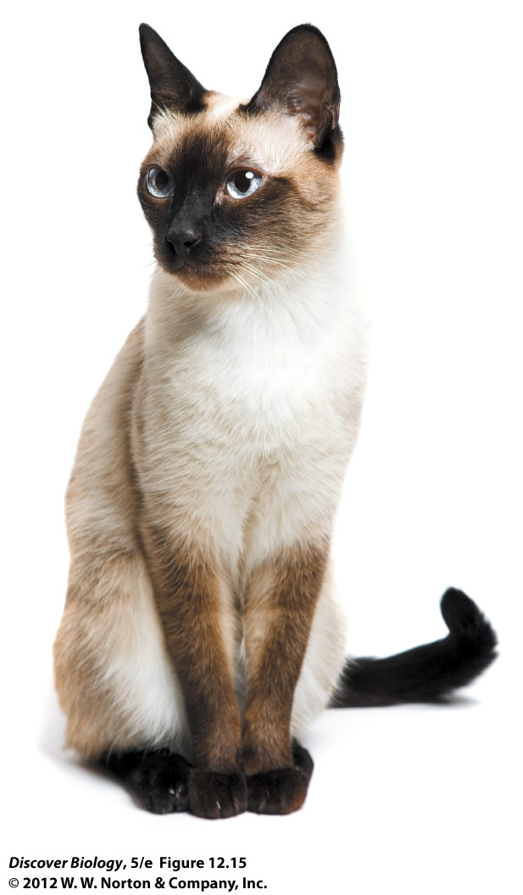
Notes:
Figure 12.15 The Environment Can Alter the Effects of Genes
Coat color in Siamese cats is controlled by a temperature-sensitive allele. The Ct allele of the C gene directs melanin production only at lower temperatures (below 37°C). Melanin therefore accumulates only in the colder extremities—the snout, tail, lower legs, and edges of the ears—and not in the main trunk, which is at the core body temperature (37°C).

Slide 46
Most Traits Are Determined by Two or More Genes
Most traits are considered polygenic because they are governed by the action of more than one gene
Skin color, running speed, blood pressure, and body size are all polygenic traits in humans
Geneticists estimate there are more than a dozen genes that control melanin production in our skin, which, when coupled with environmental influences, results in almost continuous variation in the trait

Slide 47
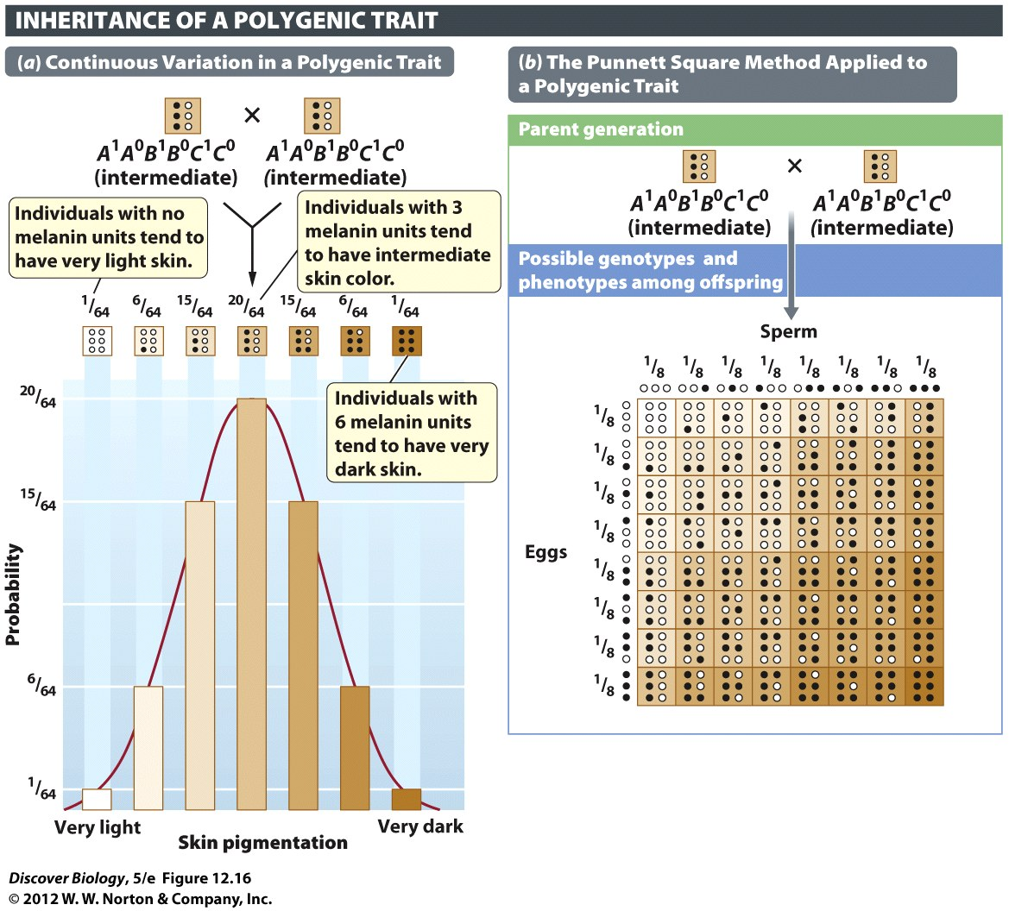
Notes:
Figure 12.16 Three Genes Can Produce a Range of Skin Color in Humans
In this model, skin color is influenced by the total number of melanin “units” specified by the person’s genotype. (a) For each of the three hypothetical genes shown here (A, B, and C), the superscript 1 (for example, A¹) identifies an allele that leads to the production of one “unit” of melanin, while the superscript 0 (for example, A⁰) identifies an allele that produces no melanin. The two alleles of each of these genes are incompletely dominant. Alleles that do not contribute to melanin production (A⁰, B⁰, and C⁰) are represented by open circles, while alleles that do contribute to melanin production (A¹, B¹, and C¹) are represented by solid circles. The bar graph depicts the seven phenotypic outcomes arranged from lightest skin to darkest skin. Bar heights indicate the relative proportions of children of each phenotype. (b) The Punnett square shows the proportions of gametes with specific genotypes that are produced by two heterozygote (A¹A⁰B¹B⁰C¹C⁰) parents and all the possible ways in which the eight different genotypes can come together during fertilization. Each of the seven different phenotypes (that is, children with 0, 1, 2, 3, 4, 5, or 6 melanin units) can be specified by one to several different genotypes. For example, children producing two melanin units can have any one of six different genotypes. Additional variation in skin color would result from different levels of sun exposure.

Slide 48
Complex Traits
Complex traits are those that cannot be predicted using Mendel’s laws of inheritance
Most traits that are essential for survival are complex traits
One explanation is that polygenic traits, combined with environmental influences, produce a smoothly graded range of phenotypic classes known as continuous variation
Phenotypic diversity is a substantial evolutionary benefit

Slide 49
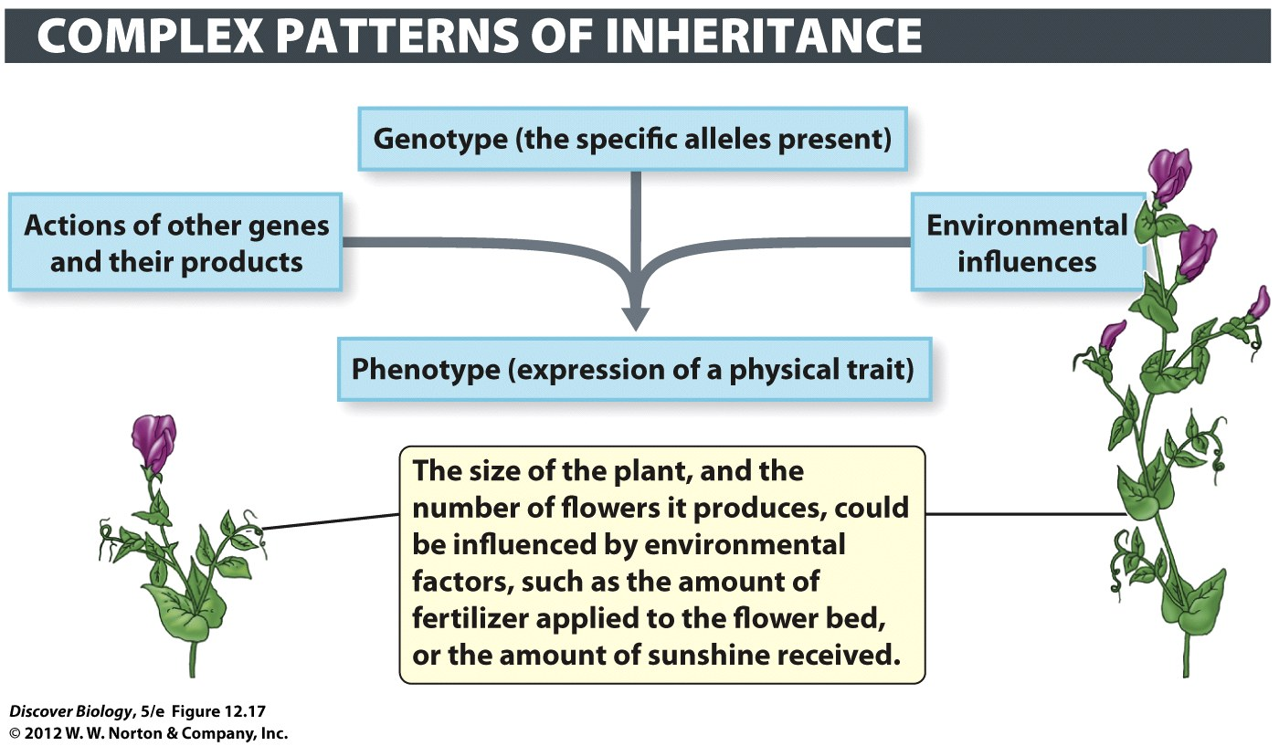
Notes:
Figure 12.17 Most Phenotypes Are Shaped by Interactions among Multiple Genes and the Environment
The effect of a gene on an organism’s phenotype can depend on a combination of the gene’s own function, the function of other genes with which it interacts, and the impact of environmental factors. As a result, two individuals with the same genotype for a gene may show very different phenotypes, as illustrated by the differences in growth between the two pea plants depicted here.

Slide 50
Solving the Mystery of the Lost Princess
Like many legends, the legend of Anastasia can be refuted with scientific evidence
In 2009, DNA recovered from a skeleton buried near the Romanov family was confirmed to be Anastasia Romanov, proving that she died in July 1918 along with her family

Slide 51
Clicker Questions
CHAPTER 12
Patterns of Inheritance

Slide 52
Concept Quiz
A red carnation and a white carnation
produce offspring that are all pink. The type
of inheritance pattern occurring is:
Complete dominance
Incomplete dominance
Codominance
Notes:
The correct answer is B.
Pink is the intermediate color between red and white.
Red and white are homozygous and pink is heterozygous.
If complete dominance were occurring, then there would only be two phenotypes, red and white.
If codominance were occurring, then the heterozygote would have both red and white patches on the same flower.

Slide 53
Concept Quiz
If an allele for tall plants (T) is dominant to
short plants (t), what offspring would you
expect from a TT x Tt cross?
½ tall; ½ short
¾ tall; ¼ short
All tall
Notes:
The correct answer is C.
The only way to have offspring that are short is if both parent plants carry the short (t) allele.
Since one parent is homozygous dominant, no short offspring can be produced.

Slide 54
Concept Quiz
Fur color in rabbits shows incomplete dominance.
F^{B}F^{B} individuals are brown, F^{B}F^{W} individuals are
cream, F^{W}F^{W} individuals are white. What is the
expected ratio of a F^{B}F^{W} x F^{W}F^{W} cross?
3 white : 1 brown
3 white : 1 cream
2 white : 2 cream
Notes:
The correct answer is C.
In order to produce brown rabbits, each parent would have to have at least one copy of the brown allele, since brown is homozygous (FBFB).
Although a 3:1 ratio is possible of the offspring, the expected ratio cannot be 3:1 (see Punnett square in Lecture notes).

Slide 55
Relevant Art from Other Chapters
All art files from the book are available in JPEG and PPT formats online and on the Instructor Resource Disc

Slide 56
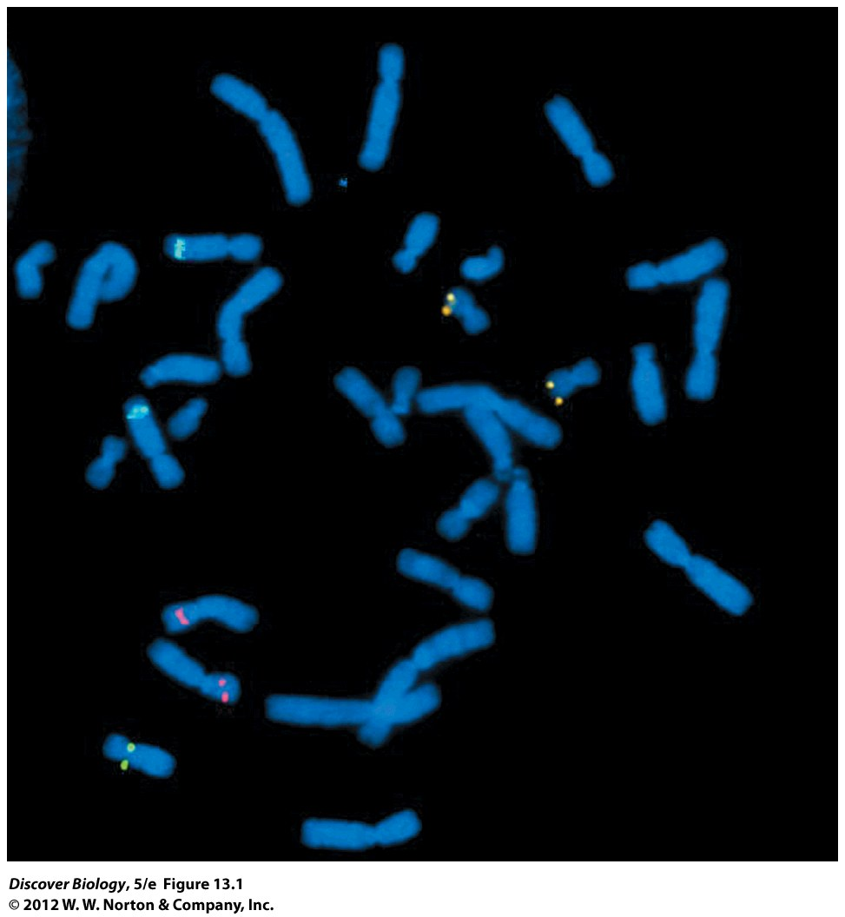
Notes:
Figure 13.1 Genes Are Located on Chromosomes
A technique called fluorescence in situ hybridization (FISH) was used to show the location of three different genes on these chromosomes prepared from tumor cells in mitosis. Each of the three genes (HER2, green; p16, pink; znk217, gold) is known to be involved in cancer.

Slide 57
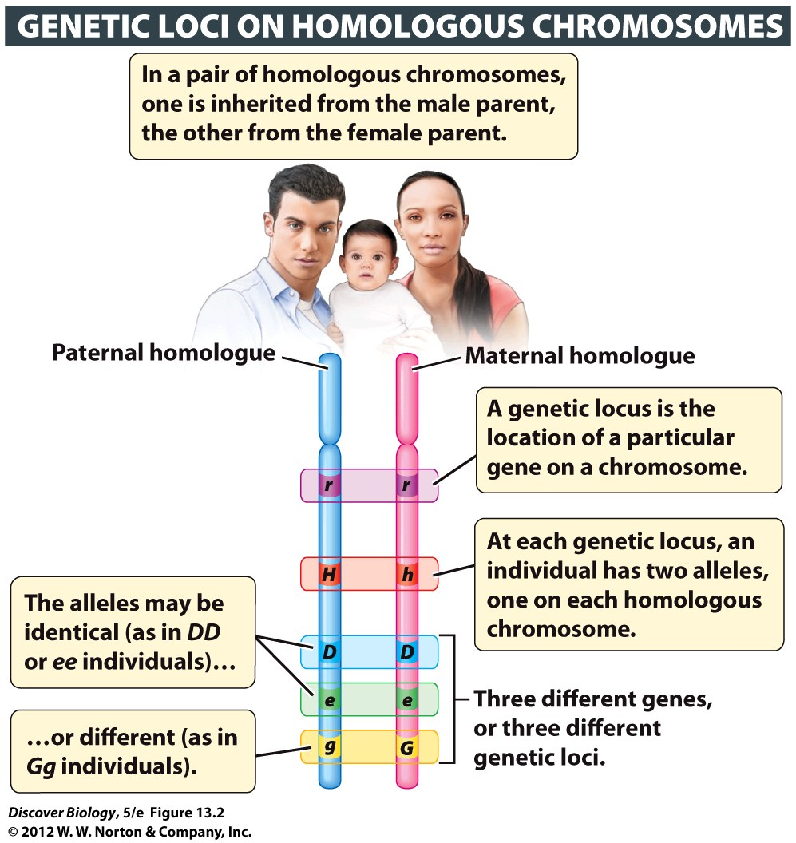
Notes:
Figure 13.2 Genes Are Located on Chromosomes
The genes shown here take up a larger portion of the chromosome than they would if they were drawn to scale. The average human chromosome has more than a thousand different genes interspersed with large stretches of noncoding DNA.

Slide 58
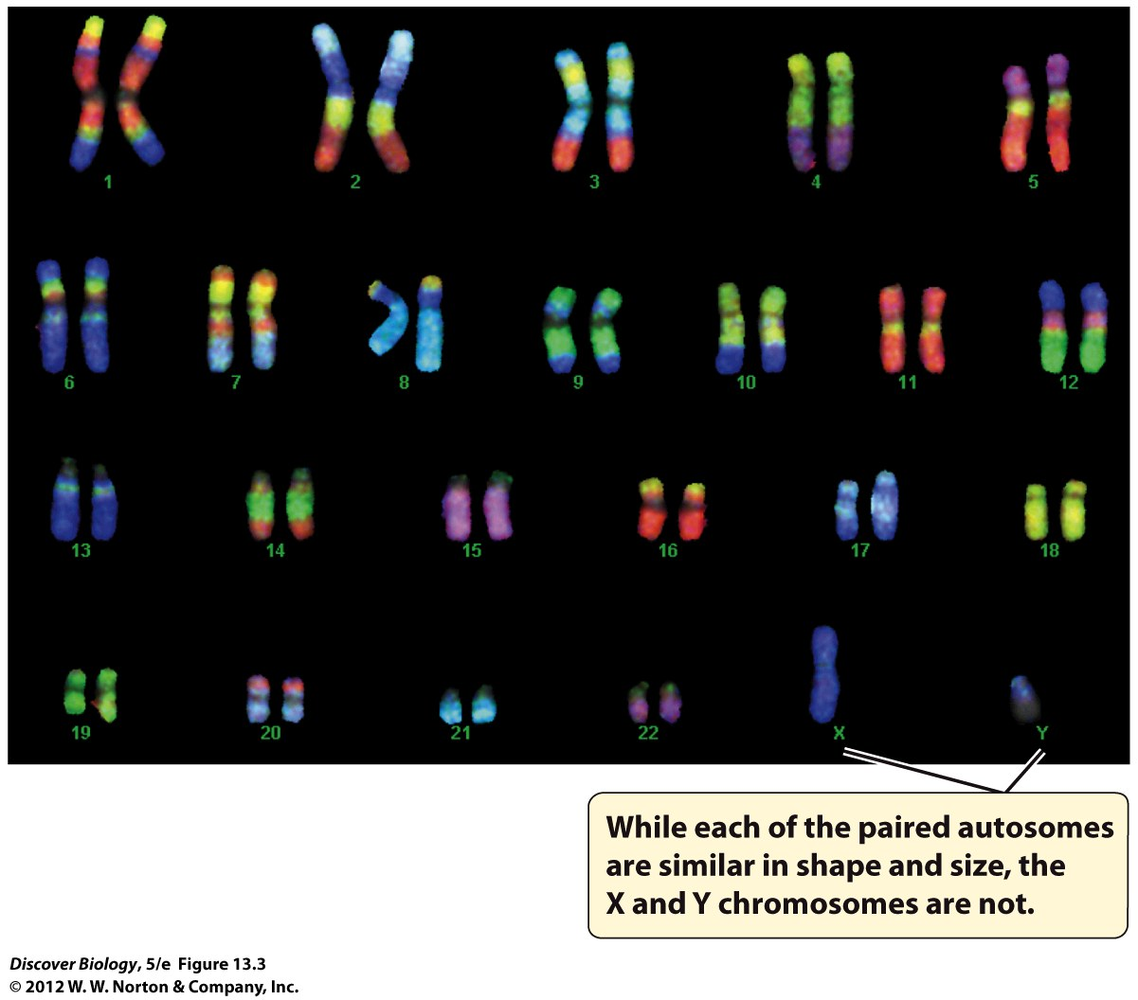
Notes:
Figure 13.3 Autosomes and Sex Chromosomes
These chromosomes have been stained using a technique called FISH (fluorescence in situ hybridization).

Slide 59
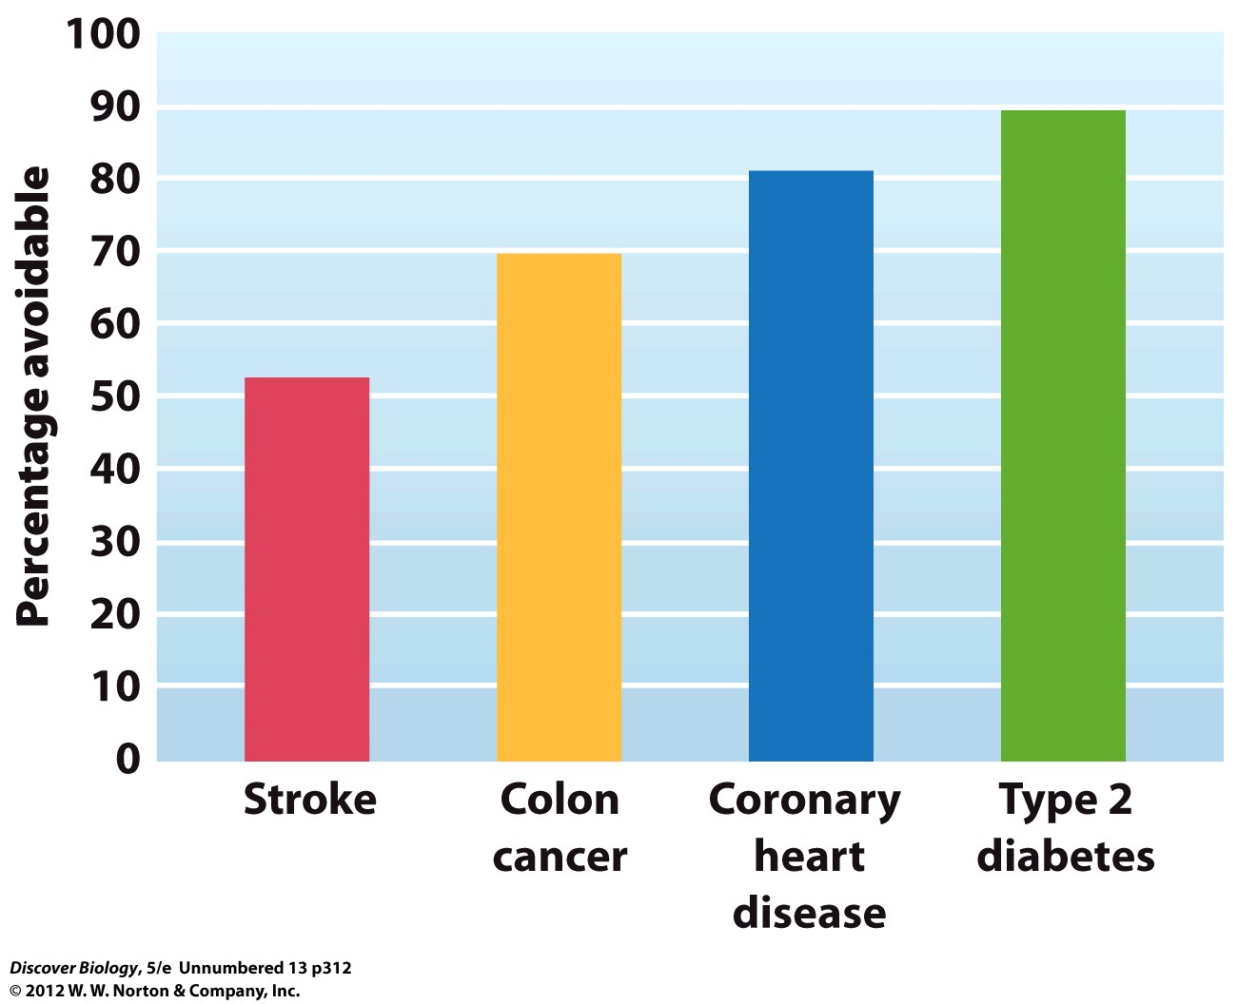
Notes:
Most Chronic Diseases Are Complex Traits

Slide 60
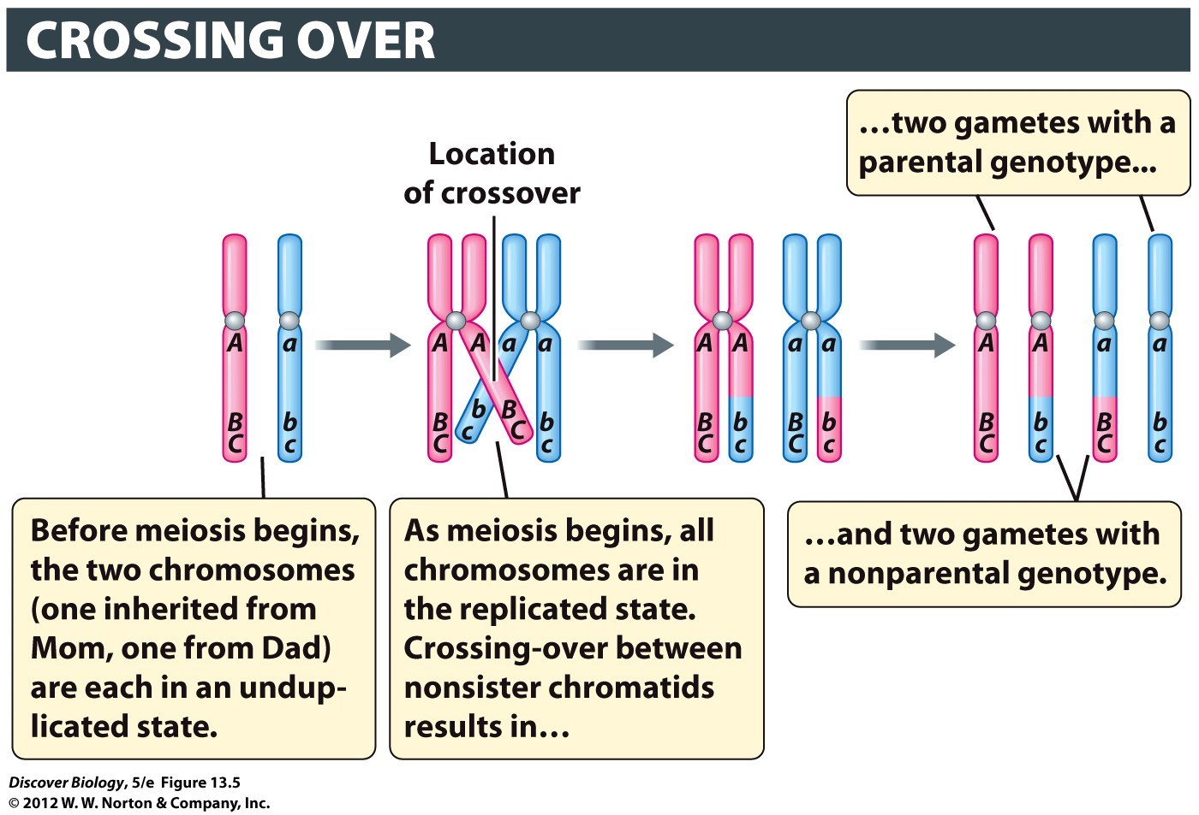
Notes:
Figure 13.5 Segments of Chromosomes Are Exchanged in Crossing-Over
Crossing-over takes place during prophase I. As a result of crossover between A/a and B/b, half of the gametes have a parental genotype (ABC or abc), while the other half have a nonparental genotype (Abc or aBC). In this example, there is no crossing-over between B/b and C/c.

Slide 61
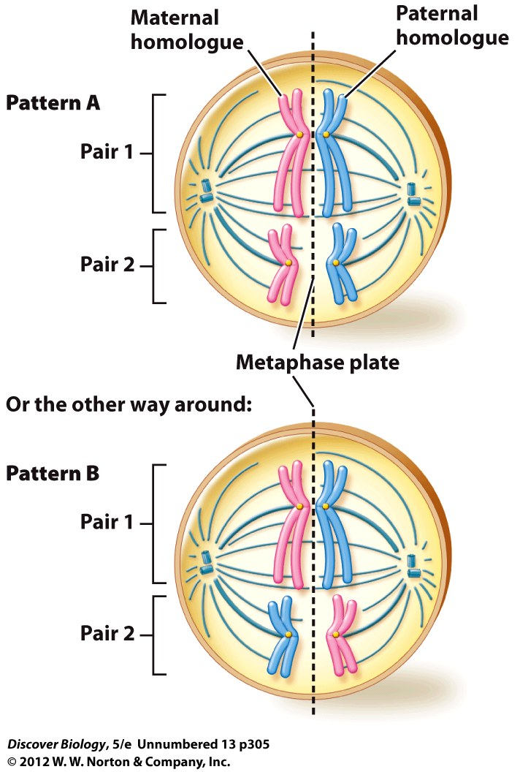

Slide 62
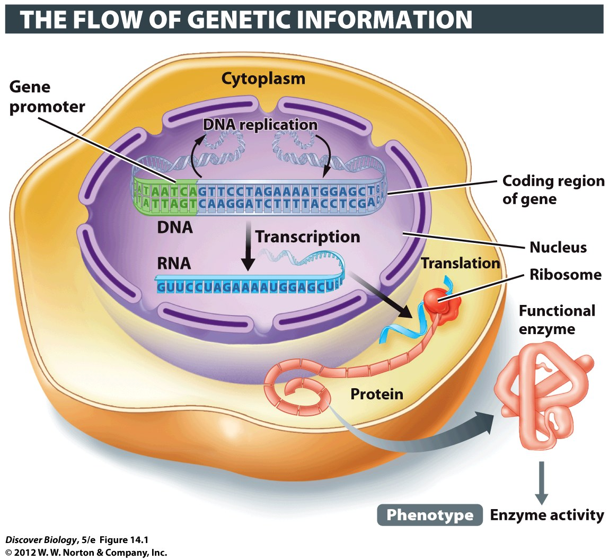
Notes:
Figure 14.1 From Gene to Phenotype at the Molecular Level
The readout of information coded in DNA produces the phenotype, such as the activity of lactase enzyme in the small intestine of humans.

Slide 63
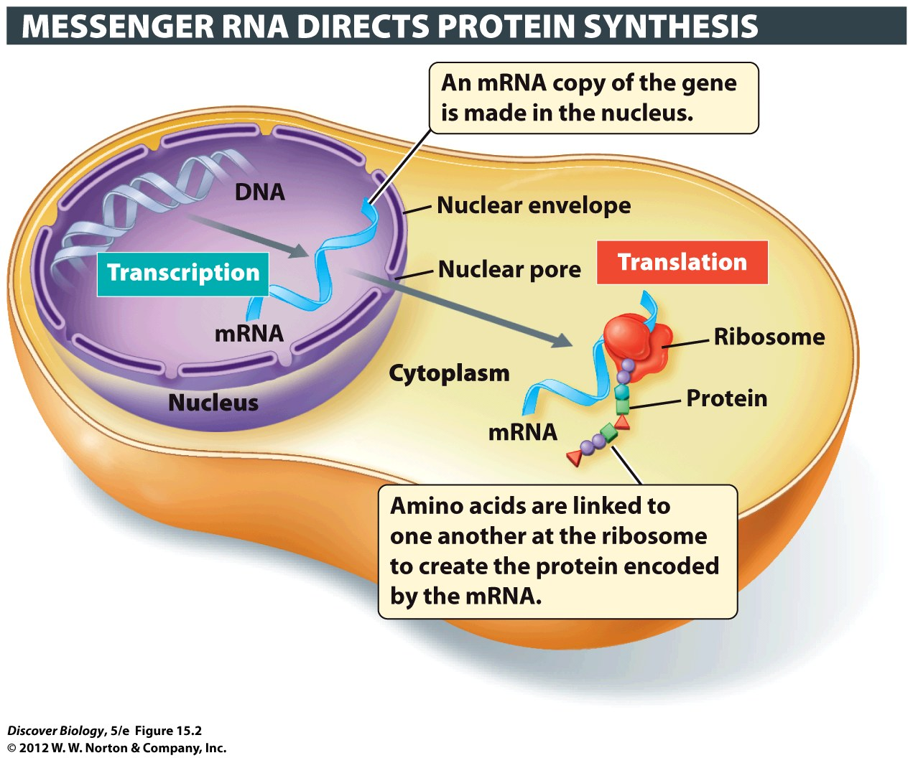
Notes:
Figure 15.2 Genetic Information Flows from DNA to RNA to Protein during Transcription and Translation
The transcription of a protein-coding gene produces an mRNA molecule, which is then transported to the cytoplasm, where translation occurs and the protein is made with the help of ribosomes. Different amino acids in the protein being constructed at the ribosome are represented here by different colors and shapes.

