Slide 1
Discover Biology FIFTH EDITION
Anu Singh-Cundy • Michael L. Cain
CHAPTER 11
Stem Cells, Cancer, and Human Health
© 2012 W. W. Norton & Company, Inc.

Slide 2
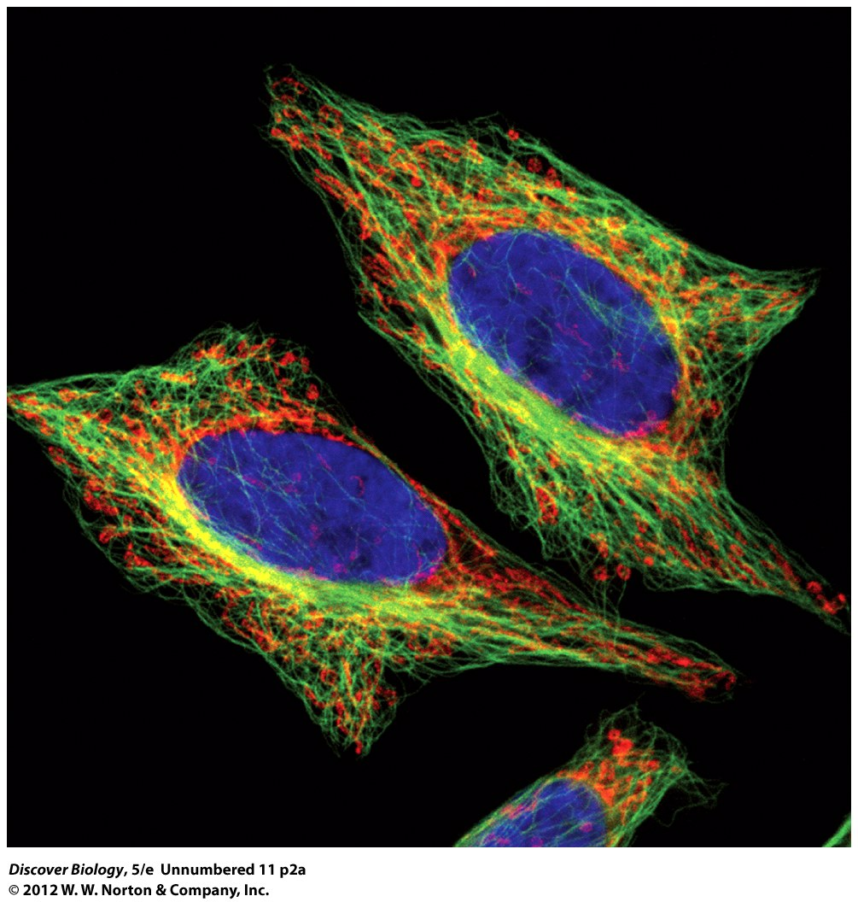
Notes:
Figure 11.1a UN
HeLa cells can grow in a lab dish. The cell line was established in 1951 from a slice of a cervical tumor taken from Henrietta Lacks. HeLa cells are now cultivated in thousands of labs all over the world. In this image, the DNA in the HeLa cell nucleus is stained blue, the microtubules are stained green, and the mitochondria are stained red.

Slide 3
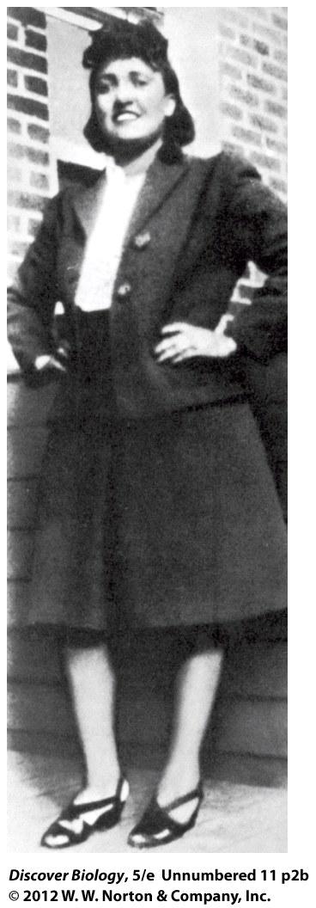
Notes:
Figure 11.1b UN
HeLa cells can grow in a lab dish. The cell line was established in 1951 from a slice of a cervical tumor taken from Henrietta Lacks (above). HeLa cells are now cultivated in thousands of labs all over the world.

Slide 4
Henrietta Lacks’s Immortal Cells
Cervical cancer cells from Lacks were the first to be grown in a laboratory setting and are still being used today
HeLa cells are among the fastest-dividing human cells ever known
Lacks’s cells are immortal and have the ability to divide indefinitely

Slide 5
The Cell Is the Basic Unit of All Life
Genes contained in cellular DNA are the blueprint for cell growth and differentiation
Genetics, as well as external cues, prompt cells to differentiate into a particular cell type
Differentiated cells exhibit different characteristics based on gene expression

Slide 6
Stem Cells: Dedicated to Division
Stems cells are a vital part of human growth, development, and maintenance
Undifferentiated stem cells can be found in tissues throughout the body:
Bone marrow
Skin
Liver
Notes:
11.1 Stem Cells: Dedicated to Division
Stem cells are a source of new cells.
Stem cell technology offers much hope and some success.
Embryonic stem cells are found only in very early stages of development.
The use of embryonic stem cells is controversial.
Induced pluripotent stem cells are derived from differentiated cells.

Slide 7
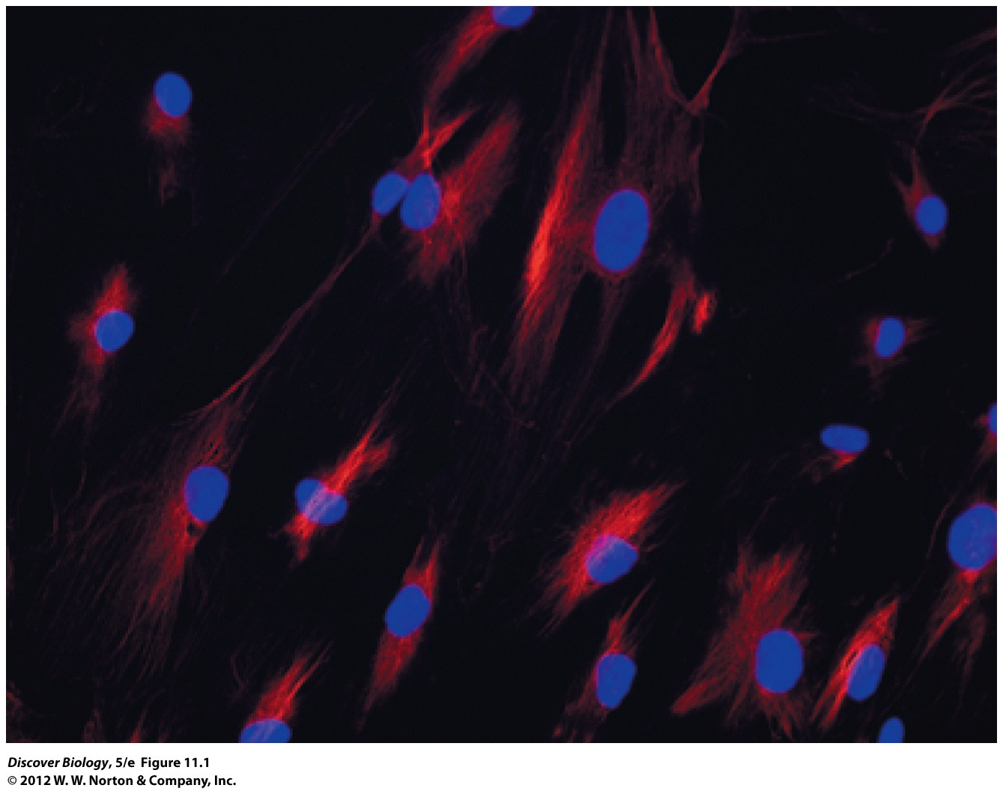
Notes:
Figure 11.1 Bone Marrow Stem Cells
These bone marrow mesenchymal stem cells are among the most versatile of adult stem cells. The descendants of mesenchymal stem cells can become bone or cartilage cells. Other stem cells in the bone marrow give rise to red blood cells, white blood cells, and small cell fragments called platelets that are important in blood clotting.

Slide 8
Stem cells are a source of new cells
Mitotic division of stem cells generates two identical daughter cells
Daughter cells can take one of two paths:
Maintain the stem cell population
Differentiate in order to perform a specialized function

Slide 9
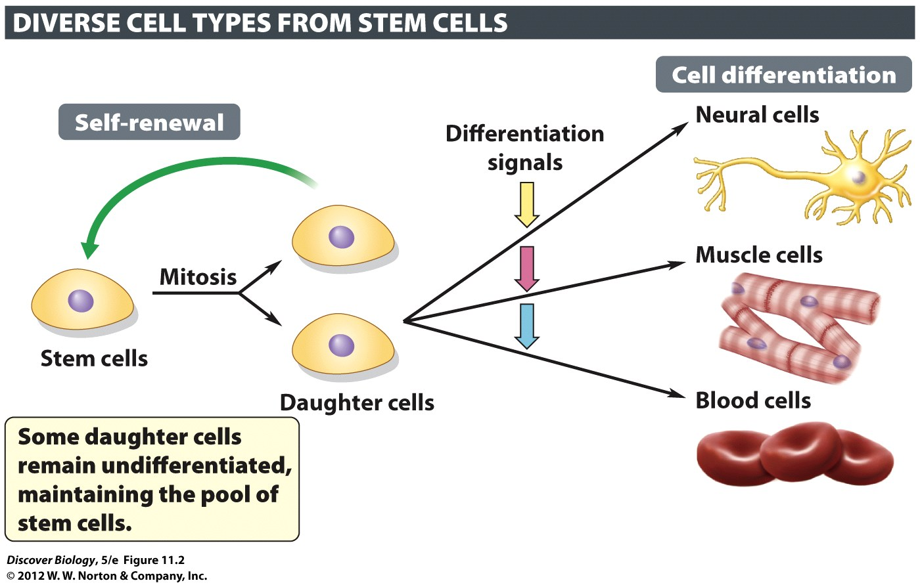
Notes:
Figure 11.2 Stem Cells Can Renew Themselves
Stem cells are undifferentiated cells that have the unique capacity of self-renewal. Given the right mix of physical and chemical signals (differentiation signals), their descendants can differentiate into highly specialized cell types.

Slide 10
Stem cells are a source of new cells
Human embryonic stem cells are found only in embryos and can differentiate into any type of specialized cell
Adult stem cells can differentiate into specialized cell types of the tissue or organ in which they are found

Slide 11
Stem cell technology offers much hope and some success
Studying stem cells and their development will help us to understand diseases and abnormalities such as cancer
Pharmaceutical companies can use stem cells to increase drug development and lower costs
Regenerative medicine uses stem cells to repair damaged or diseased tissues

Slide 12
Embryonic stem cells are found only in very early stages of development
A morula is a mass of undifferentiated totipotent stem cells, at 3–4 days after fertilization, that can give rise to any cell type in the organism
A blastocyst contains pluripotent stem cells, at 5–7 days after fertilization, that can differentiate into the embryo and any cell type in the adult body

Slide 13
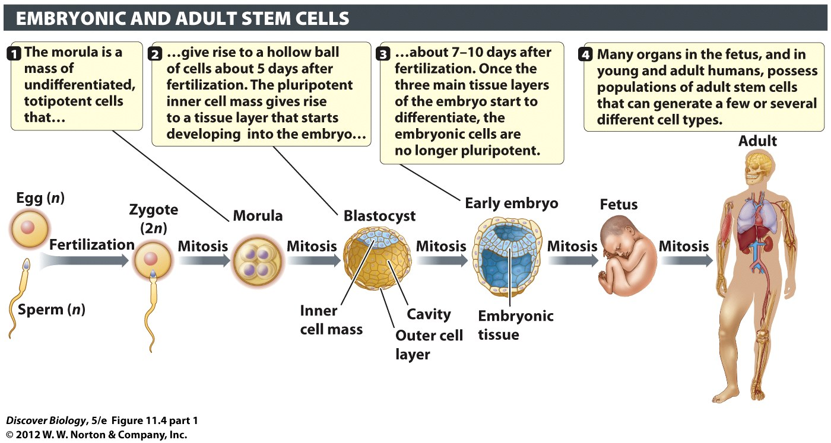
Notes:
Figure 11.4 Human Development and the Origins of Stem Cells
Embryonic stem cells are pluripotent, and their descendants can therefore differentiate into a great variety of specialized cell types in response to appropriate molecular signals. Adult stem cells, present in low numbers in well-developed tissues and organs, normally give rise to a more limited range of cell types related to these tissues.

Slide 14
Embryonic stem cells are found only in very early stages of development
Pluripotent stem cells cannot give rise to cells that make up the birth sac in mammals
Multipotent stem cells are adult stem cells that can differentiate into a limited number of specialized tissues
Unipotent stem cells are adult stem cells that give rise to only one specialized cell type

Slide 15
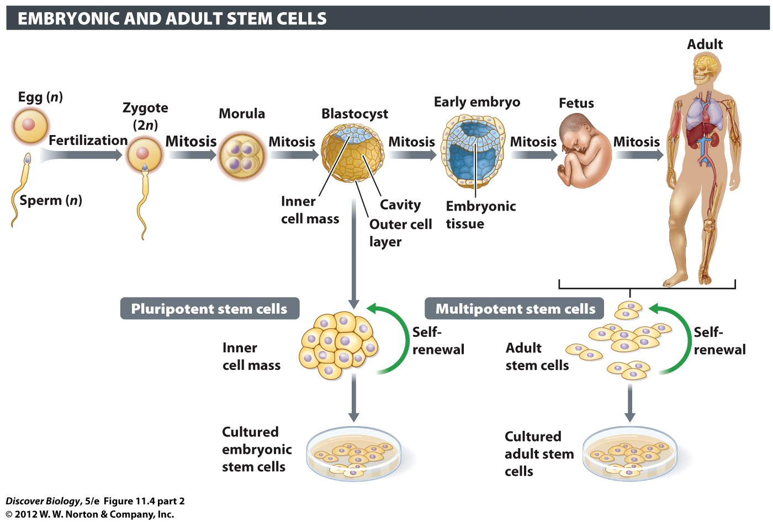
Notes:
Figure 11.4 Human Development and the Origins of Stem Cells
Embryonic stem cells are pluripotent, and their descendants can therefore differentiate into a great variety of specialized cell types in response to appropriate molecular signals. Adult stem cells, present in low numbers in well-developed tissues and organs, normally give rise to a more limited range of cell types related to these tissues.

Slide 16
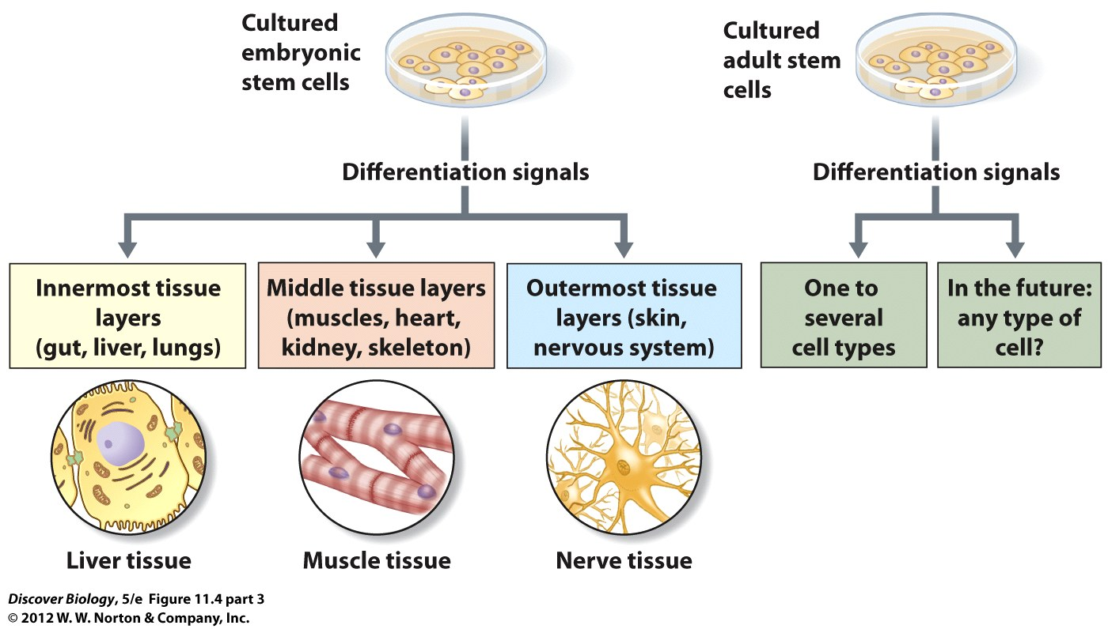
Notes:
Figure 11.4 Human Development and the Origins of Stem Cells
Embryonic stem cells are pluripotent, and their descendants can therefore differentiate into a great variety of specialized cell types in response to appropriate molecular signals. Adult stem cells, present in low numbers in well-developed tissues and organs, normally give rise to a more limited range of cell types related to these tissues.

Slide 17
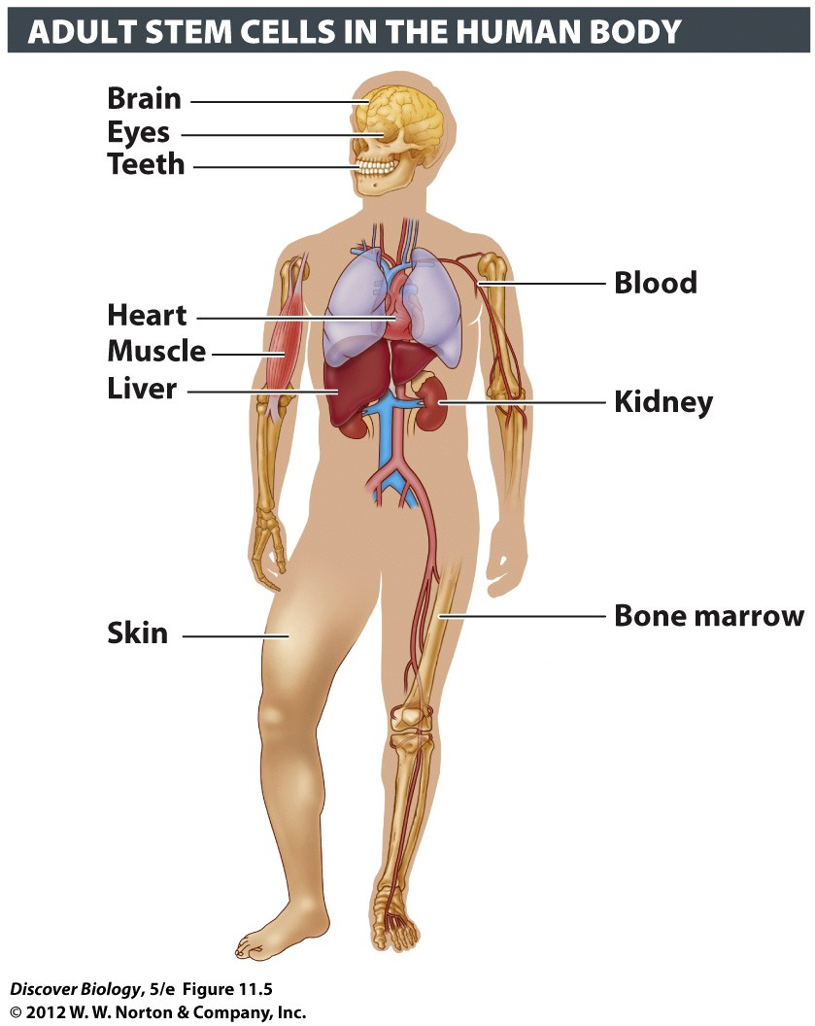
Notes:
Figure 11.5 Small Numbers of Adult Stem Cells Are Found in Certain Tissues and Organs in the Human Body
These cells are multipotent or unipotent, rather than pluripotent like embryonic stem cells. Adult stem cells from most organs (except skin and bone marrow) are harder to identify, isolate, and culture in a lab dish, compared to embryonic stem cells derived from the inner cell mass.

Slide 18
The use of embryonic stem cells is controversial
Blastocysts are the only source of pluripotent stem cells
Scientists have used IVF embryos to produce a line of human embryonic stem cells
Advocates of embryonic stem cell research believe it will produce promising therapeutic applications
Opponents believe embryos have moral status and it is unethical to use one embryo to benefit another

Slide 19
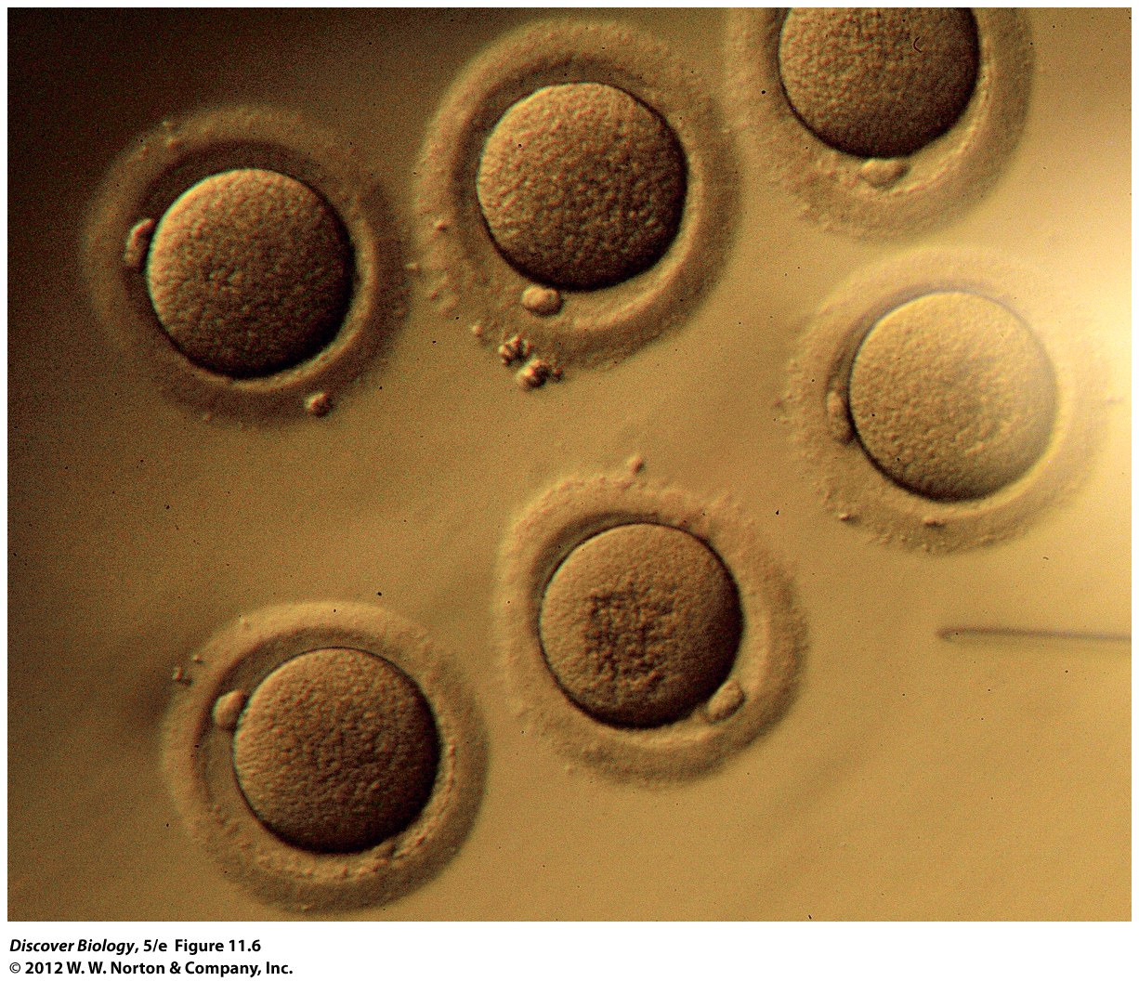
Notes:
Figure 11.6 Human Embryonic Stem Cells
The only source of human embryonic stem cells is the pool of very-early-stage human embryos (blastocysts) donated by couples using in vitro fertilization technology (IVF). The harvesting of the inner cell mass destroys the embryo.

Slide 20
Induced pluripotent stem cells are derived from differentiated cells
Induced pluripotent stem cells (IPSec) can be derived from differentiated adult cells
iPSCs are genetically altered to regain the flexibility of the embryonic pluripotent stem cells
IPSec technology is a promising new therapy that has yet to be tested on humans

Slide 21
Cancer Cells: Good Cells Gone Bad
Cancer accounts for over a half-million deaths each year
There are more than 8 million Americans diagnosed with cancer at any one time
The estimated cost of treating cancer in the United States is over $100 billion each year
Notes:
11.2 Cancer Cells: Good Cells Gone Bad
Cancer develops when cells lose normal restraints on division and migration.
Cell division is controlled by positive and negative growth regulators.
Gene mutations are the root cause of all cancers.
Most human cancers are not hereditary.
Cancer develops as multiple mutations accumulate in a single cell.
The challenge in cancer treatment is to destroy malignant cells selectively.
Avoiding risk factors is the key to cancer prevention.

Slide 22
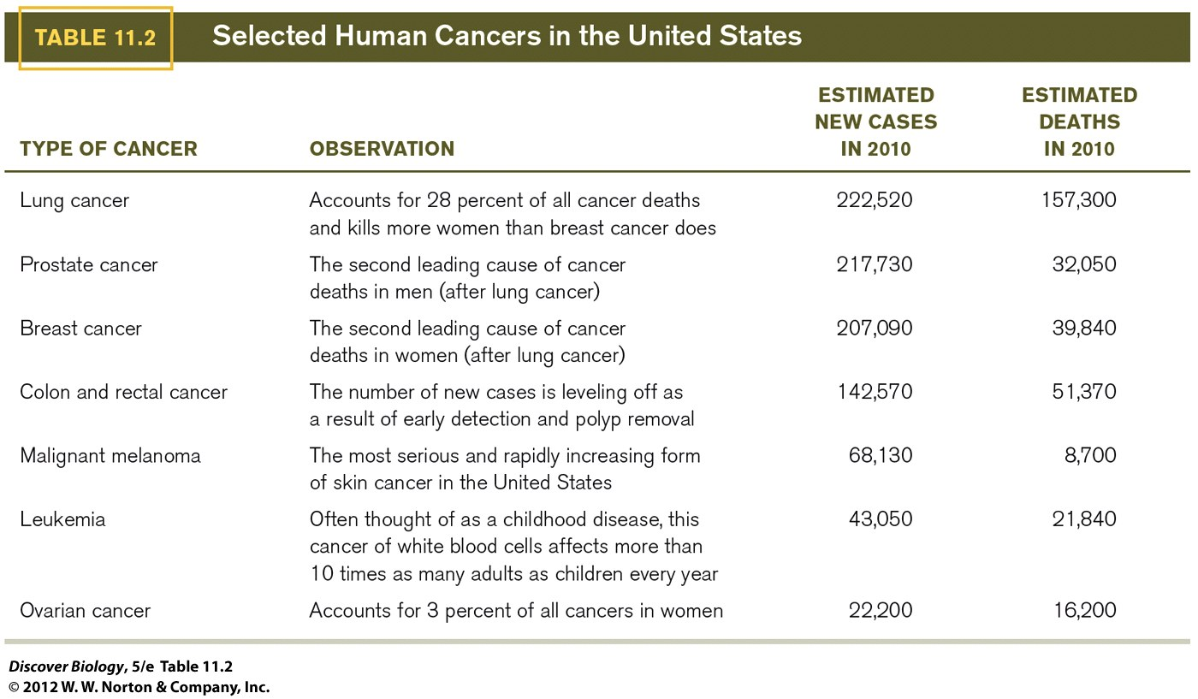

Slide 23
Cancer develops when cells lose normal restraints on division and migration.
A single cell that divides unrestrained can lead to a cell mass called a tumor
A benign tumor is one that has been confined to one site
Normal cells are anchorage dependent; cancer cells continue to divide after detachment
Angiogenesis increases blood supply to tumor cells, enabling them to proliferate

Slide 24
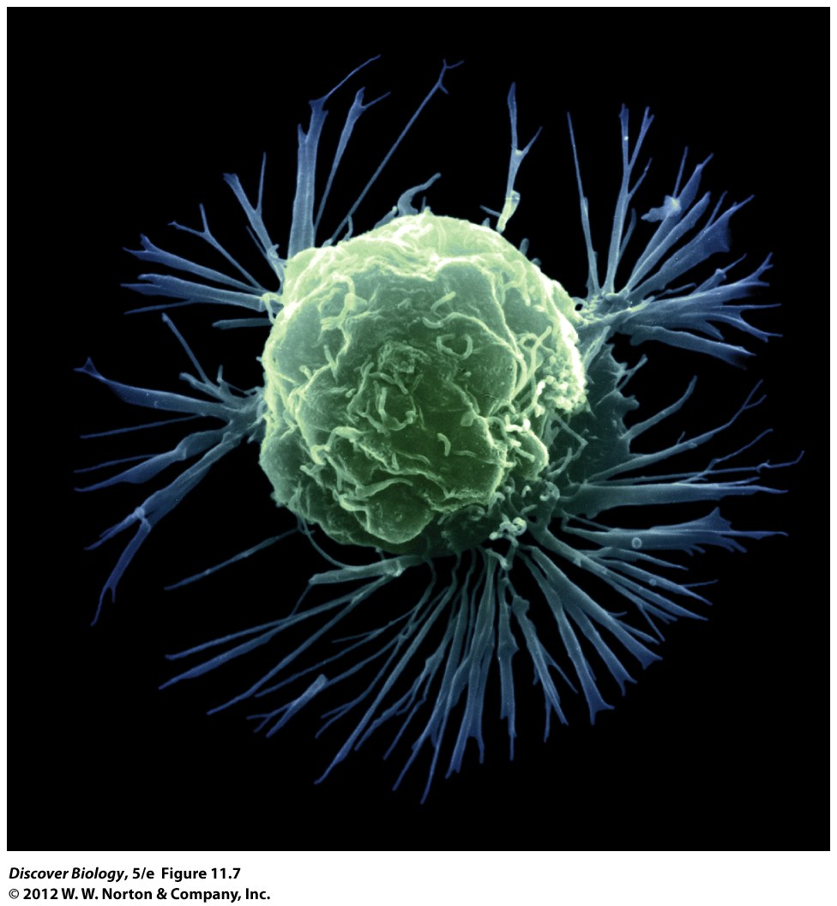
Notes:
Figure 11.7 A Home-Grown Monster
This color-enhanced photograph, captured with a scanning electron microscope, shows a breast cancer cell. A lab technician can recognize it as a cancer cell because of its large size, abnormally rounded shape, and altered cell surface.

Slide 25
Cancer develops when cells lose normal restraints on division and migration
Malignant cancer cells invade other tissues and metastasize
Certain cancers are more prone to metastasis
Cancer cells that impair the function of vital organs often lead to death

Slide 26
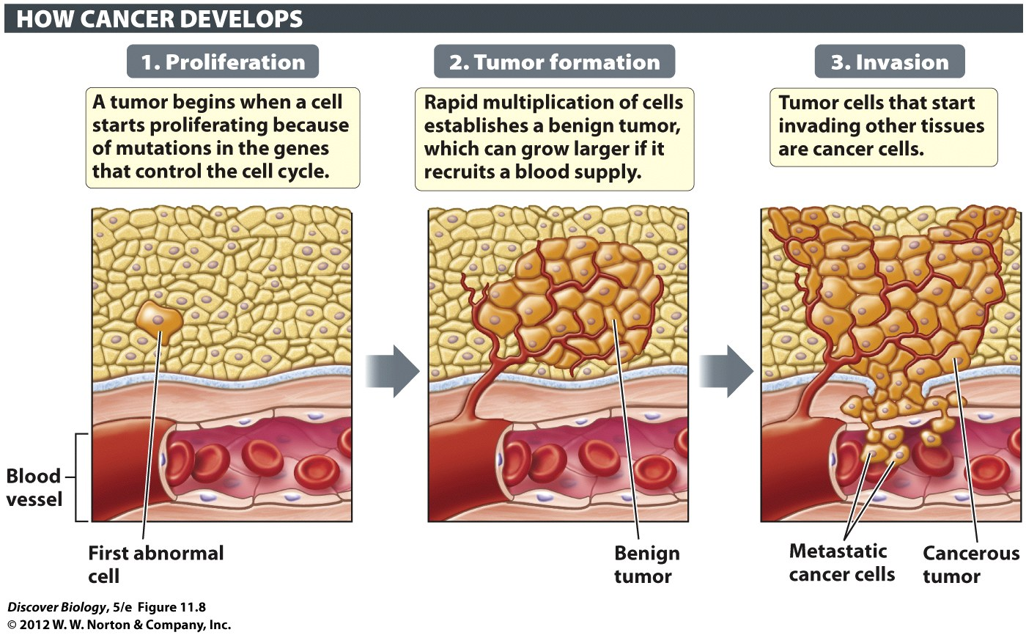
Notes:
Figure 11.8 Cancers Start with a Single Cell That Begins Dividing in an Uncontrolled Manner

Slide 27
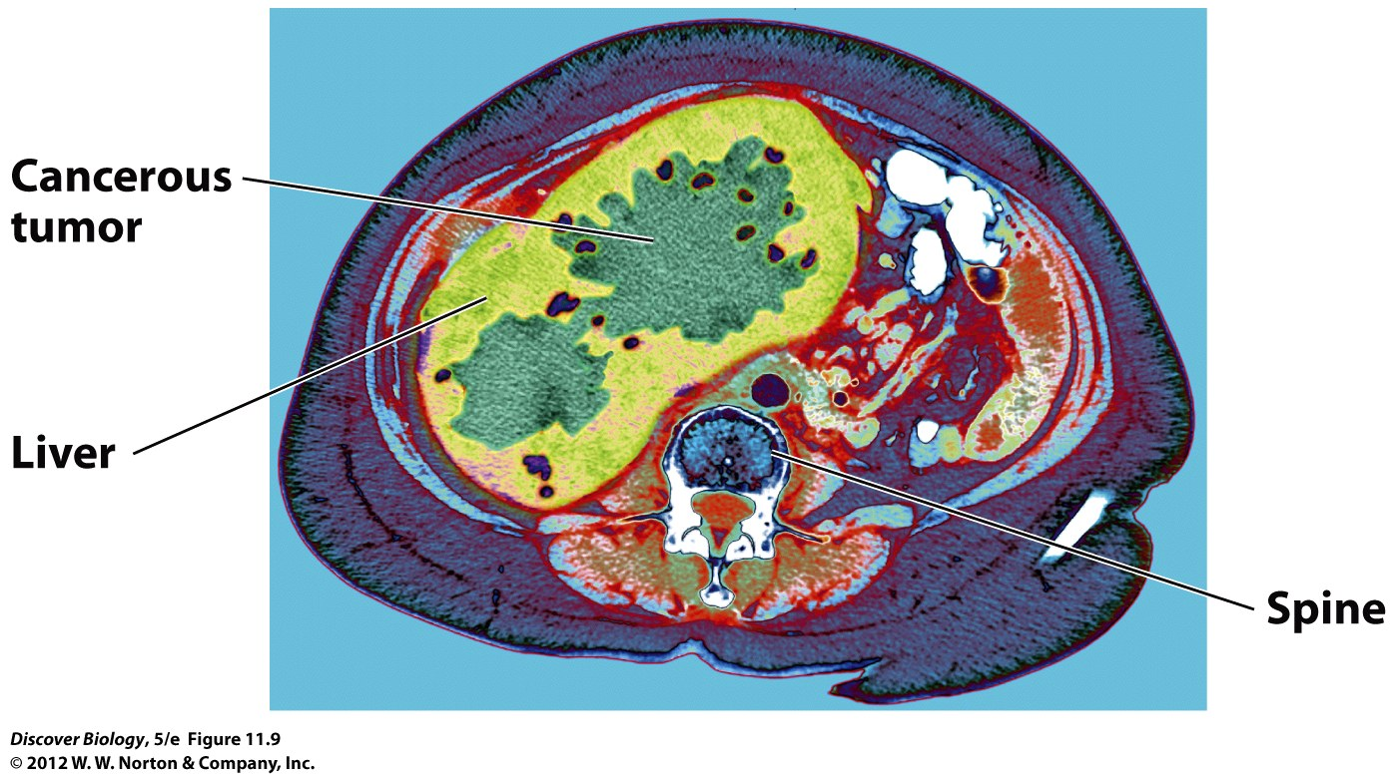
Notes:
Figure 11.9 Cancer Metastasis
This color-enhanced axial computed tomography (CT) scan shows a large cancerous tumor (dark green) in the liver (light green) of a woman who was originally diagnosed with colon cancer. The cancerous cells metastasized from the large intestine to the liver to create the secondary tumors seen here. The woman’s back and spine are at the bottom center of the CT scan, a computer-generated image that represents a slice through the body.

Slide 28
Cell division is controlled by positive and negative growth regulators
Cell division is controlled by positive and negative growth regulators
Hormones can act as either positive or negative growth regulators depending on the tissue
Negative growth regulators can prompt programmed cell death to eliminate damaged cells
A malfunction in either of the growth regulators can lead to cancer

Slide 29
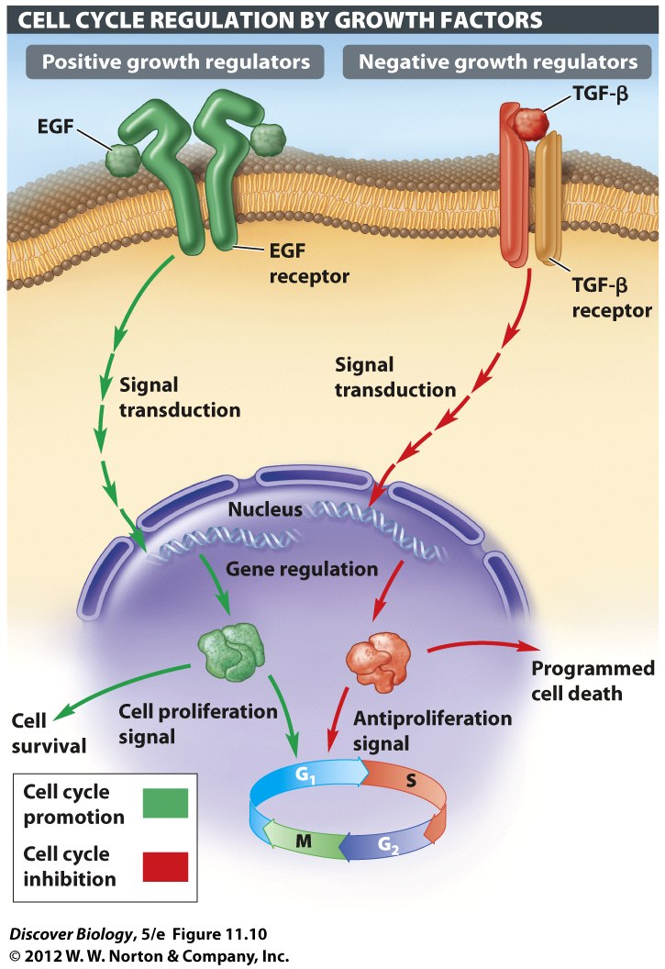
Notes:
Figure 11.10 Growth Factors Can Be Positive or Negative Regulators of the Cell Cycle

Slide 30
Gene mutations are the root cause of all cancers
Gene mutations can lead to an abnormally high or low production of certain proteins
Proto-oncogenes code for positive growth regulators and can trigger excessive cell proliferation as a result of mutations
Ontogenesis are cancerous cells that result from mutations in proto-oncogenes

Slide 31
Gene mutations are the root cause of all cancers
Tumor suppressor genes are negative growth regulators that restrain cell division and migration by:
Inhibiting the cell cycle
Stimulating repair of damaged DNA
Promoting cell adhesion
Controlling anchorage dependence
Preventing angiogenesis

Slide 32
Most human cancers are not hereditary
Only a small percentage of cancers are the result of inherited gene mutations
Inheriting a gene linked to cancer means an individual has a higher risk of developing cancer
A majority of people develop cancer as a result of a combination of environmental agents and somatic mutations

Slide 33
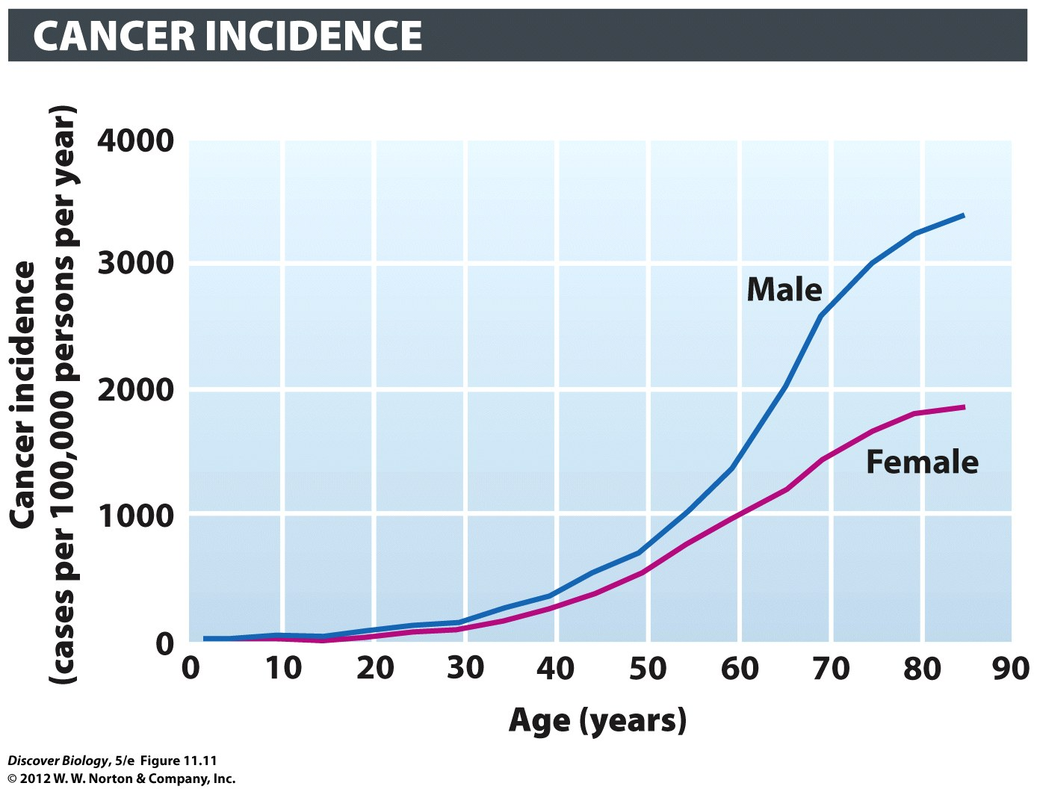
Notes:
Figure 11.11 The Incidence of Cancer Rises Sharply as We Grow Older
The graph shows incidence rates for all cancers combined, by age group and gender. The incidence of a disease refers to the number of newly diagnosed cases per year for a defined unit of the population—in this case, per 100,000 men or women in each age group.

Slide 34
Cancer develops as multiple mutations accumulate in a single cell.
Mutations accumulate over time in cells
A sequential breakdown of proto-oncogenes and tumor suppressor genes results in tumor growth
Gene p53 plays a vital role in maintaining the cellular process
More than half of all cancers indicate a loss of p53 activity in tumor cells

Slide 35
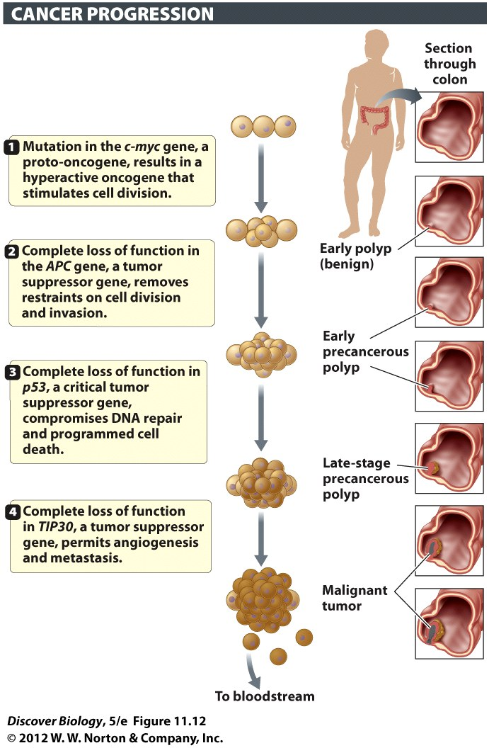
Notes:
Figure 11.12 Development of Colon Cancer Is a Multistep Process
The sequential mutation of several genes that code for positive and negative growth regulators coincides with the progression from a benign polyp in the colon to a malignant tumor. The order in which the various proto-oncogenes and tumor suppressor genes mutate is not set and can vary from one patient to another, which is why every cancer is unique.

Slide 36
The challenge in cancer treatment is to destroy malignant cells selectively
Cryosurgery and hormone therapy are used to treat abnormal or cancerous cells in a small region
Radiation and chemotherapy are standard cancer treatments that affect both cancerous and healthy cells
More selective cancer therapies are being tested in clinical trails

Slide 37
Avoiding risk factors is the key to cancer prevention
Carcinogens are physical, chemical, or biological agents that may cause cancer
Bacteria or viruses
Increased exposure to hormones
Toxic chemicals
Two unavoidable risk factors include inherited genes and aging

Slide 38
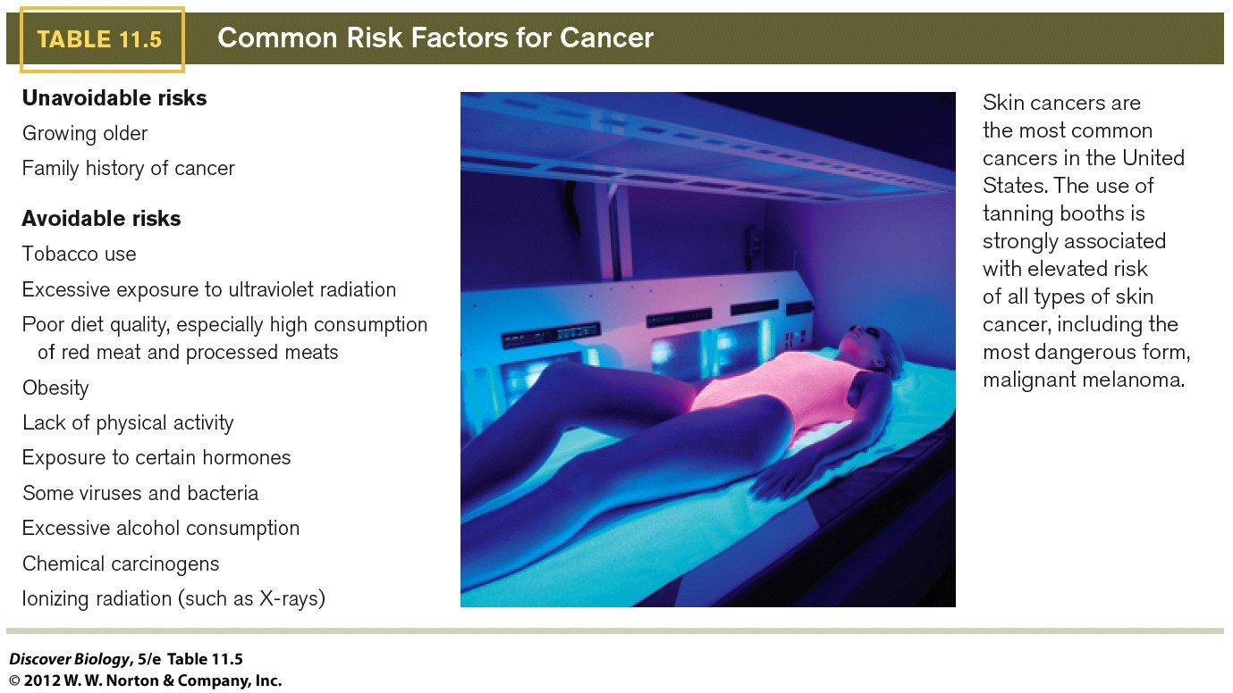
Notes:
Figure 11.2 UN
Skin cancers are the most common cancers in the United States. The use of tanning booths is strongly associated with elevated risk of all types of skin cancer, including the most dangerous form, malignant melanoma.

Slide 39
How HeLa Cells Changed Biomedicine
HeLa cells have allowed pharmaceutical companies to research and develop drugs worth billions of dollars
HeLa cells have helped develop the field of virology and further the study of viruses such as measles, mumps, and AIDS
Researchers used HeLa cells to show that the HPV infection can cause cancer

Slide 40
Clicker Questions
CHAPTER 11
Stem Cells, Cancer, and Human Health

Slide 41
Concept Quiz
An example of a negative growth regulator is
An oncogene
A tumor suppressor
A proto-oncogene
A kinase
Notes:
The correct answer is B. Negative growth regulators are called tumor suppressors.
Oncogenes produce unregulated positive growth regulators.
Proto-oncogenes normally produce regulated positive growth regulators but can be mutated into oncogenes.
Positive growth regulators are usually kinases.

Slide 42
Concept Quiz
Which of the following is not usually a cause of cancer in humans?
Environmental pollutants
Genetic predisposition
Viruses
Cigarette smoke
Notes:
The correct answer is C. It is important to note that, while the first cancer genes were isolated from a virus, viral cancers are usually found in animals other than humans. Very few human cancers are viral.
Environmental pollutants, especially tobacco smoke, are leading causes of cancer.
Many forms of cancer run in families. These are often due to mutated tumor suppressors. People with these cancers inherit the first hit that eventually leads to cancer.
Cigarette smoke is the leading source of environmental pollutants.

Slide 43
Concept Quiz
Why is p53 important in the cell?
It is a tumor suppressor that stops cells from dividing.
It blocks cells with DNA damage from dividing.
It causes cells with extreme DNA damage to die.
All of the above
Notes:
The correct answer is D. All of these are true. It is very important in cancer because the lack of this allows cells with DNA damage to divide without repairing that damage. This results in more DNA damage, which eventually produces further mutations and the multiple “hits” that cause cancer.

