Slide 1
Discover Biology
FIFTH EDITION
Anu Singh-Cundy • Michael L. Cain
CHAPTER 10
Cell Division
© 2012 W. W. Norton & Company, Inc.

Slide 2
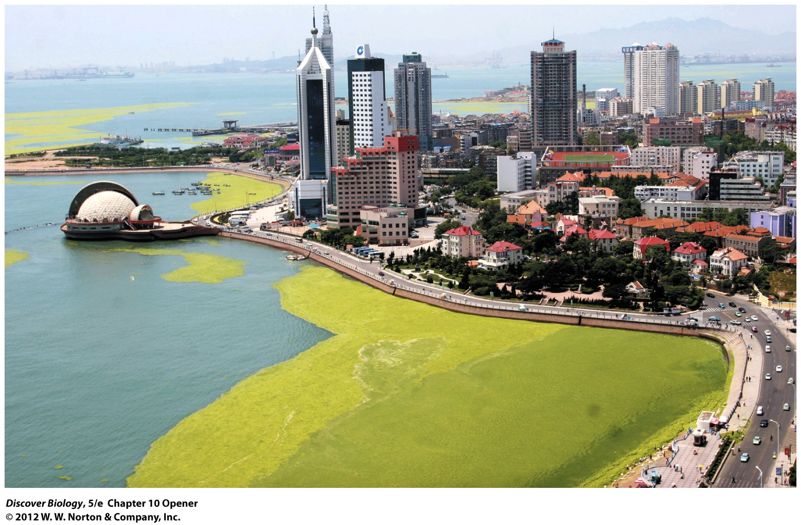
Notes:
It Isn’t Grass. A giant bloom of sticky green algae, thick and vast enough to halt sailboats and windsurfers, threatened to stall sailing events at the Olympic Games in China in 2008.

Slide 3
Olympic-Class Algal Bloom
Algae are photosynthetic eukaryotes that flourish in an abundance of sunlight and nutrients
Large mats of floating algae are capable of stopping boats and entangling wildlife

Slide 4
Cell Division Is a Distinctive Property
Without cell division, there would be no life
It takes billions of cell divisions to turn a fertilized egg into an adult human
Millions of cell divisions take place in our bodies every day to replace the cells that have died

Slide 5
Why Cells Divide
Cells divide in order to reproduce organisms and to grow and repair multicellular organisms
Cell division is the generation of daughter cells from a parent cell
Daughter cells are called offspring
Cell division involves the transfer of genetic information from parent to daughter cells

Slide 6
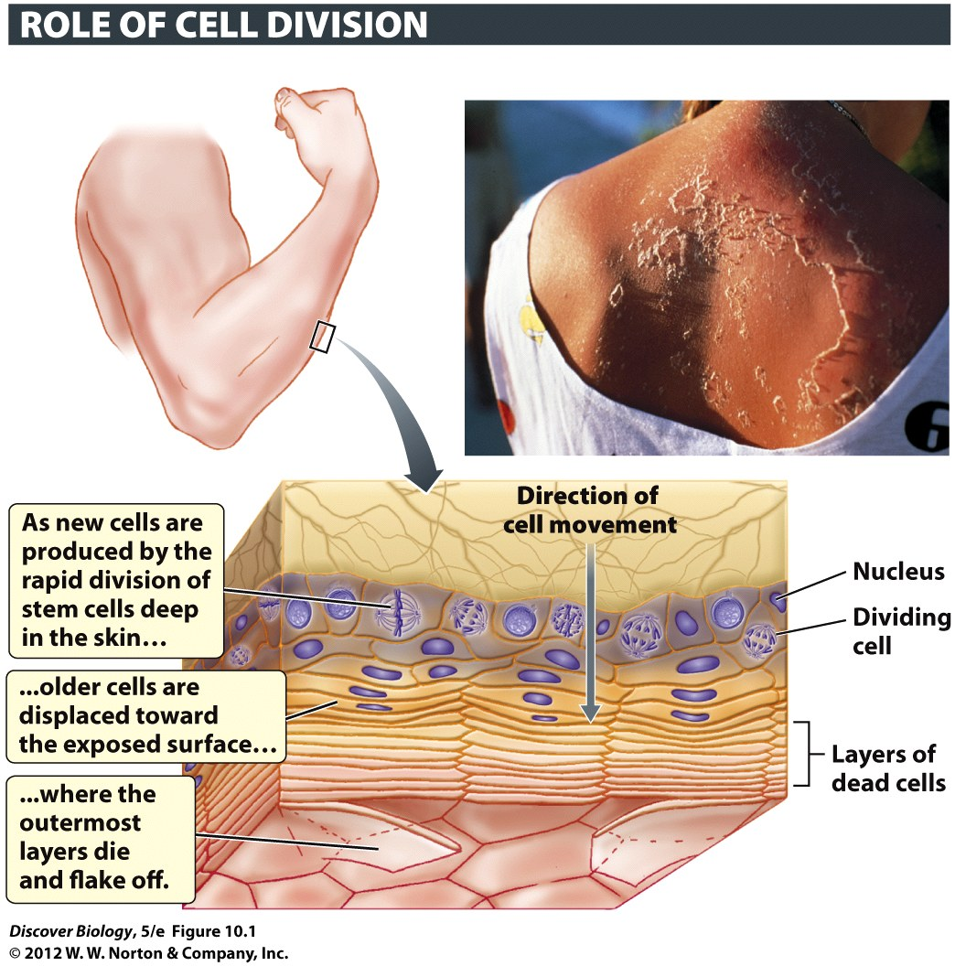
Notes:
Figure 10.1 Cell Division Replenishes the Skin
Rapid cell division in the deepest layer of the skin is necessary to replace skin cells (called keratinocytes) lost at the surface of the skin. The loss is due to the normal programmed death of the outer layers of mature keratinocytes, but it can also be the consequence of severe DNA damage, as in a peeling sunburn (inset).

Slide 7
Why Cells Divide
Asexual reproduction results in offspring that are genetically identical to the parent
Sexual reproduction combines genetic information from two individuals of opposite mating types to produce offspring
Offspring resulting from sexual reproduction are similar, but not identical, to the parents

Slide 8
Why Cells Divide
Sexual reproduction results in genetic diversity by combining the DNA of two different individuals
A genetically diverse population is better able to adapt to changing environments
Asexual reproduction is more cost-effective than sexual reproduction

Slide 9
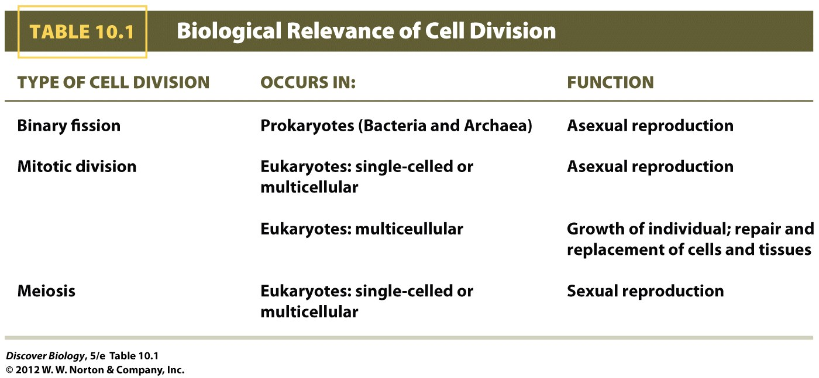
Notes:
TABLE 10.1 Biological Relevance of Cell Division

Slide 10
Many Bacteria Use Binary Fission for Asexual Reproduction
Many prokaryotes reproduce asexually through binary fission
Binary fission begins with the duplication of the genetic material
A plasma membrane splits the cell in two, with each side containing a single copy of the DNA
The resulting two daughter cells replace the single parent cell and are genetically identical

Slide 11
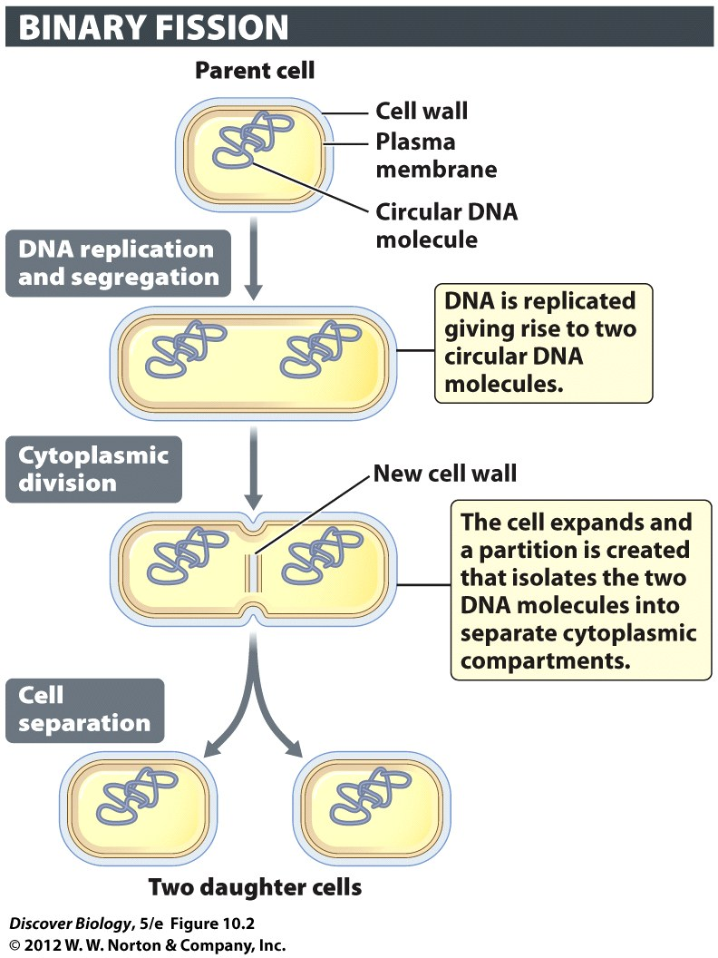
Notes:
Figure 10.2 Cell Division in a Prokaryote
Many prokaryotes, including many types of bacteria, propagate themselves asexually through a type of cell division known as binary fission.

Slide 12
Eukaryotes Use Mitosis to Generate Identical Daughter Cells
Mitotic division is the process that generates two genetically identical daughter cells from a single parent cell in eukaryotes
Mitotic cell division involves the even distribution of replicated DNA into new daughter cells
During a mitotic division, the nucleus divides in a process called mitosis, followed by a division of the cytoplasm called cytokinesis

Slide 13
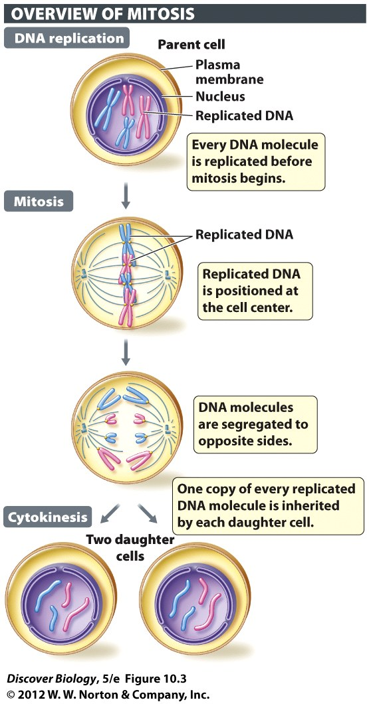
Notes:
Figure 10.3 Cell Division in a Eukaryote

Slide 14
Eukaryotes Use Mitosis to Generate Identical Daughter Cells
Mitotic cell division allows eukaryotes to replace dead cells and add new cells to the body
Many single-celled eukaryotes can reproduce asexually through mitotic division
Some multicellular eukaryotes, including fungi, seaweed, and sponges, use mitotic divisions to reproduce asexually

Slide 15
Meiosis Is Necessary for
Sexual Reproduction
Meiosis is specialized form of cell division that makes sexual reproduction possible
Meiosis in female animals results in gametes, or sex cells, that will mature into eggs
Meiosis in male animals produces gametes called sperm
Meiosis reduces the genetic information passed to the daughter cells by half

Slide 16
Meiosis Is Necessary for
Sexual Reproduction
A gamete has half the amount of genetic information as a body cell, or somatic cell
A somatic cell contains a diploid set of genetic information whereas a gamete contains a haploid set
Fertilization is the merging of a male and female gamete to produce a zygote
The zygote receives one haploid set from each gamete
The resulting embryo divides mitotically as it develops

Slide 17
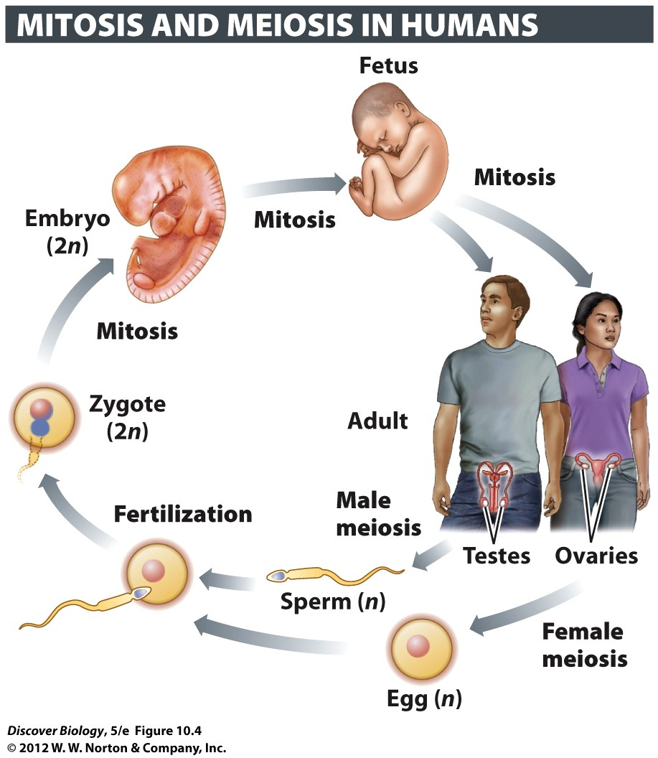
Notes:
Figure 10.4 Mitosis and Meiosis Play Vital Roles in the Human Life Cycle

Slide 18
Cell Divisions Grow, Maintain, and Reproduce the Human Body
The process of cell differentiation allows the daughter cells to become specialized into any of the 220 different cell types found in the human body
All of the genetic material present in the zygote remains present in the somatic cells of the adult body, regardless of differentiation

Slide 19
Cell Divisions Grow, Maintain, and Reproduce the Human Body
A small group of gamete-producing cells, called germ line cells, are reserved early in embryonic development for eventually producing gametes for the new individual
Adult stem cells are unspecialized stem cells that serve to grow, regenerate, and repair tissues through adulthood

Slide 20
The Cell Cycle
The cell cycle refers to the life cycle of the cell from origin to time of division
The cell cycle can take as little as 90 minutes to up to 24 hours to complete, depending on the type of cell
The cell cycle is divided into two main stages, interphase and cell division

Slide 21
The Cell Cycle
During interphase, the cell:
  Takes in nutrients and manufactures proteins and other substances
  Grows
  Conducts its specialized functions
  Prepares to divide, including replicating the genetic material
Cell division includes:
  Physical division of the cell
  Production of two daughter cells

Slide 22
DNA Is Replicated in S Phase
Interphase is divided into three main phases, G₁, S, and G₂
The replication of DNA occurs in the S phase
The G₁ and G₂ phases are important checkpoints in the cell cycle, during which the cell’s size and protein content increase

Slide 23
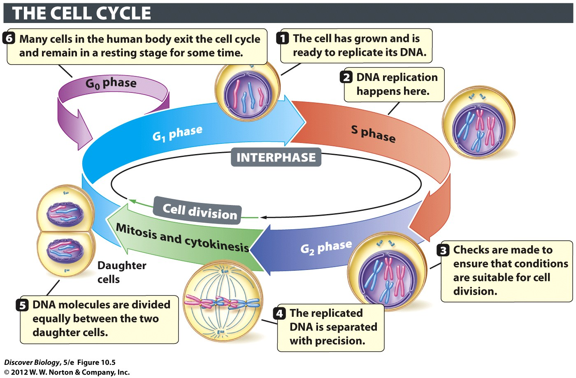
Notes:
Figure 10.5 The Cell Cycle Consists of Two Major Stages: Interphase and Cell Division
The cell prepares itself for division by increasing in size and producing proteins needed for division during G1 and G2 phases, and by replicating its DNA during S phase. Mitotic cell division consists of mitosis and cytokinesis, which result in two daughter cells that are genetically identical to the parent cell.

Slide 24
Most Cell Types in the Adult
Body Do Not Divide
Most adult cells enter a nondividing phase called G₀
The G₀ phase can last from a few days to the lifetime of the organism

Slide 25
The Cell Cycle Is Highly Regulated
Cells divide in response to internal and external signals
In humans, cell cycle regulatory proteins are activated by external signals to divide, advancing the cell from G₁ to S phase and initiating DNA replication
Cell cycle regulatory proteins can stop or pause the cell cycle if conditions are not favorable for cell division

Slide 26
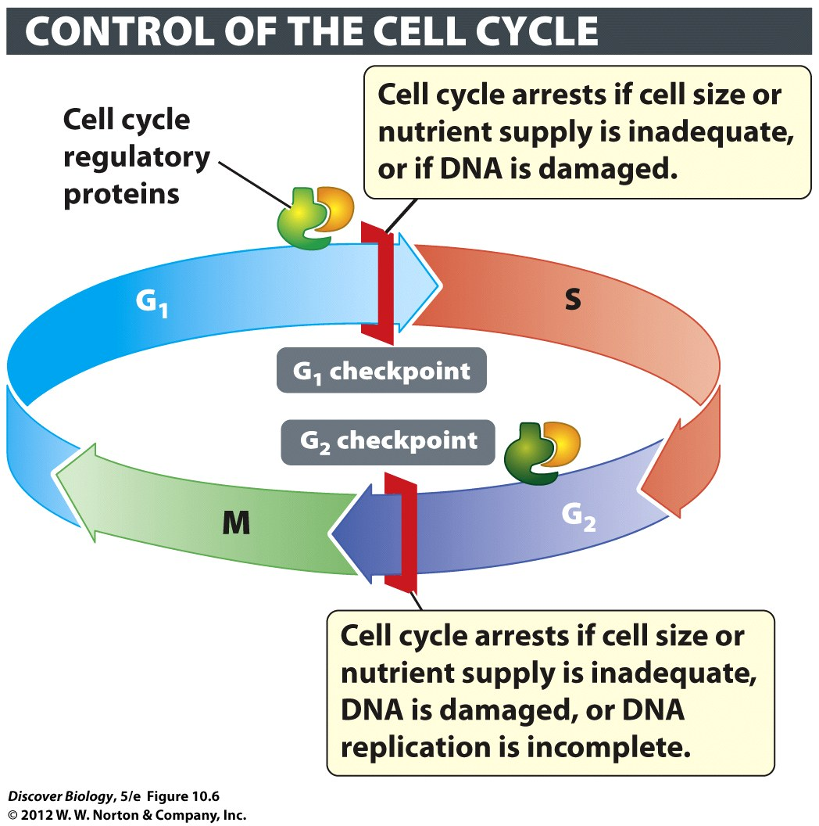
Notes:
Figure 10.6 Cell Cycle Regulatory Proteins Help Control the Cell Cycle
Only two of the known cell cycle checkpoints are depicted in this diagram. Checkpoints are known to operate in S phase and partway through mitosis as well.

Slide 27
The Chromosomal Organization of Genetic Material
Each DNA double helix is packaged with special proteins to form long strands of chromatin
Chromatin is further compacted to form chromosomes

Slide 28
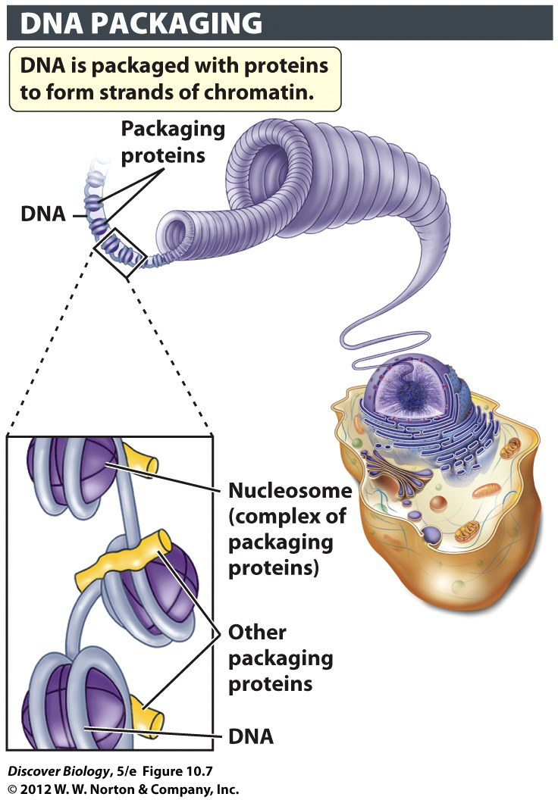
Notes:
Figure 10.7 The Packing of DNA into a Chromosome

Slide 29
The Chromosomal Organization of Genetic Material
DNA is replicated during S phase, resulting in two identical double helices, known as sister chromatids
Each human cell has twice the usual amount of DNA at the start of mitosis
The identical sister chromatids are held together at a region called the centromere

Slide 30
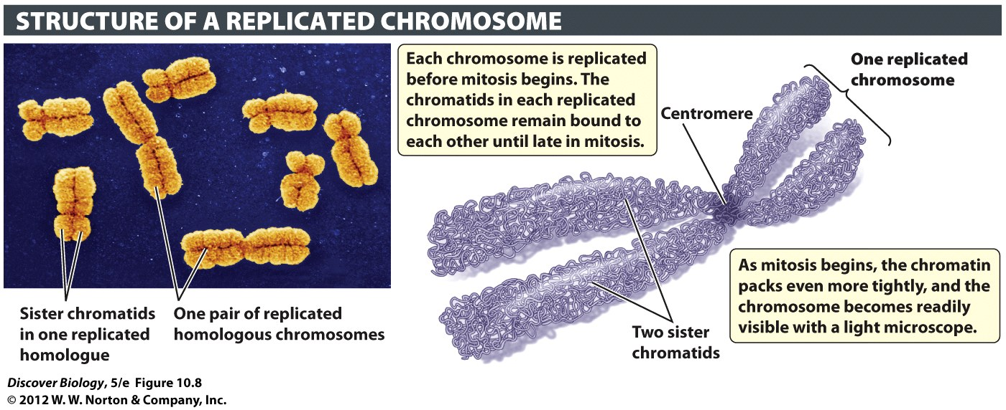
Notes:
Figure 10.8 Each Replicated Chromosome Consists of Two Identical Sister Chromatids

Slide 31
The Karyotype Describes All the Chromosomes in a Nucleus
Every species has its own characteristic number of chromosomes
The display of all the chromosomes in a somatic cell is called the karyotype
Karyotypes can be seen more easily during mitosis, when chromosomes are highly compacted
The number of chromosomes found in any given organism does not indicate the total number of genes, nor does it reflect the complexity of the organism

Slide 32
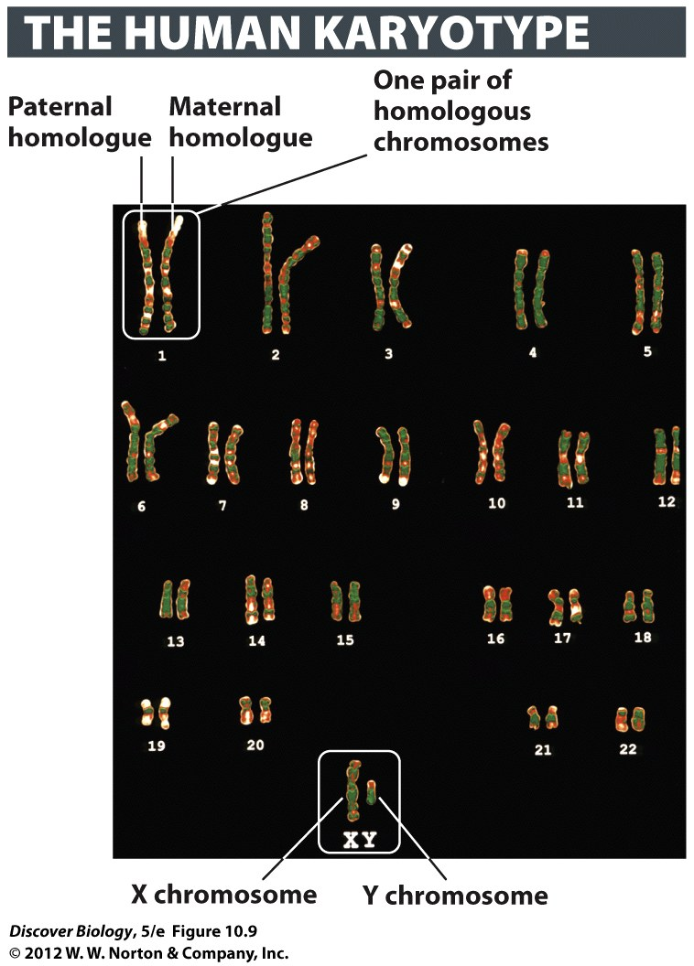
Notes:
Figure 10.9 The Karyotype Identifies All the Chromosomes of a Species
The 46 chromosomes in this micrograph represent the karyotype of a human male. With the help of computer graphics, photos of the chromosomes have been aligned so that the two members of each homologous pair are placed next to each other. The non–sex chromosomes (known as autosomes) are numbered. The sex chromosomes are represented by letters (XY, in the case of this individual, a male).

Slide 33
Most Human Cells Have Two Copies of Each Type of Chromosome
Most eukaryotes carry two copies of each chromosome called homologous chromosomes
Humans have 46 chromosomes divided into 23 homologous pairs
One set of chromosomes, called sex chromosomes, determines the sex of an individual animal

Slide 34
Mitosis and Cytokinesis: From One Cell to Two Identical Cells
Mitosis can be divided into four main phases, which are visible under a light microscope:
  Prophase
  Metaphase
  Anaphase
  Telophase
The main role of mitosis is to separate sister chromatids and distribute one of each chromosome into each of the daughter cells

Slide 35
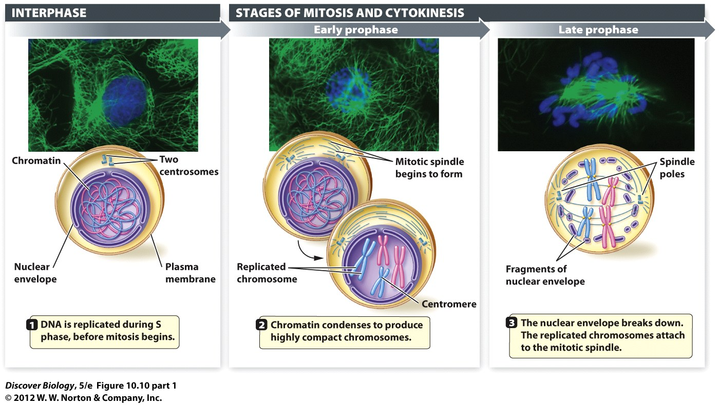
Notes:
Figure 10.10 (Part 1) Mitosis and Cytokinesis Are the Two Main Stages of Mitotic Cell Division

Slide 36
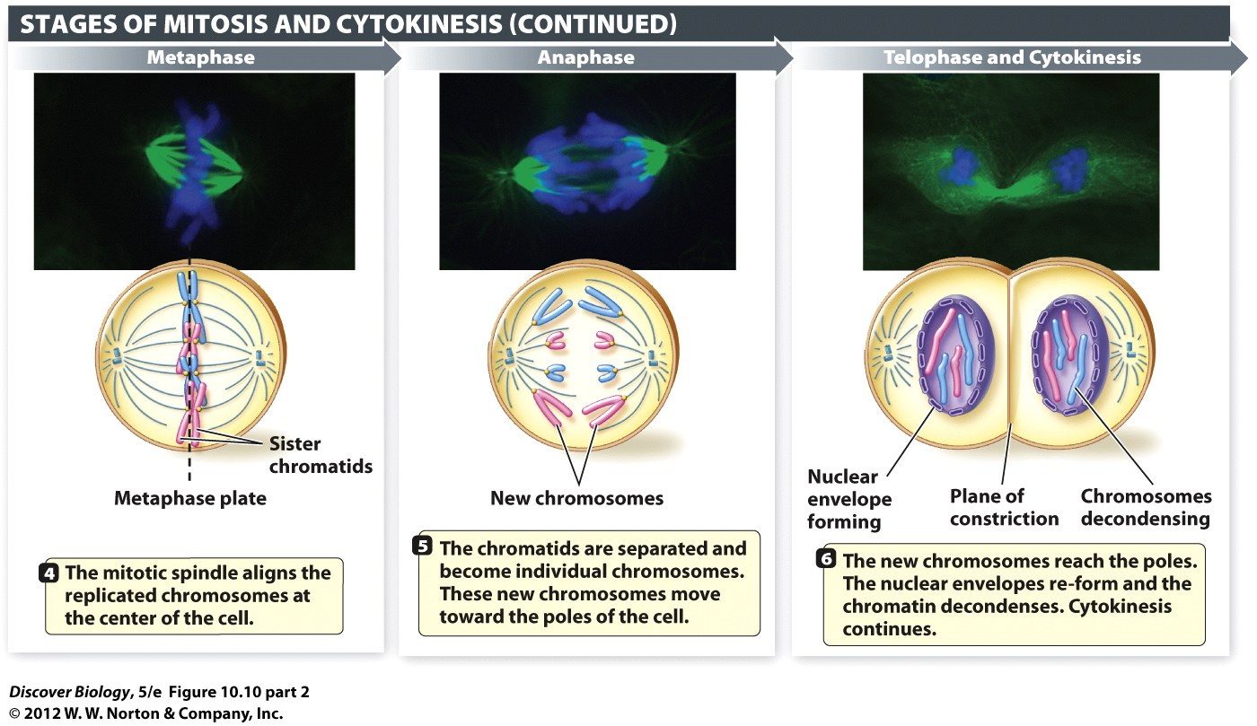
Notes:
Figure 10.10 (Part 2) Mitosis and Cytokinesis Are the Two Main Stages of Mitotic Cell Division

Slide 37
Chromosomes Are Compacted during Early Prophase
Prophase is the first stage of mitosis and results in highly compacted chromatin
Two cytoskeletal structures called centrosomes begin to move toward opposite ends of the cell
During prophase, special proteins form long cylinders called microtubules, which make up the mitotic spindle
The mitotic spindle will attach to the centrosomes and help guide sister chromatids to opposite ends of the cell

Slide 38
Chromosomes Are Attached to the Spindle in Late Prophase
The nuclear envelope breaks down to allow mitotic cell division in late prophase
Spindle microtubules attached to patches of protein, called kinetochores, on each side of the centromere capture the sister chromatids

Slide 39
Notes:
Figure 10.10 (Part 1) Mitosis and Cytokinesis Are the Two Main Stages of Mitotic Cell Division

Slide 40
Chromosomes Line up in the Middle of the Cell during Metaphase
During metaphase, all of the replicated chromosomes are arranged in a plane, which typically lies at the center of the cell
The purpose of metaphase is to align the chromosomes in order to facilitate equal distribution of chromosomes to each end of the cell

Slide 41
Chromatids Separate during Anaphase
During anaphase, sister chromatids are separated and pulled to opposite ends of the cell by the progressive shortening of the microtubules
Once separated, each chromatid is considered a new chromosome

Slide 42
New Nuclei Form during Telophase
During telophase, the microtubules break down and nuclear envelopes begin to form around the two new sets of chromosomes at each end of the cell
Within each nucleus, the chromosomes begin to unfold and become less visible

Slide 43
The Cytoplasm Is Divided during Cytokinesis
Cytokinesis is the process of dividing the parent cytoplasm into two daughter cells
In animal cells, actin microfilaments form and contract along the metaphase plate, resulting in two daughter cells, each with its own nucleus
In plant cells, a new cell wall is erected where the metaphase plate had been
Cytokinesis is the last step in the cell cycle

Slide 44
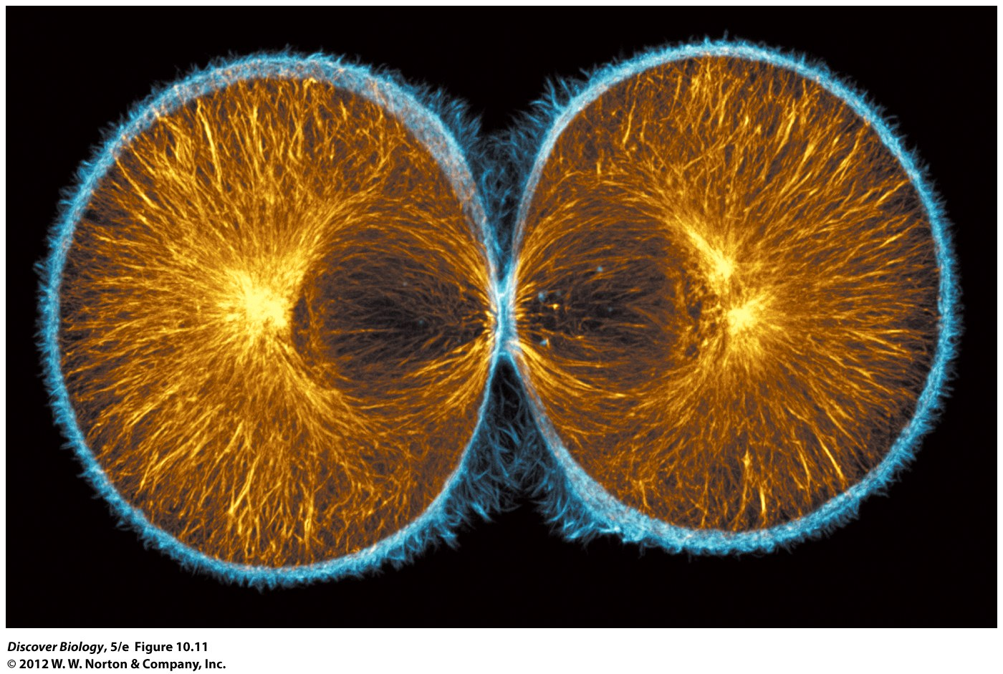
Notes:
Figure 10.11 Cytokinesis in an Animal Cell
This fluorescence image shows cytokinesis in a sea urchin zygote that is dividing into two cells. Microtubules are orange, actin filaments blue.

Slide 45
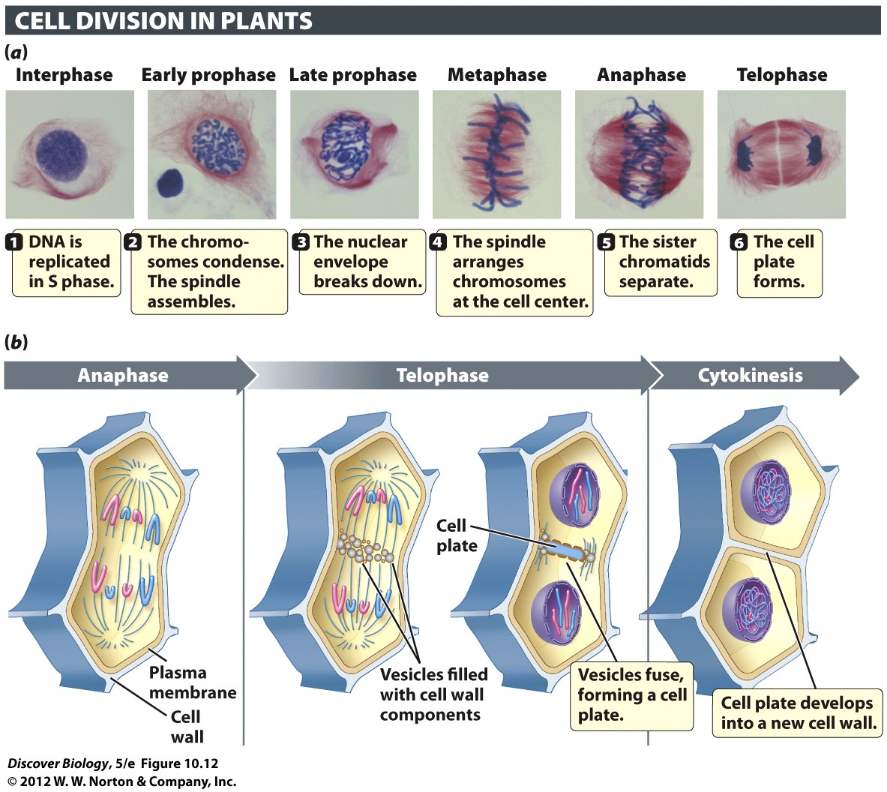
Notes:
Figure 10.12 Cell Plate Formation Is a Distinctive Feature of Cytokinesis in Plant Cells
(a) A microscopic view of mitosis and cytokinesis in lily pollen. The cell plate appears as a pale line in the center of the cell, in the last photograph in the series (telophase). (b) A diagrammatic view of the main events in mitosis and cytokinesis in a plant cell. Plant cells lack prominent centrosomes, but have structures that perform the same function.

Slide 46
Meiosis: Halving the Chromosome Set to Make Gametes
Meiosis produces daughter cells with half the number of chromosomes as the parent cell
Meiosis is the only type of cell division that produces gametes

Slide 47
Gametes Contain Half the Chromosomes Found in Somatic Cells
Sexual reproduction produces offspring that are genetically different from their parents and siblings through the fertilization of an egg by a sperm to create a zygote
Each gamete contains only one chromosome from each homologous pair
All female gametes and 50 percent of male gametes contain an X chromosome

Slide 48
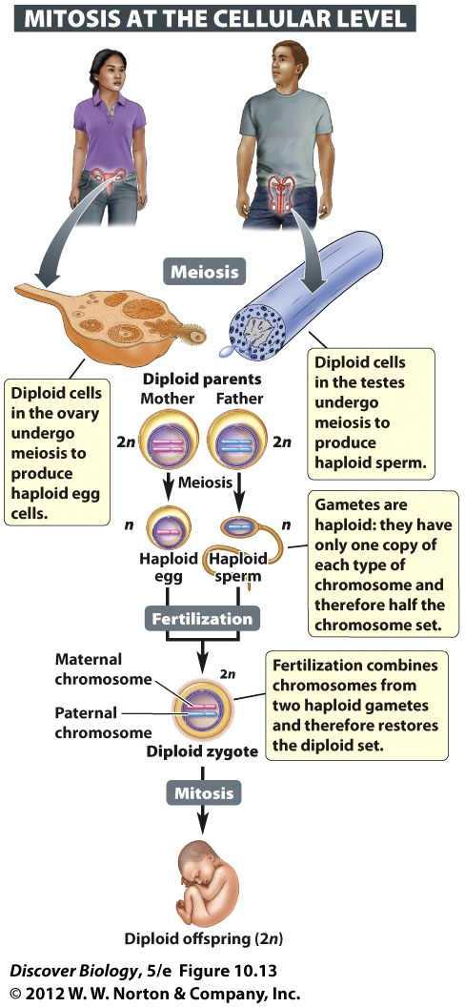
Notes:
Figure 10.13 Sexual Reproduction Requires a Reduction in the Chromosome Set in Gametes
The fusion of haploid sperm and egg at fertilization produces a zygote with the complete diploid (2n) chromosome set. Human somatic cells have 23 pairs of chromosomes. For clarity, only one homologous pair (consisting of a maternal and a paternal homologue) is shown here.

Slide 49
Gametes Contain Half the Chromosomes Found in Somatic Cells
The zygote formed by the two haploid gametes contains one paternal homologue and one maternal homologue for each chromosome
Meiosis occurs in two stages:
  Meiosis I reduces the number of chromosomes by separating homologous pairs
  Meiosis II separates sister chromatids into two different daughter cells

Slide 50
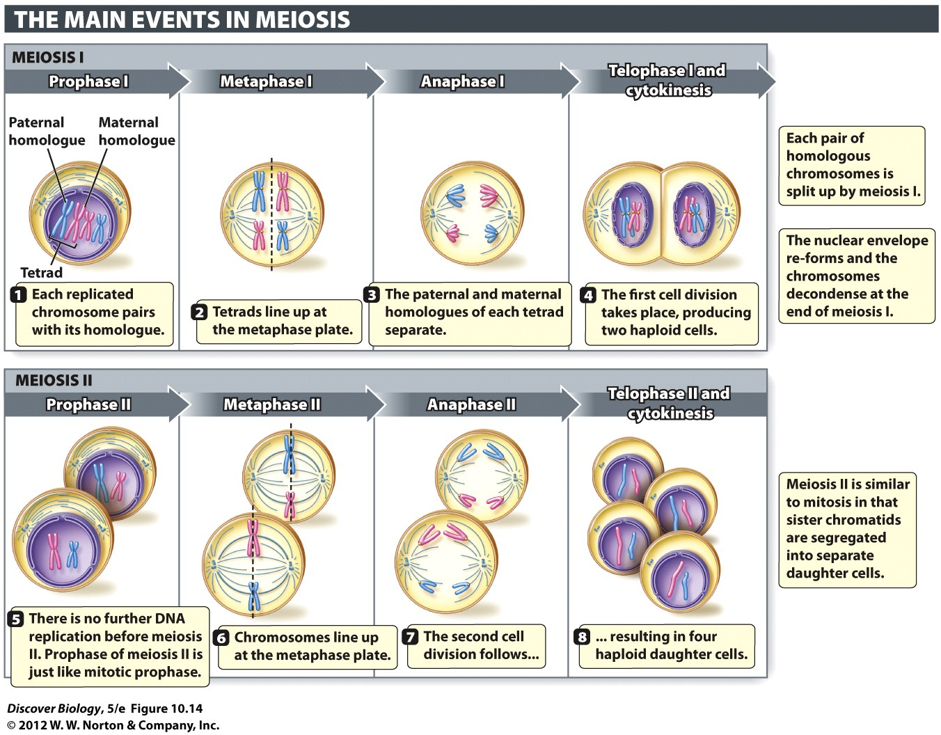
Notes:
Figure 10.14 In Meiosis, Each Daughter Cell Receives Half the Chromosome Set
The maternal and paternal homologues are paired during prophase I through metaphase I, and separated from each other during anaphase. Meiosis II is similar to mitosis in that the sister chromatids that compose each replicated chromosome are pulled apart. For simplicity and clarity, not all the steps described in the text are illustrated here.

Slide 51
Meiosis I Reduces the
Chromosome Number
During meiosis I, each paternal homologue pairs with its matching maternal homologue
Paternal and maternal partners of each homologous chromosome pair align themselves next to each other during prophase of meiosis I, known as prophase I
A tetrad consists of one replicated maternal chromosome and one replicated paternal chromosomes, for a total of four chromatids

Slide 52
Meiosis I Reduces the
Chromosome Number
During prophase I, pieces of genetic material are swapped between non–sister chromatids in a process called crossing-over
Meiosis I continues through prophase I and into metaphase I, anaphase I, and telophase I, which appear similar to mitosis except that it involves the homologous chromosome pairs rather than sister chromatids
Meiosis I is a reduction division because it halves the chromosome set, as one diploid parent cell becomes two haploid daughter cells

Slide 53
Meiosis II Segregates Sister Chromatids into Separate Daughter Cells
The purpose of meiosis II is to separate the sister chromatids into two daughter cells
Meiosis II cell division is almost exactly like mitosis
The two haploid cells produced by meiosis I give rise to a total of four haploid cells
The reduction in chromosome numbers achieved through meiosis I offsets the combining of chromosomes when gametes fuse during fertilization

Slide 54
Meiosis and Fertilization Contribute to Genetic Variation in a Population
Individuals in a population tend to be genetically different from each other thanks to sexual reproduction
Genetic variation is the raw material for evolution
Mutations are the ultimate source of genetic variation in all types of organisms
Different variations of a particular gene created through mutations are called alleles

Slide 55
Meiosis and Fertilization Contribute to Genetic Variation in a Population
Meiosis magnifies diversity by shuffling alleles between homologous pairs and then sorting these scrambled homologues randomly into gametes
The randomness of fertilization also adds to genetic diversity in sexually reproducing populations

Slide 56
Crossing-over Shuffles Alleles
Crossing-over is the physical exchange of chromosomal segments between non–sister chromatids in paired-off paternal and maternal homologues
Crossing-over exchanges alleles between the paternal and maternal chromatids, creating new groupings of alleles through the exchange of DNA segments in a process known as genetic recombination

Slide 57
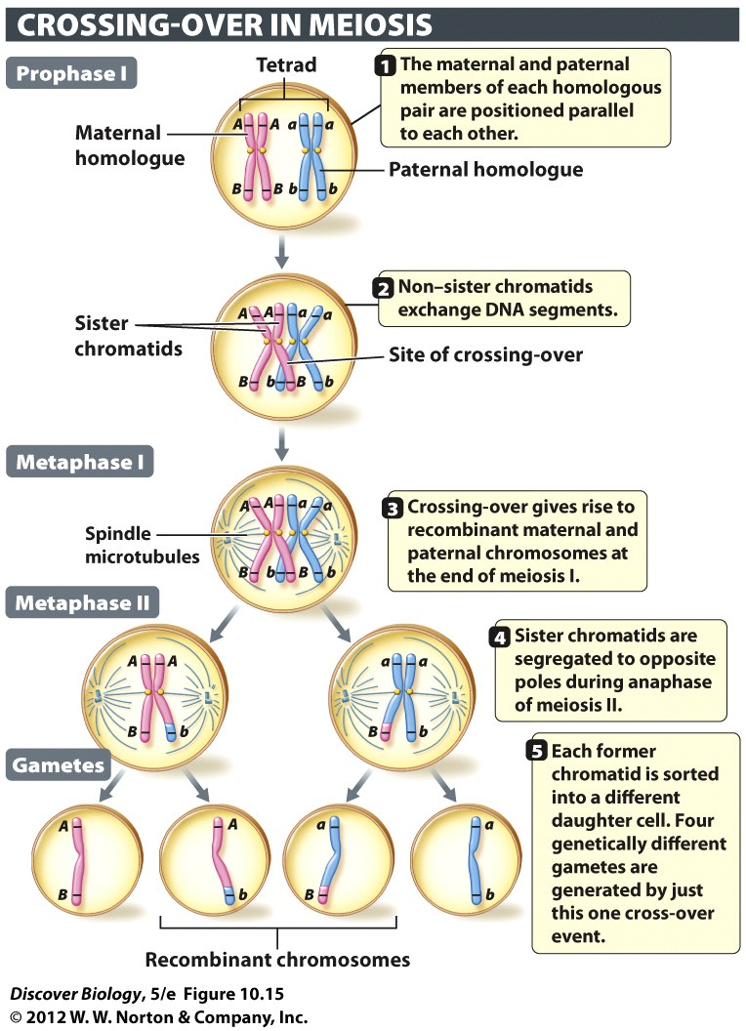
Notes:
Figure 10.15 Crossing-over Produces Recombinant Chromosomes
Crossing-over is the physical exchange of corresponding segments between the non–sister chromatids in a pair of homologous chromosomes that are aligned parallel to each other during prophase I. For clarity, only one maternal and one paternal chromatid are depicted here as exchanging segments. In human cells undergoing meiosis, most tetrads have one to three crossover sites, with longer chromosomes more likely to have multiple crossovers. A crossover site can be located at any point along the length of the paired homologues (tetrad), not just at the tips of the chromatids. The letters (A/a and B/b) represent alternative alleles of two genes, A and B. Note that the parental combinations of these alleles have been shuffled in the recombinant chromosomes.

Slide 58
The Independent Assortment of Homologous Pairs Generates
Diverse Gametes
Independent assortment is the random distribution of the different homologous chromosome pairs into daughter cells during meiosis I
Independent assortment of chromosomes creates gametes that are different from the parent and from each other
The random events in meiosis and the random fertilization of a certain egg by a particular sperm give each sexually reproducing organism genetic uniqueness

Slide 59
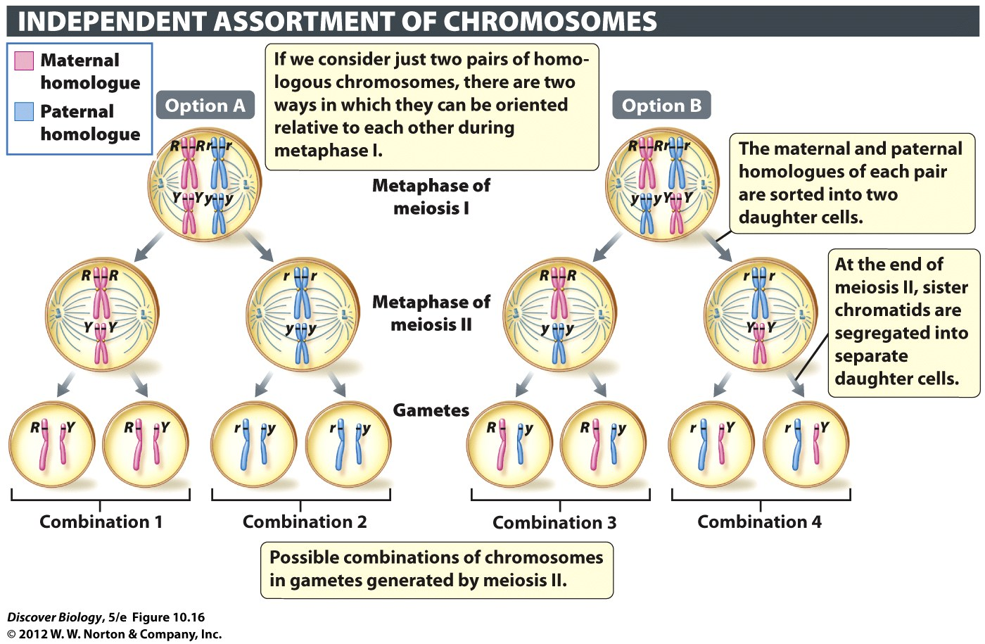
Notes:
Figure 10.16 The Random Assortment of Homologous Chromosomes Generates Chromosomal Diversity among Gametes

Slide 60
The Great Divide
Nutrients help cells divide rapidly, as seen in the bloom of “sea lettuce” that threatened to halt the 2008 Olympics
Eutrophication refers to the overfertilization of an area, typically due to agricultural runoff
Eutrophication can lead to large algal blooms

Slide 61
Clicker Questions
CHAPTER 10
Cell Division

Slide 62
Concept Quiz
Which of the following is not true about interphase?
The cell grows larger during interphase.
Chromosomes are duplicated during interphase.
Interphase is divided into three phases.
Chromosomes segregate to daughter cells during interphase.
Notes:
The correct answer is D. This does not occur during interphase, but during mitosis.
It is important to stress that interphase is composed of 3 phases in which the cell grows and the chromosomes are duplicated. Students often believe that G₁, S, and G₂ are in addition to interphase.
Answers A – C: These are all true. Growth occurs during G₁ and G₂ phases and the chromosomes are duplicated during S phase.

Slide 63
Concept Quiz
Which of the following is true about homologous chromosomes?
Both were received from the same parent.
One of each segregates to each daughter cell during mitosis.
Both stay together in meiosis I.
All 23 pairs are always homologous.
Notes:
The correct answer is B. It is important that students understand what homologous chromosomes are. These are not identical, but homologous; one came from each parent and they contain slightly different genes. One of each segregates into each daughter cell during mitosis so that each daughter cell is identical.
Answer A: As stated above, one came from each parent.
Answer C: They are separated during meiosis I, resulting in haploid daughter cells.
Answer D: Sex cells are not homologous in males, but are in females.

Slide 64
Concept Quiz
Meiosis insures that
Each gamete receives the same genes
Chromosome number is doubled in the gametes
Zygotes produced by fertilization have the normal number of chromosomes
All paternal chromosomes end up in the same gamete
Notes:
The correct answer is C. This is the key to meiosis – reduction division so that the fertilized egg restores the normal number of chromosomes.
Answer A: Each gamete doesn’t receive the same genes because the homologous chromosomes are randomly assorted during meiosis I.
Answer B: Chromosome number is halved in the gametes.
Answer D: As in the answer for A, the homologous chromosomes are randomly assorted during meiosis I.

Slide 65
Relevant Art from Other Chapters
All art files from the book are available in JPEG and PPT formats online and on the Instructor Resource Disc

Slide 66
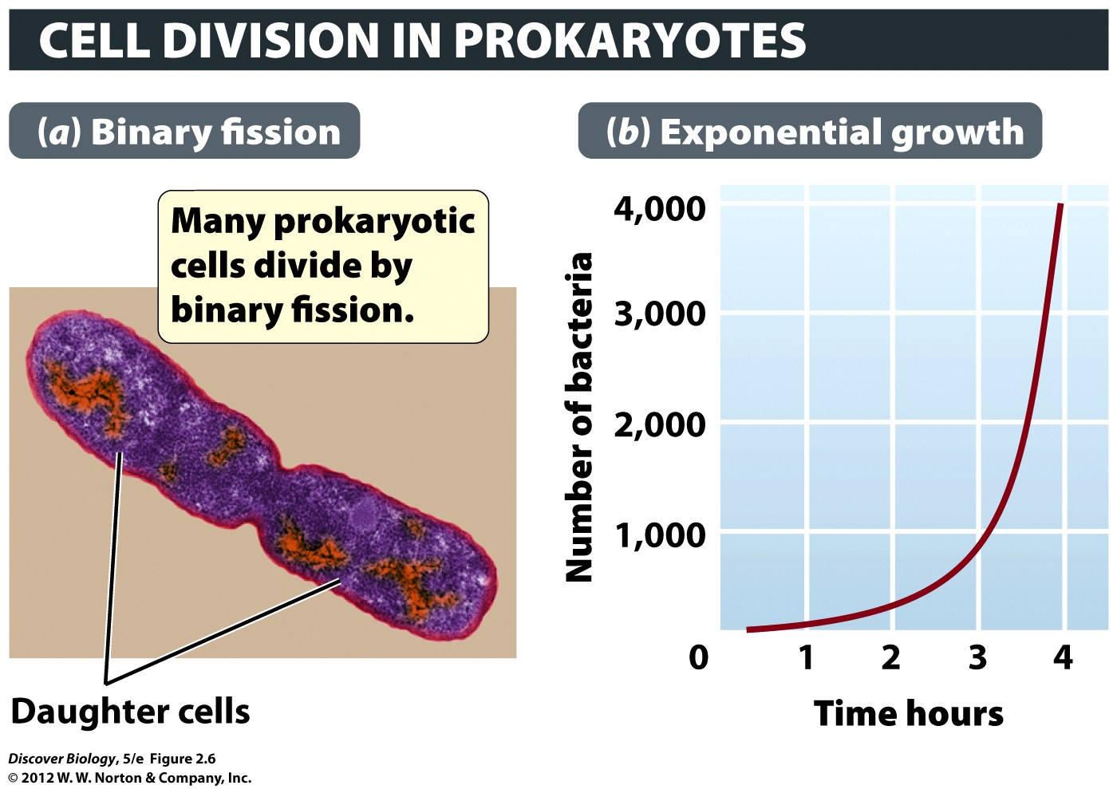
Notes:
Figure 2.6 Through Binary Fission, E. coli Multiplies at an Astounding Rate
(a) E. coli divides into two every 20 minutes, given the right conditions, especially the ready availability of food and the temperature of the human body (37°C). (b) This graph shows how the population of E. coli increases, starting from a single cell that turns into two cells in 20 minutes, which together become four cells at 40 minutes. With doubling of cell numbers every 20 minutes, there are 1,000 cells after 3 hours and 20 minutes have gone by. This type of growth, in which the number of cells added with each generation depends on the total number of cells already there, is known as exponential or geometric growth.

Slide 67
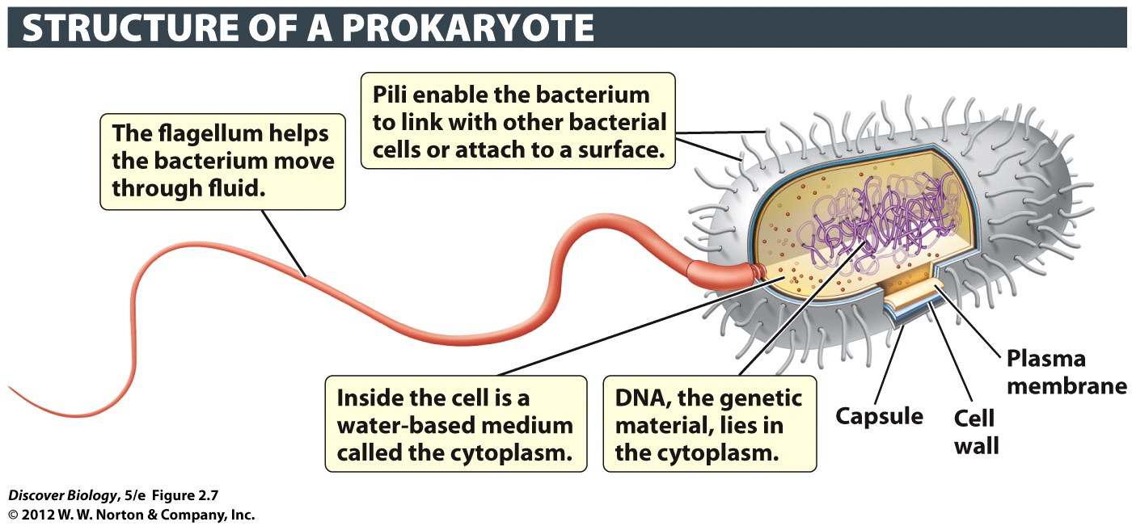
Notes:
Figure 2.7 Prokaryotic Cells Lack a Nucleus
Prokaryotic cells tend to be about 10 times smaller than eukaryotic cells, and generally have much less DNA.

Slide 68
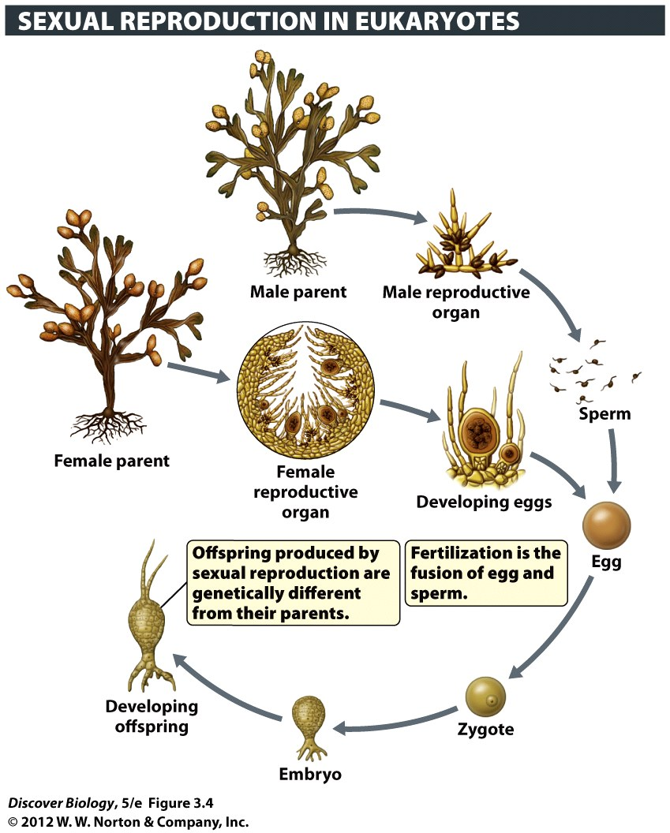
Notes:
Figure 3.4 An Example of Sexual Reproduction
The rockweed, a brown alga, produces eggs and sperm that unite to create offspring, in a life cycle that resembles that of animals. Other seaweeds have different, and more complex, life cycles.

Slide 69
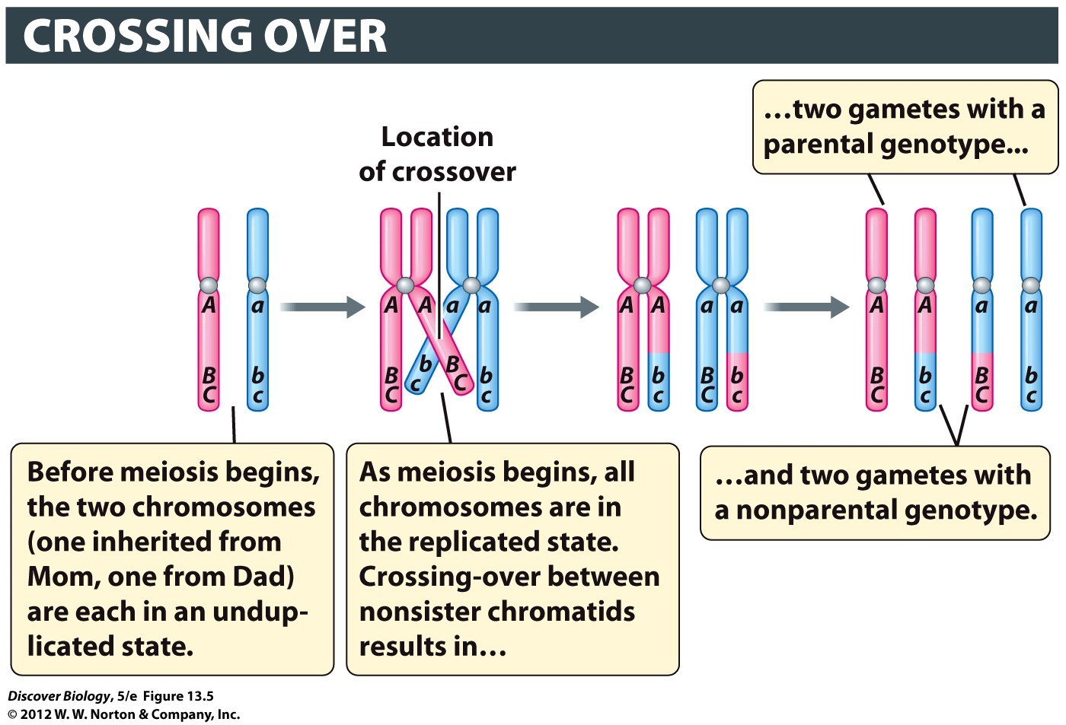
Notes:
Figure 13.5 Segments of Chromosomes Are Exchanged in Crossing-Over
Crossing-over takes place during prophase I. As a result of crossover between A/a and B/b, half of the gametes have a parental genotype (ABC or abc), while the other half have a nonparental genotype (Abc or aBC). In this example, there is no crossing-over between B/b and C/c.

Slide 70
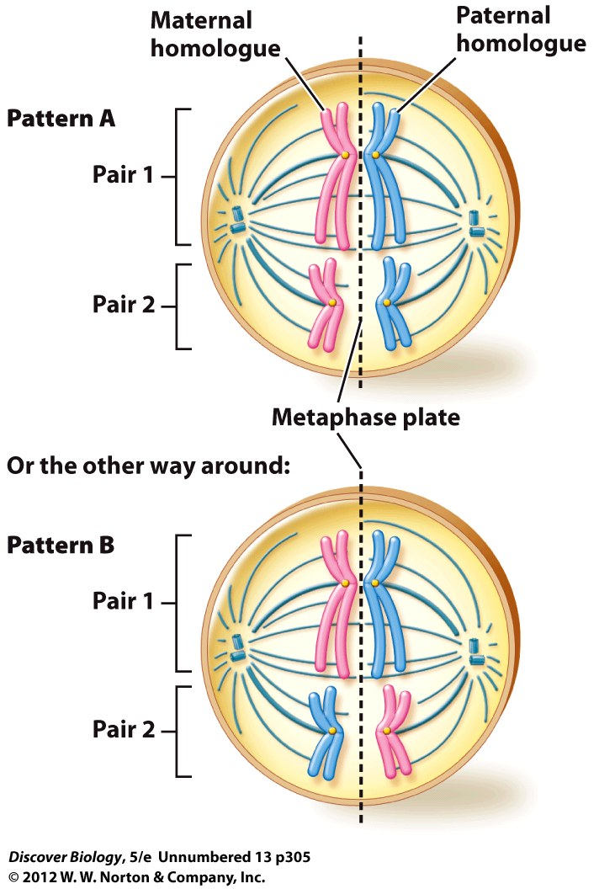

Slide 71
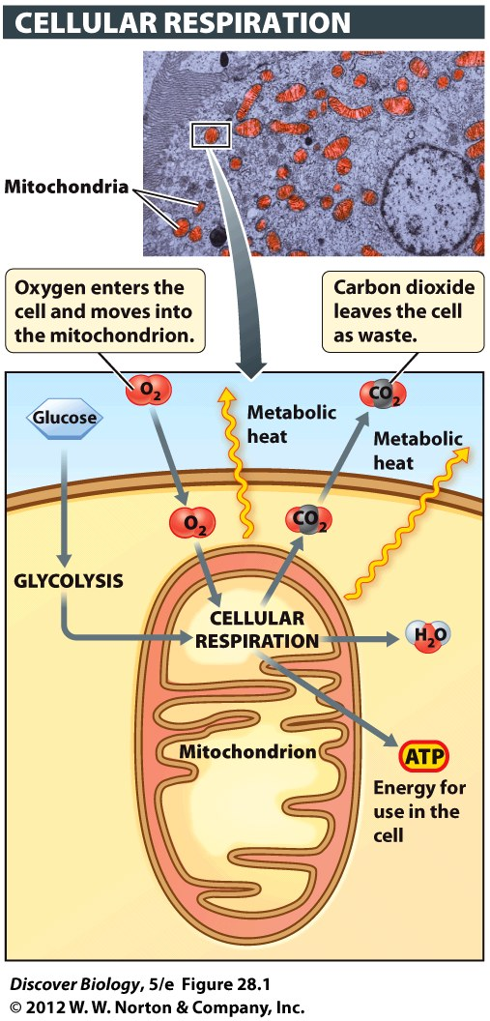
Notes:
Figure 28.1 Cellular Respiration Occurs in Mitochondria
During cellular respiration, oxygen is consumed as energy is extracted from glucose for use by the cell. Heat, water, and carbon dioxide are also produced. The inset shows mitochondria in a liver cell.

Slide 72
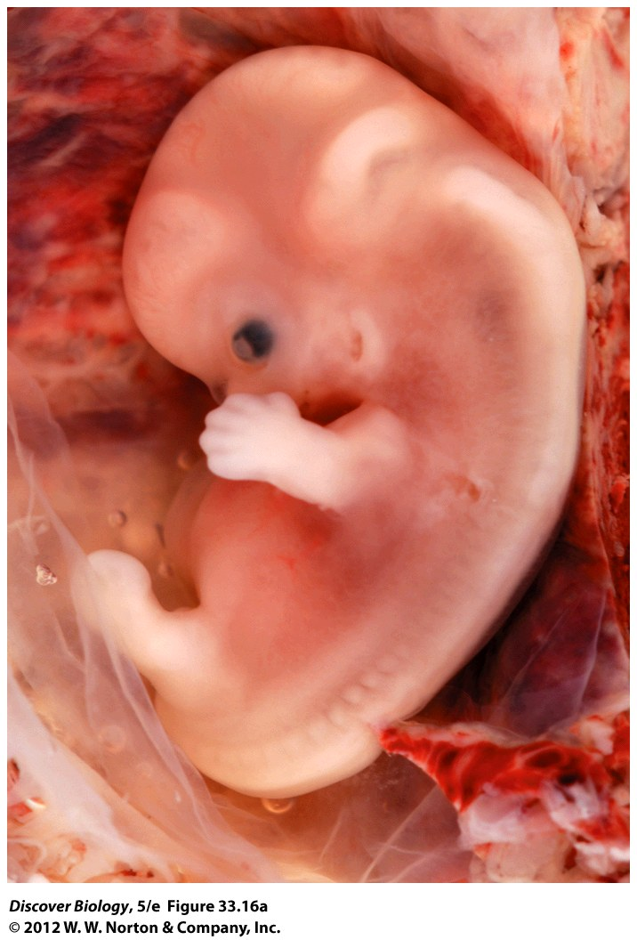
Notes:
Figure 33.16a Apoptosis Leads to Separate, Rather Than Webbed, Fingers and Toes

Slide 73
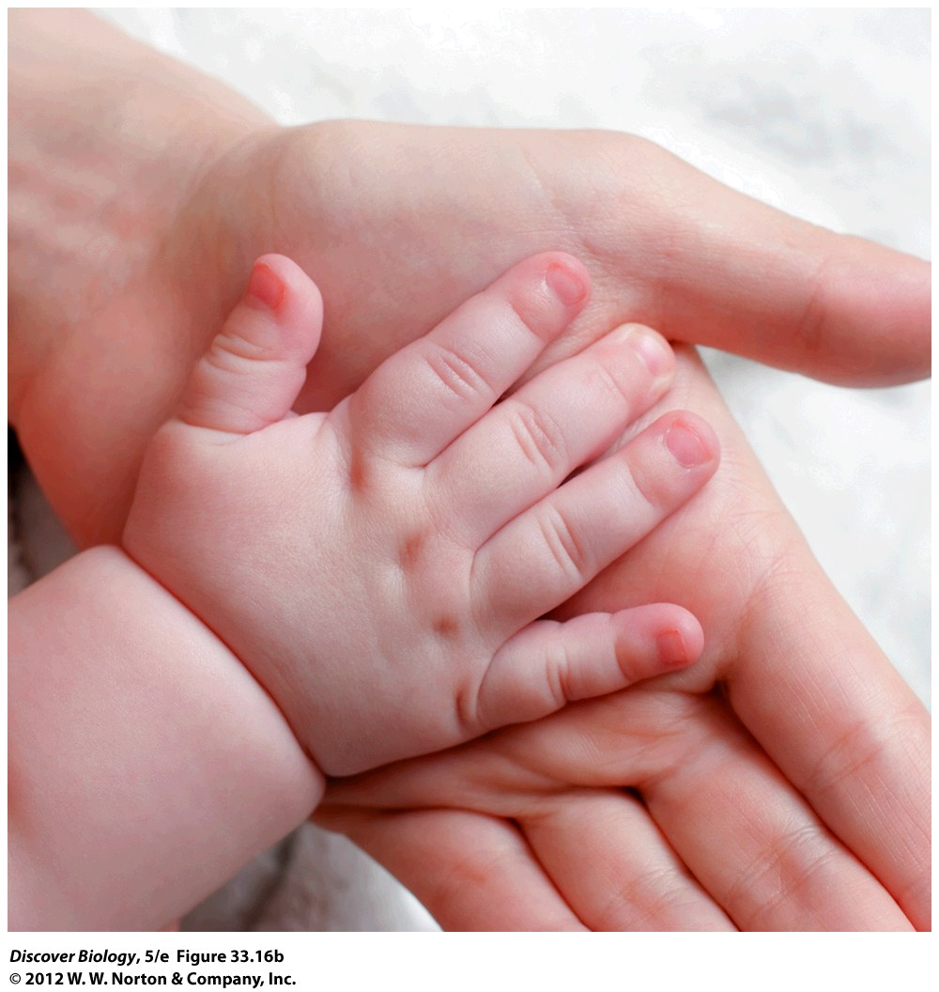
Notes:
Figure 33.16b Apoptosis Leads to Separate, Rather Than Webbed, Fingers and Toes

Slide 74
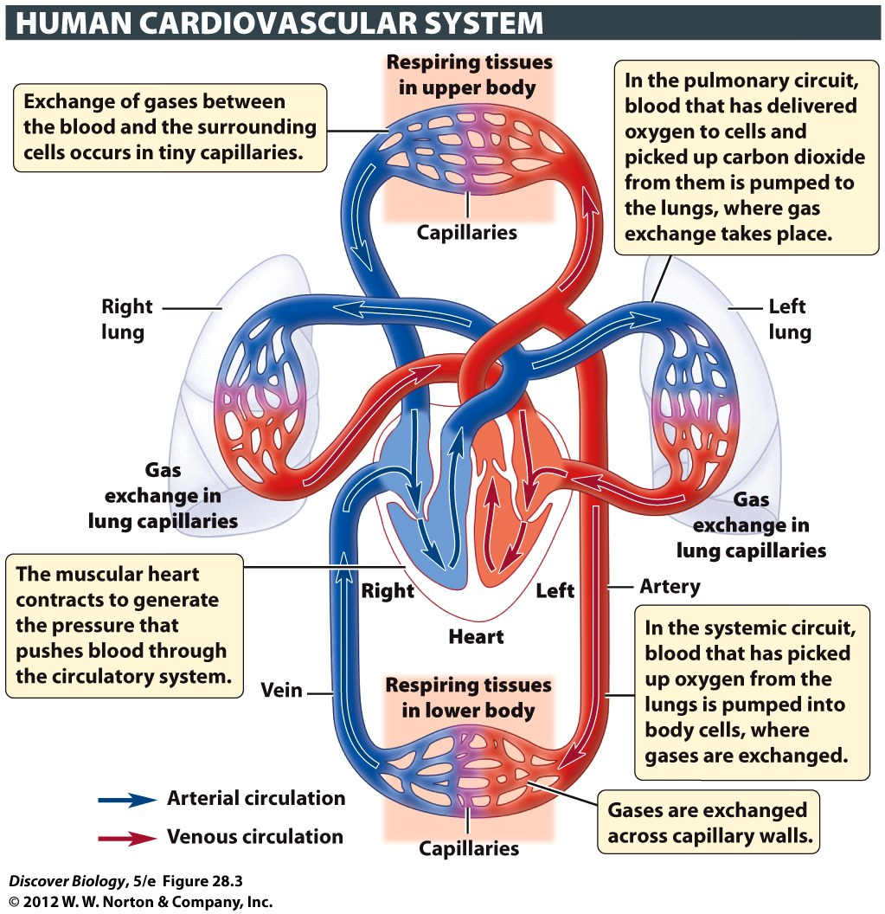
Notes:
Figure 28.3 The Heart Pushes Blood through the Systemic and Pulmonary Circuits
The systemic circuit carries oxygen-rich blood away from the heart, circulates it throughout the body, and returns oxygen-depleted blood back to the heart. The pulmonary circuit brings oxygen-poor blood from the heart to the lungs and returns oxygen-rich blood to the heart.

