Slide 1
Discover Biology FIFTH EDITION
Anu Singh-Cundy • Michael L. Cain
CHAPTER 9
Photosynthesis and
Cellular Respiration
© 2012 W. W. Norton & Company, Inc.

Slide 2
Every Breath You Take
Every person, elite athlete or couch potato, need oxygen and glucose to survive
The dangerous sport static apnea is the practice of remaining motionless with no oxygen intake for as long as possible
Static apnea requires endurance training and training at high altitudes

Slide 3
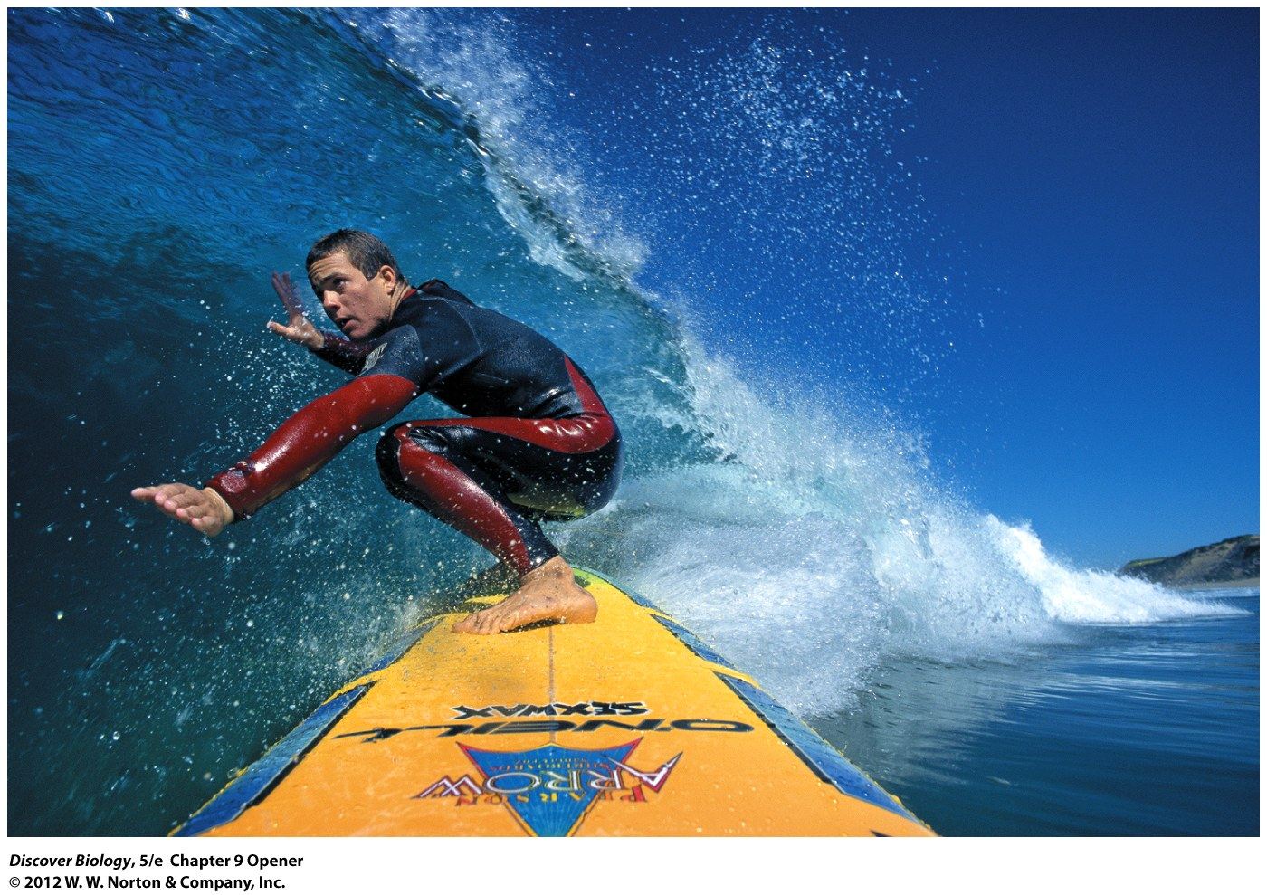
Notes:
Big-Wave Surfer Jay Moriarity. In 2001, Jay Moriarity— renowned for a spectacular wipeout that ran on the cover of Surfer magazine—died while on a photo shoot in the Maldive Islands, in the Indian Ocean. But Moriarity didn’t die surfing; he died instead meditating 45 feet below the surface of the water without oxygen—a common practice among surfers and divers called “static apnea.”

Slide 4
Energy Is Necessary
In most ecosystems, the sun is the ultimate source of energy for all living organisms
Metabolism encompasses all the chemical reactions involved in the capture, storage, and utilization of energy in a cell
Plants and photosynthetic organisms that convert light energy into food are called producers
Organisms that acquire energy by eating producers or other consumers are called consumers

Slide 5
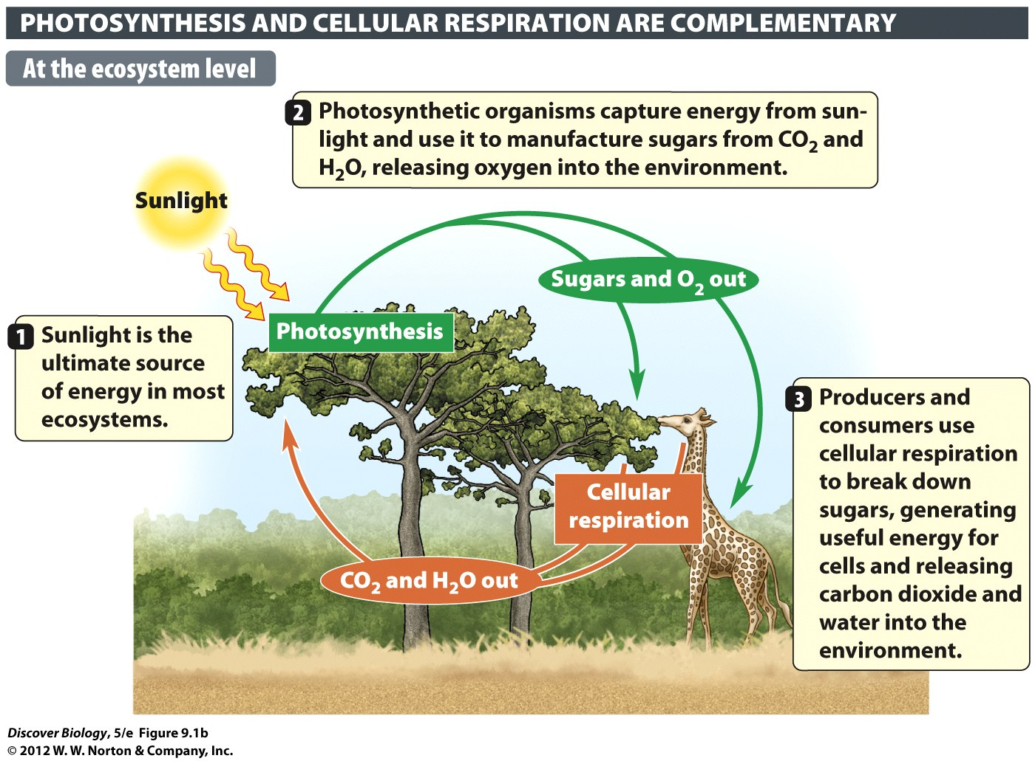
Notes:
Figure 9.1b The Relationship Between Photosynthesis and Cellular Respiration

Slide 6
Energy Is Necessary
Photosynthesis and cellular respiration are two important metabolic pathways consisting of a series of chemical reactions that transform light energy into usable energy
Photosynthesis is the process by which light energy is used to make sugars from carbon dioxide and water
Cellular respiration is the process of releasing energy from food molecules to fuel cellular activities

Slide 7
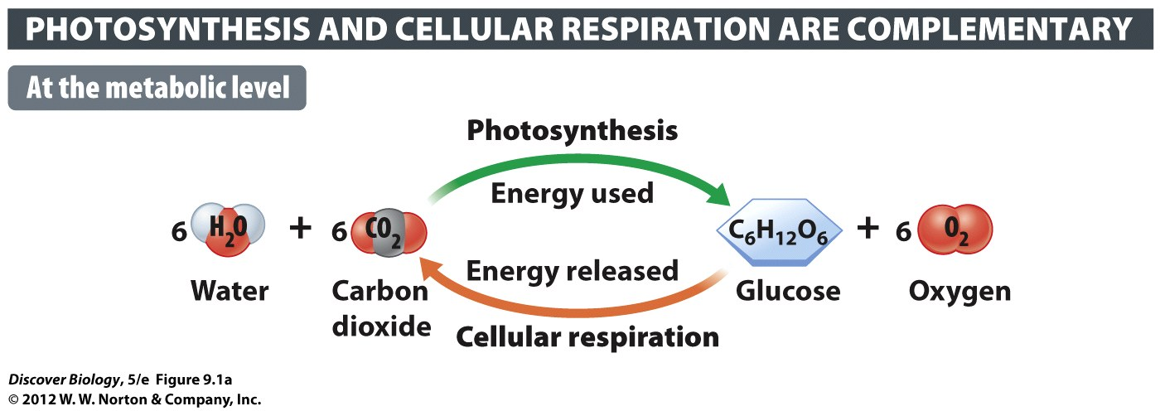
Notes:
Figure 9.1a The Relationship Between Photosynthesis and Cellular Respiration

Slide 8
Molecular Energy Carriers
Energy carriers are organic molecules that are necessary for receiving, storing, and delivering energy within the cell
Adenosine triphosphate (ATP) is the most widely used energy carrier and can release energy when it loses a terminal phosphate, thus becoming adenosine diphosphate (ADP)
During photosynthesis, energy from the sun is used to convert ADP back into ATP

Slide 9
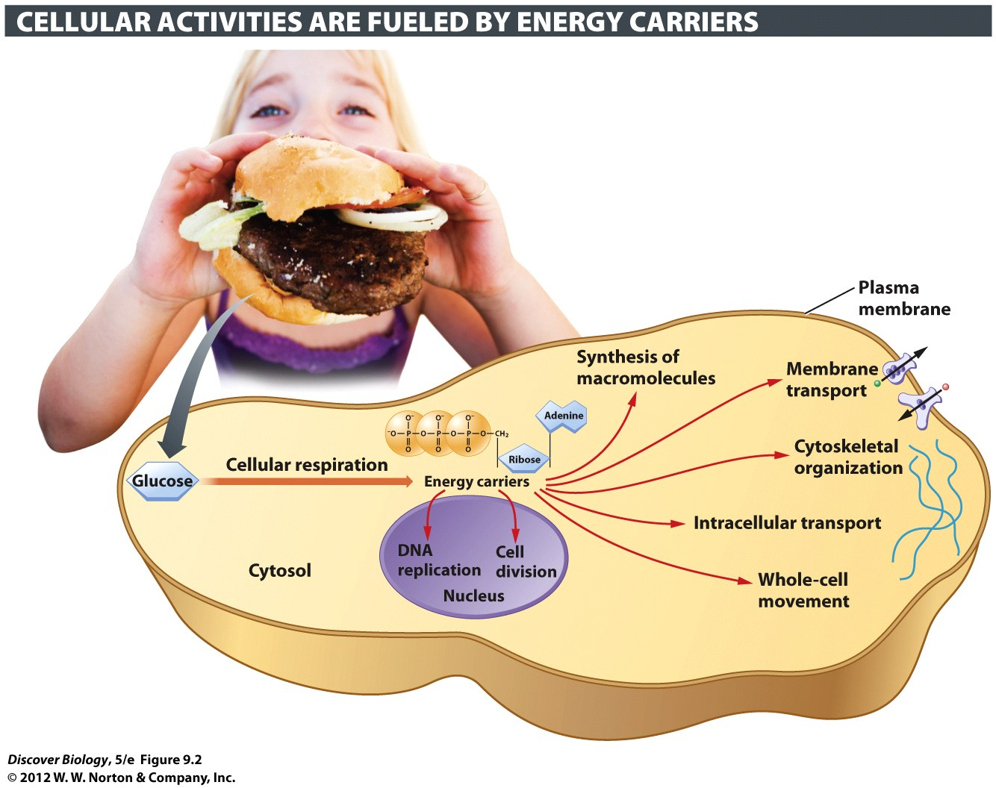
Notes:
Figure 9.2 You, Your Lunch, and Energy Carriers in the Cell
Just about all cellular processes run on molecular energy carriers. Your body needs a mechanism to turn lunch into energy carriers.

Slide 10
Molecular Energy Carriers
NADPH and NADH are specialized energy carriers that store energy in loosely bound electrons and hydrogen atoms
NADPH deliver energy by providing electrons and hydrogen atoms to anabolic pathways
NADH pick up electrons and hydrogen atoms that have been released from catabolic pathways

Slide 11
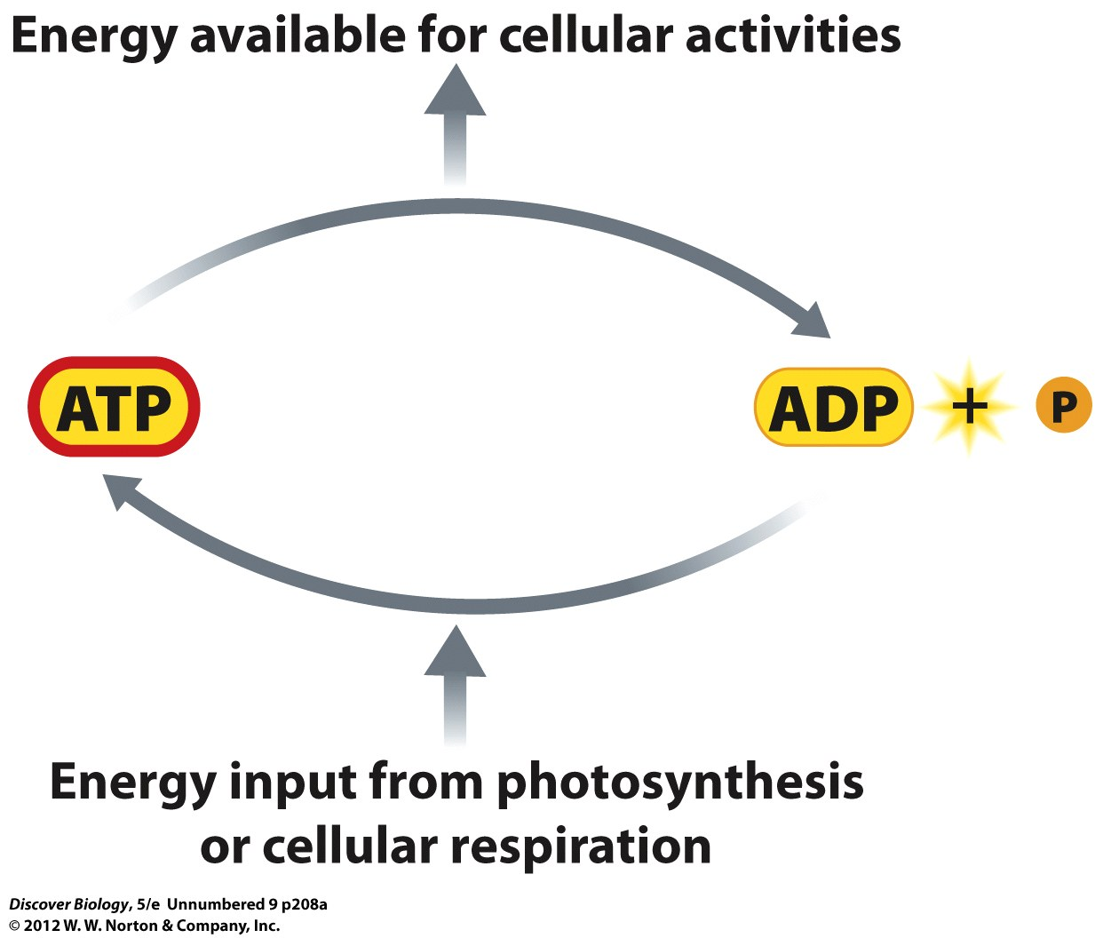

Slide 12
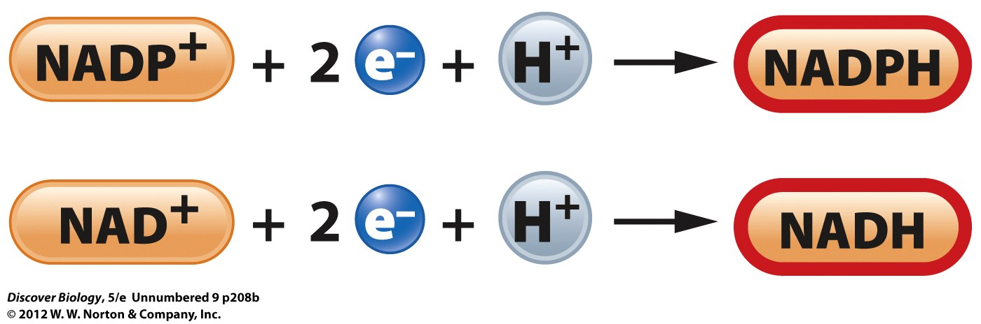

Slide 13
An Overview of Photosynthesis and Cellular Respiration
Only producers can carry out photosynthesis using ingredients from their nonliving environment
Plants
Algae
Certain bacteria
All eukaryotes and most prokaryotes carry out cellular respiration to extract chemical energy from the food they consume

Slide 14
Light Powers the Manufacture of Carbohydrates during Photosynthesis
Eukaryotes that carry out photosynthesis have specialized organelles called chloroplasts
Chloroplasts contain a green pigment called chlorophyll that absorbs light energy
The light reactions of photosynthesis generate energy carriers, which in turn drive the manufacture of sugars via the Calvin cycle

Slide 15
Light Powers the Manufacture of Carbohydrates during Photosynthesis
Photosynthesis takes place in two stages:
Light reactions
Calvin cycle
During the light reactions, water molecules are split using light energy absorbed by chlorophyll, thus releasing oxygen as a by-product
During the Calvin cycle, a series of enzyme-catalyzed chemical reactions converts carbon dioxide into sugar using ATP and NADPH

Slide 16
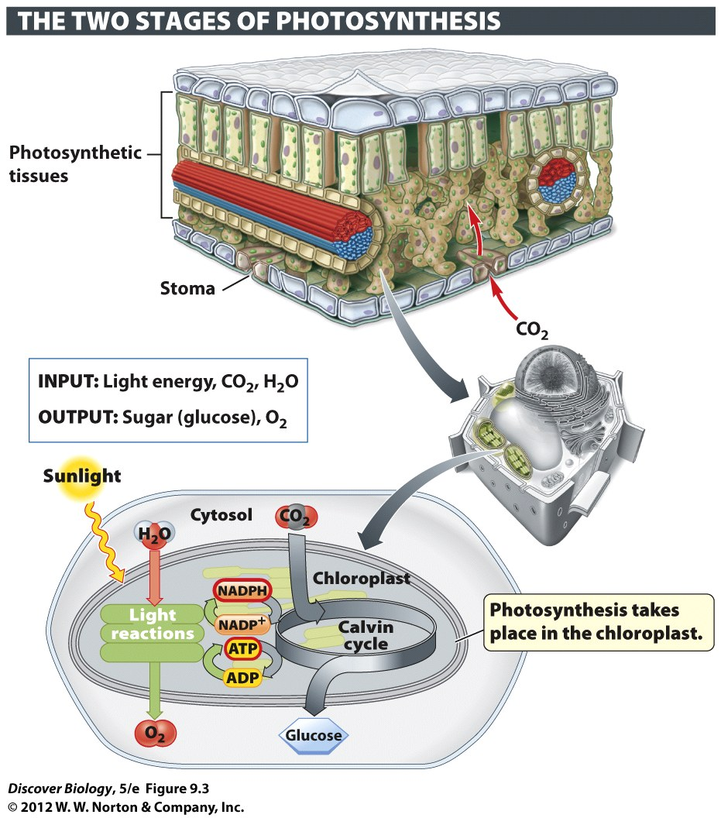
Notes:
Figure 9.3 An Overview of Photosynthesis

Slide 17
Energy From Sugars Is Used to Make ATP during Cellular Respiration
Cellular respiration requires oxygen to break down food molecules
The energy released from the food molecules is used to generate ATP
Carbon dioxide and water are by-products of cellular respiration

Slide 18
Energy from Sugars Is Used to Make ATP during Cellular Respiration
Cellular respiration takes place in three stages
Glycolysis: takes place in the cytosol
The Krebs cycle: takes place in the mitochondria
Oxidative phosphorylation: takes place in the mitochondria
Oxydative phosphorylation produces the largest amount of ATP

Slide 19
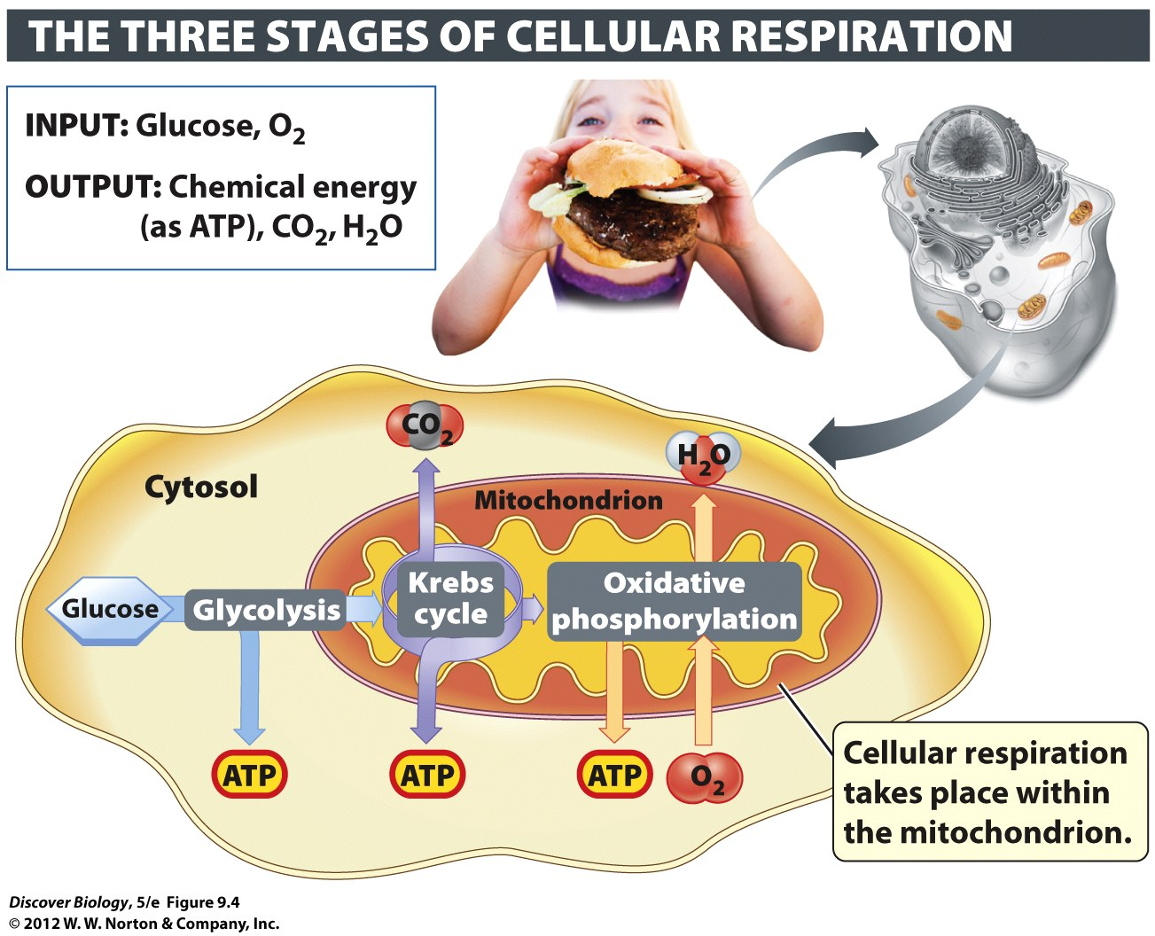
Notes:
Figure 9.4 An Overview of Cellular Respiration

Slide 20
Photosynthesis: Energy from Sunlight
Photosynthetic producers support humans as well as many other organisms by providing both the food and oxygen necessary for life

Slide 21
The Color of an Object Is Determined by the Wavelengths of Visible Light It Reflects
Photons are massless particles that carry a fixed amount of energy and exhibit wavelike characteristics
Photon energy is measured in wavelengths and covers a broad span known as the electromagnetic spectrum

Slide 22
The Color of an Object Is Determined by the Wavelengths of Visible Light It Reflects
Short wavelengths have more energy than long wavelengths
Visible light is the portion of the electromagnetic spectrum that humans can see
The color of an object is determined by the wavelengths it reflects

Slide 23
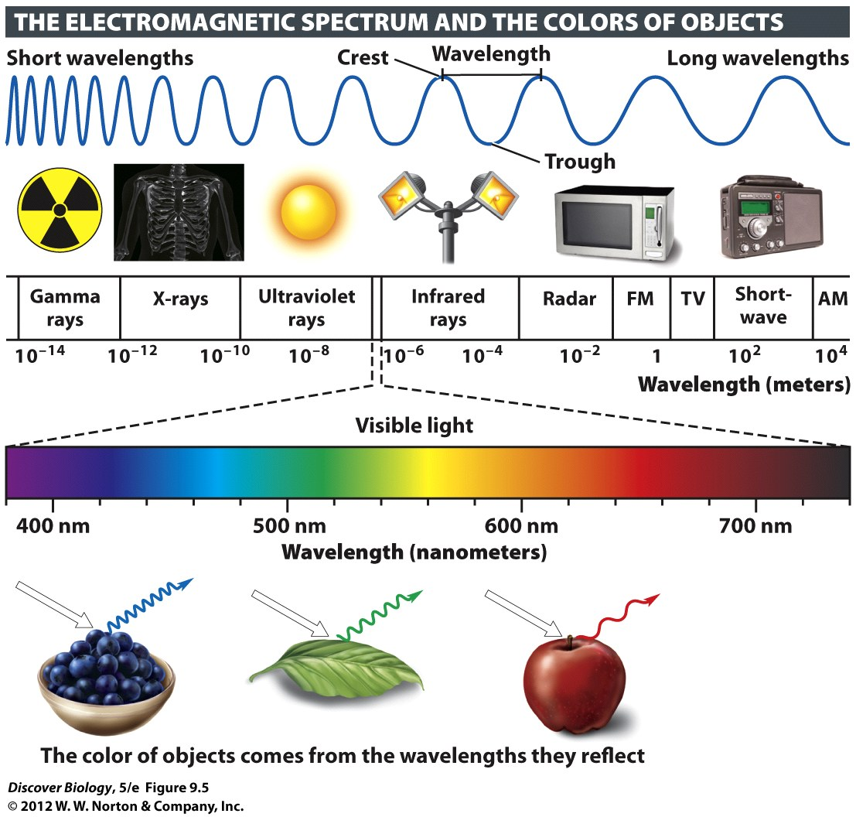
Notes:
Figure 9.5 The Color of an Object Is Determined by the Wavelengths of Light It Reflects

Slide 24
Chloroplasts Are Photosynthetic Organelles
The leaves of plants are packed with chloroplasts and are especially suited to carry out photosynthesis
Stomata located on the leaves open and close to allow carbon dioxide in and oxygen out
The Calvin cycle takes place in the stroma, a gel-like fluid within the membranes of the chloroplast, which contains the ingredients to turn carbon dioxide into sugar

Slide 25
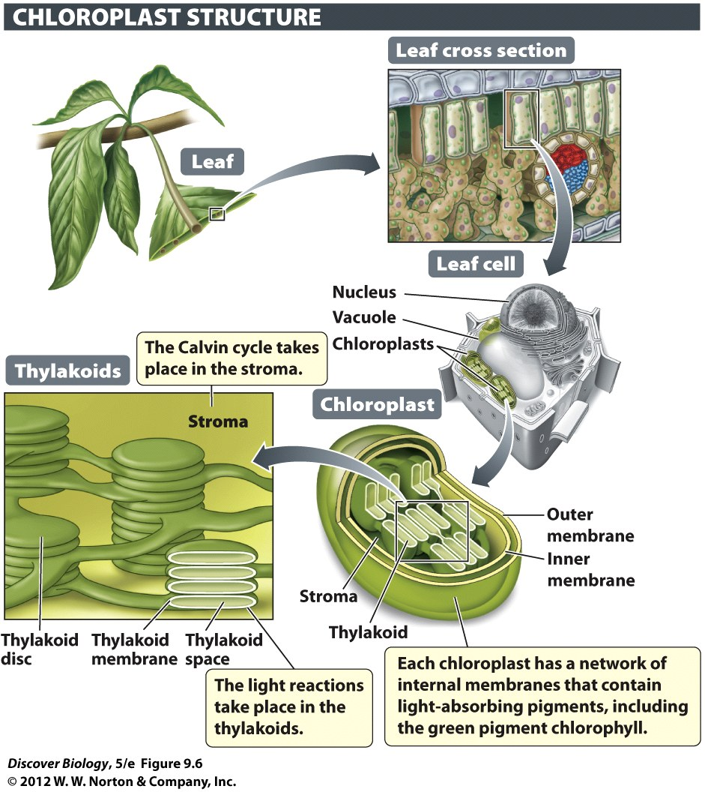
Notes:
Figure 9.6 Chloroplasts Contain Membranes Studded with Chlorophyll
Chlorophyll absorbs light energy, which is used to drive the synthesis of energy carriers. The energy carriers fuel the synthesis of sugar in the stroma of the chloroplast.

Slide 26
Light Reactions Generate Energy Carriers
Light-absorbing antenna complexes in the thylakoid membrane of the chloroplast direct light energy to the reaction center
The light reaction begins at the reaction center, where high-energy electrons are picked up by an electron transport chain (ETC)
The ETC is made up of a series of electron-accepting molecules that pass electrons from one to another, giving off small amounts of energy, which is used to generate ATP

Slide 27
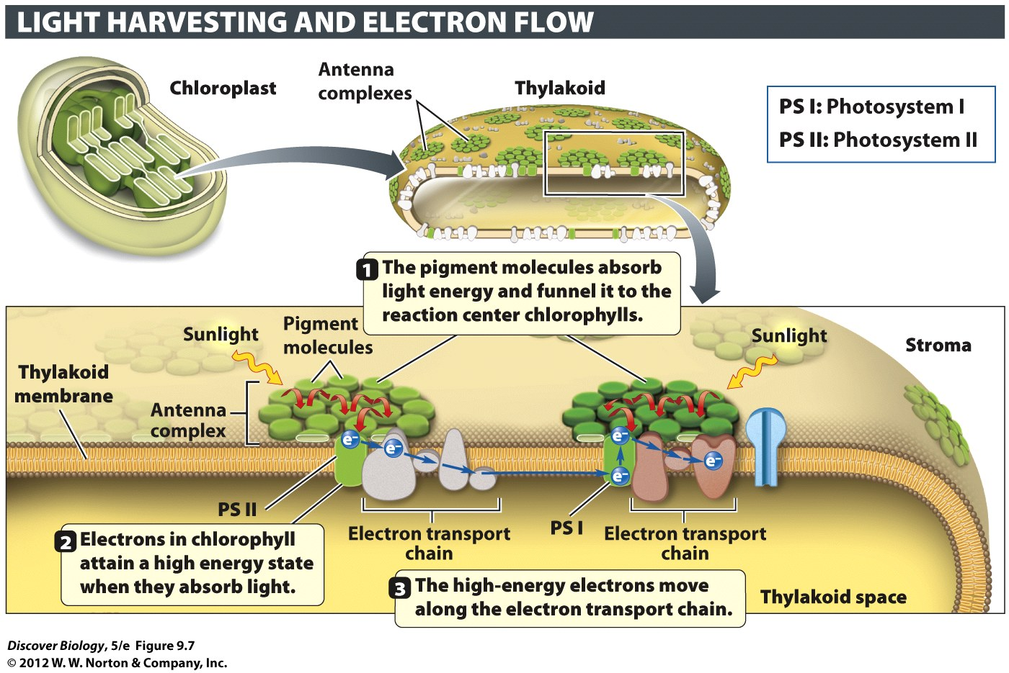
Notes:
Figure 9.7 The Light Reactions Are Conducted by Two Linked Photosystems

Slide 28
Light Reactions Generate Energy Carriers
Plant chloroplasts have two interlinked photosystems that work in tandem
Each photosystem is made up of an antenna complex and the associated reaction center
Photosystem II generates electrons, oxygen, and hydrogen ions
Photosystem I accepts electrons from photosystem II and returns them to NADP⁺ to generate NADPH

Slide 29
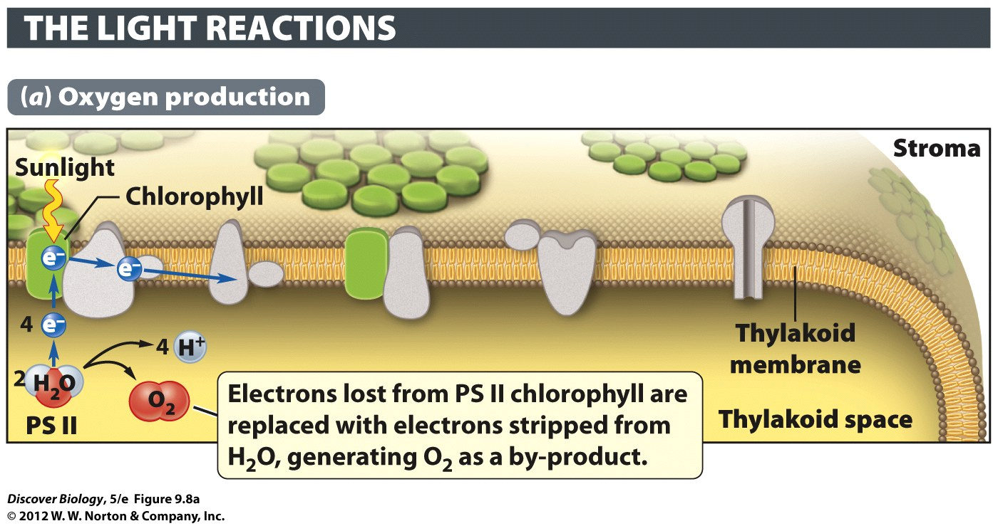
Notes:
Figure 9.8a How the Light Reactions Generate Energy Carriers

Slide 30
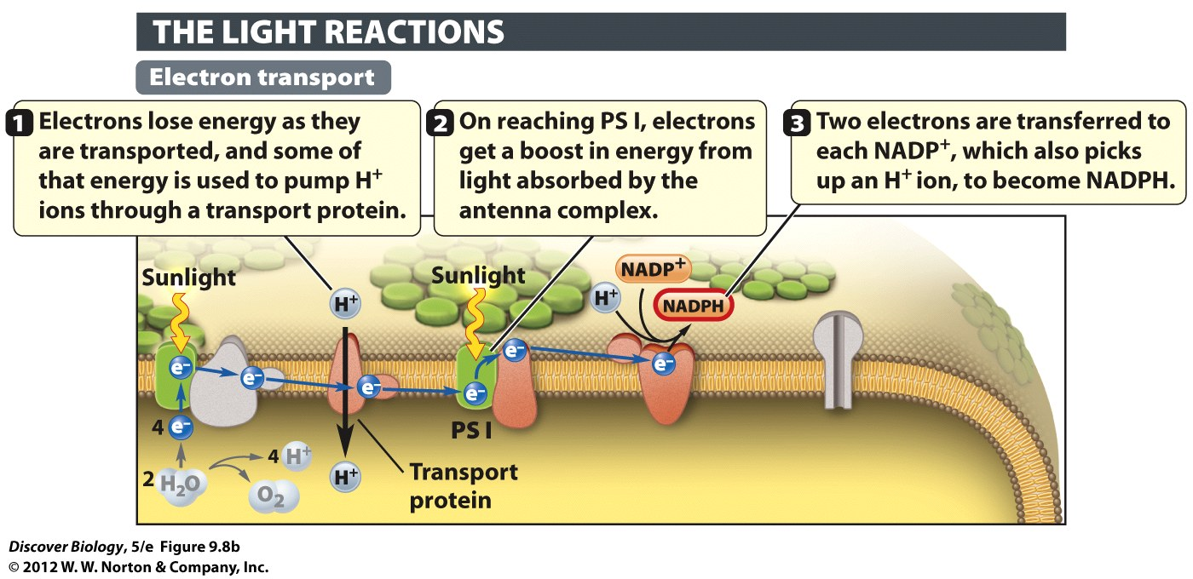
Notes:
Figure 9.8b How the Light Reactions Generate Energy Carriers

Slide 31
Light Reactions Generate Energy Carriers
As high-energy electrons move down the ETC, hydrogen ions accumulate inside the thylakoid space, creating a proton gradient
As protons pass through the ATP synthase channel, energy stored in their concentration gradient is converted into chemical energy

Slide 32
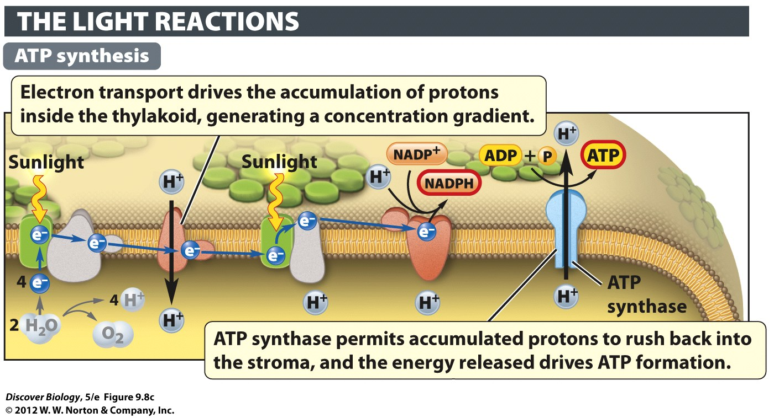
Notes:
Figure 9.8c How the Light Reactions Generate Energy Carriers

Slide 33
The Calvin Cycle Reactions Manufacture Sugars
The Calvin cycle is a series of enzymatic reactions that take place in the stroma of the chloroplast
This process, also known as carbon fixation, synthesizes sugars from carbon dioxide and water
Rubisco is an important enzyme that keeps the Calvin cycle running by serving as the acceptor molecule for carbon dioxide

Slide 34
The Calvin Cycle Reactions Manufacture Sugars
Three turns of the Calvin cycle are needed to produce a single three-carbon sugar called glyceraldehyde 3-phosphate (G3P)
G3P is the building block of glucose and all the other carbohydrates
G3P is shipped out of the chloroplast and used to fuel chemical reactions
In plants, G3P can be stored as starch for use at night

Slide 35
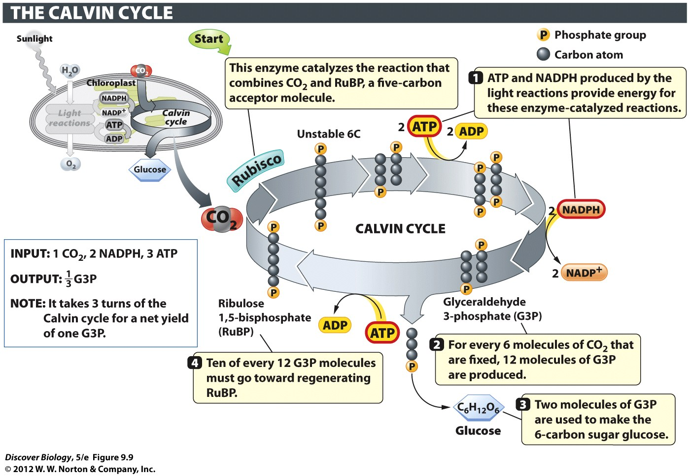
Notes:
Figure 9.9 The Calvin Cycle Converts Carbon Dioxide into Sugar
The Calvin cycle reactions fix carbon by turning CO₂ into sugar molecules using energy delivered by ATP, and electrons and protons delivered by NADPH.

Slide 36
Cellular Respiration: Energy from Food
Both producers and consumers carry out cellular respiration to extract energy from the food they eat
There are three main stages of cellular respiration:
Glycolysis
The Krebs cycle
Oxidative phosphorylation

Slide 37
Glycolysis Is the First Stage in the Cellular Breakdown of Sugars
Glycolysis is the first step in the breakdown of sugars and takes place in the cytosol
During glycolysis, enzyme-catalyzed reactions convert glucose to a six-carbon intermediate, which is then broken down to G3P
G3P is then converted into pyruvate, a three-carbon organic acid
Pyruvate then enters the mitochondria for steps two and three, during which it is broken down

Slide 38
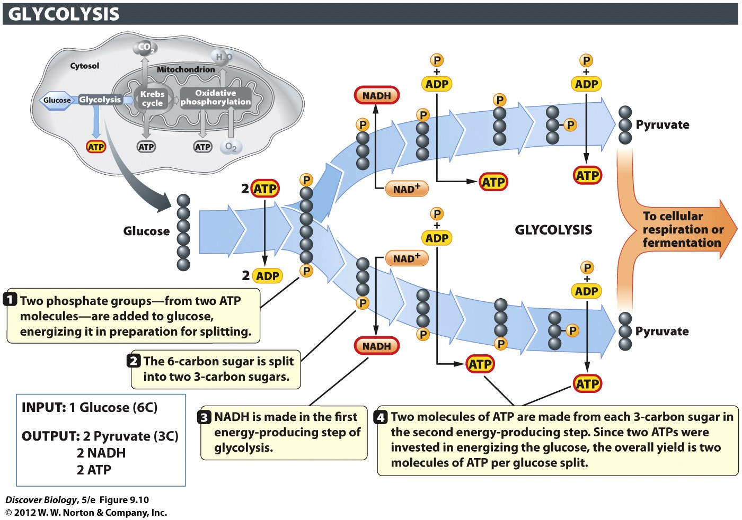
Notes:
Figure 9.10 Glycolysis Converts Glucose into Pyruvate
In glycolysis, each six-carbon glucose is converted into two molecules of pyruvate, a three-carbon organic acid.

Slide 39
Fermentation Facilitates ATP Production Through Glycolysis When Oxygen Is Absent
Glycolysis does not require oxygen; it is an anaerobic process
During fermentation, the pyruvate and NADH produced by glycolysis remain in the cytosol
Postglycolytic reactions convert pyruvate and NADH into other molecules, such as alcohol or lactic acid

Slide 40
Fermentation Facilitates ATP Production Through Glycolysis When Oxygen Is Absent
Fermentation by anaerobic yeasts converts pyruvate into an ethanol, releasing CO2 gas
Lactic acids forms in severely taxed muscle cells as a result of ATP production in the absence of oxygen

Slide 41
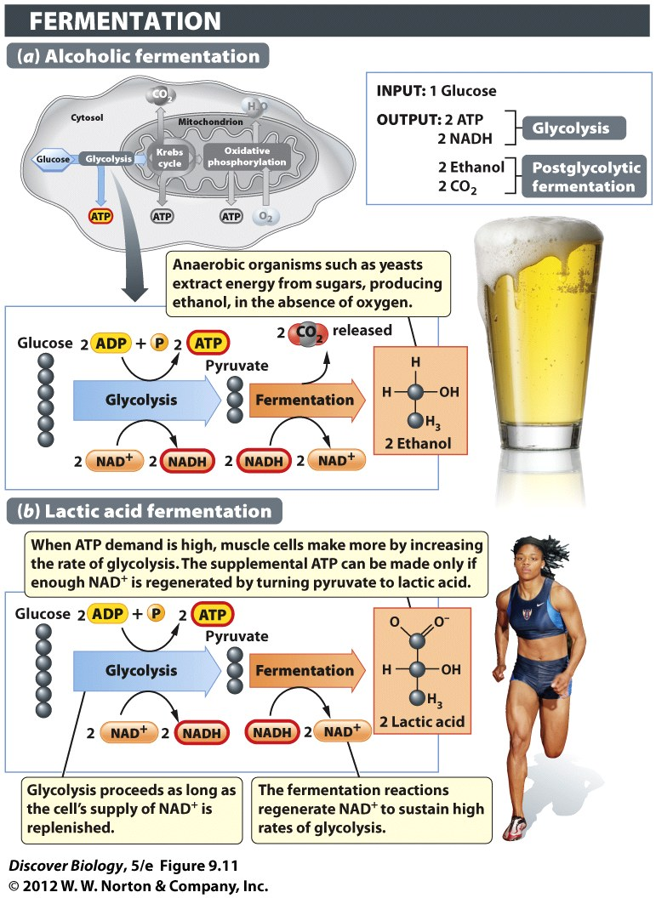
Notes:
Figure 9.11 Ethanol and Lactic Acid Are By-products of Fermentation
When the oxygen supply is inadequate for supporting ATP production through cellular respiration, fermentation supports ATP production through glycolysis alone. (a) Strains of yeasts, which are single-celled fungi, are used in the brewing of alcoholic beverages such as beer. When oxygen is excluded from the fermentation tanks, the yeasts resort to fermentation of sugars, producing ethanol and CO₂ as by-products of the postglycolytic steps. (b) A similar process occurs in our muscles during short bursts of strenuous exercise, except that the postglycolytic reactions turn pyruvate into a three-carbon organic acid known as lactic acid, and no CO₂ is made.

Slide 42
Cellular Respiration in the Mitochondrion Furnishes Much of the ATP Needed by Most Eukaryotes
The second step of cellular respiration takes place in the mitochondria and is an aerobic process
Highly aerobic tissues, such as muscle, tend to have high concentrations of mitochondria and a rich blood supply

Slide 43
The Krebs Cycle Releases Carbon Dioxide and Generates Energy Carriers
Pyruvate entering the mitochondrion must be broken down into acetyl CoA before entering the Krebs Cycle
Through a series of reactions, the Krebs cycle produces ATP, NADH, and FADH₂, energy carriers that will be used in the final stage of cellular respiration

Slide 44
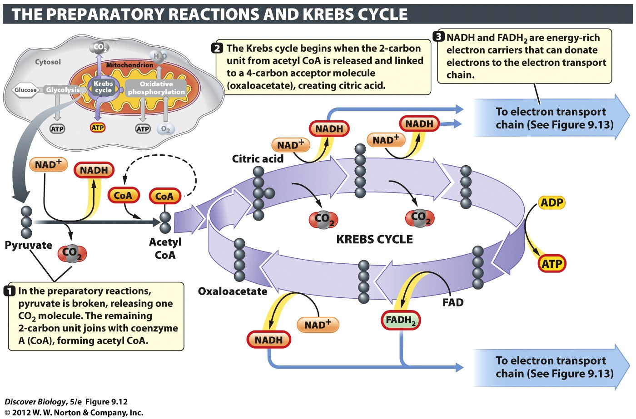
Notes:
Figure 9.12 The Krebs Cycle Releases Carbon Dioxide and Generates Energy Carriers
The Krebs cycle, also called the citric acid cycle, occurs in the mitochondrial matrix.

Slide 45
Oxidative Phosphorylation Uses Oxygen to Produce ATP in Quantity
Oxidative phosphorylation produces the largest amount of ATP during cellular respiration
Oxidative phosphorylation is the last stage of cellular respiration and takes place in the many folds (cristae) of the inner mitochondrial membrane

Slide 46
Oxidative Phosphorylation Uses Oxygen to Produce ATP in Quantity
Energy carriers produced during the Krebs cycle donate their high-energy electrons to the electron transport chain (ETC), which releases energy as it passes electrons down the chain
The energy released from the ETC is used to create a proton gradient

Slide 47
Oxidative Phosphorylation Uses Oxygen to Produce ATP in Quantity
The movement of protons through the ATP synthase channel activates enzymes that catalyze the phosphorylation of ADP to from ATP
Electrons that travel down the ETC are eventually accepted by O₂ and H⁺ to make water
Cellular respiration has a net yield of about 30 to 32 ATP molecules per molecule of glucose

Slide 48
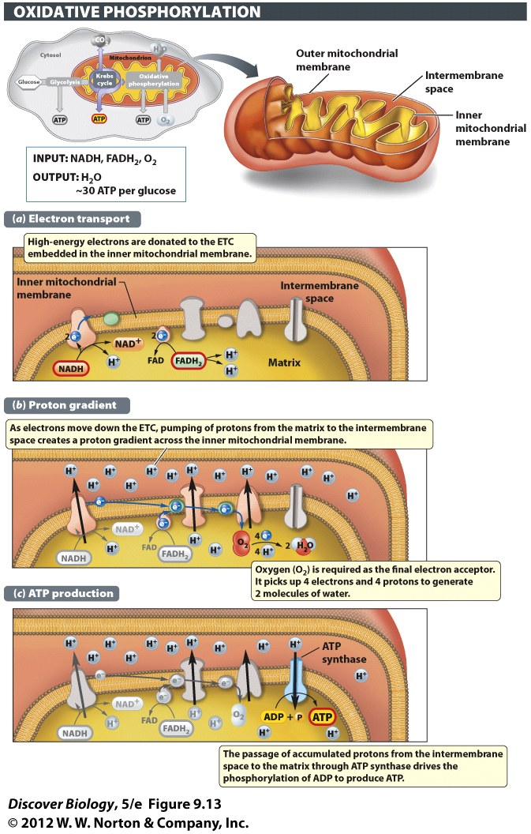
Notes:
Figure 9.13 The Mitochondrial Electron Transport Chain and ATP Synthase Generate ATP through Oxidative Phosphorylation
Oxidative phosphorylation is the last stage in cellular respiration, and it produces the most ATP of any metabolic pathway. (a) Electrons donated by NADH and FADH₂ enter the ETC. (b) A proton gradient is generated. (c) Proton flow through ATP synthase catalyzes the production of ATP.

Slide 49
Waiting to Exhale
The human body responds to low oxygen levels by increasing the number and size of red blood cells that carry oxygen and deliver it throughout the body
Endurance sport participants learn to control oxygen use through meditation, training at high altitudes, and sleeping in low-oxygen tents

Slide 50
Clicker Questions
CHAPTER 9
Photosynthesis and
Cellular Respiration

Slide 51
Concept Quiz
A common feature of both chloroplasts and mitochondria is
A. The use of chlorophyll
B. Production of CO₂
C. Use of an electron transport chain
D. Presence in all cells
Notes:
The correct answer is C. The commonality of the ETC was stressed in the lecture and is important to the function of both organelles
Answer A is incorrect because only chloroplasts use chlorophyll.
Answer B is incorrect because mitochondria produce CO₂, while chloroplasts use it.
Answer D is incorrect, because mitochondria are used in all cells, but chloroplasts are only in the photosynthesizing cells of plants.
This question can be expanded in an in-class discussion of other similarities between these two organelles.
Some other similarities include: production of an H+ gradient, production of ATP, use of energy transfer molecules (NADPH or NADH), double membrane structure, and the presence of a chromosome.

Slide 52
Concept Quiz
Photosystem II differs from photosystem I in that it produces
A. NADPH
B. O₂
C. A proton gradient
D. ATP
Notes:
The correct answer is B. O₂ production is one of the first events in photosynthesis and it is performed by Photosystem II.
Photosystem I produces NADPH.
Both photosystems add to the H+ gradient.
Neither produces ATP directly; ATP synthase does.

Slide 53
Concept Quiz
Most of the ATP produced by aerobic respiration comes from
A. Glycolysis
B. The citric acid cycle
C. Oxidative phosphorylation
D. Fermentation
Notes:
The correct answer is A. Although some ATP is made directly in glycolysis and the citric acid cycle, most of the ATP is made when the electrons from NADH are used by the ETC in Oxidative Phosphorylation. This should be stressed because this is why aerobic respiration is so much more efficient than anaerobic.
Answers B & C: As mentioned above, some ATP is made directly, but most is made by ATP synthase.
Answer D: Fermentation is not part of aerobic respiration and produces very little energy.

Slide 54
Relevant Art from Other Chapters
All art files from the book are available in JPEG and PPT formats online and on the Instructor Resource Disc

Slide 55
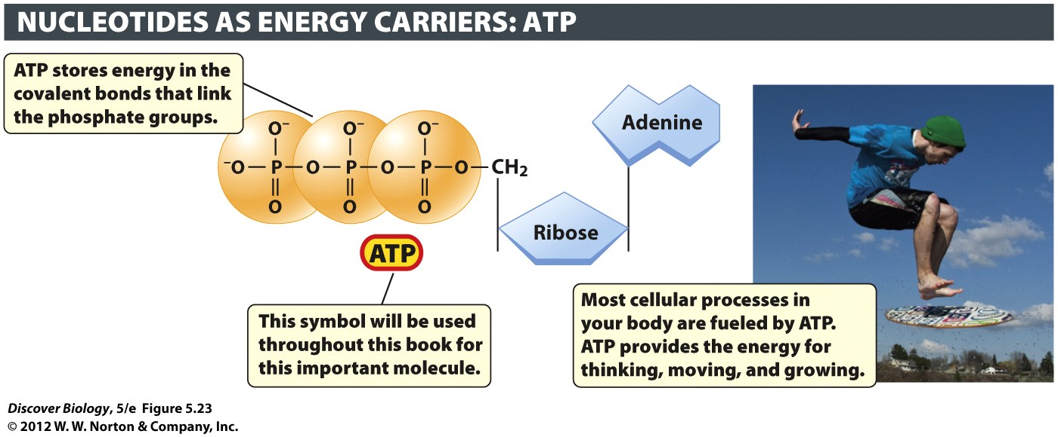
Notes:
Figure 5.23 The Nucleotide ATP Serves as an Energy Carrier in Every Living Cell
The phosphate groups in ATP are held together by energy-rich covalent bonds. Energy is released when these bonds are broken, and the released energy powers a great variety of biological processes, including the motion of the skimboarder pictured here.

Slide 56
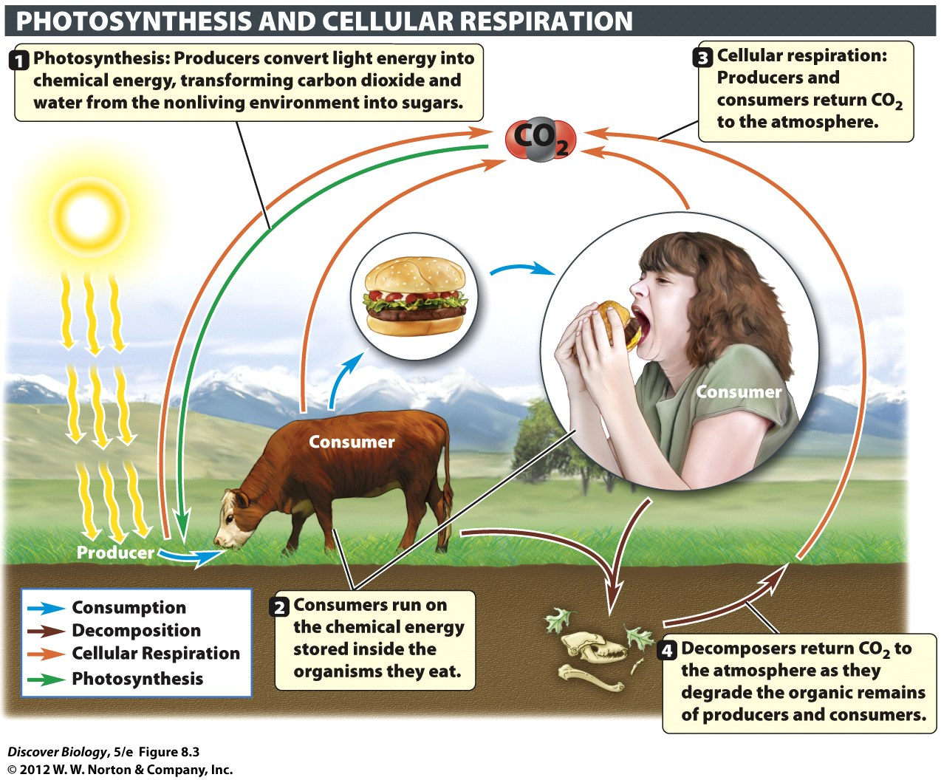
Notes:
Figure 8.3 Photosynthesis and Cellular Respiration Are Complementary Processes
Matter, in the form of carbon atoms, cycles among producers, consumers, and the environment.

Slide 57
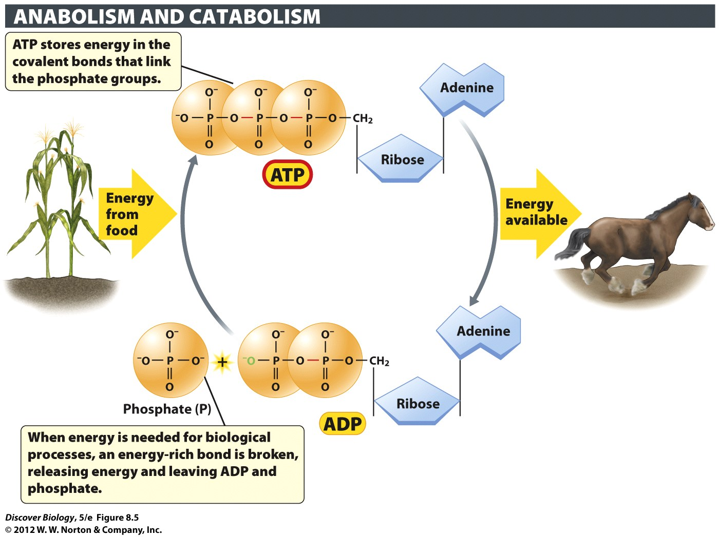
Notes:
Figure 8.5 ATP Functions as an Energy-Storing Molecule in All Cells
When the terminal high-energy bond of ATP breaks, energy is released, and ATP is turned into ADP (adenosine diphosphate) with the release of a phosphate group.

Slide 58
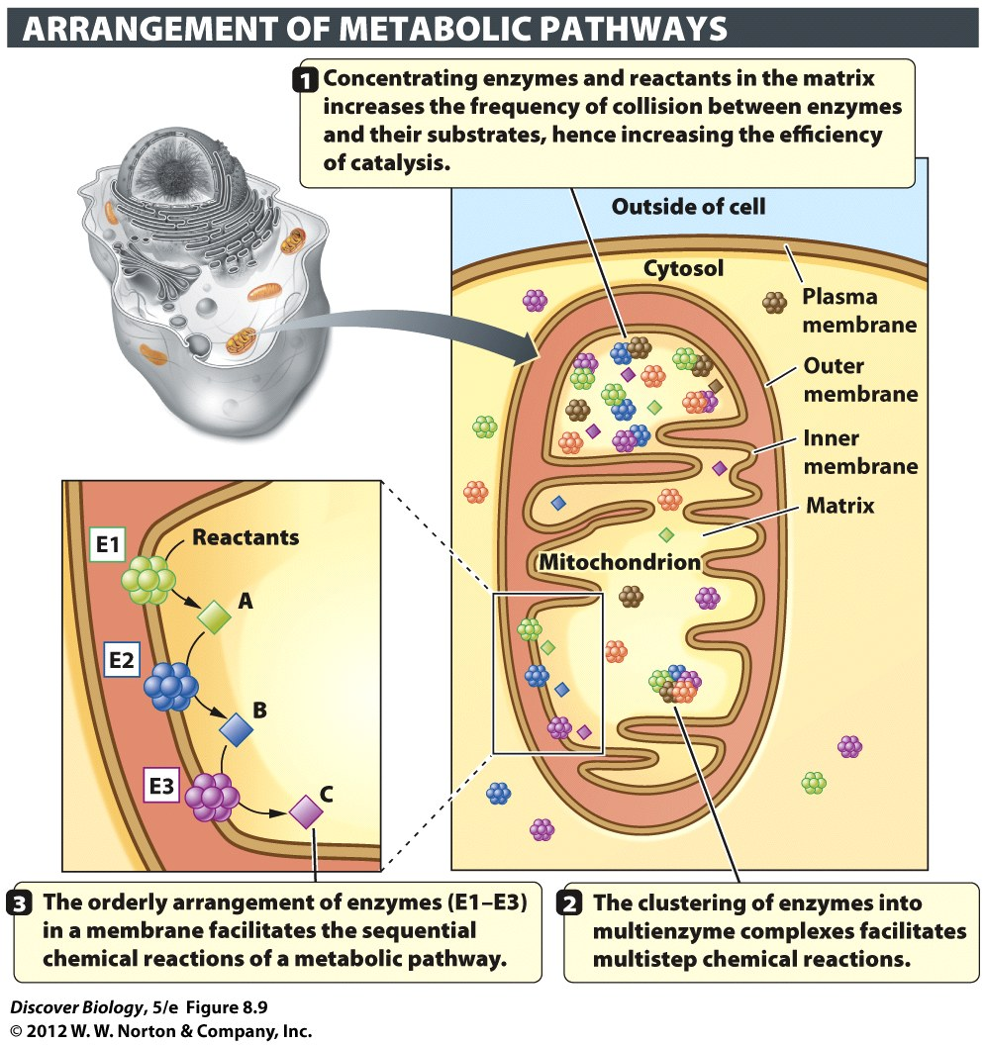
Notes:
Figure 8.9 Metabolic Pathways Are Organized in Ways That Increase Their Efficiency
Enzymes are often arranged in the cell in ways that facilitate the orderly series of chemical reactions that make up a metabolic pathway. These arrangements include the concentration of enzymes in organelles (in this case, a mitochondrion), their localization in membranes, and their clustering in multienzyme complexes.

Slide 59
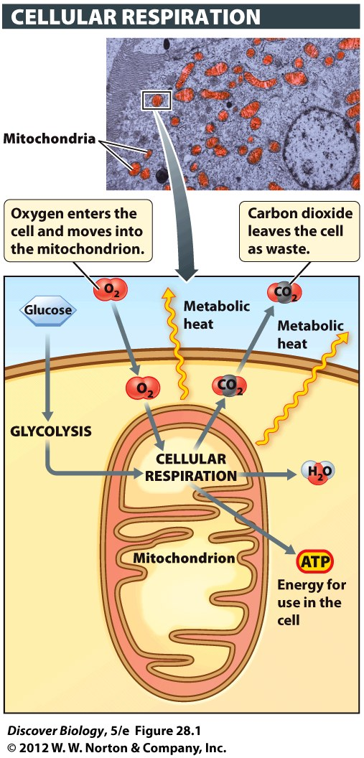
Notes:
Figure 28.1 Cellular Respiration Occurs in Mitochondria
During cellular respiration, oxygen is consumed as energy is extracted from glucose for use by the cell. Heat, water, and carbon dioxide are also produced. The inset shows mitochondria in a liver cell.

Slide 60
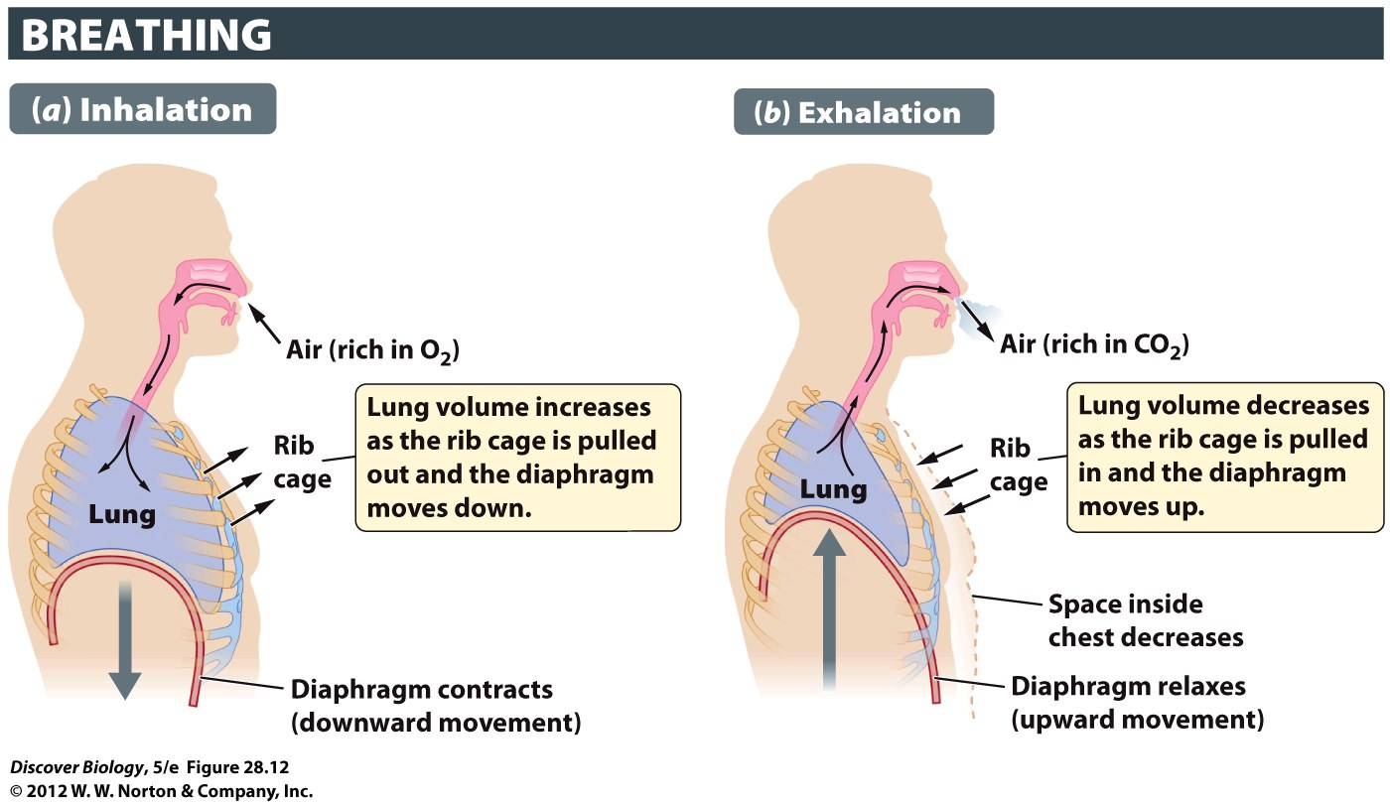
Notes:
Figure 28.12 Lung Volume Changes with Movement of the Diaphragm and Rib Cage
Breathing involves two main steps: (a) inhalation, when air is pulled into the lungs; and (b) exhalation, when air is pushed out of the lungs.

Slide 61
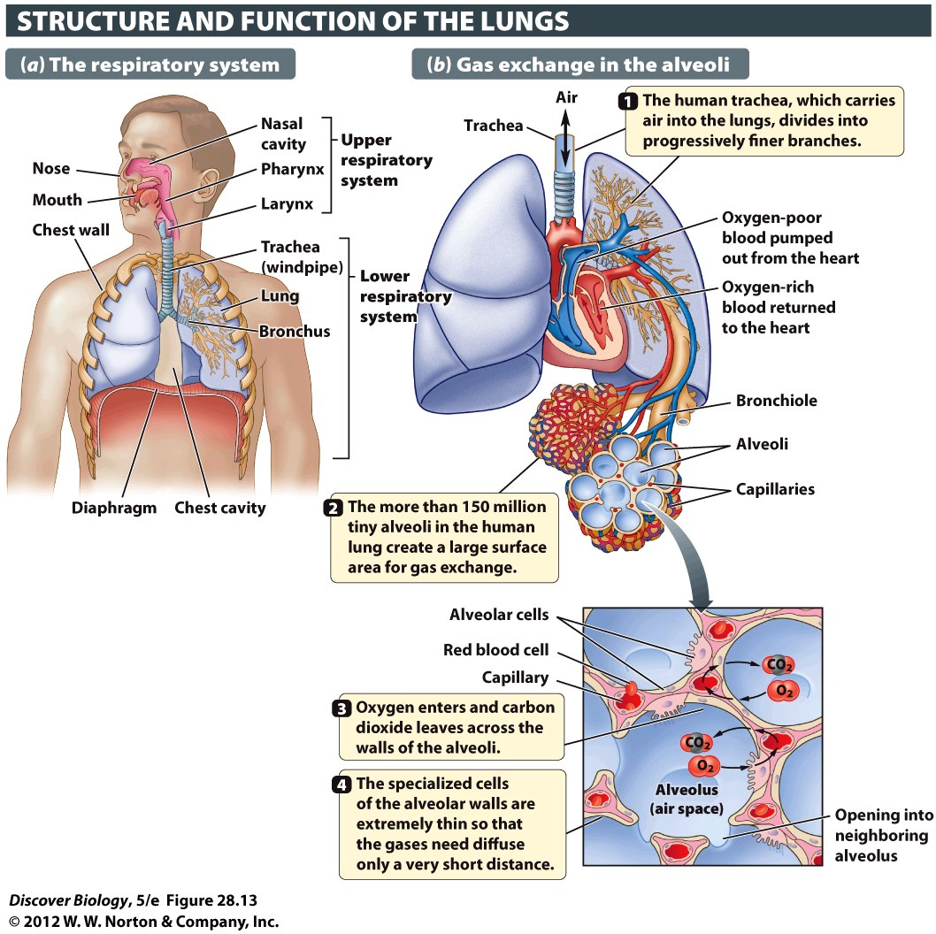
Notes:
Figure 28.13 A Large Surface Area Enables Rapid Diffusion of Gases in the Lungs
The structure of the lungs speeds the diffusion of oxygen and carbon dioxide into and out of the body by providing a large surface area for gas exchange.

