Slide 1
Discover Biology
FIFTH EDITION
Anu Singh-Cundy • Michael L. Cain
CHAPTER 8
Energy, Metabolism,
And Enzymes
© 2012 W. W. Norton & Company, Inc.

Slide 2
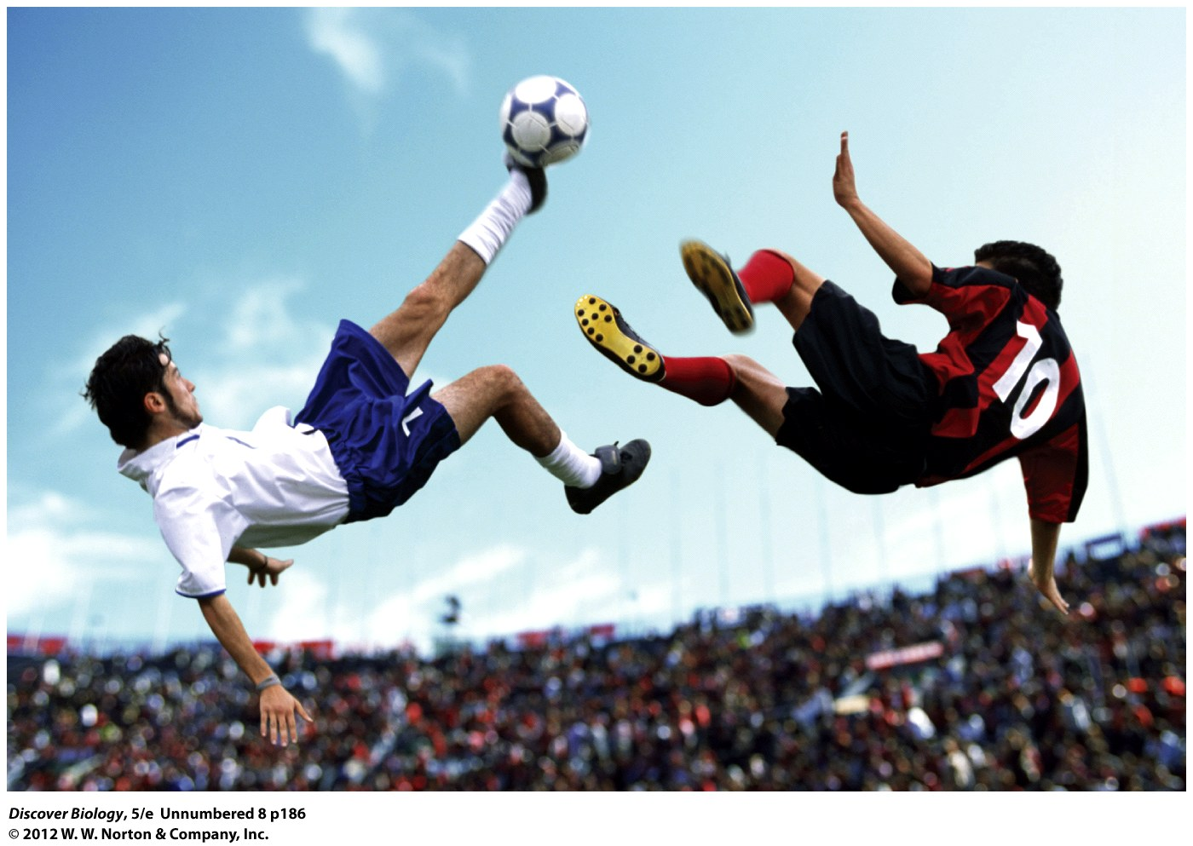
Notes:
Metabolic Kick
The kinetic energy of these spectacular moves comes from the chemical energy in the food the soccer players ate. It takes engymes to unleash that energy in a usable form.

Slide 3
Kick-Start Your Metabolic Engine!
The speed of your metabolism is a measure of how much energy your body uses for everything, from reproduction to fighting off pathogens
Your resting metabolic rate (RMR) depends on height and weight, muscle mass, age, and sex
RMR is highest in children and declines with age

Slide 4
All Living Cells Require Energy
Chemical reactions in a cell occur in chains of linked events known as metabolic pathways, which assemble or disassemble the key macromolecules of life
Enzymes are biomolecules that speed up chemical reactions by acting as biological catalysts

Slide 5
The Role of Energy in Living Systems
Energy is the capacity of any object to do work and can be found in every atom, molecule, particle, and object
Work is defined as the capacity to bring about a change in a defined system
Energy can be expressed in many forms, which are classified as either potential or kinetic energy

Slide 6
The Role of Energy in Living Systems
Potential energy is the energy stored in any system as a consequence of its position
Chemical energy is a form of potential energy stored in atoms because of their position in relation to other atoms
Kinetic energy is the energy a system possesses as a consequence of its state of motion

Slide 7
The Role of Energy in Living Systems
Kinetic energy includes:
  Mechanical energy
  Light energy
  Electrical energy
  Heat energy
Heat energy is the energy found in the random motion of particles in a system that can be transferred to other particles in the system

Slide 8
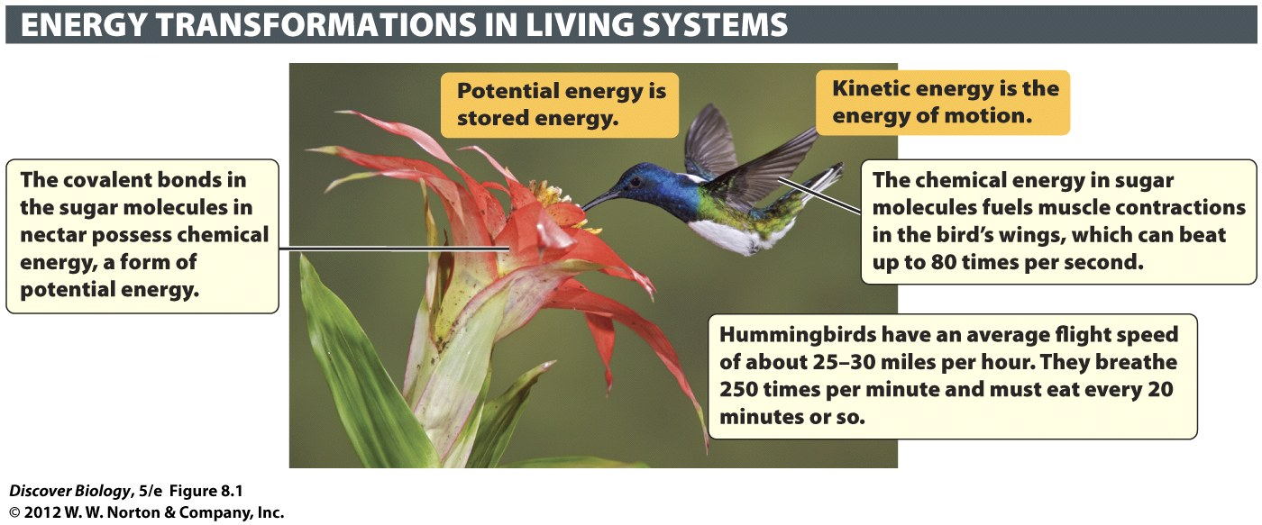
Notes:
Figure 8.1 Potential Energy in Food Is Converted to Kinetic Energy in a Hummingbird’s Body

Slide 9
The Role of Energy in Living Systems
The laws of thermodynamics state that:
  The universe contains a fixed amount of energy
  Energy can be converted from one form to another
  Energy can be neither created nor destroyed

Slide 10
The Laws of Thermodynamics Apply to Living Systems
The first law of thermodynamics states that the total energy of any closed system remains the same over time
The second law of thermodynamics states that the natural tendency of the universe is to become less organized over time

Slide 11
The Laws of Thermodynamics Apply to Living Systems
Cells must capture, store, and use energy to counteract the effects of the second law of thermodynamics
The chemical reactions needed to maintain order are not 100 percent efficient as they lose metabolic heat to the environment

Slide 12
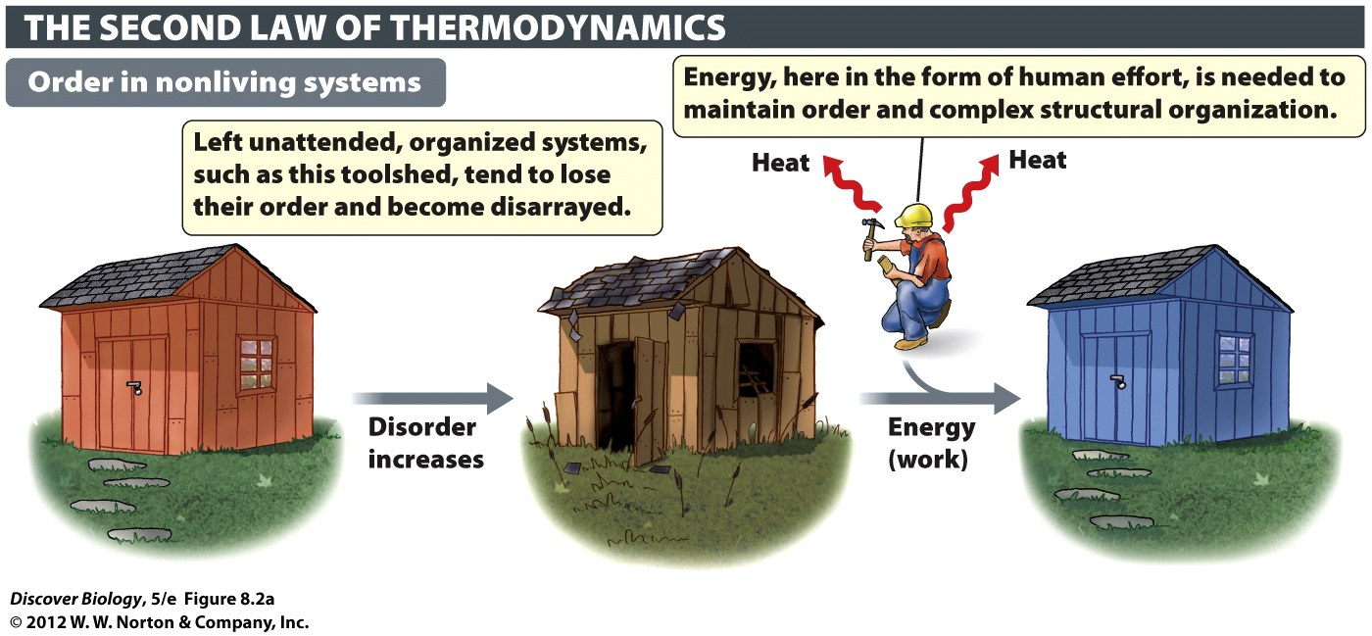
Notes:
Figure 8.2a An Input of Energy Is Needed to Create or Maintain a High Level of Organization
(a) The disorder of a system tends to increase unless that tendency is countered by an input of energy.

Slide 13
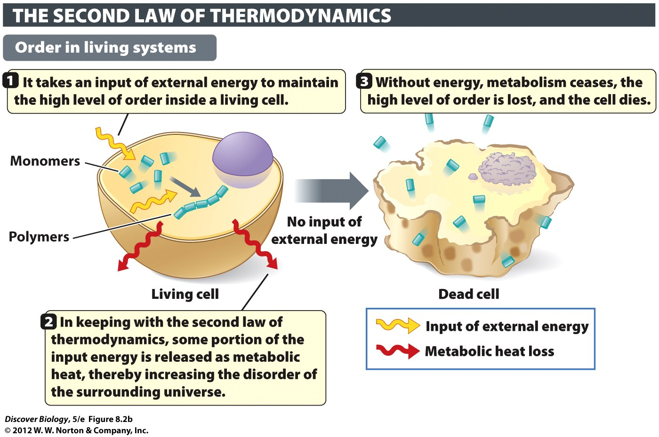
Notes:
Figure 8.2b An Input of Energy Is Needed to Create or Maintain a High Level of Organization
(b) Living cells maintain their complex organization through continual input of energy from the environment.

Slide 14
The Flow of Energy Connects Living Things with the Environment
Photosynthesis is the metabolic pathway that uses light energy from the sun to make sugar molecules
Photosynthetic organisms use sunlight, carbon dioxide, and water to produce chemical energy
Organisms that produce energy are called autotrophs or producers
Organisms that obtain energy by eating other organisms or absorbing their dead remains are called heterotrophs or consumers

Slide 15
The Flow of Energy Connects Living Things with the Environment
The sun is the primary energy source in most ecosystems
Photosynthetic organisms, such as plants, algae, and certain bacteria, make up a majority of the producers
Energy moves in one direction through an ecosystem, passing from producers to consumers, and losing some energy as metabolic heat in the process

Slide 16
The Flow of Energy Connects Living Things with the Environment
Matter is recycled in the environment from producers to consumers and back
Cellular respiration is the breakdown of food molecules to release energy
Photosynthetic cells recycle carbon from the environment and incorporate it into living systems
Cellular respiration and photosynthesis are complementary processes

Slide 17
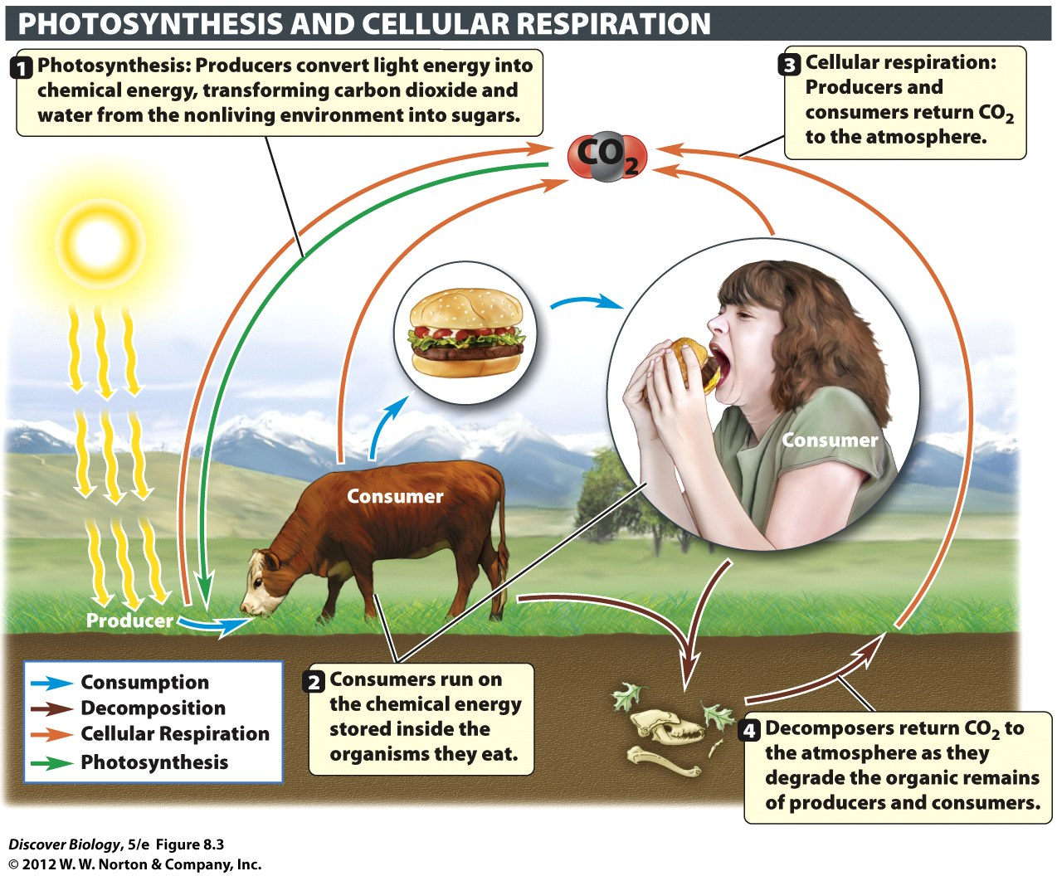
Notes:
Figure 8.3 Photosynthesis and Cellular Respiration Are Complementary Processes
Matter, in the form of carbon atoms, cycles among producers, consumers, and the environment.

Slide 18
Metabolism
Metabolism refers to all the chemical reactions within a living cell that capture, store, or use energy
Living cells require two main types of metabolism:
  Catabolism
  Anabolism

Slide 19
Metabolism
Catabolism refers to the linked chain of energy-producing reactions that release chemical energy in the process of breaking down complex biomolecules
Anabolism refers to the linked chain of energy-requiring reactions that create complex biomolecules from smaller organic compounds

Slide 20
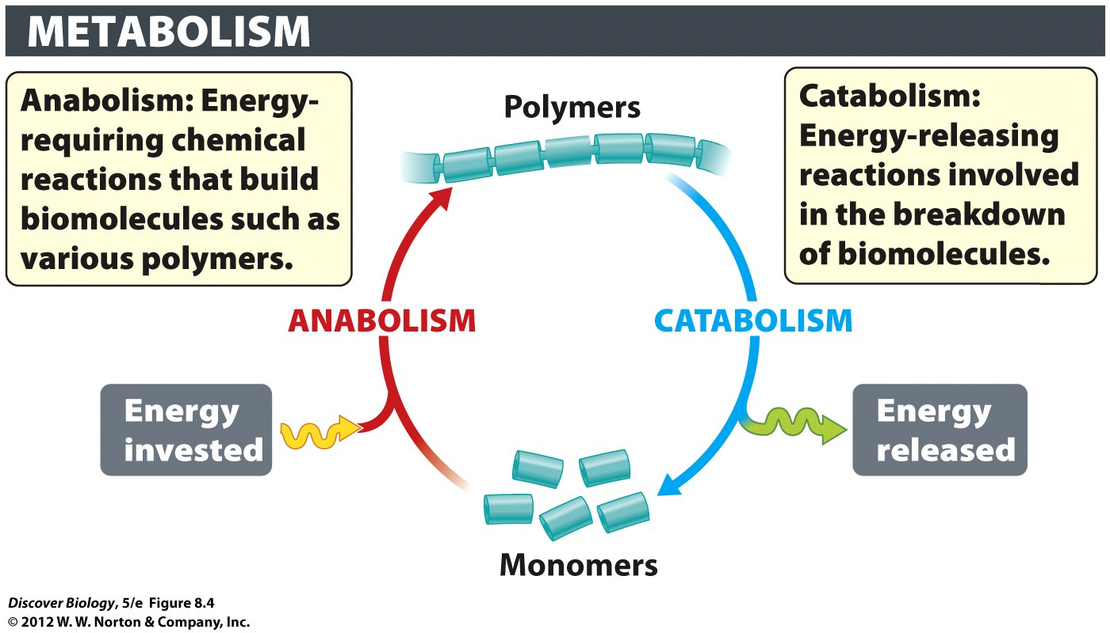
Notes:
Figure 8.4 Anabolic Reactions Build Macromolecules, Catabolic Reactions Degrade Them

Slide 21
ATP Delivers Energy to Anabolic Pathways and Is Regenerated via Catabolic Pathways
ATP fuels a variety of cellular activities, including anabolism
Much of the energy found in ATP is stored in its phosphate bonds and is released when a molecule of ATP loses its terminal phosphate group to become ADP
Producers use light energy to turn ADP back into ATP through catabolic pathways

Slide 22
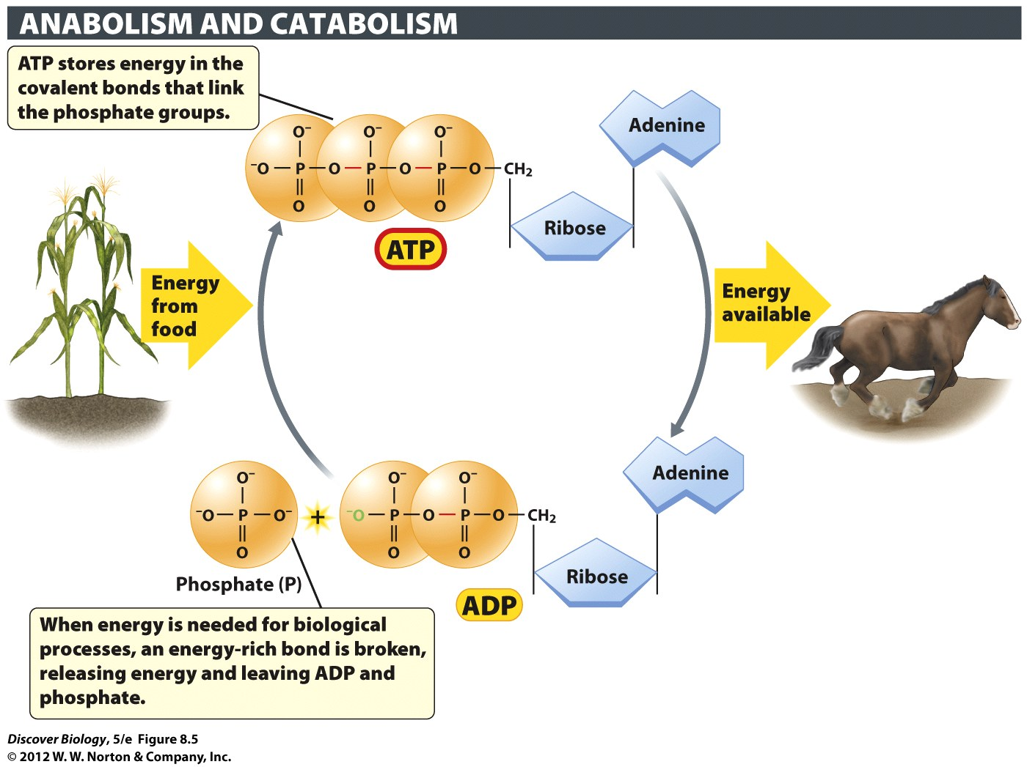
Notes:
Figure 8.5 ATP Functions as an Energy-Storing Molecule in All Cells
When the terminal high-energy bond of ATP breaks, energy is released, and ATP is turned into ADP (adenosine diphosphate) with the release of a phosphate group.

Slide 23
Energy Is Extracted from Food through a Series of Oxidation-Reduction Reactions
Oxidation is the loss of a molecule, atom, or ion
Reduction is the gain of electrons by a molecule, atom, or ion
Oxidation and reduction are complementary reactions and together are referred to as oxidation-reduction reactions or redox reactions

Slide 24
Energy Is Extracted from Food through a Series of Oxidation-Reduction Reactions
Cellular respiration takes place in the oxygen-dependent catabolic pathways that extract energy from glucose molecules to make ATP in cells
Photosynthesis is an anabolic pathway in which carbon dioxide is reduced as it gains electrons and hydrogen atoms, to be transformed into glucose

Slide 25
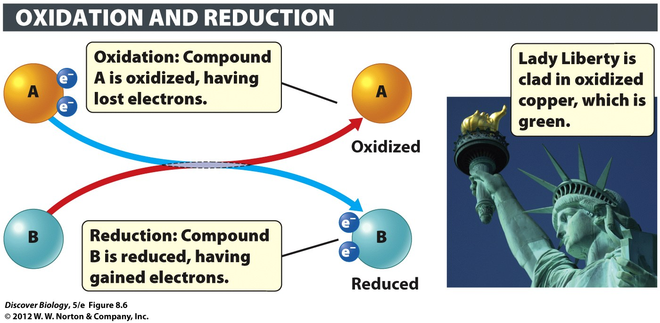
Notes:
Figure 8.6 Oxidation and Reduction Reactions Go Together

Slide 26
Chemical Reactions Are Governed by the Laws of Thermodynamics
Chemical reactions can occur spontaneously if the products are at a lower energy state than the reactants
Energy is required to create products that have a higher energy state than the reactants
The amount of energy need for reactants to overcome an energy barrier is called the activation energy

Slide 27
Enzymes
Nearly all the chemical reactions that take place in the cell are mediated by enzymes
Enzymes are proteins that act as biological catalysts that speed up chemical reactions without being changed themselves

Slide 28
Enzymes Remain Unaltered and Are
Reused in the Course of a Reaction
Enzymes are highly specific catalysts that remain unaltered by a reaction and can be reused
Substrates bind to the active site of an enzyme based on the site’s size, shape, and chemistry
Heat, high acidity, and high alkalinity can denature, or destroy, enzymes
Some enzymes require cofactors in order to catalyze a reaction

Slide 29
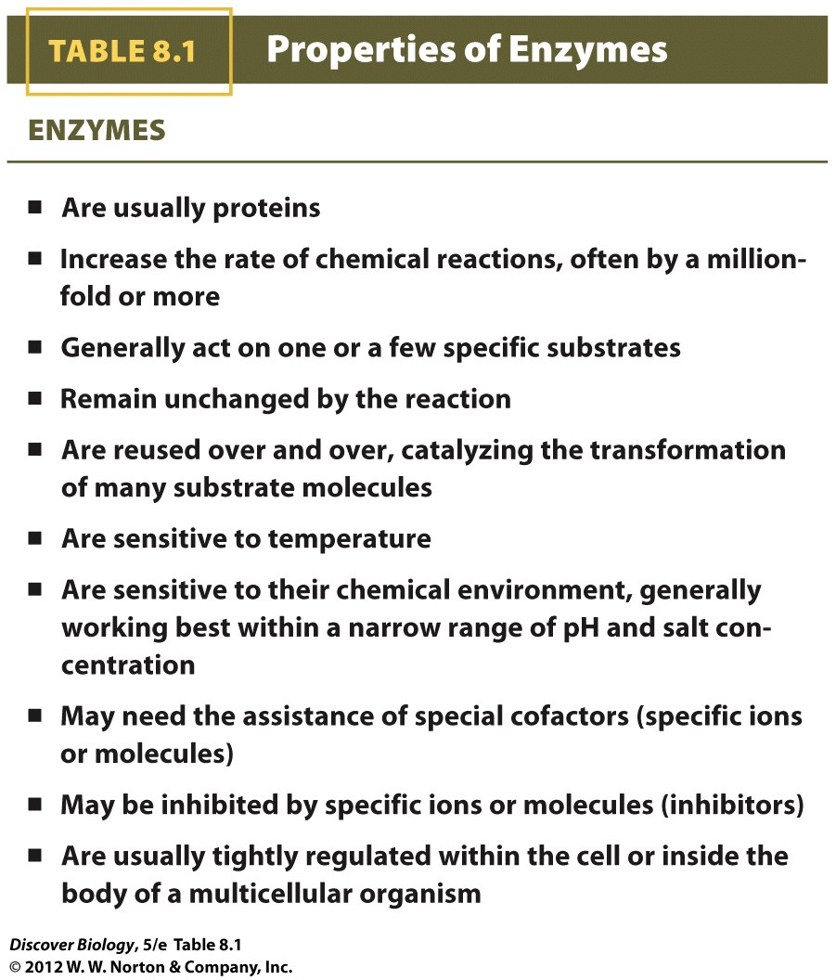
Notes:
TABLE 8.1 Properties of Enzymes

Slide 30
The Shape of an Enzyme Determines Its Function
The binding of an enzyme to its particular substrate depends on the three-dimensional shapes of both the substrate and the enzyme molecules
According to the induced fit model, enzymes can adjust slightly to fit a substrate.

Slide 31
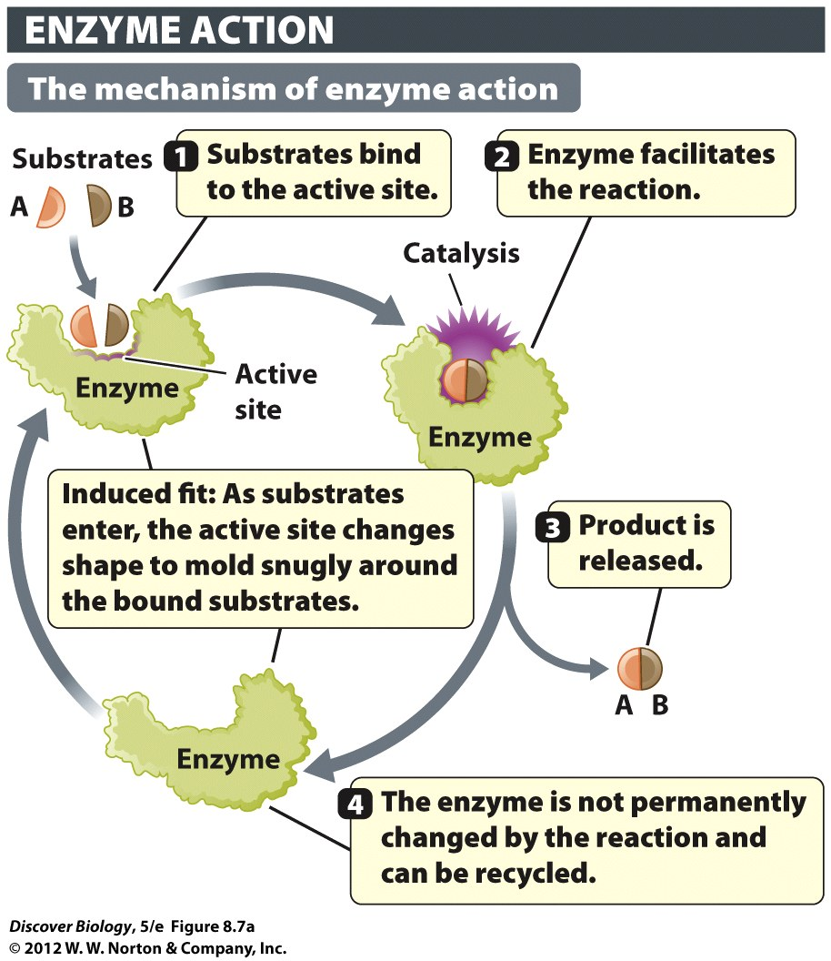
Notes:
Figure 8.7a Enzymes as Molecular Matchmakers
(a) An enzyme brings together two reactants (A and B) to form the product AB.

Slide 32
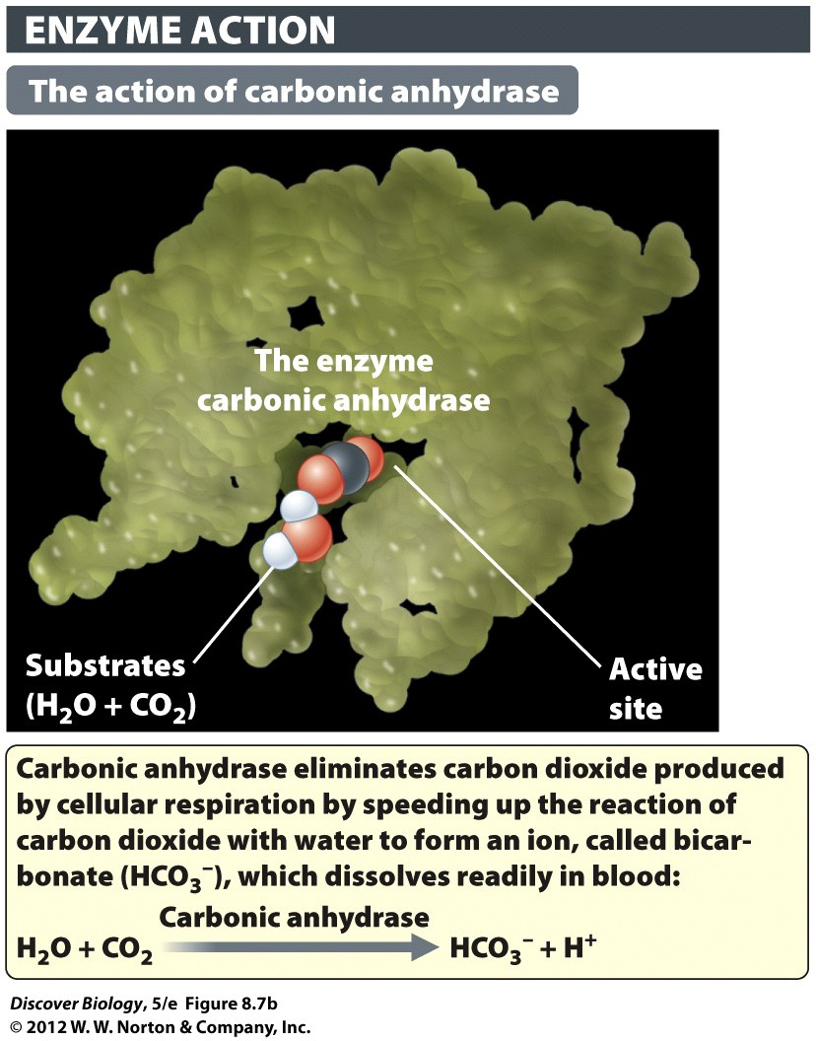
Notes:
Figure 8.7b Enzymes as Molecular Matchmakers
(b) Carbonic anhydrase catalyzes the reaction of carbon dioxide and water (substrates) to form bicarbonate (product).

Slide 33
Enzymes Increase Reaction Rates by Lowering the Activation Energy Barrier
Enzymes lower the activation energy of a reaction, allowing more reactants to make it over the energy barrier and thus increasing the speed of the reaction
Activation energy is lowered when reactants bind with enzymes and strain their chemical bonds in ways that promote product formation

Slide 34
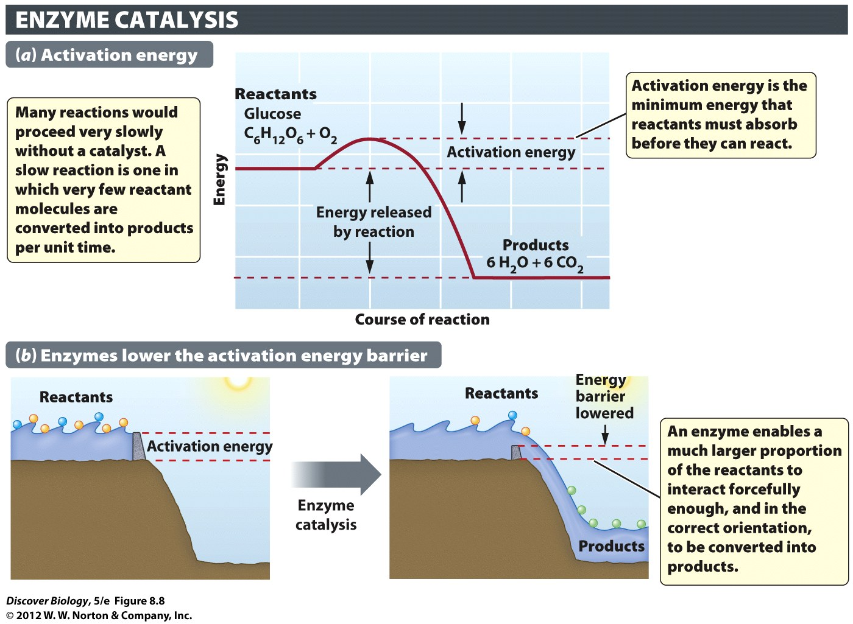
Notes:
Figure 8.8 Enzymes Reduce the Activation Energy Needed to Initiate a Reaction
(a) In the combustion (burning) of glucose, the reactants (glucose and oxygen) are at a higher energy level than the products (carbon dioxide and water), as represented by the solid red line. (b) In the analogy shown here, the reactants are represented by water in the reservoir of a dam. On the left, the dam (representing the energy barrier) is so high that most of the waves (reactants) cannot spill over it. But if the dam is lowered (as shown on the right), a large proportion of the waves (reactants) will overcome the barrier and run downhill (be turned into products).

Slide 35
Metabolic Pathways
Enzymes are often involved in sequences of chemical reactions known as metabolic pathways
Multistep metabolic pathways can proceed rapidly and efficiently because enzymes in the pathway are close together and the products of one reaction act as the substrate for the next reaction in the series

Slide 36
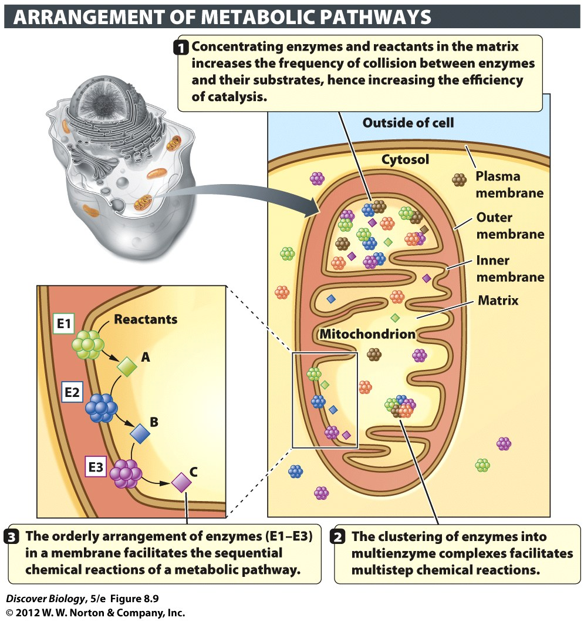
Notes:
Figure 8.9 Metabolic Pathways Are Organized in Ways That Increase Their Efficiency
Enzymes are often arranged in the cell in ways that facilitate the orderly series of chemical reactions that make up a metabolic pathway. These arrangements include the concentration of enzymes in organelles (in this case, a mitochondrion), their localization in membranes, and their clustering in multienzyme complexes.

Slide 37
Metabolic Rates, Health, and Longevity
A majority of the food we eat goes to run organ systems and sustain life
The energy it takes a person to sustain life is called the basal metabolic rate (BMR)
BMR decreases with age and is directly linked to surface area–to–volume ratio
Studies have shown that a calorie-restricted diet may lead to longevity

Slide 38
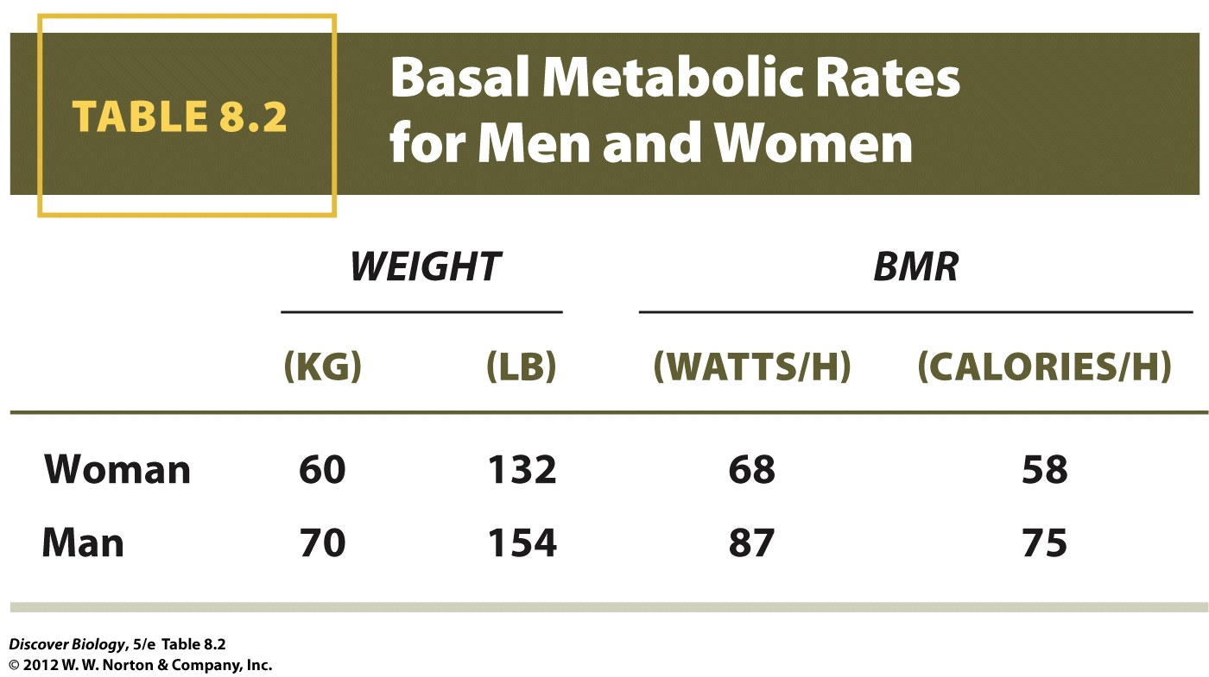
Notes:
TABLE 8.2 Basal Metabolic Rates for Men and Women

Slide 39
Clicker Questions
CHAPTER 8
Energy, Metabolism,
And Enzymes

Slide 40
Concept Quiz
Why are high fevers dangerous and
sometimes life‑threatening?
Molecules move faster at higher temperatures.
Enzymes may change shape at high temperatures.
Invading microbes survive better and reproduce faster at high temperatures.
Notes:
The correct answer is B. High fevers are life-threatening for a long period of time because enzymes begin to denature at higher temperatures.
Lower fevers can actually be beneficial to the body. It is the natural defense mechanism.
Molecules do move faster at higher temperatures, but this answer choice does not address the question.
Microbes may reproduce faster at higher temperatures, up to an optimal temperature. Higher than the optimum, microbes can be destroyed.

Slide 41
Concept Quiz
The loss of electrons is called
Oxidation
Reduction
Redox
Notes:
The correct answer is A.
Students often incorrectly think of loss of electrons as reduction.
Remind them if something is being reduced, it is acquiring a negative charge and, therefore, gaining an electron.
Redox refers to both oxidation and reduction.

Slide 42
Concept Quiz
Where a substrate binds to an enzyme is known as the
Active site
Activation energy
Energy transfer site
Notes:
The correct answer is A. The active site is where a substrate binds. The shape of the active site dictates the enzyme’s activity and which substrates may bind to it.
Activation energy is the energy required to start a reaction.
Energy transfer site is listed as a distraction.

Slide 43
Relevant Art from Other Chapters
All art files from the book are available in JPEG and PPT formats online and on the Instructor Resource Disc

Slide 44
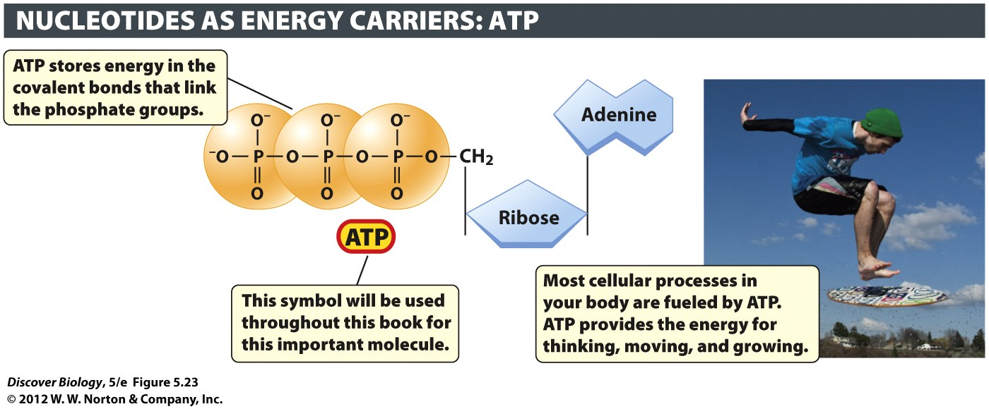
Notes:
Figure 5.23 The Nucleotide ATP Serves as an Energy Carrier in Every Living Cell
The phosphate groups in ATP are held together by energy-rich covalent bonds. Energy is released when these bonds are broken, and the released energy powers a great variety of biological processes, including the motion of the skimboarder pictured here.

