Slide 1
Discover Biology FIFTH EDITION
Anu Singh-Cundy • Michael L. Cain
CHAPTER 7
Cell Membranes, Transport, and
Communication
© 2012 W. W. Norton & Company, Inc.

Slide 2
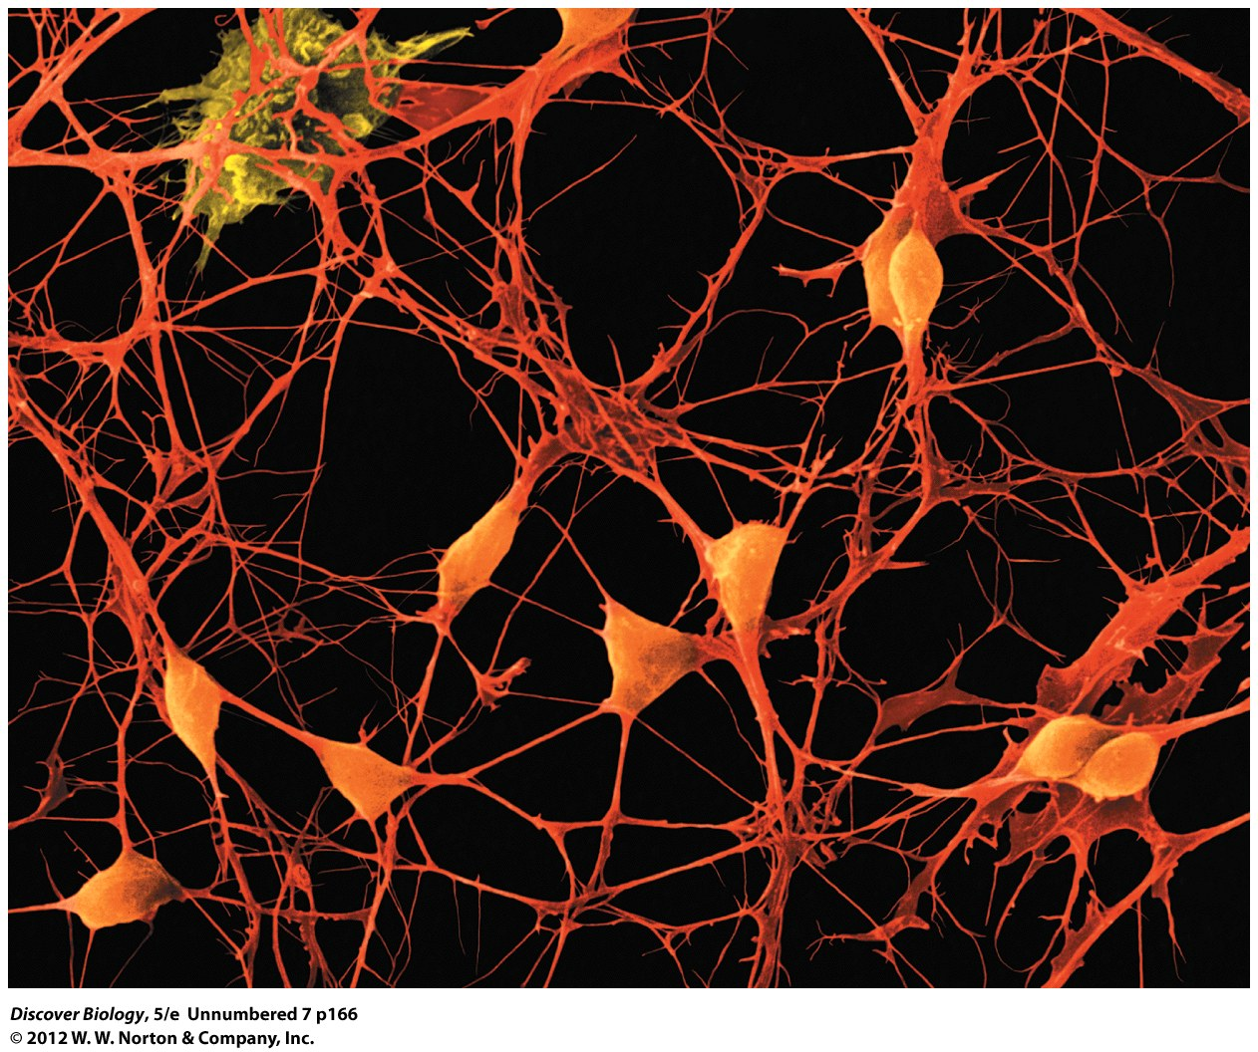
Notes:
BRAIN CELLS.
These cells from the brain cortex are growing in a lab dish. Neurons (orange) have large cell bodies and many projections used in communication. Glial cells (yellow) support and protect the neurons.

Slide 3
Mysterious Memory Loss
Cholesterol can affect the brain as well as cell membranes and cell communication
Certain drugs can affect the ability of membranes to perform their functions

Slide 4
Most Life-Sustaining Chemical Reactions Cannot Take Place Outside of Cells
All cells must have a mechanism to move material into and out of themselves
Cell membranes are essential in managing the relationships with their surroundings

Slide 5
The Plasma Membrane as Gate and Gatekeeper
The plasma membrane is made up of a double layer of lipids called the phospholipid bilayer
Proteins embedded in the phospholipid bilayer perform a variety of functions
Transport proteins span the width of the plasma membrane and provide pathways by which materials can enter or leave cells
The proteins and the plasma membrane make up a selectively permeable membrane, which allows only certain substances to enter or leave the cell

Slide 6
The Plasma Membrane as Gate and Gatekeeper
The selectively permeable membrane of the cell ensures that the cell interior is chemically different than the extracellular environment
Cells must expend a large sum of energy to maintain the chemical balance between the interior and exterior of the cell

Slide 7
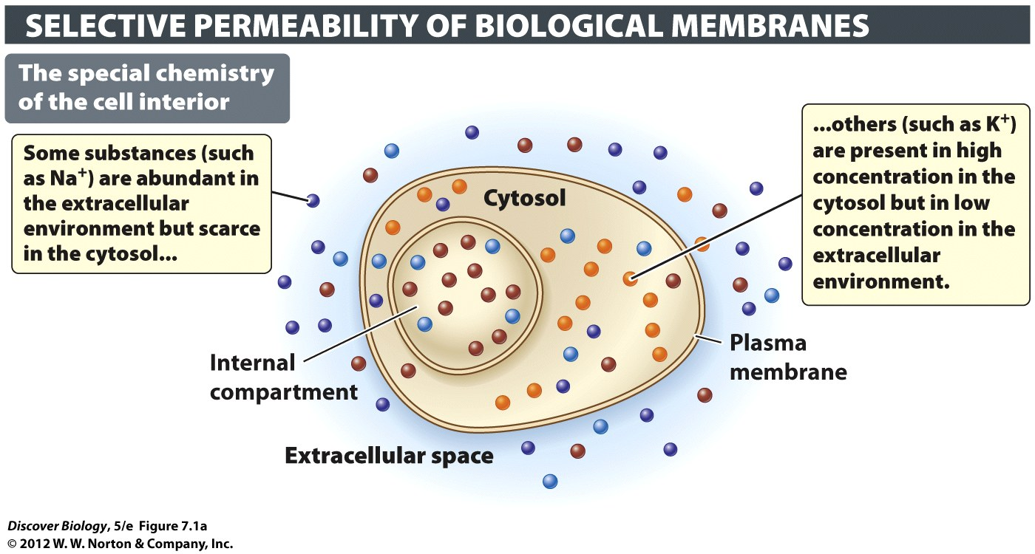
Notes:
Figure 7.1 The Plasma Membrane Is a Barrier and a Gatekeeper
(a) The chemistry of the cytosol is distinctly different from that of the extracellular environment, in part because the plasma membrane moves substances in a highly selective fashion. Some substances are shut out altogether, while others are allowed to enter or leave in a controlled fashion. (b) The selectivity of biological membranes is determined in large part by the types of membrane proteins in their phospholipid bilayer.

Slide 8
In Diffusion, Substances Move Passively down a Concentration Gradient
Passive transport is the spontaneous movement of a substance and can take place without the input of energy
Active transport is the movement of a substance in response to an input of energy

Slide 9
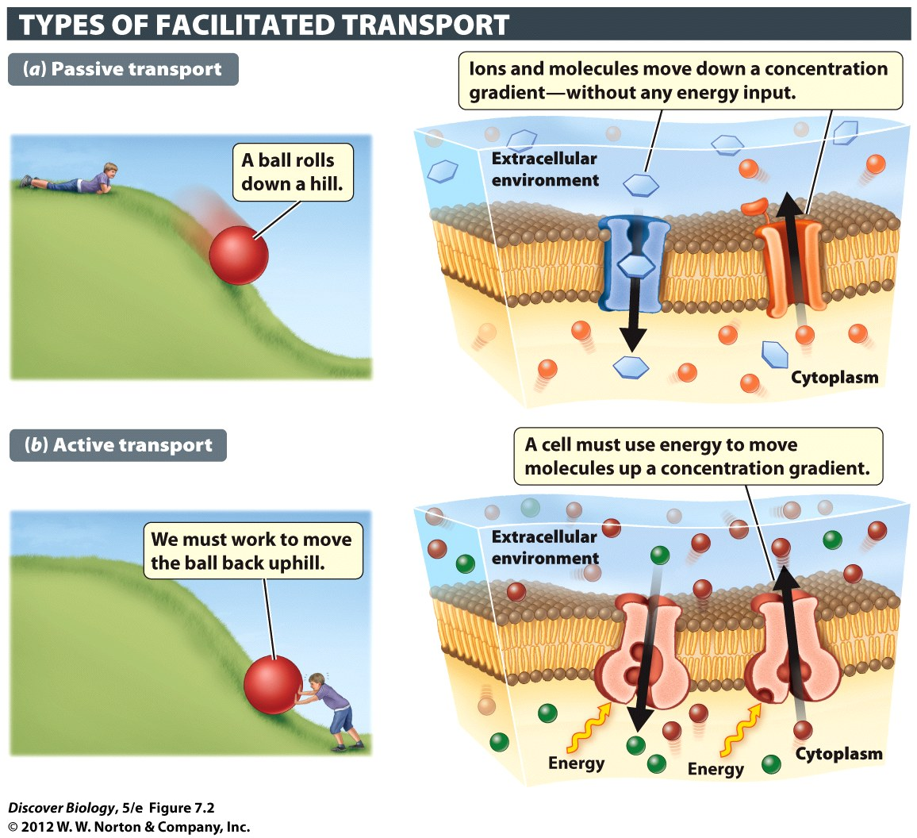
Notes:
Figure 7.2 Active versus Passive Movement of Substances
Materials can move into and out of organisms either passively (without an input of energy) or actively (with an input of energy). (a) Substances can move passively through a membrane from a region where they are present at high concentration to a region of low concentration. (b) Energy is required to move substances from regions of low concentration to regions of high concentration.

Slide 10
In Diffusion, Substances Move Passively down a Concentration Gradient
Diffusion is the passive transport of a substance from a region of higher concentration to a region of lower concentration until it has reached equilibrium
Small substances diffuse faster than larger substances
Heat increases the rate of diffusion
The greater the difference in concentration of two substances, the greater the rate of diffusion

Slide 11
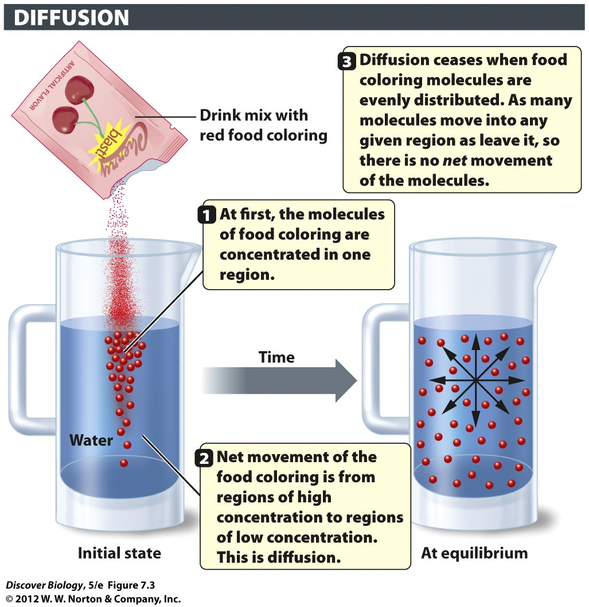
Notes:
Figure 7.3 Diffusion Is a Passive Process
Diffusion is the spontaneous movement of a substance (such as the food coloring in the drink mix) from a region of high concentration to a region of low concentration without an input of energy. Net movement ceases, and equilibrium is reached, when the substance becomes uniformly distributed.

Slide 12
Some Small Molecules Can Diffuse through the Phospholipid Bilayer
Water, oxygen, and carbon dioxide can pass through the cell membrane without assistance through simple diffusion
Most hydrophobic molecules can pass through the cell membrane’s hydrophobic interior

Slide 13
Osmosis
Maintaining a proper water balance is vital for every cell
Osmosis is a type of passive diffusion that moves water across a selectively permeable membrane from an area of lower solute concentration to an area of higher solute concentration
Osmosis does not involve the movement of solutes

Slide 14
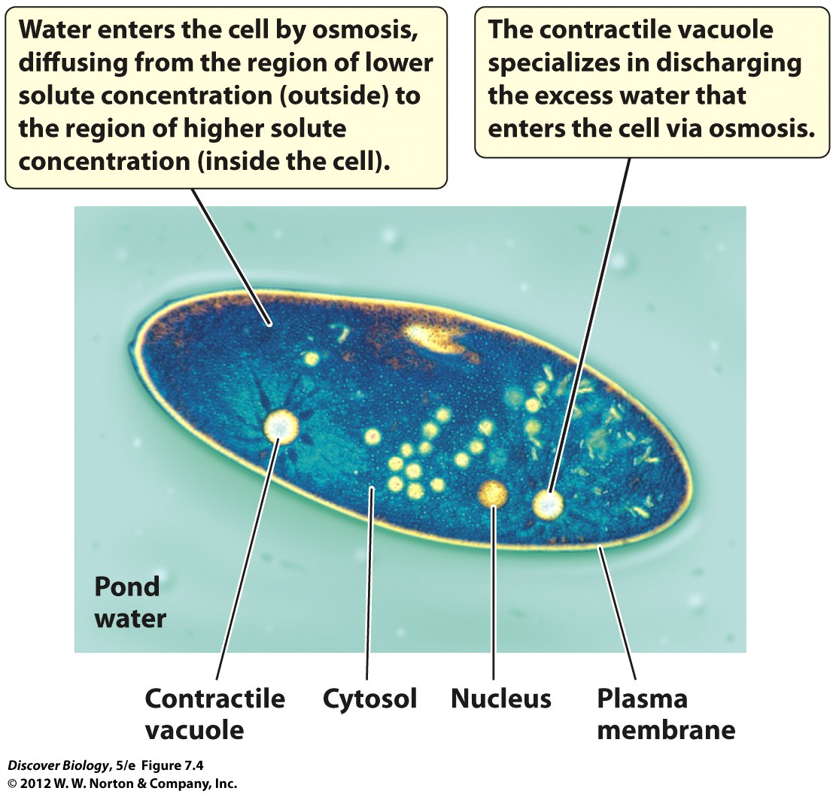
Notes:
Figure 7.4 Osmotic Balance in Paramecium
Paramecium is a wall-less, single-celled protist that ingests bacteria and other small organisms at lake bottoms.

Slide 15
Osmosis
A hypotonic solution has a lower solute concentration than the cytosol of a cell, which causes water to flow into the cell and make it swell
A hypertonic solution has a higher solute concentration than the cytosol of a cell, which causes water to flow out of the cell and make it shrink
An isotonic solution has an equal concentration of solute inside and outside the cell

Slide 16
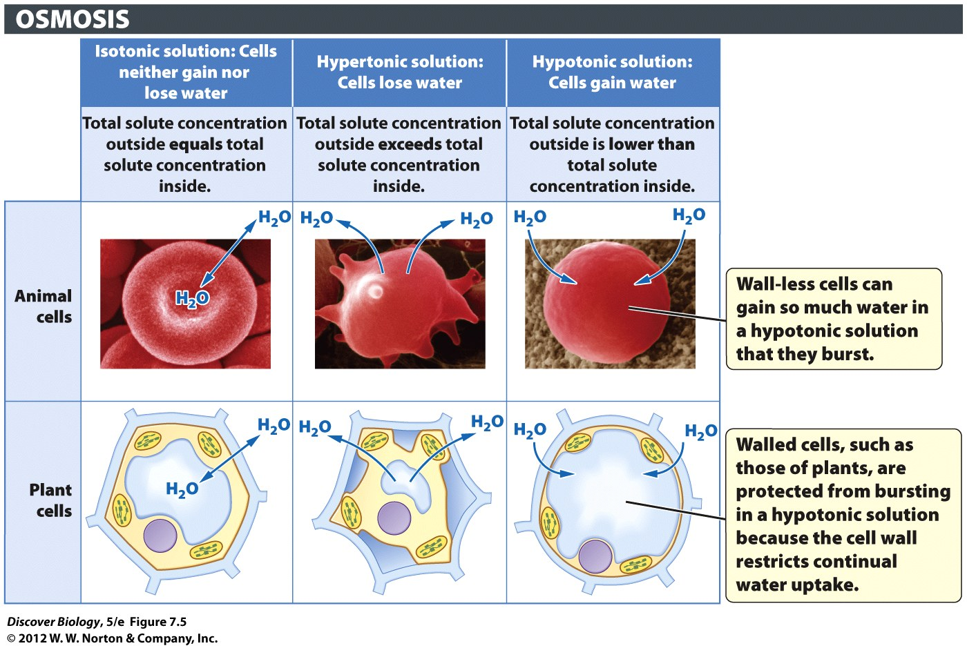
Notes:
Figure 7.5 Water Moves into and out of Cells by Osmosis
Osmosis is the diffusion of water across a selectively permeable membrane. Cells lose water in a hypertonic solution and gain water in a hypotonic solution. Our cells are bathed in an isotonic fluid to prevent osmotic swelling and bursting.

Slide 17
Facilitated Membrane Transport
Hydrophilic substances cannot cross the plasma membrane without assistance
Facilitated diffusion is the passive transmembrane movement of a substance with the assistance of two types of membrane transport proteins:
Channel proteins
Carrier proteins

Slide 18
Facilitated Membrane Transport
Channel proteins move substances down a concentration gradient based on a molecule’s size and charge, and without an energy input
Carrier proteins transport specific molecules across the plasma membrane based on the shape of the molecule, and are of two types:
Passive carrier proteins
Active carrier proteins

Slide 19
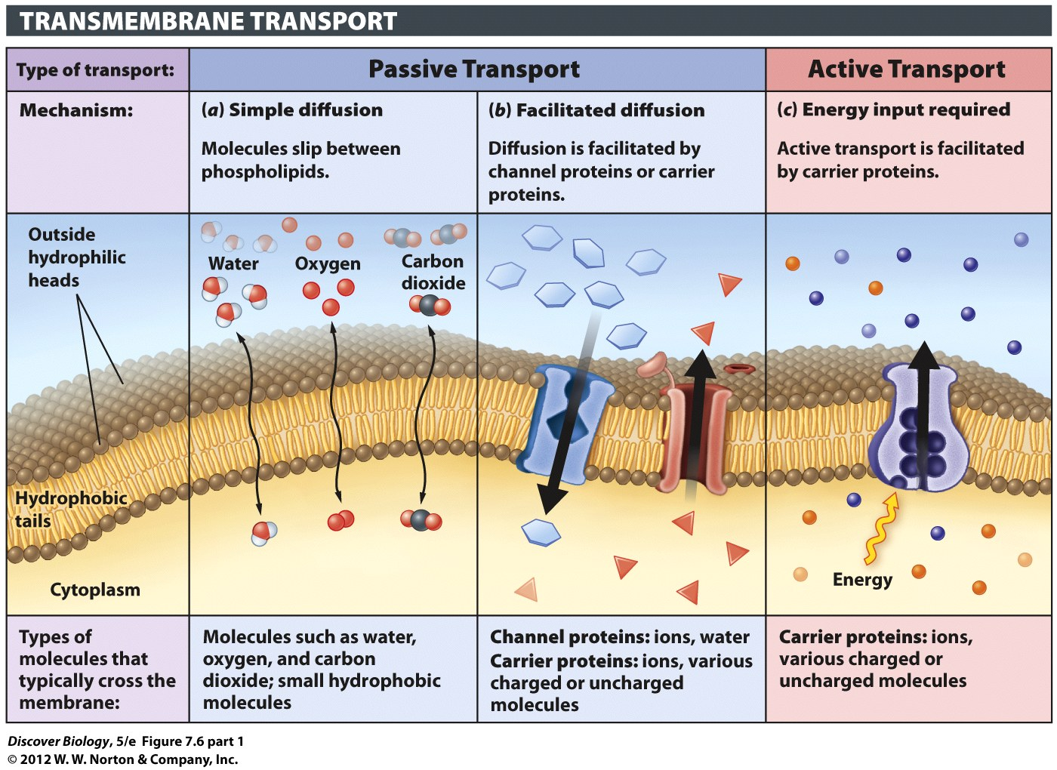
Notes:
Figure 7.6 (part 1) The Plasma Membrane Controls What Enters and Leaves the Cell
Proteins that span the plasma membrane (b, c) play an important role in moving materials into and out of cells. The flowchart summarizes the different types of processes that move materials across biological membranes.

Slide 20
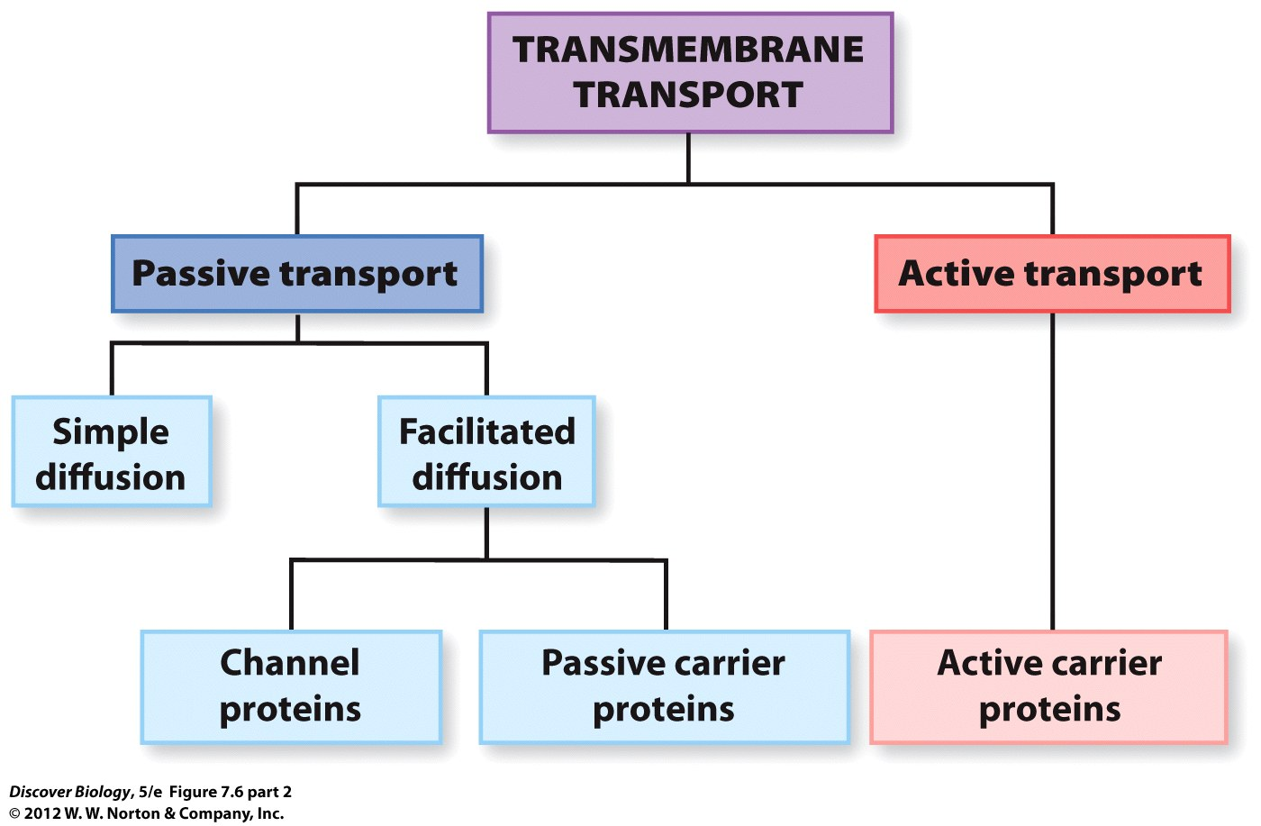
Notes:
Figure 7.6 (part 2) The Plasma Membrane Controls What Enters and Leaves the Cell
Proteins that span the plasma membrane (b, c) play an important role in moving materials into and out of cells. The flowchart summarizes the different types of processes that move materials across biological membranes.

Slide 21
Passive Carrier Proteins Mediate Facilitated Diffusion
Passive carrier proteins assist in the diffusion of molecules and ions from an area of higher concentration to an area of lower concentration
An important passive carrier of glucose is a protein called GLUT, which helps maintain blood glucose levels through facilitated diffusion

Slide 22
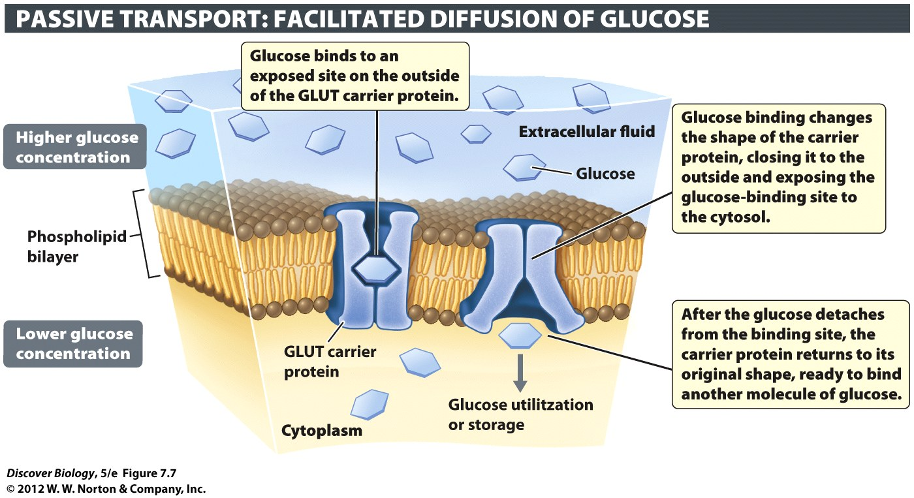
Notes:
Figure 7.7 Passive Carrier Proteins
The facilitated diffusion of glucose into our cells is mediated by a class of passive carriers called GLUT proteins. No energy is required for the transport of glucose by carrier proteins. The sugar moves from the side of the membrane where it is at high concentration to the side where it is at lower concentration.

Slide 23
Active Carrier Proteins Move Materials against a Concentration Gradient
Active carrier proteins use ATP to pump molecules across the plasma membrane against a concentration gradient
An important active carrier protein called the sodium-potassium pump plays a vital role in maintaining the ratio of sodium–potassium concentration by exporting sodium from the cell and importing potassium ions against a concentration gradient

Slide 24
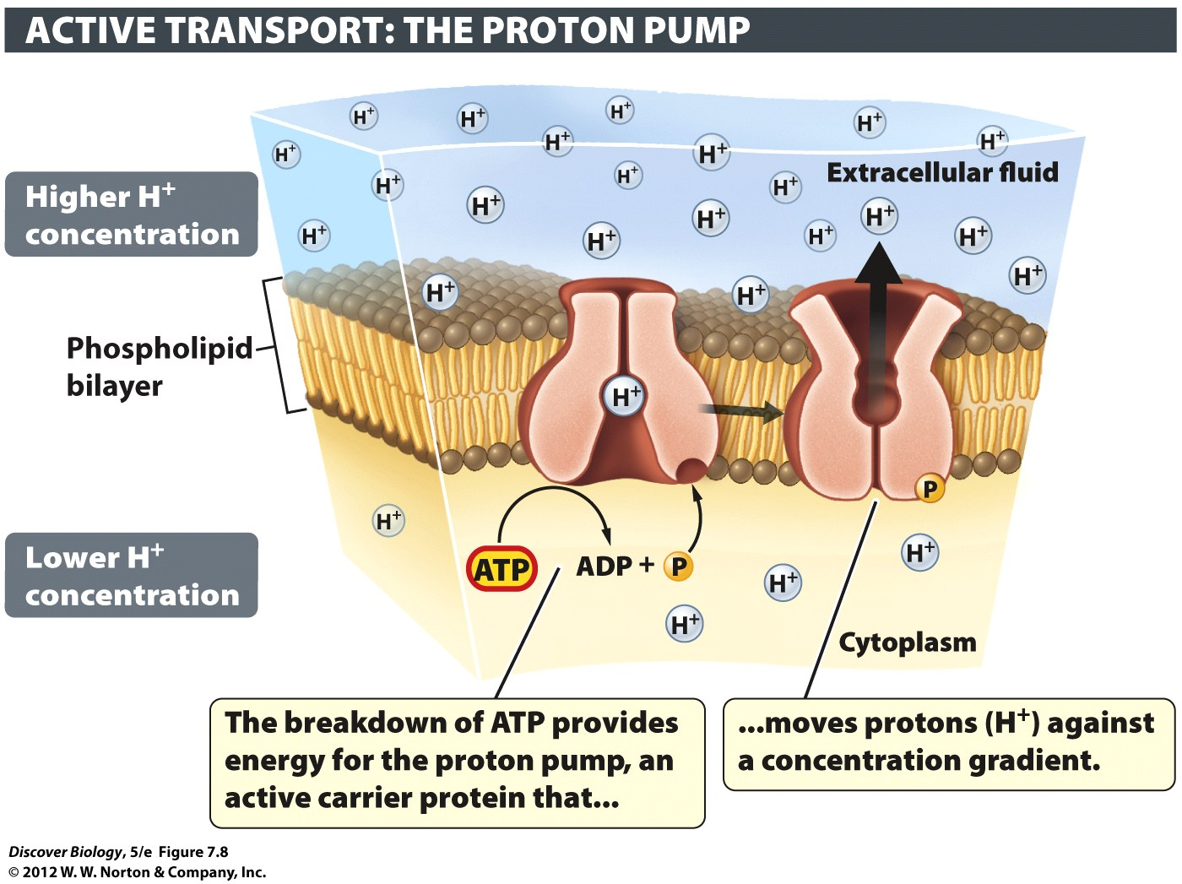
Notes:
Figure 7.8 Active Carrier Proteins
Active carrier proteins use energy to move materials from regions of low concentration to regions of high concentration. When food arrives, proton pumps secrete hydrogen ions (H⁺) into your stomach.

Slide 25
Endocytosis and Exocytosis
Substances to be exported from a cell are packaged into transport vesicles that fuse with the plasma membrane and expel the contents into their surrounding in a process called exocytosis
Endocytosis brings substances into the cell by wrapping them in a section of the plasma membrane that eventually breaks free inside the cell

Slide 26
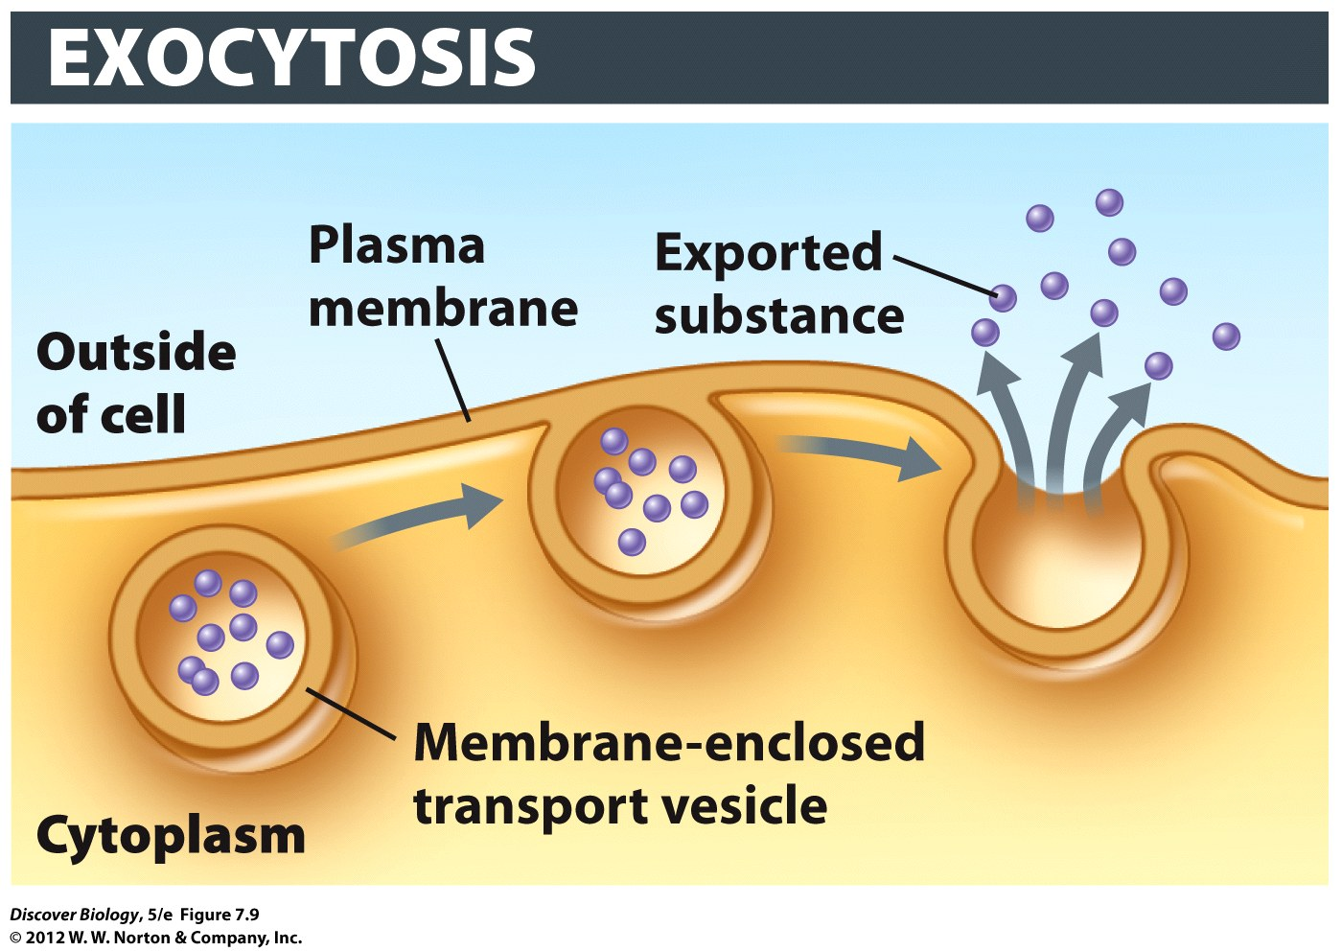
Notes:
Figure 7.9 Cell Contents Are Exported through Exocytosis
Exocytosis exports materials from the cell.

Slide 27
Endocytosis and Exocytosis
Pinocytosis is a nonspecific type of endocytosis that brings in all the material in an immediate area
Receptor-mediated endocytosis uses specialized receptor proteins to determine which substances are incorporated into the vesicle created by the plasma membrane
White blood cells, among others, use phagocytosis to ingest large particles such as a bacteria or viruses

Slide 28
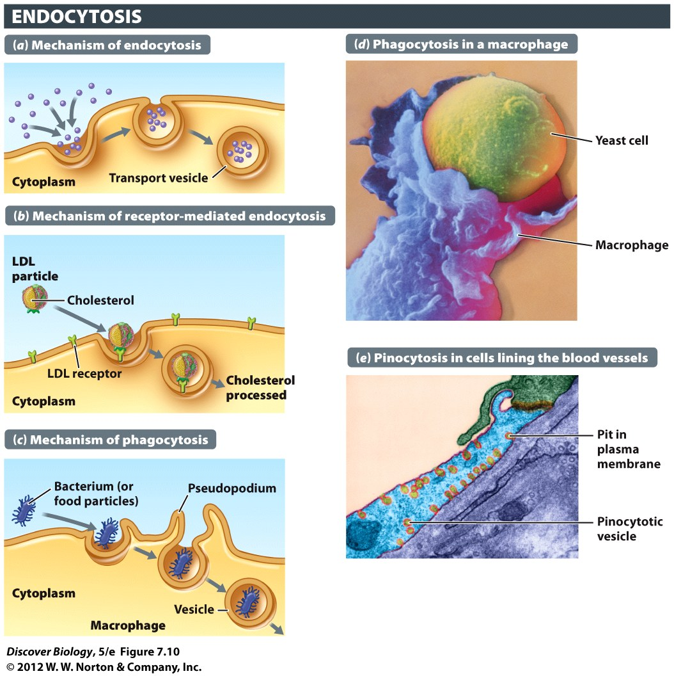
Notes:
Figure 7.10 Extracellular Substances Are Imported through Endocytosis
(a) Endocytosis brings material from the outside of the cell to the inside, wrapped in membrane vesicles. (d) Pinocytosis is nonspecific endocytosis of external fluid. (b) Receptor-mediated endocytosis is a highly selective process in which only certain extracellular molecules are recognized by, and bound to, special plasma membrane receptors. (c, e) Phagocytosis is endocytosis on a large scale. A macrophage (blue) engulfing an invading yeast cell (yellow) is seen in (e). Macrophages are part of the body’s defense system.

Slide 29
Cellular Connections
Plasma membrane structures that interconnect adjacent cells are known as cell junctions
Vertebrate animals have three types of cell junctions:
Anchoring junctions
Tight junctions
Gap junctions

Slide 30
Cellular Connections
Anchoring junctions form patches of proteins that extend through the plasma membrane and link cells that typically undergo heavy structural stress
Tight junctions are formed by belts of proteins that create leak-proof sheets of cells, which can be found in the skin and lining of the body cavities

Slide 31
Cellular Connections
Gap junctions are direct cytoplasmic connections between two cells formed by protein-lined tunnels that span the intercellular space between adjacent cells
Gap junctions facilitate the rapid passage of ions and small molecules, including electrical signals, between adjacent cells
Plant cells use plasmodesmatas to communicate, much like gap junctions are used in animal cells

Slide 32
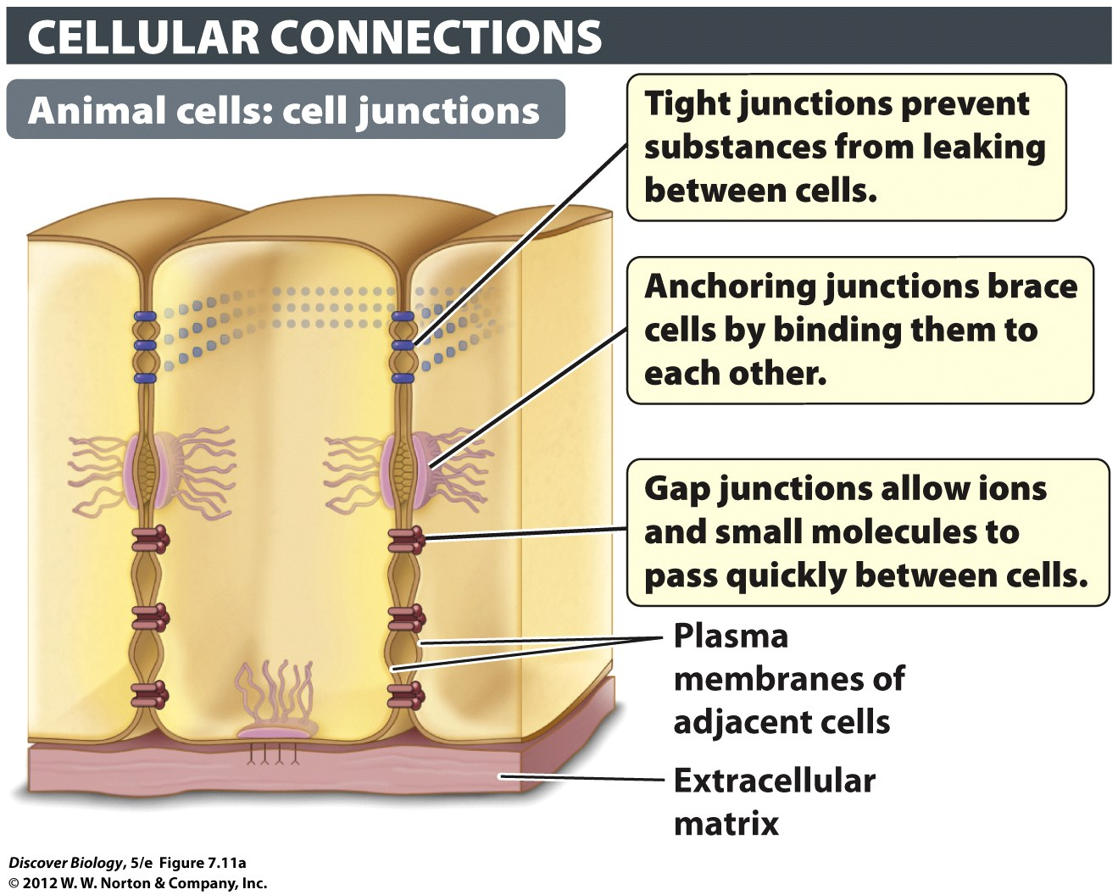
Notes:
Figure 7.11a Cells in Multicellular Organisms Are Interconnected in Various Ways
(a) Many animal cells are joined by different types of junctions.

Slide 33
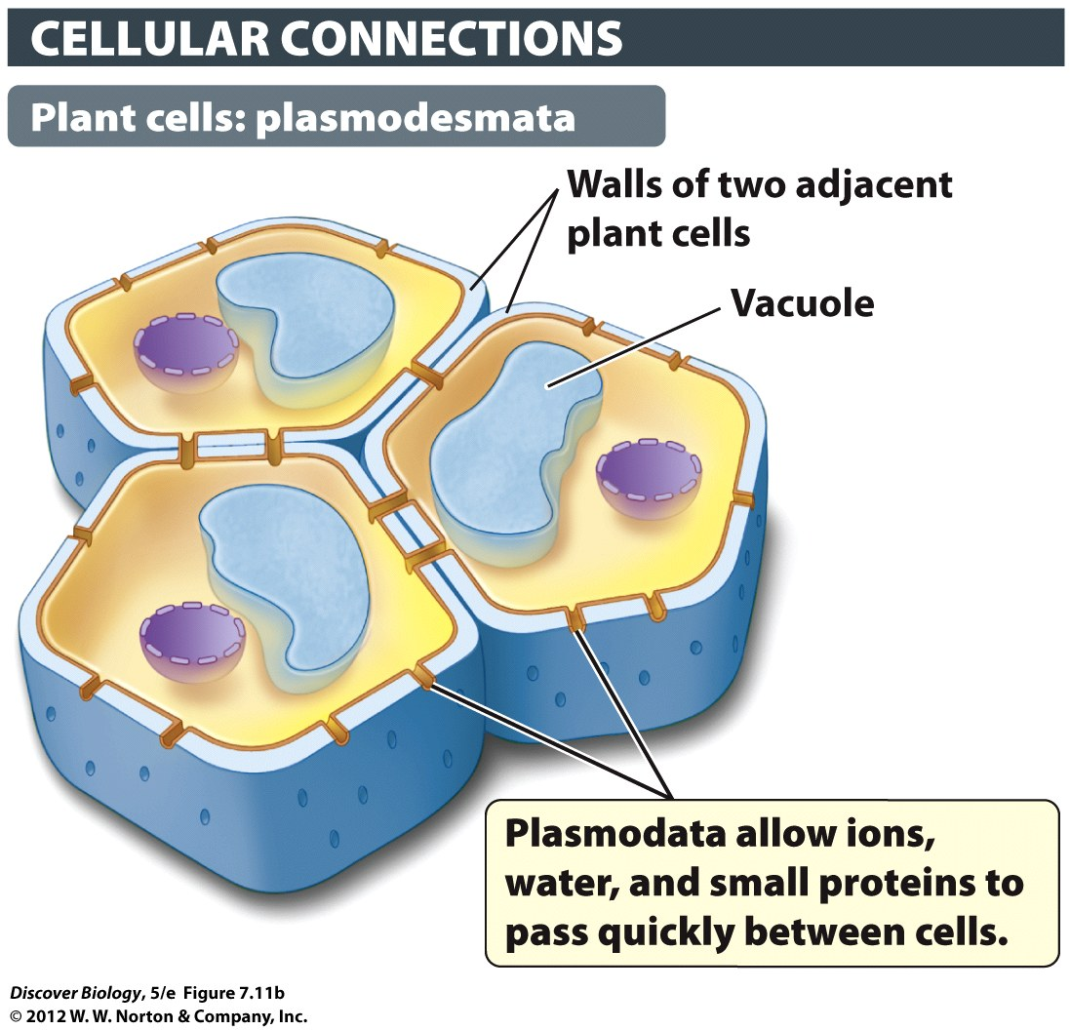
Notes:
Figure 7.11b Cells in Multicellular Organisms Are Interconnected in Various Ways
(b) Plant cells are interconnected by plasmodesmata.

Slide 34
Cell Signaling
Communication between cells is based on the release and perception of signaling molecules
A target cell receives a signal through receptor proteins located on the plasma membrane
Signaling molecules at the cell surface relay signals through the cytoplasm through a series of events known as signal transduction pathways

Slide 35
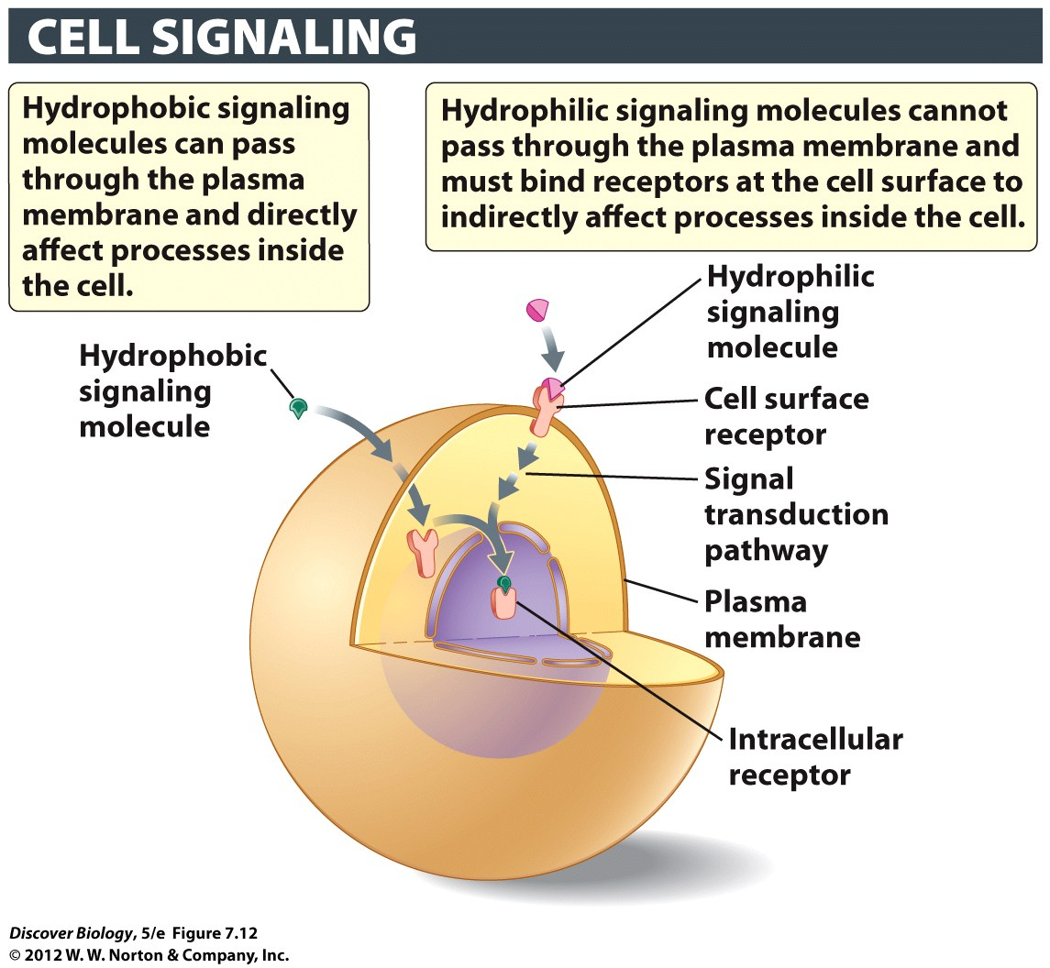
Notes:
Figure 7.12 Receptors for Signaling Molecules
Intracellular receptors reside in the cytosol or the nucleus and bind to hydrophobic signaling molecules that can cross the plasma membrane. Cell surface receptors are embedded in the plasma membrane and bind to hydrophilic signaling molecules that cannot cross the membrane.

Slide 36
Clicker Questions
CHAPTER 7
Cell Membranes, Transport, and
Communication

Slide 37
Concept Quiz
The main difference between active and passive transport is
Passive transport goes up a concentration gradient.
Active transport goes down a concentration gradient.
Active transport requires energy.
Passive transport requires energy.
Notes:
The correct answer is C. It is important to stress that it takes energy to move a molecule or ion against it’s concentration gradient, and only pumps (ATPases) can do this.
Passive transport goes down a concentration gradient.
Active transport goes up a concentration gradient.
Passive transport does not require energy.

Slide 38
Concept Quiz
______ are connections between animal cells that allow communication.
Plasmodesmata
Gap junctions
Anchoring junctions
Tight junctions
Notes:
The correct answer is B. This question causes students to distinguish both between different types of animal junctions and between animal and plant channel-type junctions (i.e., plasmodesmata and gap junctions are similar in function).
Answer A: Plasmodesmata are channels between plant cells.
Answers C & D: Neither of these allow for communication between cells.

Slide 39
Concept Quiz
__________ involves the ingestion of specific molecules by the membrane
A. Endocytosis
B. Pinocytosis
C. Exocytosis
D. Receptor‑mediated endocytosis
Notes:
The correct answer is D. Receptor mediated endocytosis is a very specific process, where as other forms of ingestion take in everything that is found in the extracellular medium.
Answer A: This is less specific since receptors are used to identify particles to be ingested.
Answer B: This is “cell drinking” and is very non-specific.
Answer C: This doesn’t involve ingesting at all; it is the release of substances.

Slide 40
Relevant Art from Other Chapters
All art files from the book are available in JPEG and PPT formats online and on the Instructor Resource Disc

Slide 41
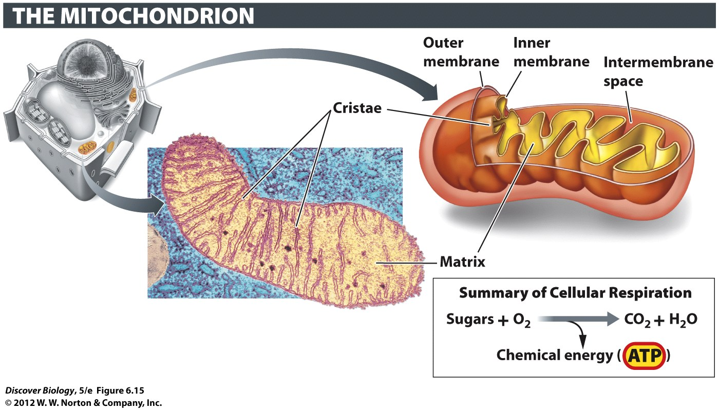
Notes:
Figure 6.15 Mitochondria Generate Energy in the Form of ATP
Each mitochondrion has a double membrane. The infoldings of the inner membrane (cristae) create a large surface area which enables many units of ATP-generating enzymes to be located there.

Slide 42
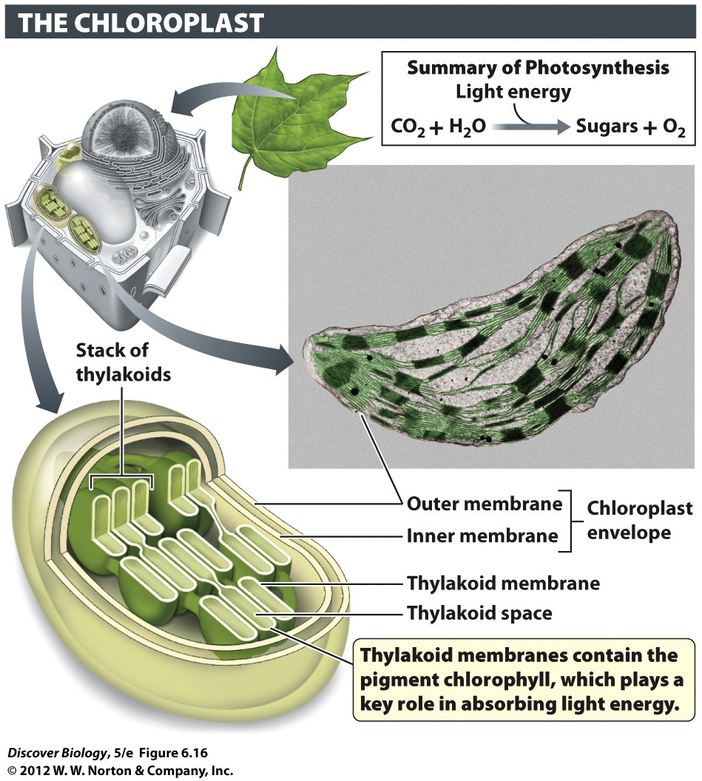
Notes:
Figure 6.16 Chloroplasts Capture Energy from Sunlight and Use It to Make Sugars
Chloroplasts are found in green plant parts and in the protists known as algae.

Slide 43
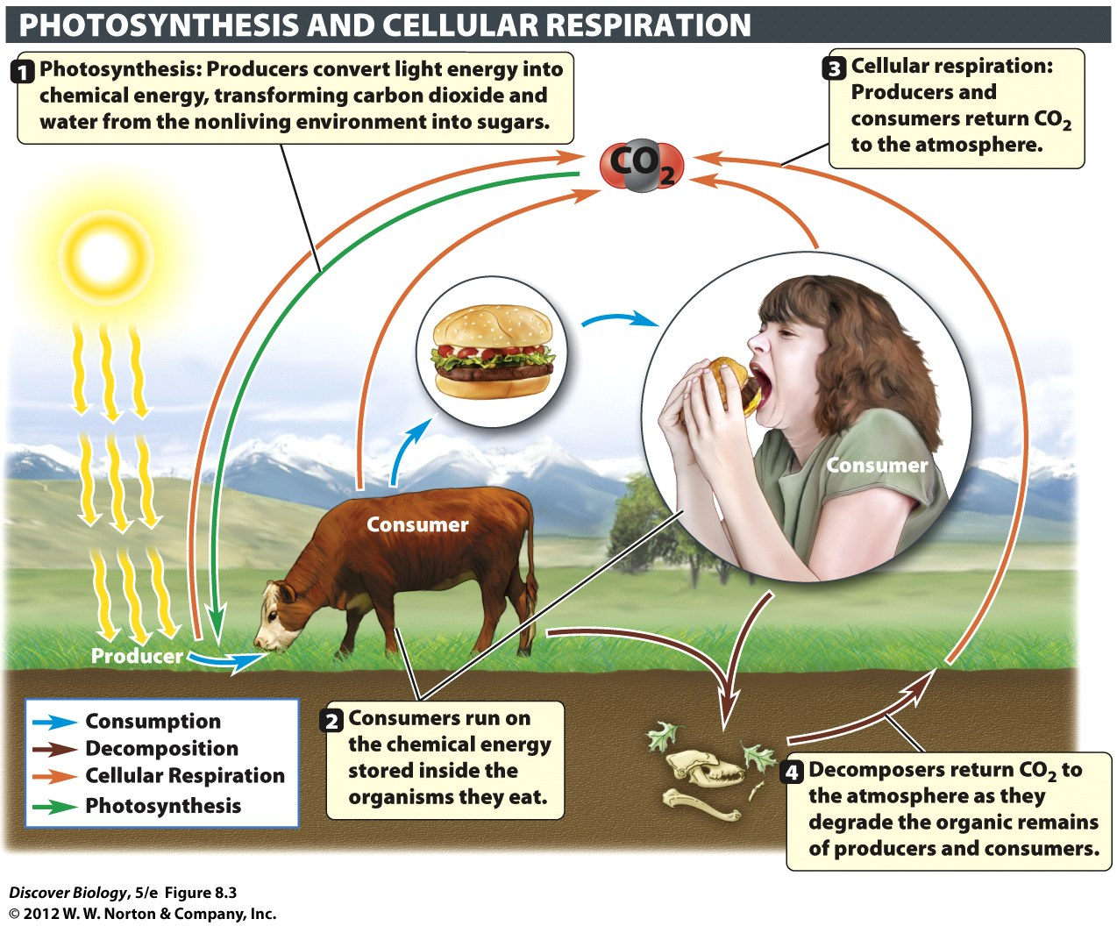
Notes:
Figure 8.3 Photosynthesis and Cellular Respiration Are Complementary Processes
Matter, in the form of carbon atoms, cycles among producers, consumers, and the environment.

