Slide 1
Discover Biology FIFTH EDITION
Anu Singh-Cundy • Michael L. Cain
CHAPTER 6
Cell Structure and Internal
Compartments
© 2012 W. W. Norton & Company, Inc.

Slide 2
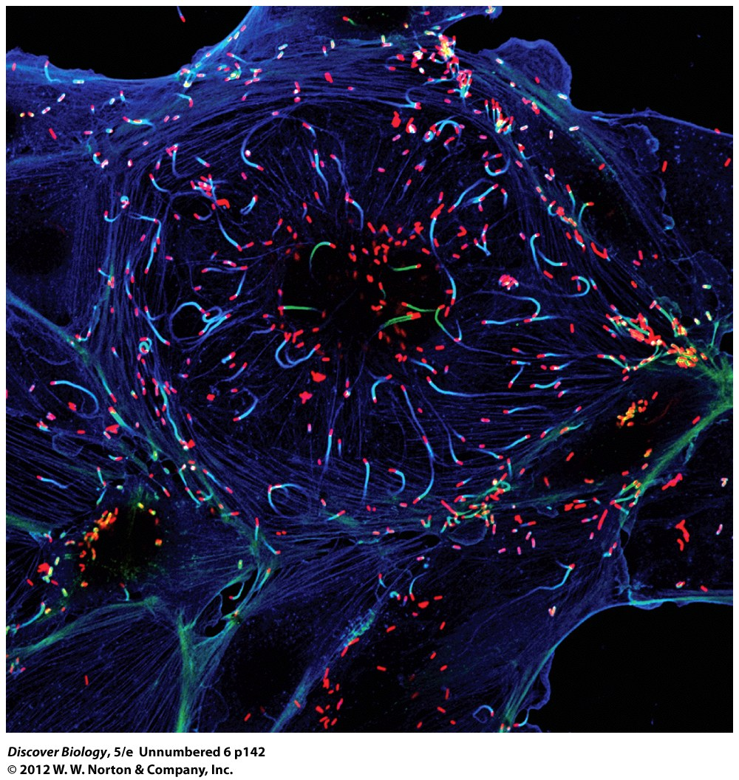
Notes:
Invaders in Inner Space.
Bacteria (red) of the species Listeria monocytogenes that have infected a human cell are pushed along on cables of protein (blue and green strands).

Slide 3
Wanted: Long-Term Roommate; Must Help Keep House and Have Own DNA
Only a fraction of the cells in our bodies are our own
Parasites and microbes make up the remainder of our body composition
The evolution of eukaryotes is closely linked to their relationship with prokaryotes

Slide 4
Certain Large Biomolecules are Common to All Life-Forms
The cell is the smallest and simplest unit of life
Prokaryotes differ from eukaryotes in several key characteristics
Internal structures enable cells to function as an efficient and well-coordinated unit

Slide 5
Cells: The Smallest Units of Life
The cell theory is a unifying principle of biology
The cell theory is based on two concepts:
Every living organism is composed of one or more cells
All cells living today came from a preexisting cell
A cell is composed of an aqueous interior enclosed in a lipid-based plasma membrane

Slide 6
Cells: The Smallest Unit of Life
Cytoplasm contains a thick fluid called cytosol, consisting of ions and biomolecules mixed in water
An organelle is a cytoplasmic structure that performs a unique function in the cell
The nucleus contains the DNA enveloped in double membranes
The mitochondrion (plural: mitochondria) provides the energy that fuels all cellular functions
Ribosomes are important protein-manufacturing organelles

Slide 7
Cells: The Smallest Unit of Life
Cells have many different shapes, sizes, life strategies, and behaviors
Prokaryotes are generally single-celled organisms
All members of the plant and animal kingdom are multicellular

Slide 8
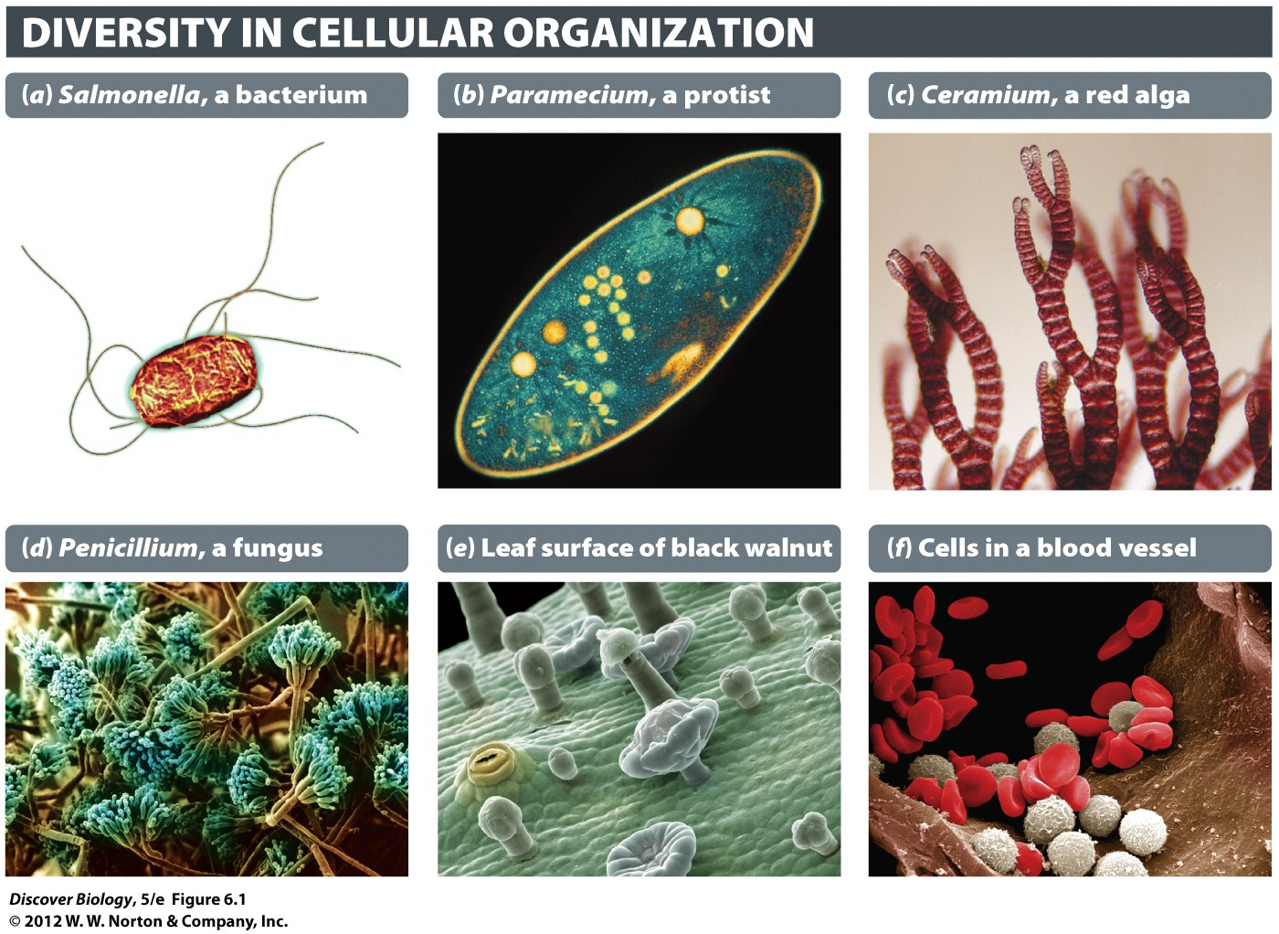
Notes:
Figure 6.1 An Individual Organism May Consist of a Single Cell or Very Many Cells
(a) Salmonella typhimurium, a singlecelled prokaryote that is a common cause of food poisoning. (b) Paramecium caudatum, a singlecelled eukaryote that lives in freshwater. (c) Ceramium pacificum, a multicellular red alga. (d ) Penicillium camembertii, a multicellular fungus, with spores (green) used for asexual reproduction. (e) Surface view of a black walnut (Juglans nigra) leaf, with stomata and protective hair. (f ) Red blood cells and white blood cells inside an arteriole, one of the smaller blood vessels in the human body.

Slide 9
The Microscope Is a Window into the Life of a Cell
The light microscope was the first instrument that enabled scientists to view the cell
Electron microscopes use streams of electrons focused with magnets to magnify specimens more than 100,000 times
A scanning electron microscope creates a three-dimensional view of specimen

Slide 10
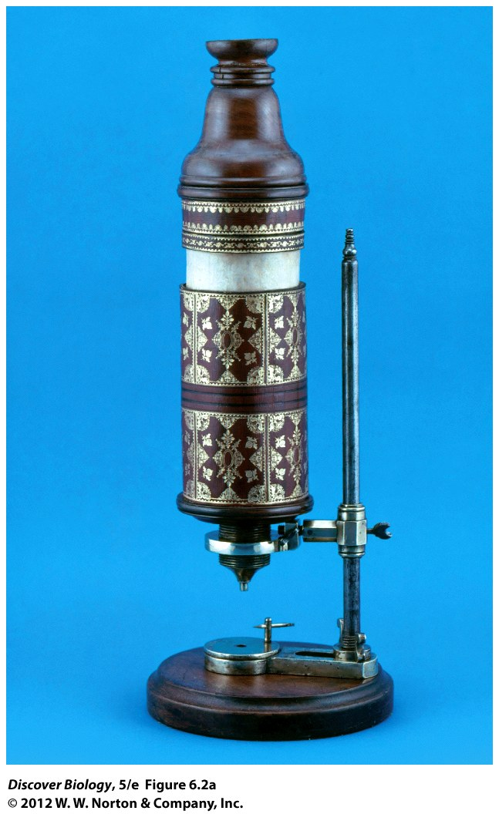
Notes:
Figure 6.2a Light Microscope Used by Robert Hooke (1635–1703)
(a) Hooke’s microscope.

Slide 11
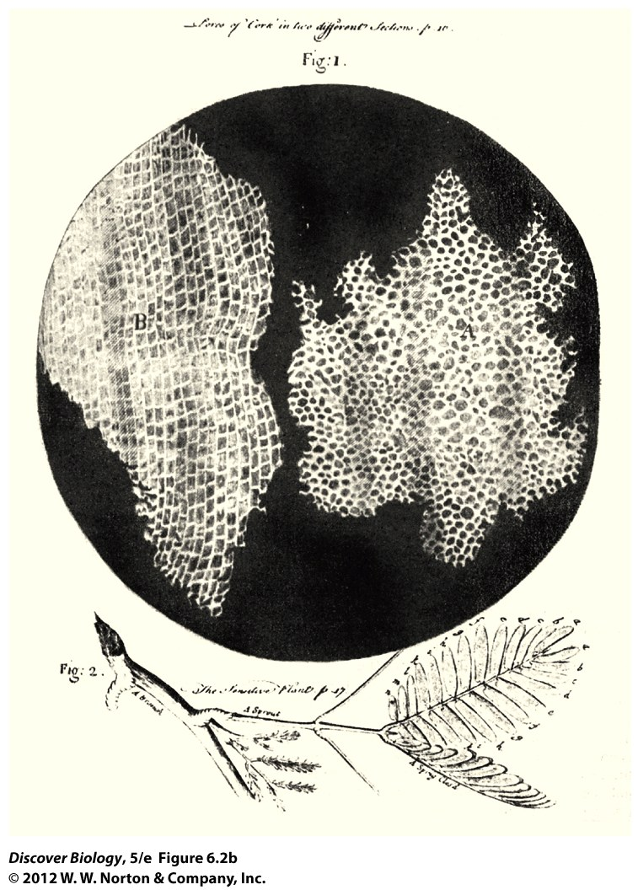
Notes:
Figure 6.2b Light Microscope Used by Robert Hooke (1635–1703)
(b) A piece of cork examined under Hooke’s microscope.

Slide 12
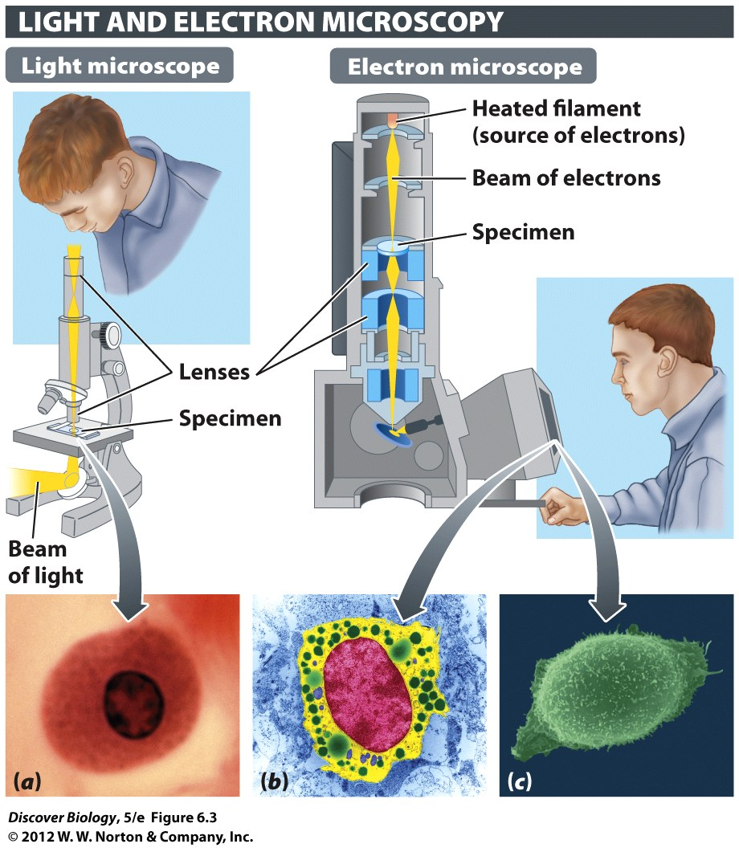
Notes:
Figure 6.3 Microscopy Enables Us to Visualize Cells and Cell Structures
The photos show human mast cells imaged through light microscopy (a), transmission electron microscopy (b), and scanning electron microscopy (c). Mast cells are immune cells, part of the body’s defense against invaders.

Slide 13
The Ratio of Surface Area to Volume Limits Cell Size
Most cells are microscopic and cannot be seen with the naked eye
Prokaryotic cells are generally smaller than eukaryotic cells
Cell size is limited in order to maintain a ratio of surface area to volume that allows the cell to efficiently exchange materials with the environment

Slide 14
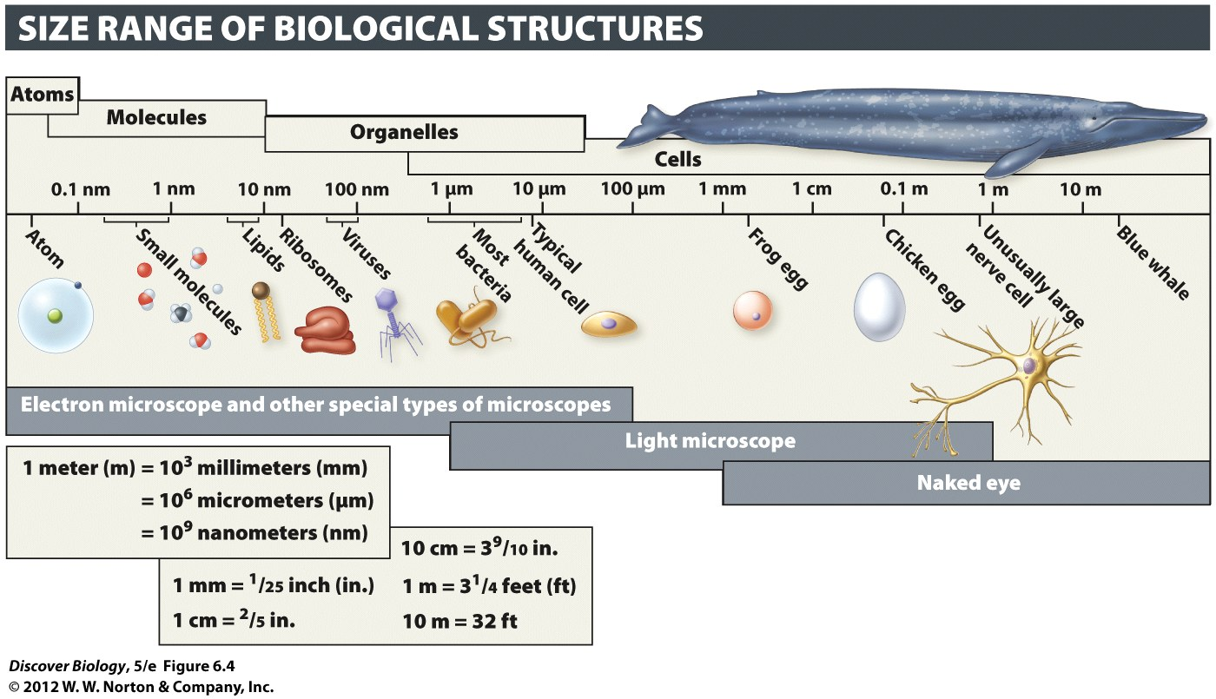
Notes:
Figure 6.4 Most Cells Are Microscopic

Slide 15
Multicellularity Enables Larger Body Size and Efficiency through Division of Labor
A multicellular organism consists of an interdependent group of genetically identical cells that developed from a single cell and whose cells are incapable of living independently
Colonial organisms consist of a loose group of cells that cooperate for mutual benefit but can also exist independently

Slide 16
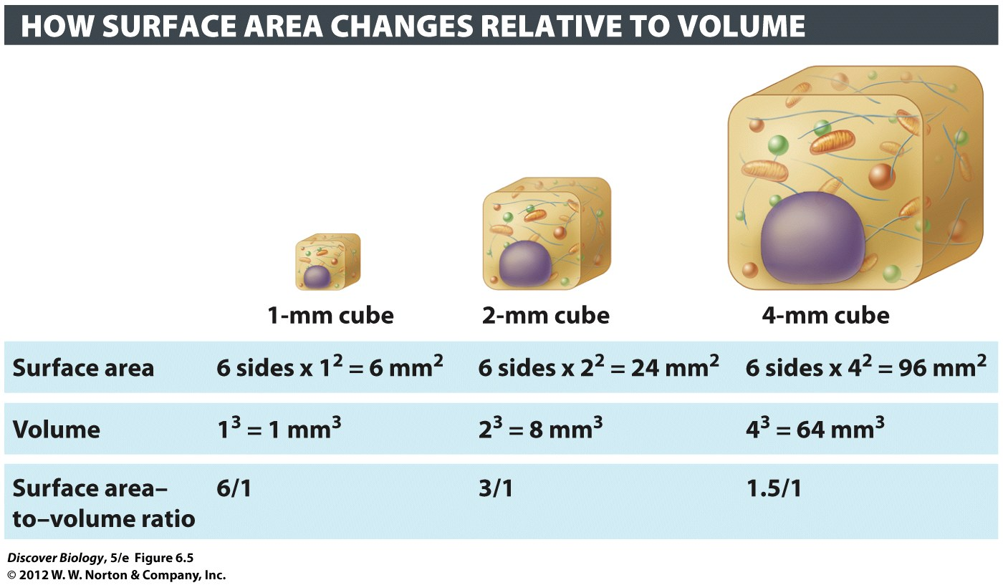
Notes:
Figure 6.5 Limits to Cell Size
As the width of a cell increases, the volume increases more steeply than the surface area. Cells exchange nutrients and wastes across the cell surface and must have a large enough surface area for that exchange to take place rapidly and efficiently.

Slide 17
Multicellularity Enables Larger Body Size and Efficiency through Division of Labor
Multicellularity makes cell specialization possible and enables the individual to function more efficiently through division of labor
Multicellular organisms have different cell types that share the same DNA but express different subsets of DNA information, giving the cells different skill sets

Slide 18
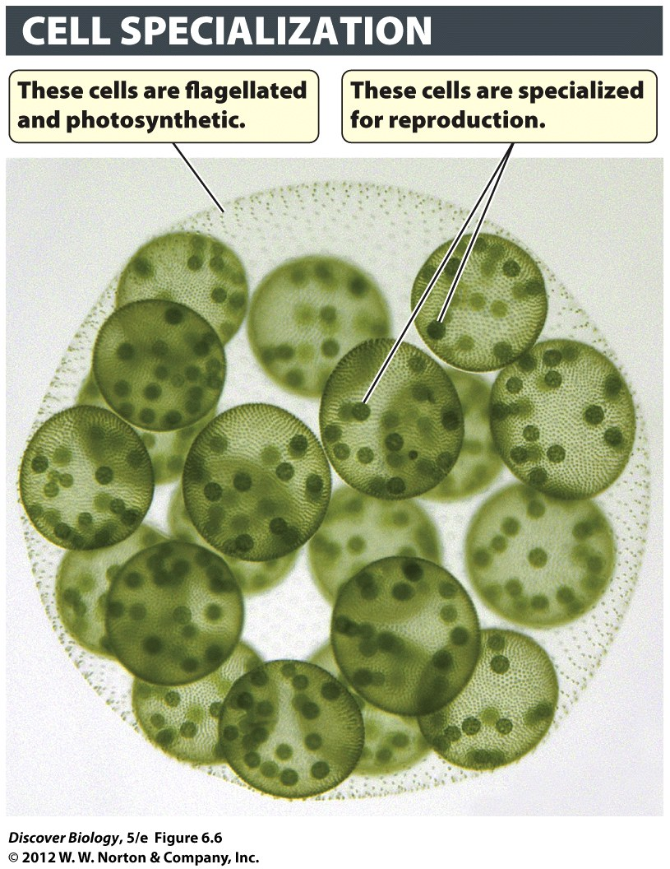
Notes:
Figure 6.6 Cell Specialization Is One Benefit of Multicellularity
Recent studies show that Volvox carteri, a green alga, is a multicellular organism with specialized cell types that function in an integrated manner.

Slide 19
The Plasma Membrane
Every cell has a plasma membrane that separates the cell from its surrounding environment
The plasma membrane acts to facilitate chemical processes by concentrating the needed raw materials in a limited space

Slide 20
The Plasma Membrane
The plasma membrane is a selectively permeable barrier that is responsible for the following:
Capturing needed molecules and bringing them into the cell
Removing waste from the cell
Communicating with other cells and the environment
Anchoring the cell in place

Slide 21
The Plasma Membrane
Proteins embedded in the phospholipid bilayer are responsible for the diverse functions carried out by plasma membrane and include:
Transport proteins
Receptor proteins
Adhesion proteins
The fluid mosaic model of the plasma membrane allows the proteins to drift within the plane of the phospholipid bilayer

Slide 22
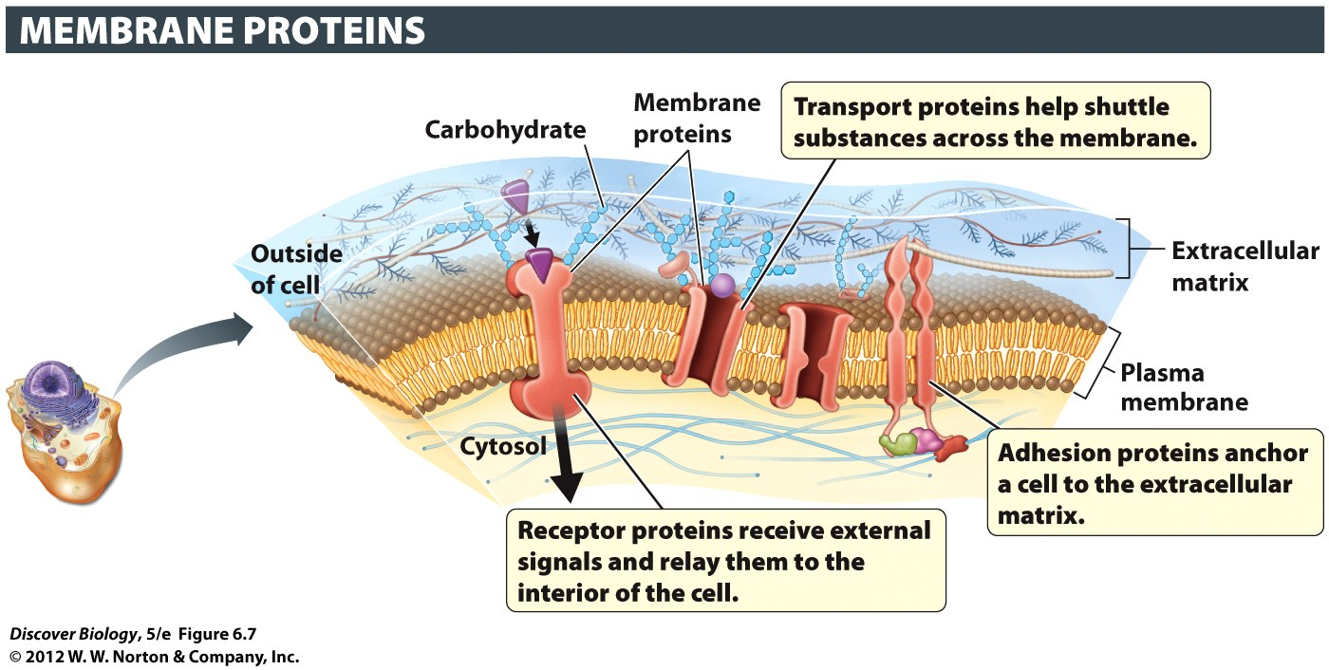
Notes:
Figure 6.7 The Many Functions of Membrane Proteins

Slide 23
Prokaryotic and Eukaryotic Cells
Most prokaryotes have a tough cell wall outside the plasma membrane
Some bacteria have a slippery, protective layer called a capsule
Eukaryotes are characterized by membrane-bound organelles that confer speed and efficiency through intracellular division of labor

Slide 24
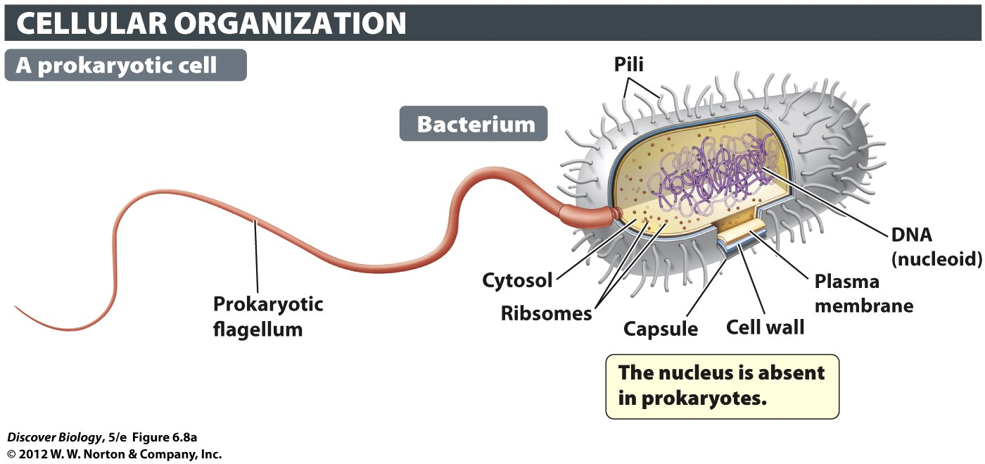
Notes:
Figure 6.8a Prokaryotic and Eukaryotic Cells Compared

Slide 25
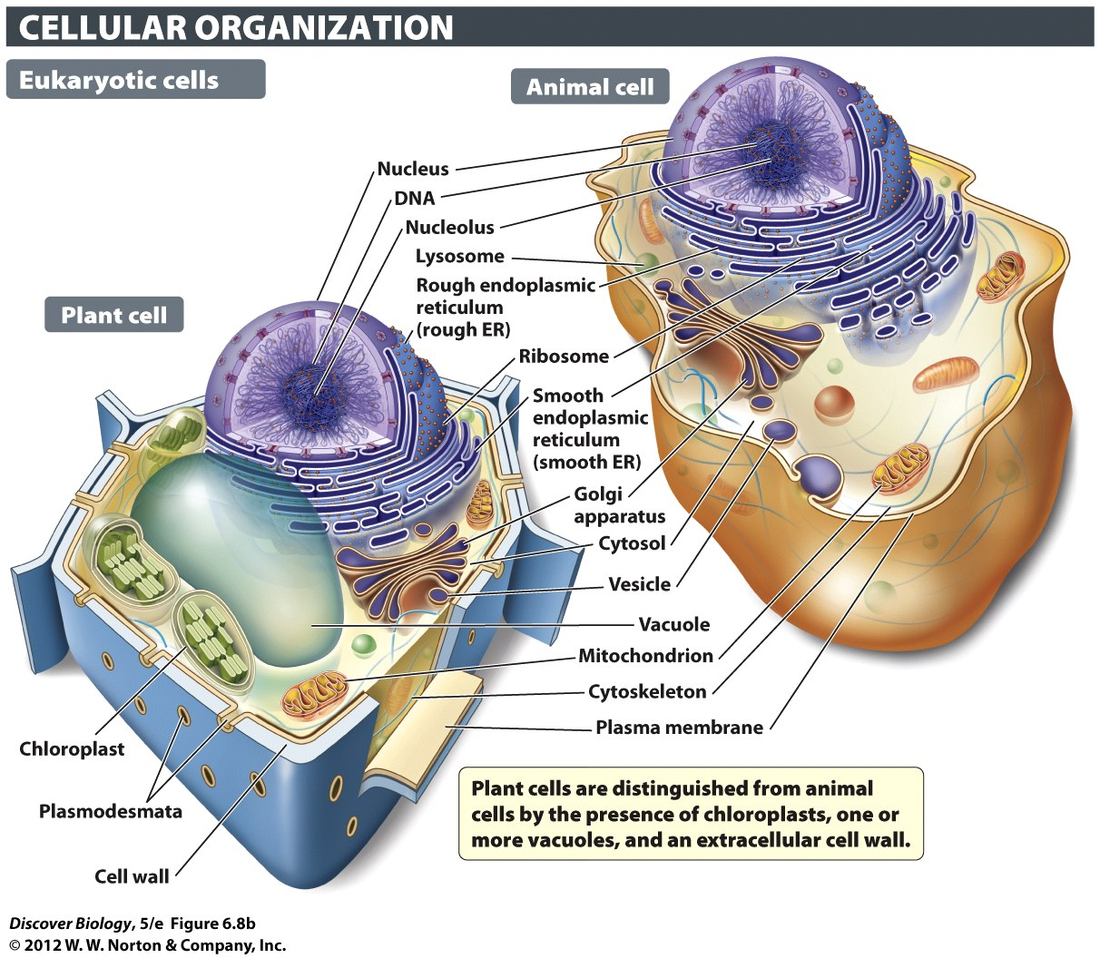
Notes:
Figure 6.8b Prokaryotic and Eukaryotic Cells Compared

Slide 26
Internal Compartments of Eukaryotic Cells
Eukaryotic cells are highly structured, efficient, energy-dependent factories that have the capacity to reproduce themselves
All living creature are vastly more complex than any man-made machine

Slide 27
The Nucleus Houses Genetic Material
In eukaryotic cells, the nucleus in bound by a double plasma membrane called the nuclear envelope
The nucleus contains the DNA required for building, managing, growing, and reproducing all cells
Each DNA double helix is condensed into chromosomes

Slide 28
The Nucleus Houses Genetic Material
The nuclear envelope contains nuclear pores through which ions and small molecules pass freely
Passage of larger molecules and proteins is regulated by the nuclear pores
RNA is used to carry directions for making proteins to the ribosomes

Slide 29
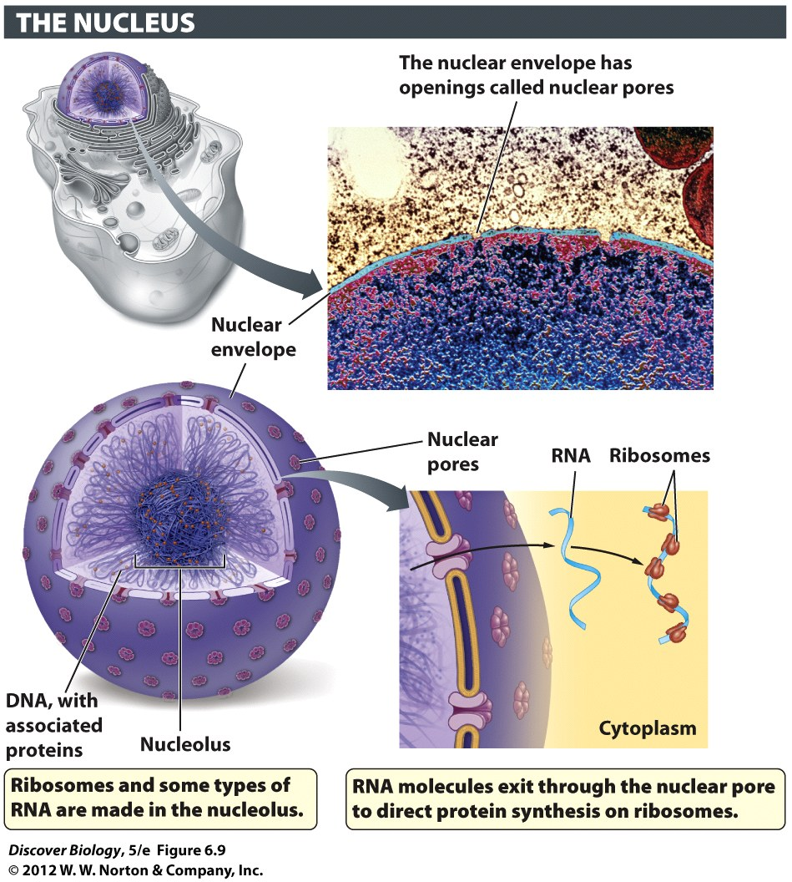
Notes:
Figure 6.9 The Nucleus Contains DNA, the Genetic Material of the Cell
The nucleus is enclosed within a double-membrane nuclear envelope. Nuclear pores provide a regulated passageway for molecules entering and exiting the nucleus.

Slide 30
The Endoplasmic Reticulum Manufactures Certain Lipids and Proteins
The endoplasmic reticulum (ER) is an interconnected network of tubes and flattened sacs that produces certain lipids and proteins
Enzymes of the smooth ER produce lipids for other cellular compartments and help break down toxic organic compounds in the cell
The rough ER is dotted with ribosomes that produce proteins for use both inside and outside the cell

Slide 31
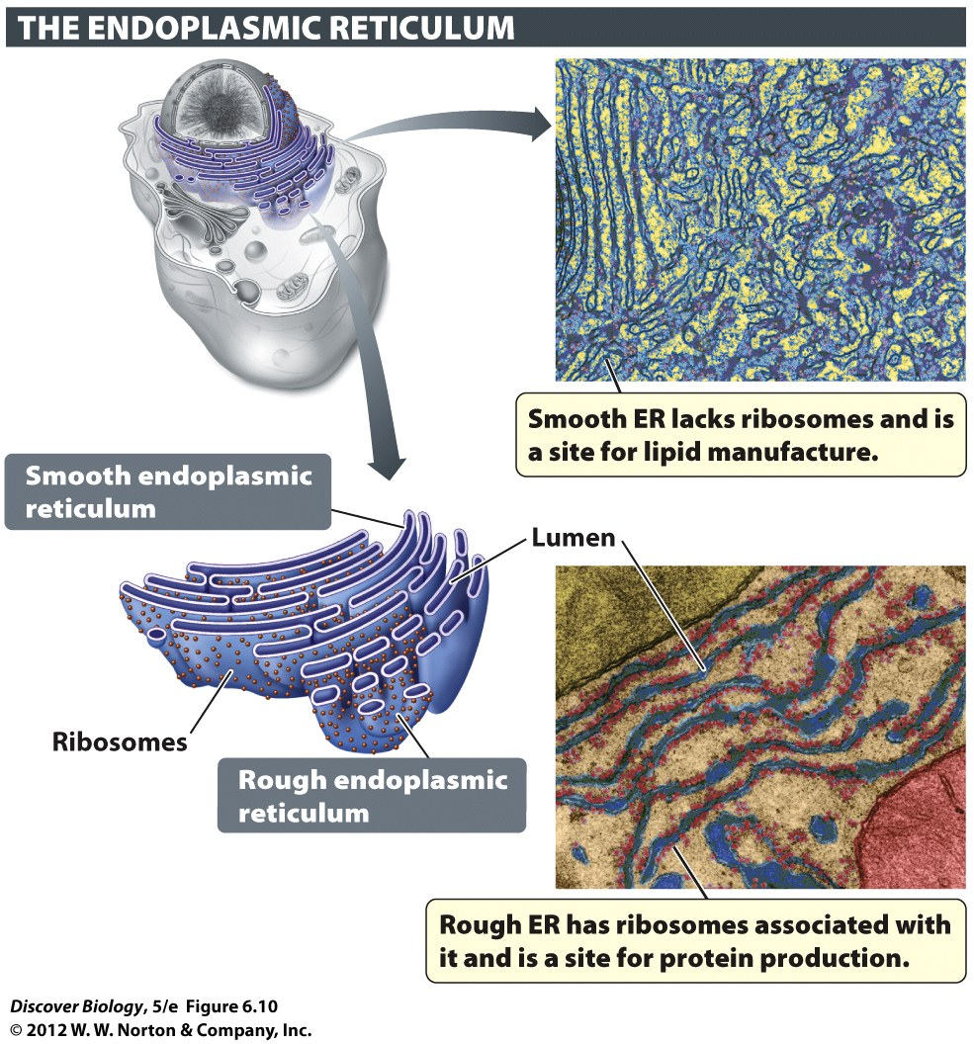
Notes:
Figure 6.10 Some Types of Lipids and Proteins Are Made in the Endoplasmic Reticulum

Slide 32
Transport Vesicles Move Materials
A transport vesicle is a small, spherical, membrane-enclosed sac that moves lipids, proteins, and carbohydrates between cellular compartments
The transport vesicle fuses with the membrane of the target destination in order to deliver its contents

Slide 33
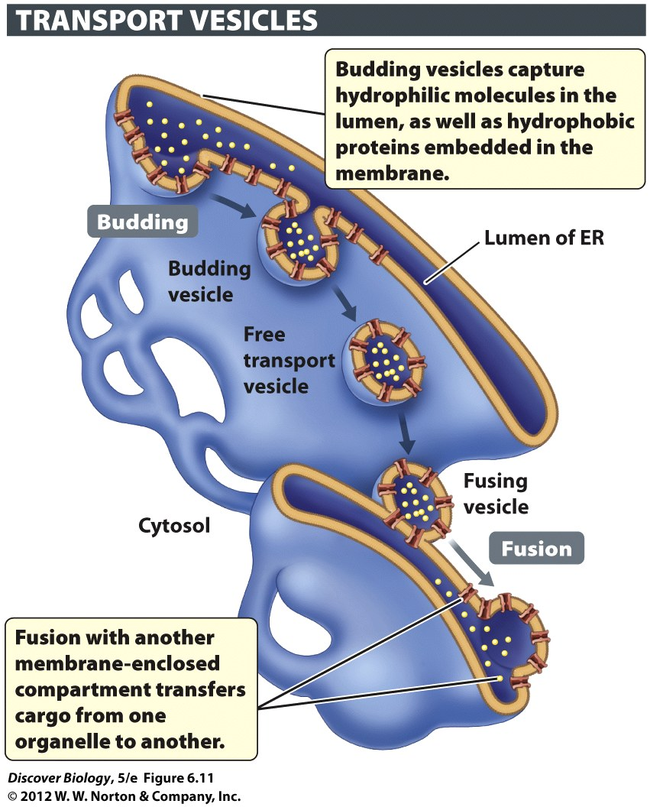
Notes:
Figure 6.11 Cellular Materials Are Dispatched to a Wide Variety of Destinations via Vesicles
Here, molecules are being shipped from the ER to the Golgi apparatus.

Slide 34
The Golgi Apparatus Sorts and Ships Macromolecules
The Golgi apparatus directs proteins and lipids produced by the ER to their final destination, either inside or outside the cell, through the addition of specific chemical groups
Vesicles move the lipids and proteins from the ER to the Golgi apparatus

Slide 35
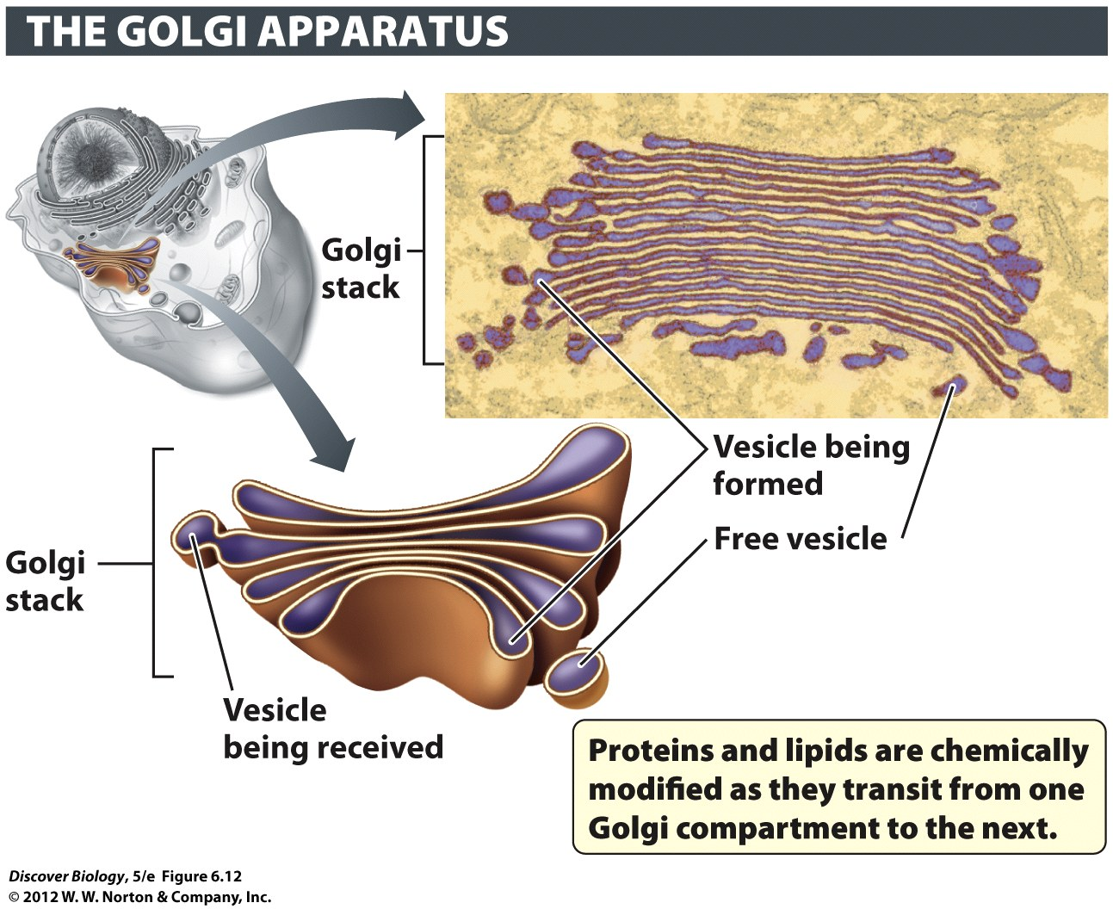
Notes:
Figure 6.12 The Golgi Apparatus Routes Proteins and Lipids to Their Final Destinations
Proteins and lipids are chemically modified, sorted, and shipped to their final destinations, inside or outside the cell, by the Golgi apparatus.

Slide 36
Lysosomes and Vacuoles Disassemble Macromolecules
Lysosomes use a variety of enzymes to break down macromolecules and release the subunits into the cytoplasm for recycling or waste removal
The interior of lysosomes is highly acidic, with a pH of about 5

Slide 37
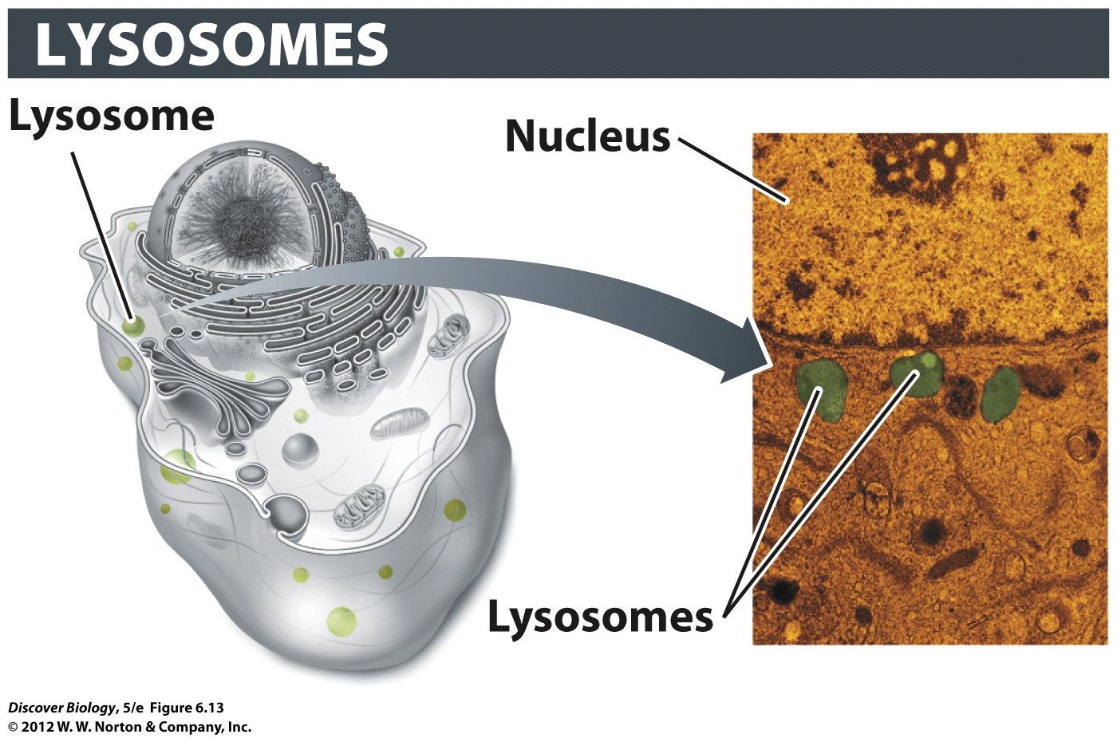
Notes:
Figure 6.13 Lysosomes Degrade Macromolecules
Lysosomes are found in animal cells. Lysosomes help to digest molecules taken up from outside and to break down cell components whose molecules can be repurposed.

Slide 38
Lysosomes and Vacuoles Disassemble Macromolecules
Plant organelles called vacuoles act much like lysosomes to break down macromolecules
Vacuoles can also store ions and water-soluble molecules as well as noxious compounds, which deter herbivores
Vacuoles filled with water provide turgor pressure, which helps make the nonwoody parts of plant cells rigid

Slide 39
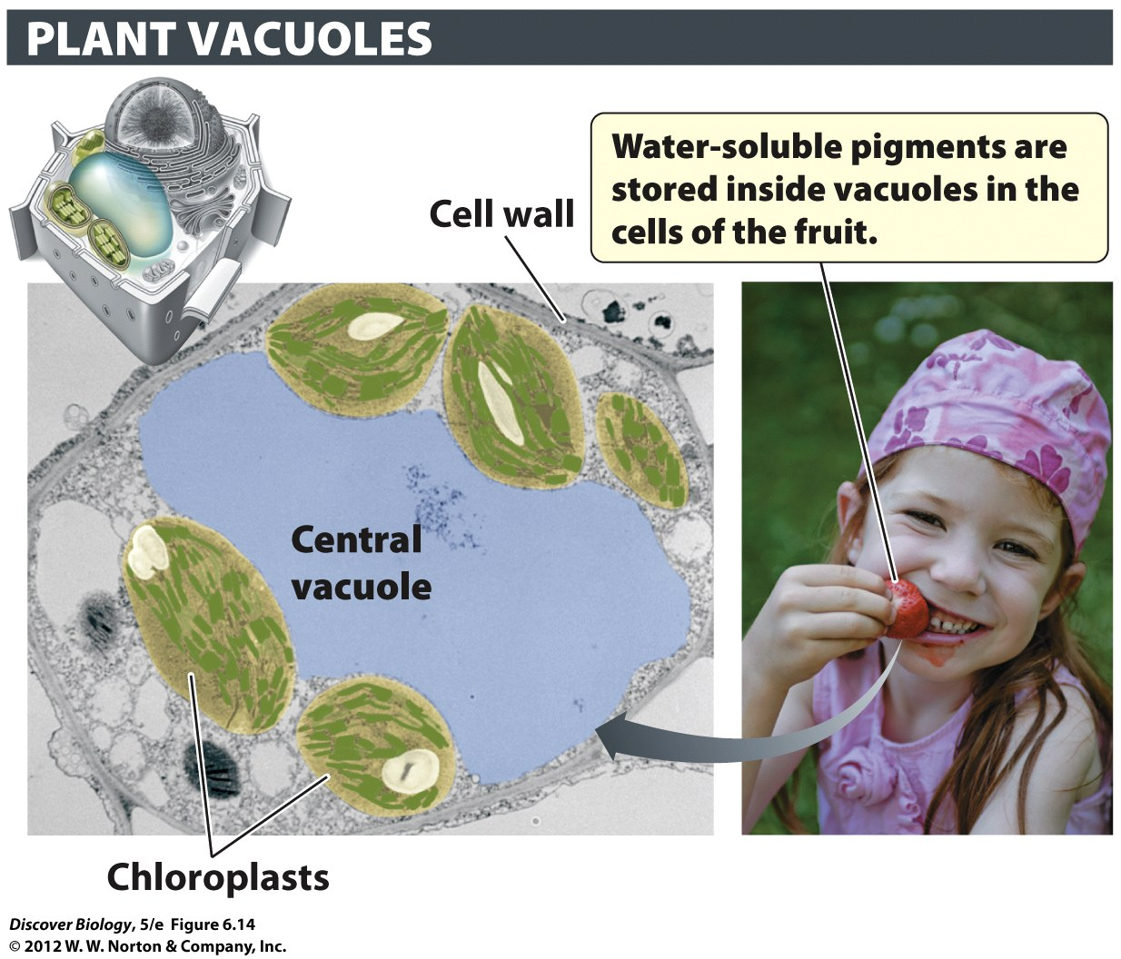
Notes:
Figure 6.14 Plant Vacuoles Store, Recycle, and Provide Turgor
Plant vacuoles contain enzymes for degrading large macromolecules. They also store water, ions, sugars, and other nutrients, and they may contain pigments that attract pollinators and/or toxins that deter herbivores. The fluid pressure that develops inside the vacuole gives turgidity to plant cells.

Slide 40
Mitochondria Power the Cell
The mitochondrion fuels cellular activities by extracting energy from food molecules
Plant cells have an additional organelle called the chloroplast, which uses sunlight to make energy-storing molecules
The mitochondrion is bound by double membranes that form an intermembrane space

Slide 41
Mitochondria Power the Cell
The folds of the inner membrane form the cristae, which help to increase the surface area for chemical reactions
Mitochondria use chemical reactions to turn food molecules into ATP, which can be used to fuel the chemical reactions of the cell
The process of turning food molecules into energy is called cellular respiration

Slide 42
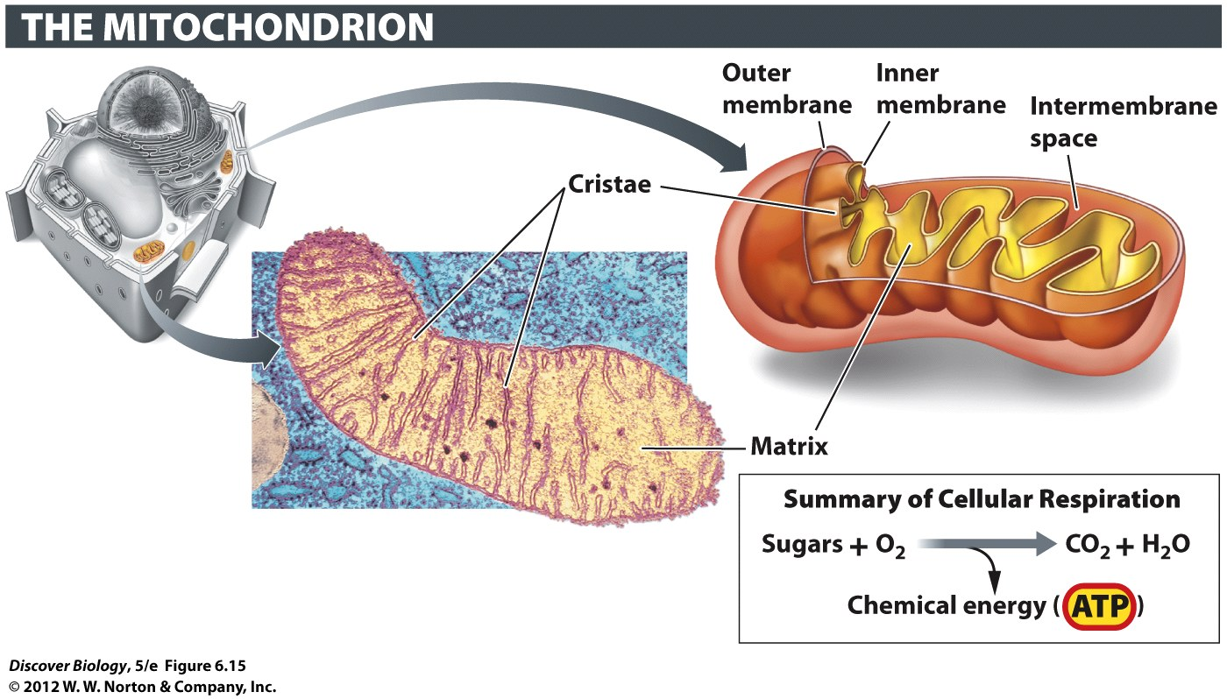
Notes:
Figure 6.15 Mitochondria Generate Energy in the Form of ATP
Each mitochondrion has a double membrane. The infoldings of the inner membrane (cristae) create a large surface area which enables many units of ATP-generating enzymes to be located there.

Slide 43
Chloroplasts Capture Energy from Sunlight
Plants and algae use chloroplasts to capture energy from sunlight to produce ATP
The ATP is then used to assemble sugar molecules from carbon dioxide and water in a process called photosynthesis
The energy in plant sugars is used directly by plants and indirectly by all organisms that eat plants
Oxygen is a by-product of photosynthesis and sustains life for humans and many other organisms

Slide 44
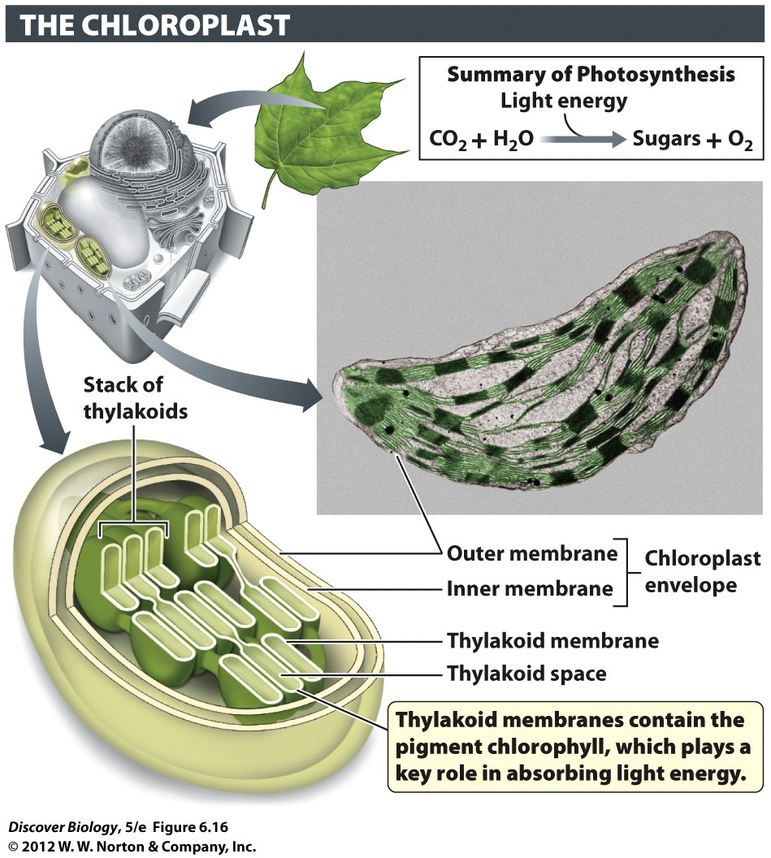
Notes:
Figure 6.16 Chloroplasts Capture Energy from Sunlight and Use It to Make Sugars
Chloroplasts are found in green plant parts and in the protists known as algae.

Slide 45
The Cytoskeleton
The interior of a cell is organized by a network of protein cylinders and filaments called the cytoskeleton
The cytoskeleton supports the movement of organelles, strengthens cell membranes, and can even enable cell movement, and contains:
Microtubules
Intermediate filaments
Microfilaments

Slide 46
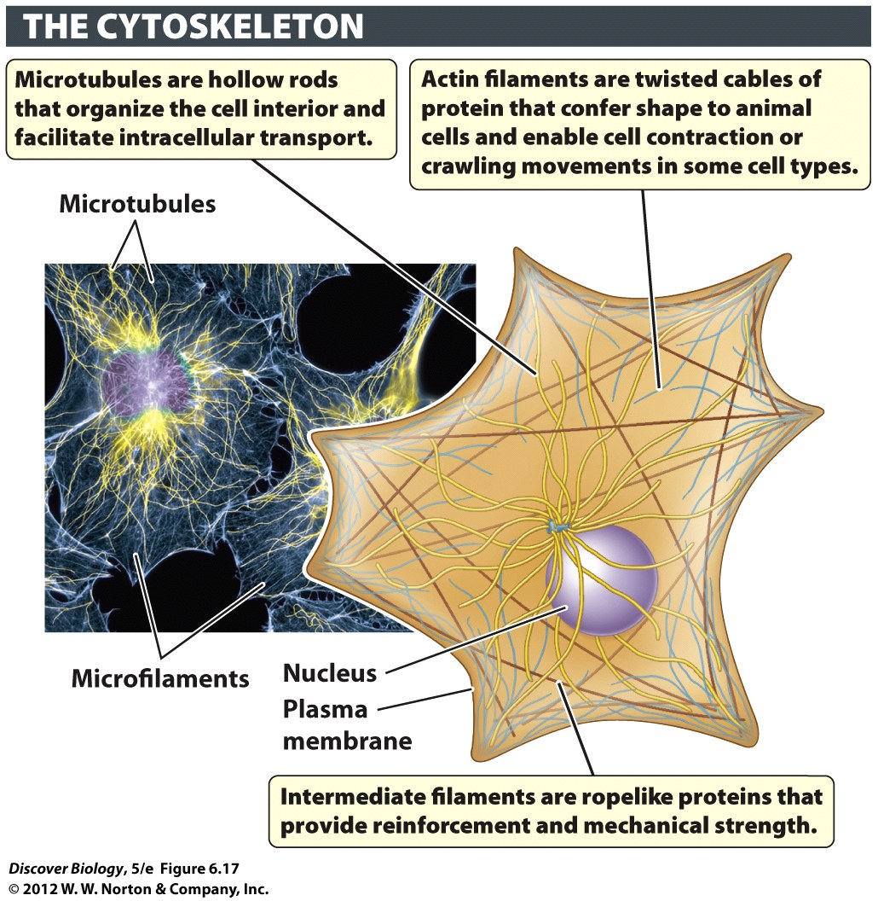
Notes:
Figure 6.17 An Overview of the Cytoskeletal System

Slide 47
The Cytoskeleton Consists of Three Basic Components
Microtubules are rigid, hollow cylinders of protein used for:
Positioning organelles
Moving transport vesicles and other organelles
Generating force to propel the cell
Intermediate filaments are ropelike cables of protein that provide mechanical reinforcement to the cell
Microfilaments are thin, flexible proteins that create cell shape and generate crawling movements in some cells

Slide 48
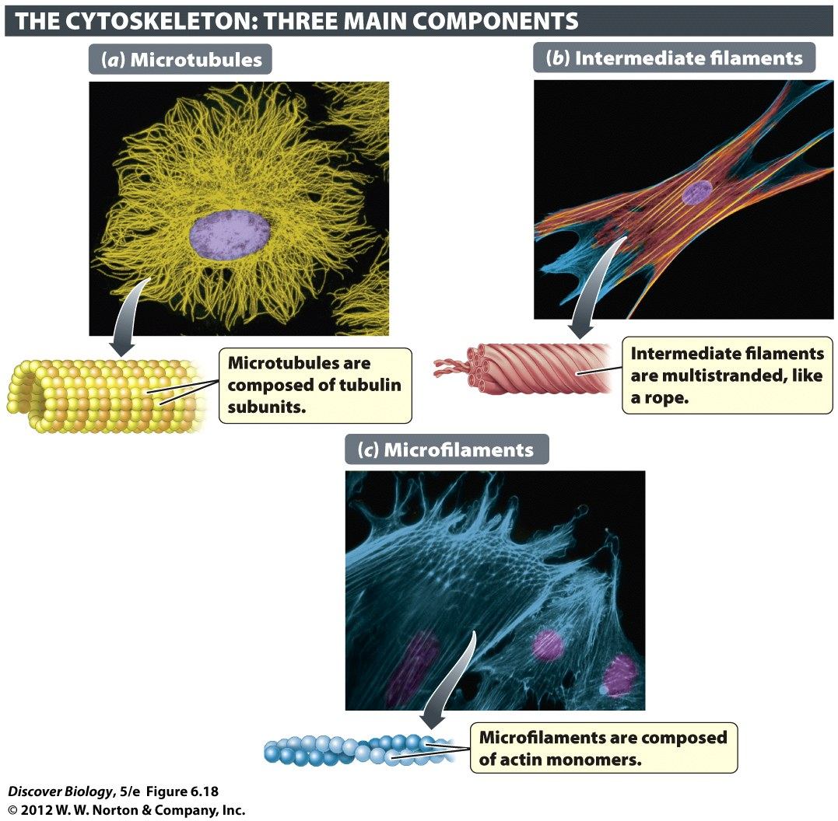
Notes:
Figure 6.18 The Structure of Microtubules, Intermediate Filaments, and Microfilaments
The cytoskeleton is composed of three basic units: (a) microtubules, (b) intermediate filaments, and (c) microfilaments.

Slide 49
Microtubules Support Movement inside the Cell
Microtubules are made of protein subunits called tubulin
Most cells have a radial pattern of microtubules, which acts as a scaffold that helps position organelles within the cytosol
Microtubules can act as a rail system to guide organelles to their destination within the cell

Slide 50
Intermediate Filaments Provide Mechanical Reinforcement
Intermediate filaments are thinner than microtubules and provide structural and mechanical support
The nuclear membrane is supported by intermediate filaments

Slide 51
Microfilaments Are Involved in Cell Movement
Microfilaments are thin strands of protein called actin that can lengthen and shorten to create movement in a cell
Cell crawling enables amoebas and slime molds to find food and mating partners
Wound healing and embryonic development both rely on cell crawling

Slide 52
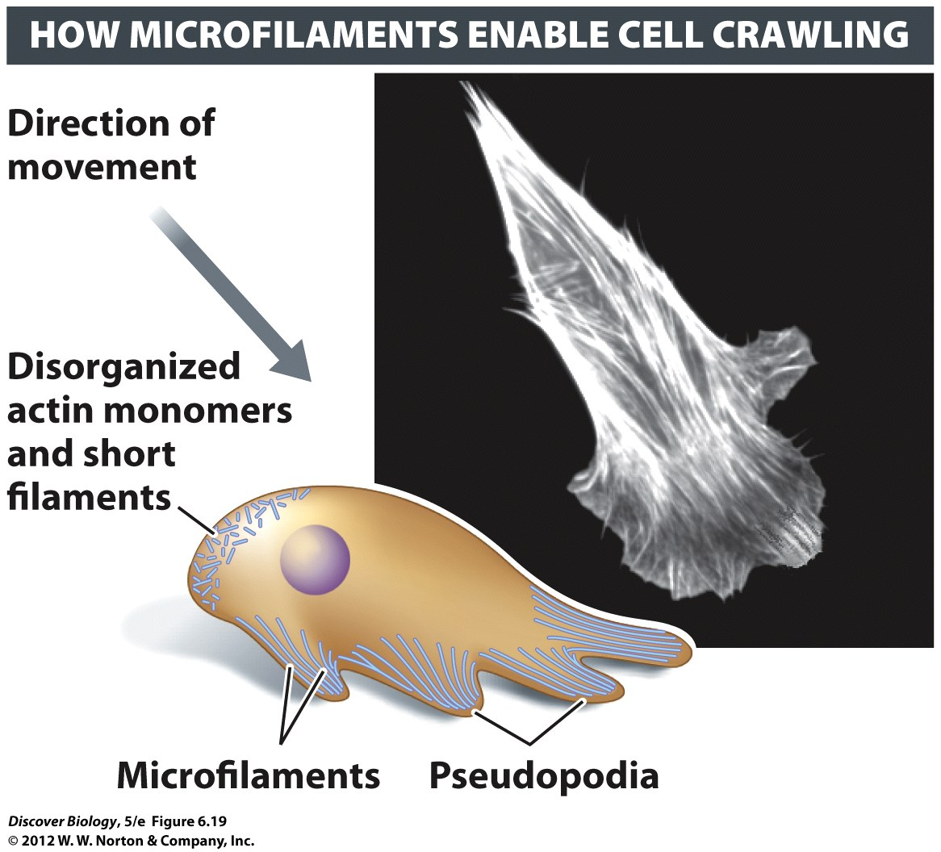
Notes:
Figure 6.19 Microfilaments Drive Some Types of Whole Cell Movement

Slide 53
Cilia and Flagella Enable Whole Cell Movement
Many protists and animals have cells covered in hairlike projections called cilia
Cilia can be moved back and forth to move a whole cell through liquid
Motor proteins interlinking the microtubules use ATP to cause the cilia to bend, causing the cell to move

Slide 54
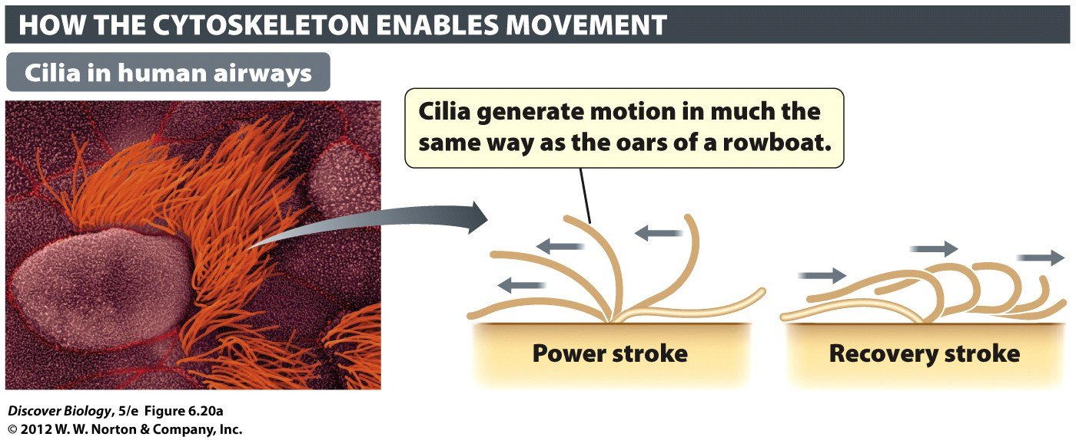
Notes:
Figure 6.20 Cilia and Flagella Generate Movement
Many organisms, especially singlecelled ones, use cilia or flagella to generate movement. (a) Tufts of cilia are present on the cells that line our breathing tubes (bronchi). (b) Eukaryotic flagella, such those in sperm cells, are much longer than cilia. Eukarytotic cilia and flagella contain bundles of microtubules arranged in a 9+2 pattern (inset) and are covered by a plasma membrane. Prokaryotic flagella have a very different structure. (c) A prokaryotic flagellum, such as the one on this bacterium (Bdellovibrio bacteriovorus), consists of ropelike proteins attached to protein complexes anchored in the cell membranes.

Slide 55
Cilia and Flagella Enable Whole Cell Movement
Some bacteria, archaeans, and protists and the sperm cells of some plants and animals use a flagellum (plural: flagella) to propel themselves through fluid
Flagella are similar to cilia in structure
Eukaryotic flagella differ from the flagella of prokaryotes in structure and movement

Slide 56
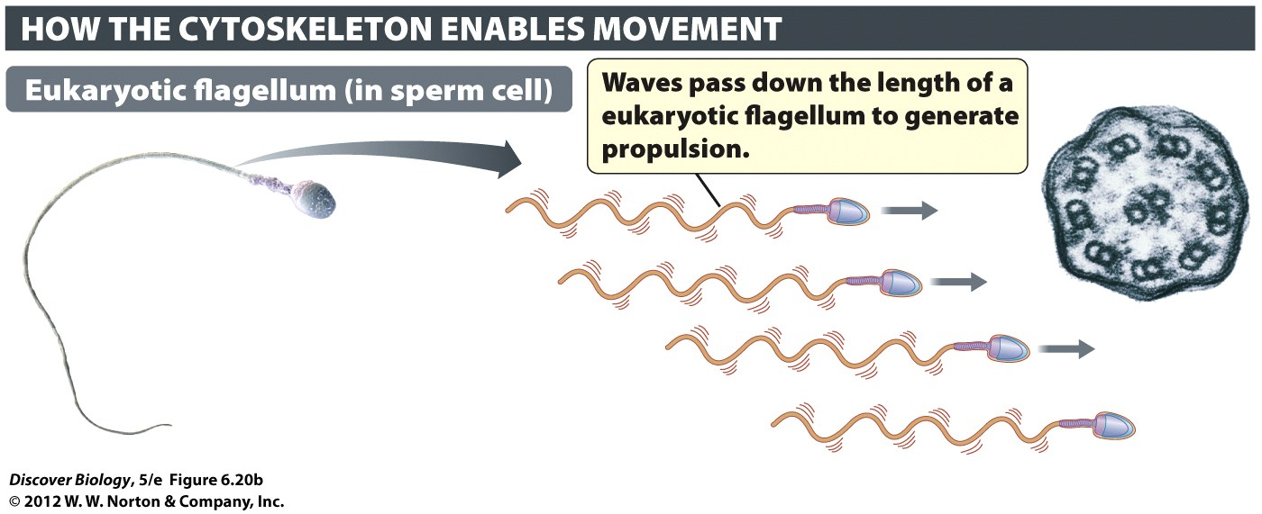
Notes:
Figure 6.20b Cilia and Flagella Generate Movement
Many organisms, especially singlecelled ones, use cilia or flagella to generate movement. (b) Eukaryotic flagella, such those in sperm cells, are much longer than cilia. Eukarytotic cilia and flagella contain bundles of microtubules arranged in a 9+2 pattern (inset) and are covered by a plasma membrane. Prokaryotic flagella have a very different structure.

Slide 57
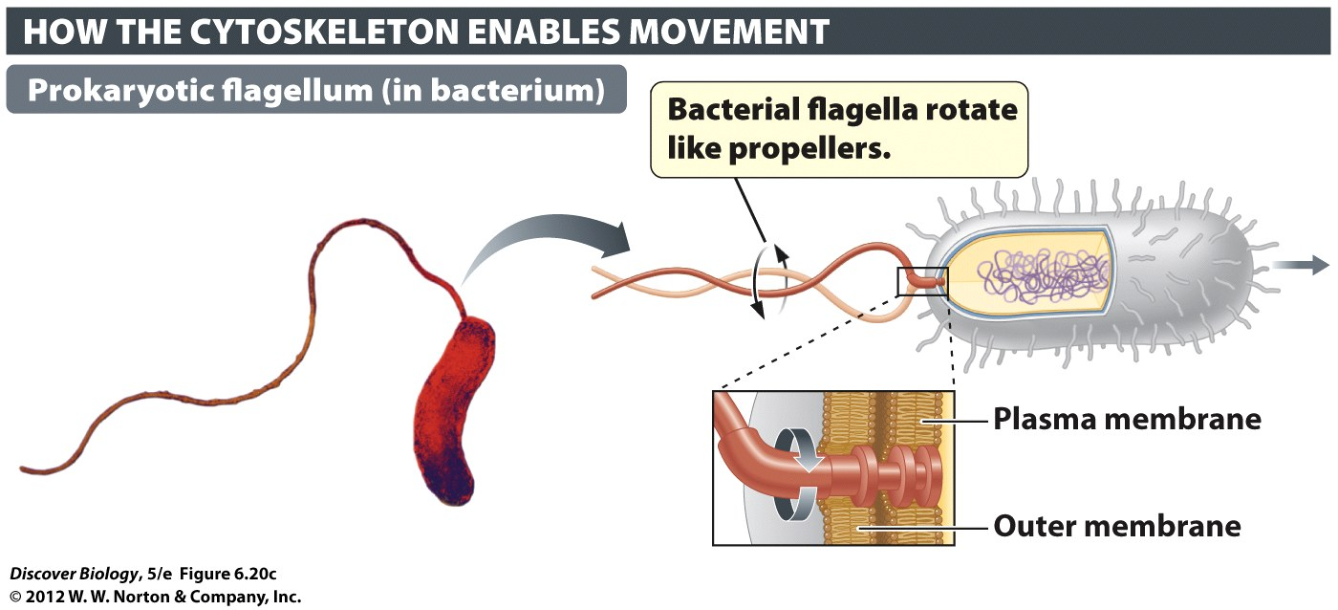
Notes:
Figure 6.20c Cilia and Flagella Generate Movement
Many organisms, especially singlecelled ones, use cilia or flagella to generate movement. (c) A prokaryotic flagellum, such as the one on this bacterium (Bdellovibrio bacteriovorus), consists of ropelike proteins attached to protein complexes anchored in the cell membranes.

Slide 58
The Evolution of Eukaryotes
Cells can exhibit mutualism when two cell merge
Eukaryotic organelles are believed to have originally been free-living prokaryotes that were engulfed by a predatory cell

Slide 59
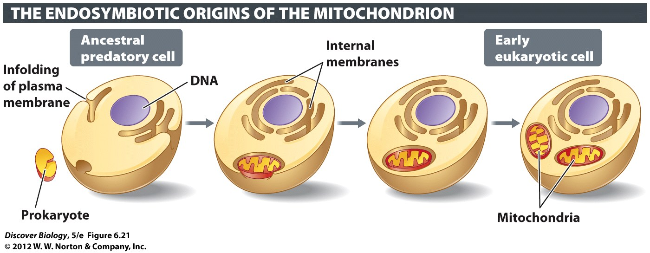
Notes:
Figure 6.21 How Ancestral Eukaryotes Acquired Membrane- Enclosed Organelles
Some organelles, such as mitochondria and chloroplasts, are likely descendants of engulfed prokaryotes. Other membrane-enclosed organelles, such as the endoplasmic reticulum, probably arose through an infolding of the plasma membrane.

Slide 60
Clicker Questions
CHAPTER 6
Cell Structure and Internal
Compartments

Slide 61
Concept Quiz
Where is the secreted protein insulin synthesized?
In the Golgi apparatus
On the rough ER
On ribosomes in the cytoplasm
In the nucleus
Notes:
The correct answer is B. From the chapter, the students should realize that membrane and secreted proteins are made in the rough ER. This allows them to be made on the “outside” of the membrane. As a result, the hydrophilic protein can be secreted by being packaged in a vesicle and fusing this vesicle to the membrane.
Answer A is incorrect because the Golgi completes the protein, but doesn’t synthesize it.
Answer C is incorrect because insulin is secreted and must be synthesized in the rough ER.
Answer D is incorrect because the nucleus doesn’t synthesize proteins.

Slide 62
Concept Quiz
Two main types of cells are ______ and _______.
Prokaryotic; eukaryotic
Bacterial; animal
Nerves; muscles
Plant; animal
Notes:
The correct answer is A. Many students miss this important distinction because it is only mentioned at the beginning of the chapter, after which only plant and animal cells are discussed. It’s worth stressing that most of life on earth is prokaryotic.
Answer B is incorrect because there are eukaryotic cells besides animal cells (e.g., plant and fungi).
Answer C is incorrect because these are just two examples of eukaryotic cells in animals.
Answer D is incorrect because these are just two examples of eukaryotic cells.

Slide 63
Concept Quiz
The boundary structure that physically defines a cell is the .
Cell wall
Selective permeability
Plasma membrane
Protein coat
Notes:
The correct answer is C.
Many students believe that all cells, including animal cells, have a cell wall.
Answer A is incorrect, because only plants and some bacteria have a cell wall.
Answer B is incorrect because this is not a structure, but a function.
Answer D is incorrect because no cells have a protein coat. Only viruses have these.

Slide 64
Relevant Art from Other Chapters
All art files from the book are available in JPEG and PPT formats online and on the Instructor Resource Disc

Slide 65
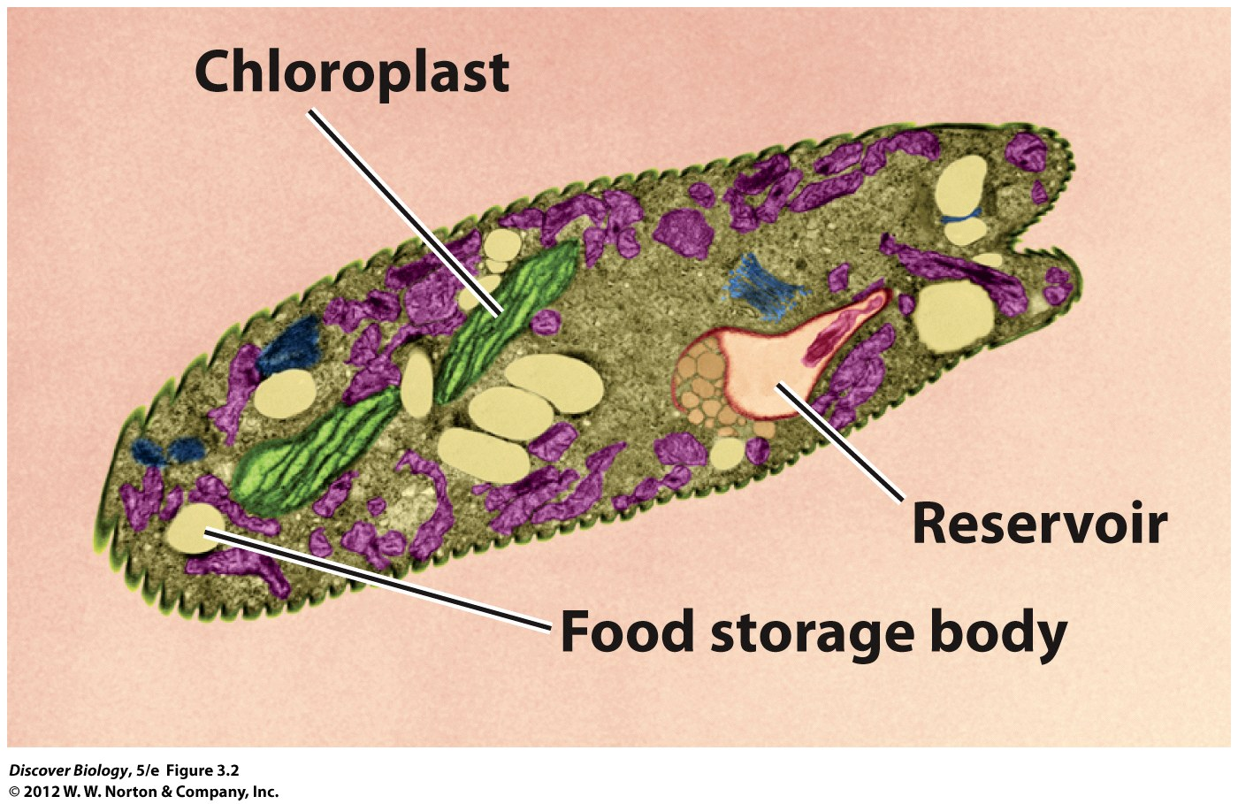
Notes:
Figure 3.2 Internal Organization in Euglena
The compartments seen in this green alga, Euglena gracilis, include the nucleus, and structures specialized for conducting photosynthesis (chloroplasts) and storing food. The protist uses a long, whiplike structure (the flagellum) to swim about. The flagellum is not visible in this color-enhanced electron microscope photograph. The reservoir is a pocket in which flagella are anchored. The following additional membraneenclosed compartments are also visible in this photograph: mitochondria (purple), lipid bodies (dark orange), Golgi apparatus (blue). The functions of these organelles are described in Chapter 6.

Slide 66
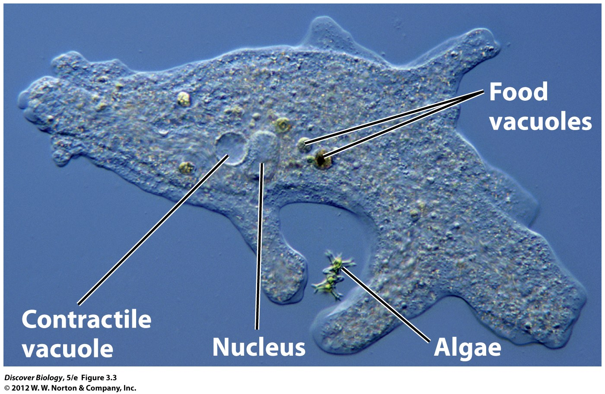
Notes:
Figure 3.3 An Amoeba Digesting Its Prey
The prey being ingested by the amoeba are a type of single-celled algae known as desmids.

Slide 67
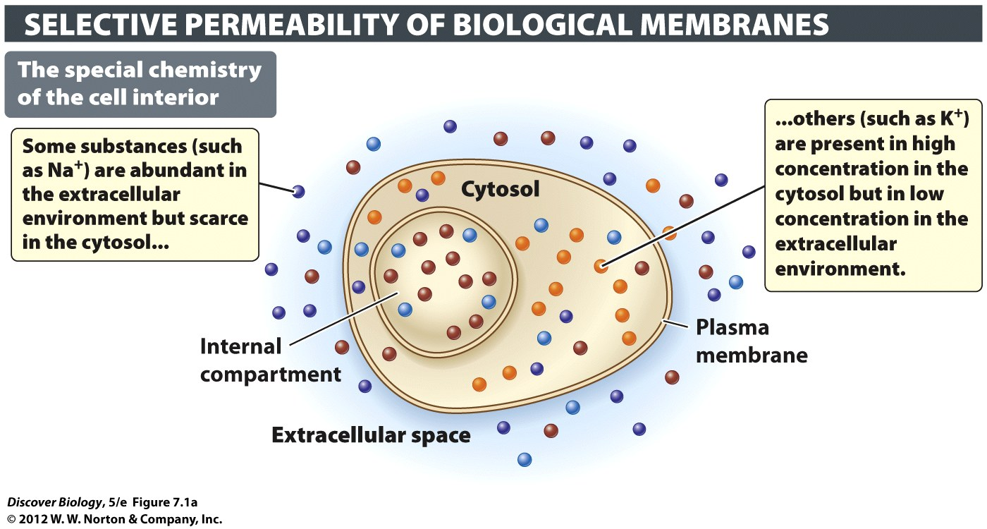
Notes:
Figure 7.1 The Plasma Membrane Is a Barrier and a Gatekeeper
(a) The chemistry of the cytosol is distinctly different from that of the extracellular environment, in part because the plasma membrane moves substances in a highly selective fashion. Some substances are shut out altogether, while others are allowed to enter or leave in a controlled fashion. (b) The selectivity of biological membranes is determined in large part by the types of membrane proteins in their phospholipid bilayer.

Slide 68
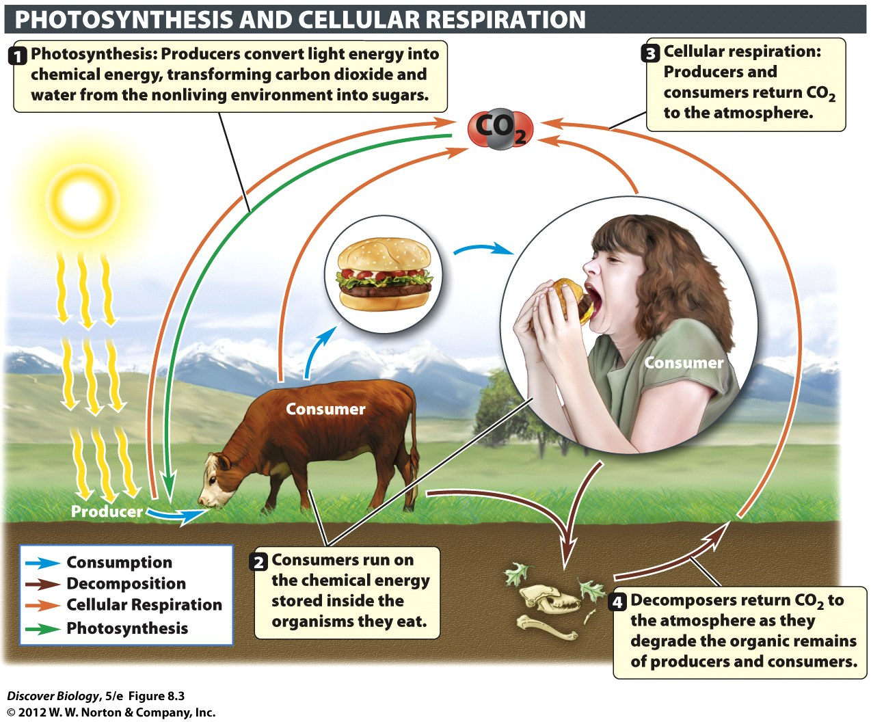
Notes:
Figure 8.3 Photosynthesis and Cellular Respiration Are Complementary Processes
Matter, in the form of carbon atoms, cycles among producers, consumers, and the environment.

Slide 69
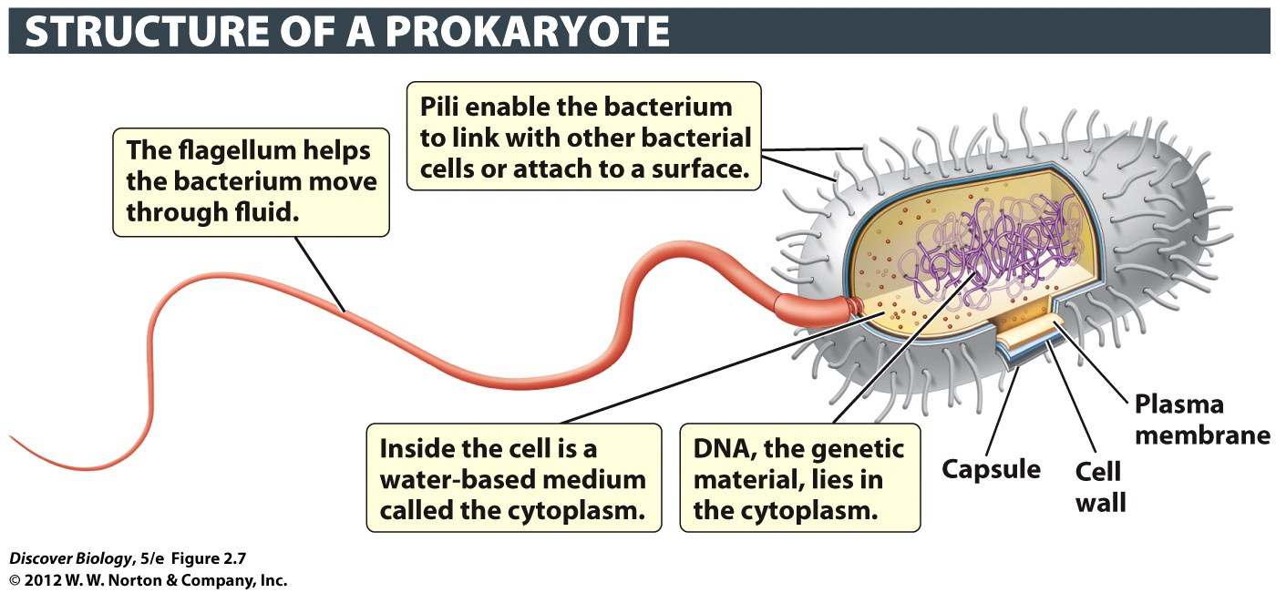
Notes:
Figure 2.7 Prokaryotic Cells Lack a Nucleus
Prokaryotic cells tend to be about 10 times smaller than eukaryotic cells, and generally have much less DNA.

