Slide 1
Discover Biology FIFTH EDITION
Anu Singh-Cundy • Michael L. Cain
CHAPTER 5
The Chemistry of Life
© 2012 W. W. Norton & Company, Inc.

Slide 2
Notes:
An Anti–Trans Fat Rally.
A young protestor makes her views known, as the New York City Board of Health holds public hearings on a plan to ban trans fats from city restaurants.

Slide 3
How the “Cookie Monster” Tackled Trans Fats
Trans fats, found in everything from cooking oil to Oreos, have been linked to the development of heart disease
Banning trans fats is one way of protecting consumers and decreasing heart disease

Slide 4
Despite All Life’s Remarkable Diversity
All cells share a limited number of atomic ingredients that combine to form many different types of molecules
Biomolecules are those molecules found in living cells
All biomolecules are carbon based

Slide 5
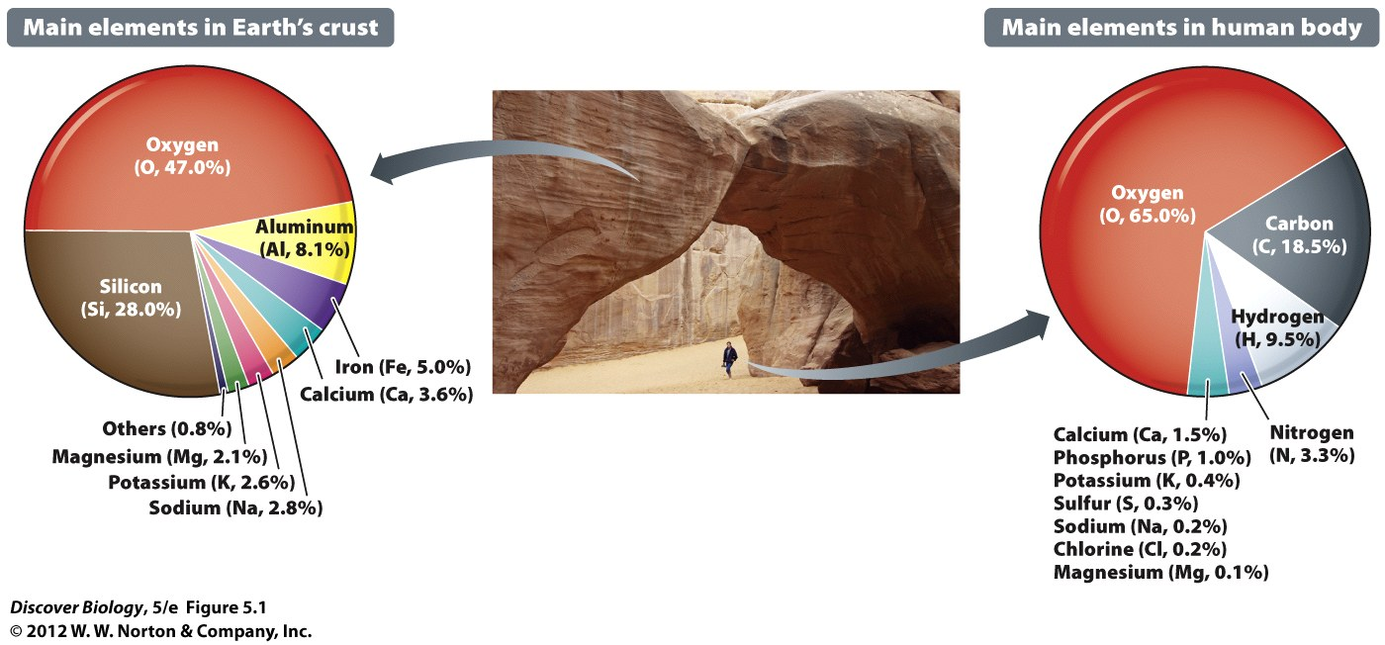
Notes:
Figure 5.1 Chemical Composition of Earth’s Crust and the Human Body

Slide 6
Matter, Elements, and Atomic Structure
Matter is anything that has mass and occupies space
A pure substance with unique physical and chemical properties is called an element and cannot be broken down into other substances
An atom is the smallest unit of an element

Slide 7
Matter, Elements, and Atomic Structure
Each type of atom contains a unique combination of protons, electrons, and neutrons
Protons have a positive (+) charge
Electrons have a negative (-) charge
Neutrons lack an electrical charge
The positively charged nucleus of an atom contains one or more protons and the same number of neutrons
Negatively charged neutrons move around the nucleus in electron shells

Slide 8
Notes:
Figure 5.2 Atomic Structure
The electrons, protons, neutrons, and nuclei of these hydrogen and carbon atoms are shown greatly enlarged in relation to the size of the whole atom. An electron shell is a simplified way of representing the space that electrons move in as they orbit the nucleus.

Slide 9
The Size and Structure of Atoms Can Be Described with Numbers
The atomic number represents the number of protons in an atom
The atomic mass number is the total number of protons and neutrons in an atom

Slide 10
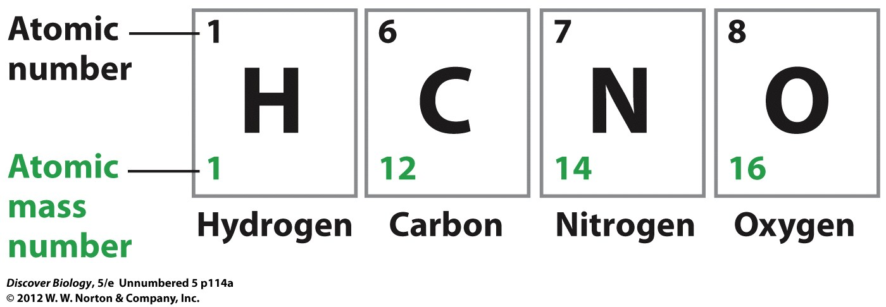

Slide 11
Some Elements Exist in Variant Forms Called Isotopes
An element can come in different forms called isotopes that differ only in their atomic mass
Isotopes have the same number of protons and neutrons but differ in the number of neutrons
Radioisotopes have unstable nuclei that decay into simpler forms, releasing high-energy radiation in the process

Slide 12
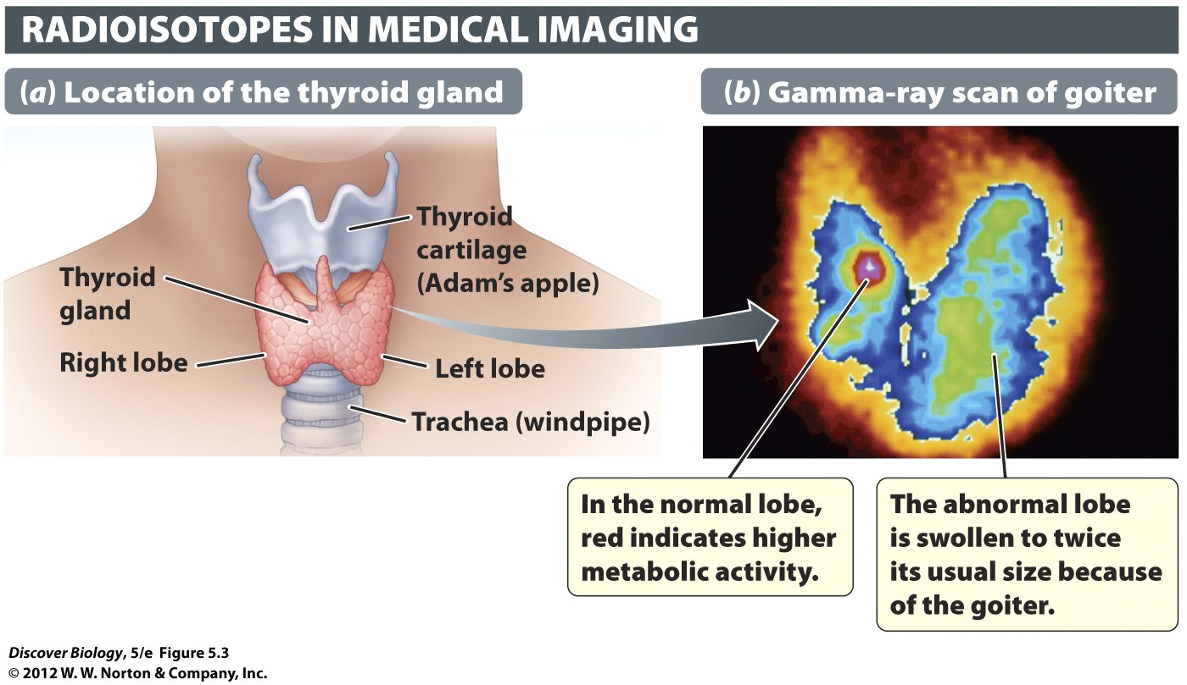
Notes:
Figure 5.3 Radioisotopes Are Useful in Medical Imaging
(a) The thyroid gland, located in the neck, helps regulate metabolism. The element iodine accumulates in the gland and is necessary for normal thyroid function. (b) This image is a visualization of the thyroid gland in a patient with goiter, an enlargement of the thyroid gland, often caused by iodine deficiency. Small amounts of radioactive iodine were given to the patient, and the accumulated radioisotope was visualized with a gamma-ray scan.

Slide 13
Covalent and Ionic Bonds
Molecules are two or more atoms that share electrons through a chemical bond known as a covalent bond
Molecules can contain atoms of the same element or different elements
Atoms that have gained or lost electrons have an electrical charge and are called ions
An ionic bond is a bond that occurs between negatively and positively charged ions

Slide 14
Covalent and Ionic Bonds
A substance that contains atoms from two or more different elements in a precise ratio is called a chemical compound
Chemical formulas are used to describe chemical and ionic compounds

Slide 15
Covalent Bonds Form by Electron Sharing between Atoms
The maximum number of electrons in any atomic shell is fixed
When all shells are filled to capacity, an atom is most stable
Atoms with unfilled shells interact to share electrons in order to reach a more stable state

Slide 16
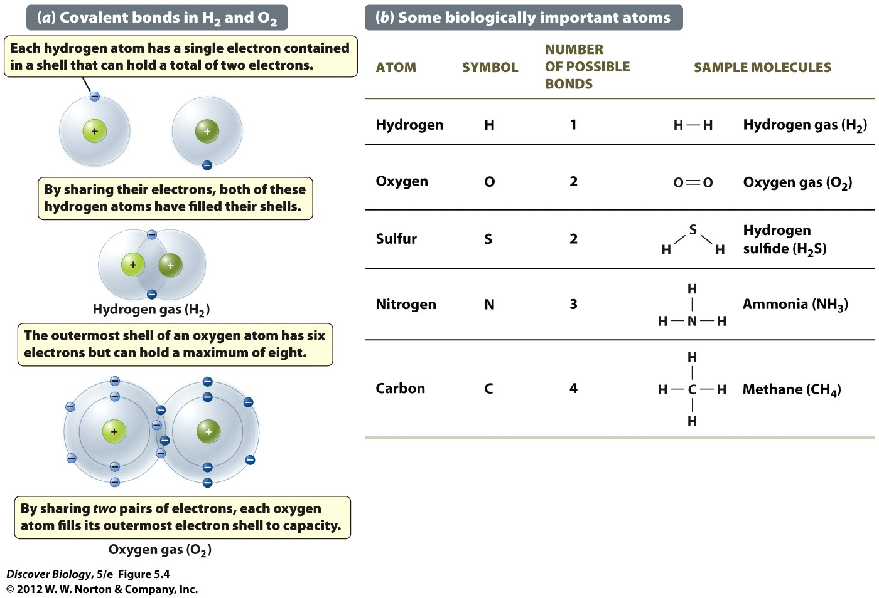
Notes:
Figure 5.4 Covalent Bonds and Electron Shells
Atoms in biologically important molecules have as many as four electron shells. The innermost shell holds a maximum of two electrons, and the next shell outside it holds a maximum of eight. (a) A single covalent bond is formed by the sharing of one pair of electrons between two atoms. Two hydrogen atoms can share one pair of electrons, forming one covalent bond. An oxygen atom requires two additional electrons to fill its outermost shell and can therefore form two covalent bonds. (b) The number of covalent bonds an atom can form depends on the number of electrons needed to fill its outermost shell to capacity. A carbon atom can form four bonds because it has only four electrons in its outermost shell and requires four more electrons to fill that shell.

Slide 17
Covalent Bonds Form by Electron Sharing between Atoms
Each pair of electrons shared between two atoms represents a covalent bond
A double bond exists when two sets of atoms share electrons
A triple bond exists when three sets of atoms share electrons
Molecular representations include the structural formula, the ball-and-stick model, and the space-filling model

Slide 18
Notes:
Figure 5.5 Covalent Bonds between Atoms Can Be Represented in Various Ways
By convention, hydrogen is shown in white and oxygen in red.

Slide 19
Ionic Bonds Form between Atoms of Opposite Charge
An ionic bond forms between atoms with opposite electrical charges
The loss of an electron by one atom and the gain of an electron by an atom of the opposite charge neutralizes the pair
Salts are compounds that are held together by ionic bonds that form a crystal lattice

Slide 20
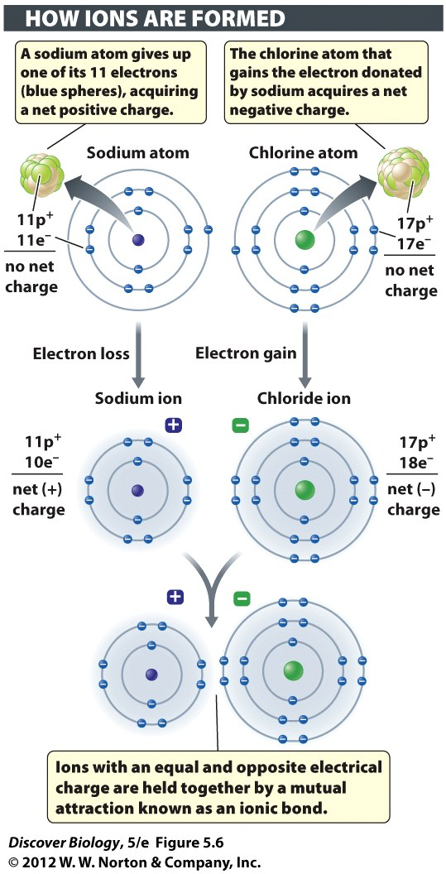
Notes:
Figure 5.6 Ions Are Created through the Loss or Gain of Electrons
Negatively charged ions are often given special names, such as “chloride” for the chlorine ion (Cl⁻) and “fluoride” for the fluorine ion (F⁻).

Slide 21
Notes:
Figure 5.7 Salts Are Ionic Compounds

Slide 22
The Special Properties of Water
Water sustains all life as we know it
The average cell is about 70 percent water by weight
Almost every chemical process associated with life occurs in water

Slide 23
Water Is a Polar Molecule
Water consists of two hydrogen atoms and one oxygen atom held together by covalent bonds
When one or more atoms in a molecule are more electronegative, the result is a polar covalent bond
Polar molecules contain an uneven distribution of electrical charges that make one end of the molecule slightly negative and the other end slightly positive

Slide 25
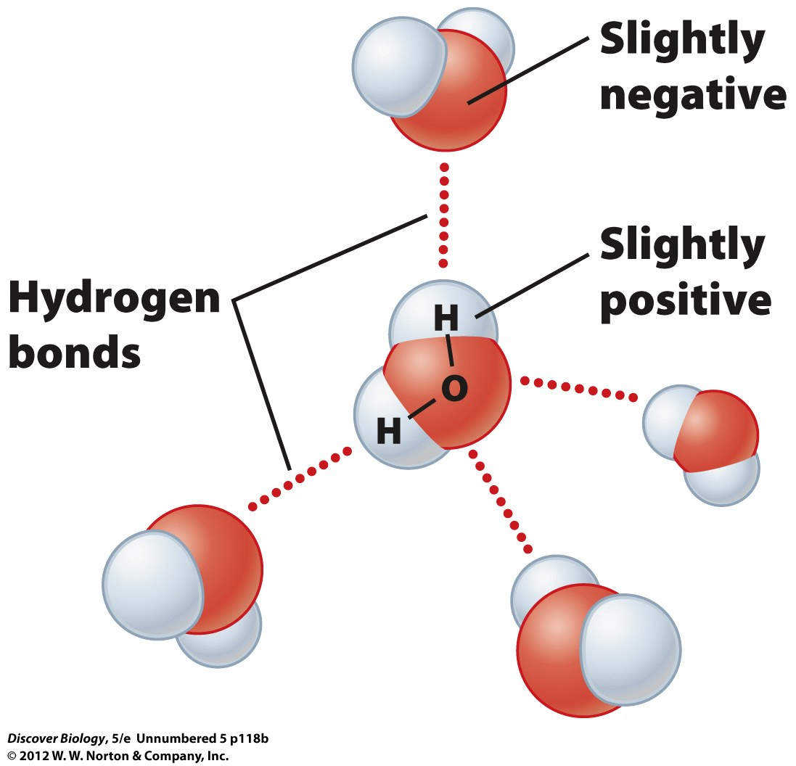

Slide 26
Water Is a Polar Molecule
Water is a polar molecule with slightly positive hydrogen atoms and a slightly negative oxygen atom
Hydrogen bonds form between positively charged hydrogen atoms and adjacent, negatively charged oxygen atoms
The polarity of water and the resulting hydrogen bonds are what give water its unique properties

Slide 27
Water Is a Solvent for Charged or Polar Substances
Polar compounds are soluble in water
A solute is a substance dissolved in a solvent, which is the term for the fluid in which it is dissolved
Water is an excellent solvent
Nonpolar molecules are not soluble in water or other polar solvents
Hydrophobic molecules are typically nonpolar and do not associate with water
Hydrophilic molecules are polar and interact with water

Slide 28
Notes:
Figure 5.8 Charged Substances Dissolve in Water to Form Solutions

Slide 29
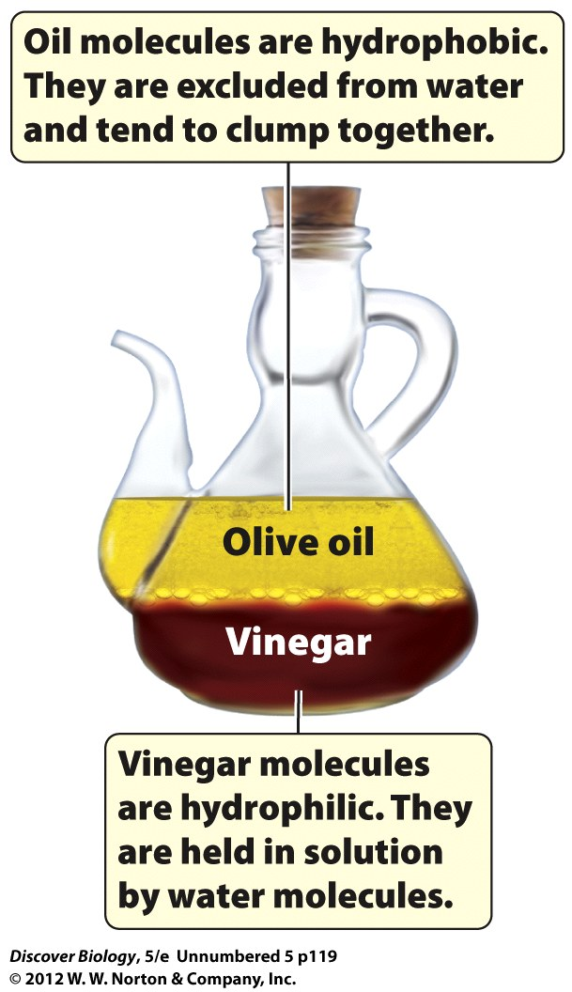

Slide 30
Hydrogen Bonding Accounts for the Physical Properties of Liquid Water and Ice
At room temperature, the hydrogen bonds in water are continually forming and re-forming, creating a liquid state
At 0°C, water molecules slow and stronger hydrogen bonds form in an orderly pattern
Water molecules are farther apart in ice than in water, causing ice to be less dense and to float

Slide 31
Notes:
Figure 5.9 Hydrogen Bonding between Water Molecules
A hydrogen bond is the weak attraction between a hydrogen atom with partial positive charge and the partially negative region of any polar molecule. In vapor form, water molecules move too rapidly, and are too far apart, to form hydrogen bonds.

Slide 32
Water Moderates Temperature Swings
Heat capacity is the amount of heat it takes to raise the temperature of a specific volume of water by a fixed amount
Water has a high heat capacity and can absorb and release large amounts of heat
The high heat capacity of water in cells serves to protect them from changes in internal temperatures

Slide 33
The Evaporation of Water Has a Cooling Effect
When water molecules are heated, they become energetic enough to escape their hydrogen bonds as water vapor in a process called evaporation
As high-energy water molecules evaporate, the average temperature of the remaining liquid drops; this process is called evaporative cooling

Slide 34
Hydrogen Bonding Accounts for the Cohesion of Water Molecules
The hydrogen bonds between water molecules generate an attractive force called cohesion
Cohesion is what allows plants and trees to transport water up to the leaves
Surface tension results from the pull of hydrogen atoms on the water molecules at the air-water boundary

Slide 35
Notes:
Figure 5.10 Hydrogen Bonding between Water Molecules Contributes to the High Surface Tension of Water
The cohesion of water molecules gives rise to surface tension, a force that resists the stretching of the water surface at any air-water boundary.

Slide 36
Chemical Reactions
Breaking and forming atomic bonds is necessary to carry out chemical reactions
A reactant is a substance that undergoes a chemical change to form a new substance, called a product
Certain reactions generate energy, while others require energy in order to take place
A chemical reaction can neither create nor destroy atoms

Slide 37
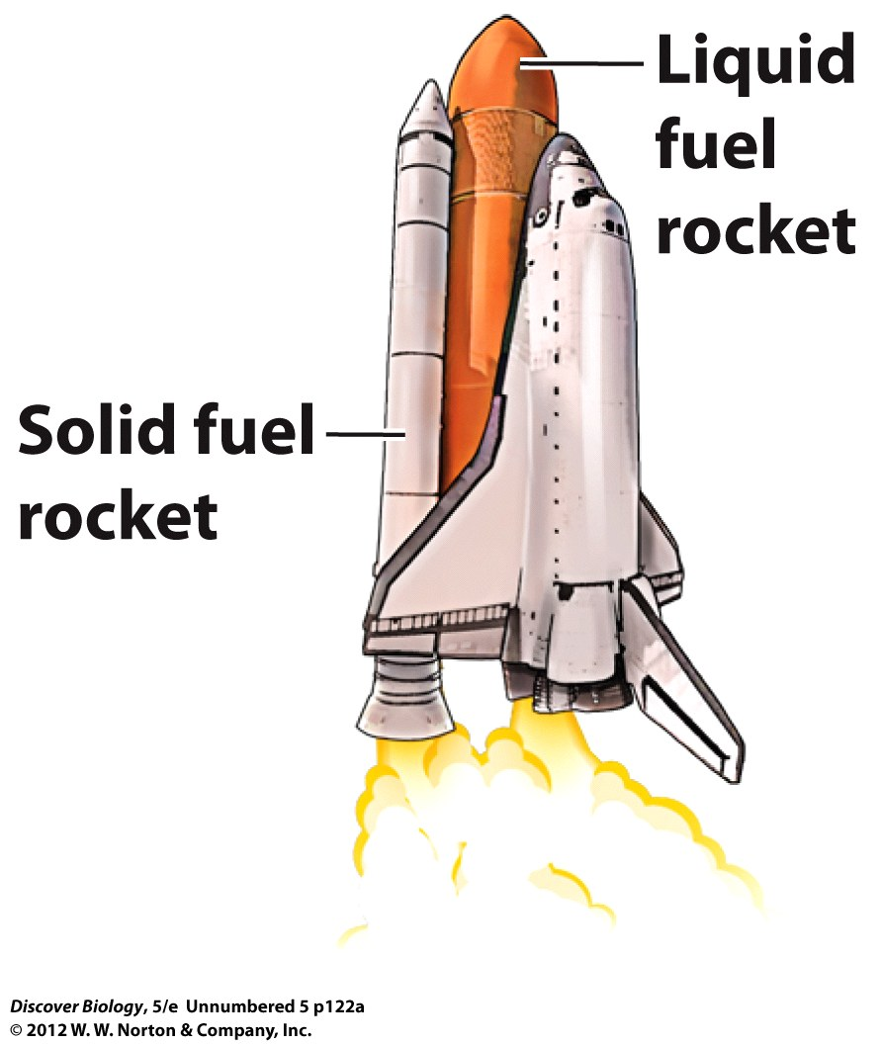

Slide 39
The pH Scale
An acid is a hydrophilic compound that dissolves in water and releases hydrogen ions
A base is a hydrophilic compound that removes hydrogen ions from the solution
A pH scale measures the concentration of hydrogen ions on a scale of 0–14
Pure water is a neutral solvent and has a pH of 7
Living systems function best at a pH close to neutral

Slide 40
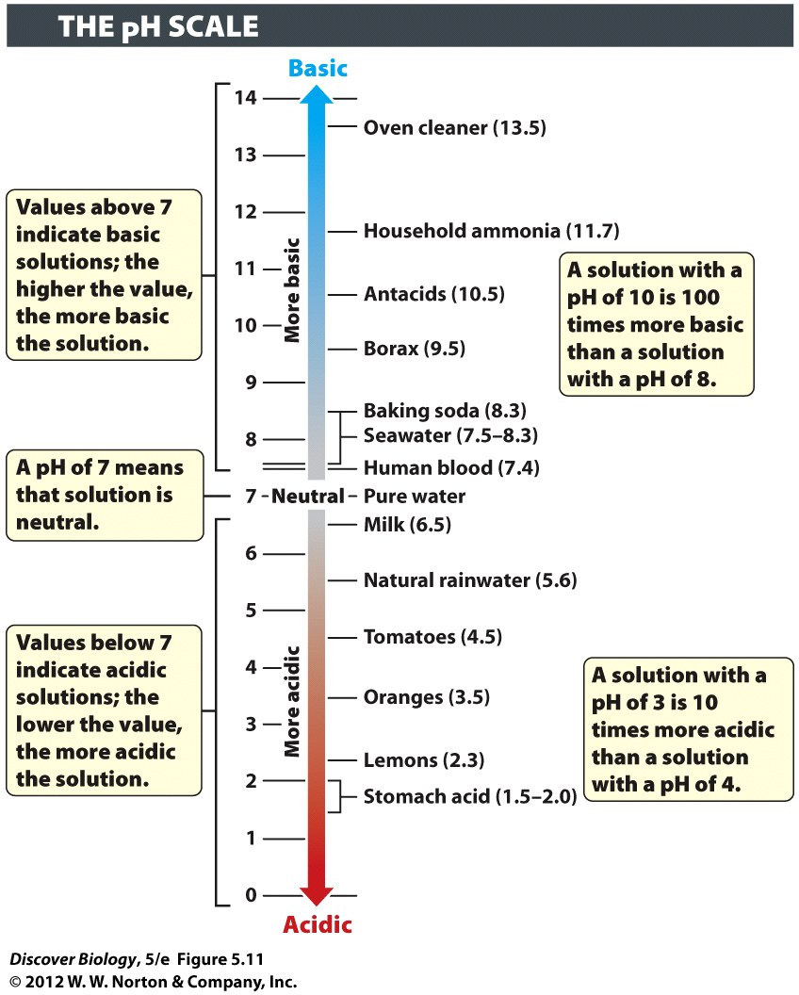
Notes:
Figure 5.11 The pH Scale Indicates Hydrogen Ion Concentration, a Measure of Acidity versus Basicity

Slide 41
The Chemical Building Blocks of Life
Four major classes of molecules are essential to life:
Carbohydrates
Proteins
Lipids
Nucleic acids
Each of these molecules is made up of varying combinations of carbon, hydrogen, oxygen, nitrogen, phosphorus, and sulfur

Slide 42
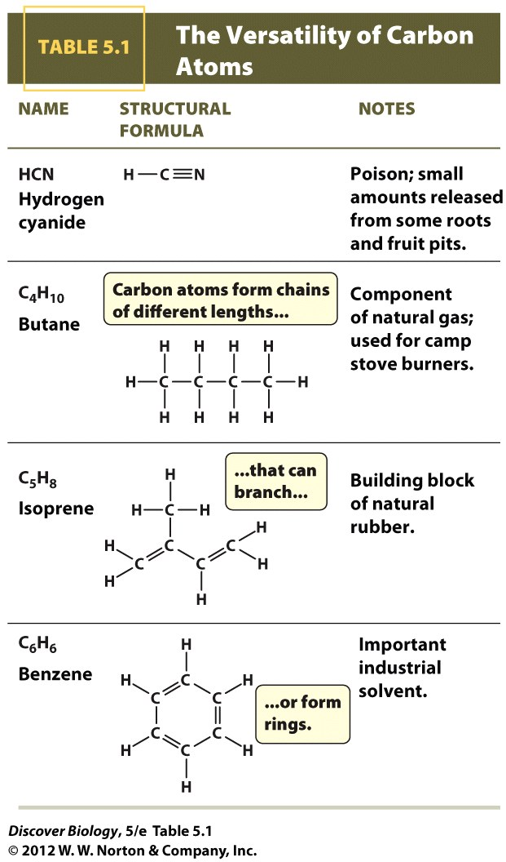
Notes:
TABLE 5.1 The Versatility of Carbon Atoms

Slide 43
The Chemical Building Blocks of Life
The vast array of biological processes are dependent on a carbon-carbon framework with small amounts of other atoms attached
An organic molecule is one that contains at least one carbon-hydrogen bond
Living cells contain many types of organic molecules

Slide 44
Notes:
Figure 5.12 Polymers Are Long Chains Made from Repeating Units Known as Monomers
A handful of monomers can be assembled into a great variety of polymers. The formula is: number of available monomers^{n}, where n is the chain length (total number of monomers in each polymer). In this example, we have 5⁶, which is 15,625.

Slide 45
The Chemical Building Blocks of Life
Small organic molecules can covalently bond to other organic molecules to form macromolecules
Macromolecules are made up of building blocks called polymers, which contain small, repeating organic molecules known as monomers
The properties of organic polymers depend on the clusters of atoms covalently bonded together, called functional groups

Slide 46
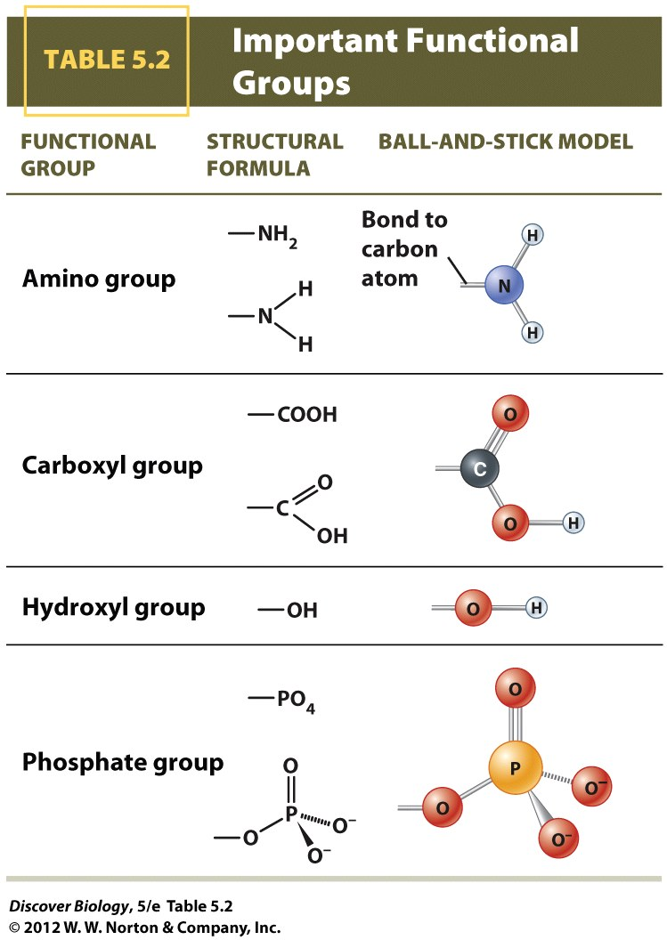
Notes:
TABLE 5.2 Important Functional Groups

Slide 47
Carbohydrates
Sugars are a source of stored energy and are called carbohydrates
Glucose is a type of simple sugar called a monosaccharide
Glucose is found in almost every cell and is involved in every chemical reaction that produces energy in living organisms

Slide 48
Carbohydrates
Table sugar is an example of a disaccharide, which is formed when two monosaccharides, glucose and fructose, are covalently bonded
Disaccharides are broken down via hydrolytic reactions, which use water to break the covalent bonds between monomers
Polysaccharides are large polymers built by linking many monosaccharides together

Slide 49
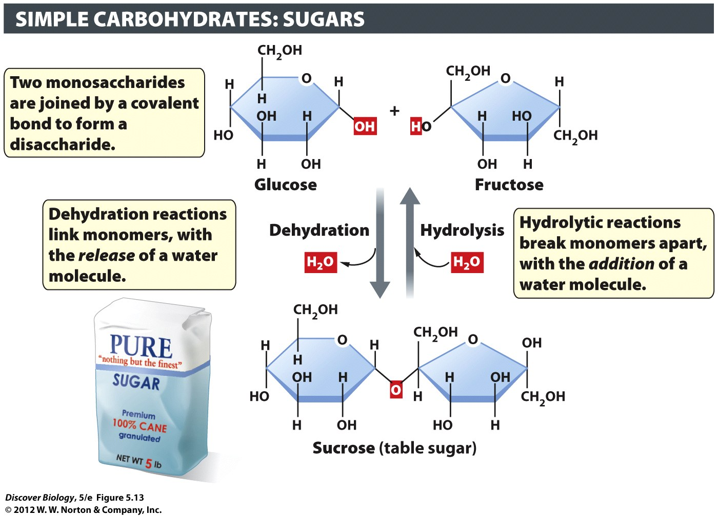
Notes:
Figure 5.13 Monosaccharides Can Bond Together to Form Disaccharides
Glucose and fructose are sugar monomers that, when linked by a covalent bond, form the disaccharide sucrose, or table sugar.

Slide 50
Carbohydrates
Cellulose and starch are both found in plants and made from glucose, but differ in the way the monosaccharides are linked
Glycogen is a highly branched polysaccharide that stores energy in animal cells for rapid release when needed

Slide 51
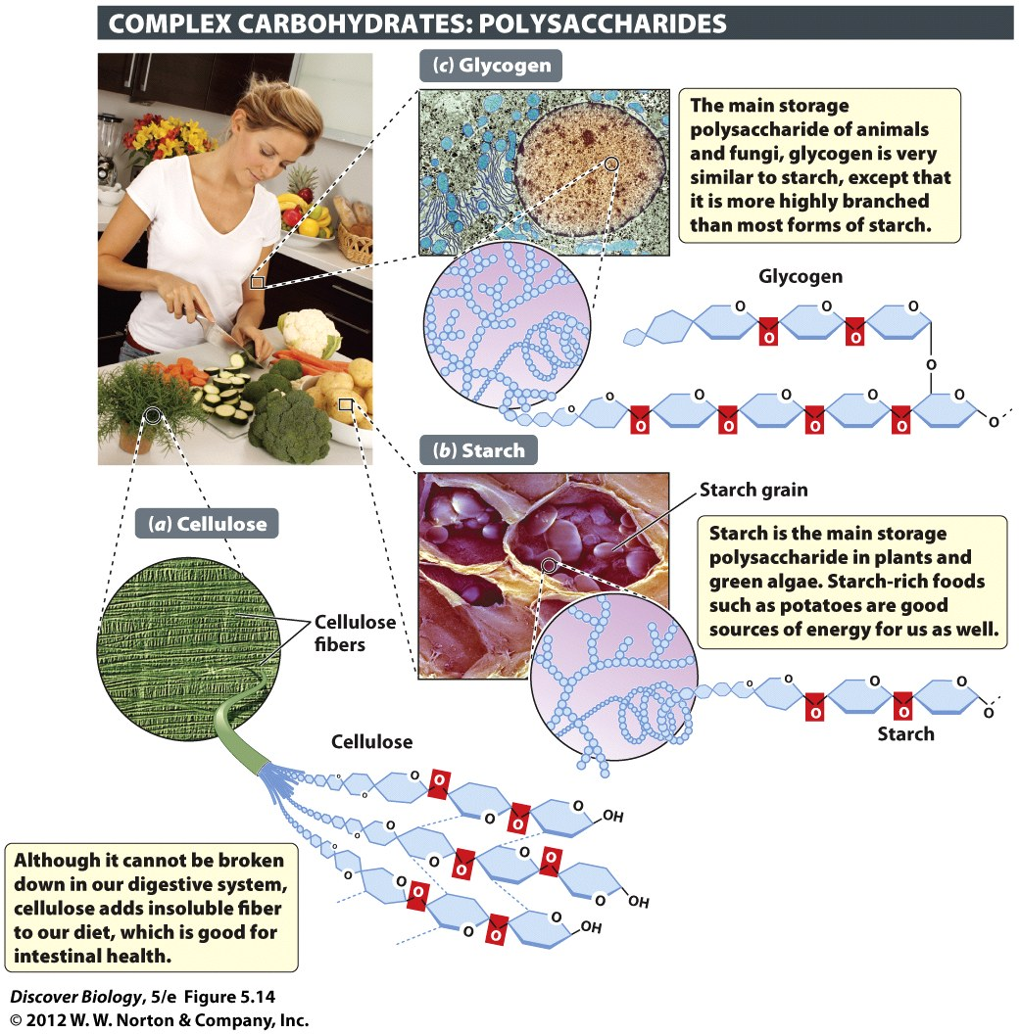
Notes:
Figure 5.14 Monosaccharides Can Bond Together to Form Polysaccharides
Cellulose, starch, and glycogen are all polymers built from glucose subunits.

Slide 52
Proteins
Proteins are categorized by the function they perform:
Storage
Structure
Transport
Catalysis

Slide 53
Proteins Are Built from Amino Acids
All proteins are built from monomers called amino acids
There are 20 different amino acids that can be arranged in a multitude of ways to construct the variety of proteins needed for life
An amino acid consists of an alpha carbon attached to a hydrogen atom, an R group, an amino group, and a carboxyl group

Slide 54
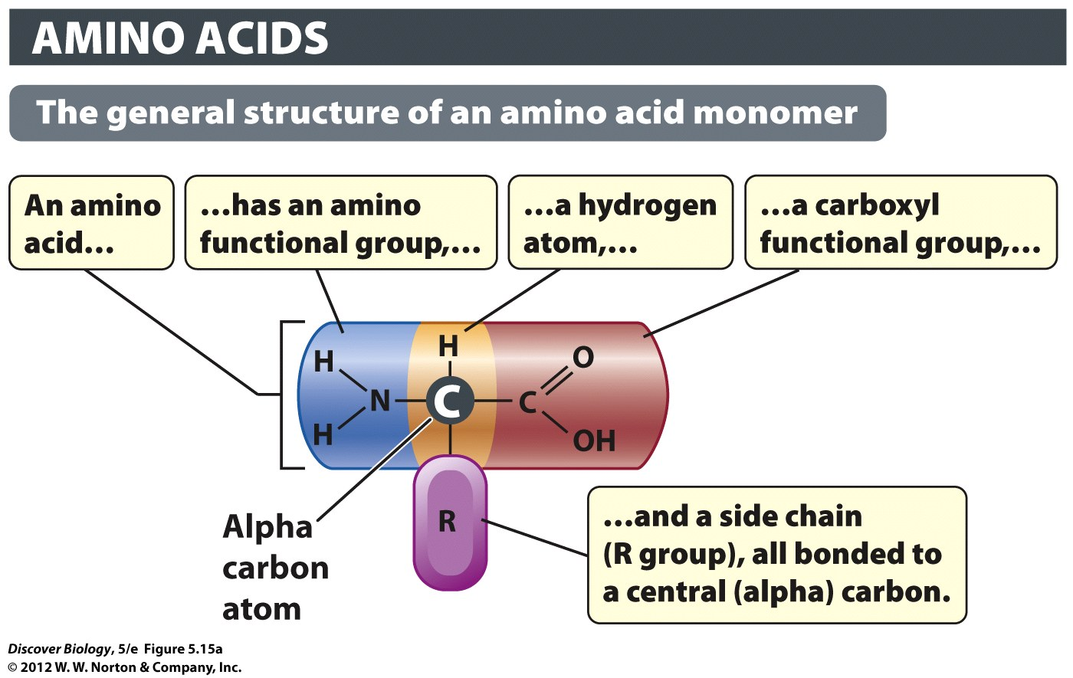
Notes:
Figure 5.15a The Structure and Diversity of Amino Acids: The General Structure of an Amino Acid Monomer
(a) Amino acids are the building blocks of proteins. Twenty different amino acids can be found in proteins, each differing from the other only in the nature of its R group.

Slide 55
Proteins Are Built from Amino Acids
Amino acids differ only in the type of R group that they include
The R group gives each protein its unique properties and can vary from having just one atom to complex ring structures

Slide 56
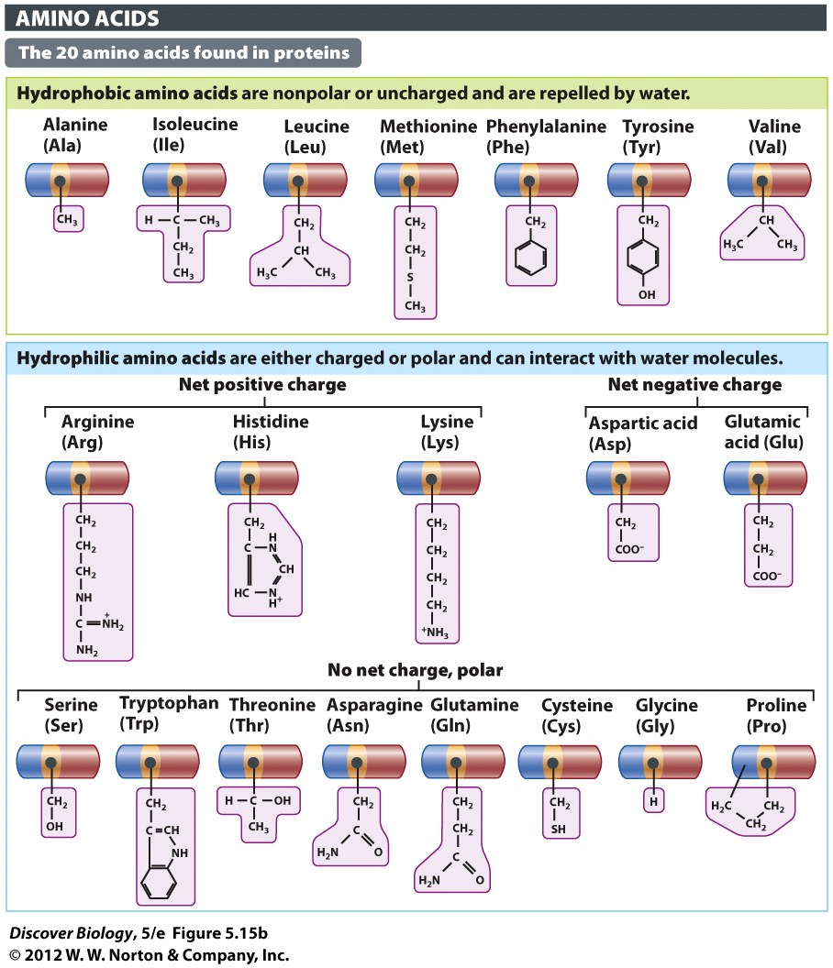
Notes:
Figure 5.15b The Structure and Diversity of Amino Acids: The 20 Amino Acids Found in Proteins
(b) Each of the 20 amino acids has a different R group bonded to the alpha carbon. The R group is responsible for the distinctive properties of each amino acid.

Slide 57
Proteins Are Built from Amino Acids
Polypeptides are formed when the amino group of one amino acid is linked to the carboxyl group of another through a peptide bond
Polypeptides are differentiated by the sequence of linked amino acids

Slide 58
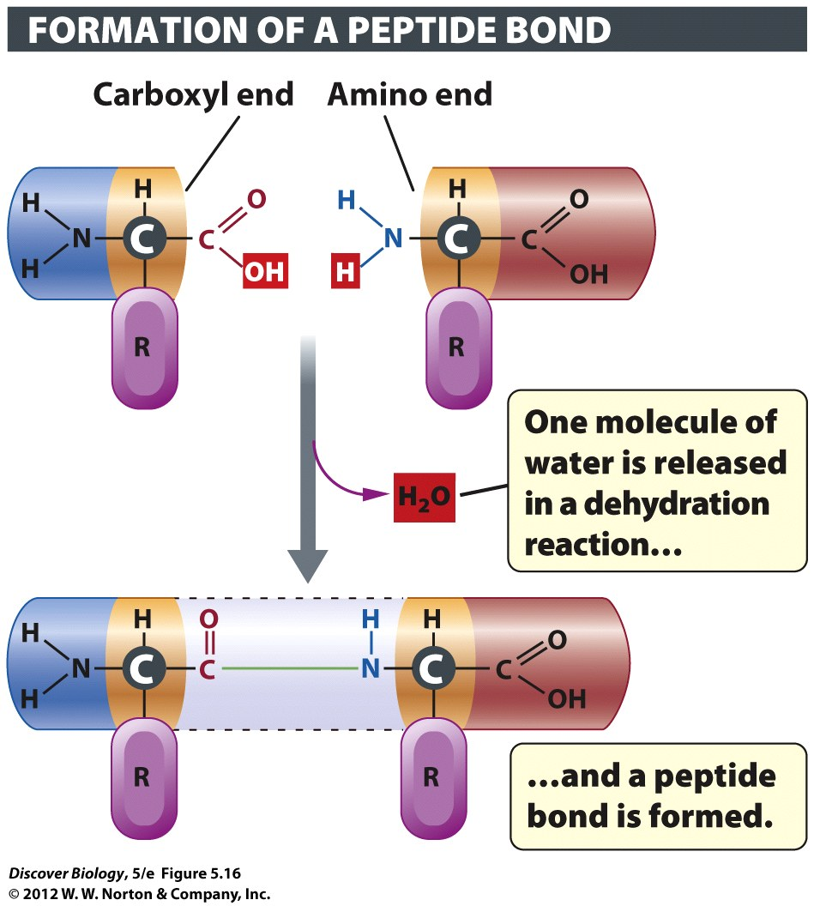
Notes:
Figure 5.16 Peptide Bonds Link Amino Acids

Slide 59
A Protein Must Be Correctly Folded to Be Functional
The sequence of amino acids in a polypeptide is known as the primary structure
The secondary structure is created by the regional folding of the polypeptide into three-dimensional patterns
The tertiary structure is formed by the interactions of distantly placed segments of the polypeptide chain

Slide 60
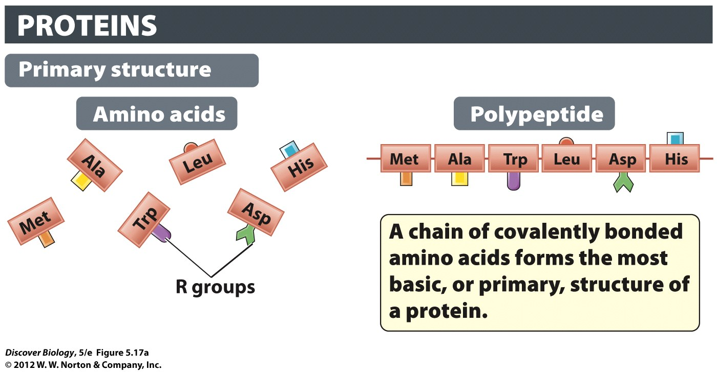
Notes:
Figure 5.17a The Four Levels of Protein Structure: Primary Structure
(a) All proteins have a primary structure composed of a linear chain of amino acids known as a polypeptide.

Slide 61
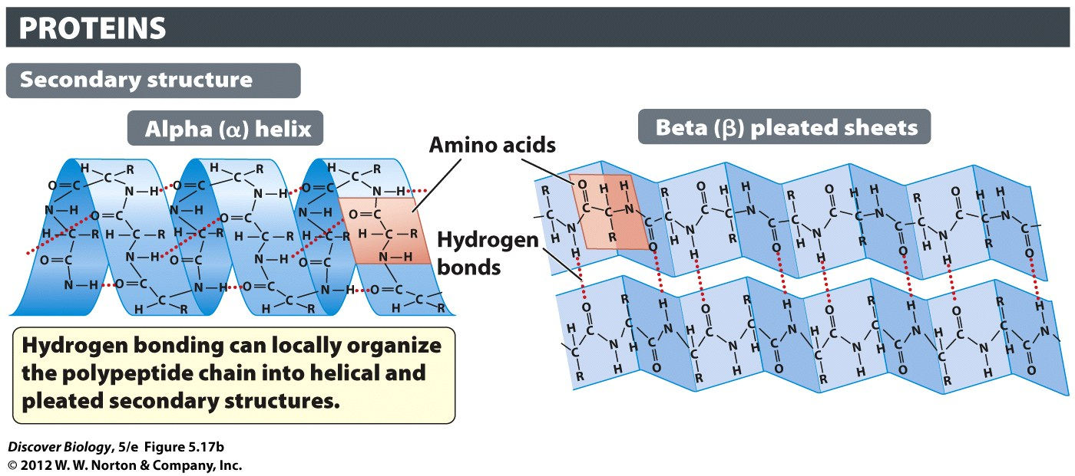
Notes:
Figure 5.17b The Four Levels of Protein Structure: Secondary Structure
(b) Regional coiling and folding of the polypeptide chain gives a protein its secondary structure.

Slide 62
Notes:
Figure 5.17c The Four Levels of Protein Structure: Tertiary Structure
(c) Further folding, stabilized by long-distance interactions, gives a protein its tertiary structure.

Slide 63
A Protein Must Be Correctly Folded to Be Functional
Certain proteins have a quaternary structure created by the interaction of another polypeptide chain
Denaturation is the destruction of a protein’s three-dimensional shape, resulting in a loss of protein activity
Extreme temperatures, pH, and salt concentration can cause denaturation of proteins

Slide 64
Notes:
Figure 5.17d The Four Levels of Protein Structure: Quaternary Structure
(d) Proteins composed of more than one polypeptide have a quaternary structure stabilized by bonds between the chains.

Slide 65
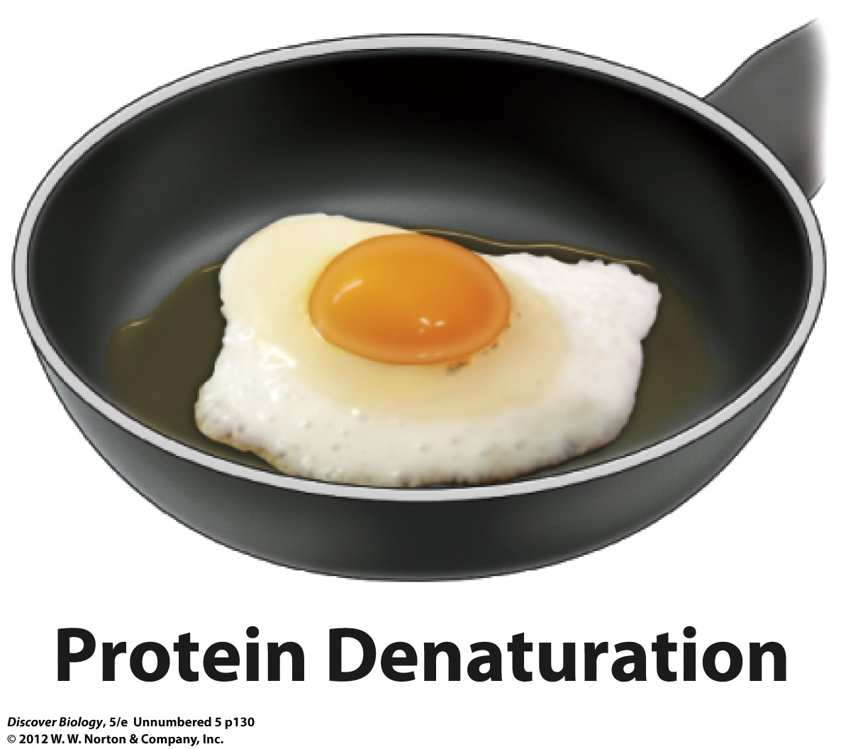

Slide 66
Lipids
Lipids are made up of fatty acids containing long hydrocarbon chains attached to a hydrophilic head
Fatty acids in which all the carbon atoms in the hydrocarbon chain are linked with a single covalent bond are called saturated fatty acids
Fatty acids in which one or more carbon atoms in the hydrocarbon chain are linked by a double bond are called unsaturated fatty acids

Slide 67
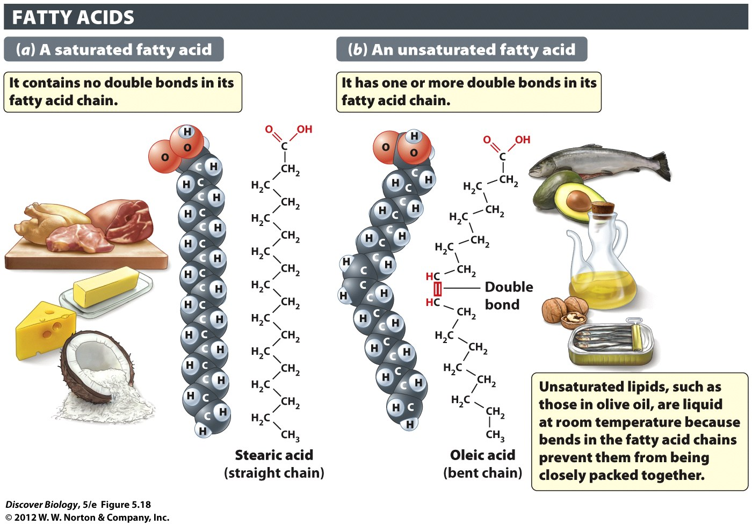
Notes:
Figure 5.18 Saturated and Unsaturated Fatty Acids Are the Two Main Types of Fatty Acids
The space-filling models of (a) stearic acid and (b) oleic acid show that a saturated fatty acid is a straight molecule, whereas an unsaturated fatty acid molecule has a bend in it. Saturated fatty acids can pack tightly to form a solid at room temperature, whereas unsaturated lipids cannot.

Slide 68
Animals Store Surplus Energy as Triglycerides
Three fatty acid molecules bonded to a glycerol molecule make up a triglyceride, which is commonly found in our diet
Triglycerides built from saturated fatty acids are known as fats and are solid at room temperature
Triglycerides built from unsaturated fatty acids tend to be liquid at room temperature and are called oils

Slide 69
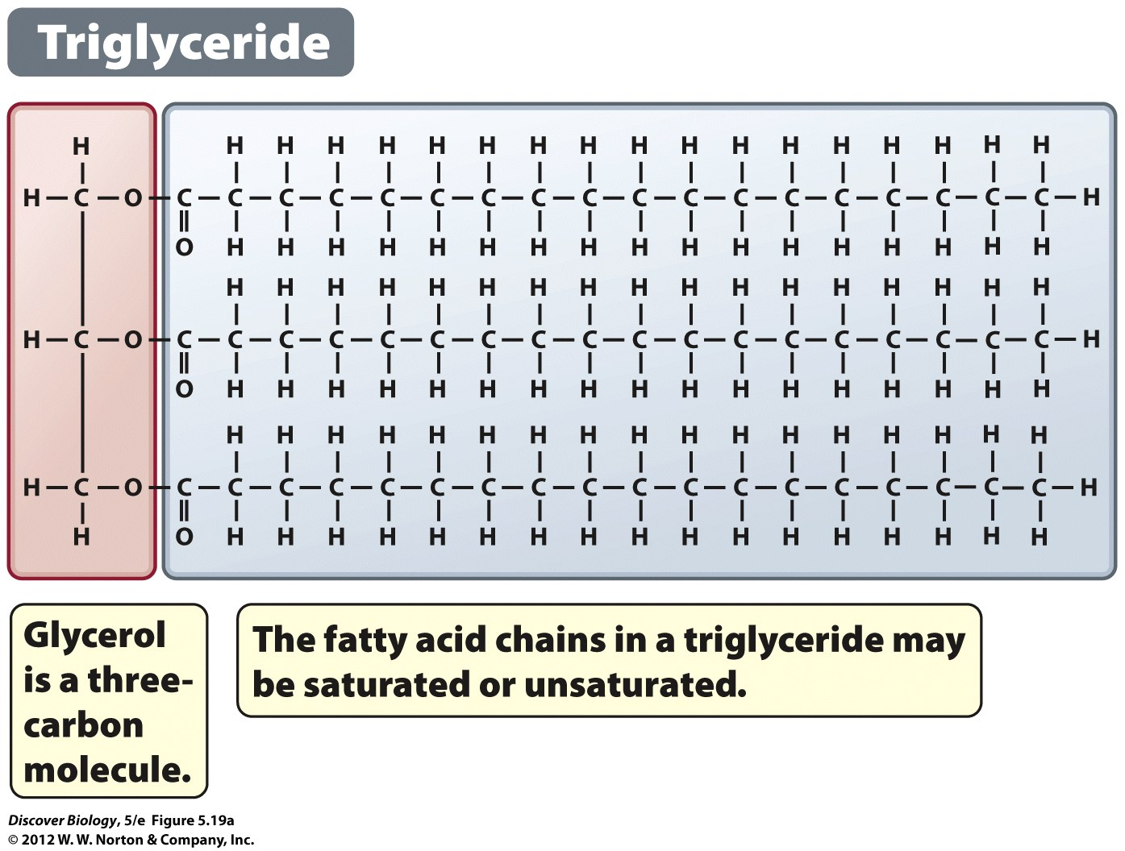
Notes:
Figure 5.19a Triglycerides Contain Three Fatty Acids Bound to a Glycerol: Triglyceride
(a) Glycerides consist of a three-carbon sugar alcohol called glycerol, bound to one, two, or three fatty acids. Triglycerides have three fatty acids, one linked to each of the three carbons of glycerol. The triglyceride depicted here is glyceryl tristearate, the most common storage lipid in animal cells.

Slide 70
Animals Store Surplus Energy as Triglycerides
Energy can be stored in the form of triglycerides deposited in the cytoplasm of cells
Lipids contain more than twice the energy of protein or carbohydrates of the same volume

Slide 71
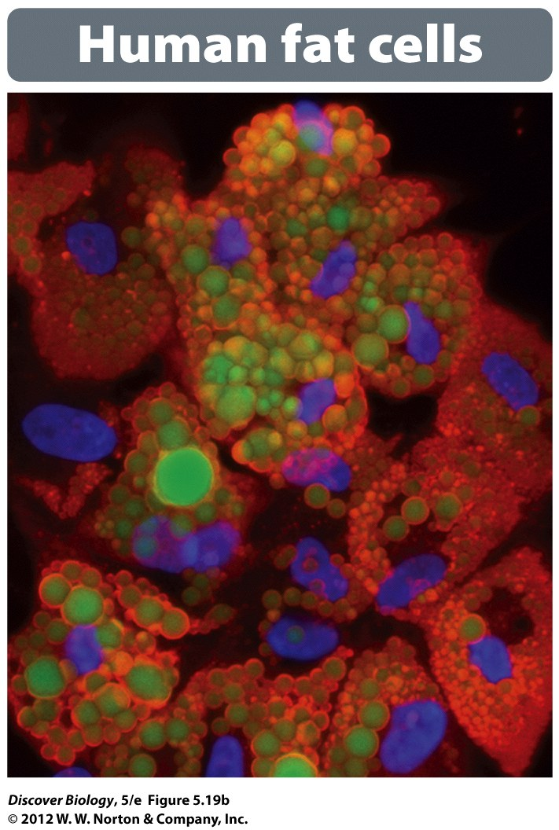
Notes:
Figure 5.19b Triglycerides Contain Three Fatty Acids Bound to a Glycerol: Human Fat Cells
(b) Color-enhanced photograph of human adipocytes, which are cells specialized for storing triglycerides (green deposits). The blue structure is the nucleus.

Slide 72
Phospholipids Are Important Components of Cell Membranes
A type of glyceride called a phospholipid is an important component in cell membranes
Phospholipids are made up of two hydrophobic fatty acid tails bonded to a hydrophilic head consisting of a glycerol and a phosphate group
When exposed to water, phospholipids form a phospholipid bilayer, with the hydrophilic heads facing outward and the hydrophobic tails facing inward

Slide 73
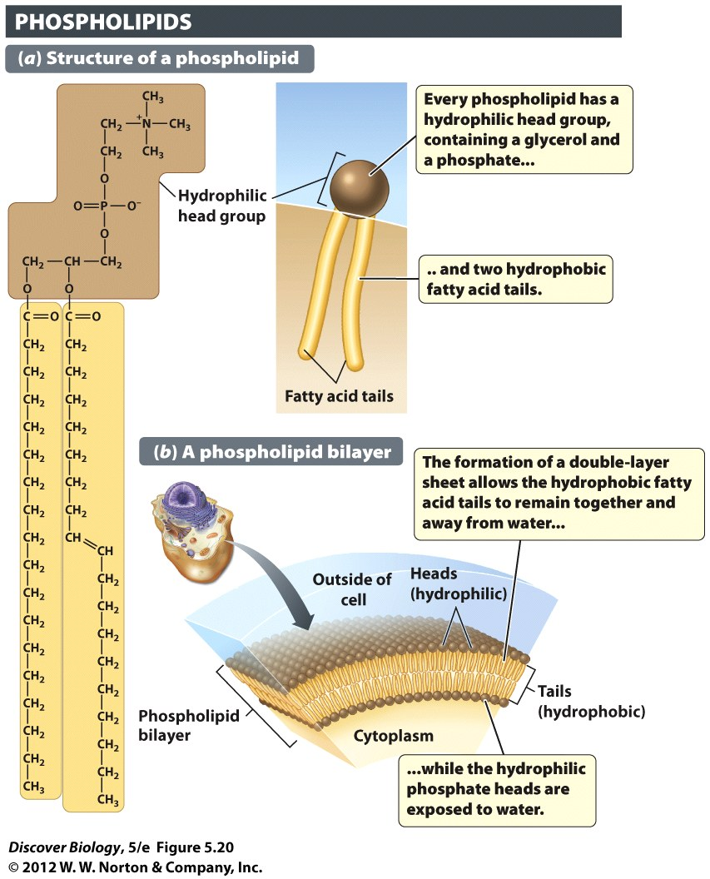
Notes:
Figure 5.20 Membranes Contain Double Sheets of Phospholipids
Phospholipids spontaneously orient themselves into a double-layer sheet in which their hydrophilic head groups are oriented toward the watery environments of the cell interior and exterior, while the hydrophobic fatty acid chains convene in the middle of the “sandwich.”

Slide 74
Sterols Play Vital Roles in a Variety of Life Processes
Sterols are a class of lipids that contain four hydrocarbon rings fused together
Sterols differ only in the number, type, and position of functional groups and in the carbon side chains linked to the hydrocarbon rings
Cholesterol, testosterone, estrogen, and vitamin D are all sterols

Slide 75
Sterols Play Vital Roles in a Variety of Life Processes
Cholesterol is a vital component of cell membranes and is the starting molecule for many other sterols and steroid hormones
Cholesterol can be manufactured in our liver, and ingesting too much cholesterol can lead to cardiovascular disease
Hormones are signaling molecules that are active at low levels and control many processes in plants and animals

Slide 76
Notes:
Figure 5.21 Sterols Are Lipids Built from Four Fused Hydrocarbon Rings
All sterols share the same basic four-ring structure but have different groups of atoms (functional groups) attached to these rings. Testosterone is a hormone that controls male sexual characteristics in many animals, including the male wood duck (photo, left). Cholesterol is an important constituent of the cell membranes of all birds and mammals, and of many other animals as well.

Slide 77
Nucleotides and Nucleic Acids
Nucleotides are the building blocks of hereditary material
Nucleotides are made up of a nitrogenous base covalently bonded to a five-carbon sugar, which is then covalently bonded to a phosphate group
Five different nucleotides make up a class of polymers called nucleic acids

Slide 78
Nucleotides and Nucleic Acids
There are two types of nucleic acids
Deoxyribonucleic acid (DNA)
Ribonucleic acid (RNA)
Each type of nucleic acid differs in its combination of five different nitrogenous bases
RNA is a single-stranded chain of polynucleotides
DNA is a double-stranded chain of polynucleotides

Slide 79
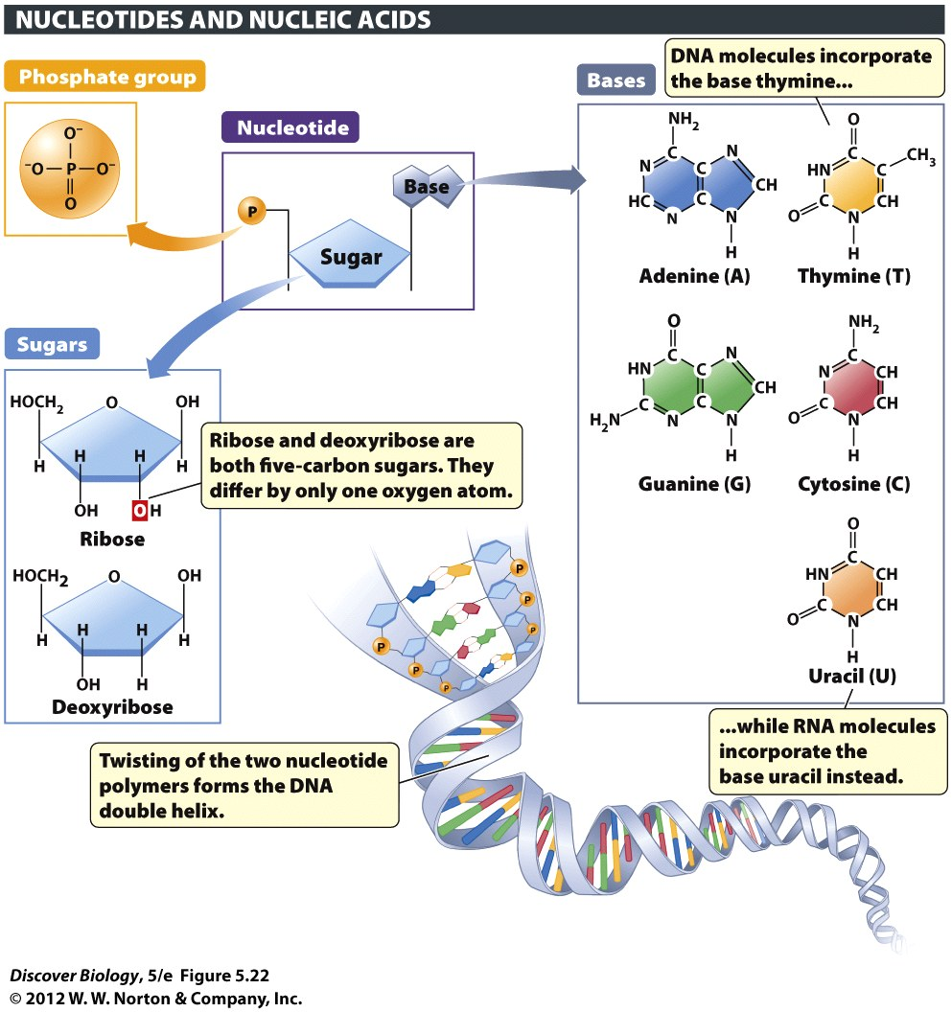
Notes:
Figure 5.22 Nucleotides Are the Building Blocks of Nucleic Acids
Each nucleotide consists of a five-carbon sugar linked to a nitrogenous base and one or more phosphate groups. The bases adenine, guanine, cytosine, and thymine, when linked to the sugar deoxyribose, form the building blocks of DNA. The bases adenine, guanine, cytosine, and uracil, when linked to the sugar ribose, form the building blocks of RNA.

Slide 80
Nucleotides and Nucleic Acids
Nucleotides are essential for the storage of information and energy transfer
Hereditary information is coded in the precise order in which nucleotides are joined together in DNA
Adenosine triphosphate (ATP) is a universal energy-carrying nucleotide found in all living organisms

Slide 81
Notes:
Figure 5.23 The Nucleotide ATP Serves as an Energy Carrier in Every Living Cell
The phosphate groups in ATP are held together by energy-rich covalent bonds. Energy is released when these bonds are broken, and the released energy powers a great variety of biological processes, including the motion of the skimboarder pictured here.

Slide 82
How Bad Are Trans Fats?
Trans fats change the ratio of the two types of cholesterols in our blood, increasing the risk of heart disease
Experts estimate that trans fats contribute to 30,000–100,000 deaths per year from heart disease
Trans fats can be found in any foods containing hydrogenated oils

Slide 83
Clicker Questions
CHAPTER 5
The Chemistry of Life

Slide 84
Concept Quiz
What types of intermolecular bonds are formed between biological molecules and hold them together?
Hydrogen bonds
Covalent bonds
Ionic bonds
All of the above
A and C
Notes:
The correct answer is E. Intramolecular bonds are covalent, but the intermolecular bonds are hydrogen bonds and salt bridges. This allows molecules to interact, and then separate.
Answer A: Hydrogen bonds are made between molecules or, in this case, between different parts of a molecule.
Answer B: Covalent bonds link two different atoms within one molecule.
Answer C: As in answer A, ionic bonds are between molecules or parts of one large molecule.

Slide 85
Concept Quiz
What determines the folding pattern of a peptide turning into a completed protein?
The amino acid sequence (primary structure)
The source of the amino acids
The absorption of light
The size of the ribosomes used
Notes:
The correct answer is A. The hydrophobic/hydrophilic character of the amino acids, and their linear arrangement, dictate the way the protein folds.
Answer B: Amino acids are identical, no matter where they come from.
Answer C: Light has no effect on folding.
Answer D: The ribosomes of all eukaryotes (or prokaryotes) are the same.

Slide 86
Concept Quiz
_________ bonds are the strongest bonds formed between molecules.
Hydrogen
Covalent
Ionic
Nonpolar
Notes:
The correct answer is C.
Answer A: Hydrogen bonds are the most prevalent, and collectively add up to strong interactions, but are individually less strong than ionic bonds.
Answer B: Covalent bonds are the strongest bonds, but they are intramolecular.
Answer D: Non-polar bonds are intermolecular, but they are the weakest intermolecular bonds.

Slide 87
Concept Quiz
The main difference between the 20 amino acids is the
Central carbon
Amine group
Acid group
Side chain
Notes:
The correct answer is D.
It’s important that students realize that the only difference between the amino acids is the side chains. This is why the primary sequence is so important. The order of the side chains in the primary sequence determines how the protein folds, which in turn determines the function of the protein.
Answers A - C: All of these are identical in every amino acid.

Slide 88
Relevant Art from Other Chapters
All art files from the book are available in JPEG and PPT formats online and on the Instructor Resource Disc

Slide 89
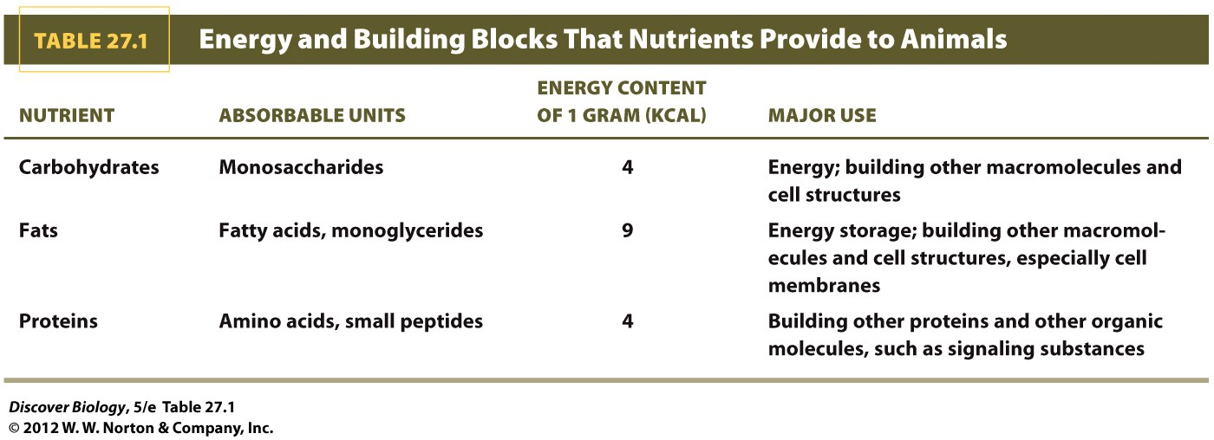

Slide 90
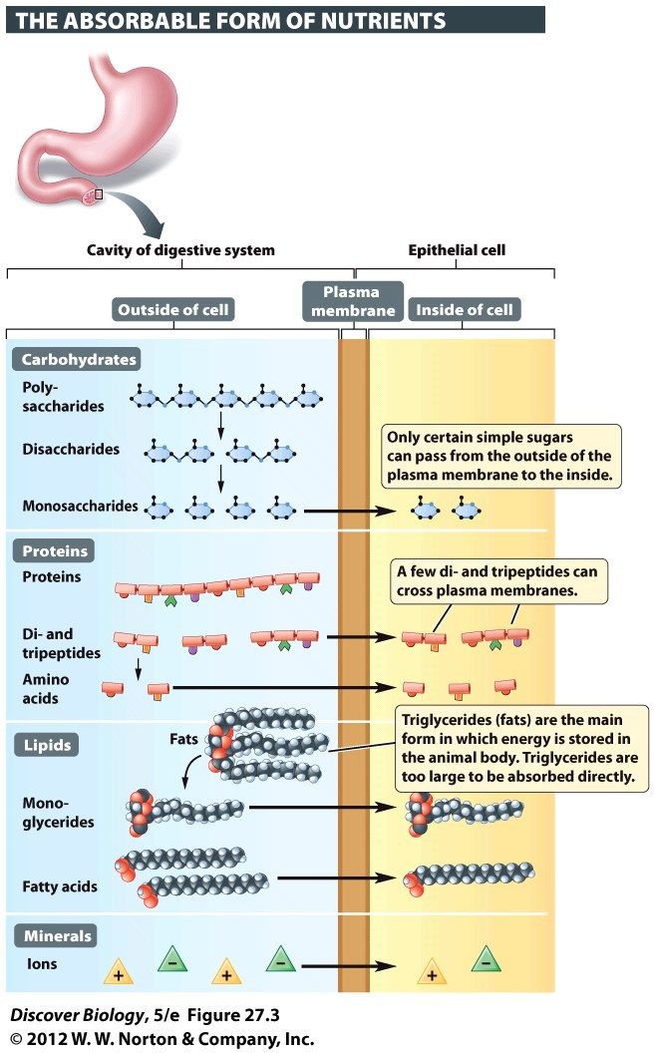
Notes:
Figure 27.3 Large Biomolecules Must Be Broken Down Before They Can Be Absorbed
Enzymes degrade proteins, lipids, and large carbohydrates to their smaller building blocks, which are then absorbed by the cells that line the small intestines. Minerals cross membranes in their ionic form.

Slide 91
Notes:
Figure 27.4 Adult Humans Cannot Make 8 of the 20 Amino Acids That We Need to Build Proteins
Meat contains all the essential amino acids, but vegetarians must combine different grains and legumes to get all of them. The pink box lists amino acids that both grains and legumes provide in adequate quantities. Legumes are plants in the pea family, which includes beans, garbanzos (chickpeas), and lentils.

Slide 92
Notes:
Figure 1 Digestion of Lactose by Lactase
Lactase is the enzyme that digests lactose, the major sugar in milk. Accumulation of undigested lactose in individuals who do not produce enough lactase gives rise to the intestinal problems known as lactose intolerance.

Slide 93
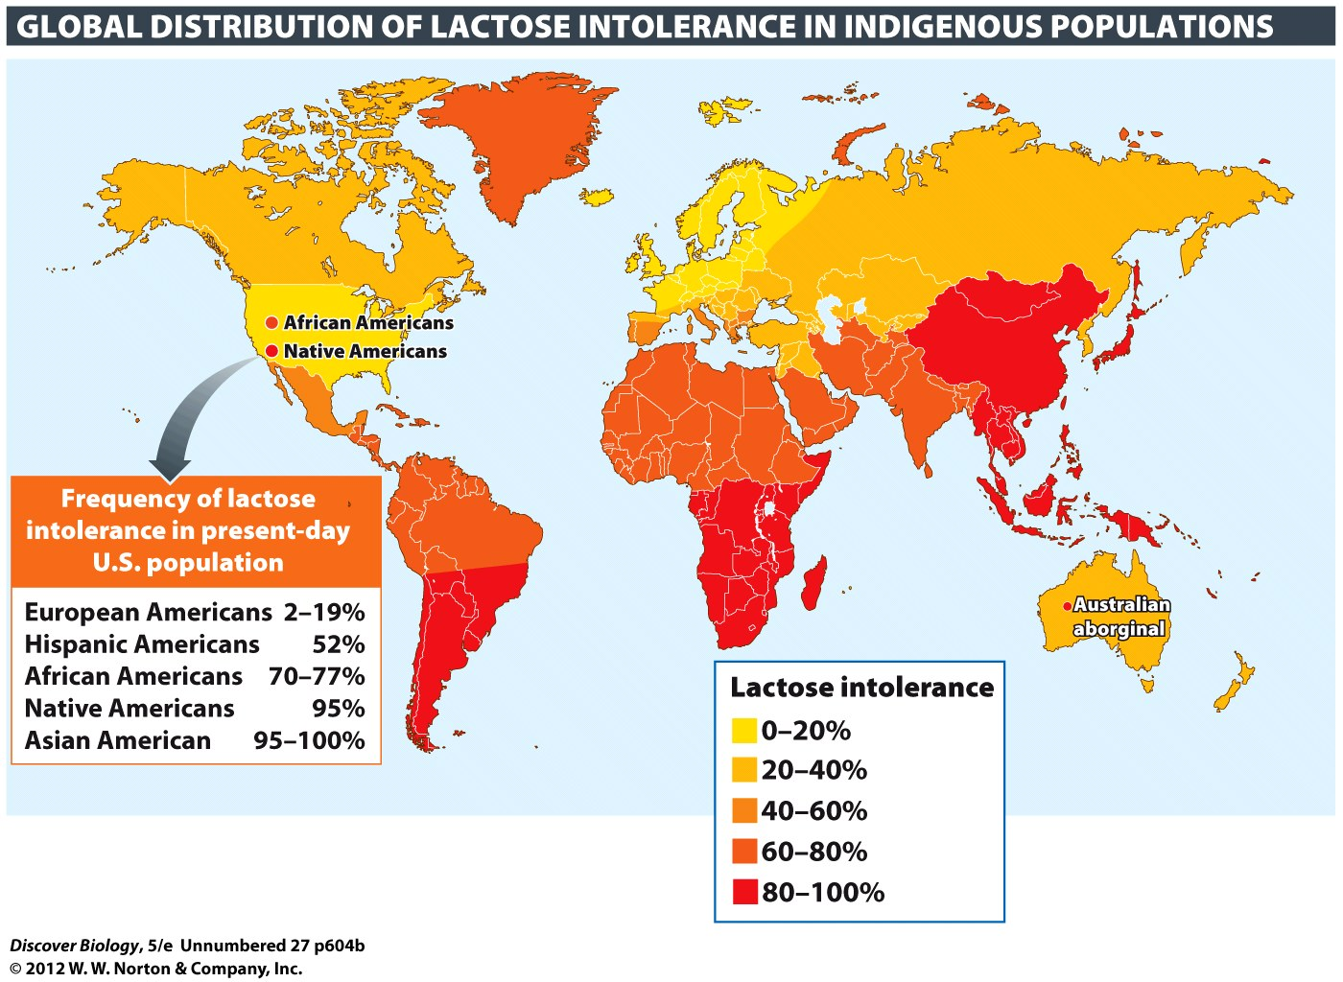
Notes:
Figure 2 The Frequency of Lactose Intolerance
About 70 percent of the world’s population is unable to produce lactase in adulthood. This map shows the frequency of the allele encoding a nonfunctional adult lactase in populations native to various regions of the world. A very small proportion of adults in East Asia and sub-Saharan Africa produce lactase. This is also true of the original natives of the Americas and the Pacific islands.

Slide 94
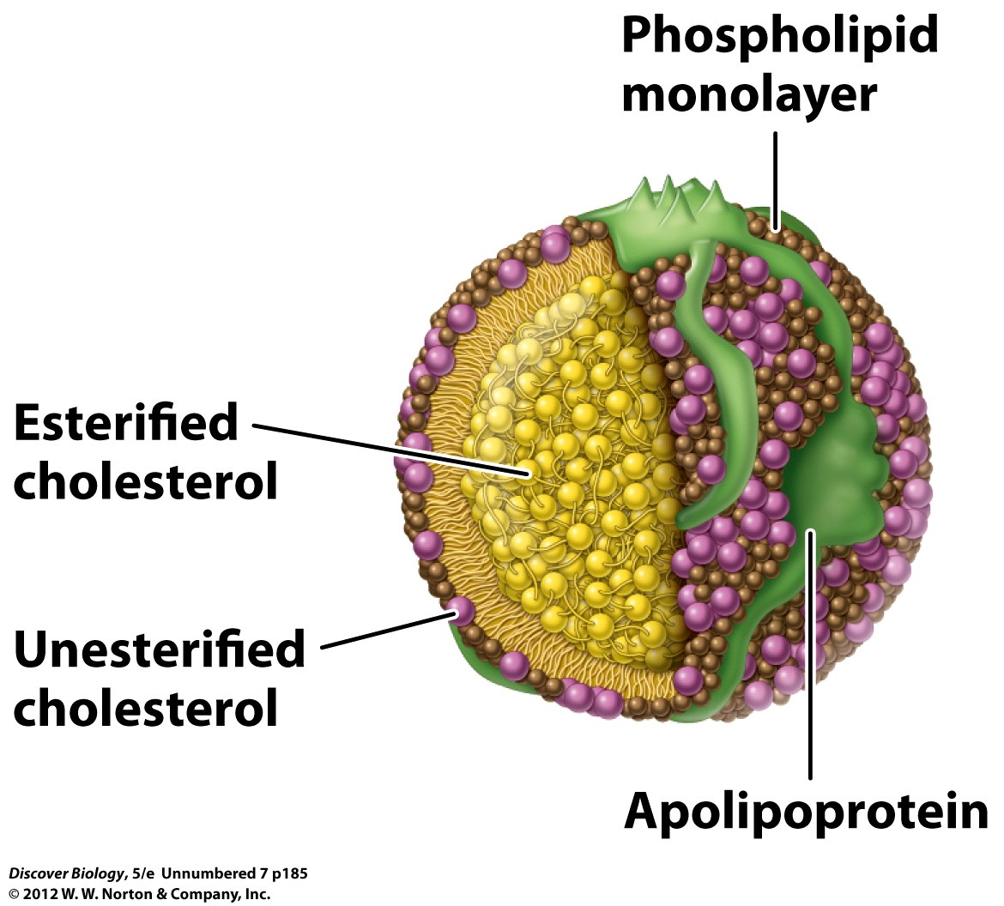
Notes:
Structure of LDL particle

Slide 95
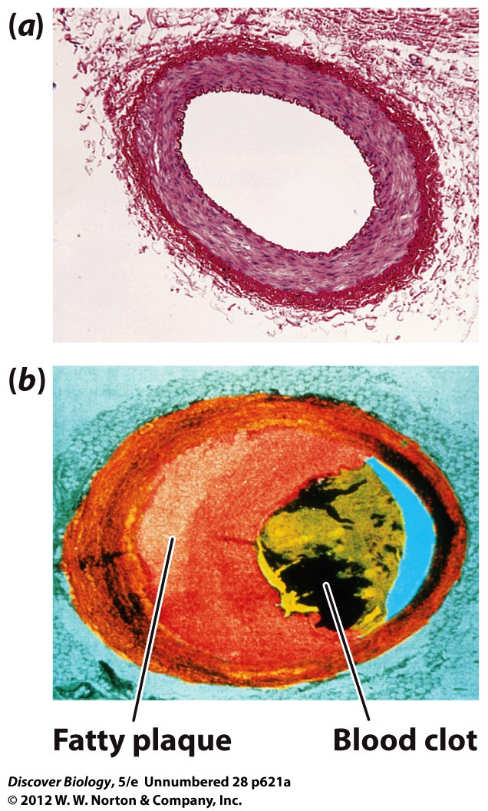
Notes:
Figure 1 Healthy and Clogged Arteries
(a) Cross section of a healthy artery. (b) Artery dangerously clogged by plaque and a blood clot. A heart attack is likely if the arteries supplying blood to the heart muscle become clogged. Similar clogging of arteries in the brain results in a stroke, a condition in which brain tissue is killed when blocked arteries fail to deliver enough blood.

Slide 96
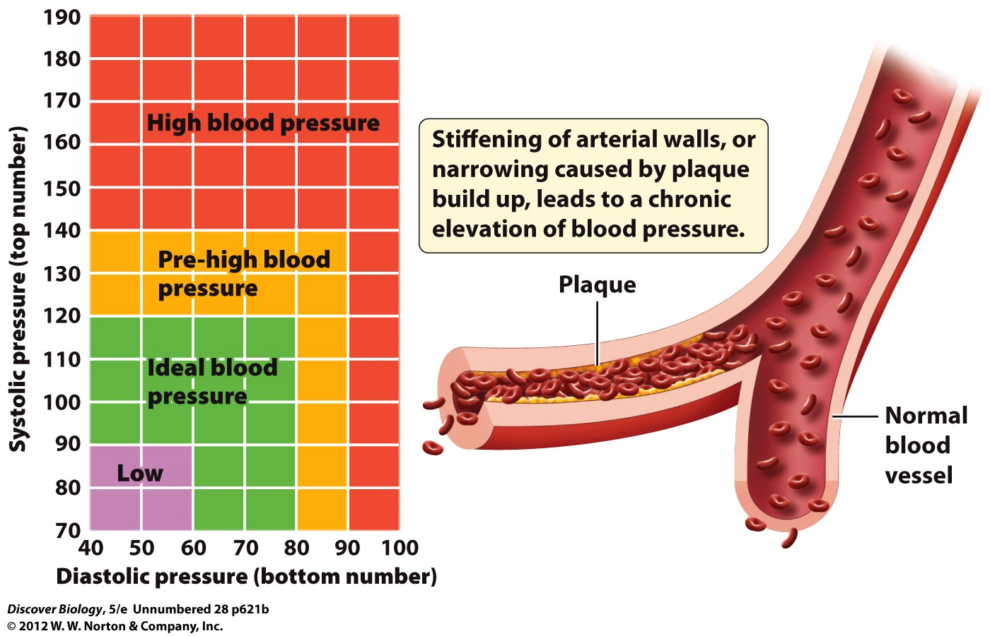
Notes:
Figure 2 Adult Blood Pressure Ranges

