Slide 1
Discover Biology FIFTH EDITION
Anu Singh-Cundy • Michael L. Cain
CHAPTER 4
Animalia
© 2012 W. W. Norton & Company, Inc.

Slide 2
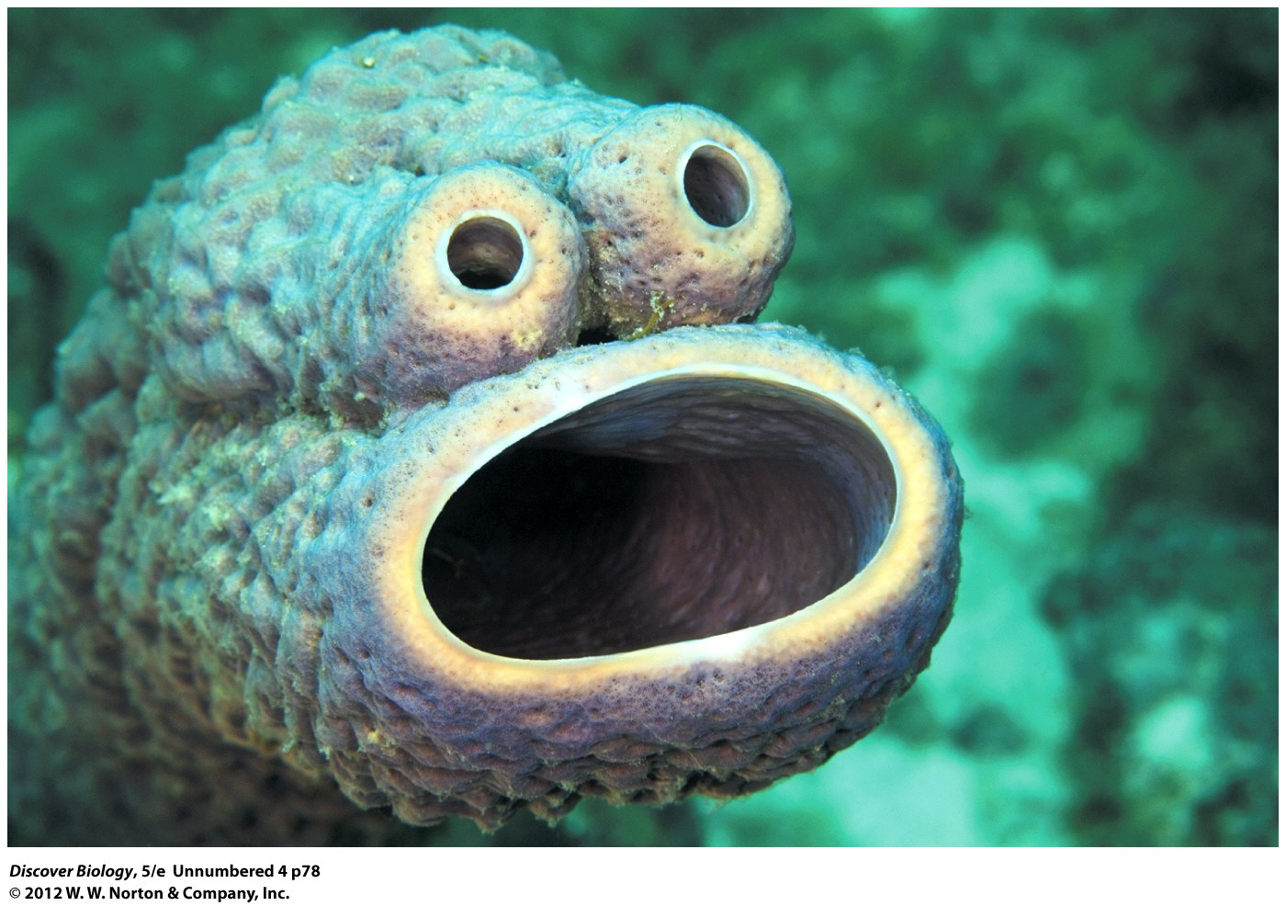
Notes:
Sponges Are the Simplest Animals.
Like other animals, sponges develop from an embryo and feed off other organisms. But sponges’ lack of symmetry or complex tissues and organs make them look like blobs unless, like this sponge, they appear to have a face.

Slide 3
Who We Are
The earliest animals were soft, multicellular organisms similar to sponges and jellyfish
Humans are descended from tiny colonial microorganisms

Slide 4
What Do You Think Are the Quintessential Qualities of an Animal?
Animals are a diverse group of organisms
Animals can be organized into groups based on body plans
The evolution of organ systems has allowed animals to achieve more complex behaviors, including the ability to reflect on the nature of all life

Slide 5
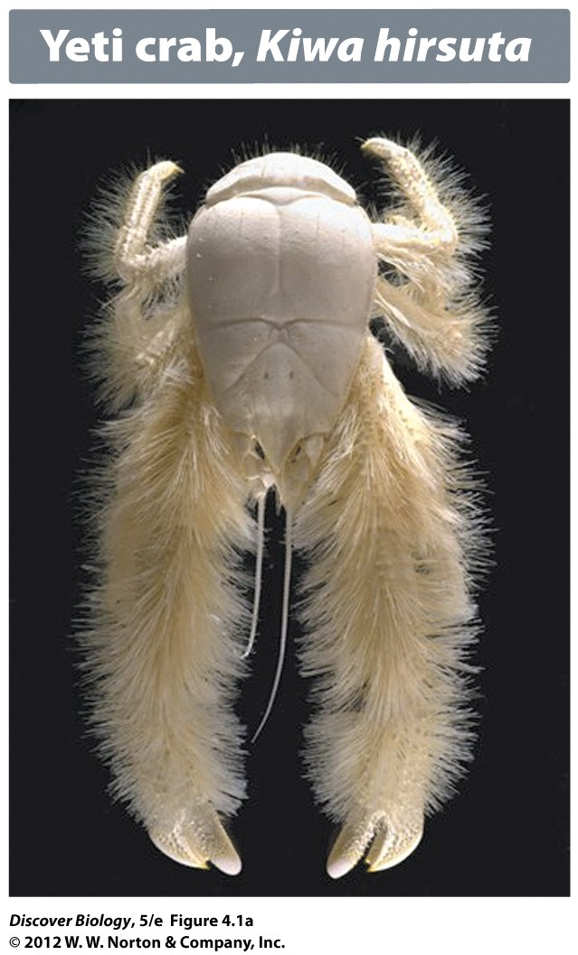
Notes:
Figure 4.1a A Gallery of Animalia
Can you guess which of these animals is most closely related to us?

Slide 6
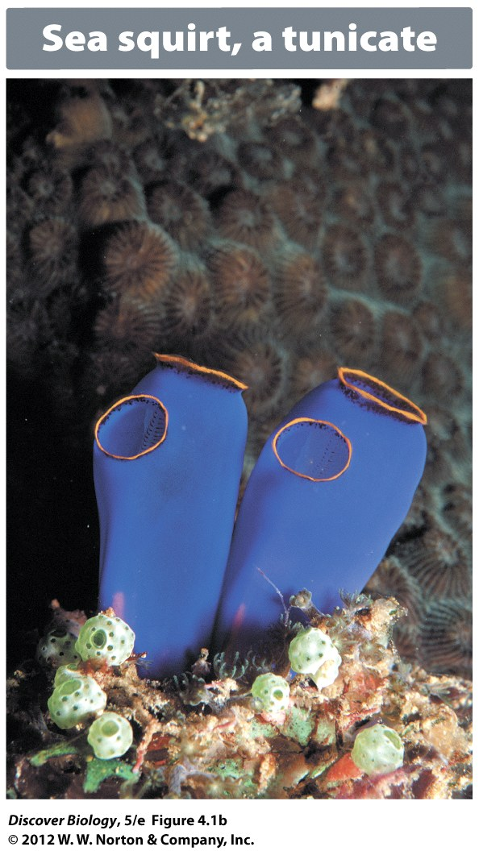
Notes:
Figure 4.1b A Gallery of Animalia
Can you guess which of these animals is most closely related to us?

Slide 7
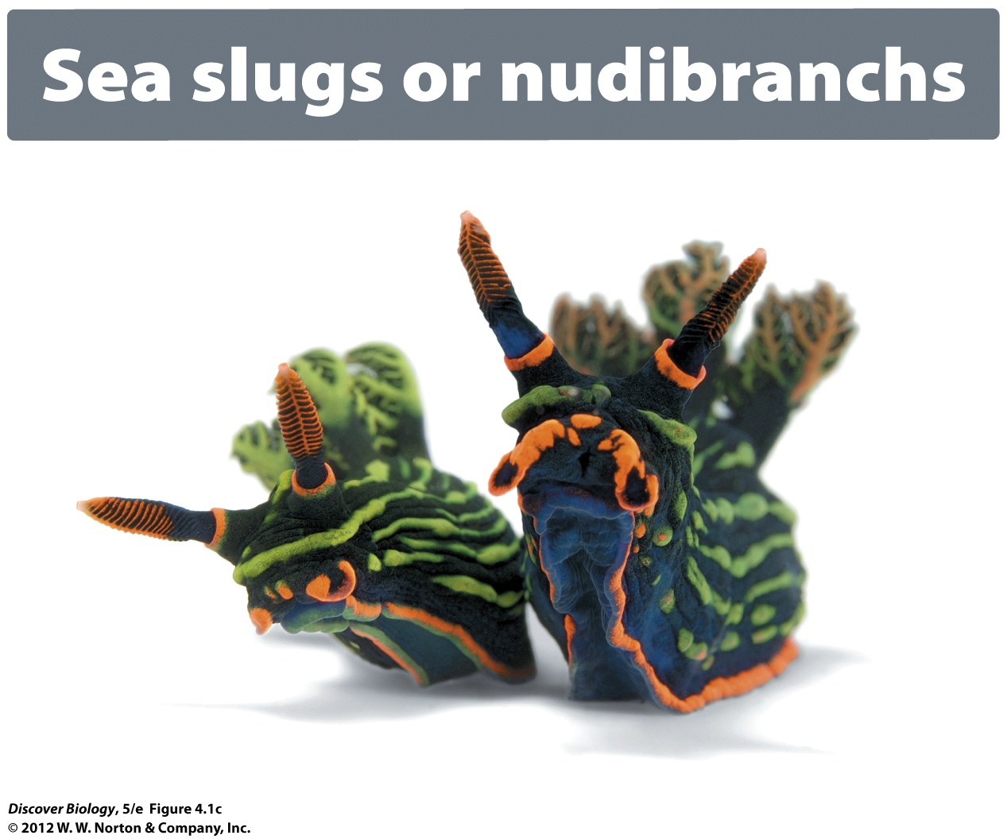
Notes:
Figure 4.1c A Gallery of Animalia
Can you guess which of these animals is most closely related to us?

Slide 8
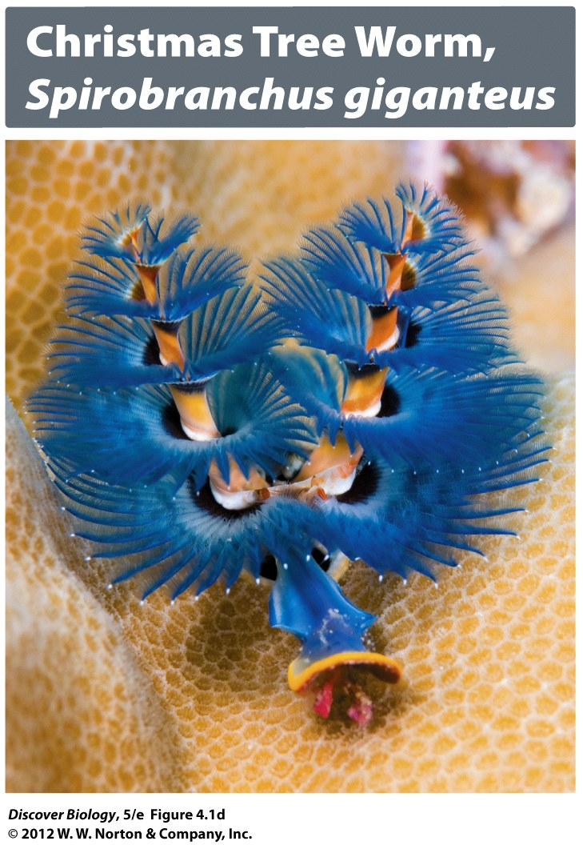
Notes:
Figure 4.1d A Gallery of Animalia
Can you guess which of these animals is most closely related to us?

Slide 9
The Evolutionary Origins of Animalia
Animals are heterotrophs that obtain energy and carbon by ingesting food
All animals are consumers, and some are decomposers
Most animals exhibit locomotion
The first animals are thought to be descendants of protists similar to choanoflagellates

Slide 10
The Evolutionary Origins of Animalia
Sponges are the earliest animal lineage, followed by the cnidarians, which include jellyfish and corals
Protostomes and deuterostomes are two broad groups of animals identified by different patterns of embryonic development
Chordates that possess a backbone are called vertebrates; all other animals are invertebrates

Slide 11
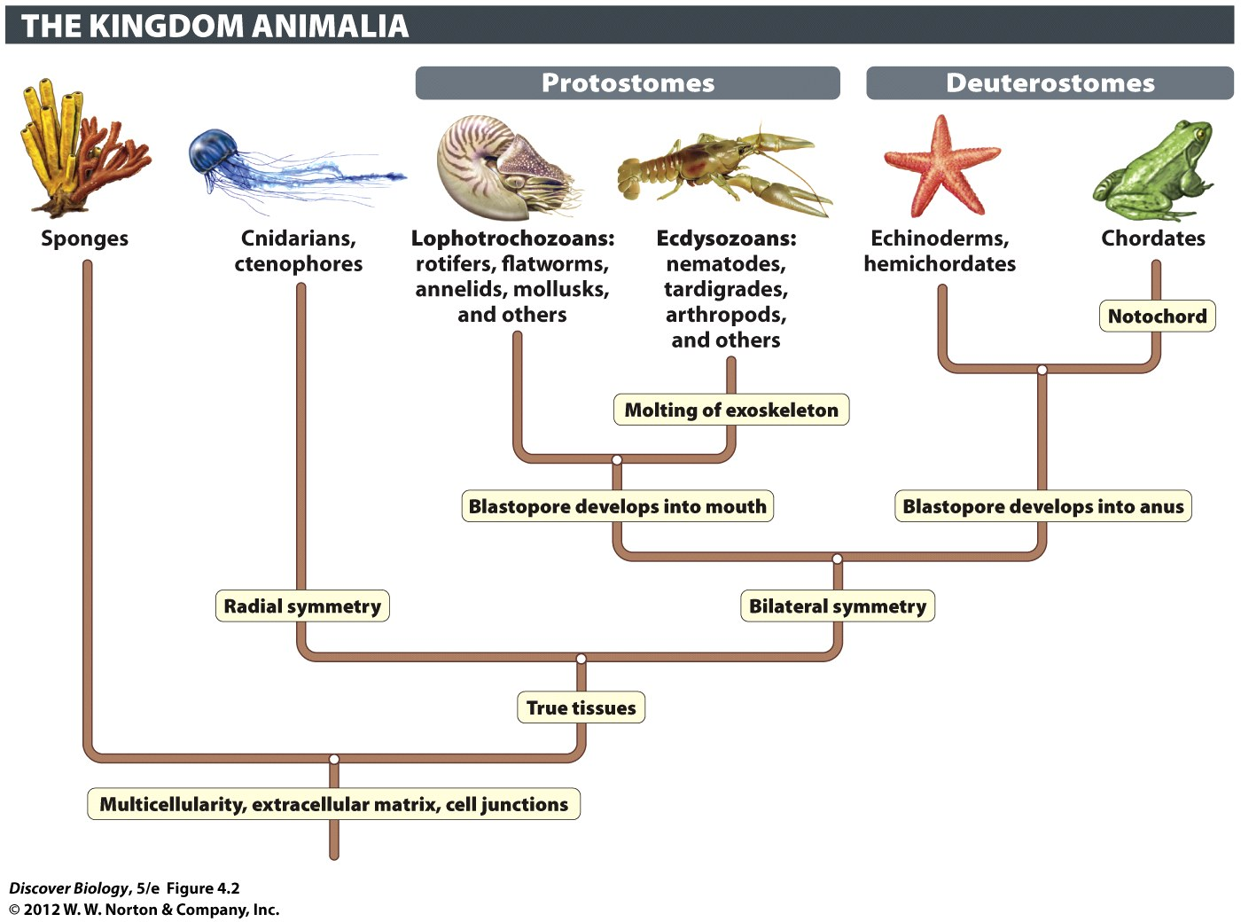
Notes:
Figure 4.2 Evolutionary Tree of the Animalia
The unique evolutionary innovations of each lineage are shown with boxed labels.

Slide 12
Characteristics of Animals
Animal cells lack a cell wall and are instead attached to an extracellular matrix
Velcro-like patches of proteins called cell junctions allow animal cells to attach to each other

Slide 13
Most Animals Have True Tissues
Sponges lack true tissues
Choanocytes, or collar cells, line the canals and interior chambers of sponges
The choanocytes use sticky secretions to snare passing food
Spicules are sharp structures that help protect and provide structural support to sponges

Slide 14
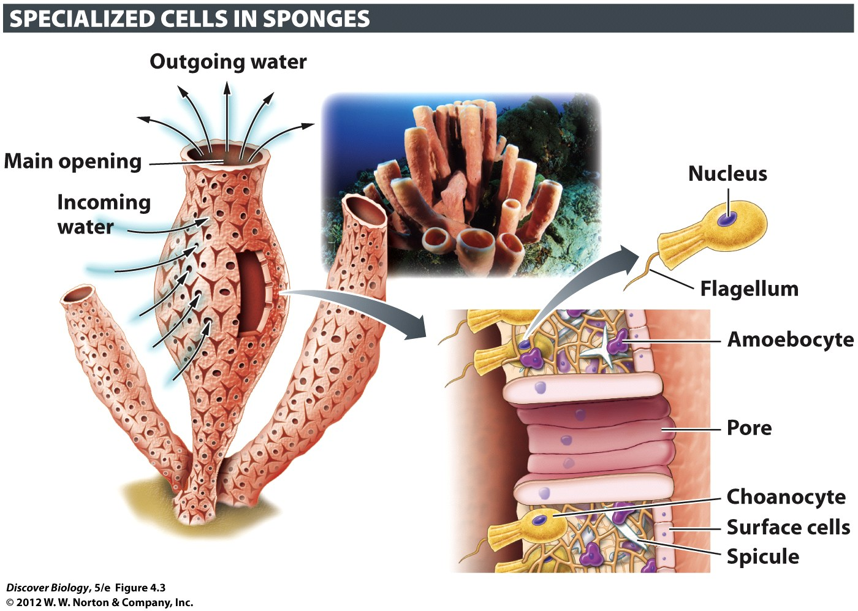
Notes:
Figure 4.3 Sponges Have Specialized Cells but Lack Tissues
Sponges are loose associations of cells. Although some of these cells are specialized, none are organized as tissues as they are in most other animals.

Slide 15
Most Animals Have True Tissues
Cnidarians are one of the first animal groups to have evolved true tissues
Cnidarians have a network of interconnected nerve cells and light-sensitive regions known as eye spots
Muscle tissue is found in all animals except sponges and placozoans
Specialized tissues facilitate complex animal behaviors

Slide 16
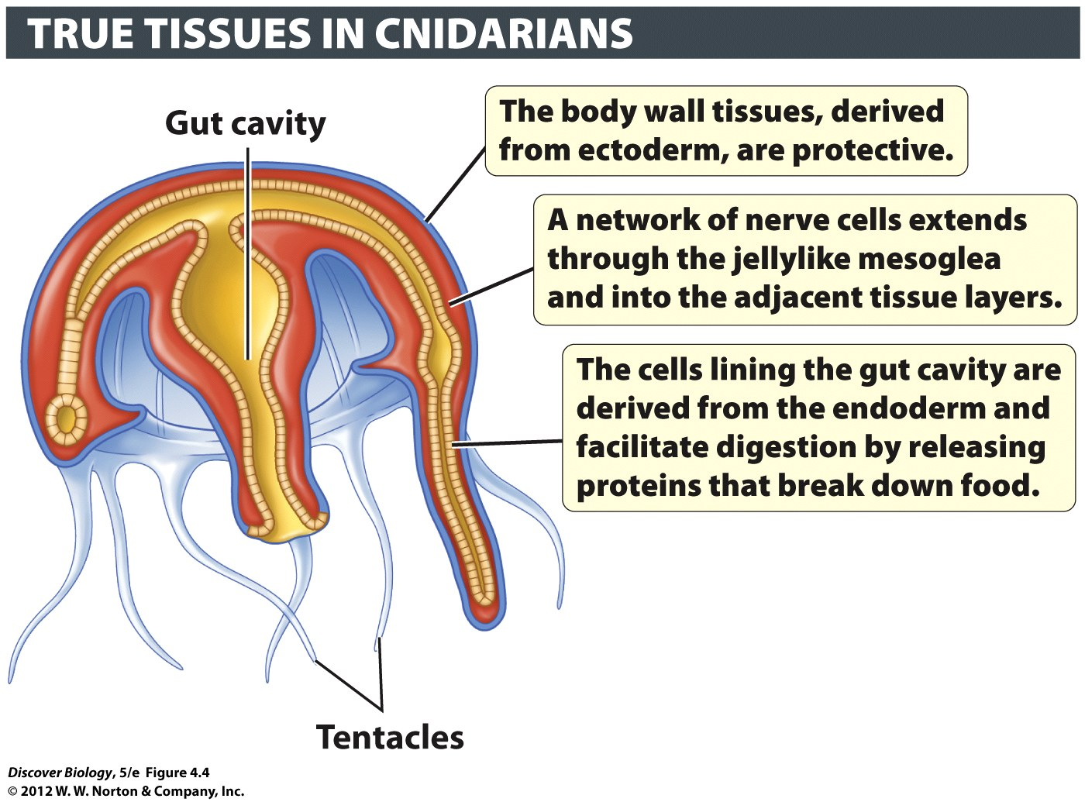
Notes:
Figure 4.4 Jellyfish Have True Tissue Layers
Cnidarians (including jellyfish) were one of the earliest groups to evolve true tissues. These tissues include the ectoderm (ecto, “outer”; derm, “skin”) and the endoderm (endo, “inner”). For clarity, these two layers are color-coded blue and yellow, respectively. Sandwiched between them is an inner (red) layer of secreted material known as the mesoglea (meso, “middle”; glea, “jelly”).

Slide 17
Animals Exhibit Unique Patterns of Embryo Development
Cell migration within developing embryos produces distinct embryonic cell layers
Embryonic cell layers generate all the different types of tissues found in adult bodies
Protostomes and deuterostomes develop the digestive system in opposite directions

Slide 18
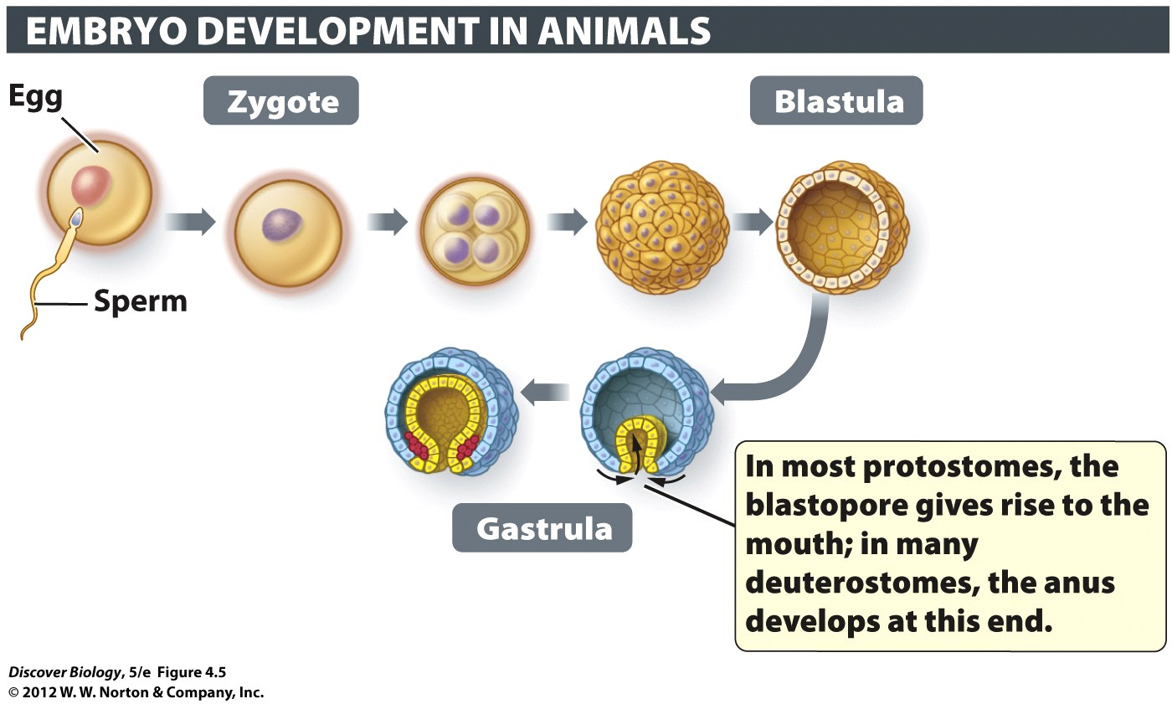
Notes:
Figure 4.5 Early Embryo Development Distinguishes Protostomes and Deuterostomes

Slide 19
Most Animals Have Symmetrical Bodies
Most animals exhibit either radial or bilateral symmetry
Radial symmetry gives sessile animals greater access to their environment
Bilateral symmetry is seen in all protostomes and deuterostomes; it divides the body into two halves that mirror each other

Slide 20
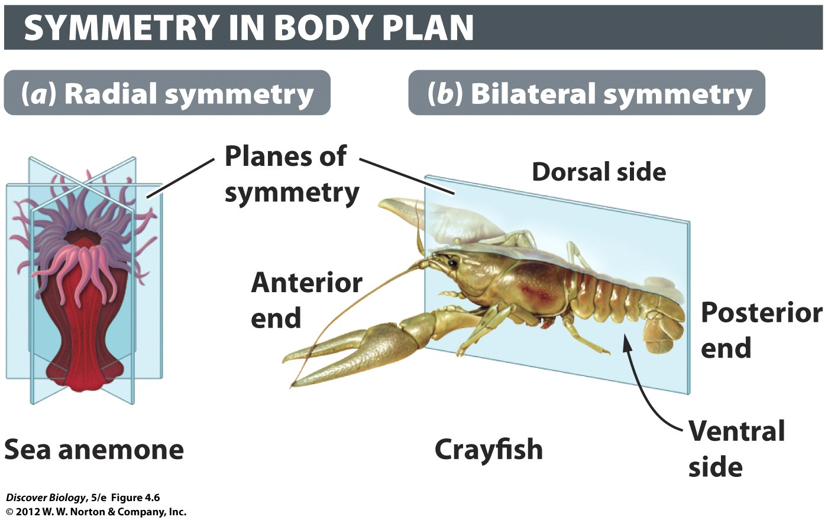
Notes:
Figure 4.6 Most Animals Display Either Radial or Bilateral Symmetry

Slide 21
Most Animals Have Organs and Organ Systems
Organs allow animals to function more efficiently
Organs have a definite shape, size, and location within the body
Two or more organs working together form an organ system

Slide 22
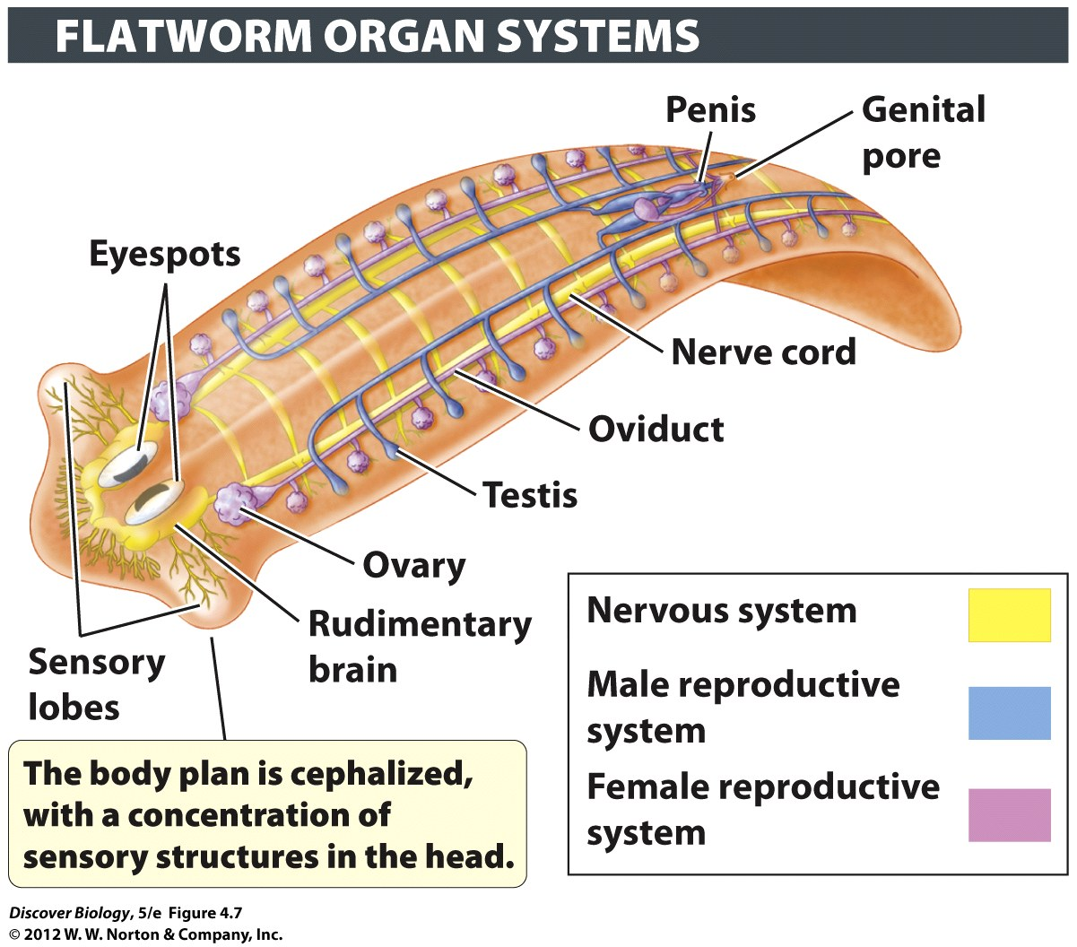
Notes:
Figure 4.7 Protostomes and Deuterostomes Have Organ Systems
The flatworm is a hermaphrodite, meaning that it contains both male and female structures.

Slide 23
Some Animals Evolved Complex Body Cavities
Body cavities allow an animal’s internal organs to grow freely and function independently
Most body cavities also provide padding and protection for organs
There are three types of body cavities found in animals:
Acoelomate
Pseudocoelomate
Coelomate

Slide 24
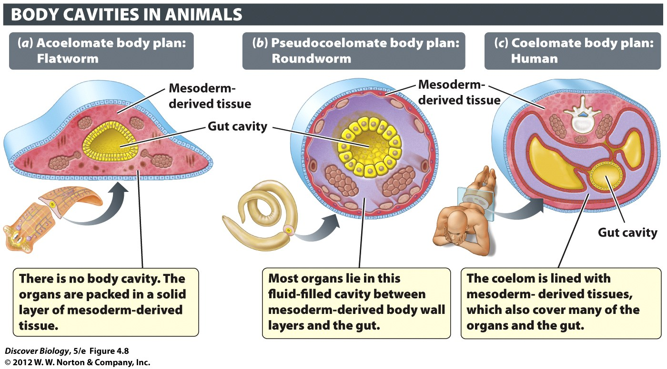
Notes:
Figure 4.8 Some Protostomes and All Deuterostomes Have a True Coelom

Slide 25
Segmentation Enabled Division of Labor among Body Parts
Many animals have repeated units called segments
Appendages are specialized body parts that arise from body segments and allow for evolutionary adaptations

Slide 26
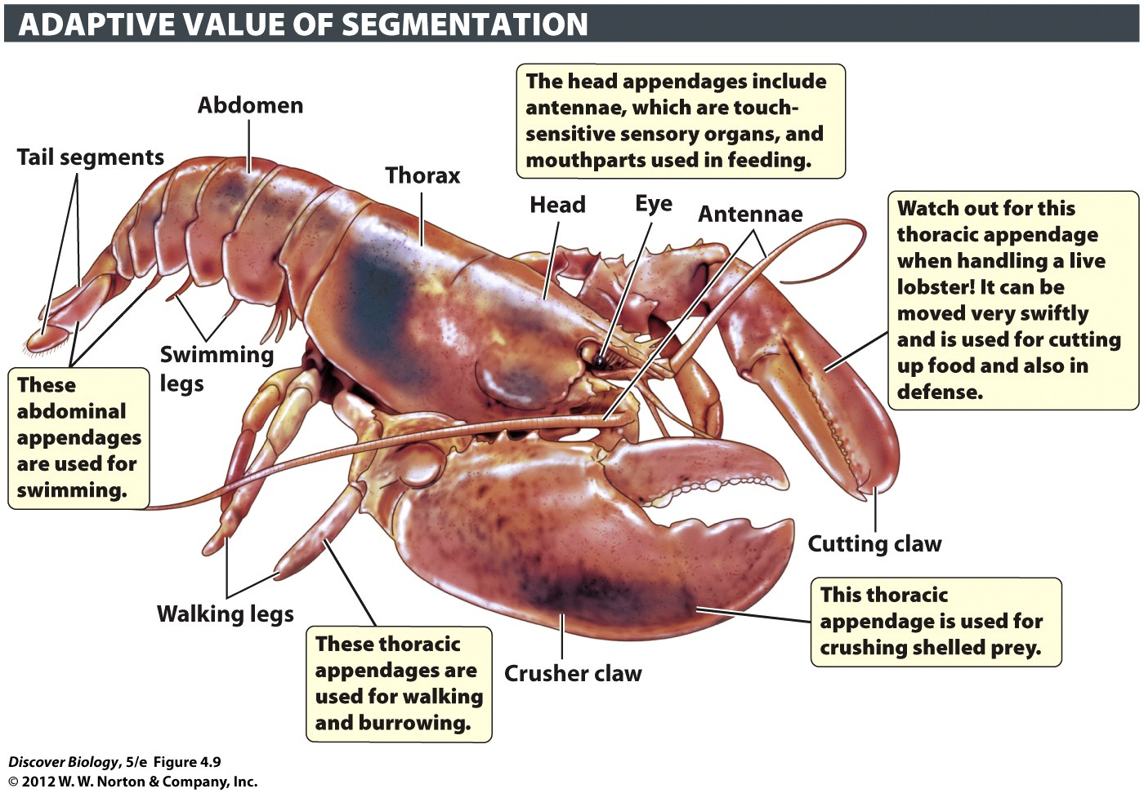
Notes:
Figure 4.9 Body Segments Evolved Diverse Functions
Segmentation, a body plan in which segments repeat, enables the evolution of diverse uses of appendages, as shown here in the body of a lobster.

Slide 27
The First Invertebrates: Sponges, Jellyfish, and Relatives
Animal lineages diverged very early in animal evolution
Sponges, jellyfish, corals, and hydras are among the earliest animals

Slide 28
Sponges Have a Simple Body Plan
There are three main groups of sponges
Desmosponges
Glass sponges
Calcareous sponges
Sponges are filter feeders that feed on bacteria, amoebas, and other organisms they acquire from their environment

Slide 29
Cnidarians and Ctenophores Have Radial Symmetry
Cnidarians include corals, sea anemones, and jellyfish
Characteristics of cnidarians include:
Radial symmetry
Two distinct tissue layers separated by an extracellular matrix
A nerve network
A lack of organs and organ systems
Cnidocytes, or stinging cells, used to immobilize prey

Slide 30
The Protostomes
Protostomes comprise the largest branch of the evolutionary tree and range in size from microscopic to rotifers to the colossal squid
Protostomes share the following characteristics
Bilateral body symmetry at some life stage
Three embryonic cell layers
Development of the mouth from the embryonic blastopore
Cephalization

Slide 31
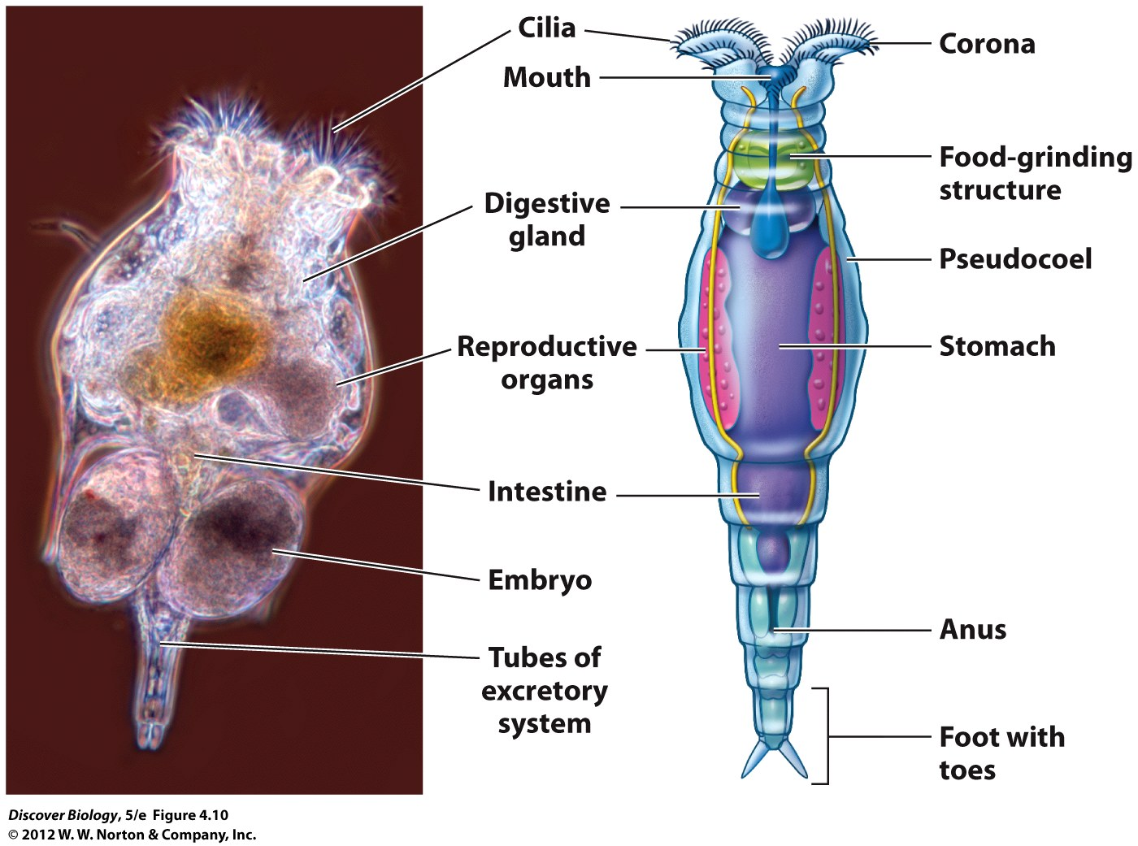
Notes:
Figure 4.10 Rotifers Are Smaller than Some Protists

Slide 32
Rotifers and Flatworms Lack a True Coelom
Rotifers are important aquatic decomposers
Flatworms are acoelomates that lack an anus
Flatworms can be free living or parasitic and lack respiratory and circulatory systems

Slide 33
Annelids Are Coelomate Worms with Segmented Bodies
Most annelids have a simple brain connected to a pair of nerve cords
Earthworms are the most familiar annelid and are important decomposers
Earthworms have a well-developed digestive system but lack a respiratory system
Gas exchange takes place across the moist skin of the earthworm

Slide 34
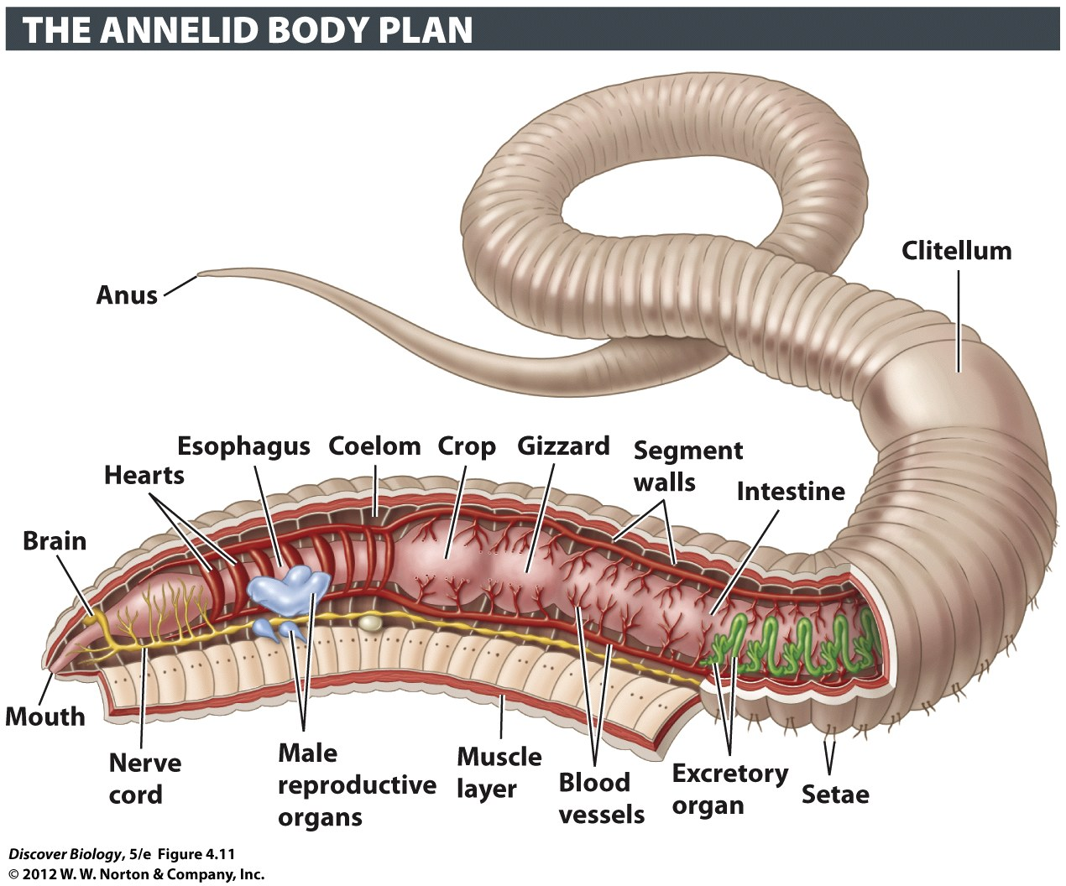
Notes:
Figure 4.11 Segmentation Is a Key Feature of the Annelids
Annelids have a true coelom and well-developed organ systems.

Slide 35
Mollusks Constitute the Largest Marine Phylum
The mollusca is one of the most diverse phylum of animals and includes shellfish, snails, slugs, squid, and octopi
All mollusks share the following characteristics:
A muscular foot at the base of the body
A compact grouping of internal organs called the visceral mass
A mantle enclosing the body cavity and the visceral mass

Slide 36
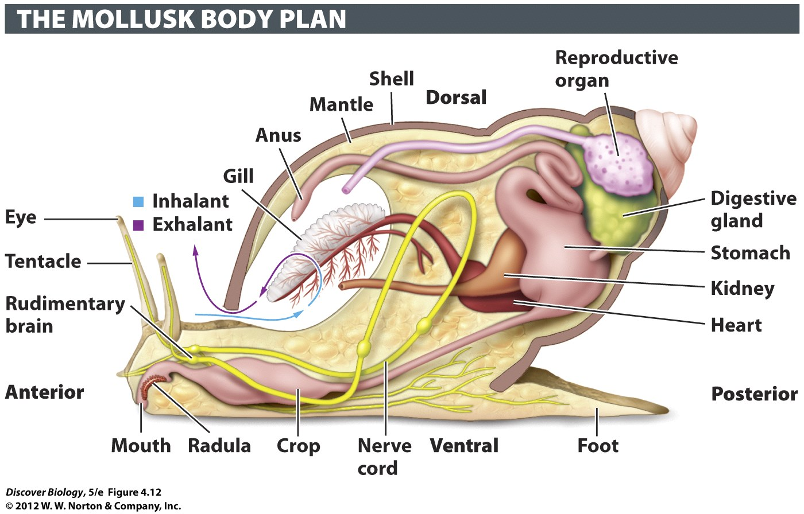
Notes:
Figure 4.12 Mollusk Body Plans Are Variation on a Basic Theme
Although they show astounding diversity, mollusks have certain commonalities in their body plans. For example, all mollusks are bound by a tense sheet of tissue called the mantle, which wraps around the visceral mass, the compact lump formed by the internal organs. Most mollusks have a muscular foot used in locomotion.

Slide 37
Mollusks Constitute the Largest Marine Phylum
Bivalves, or shellfish, are mollusks that shelter their soft bodies inside a hard, hinged shell
Most gastropods have a spiral shell on the dorsal side of the animal
Cephalopods are marine animals that include the nautilus, squid, and cuttlefish and are thought to be the smartest invertebrates

Slide 38
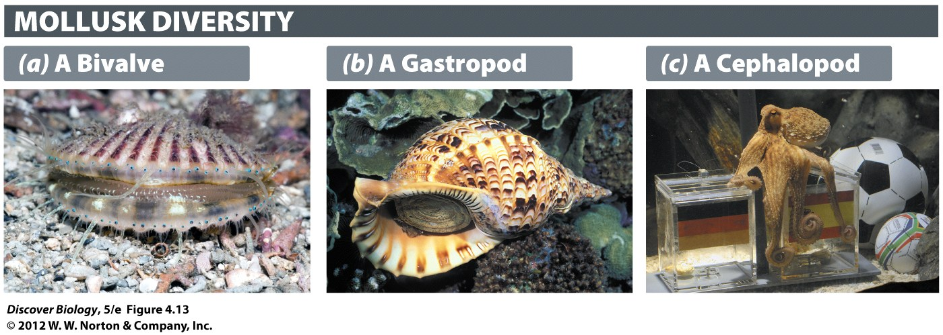
Notes:
Figure 4.13 Mollusks Dominate the Sea
(a) Bivalve: The rows of simple eyes (at shell edges) of the Atlantic bay scallop can detect motion by sensing changes in light levels. (b) Gastropod: At 40 pounds and 30 inches long, the Australian trumpet snail is the largest gastropod in the world. (c) Cephalopod: The octopus Paul is credited with correctly predicting the outcomes of all international games played by the German national soccer team. Paul died in 2010 of natural causes.

Slide 39
Some Protostomes Shed Their Outer Covering to Enable Growth
Ecdysozoans shed their outer covering on a regular basis in a process known as molting
Arthropoda are ecdysozoans that have jointed body parts and include
Crustaceans
Chelicerates (horseshoe crabs, spiders)
Millipedes and centipedes
All insects

Slide 40
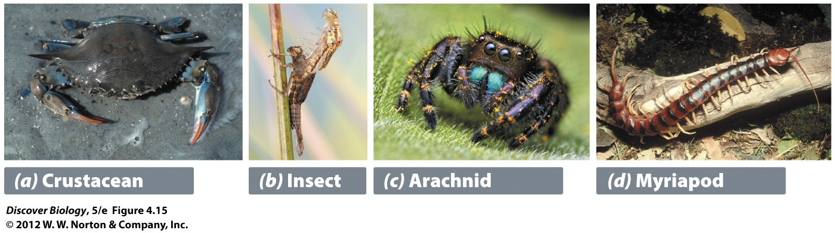
Notes:
Figure 4.15 Arthropods
(a) Crustaceans(lobsters, shrimp, and crabs) are primarily water dwellers with 10 or more legs. (b) Insects have 6 legs. (c) Arachnids (mites, ticks, spiders, and scorpions) have 8 legs. (d) Myriapods (millipedes and centipedes) live on land and have many more than 10 legs.

Slide 41
Arthropoda Is the Most Species-Rich Phylum
More than a million species of arthropods have been identified
Arthropods have a hard outer exoskeleton that is made of chitin
Evolutionary changes to individual body segments have produced different types of legs, antennae, and specialized appendages

Slide 42
Arthropoda Is the Most Species-Rich Phylum
Arthropods share these common features:
Jointed appendages
A cuticle that forms a hard exoskeleton
A segmented body plan at some stage of the life cycle
A three-part body plan that consists of an anterior head, a thorax, and a posterior abdomen

Slide 43
Arthropoda Is the Most Species-Rich Phylum
Crustaceans are aquatic animals that have developed a variety of appendages and are an important part of the marine food chain
About half of all the known species in the world are insects
Insects have a three-part body plan with six legs attached to the thorax

Slide 44
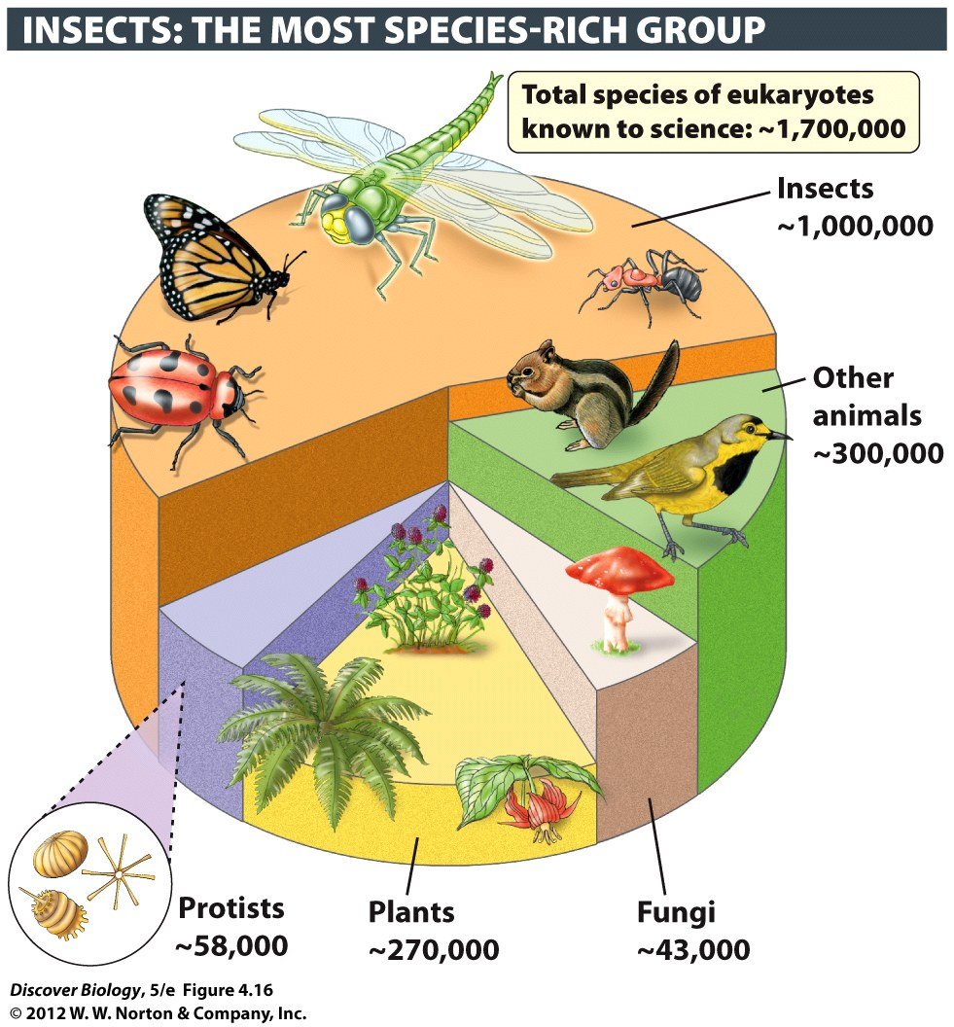
Notes:
Figure 4.16 Some Animal Groups Are More Species-Rich than Others

Slide 45
Arthropoda Is the Most Species-Rich Phylum
Insects have developed a unique respiratory system that allows gases to move directly to and from the bloodlike fluid
Insects have a highly developed visual system
Most insects have wings that enable them to evade predators

Slide 46
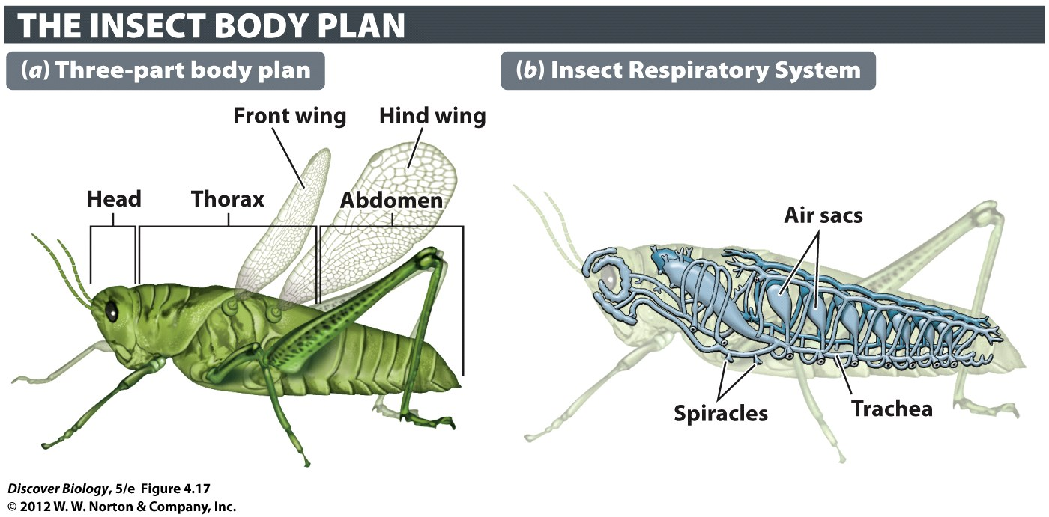
Notes:
Figure 4.17 Insects Have a Three-Part Body Plan and an Enclosed Respiratory System

Slide 47
Arthropoda Is the Most Species-Rich Phylum
Metamorphosis is the multistep process through which immature forms of animals are transformed into adults
Incomplete metamorphosis describes gradual changes from one developmental stage to the next
Complete metamorphosis describes dramatic developmental changes from one stage to the next

Slide 48
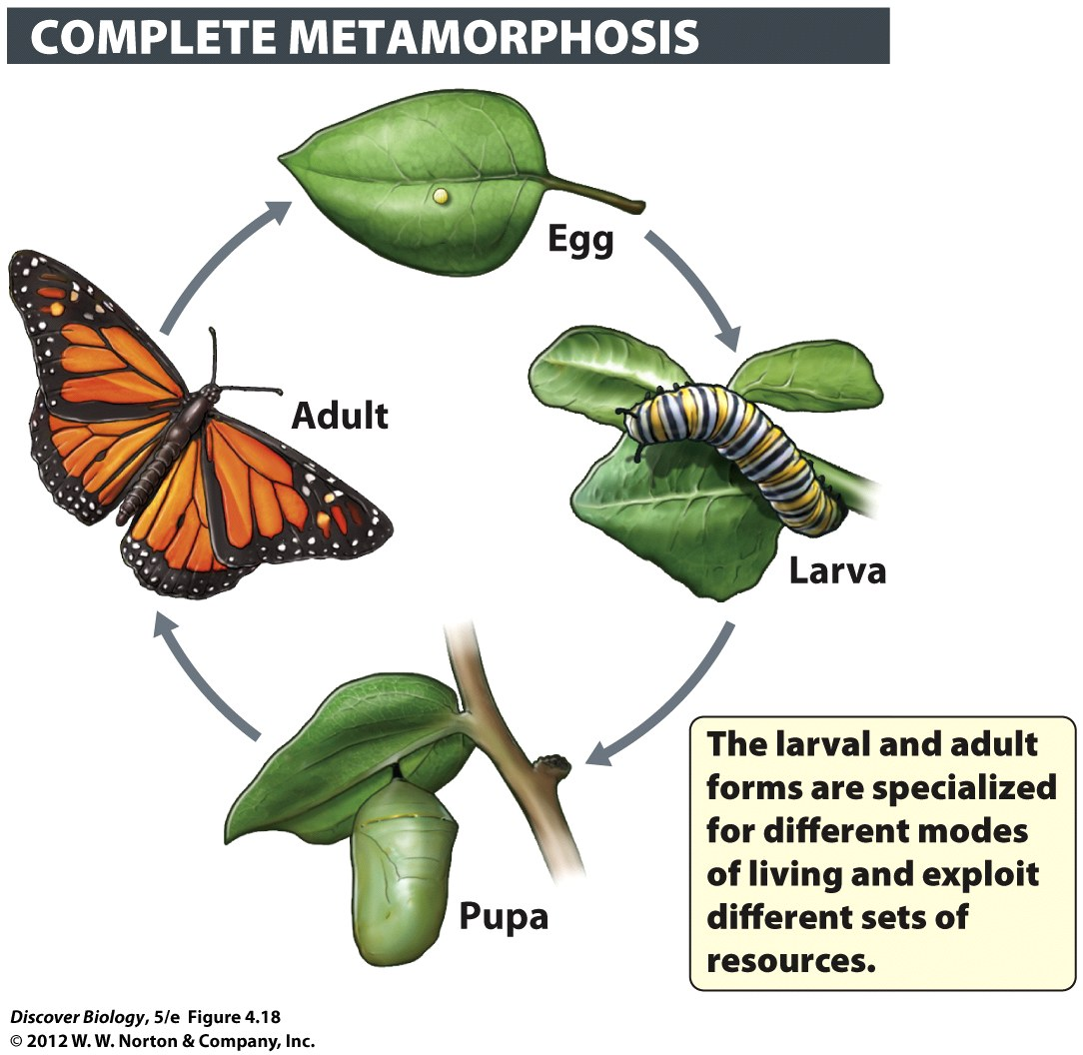
Notes:
Figure 4.18 Butterflies Are among the Insects That Undergo Complete Metamorphosis

Slide 49
The Deuterostomes—I: Echinoderms, Chordates, and Relatives
All deuterostomes share two basic characteristics:
The embryonic blastopore gives rise to the anus, and the mouth forms secondarily
There is a hollow nerve cord located on the dorsal side
Adult deuterostomes are generated by three distinct embryonic cell layers and have a true coelom

Slide 50
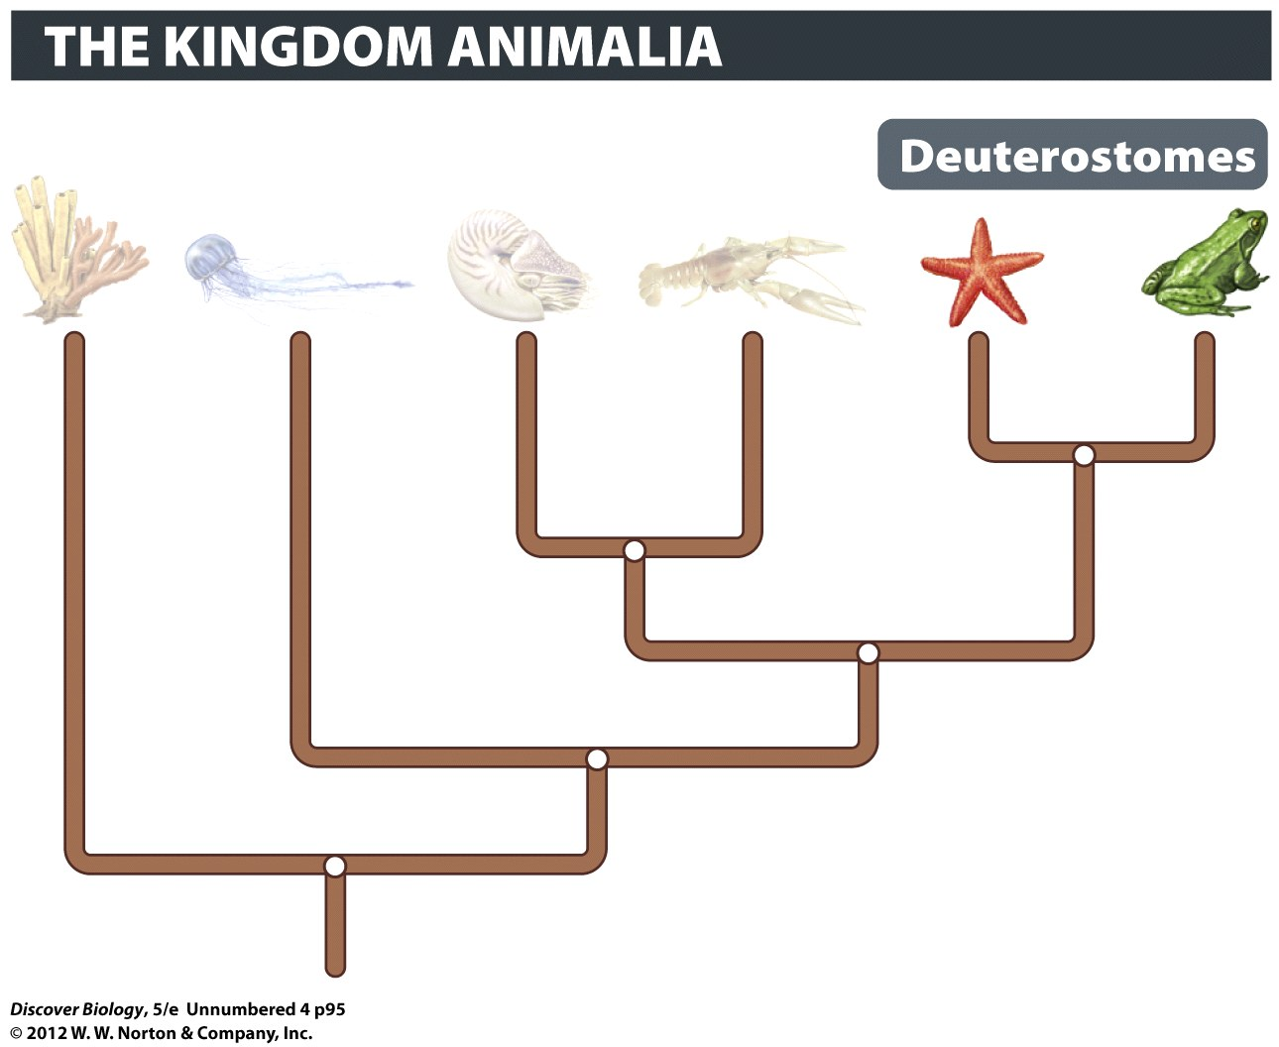

Slide 51
Echinoderms Use a Water Vascular System for Locomotion and Gas Exchange
Sea stars, sea urchins, and sand dollars are bilaterally symmetrical as larvae and radially symmetrical as adults
Some echinoderms are sessile, while others move with tube feet that use a water vascular system to apply suction to surfaces and prey
The circulation of water through the canals of the digestive system facilitates gas exchange

Slide 52
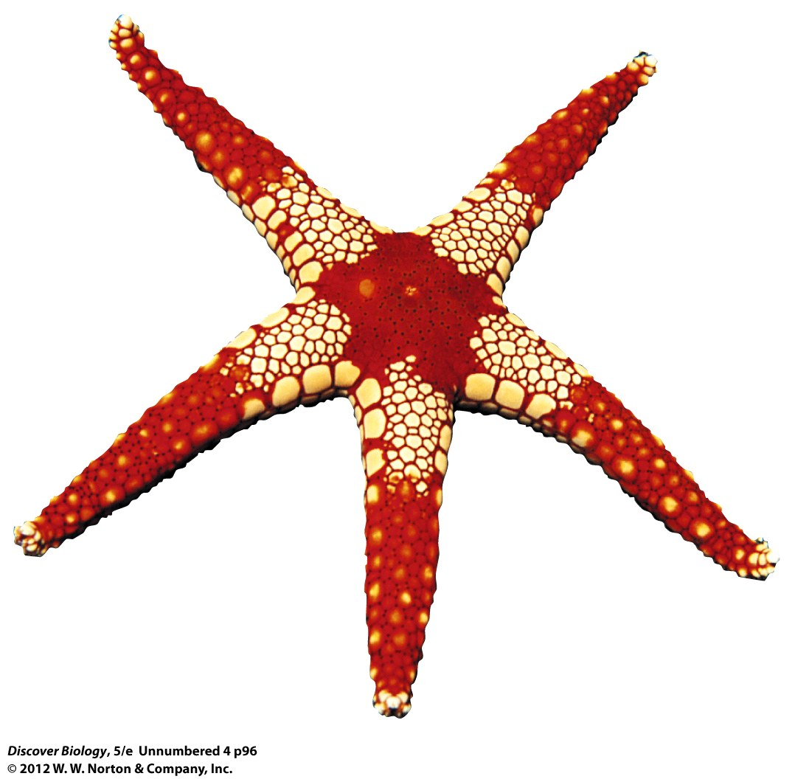
Notes:
Echinoderms, like this necklace sea star from the Red Sea, are closely related to the vertebrates.

Slide 53
Chordates Possess a Dorsal Notochord at Some Stage of Their Life Cycle
Chordates have the following characteristics:
A dorsal rod of strengthening tissue called a notochord
Pharyngeal pouches, which develop on either side of the throat in the embryo
A post-anal tail
The notochord is a collection of large cells that form a strong, flexible bar, which runs the length of the animal and provides support for the body

Slide 54
Chordates Possess a Dorsal Notochord at Some Stage of Their Life Cycle
Vertebrates are animals with an internal vertebral column composed of hollow cylindrical sections called vertebrae
The vertebral column encloses the nerve cord that runs down the dorsal side of all deuterostomes
Vertebrates include fish, amphibians, reptiles, birds, and mammals

Slide 55
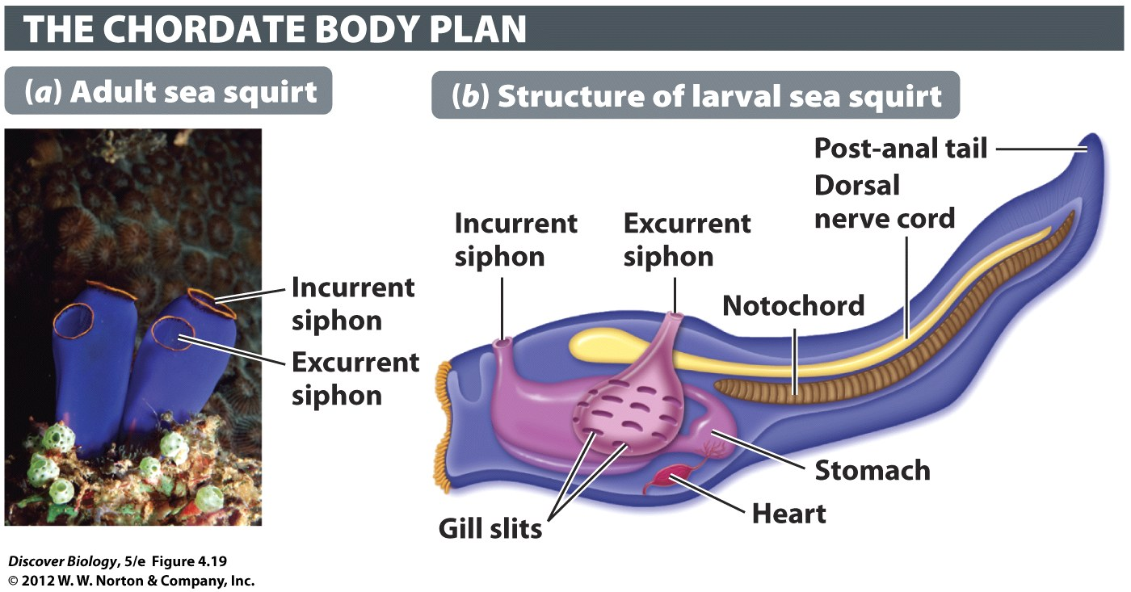
Notes:
Figure 4.19 The Notochord Is Unique to the Chordates
Although the adult form of the sea squirt Ciona (a) looks very different from that of other chordates, such as people, the chordate hallmarks are evident in the larval form of the animal (b).

Slide 56
The Deuterostomes—II: Vertebrates
The first vertebrates were the jawless fishes that first evolved in the Cambrian period
Common characteristics of the early vertebrates include:
A strong internal skeleton held together by a vertebral column
An anterior braincase, or skull
A closed circulatory system with a pumping organ, the heart

Slide 57
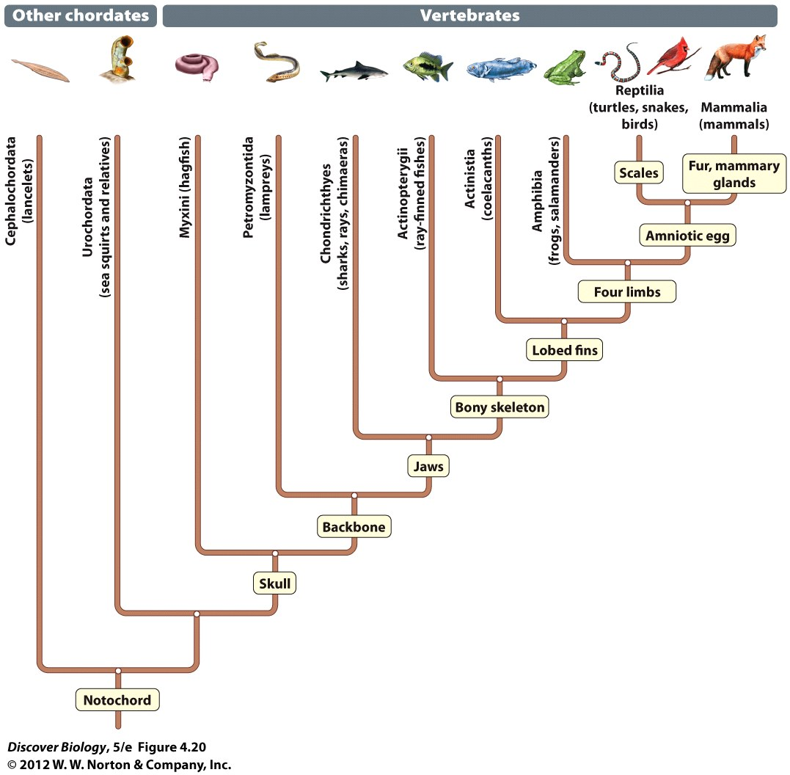
Notes:
Figure 4.20 Evolutionary Tree of the Vertebrates

Slide 58
Jaws and a Bony Skeleton Represent Major Steps in Vertebrate Evolution
Anterior gill arches of jawless fish evolved into hinged jaws that allowed for more efficient predation
Fins are modified appendages of fish used for stability and swimming
Ray-finned fishes developed spike-like extensions of their skeleton, which are used for support
Lobe-finned fishes have paired fins with thick muscular lobes supported by joint-like bones that can move independently

Slide 59
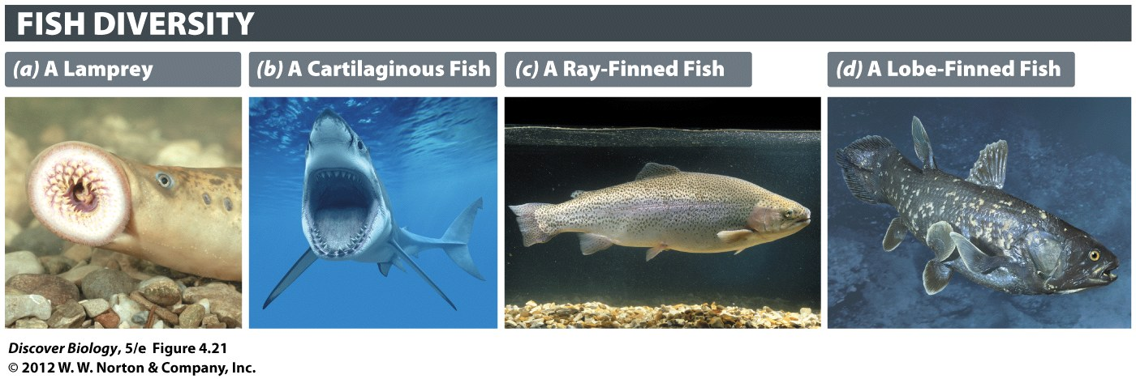
Notes:
Figure 4.21 Fishes May Be Jawless or Jawed
(a) Lampreys and hagfishes are jawless fishes, but the three other categories of fish shown here have a hinged jaw attached to the skull. (b) Sharks have thousands of teeth. The large main teeth are continually shed and replaced by smaller teeth in the inner rows. Shark teeth retract into the gums when the mouth closes. (c) Ray-finned fish have a lateral line, a sensory organ that enables fish to detect movement by sensing pressure. (d) The muscular lobed fins of the coelacanth have leglike bones inside. An ancestor of a fish like this one is thought to have played a role in the evolution of the vertebrates.

Slide 60
Jaws and a Bony Skeleton Represent Major Steps in Vertebrate Evolution
Only eight species of lobe-finned fish are present today
Cartilaginous fishes must gulp or swim constantly to move enough oxygen-rich water over their gills
Bony fishes have evolved a gas-filled bladder that helps provide buoyancy
Scientists believe gas-filled bladders later evolved into the lungs of land-dwelling animals, which was a crucial development in the transition onto land

Slide 61
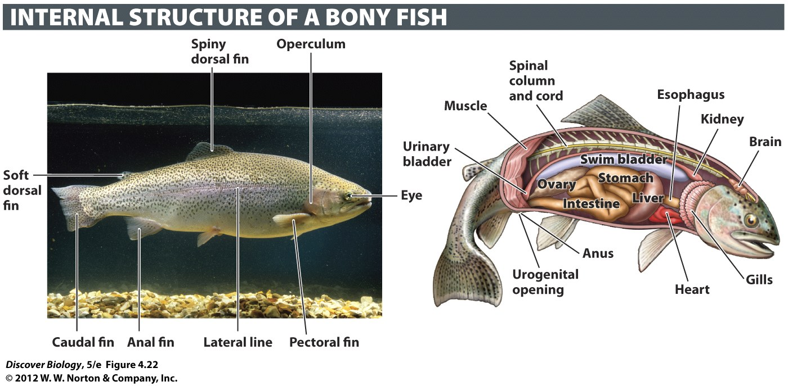
Notes:
Figure 4.22 Bony Fishes Have a Strong Internal Skeleton
The swim bladder provides buoyancy, reducing the energy required to stay afloat.

Slide 62
Amphibians Breathe through Both the Lungs and the Skin Surface
Tetrapods are terrestrial vertebrates with four limbs
There are several thousand species of amphibians, including frogs and salamanders
Amphibians are considered semiaquatic, and many are characterized by complete metamorphosis, such as frogs

Slide 63
Reptiles Exhibit Adaptations to a Drier Environment
Reptiles evolved a number of adaptive traits that allowed them to survive outside of aquatic environments and included:
Skin covered in waterproof scales
A water-conserving excretory system
The amniotic egg, containing stored food and a waterproof shell
Internal fertilization

Slide 64
Reptiles Exhibit Adaptations to a Drier Environment
A lineage of tetrapods gave rise to the reptiles in the Carboniferous period, about 354 million years ago
The dinosaurs were a successful line of reptiles in the Mesozoic era
Turtles, tortoises, and box turtles are among the oldest reptiles

Slide 65
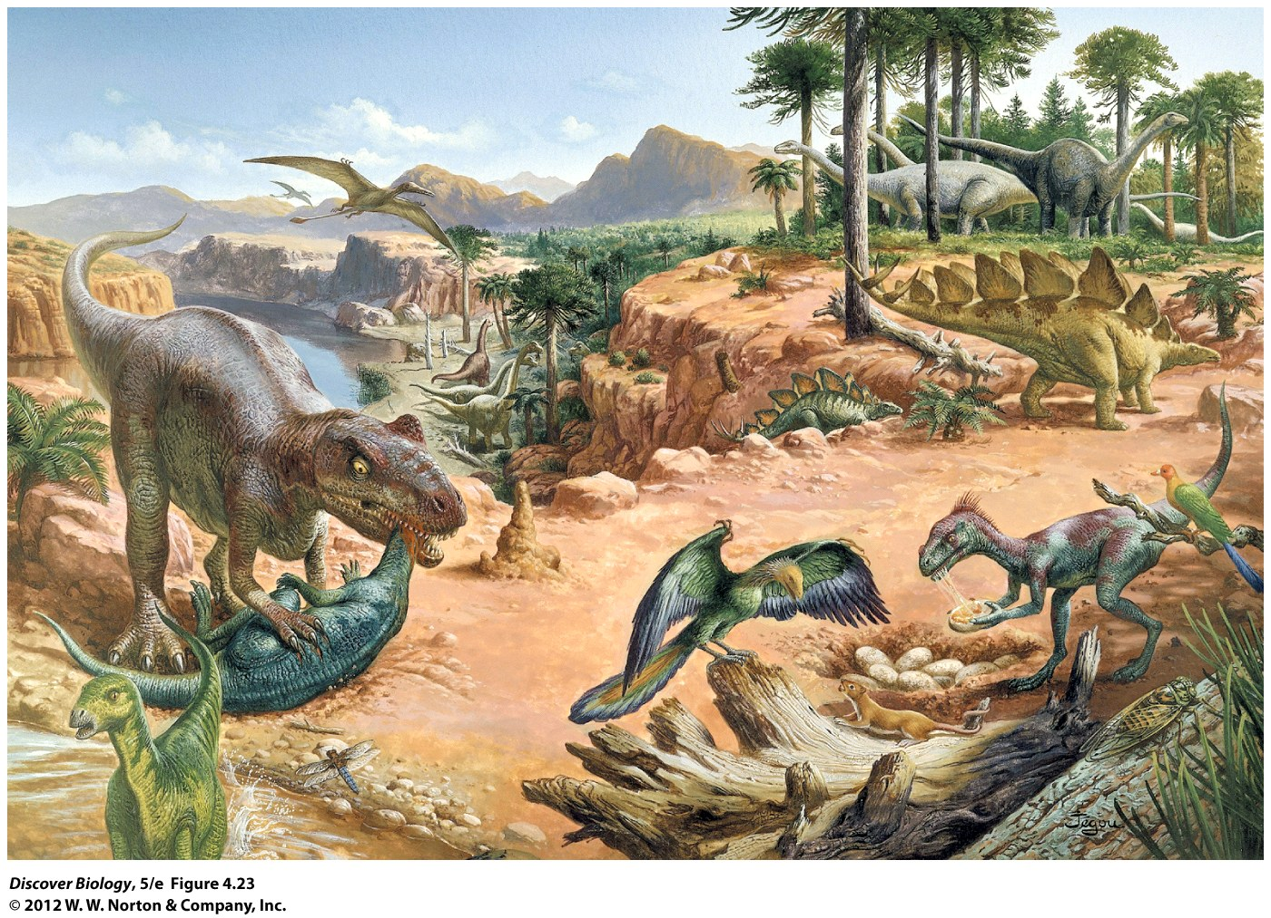
Notes:
Figure 4.23 Jurassic Park
Dinosaurs reached the height of their dominance during the Jurassic, the middle period of the Mesozoic era.

Slide 66
Reptiles Exhibit Adaptations to a Drier Environment
The amniotic egg protects the developing embryo, promotes gas exchange, and stores waste
The yolk of an amniotic egg is a mass of stored food that enables the young to reach a relatively advanced level of development before hatching
Reptiles have overlapping scales that help reduce water loss from the skin surface
Reptiles are ectotherms, meaning that their body temperature matches that of their environment

Slide 67
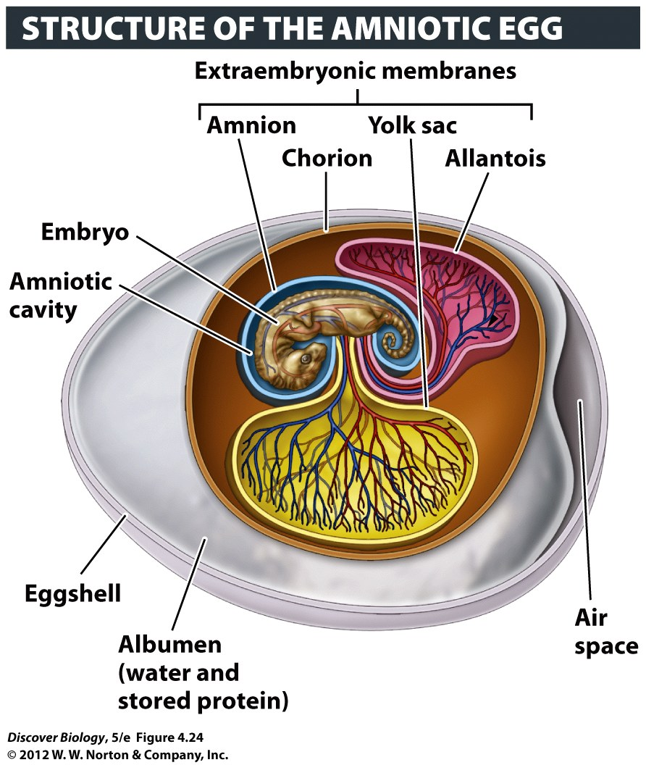
Notes:
Figure 4.24 The Amniotic Egg Was a Crucial Evolutionary Innovation for Life on Land

Slide 68
Birds Are Adapted for Flight
Birds evolved from a lineage of feathered theropod dinosaurs
Feathers initially evolved for warmth and eventually adapted for flight
Birds have an efficient one-way respiratory system and a reduced number of organs to facilitate flight
Birds are endotherms and maintain a constant internal temperature

Slide 69
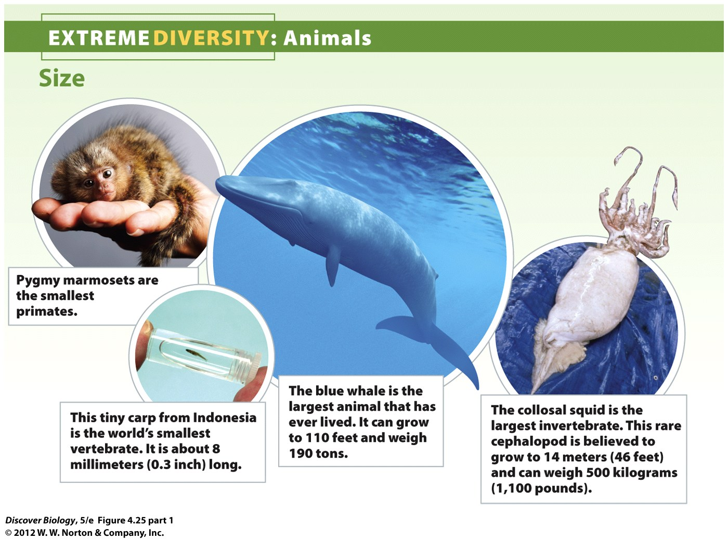
Notes:
Figure 4.25 Extreme Diversity: The Animals

Slide 70
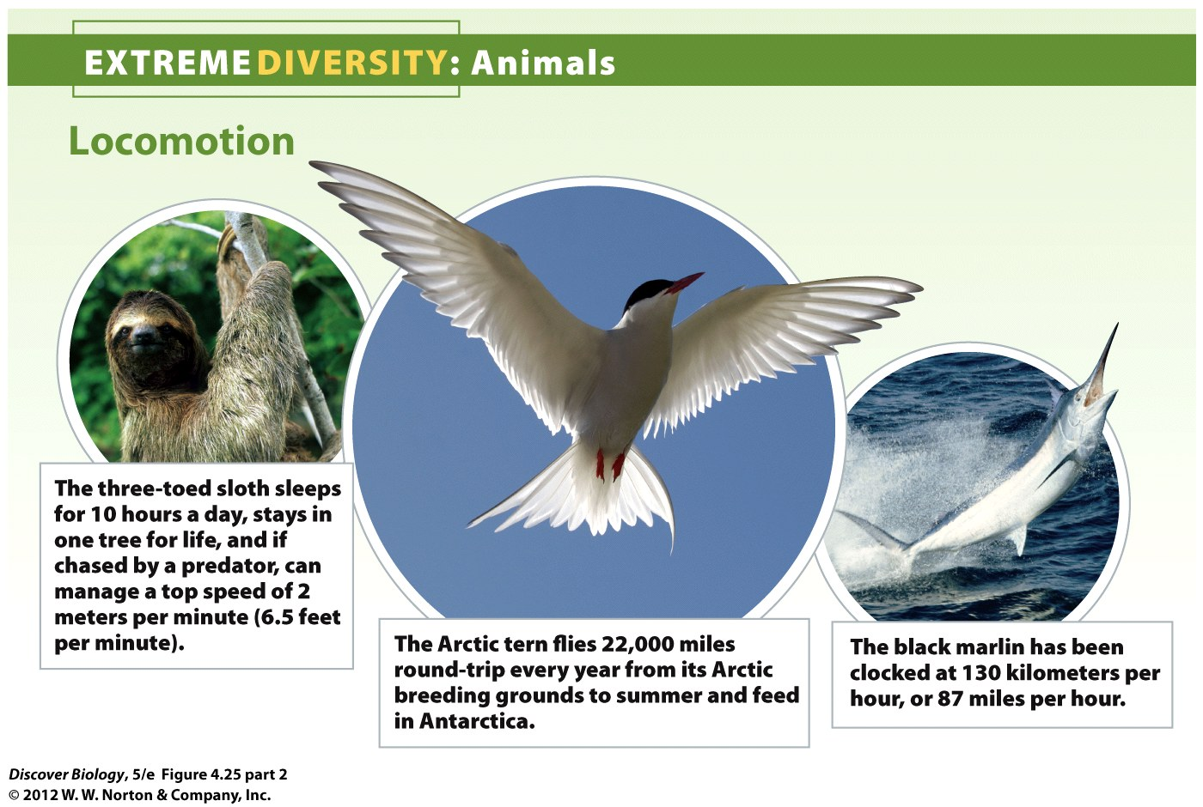
Notes:
Figure 4.25 Extreme Diversity: The Animals

Slide 71
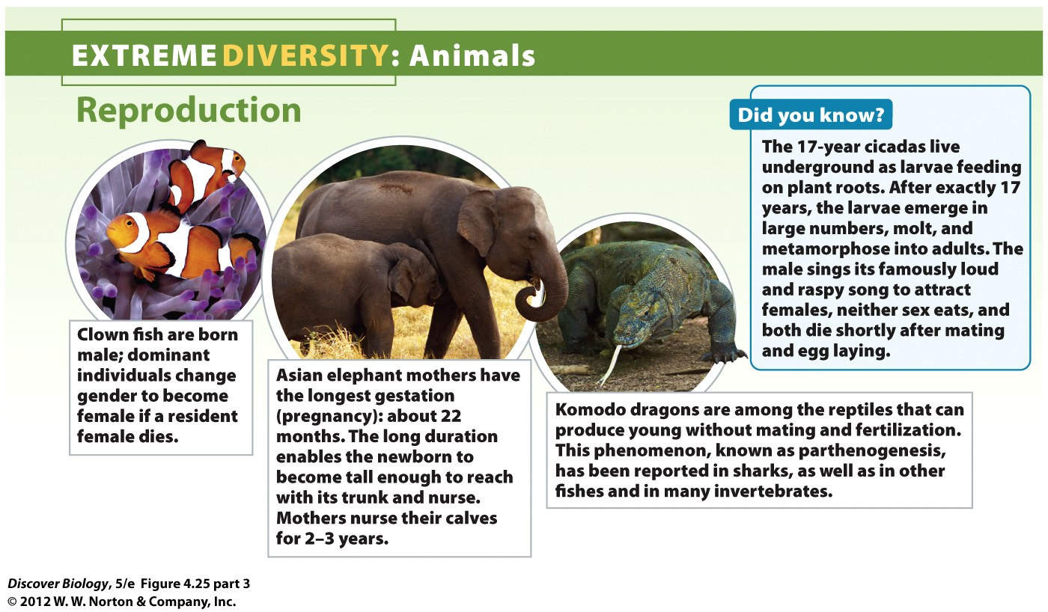
Notes:
Figure 4.25 Extreme Diversity: The Animals

Slide 72
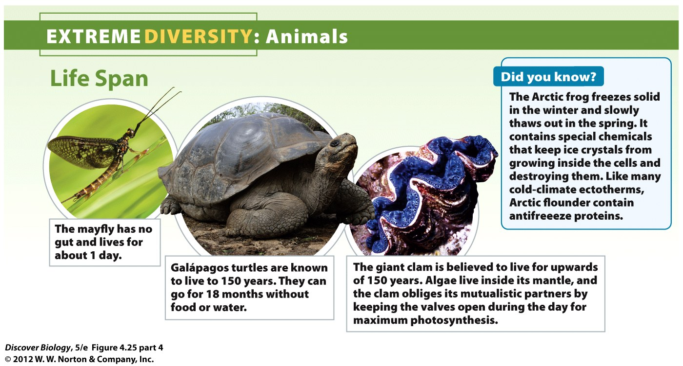
Notes:
Figure 4.25 Extreme Diversity: The Animals

Slide 73
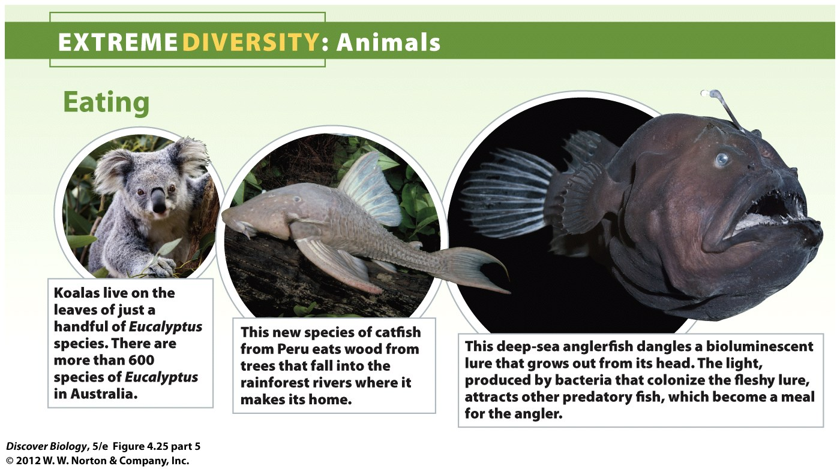
Notes:
Figure 4.25 Extreme Diversity: The Animals

Slide 74
Mammals Came into Prominence When Dinosaur Populations Declined
Mammals evolved about 225 million years ago and all share these common characteristics:
Hair on the body and endothermy
Sweat glands that cool the body through evaporation
Young nourished with milk from mammary glands
Internal fertilization and parental care

Slide 75
Mammals Came into Prominence When Dinosaur Populations Declined
Mammals can be divided into three broad categories:
The monotremes, which include nonplacental egg-laying mammals
The marsupials, which protect and feed their young with milk in an external pocket or pouch
The eutherians, which nourish their young internally through a special organ called the placenta

Slide 76
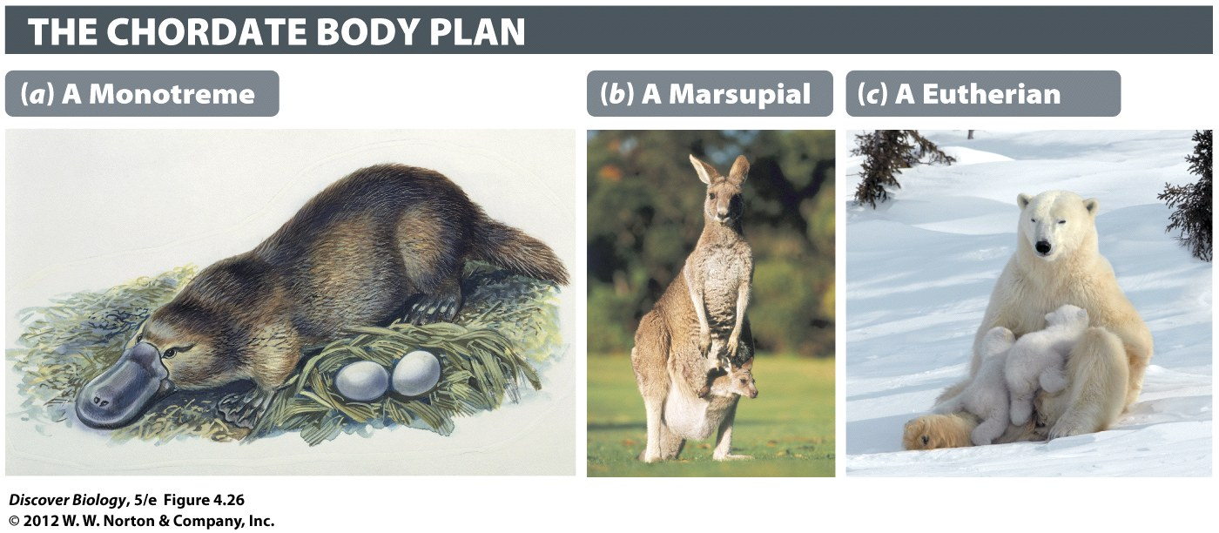
Notes:
Figure 4.26 Three Categories of Mammals
(a) Monotremes like the platypus are characterized by milk-producing mammary glands in females. Unlike all other mammals, however, monotremes lay eggs instead of giving birth to live young. (b) Kangaroos are marsupial mammals that give birth to relatively immature young that finish developing in a pouch (marsupium). (c) Eutherians give birth to well-developed young and suckle from the mammary glands.

Slide 77
Mammals Can Live in Diverse Habitats Because They Regulate Body Temperature
All mammals are endotherms and homeotherms
Endothermy and hair allow mammals to colonize cold regions
Only mammals have sweat glands, which enable them to reduce body temperature through evaporation
Aquatic mammals and fur-bearing mammals lack sweat glands, however

Slide 78
Parental Care Contributed to the Success of Mammals
All mammals have internal fertilization
The placenta of eutherians is an organ comprised of embryonic and maternal tissues with an extensive blood supply
The placenta supplies the embryo with nutrients and oxygen and removes waste chemicals and carbon dioxide
Mammals guard their newborns until they are capable of living independently

Slide 79
Parental Care Contributed to the Success of Mammals
Mammary glands are the most distinctive feature of mammals; they produce a liquid rich in fat, proteins, and other substances that nourish the newborn
Mammals have developed learning to the highest degree
Primates evolved about 56 million years ago and gave rise to the hominid lineage, which includes humans, about 6 million years ago

Slide 80
Clues to the Evolution of Multicellularity
Choanoflagellates remained single-celled but kept their colony-forming abilities
The feeding cells of choanoflagellates work like those of the simplest animals
The divide-and-stick-together development of animals and colonial choanoflagellates to form cooperative groups is a shared trait, which supports the theory that they are related

Slide 81
Clicker Questions
CHAPTER 4
Animalia

Slide 82
Concept Quiz
If two species share a common characteristic, such as a long tongue, does that mean they evolved from common ancestors?
Yes
No
Notes:
The correct answer is No because convergent evolution may lead to two very distant species sharing a remarkably similar characteristic. Both species evolved independently to do a similar task of survival so the resulting characteristic is functionally and apparently the same.

Slide 83
Concept Quiz
Which of the following is ordered correctly on the basis of evolutionary development?
Plants → Fungi → Animals
Fungi → Plants → Animals
Animals → Plants → Fungi
Notes:
The correct answer is A.
Answer B: Although many classification systems place plants next to animals in the organization hierarchy, they exhibit less evolutionary development than the fungi.
Answer C: Animals are the most developed of the organisms and therefore, are not the evolutionary ancestors of the plants and fungi.

Slide 84
Relevant Art from Other Chapters
All art files from the book are available in JPEG and PPT formats online and on the Instructor Resource Disc

Slide 85
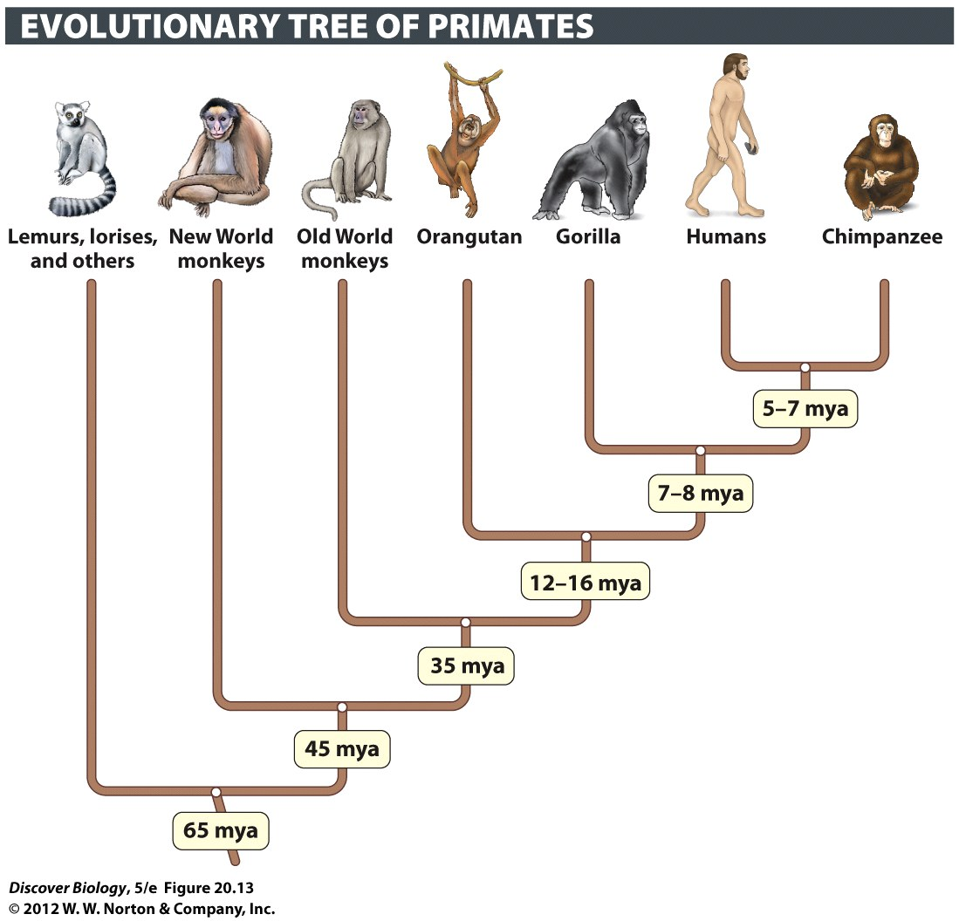
Notes:
Figure 20.13 The Primates Include Lemurs, Monkeys, and Apes

