Slide 1
Discover Biology FIFTH EDITION
Anu Singh-Cundy • Michael L. Cain
CHAPTER 3
Protista, Plantae, and Fungi
© 2012 W. W. Norton & Company, Inc.

Slide 2
Did Plants Teach Rivers to Wander?
Meandering rivers promote ecological diversity
Damaged rivers can harm an ecosystem by washing away fertile soils
River restoration projects must start by determining what makes rivers meander

Slide 3
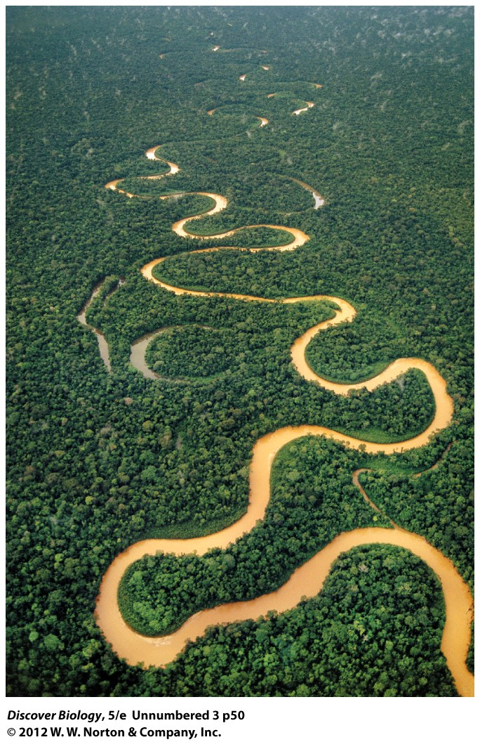
Notes:
Meandering River
A river displays distinctive meanders as it winds through the upper Amazon basin in Peru.

Slide 4
The Mind-Boggling Diversity of Life
The Eukarya domain contains four kingdoms
Protista
Plantae
Fungi
Animalia
Eukaryotes evolved sometime after prokaryotes populated the Earth

Slide 5
The Dawn of Eukarya
The oldest Eukaryote fossil dates back 2.1 billion years
The evolution of eukaryotes introduced new ways of organizing cell structures and propagating life

Slide 6
The Dawn of Eukarya
Key evolutionary features of eukaryotes
Presence of a nucleus and many other membrane-bound internal compartments
Comparatively larger cell size
Sexual reproduction
Multicellularity

Slide 7
Eukaryotes Have Subcellular Compartmentalization and Larger Cells
Eukaryotic DNA is enclosed in a nuclear membrane
The increased number and complexity of subcellular compartments allows eukaryotes to function with greater efficiency
Eukaryotes are 10 times wider than prokaryotes on average and thousands of times larger in volume

Slide 8
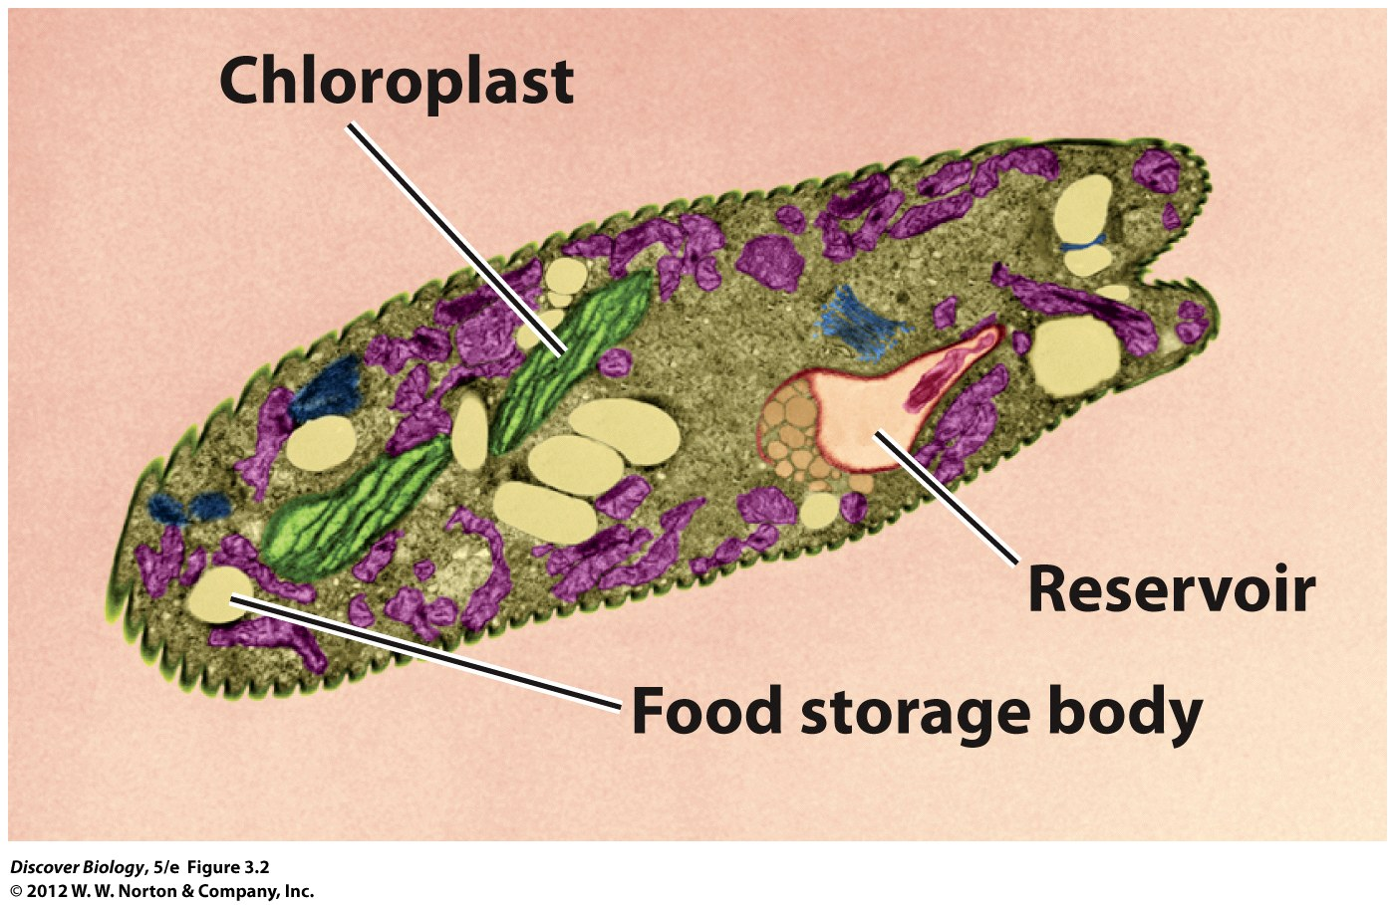
Notes:
Figure 3.2 Internal Organization in Euglena
The compartments seen in this green alga, Euglena gracilis, include the nucleus, and structures specialized for conducting photosynthesis (chloroplasts) and storing food. The protist uses a long, whiplike structure (the flagellum) to swim about. The flagellum is not visible in this color-enhanced electron microscope photograph. The reservoir is a pocket in which flagella are anchored. The following additional membraneenclosed compartments are also visible in this photograph: mitochondria (purple), lipid bodies (dark orange), Golgi apparatus (blue). The functions of these organelles are described in Chapter 6.

Slide 9
Sexual Reproduction Increases Genetic Diversity
Sexual reproduction increases genetic diversity by producing offspring that are different from each other and from both parents.
During sexual reproduction, the nuclei of two different gametes fuse to form a new organism
Some eukaryotes, including certain algae and some protists, can reproduce asexually

Slide 10
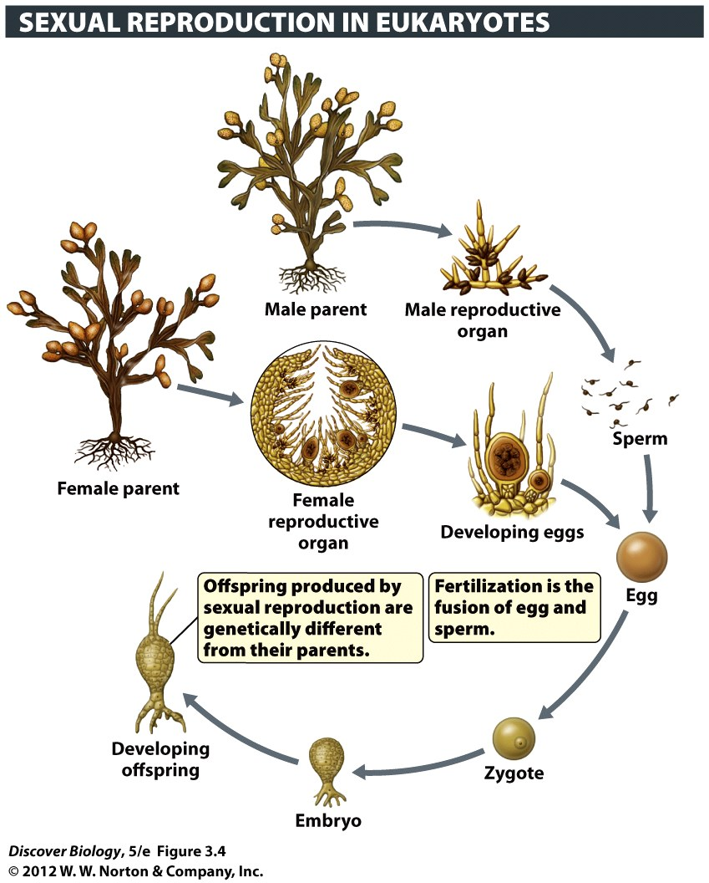
Notes:
Figure 3.4 An Example of Sexual Reproduction
The rockweed, a brown alga, produces eggs and sperm that unite to create offspring, in a life cycle that resembles that of animals. Other seaweeds have different, and more complex, life cycles.

Slide 11
Multicellularity Evolved Independently in Several Eukaryotic Lineages
Protists and fungi can be single-celled or multicellular organisms
Plants and animals are exclusively multicellular
Groups of cells perform specialized functions in multicellular organisms

Slide 12
Multicellularity Evolved Independently in Several Eukaryotic Lineages
Multicellularity enables organisms to grow larger
Larger individuals can:
Gather resources from the environment more efficiently
Produce more surviving offspring than smaller organisms
Evade predators

Slide 13
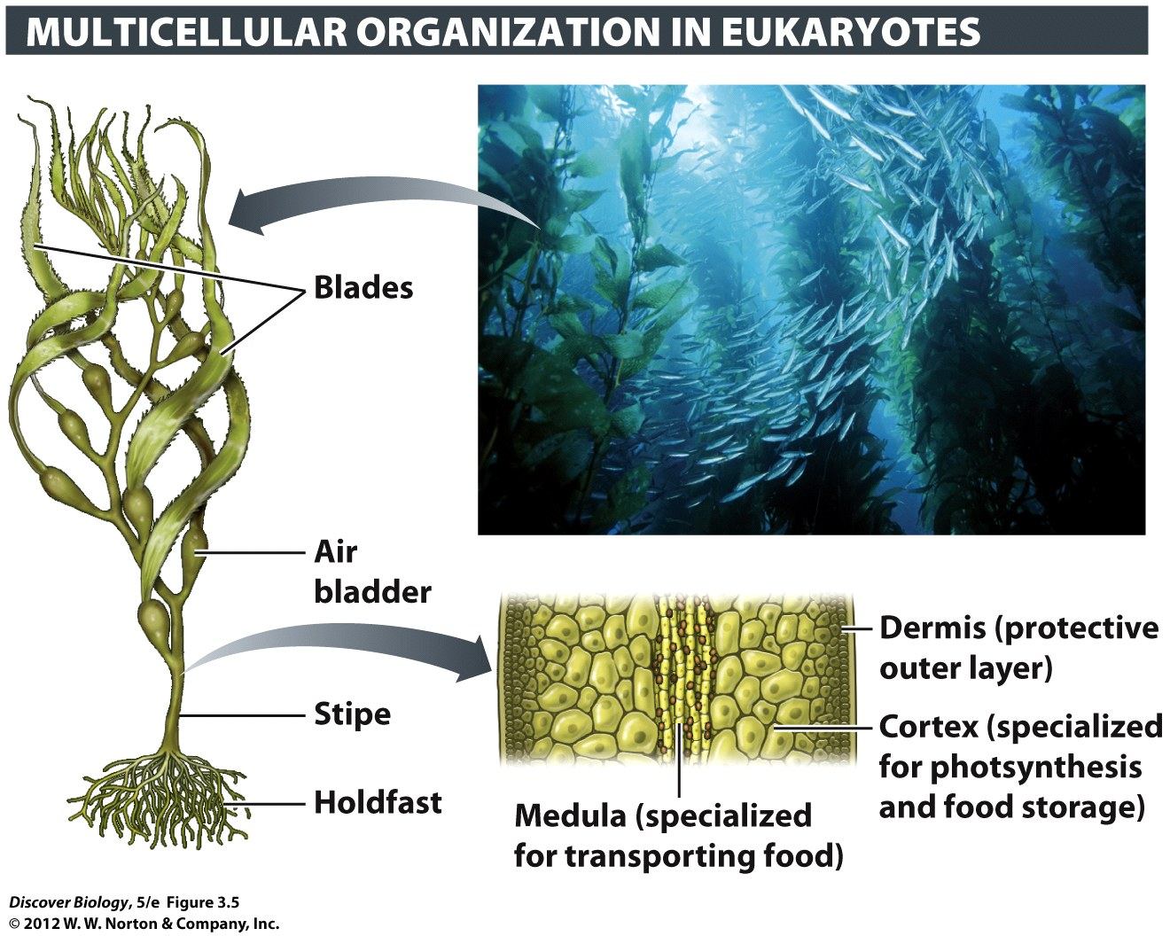
Notes:
Figure 3.5 Specialized Cells Perform Different Functions in the Giant Kelp

Slide 14
Protista: The First Eukaryotes
The protists include any organism that do not fit into the other kingdom classifications
The kingdom Protista includes many disparate organisms, such as the amoebas and dinoflagellates

Slide 15
Protists Are Not a Natural Grouping
Some scientists propose an evolutionary tree based on multiple lines of evidence including:
Cell structure comparison
Metabolic chemistry
DNA
Protozoans are protists categorized as being photosynthetic and motile
Algae are protists categorized as being photosynthetic and may (or may not) be motile

Slide 16
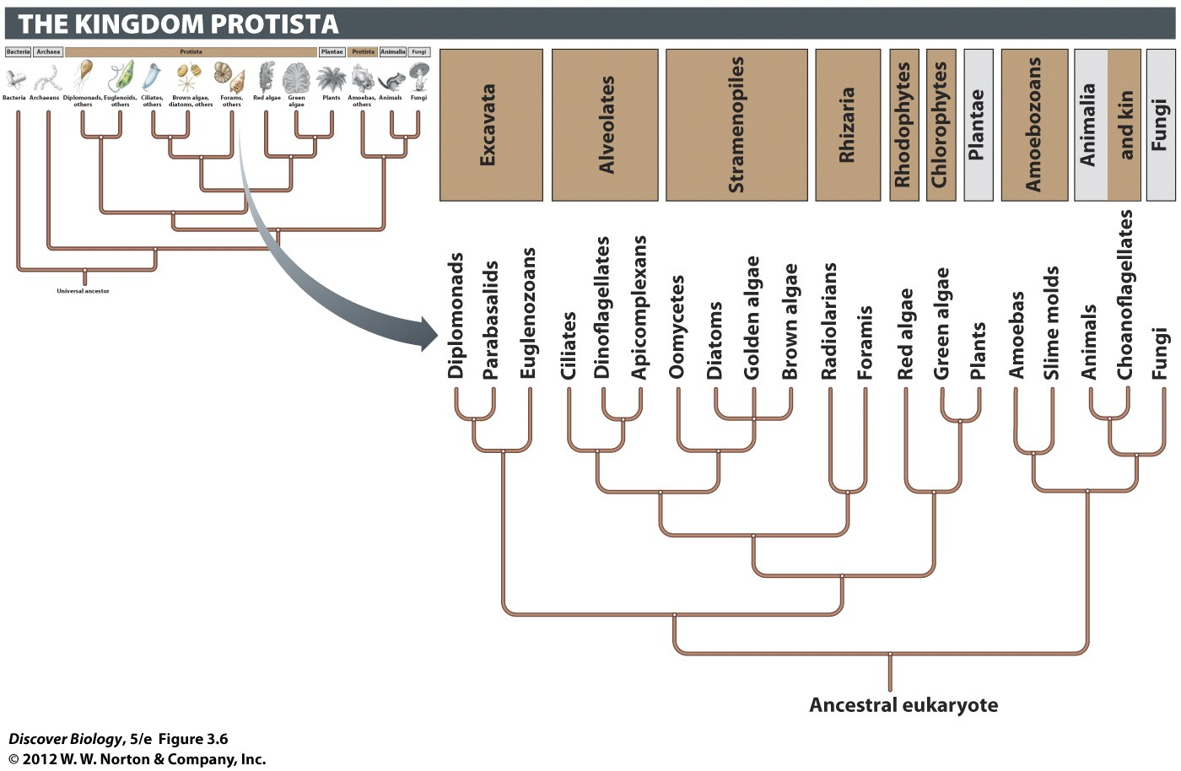
Notes:
Figure 3.6 Evolutionary Tree of the Protista
The tree shows evolutionary relationships hypothesized for some of the major groups of protists. The colored boxes show labels commonly used for some of the “supergroups” among the protista.

Slide 17
Most Protists are Single-Celled and Microscopic
Protists are mobile, single-celled microscopic organisms
Protists move about by means of flagella, cilia, or pseudopodia
Slime molds, commonly found on rotting vegetables, can exist as either a single-celled or multicellular organism

Slide 18
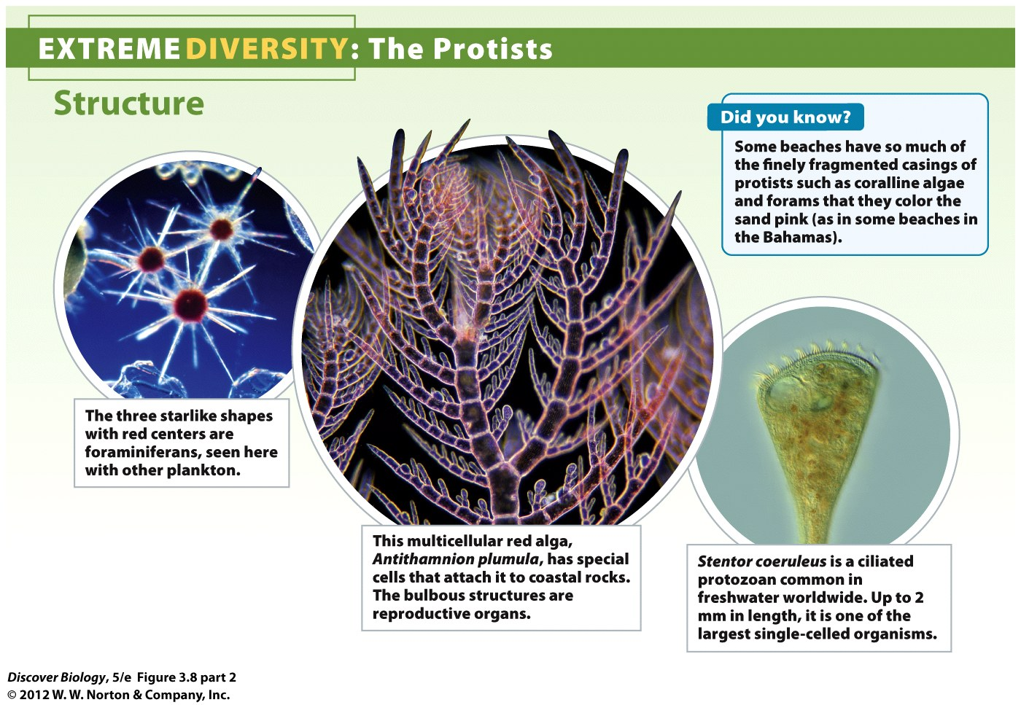
Notes:
Figure 3.8 Extreme Diversity: The Protists

Slide 19
Protists are Autotrophs, Heterotrophs, or Mixotrophs
Algae are autotrophic producers that use energy from sunlight to carry out photosynthesis and release oxygen gas as a by-product
Nearly half of the photosynthesis on Earth is carried out by free-floating, single-celled algae called phytoplankton

Slide 20
Protists are Autotrophs, Heterotrophs, or Mixotrophs
Heterotrophic protists rely on other organisms for energy
Decomposers are heterotrophs that break down waste or dead material, releasing nutrients into the environment
Mixotrophs obtain energy from a variety of sources, depending on environmental conditions

Slide 21
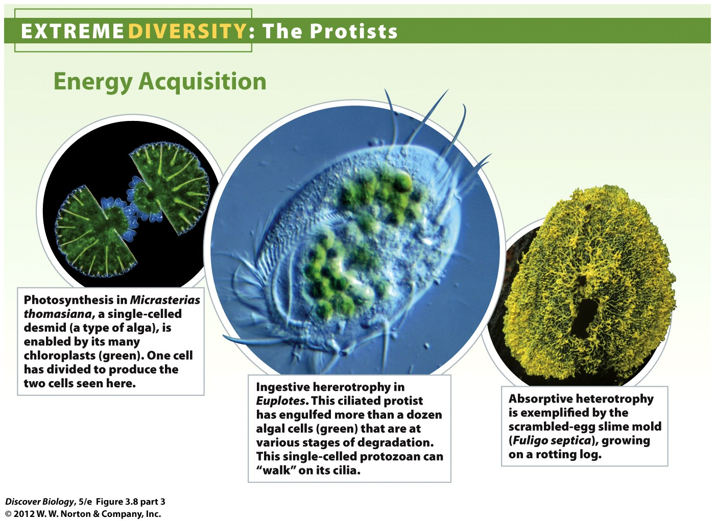
Notes:
Figure 3.8 Extreme Diversity: The Protists

Slide 22
Some Protists Are Pathogens
Some of the best-known protists are disease-causing pathogens
Dinoflagellates
Plasmodium
Trichomonas vaginalis

Slide 23
Plantae: The Green Mantle of Our World
Plants are multicellular autotrophs that use specialized organelles called chloroplasts to carry out photosynthesis
Plants can reproduce both sexually and asexually

Slide 24
Plantae: The Green Mantle of Our World
Bryophytes were the earliest land plants and include mosses, liverwort, and hornwort
Gymnosperms include conifers such as pines and firs
Angiosperms are flowering plants and are vital to humans for food, clothing, medicines, and many other products

Slide 25
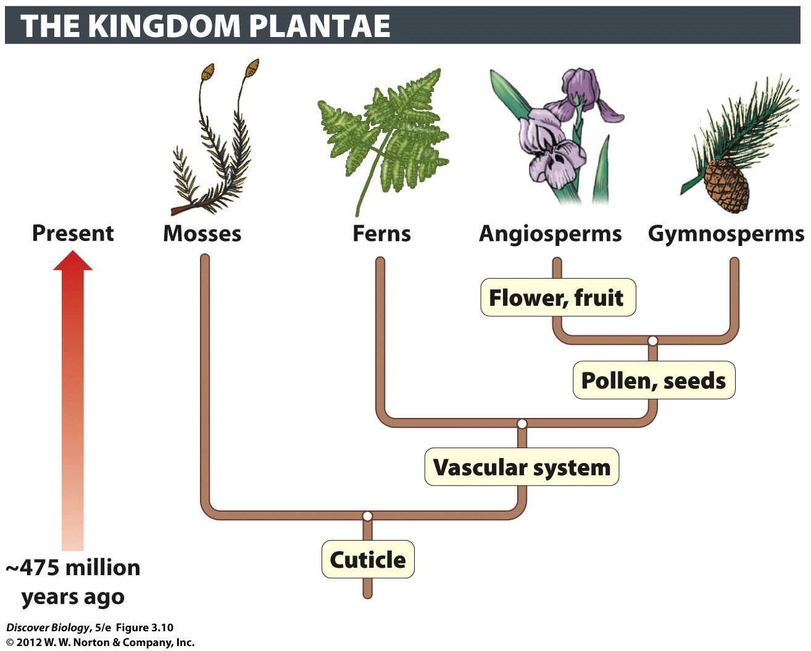
Notes:
Figure 3.10 Evolutionary Tree of the Plantae

Slide 26
Plants Had to Adapt to Life on Land
In order to evolve on land, plants developed a waxy cuticle that prevents them from drying out
Stomata are pores that open and close to allow the carbon dioxide needed for photosynthesis to enter the leaves

Slide 27
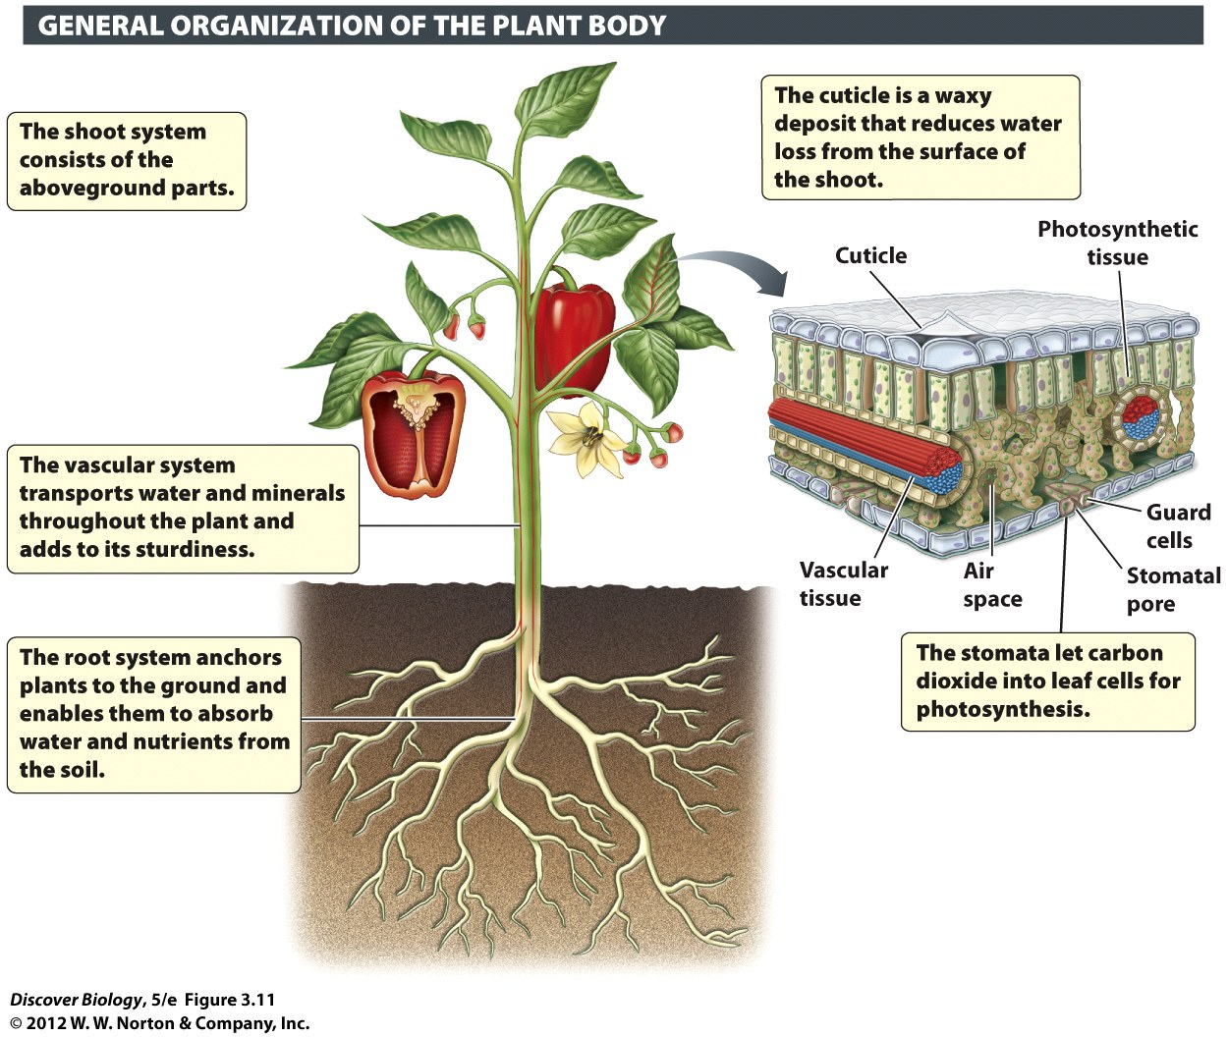
Notes:
Figure 3.11 The Plant Body Consists of the Shoot and Root Systems
Shown here is a bell pepper plant (Capsicum annuum). Because it is a member of the angiosperms, the last of the major plant groups to evolve, this one plant illustrates all the evolutionary innovations that distinguish plants.

Slide 28
Lignin Enables Plants to Grow Tall
Plants have a strong but flexible cell wall composed of cellulose
Lignin is one of the strongest natural substances; it links cellulose fibers together to create a rigid cell network
Together, lignin and cellulose enable trees and plants to grow tall

Slide 29
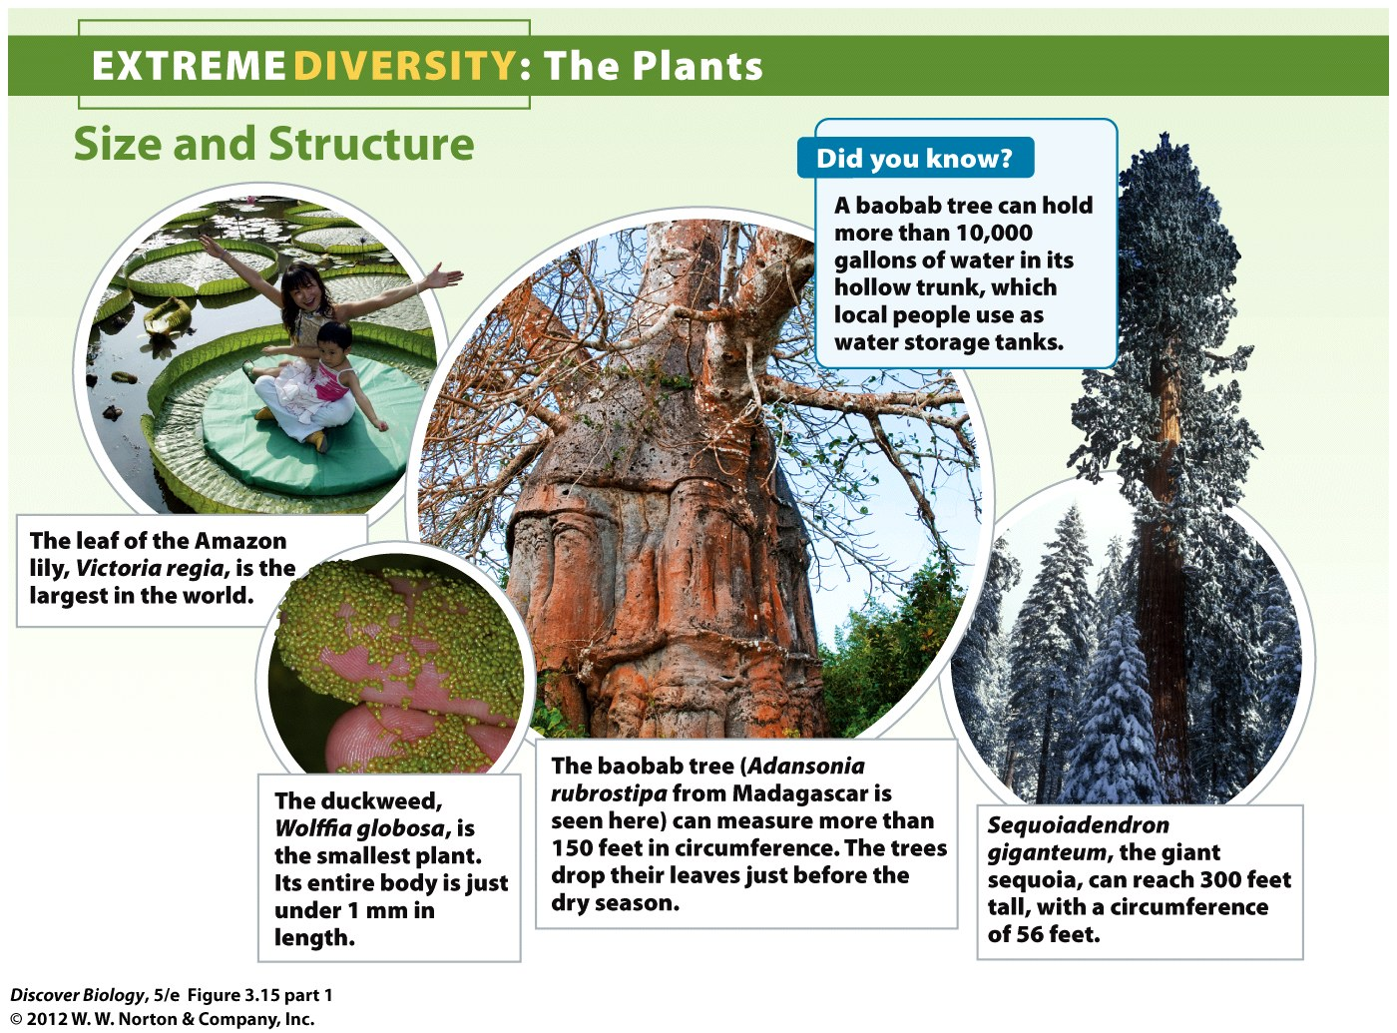
Notes:
Figure 3.15 Extreme Diversity: The Plants

Slide 30
The Vascular System Enables Plants to Move Fluids Efficiently
Bryophytes often grow in moist environments, allowing them to obtain water through capillary action
Angiosperms and gymnosperms have specialized tissues that form a vascular system
Phloem is vascular tissue that transports food molecules to plant cells
Xylem is vascular tissue that transports water and dissolved nutrients to plant cells

Slide 31
The Vascular System Enables Plants to Move Fluids Efficiently
Root xylem brings water from the soil to the aboveground parts of the plant
Root phloem delivers sugars produced in the leaves to nonphotosynthetic tissues belowground

Slide 32
The Evolution of Seeds Contributed to the Success of Gymnosperms
Gymnosperms were the first plants to evolve pollen, a microscopic structure that contains sperm cells
Pollen is dry, powdery, and produced in great quantities
Gymnosperms were the first plants to evolve the seed

Slide 33
The Evolution of Seeds Contributed to the Success of Gymnosperms
A seed is made up of a plant embryo and a short supply of food encased in a protective seed coat
Gymnosperms produce winged seeds that can drift far from the parent to increase the chance of survival

Slide 34
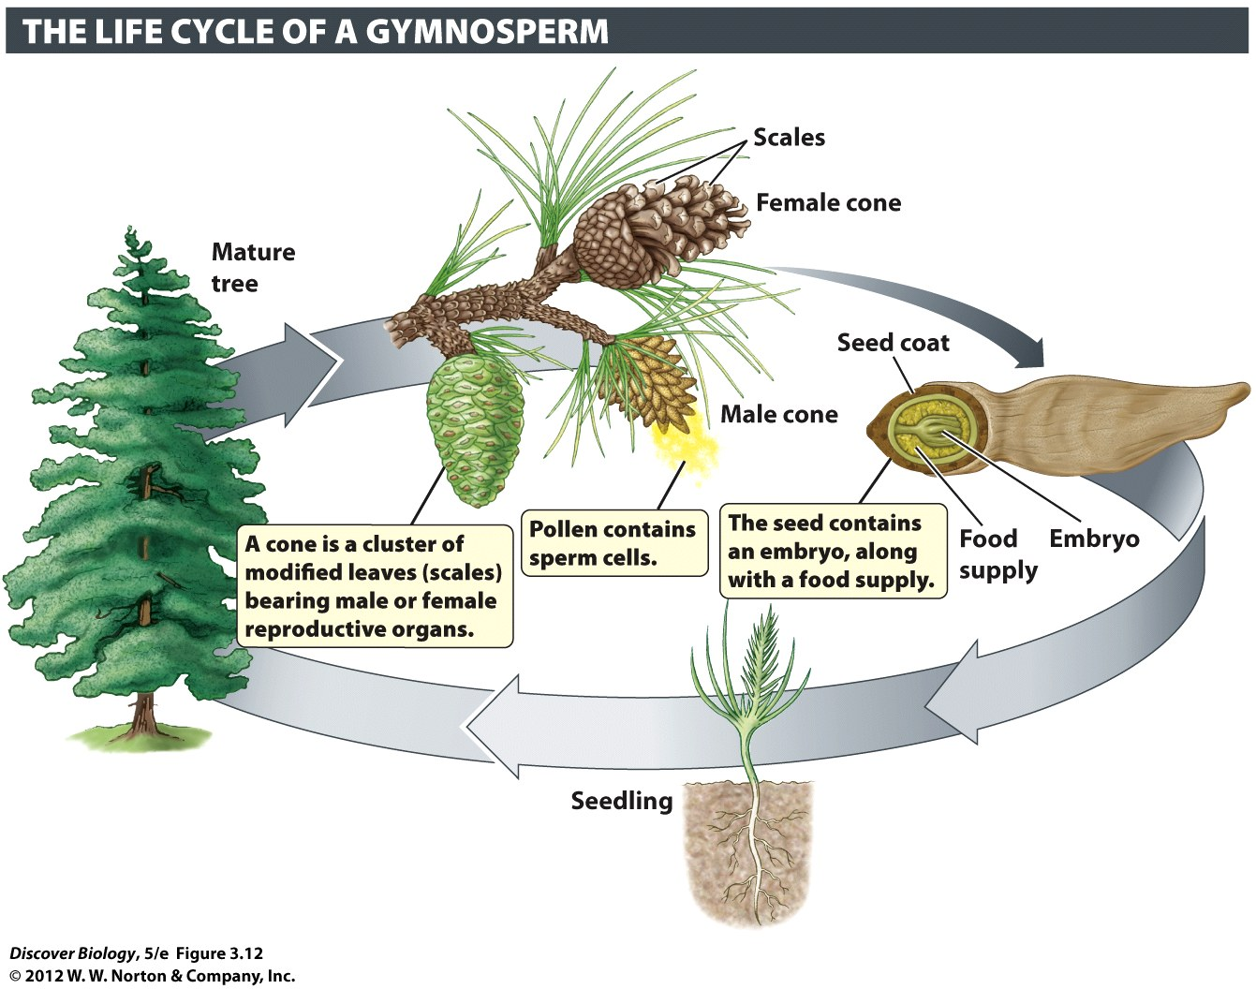
Notes:
Figure 3.12 Gymnosperms Were the First Plants to Produce Pollen and Seeds

Slide 35
Angiosperms Produce Flowers and Fruit
Angiosperms are the most dominant and diverse group of plants
The flowers of angiosperms facilitate sexual reproduction by bringing together the male and female gametes
Plants are considered bisexual; they contain both male and female structures
The stamen is the male structure; it produces pollen, which contains sperm

Slide 36
Angiosperms Produce Flowers and Fruit
The carpel is the female structure that houses the ovary
After fertilization, the embryo is enclosed in protective layers that form the seed
The base of the carpel matures into the fruit, which contains the seeds

Slide 37
Angiosperms Produce Flowers and Fruit
Some angiosperms rely on the wind for pollination while others rely on animals to transport their pollen
Bright petals, odors, and sugary nectar are used to attract pollinators
Animal pollination is more effective and targeted than wind pollination

Slide 38
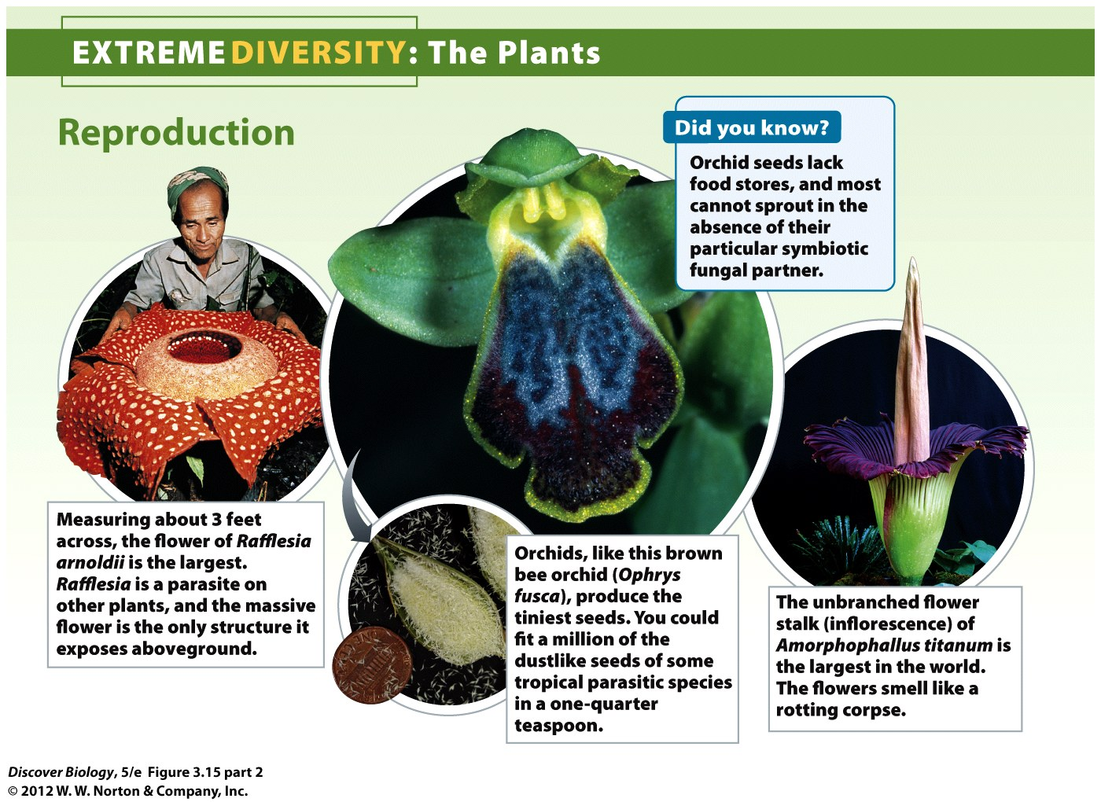
Notes:
Figure 3.15 Extreme Diversity: The Plants

Slide 39
Plants Are the Basis of Land Ecosystems and Provide Many Valuable Products
Nearly all organisms on land depend on plants for food
Humans depend on plants for food, clothes, medicines, and many other products
Plants have value when left in nature as well
Preventing runoff and erosion
Recycle carbon dioxide from the atmosphere
Produce oxygen to breath

Slide 40
Fungi: A World of Decomposers
Fungi are absorptive heterotrophs that digest organic material outside the body and absorb the released molecules
Fungal cells have a protective cell wall that can produce chitin to help protect the cell
DNA comparisons show that fungi are more closely related to humans than to plants

Slide 41
Fungi: A World of Decomposers
There are three main fungal groups organized by their unique reproductive structures
Zygomycetes
Basidiomycetes
Ascomycetes
Decomposers are fungi that live off nonliving organic material
Parasites are fungi that live off other organisms, causing harm
Mutualists are fungi that live off other organisms, causing both organisms to benefit

Slide 42
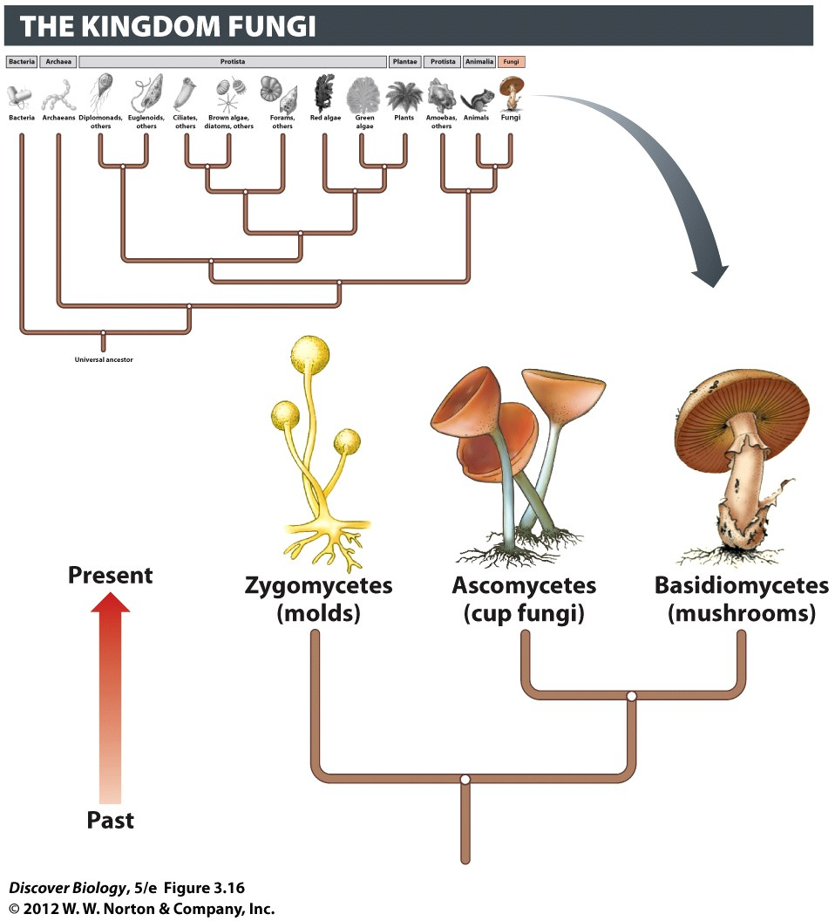
Notes:
Figure 3.16 Evolutionary Tree of the Fungi

Slide 43
Fungi Are Adapted for Absorptive Heterotrophy
Fungi can be multicellular or single-celled species
The body of a multicellular fungus is called the mycelium and is made up of many mycelial strands of hyphae
Mycelia extend in the medium the fungus is growing on, and the hyphae absorb nutrients for the fungus to use

Slide 44
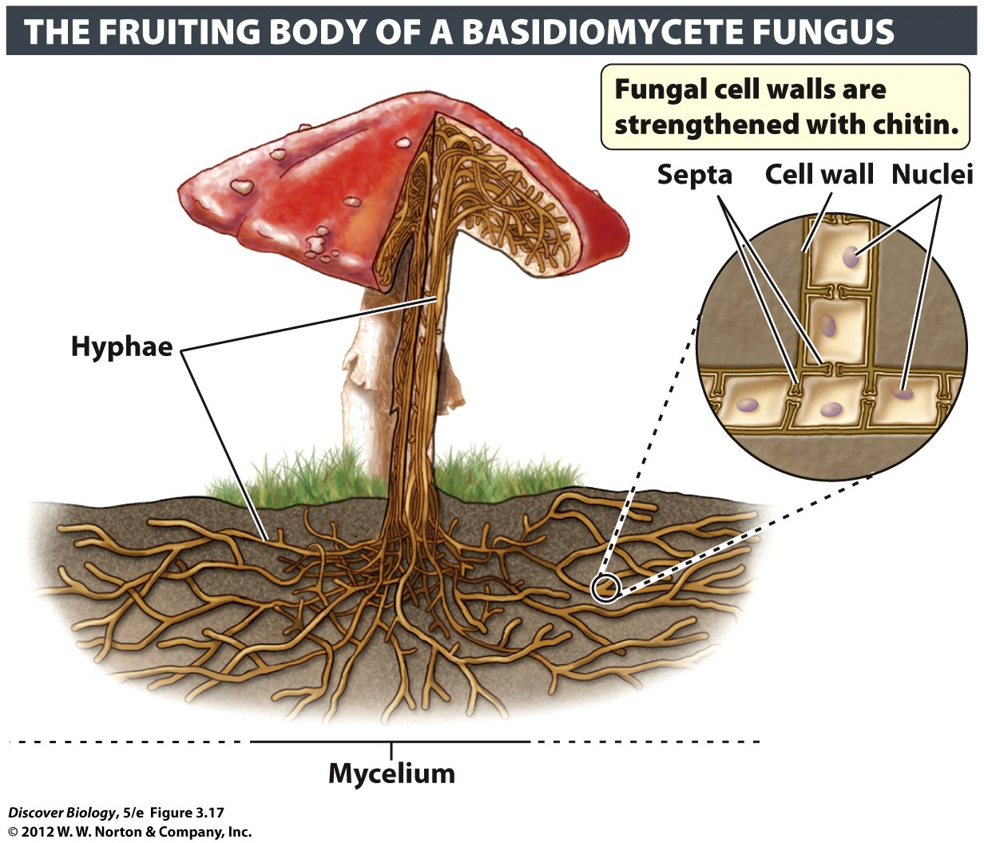
Notes:
Figure 3.17 The Basic Structure of a Multicellular Fungus
Mats of hyphae, known collectively as a mycelium, form the main body of a fungus. Each hypha is a row of cells separated by septa. Openings in the septa allow organelles to move from one compartment to another. The fungal cell walls encasing the hyphae contain chitin, the same material that makes up the hard outer skeleton of insects.

Slide 45
Fungi Have Unique Ways of Reproducing
Fungi can reproduce both sexually and asexually
Yeast are single-celled fungi that reproduce asexually by budding, producing genetically identical offspring
Multicellular fungi can reproduce by fragmentation
Spores are asexual reproductive structures that can survive for long periods of time in a dormant state

Slide 46
Fungi Have Unique Ways of Reproducing
Sexual reproduction of fungi requires opposite mating types to come together to form fruiting bodies, which can then release spores
The spores of fruiting bodies produce genetically diverse fungi

Slide 47
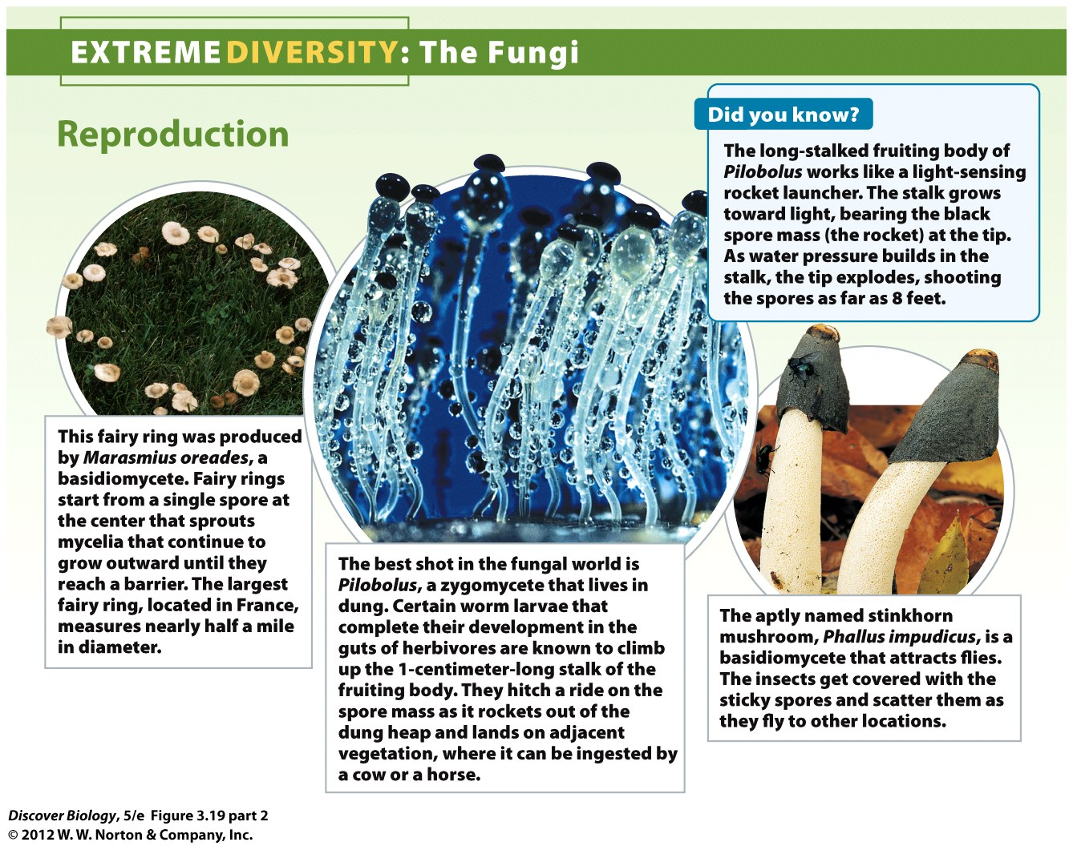
Notes:
Figure 3.19 Extreme Diversity: The Fungi

Slide 48
Fungi Play a Key Role as Decomposers
Fungi are the most important decomposers on land
Fungi are responsible for recycling nutrients by breaking down leaf litter and dead organisms into inorganic chemicals, which are used by other organisms to produce food

Slide 49
Fungi Can be Dangerous Parasites
Parasitic fungi grow their hyphae through the tissue of living organisms
Fungi are the most significant parasite of plants and are responsible for two-thirds of all the plant diseases

Slide 50
Fungi Can Benefit Human Society
Fungi provide humans with pharmaceuticals such as penicillin
Yeasts are essential fungi in the baking and alcohol industries
Truffles are fungal delicacies

Slide 51
Lichens and Mycorrhizae: Collaborations between Kingdoms
Symbiosis is the process of two organisms working together in close association
Ectosymbionts
Endosymbionts
Fungi have formed beneficial relationships with members of almost every kingdom

Slide 52
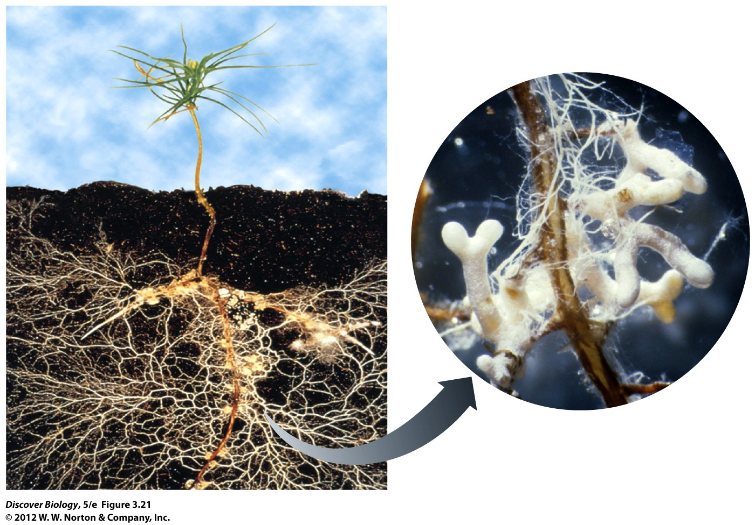
Notes:
Figure 3.21 Mycorrhizae Are Mutualisms between Fungi and Plant Roots

Slide 53
Lichens Contain a Fungus and a Photosynthetic Microbe
A lichen is a mutualistic association between a photosynthetic microbe and a fungus
The body of a lichen is created by packed mycelial strands with algal or cyanobacterial cells embedded on the mycelial mat
Lichens grow very slowly and are highly susceptible to pollutants in the environment
Lichens are pioneers of barren environments, helping to facilitate soil formation

Slide 54
Mycorrhizae are Beneficial Associations between a Fungus and the Plant Root
Mycorrhizae are mutualistic associations between fungal mycelia and the root system of a plant
Mycorrhizae benefit plants by absorbing more water and nutrients than the plant could absorb on its own
Mycorrhizae receive sugars manufactured by the plant through photosynthesis
Mycorrhizae greatly improve soil quality

Slide 55
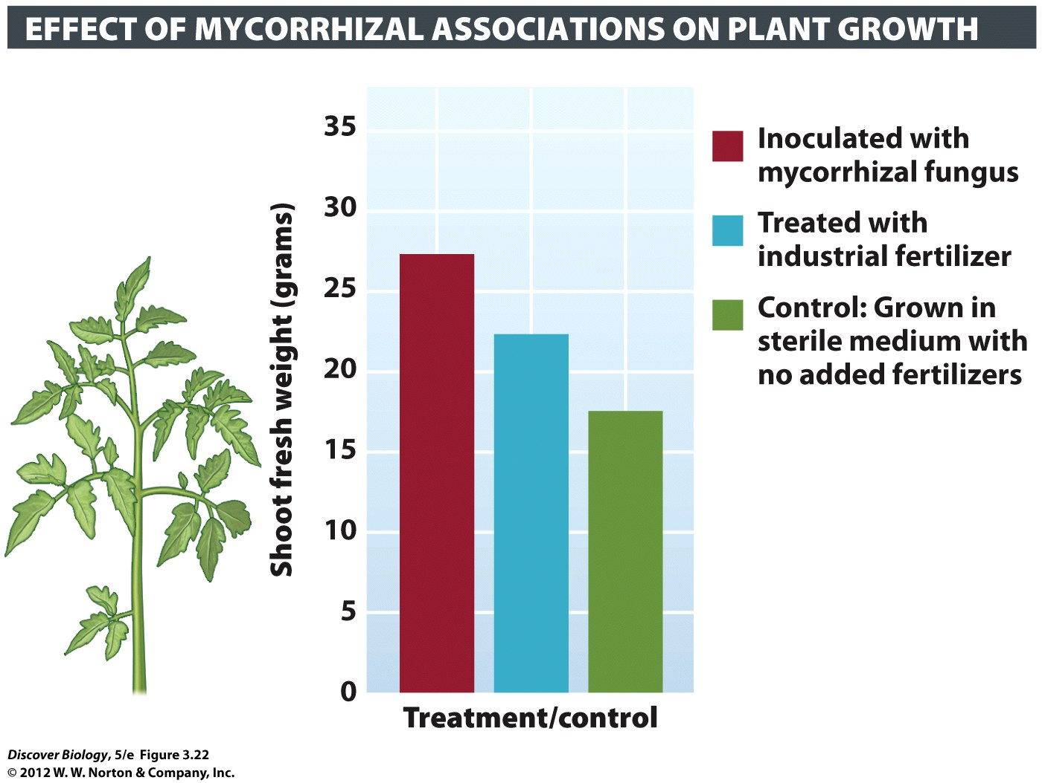
Notes:
Figure 3.22 Mycorrhizal Associations Benefit Growth of Tomato Plants

Slide 56
The Root of the Problem: Why Rivers Meander
Research indicates that rivers meander as a result of vascular plants, whose roots hold soil in place
Vascular plants sculpt modern rivers in this way, promoting terrestrial diversity of life

Slide 57
Clicker Questions
CHAPTER 3
Protista, Plantae, and Fungi

Slide 58
Concept Quiz
Giardia has two nuclei. To which of the following domains does it belong?
Archaea
Bacteria
Eukarya
Notes:
The correct answer is C. It belongs to the Kingdom Protista, the group most similar to the other domains, but the cells are eukaryotic because of the presence of a nucleus, or two nuclei in this case.
Answers A and B are both incorrect. Both Archaea and Bacteria consist of prokaryotes, organisms which lack a nuclei.

Slide 59
Concept Quiz
Which of the following is really a plant?
Sponges
Mushrooms
Mosses
Notes:
The correct answer is C. Mosses are the simplest form of plants. Since they lack a vascular system, they cannot grow very high, but they do have other characteristics of plants such as their cell structure and ability to perform photosynthesis.
Answer A: Sponges are not plants. They belong to the Kingdom Animalia.
Answer B: Mushrooms also are not plants. Although they look much like some plants, they belong to the Kingdom Fungi.

Slide 60
Relevant Art from Other Chapters
All art files from the book are available in JPEG and PPT formats online and on the Instructor Resource Disc

Slide 61
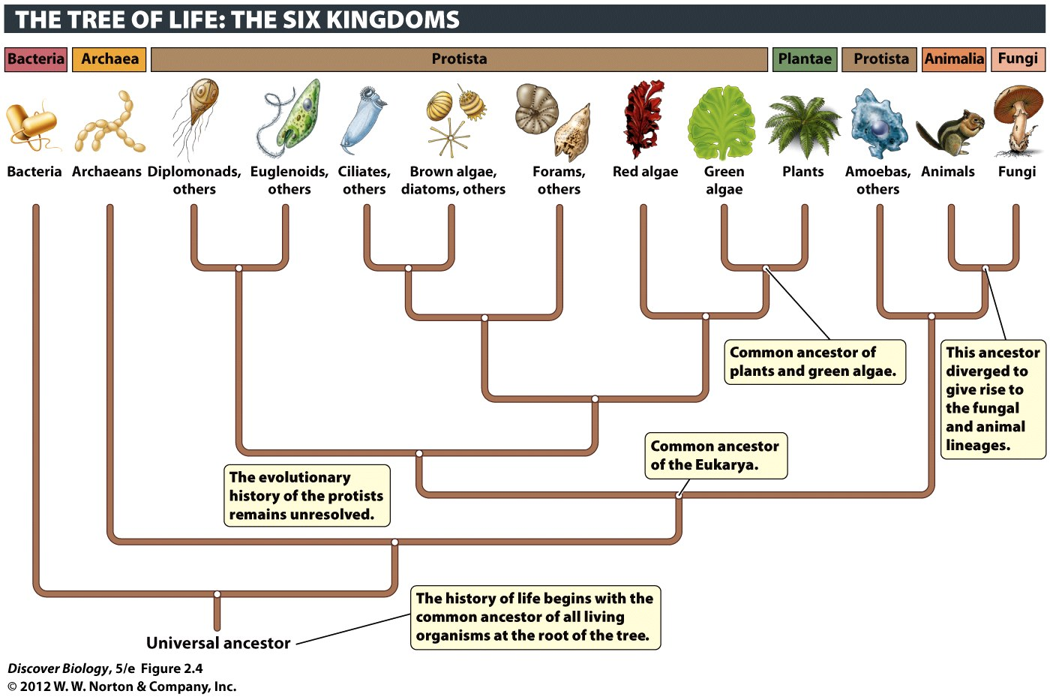
Notes:
Figure 2.4 The Three Domains and Six Kingdoms of Life
This evolutionary tree shows the hypothesized relationships among the six kingdoms, as well as the three domains. Each group branching off the tree can be thought of as a cluster of close relatives, or clade.

Slide 62
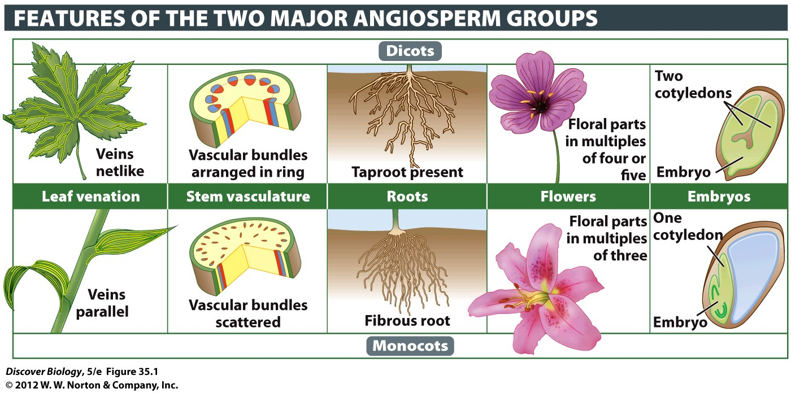
Notes:
Figure 35.1 Comparing Dicots and Monocots

Slide 63
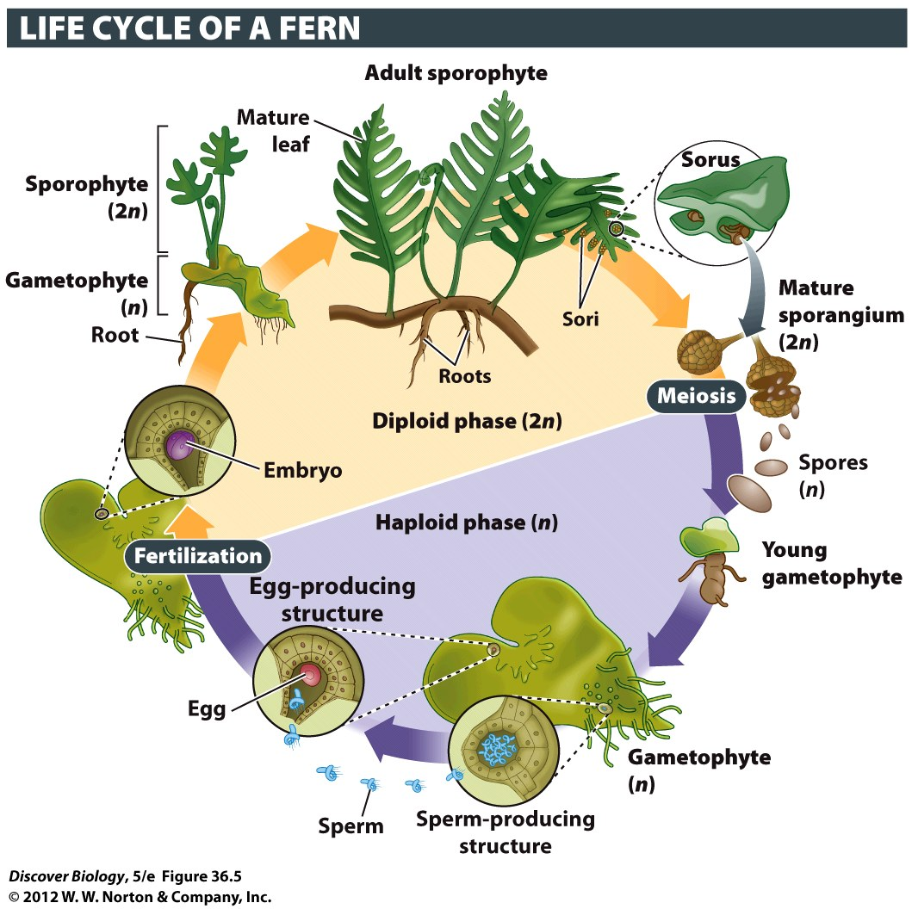
Notes:
Figure 36.5 Plants Display Alternation of Generations
The life cycle of plants is characterized by the alternation of two phases: a haploid phase (shown in purple) and a diploid phase (orange). The fern plant, with its green fronds, is a diploid, multicellular individual (a sporophyte). If you turn over the fronds (leaves), you might see raised, brown patches. Meiosis occurs in these structures, called sporangia (singular “sporangium”), giving rise to haploid spores that are shed into the air. When they encounter a suitable environment, the spores produce a multicellular gametophyte. Certain cells in the gametophyte differentiate into sperm or egg cells. In some species, both types of gametes are formed on the same gametophyte; other species produce separate male and female gametophytes. Fern gametophytes live independently of the sporophyte and are often photosynthetic. Fern species that are commonly grown as houseplants produce gametophytes that are about 8 millimeters (0.3 inch) wide. If you examine the soil around an old potted fern, you might find the flat, green, heart-shaped gametophytes on the soil surface.

Slide 64
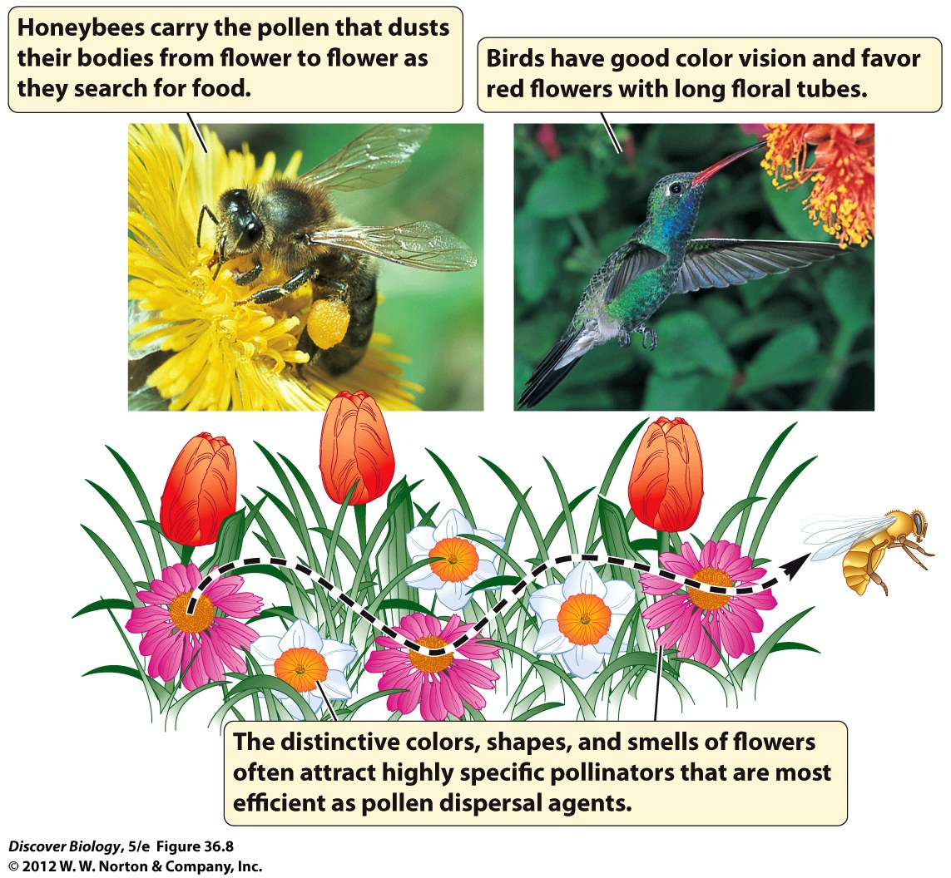
Notes:
Figure 36.8 Bribing Animals to Do the Work
Pollinators provide stationary plants with a way of transporting sperm to eggs. The spectacular colors, shapes, and odors of flowers, in combination with food rewards such as nectar, lure pollinating animals into visiting several flowers of the same species, accidentally transferring pollen in the process.

Slide 65
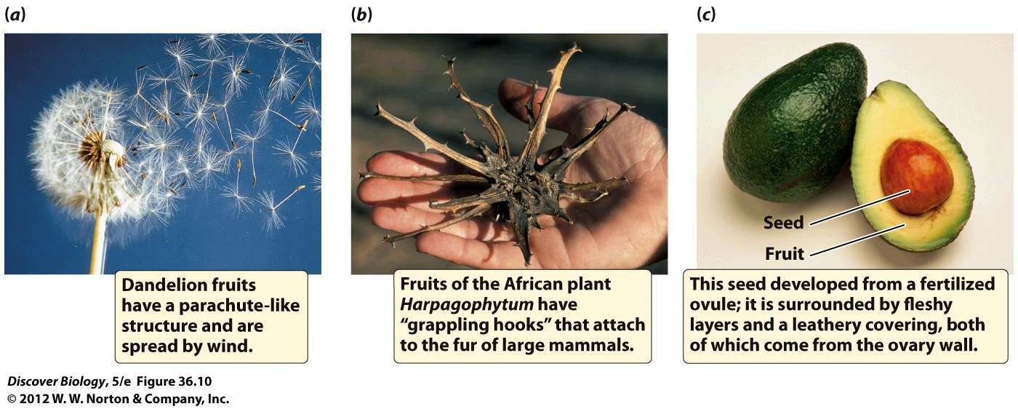
Notes:
Figure 36.10 Plants Produce a Vast Variety of Fruits

