Slide 1
Discover Biology FIFTH EDITION
Anu Singh-Cundy • Michael L. Cain
CHAPTER 2
Biological Diversity, Bacteria,
and Archaea
© 2012 W. W. Norton & Company, Inc.

Slide 2
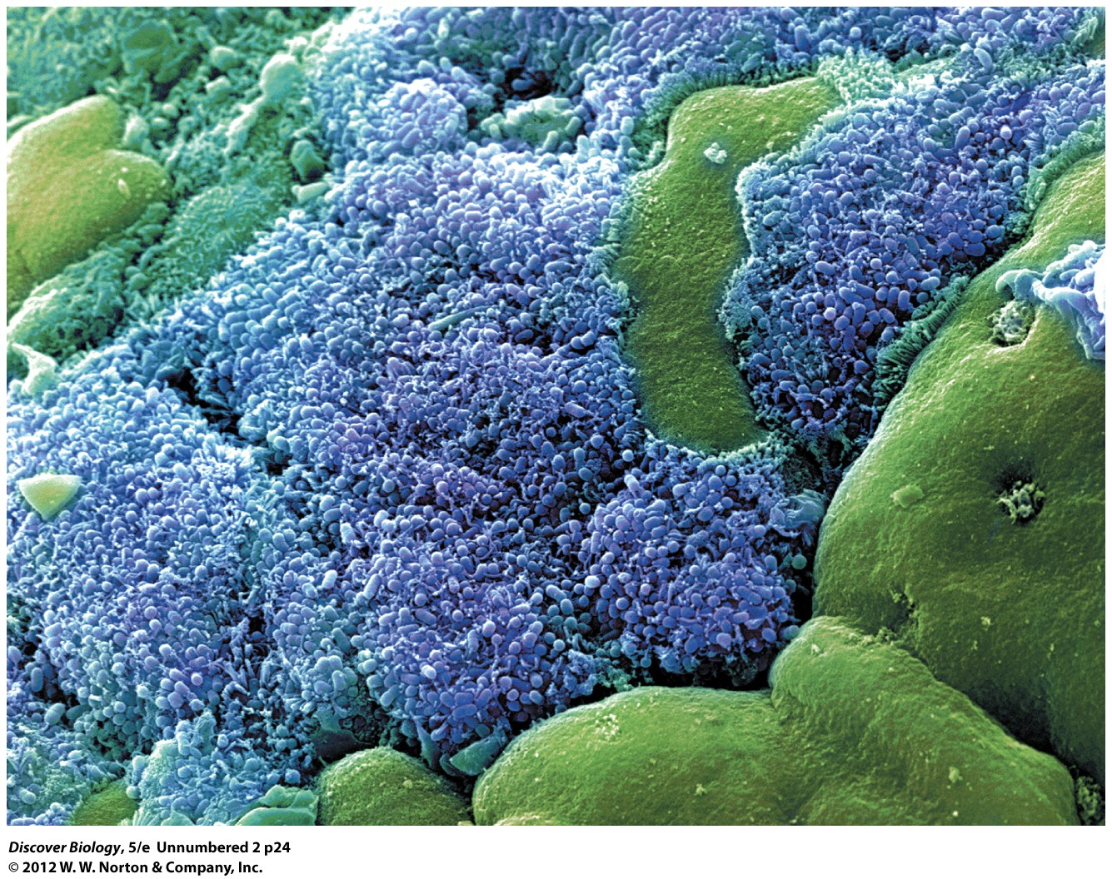
Notes:
Gut Bacteria
Microscopic bacteria called Escherichia coli
(E. coli), shown here in blue and purple, grow in the human
small intestine (green) as part of a community of hundreds of
kinds of microorganisms.

Slide 3
A Hitchhiker's Guide to the Human Body
All organisms share their bodies with other organisms
The human flora includes some 100 trillion individual bacteria from a thousand different species of microbes
A majority of these organisms are beneficial

Slide 4
You May Have Encountered Some Living Things
Using the Linnaean hierarchy, we can begin to classify the immense diversity of life on Earth
We can use a tree of life to trace the common heritage of all living organisms

Slide 5
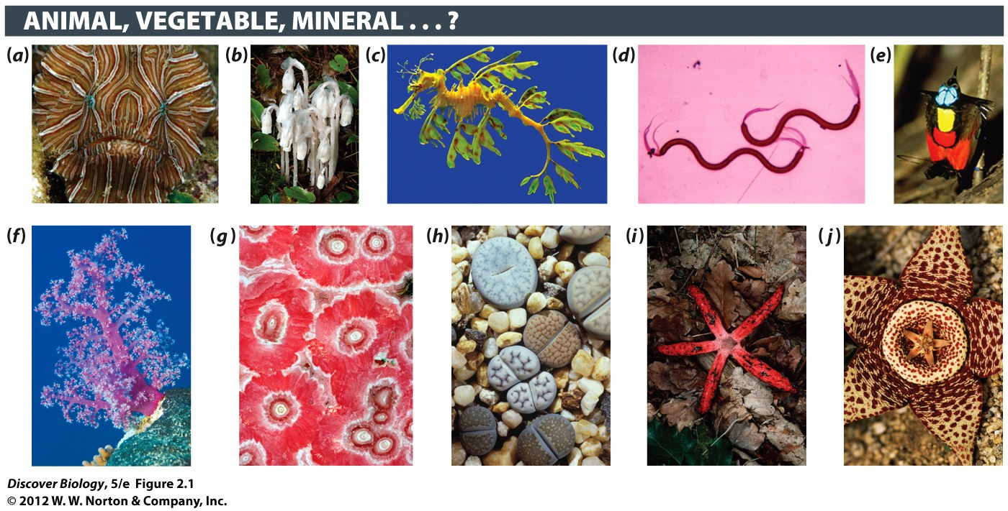
Notes:
Figure 2.1 How Many Organisms Do You See Here?
Can you distinguish the nonliving from the living in these photos? Can you classify any of these organisms as plants or animals? Some of the organisms pictured here are singlecelled, others are multicellular. Some are microscopic (not readily seen without a microscope), but most are visible to the naked eye. For the answers, turn to page 28.

Slide 6
The Unity and the Diversity of Life
Humans have only begun to identify, name, and count the many organisms on Earth
Biologists are tasked with categorizing these organisms

Slide 7
A Common Origin Explains the Unity of Life on Earth
Scientists believe that all life descended, with evolutionary modification, from a common ancestor and shares a set of basic characteristics
All life is categorized in one of three domains: Archaea, Bacteria, and Eukarya
A branching diagram called an evolutionary tree shows the relationships among groups of organisms

Slide 8
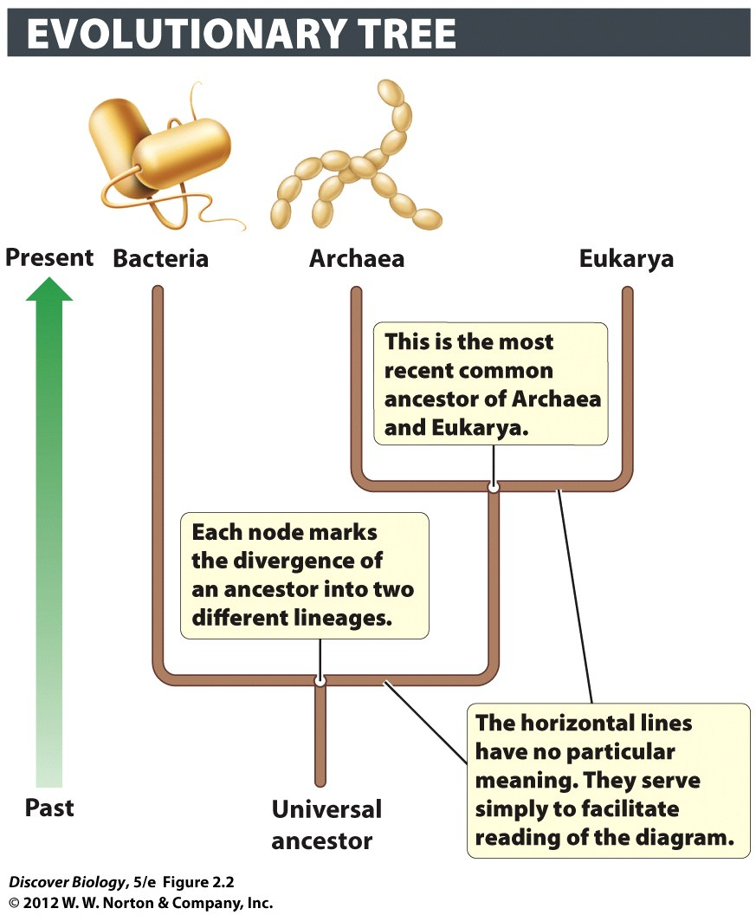
Notes:
Figure 2.2 Evolutionary Tree of Domains
This tree shows one model of the relationships of the three domains. At the root of the tree is the universal ancestor, from which all living things descended. Of the three surviving lineages, the first split came between the Bacteria and the lineage that would give rise to the Archaea and Eukarya. The next split was between the Archaea and the Eukarya, making Archaea and Eukarya more closely related to each other than either group is to Bacteria.

Slide 9
Evolutionary Divergence Explains the Diversity of Life on Earth
A node on an evolutionary tree represents the most recent common ancestor of two organisms
A given ancestor and all its descendants make up a clade, or branch, on an evolutionary tree
Shared derived traits are evolutionary novelties that are used to help determine relatedness among species

Slide 10
The Extent of Earth’s Biodiversity Is Unknown
The Earth’s biodiversity includes all living things as well as their interactions with one another and the nonliving world
Humans have only identified 1.5 million of an estimated 3 to 100 million species

Slide 11
All Life on Earth Can Be Sorted into Three Distinct Domains
Bacteria, which includes disease-causing organisms
Archaea, single-celled organisms that tend to live in extremely harsh environments
Eukarya, which includes plants, animals, and fungi
Prokaryotes refers to Bacteria and Archaea
Eukaryotes refers to all other organisms

Slide 12
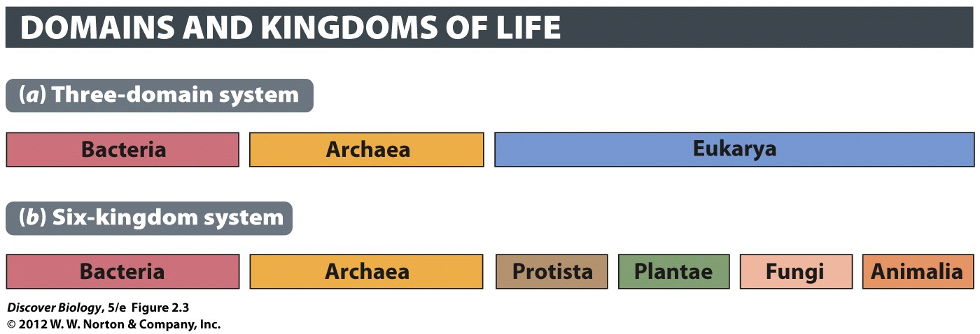
Notes:
Figure 2.3 The Three Domains of Life Are Divided into Six Kingdoms
This book employs both the three-domain system (a) and the widely used six-kingdom system (b) for classifying life. The domain Bacteria is equivalent to the kingdom Bacteria, and the domain Archaea is equivalent to the kingdom Archaea. The domain Eukarya encompasses four kingdoms in the six-kingdom scheme: Protista (protists, which include organisms such as amoebas and algae), Plantae (plants), Fungi (including yeasts and mushroom-producing species), and Animalia (animals).

Slide 13
The Eukarya are Sorted into Four Different Kingdoms
Eukaryotes are sorted into four kingdoms:
Protista
Plantae
Fungi
Animalia
Scientists use DNA and shared evolutionary innovations to place members of the six kingdoms of life on an evolutionary tree

Slide 14
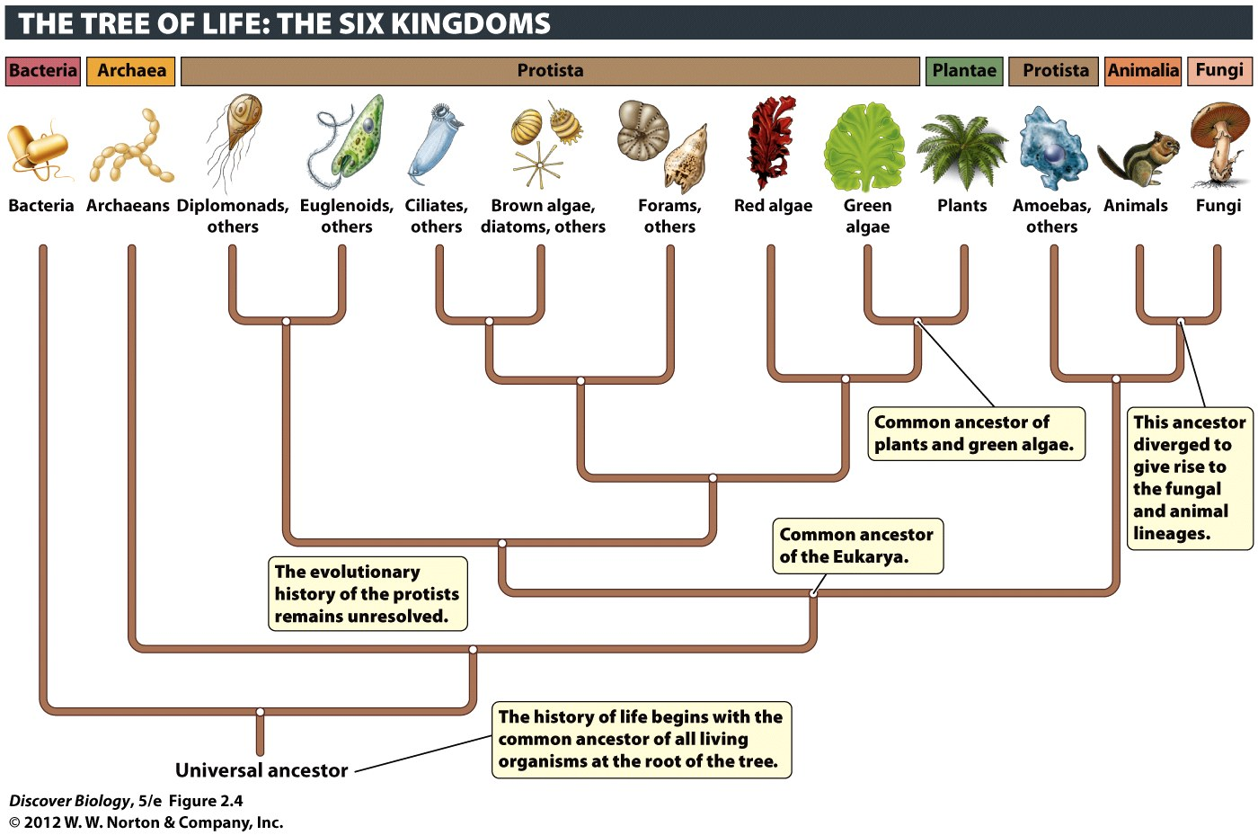
Notes:
Figure 2.4 The Three Domains and Six Kingdoms of Life
This evolutionary tree shows the hypothesized relationships among the six kingdoms, as well as the three domains. Each group branching off the tree can be thought of as a cluster of close relatives, or clade.

Slide 15
The Linnaean System of Biological Classification
The species is the smallest unit of classification in the Linnaean hierarchy
Closely related species are grouped together to form a genus
Closely related genera are grouped together into a family
Closely related families are grouped together into an order

Slide 16
The Linnaean System of Biological Classification
Closely related orders are grouped together into a class
Closely related classes are grouped together into a phylum
Closely related phylum are grouped together into a kingdom

Slide 17
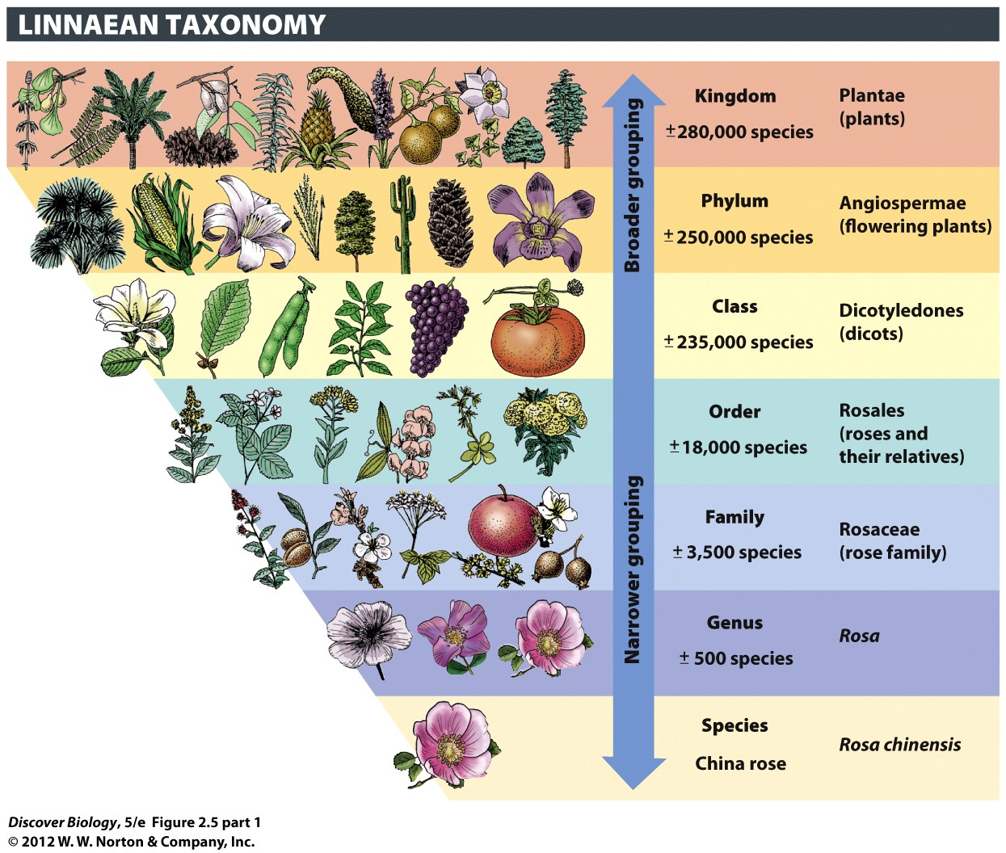
Notes:
Figure 2.5 The Linnaean Hierarchy Places Organisms In Successively Largely Categories
The smallest unit of classification is the species (here, the China rose, whose scientific name is Rosa chinensis). This species belongs to the genus Rosa, which includes other roses. The genus Rosa lies within the family Rosaceae [roh-ZAY-see-ee], which lies within the order Rosales [roh-ZAH-leez], within the class Dicotyledones [dye-kah-tuh-LEE-dun-eez], within the phylum Angiospermae and the kingdom Plantae. We can use the same categories—from species to kingdom—to classify all organisms. This classification system was first devised by the Swedish naturalist Carolus Linnaeus (inset).

Slide 18
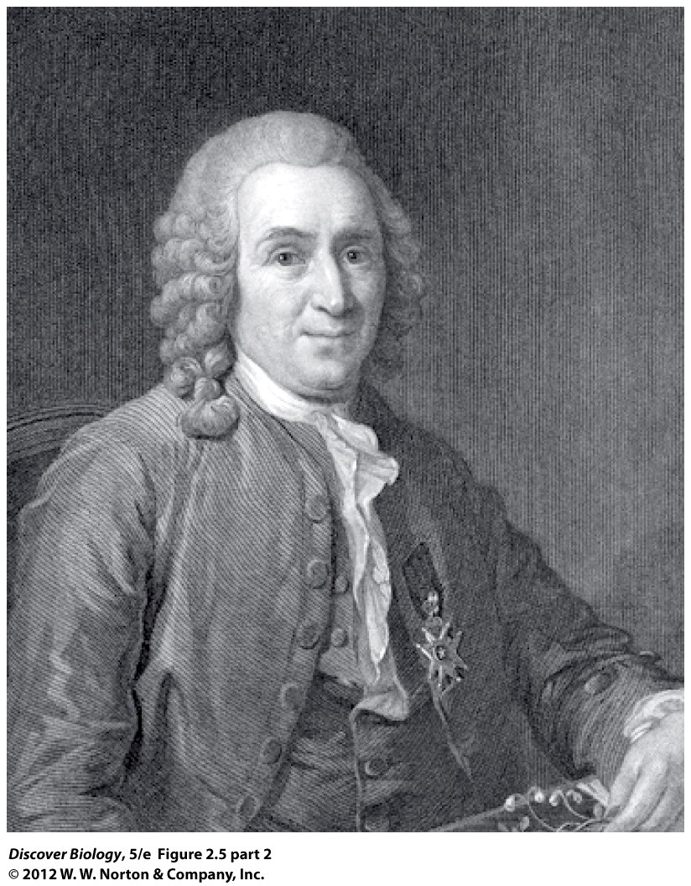
Notes:
Figure 2.5 The Linnaean Hierarchy Places Organisms In Successively Largely Categories
This classification system was first devised by the Swedish naturalist Carolus Linnaeus (inset).

Slide 19
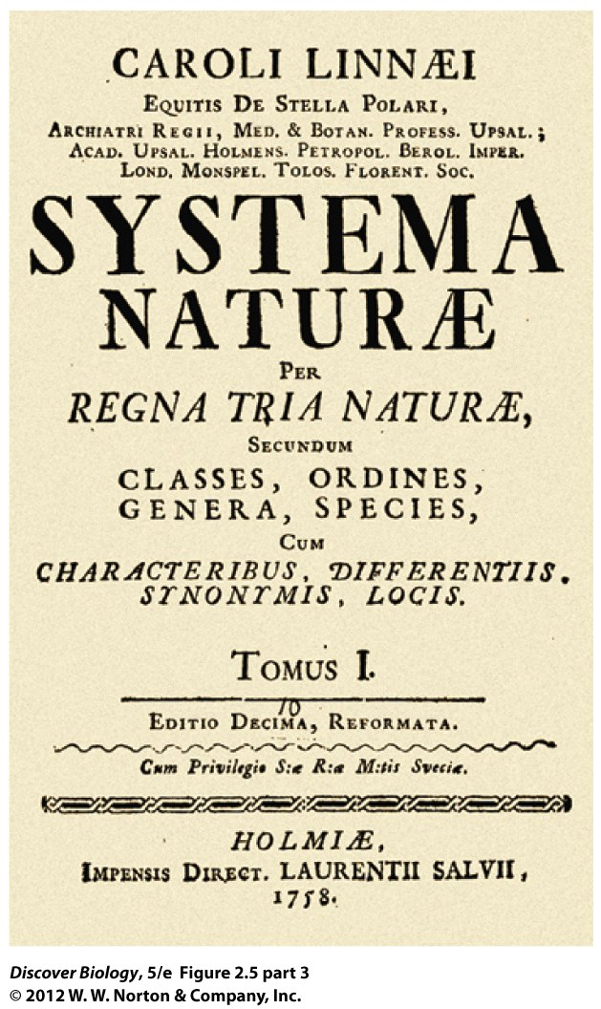
Notes:
Figure 2.5 The Linnaean Hierarchy Places Organisms In Successively Largely Categories
This classification system was first devised by the Swedish naturalist Carolus Linnaeus (inset).

Slide 20
Bacteria and Archaea: Tiny, Successful, and Abundant
Bacteria are single-celled organisms
The majority of bacteria are not harmful to humans
Archaeans are single-celled organisms and are not believed to cause disease

Slide 21
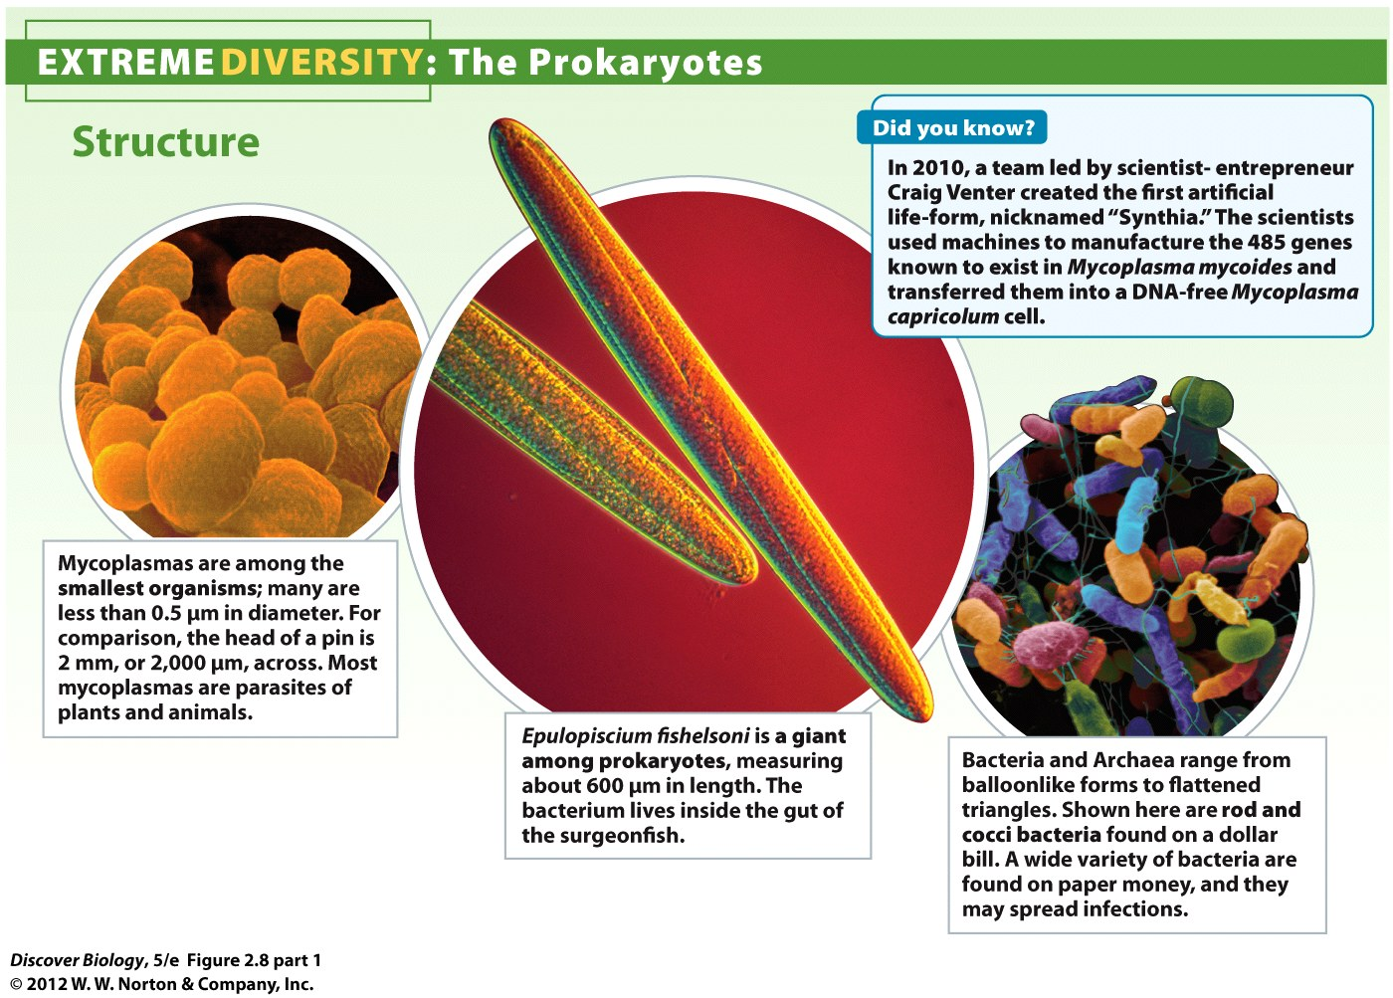
Notes:
Figure 2.8 Prokaryotes Are Extremely Diverse in Structure, Habitat, and Modes of Energy Acquisition

Slide 22
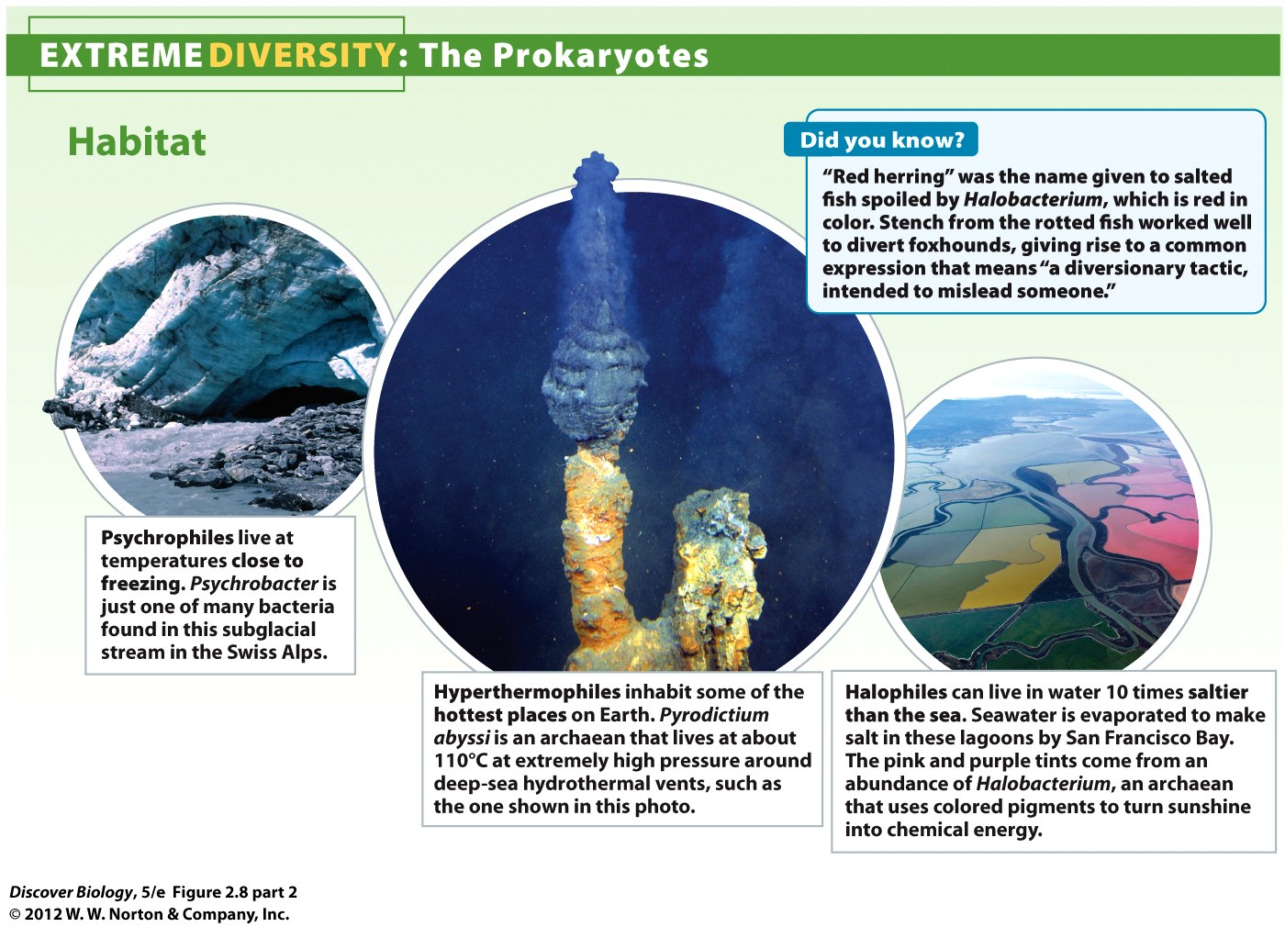
Notes:
Figure 2.8 Prokaryotes Are Extremely Diverse in Structure, Habitat, and Modes of Energy Acquisition

Slide 23
Archaeans Constitute a Distinct Domain of Life
Archaeans have a unique plasma membrane that separates them from Bacteria and Eukarya
Extremophiles are archaeans that thrive in extreme environments such as geysers and acidic waters

Slide 24
Prokaryotes Represent Biological Success
Bacteria are the most widespread organisms and can reproduce quickly through a process called binary fission
Scientists use DNA analysis to detect and classify the millions of bacteria

Slide 25
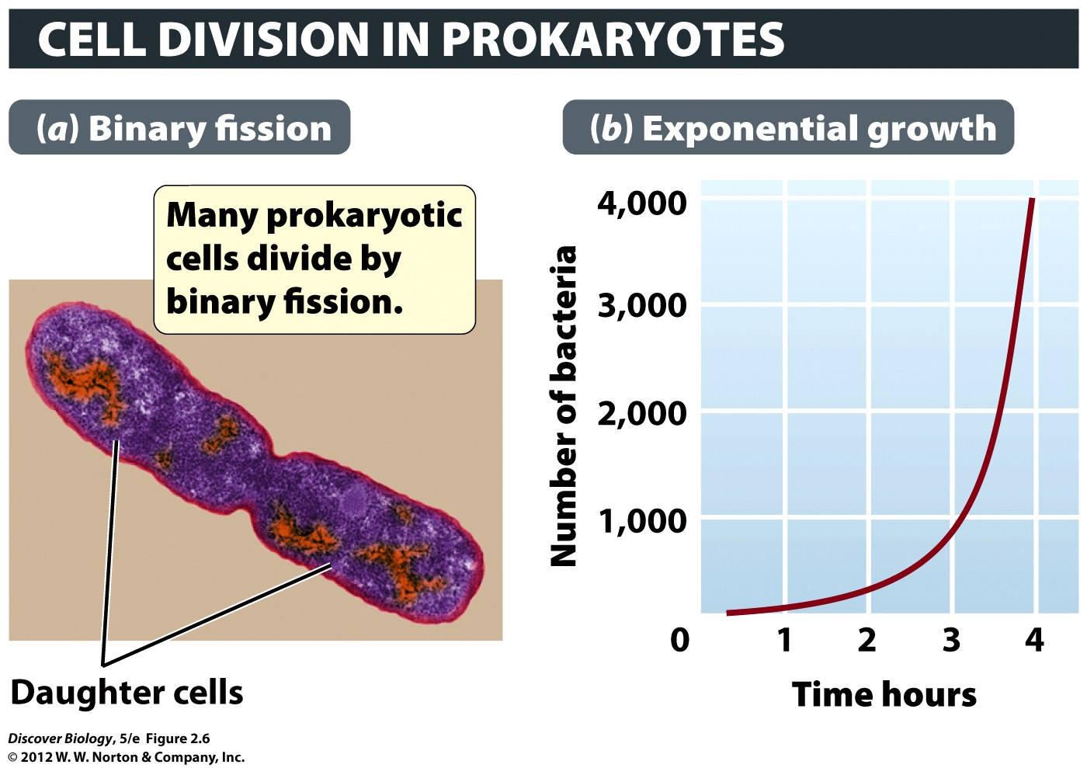
Notes:
Figure 2.6 Through Binary Fission, E. coli Multiplies at an Astounding Rate
(a) E. coli divides into two every 20 minutes, given the right conditions, especially the ready availability of food and the temperature of the human body (37°C). (b) This graph shows how the population of E. coli increases, starting from a single cell that turns into two cells in 20 minutes, which together become four cells at 40 minutes. With doubling of cell numbers every 20 minutes, there are 1,000 cells after 3 hours and 20 minutes have gone by. This type of growth, in which the number of cells added with each generation depends on the total number of cells already there, is known as exponential or geometric growth.

Slide 26
Prokaryotes Occupy a Great Diversity of Habitats
Bacteria can be found in some of the most extreme environments on Earth
Bacteria that require oxygen to survive are called aerobes
Bacteria that do not require oxygen to survive are called anerobes
Methanogens are anerobic archaeans that produce methane gas as a by-product of metabolism

Slide 27
Prokaryotes are Mainly Single-Celled, But Some Show Social Behaviors
Prokaryotes all have the same basic structural plan and come in a variety of shapes
Most prokaryotes have a cell wall that surrounds a plasma membrane
Some prokaryotes have a capsule that helps them evade an organism’s defense system
Pilli and flagella are structures that allow bacteria to thrive in certain environments

Slide 28
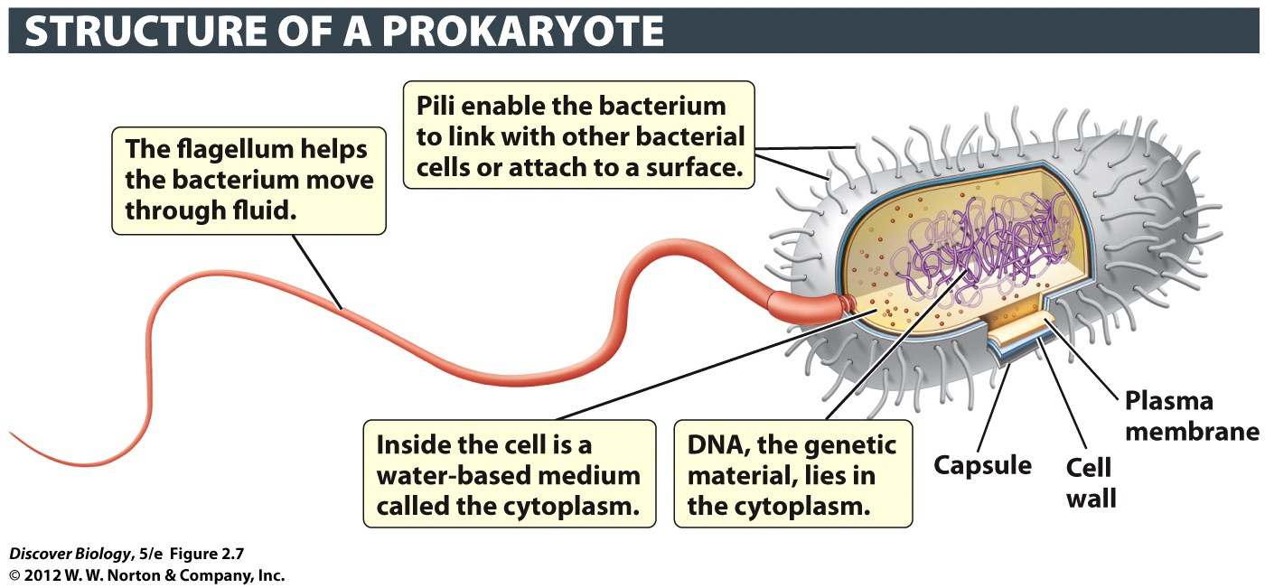
Notes:
Figure 2.7 Prokaryotic Cells Lack a Nucleus
Prokaryotic cells tend to be about 10 times smaller than eukaryotic cells, and generally have much less DNA.

Slide 29
Prokaryotes are Mainly Single-Celled, But Some Show Social Behaviors
Prokaryotes contain less DNA material than eukaryotic organisms
Although they are single-celled organisms, some prokaryotes exhibit multicellular organization

Slide 30
Prokaryotes Reproduce Asexually
During binary fission, a copy of the DNA is transferred to each of the offspring
Reproduction of prokaryotes is limited by available resources
Some bacteria produce spores that can withstand both boiling and freezing environments
Some prokaryotes can use bits of DNA from their environment as well as other species and incorporate them into their own DNA

Slide 31
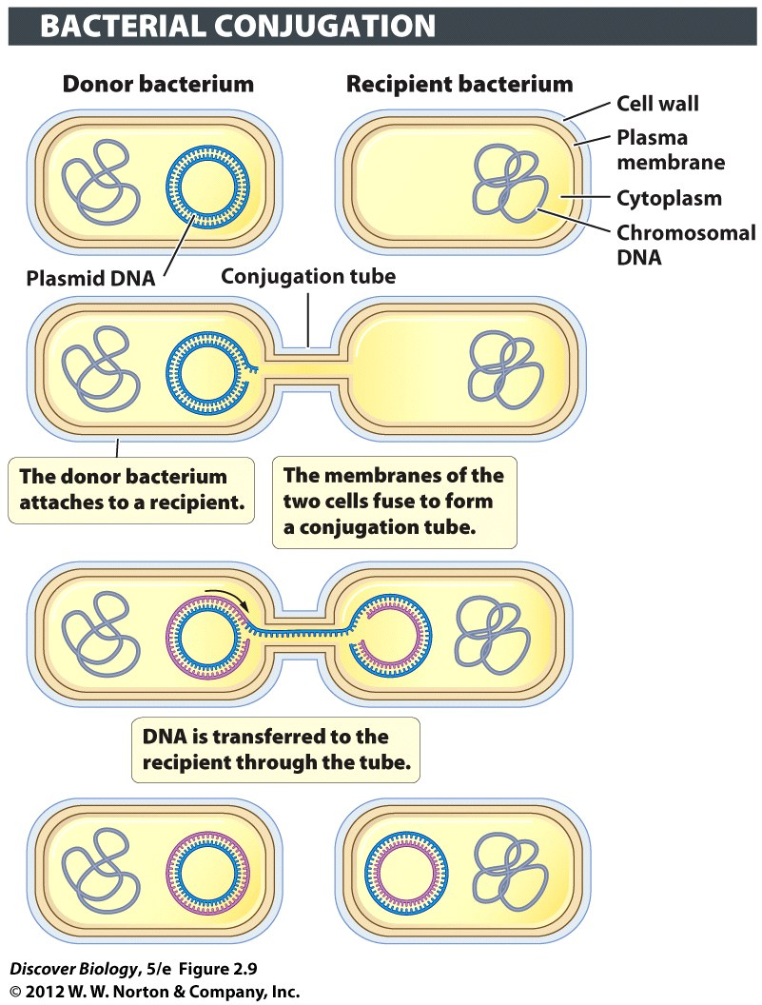
Notes:
Figure 2.9 Lateral Gene Transfer Accelerates the Rate of Evolution in Prokaryotes
Bacterial conjugation is one mechanism by which DNA is transferred from one bacterium to another. This diagram depicts the transfer of plasmid DNA, but chromosomal DNA can also be transferred through conjugation.

Slide 32
Prokaryotes Are Unrivaled in Metabolic Diversity
Cyanobacteria are photoautotrophs that use light energy and inorganic carbon to produce food
Some autotrophic prokaryotes, called chemoautotrophs, use inorganic chemicals from their environment, such as iron ore, hydrogen, or ammonia, to carry out metabolism

Slide 33
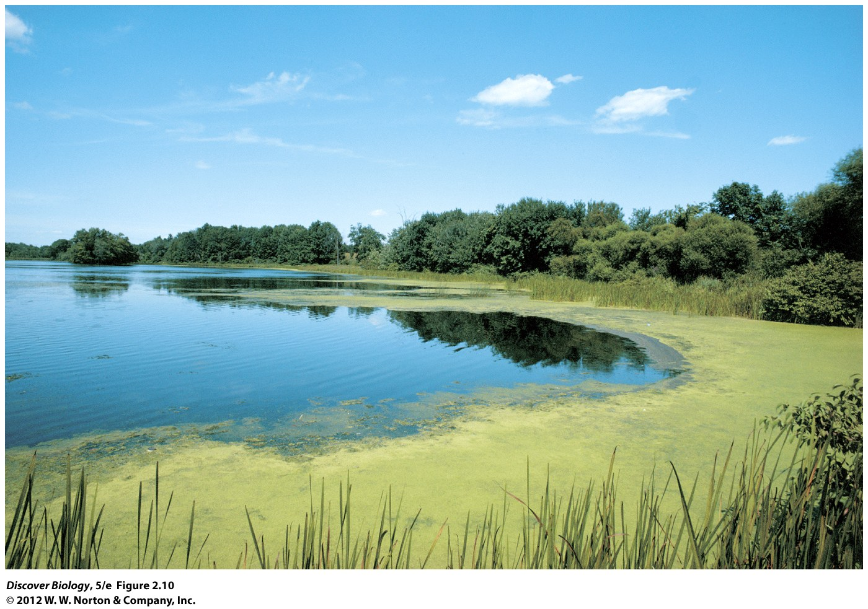
Notes:
Figure 2.10 Pond Scum Contains Bacteria That Photosynthesize
Photosynthetic bacteria, called cyanobacteria or “blue-green algae,” can be found growing as slimy mats on freshwater ponds. The green mats may also include true algae, which are photosynthetic protists.

Slide 34
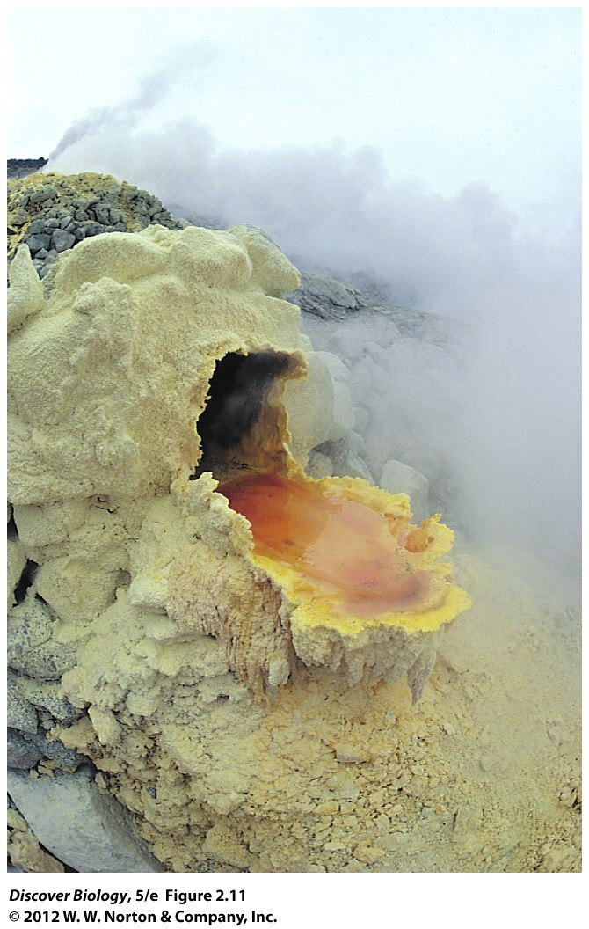
Notes:
Figure 2.11 This Chemoautotroph Has an Appetite for Metal
The crusty orange and yellow puddle is a colony of the organism known as Sulfolobus [sul-FAH-luh-bus], an archaean that gets its carbon from carbon dioxide, as plants do. This archaean, however, gets its energy in an unusual way—not by harnessing sunlight (as plants do), or by eating other organisms (as animals do), but by chemically processing inorganic chemicals such as iron ore. This chemoautotroph is living in a volcanic vent in Japan.

Slide 35
Prokaryotes Are Unrivaled in Metabolic Diversity
Photoheterotrophs are bacteria or archaeans that use light as an energy source but obtain carbon from organic molecules
Chemoheterotrophs are organisms that obtain energy and carbon from organic molecules

Slide 36
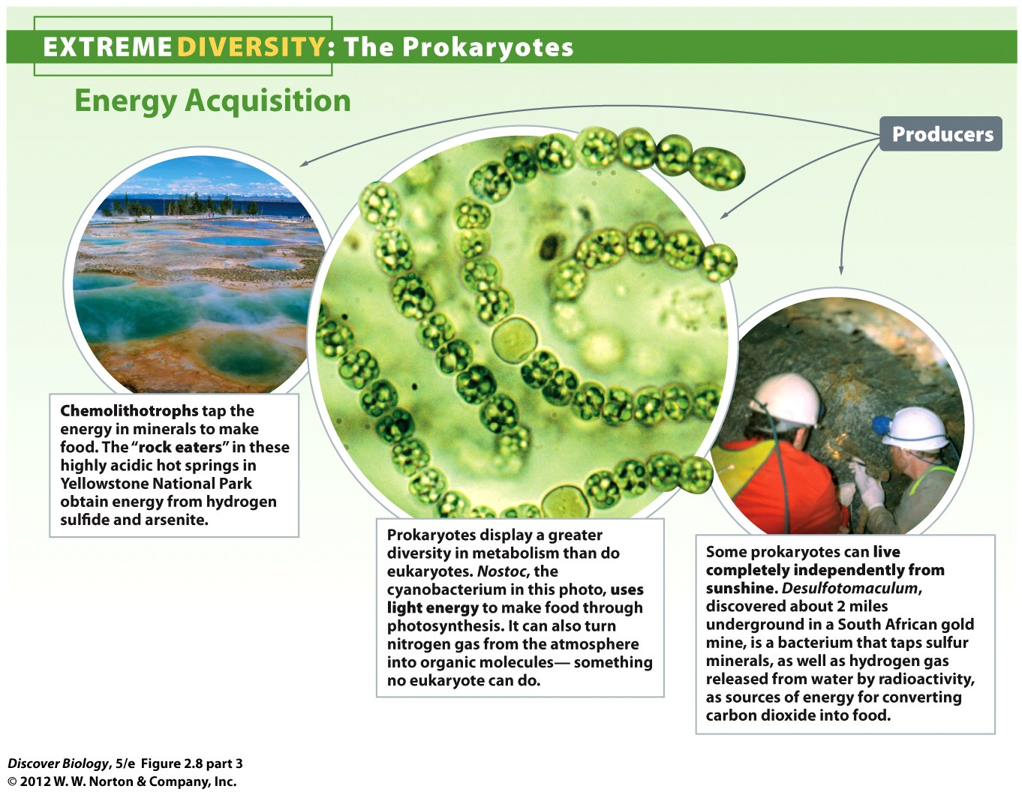
Notes:
Figure 2.8 Prokaryotes Are Extremely Diverse in Structure, Habitat, and Modes of Energy Acquisition

Slide 37
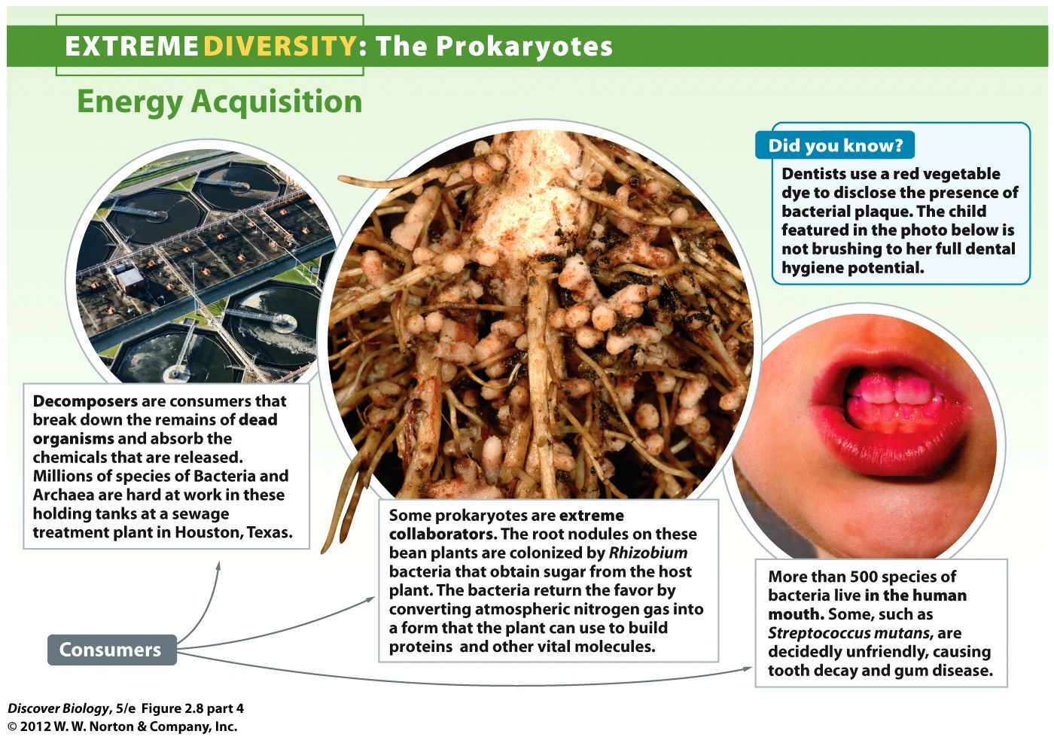
Notes:
Figure 2.8 Prokaryotes Are Extremely Diverse in Structure, Habitat, and Modes of Energy Acquisition

Slide 38
Prokaryotes Changed the World with Oxygen-Producing Photosynthesis
Eukaryotic photosynthesis changed the atmospheric composition of Earth by increasing the level of available oxygen
The increased oxygen levels in the atmosphere allowed for larger eukaryotic cells that require more energy to thrive

Slide 39
Prokaryotes Play Important Roles in the Biosphere and in Human Society
Prokaryotes are important members of all ecosystems:
Cyanobacteria are the basis of the food chain in aquatic ecosystems
Decomposers are heterotrophic bacteria and archaeans that break down dead organisms and recycle the nutrients back into the environment
Plants benefit from bacteria that use atmospheric nitrogen and convert it into ammonia through nitrogen fixation

Slide 40
Prokaryotes Play Important Roles in the Biosphere and in Human Society
Humans benefit from prokaryotes
Prokaryotes produce antibiotics as a by-product of metabolism
Fermentation occurs when certain bacteria lack oxygen to carry out metabolism. Fermentation produces such things as alcohol, cheese, and butter
Bioremediation is the use of organisms to clean up environmental pollution

Slide 41
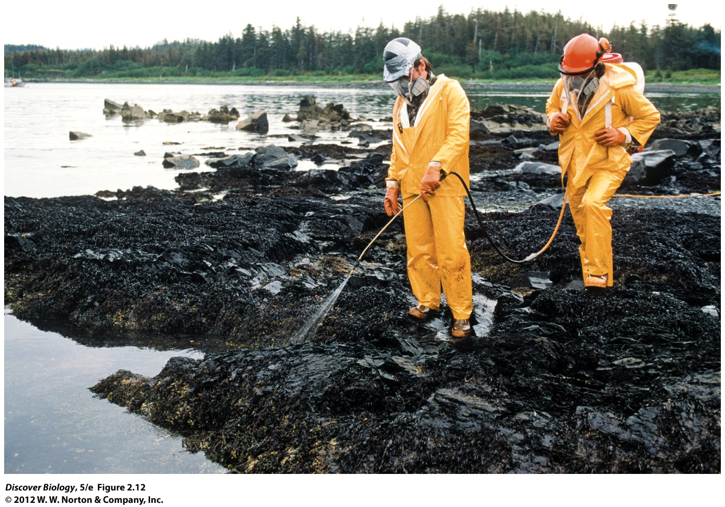
Notes:
Figure 2.12 Bioremediation by Prokaryotes
Workers spray fertilizer on an oil-contaminated shore to stimulate the growth of oil-degrading bacteria.

Slide 42
Some Bacteria Cause Disease
Organisms that cause disease in other organisms are called pathogens
Most pathogens are host specific
Certain pathogens can secrete exotoxins that damage surrounding tissue, while others produce endotoxins within the their cell walls, which triggers illness in the host organism

Slide 43
Some Bacteria Cause Disease
Antibiotics are secreted by some microorganisms to kill or slow the growth of another microorganism
Overuse of antibiotics can lead to selection for antibiotic resistance
Antibiotics are ineffective against viruses

Slide 44
Viruses: Nonliving Infectious Agents
A virus is a microscopic, noncellular infectious particle
Viruses are know to attack organisms in every kingdom of life

Slide 45
Viruses Lack Cellular Organization
Although viruses contain DNA and can reproduce, and evolve, they lack the structures within cells that are necessary for cellular life
Viruses release their DNA, and sometimes RNA, into the host cell, highjacking their metabolism for the benefit of the virus

Slide 46
Viruses are Classified by Structure and Type of Infection
Viruses are classified by:
The type of genetic material they contain
Their shape and structure
The type of organism they infect
The disease they produce
Viruses are host specific, but have been known to jump from one host species to another and new strain in the process
Avian influenza
H1N1

Slide 47
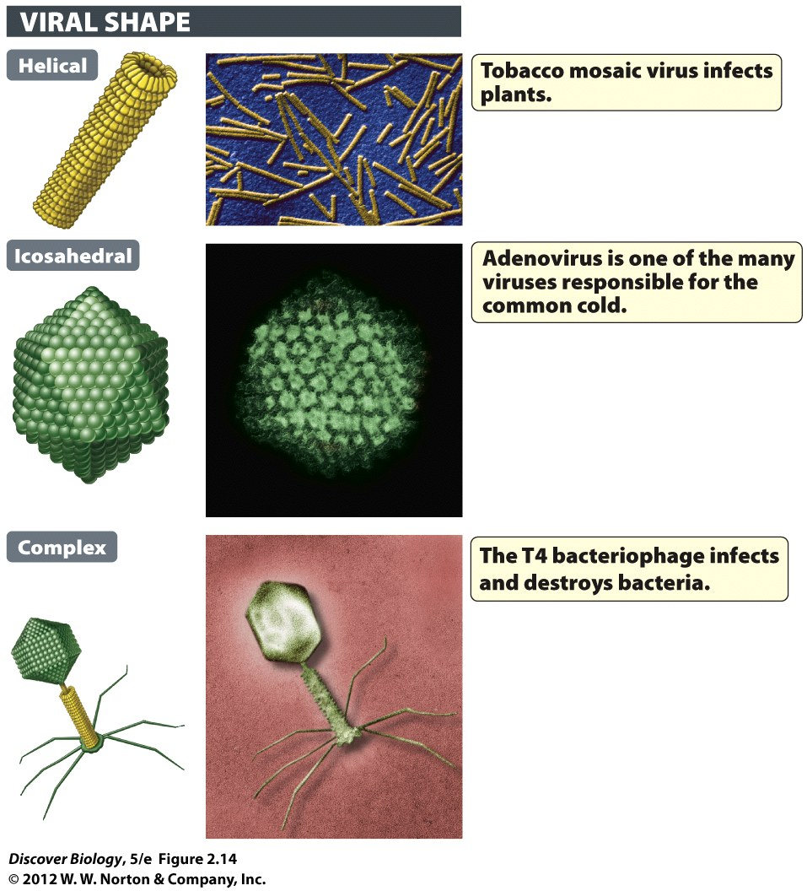
Notes:
Figure 2.14 Viruses Can Be Classified by Their Shape

Slide 48
Flu Viruses Evolve Rapidly
Once infected, the flu virus is shed into the environment 2 to 3 days before being symptomatic and remains infective for 7 days
The virus can survive on a hard surface for a few days and a moist surface for up to 2 weeks
The virus evolves so rapidly that vaccines and antiviral drugs are often ineffective by the time they become ready for use

Slide 49
All of Us Together
The Human Microbiome Project is an attempt to identify and catalog the proposed several thousand species of microbes inhabiting the human body
A majority of the microbes in and on the human body are beneficial; however, some are opportunistic, like Staphylococcus aureus, and can cause infection

Slide 50
Clicker Questions
CHAPTER 2
Biological Diversity, Bacteria,
and Archaea

Slide 51
Concept Quiz
Which of the following is the most accurate method of determining relatedness?
Common appearance
DNA
Common behavior
Notes:
The correct answer is B. DNA is the underlying blueprint for the more visible and sometimes unseen characteristics of organisms. The more closely related the DNA of organisms, the more closely related those organisms actually are.
Answer A. Although appearance is often used as a shared derived feature, some aspects of appearance may develop totally independently in unrelated organisms.
Answer C: Behavior may be a result of common ancestry, but it is the weakest tool of the three listed to help determine relatedness.

Slide 52
Concept Quiz
According to this evolutionary tree, which of the following is the least related to the fungi?
Bacteria
Plants
Animals
© 2009 W.W. Norton & Company, Inc. DISCOVER BIOLOGY 4/e
Notes:
Answer A is correct. Bacteria are the furthest on the evolutionary tree from the plants and animals. They are the earliest life forms and the simplest.
Answers B and C: Plants and animals are both next to the Fungi on the tree, with the plants arising before the Fungi and animals after the Fungi.

