Slide 1
Discover Biology FIFTH EDITION
Anu Singh-Cundy • Michael L. Cain
CHAPTER 1
The Nature of Science and the
Characteristics of Life
© 2012 W. W. Norton & Company, Inc.

Slide 2
Earthbound Extraterrestrial? Or just Another Microbe in the Mud?
A bacterium has been discovered that uses arsenic instead of phosphorus in its DNA
This discovery upends the belief that all life is created from a set recipe of chemical building blocks

Slide 3
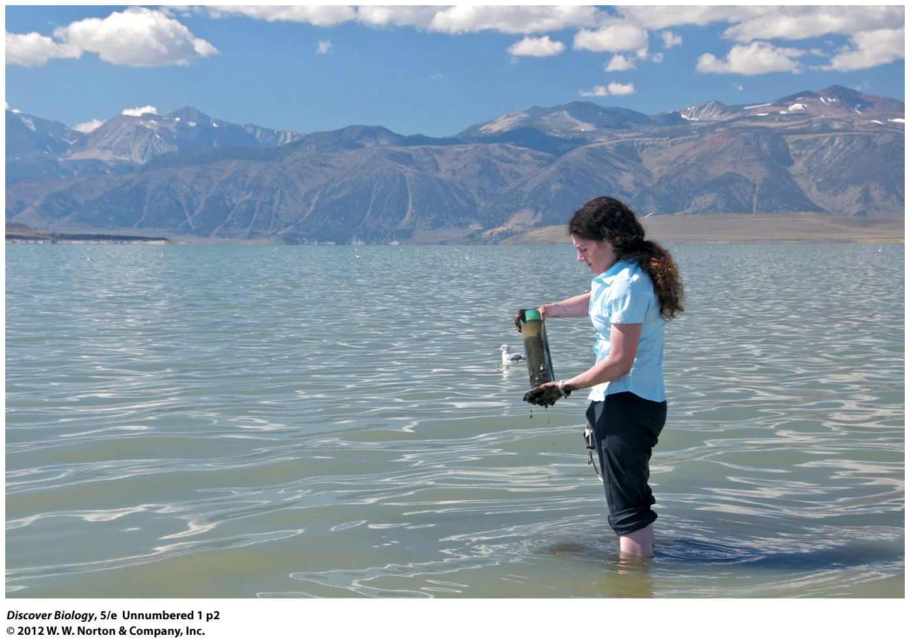
Notes:
Arsenic Bacteria. Geomicrobiologist Felisa Wolfe-Simon collects mud from the bottom of Mono Lake, California. Bacteria from the lake tolerate high concentrations of salt and arsenic.

Slide 4
This Book Is about You…
This book is about us and how we connect with other living beings and our surroundings
Controversies facing society today require an understanding of the underlying science in order to make informed decisions
Biology is the scientific study of life

Slide 5
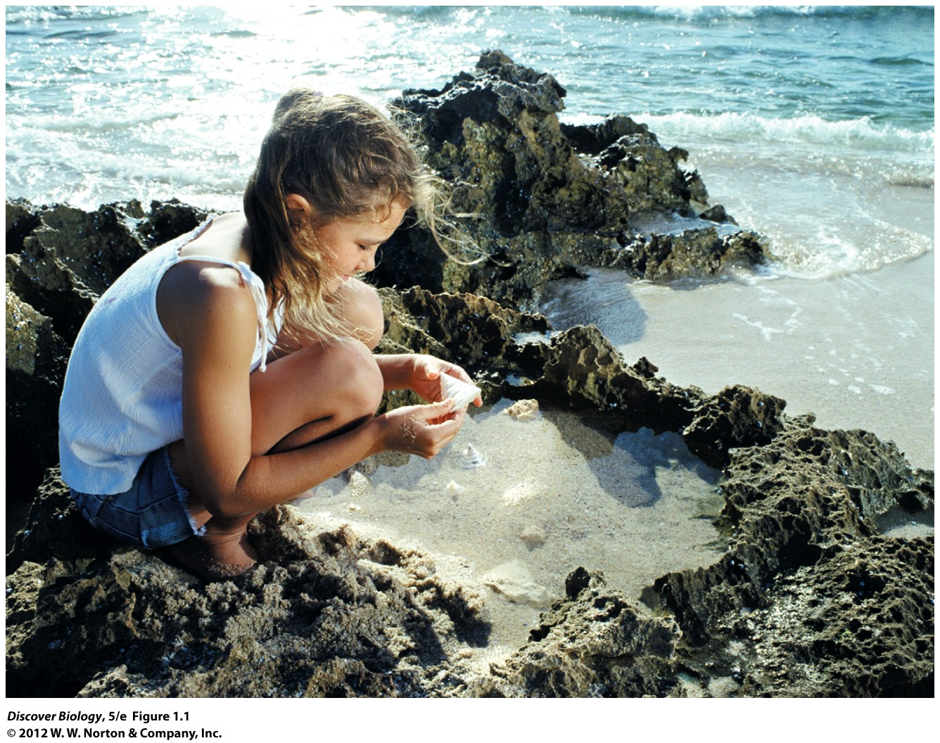
Notes:
Figure 1.1 Curiosity Is at the Heart of Scientific Inquiry

Slide 6
The Nature of Science
Humans have a natural spirit of inquiry, which is the driving force behind science
Scientific thinking is objective and values evidence over all other ways of discovering the truth

Slide 7
Science Is a Body of Knowledge and a Process for Generating That Knowledge
Science is a body of knowledge and an evidence-based process for acquiring that knowledge
Science deals with the natural world
Science is based on evidence that can be demonstrated through observation and/or experiments
Science is subject to independent validation and peer review
Science can be challenged on the basis of evidence
Science is self-correcting

Slide 8
Science Is a Body of Knowledge and a Process for Generating That Knowledge
The process that generates scientific knowledge is called the scientific method
The scientific method can be applied to all areas of science

Slide 9
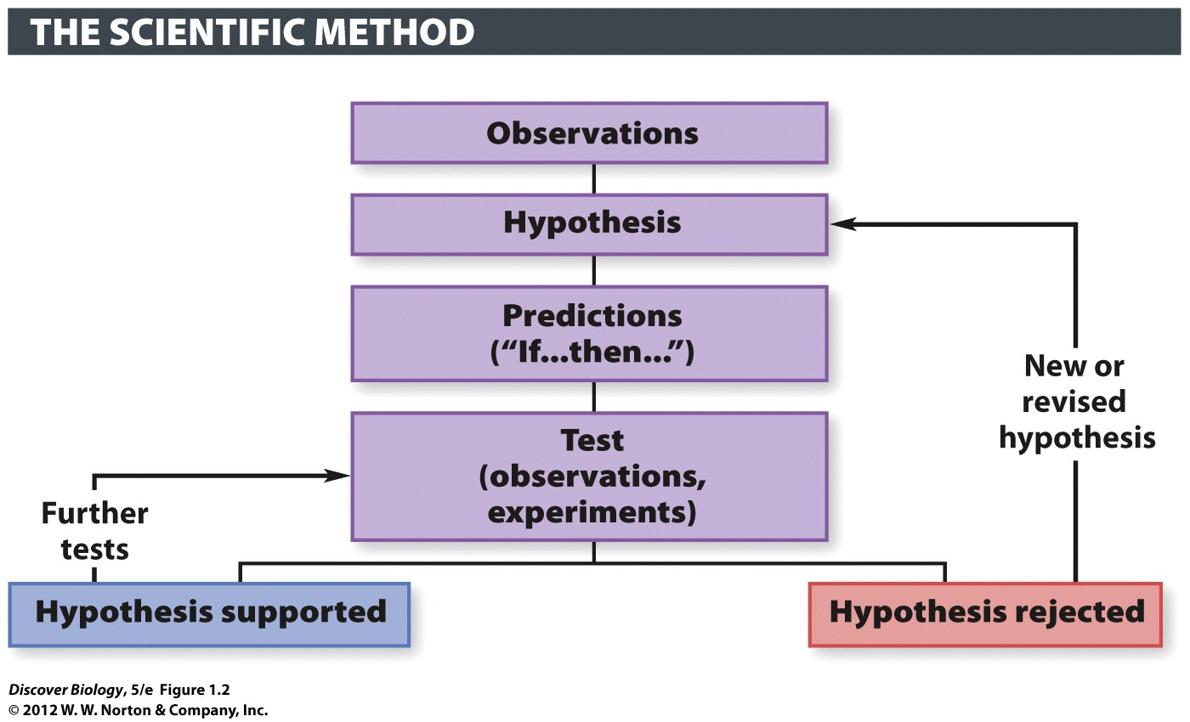
Notes:
Figure 1.2 Scientific Hypotheses Must be Testable

Slide 10
Observations Are the Wellspring of Science
The process of science begins with an observation of the natural world
An observation is a description, measurement, or record of any object or phenomenon
An observation must be reproducible

Slide 11
Notes:
Figure 1.3 Mystery of the Dying Fish: Observations
(a) Massive fish die-offs were seen in many North Carolina rivers in the 1990s. Approximately a million fish were affected, as this photograph taken in 1991 of Blount Bay, in the Pamlico Estuary of North Carolina, illustrates.

Slide 12
Scientific Hypotheses Must be Testable and Falsifiable
A scientific hypothesis is an informed, logical, and plausible explanation or educated guess about the natural world
A hypothesis should:
Seek to explain observed phenomena
Make predictions in “if-then” statements
Be repeatedly and independently testable
Be potentially falsifiable
Never be proven, but only supported

Slide 13
Notes:
Figure 1.3 Mystery of the Dying Fish: Observations, Hypothesis, and Predictions
(a) Massive fish die-offs were seen in many North Carolina rivers in the 1990s. Approximately a million fish were affected, as this photograph taken in 1991 of Blount Bay, in the Pamlico Estuary of North Carolina, illustrates. Scientists observed bloody sores on the bodies of the dead fish (inset). (b) Pfiesteria piscicada, a single-celled dinoflagellate was determined to be the cause.

Slide 14
Hypotheses Can Be Tested with Observations or Experiments or Both
A hypothesis can be tested through observational studies or experimental studies
Observational studies can be descriptive or analytical
Most observational studies use both descriptive and observational data to test a hypothesis
Scientists use statistics to estimate the reliability of data

Slide 15
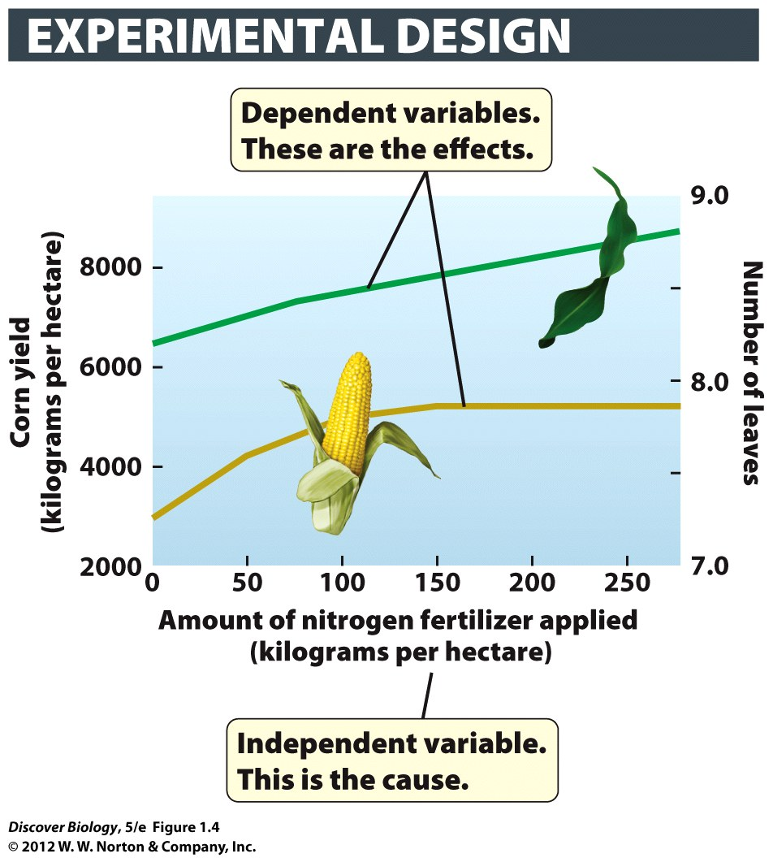
Notes:
Figure 1.4 Testing How Fertilizer Affects Corn Yield
The graph shows the effect of applying nitrogen fertilizer on average corn yield over three seasons (left-hand y-axis). The right-hand y-axis shows the average number of leaves on 10 randomly selected plants from each season’s crop 5 months after sowing. One hectare = 2.5 acres of land.

Slide 16
Experiments Are the Gold Standard for Establishing Causality
An experiment is a repeatable manipulation of one or more aspects of the natural world by experimenters
In an experiment, generally only one independent variable is manipulated at a time
A controlled experiment measures the value of the dependent variable in two or more groups while manipulating one independent variable

Slide 17
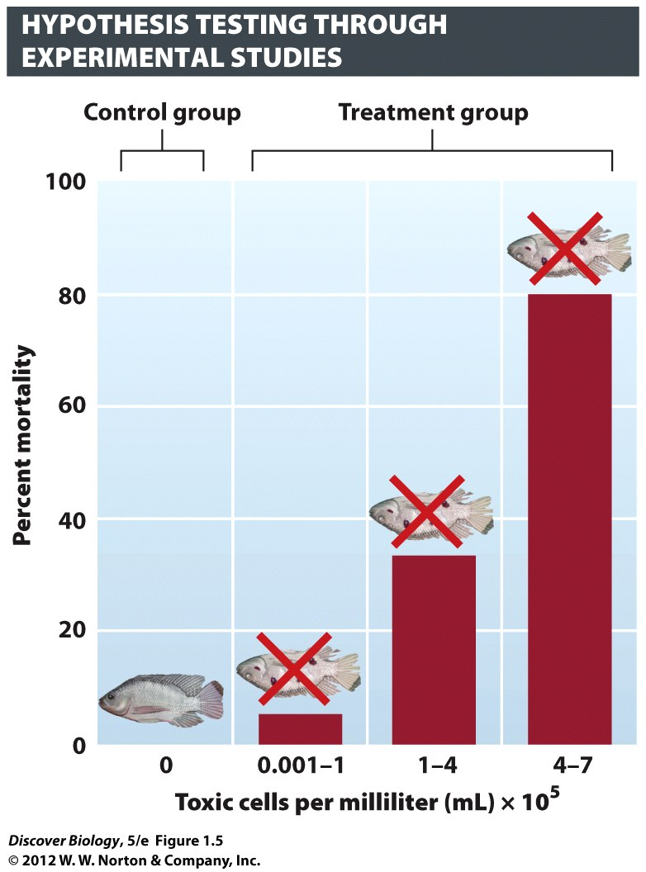
Notes:
Figure 1.5 Effect of Purified Pfiesteria on Survival of Aquarium
Fish Researchers exposed a fish called tilapia to three different concentrations of the toxic dinoflagellate for 16 hours and counted the number of fish that died in that time span. The controls in this experiment were fish that were not exposed to Pfiesteria at all. All of the controls were alive at the end of the study period.

Slide 18
Testing Does Not Prove a Hypothesis with Absolute Certainty
A hypothesis can be supported, but never proven true
When a hypothesis is falsified, it must be reexamined and then changed or discarded

Slide 19
The Scientific Method Requires Objectivity
Independent researchers should be able verify the observations of the experiment
The process of peer review seeks to limit group bias and fraud in the scientific community
Peer review is conducted by experts who have no direct involvement in the research under review

Slide 20
The Acceptance of Scientific Hypotheses Is Provisional
Scientific knowledge is open to challenge at any time by anybody
Even well-established scientific knowledge can be overturned by new evidence

Slide 21
A Scientific Theory Is a Body of Knowledge That Has Stood the Test of Time
A hypothesis becomes a scientific theory:
After it has been repeatedly confirmed through diverse methods of testing
When it is accepted by experts as the best explanation of the truth about the phenomenon
A scientific fact is a direct and repeatable observation about the natural world

Slide 22
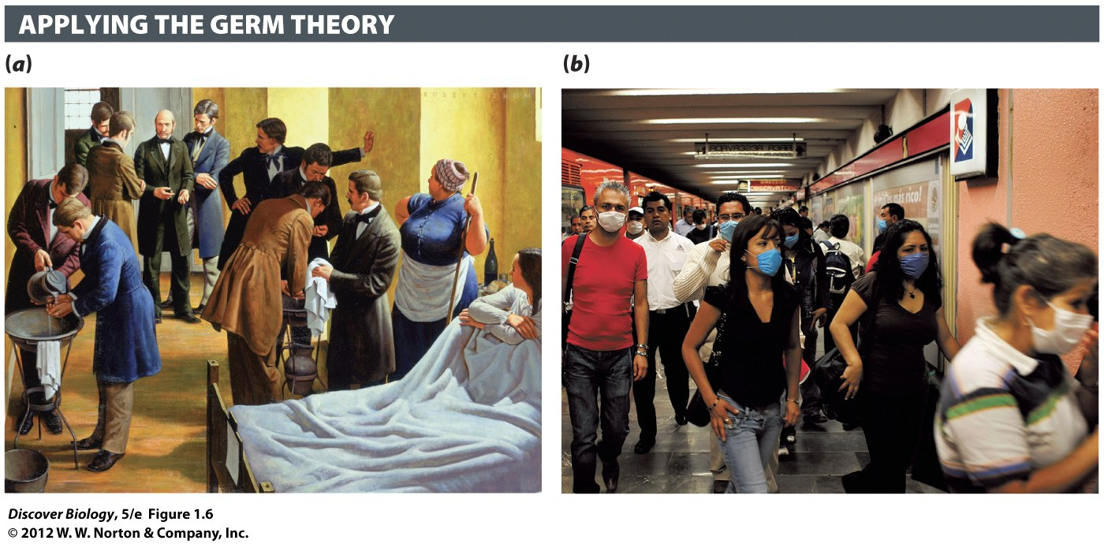
Notes:
Figure 1.6 The Germ Theory of Disease Is a Scientific Theory
The germ theory of disease holds that some diseases are caused by microorganisms, minute organisms visible only with a microscope. Application of the germ theory, through such measures as scrupulous hand washing (a), cut death rates in hospital wards by half in the late nineteenth century. The germ theory remains a cornerstone of modern medicine and hygiene, and people put this scientific theory into practice in everyday life (b). [Photo credit for (a) Robert Thom (Grand Rapids, MI, 1915–1979, Michigan). Semmelweis-Defender of Motherhood. Oil on Canvas. Collection of the University of Michigan Health System. Gift of Pfizer, Inc. UMHS.26.]

Slide 23
The Characteristics of Living Organisms
All living organisms share a set of common characteristics
Living organisms:
Are composed of one or more cells
Reproduce using deoxyribonucleic acid (DNA)
Obtain energy from their environment to support metabolism
Sense and respond to their environment
Maintain homeostasis
Are capable of evolving as a group

Slide 24
Living Organism Are Composed of Cells
Cells are the basic unit of life and are the foundation for all living things
Cells are self-contained units enclosed by a water-repellent layer called the plasma membrane
A bacterium is an example of a single-celled organism
Multicellular organisms are composed of many different kinds of specialized cells working together

Slide 25
Living Organisms Reproduce Themselves via DNA
Living organisms use DNA to produce offspring
Sexual reproduction requires specialized reproductive cells from two individuals to join together in a process called fertilization
Asexual reproduction does not require specialized reproductive cells or fertilization

Slide 26
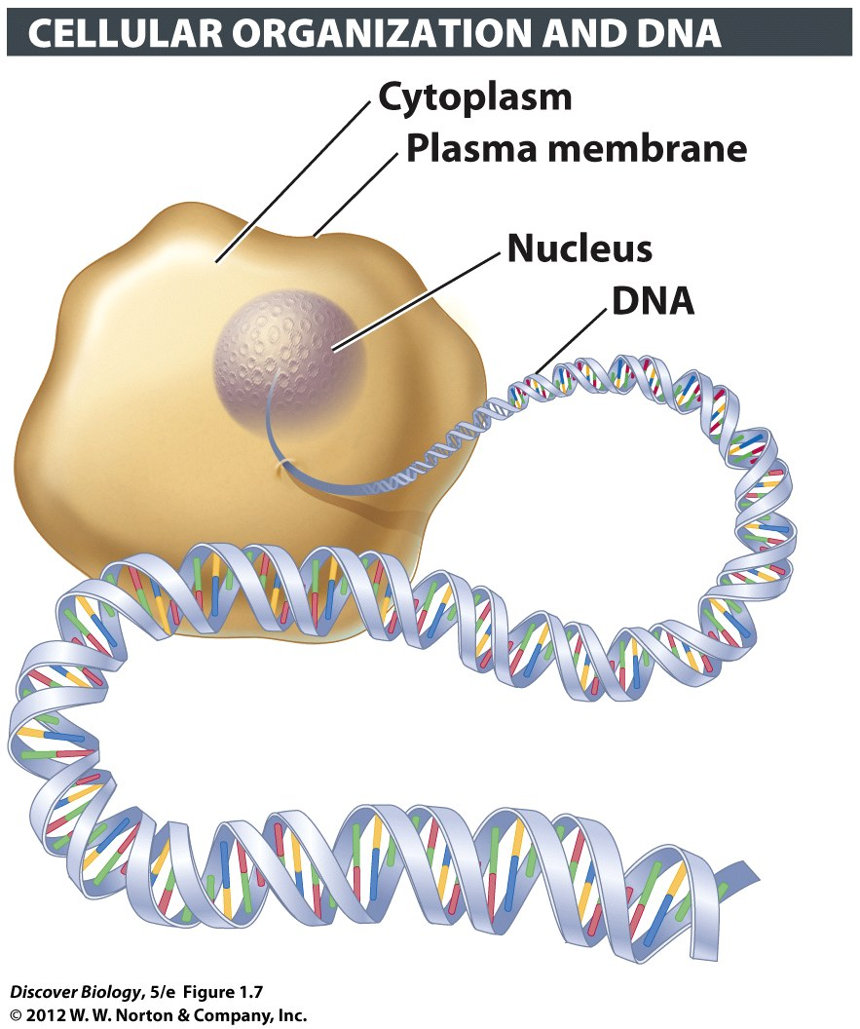
Notes:
Figure 1.7 DNA Is an Information-Storing Molecule
Organisms pass genetic information to their young by transferring copies of DNA to their offspring.

Slide 27
Living Organisms Reproduce Themselves via DNA
DNA is genetic material that contains all the instructions for building new organisms
Almost every cell in an organism contain a full set of DNA instructions
DNA is stored in a membrane-bound nucleus in plant and animal cells
A gene is a segment of DNA that codes for a specific trait or characteristic

Slide 28
Living Organisms Obtain Energy from Their Environment
Metabolism is the capture, storage, and use of energy by an organism
Plants are producers that convert energy from the sun into chemical energy used for manufacturing food in a process known as photosynthesis
Autotrophic bacteria also carry out photosynthesis

Slide 29
Living Organisms Obtain Energy from Their Environment
Consumers, or heterotrophs, use energy from other consumers or directly from producers
The nutritional relationship between producers and consumers in a particular environment can be illustrated in a food web
A food chain is a simplified portion of a food web showing who eats whom

Slide 30
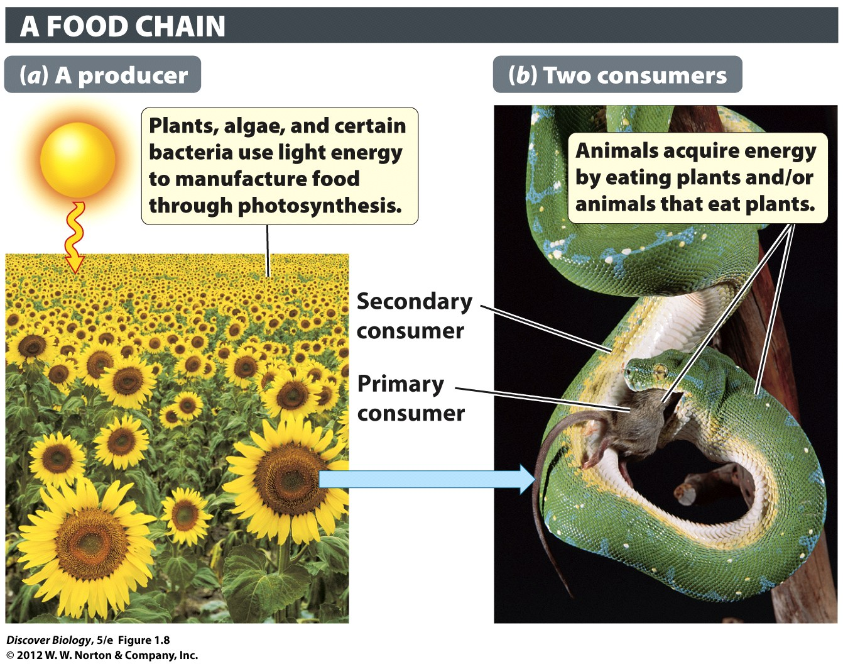
Notes:
Figure 1.8 Energy Capture by Organisms
Whereas plants can capture energy from sunlight through photosynthesis (a), animals must get their energy by eating other organisms (b). The green tree python pictured in (b) is ingesting a source of energy (a rat) that itself derived energy from eating plants.

Slide 31
Living Organisms Actively Maintain Their Internal Conditions
Organisms sense and respond to their environment in order to maintain constant internal conditions through a process called homeostasis

Slide 32
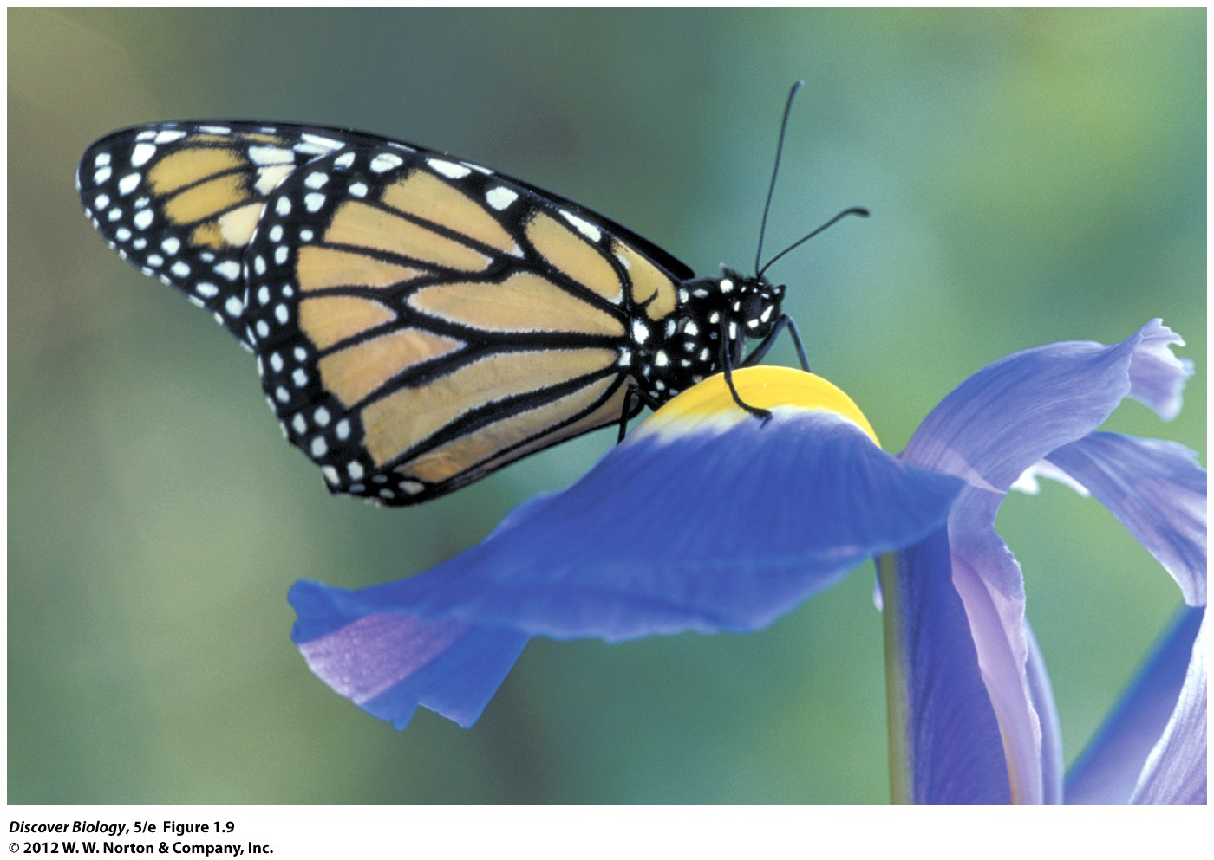
Notes:
Figure 1.9 Organisms Sense and Respond to Their Environment
This monarch butterfly detects suitable flowers by “smelling” the plant chemicals with its feet.

Slide 33
Groups of Living Organisms Can Evolve
A change in the frequency of genetic characteristics over multiple generations is called biological evolution
Artificial selection occurs when humans cause the genetic characteristics of a group of organisms to change over time

Slide 34
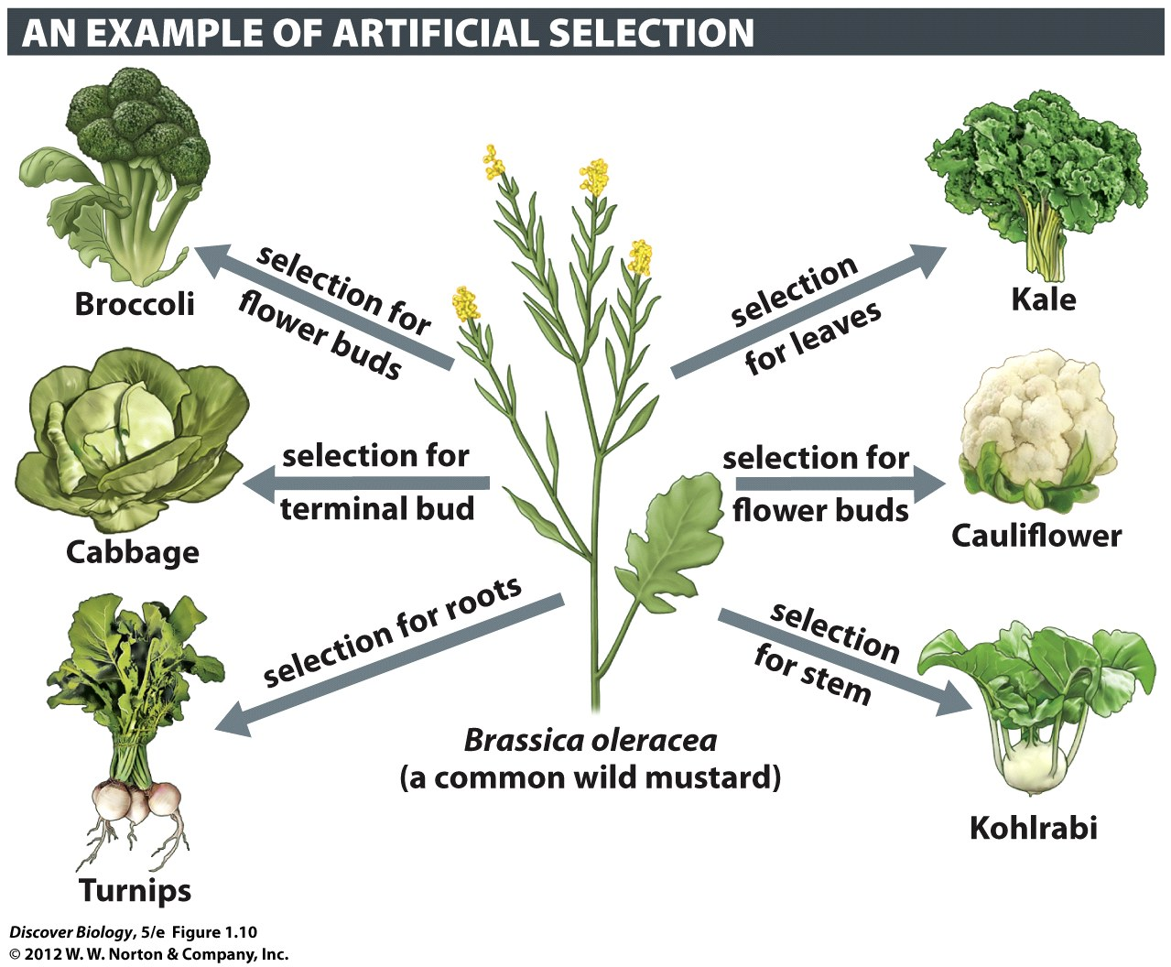
Notes:
Figure 1.10 Evolution of Wild Mustard through Domestication
In artificial selection, humans are the selective agents. The many different varieties of cruciferous plants were created by humans through selective breeding of genetically varied wild mustard plants. Individuals with desired genetic characteristics were bred with each other until their descendants became distinctly different from the ancestor, the wild mustard.

Slide 35
Groups of Living Organisms Can Evolve
A species is a group of organisms that interbreed under natural conditions to produce fertile offspring
A group of organisms within a species that shares a common habitat is called a population

Slide 36
Groups of Living Organisms Can Evolve
Adaptive traits allow an organism to survive and reproduce better than competing organisms in a process known as adaptation
Natural selection causes an adaptive trait to become more common in a population over multiple generations

Slide 37
Notes:
Figure 1.11 Groups of Living Organisms Can Evolve
Natural selection, exerted through predators looking for a meal, favors the survival and reproduction of fast pronghorn over the slower animals in the population. The next generation of pronghorn has evolved, and is better adapted to the presence of predators, because it contains many more fast runners than the previous generation had.

Slide 38
The Biological Hierarchy
Atoms are the building blocks of all matter
A molecule is created when two or more atoms are held together by chemical bonds
Biomolecules are molecules found in all living cells and generally contain carbon
Cells that perform a set of unique tasks are grouped together as a tissue
Different types of tissues make up organs that can perform a broader range of functions than any of the individual types

Slide 39
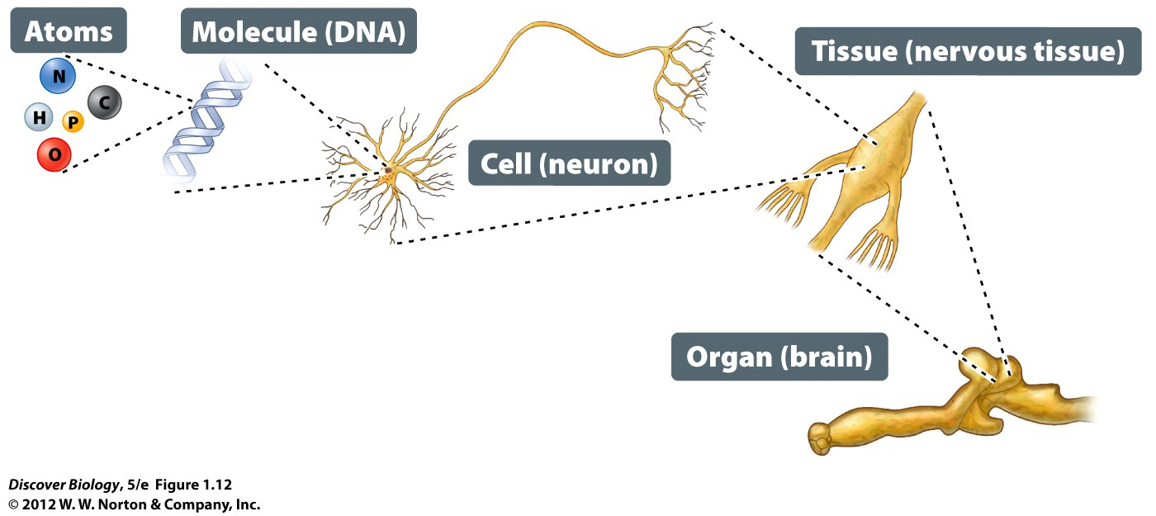
Notes:
Figure 1.12 The Biological Hierarchy Extends from the Atom to the Biosphere
Levels of biological organization can be traced from atoms and molecules found in organisms all the way up through levels of increasing organization to the biosphere, which includes all living organisms and their nonliving environment. Aquarium enthusiasts may recognize the emperor angelfish pictured in the hierarchy.

Slide 40
The Biological Hierarchy
Organs are networked into organ systems that come together to form an individual organism
Groups of different species that live and interact with one another in a particular environment are called a biological community

Slide 41
The Biological Hierarchy
A physical environment and all the communities in it make up an ecosystem
Biomes are large regions of the world that share physical characteristics such as climate and the organisms that live there

Slide 42
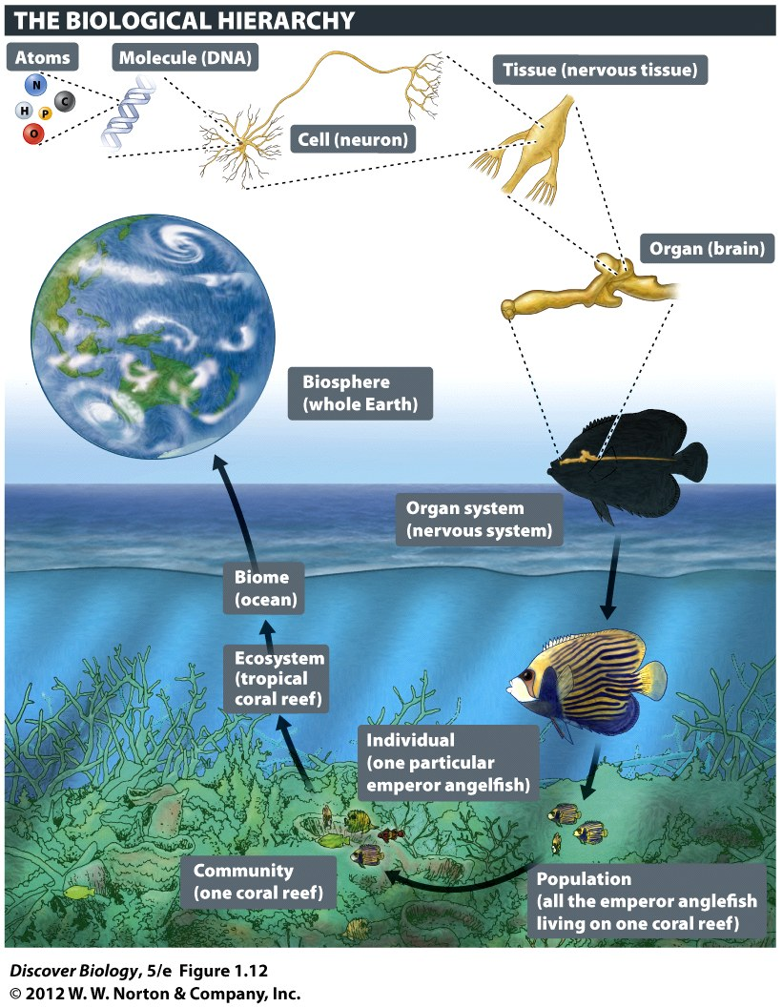
Notes:
Figure 1.12 The Biological Hierarchy Extends from the Atom to the Biosphere
Levels of biological organization can be traced from atoms and molecules found in organisms all the way up through levels of increasing organization to the biosphere, which includes all living organisms and their nonliving environment. Aquarium enthusiasts may recognize the emperor angelfish pictured in the hierarchy.

Slide 43
Researches Wrangle over Bacteria
Previously, scientists agreed that all life on Earth required six major elements:
Carbon
Hydrogen
Nitrogen
Oxygen
Sulfur
Phosphorus
The recent discovery of a bacteria that does not require phosphorus raises the question of whether any of the six major elements of life are actually required

Slide 44
Notes:
Arsenic Bacteria. Geomicrobiologist Felisa Wolfe-Simon collects mud from the bottom of Mono Lake, California. Bacteria from the lake tolerate high concentrations of salt and arsenic.

Slide 45
Clicker Questions
CHAPTER 1
The Nature of Science and the
Characteristics of Life

Slide 46
Concept Quiz
Observation: After a lengthy rainstorm, earthworms are on the surface of a sidewalk.
Which of the following is an adequate hypothesis for the observation?
The sidewalk is hard and flat.
Lightning attracts earthworms.
Saturated soil makes it difficult for the earthworms to “breathe” so they come out of the ground.
Notes:
The correct answer is C. It is a testable hypothesis which could explain the observation. It leads to additional questions such as “do earthworms breathe?” This provides an opportunity to emphasize that development of an hypothesis should be accompanied by acquisition of as much information as possible.
Note: The students may be encouraged to discuss and develop a different hypothesis which explains the observation. Then have the groups share their ideas to see how varied the possible hypotheses are. The next step would be to have them explain an experiment which tests their hypothesis.
Although a true statement, Answer A does not address the question which arises from the observation, “why do earthworms migrate to the sidewalk during rainstorms?” Emphasize that it helps to generate a question based on the observation when developing an hypothesis.
Answer B is not based on the observation.

Slide 47
Concept Quiz
Which of the following is a
characteristic shared by all living
organisms?
Movement
Reproduction
Breathing
Notes:
The correct answer is B. All living organisms must reproduce but not all organisms have movement or breathe.
Answer A: Not all organisms have movement. Most have some form of movement, even if it is just intracellular transport of molecules. However, movement as a general characteristic is not universal for all living organisms.
Answer C: Although the definition of breathing is typical of most higher organisms, especially when broadened to include gas exchange, many simple organisms only exchange metabolic products and not gases.

Slide 48
Concept Quiz
Which organism is the producer?
Cactus
Rattlesnake
Hawk
© 2009 W.W. Norton & Company, Inc. DISCOVER BIOLOGY 4/e
Notes:
The correct answer is A. The cactus is converting sunlight into chemical energy.
Answer B: The rattlesnake is simply a mid-level consumer because it consumes the rodent and is consumed by the hawk.
Answer C: Although the hawk is producing heat, the producer referred to in this diagram is only the organism that uses photosynthesis to produce chemical energy.

Slide 49
Relevant Art from Other Chapters
All art files from the book are available in JPEG and PPT formats online and on the Instructor Resource Disc

Slide 50
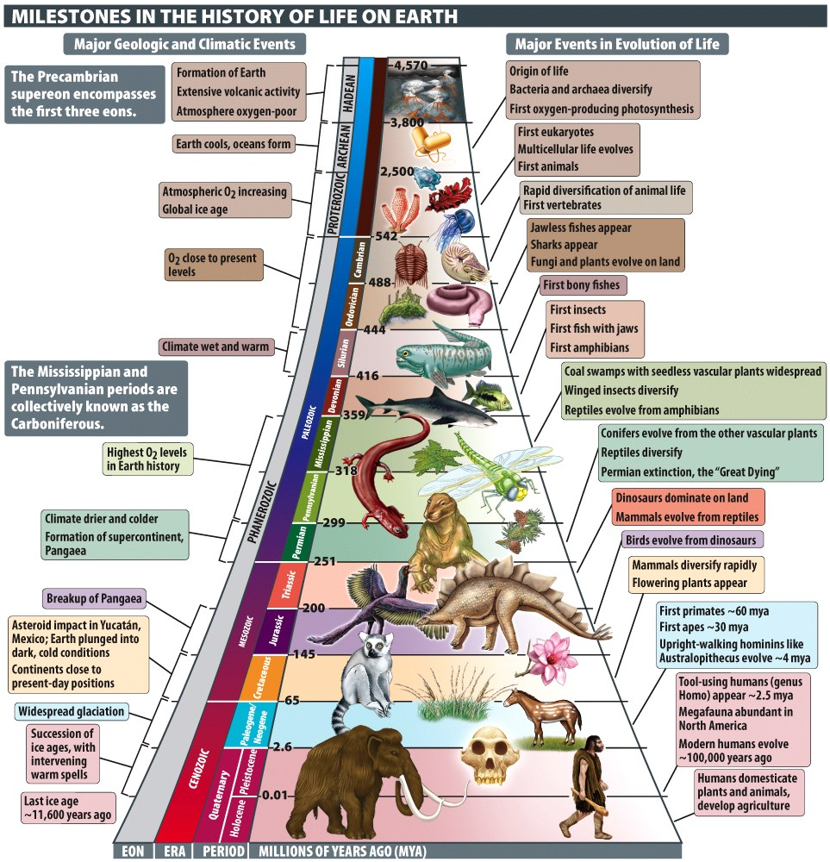
Notes:
Milestones in the History of Life on Earth

Slide 51
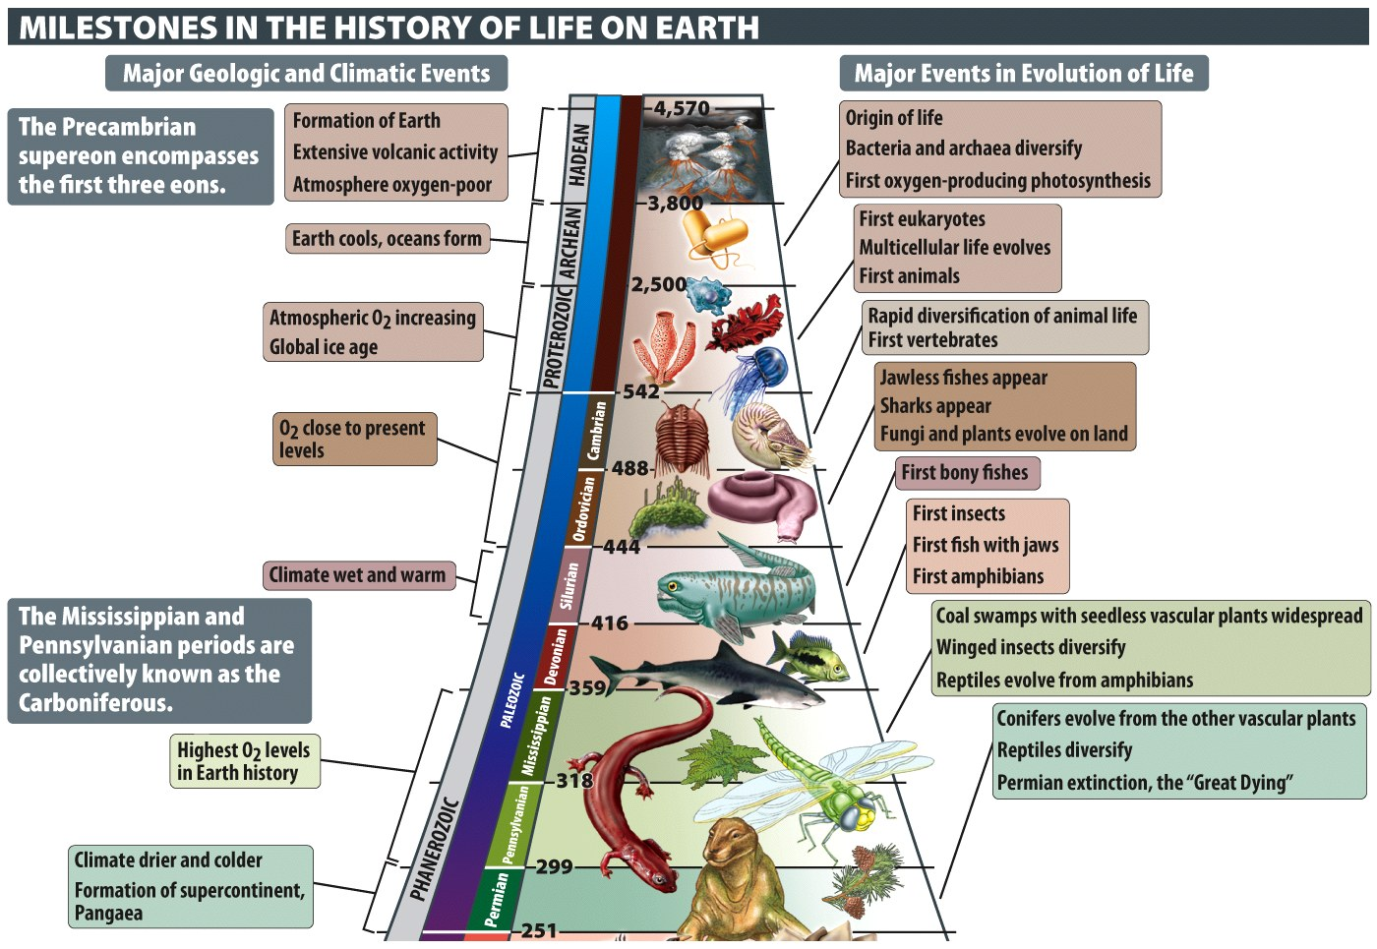
Notes:
Milestones in the History of Life on Earth

Slide 52
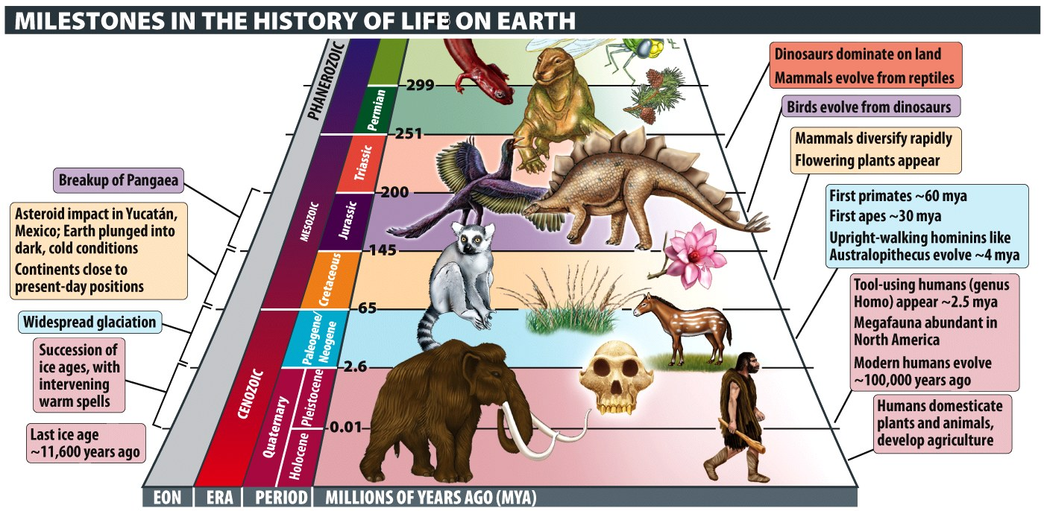
Notes:
Milestones in the History of Life on Earth

Slide 53
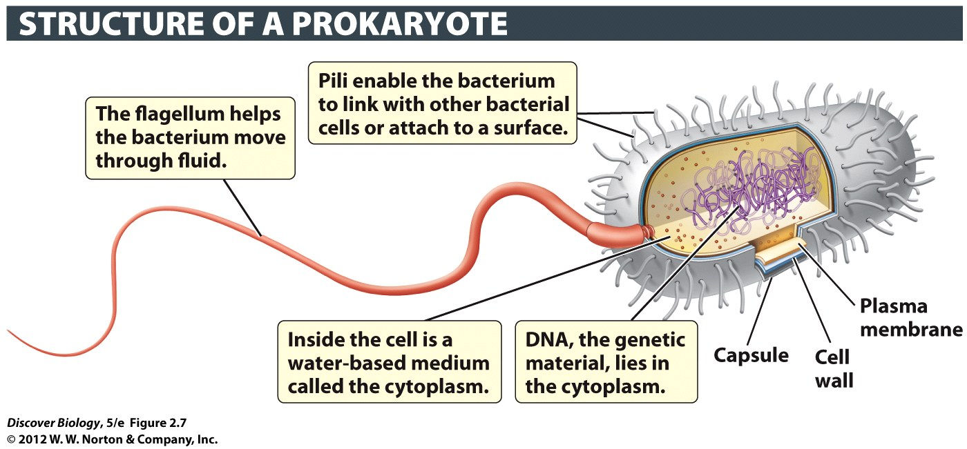
Notes:
Figure 2.7 Prokaryotic Cells Lack a Nucleus
Prokaryotic cells tend to be about 10 times smaller than eukaryotic cells, and generally have much less DNA.

Slide 54
Notes:
Figure 6.1 An Individual Organism May Consist of a Single Cell or Very Many Cells
(a) Salmonella typhimurium, a singlecelled prokaryote that is a common cause of food poisoning. (b) Paramecium caudatum, a singlecelled eukaryote that lives in freshwater. (c) Ceramium pacificum, a multicellular red alga. (d ) Penicillium camembertii, a multicellular fungus, with spores (green) used for asexual reproduction. (e) Surface view of a black walnut (Juglans nigra) leaf, with stomata and protective hair. (f ) Red blood cells and white blood cells inside an arteriole, one of the smaller blood vessels in the human body.

Slide 55
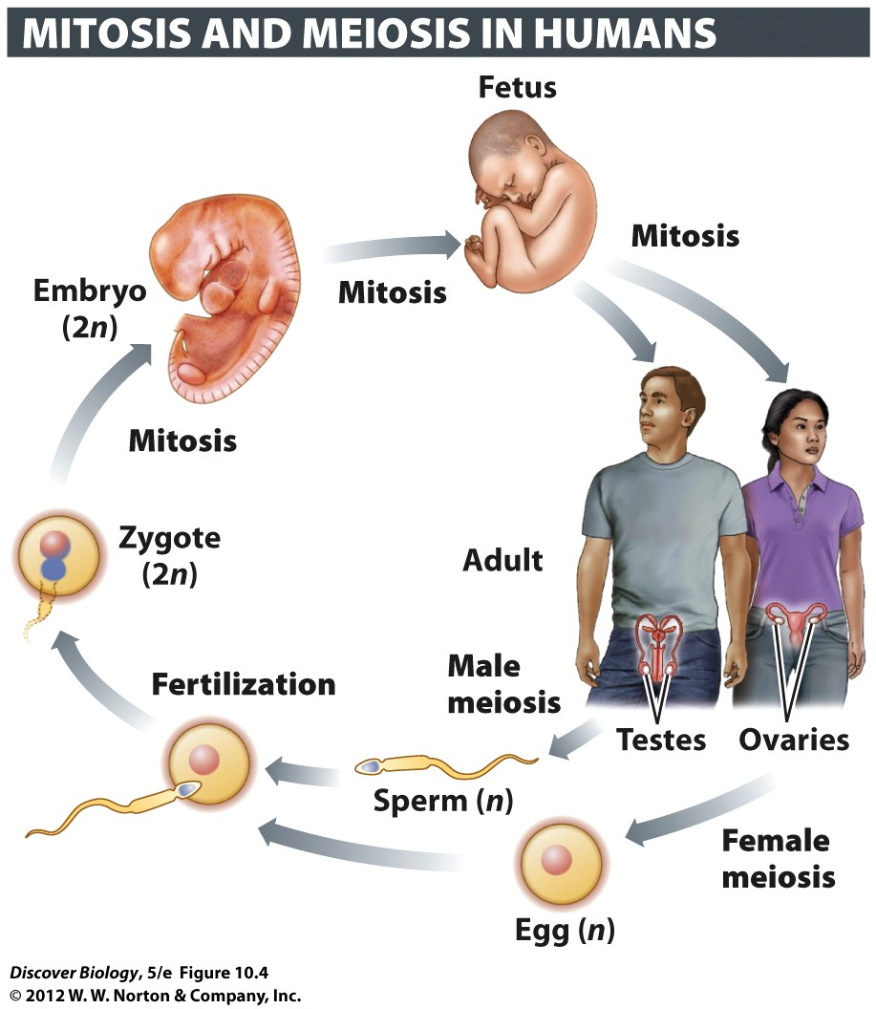
Notes:
Figure 10.4 Mitosis and Meiosis Play Vital Roles in the Human Life Cycle

Slide 56
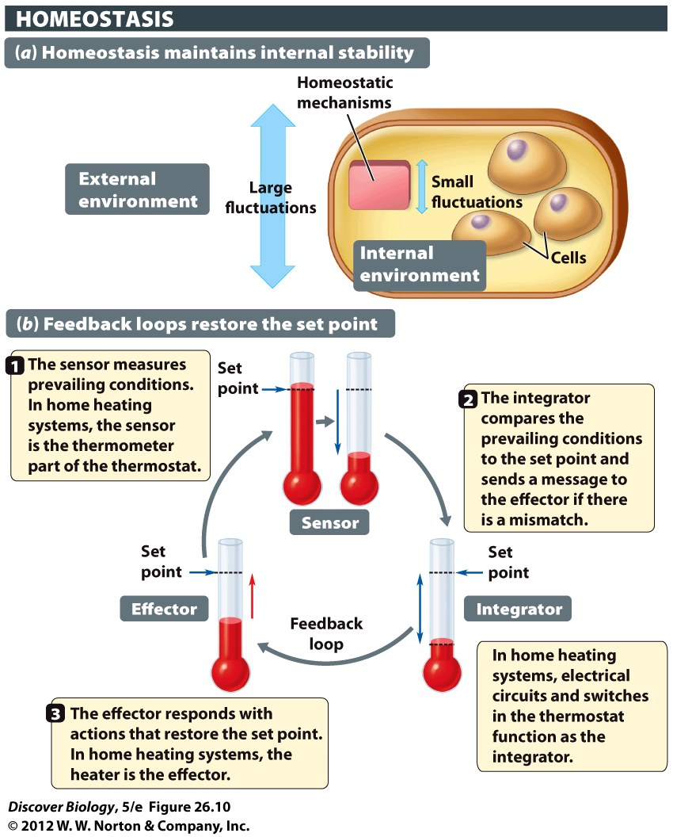
Notes:
Figure 26.10 Homeostatic Mechanisms Maintain Stable Internal Conditions despite Fluctuations in External Conditions
(a) Because of homeostatic mechanisms, large fluctuations in external conditions produce little or no change in the overall state within the animal body. (b) A home heating system is analogous to the homeostatic mechanisms that maintain our body temperature. Temperature receptors in the skin function as sensors in the human body. A brain structure called the hypothalamus acts as the integrator, launching corrective action if core body temperature deviates from the set point (about 37°C). If body temperature declines, the hypothalamus activates a number of different effectors, including muscles that constrict surface blood vessels to reduce heat loss and those that produce shivering to generate extra metabolic heat.

Slide 57
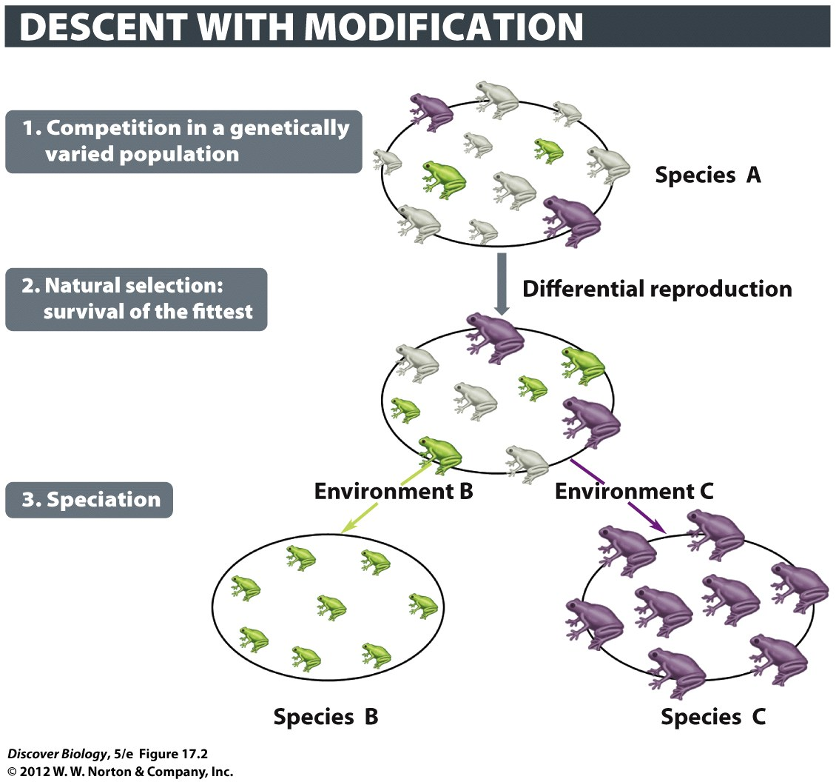
Notes:
Figure 17.2 Darwin Proposed Natural Selection as the Mechanism behind Species Formation

Slide 58
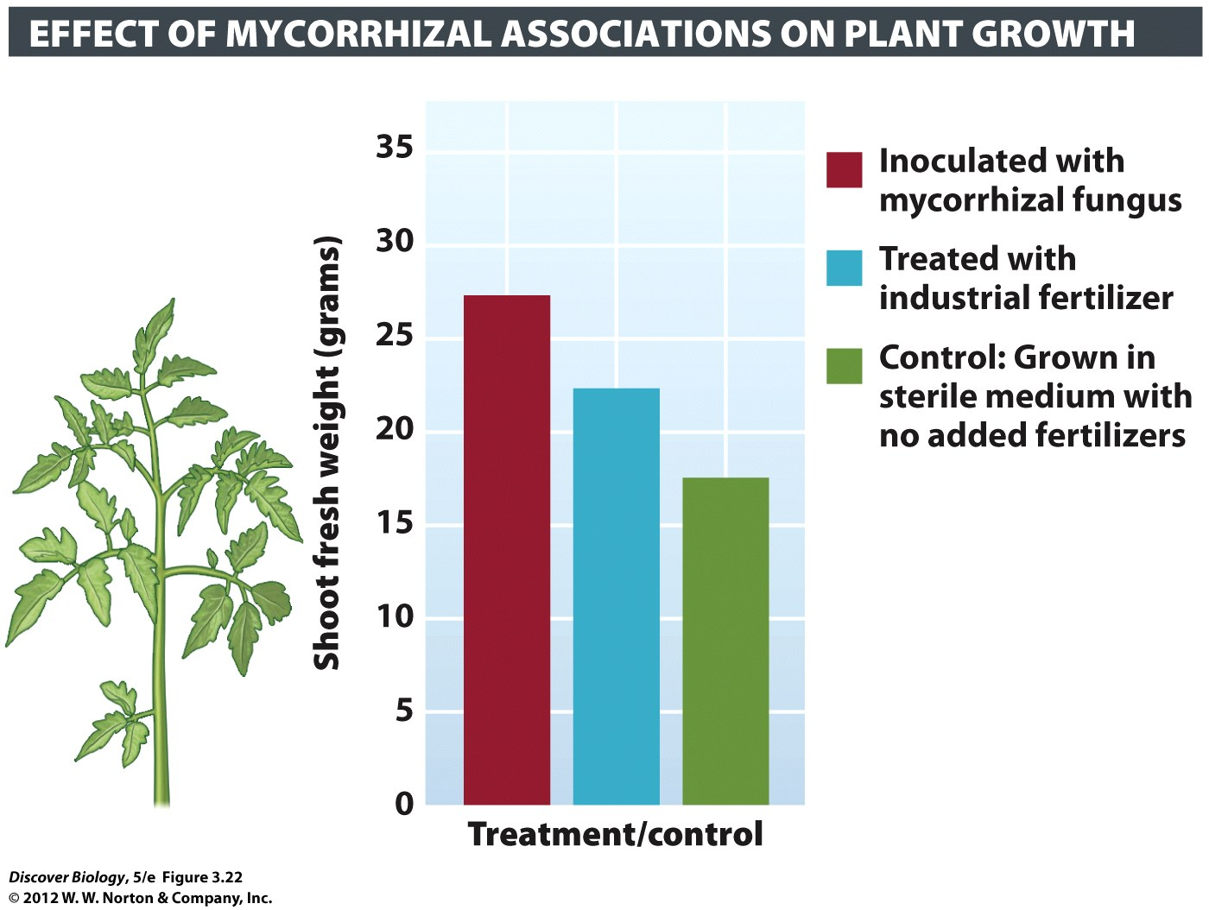
Notes:
Figure 3.22 Mycorrhizal Associations Benefit Growth of Tomato Plants

Slide 59
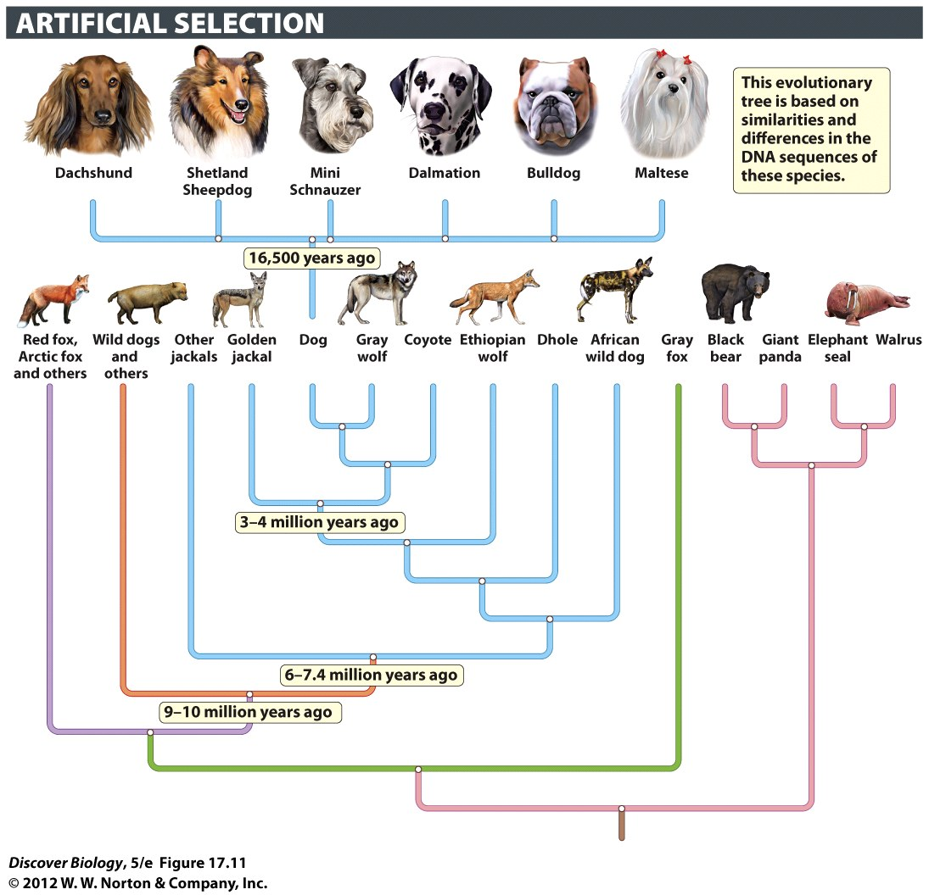
Notes:
Figure 17.11 Artificial Selection Produces Genetic Change
Humans have directed the evolution of the gray wolf to produce the many breeds of dogs. Despite the dramatic differences exhibited by the gray wolf, the Chihuahua, and the Great Dane, all three are members of the same species: Canis lupus. Selective breeding for specific genetic characteristics is responsible for the difference in form and behavior among the dog breeds.

Slide 60
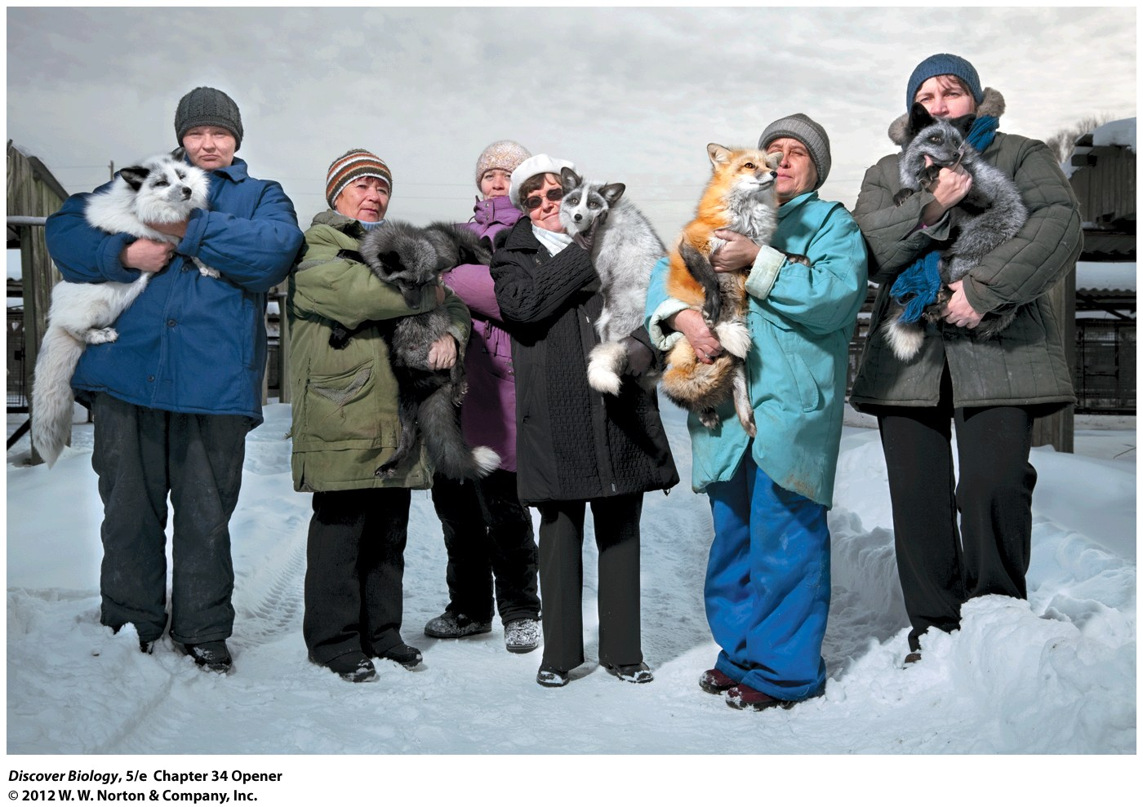
Notes:
Domesticated Siberian Silver Foxes. Not just hand-raised descendants of wild foxes, these foxes have been bred since 1959 only to respond positively to humans. In the process of genetic domestication, the foxes also evolved multicolored coats, curly tails, broader heads, and other traits typical of domesticated animals. Domesticated foxes, unlike their wild cousins, make great pets.

