Slide 1
Log into PAL
Have you taken the latest quiz?
When is your next paper due?
If you are not sure, you need to

Slide 2
Chapter 10
Cell Division

Slide 3
Cell Division – 2 ½ types
Meiosis – eukaryotes make cells for sex
    In humans, “eggs” or “sperm”
    Half the DNA of normal cells
Mitosis – eukaryotes make any other cells
“binary fission” – prokaryote division

Slide 4
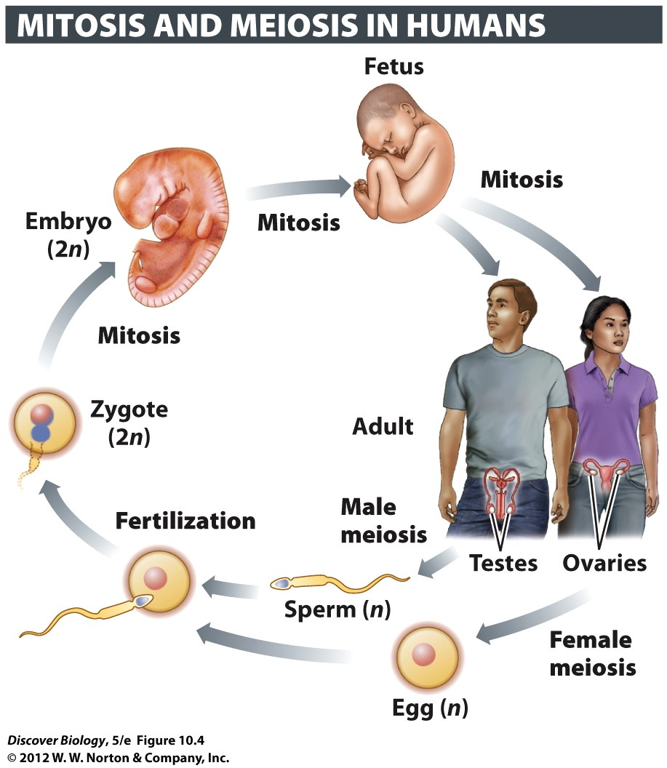
Notes:
Figure 10.4 Mitosis and Meiosis Play Vital Roles in the Human Life Cycle

Slide 5
Meiosis - Why have sex?
Asexual reproduction - offspring usually identical to the parent
    Same vulnerabilities
Sexual reproduction – some DNA from each parent
  Similar to, but not the same as either parent
  May have better combination of genes
    Better chance to survive and breed

Slide 6
Meiosis – making sex cells
Gamete – sex cell, ½ the DNA of normal cell
    Each cell in you
      ½ DNA from dad’s sperm (a gamete)
      ½ DNA from mom’s egg (a gamete)
More detail on this process later.

Slide 7
Mitosis & Binary Fission
“Binary Fission” – how prokaryotes reproduce
Mitosis – how eukaryotes make normal cells
    New cells for growth
    New cells for replacement of old/damaged cells
    Asexual reproduction

Slide 8
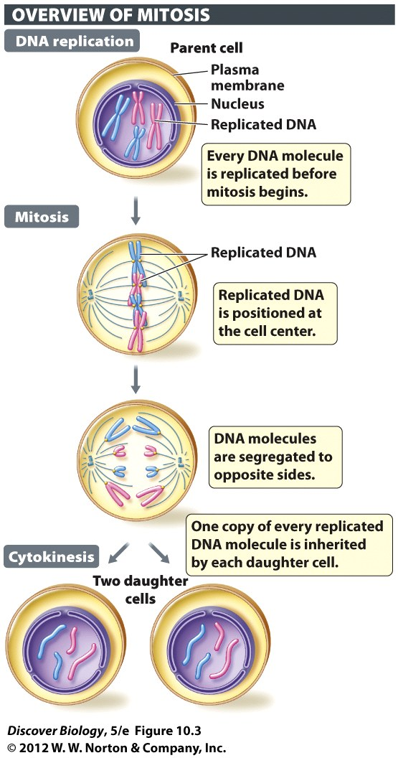
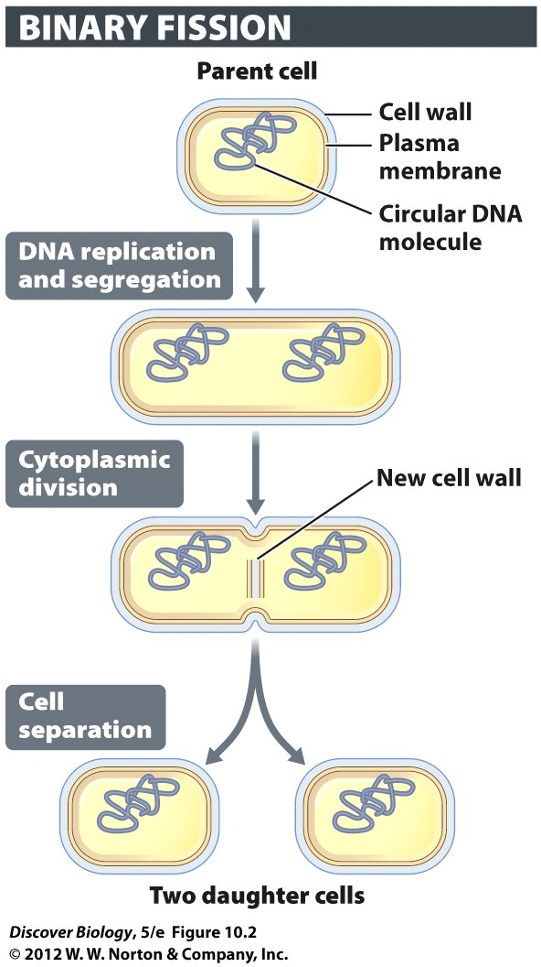
1 Parent ➔ 2 Daughter

Slide 9
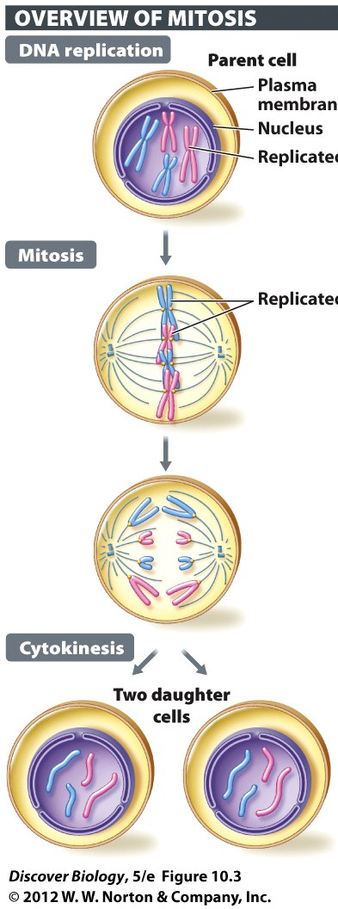
Cell Division - Terms to know
“parent cell” – one that will divide
“daughter cell” – created by cell division
One parent forms two daughters
  Equal division (daughters are identical)

Slide 10
Mitosis – eukaryote’s normal cell division
Eukaryotes – equal DNA in each daughter
One normal cell ➔ adult human
    (or any other organism)
Replacement cells
    RBC wear out
    Stomach cells eaten by acid
    Skin cells worn away

Slide 11
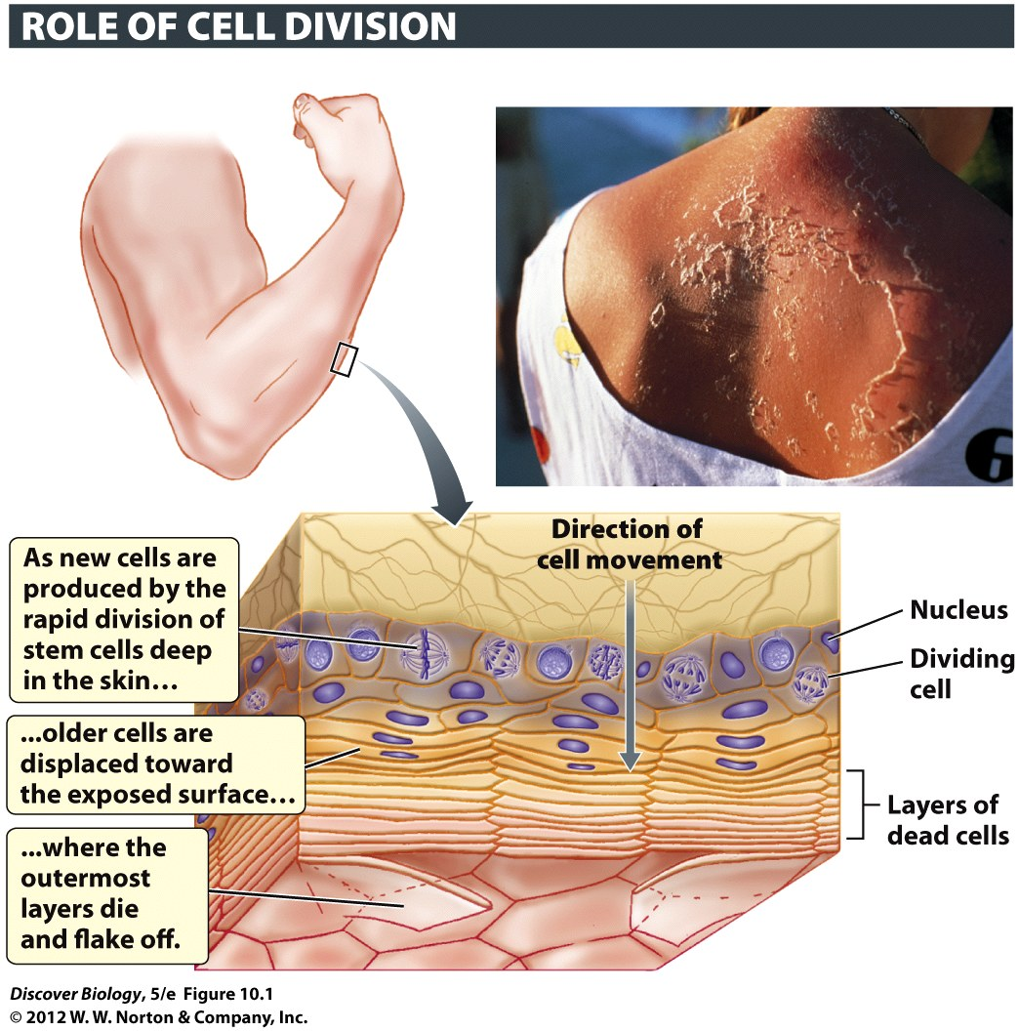
Notes:
Figure 10.1 Cell Division Replenishes the Skin
Rapid cell division in the deepest layer of the skin is necessary to replace skin cells (called keratinocytes) lost at the surface of the skin. The loss is due to the normal programmed death of the outer layers of mature keratinocytes, but it can also be the consequence of severe DNA damage, as in a peeling sunburn (inset).

Slide 12
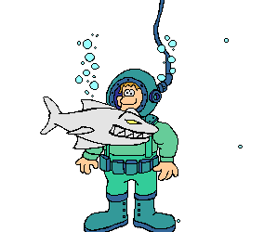
Mitosis – asexual reproduction
Many single-celled eukaryotes
Some multicellular eukaryotes
    Example: fungi, seaweed, and sponges
DO NOT ASK (yet)

Slide 13

Eukaryotes – “mitotic division”
Mitotic division – 1 parent ➔ 2 daughter cells
    Each daughter identical to parent
    Same DNA as parent
Two processes in mitotic division
    Mitosis – dividing the nucleus
    Cytokinesis – dividing the rest of the cell

Slide 14
Prokaryotes – binary fission
Prokaryote cell repro
    “binary fission”
Same idea as mitosis
No nucleus to divide

Slide 15
Mitosis – DNA In Daughter Cells
Same DNA as each other
Same amount as parent originally had
How?
  Double the DNA, then Divide
When?
  Before mitosis
  “INTERPHASE”

Slide 16
Both mitosis and binary fission
Mitosis - “Double the DNA, then divide”
Parent starts with normal
Parent DOUBLES the dna
Parent divides
    1 parent ➔ 2 daughter cells
Each daughter has normal amount of DNA

Slide 17
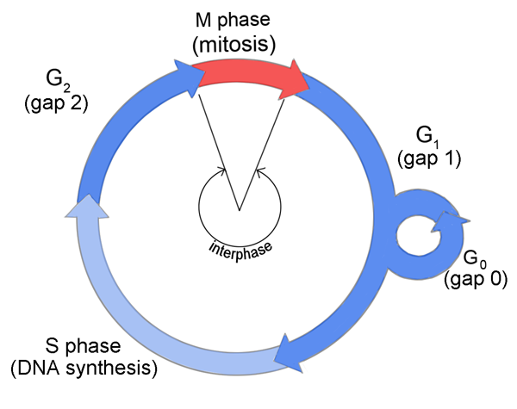
Interphase – when we double
“Interphase” = time between divisions
most of the time is spent in interphase
Doubling of DNA happens during interphase
More details later

Slide 18
The Cell Cycle
The cell cycle = new cell ➔ dividing cell
90 minutes to 24 hours, varies with cell type
Two main stages
    Interphase
    Mitosis (cell division)

Slide 19
Cell Cycle – 2 main stages
Interphase:
  Does normal cell stuff
    Nutrients in, makes proteins, special functions
  Grows
  Gets ready to divide (includes “double the DNA”)
Mitosis (divides):
  Physical division of the cell
  Production of two daughter cells

Slide 20
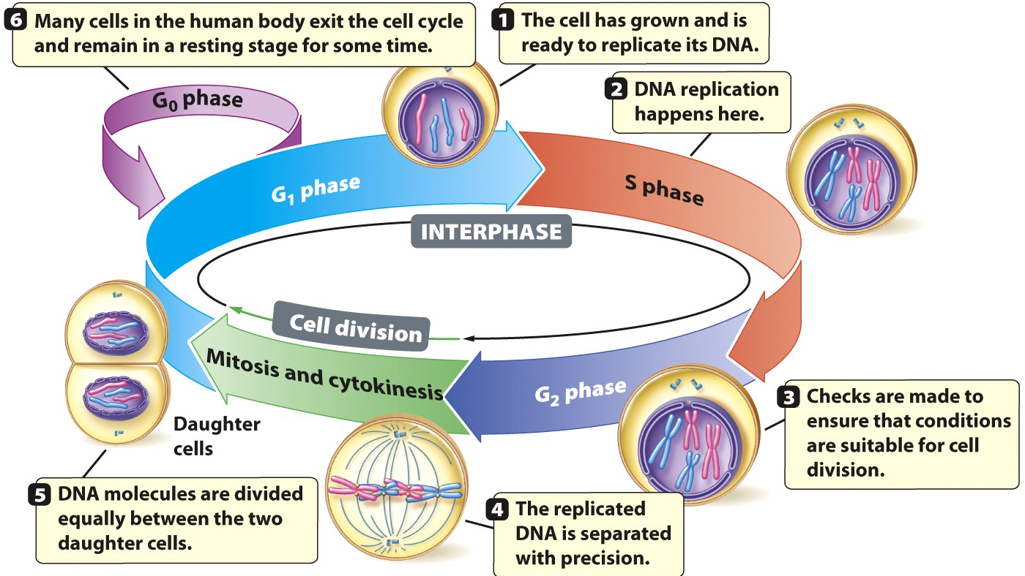
Interphase – three phases
Interphase = G₁, S, and G₂
  G₁ = Grow the cell
  S = “Synthesis” (when we double the DNA)
  G₂ = Grow some more

Slide 21
Most Cells in Adult Don’t Divide
Most adult cells enter a nondividing phase called G₀
The G₀ phase can last from a few days to the lifetime of the organism

Slide 22
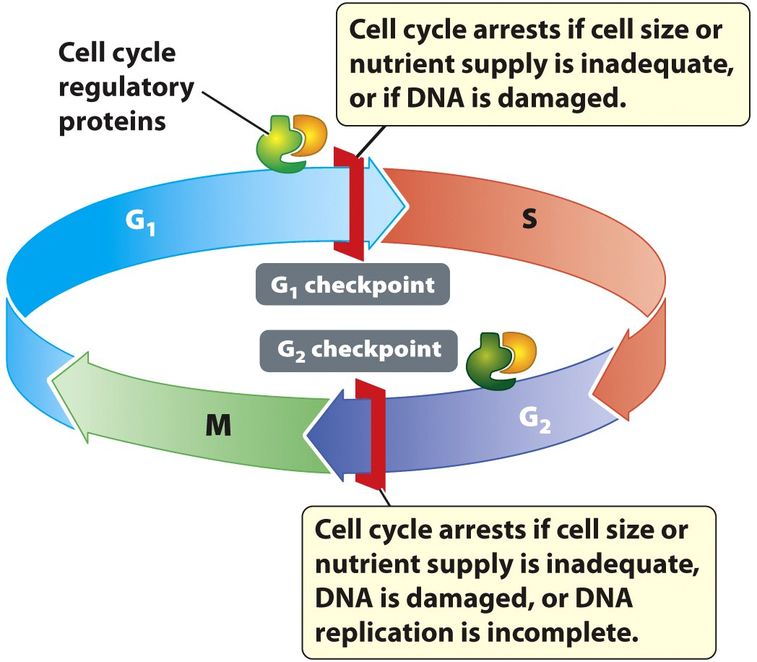
Proteins regulate growth & division
Cells divide when signaled (internal or external)
Humans have cell cycle regulatory proteins
Can start division or stop/pause it

Slide 23
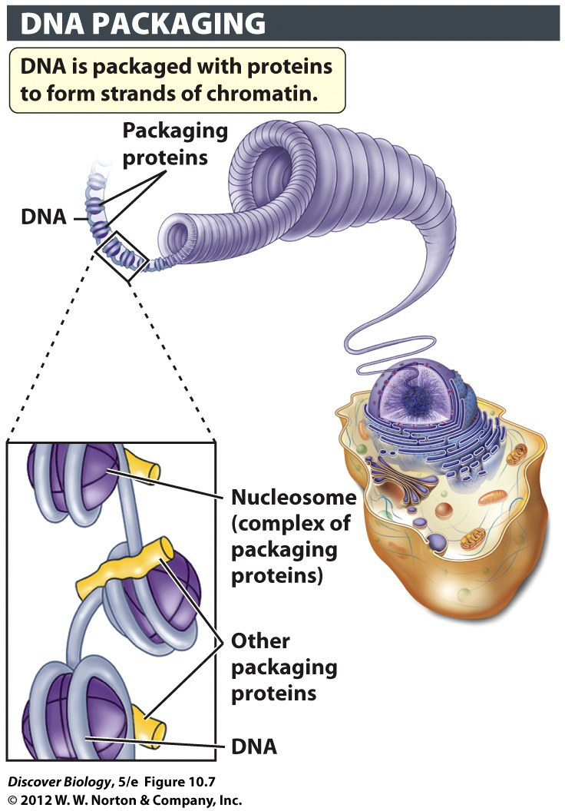
Chromosomes
DNA wrapped around histone proteins
    “chromatin”
    Long strands
Chromatin packed into chromosomes

Slide 24
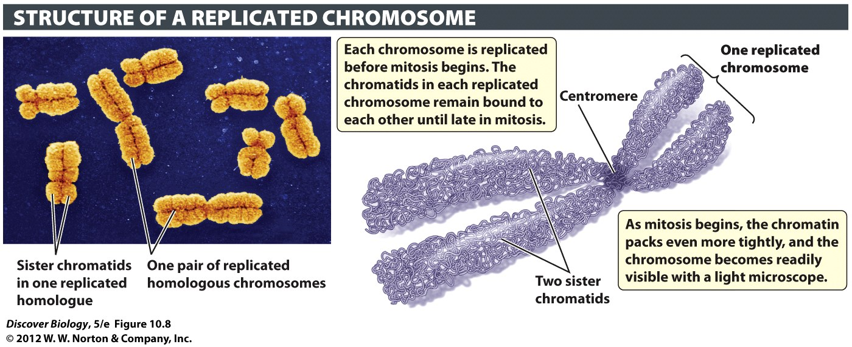
The Chromosomal Organization of Genetic Material
DNA is doubled during S phase
    Two identical copies, hooked together at “centromere”
    “sister chromatids”
    Will separate and put one in each daughter cell

Slide 25
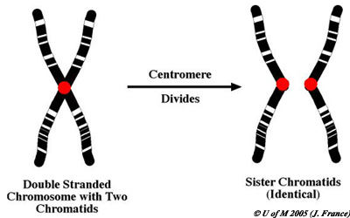
Stupid Names: Chromosomes & chromatids
1 doubled two new
Chromosome chromosomes

Slide 26
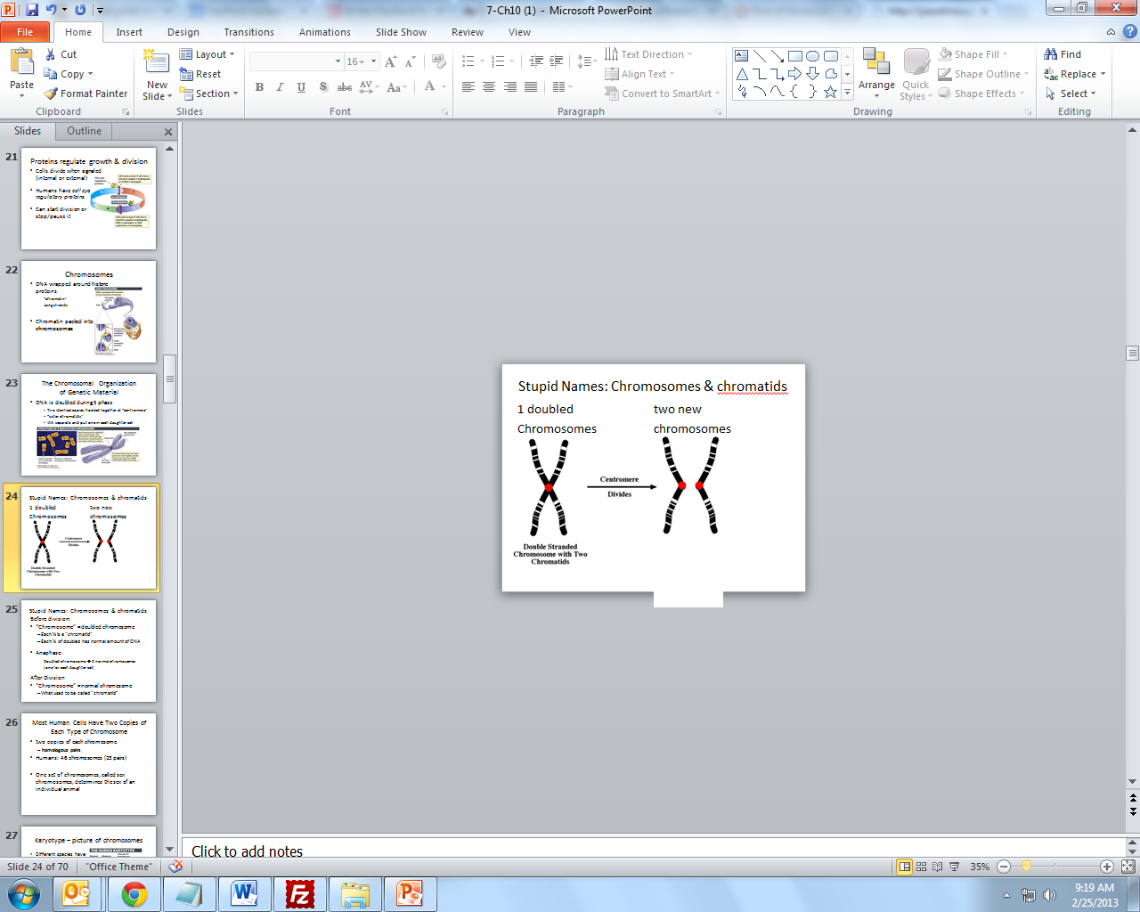
Stupid Names: Chromosomes & chromatids
Before division:
“Chromosome” = doubled chromosome
  Each ½ is a “chromatid”
  Each ½ of doubled has normal amount of DNA
Anaphase:
Doubled chromosome ➔ 2 normal chromosomes
(one for each daughter cell)
After Division
“Chromosome” = normal chromosome
  What used to be called “chromatid”

Slide 27
Chromatid ➔ Chromosome
Each “chromatid” is a future chromosome
has the normal amount of DNA
After division, we change the name to
“chromosome”

Slide 28
Most Human Cells Have Two Copies of Each Type of Chromosome
two copies of each chromosome
  homologous pairs
Humans: 46 chromosomes (23 pairs)
One set of chromosomes, called sex chromosomes, determines the sex of an individual animal

Slide 29
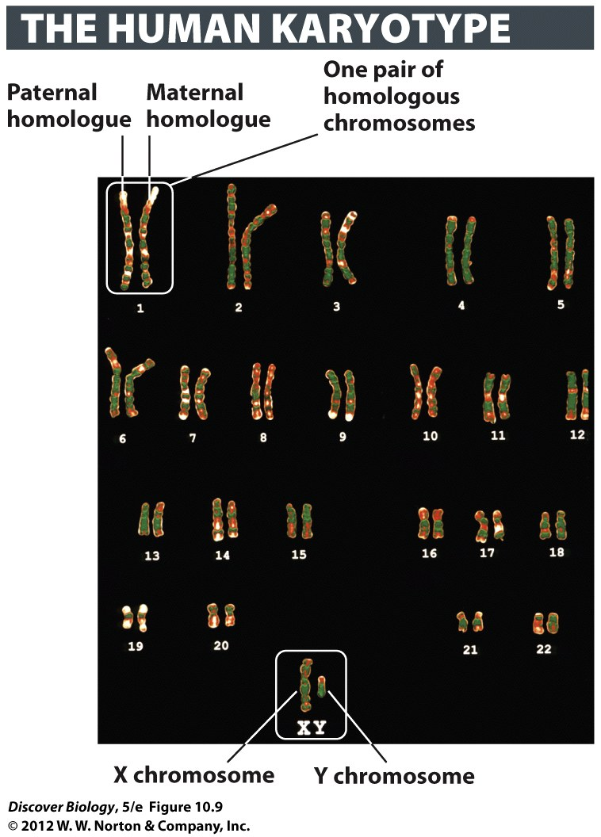
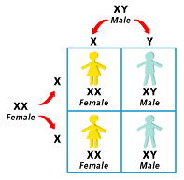
Karyotype – picture of chromosomes
Different species have different chromosome #
“karyotype” = Picture of all the chromosomes in normal cell
“Homologous” pairs

Slide 30

Cell Cycle
Interphase – growing cell and doubling DNA
Mitosis – dividing the nucleus and chromosomes
Stages of mitosis
  TAMPA
  PMAT (nonsense word)

Slide 31
Mitosis = separating chromatids
four main phases of mitosis:
  Prophase
  Metaphase
  Anaphase
  Telophase
Mitosis = separating DNA and putting a copy in each daughter cell

Slide 32
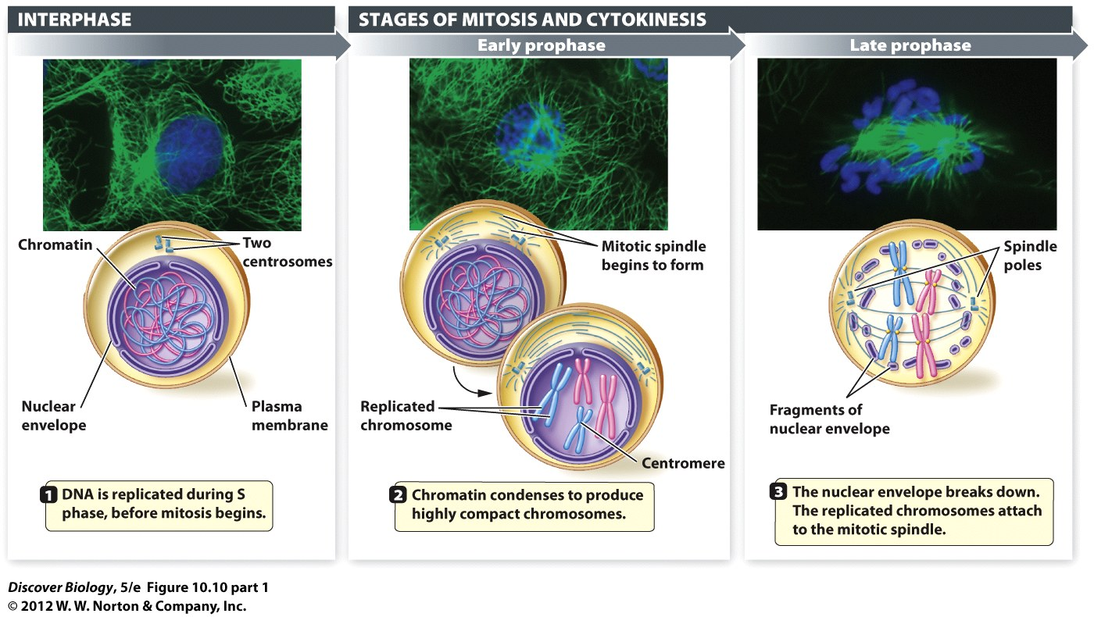
Interphase
G1 = Growth
S = Double the DNA
G2 = Growth

Slide 33
Prophase
Spindle forms
Chromatin packaged as chromosomes
Nuclear envelope breaks down

Slide 34
Early Prophase
Chromatin packaged into chromosomes
Two cytoskeletal structures called centrosomes begin to move toward opposite ends of the cell
mitotic spindle forms
  centrosomes move towards pole
  microtubules grow

Slide 35
Late Prophase
nuclear envelope breaks down
Spindle fibers attached to centromeres

Slide 36
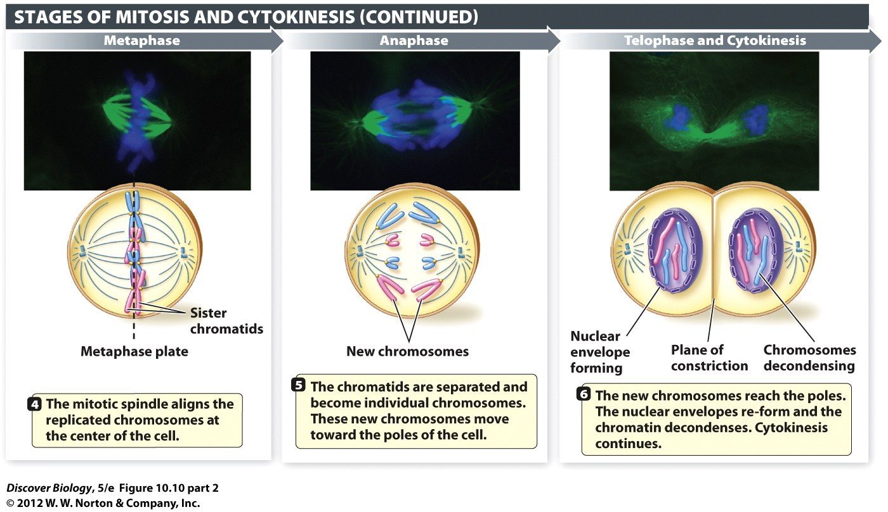
Metaphase
Chromosomes line up in the Middle

Slide 37
Metaphase
Chromosomes line up in the middle
Why the middle?
  Spindle fibers pulling

Slide 38
Anaphase
Chromosomes are torn Apart
Spindle fibers shorten (pull chromosomes apart)

Slide 39
Anaphase – Chromosome pulled Apart
sister chromatids are separated
    Why? Microtubules get shorter
Once separated, each “chromatid” is considered a new “chromosome”

Slide 40
Telophase
Chromosomes are distant
“Tel” = distant
    Telephone
    Television
Nucleus reforms
Cytokinesis continues

Slide 41
Telophase - New Nuclei
nuclear envelopes for each set of chromosomes
chromosomes begin to unwind
    (become less visible)

Slide 42
Mitosis: the quick review
Prophase: nucleus breaks down, chromosomes condense, spindle fibers form as centrioles move to poles
Metaphase: no nucleus, chromosomes line up at the middle as spindle fibers pull on them
anaphase: no nucleus, chromosomes torn apart by shortening spindle fibers
telophase: nucleus reforms, chromosomes begin to unwind, spindle fibers break down

Slide 43
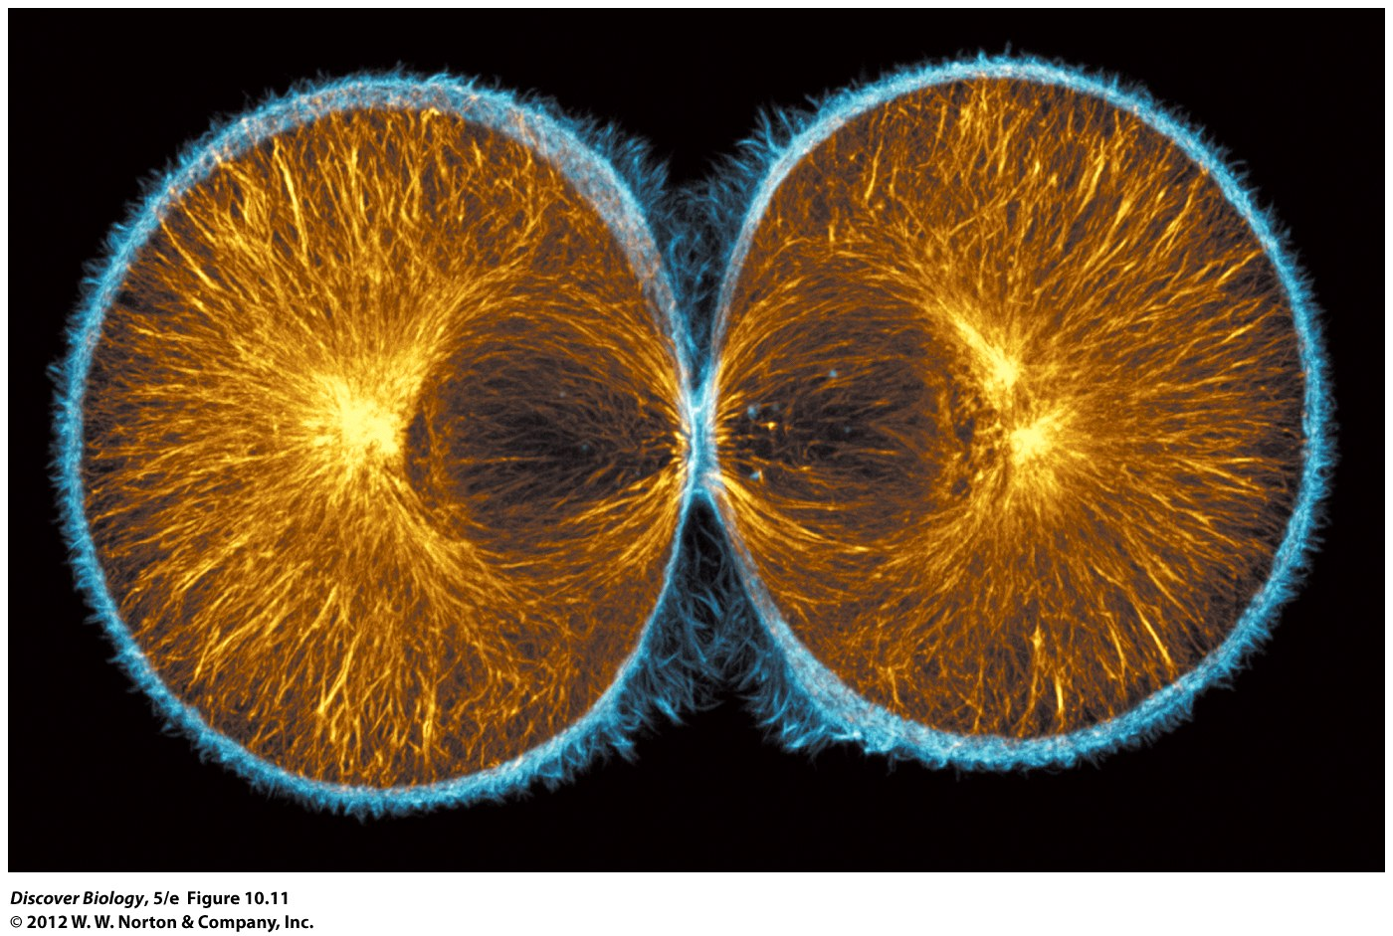
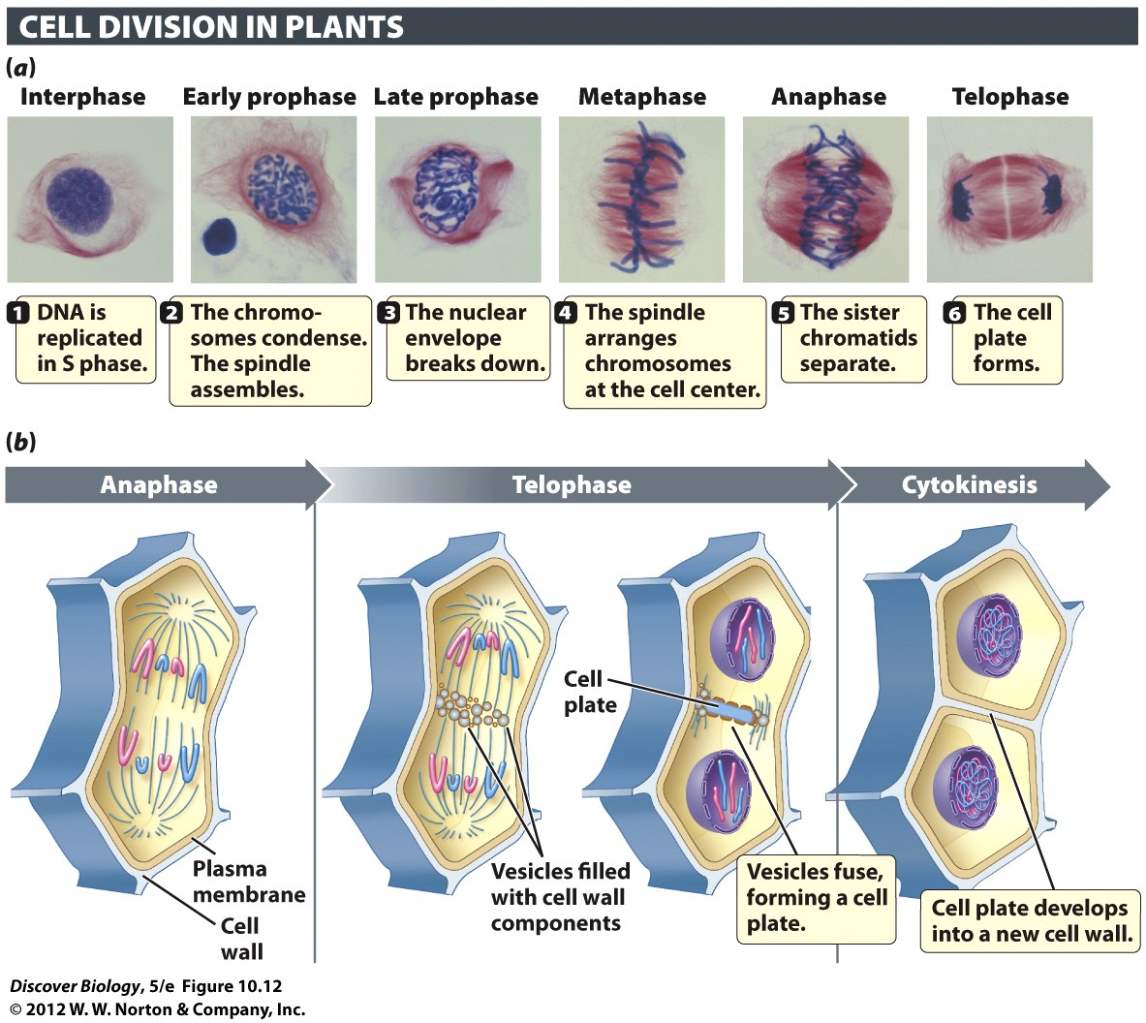
Cytokinesis - Dividing The Cytoplasm
“Cyto”(cell) + “kinesis”(movement)
  Cytokinesis separating the cells: starts in telophase
  Makes 2 daughter cells
animal cells - actin microfilaments contract
    Squeeze in middle
plant cells – grow a new wall

Slide 44
Notes:
Figure 10.12 Cell Plate Formation Is a Distinctive Feature of Cytokinesis in Plant Cells
(a) A microscopic view of mitosis and cytokinesis in lily pollen. The cell plate appears as a pale line in the center of the cell, in the last photograph in the series (telophase). (b) A diagrammatic view of the main events in mitosis and cytokinesis in a plant cell. Plant cells lack prominent centrosomes, but have structures that perform the same function.

Slide 45
Somatic Cells and Gametes
“Somatic Cell”
    Normal cell = made by mitosis
    “diploid” = two sets of DNA (dad and mom)
    2n = has two sets
Gamete
    Cell to use in sex = made by meiosis
    “haploid” = one set of DNA (Half the normal amount)
    1n = only one set of DNA

Slide 46
Stem Cells and Germ Cells
Germ cells = cell that will be used to make gametes
Stem Cells
Unspecialized (can make lots of cell types) growth, regenerate, and repair tissues

Slide 47
Meiosis: Making cells for sex
Gametes – cells for reproduction
  Sperm & egg
  haploid (1n)
  1 of each type of chromosome
  “one of each homologous pair of chromosomes”
Meiosis = how we get Gametes
“double the DNA, Divide, Divide Again”

Slide 48
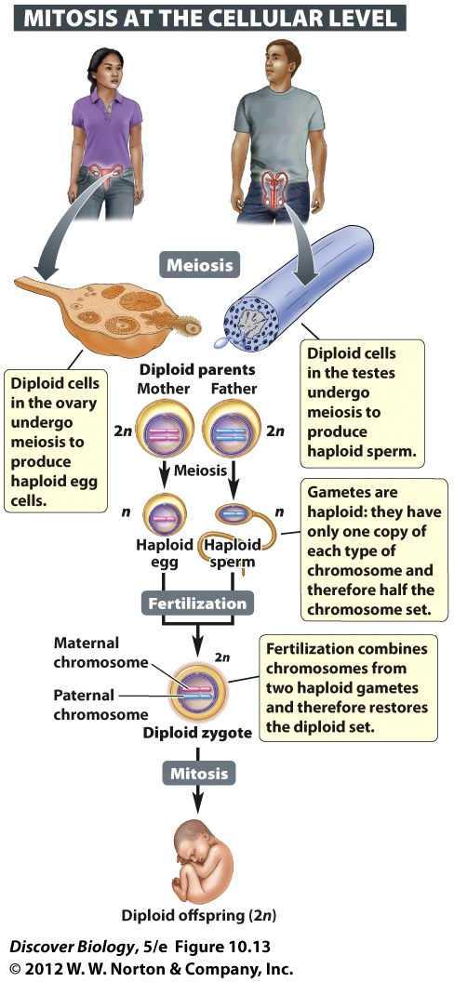
Reproduction
Fertilization
  Sperm (1n) + egg (1n) = “zygote” (2n)
  Zygote has normal amount of DNA
  “diploid” = 2n
Offspring = different from parents
  Gene combination neither parent has
Zygote ➔ embryo ➔ adult
Mitosis - all the somatic cells of body

Slide 49
Sex Determination
xx = female, xy = male
EACH GAMETE HAS 1!!!!
All eggs have ‘x’
50% of sperm have ‘x’
50% of sperm have ‘y’

Slide 50
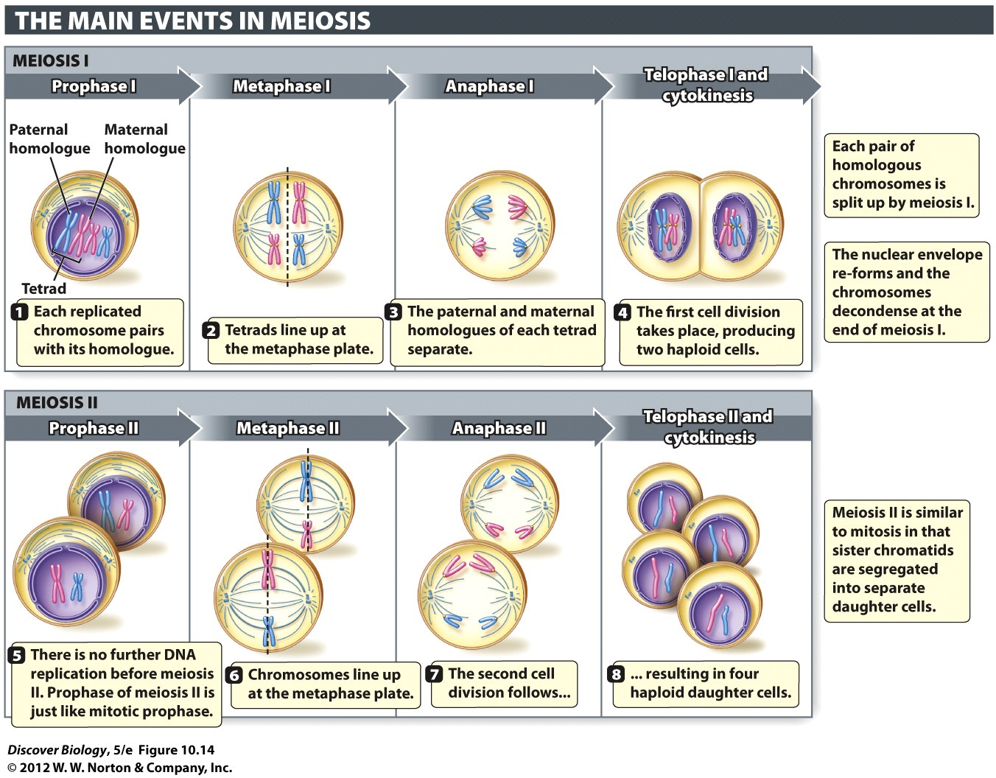
Meiosis: Two Cell Divisions
“Double the DNA, Divide, Divide again”
Meiosis 1 – first division
    Separates homologous pairs
    Separates homologous pairs
Meiosis II – second division
    tears chromosomes apart
    (like mitosis)

Slide 51
Meiosis: Two Cell Divisions
Named like Mitosis
Meiosis 1 - first division
    Prophase I, metaphase I, anaphase I, telophase I
    Separates homologous pairs
Meiosis II – second division
    Prophase II, metaphase II, anaphase II, telophase II
    tears chromosomes apart (like mitosis)

Slide 52
Meiosis: Terms to know
Homologous = “the same as”
    Chromosomes in homologous pairs
    Chromosome 1 from dad is the same kind of chromosome as chromosome 1 from mom
Paternal = “from dad”
Maternal = “from mom”

Slide 53
Meiosis: Terms to know
Tetrad = “group of four”
    Four “chromatids” = Two doubled chromosomes
    (these are four future chromosomes)
Metaphase Plate
    imaginary line in middle of cell
    Where chromosomes line up during metaphase

Slide 54
Notes:
Figure 10.14 In Meiosis, Each Daughter Cell Receives Half the Chromosome Set
The maternal and paternal homologues are paired during prophase I through metaphase I, and separated from each other during anaphase. Meiosis II is similar to mitosis in that the sister chromatids that compose each replicated chromosome are pulled apart. For simplicity and clarity, not all the steps described in the text are illustrated here.

Slide 55
Meiosis I - separate the pairs
Each chromosome was doubled during interphase
Metaphase 1 = “Homologous pairs” line up
  doubled chromosomes of same kind line up together
Tetrad = another name for pairs of doubled chromosomes
Four “chromatids” = four future chromosomes

Slide 56
Meiosis I - separate the pairs
Anaphase 1 = separate the Homologous pairs
Spindle fibers NOT in a tug of war.
  Each pulls a chromosome to the pole

Slide 57
Meiosis II: separate doubled chromosomes
Just like mitosis
Metaphase II
    Line up down the Middle
Anaphase II
  Tear them Apart

Slide 58
Meiosis II: Double, Divide, Divide
Double DNA in Interphase
Meiosis I = 1 parent ➔ 2 daughter cells
Meiosis 2 = each daughter cell divides again
Total of four cells at the end exception

Slide 59
Compare: Mitosis & Meiosis
 | Mitosis | Meiosis
Before Interphase | 1 Parent (2n) | 1 Parent (2n)
Double in Interphase | Temporarily 4n | Temporarily 4n
Divide | End with 2 somatic cells (2n) | Have 2 cells (2n)
Divide again |  | End with 4 gametes, each is 1n
Meiosis & sexual reproduction
creates genetic variation
better chance to survive

Slide 60

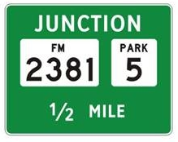
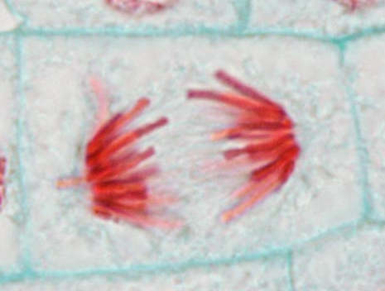
Junction/Disjunction
Junction: where things come together
Disjunction: where things separate

Slide 61
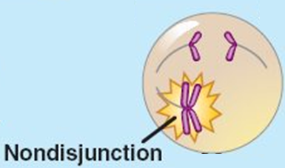
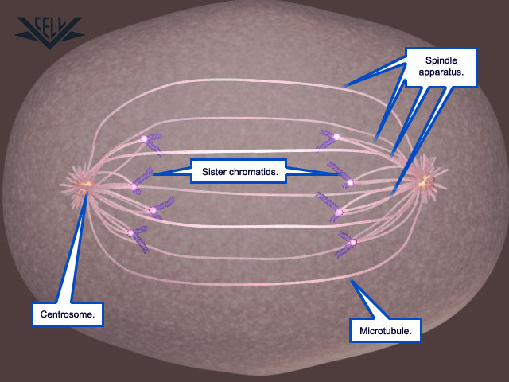
Non-Disjunction
Things that should separate do not
Often caused by broken spindle fibers

Slide 62
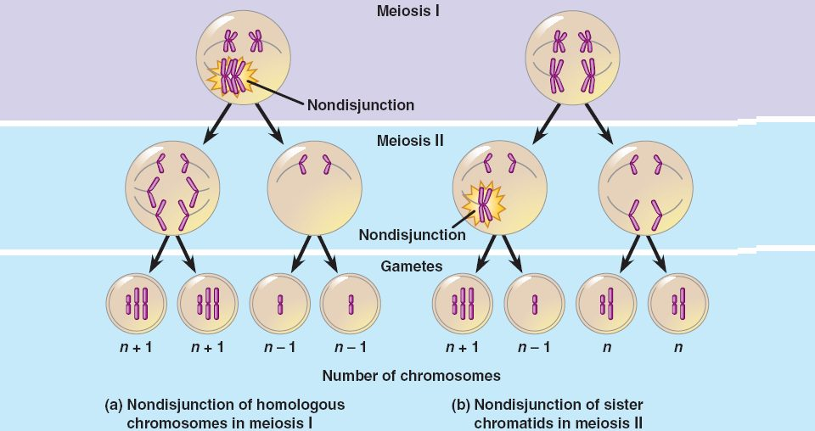
Nondisjunction: abnormal gametes

Slide 63
Inherited Chromosomal Abnormalities
“eu”(normal) + “ploidy”(number) = euploidy
“An” = NOT
“aneuploidy” = abnormal # of chromosomes
serious abnormality for animals
Often lethal for embryo
Caused by problem during meiosis
spindle fiber(s) can break

Slide 64
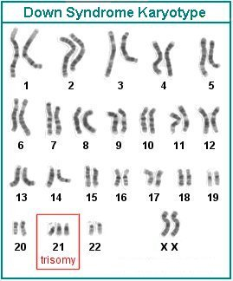
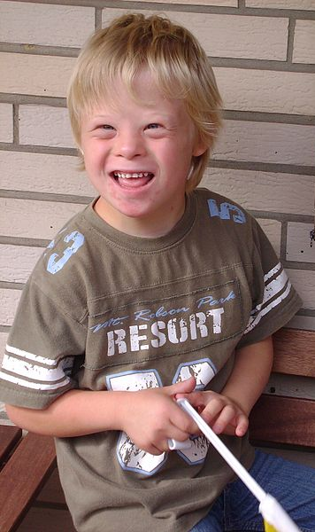
Aneuploidy in autosomes
Big chromosomes: probably lethal to animals
Small chromosomes: side effects

Slide 65
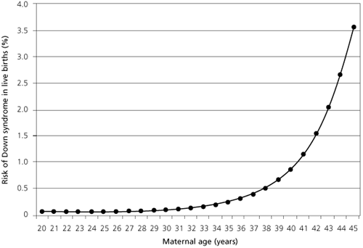
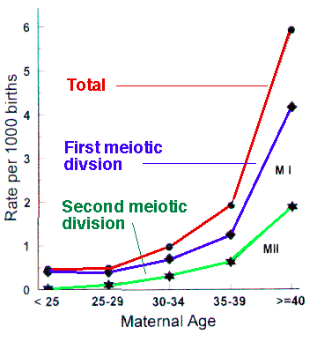
Aneuploidy: trisomy 21
Age of mother

Slide 66
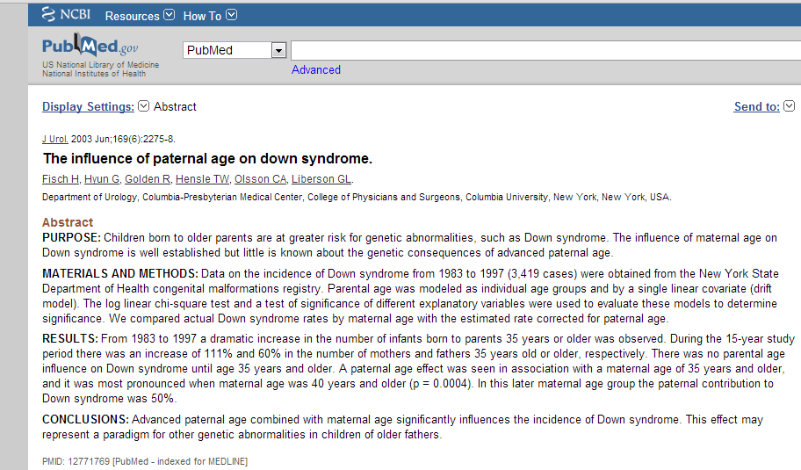
Aneuploidy: trisomy 21
Father’s age matters too
    Advanced paternal age combined with maternal age significantly influences the incidence of Down syndrome.

Slide 67
Aneuploidy in sex chromosomes
Effects often more minor than in autosomes
XXX
XO – Turner’s Syndrome
XXY – Kleinfelter’s syndrome
XYY
XXYY

Slide 68
Sexual Reproduction = Genetic Variation
Three Sources Of Genetic Variation
  Independent Assortment
  Crossing Over
  Random Fertilization

Slide 69
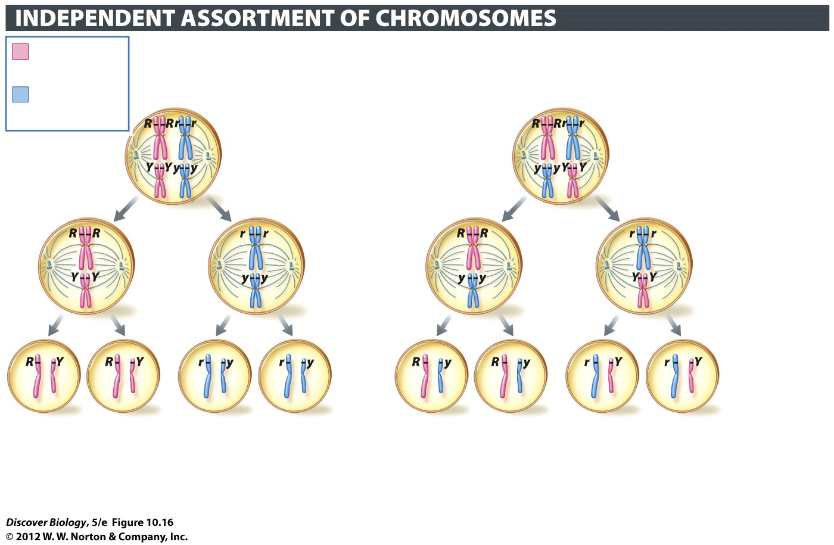
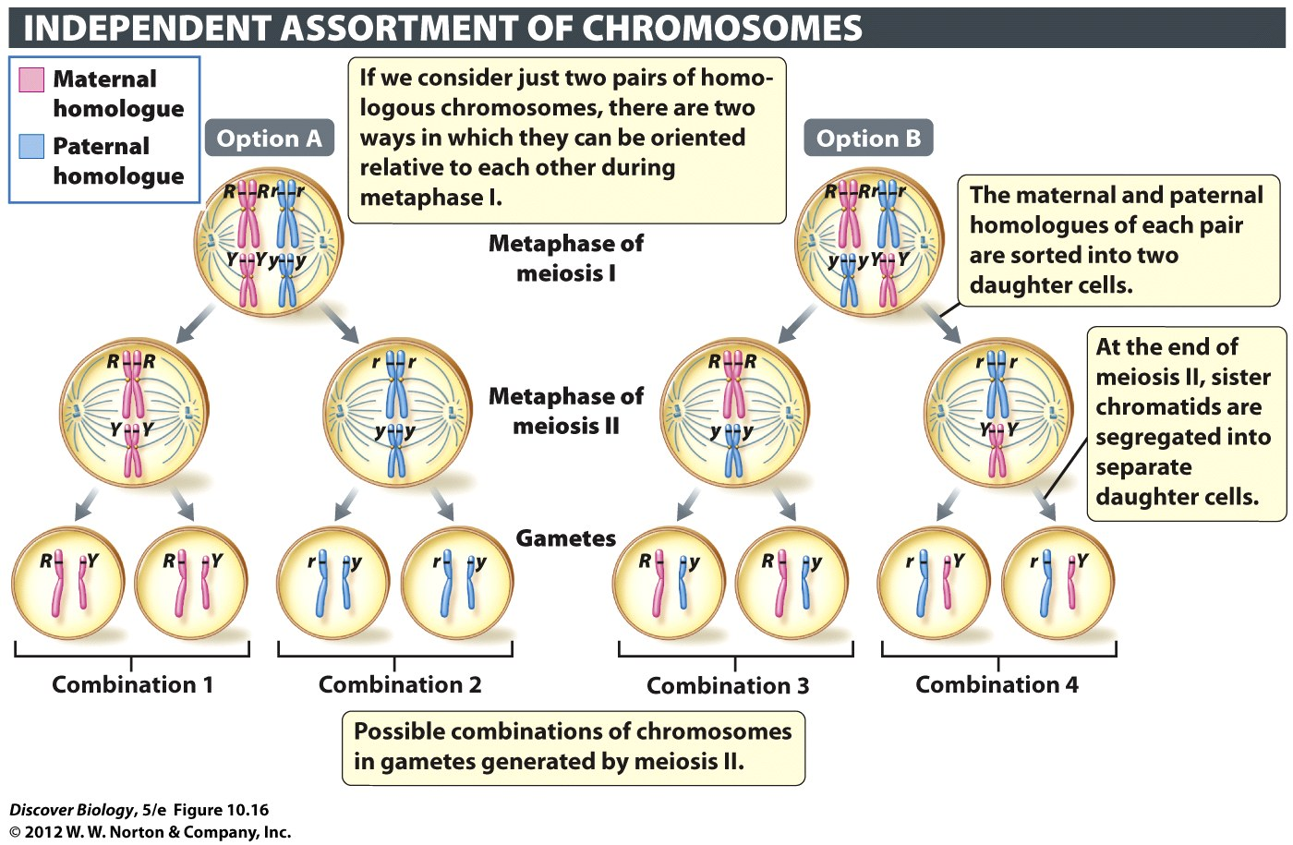
Gene variation: 1 independent assortment
pairs line up randomly
  (Exception: Platypus sex chromosomes are weird. Ask outside class)
Many possible gametes

Slide 70
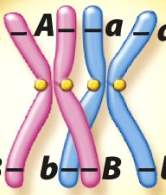
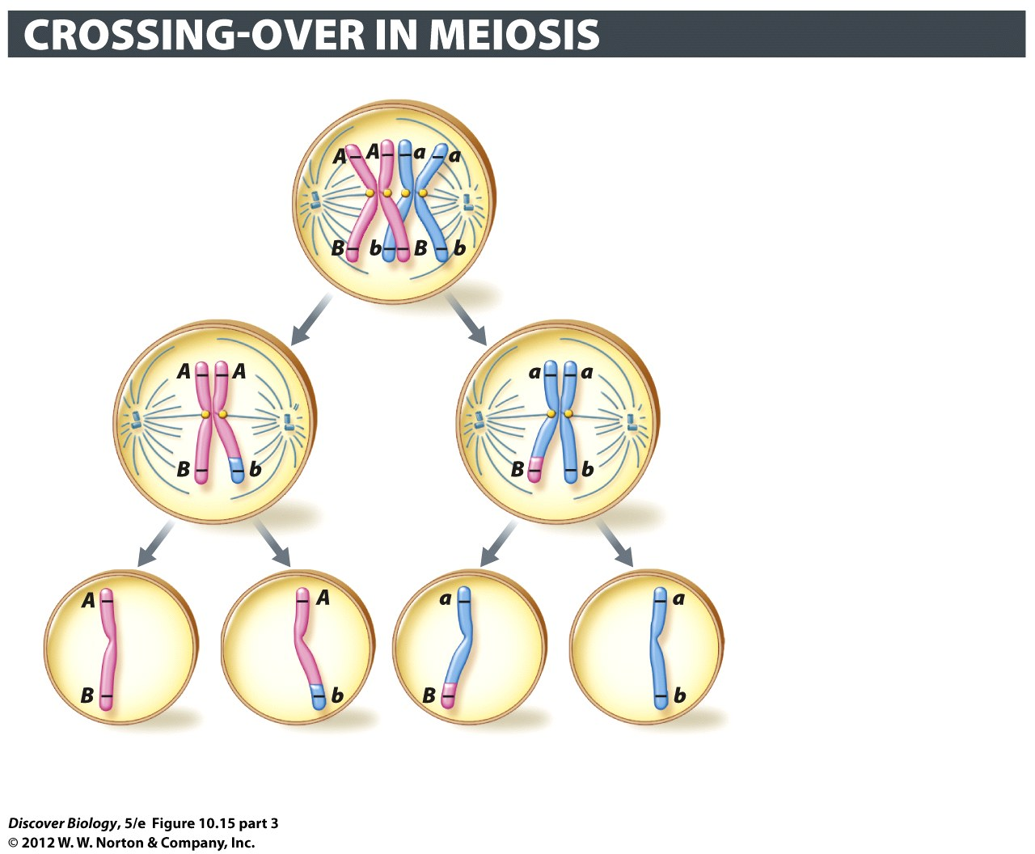
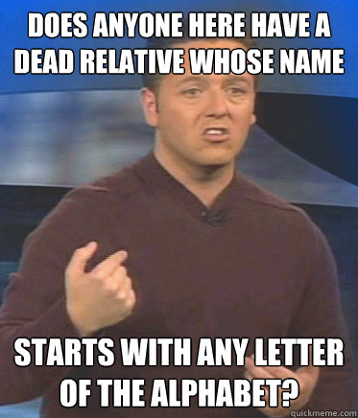
Genetic Variation: 2 – crossing over
“Crossing Over” = a way to shuffle genes
Paternal and maternal chromosomes can swap parts.
ONLY MEIOSIS 1: Usually happens in prophase I
(also sometimes metaphase 1)

Slide 71
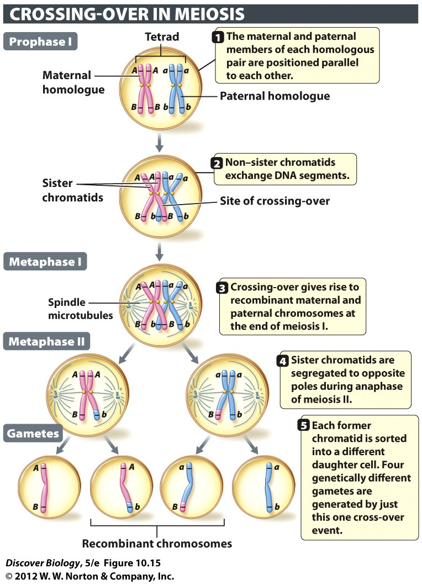
Crossing Over: Meiosis & Variation
Increases variation
Example:
    Four possible gametes
Many chromosomes
    Many possible gametes
    Genetic recombination

Slide 72
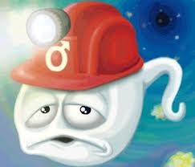
Genetic Variation: 3 – random fertilization
  Lots of sperm (more than needed for reproduction)
  Different gene combinations in each
  Most don’t get to fertilize

Slide 73
Meiosis, Sex and Variation
Sources Of Genetic Variation
  Independent Assortment
  Crossing Over
  Random Fertilization

Slide 74
Review Questions
CHAPTER 10
Cell Division

Slide 75
Concept Quiz
Which of the following is not true about interphase?
The cell grows larger during interphase.
Chromosomes are duplicated during interphase.
Interphase is divided into three phases.
Chromosomes segregate to daughter cells during interphase.
Notes:
The correct answer is D. This does not occur during interphase, but during mitosis.
It is important to stress that interphase is composed of 3 phases in which the cell grows and the chromosomes are duplicated. Students often believe that G₁, S, and G₂ are in addition to interphase.
Answers A – C: These are all true. Growth occurs during G₁ and G₂ phases and the chromosomes are duplicated during S phase.

Slide 76
Concept Quiz
Which of the following is true about homologous chromosomes?
Both were received from the same parent.
One of each segregates to each daughter cell during mitosis.
Both stay together in meiosis I.
All 23 pairs are always homologous.
Notes:
The correct answer is B. It is important that students understand what homologous chromosomes are. These are not identical, but homologous; one came from each parent and they contain slightly different genes. One of each segregates into each daughter cell during mitosis so that each daughter cell is identical.
Answer A: As stated above, one came from each parent.
Answer C: They are separated during meiosis I, resulting in haploid daughter cells.
Answer D: Sex cells are not homologous in males, but are in females.

Slide 77
Concept Quiz
Meiosis insures that
Each gamete receives the same genes
Chromosome number is doubled in the gametes
Zygotes produced by fertilization have the normal number of chromosomes
All paternal chromosomes end up in the same gamete
Notes:
The correct answer is C. This is the key to meiosis – reduction division so that the fertilized egg restores the normal number of chromosomes.
Answer A: Each gamete doesn’t receive the same genes because the homologous chromosomes are randomly assorted during meiosis I.
Answer B: Chromosome number is halved in the gametes.
Answer D: As in the answer for A, the homologous chromosomes are randomly assorted during meiosis I.

Slide 78
Free Biology Tutoring
Not Happy with your grade?
Not understanding the material?
Remember that the TLCC has

