Slide 1
Free Biology Tutoring
Not Happy with your grade?
Not understanding the material?
Remember that the TLCC has

Slide 2
Photosynthesis and Respiration
Chapter 9

Slide 3
Photosynthesis & respiration
most ecosystems based on photosynthesis
Photosynthesizers are producers
Everything else is a consumers
“Metabolism” – reactions to capture, store and use energy

Slide 4
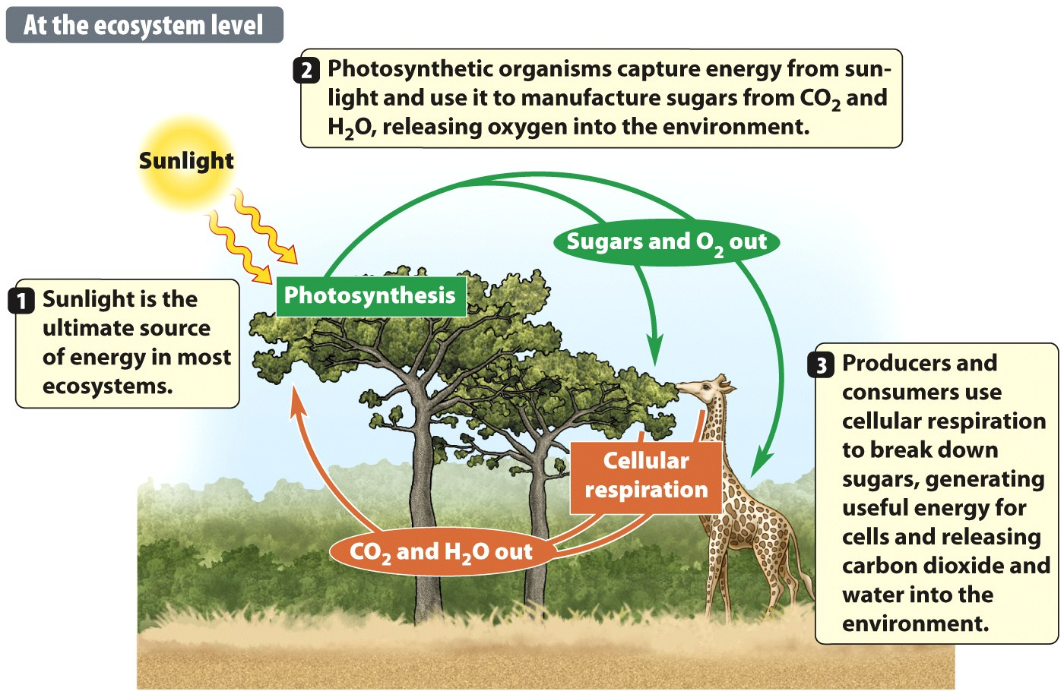
Notes:
Figure 9.1b The Relationship Between Photosynthesis and Cellular Respiration

Slide 5
Energy: two major paths
Photosynthesis
Cellular Respiration
Most producers (autotrophs) do both
Most consumers (Heterotrophs) don’t use photosynthesis
BOTH USE AN ELECTRON TRANSPORT CHAIN

Slide 6
Producers (autotrophs)
Take energy from the environment
Chemosynthesis
Photosynthesis = uses light to make sugar (G3P)
Photosynthesis:
Inputs
CO2, H2O, light
Outputs
Sugars and oxygen
Use own sugars for respiration
Eukaryotes use mitochondria for respiration

Slide 7
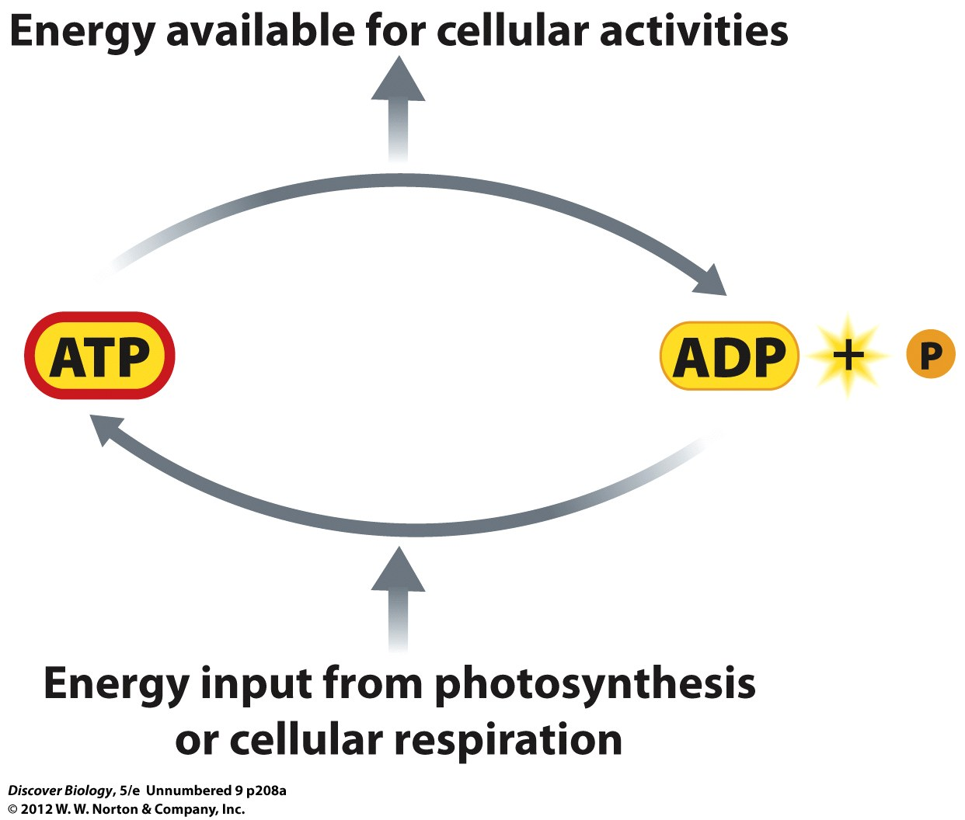
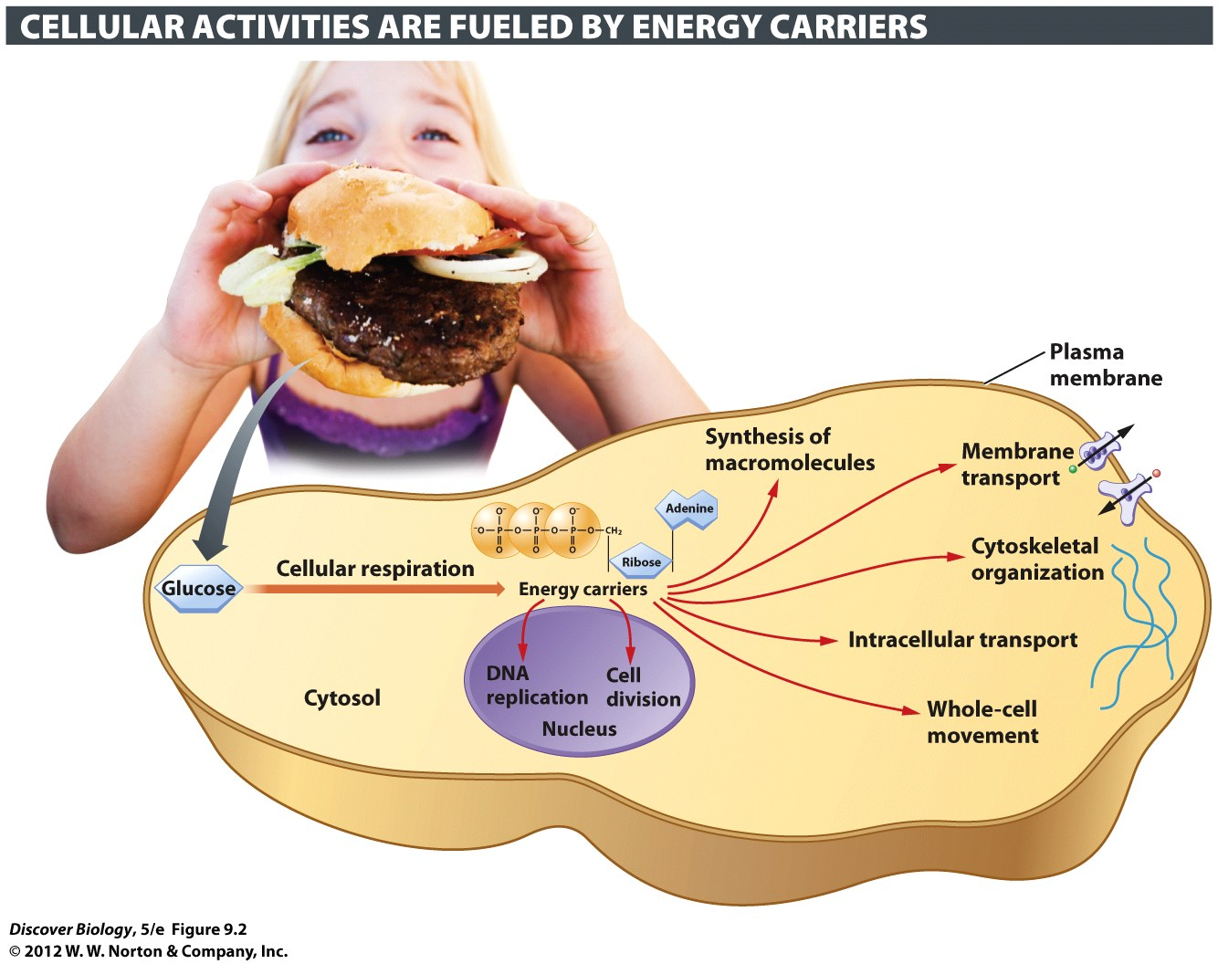
Molecular Energy Carriers: ATP
Adenosine triphosphate (ATP)
ATP is the main energy source of cell
Requires energy
Photosynthesis
Respiration

Slide 8
Molecular Energy Carriers
ATP (used for MANY types of reactions)
NADPH (some energy for anabolic reactions)
NADH (absorbs energy released in catabolic)

Slide 9
NADPH & NADH
NADPH: electrons & hydrogen to anabolic react.
NADH: picks up electrons and hydrogen released from catabolic reactions

Slide 10
Light: energy to make Carbohydrates
Chloroplast – Eukaryote organelles for photosynthesis
Have chlorophyll to absorb light energy
Light reactions – make energy molecules
Calvin cycle – make sugars

Slide 11
Photosynthesis: Two Stages
Photosynthesis stages:
Light reactions
Use light energy to make ATP, NADPH, and break water
broken water molecules: source of oxygen
Calvin cycle
CO2 ➔ sugar using energy from ATP and NADPH
Entire ecosystem depends on this sugar!!!

Slide 12
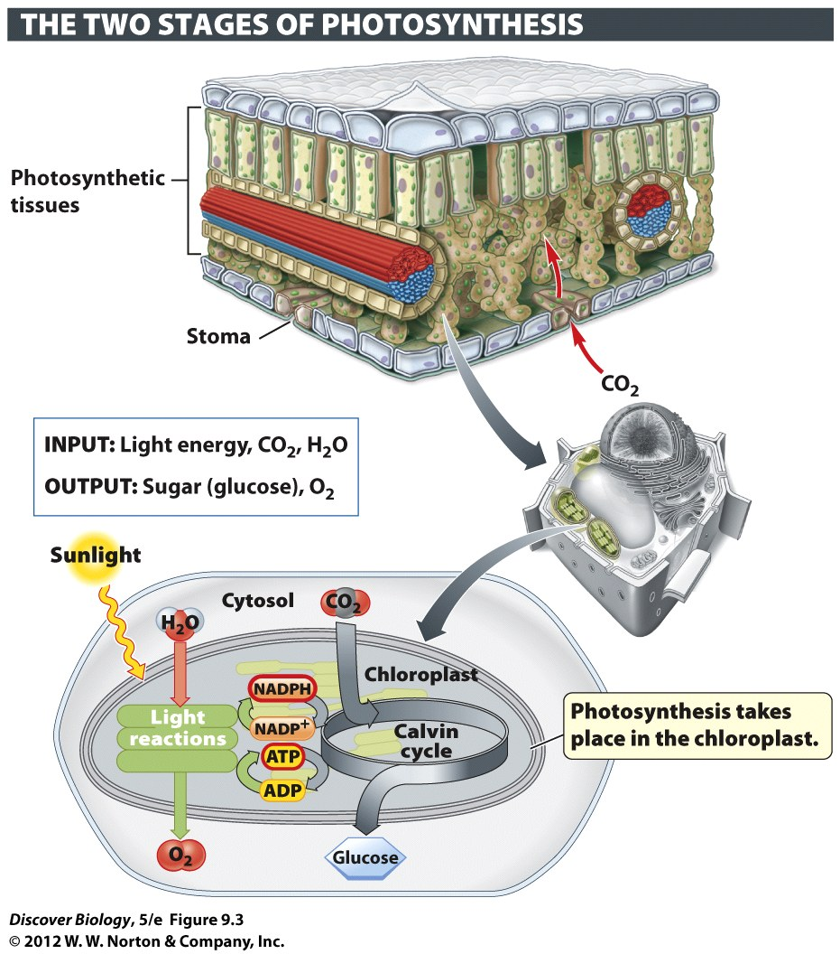
Notes:
Figure 9.3 An Overview of Photosynthesis

Slide 13
Leaves
Stomata – how plants “breath”
Take in CO2, release O2 (opposite of respiration)
Many cells full of Chloroplasts
Photosynthesis organelle
Calvin Cycle (sugar production) happens here

Slide 14
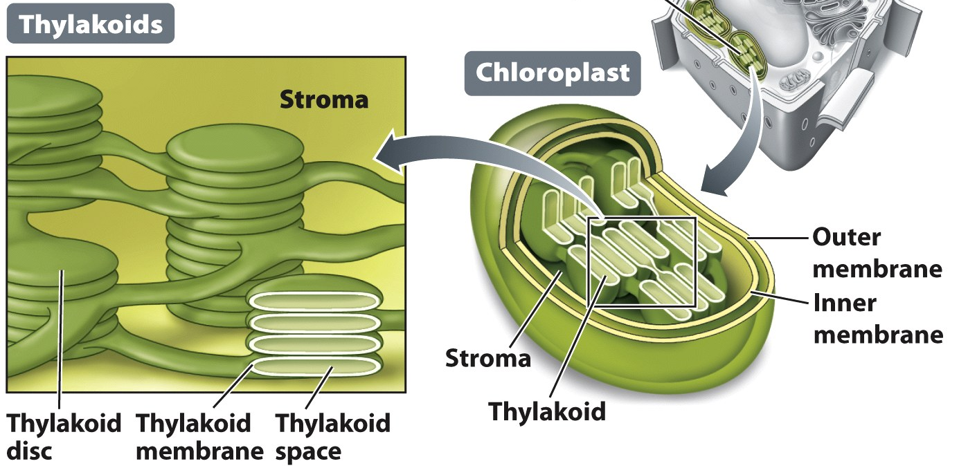
Chloroplasts
Light reactions in Thylacoids
The Calvin cycle (CO2 ➔ sugar) in stroma

Slide 15
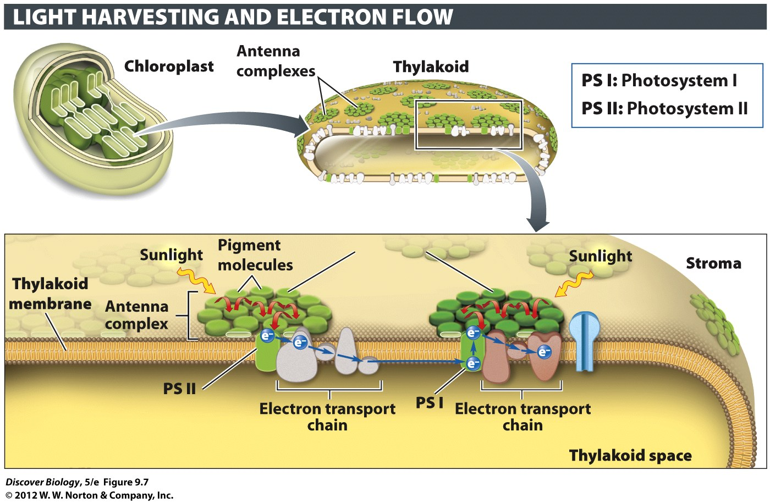
Notes:
Figure 9.7 The Light Reactions Are Conducted by Two Linked Photosystems

Slide 16
Chloroplast: Light Reactions
Light-absorbing molecules in thylakoid membrane collect energy from sunlight
Absorbed light “excites” electrons (higher energy)
Chloroplast ETC plays “hot potato” with electron
Uses energy to move protons (hydrogen ions)

Slide 17
Chloroplast: Light Reactions
Thylacoid membranes full of hydrogen ions
From splitting water
From chloroplast electron transport chain

Slide 18
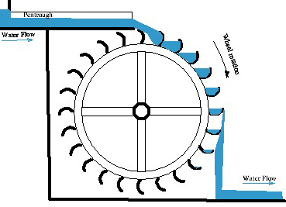
Making ATP : movment of H+ ions
Thylacoid membranes full of hydrogen ions
H+ wants to move: high concentration ➔ low
H+ movement = energy (like water wheel)
The movment of hydrogen
ions powers the production
of ATP (“ATP synthesis”) and
NADPH

Slide 19
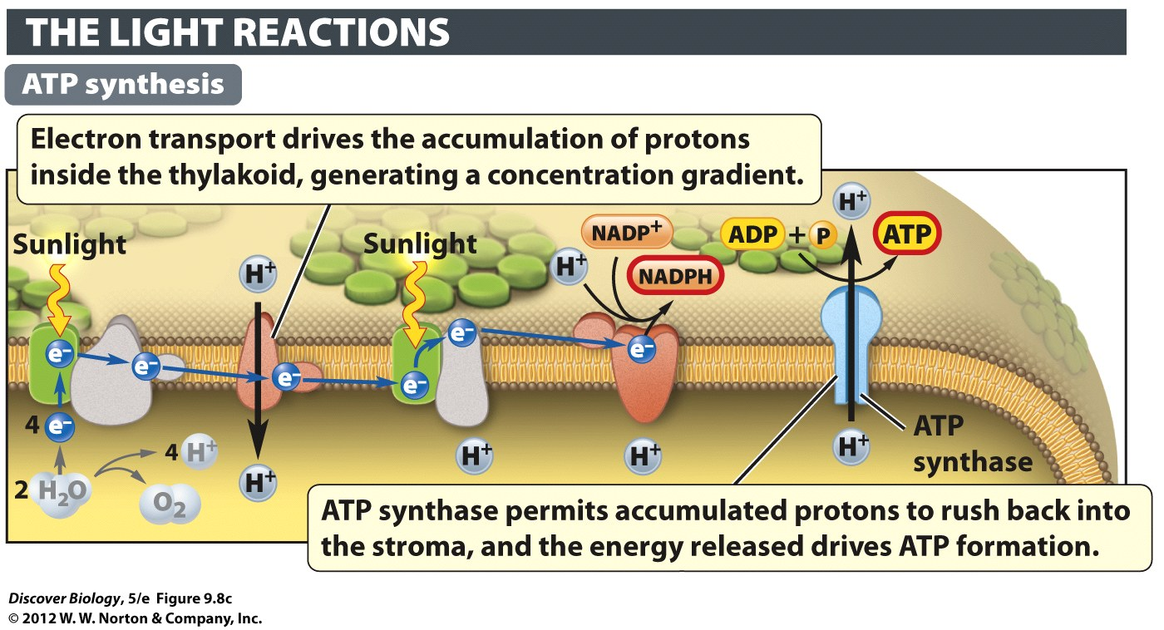
Notes:
Figure 9.8c How the Light Reactions Generate Energy Carriers

Slide 20
Making Oxygen: byproduct
Splitting water frees Oxygen
Two broken H20 molecules
Two free oxygens combine
O + O ➔ O2
Oxygen Gas
Needed for all life on earth!!!

Slide 21
Chloroplasts
Light reactions in Thylacoids
The Calvin cycle (CO2 ➔ sugar) in stroma

Slide 22
Calvin Cycle: making sugars
Happens in Stroma
Uses carbon dioxide from air
“carbon fixation”
Makes a three carbon sugar
glyceraldehyde 3-phosphate (G3P)
Depends on an enzyme nickname “Rubisco”

Slide 23
Calvin Cycle: making sugars
Calvin Cycle needs energy
Fixes one carbon each cycle
3 cycles to make each 3 carbon sugar (G3P)
G3P is the building block of all carbohydrates

Slide 24
Notes:
Figure 9.9 The Calvin Cycle Converts Carbon Dioxide into Sugar
The Calvin cycle reactions fix carbon by turning CO₂ into sugar molecules using energy delivered by ATP, and electrons and protons delivered by NADPH.

Slide 25
G3P: building block of sugars
G3P is the building block of glucose and all the other carbohydrates
Leaves chloroplast, fuel chemical reactions
In plants, G3P can be stored as starch for use at night

Slide 26
Photosynthesis: Two Stages
Photosynthesis stages:
Light reactions
Use light energy to make ATP, NADPH, and break water
broken water molecules: source of oxygen
Calvin cycle
CO2 ➔ sugar using energy from ATP and NADPH
Entire ecosystem depends on this sugar!!!

Slide 27
Cellular Respiration: Sugar➔ ATP
Cellular respiration requires oxygen to break down food molecules
The energy released from the food molecules is used to generate ATP
Carbon dioxide and water are by-products of cellular respiration

Slide 28
Cellular Respiration: Sugar➔ ATP
Getting ATP from food molecules
Three Stages
Glycolysis
Kreb cycle – requires oxygen
“oxidative phosphoryation”– requires oxygen
Electron transport chain
By-products: CO2 and water

Slide 29
Cellular Respiration: Sugar➔ ATP
Three Stages
Glycolysis – in cytosol
Kreb cycle – in mitochondria
“oxidative phosphoryation”– in mitochondria
Electron transport chain

Slide 30
Notes:
Figure 9.4 An Overview of Cellular Respiration

Slide 31
Cellular Respiration: Energy from Food
Both producers and consumers do Cellular Respiration
Three main stages of cellular respiration:
Glycolysis
The Krebs cycle
Oxidative phosphorylation
(electron transport chain)

Slide 32
Glycolysis
1st part of cellular metabolism
“Glyco”(glucose) + “lyse”(break) = breaking glucose
Happens in cytosol
Outside Mitochondria
6-carbon glucose ➔ 3-carbon pyruvate

Slide 33
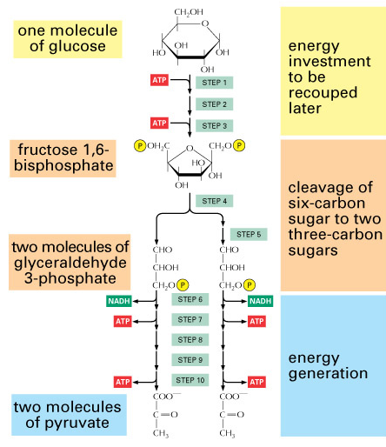
Glycolysis: Cellular Metabolism (part 1)
Uses 2 ATP
Makes 4 ATP
Net gain of 2
Makes 2 NADH
Pyruvate then enters the mitochondria for steps two and three, during which it is broken down

Slide 34
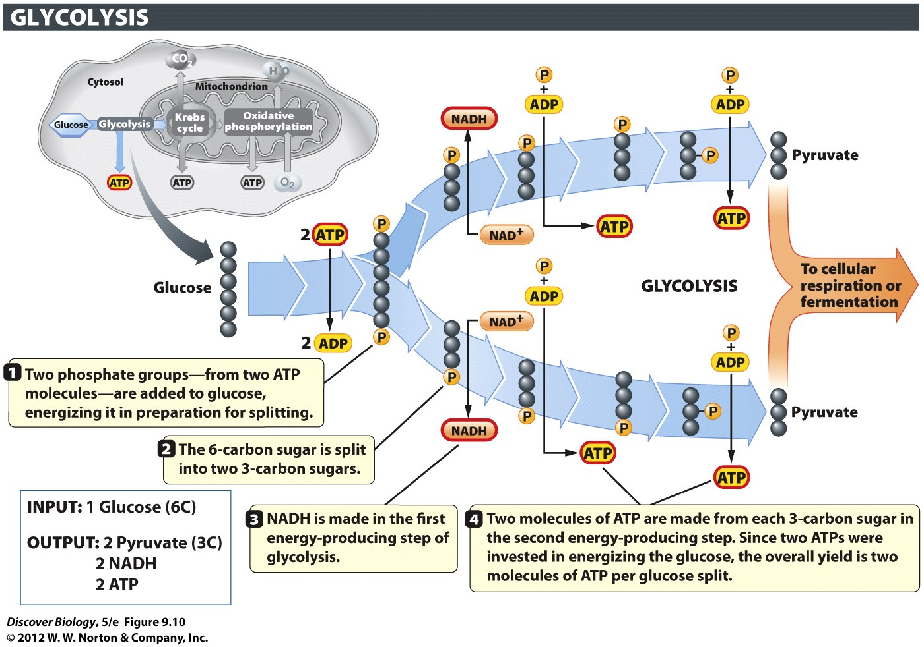
Notes:
Figure 9.10 Glycolysis Converts Glucose into Pyruvate
In glycolysis, each six-carbon glucose is converted into two molecules of pyruvate, a three-carbon organic acid.

Slide 35
We need LOTS of ATP
Glycolysis
No O2 used
doesn’t make enough ATP (>1/4 total)
exception: some bacteria and fungi (yeast)
Two more steps in Cellular Respiration
Kreb Cycle – Needs O2
“Oxidative phosphorylation” – needs O2

Slide 36
Krebs Cycle: Cellular Metabolism (part2)
“aerobic” – uses oxygen
Happens in mitochondria
Lots of mitochondria in muscle
Lots of energy for muscle
Requires lots of blood flow (oxygen for mitochondria)

Slide 37
Krebs Cycle: Cellular Metabolism (part2)
Pyruvate into mitochondria
output (product) from glycolysis
will be used as input (reactant) for Krebs
must be modified first!!!
Pyruvate ➔ acetyl CoA (requires oxygen)
Krebs (a.k.a. “Citric Acid Cycle”) makes ENERGY
a little ATP
a LOT of NADH
a little FADH₂,

Slide 38
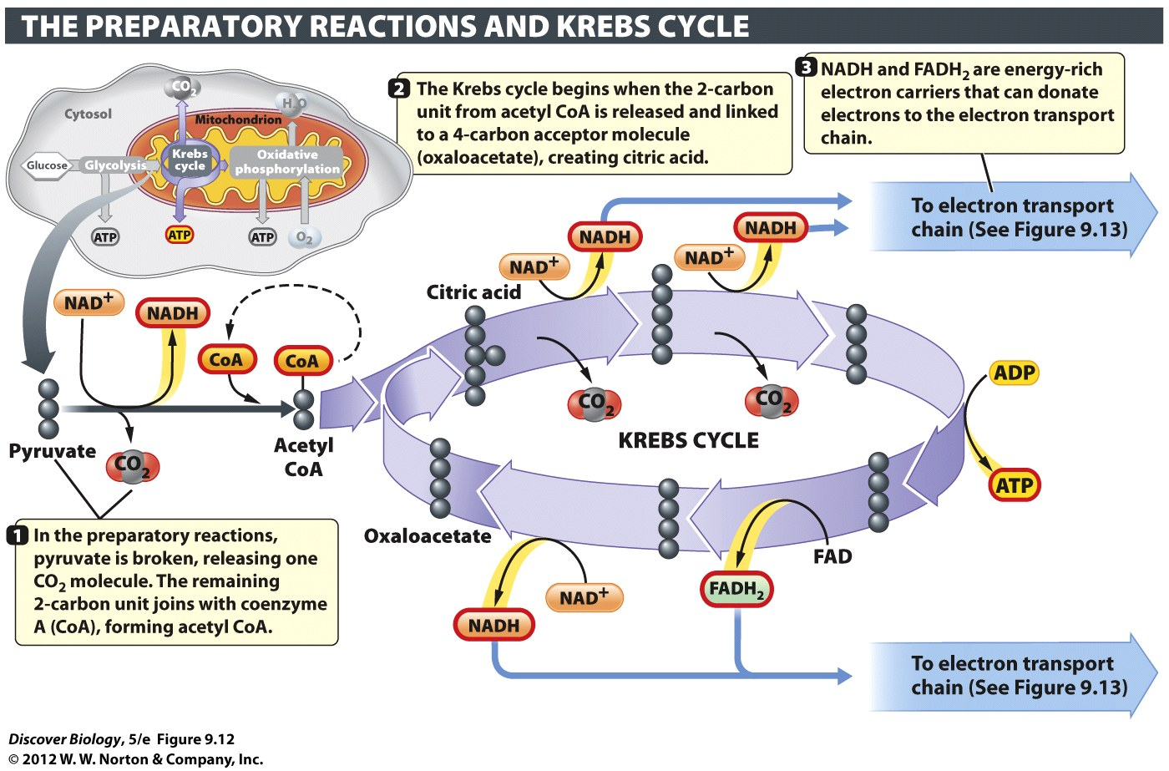
Krebs Cycle: Cellular Metabolism (part2)
Pyruvate ➔ acetyl CoA (requires oxygen)
Krebs (a.k.a. “Citric Acid Cycle”) makes ENERGY
a little ATP, LOTS of NADH, a little FADH₂,

Slide 39
Krebs Cycle: Cellular Metabolism (part2)
Krebs Releases Carbon Dioxide (why we exhale CO2)
energy molecules from Krebs: , NADH, FADH2
Why NADH & FADH2?
(NEVER WASTE ENERGY)

Slide 40
Krebs Cycle: Cellular Metabolism (part2)
Before: “NADH picks up electrons and hydrogen released from catabolic reactions”
Now: WHY we do this.
we can use & to make more ATP

Slide 41
Notes:
Figure 9.12 The Krebs Cycle Releases Carbon Dioxide and Generates Energy Carriers
The Krebs cycle, also called the citric acid cycle, occurs in the mitochondrial matrix.

Slide 42
O.P.: Cellular Metabolism (part 3)
“Oxidative Phosphorylation”
Requires Oxygen
“use oxygen to add phosphate”
Happens in mitochondria
WHERE MOST ATP COMES FROM!!!!

Slide 43
It’s all about the oxygens
Oxygen is electronegative
Wants
Wants to become negative
receptor at end of chain

Slide 44
Oxidative Phosphorylation .
Oxidative phosphorylation most of ATP
3rd (last) stage of cellular respiration
Happens in folds (cristae) of mitochondria
Inner membrane (no folds in outer)

Slide 45
O.P.: Cellular Metabolism (part 3)
Uses Oxygen to Produce ATP in Quantity
NADH & FADH2 from Krebs: electron source
Electron Transport Chain (ETC)
Gets energy from the electrons
uses energy to pump protons
active transport (like subway)

Slide 46
O.P.: Cellular Metabolism (part 3)
Protons move from high ➔ low concentration
Moving protons = energy
Moving protons turn ATPsynthase (enzyme)
ATPsynthase synthesizes ATP

Slide 47
O.P.: Cellular Metabolism (part 3)
Electrons from ETC are to O₂
Electrons + O₂ + H⁺ ➔ water (H2O)

Slide 48
Cellular Respiration: Total ATP yield
Cellular respiration has three steps
Glycolysis – no oxygen needed
Krebs Cycle – Needs Oxygen
Oxidative Phosphorylation – Needs Oxygen
Cellular respiration = 30 to 32 ATP / glucose

Slide 49
Anaerobic respiration: Problem
Only do Glycolysis - No oxygen needed
Glycolysis requires NAD+
No NAD+ = no glycolysis
Glycolysis stops if we can
not turn NADH back into
NAD+

Slide 50
Anaerobic respiration: Solution
Turn pyruvate from glycolysis into something else (requires energy and hydrogen)
NADH ➔ NAD+
Now we can still do glycolysis
Pyruvate turned into alcohol or lactic acid

Slide 51
Fermentation Facilitates ATP Production Through Glycolysis When Oxygen Is Absent
Fermentation by anaerobic yeasts converts pyruvate into an ethanol, releasing CO2 gas
Lactic acids forms in severely taxed muscle cells as a result of ATP production in the absence of oxygen

Slide 52
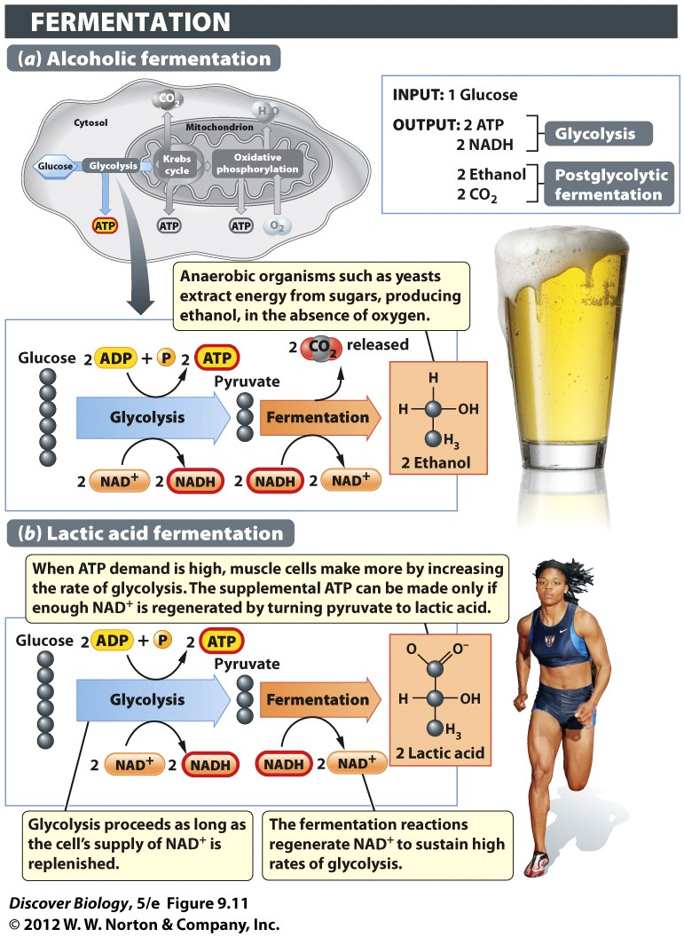
Notes:
Figure 9.11 Ethanol and Lactic Acid Are By-products of Fermentation
When the oxygen supply is inadequate for supporting ATP production through cellular respiration, fermentation supports ATP production through glycolysis alone. (a) Strains of yeasts, which are single-celled fungi, are used in the brewing of alcoholic beverages such as beer. When oxygen is excluded from the fermentation tanks, the yeasts resort to fermentation of sugars, producing ethanol and CO₂ as by-products of the postglycolytic steps. (b) A similar process occurs in our muscles during short bursts of strenuous exercise, except that the postglycolytic reactions turn pyruvate into a three-carbon organic acid known as lactic acid, and no CO₂ is made.

Slide 53
Clicker Questions
CHAPTER 9
Photosynthesis and
Cellular Respiration

Slide 54
Concept Quiz
A common feature of both chloroplasts and mitochondria is
A. The use of chlorophyll
B. Production of CO₂
C. Use of an electron transport chain
D. Presence in all cells
Notes:
The correct answer is C. The commonality of the ETC was stressed in the lecture and is important to the function of both organelles
Answer A is incorrect because only chloroplasts use chlorophyll.
Answer B is incorrect because mitochondria produce CO₂, while chloroplasts use it.
Answer D is incorrect, because mitochondria are used in all cells, but chloroplasts are only in the photosynthesizing cells of plants.
This question can be expanded in an in-class discussion of other similarities between these two organelles.
Some other similarities include: production of an H+ gradient, production of ATP, use of energy transfer molecules (NADPH or NADH), double membrane structure, and the presence of a chromosome.

Slide 55
Concept Quiz
Photosystem II differs from photosystem I in that it produces
A. NADPH
B. O₂
C. A proton gradient
D. ATP
Notes:
The correct answer is B. O₂ production is one of the first events in photosynthesis and it is performed by Photosystem II.
Photosystem I produces NADPH.
Both photosystems add to the H+ gradient.
Neither produces ATP directly; ATP synthase does.

Slide 56
Concept Quiz
Most of the ATP produced by aerobic respiration comes from
A. Glycolysis
B. The citric acid cycle
C. Oxidative phosphorylation
D. Fermentation
Notes:
The correct answer is A. Although some ATP is made directly in glycolysis and the citric acid cycle, most of the ATP is made when the electrons from NADH are used by the ETC in Oxidative Phosphorylation. This should be stressed because this is why aerobic respiration is so much more efficient than anaerobic.
Answers B & C: As mentioned above, some ATP is made directly, but most is made by ATP synthase.
Answer D: Fermentation is not part of aerobic respiration and produces very little energy.

Slide 57
Free Biology Tutoring
Not Happy with your grade?
Not understanding the material?
Remember that the TLCC has

