Slide 1
Log into PAL
Have you taken the latest quiz?
When is your next paper due?
If you are not sure, you need to

Slide 2
Plasma Membrane: the bouncer (controls who gets in and who leaves)
The plasma membrane
phospholipid bilayer
embedded proteins (some are Transport Proteins)
Transport proteins
big enough to completely cross the plasma membrane
How materials can enter or leave cells
Some transport proteins need energy (ATP) to work

Slide 3
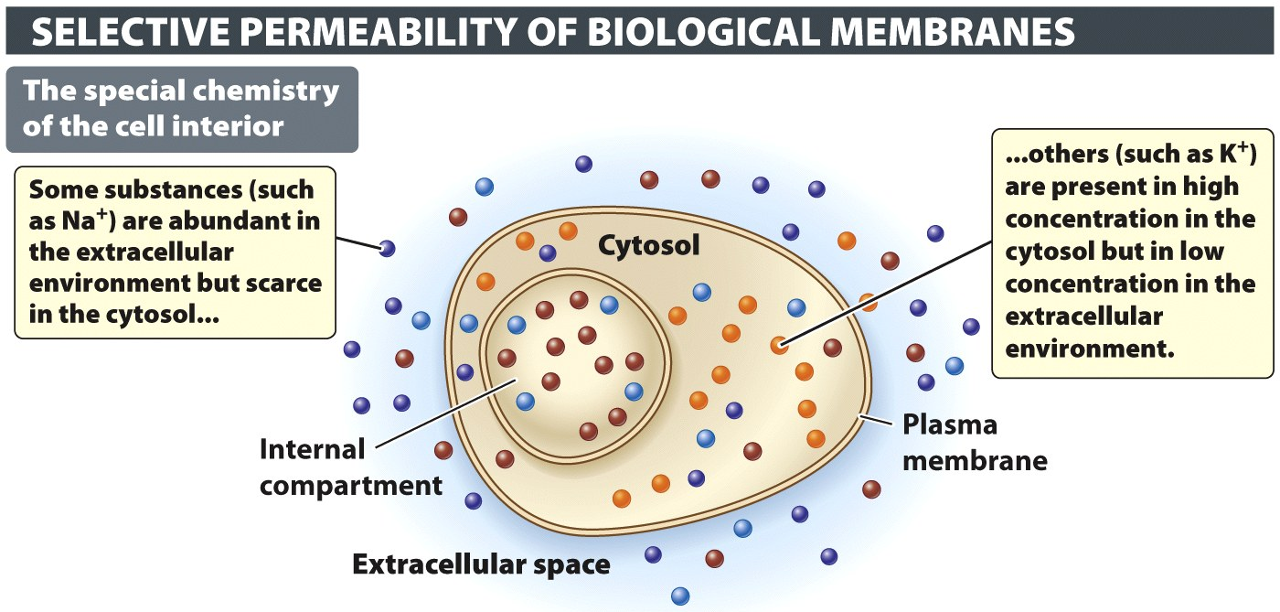
Plasma Membrane: the bouncer (controls who gets in and who leaves)
plasma membrane is selectively permeable
Only lets some substances to enter or leave cell
Keeps inside of cell different from outside

Slide 4
Types of Transport
Passive transport – no energy needed
Active transport – needs energy (ATP)
Putting molecules into a concentrated area
Subway example

Slide 5
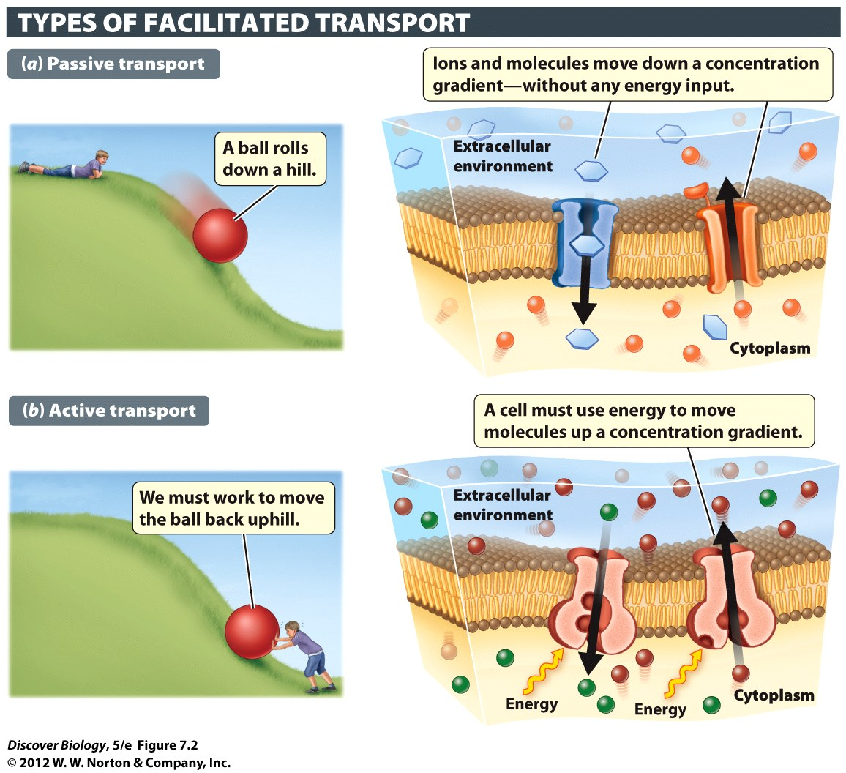
Notes:
Figure 7.2 Active versus Passive Movement of Substances
Materials can move into and out of organisms either passively (without an input of energy) or actively (with an input of energy). (a) Substances can move passively through a membrane from a region where they are present at high concentration to a region of low concentration. (b) Energy is required to move substances from regions of low concentration to regions of high concentration.

Slide 6
Diffusion: passive transport
Stuff moves from concentrated (crowded) area to one that is less crowded with same kind of stuff
Diffusion stops if you reach equilibrium (same inside and out
Small things diffuse faster than larger substances
Heat increases the rate of diffusion
Bigger difference = faster diffusion

Slide 7
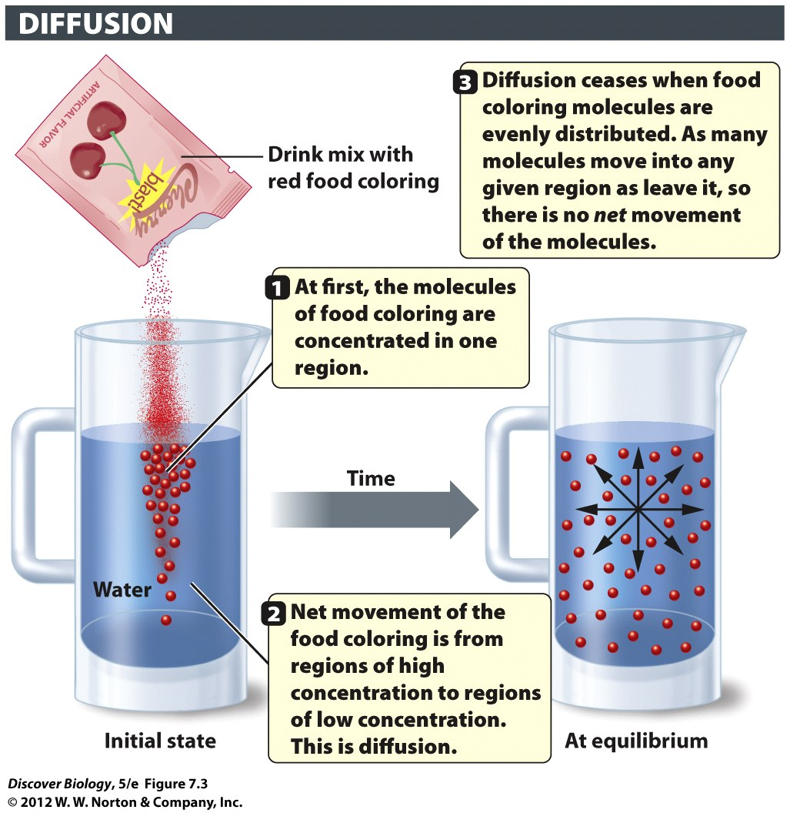
Notes:
Figure 7.3 Diffusion Is a Passive Process
Diffusion is the spontaneous movement of a substance (such as the food coloring in the drink mix) from a region of high concentration to a region of low concentration without an input of energy. Net movement ceases, and equilibrium is reached, when the substance becomes uniformly distributed.

Slide 8
Speed of Diffusion
Small things diffuse faster than big ones
Bigger difference = faster diffusion
Heat increases the rate of diffusion
Why? (hot molecules move faster)

Slide 9
Simple Diffusion (don’t need transport proteins)
Some small stuff goes straight through the Phospholipid Bilayer
Doesn’t need transport protein
Examples: H2O, O2, CO2
hydrophobic molecules also go through
Why (middle of membrane is hydrophobic)
Oil/water

Slide 10
Osmosis: movement of water
Osmosis: A special name for diffusion of water
“Water wants to dilute stuff”
No exception!!!!
Osmosis: water moves. Solute does not

Slide 11
Osmosis
hypotonic solution:
Less concentrated than inside of cell
Water flows into cell (wants to dilute)
hypertonic solution has a higher solute
More concentrated than inside of cell
Water flows out of cell (wants to dilute)
isotonic solution has an equal concentration of
Same inside and out
Water doesn’t move (no way to dilute)

Slide 12
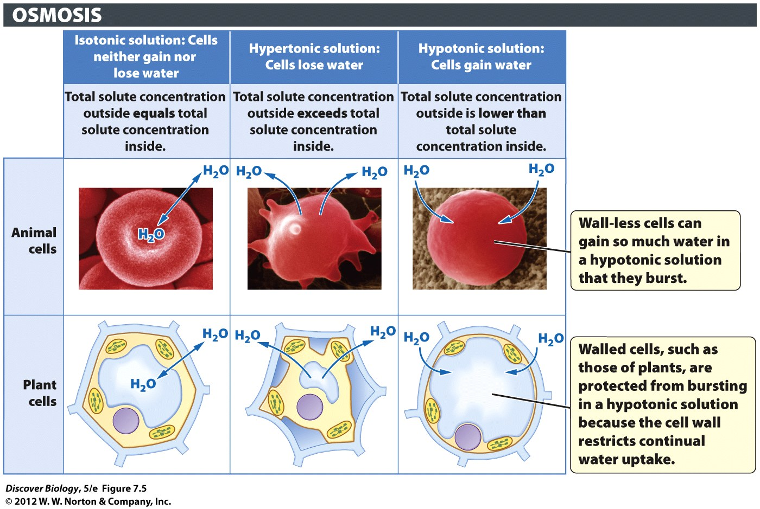
Notes:
Figure 7.5 Water Moves into and out of Cells by Osmosis
Osmosis is the diffusion of water across a selectively permeable membrane. Cells lose water in a hypertonic solution and gain water in a hypotonic solution. Our cells are bathed in an isotonic fluid to prevent osmotic swelling and bursting.

Slide 13
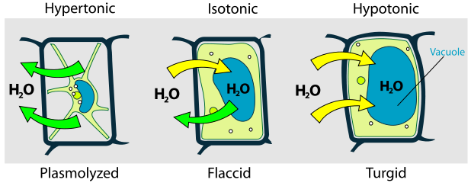
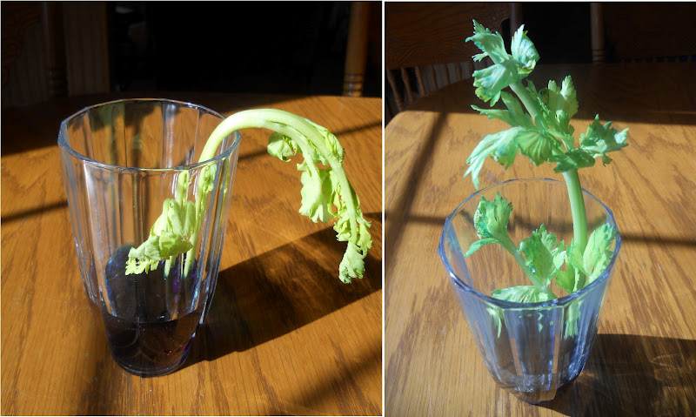
Turgor Pressure

Slide 14
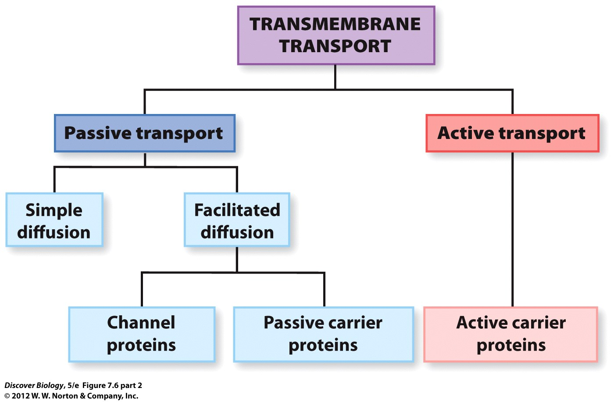
Notes:
Figure 7.6 (part 2) The Plasma Membrane Controls What Enters and Leaves the Cell
Proteins that span the plasma membrane (b, c) play an important role in moving materials into and out of cells. The flowchart summarizes the different types of processes that move materials across biological membranes.

Slide 15
Facilitated Diffusion
passive (no ATP) movement of stuff that can’t cross lipids
Hydrophilic – needs transport protein
Channel proteins
Carrier proteins

Slide 16
Passive Transport: Channel Proteins
“facilitated diffusion”
No energy (ATP) used
Limit stuff by size and charge

Slide 17
Passive Transport: Carrier Proteins
“facilitated diffusion”
Moves specific proteins
high ➔ low concentration
No energy (ATP) needed
(molecules want to move)

Slide 18
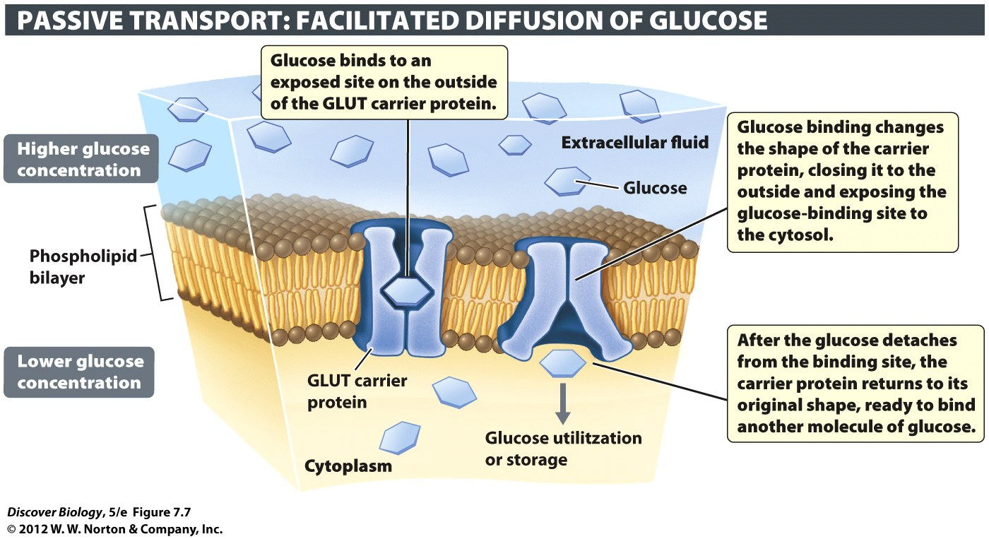
Notes:
Figure 7.7 Passive Carrier Proteins
The facilitated diffusion of glucose into our cells is mediated by a class of passive carriers called GLUT proteins. No energy is required for the transport of glucose by carrier proteins. The sugar moves from the side of the membrane where it is at high concentration to the side where it is at lower concentration.

Slide 19
Active Transport (Active Carrier Proteins)
Moves specific proteins
low ➔ high concentration
Requires energy (ATP)
Like subway pushers

Slide 20
Notes:
Figure 7.6 (part 1) The Plasma Membrane Controls What Enters and Leaves the Cell
Proteins that span the plasma membrane (b, c) play an important role in moving materials into and out of cells. The flowchart summarizes the different types of processes that move materials across biological membranes.

Slide 21
Notes:
Figure 7.6 (part 2) The Plasma Membrane Controls What Enters and Leaves the Cell
Proteins that span the plasma membrane (b, c) play an important role in moving materials into and out of cells. The flowchart summarizes the different types of processes that move materials across biological membranes.

Slide 22
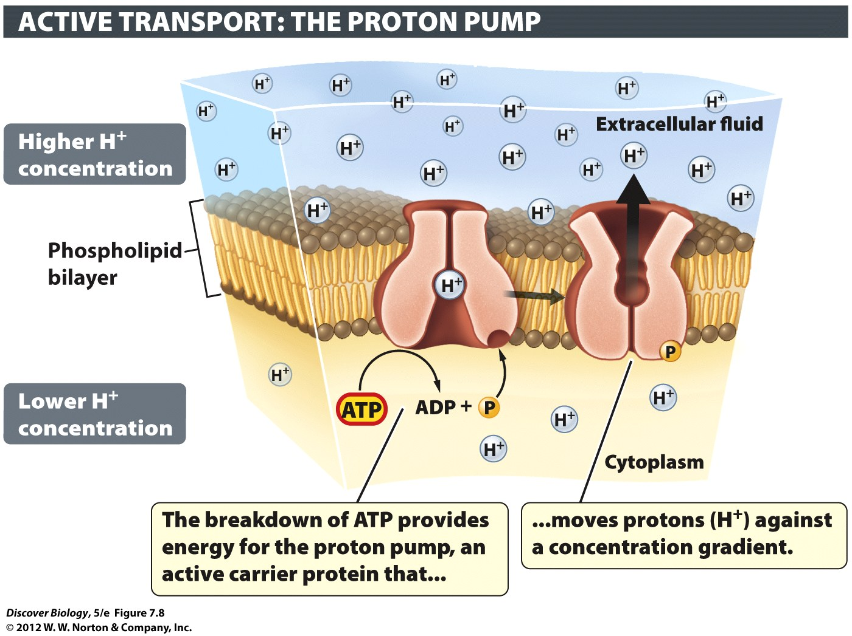
Notes:
Figure 7.8 Active Carrier Proteins
Active carrier proteins use energy to move materials from regions of low concentration to regions of high concentration. When food arrives, proton pumps secrete hydrogen ions (H⁺) into your stomach.

Slide 23
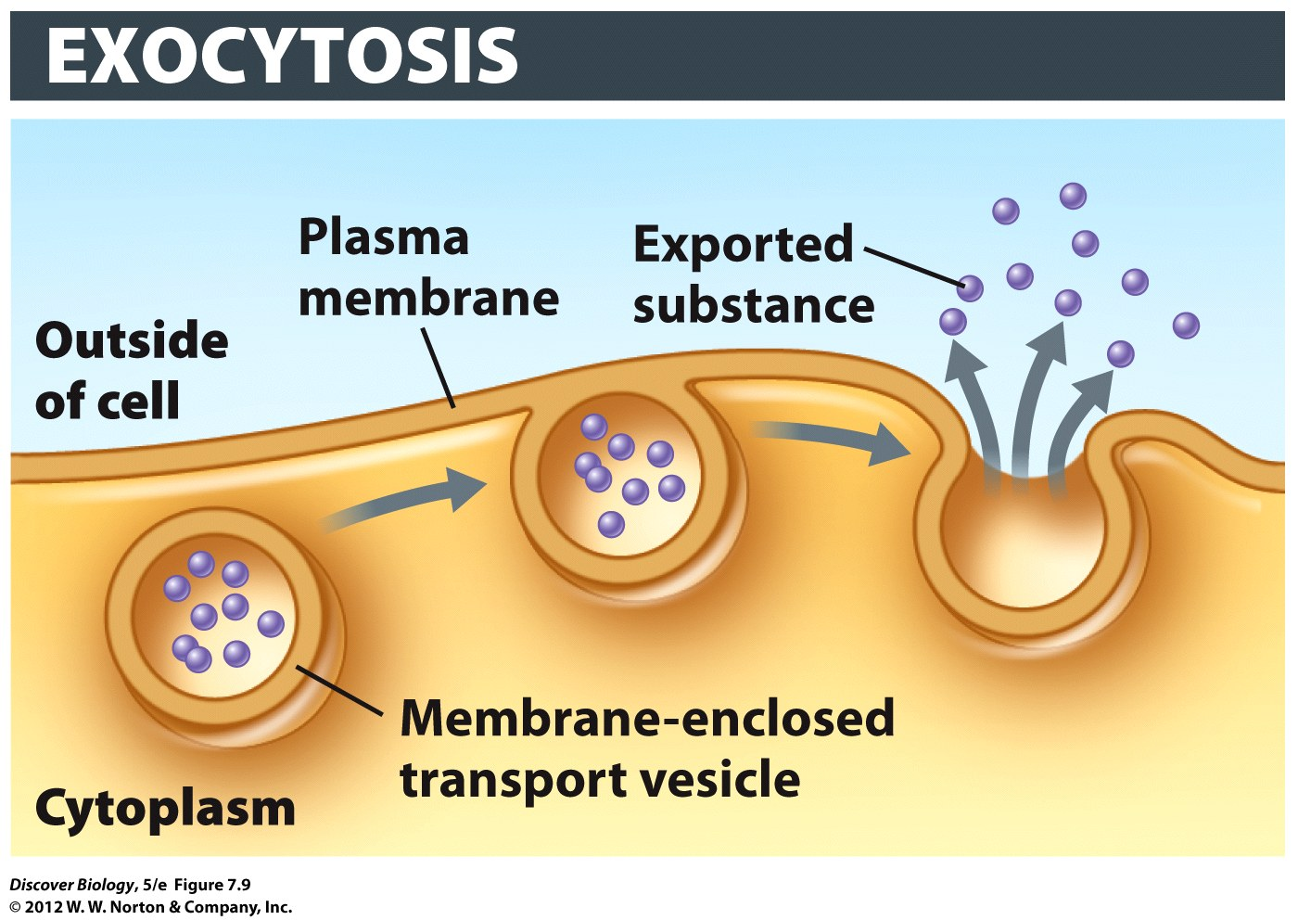
Exocytosis: getting stuff out
Exocytosis = Exo(“outside”) + Cyto(“Cell”)
Exocytosis: stuff Exits Cell
Transport vesicles fuse to plasma membrane
Spill contents outside cell

Slide 24
Notes:
Figure 7.9 Cell Contents Are Exported through Exocytosis
Exocytosis exports materials from the cell.

Slide 25
Endocytosis: three names
Pinocytosis (“cells drink”)
take in fluid and small stuff
nonspecific – takes in everything in the area
phagocytosis (“cells eat”) take in big stuff
bacteria or viruses
Receptor-mediated endocytosis
Only takes in stuff that fits receptor

Slide 26
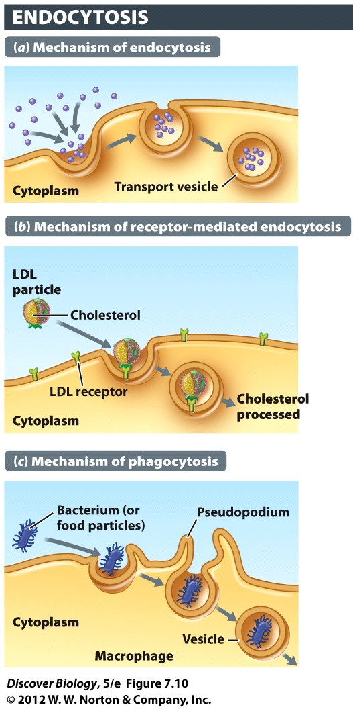
Small particles and fluid
Stuff that fits the receptor protein
Big stuff
Notes:
Figure 7.10 Extracellular Substances Are Imported through Endocytosis
(a) Endocytosis brings material from the outside of the cell to the inside, wrapped in membrane vesicles. (d) Pinocytosis is nonspecific endocytosis of external fluid. (b) Receptor-mediated endocytosis is a highly selective process in which only certain extracellular molecules are recognized by, and bound to, special plasma membrane receptors. (c, e) Phagocytosis is endocytosis on a large scale. A macrophage (blue) engulfing an invading yeast cell (yellow) is seen in (e). Macrophages are part of the body’s defense system.

Slide 27
Review and Concept Questions

Slide 28
Concept Quiz
The main difference between active and passive transport is
Passive transport goes up a concentration gradient.
Active transport goes down a concentration gradient.
Active transport requires energy.
Passive transport requires energy.
Notes:
The correct answer is C. It is important to stress that it takes energy to move a molecule or ion against it’s concentration gradient, and only pumps (ATPases) can do this.
Passive transport goes down a concentration gradient.
Active transport goes up a concentration gradient.
Passive transport does not require energy.

Slide 29
Concept Quiz
__________ involves the ingestion of specific molecules by the membrane
A. Endocytosis
B. Pinocytosis
C. Exocytosis
D. Receptor‑mediated endocytosis
Notes:
The correct answer is D. Receptor mediated endocytosis is a very specific process, where as other forms of ingestion take in everything that is found in the extracellular medium.
Answer A: This is less specific since receptors are used to identify particles to be ingested.
Answer B: This is “cell drinking” and is very non-specific.
Answer C: This doesn’t involve ingesting at all; it is the release of substances.

Slide 30
Free Biology Tutoring
Not Happy with your grade?
Not understanding the material?
Remember that the TLCC has

