Slide 1
Free Biology Tutoring
Not Happy with your grade?
Not understanding the material?
Remember that the TLCC has

Slide 2
The Microscope Is a Window into the Life of a Cell
The light microscope was the first instrument that enabled scientists to view the cell
Electron microscopes use streams of electrons focused with magnets to magnify specimens more than 100,000 times
A scanning electron microscope creates a three-dimensional view of specimen

Slide 3
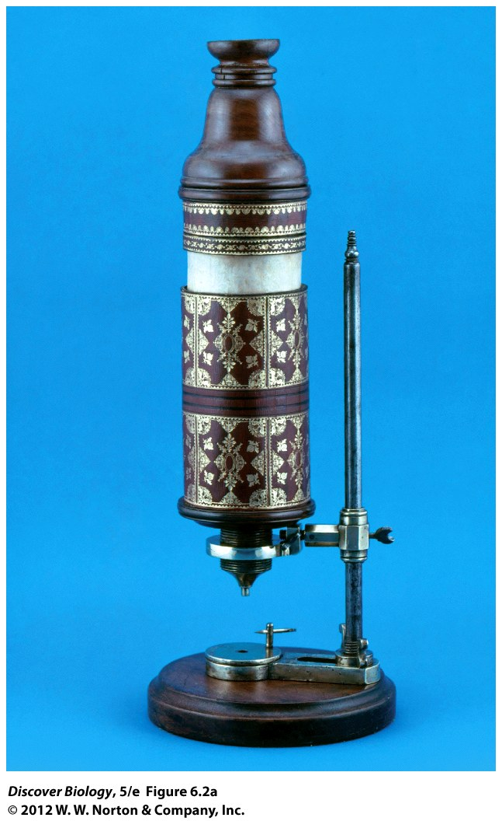
Notes:
Figure 6.2a Light Microscope Used by Robert Hooke (1635–1703)
(a) Hooke’s microscope.

Slide 4
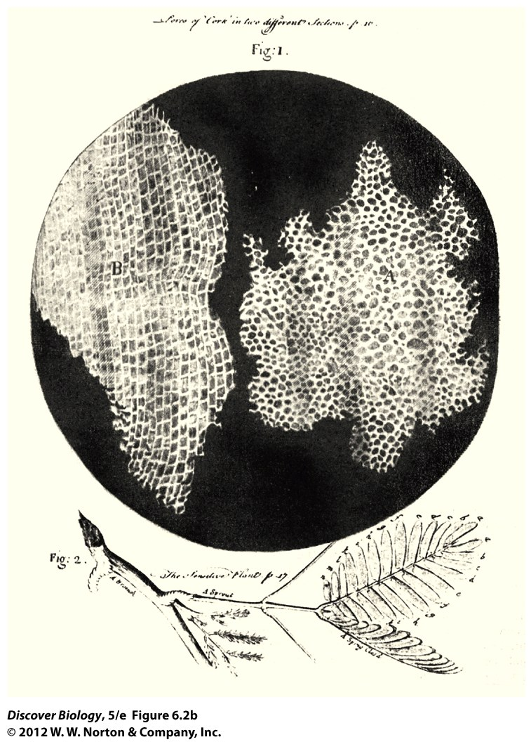
Notes:
Figure 6.2b Light Microscope Used by Robert Hooke (1635–1703)
(b) A piece of cork examined under Hooke’s microscope.

Slide 5
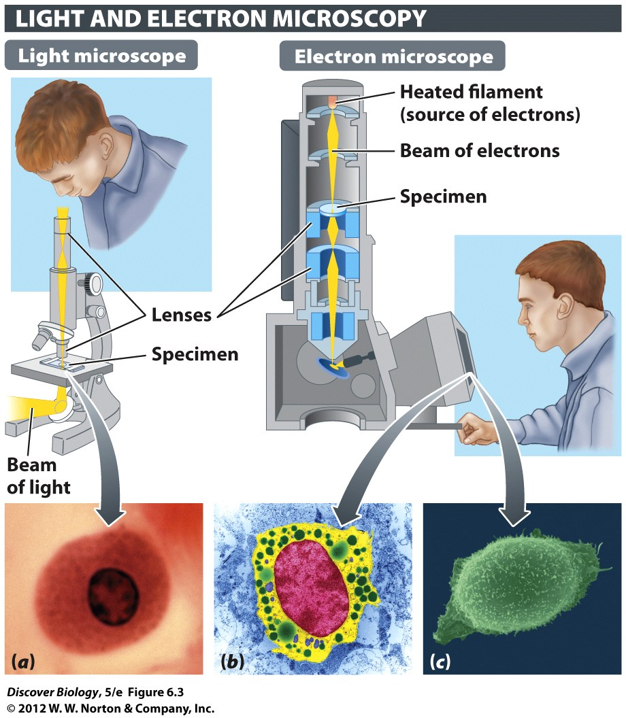
Notes:
Figure 6.3 Microscopy Enables Us to Visualize Cells and Cell Structures
The photos show human mast cells imaged through light microscopy (a), transmission electron microscopy (b), and scanning electron microscopy (c). Mast cells are immune cells, part of the body’s defense against invaders.

Slide 6
Cells
The cell is the smallest and simplest unit of life
A cell is composed of an aqueous interior enclosed in a lipid-based plasma membrane
Prokaryotes – smaller, few/no organelles
  NO NUCLEUS
Eukaryotes – bigger, more organelles

Slide 7
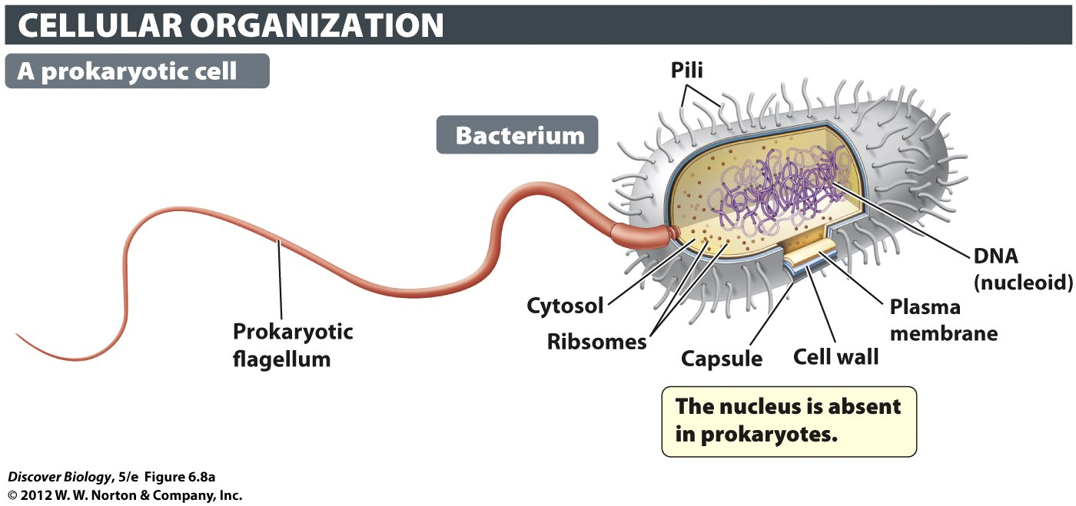
Prokaryotes
Most prokaryotes have a tough cell wall outside the plasma membrane
Prokaryotes: bacteria and archea
Some bacteria have a slippery, protective layer called a capsule

Slide 8
Eukaryotic Cells
Are much bigger than prokaryotes
have many organelles
Eukaryotes: Plants, animals, algae and other protists, Fungi

Slide 9
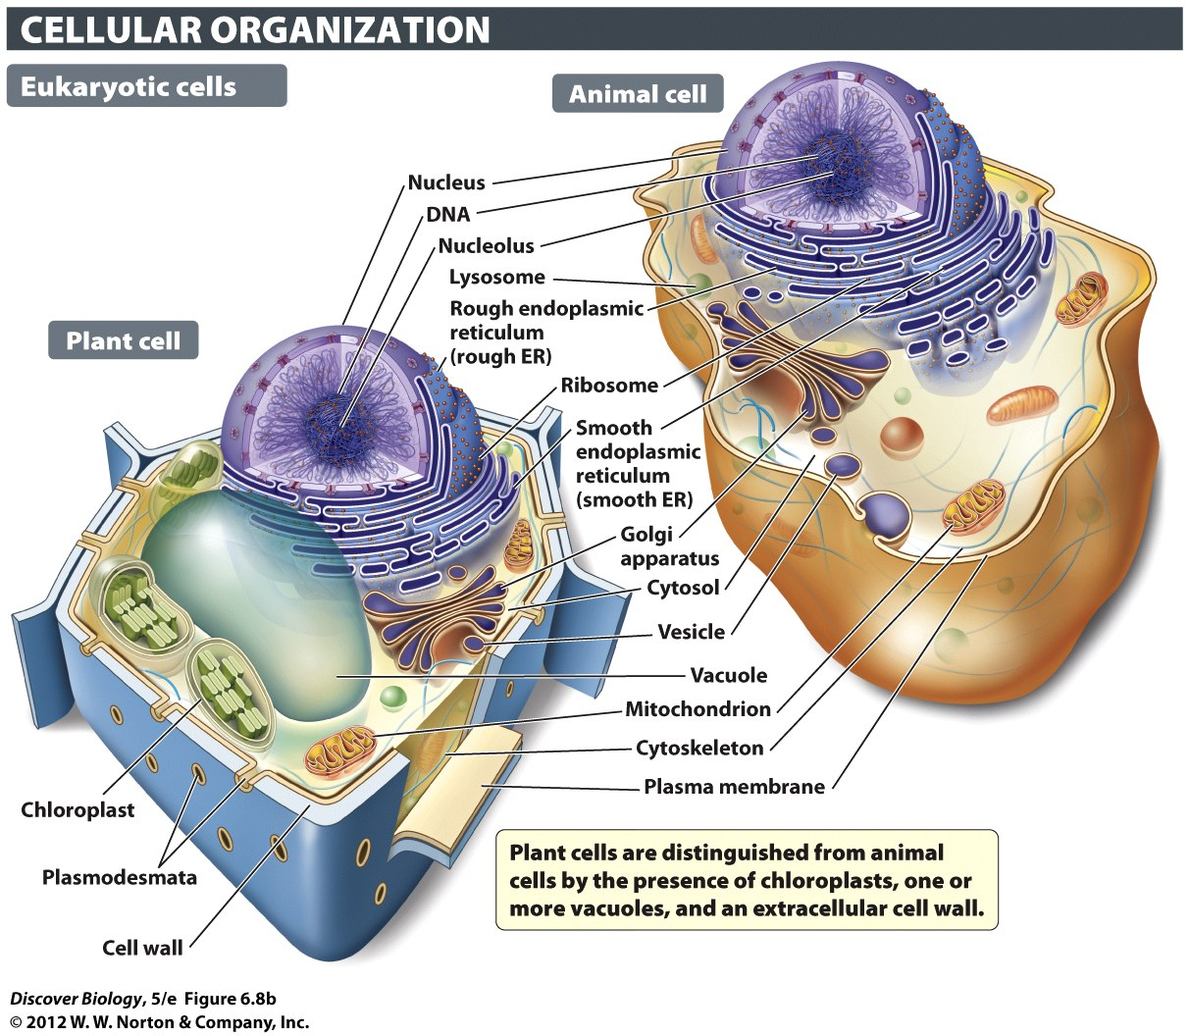
Notes:
Figure 6.8b Prokaryotic and Eukaryotic Cells Compared

Slide 10
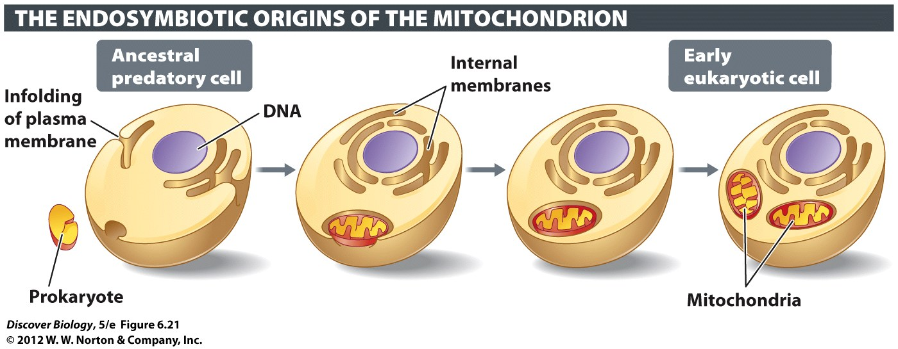
Endosymbiosis
Endo(“inside”) + Sym(“same”)+Bio(“life”)
The idea that eukaryotic organelles were originally free-living prokaryotes
predation => symbiosis => organelles
Notes:
Figure 6.21 How Ancestral Eukaryotes Acquired Membrane- Enclosed Organelles
Some organelles, such as mitochondria and chloroplasts, are likely descendants of engulfed prokaryotes. Other membrane-enclosed organelles, such as the endoplasmic reticulum, probably arose through an infolding of the plasma membrane.

Slide 11
Endosymbiosis: the evidence
The mitochondrion (plural: mitochondria) and chloroplasts reproduce on their own
Mitochondria and chloroplasts have own DNA
  DNA sequences more like bacteria than like the DNA in their cell’s nucleus
Wrap DNA around different histone proteins
  Also bacteria-like

Slide 12
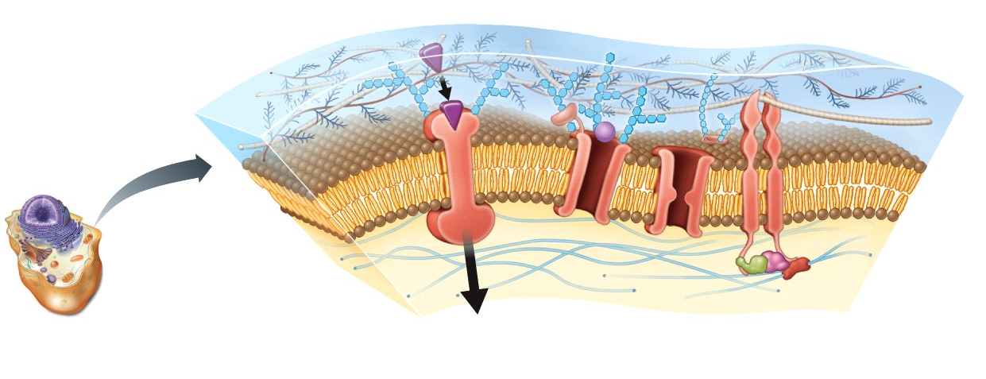
The Plasma Membrane
Every cell has a plasma membrane that separates the cell from its surrounding environment
Phospholipid bilayer with embedded proteins

Slide 13
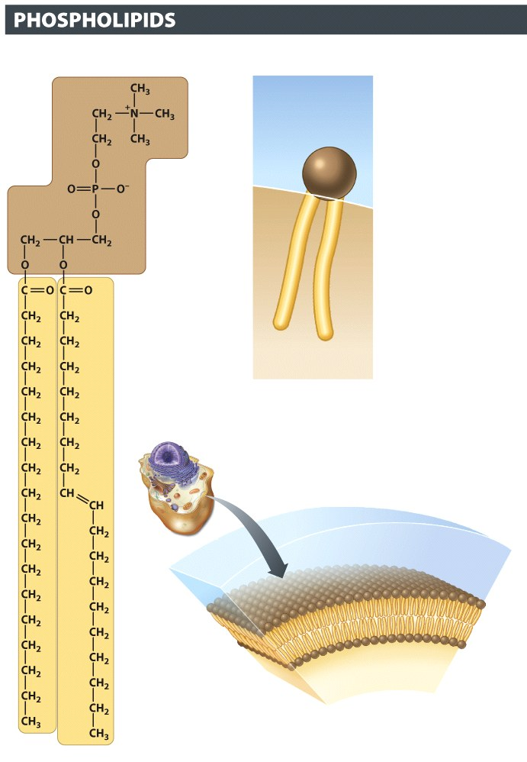

Phospholipids
Opposite behavior on ends
Head loves water (hydrophilic)
Tail hates water (hydrophobic)

Slide 14
The Plasma Membrane
Controls the movement of molecules in & out:
  Brings necessary molecules in
  Passes waste out
Communicates with other cells
Interacts with environment
Anchors the cell in place

Slide 15
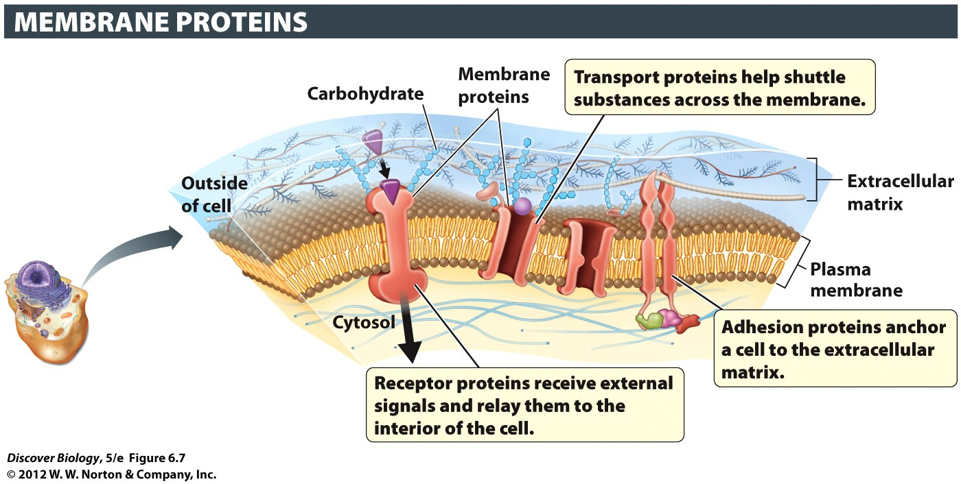
Proteins of Plasma Membrane
Proteins in the phospholipid bilayer
  Transport, receptor, adhesion
The fluid mosaic model: proteins drift inside the phospholipid bilayer

Slide 16
Eukaryotic Cells: The parts
A cell is composed of an cytoplasm interior enclosed in a lipid-based plasma membrane
Cytoplasm contains a thick fluid called cytosol, consisting of ions and biomolecules mixed in water
An organelle is a cytoplasmic structure that performs a unique function in the cell
The nucleus contains the DNA enveloped in double membranes
The mitochondrion (plural: mitochondria) provides the energy that fuels all cellular functions
Ribosomes are important protein-manufacturing organelles

Slide 17
Eukaryote Nucleus: Where the DNA is
DNA has instructions to make all the stuff for a cell to live, growing, or reproducing
Stored as chromosomes
nuclear envelope - a double layer of membrane (outside of nucleus)

Slide 18
The Nucleus Houses Genetic Material
Nuclear pores are channels through the nuclear envelope
DNA info stays in the nucleus. RNA copies of that info The nuclear envelope contains nuclear pores
RNA info will be read by ribosomes

Slide 19
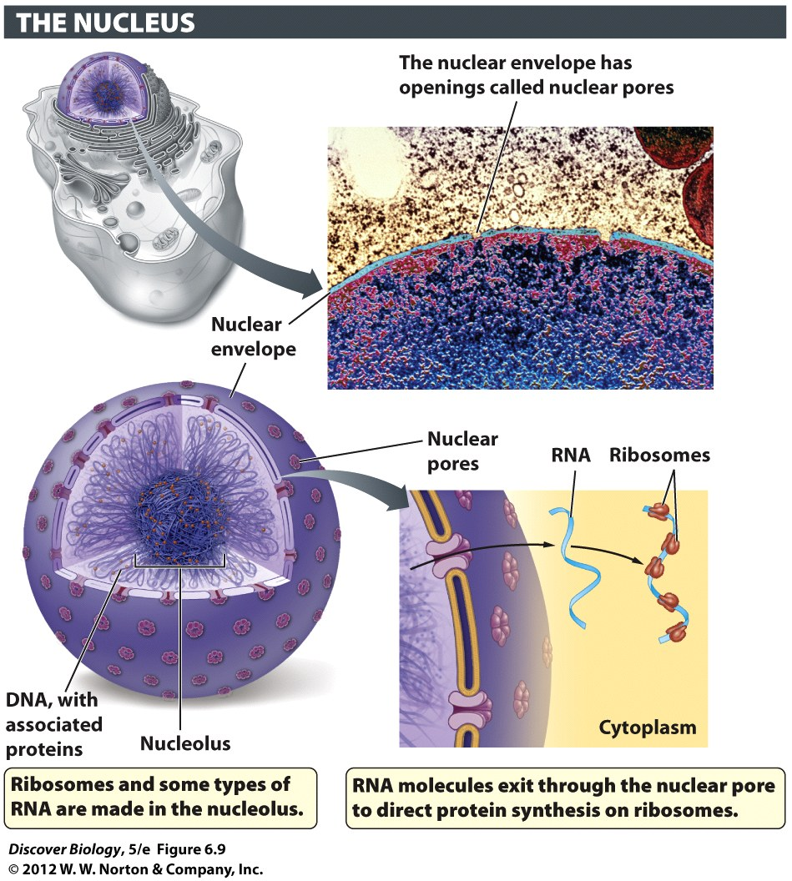
Notes:
Figure 6.9 The Nucleus Contains DNA, the Genetic Material of the Cell
The nucleus is enclosed within a double-membrane nuclear envelope. Nuclear pores provide a regulated passageway for molecules entering and exiting the nucleus.

Slide 20
Endoplasmic Reticulum: makes stuff
endoplasmic reticulum (ER) a network of connected sacs and tubes made out of membranes
smooth ER makes lipids and breaks down toxins for other cellular compartments and help break down toxic organic compounds in the cell
rough ER covered in ribosomes. Makes proteins dotted with ribosomes that produce proteins for

Slide 21
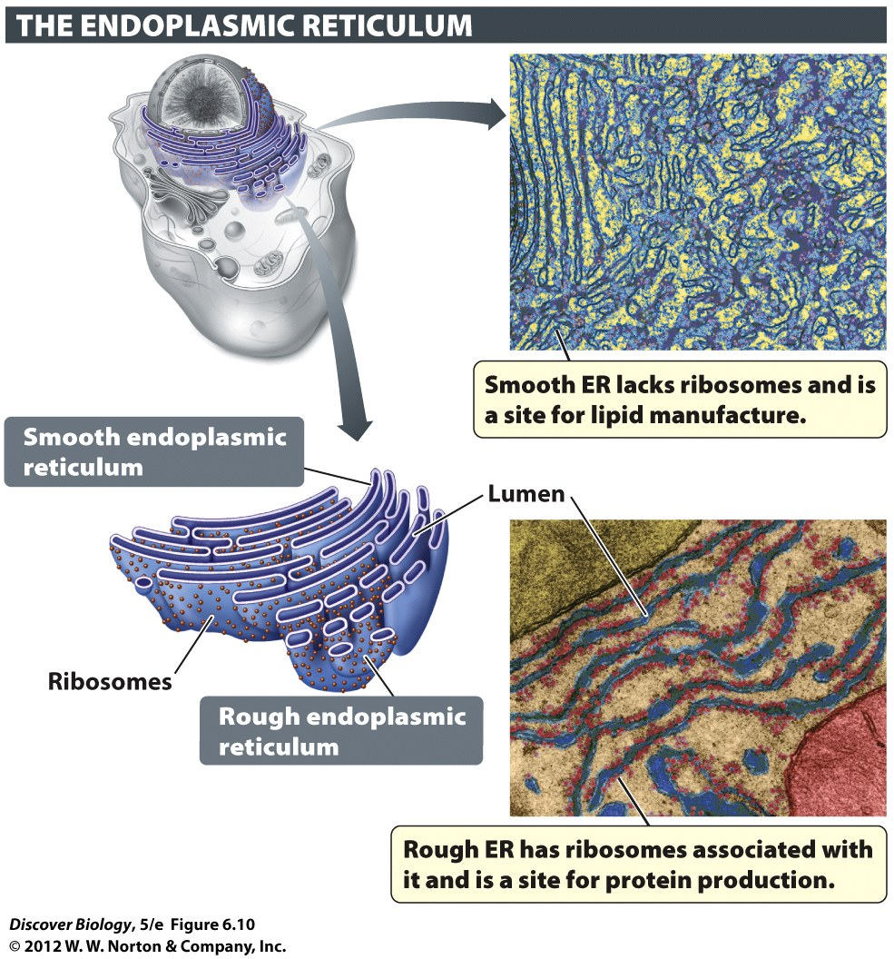
Notes:
Figure 6.10 Some Types of Lipids and Proteins Are Made in the Endoplasmic Reticulum

Slide 22
Transport Vesicles: Move stuff
A transport vesicle is a small sac of membrane used to move lipids, proteins, and carbohydrates between cellular compartments
The transport vesicle fuses with the membrane of the target destination in order to deliver its contents

Slide 23
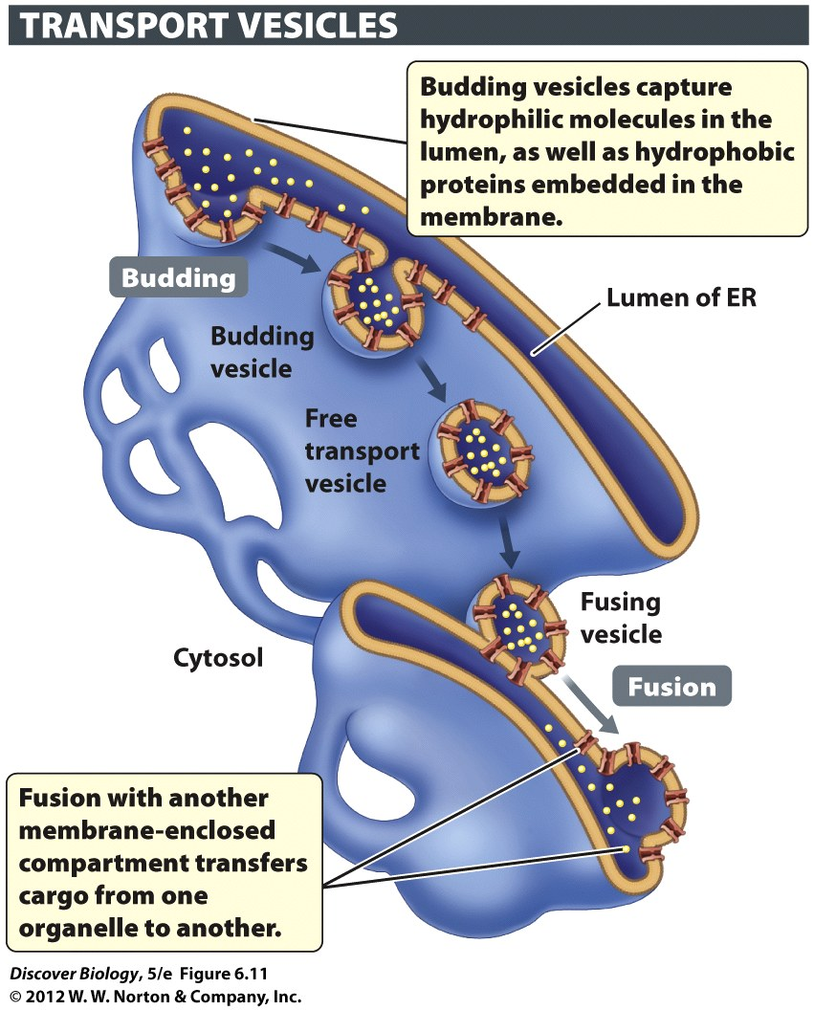
Notes:
Figure 6.11 Cellular Materials Are Dispatched to a Wide Variety of Destinations via Vesicles
Here, molecules are being shipped from the ER to the Golgi apparatus.

Slide 24
Golgi Apparatus: Sorts/Ships stuff
The Golgi apparatus directs proteins and lipids produced by the ER to their final destination (in or out of cell)
“addresses” packages by adding specific chemical groups
Vesicles move the lipids and proteins from the ER to the Golgi apparatus

Slide 25
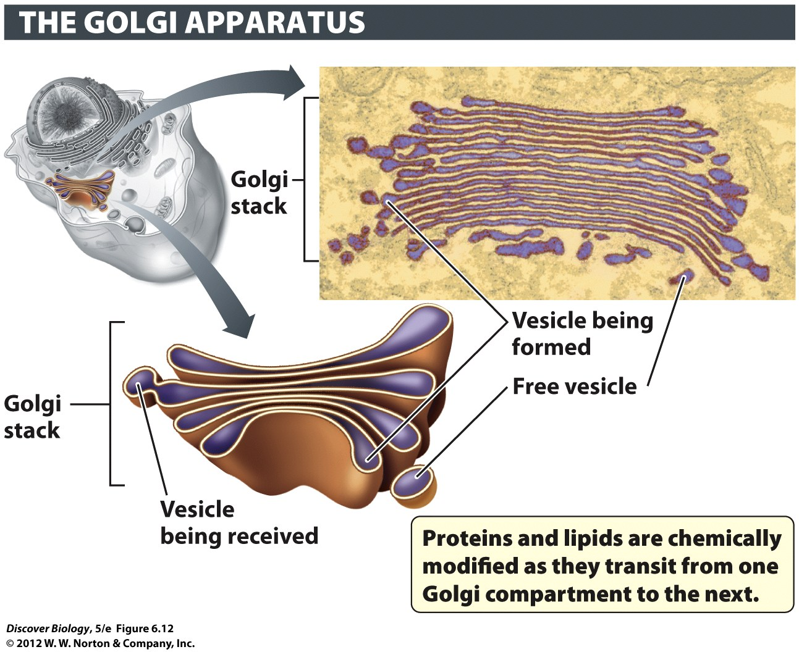
Notes:
Figure 6.12 The Golgi Apparatus Routes Proteins and Lipids to Their Final Destinations
Proteins and lipids are chemically modified, sorted, and shipped to their final destinations, inside or outside the cell, by the Golgi apparatus.

Slide 26
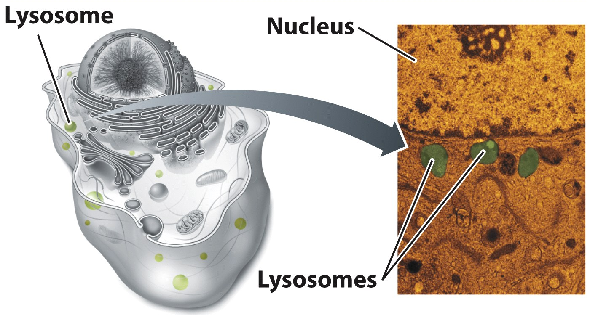
Lysosomes: they break stuff apart
Lysosomes use enzymes to break down macromolecules (big stuff) and release the parts into the cytoplasm
The interior of lysosomes is acidic (pH ~5)

Slide 27
Notes:
Figure 6.13 Lysosomes Degrade Macromolecules
Lysosomes are found in animal cells. Lysosomes help to digest molecules taken up from outside and to break down cell components whose molecules can be repurposed.

Slide 28
Vacuoles: breaking or storage
Plant organelles called vacuoles act much like lysosomes to break down macromolecules
Vacuoles can also store ions, water-soluble molecules, and bad tasting compounds ((don’t eat me”)
Vacuoles filled with water to help make the nonwoody parts of plant cells rigid

Slide 29
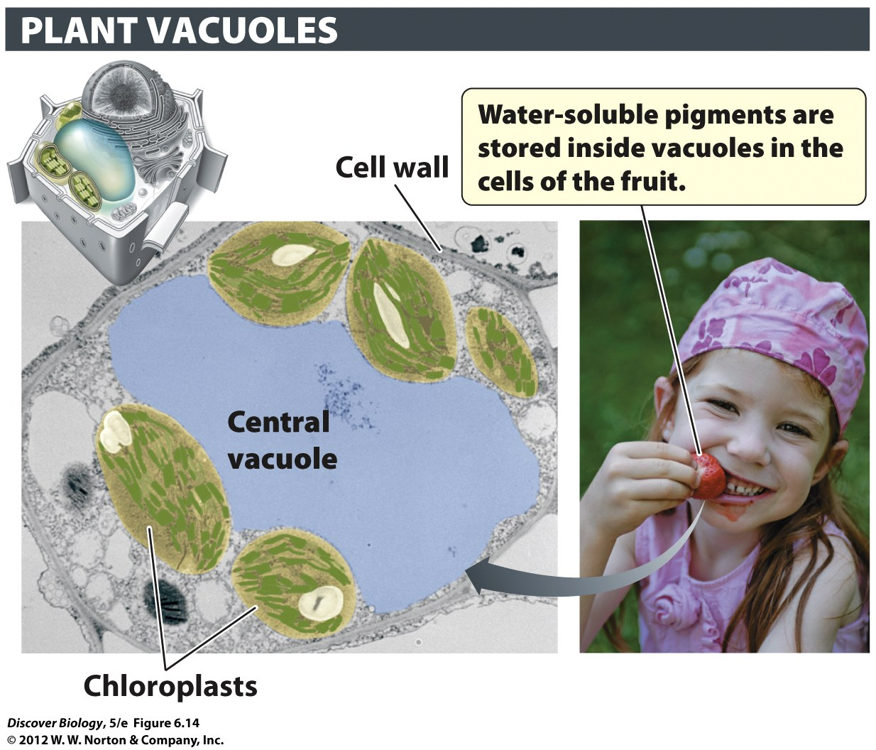
Notes:
Figure 6.14 Plant Vacuoles Store, Recycle, and Provide Turgor
Plant vacuoles contain enzymes for degrading large macromolecules. They also store water, ions, sugars, and other nutrients, and they may contain pigments that attract pollinators and/or toxins that deter herbivores. The fluid pressure that develops inside the vacuole gives turgidity to plant cells.

Slide 30
Mitochondria: the Power plant
Uses food molecules to make ATP (energy)
Plants also havecalled the chloroplast, which uses sunlight to make energy-storing molecules
The mitochondrion is bound by double membranes that form an intermembrane space

Slide 31
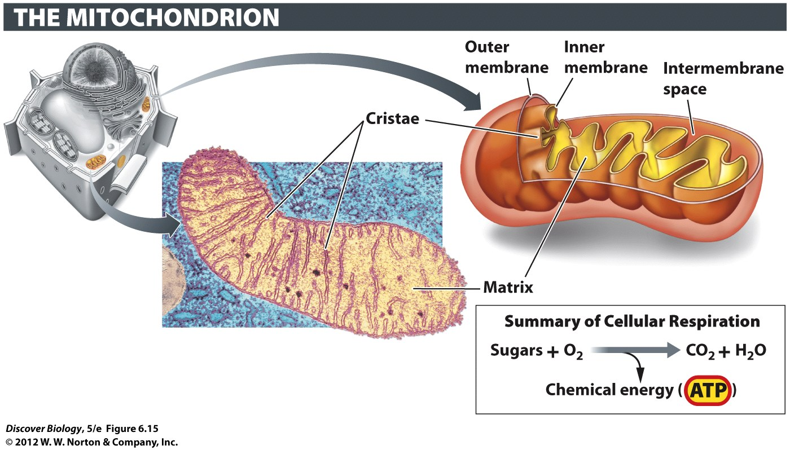
Notes:
Figure 6.15 Mitochondria Generate Energy in the Form of ATP
Each mitochondrion has a double membrane. The infoldings of the inner membrane (cristae) create a large surface area which enables many units of ATP-generating enzymes to be located there.

Slide 32
Mitochondria Power the Cell
The folds of the inner membrane form the cristae, which help to increase the surface area for chemical reactions
Mitochondria use chemical reactions to turn food molecules into ATP, which can be used to fuel the chemical reactions of the cell
The process of turning food molecules into energy is called cellular respiration

Slide 33
Chloroplast: solar energy
Chloroplast uses light to make ATP. (short lived energy source)
Uses ATP from light with CO2 to make sugars
  Called “photosynthesis”; releases O2!!!
Sugars = longer term energy storage
Sugars used by mitochondria of plant
  And everything else on earth!!!

Slide 34
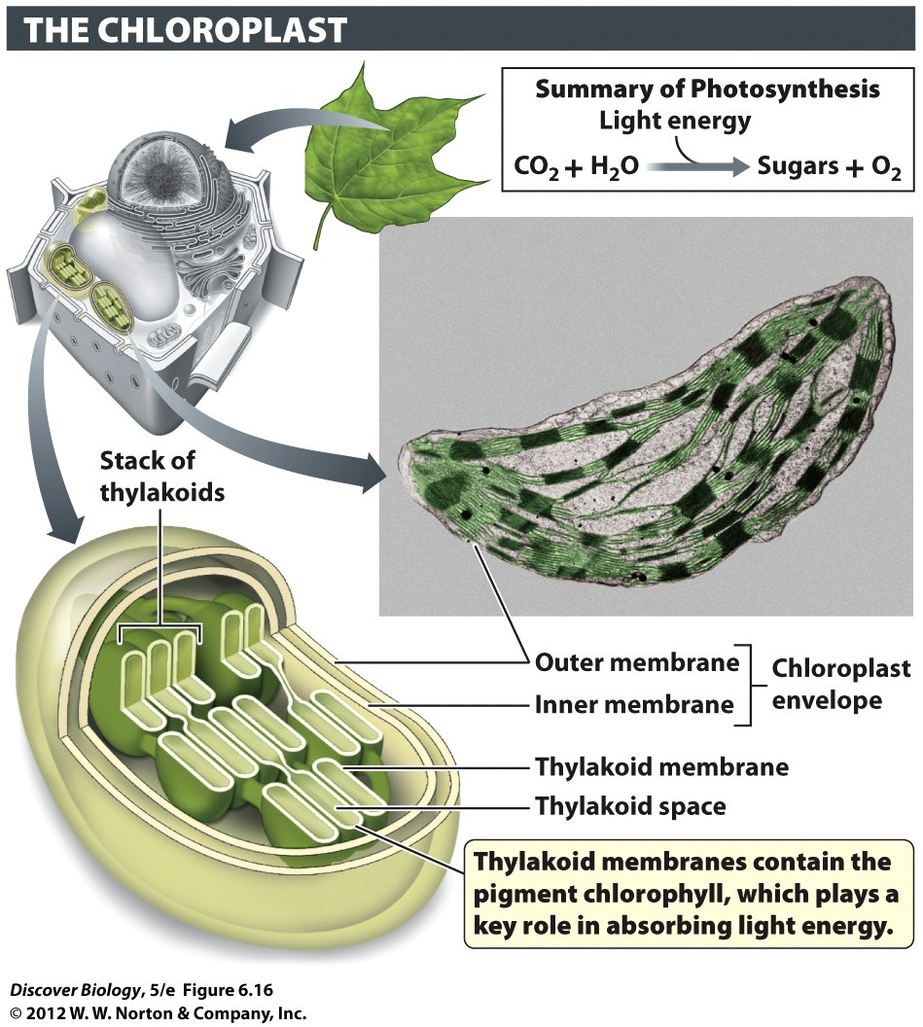
Notes:
Figure 6.16 Chloroplasts Capture Energy from Sunlight and Use It to Make Sugars
Chloroplasts are found in green plant parts and in the protists known as algae.

Slide 35
Cytoskeleton: “bones” of cell
Protein cylinders and filaments
  Microtubules (big)
  Intermediate filaments (medium)
  Microfilaments (small)
Used to: help organelles move, strengthen membrane, move entire

Slide 36
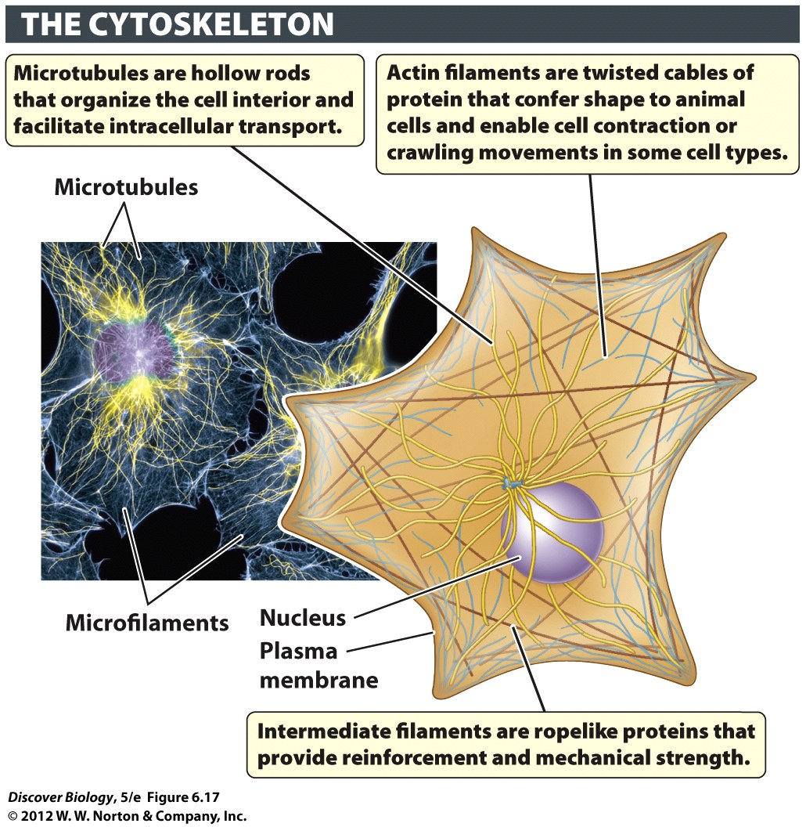
Notes:
Figure 6.17 An Overview of the Cytoskeletal System

Slide 37
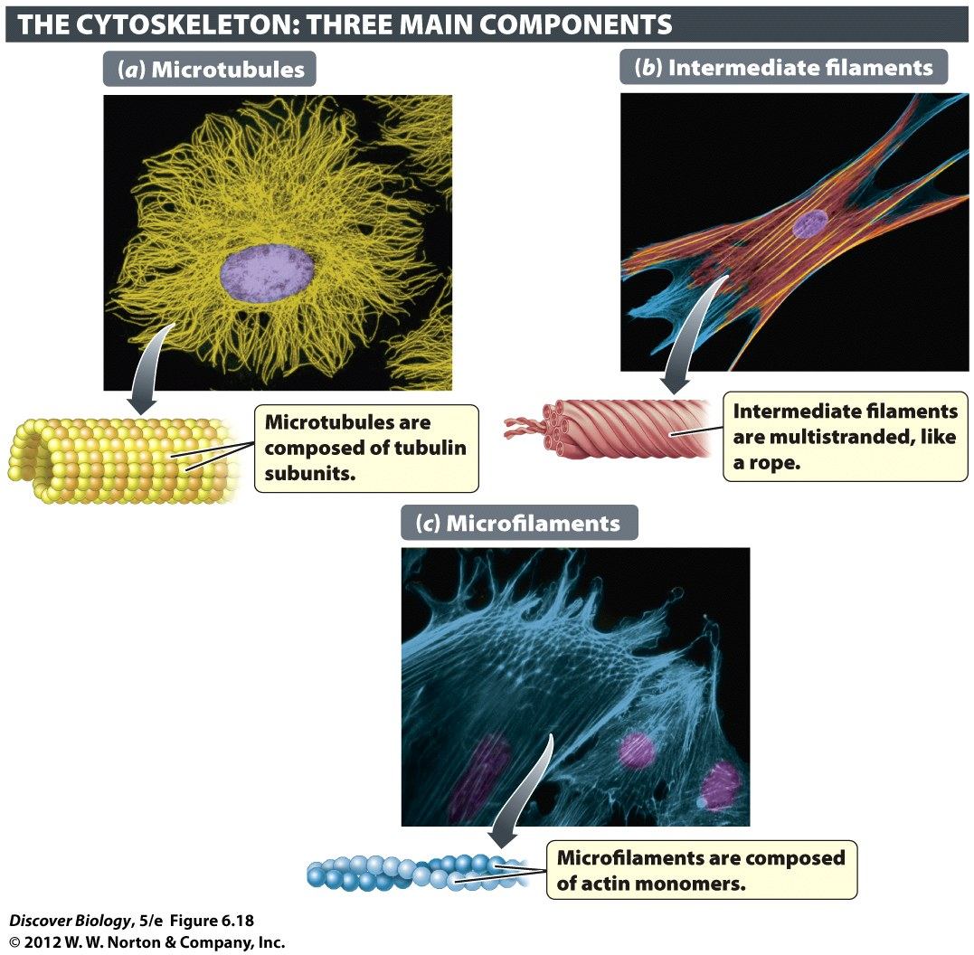
Notes:
Figure 6.18 The Structure of Microtubules, Intermediate Filaments, and Microfilaments
The cytoskeleton is composed of three basic units: (a) microtubules, (b) intermediate filaments, and (c) microfilaments.

Slide 38
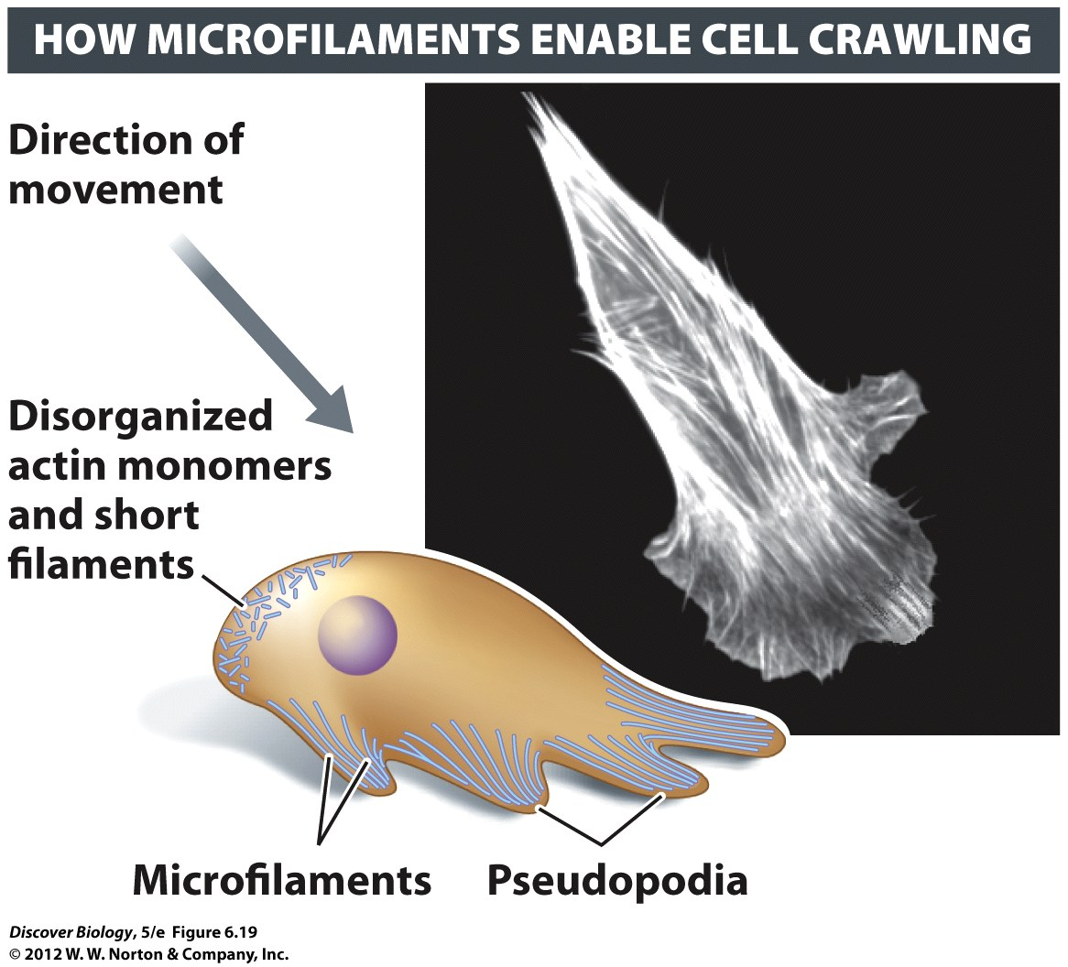
Notes:
Figure 6.19 Microfilaments Drive Some Types of Whole Cell Movement

Slide 39
Cilia and Flagella
(microtubules used for swimming)
Many protists and animals have cells covered in hairlike cilia
Microtubules inside cilia
Motor proteins use ATP to bend cilia
Cilia can be moved back and forth like oars

Slide 40
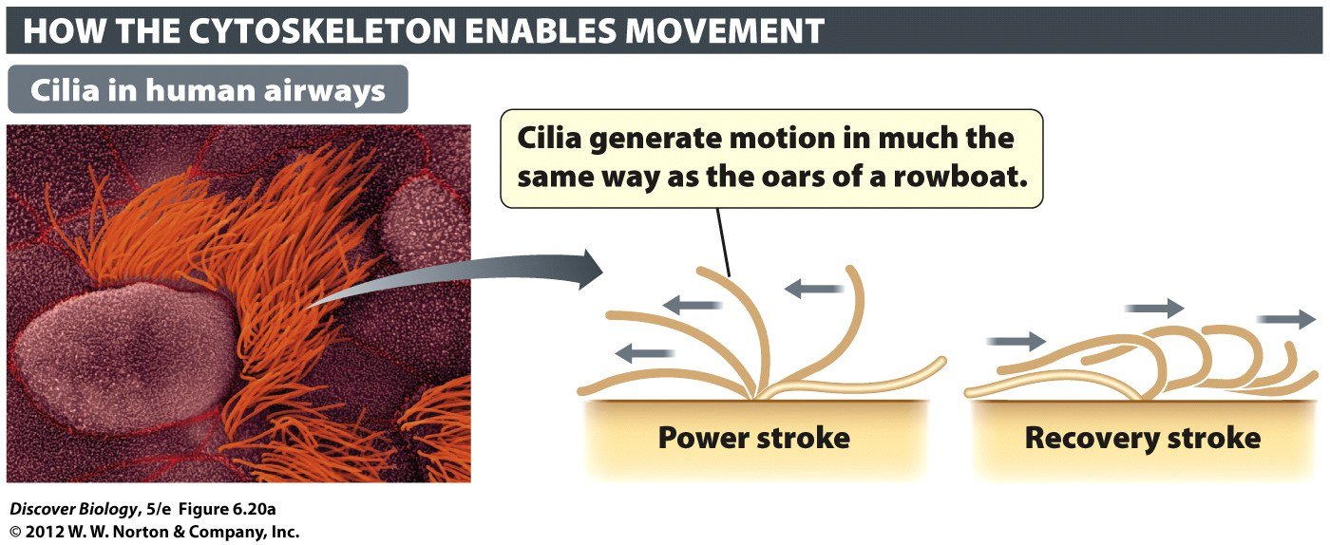
Notes:
Figure 6.20 Cilia and Flagella Generate Movement
Many organisms, especially singlecelled ones, use cilia or flagella to generate movement. (a) Tufts of cilia are present on the cells that line our breathing tubes (bronchi). (b) Eukaryotic flagella, such those in sperm cells, are much longer than cilia. Eukarytotic cilia and flagella contain bundles of microtubules arranged in a 9+2 pattern (inset) and are covered by a plasma membrane. Prokaryotic flagella have a very different structure. (c) A prokaryotic flagellum, such as the one on this bacterium (Bdellovibrio bacteriovorus), consists of ropelike proteins attached to protein complexes anchored in the cell membranes.

Slide 41
Flagella: another way to swim
flagellum (plural: flagella) has microtubules inside (like cilia, but longer)
Looks like a long tail. Is used to swim
Used by bacteria, archaeans, and protists, and the sperm cells (plants and animals)

Slide 42
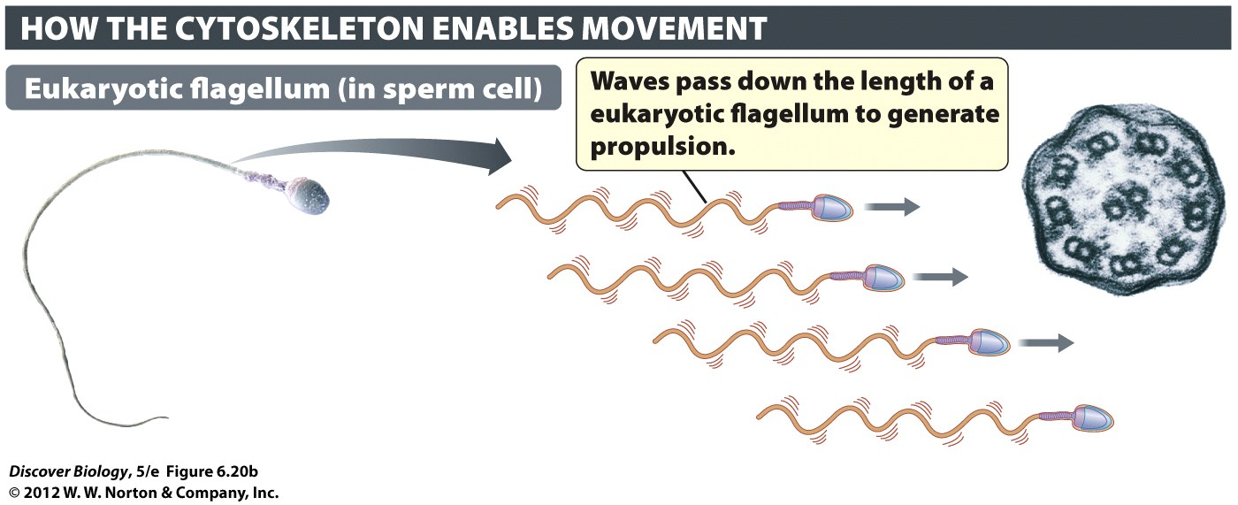
Notes:
Figure 6.20b Cilia and Flagella Generate Movement
Many organisms, especially singlecelled ones, use cilia or flagella to generate movement. (b) Eukaryotic flagella, such those in sperm cells, are much longer than cilia. Eukarytotic cilia and flagella contain bundles of microtubules arranged in a 9+2 pattern (inset) and are covered by a plasma membrane. Prokaryotic flagella have a very different structure.

Slide 43
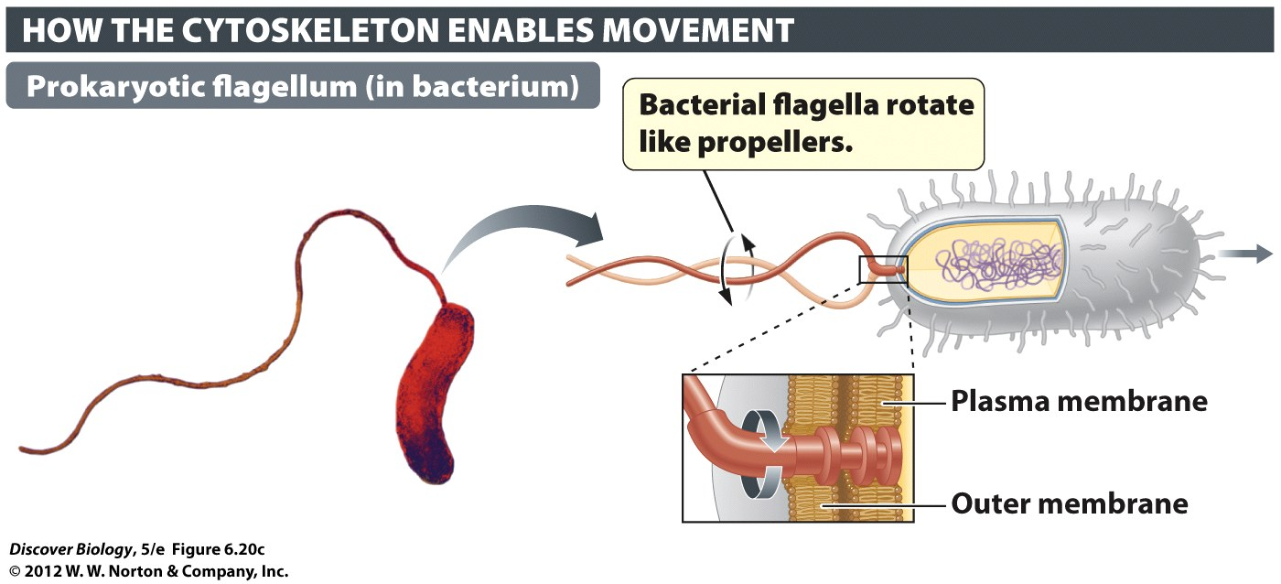
Notes:
Figure 6.20c Cilia and Flagella Generate Movement
Many organisms, especially singlecelled ones, use cilia or flagella to generate movement. (c) A prokaryotic flagellum, such as the one on this bacterium (Bdellovibrio bacteriovorus), consists of ropelike proteins attached to protein complexes anchored in the cell membranes.

Slide 44
Concept & Review Questions

Slide 45
Concept Quiz
Where is the secreted protein insulin synthesized?
In the Golgi apparatus
On the rough ER
On ribosomes in the cytoplasm
In the nucleus
Notes:
The correct answer is B. From the chapter, the students should realize that membrane and secreted proteins are made in the rough ER. This allows them to be made on the “outside” of the membrane. As a result, the hydrophilic protein can be secreted by being packaged in a vesicle and fusing this vesicle to the membrane.
Answer A is incorrect because the Golgi completes the protein, but doesn’t synthesize it.
Answer C is incorrect because insulin is secreted and must be synthesized in the rough ER.
Answer D is incorrect because the nucleus doesn’t synthesize proteins.

Slide 46
Concept Quiz
Two main types of cells are ______ and _______.
Prokaryotic; eukaryotic
Bacterial; animal
Nerves; muscles
Plant; animal
Notes:
The correct answer is A. Many students miss this important distinction because it is only mentioned at the beginning of the chapter, after which only plant and animal cells are discussed. It’s worth stressing that most of life on earth is prokaryotic.
Answer B is incorrect because there are eukaryotic cells besides animal cells (e.g., plant and fungi).
Answer C is incorrect because these are just two examples of eukaryotic cells in animals.
Answer D is incorrect because these are just two examples of eukaryotic cells.

Slide 47
Concept Quiz
The boundary structure that physically defines a cell is the .
Cell wall
Selective permeability
Plasma membrane
Protein coat
Notes:
The correct answer is C.
Many students believe that all cells, including animal cells, have a cell wall.
Answer A is incorrect, because only plants and some bacteria have a cell wall.
Answer B is incorrect because this is not a structure, but a function.
Answer D is incorrect because no cells have a protein coat. Only viruses have these.

Slide 48
Free Biology Tutoring
Not Happy with your grade?
Not understanding the material?
Remember that the TLCC has

