Slide 1
How’s your grade?
Have you calculated your grade lately?
If not, use the spreadsheet
Are all your assignment listed in PAL?
You need to let me know if they are not

Slide 2
Discover Biology
FIFTH EDITION
CHAPTER 17
A quick and dirty look at the E-word
© 2012 W. W. Norton & Company, Inc.

Slide 3
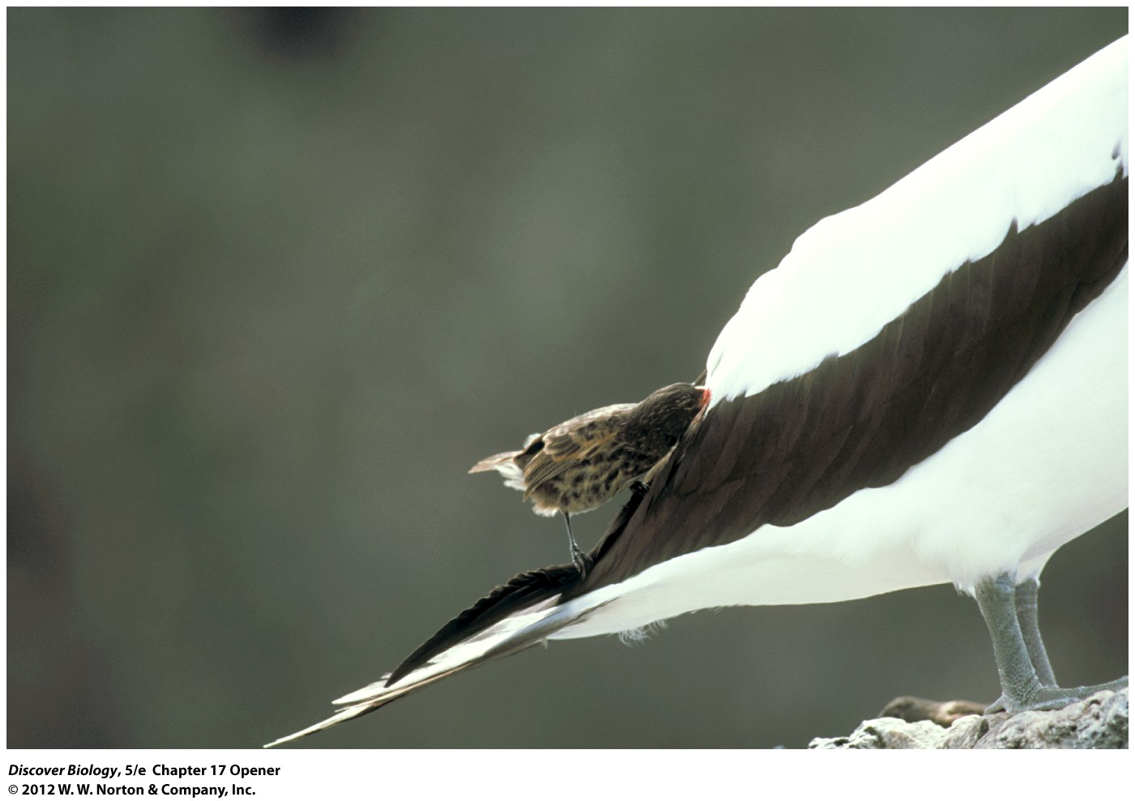
Vampire Finches Suck (blood)
We’re (eventually) going to talk about why
But first…..artificial selection
Notes:
Vampire finch.
This subspecies of the sharp-billed ground finch lives on two of the Galápagos Islands. In addition to eating insects, the birds drink nectar from flowers, the contents of eggs, and sometimes, the blood of other birds. Scientists speculate that the strange diet may be driven by the scarcity of fresh water on the islands inhabited by this subspecies.

Slide 4
Artificial Selection
When people change the genetic makeup of a population
Requires two things
  Variation between organisms (different alleles)
  A selective pressure (people choosing)

Slide 5
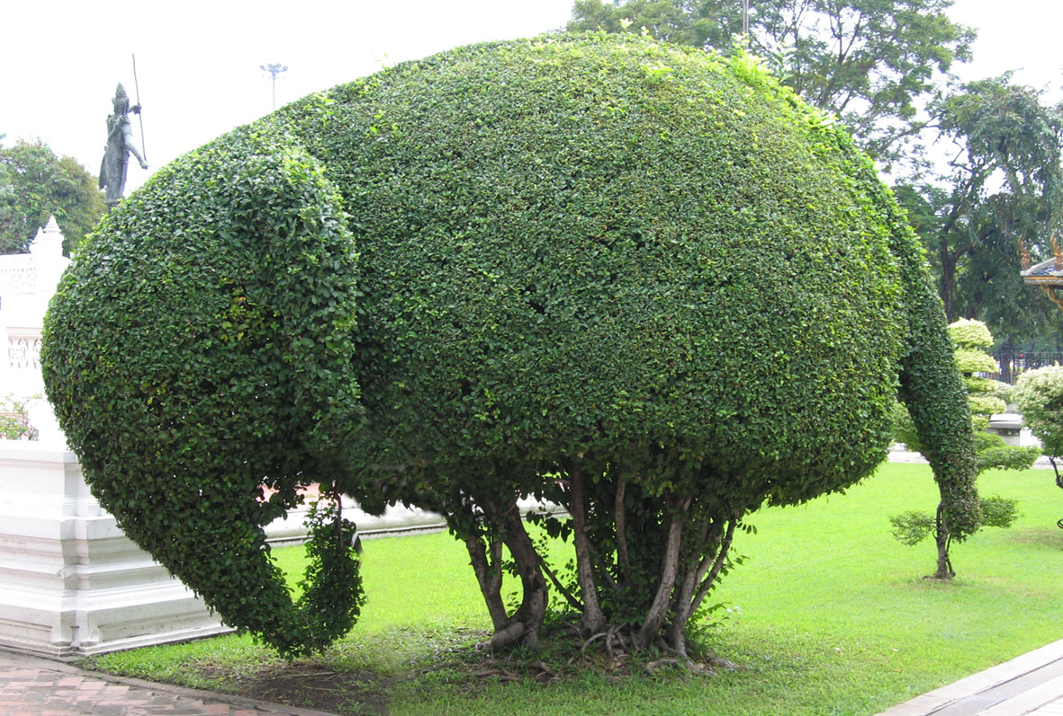
Selection: bring me a shrubbery
Random branch growth
Pruning branches that grow in the wrong direction
Eventually your bush looks like an elephant

Slide 6
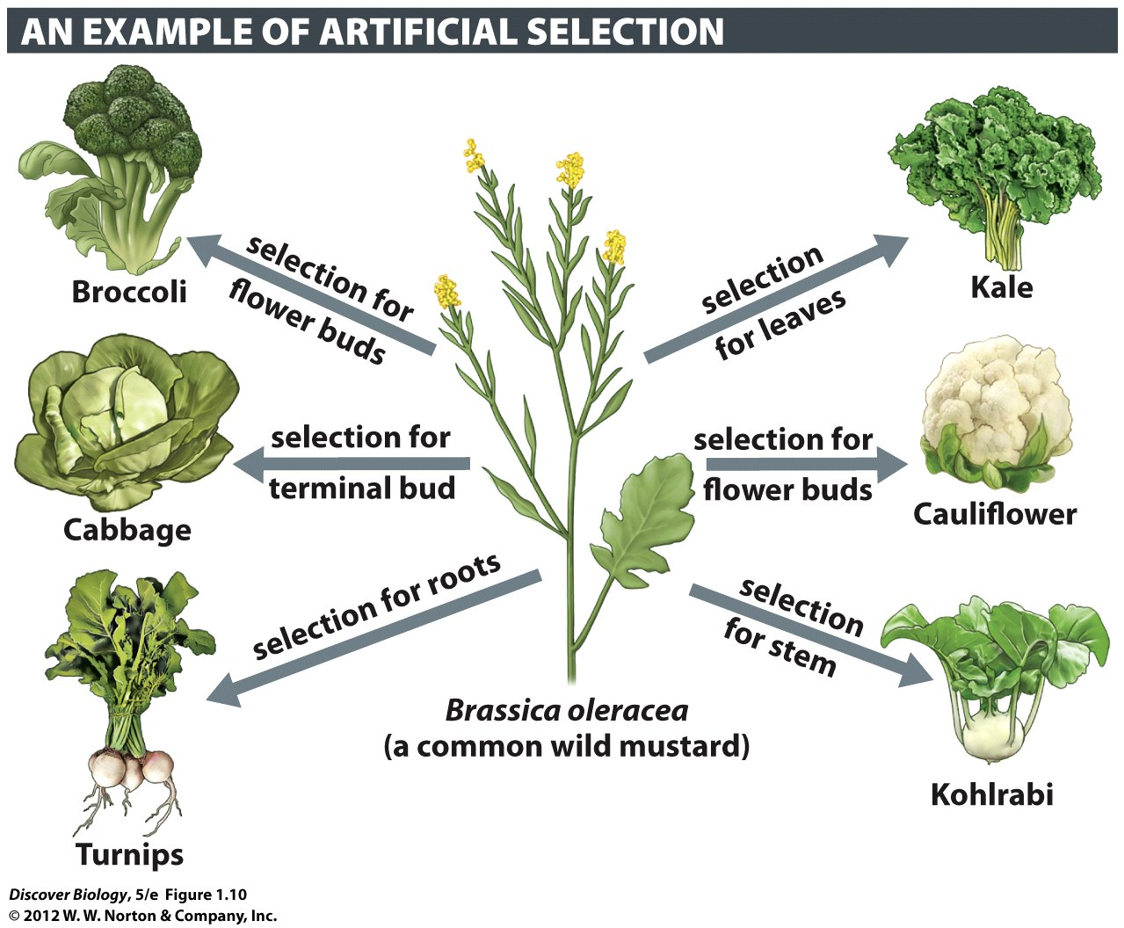
Notes:
Figure 1.10 Evolution of Wild Mustard through Domestication
In artificial selection, humans are the selective agents. The many different varieties of cruciferous plants were created by humans through selective breeding of genetically varied wild mustard plants. Individuals with desired genetic characteristics were bred with each other until their descendants became distinctly different from the ancestor, the wild mustard.

Slide 7
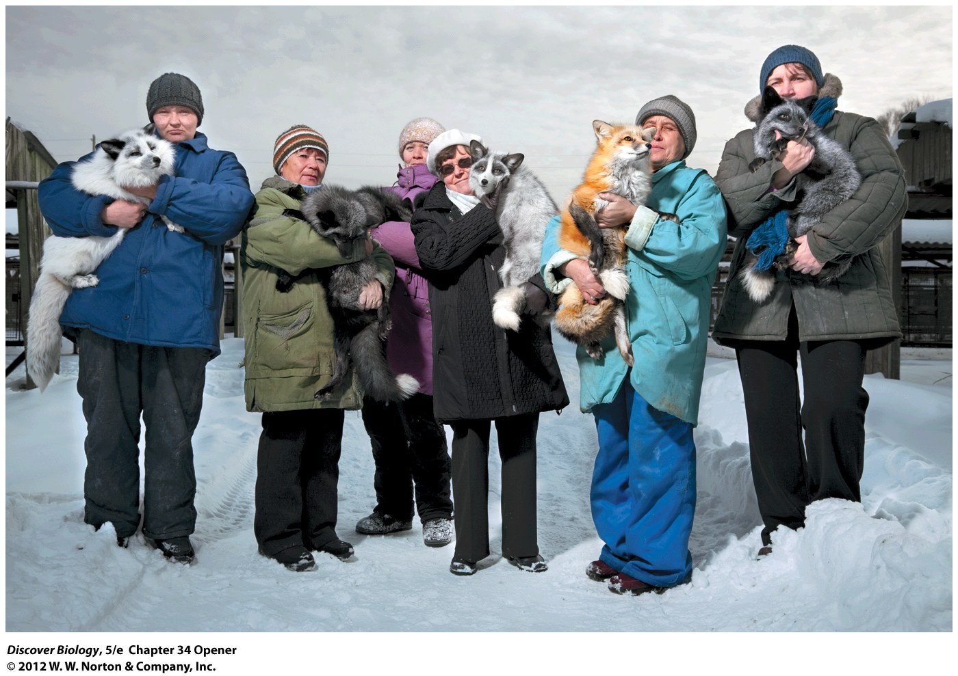
Notes:
Domesticated Siberian Silver Foxes. Not just hand-raised descendants of wild foxes, these foxes have been bred since 1959 only to respond positively to humans. In the process of genetic domestication, the foxes also evolved multicolored coats, curly tails, broader heads, and other traits typical of domesticated animals. Domesticated foxes, unlike their wild cousins, make great pets.

Slide 8
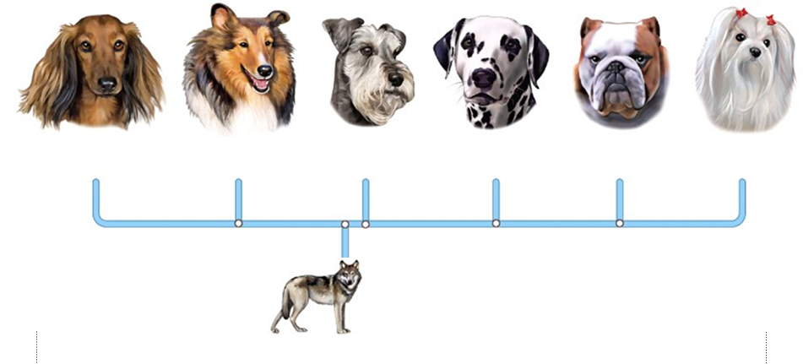
Artificial Selection
Variation
  Mutation creates different alleles
Requires Selective Pressure
  People choosing traits we like
  Letting organisms with that trait breed

Slide 9
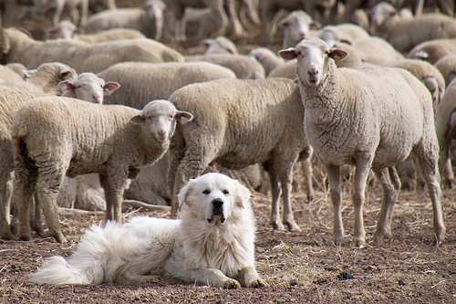
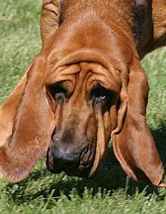
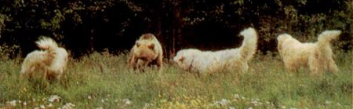
Many Types of Dogs
We used Artificial Selection to make many kinds of dogs
Breeds created for very specific purposes

Slide 10
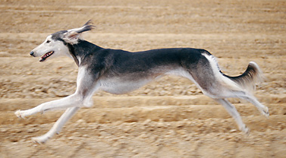
Selection: bring me a fast dog
Random variation
No breeding allowed for slow dogs
Eventually your population looks like salukis

Slide 11
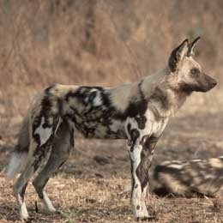
Selection: evolve a fast dog
Random variation
No breeding for slow dogs (they starved)
Natural Selection causes population to look like a cape hunting dog
“the non-random survival of random variants”

Slide 12
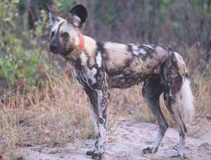
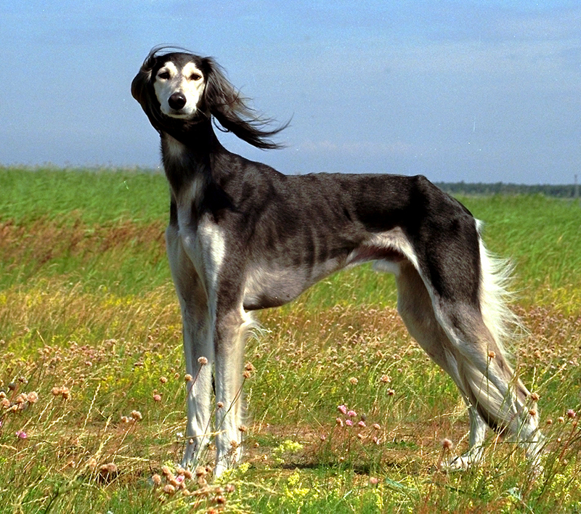
Fast dogs look similar
Similar lifestyle
Similar appearance
Long legs for big stride
Tucked waist
    Maximum range of leg movement

Slide 13
Fast dogs look similar due to selection
Artificial selection:
Characteristics that people choose will become more common in population.
natural selection: characteristics that help you survive and breed become more common in a population
We choose who gets to breed
Long legs for big stride Tucked waist for Maximum range of leg movement

Slide 14
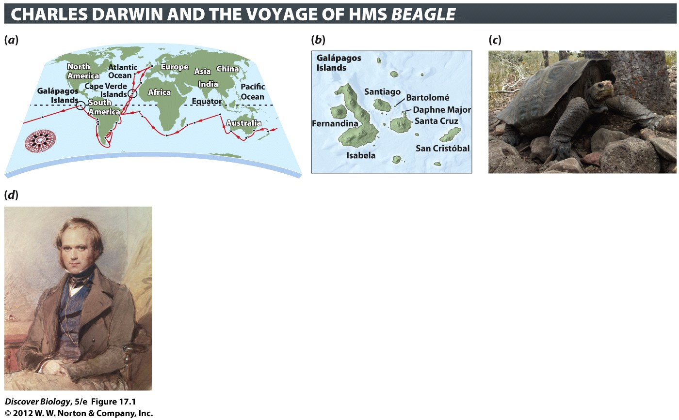
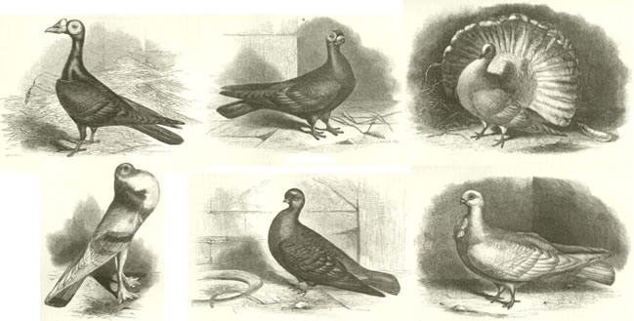
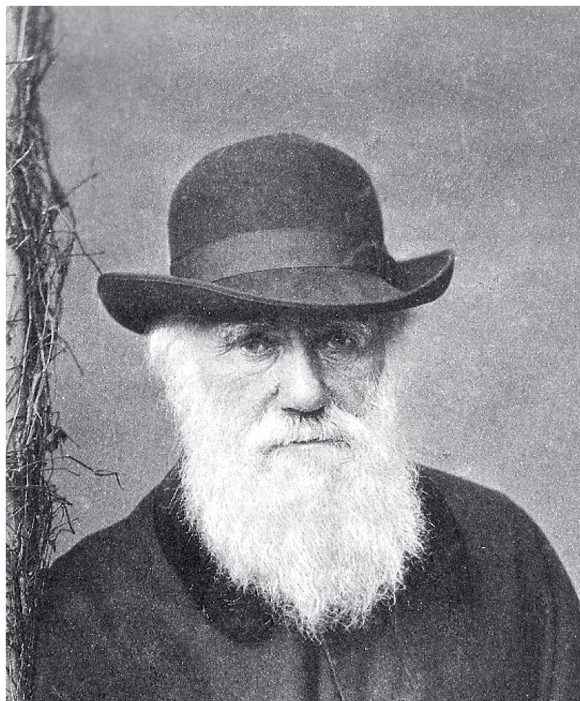
Darwin: Descent with Modification

Slide 15
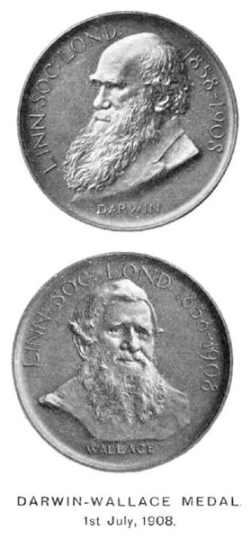
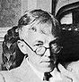
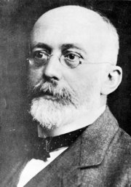
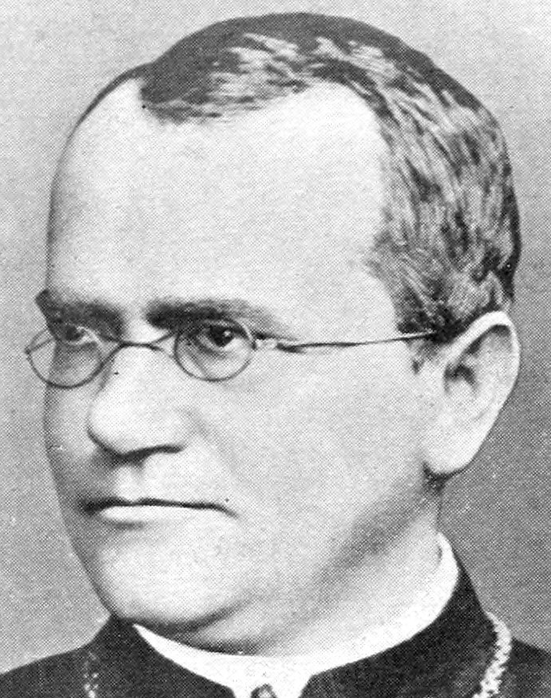
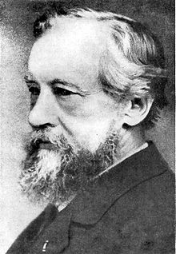
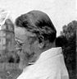
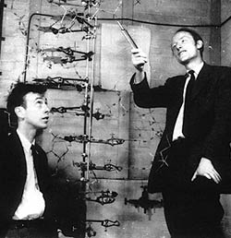
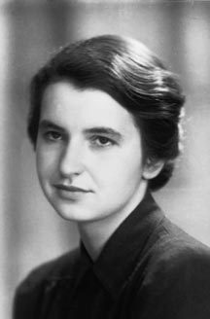
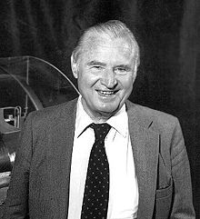
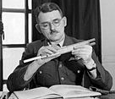
The “Somebody would have figured it out” principle

Slide 16
Natural Selection: Historical Context
What people had written before about nature
What people were doing (Victorian era hobbies)
Non-biology books that people were reading and talking about
Awareness of these things shape the thoughts of current scientists (also true in Darwin’s era)

Slide 17
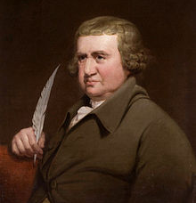
Erasmus Darwin: Older idea
Chuck’s Grandpa
Zoonomia (1796)
many current species may have descended from a single earlier
species
Would it be too bold to imagine, that in the great length of time, since the earth began to exist, perhaps millions of ages before the commencement of the history of mankind, would it be too bold to imagine, that all warm-blooded animals have arisen from one living filament, which THE GREAT FIRST CAUSE endued with animality, with the power of acquiring new parts, attended with new propensities, directed by irritations, sensations, volitions, and associations; and thus possessing the faculty of continuing to improve by its own inherent activity, and of delivering down those improvements by generation to its posterity, world without end!

Slide 18
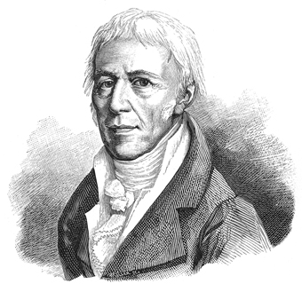
Lamarck: Older idea
Right: Decent with modification happens in the wild
Wrong: Mechanism
  Lamarck thought that the organisms automatically get traits they need

Slide 19
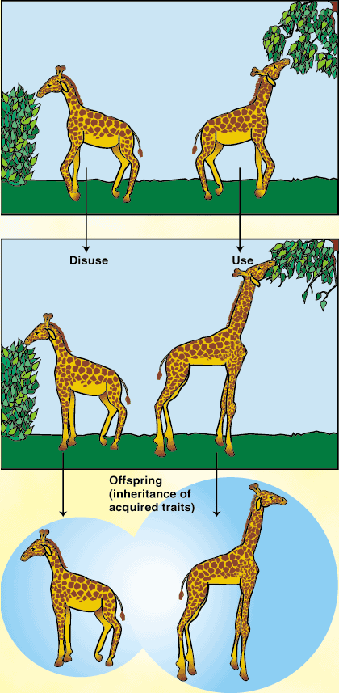
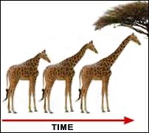
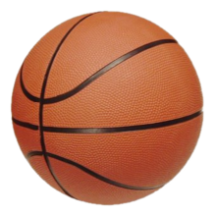
Lamarck: right idea, wrong method
I’ll never play
in the NBA

Slide 20
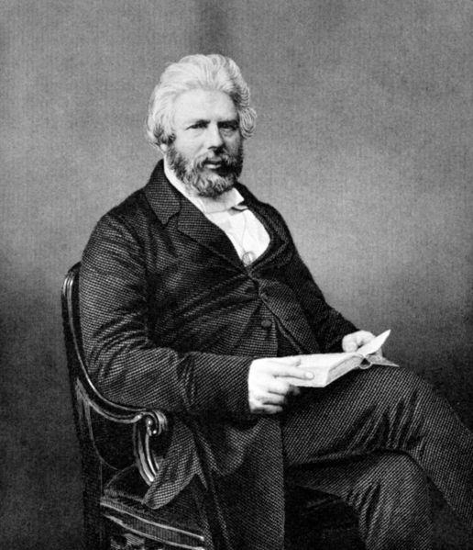
Robert Chambers, journalist
Vestiges of the Natural History of Creation
1844, published anonymously
“progressive transmutation of species”
Implied that it might
happen naturally
Controversial (chartists)

Slide 21
Victorian Hobbies
Selective Breeding (artificial selection) of plants and animals was a common hobby among the wealthy in Victorian England.
Well known fact: Selection can make the next generation of animals or plants different from this generation

Slide 22
Books people were talking about
Charles Lyle’s - Principles of Geology (1830-1833)
Big Changes = Many small changes over time
Augustin Pyramus de Candolle - "Nature's war“ (1820s)
(Plants are competing with each other)

Slide 23
Books people were talking about
Thomas Malthus - An Essay on the Principle of Population
(Human populations can grow beyond available resources.) (1798 – Darwin referenced after Beagle)
Robert Chambers – Vestiges of the natural history
species have changed
Darwin - ”calling attention to the subject, in removing prejudice, and in thus preparing the ground for the reception of analogous views.“
where Wallace got idea

Slide 24
Early Ideas: wrong mechanism
Grandpappy Darwin wrote Zoonomia (1796)
Lamarck lectured and wrote 1800-1822
Darwin’s Beagle trip was in 1831
    He was aware of these ideas before the trip

Slide 25
Darwin: 1832-1858 evidence

Slide 26
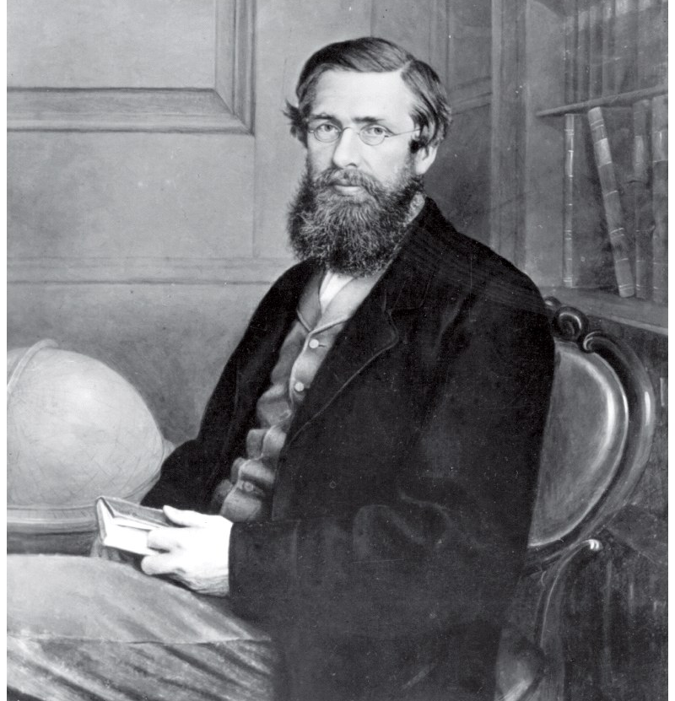
1848: Brazil with Bates
1854-1862: Southeast Asia
Different guy with same idea as Darwin
Only a slight modification of earlier ideas
  Earth is old, changes
  Species change
  Not everyone survives
  There’s competition
  That’s WHY they change
Wallace
They both figured out that differential reproductive success could change a species

Slide 27
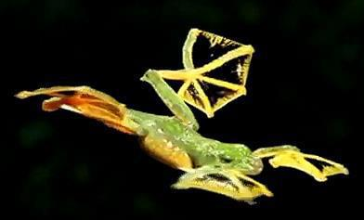
Darwin & Wallace: Similar background
Darwin & Wallace: traveled, saw new species
Many similar species, only found in that location
possibly descended from one older species
Their new idea: Natural Selection
Selection happens in the wild
      Different mechanism than Lamarck
“Descent with Modification” = now “evolution”

Slide 28

Darwin & Wallace: new species
Darwin & Wallace: traveled, saw new species
groups of similar species
only found in that location
possibly descended from one older species
Darwin: tortoises, finches
Wallace: Frogs, beetles, birds

Slide 29
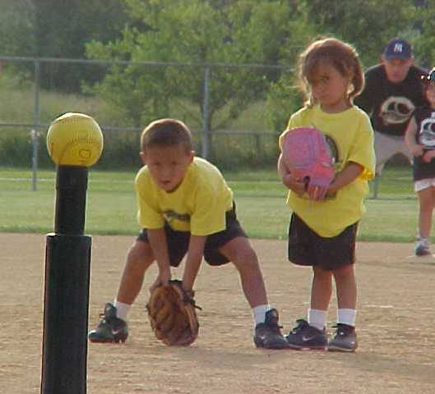
Natural Selection
Three basic needs
  Variation exists
  Competition exists
  winners pass on genes
Losing means you don’t get to breed
(you may also get eaten)

Slide 30
Mutations make Genetic Variation
Mutations: the source of all genetic variation
random changes in DNA sequences
create new alleles (version of gene)
mutations that can be inherited
change genetic composition of a population
(cause evolution)

Slide 31
Competition
For resources (food, water, territory)
For mates
Without these things you won’t be able to breed and pass on your genes to the next generation

Slide 32
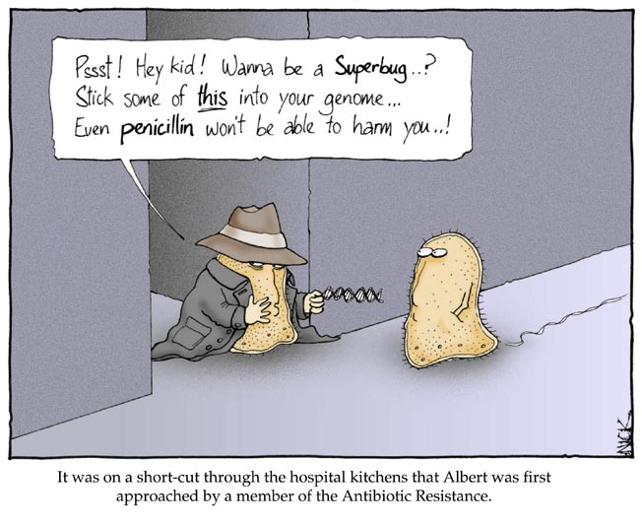
Winning: passing on your genes

Slide 33
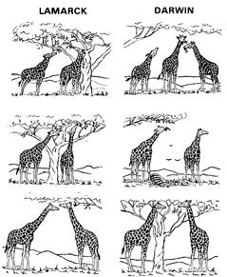
“Descent with Modification”: evolution
Change in A POPULATION over time
      Different mechanism than Lamarck
The Darwin/Wallace mechanism is now called natural selection

Slide 34
Natural Selection: What’s that?
Causes populations to change over time
This generation is different than the last one
the change in the population is evolution
Natural selection adapts a population to its environment
Natural selection is NOT random

Slide 35
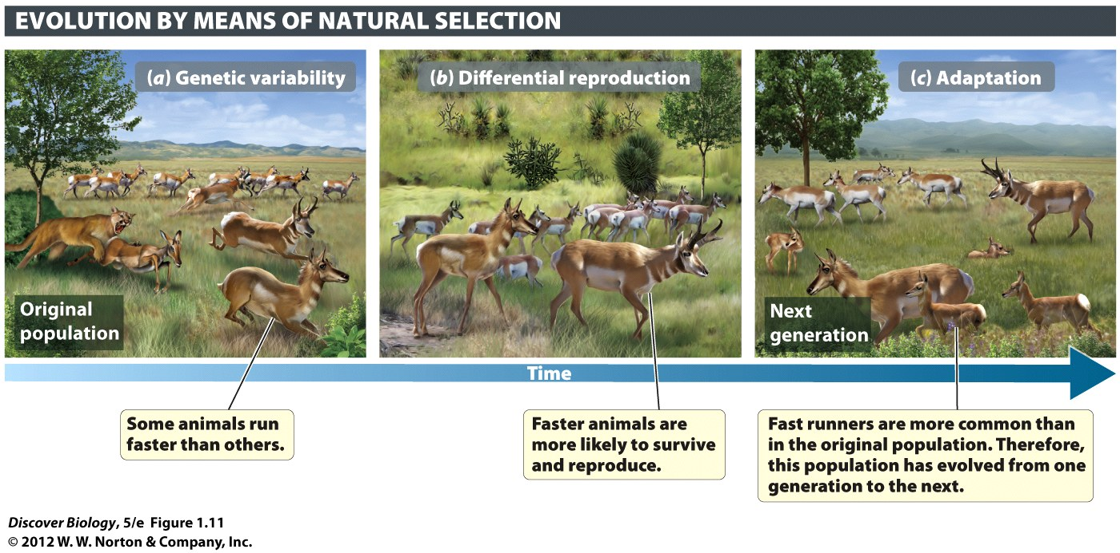
Slow antilope are tasty
  (and have few children)
characteristics that help you survive and breed become more common in population

Slide 36
Natural Selection: not random
Mutations (random) create variation
  Can be good or bad
  Create new alleles (variation)
Natural Selection chooses from this variation
Cougars eat slower pronghorn
  Faster pronghorn survive and breed
natural selection: characteristics that help you survive and breed become more common in a population
“the non-random survival of random variants”

Slide 37
Natural Selection: The results
Natural Selection has created MANY species
Lots of organisms are good at what they do
Seem to fit their environment VERY well
Due to survival/breeding

Slide 38
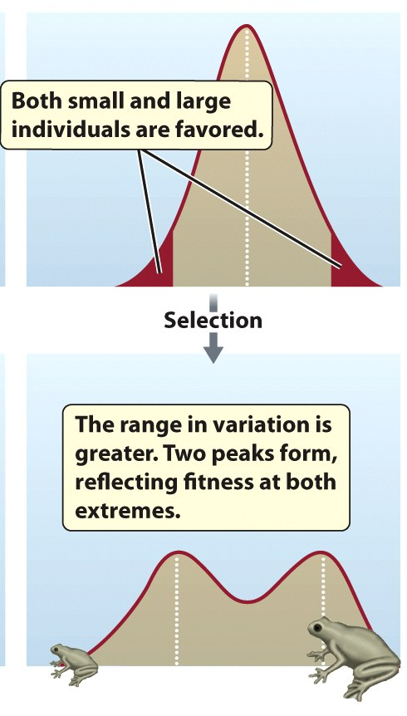
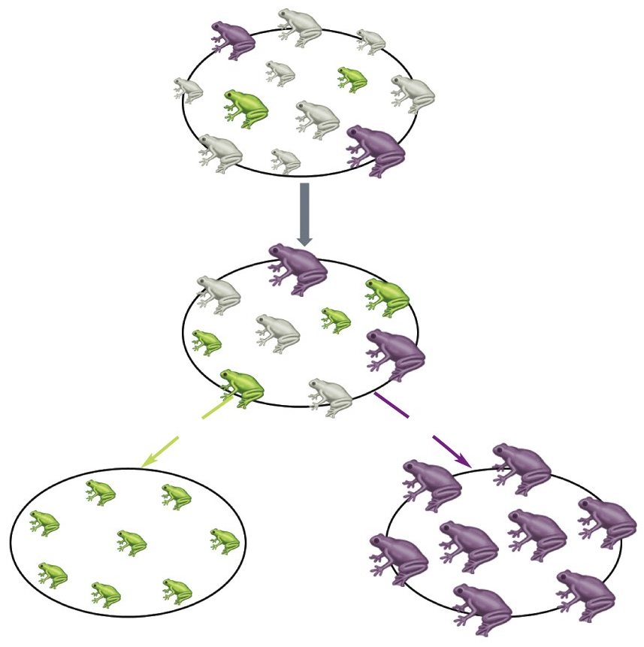
Notes:
Figure 17.2 Darwin Proposed Natural Selection as the Mechanism behind Species Formation

Slide 39
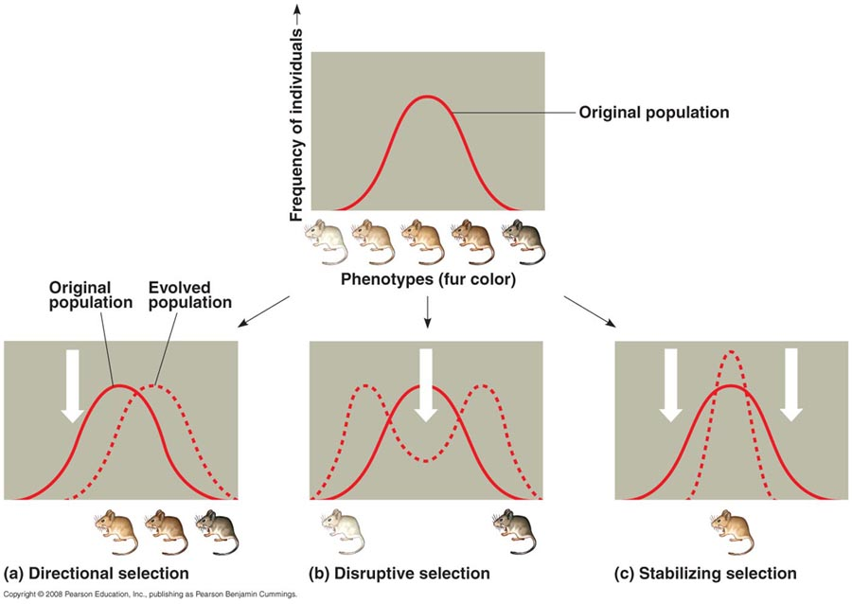
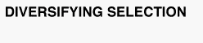
Know: 3 types of selection
Notes:
Figure 17.2 Darwin Proposed Natural Selection as the Mechanism behind Species Formation

Slide 40
Natural Selection: not random
Seem to fit their environment VERY well
Why?
      The ones that don’t are less likely to pass on their genes.
“the non-random survival of random variants”

Slide 41
Natural Selection: causes adaptation
Directional (NOT RANDOM)
alters population over time
organisms get better at their jobs
Why: Competition and success
loosers don’t get to pass on their genes
Works on phenotypes

Slide 42
Natural Selection: causes adaptation
If you’re better at your lifestyle, and can pass the gene on, you’ll probably have more kids in the next generation.
Adaptive traits: help you compete or survive
more likely to live long and have many kids
Population becomes better matched habitat
(has adapted to its environment)
takes lots of generations
is a form of evolution

Slide 43
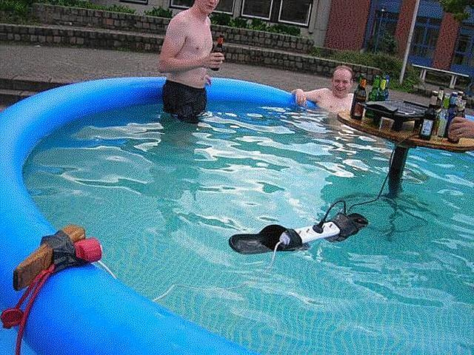
Reminder: Populations Evolution
Population evolve, not individuals
evolution = change in alleles of a population
All the genes in a population = “gene pool”
Some are removed
from the gene pool

Slide 44
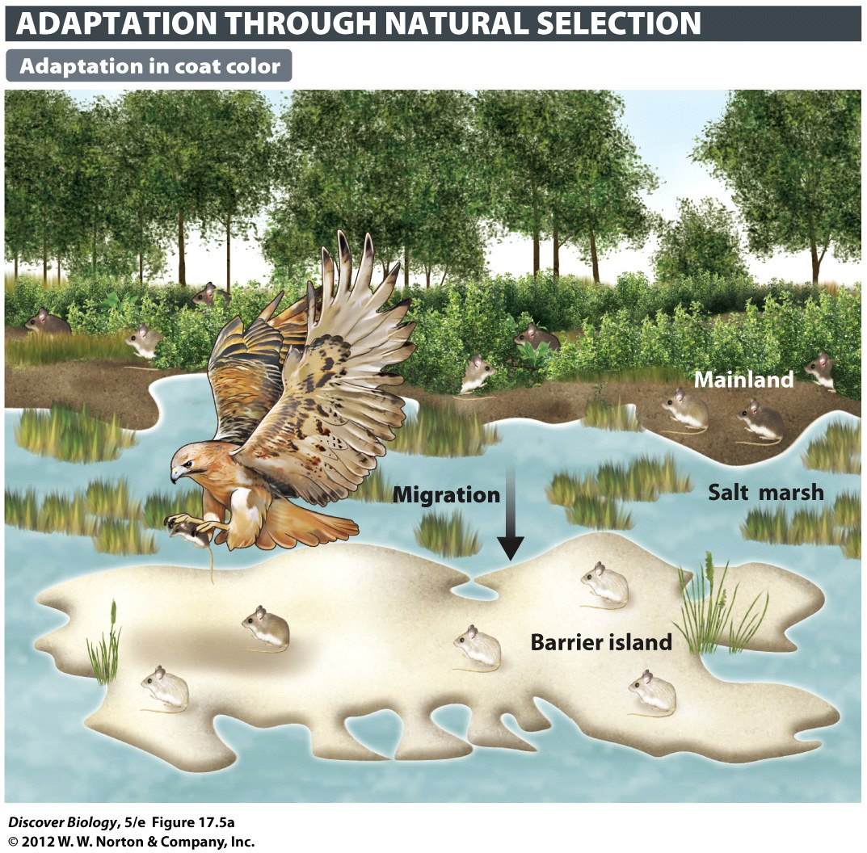
Notes:
Figure 17.5a Natural Selection Adapts a Population to Its Environment
Researchers studied subspecies of a deer mouse (Peromyscus polionotus) that inhabit each of eight barrier islands off the coast of Florida. Darker and more extensive areas of pigmentation are most common among the mainland subspecies (called the oldfield mouse). (a) The barrier island subspecies, known as beach mice, tend to have paler coats and reduced areas of pigmentation on the back.

Slide 45
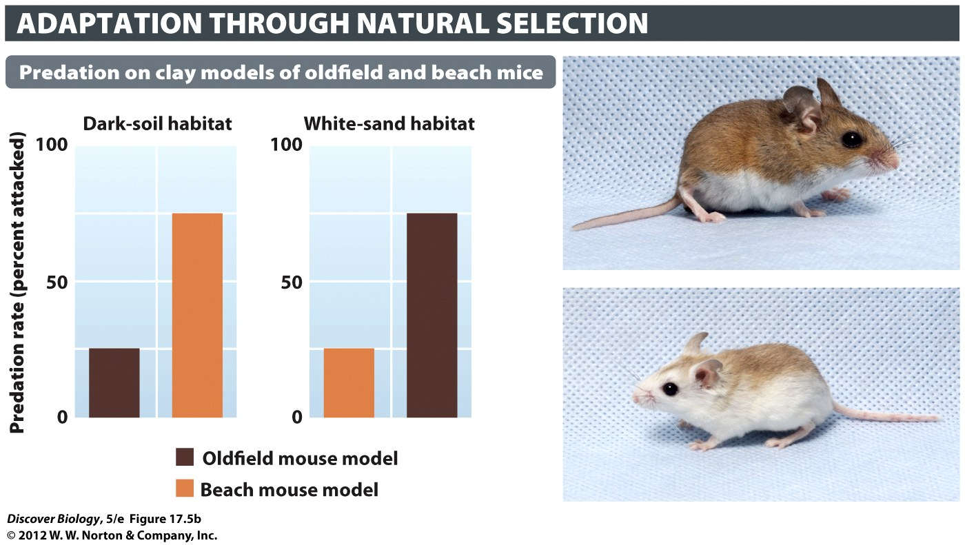
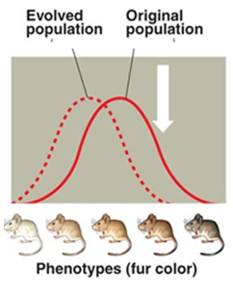
Island mouse phenotype becoming different from mainland mice
Notes:
Figure 17.5b Natural Selection Adapts a Population to Its Environment
Researchers studied subspecies of a deer mouse (Peromyscus polionotus) that inhabit each of eight barrier islands off the coast of Florida. Darker and more extensive areas of pigmentation are most common among the mainland subspecies (called the oldfield mouse). (b) Researchers used clay models of oldfield mice and beach mice to test the hypothesis that predators will see and attack coat patterns that contrast with their background.

Slide 46
Species in the Galapagos
Darwin saw lots of new species in the Galapagos
Many were unique to those islands
similar to a species found on mainland
Explanation: common ancestor
descent with modification

Slide 47
Darwin’s Finches: Evolution in Action
After returning to England, Darwin concluded that all the finches in the Galápagos Islands were descended from a single species from the mainland that had split into a dozen new species
The Galápagos Islands serve as a natural laboratory for studying evolution, with the 14 species of finches found there serving as one good example

Slide 48

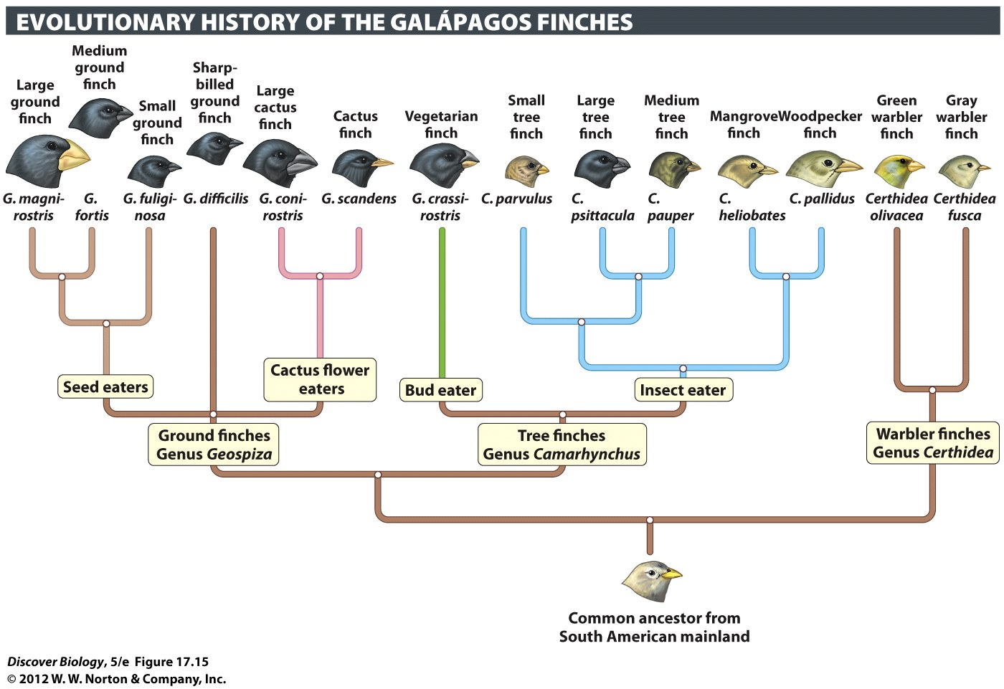
Notes:
Figure 17.15 Unique Species of Finches Evolved in the Galápagos Islands
This evolutionary tree is based on comparison of DNA sequences from each of the 14 species. The descendants of the ancestral form diverged into different evolutionary lineages as they adapted to diverse environments and different diets.

Slide 49
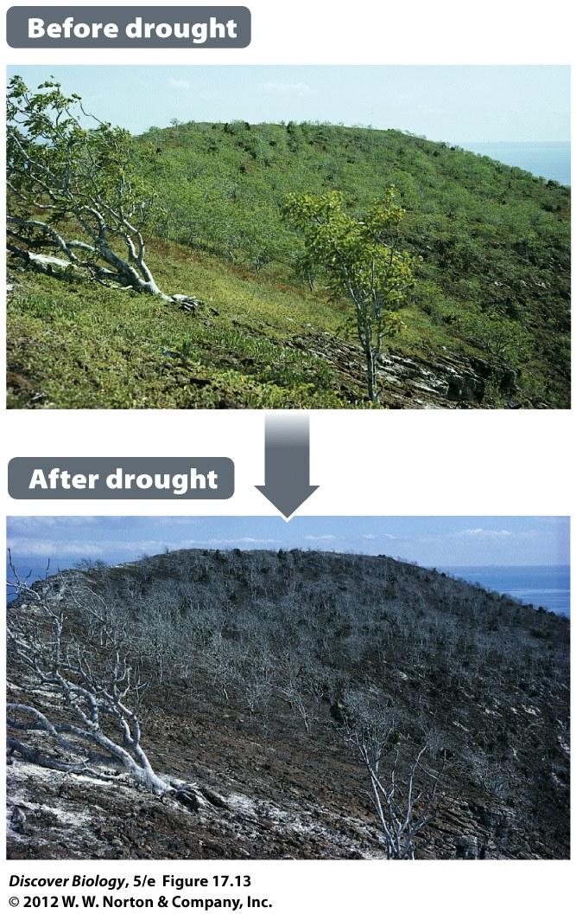
Notes:
Figure 17.13 A Drought Results in Rapid Evolutionary Change
The 1977 drought on Daphne Major in the Galápagos Islands had a dramatic effect on the plant life there, setting the stage for natural selection to cause rapid evolutionary change in birds that depended on the plants for food.

Slide 50
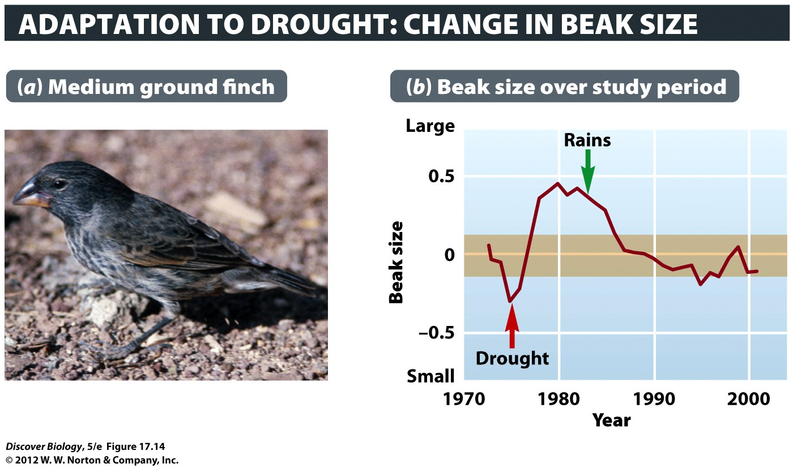
Notes:
Figure 17.14 Evolutionary Change within a Species
Scientists have been studying the medium ground finch (a) on the Galápagos island Daphne Major for more than 30 years. Average beak size increased in the population after a severe drought in 1977. When rainfall resumed, natural selection drove the evolution of smaller beaks (b). The orange-colored band indicates the range of values that would be expected without evolutionary change.

Slide 51
Evolution:
a change in the genetic makeup of a population
Other ways:
Sexual selection
Mutation
Gene Flow
Genetic Drift
bottleneck
founder’s effect
Natural selection is not the only way that evolution happens!!!

Slide 52
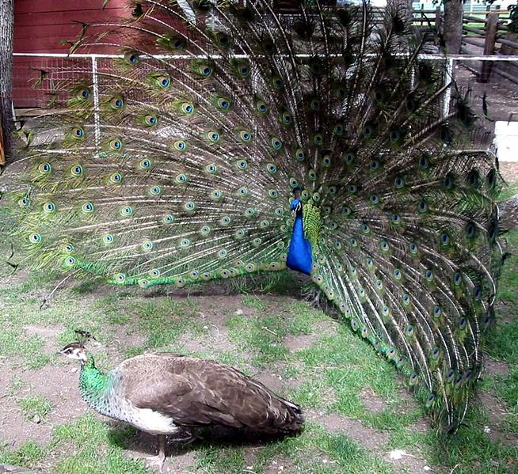
You need to attract a mate!!!
Sexual Selection:
The ladies can change a population by choosing who to mate with
This tail ➔ doesn’t help him survive
This change = evolution

Slide 53
Mutations = evolution
(new alleles in population)
Mutations create new alleles
random effect: You may NEVER get a good/useful mutation.
New alleles can make new phenotypes
Then, natural selection can act on alleles
Natural Selection chooses between the different EXISTING phenotypes

Slide 54
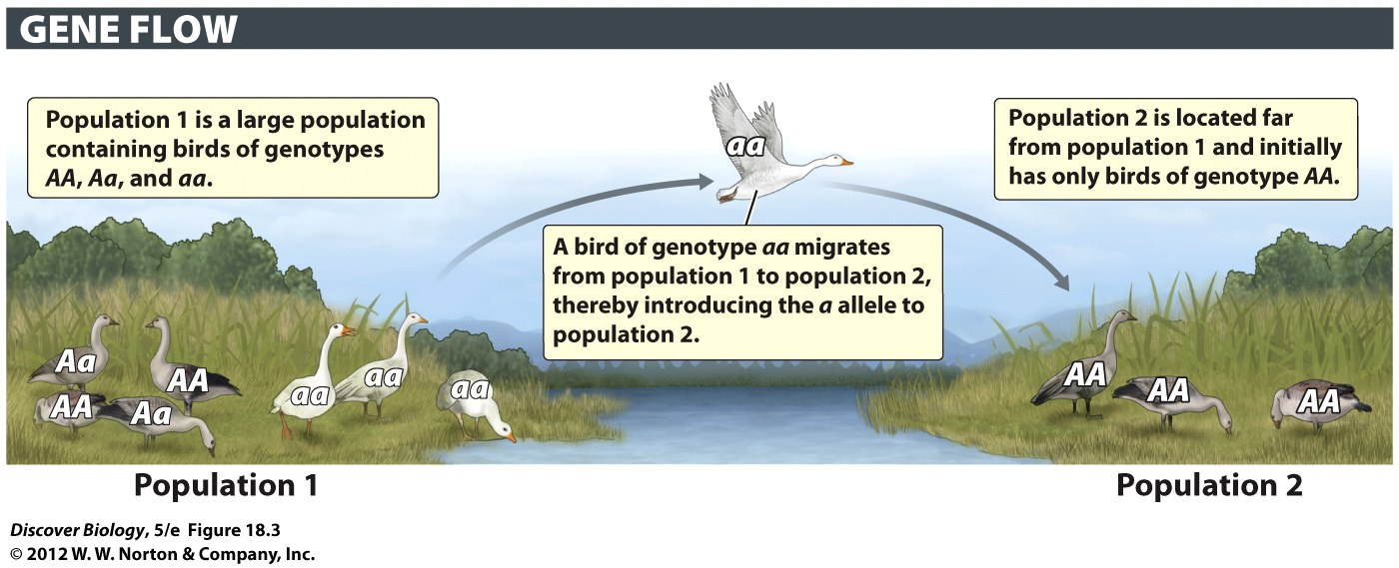
Gene Flow: Genes move between Populations
  Immigration = new alleles arriving in population
  Emmigration = loosing alleles from a population
This is a form of evolution!!!
(change in genetic makeup of a population)

Slide 55
Genetic Drift: accidents cause evolution
Catastrophe: most a population’s organisms die
The ones that survive are the ones that breed
The new population may be different than the old one
Uncommon allele ➔ common allele
common allele ➔ uncommon allele
Who survives to breed? Usually random

Slide 56

Fig. 23-8-3
C^{R} C^{R}
C^{R} C^{R}
C^{W} C^{W}
C^{R} C^{R}
C^{R} C^{R}
C^{R} C^{W}
C^{R} C^{W}
C^{R} C^{R}
C^{R} C^{R}
C^{W} C^{W}
C^{R} C^{R}
C^{R} C^{R}
C^{W} C^{W}
C^{R} C^{R}
C^{R} C^{R}
C^{R} C^{W}
C^{R} C^{W}
C^{R} C^{R}
C^{R} C^{R}
C^{R} C^{R}
C^{R} C^{W}
C^{W} C^{W}
C^{R} C^{R}
C^{R} C^{R}
C^{R} C^{R}
C^{R} C^{W}
C^{R} C^{W}
C^{R} C^{W}
C^{R} C^{R}
C^{R} C^{R}
Generation 1
Generation 2
Generation 3
p (frequency of C^{R}) = 0.7
p = 0.5
p = 1.0
q (frequency of C^{W} ) = 0.3
q = 0.5
q = 0.0
Notes:
Figure 23.8 Genetic drift

Slide 57


Genetic Drift: evolution by accident
Can loose entire alleles
(less genetic diversity in population)
more likely in small population
easier to cause big changes in population
Notes:
Figure 17.3 Genetic Variation in Happy-Face Spiders
Markings on the backs of happy-face spiders, which inhabit four of the Hawaiian Islands.

Slide 58
Genetic Drift: accidents cause evolution
Can loose entire alleles
(less genetic diversity in population)
more likely in small population
easier to cause big changes in population

Slide 59


Genetic Drift: The Bottleneck Effect
Very big population ➔ very small, VERY QUICKLY and IN THE ORIGINAL PLACE bottleneck effect
Survivors usually have different % of alleles
If the population remains small, it may be further affected by genetic drift
Small population = inbreeding

Slide 60



Understanding the bottleneck effect can increase understanding of how human activity affects other species

Slide 61



Genetic Drift: The Founder’s Effect
founder effect: a few individuals become isolated from a larger population
Allele frequencies in new founding population are different from original big population

Slide 62
Evolution explains lots of stuff
How new species are formed
Why very different organisms have same trait
because of ancestors = “homologous”
unrelated = “convergent”
Why structures still exist when their function is reduced or eliminated. (vestigial)

Slide 63
How new species are formed
Speciation: one species becomes two
why there’s so much “diversity” (# of species)
“sym”(same) + “patric”(place)
Sympatric speciation=happens in same place
“allo”(other) + “patric”(place)
Allopatric speciation=happens when populations are separated

Slide 64
Allopatric Speciation
Populations become geographically separated
Over time the separated populations may accumulate so many genetic changes that they are no longer able (or willing) to reproduce with each other

Slide 65

Notes:
Figure 19.10 The Grand Canyon Is a Geographic Barrier for Squirrels
The Kaibab squirrel is confined to the ponderosa pine forests on the north rim of the Grand Canyon. Abert’s squirrel lives on the south rim and also farther south on the Colorado Plateau and in the southern Rocky Mountains to Mexico. The Kaibab population became isolated from the Abert’s squirrels when the Colorado River cut a canyon—as deep as 6,000 feet in some places. With gene flow between them blocked, probably beginning about 5 million years ago, the Kaibab population diverged from the ancestral Abert’s squirrel. The two squirrels used to be considered separate species, but now most experts classify them as subspecies of the Abert’s squirrel, Sciurus aberti.

Slide 66

Same features: common ancestor
Homologous features: shared by organisms related by common descent
All mammals have
similar limb skeleton

Slide 67

Why organisms have same features
Converge: to come together
Convergent Evolution: when
natural selection causes organisms
to have similar adaptations
Similar lifestyles ➔ similar adaptations
Analogous features: similar features NOT due to a common ancestor

Slide 68

Convergent Evolution
Euphorbia (spurge)
Echinocereus [(cactus)
Hoodia, (milkweed)
Fleshy stems, spines, reduced leaves
Notes:
Figure 17.8 The Power of Natural Selection
(a–c) These three plants evolved from very different groups of leafy plants. They resemble one another because of convergent evolution: each was similarly driven by natural selection to adapt to life in a desert. Their shared structures (fleshy stems, spines, reduced leaves) are therefore analogous, not homologous. (a) Euphorbia [yoo-fohr-bee-uh] belongs to the spurge family and can be found in Africa. (b) Echinocereus [ee-kye-noh-seer-ee-us] is a cactus found in North America. (c) Hoodia, a fleshy milkweed, can be found in Africa. (d,e) Convergent evolution can be a powerful force shaping animals as well. Here we see how natural selection has caused two distantly related animals—sharks (d) and dolphins (e)—to look very similar. Sharks are a kind of fish; dolphins are mammals.

Slide 69
Convergent evolution
Streamlined body shape
Dorsal fin for stability
Wide pectoral fin/flipper to maneuver
Notes:
Figure 17.8 The Power of Natural Selection
(a–c) These three plants evolved from very different groups of leafy plants. They resemble one another because of convergent evolution: each was similarly driven by natural selection to adapt to life in a desert. Their shared structures (fleshy stems, spines, reduced leaves) are therefore analogous, not homologous. (a) Euphorbia [yoo-fohr-bee-uh] belongs to the spurge family and can be found in Africa. (b) Echinocereus [ee-kye-noh-seer-ee-us] is a cactus found in North America. (c) Hoodia, a fleshy milkweed, can be found in Africa. (d,e) Convergent evolution can be a powerful force shaping animals as well. Here we see how natural selection has caused two distantly related animals—sharks (d) and dolphins (e)—to look very similar. Sharks are a kind of fish; dolphins are mammals.

Slide 70

Convergent evolution
placentals & marsupials

Slide 71
Vestigial Organs
Reduced in size or development
Original function is absent or reduced

Slide 72



Function: Lizard legs
Walking
Holding onto Mate
Stimulating Mate

Slide 73



Skinks: Some have reduced legs

Slide 74



Florida’s Skinks: divided on issue of legs
Five lined (blue tailed) skink
“I love legs”
Glass lizard Worm Lizard
“We don’t need no stinkin’ legs”
http://ufwildlife.ifas.ufl.edu/snakes/leglesslizards.shtml

Slide 75


Reduced Function: Boa Constrictor
Very little left of legs
Function? Walking, holding mate, stimulate?

Slide 76


Vestigial Organs: Cave Tetra
Astyanax mexicanus (same species as above cave)
Cave populations have reduced, nonfunctional eye
Eyes no longer needed. No negative effect if mutations cause eyes to form wrong

Slide 77


Vestigial Organs: Whale Pelvis
reduced size, Not attached to vertebra
REDUCED FUNCTION
Can’t use for walking
Still attached to penis

Slide 78

They still have the genes for legs
http://news.nationalgeographic.com/news/2006/11/061106-dolphin-legs.html
2006, Taiji, Japan
Dolphin captured with
Four flippers

Slide 79
Evolution: 6 types of evidence
Six lines of evidence provide compelling support for biological evolution:
  Fossils
  Traces of evolutionary history in existing organisms
  Similarities and divergences in DNA
  Direct observations of genetic change in populations
  Continental drift
  The present-day formation of new species

Slide 80

Evolution Is Strongly Supported by the Fossil Record
Fossils are the preserved remains, or their impressions, of formerly living organisms
Intermediate species: fossils that have traits of both ancestor types and descendants
(“missing links”)

Slide 81


Intermediates: Archeopteryx
Bird traits
Feathers
Lizard traits
teeth
no big breast bone
long boney tail skeleton
thumbs

Slide 82

Intermediates: Horse Toes
Notes:
Figure 17.9 Fossils Reveal Descent with Modification in Horse Lineages
The evolutionary tree of the horse family (Equidae) is highly branched, as deduced from the fossil remains of more than 200 different species. Progressive changes in the anatomy, especially of the leg bones and teeth, are seen in some lineages.

Slide 83




Horses with extra toes
Atavism: an condition where traits that have been lost for generations reappear.
Why possible: still have those genes

Slide 84

Intermediates: Whales

Slide 85



Dorudon
Notes:
Dorudon
https://www.youtube.com/watch?v=uXhMtxgsGMs

Slide 86

Dorudon: front flippers had elbows

Slide 87

Intermediates: Whales
MANY intermediate fossils have been found for whales and dolphins

Slide 88
Fetal Traits: similar to others
Patterns of growth = possible evidence of evolutionary past
Early development may show clues of ancestry

Slide 89


Humans NEVER use gills
Human embryos get oxygen from umbilical chord, but they develop (and later re-absorb) gill structures.
Notes:
Human embryo, about 30 days after fertilization

Slide 90
DNA: evidence of evolution
Universal Code
Similarities in DNA sequences
    more similar in things we expect to be more related

Slide 91

DNA: evidence of evolution

Slide 92

Notes:
Figure 17.10 Independent Lines of Evidence Yield the Same Result
Cytochrome c is an enzyme that functions in aerobic respiration and is found in all eukaryotes. A pattern of evolutionary relationships among animals is based on the number of DNA sequence differences between the cytochrome c gene found in humans and other organisms. The pattern of evolutionary relationships shown here, in which humans are most closely related to rhesus monkeys and least closely related to moths, matches the pattern derived independently from anatomical features.

Slide 93
Genetic Changes within Species
We’ve seen it
We’ve done it (Artificial selection)

Slide 94
Continental Drift: what lives where
Slow movement of the continent
  continental drift, or plate tectonics
Scientists can use drift to explain where fossils are found
  Evidence of common descent & evolution

Slide 95

Notes:
Figure 17.12 The Biogeography of a Lungfish Reflects Its Evolutionary Past
Ancestors of the freshwater lungfish Neoceratodus fosteri (inset) lived during the time of Pangaea. N. fosteri fossils have been found on all continents except Antarctica. Currently found only in the orange-shaded region of northeastern Australia, this species is the only surviving member of its family. Red dots indicate places where fossils of N. fosteri’s ancestors have been found.

Slide 96

Oldest marsupial fossils in Americas
Radiated all over
Out competed everywhere except
Americas and Austrailia

Slide 97
New species formation: caused it, saw it wild
Primrose – made in the captivity (1900s)
Scientists have also directly observed new species forming in nature

Slide 98
Clicker Questions
CHAPTER 17
How Evolution Works

Slide 99
Concept Quiz
Of the following situations that pertain to
evolution, which one is false?
Organisms inherit traits from their parents.
Organisms can adapt to prepare their offspring for future events.
Evolution can happen by chance.
Notes:
The correct answer is B.
Students may feel compelled to answer choice C; evolution can happen by chance.
Remind them that evolution can happen in two ways: natural selection and genetic drift. Genetic drift is a random event.

Slide 100
Concept Quiz
Evolution is the change that occurs in
__________ over time.
A population
An organism
The environment
Notes:
The correct answer is A.
Populations can evolve over time, but an individual organism cannot evolve because its genes are mostly fixed at the time of conception.

Slide 101
Concept Quiz
Of the following, which term or phrase best
describes the process of natural selection?
Genetic drift
Differential reproductive success
Speciation
Notes:
The correct answer is B.
Natural selection is often described as the “survival of the fittest”.
The best adapted organisms have a better chance at a longer life, which gives them a better chance at reproduction.
Genetic drift is a random process and is evolution without natural selection.
Speciation may be the result of natural selection, but does not describe the process.

Slide 102
Free Biology Tutoring
Not Happy with your grade?
Not understanding the material?
Remember that the TLCC has

Slide 103
Relevant Art from Other Chapters
All art files from the book are available in JPEG and PPT formats online and on the Instructor Resource Disc

Slide 104



