Slide 1
Log into PAL
Have you taken the latest quiz?
When is your next paper due?
If you are not sure, you need to

Slide 2
Discover Biology
FIFTH EDITION
Anu Singh-Cundy • Michael L. Cain
CHAPTER 15
From Gene to Protein
© 2012 W. W. Norton & Company, Inc.

Slide 3
Proteins: you need them
Proteins essential to life, used for EVERYTHING
What enzymes do you have?
controls most phenotypes
e.g. mouse fur color
Idea from early 1900’s:
genes needed to make enzymes
wrong enzymes = metabolic disorders
BOTH TRUE

Slide 4
Genes Contain Information for Building RNA Molecules
Transcription: DNA➔ mRNA
Translation: mRNA ➔ protein
KNOW DIFFERENCES BETWEEN DNA and RNA
      __________________
      __________________
      __________________

Slide 5
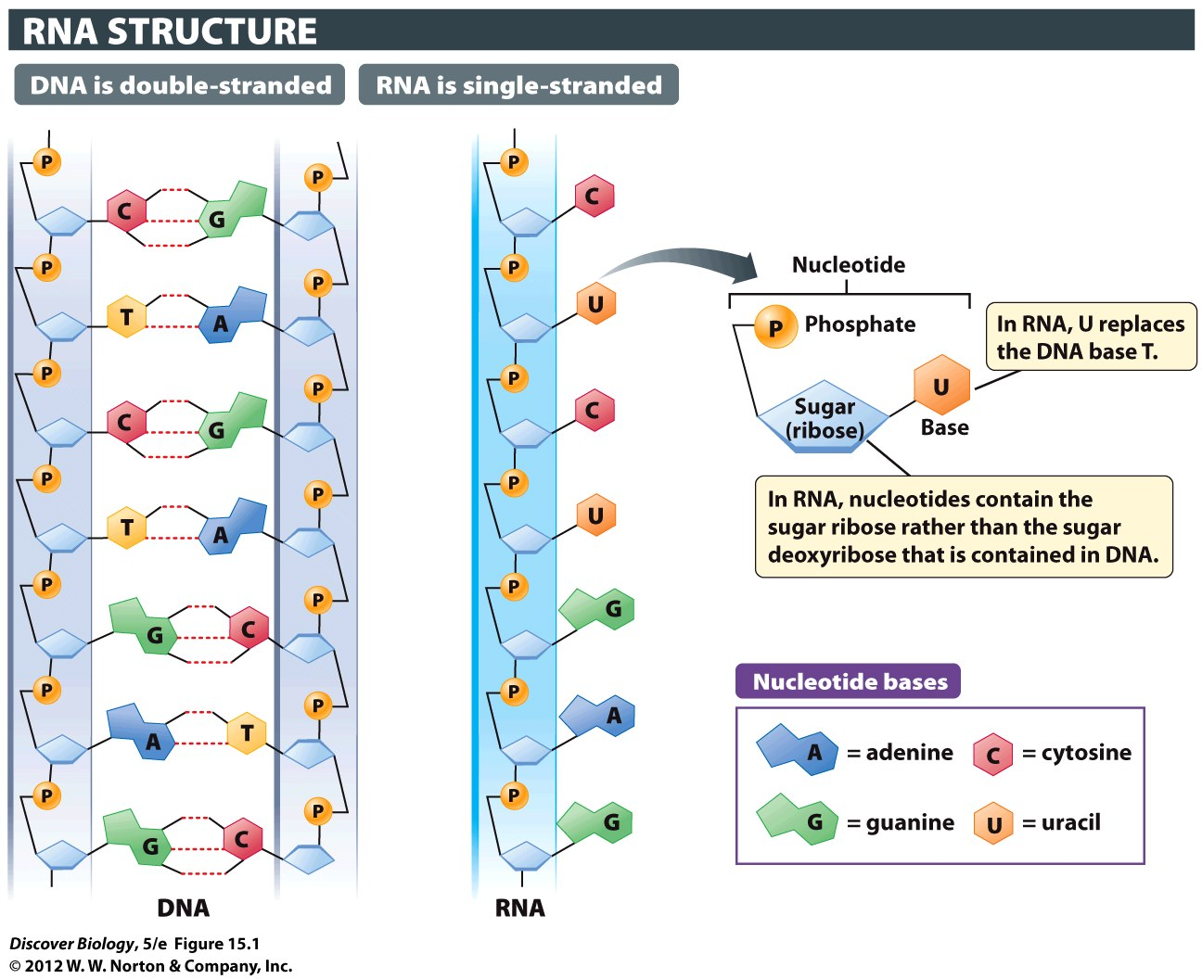
Notes:
Figure 15.1 RNA Is a Single-Stranded Chain of Nucleotides

Slide 6
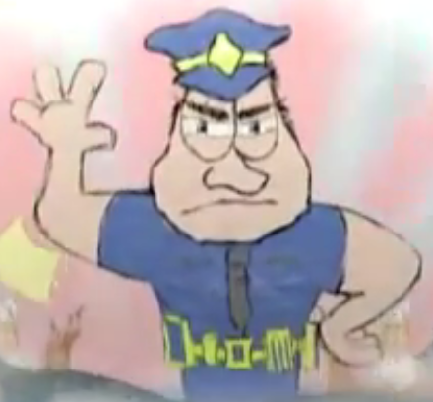
RNA: like DNA, but different
Still made of nucleotides
Used for many things:
  Messenger RNA (copy of recipe) = mRNA
  Biggest part of ribosome (chef) = rRNA
  Transfer RNA (helper chef) = tRNA
  Ribozyme (acts sort of like an enzyme)
  Shuts genes off quickly = siRNA (double stranded!!)

Slide 7
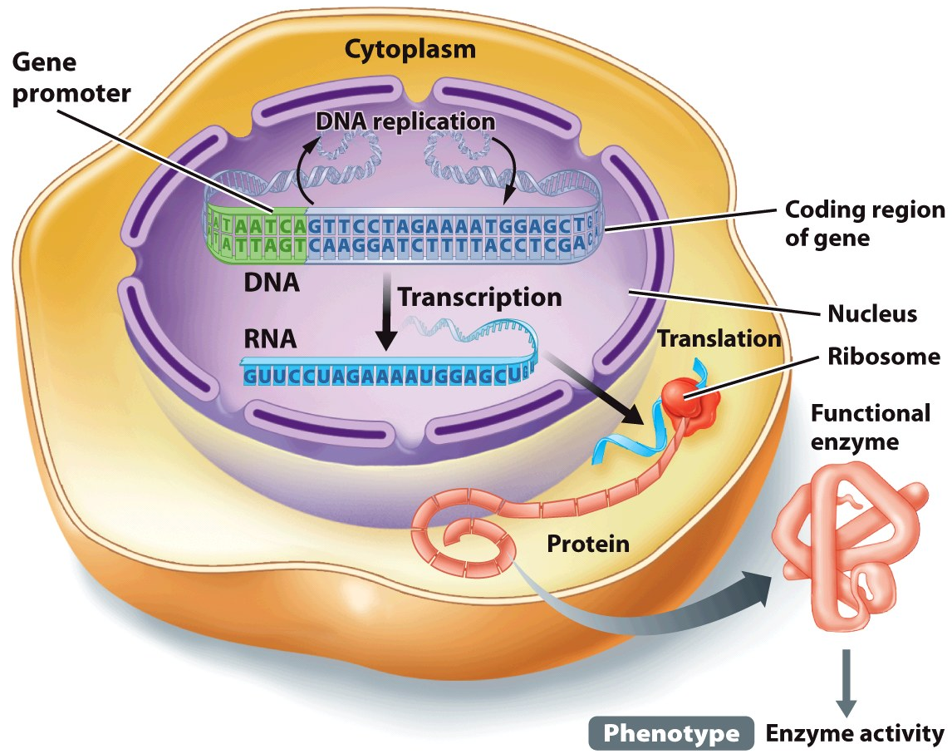
Genetic info and protein
Gene expression: what happens if we read a gene (DNA sequence) and do what it says
Usually, that is making a protein
Protein: chain of amino acids
  shape controlled by which amino acids
mRNA (copy of recipe) is read by ribosome(chef)
tRNA (helper chef) brings amino acids to ribosome
Amino acids (ingredients) used to make proteins

Slide 8
Three Types of RNA Assist in the Manufacture of Proteins
Cells use three main types of RNA molecules to construct proteins:
  Messenger RNA (mRNA) = recipe
  must “edit” first (remove introns)
  Ribosomal RNA (rRNA) = part of ribosome (chef)
  ribosome also contains protein
  Transfer RNA (tRNA) = helper chef
  brings amino acids (ingredients)
  to the ribosome

Slide 9
How Genes tell us to make Proteins
Codons of mRNA molecule say which amino acids to use
Ribosomes read mRNA
tRNA brings amino acids to ribosomes

Slide 10
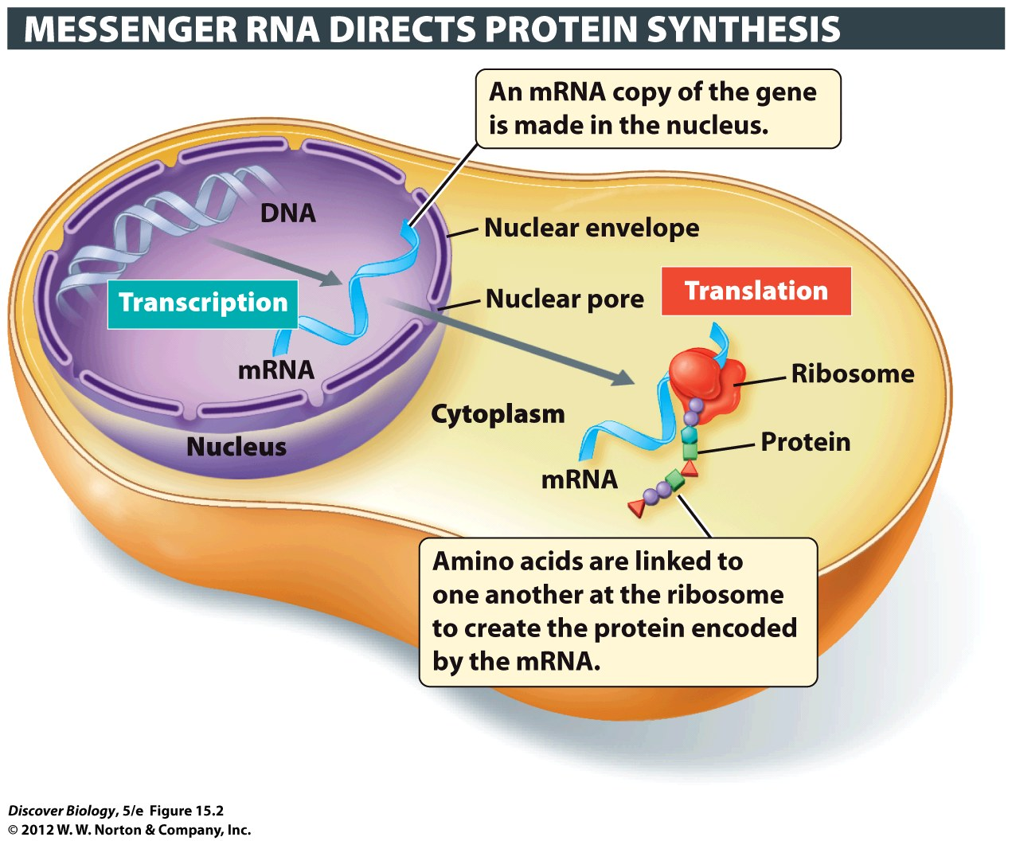
Notes:
Figure 15.2 Genetic Information Flows from DNA to RNA to Protein during Transcription and Translation
The transcription of a protein-coding gene produces an mRNA molecule, which is then transported to the cytoplasm, where translation occurs and the protein is made with the help of ribosomes. Different amino acids in the protein being constructed at the ribosome are represented here by different colors and shapes.

Slide 11
Transcription: Read DNA, make RNA
RNA polymerase = enzyme that reads DNA to make RNA
Reads tiny part of DNA (one gene)
RNA polymerase binds to promoter of DNA
Unwinds and unzips DNA.
(Smarter than DNA polymerase)

Slide 12

Transcription: Read DNA, make RNA
RNA polymerase binds to promoter DNA on template strand
Only one strand has promotor
RNA polymerase stops reading DNA when it gets to “terminator “

Slide 13
Nerd Words: Transcription vs Translation
Name | Process | Start Signal | Stop Signal
Transcription | Read DNA and make RNA | Promotor | Terminator
Translation | Read RNA and make Protein | Start Codon | Stop codon

Slide 14
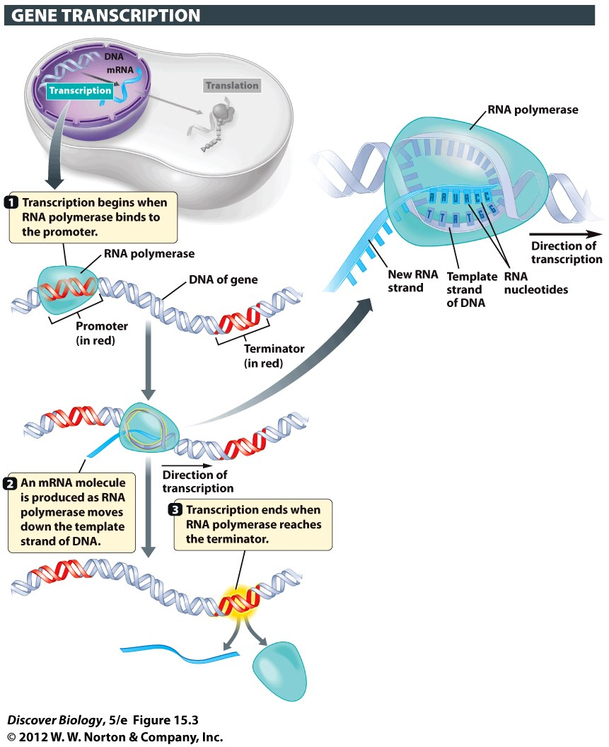
Notes:
Figure 15.3 RNA Polymerase Transcribes DNA-Based Information into RNA-Based Information

Slide 15
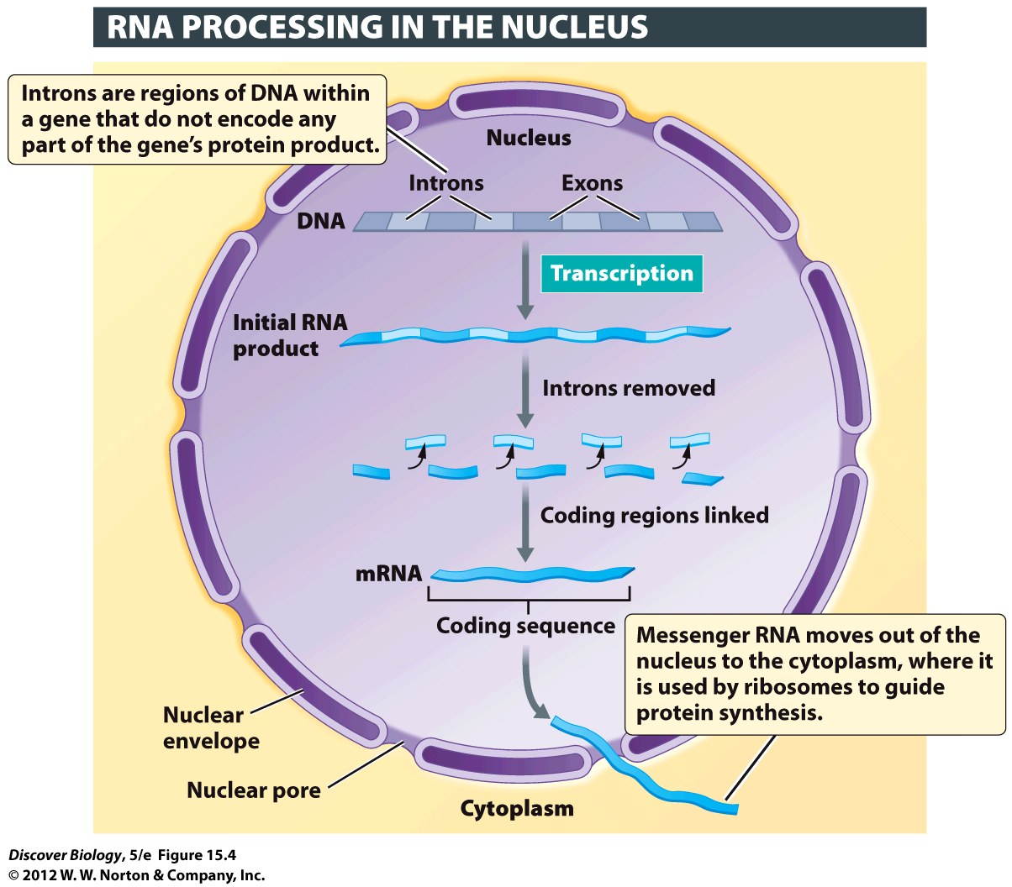
RNA splicing
mRNA is modified before leaving nucleus
mRNA (recipe) then leaves the nucleus
RNA splicing:
remove introns
join exons together

Slide 16
Info in RNA
RNA has “words” (codons)
written in “letters” (nucleotides)
three nucleotides
which amino acid to use
There are 64 codons that make up the information in the genetic code
Start @ start codon. End @ stop codon
1 start codon, 3 stop codons

Slide 17
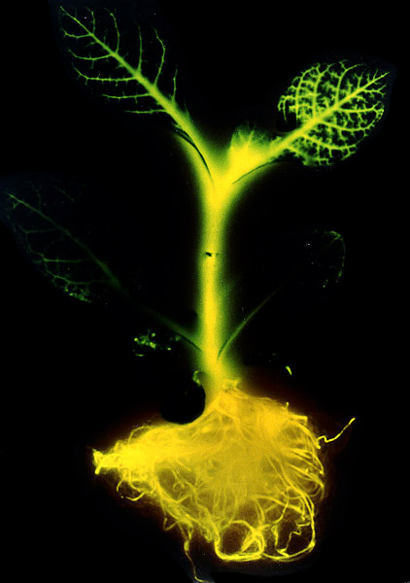
Codon System
Advantages of “genetic code”:
  It is unambiguous
  It is redundant
  It is universal (mostly*)
  Know those three
  and what they mean!!!
* - there are some variations
  http://www.ncbi.nlm.nih.gov/Taxonomy/taxonomyhome.html/index.cgi?chapter=cgencodes

Slide 18
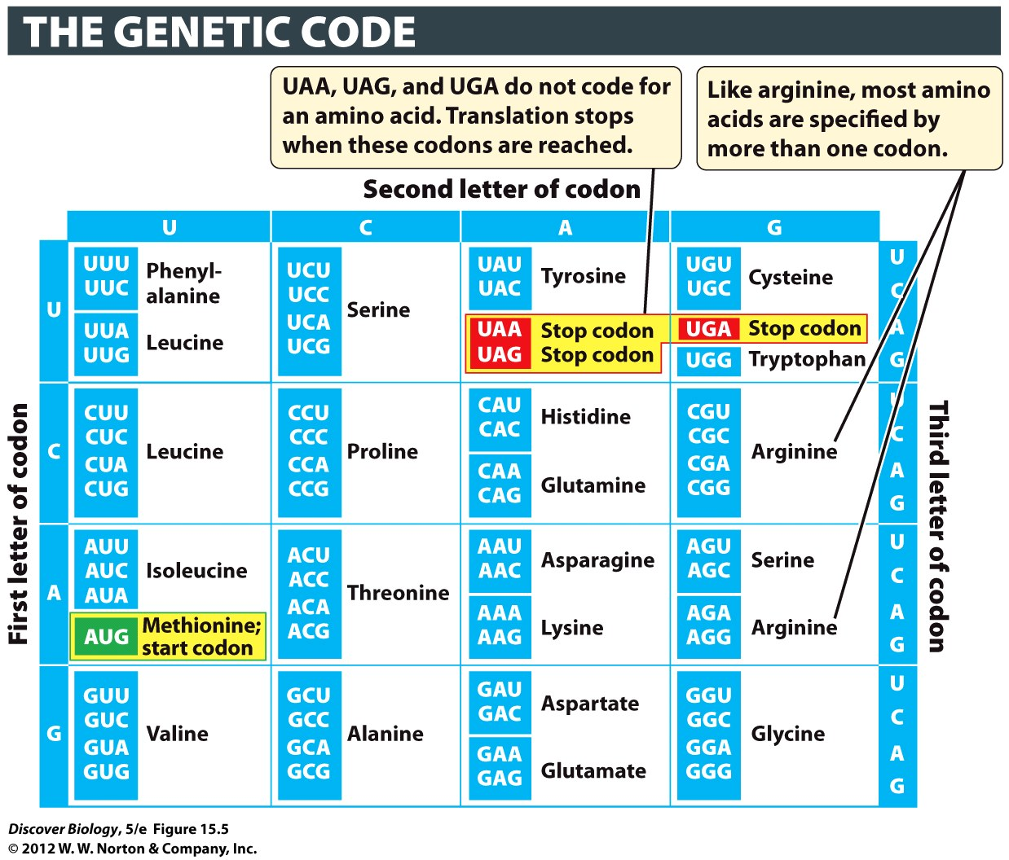
  (for us*)
  This chart is on your test
  Be able to read it
Notes:
Figure 15.5 The 64 Possible Codons Specify Amino Acids or Signals That Start or Stop Translation

Slide 19
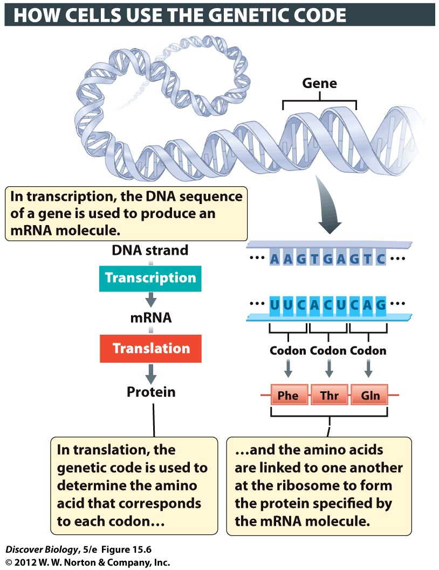
Notes:
Figure 15.6 The Genetic Code Is Read in Sets of Three Bases, Each Set Constituting a Codon

Slide 20
Translation: mRNA to Protein
Use codon information to choose correct amino acids for protein
Ribosomes: do translation (chef)
part rRNA, part Protein
20 kinds of tRNA (one for each amino acid)

Slide 21
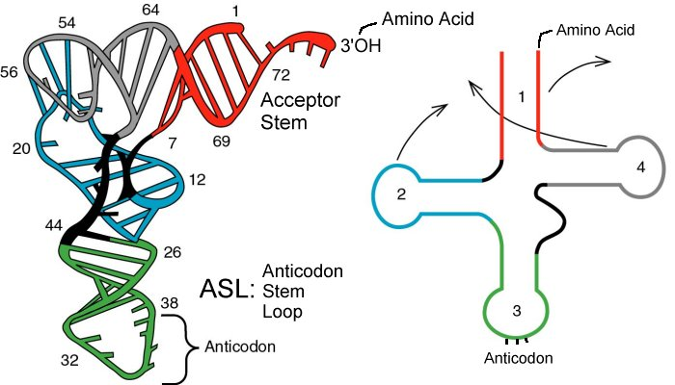
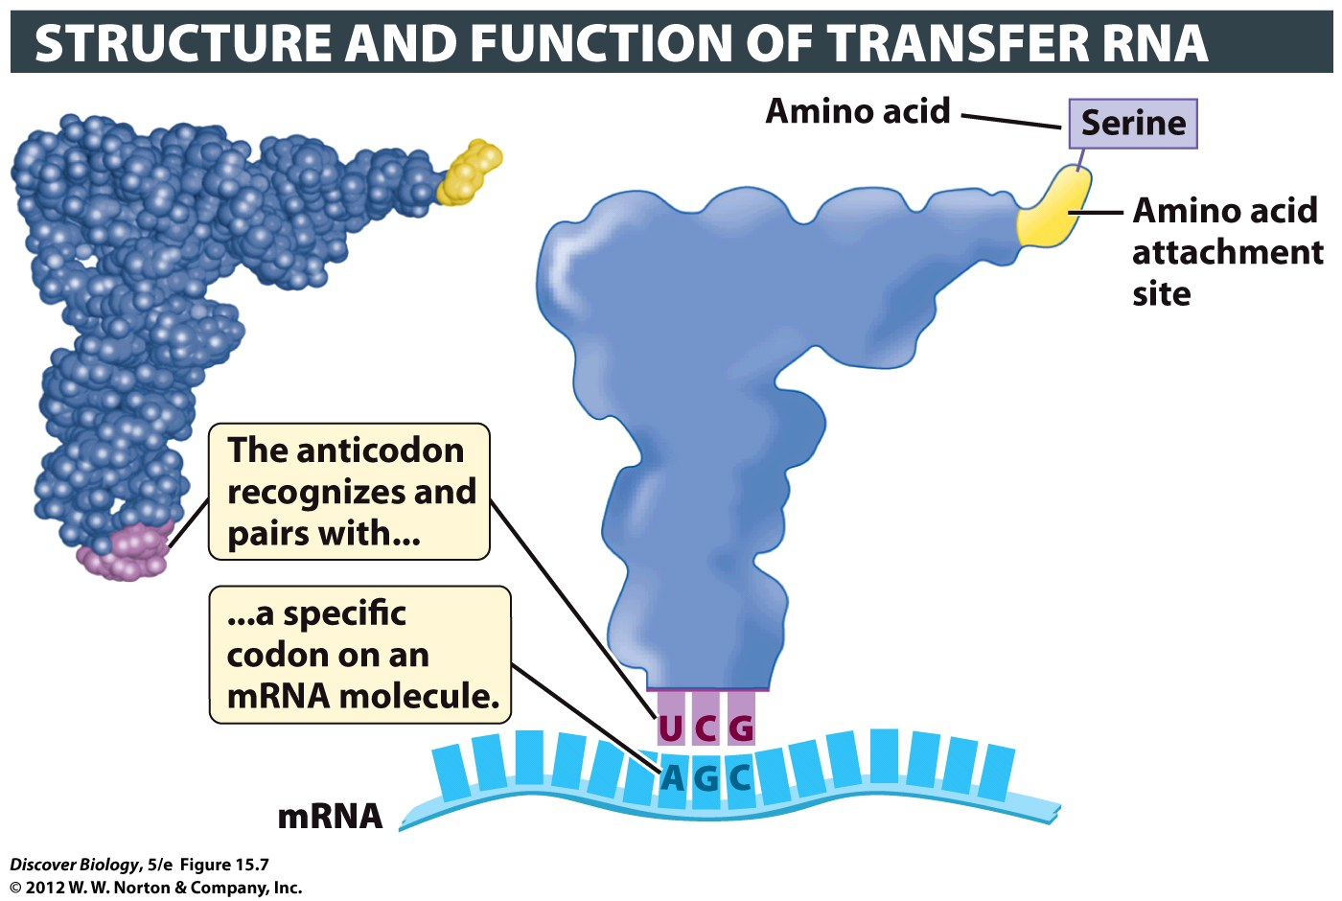
Notes:
Figure 15.7 Transfer RNA Delivers Amino Acids Specified by mRNA Codons
A space-filling-model (left) and a diagrammatic version (right) illustrate the general structure of all tRNA molecules. Similar regions in the space-filling model and on the diagram are shown in matching colors. Each tRNA carries a specific amino acid (serine in this example) and has a specific anticodon sequence (UCG in this example) that binds to a complementary three-base sequence (the codon) in the mRNA.

Slide 22
Translation: mRNA to protein
Anticodon: three RNA nucleotides at tip of tRNA
matches codon of mRNA
tells ribosome which tRNA to take amino acid from
Ribosome adds amino acid to growing protein chain
Stop codon: mRNA and protein chain leave ribosome

Slide 23
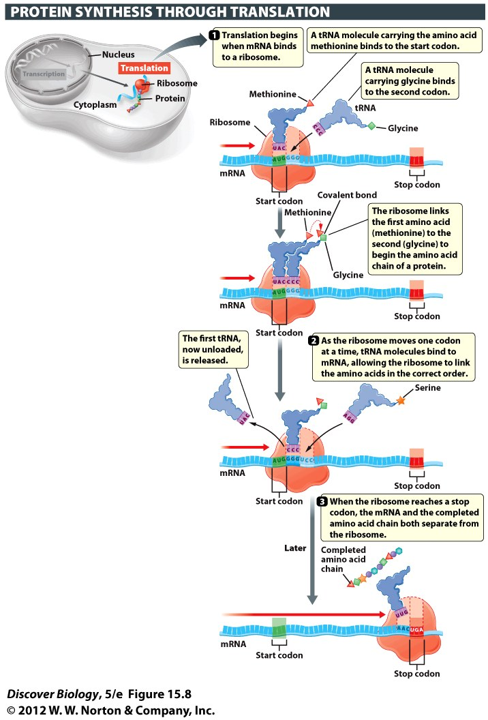
Notes:
Figure 15.8 In Translation, Information Coded in mRNA Directs the Synthesis of a Protein That Has a Particular Amino Acid Sequence

Slide 24
Mutations and Protein Synthesis
Changing base sequence of DNA can change the protein that is made
Can have no effect, minor effect, or horrible
Groups of similar amino acids behave the same way.
Little or no effect if same group is substituted

Slide 25
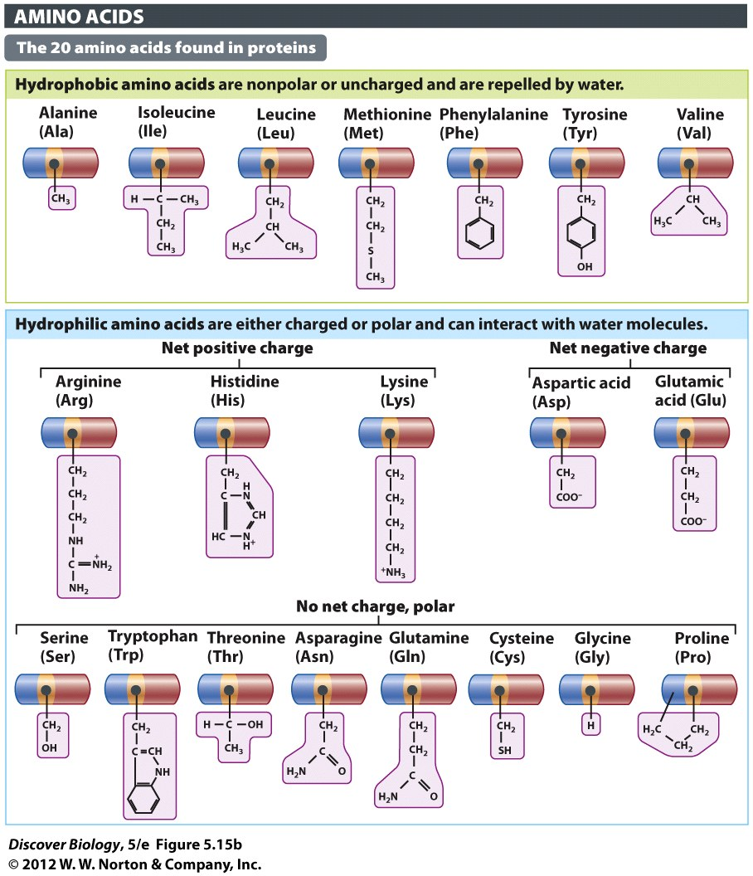
  Know which mutations are the most likely to alter protein
Hydrophobic
Hydrophilic, charged
Hydrophilic, uncharged
  This chart is on your test
  Be able to read it

Slide 26
Which mutation causes the biggest change?
AAA➔AAG
AAG➔AGG
AGG➔AUG
Which amino acids?
In same family?

Slide 27
Mutations Can Alter One or Many
Bases in a Gene’s DNA Sequence
There are three major types of mutations:
  Substitutions
  Insertions
  Deletions
Mutations in which a single base is altered are called point mutations
A substitution mutation occurs when one base is substituted for another in a DNA sequence

Slide 28
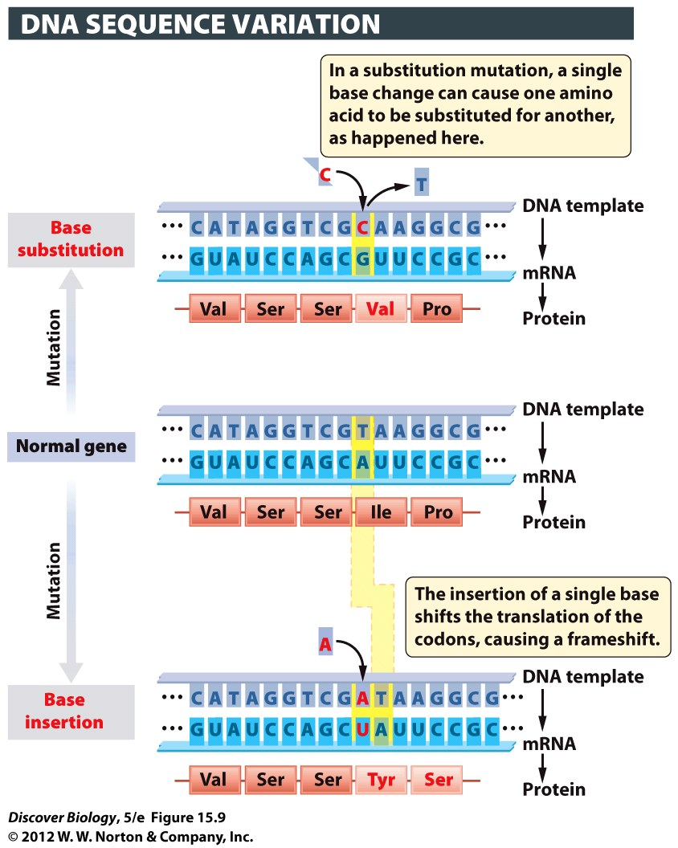
Subsitutions (point mutation):
May only change one amino acid
(exception: start/stop codon)
Frameshift:
Change everything after point of mutation
Notes:
Figure 15.9 A Change in the DNA Sequence Translates into a Change in the Amino Acid Sequence of the Protein
Two kinds of mutations are shown here: a substitution and an insertion. In each case, the mutation and its effects on transcription and translation are shown in red.

Slide 29
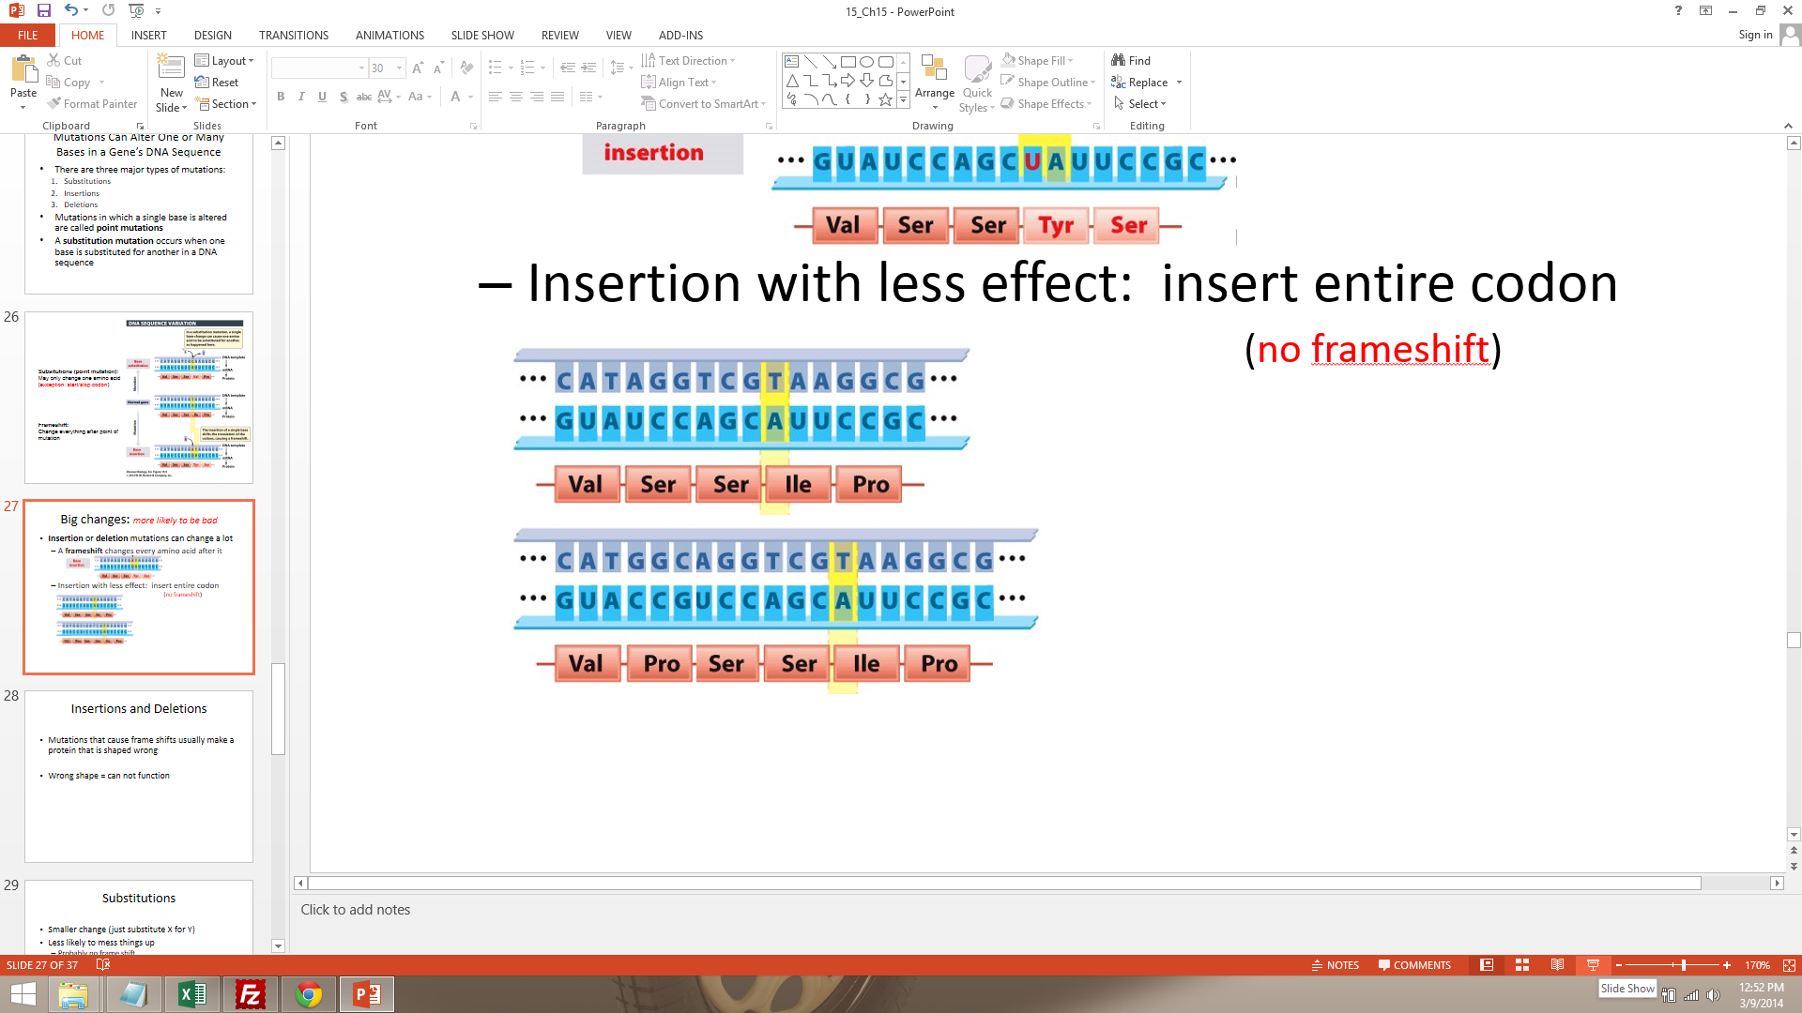
Big changes: more likely to be bad
Insertion or deletion mutations can change a lot
  A frameshift changes every amino acid after it
  Insertion with less effect: insert entire codon
                (no frameshift)

Slide 30
Insertions and Deletions
Mutations that cause frame shifts usually make a protein that is shaped wrong
Wrong shape = can not function

Slide 31
Substitutions
Smaller change (just substitute X for Y)
Less likely to mess things up
  Probably no frame shift
  Protein may or may not keep normal shape
If normal shape, has normal function
If abnormal shape, could be good or bad

Slide 32
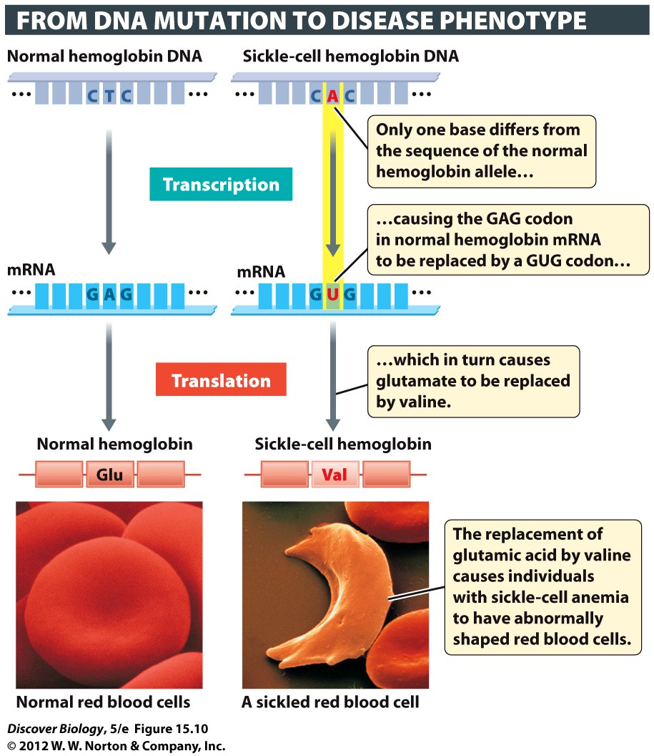
Notes:
Figure 15.10 Mutations in a Single Base in the Hemoglobin Gene Can Lead to Sickle-Cell Anemia

Slide 33
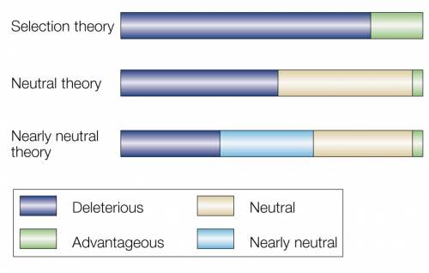
Mutations that don’t suck
“Silent Mutation” that does not change protein
No change in phenotype
Beneficial mutations: rare
improve protein function
usually a small change
Bromham & Penny (2003)
Old view
Current view: most mutations
Have little or no effect

Slide 34
Mutation: cause & effect
Can cause mutations:
  Mistakes in DNA replication
  Collisions of the DNA molecule with other molecules
  Damage from heat or chemical agents
Effect: Only mutations in gametes matter
if you can’t inherit it, it won’t have an effect on the population
(must pass on to cause evolution)

Slide 35
Clicker Questions
CHAPTER 15
From Gene to Protein

Slide 36
Concept Quiz
Which of the following is true?
Transcription occurs in the cytoplasm and produces RNA.
Transcription occurs in the nucleus and produces proteins.
Translation occurs in the cytoplasm and produces proteins.
Translation occurs in the nucleus and produces RNA.
Notes:
The correct answer is C.
Students often confuse transcription and translation because they sound similar.
Translation occurs in the cytoplasm and produces proteins.
Transcription occurs in the nucleus and produces RNA.

Slide 37
Concept Quiz
Which of the following is not true about the genetic code?
It is based on three base codons.
There are 64 possible codons.
Amino acids only have one codon.
Every codon has a corresponding amino acid.
Notes:
The correct answer is D. Every codon doesn’t have an amino acid; three codons have no amino acids and are STOP codons.
Answers A, B, and C all contain true information about the genetic code.

Slide 38
Concept Quiz
Frameshift mutations
Occur when part of a chromosome is missing
Occur when one base is changed to another
Don’t change the structure of the protein
Include insertion and deletion mutants
Notes:
The correct answer is D.
Answer A is incorrect, because this is a chromosomal break.
Answer B is incorrect, because this is a substitution mutation.
Answer C is incorrect, because frameshifts usually destroy the function of a protein.

Slide 39
Free Biology Tutoring
Not Happy with your grade?
Not understanding the material?
Remember that the TLCC has

