Slide 1
Free Biology Tutoring
Not Happy with your grade?
Not understanding the material?
Remember that the TLCC has

Slide 2
Discover Biology
FIFTH EDITION
Anu Singh-Cundy • Michael L. Cain
CHAPTER 14
DNA and Genes
© 2012 W. W. Norton & Company, Inc.

Slide 3
Genes and Chromosomes
Genes = part of a chromosomes
  control/cause traits you inherit
DNA = genetic material
What genes and chromosomes are made of
  What genotype and phenotype are caused by

Slide 4
An Overview of DNA and Genes
Early 1900s: Genes have traits
Made of chromatin
DNA or protein?
By 1952: DNA, not protein, contains traits

Slide 5
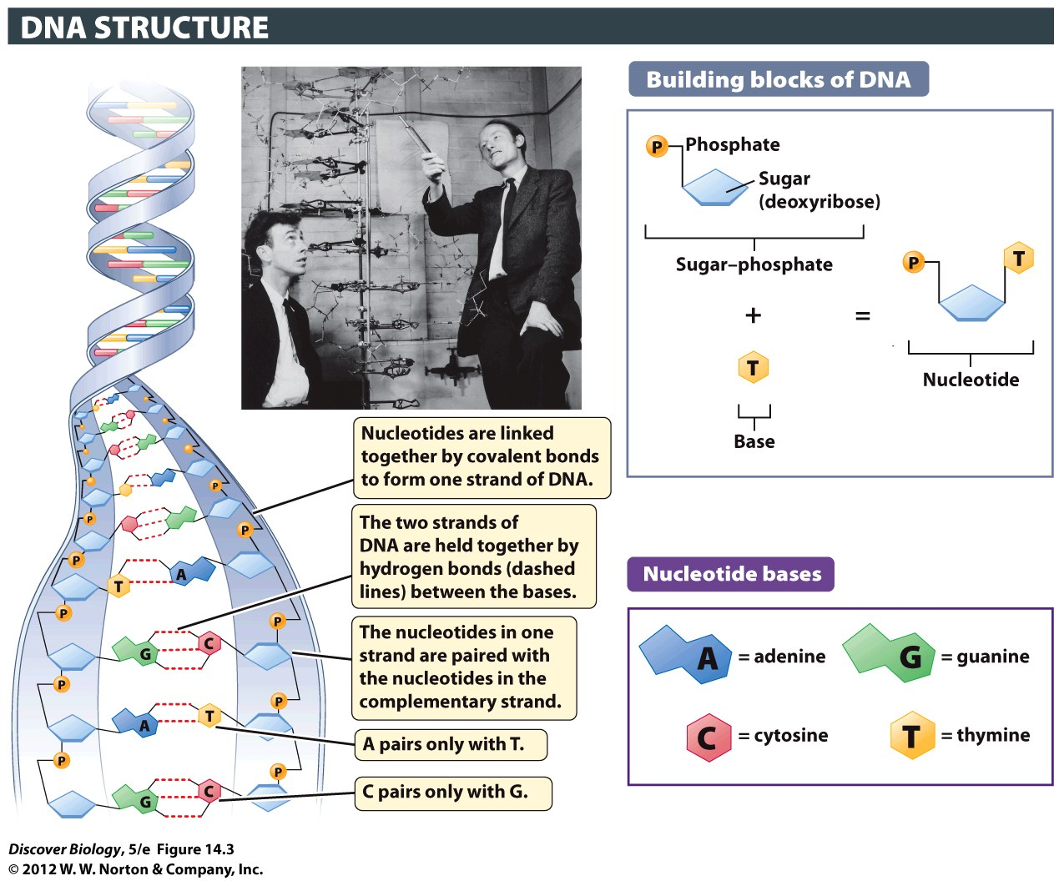
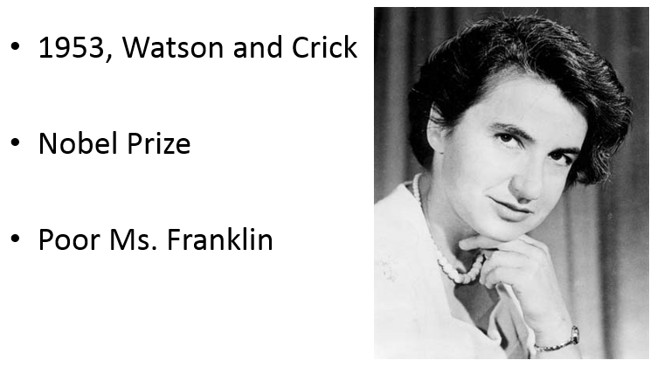
DNA: The twisty ladder thing
DNA = deoxyribonucleic acid
two strands
Hydrogen Bonds hold together!!

Slide 6

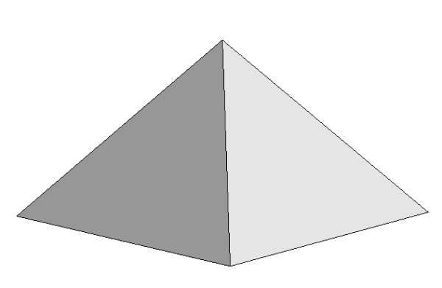
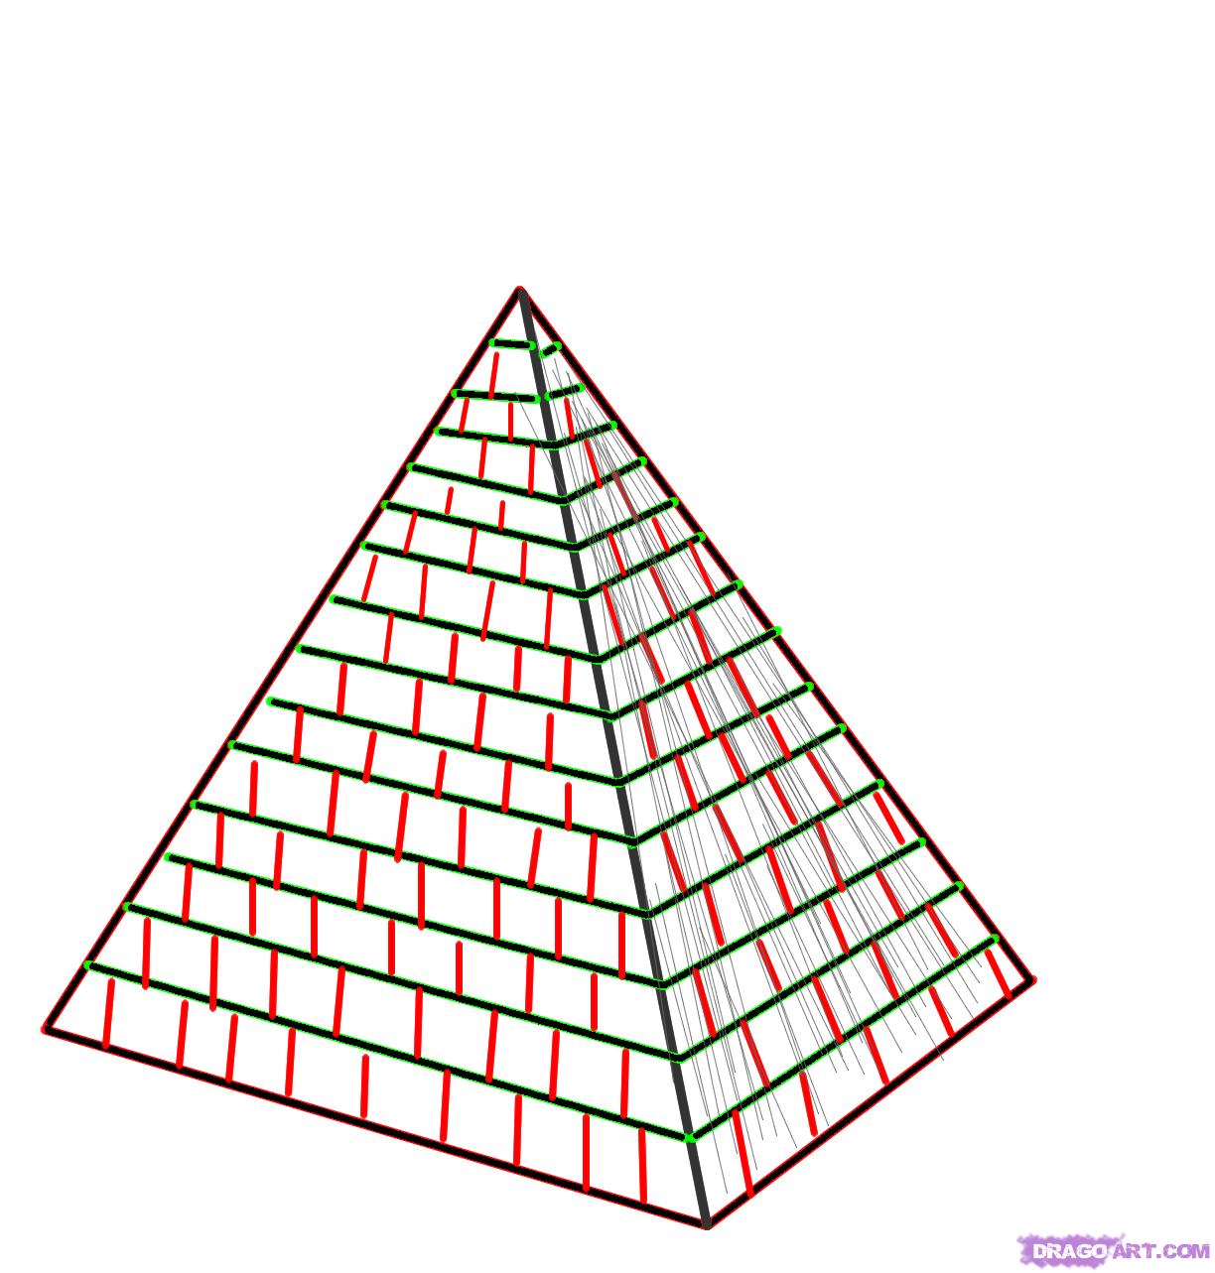
DNA Info: written in Nucleotides
Nucleotide = sugar (deoxyribose) + phosphate + base
                Four bases:
                Adenine
                Cytosine
                Guanine
                Thymine

Slide 7
DNA Info: written in Nucleotides
gene = DNA segment
Info for one at least one genetic trait
“Genome” = all the DNA info an organism has
eukaryote = info in nucleus
prokaryote = info in nucleoid region
Every species has a unique genome

Slide 8
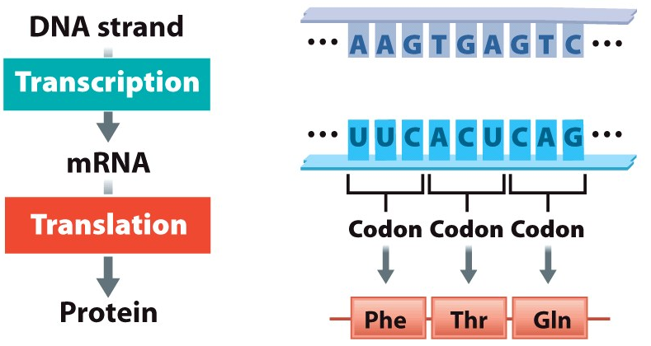
Reminder: Making Protein = 2 steps
This chapter
Transcription: reading DNA and copying that info into RNA
DNA ➔ messenger RNA (mRNA)
Translation: Reading the RNA copy and using the instructions to make a protein
mRNA ➔ protein
Next chapter
mRNA (copy of recipe) is read by ribosome(chef)
tRNA (helper chef) brings amino acids to ribosome
Amino acids (ingredients) used to make proteins

Slide 9
RNA vs DNA
 | DNA | RNA
Sugar | Deoxyribose | Ribose
Phosphate | Yes | Yes
Base | Adenine, Cytosine, Guanine, Thymine | Adenine, Cytosine, Guanine, Uracil
strands | Usually two | Usually one

Slide 10
Info stored in DNA
DNA has “words” (codons)
written in “letters” (nucleotides)
which amino acid to use
Genetic variation:
sequences vary can between species
sequences can vary between individuals

Slide 11
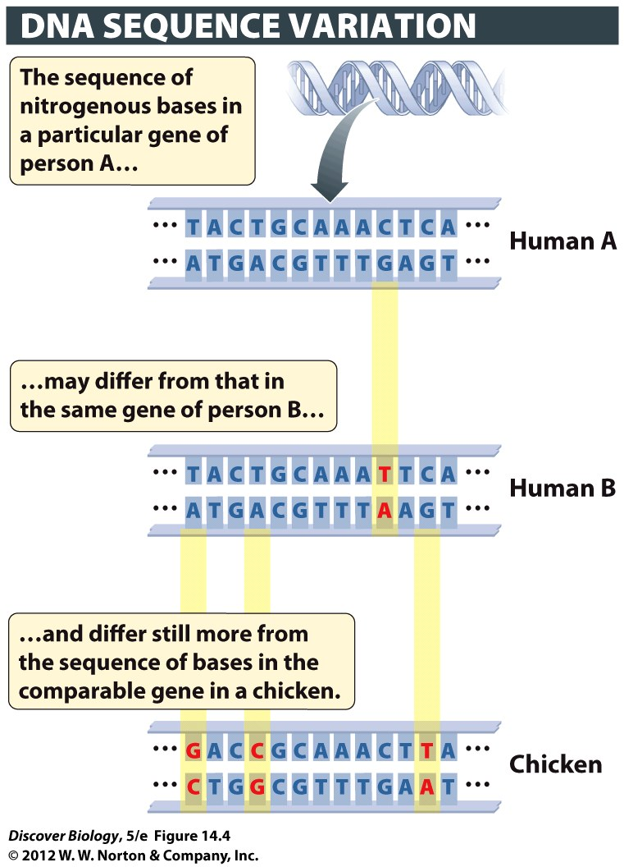
Notes:
Figure 14.4 The Sequence of Bases in DNA Differs among Species and among Individuals within a Species
Here the sequence of bases in a hypothetical gene is compared for two humans (A and B) and a chicken. Base pairs highlighted in yellow are variant; that is, they differ between the genes of persons A and B, and between the comparable human and chicken genes.

Slide 12
Replicating (copying) DNA
Unwind
Unzip
Use old strands as templates to make new
DNA polymerase (and more than a dozen other enzymes and proteins)

Slide 13
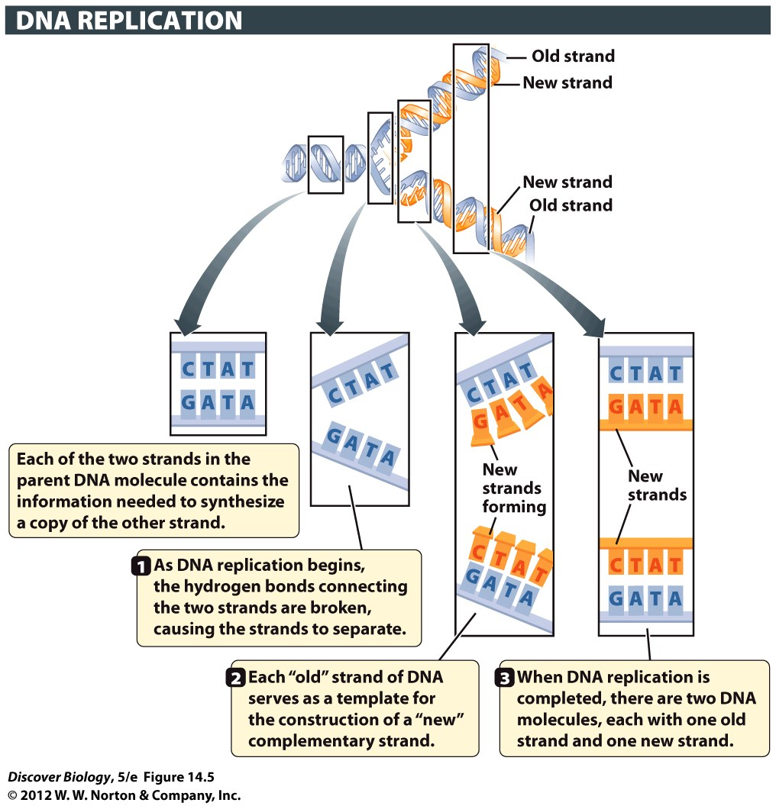
Notes:
Figure 14.5 The Replication of DNA Is Semiconservative
In this overview of DNA replication, the template DNA strands are blue, and the newly synthesized strands are orange. One strand (blue) from the parent double helix is conserved in each newly made daughter double helix (blue and orange).

Slide 14
Copying errors are BAD
Copy Six billion base pairs for each cell division
Replication errors can kill cells
Replication errors can cause diseases that kill the entire organism

Slide 15
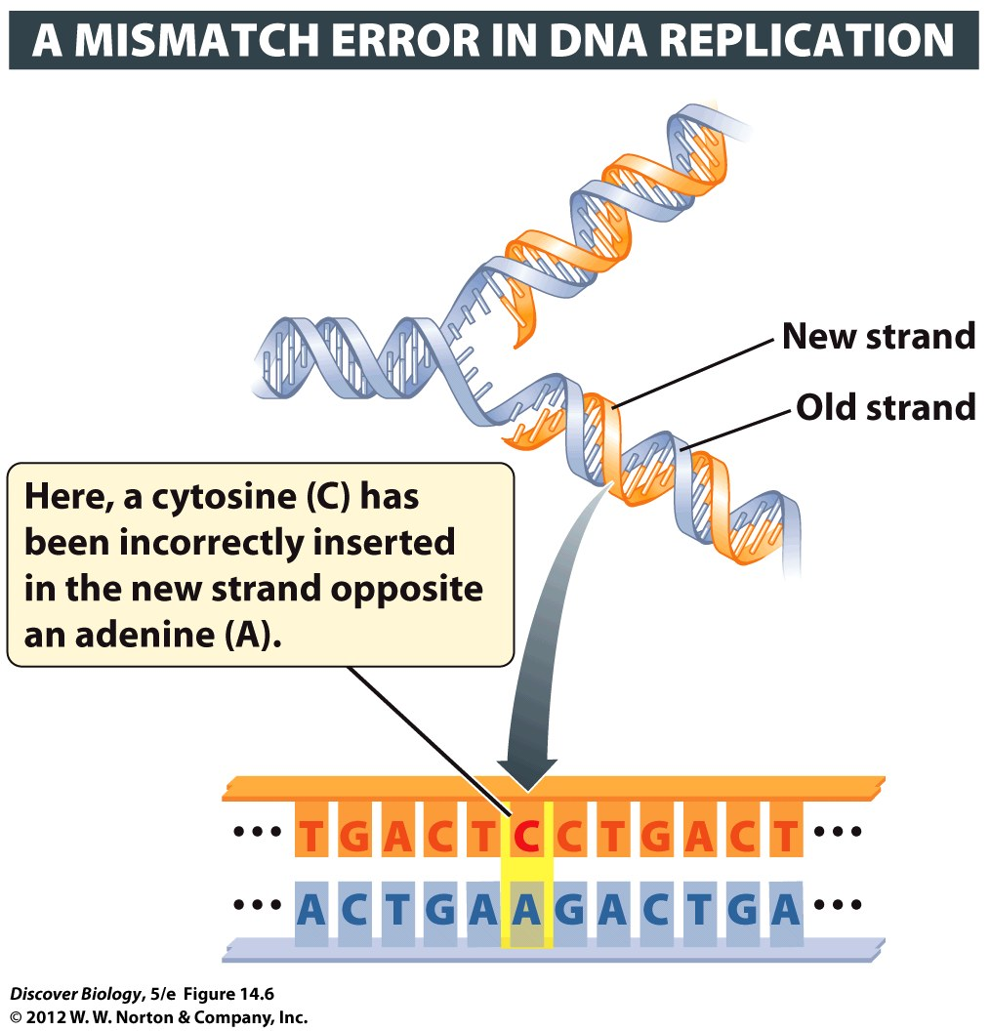
Notes:
Figure 14.6 Mistakes in DNA Replication May Lead to Mutations
DNA repair enzymes usually detect and fix mismatch errors such as the one shown here before the cell’s DNA is replicated again. If the mismatch is not repaired before the next round of DNA replication, half the daughter helices made by this DNA will have a C-G base pair in place of the original A-T base pair. Such a change in the DNA sequence constitutes a mutation.

Slide 16
Finding/fixing errors
DNA polymerase proofreads before joining base pairs
Other proteins double check
  Fix approx. 99% of errors DNA polymerase missed
Uncorrected changes/errors = “mutation”

Slide 17
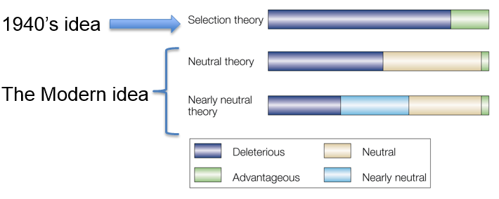
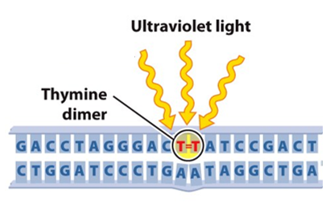
Replication errors
Mutagen = something that causes mutations
Most mutations are neutral or bad
  Harmful mutations can cause diseases
  cancer
  Huntington’s disease

Slide 18
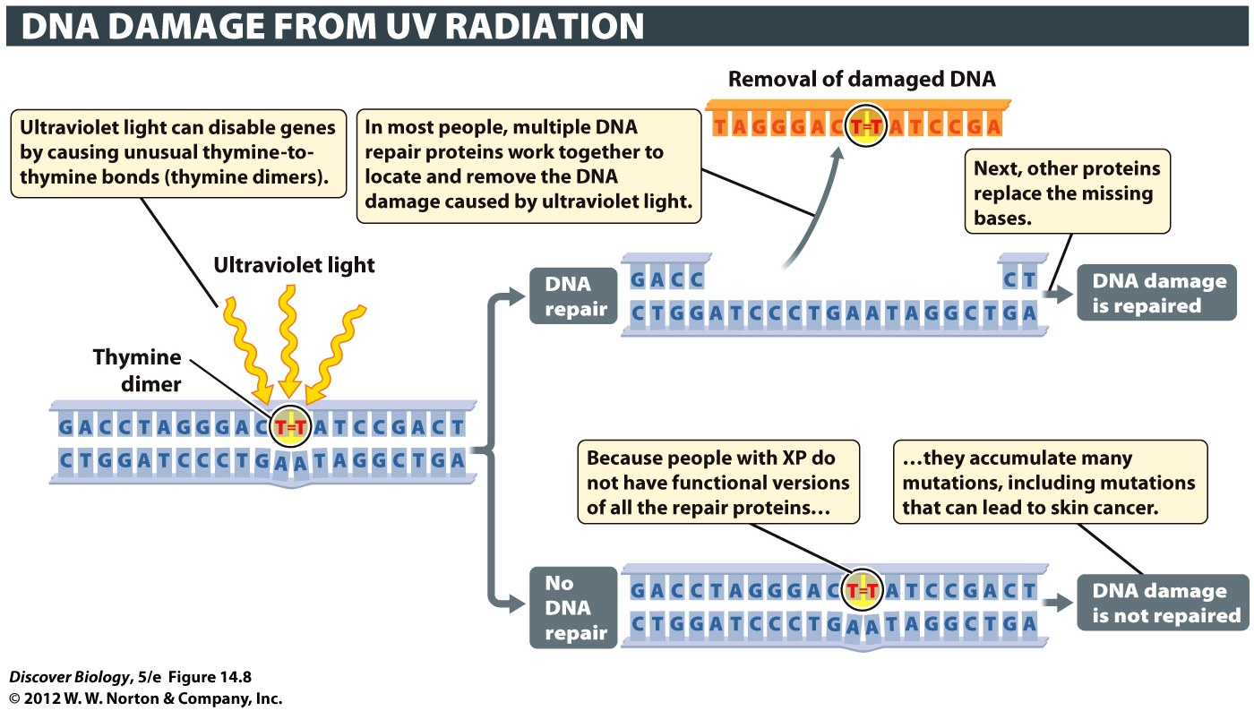
Notes:
Figure 14.8 The Importance of DNA Repair Mechanisms
When DNA repair mechanisms fail to work properly, the consequences can be severe, as illustrated by the high frequency of skin cancers in people who have xeroderma pigmentosum (XP), a recessive genetic disorder in which cells are unable to make a protein used to repair DNA damage caused by ultraviolet light.

Slide 19
Fixing the mistakes
DNA repair requires a three-step process:
  Recognition
  Removal
  Replacement
Special enzymes and other proteins for each step

Slide 20
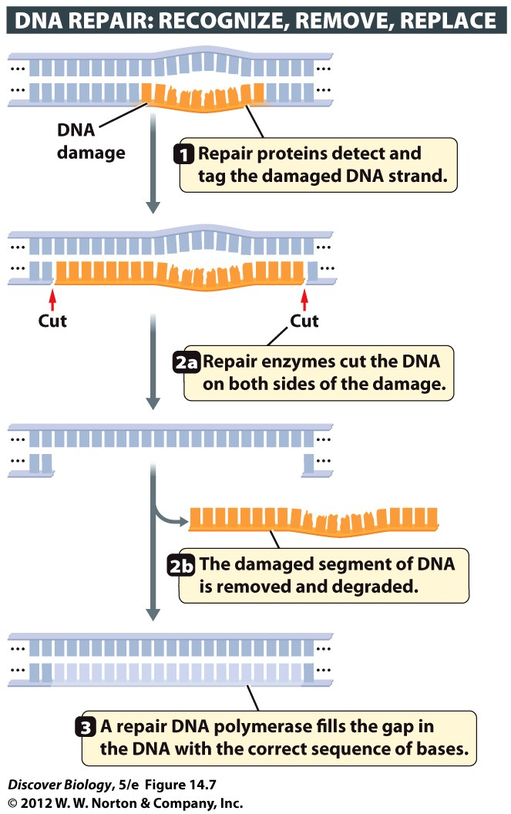
Notes:
Figure 14.7 Repair Proteins Fix DNA Damage
Large complexes of DNA repair proteins work together to fix damaged DNA. They (1) recognize DNA damage, (2) remove the segment of DNA strand that is damaged, and (3) replace the missing segment through new DNA synthesis.

Slide 21
Prokaryotes
one chromosome
several million base pairs of DNA
All that DNA is useful (has DNA code)
Prokaryotic genes tend to be organized by function

Slide 22
Eukaryotes
Eukaryotes have a lot more DNA (many chromosomes) in nucleus
Most of it is NOT instructions for a protein
  doesn’t make functional RNA
Used to talk about “junk” DNA
  now – MOST (maybe 80%) is useful
  ENCODE project

Slide 23
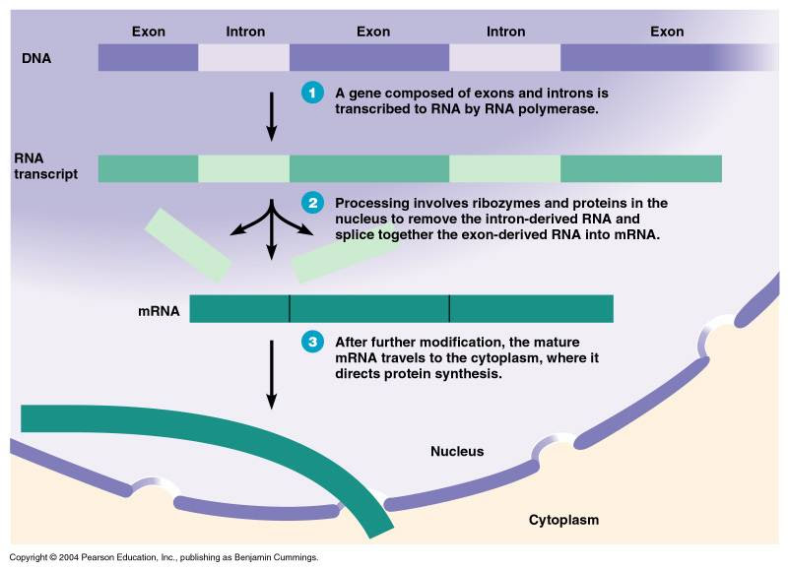
Non-coding DNA: not part of gene
introns - DNA who’s RNA won’t be used
stays in the nucleus
exons – DNA who’s RNA will be used by ribosomes
exits the nucleus as messenger RNA

Slide 24
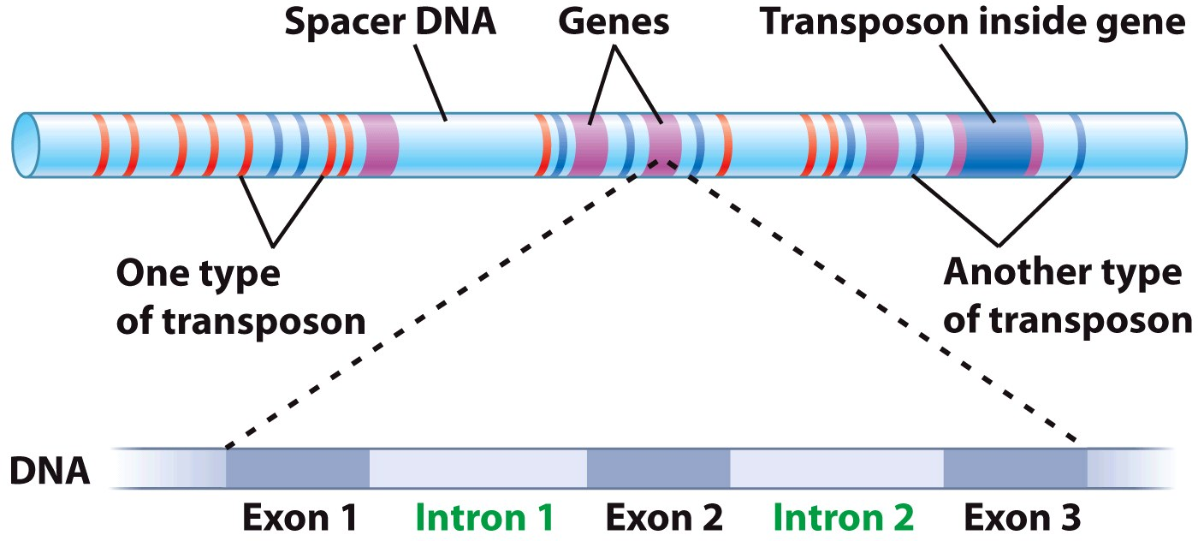
Non-coding DNA: not part of gene
spacer DNA - Noncoding DNA
    separates one gene from another
Transposons – “Jumping Genes”
move within & between chromosomes
can mess up the function of a gene
insert in the middle of it
(non-homologous)

Slide 25
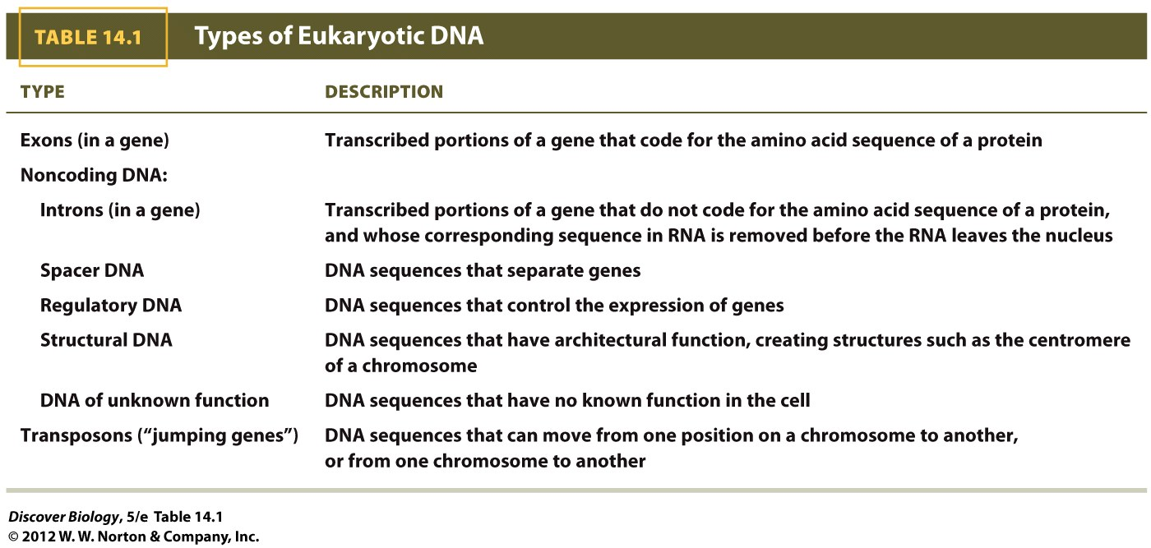
*
*
*
(e.g. operons)
*

Slide 26
Patterns of Gene Expression
Which genes we read and express controls a cell’s structure and function
Changes over time
whole organism
inside a single cell

Slide 27
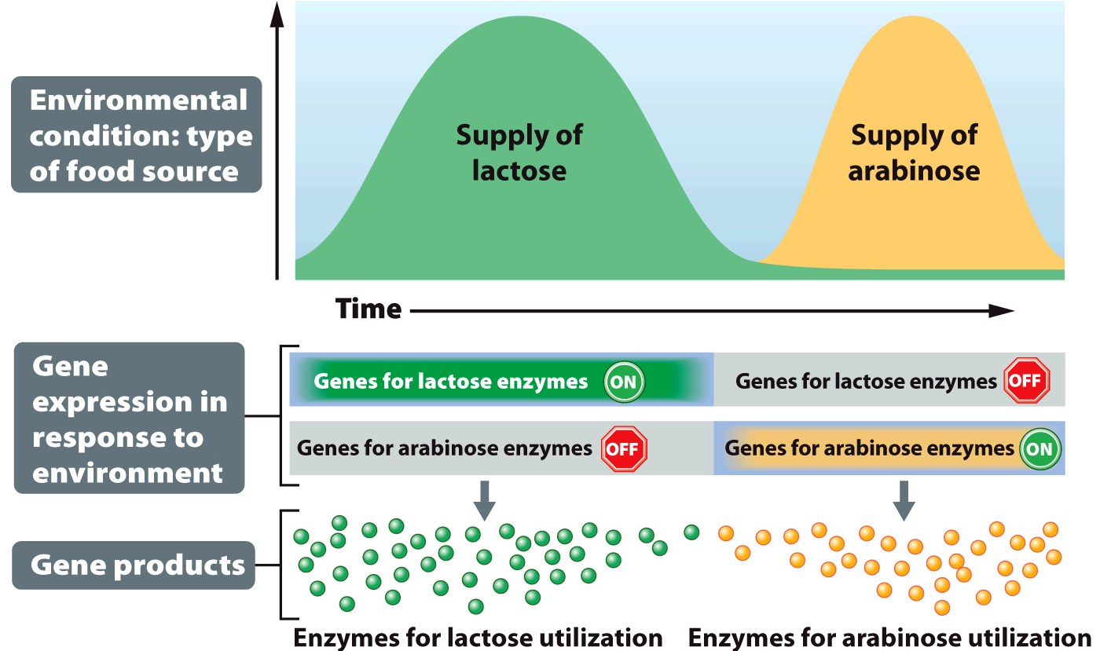
Environment: genes turn on or off
Bacteria - turn on genes for enzymes to match available foods
Don’t waste energy making stuff whey won’t use

Slide 28
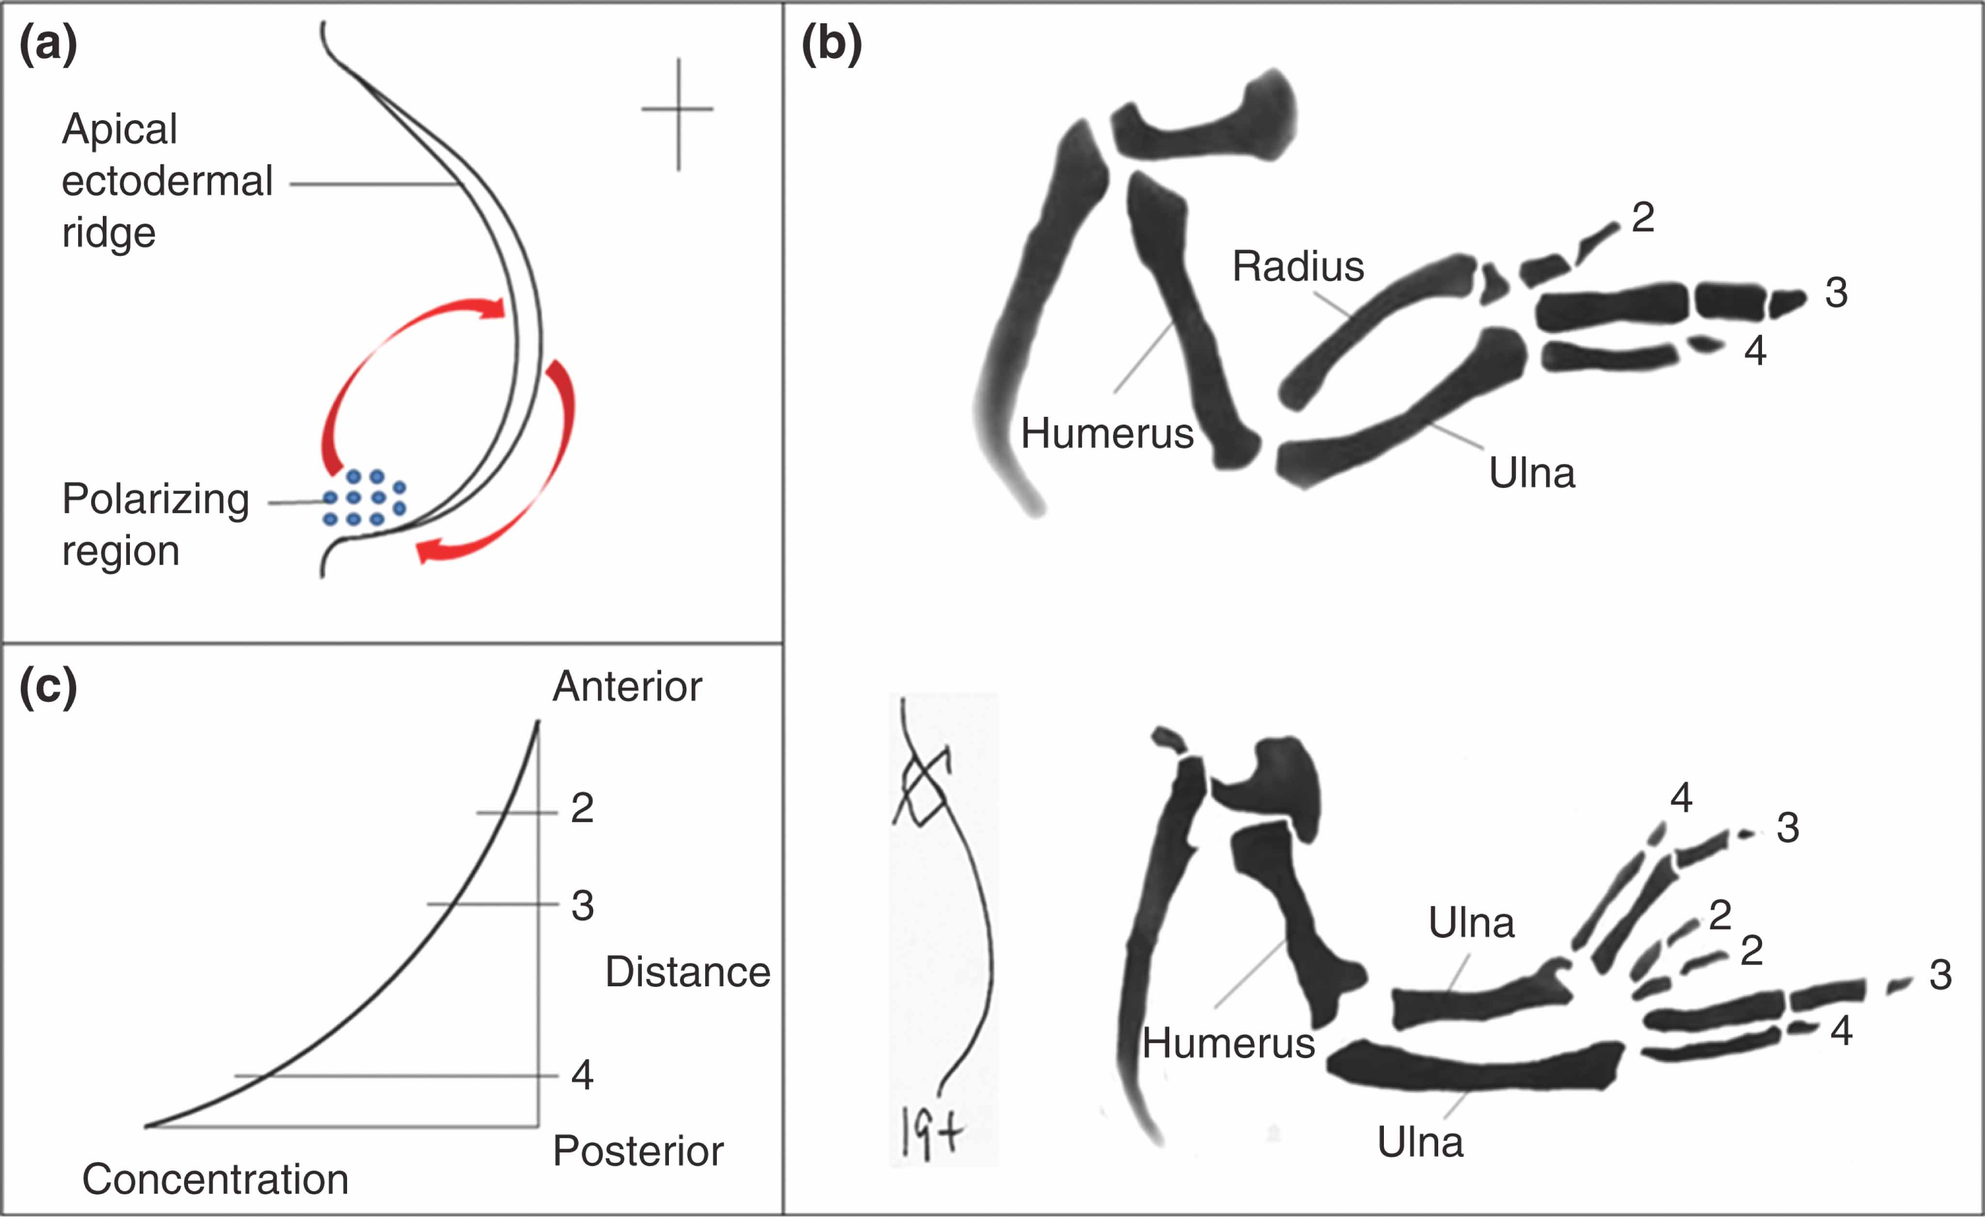
Environment: genes turn on or off
Multicellular organisms
signals to change gene expression
internal signal (in cell)
external signal
cell to cell

Slide 29
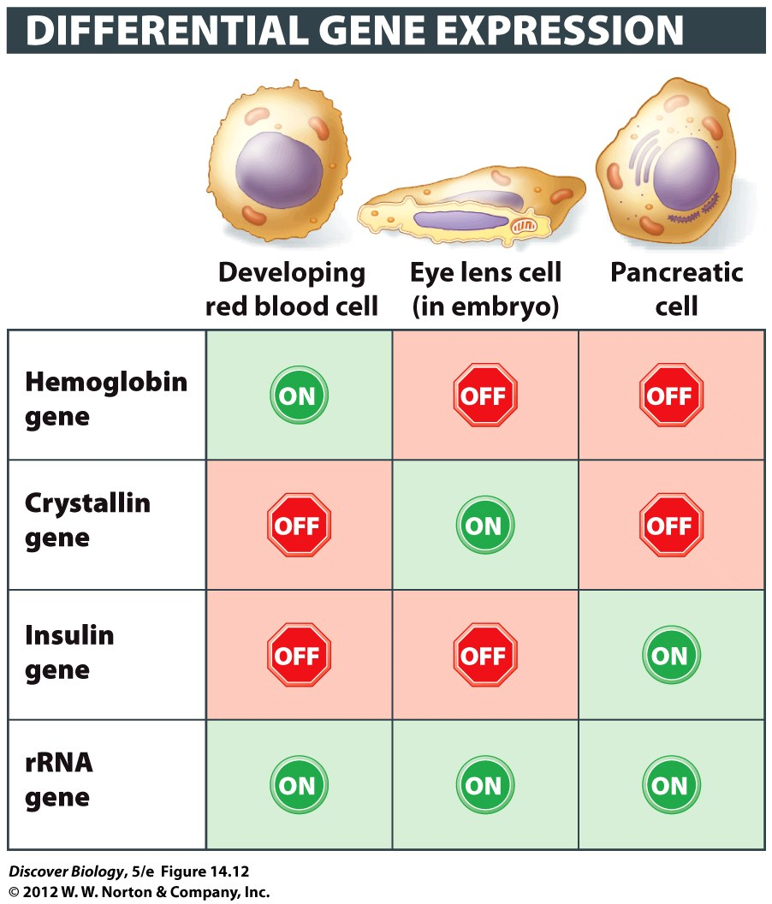
Cell Types: caused by gene expression
Same DNA, but cells differentiate depending on which genes are activated

Slide 30
Transcription: most of gene control
Transcription: reading DNA to make RNA
We can stop this process
regulatory DNA
covering promoters
regulatory proteins

Slide 31
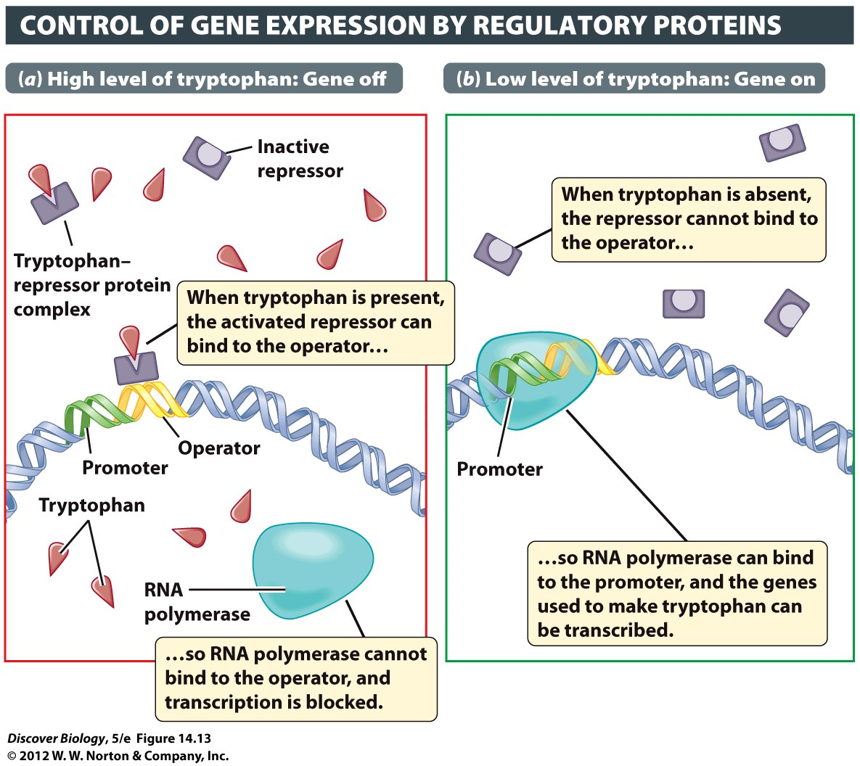
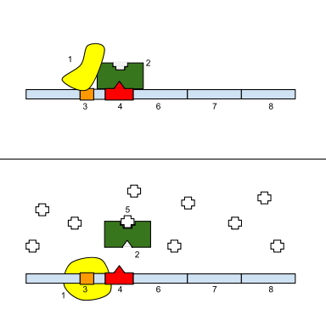
Transcription Factors
regulatory proteins to control gene expression
environment
regulatory DNA

Slide 32
Other ways to control expression
Pack DNA very tight
cannot read it to transcribe
why waste energy
Make mRNA with short life span
Won’t make protein after need is gone

Slide 33
Control at translation
Can keep some mRNA around, but unusable
can make protein quickly when needed

Slide 34
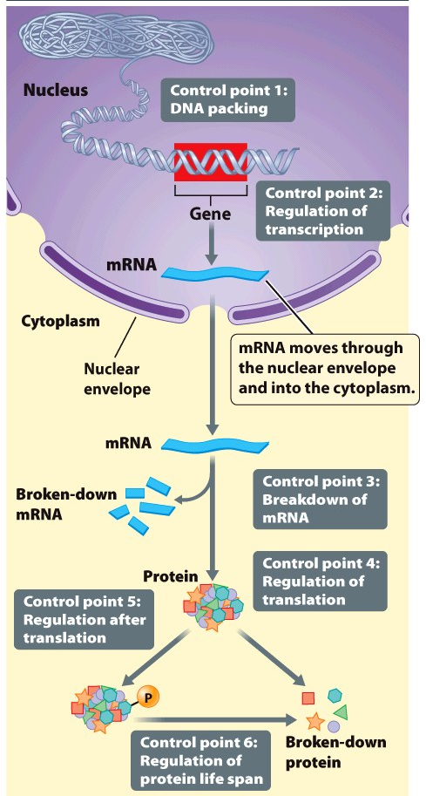
Control protein after use
Bind other stuff to it to inactivate
Unbind to use
Better that making/breaking

Slide 35
Different Cells read Different Genes
cells have exactly the same information (exact same DNA) usually
Most cells only read the DNA that is for their type of cell
Some genes are “developmentally regulated”
Only turned on during part of development

Slide 36

Promoter: on/off switch for translation
Start reading DNA at promoter:
RNA polymerase stops reading DNA when it gets to “terminator “
If you can’t read a promoter, you ignore the gene
 | DNA | RNA
Start @ | Promoter | Start Codon
End @ | Terminator | End Codon

Slide 37
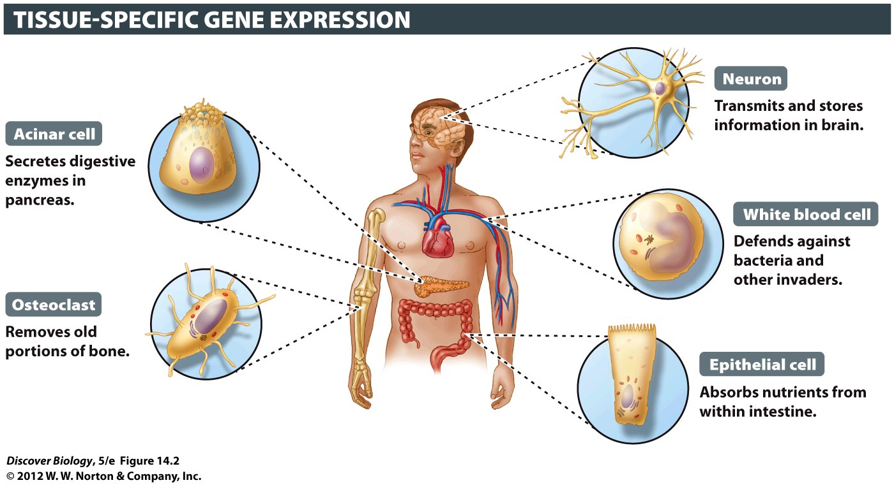
Same DNA, different cell types
Notes:
Figure 14.2 Different Cell Types Have the Same Genes
Although all cells within a multicellular organism have the same genes, these cells can differ greatly in structure and function because different genes are active in different types of cells.

Slide 38
Base Pairs
complementary strands of DNA
“compliment each other”
(made to be together)

Slide 39
Clicker Questions
CHAPTER 14
DNA and Genes

Slide 40
Concept Quiz
Watson and Crick showed that
A binds to T and G binds to C.
One strand is a template for the other strand.
The DNA molecule can be easily replicated.
All of the above
Notes:
The correct answer is D. These were all important discoveries based on the structure of the DNA molecule.

Slide 41
Concept Quiz
DNA repair is
Important only during replication.
Found in some species.
Vital to maintaining DNA’s integrity.
An inherited disorder.
Notes:
The correct answer is C. DNA repair is vital to maintaining the integrity of DNA.
DNA repair is also important to correct changes made by environmental mutagens.
DNA repair is important to all species.
The lack of DNA repair is an inherited disorder.

Slide 42
Free Biology Tutoring
Not Happy with your grade?
Not understanding the material?
Remember that the TLCC has

