Slide 1
Log into PAL
Have you taken the latest quiz?
When is your next paper due?
If you are not sure, you need to

Slide 2
Discover Biology
FIFTH EDITION
Anu Singh-Cundy • Michael L. Cain
CHAPTER 13
Chromosomes and Human
Genetics
© 2012 W. W. Norton & Company, Inc.

Slide 3
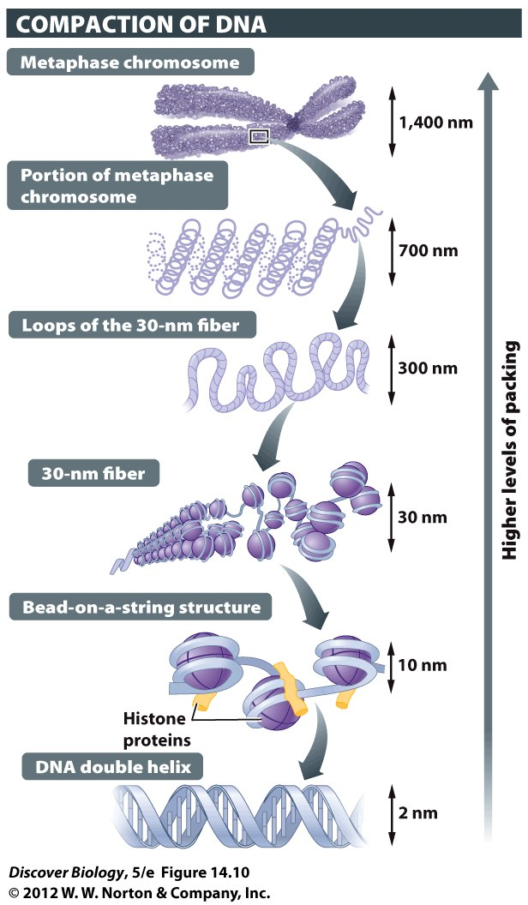
Genes & Chromosomes
Chromosome: one LONG DNA molecule
Wrapped around histone proteins
Many genes on each chromosome

Slide 4
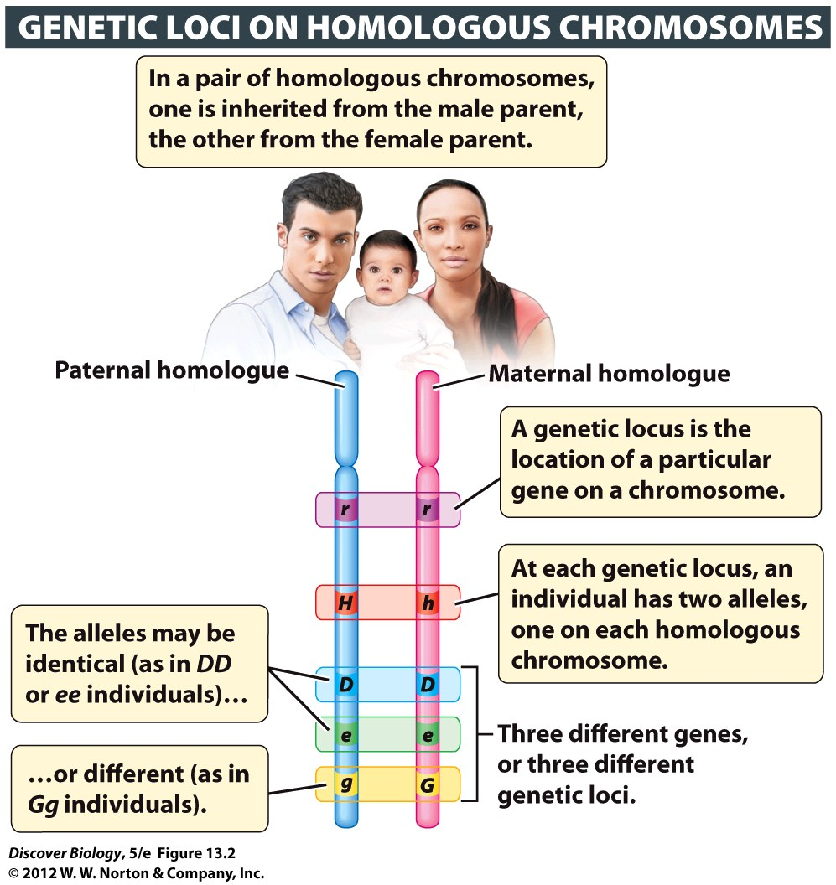
Genes & Chromosomes
23 pairs of
chromosomes
~25,000 genes

Slide 5
Vocabulary
Locus – location of a gene on a chromosome
Autosomes – chromosomes that don’t control sex
44 of our 46 chromosomes are autosomes
Sex chromosomes – they control our sex
2 of our 46
one X, one that is either X or Y
XX=female, XY=male

Slide 6
Genes on sex chromosomes
Genes on X chromosome
women have 2 copies, men have 1
Genes on Y chromosome
men have 1 copy, women have none
Men don’t like recessive disorders on sex chromosomes!!!

Slide 7
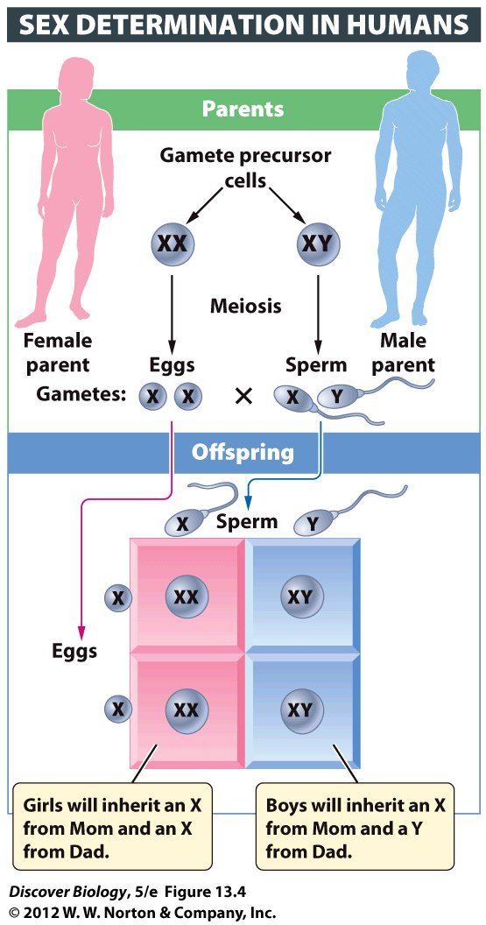
SRY: The maleness gene
One gene on Y controls all other genes that cause male traits
No SRY?
  Develop as a female

Slide 8
Mendel was WRONG!!
Mendel’s “law of independent assortment”
only if genes are on different chromosomes
Some genes are normally inherited together
“genetically linked”
stuff on the same chromosome

Slide 9
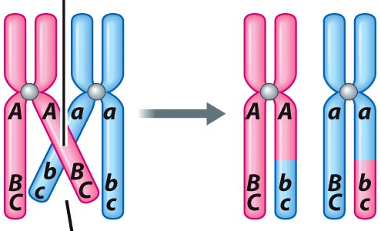
Crossing-Over VS Genetic Linkage
Genes on same chromosome (linked)
normally inherited together
crossing over can alter
A & C: linked
B & C: tightly linked
(less likely to separate via crossover)

Slide 10
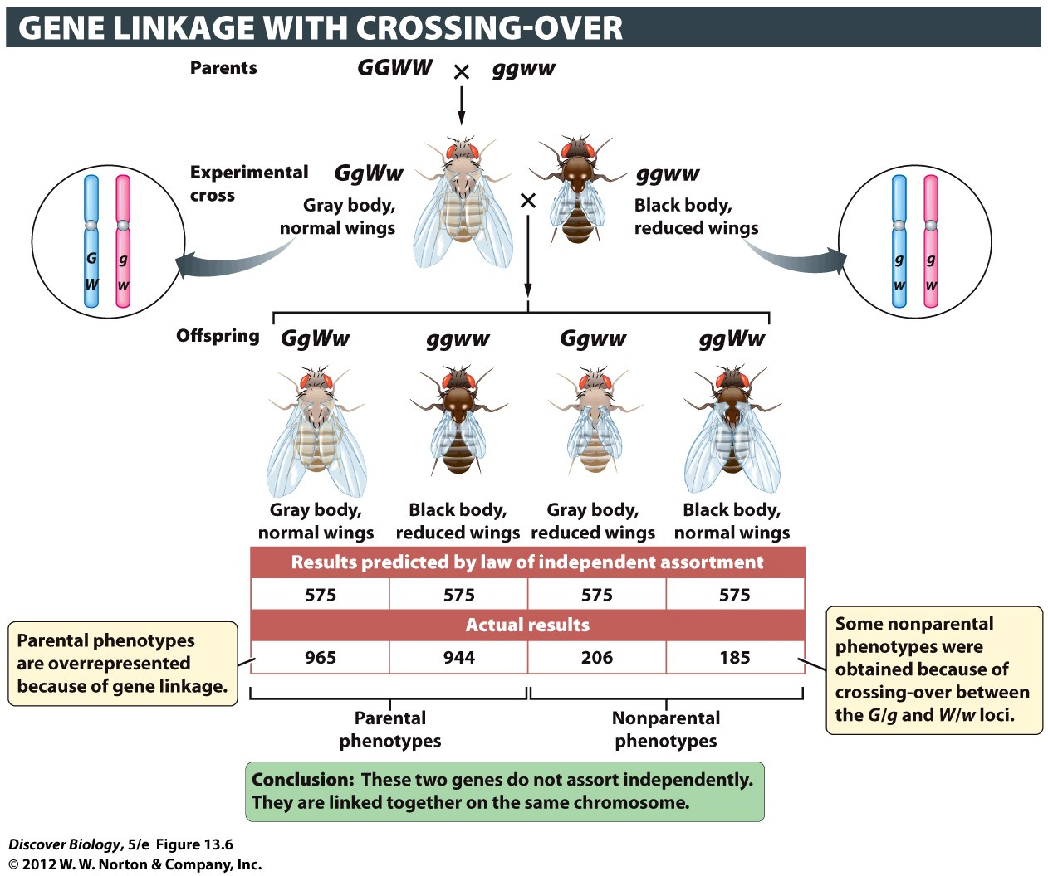
Genetic Linkages cause weird ratios
Genes on same chromosome often move together
Weird ratios
No independent assortment
Mendel got lucky: all 7 traits on different chromosomes
Notes:
Figure 13.6 Genes on the Same Chromosome May Not Assort Independently
By crossing flies of genotype GgWw with flies of genotype ggww, Morgan found that the gene for body color (dominant allele G for gray, recessive allele g for black) is linked to the gene for wing length (dominant allele W for normal length, recessive allele w for reduced length). The parental genotypes are overrepresented because the G and W genes are linked to each other: the two genes are located relatively close to each other on the same chromosome.

Slide 11
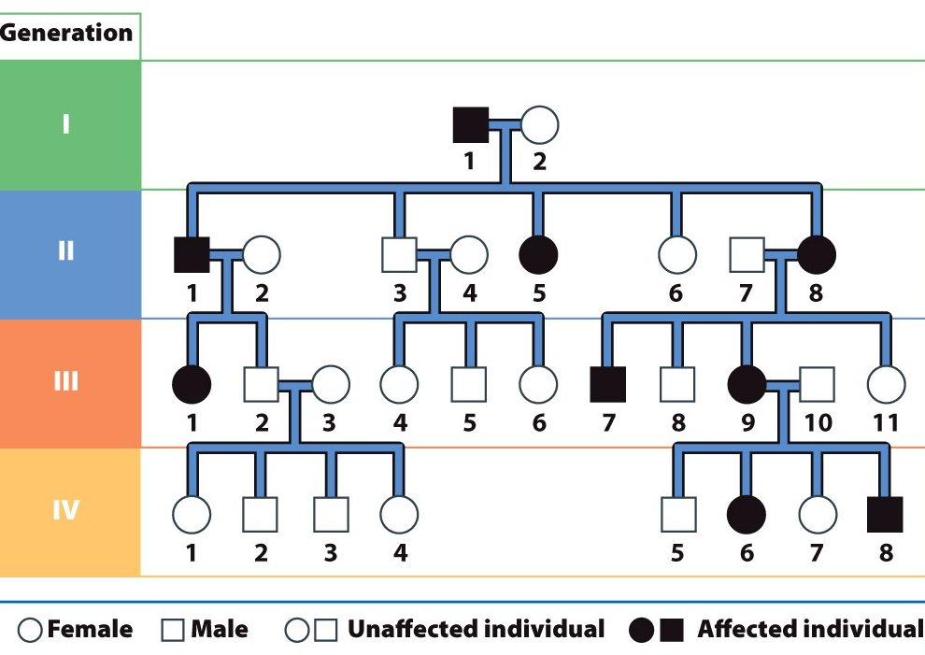
Pedigree: Who’s your daddy?
pedigree: a chart showing genetic relationships
for two or more generations
Geneticists use to study
inheritance

Slide 12
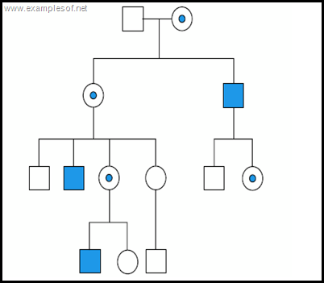
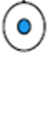
Example: Pedigree Chart
Pedigree chart for X-linked recessive
heterozygote

Slide 13
Genetic Disorders
Somatic mutations: not passed on to kids
Mutations in gametes: can be passed on
Sources of genetic disorders:
  Mutations in individual genes
  Abnormal chromosome number
  Gene turned on/off (epigenetics) not in book!!!

Slide 14
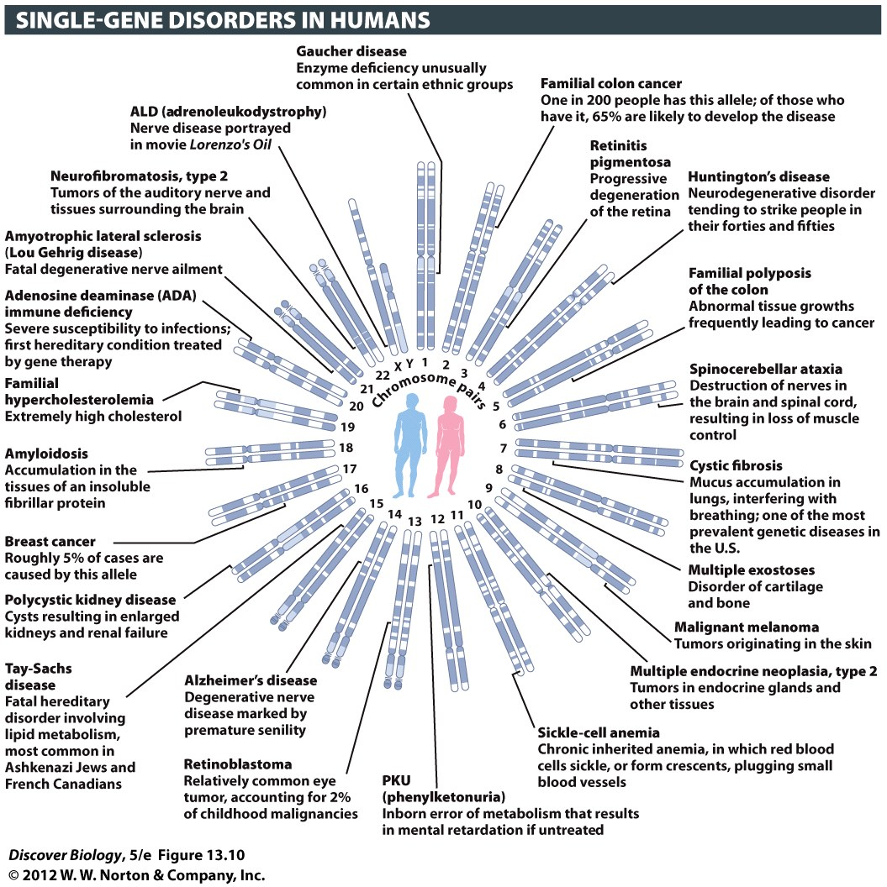
Notes:
Figure 13.10 Genes Known to be Associated with Inherited Genetic Disorders in Humans
About 2,000 Mendelian traits are known, and each has been mapped to one of the 23 pairs of human chromosomes. Mutations of single genes that lead to genetic disorders are found on the X chromosome and on each of the 22 autosomes in humans. For clarity, we show only one such genetic disorder per chromosome.

Slide 15
Single-Gene Mutations
Many are recessive
Can have dominant gene and phenotype
look/act normal but carry disease
can skip generations

Slide 16
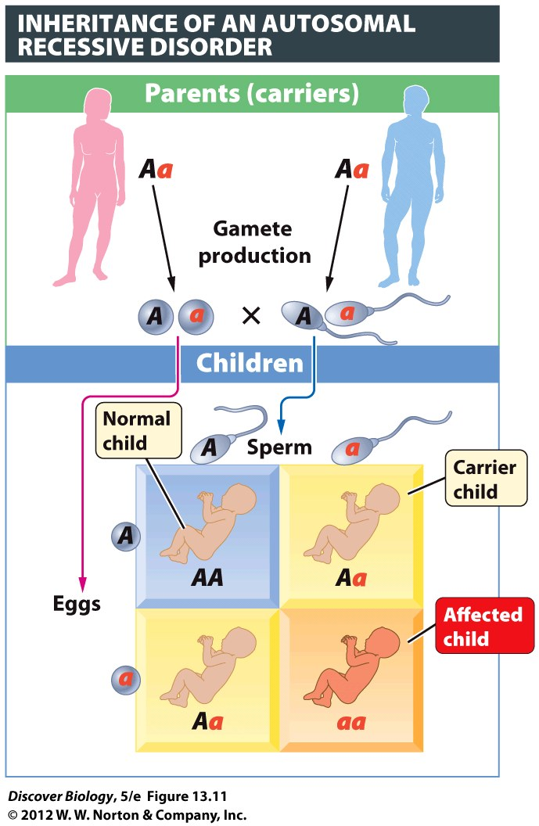
Autosomal Recessive Disorders
3:1 = 75% chance of no symptoms
recessives more likely to stay in population
heterozygotes can pass on without symptoms
e.g. lethal recessives passed on

Slide 17
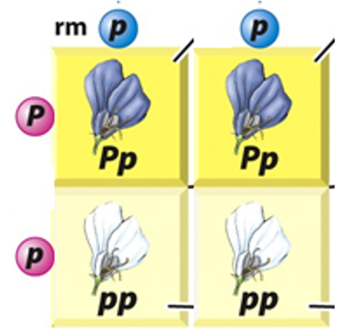
Autosomal Dominant Disorders
Affect more of offspring
  50% chance of passing on to the children
More rare
  If you can’t breed, won’t pass on
  Removed via natural selection
  Tend to be new mutations
Exception: Huntington’s
why? Symptoms show up later in life

Slide 18
Huntington’s Disease
caused by dominant allele
50% chance child has
Coordination, cognitive decline
  Nursing home in middle age
Old Days: give to kids before you know you have
Now: numbers down, genetic testing & counciling

Slide 19
Sex linked Mutations
on the X or Y chromosome
There are about 50 human Y-linked genes and approximately 1,100 human X-linked genes

Slide 20
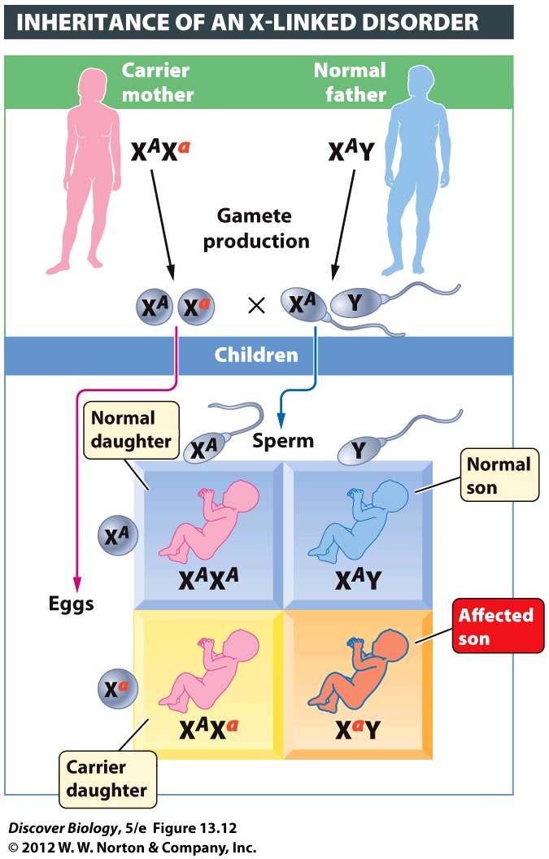
Sex-Linked disorders
Less common in women (XX)
  X linked: 2 copies of recessive before she’s affected
  Y linked: immune

Slide 21
Genes on sex chromosomes
Genes on X chromosome
women have 2 copies, men have 1
Genes on Y chromosome
men have 1 copy, women have none
Men don’t like recessive disorders on sex chromosomes!!!

Slide 22
Sex-Linked disorders
More common in men
  X: dominant or recessive, he has it
  Y: dominant or recessive he has it
  No other copy of chromosome to block

Slide 23
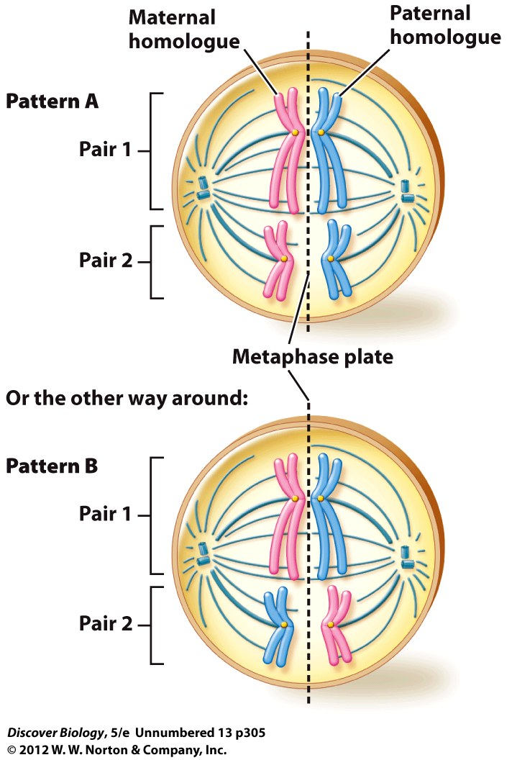
Genetic variation
  Crossing-over
  Independent assortment of chromosomes
  Fertilization

Slide 24


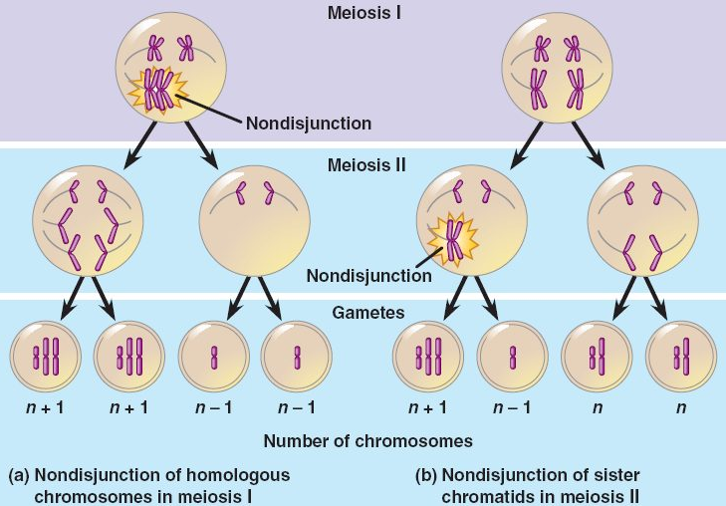
Junction: where things come together
Disjunction: where things separate
Non-disjunction: mistake in separating chromatids during meiosis

Slide 25
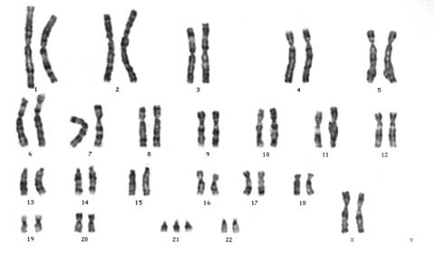
Nerd Words
Aneuploidy = has an unusual number of chromosomes
Monosomy = has one copy of a chromosome
Trisomy = has three copies of a chromosome
Down’s Syndrome is caused by trisomy 21

Slide 26
Syndromes from Aneuploidy
Down’s Syndrome = trisomy 21
Edward’s Syndrome = trisomy 18
Kleinfelter’s Syndrome = XXY
Turner’s Syndrome = XO
XYY Syndrome

Slide 27
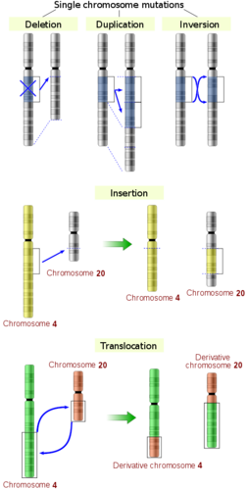
Ways to alter chromosomes
Misalignment/ separation errors
Can cause insertions, deletions, duplications, translocations, inversions, etc.
Pay attention: at least one picture will be on test

Slide 28
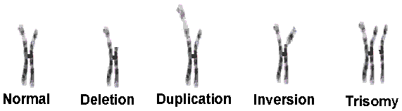
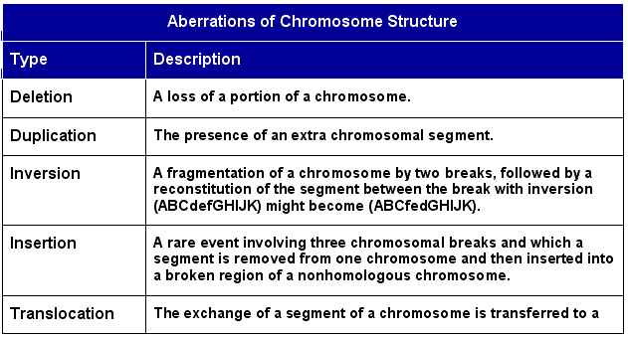
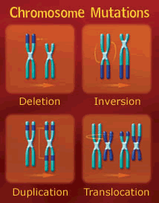
Ways to alter chromosomes
Mistakes in prophase move sections of chromosomes

Slide 29
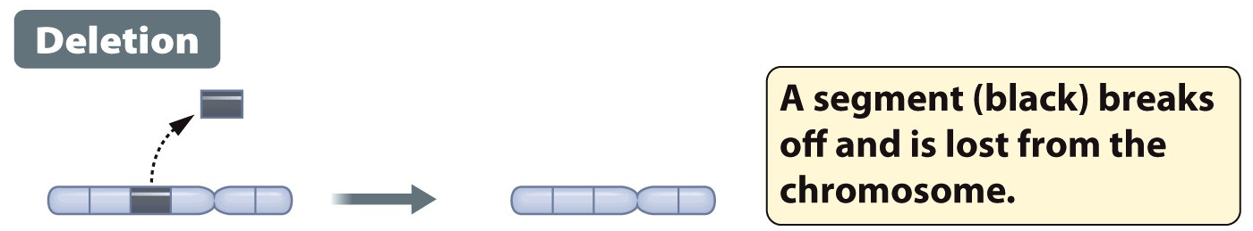
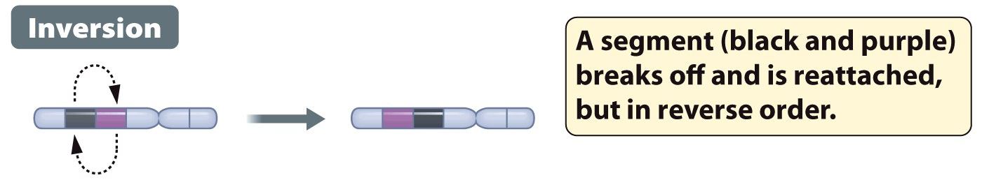
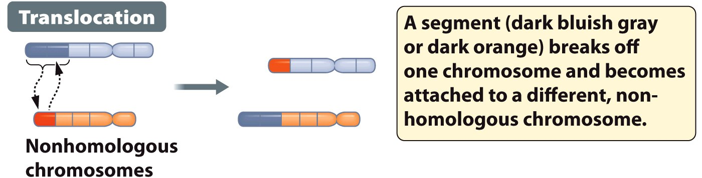
Ways to alter chromosomes
Notes:
Figure 13.14a Chromosome Rearrangements Can Cause Serious Genetic Disorders

Slide 30
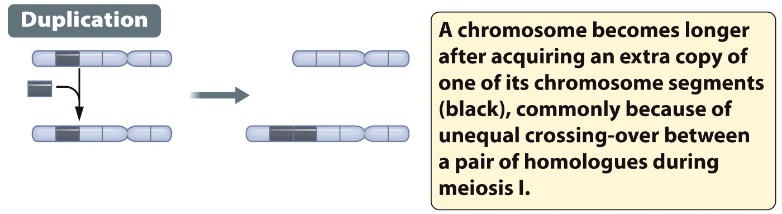
Ways to alter chromosomes
Duplication: an important role in evolution
two copies: one has original function
one mutates to new function

Slide 31
Mutation: cause & effect
Can cause mutations:
  Mistakes in DNA replication
  Collisions of the DNA molecule with other molecules
  Damage from heat or chemical agents
Effect: Only mutations in gametes matter
if you can’t inherit it, it won’t have an effect on the population
(must pass on to cause evolution)

Slide 32
Clicker Questions
CHAPTER 13
Chromosomes and Human
Genetics

Slide 33
Concept Quiz
Which of the following is not true of homologous chromosomes?
They contain the same alleles.
They contain the same genes.
One came from each parent.
Each is duplicated during replication.
Notes:
The correct answer is A; they don’t necessarily carry the same alleles
This stresses the difference between genes and alleles, which is confusing to students; alleles are what create genetic diversity, so there must be differences between maternal and paternal alleles
Answer B is true, unless there is a chromosomal abnormality
Answer C is true; this is the result of fertilization
Answer D is true; students often confuse sister chromatids with homologous chromosomes; Stress that homologous means “similar” not identical

Slide 34
Concept Quiz
Genes that are linked on the same chromosome always segregate together.
True
False
Notes:
False. While linked genes usually segregate together (which means that they don’t obey the Law of Independent Assortment), crossing over can cause them to act as if they aren’t linked.

Slide 35
Concept Quiz
Autosomal‑dominant disorders
Are carried on the X chromosome.
Often express late in life.
Are spread by carriers (heterozygotes) mating.
Are more common than recessive disorders.
Notes:
The correct answer is B. Autosomal dominant disorders are rare because affected individuals usually die before mating and passing the gene on. The exception is autosomal dominant disorders that express late in life, like Huntington’s Disease.
Sex-linked diseases are associated with the X chromosome (although the X and Y share 18 genes and these act as autosomal genes).
Since the is dominant, people with one gene are affected. There are no carriers.
Recessive disorders are more common because they are spread by carriers.

Slide 36
Free Biology Tutoring
Not Happy with your grade?
Not understanding the material?
Remember that the TLCC has

