Slide 1
How’s your grade?
Have you calculated your grade lately?
If not, use the spreadsheet
Are all your assignment listed in PAL?
You need to let me know if they are not

Slide 2

Warning: Word Problems
If you don’t understand them, get help!!!

Slide 3
Discover Biology
FIFTH EDITION
CHAPTER 12
Genetics
© 2012 W. W. Norton & Company, Inc.

Slide 4
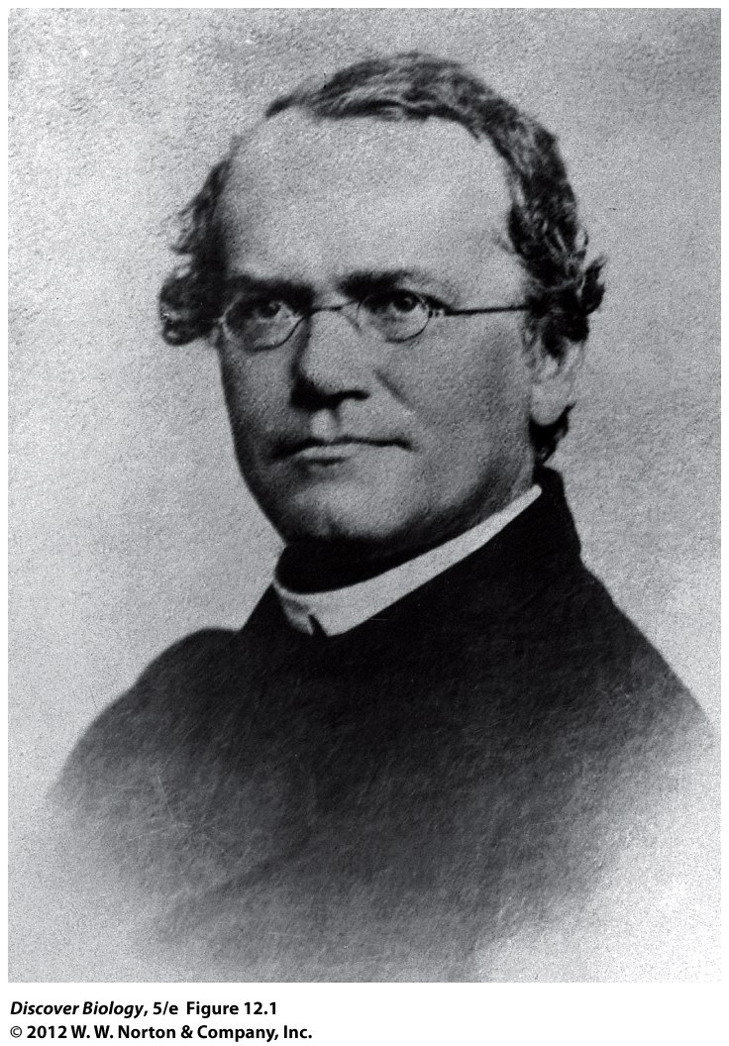
Gregor Mendel: “Father of Genetics”
1866: a paper on peas
ignored for 30 years
Everything rediscovered
    Hugo de Vries
    Carl Correns

Slide 5
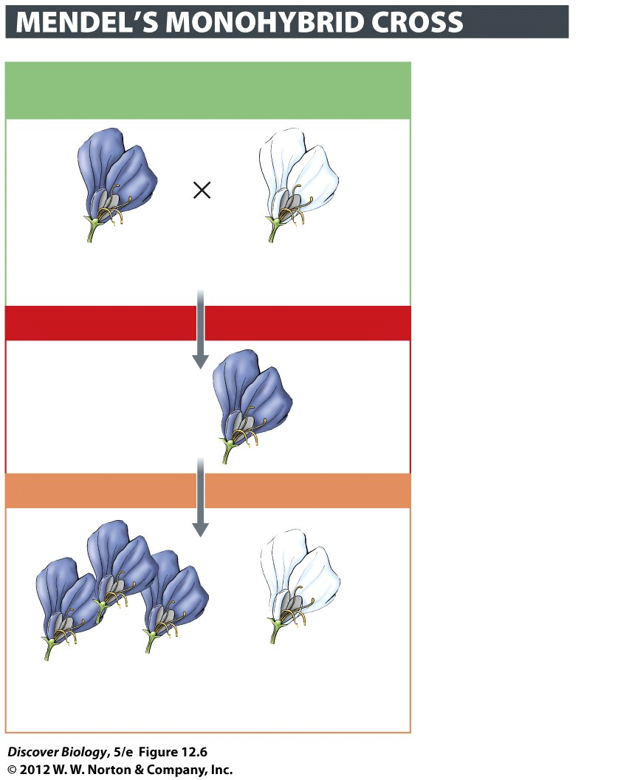
Gregor Mendel: He Studied Peas
Bred peas, tracked 7 traits
Looked for mathematical patterns in offspring
Before Mendel: “kids are blend of parents traits”
    For most traits: FALSE

Slide 6
Nerd Words for in Genetics
genetic trait: anything you can see/detect
Invariant – everybody the same
variable – in your phenotype
“Express” a gene – have, and show
not just in genotype
also in phenotype

Slide 7
Mendel: found Inherited Traits
Kids get two sets of info
one from each parent
Most traits don’t blend
No idea what information was or how it was stored

Slide 8
After Mendel: “genetics”
1950’s: Watson & Crick find structure of DNA
Info stored in DNA
Now: epigenetics – info on what DNA to read
Which genes are turned on!!!

Slide 9
Diploid Cells: 2 Copies of all Genes
Normal (somatic) cells: diploid (2n) 46 chromosomes
23 paternal, 23 maternal homologue
2 copies of each chromosome
made by mitosis
reproductive (Gamete) cells: Haploid (1n) 23 chromosomes
One set of chromosomes
some from each parent
in humans, made by Meiosis
Haploid Cells: Half the normal DNA

Slide 10
Nerd Words for in Genetics
Gene: an instruction written in DNA
Usually instructions for a protein
many genes on each chromosome
Genotype: The type of Genes you have
Phenotype: The traits you display
hair color, freckles, blood type, eyesight
  (many are things you can feel)

Slide 11
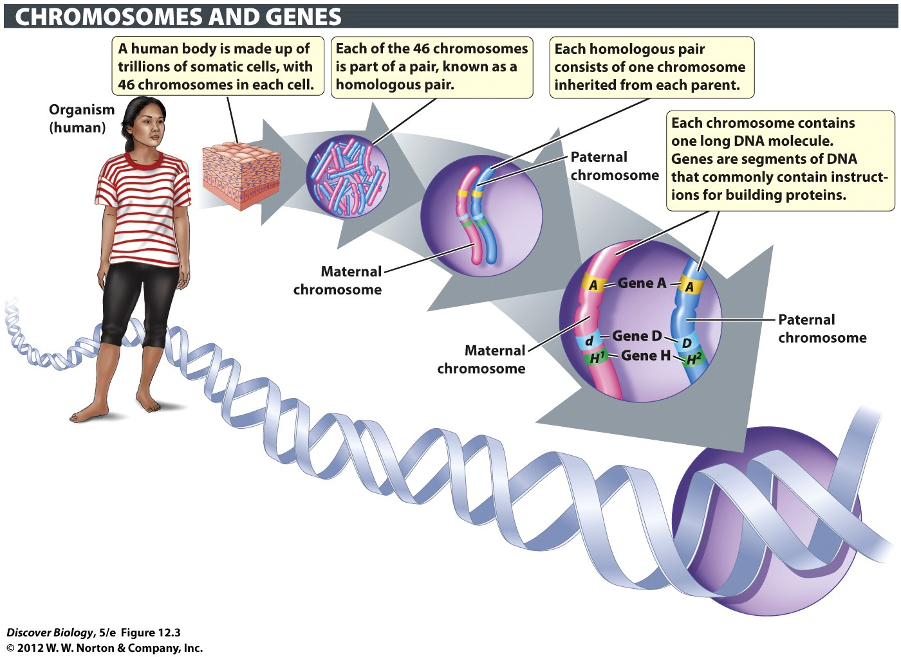
Notes:
Figure 12.3 Somatic Cells Have Two Copies of Most Genes
Somatic cells make up the large majority of cells in the body of a multicellular organism. Somatic cells in plants and animals are diploid: each type of chromosome occurs as a pair, known as a homologous pair. Alternative versions of a gene are known as alleles. In a matched pair of homologous chromosomes, a given gene is found at the same location on each chromosome, but the paternal and maternal homologues may carry different alleles of that gene.

Slide 12
Nerd Words for in Genetics
Alleles: versions of a gene
hair color gene
blonde allele
redhead allele
brunette allele
black hair allele
Genetic Diversity: having more than one version (allele) of a gene in a population
More alleles = more genetic diversity

Slide 13
Genotype Nerd Words
Phenotype: the genes you express
Genotype: the genes you have
  Homozygous: all the same alleles (versions) of a gene
  “Homo” = same kind
  Heterozygous: more than one allele (version) of a gene
  “Hetero” = not the same kind

Slide 14
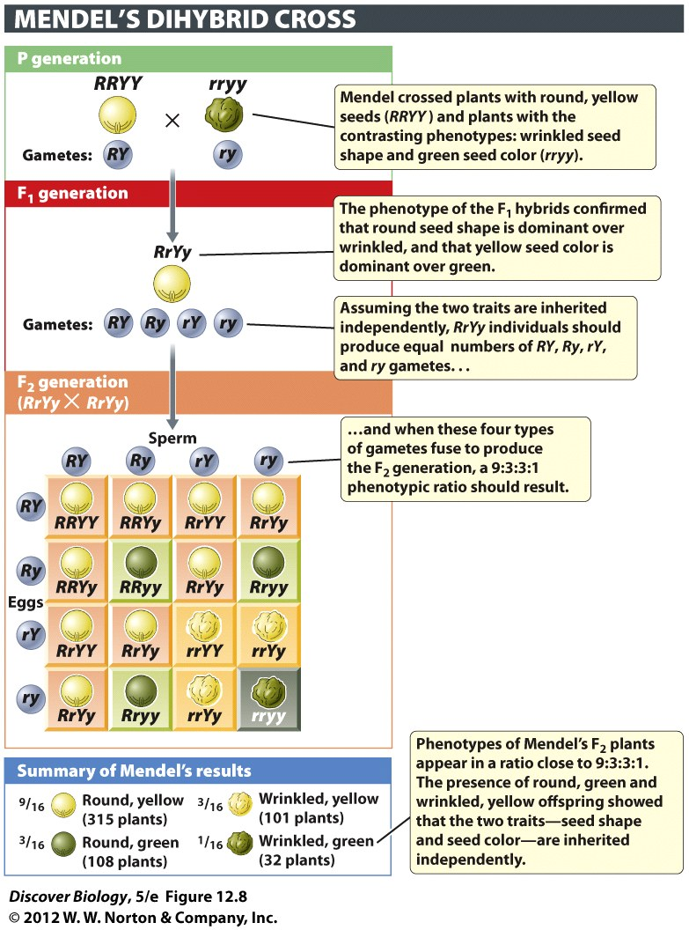
Genotype Nerd Words
Hybrid: has heterozygous genotype (Ss)
Dihybrid: is heterozygous for two traits (SsTt)

Slide 15
Genotype Nerd Words
Dominant: an allele (version) that will be expressed if it is there
Recessive: an allele that will be expressed if it is not being blocked
Multigenic: a trait controlled by more than one gene

Slide 16
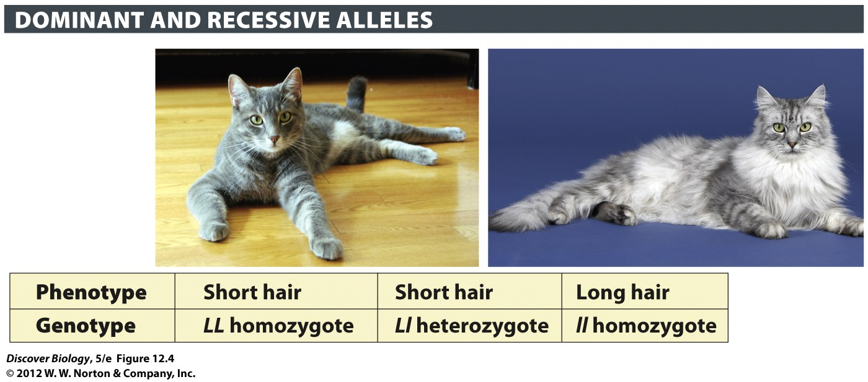
Genotype Symbols
Use same letter for same gene
Capital Letter: use for dominant allele (version)
Lower Case Letter: use for recessive allele
Notes:
Figure 12.4 In Cats, Short Hair Is Dominant over Long Hair
The L allele is dominant over the l allele and therefore confers short hair in both the homozygous and heterozygous states (LL and Ll). The long-hair phenotype, controlled by the l allele, is manifested only when unmasked in the ll homozygote.

Slide 17
Mutations: making new alleles
Mutation: changes to DNA
new version (allele) of gene
= Where genetic diversity comes from
      (Darwin didn’t know this. Mendel didn’t know this)
Bad mutations: often recessive
  You survive if you have a good copy (dominant)
  Pass harmful version on to kids

Slide 18
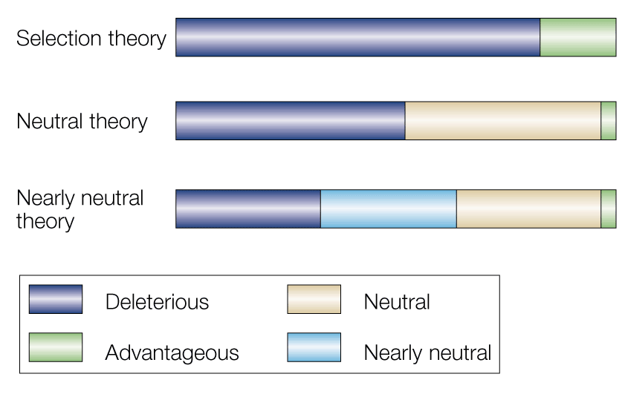
Mutations: making new alleles
mutations are random
  You may get something useful, you may not
Most have no effect (….and good ones are rare)
Only passed on if in cells making gametes
1940’s idea
The Modern idea

Slide 19
Controlled Crosses: what Mendel did
genetic cross: controlled mating experiment
used to learn about inheritance
P generation: parents (P)
Filial (F): descendants
F₁ generation = kids
F₂ generation = grandkids

Slide 20
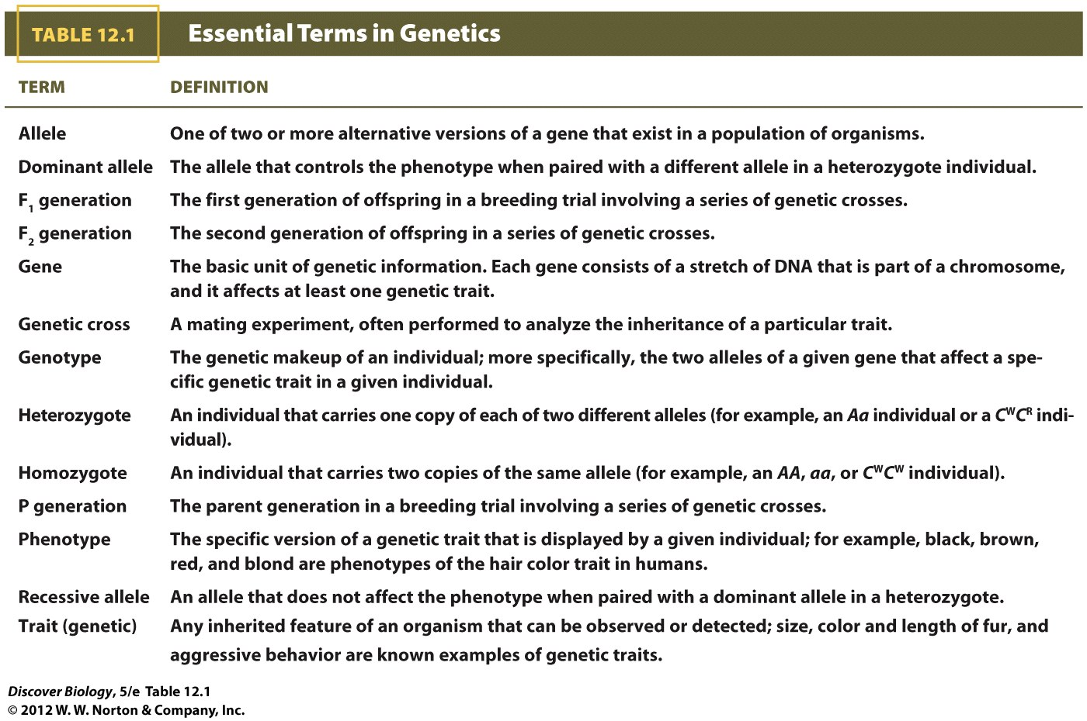
Notes:
Table 12.1 Essential Terms in Genetics

Slide 21
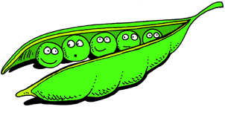
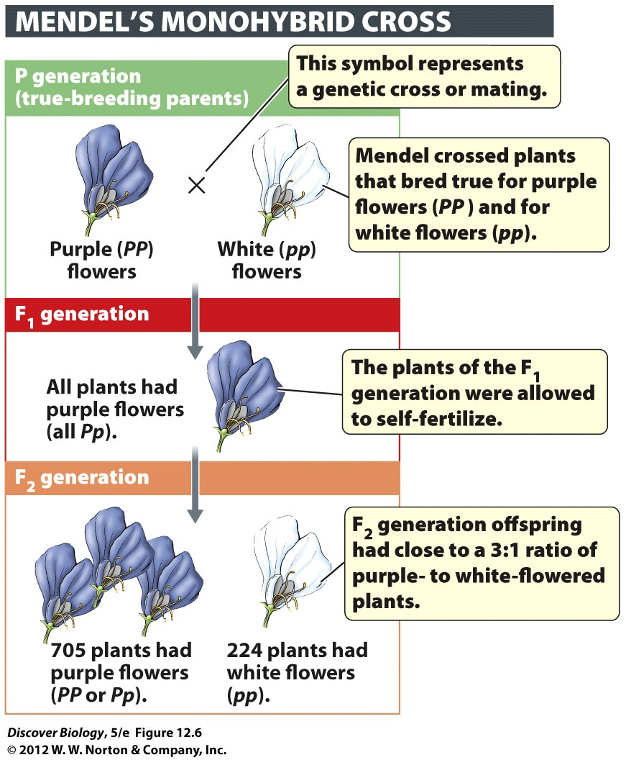
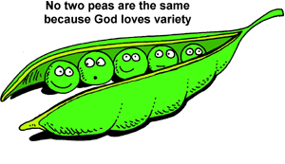
Mendel: He liked peas .
true-breeding: purebred (homozygous)
Mendel crossed pure-breeding plants
Recorded phenotype of offspring

Slide 22
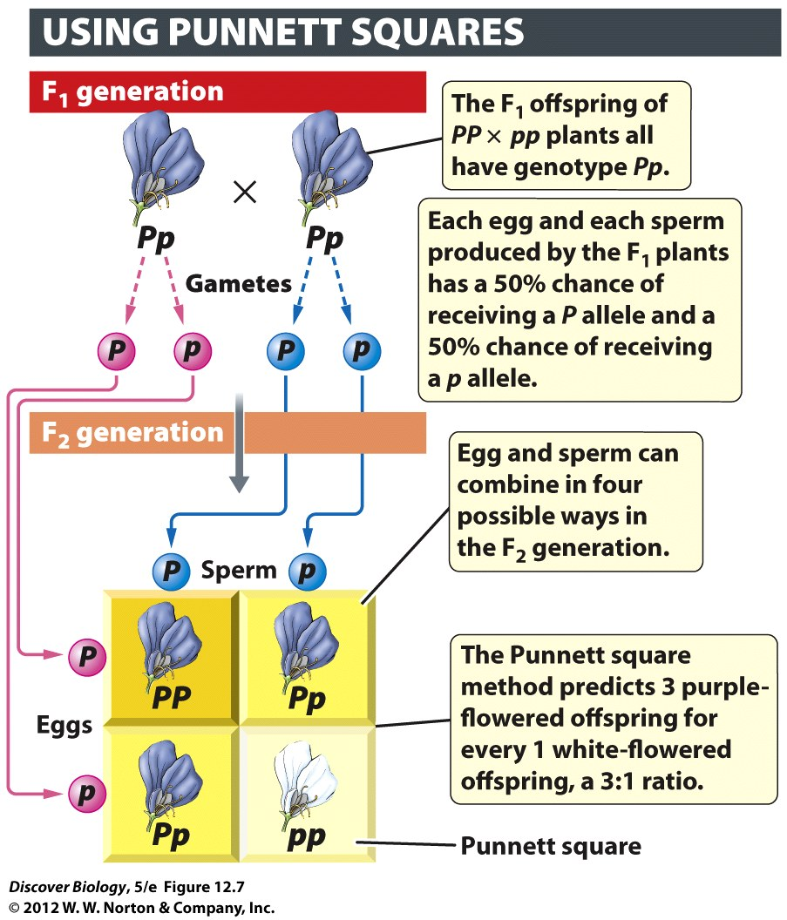
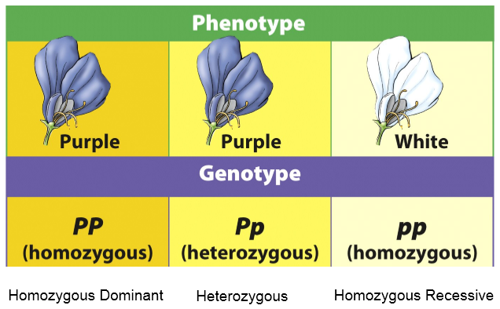
Mendel’s Results
Mendel repeatedly saw a 3:1 (dominant:recessive) phenotype ratio in f2 kids
3:1 ratio means
One gene is involved
One allele has complete dominance
Both parents are heterozygous

Slide 23
Modern interpretation of
Mendel’s Five important ideas
  Variation in traits = different versions of genes
  one copy of a gene from each parent
  Dominant = expressed if present (controls phenotype)
  Two copies of a gene separate in meiosis
  end up in separate gametes
  Gametes fuse randomly (random fertilization)

Slide 24
Mendel REALLY liked peas .
LOTS of experiments: 7 years, 29K plants
Experiments tracking one trait
described before – e.g. flower color
Mendel found law of segregation
law of segregation: the two copies of a gene are separated during meiosis and end up in different gametes (usually)

Slide 25
“Law” of Segregation
Punnett square: shows all the possible ways in which two alleles can recombine through fertilization

Slide 26
3:1 phenotype ratio in F2
One gene is involved
One allele has complete dominance
Both parents are heterozygous
Notes:
Figure 12.7 The Punnett Square Method Is Used to Predict All Possible Outcomes of a Genetic Cross
Punnett squares chart the segregation (separation) of alleles into gametes and all the possible ways in which the alleles borne by these gametes can be combined to produce offspring.

Slide 27
Mendel: more peas, please .
Experiments tracking two traits
e.g. seed color and texture
dihybrid cross:
parents are heterozygous for two traits
Mendel found independent assortment
2 copies of a gene segregate separately from the 2 copies of other genes
Only works on if genes are on different chromosomes

Slide 28
Magic Phenotypic Ratio:
9:3:3:1 in F2
9:3:3:1 ratio in F2 means
Two genes are involved
Both = complete dominance
Both parents are heterozygous for BOTH genes
Notes:
Figure 12.8 Inheritance of Two Traits over Three Generations
Mendel used two-trait breeding experiments to test the hypothesis that the alleles of two different genes are inherited independently from each other. In one set of experiments, illustrated here, Mendel tracked the seed shape trait controlled by the R/r alleles and the seed color trait controlled by the Y/y alleles. The real test of the hypothesis came when Mendel examined the phenotypes of the offspring produced by crossing the heterozygous F₁ plants (RrYy). As predicted by the hypothesis, two new phenotypic combinations were found among the F₂ offspring: plants that made round, green seeds (R-yy) and plants that made wrinkled, yellow seeds (rrY-). The bottom panel summarizes the ratio of the two parental phenotypes and the two novel, nonparental phenotypes. A two-trait breeding experiment in which the F₁ plants are double heterozygotes (heterozygous for both traits) is called a dihybrid cross.

Slide 29
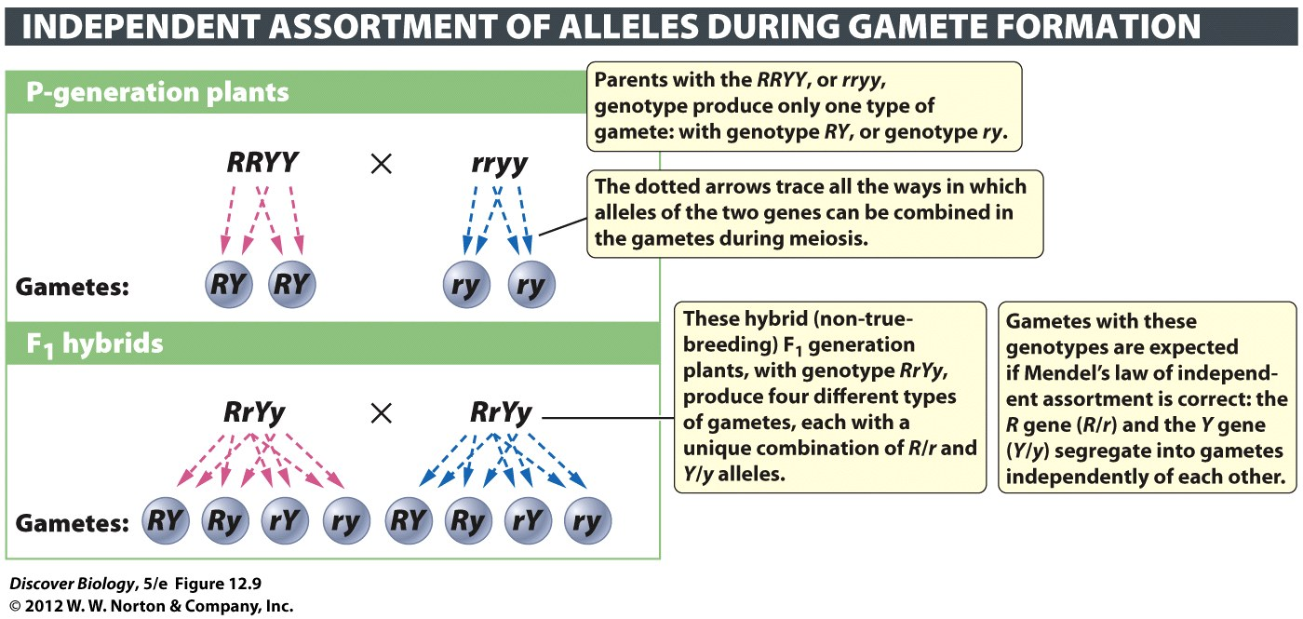
Notes:
Figure 12.9 The Alleles of Two Genes Are Sorted into Gametes Independently
The 9:3:3:1 phenotypic ratios in the F₂ generation of Mendel’s dihybrid cross are best explained by the law of independent assortment, according to which the alleles of the R gene segregate independently of the alleles of the Y gene during meiosis.

Slide 30
Probability
can predict the probability of a phenotype or genotype
Can’t predict actual phenotype or genotype
probability of a specific phenotype unaffected by # of offspring
Siblings don’t count!!

Slide 31
Mendel Got Lucky
All the traits he looked at were easy
controlled by one gene
normal dominant and recessive alleles
lots of traits are more messy
His laws were “expanded” to explain more complicated stuff

Slide 32
Incomplete Dominance
Dominant: an allele (version) that will be expressed if it is there
Recessive: an allele that will be expressed if it is not being blocked
Incomplete dominance: dominant genes doesn’t fully block recessive (wimpy dominant)

Slide 33
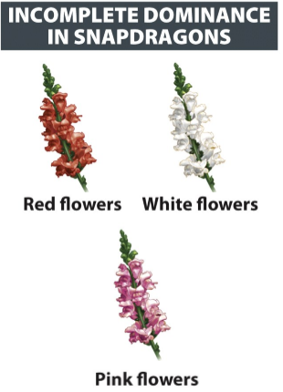
Incomplete Dominance
dominant genes doesn’t fully block recessive
some dominant is expressed
some recessive is expressed
intermediate phenotype
pink, not red or white
1:2:1 Phenotype ratio in F2
One gene
Incomplete dominance
Both parents are heterozygous

Slide 34
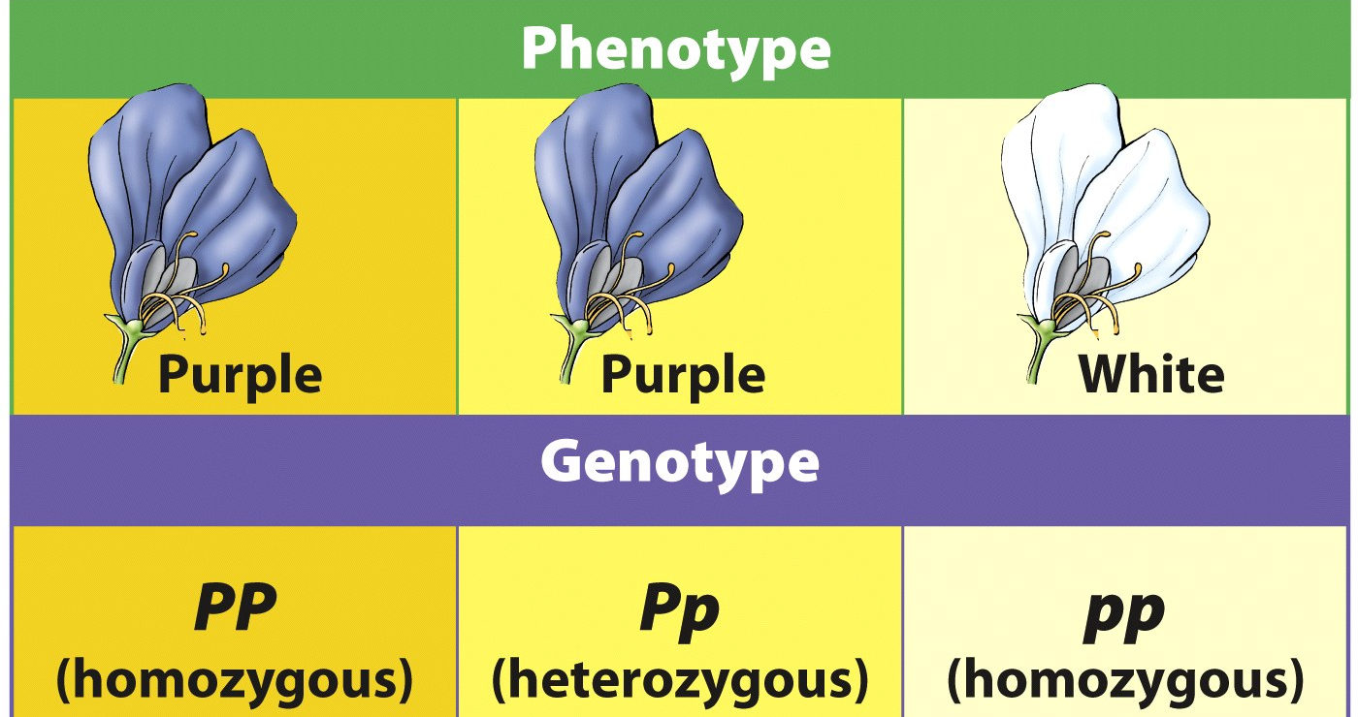
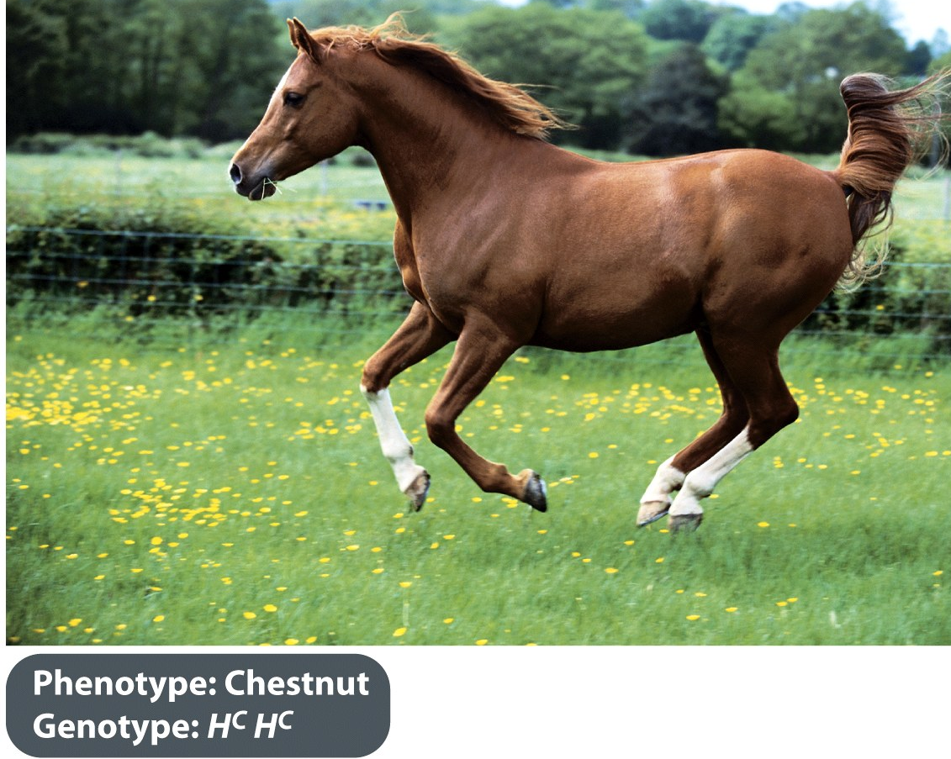
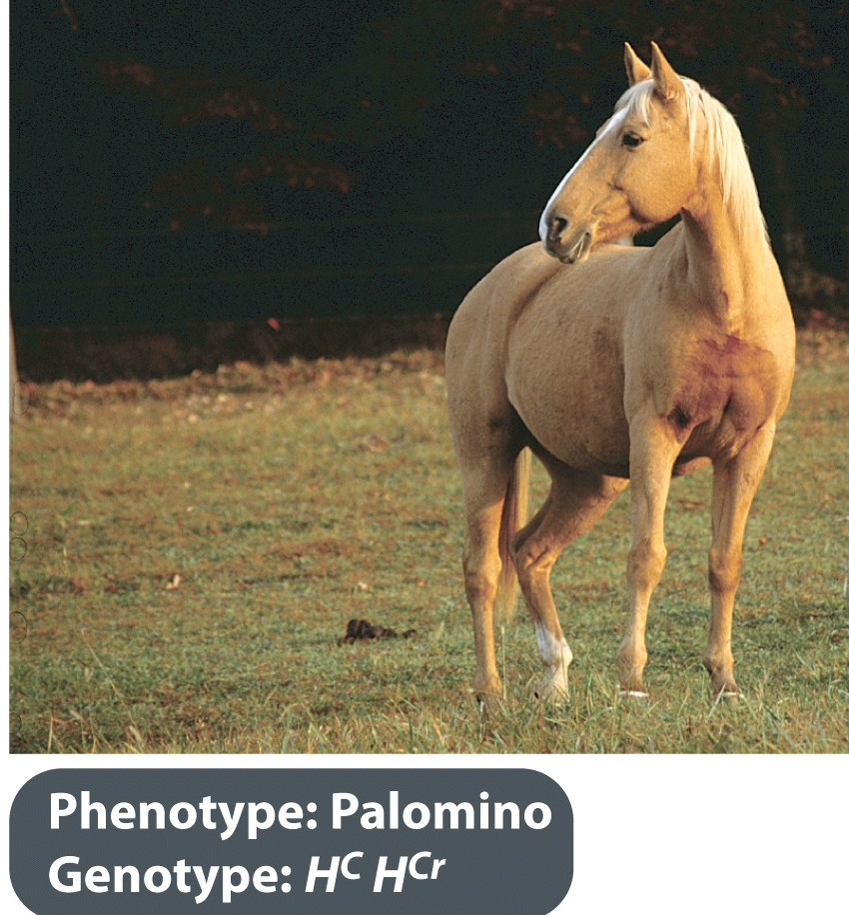
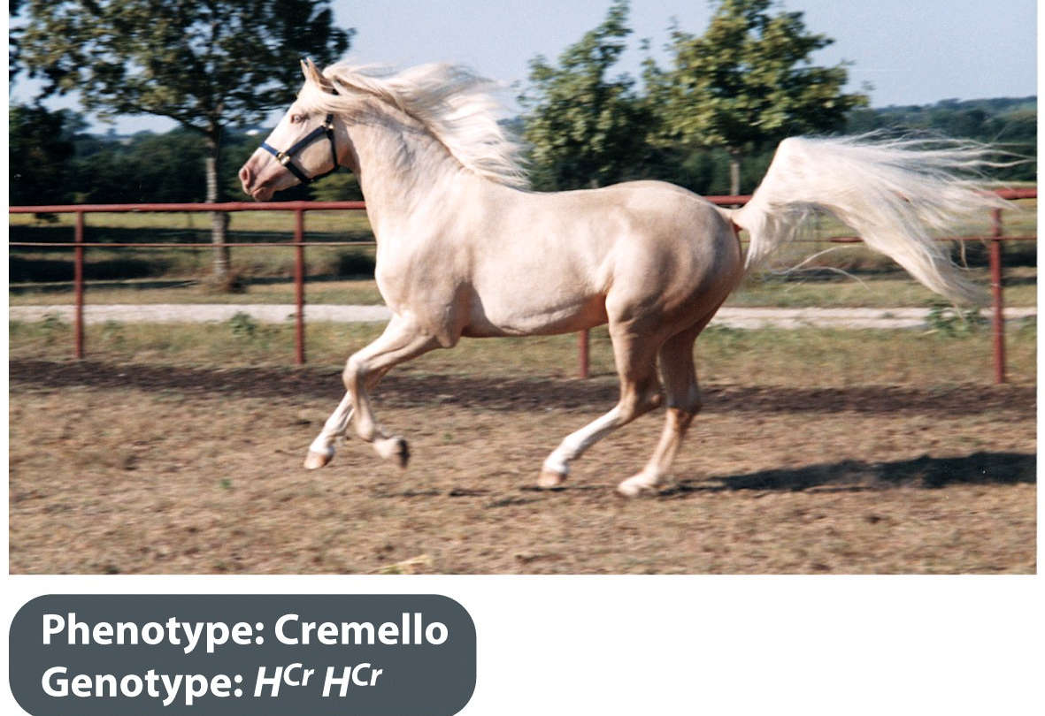
Complete (normal) Dominance ➔
Incomplete Dominance

Slide 35
Magic Ratios Review – 3:1
3:1 phenotypic ratio in F2
This gene has complete (normal) dominance
The more common trait is dominant
The less common trait is recessive
the parents were both heterozygotes

Slide 36
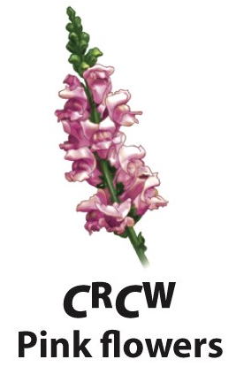
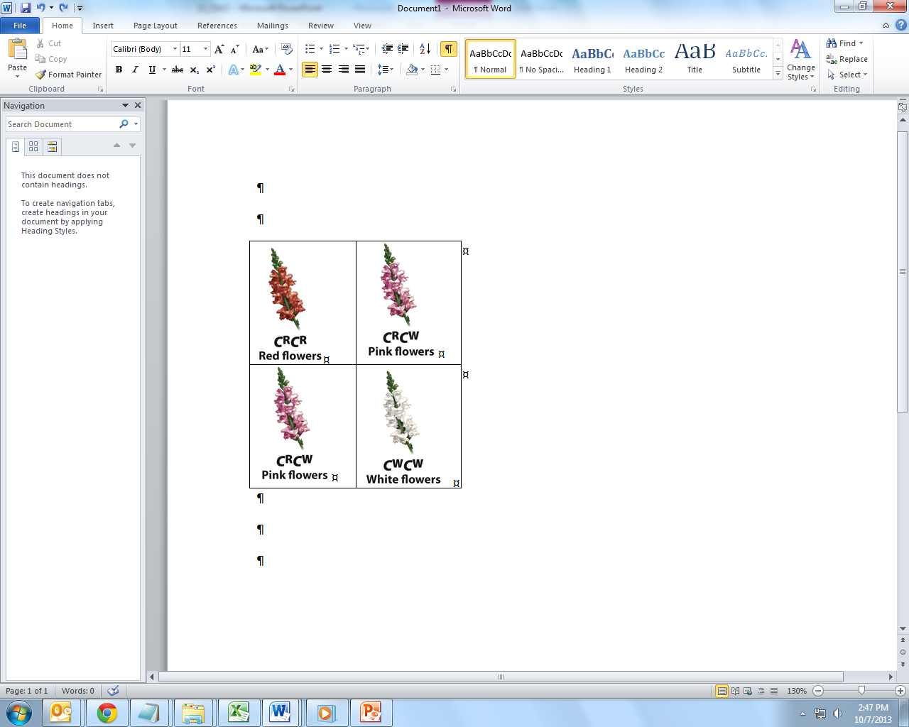
Magic Ratios Review – 1:2:1
1:2:1 phenotypic ratio in F2
This gene has incomplete dominance
The most common trait is heterozygous
Both parents are heterozygous
Both parents are intermediate

Slide 37
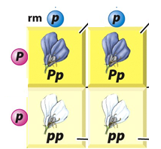
Magic Ratios Review – 1:1
1:1 phenotypic ratio in F2 (usually recessive)
Gene could be complete (more common) or incompletely dominant
One gene is involved
One parent is heterozygous, the other is not

Slide 38
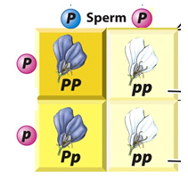
Test Cross: what ratio do you get
Dominant Phenotype, unknown genotype
Do a test cross to learn genotype
Cross to learn genotype A? x aa
AA x aa = all look dominant (100%)
Aa x aa = 1:1 50% dominant 50% recessive

Slide 39
Magic Ratios Review – 9:3:3:1
9:3:3:1 phenotypic ratio in F2
Two traits, both 3:1
Both traits are normal dominance
Genes move independently of each other
Both parents heterozygous for each trait

Slide 40
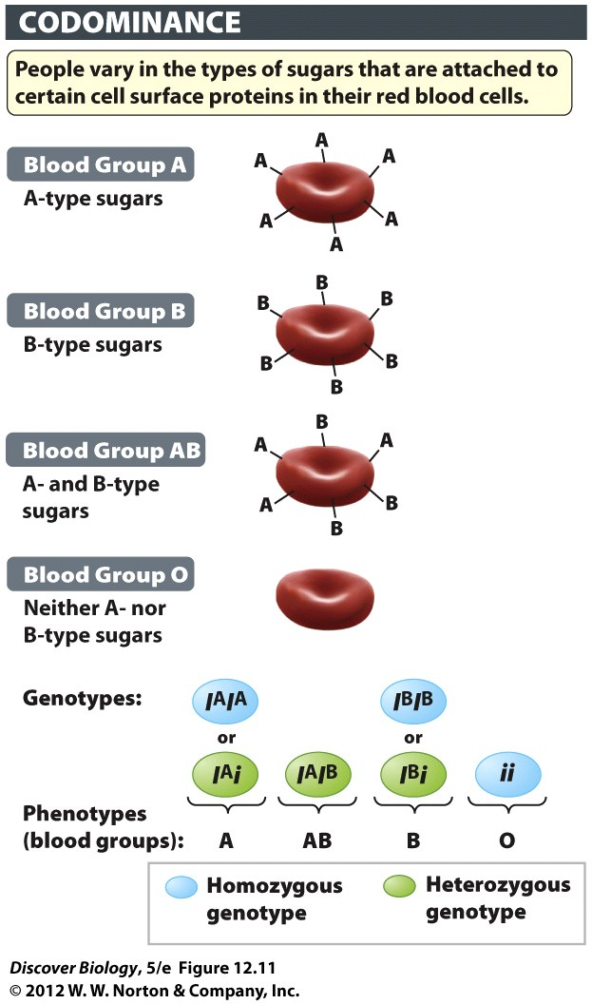
Codominant
Codominance - more than one dominant
(Can still have a recessive allele)
have both traits (equally visible)
No blending or diluting
AB blood type
have type A proteins on RBC
have type B proteins on RBC

Slide 41
Other genetic traits
Pleiotrophic
Multigeneic
Environmental Controls

Slide 42
Pleiotropic Genes
Gene that controls more than one trait
mutation in one gene changes many things Albinism
skin or hair pigment
light sensitivity in eyes

Slide 43
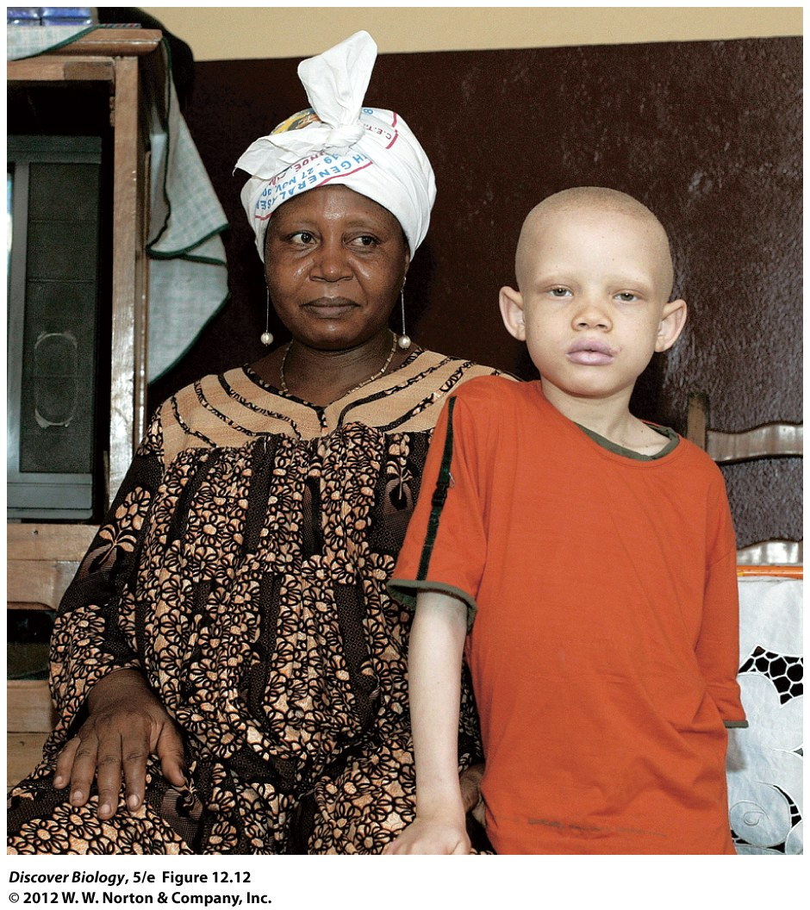
Notes:
Figure 12.12 A Child with Albinism
A mother and her son, who has albinism, in their living room in Douala, Cameroon, Africa. Because it affects eyesight as well as pigmentation in skin, eyes, and hair, albinism is an example of a pleiotropic condition.

Slide 44
Multigenic traits
Multigenic: more than one gene needed
“epistasis” = Gene A depends on Gene B independently inherited genes
both needed for phenotype
Animal fur color: tyrosine ➔ melanin
multistep pathway (several enzymes)
several genes

Slide 45
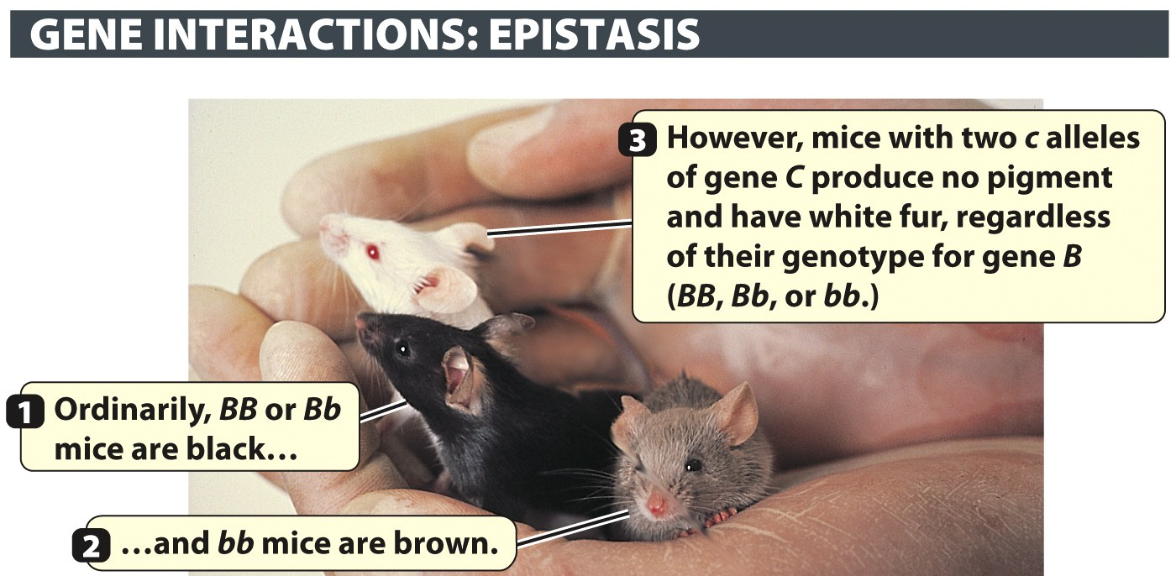
Mice: B gene depends on C gene
Notes:
Figure 12.14 Alleles of One Gene May Affect the Phenotype Produced by Alleles of Another Gene
In this example the c allele of gene C masks the alleles of another gene, B. In mice with the CC or Cc genotype, the dominant B allele directs the production of melanin, resulting in black fur, while the recessive bb genotype “dilutes” melanin accumulation so that brown fur results. Mice with the cc genotype are albinos because melanin production gets blocked at an early point in the pathway, before the B gene exerts its influence. The cc genotype always results in albinism, regardless of whether the genotype with respect to the B gene is BB, Bb, or bb.

Slide 46
Genes affected by environment
External factors can alter gene expression
Chemicals
nutrition
sunlight
temperature

Slide 47
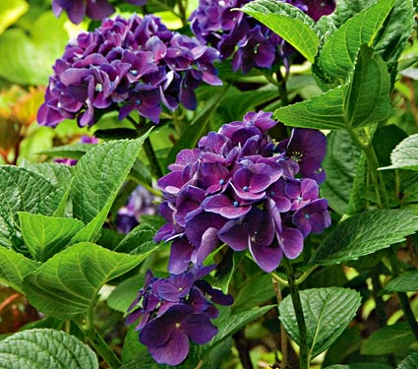
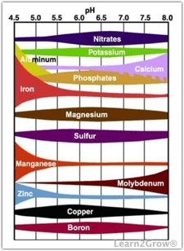
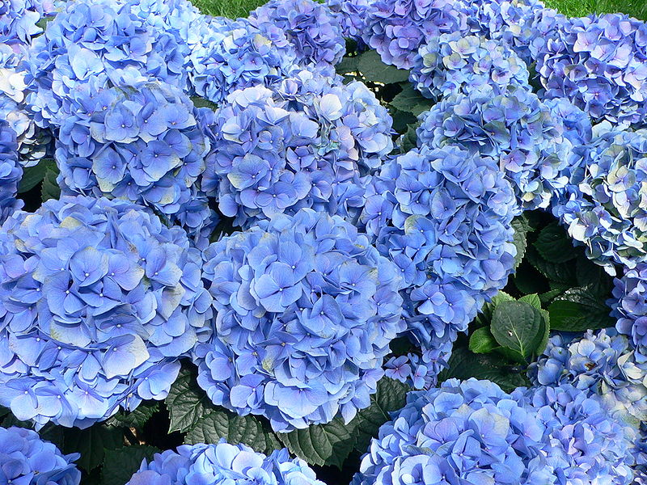
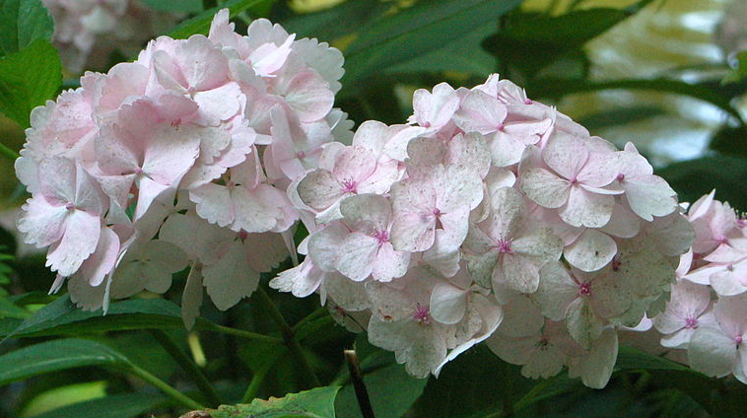
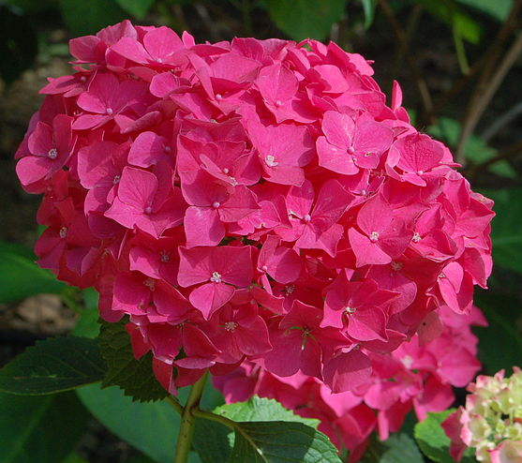
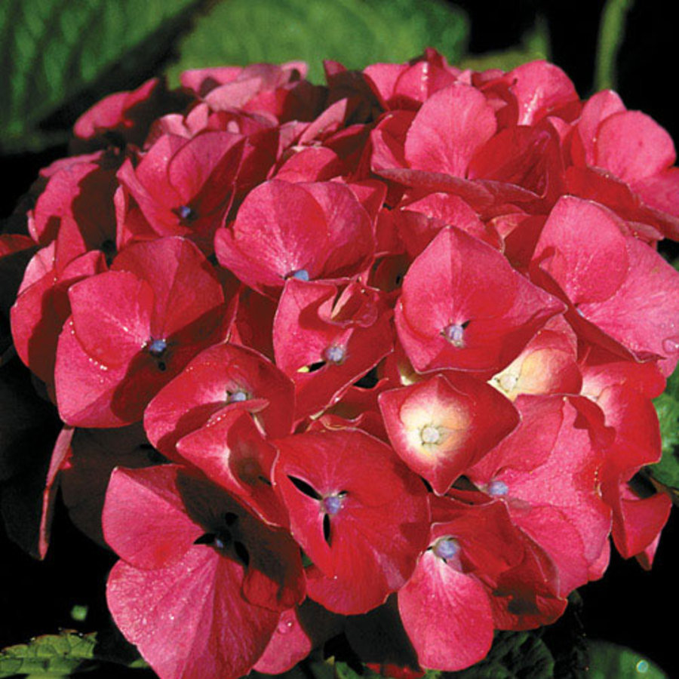
Hydrangea: Soil pH and trace elements

Slide 48
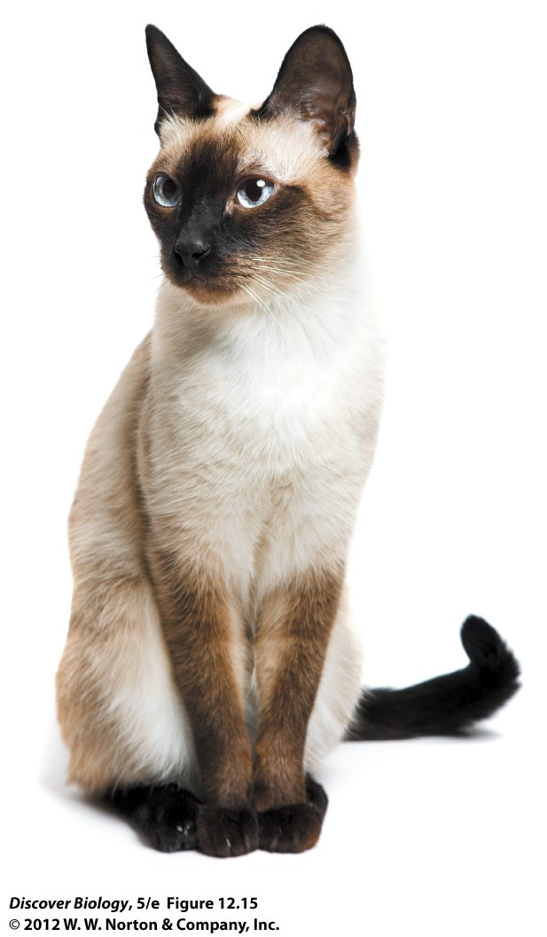
Genes and Temperature
melanin in Siamese cats:
Same fur gene on whole body
Cool areas of body have dark fur

Slide 49
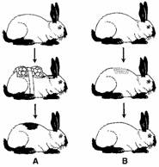
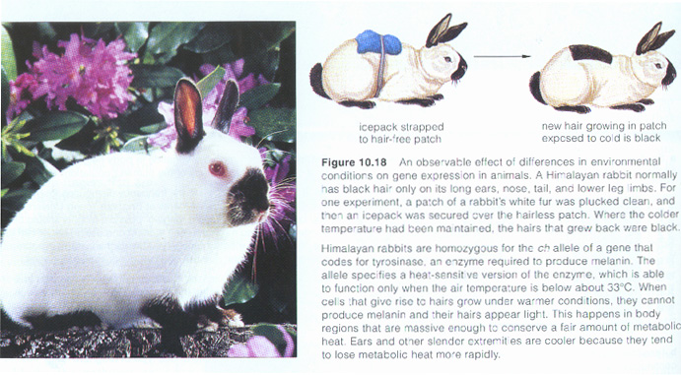
Himalayan rabbits
Notes:
Figure 12.15 The Environment Can Alter the Effects of Genes
Coat color in Siamese cats is controlled by a temperature-sensitive allele. The Ct allele of the C gene directs melanin production only at lower temperatures (below 37°C). Melanin therefore accumulates only in the colder extremities—the snout, tail, lower legs, and edges of the ears—and not in the main trunk, which is at the core body temperature (37°C).

Slide 50
Himalayan rabbits
Notes:
Figure 12.15 The Environment Can Alter the Effects of Genes
Coat color in Siamese cats is controlled by a temperature-sensitive allele. The Ct allele of the C gene directs melanin production only at lower temperatures (below 37°C). Melanin therefore accumulates only in the colder extremities—the snout, tail, lower legs, and edges of the ears—and not in the main trunk, which is at the core body temperature (37°C).

Slide 51
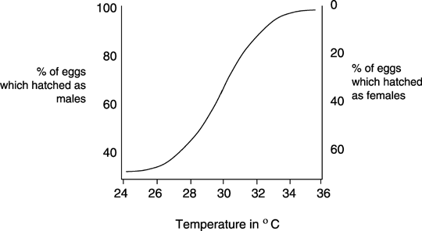
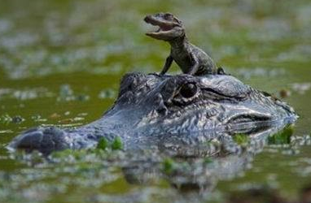
Temperature: Alligator sex
Notes:
Figure 12.15 The Environment Can Alter the Effects of Genes
Coat color in Siamese cats is controlled by a temperature-sensitive allele. The Ct allele of the C gene directs melanin production only at lower temperatures (below 37°C). Melanin therefore accumulates only in the colder extremities—the snout, tail, lower legs, and edges of the ears—and not in the main trunk, which is at the core body temperature (37°C).

Slide 52
Multigenic/Polygenic
MOST traits depend on more than one gene
Humans - Skin color, running speed,
blood pressure, body size
Geneticists: “more than a dozen genes that control melanin”
environmental factors: even more variation
MENDEL GOT LUCKY!!! (Chose simple stuff to study)

Slide 53
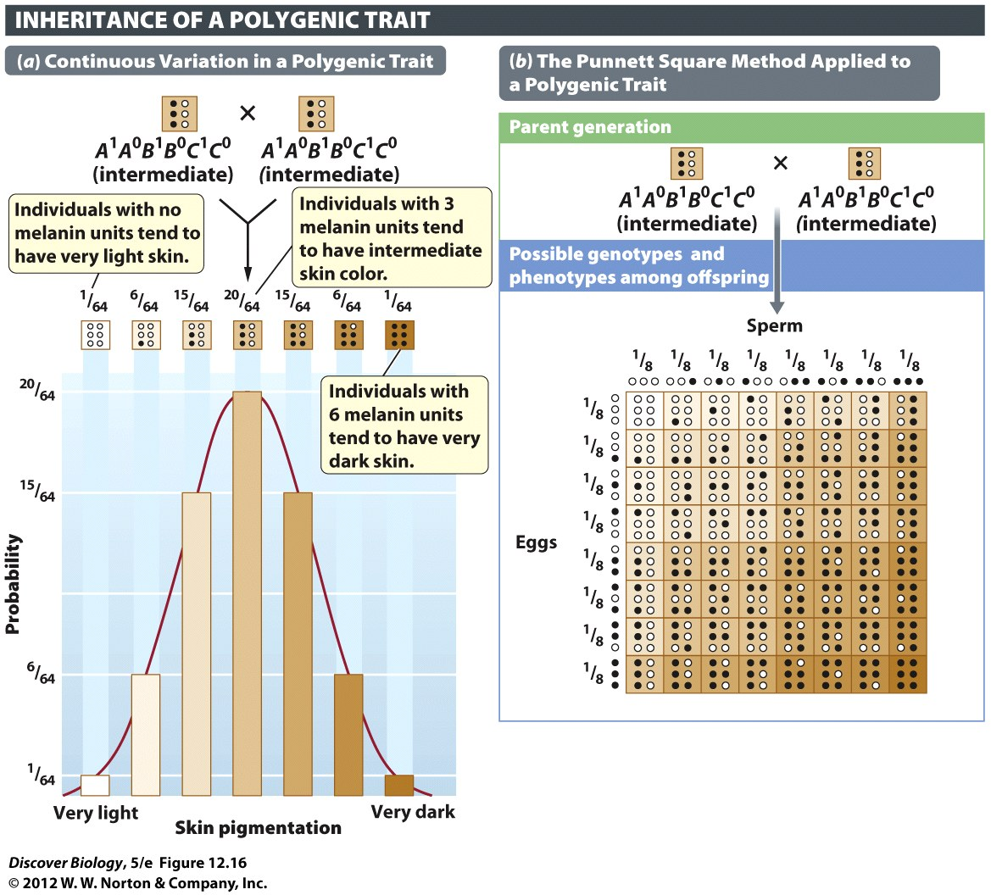
Notes:
Figure 12.16 Three Genes Can Produce a Range of Skin Color in Humans
In this model, skin color is influenced by the total number of melanin “units” specified by the person’s genotype. (a) For each of the three hypothetical genes shown here (A, B, and C), the superscript 1 (for example, A¹) identifies an allele that leads to the production of one “unit” of melanin, while the superscript 0 (for example, A⁰) identifies an allele that produces no melanin. The two alleles of each of these genes are incompletely dominant. Alleles that do not contribute to melanin production (A⁰, B⁰, and C⁰) are represented by open circles, while alleles that do contribute to melanin production (A¹, B¹, and C¹) are represented by solid circles. The bar graph depicts the seven phenotypic outcomes arranged from lightest skin to darkest skin. Bar heights indicate the relative proportions of children of each phenotype. (b) The Punnett square shows the proportions of gametes with specific genotypes that are produced by two heterozygote (A¹A⁰B¹B⁰C¹C⁰) parents and all the possible ways in which the eight different genotypes can come together during fertilization. Each of the seven different phenotypes (that is, children with 0, 1, 2, 3, 4, 5, or 6 melanin units) can be specified by one to several different genotypes. For example, children producing two melanin units can have any one of six different genotypes. Additional variation in skin color would result from different levels of sun exposure.

Slide 54
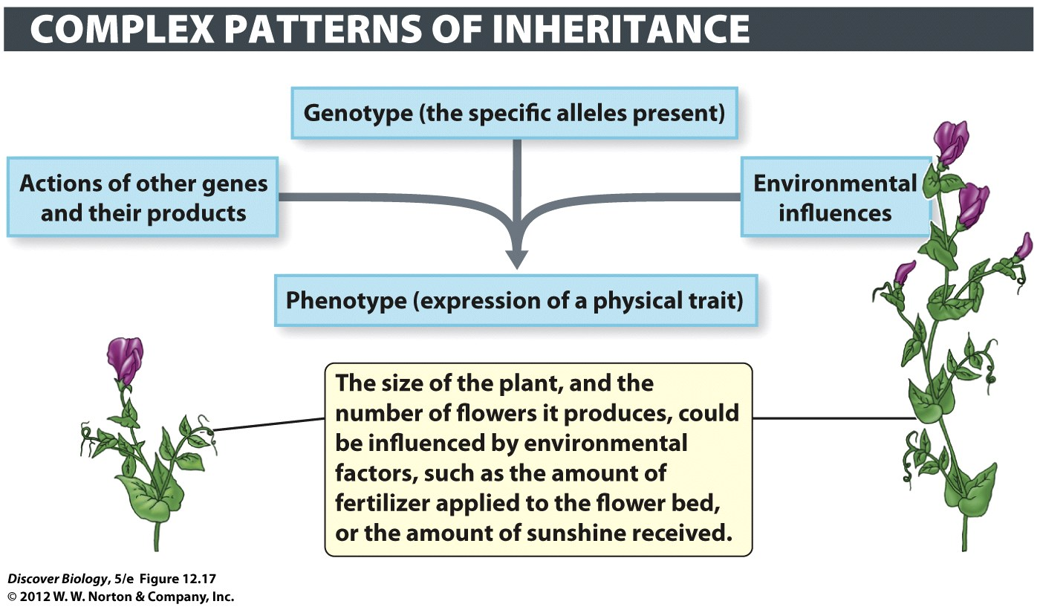
Complex Traits
Many factors: predicting phenotype is difficult

Slide 55
Clicker Questions
CHAPTER 12
Patterns of Inheritance

Slide 56
Concept Quiz
A red carnation and a white carnation
produce offspring that are all pink. The type
of inheritance pattern occurring is:
Complete dominance
Incomplete dominance
Codominance
Notes:
The correct answer is B.
Pink is the intermediate color between red and white.
Red and white are homozygous and pink is heterozygous.
If complete dominance were occurring, then there would only be two phenotypes, red and white.
If codominance were occurring, then the heterozygote would have both red and white patches on the same flower.

Slide 57
Concept Quiz
If an allele for tall plants (T) is fully dominant to short plants (t), what offspring would you expect from a TT x Tt cross?
½ tall; ½ short
¾ tall; ¼ short
All tall
Notes:
The correct answer is C.
The only way to have offspring that are short is if both parent plants carry the short (t) allele.
Since one parent is homozygous dominant, no short offspring can be produced.

Slide 58
Concept Quiz
Fur color in rabbits shows incomplete dominance.
F^{B}F^{B} individuals are brown, F^{B}F^{W} individuals are
cream, F^{W}F^{W} individuals are white. What is the
expected ratio of a F^{B}F^{W} x F^{W}F^{W} cross?
3 white : 1 brown
3 white : 1 cream
2 white : 2 cream
Notes:
The correct answer is C.
In order to produce brown rabbits, each parent would have to have at least one copy of the brown allele, since brown is homozygous (FBFB).
Although a 3:1 ratio is possible of the offspring, the expected ratio cannot be 3:1 (see Punnett square in Lecture notes).

Slide 59
Free Biology Tutoring
Not Happy with your grade?
Not understanding the material?
Remember that the TLCC has

