Slide 1
Log into PAL
Have you taken the latest quiz?
When is your next paper due?
If you are not sure, you need to

Slide 2
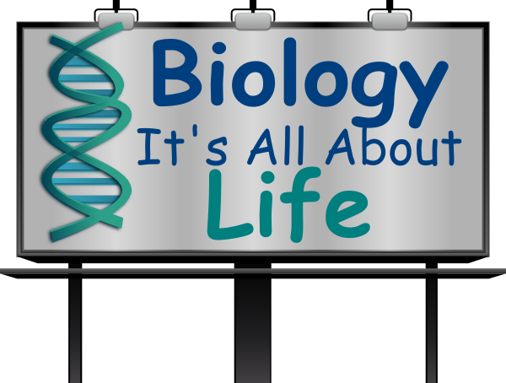
Introduction

Slide 3
biology
Bio (“life”) + logy (“study of”)
Scientific study of life (pg. 4)

Slide 4
Major themes for chapter 1
Scientific Method
Characteristics and organization of living things

Slide 5
What is Science
“Knowledge about the natural world and the evidence based process for acquiring that knowledge”
How we try to understand natural world
  What we can observe or measure the effects of
  There are things science cannot answer (pg. 4 & 13)
Goals – logical, objective, based on evidence

Slide 6
Characteristics of
Scientific Knowledge
Natural world – what we detect, observe or measure
Evidence based – experiments or observation
Peer review and independent validation (pg. 3, 20 & 21)
Open to evidence based challenge by anyone
    New evidence can change everything
Self correcting process
Listed on Pg. 4

Slide 7
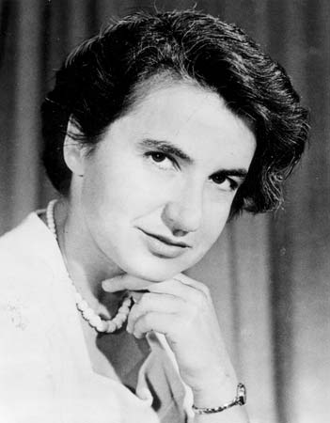

The Bad News
Scientists are human.
Mistakes
Fraud
Cheating

Slide 8
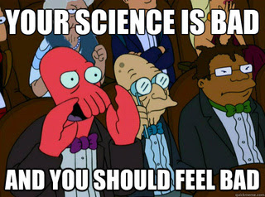
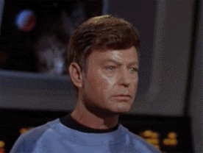
The Peer Review Problem
Scientific mistakes and fraud can only be detected if people
See errors in the methodology of the research
Try to duplicate the experiment without those mistakes (have evidence it doesn’t work as described)
This doesn’t always happen
(if reported results match everyone’s expectations,
they probably won’t be checked)
What often happens ➔
What we want ➔

Slide 9
How to do GOOD science
Be skeptical about results (even your own!!)
If results seem AMAZING
Check your equipment
Talk to another scientist before running to the press.
  Can they find problems w/ your experiment
  Do they think your results seem reasonable
Key - Must try to prove false what you believe is true

Slide 10
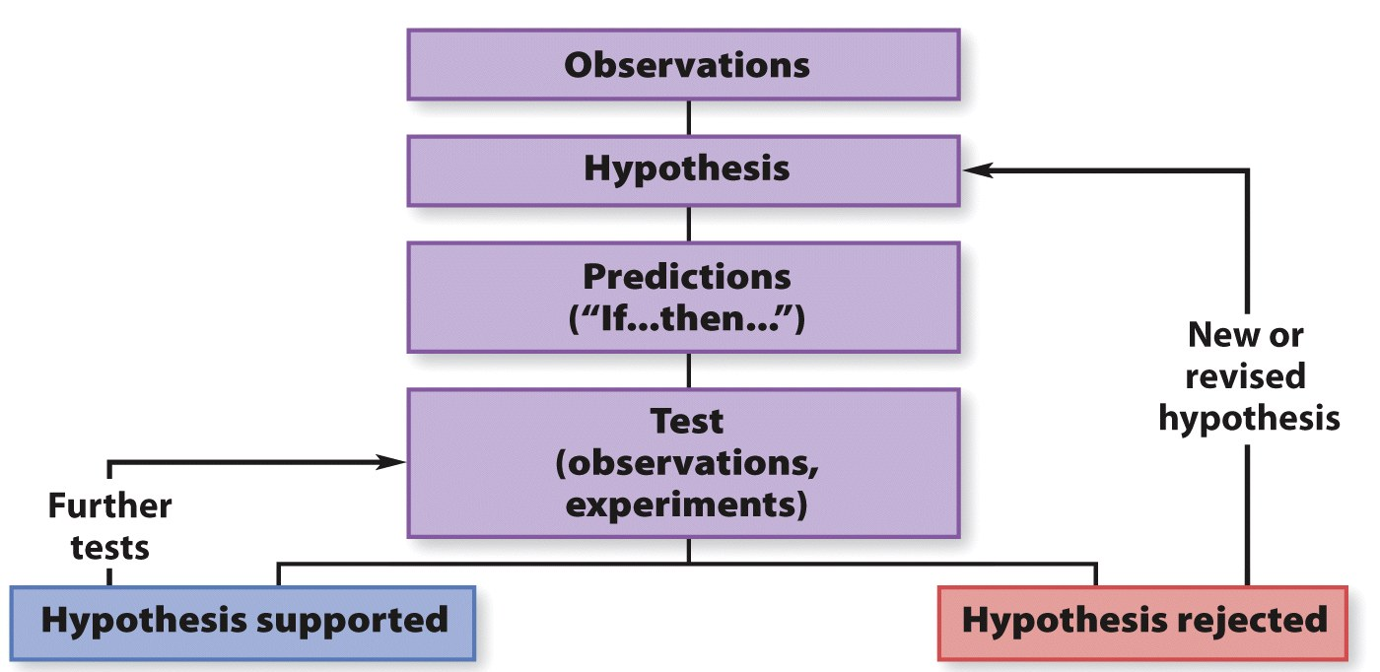
Scientific Method
A description of the core logic of how science works
Not a recipe of steps that all scientists use all the time
  example: like learning to waterski

Slide 11
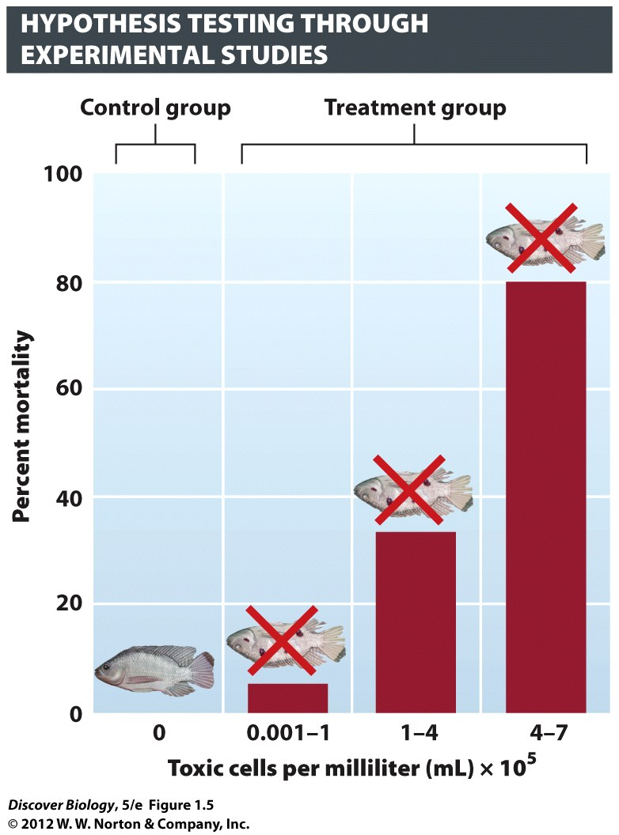
Steps in the Scientific Method
Observation fish dying near factory
Hypothesis factory chemicals kill fish
Making a prediction if true, chemicals kill fish in lab
Testing
  Same water conditions for all
  (pH, temp, oxygenconcentration)
  Control Group
  no change in experimental variable
  why?
  Ensure results due to exp. variable
Results – support hypothesis?
pg. 5

Slide 12
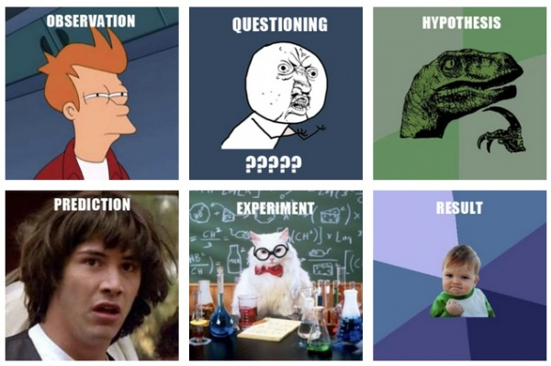
Steps in the Scientific Method

Slide 13
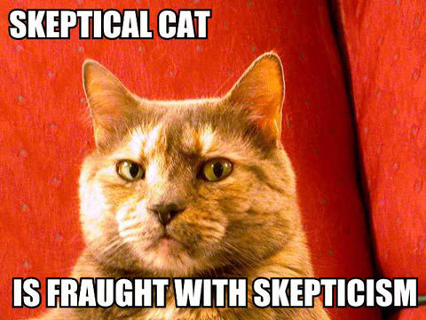
Observations
Description, measurement or record
Reproducible by others
  Detailed Description of Methods & Conditions
  be skeptical of
  both the initial
  observations
  and the results
  Be very suspicious of claims without detailed methods – often a scam
pg. 6

Slide 14
Hypothesis
“informed, logical and plausible explanation for observations of the natural world” (pg. 7)
“Educated guess” that explains observations
What the rest of the world means when they say “theory”
  Scientists use the word “theory” in a VERY different way….more on that later.

Slide 15
Characteristics of a Hypothesis
Explains prior observations
Makes “If…then”-style predictions
Something that can be tested by skeptics
CAN BE PROVEN FALSE!!!!!!
Can never be proven correct
  Can be supported by prior observations and test results
pg. 7

Slide 16
Testing a Hypothesis
The scientist who proposes a hypothesis is the one who should test to see if it is false
Can test with observations or experiments
    Experiments are best, but some forms of science don’t have that option. Astronomers can’t blow up stars to observe the results.
Tests usually involve measuring VARIABLES (characteristics that can change)

Slide 17
Experiment
“a repeatable manipulation of one or more aspects of the natural world”
Modifying one variable to see what happens to another one
The thing we record for results are the “dependent variable.”
The variable we control and change as part of the experiment is the “independent variable”
pg. 8

Slide 18
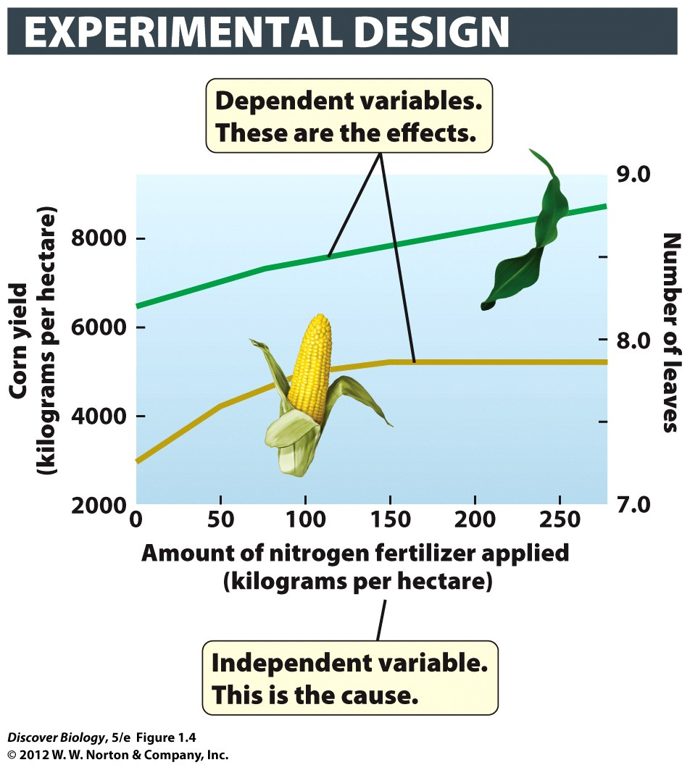
Testing a Hypothesis
“No amount of experimentation can ever prove me right; a single experiment can prove me wrong”
- Albert Einstein

Slide 19
Experimental Control
a group maintained under a standard set of conditions with no change in the independent variable
If fish in the control group are dying, you cannot be sure the other results are due to the experiment
pg. 9

Slide 20
Testing can support a hypothesis, but cannot prove it
“No amount of experimentation can ever prove me right; a single experiment can prove me wrong”
                – Albert Einstein
Repeated tests can provide evidence that supports a hypothesis, but they cannot PROVE it.
When lots of evidence supports a hypothesis, scientists can be confident in it
pg. 10

Slide 21
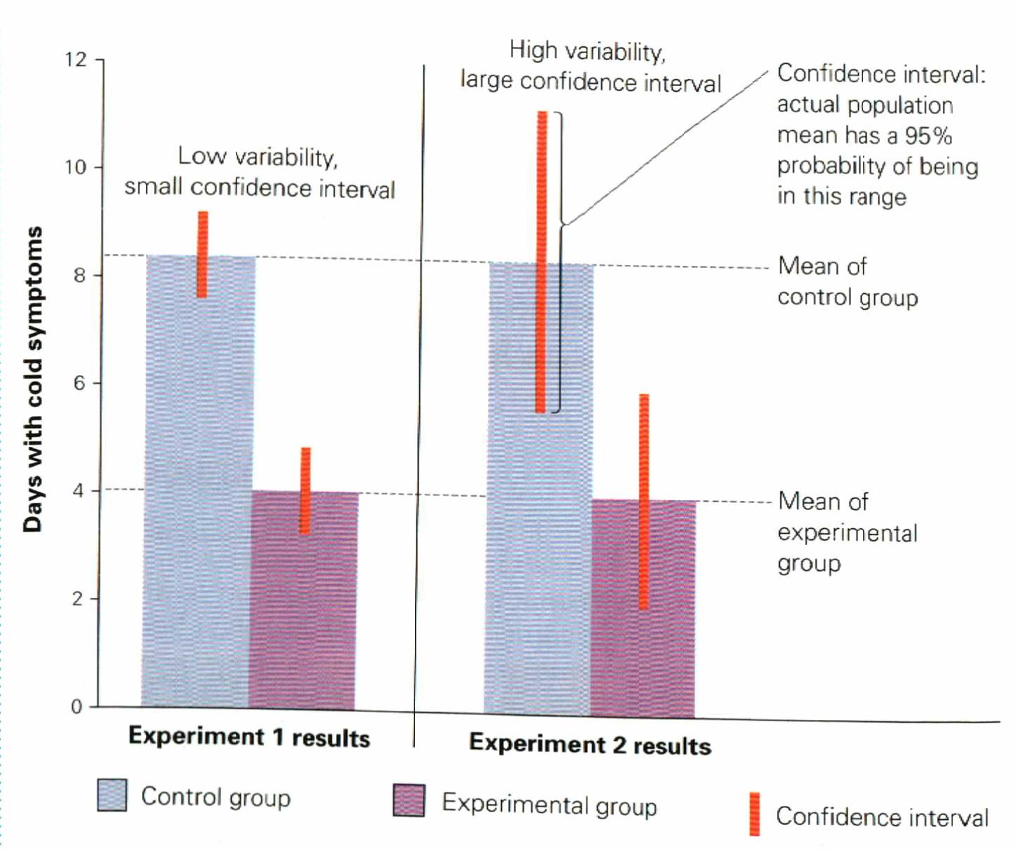
Statistics
using math to describe our observations
values like the margin of error and the confidence interval tell us how confident we can be that the results of a test are meaningful
Small Confidence Interval
Means results are more
likely to happen because
of the experiment
Large Confidence Interval
Means low confidence
In results of test
(could be due to chance)

Slide 22
Nerd Words for Statistics
“Statistically Significant”
“Pay attention to this result”
very unlikely that this difference is the result of chance
We must use statistics to decide if our results can be explained away by dumb luck (random chance)
If a result is VERY VERY improbable, we are more likely to trust it .
WHY? Probably wouldn’t happen by chance

Slide 23
Correlation
two variables are related in some way
    Example: a large value for variable occurs when there is a large value for another variable
Does not prove cause and effect
Correlation is often described in situations where scientists are unable to perform experiments
pg. 8

Slide 24
Theory
(Not what most people think it means)
“My theory is that Susan and Jim are going to start dating…”
That is an informed guess, what scientists would call a hypothesis.
It is almost the exact opposite of a scientific theory
pg. 11

Slide 25
Scientific Theory
an explanation of the natural world that is strongly supported and widely accepted by scientists
    Support comes from repeated testing over several decades
    Far greater confidence in this explanation than in an educated guess
A hypothesis does not become a theory.
Theories are more general (applies to many situations)
pg. 12

Slide 26
Characteristics of
Living Organisms
made of one or more cells
      More than one = “multicellular organism”
Reproduce using DNA
Obtain energy from their environment to support metabolism
Sense their environment and respond to it
Homeostasis – try to keep their interior conditions constant
groups of them can change (evolve)
pg. 12

Slide 27
The Cell
Smallest and most basic unit of life
“Plasma Membrane” = outside layer
Some cells keep their DNA in a nucleus, some do not
  Prokaryotes = no nucleus
  Eukaryotes = nucleus
pg. 12

Slide 28
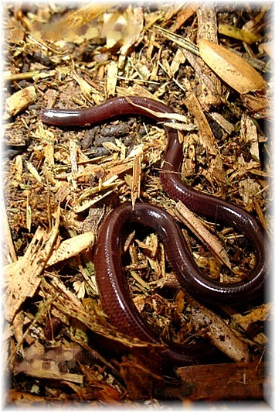
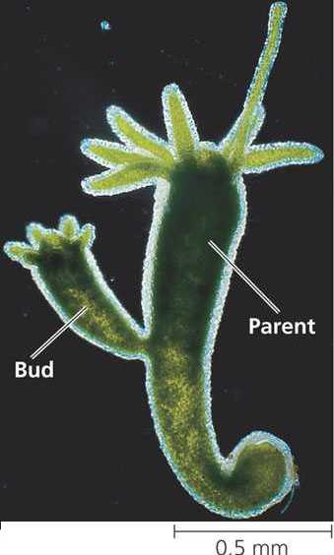
Reproduction
Making offspring of same type as yourself
Sexual – offspring has DNA from both parents
Asexual – offspring DNA from only parent
pg. 14

Slide 29
DNA
Deoxyribonucleic Acid (yes, be able to spell it)
If a cell has a nucleus, that’s where the DNA should be
“gene” – part of a DNA molecule with instructions for a genetic trait
“Chromosome” – very big DNA molecule (has many genes)
Unambiguous, redundant, universal
pg. 14

Slide 30
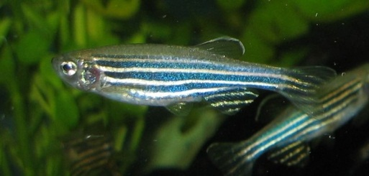
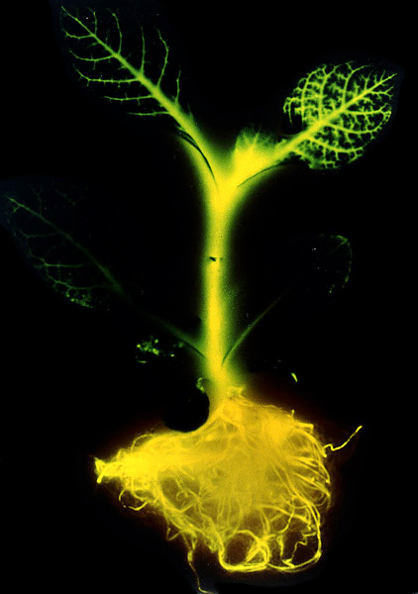
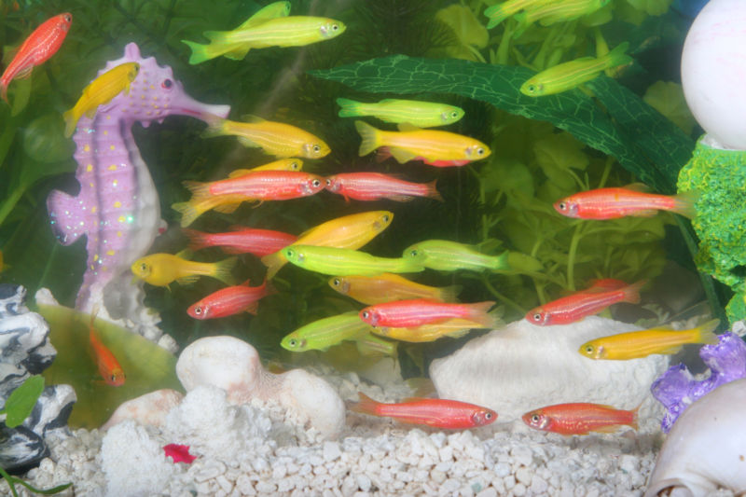
DNA - universal
All living organisms use the same genetic code

Slide 31
Metabolism
Getting, storing and using energy
Producers (aka “autotrophs”) produce own food
  Photosynthesis
  Chemosynthesis
Consumers (aka “heterotrophs”) consume other organisms
  Eat producers or other consumers
pg. 14

Slide 32
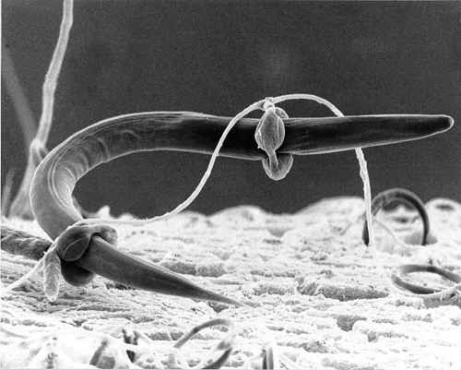
Response to Stimuli
Living things sense conditions in their body and environment and respond to those conditions
Goal: homeostasis (constant internal conditions)
pg. 15

Slide 33

Evolution
(Darwin doesn’t matter)
Somebody else would have figured it out (….and did)
Details later

Slide 34
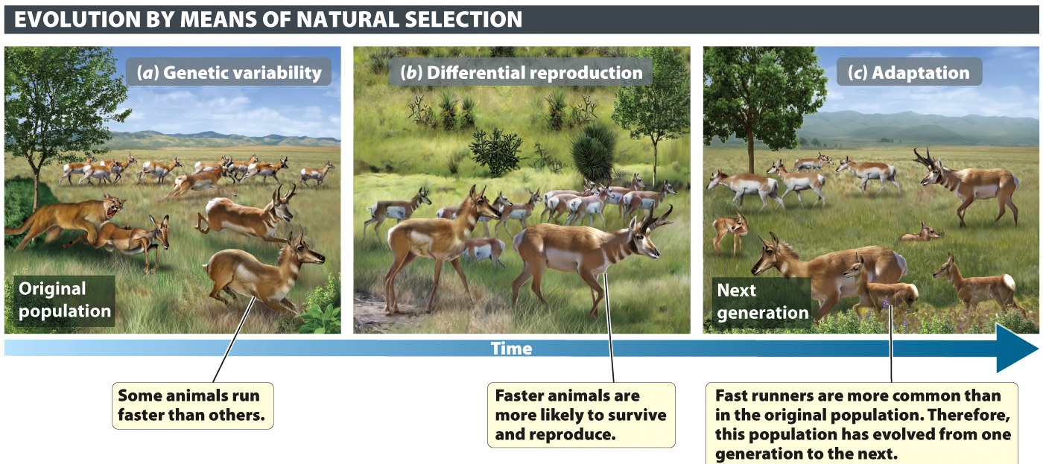
What Is Evolution
Change in a population (not an individual)
Two requirements
Variation in the population (often random)
Selection (NOT random – more info later)

Slide 35
Adaptation
Organisms better suited to their environment will leave more offspring
Population will change over time (evolution) to better fit conditions of environment
Adaptive traits and “fitness”
pg. 15

Slide 36
Characteristics of
Living Organisms
made of one or more cells
      More than one = “multicellular organism”
Reproduce using DNA
Obtain energy from their environment to support metabolism
Sense their environment and respond to it
Homeostasis – try to keep their interior constant
groups of them can change (evolve)
pg. 12

Slide 37
Is a virus alive?
Reproduction
metabolism

Slide 38
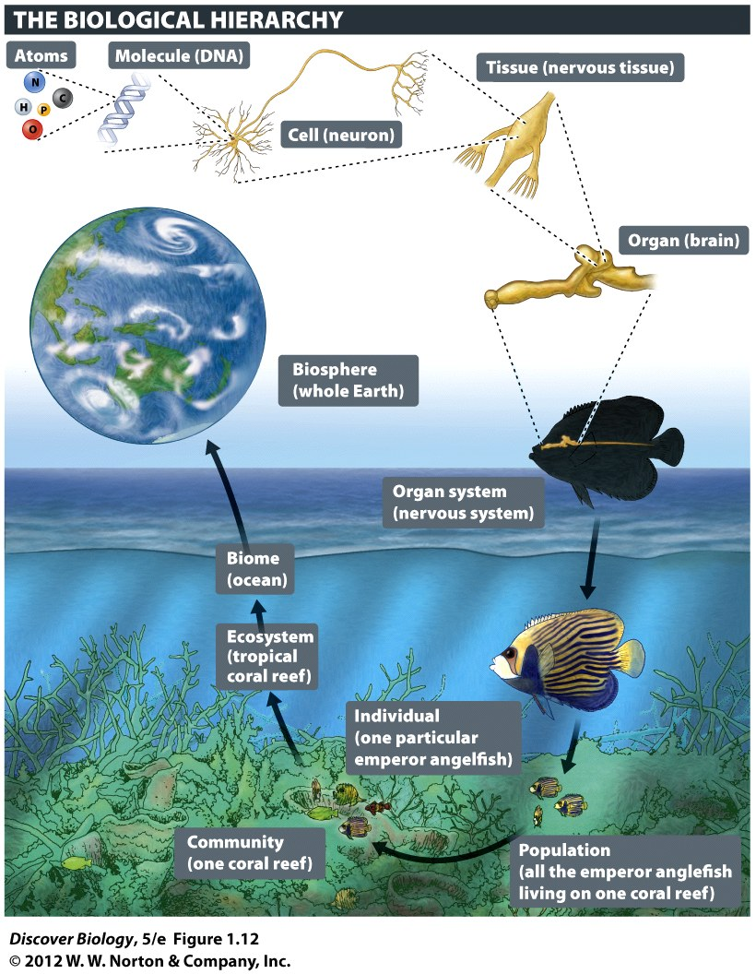
The Biological Heirarchy
Biome
Ecosystem
Community
  Population
    Individual
      Organ system
        Organ
          Tissue
            Cell
              Molecule
                atom

Slide 39
Species
Organisms that breed in natural surroundings and create fertile offspring
population
A group within a species that has a common habitat
pg. 16

Slide 40
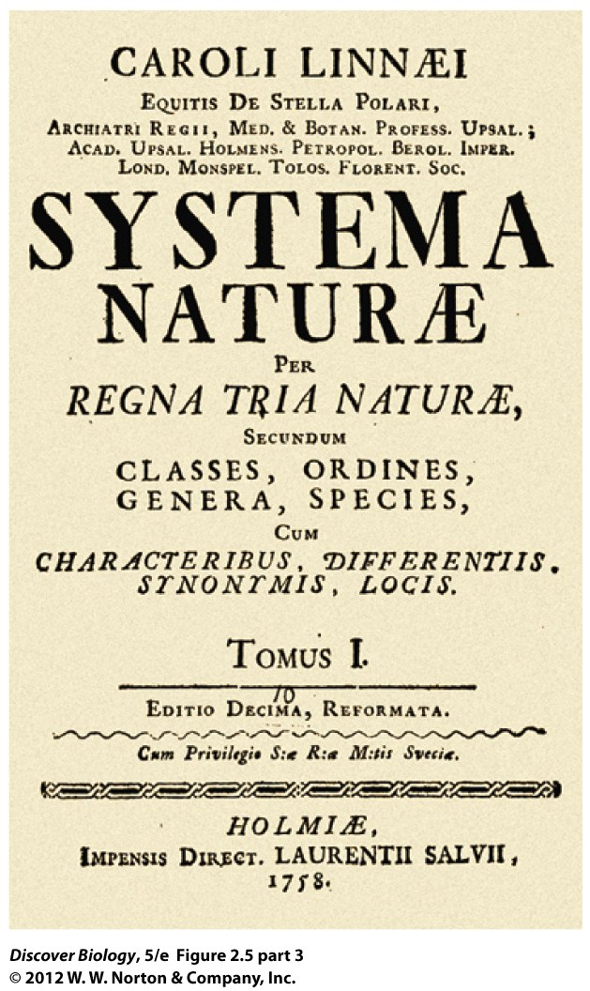
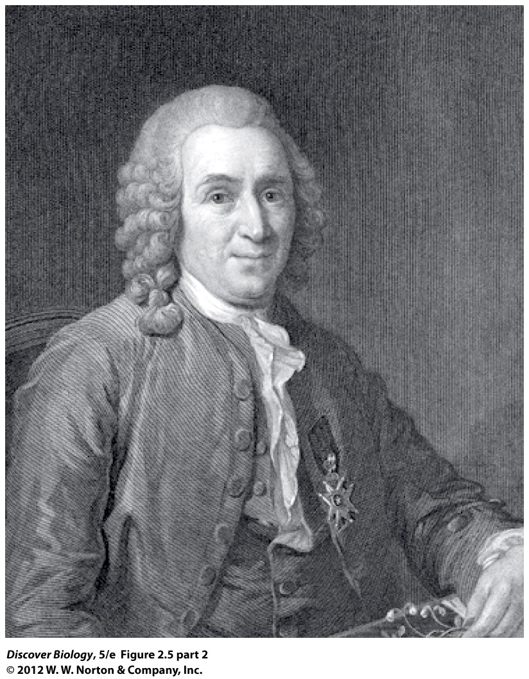
Carolus Linnaeus

Slide 41
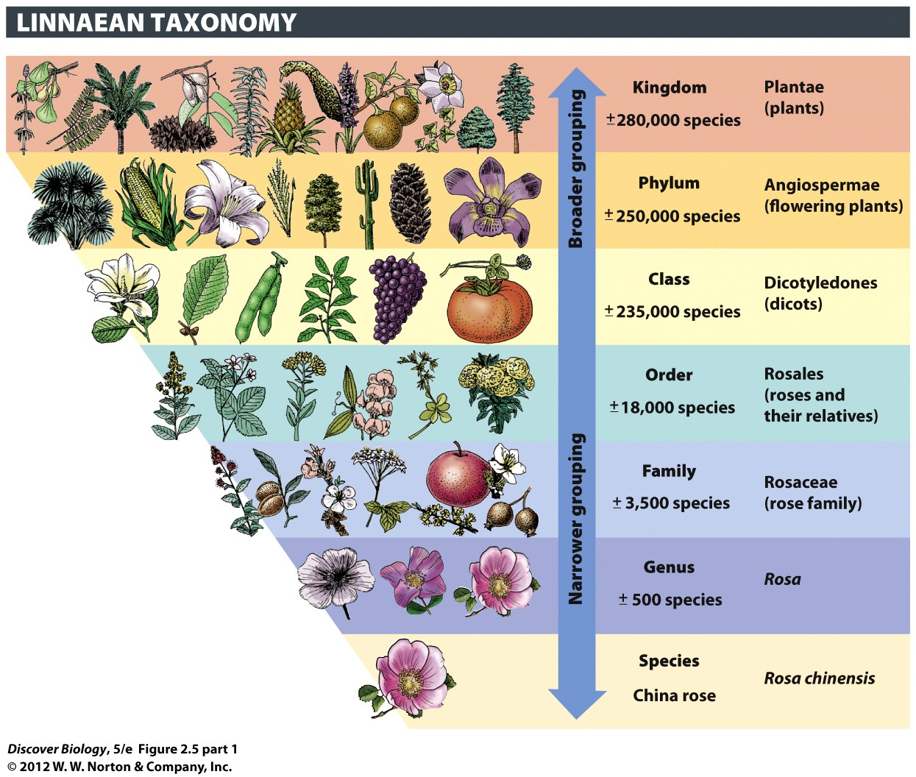
Book
Illustration
(next slide,
Animals!!!)

Slide 42
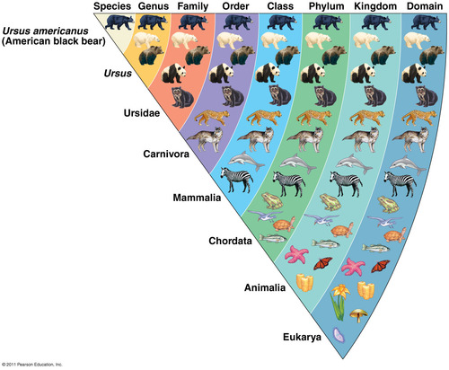
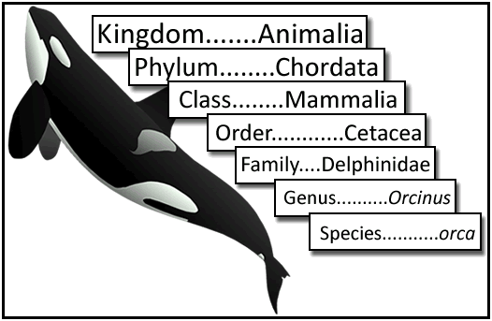
Very
Specific
General
The larger groups are less specific and contain more kinds of organisms
We’ve added a new
level since Linnaeus
(more info later)

Slide 43
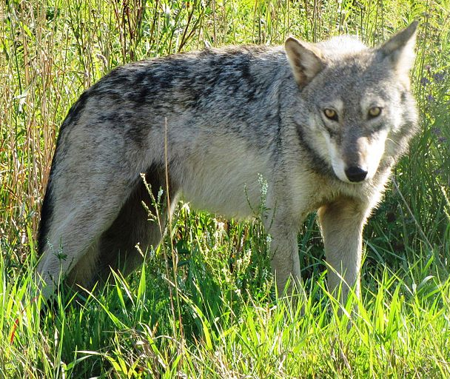
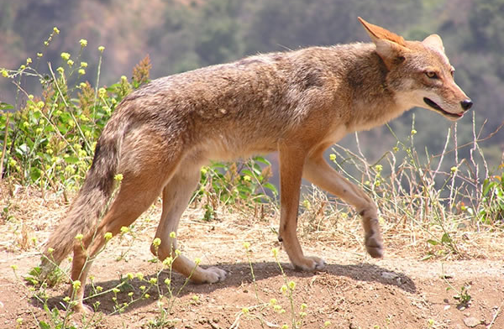
Scientific Name (2 parts)
Species Name ⬅ put it in italics or underline it
1) Genus ⬅ must be capitalized (e.g. Canis)
2) specific to the species ⬅ must be lower case
Canis latrans
Canis lupus

Slide 44
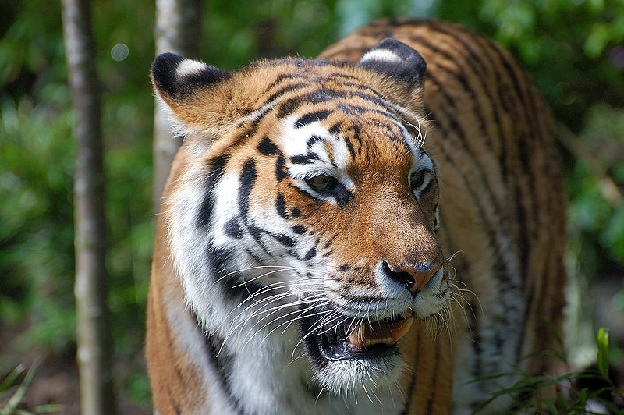
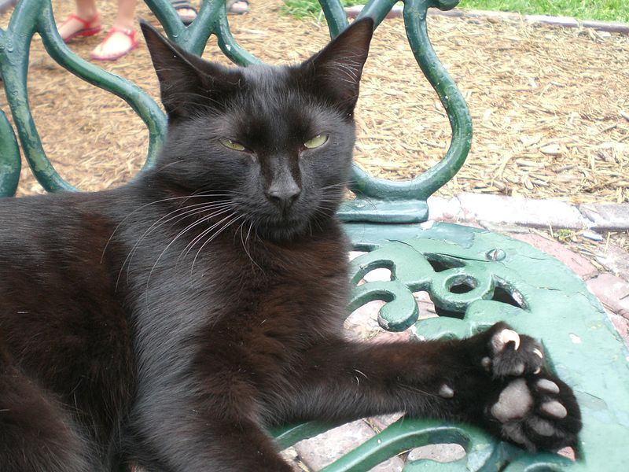
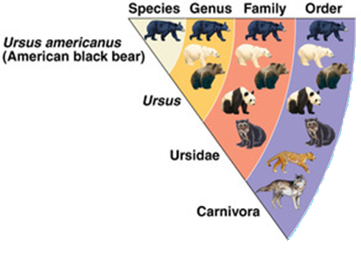
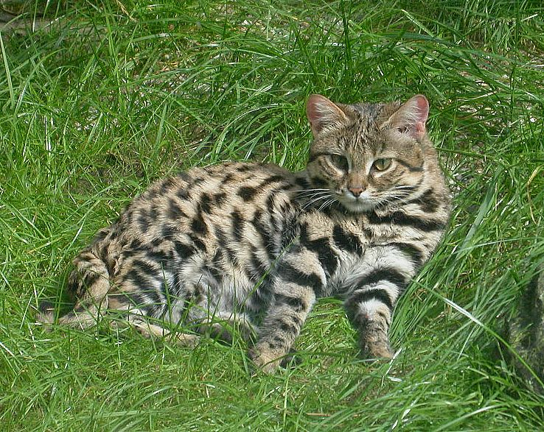
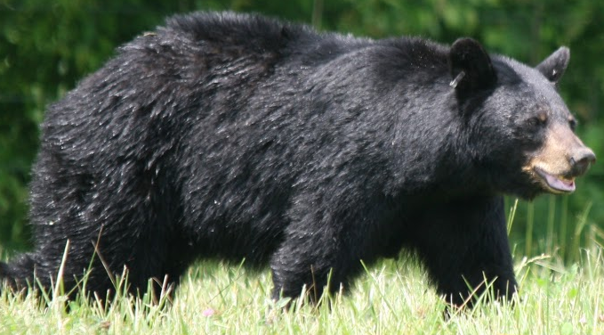
Same Family – less related
Same Genus – closely related
Panthera tigris
Felis silvestris
Same Order – distantly related
Felis nigripes
Order Carnivora
Ursus americanus

Slide 45
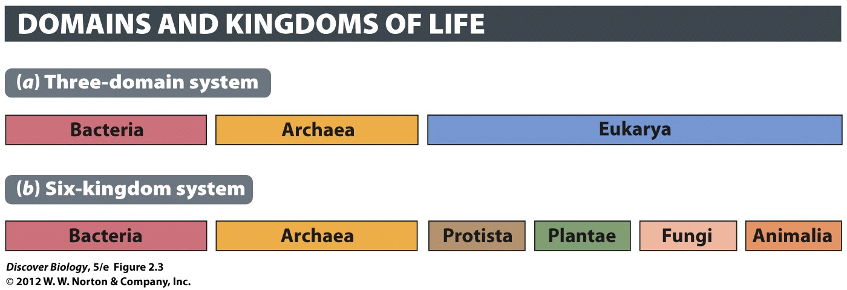
Eukaryotes = Eu(“with”) + karyo(“kernel”; i.e. nucleus)
Most stuff: plants, animals, fungi, many microbes
Prokaryotes = Pro(“before”) + karyo(“kernel”; i.e. nucleus)
very little cells without a nucelus
Terms change over time
“bacteria” ➔ “Eubacteria “ & “Archebacteria” ➔ “Bacteria” & “Archea”

Slide 46
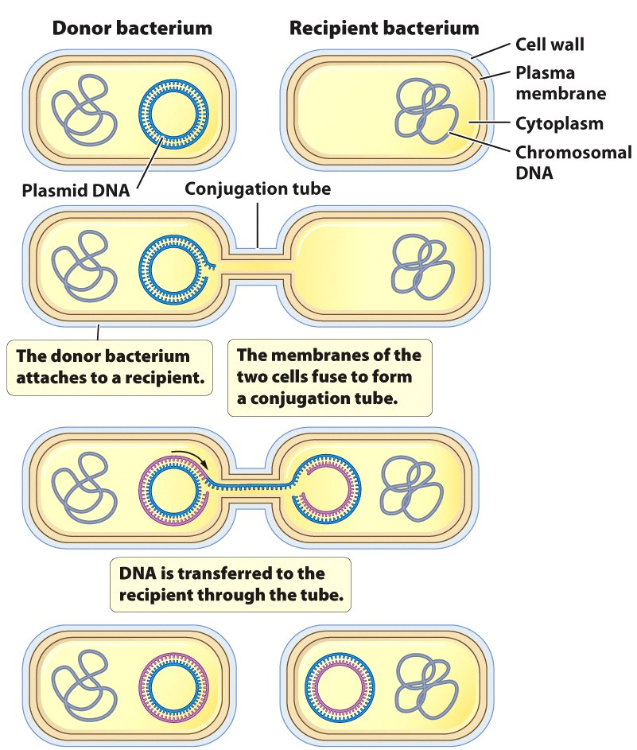
Prokaryotes – two domains
Bacteria
Small cells
Asexual reproduction
No nucleus (“prokaryote”)
bacteial chromosome
plasmid – DNA loop
NO ORGANELLES
Archea
Small like bacteria
No nucleus (“prokaryote”) or Organelles
Many can live in extreme conditions
thermatogens
halophiles
Neither one has DNA in nucleus

Slide 47
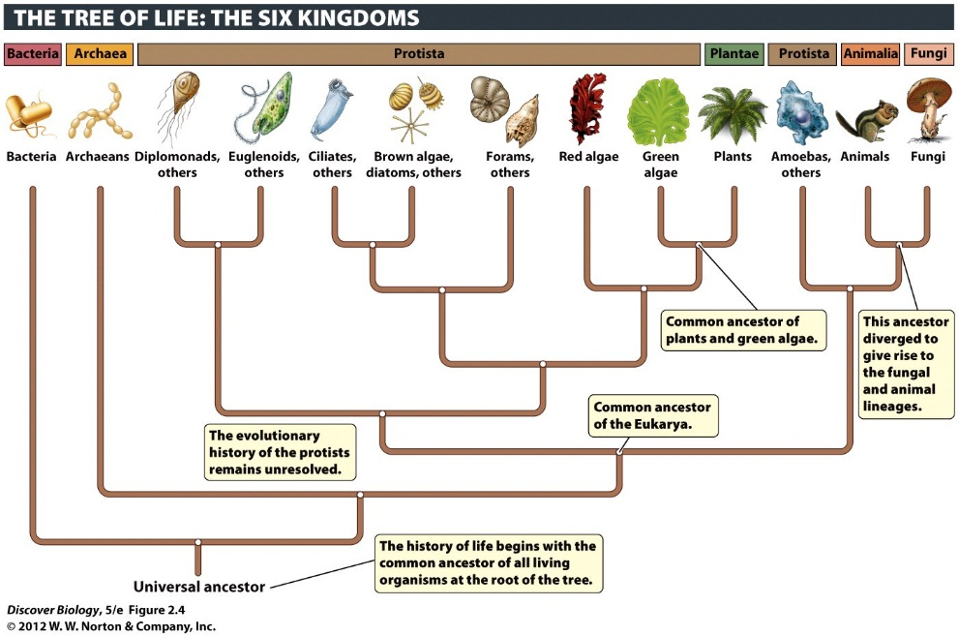
Eukaryotes – One Domain
Four kingdoms – all have DNA in nucleus
Animals = kingdom Animalia
Plants = kingdom Plantae
Fungi = Kingdom Fungi
Protists = Kingdom Protista
algae, amoeba, lots of microbes (e.g. Noctiluca)

Slide 48
Eukaryotes - characteristics
Have a nucleus (that’s where DNA)
Have organelles (little parts with separate jobs)
mitochondria – make energy (the power plant)
golgi aparatus – chemicals are packaged/modified
endoplasmic reticulum – manufacturing (factory)
vacuole – storage (warehouse)
Endosymbiont Theory
Will cover in detail when we study cells – lab & lecture

Slide 49
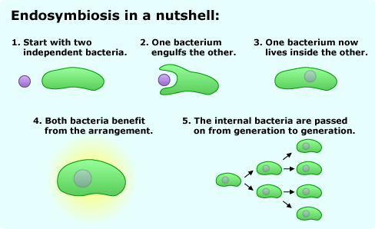
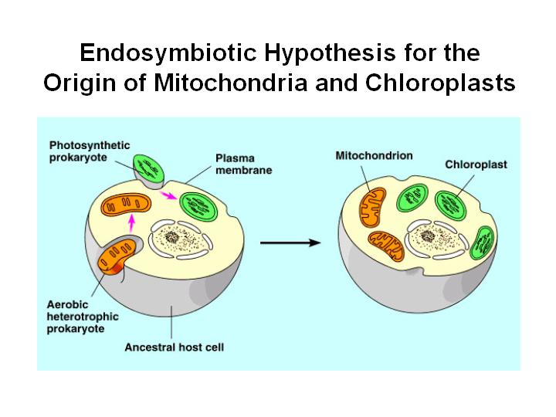
Endosymbiosis
Endosymbiosis = endo(“within”) + sym(“same”) + bio
The idea that complex cells (eukaryotes) formed when small cells started living inside big cells
evidence: double membrane, ribosomes, DNA

Slide 50
Free Biology Tutoring
Not Happy with your grade?
Not understanding the material?
Remember that the TLCC has

