Slide 1
Global Warming
(You wanted controversies, right?)
Chapter 5 (pg. 94)

Slide 2
Global Warming
Book Definition
“Progressive increase of Earth’s average temperature that has been occuring over the past half century.” – pg. 94

Slide 3
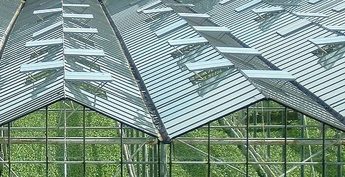
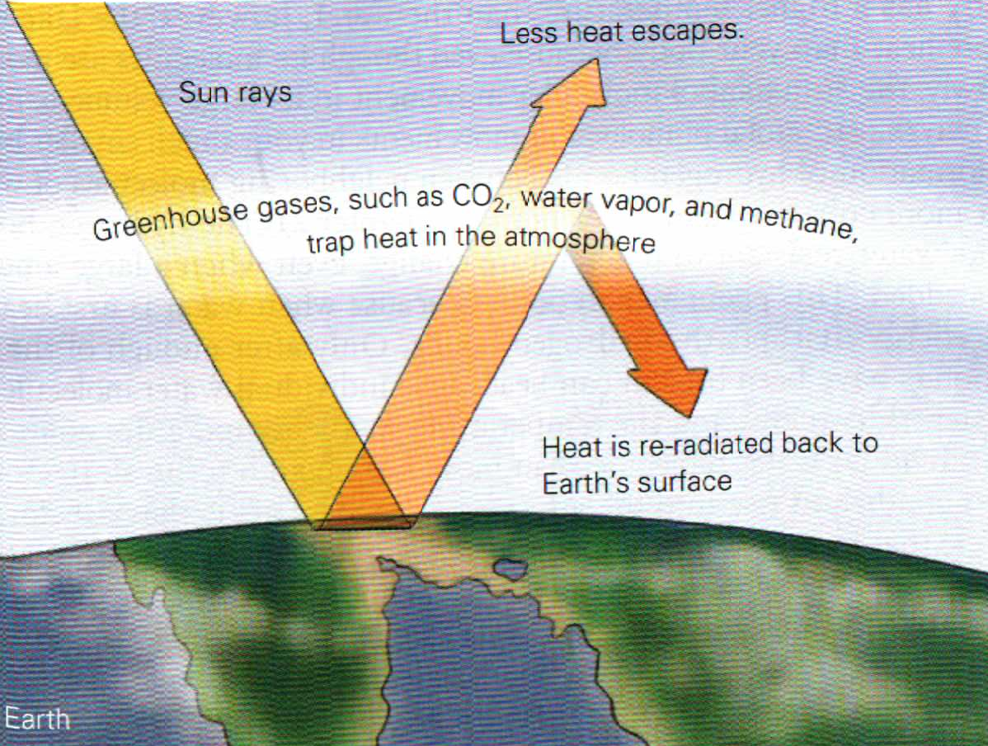
Greenhouse Effect
“Greenhouse effect” is not “global warming”
Greenhouse: keep heat inside that is trying to escape

Slide 4
Atmospheric Gasses
The atmosphere causes Greenhouse Effect
Moon (thin atmosphere)
-279.67 °F to 242.33 °F
Earth (thicker atmosphere)
−128.6 °F to 134 °F

Slide 5
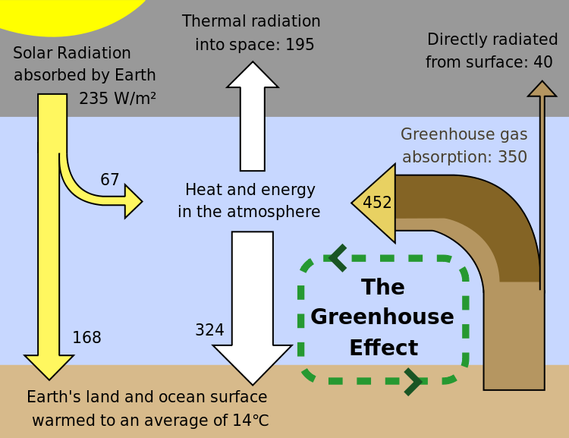
Greenhouse Gasses
Water Vapor (# 1)
Carbon Dioxide
Methane
Nitrous Oxide
Ozone
Now: Ave. Temp = 57.2 °F
Without Greenhouse: Ave. Temp = -2.2 °F

Slide 6
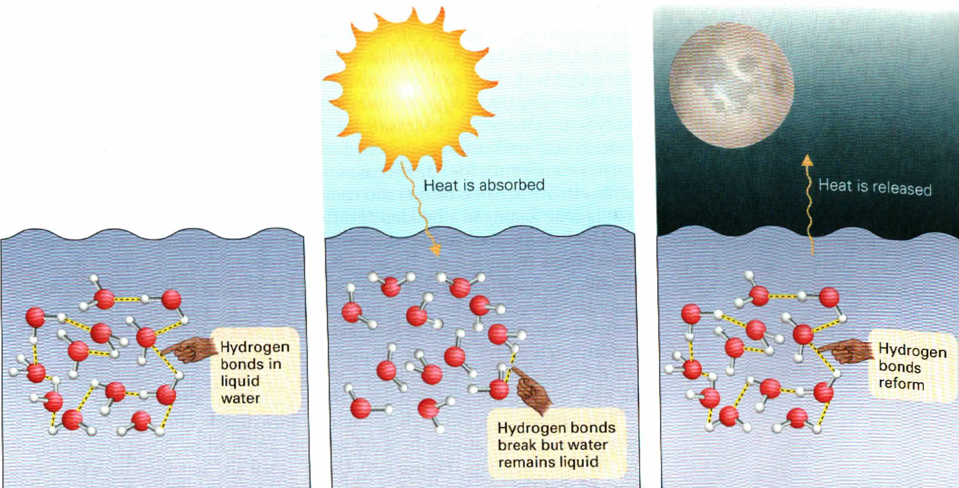
Why is water so important?
It takes a lot of energy to vaporize water
(makes highs and lows less intense)

Slide 7
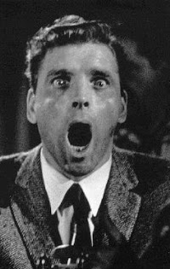
Water causes greenhouse effect!!!!
Why worry about CO₂ instead of water?
Water: not from human activity
Can’t Control
(oceans exist)
Other gasses
carbon dioxide, methane
(will discuss later)

Slide 8
So what’s the big deal?
Some greenhouse effect is good
Are we getting too much of a good thing?
Is it causing temperatures to rise?
“global warming”
Is that caused by humans
“Anthropogenic”
caused by humans

Slide 9
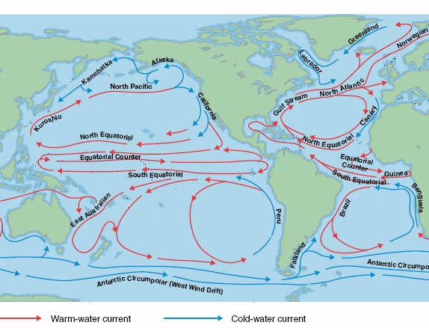
Climate Change vs “Global Warming”
Ocean Currents
Local changes might be different than global trend

Slide 10
“Anthropogenic Climate Change”
Human-generated changes to the climate
A better term than “global warming”
Temperature changes (locally up or down)
Changes in rain fall
(some places drier, others more wet)

Slide 11
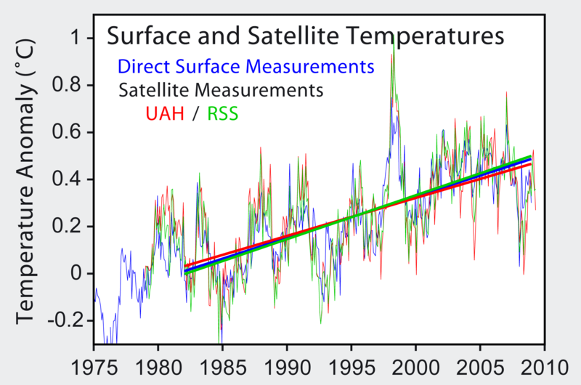
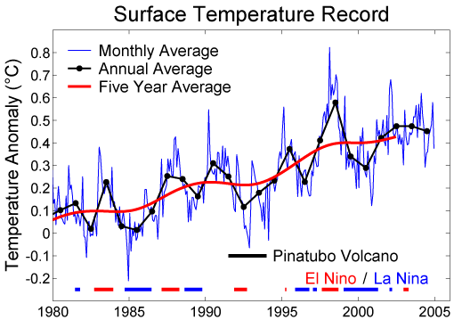
Recently: “it’s getting hot in here”
Measured by satellite
http://en.wikipedia.org/wiki/File:Satellite_Temperatures.png
Any instrument
http://en.wikipedia.org/wiki/File:Short_Instrumental_Temperature_Record.png

Slide 12
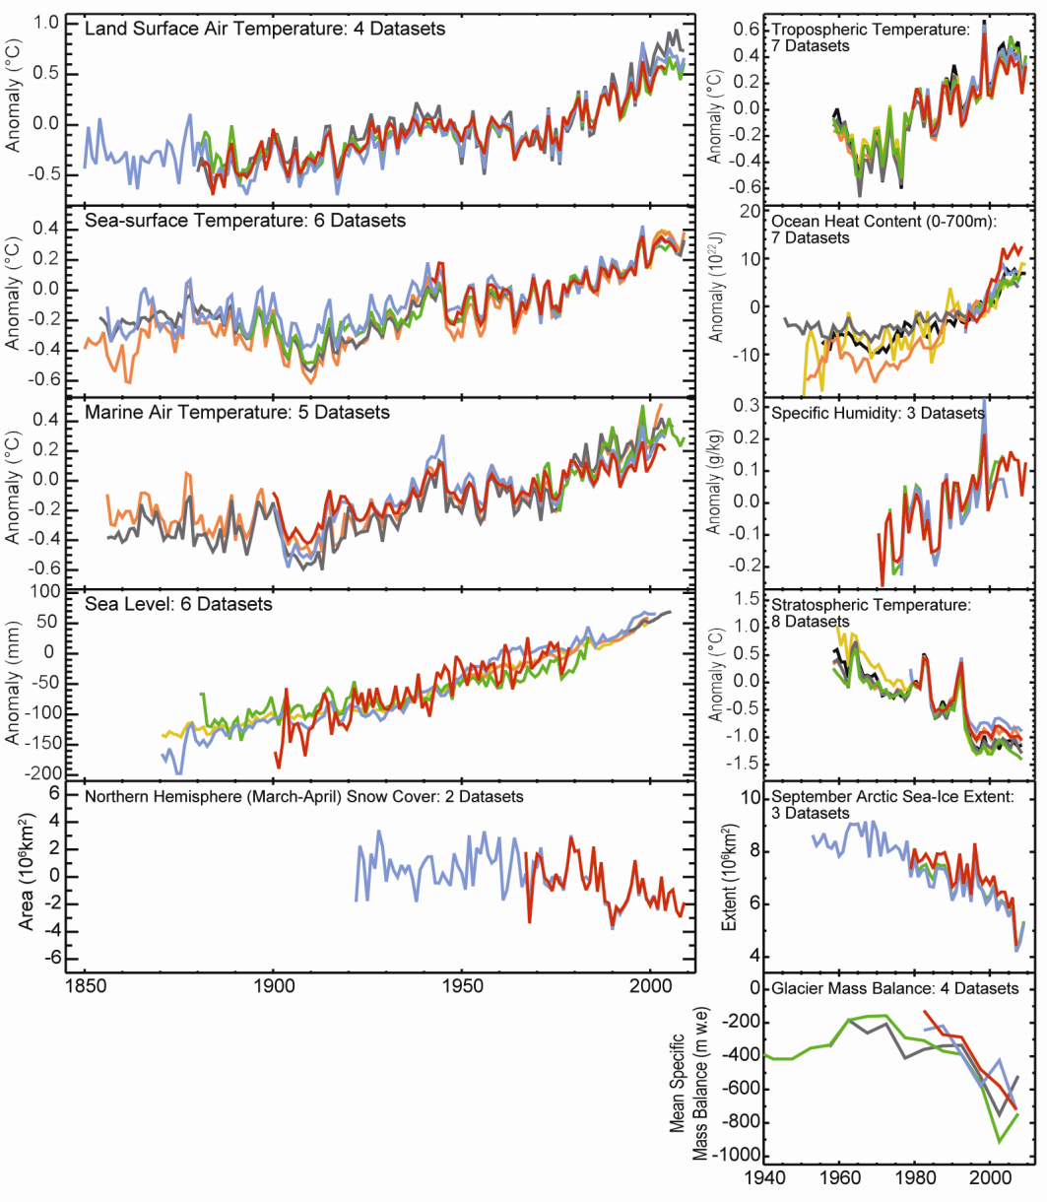
Instrumental measures

Slide 13
“Scientists say…”
How do they know the temperature went up?
(they were not there)
Paleoclimatology – study of ancient climate
proxies – things we can measure now
that tell us about past temp.
(temp. can cause lasting change)

Slide 14
Climate Proxies: Tree Rings
Count the rings to get the age of tree
thick rings = good growing season
temp. (and other contitions)
are near plant’s ideal conditions
thin rings = poor growing season
Can estimate temperature in a given year

Slide 15
Climate Proxies: Ice Cores
Glaciers and ice shelves:
places where ice never fully melts
new ice laid down each year
scientists look at stuff trapped in ice
air bubbles, pollen grains,
dissolved gasses
If you know what year a layer was laid down….

Slide 16
Climate Proxies: Ice Cores
Air bubbles: measure CO₂ and methane levels
Pollen: travels long distances in wind
what types of plants were blooming
that year (subject to wind currents)
Dissolved gasses: which isotopes are common?
Oxygen isotopes:
¹⁸O isotopes fall easier
no ¹⁶O = warmer temps

Slide 17
Oxygen isotopes and pollen
Paleoclimatologists actually use a lot
ice cores
lake sediment layers
coral reefs (oxygen, not the pollen)
shells of small critters (diatoms and such)

Slide 18
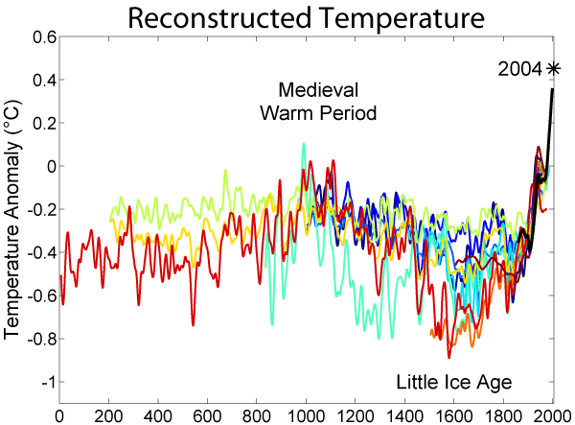
Using all that stuff….
We can estimate earlier temperatures
Details vs. trends, most agree on trends
http://en.wikipedia.org/wiki/File:2000_Year_Temperature_Comparison.png

Slide 19
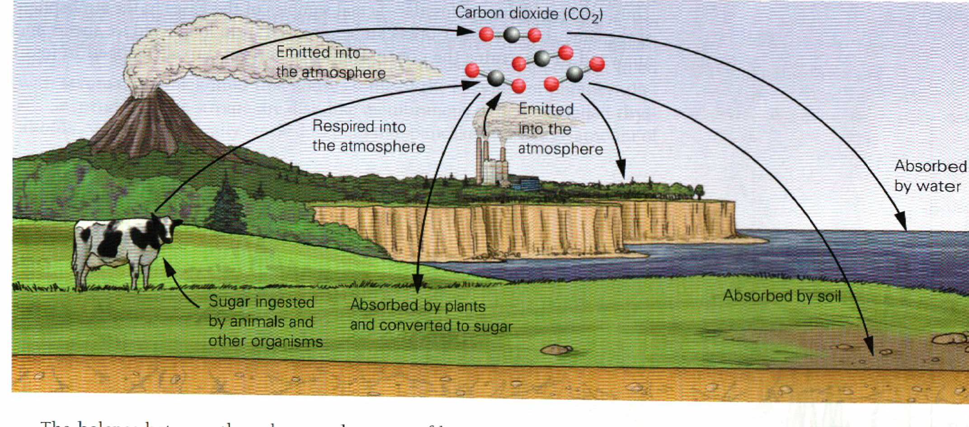
The Carbon Cycle
CO₂ released to air: plants, animals, humans, volcanos
CO₂ removed from air: plants, dirt, water

Slide 20
Emphasis on CO₂
CO₂: Some of CO₂ is due to human activity
might be able to control some
cost/benefit – people argue

Slide 21
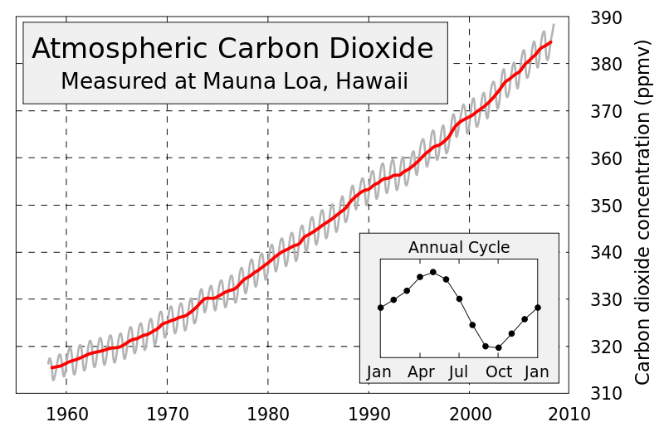
CO₂ levels have definitely gone up

Slide 22
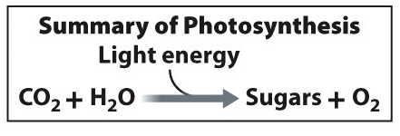
Plants take CO₂ out of the air
“Hurray, problem solved. Let’s plant trees!”
Problem: plants are not as good at this when they are too hot (pg. 103)

Slide 23
Heat affects photosynthesis
Plants close stomata so they don’t dry out
less gas exchange
reduced photosynthesis
increased photorespiration
Photorespiration makes plants create CO2 instead of removing CO2 from air

Slide 24
Photorespiration
Plants make Glycolate
need energy to break it down
mitochondria make ATP and CO2

Slide 25
Ocean Acidification
CO2 + H2O ⬅➔ H2CO3 ⬅➔ H+ + HCO-
More CO2 in water means more carbonic acid
Lower pH affects many marine organisms

Slide 26
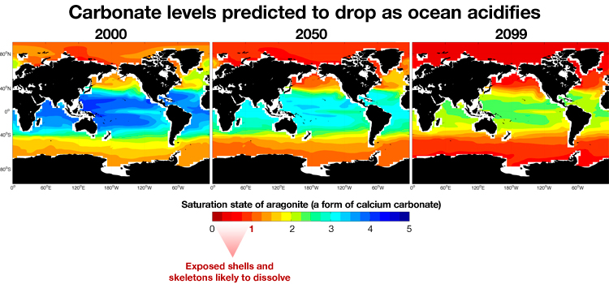
Predicted Ocean pH Change

Slide 27
Why predictions may not be right
Bad assumptions (Bad mathematical models)
Change in Human Behavior
Reversal of natural cycle

Slide 28
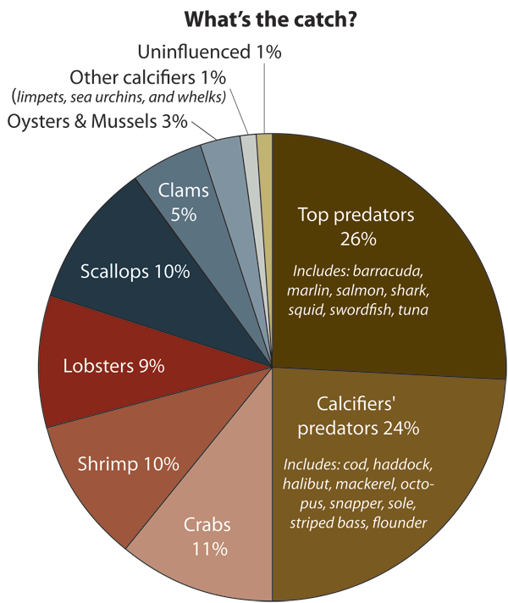
What if predictions are right
2007: $4 billon of profit
Which species are affected
Which fisheries are affected
http://www.whoi.edu/oceanus/viewArticle.do?id=65266

