Slide 1
Chemistry Of Life

Slide 2
Matter
Has Mass
Takes up space (volume)
Made of atoms

Slide 3
Elements
Elements are chemicals in their pure form; i.e. not combined with anything else
25 essential elements (ones needed for life)
Carbon, hydrogen, oxygen and nitrogen make up 96% of living organisms
Elements cannot be broken down into simpler chemicals through chemical methods

Slide 4
Atom
Smallest amount of an element that still has normal chemical properties
Greek ἄτομος (atomos, "indivisible")
We can split atoms, but they loose their chemical properties, and it takes a lot of energy

Slide 5
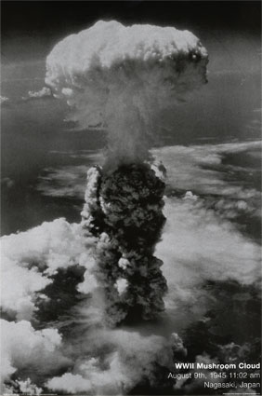
….and can be a messy process

Slide 6
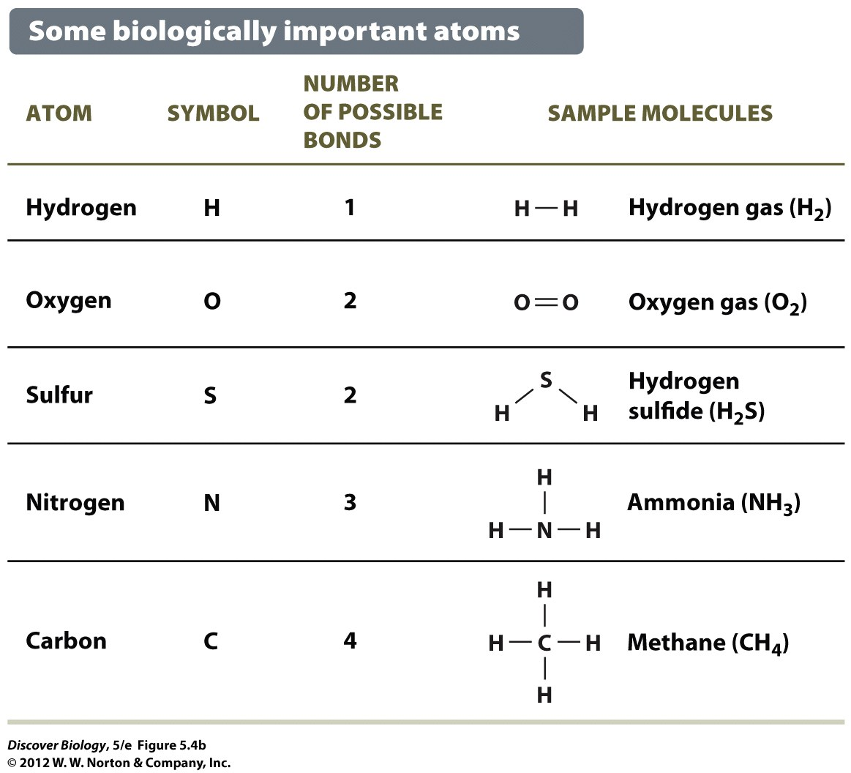
Atoms
The smallest piece of an element that has the same chemical properties as larger amounts of the element would

Slide 7
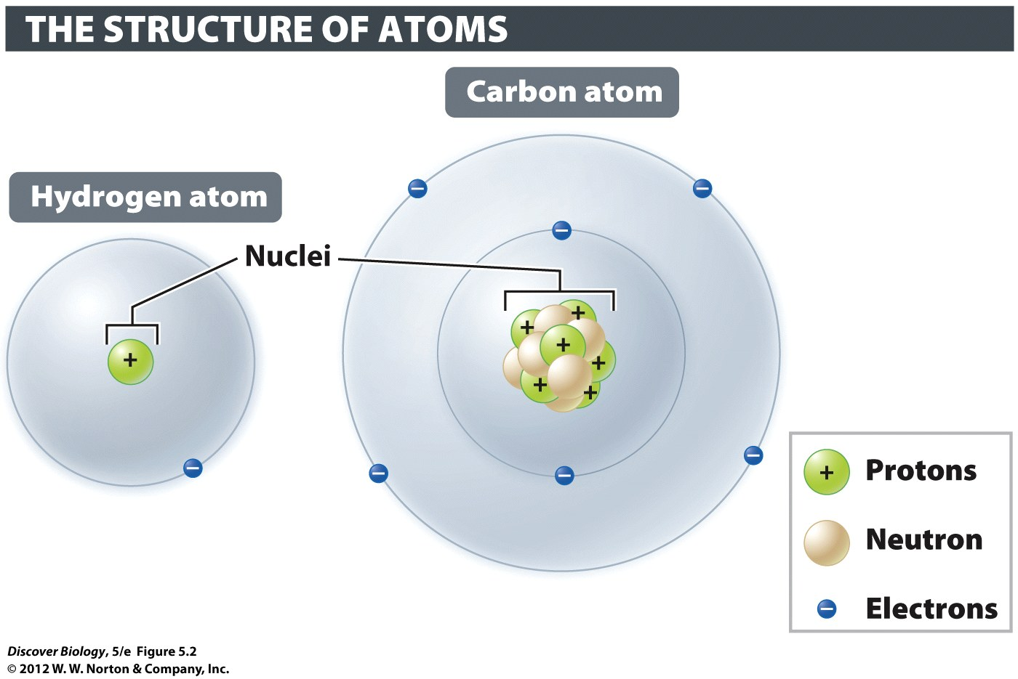
Subatomic Particles
Only three last long enough to matter us

Slide 8
“Atomic Number” = number of protons
The atomic number determines what type of element an atom is. All atoms of carbon have six for their atomic number. All atoms of oxygen have eight protons. The atomic number never changes in nature.

Slide 9
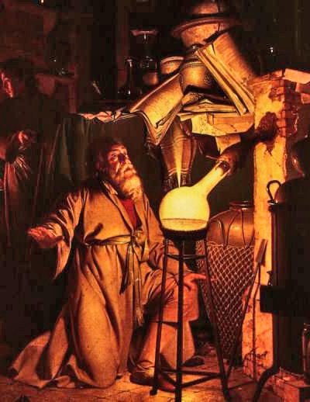
Alchemists tried to turn other stuff into gold

Slide 10
Isotopes
Isotopes are versions of atoms with different weights. All isotopes of an element have the same number of protons (that’s why they are the same element)
They differ from other isotopes of the element because they have a different number of neutrons

Slide 11
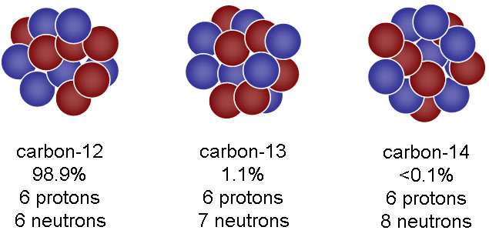
The number of neutrons is different in different isotopes. That gives different isotopes different masses.
Example: C-12, C-13, C-14

Slide 12

Some isotopes are unstable (Atoms of this isotope fall apart easily)
When atoms break down, part of them will become an atom of a new element, but part of them will become radioactive energy

Slide 13

Radioactive stuff is useful!!!
(but not this way)

Slide 14
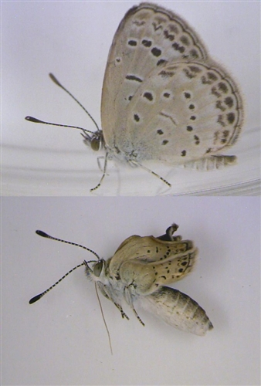
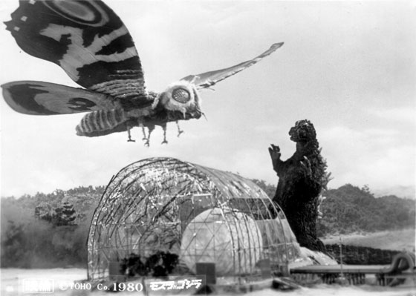
Mutant Butterfies in Japan

Slide 15
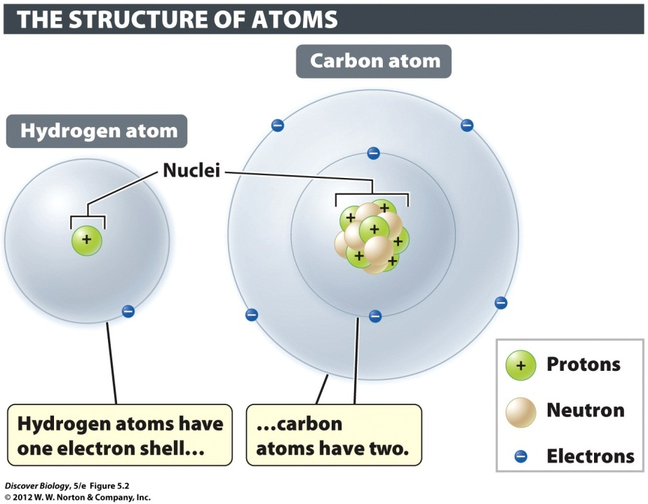
Energy Levels of Electrons
Around the nucleus
in layers like onion
Layers = “shells”

Slide 16
Energy Levels of Electrons
Big orbit = more energy
“energy layer” or “electron shell”

Slide 17
Energy Levels
arrangement of electrons = chemical properties
“Valence electrons”
# of valence electrons is most important

Slide 18
Valence Electron Layers
Atoms want full, empty, or eight electrons
DO NOT WRITE LAYERS!!!!
Layer 1 = Maximum of 2
Layer 2 = Maximum of 8
Layer 3 = Maximum of 18
Layer 4 = Maximum of 32
Layer 5 = Maximum of 32
Layer 6 = Maximum of 18

Slide 19


Slide 20
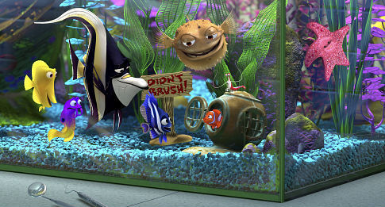



Slide 21
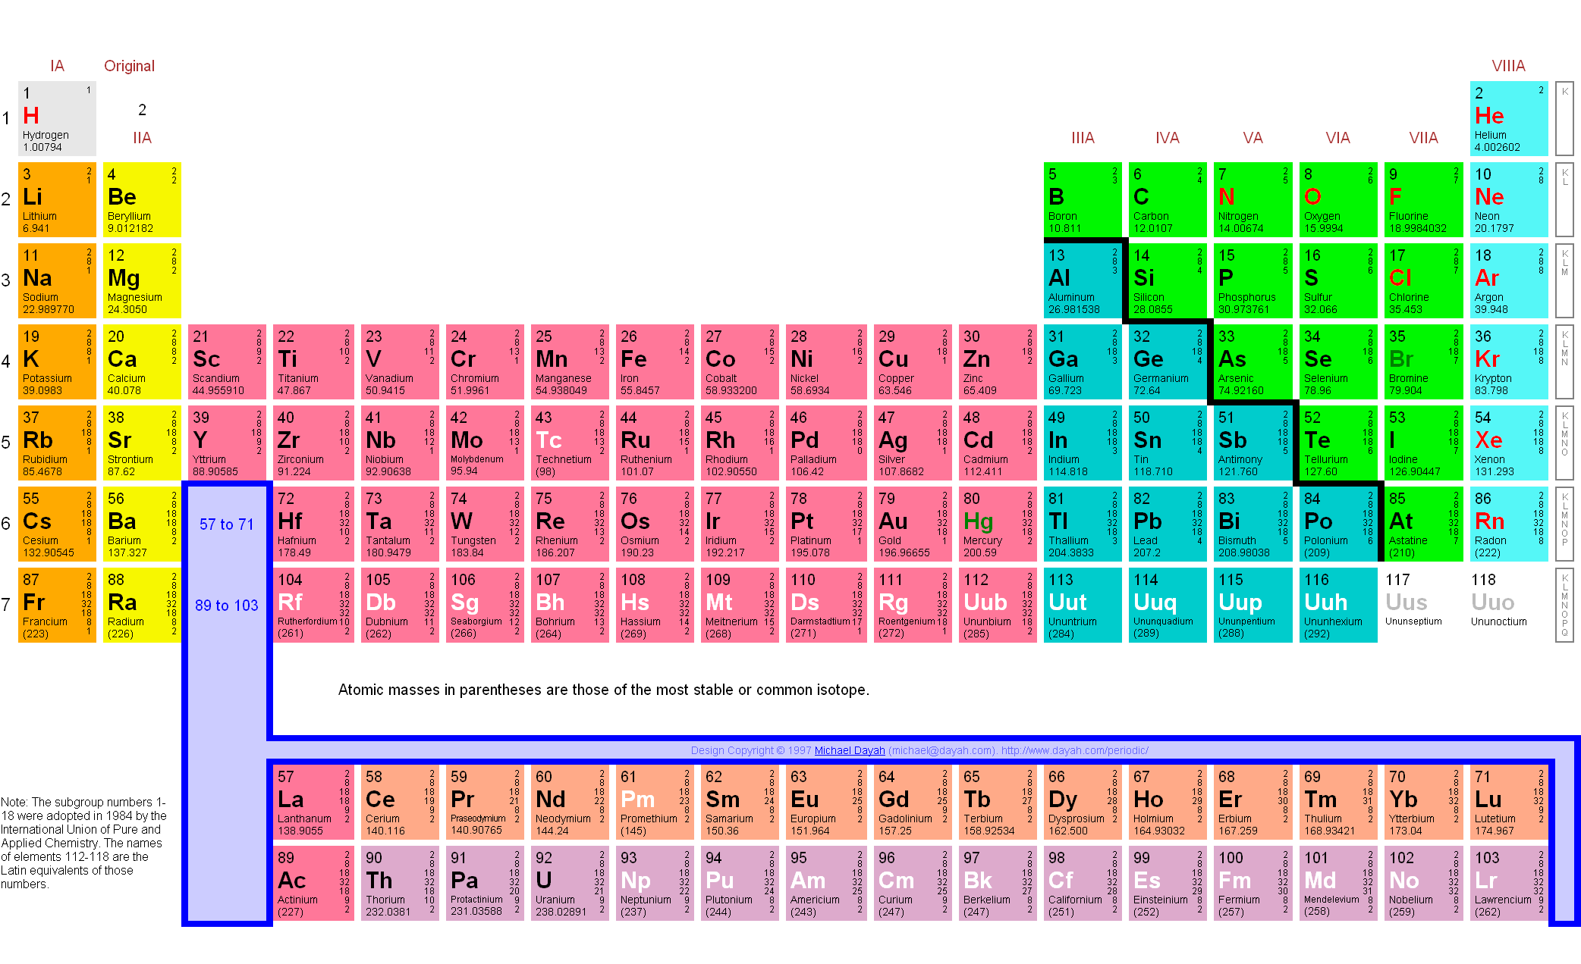

Slide 22
Mixture (vs. compound)
Two or more substances together
Amounts may vary

Slide 23
Compounds (chemical bonds)
Two or more elements together
Fixed ratio (always the same ratio)
Emergent properties – behavior of compound may be drastically different than the behavior of the individual elements

Slide 24
Chemical Bonds
(getting everybody to a happy valence number)
Covalent Bonds
Ionic Bonds
Weak bonds

Slide 25
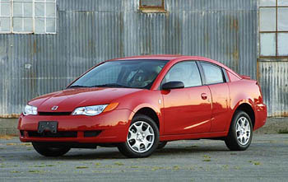
Ions
Normal: Atoms with no charge
  # number of protons (+) = # of electrons (-)
Ion: Atoms with a charge
not one of these ➔

Slide 26
Types of Ions
“Cations”
“Anions”
Opposite charges attract

Slide 27
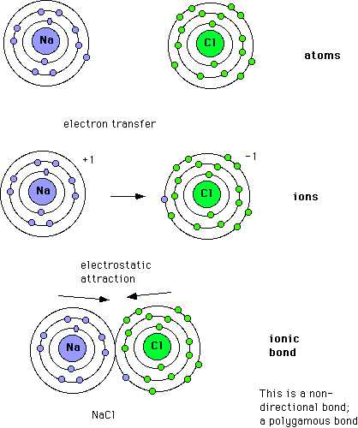
Ionic Bonds
Opposites attract
“salts”

Slide 28
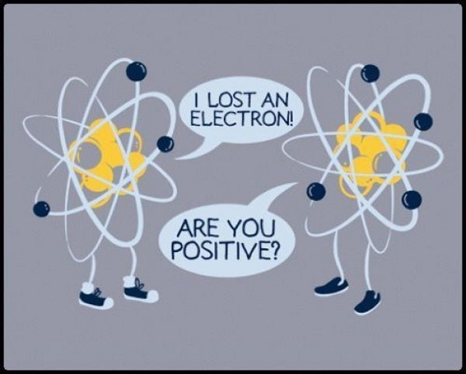
Chemistry Humor

Slide 29
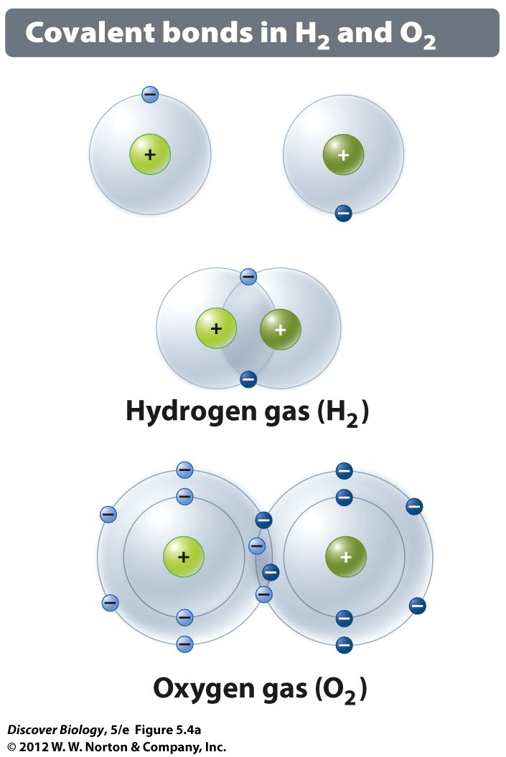
Covalent Bonds
strong
“single”, “double” or “triple”
  # of shared electrons
“molecules”

Slide 30
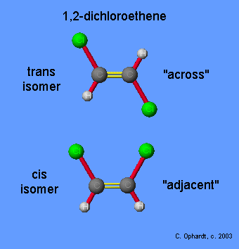
Double bonds allow for cis and trans versions of the same molecule

Slide 31
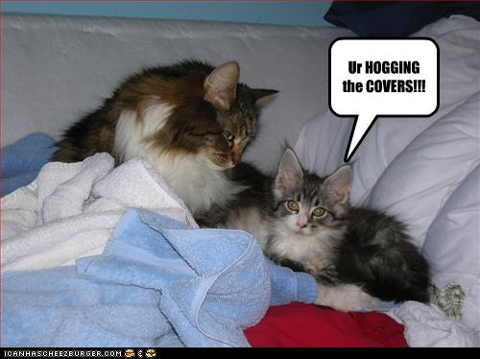
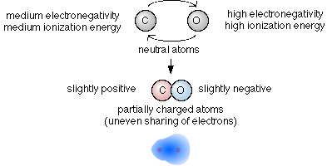
Polar Covalent Bonds
Charged
Negative end hogs electrons

Slide 32
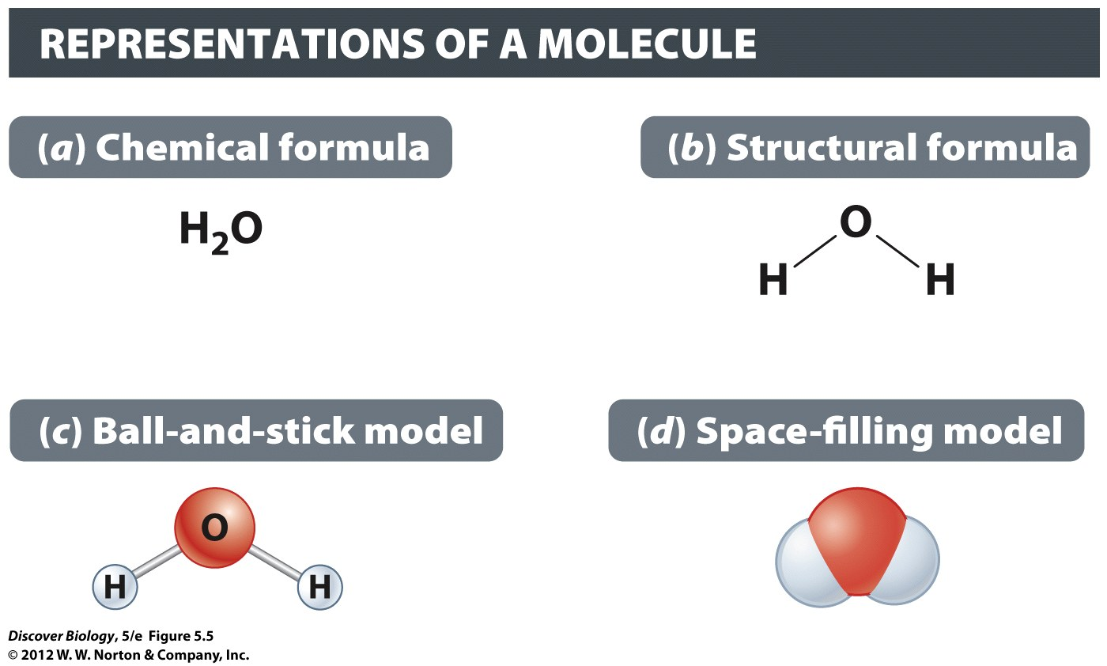

Slide 33
Weak Chemical Bonds
Hydrogen bonds – polar molecules
Van der Waals bonds – non-polar, temporary

Slide 34
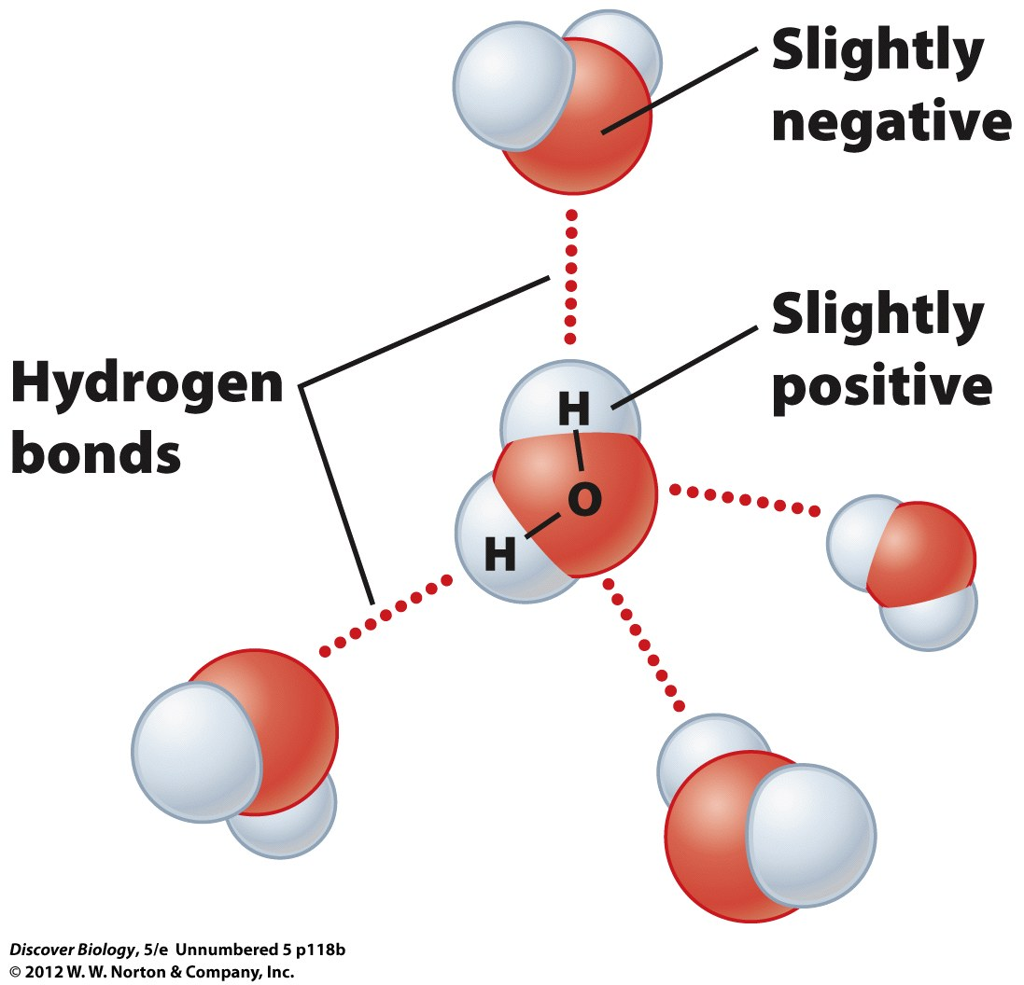

Slide 35
Molecular Shape and Function
The shape of a molecule is what allows it to do its job.

Slide 36
Properties of Water

Slide 37
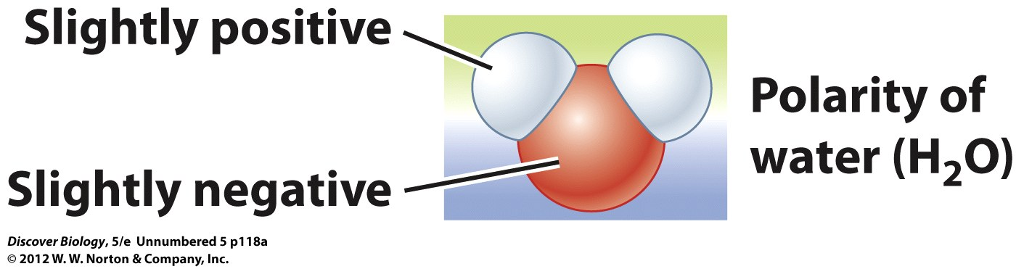
105° Bond
Angle lets water bond to many things

Slide 38

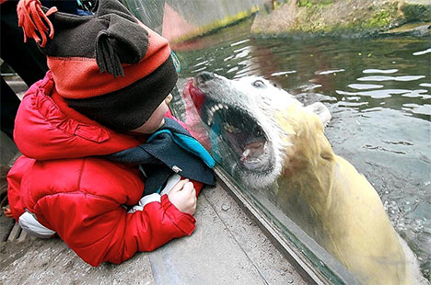
Polar Molecule

Slide 39
Polar Molecule
Oxygen attracts most of the electrons
(+) charge by hydrogens
(-) charge by oxygens

Slide 40
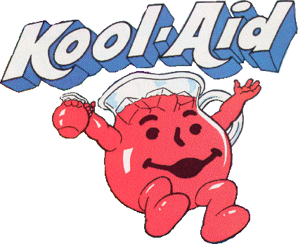
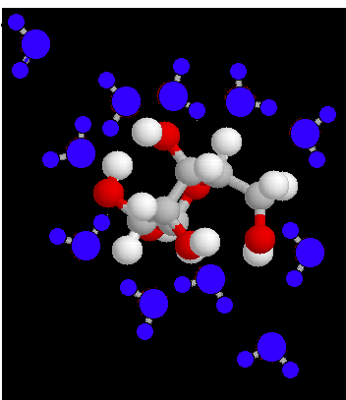
Hydration Shells
(Opposites Attract)
Solute
Solvent

Slide 41
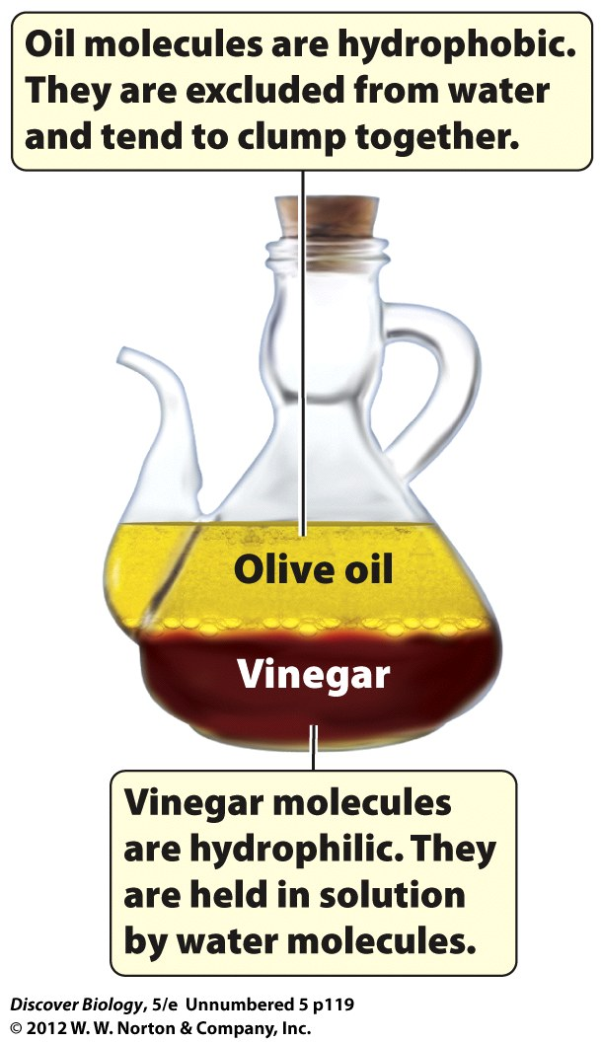
Water likes polar substances
Hydrophillic vs Hydrophobic
This is why membranes work

Slide 42
Emergent Properties of Water
Cohesion
Temperature moderation
Insulation of water
Effective solvent

Slide 43

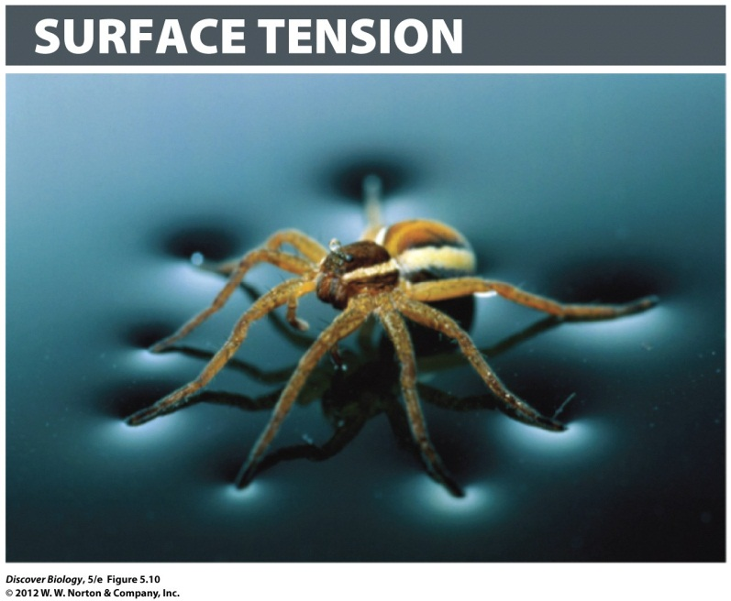
Water molecules stick together due to hydrogen bonds (polar molecules)
  Self = cohesion (e.g. surface tension)
  Other = adhesion

Slide 44
Temperature Moderation
High Specific Heat
  kinetic energy
  Heat vs. temperature
  Celsius
  Calories and kilocalories
Evaporative cooling

Slide 45
Ice Floats!!!
Solid that is less dense than the liquid
Insulates lake

Slide 46
Good Solvent
Solutions
  Solution
  Solvent
  Solute
  “aqueous”

Slide 47
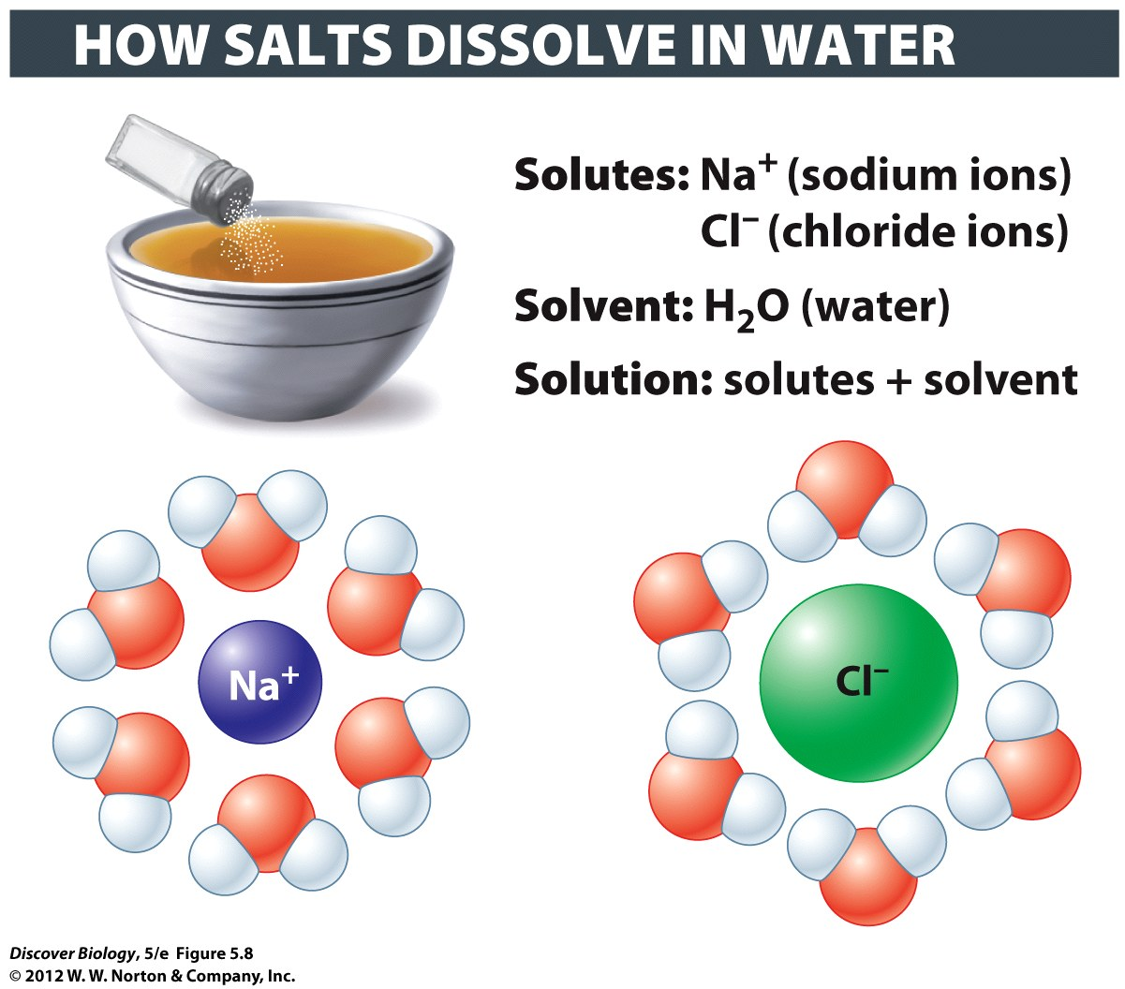
Hydration Shells
(Opposites Attract)
Solute
Solvent

Slide 48
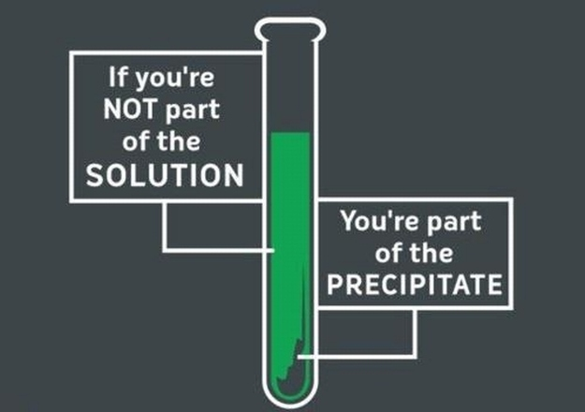
Bad Chemistry Joke

Slide 49
Hydrophillic
Hydrophobic

Slide 50
pH
How acid is it?
pH = -log[H+] DO NOT WRITE!!!!!
  Lower numbers mean more hydrogen
    (i.e. more acid)

Slide 51
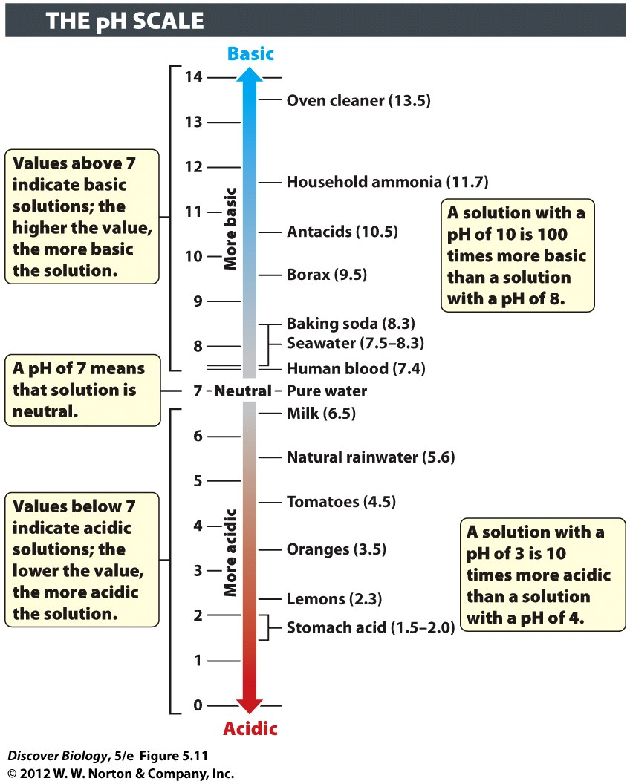
pH
Base – over 7
  OH > H
  High # = more basic
Neutral = 7
  H⁺ = OH⁻
Acid – under 7
    OH < H
    Low # = more acidic

Slide 52
Buffer
Limits changes in pH
Keeps conditions from getting too acid or too basic

Slide 53



“Mono”
“Bi” or “Di”
“Tri”

Slide 54
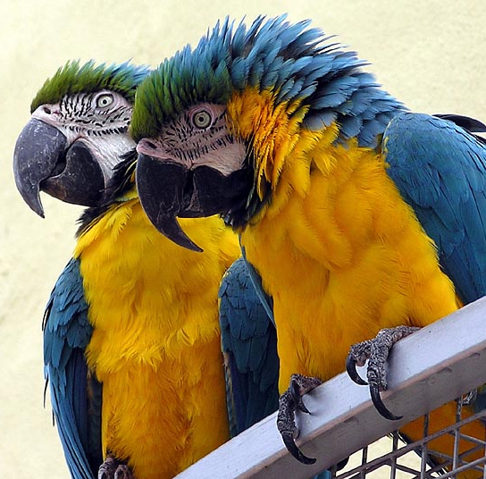
If there are more than three, we usually just say, “Poly”, which is a fancy way to say “there are many”

Slide 55
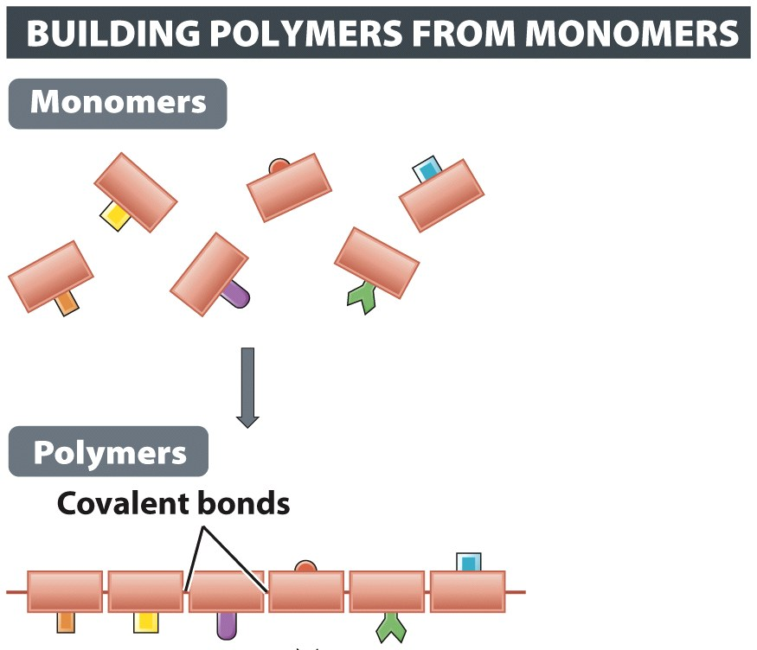
Polymers
One polymer is made from many monomers

Slide 56
Natural Polymers
Cellulose – structural material (cell walls)
Starch – used by plants for energy storage
Glycogen – used by animals for energy storage
Proteins – used by everything, for everything

Slide 57
Four Macromolecules
Carbohydrates – sugars, starches, cellulose
Proteins – structural, functional, enzymes
Lipids – Oils, fats, phospholipids, steroids
Nucleic acids – DNA and RNA

Slide 58
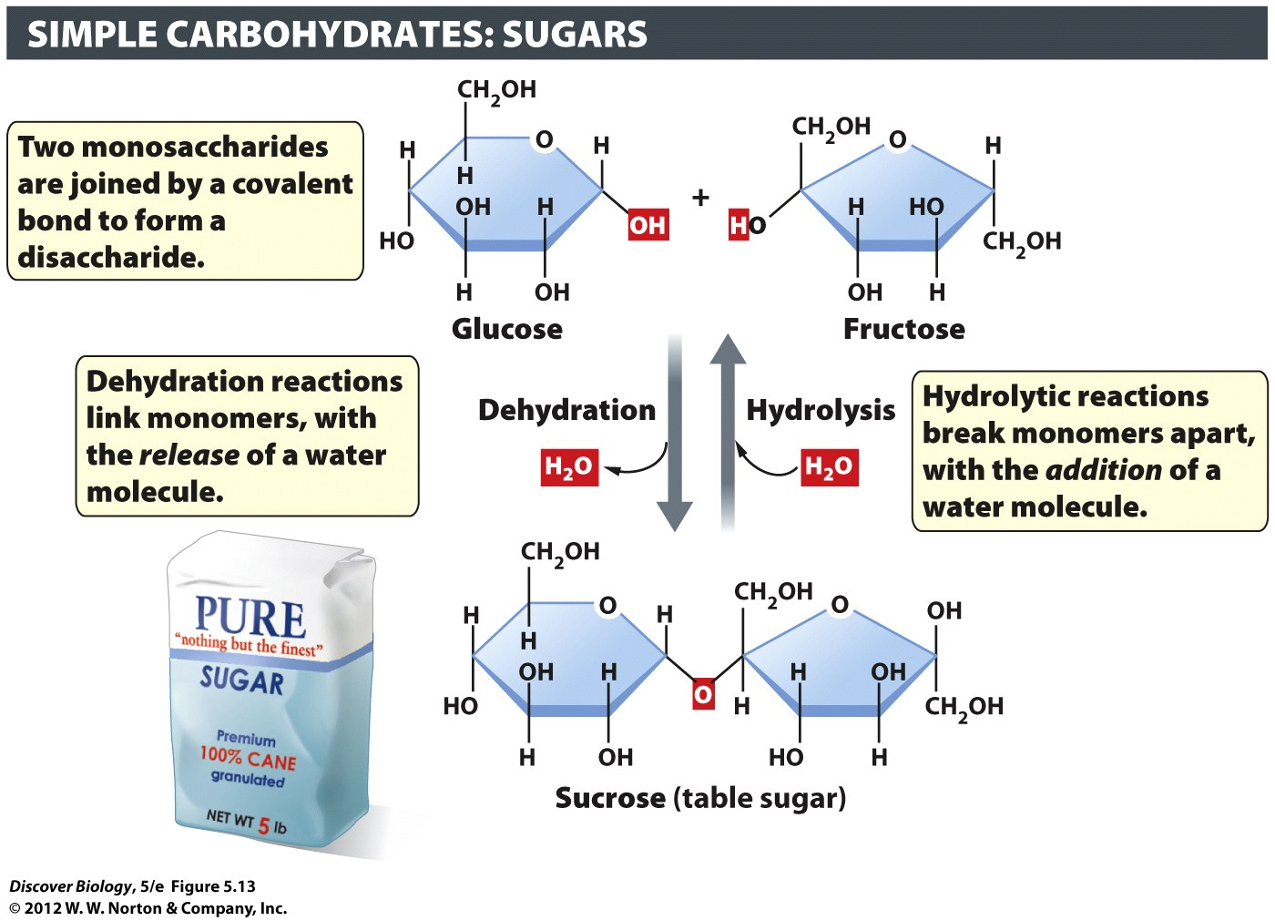

Slide 59
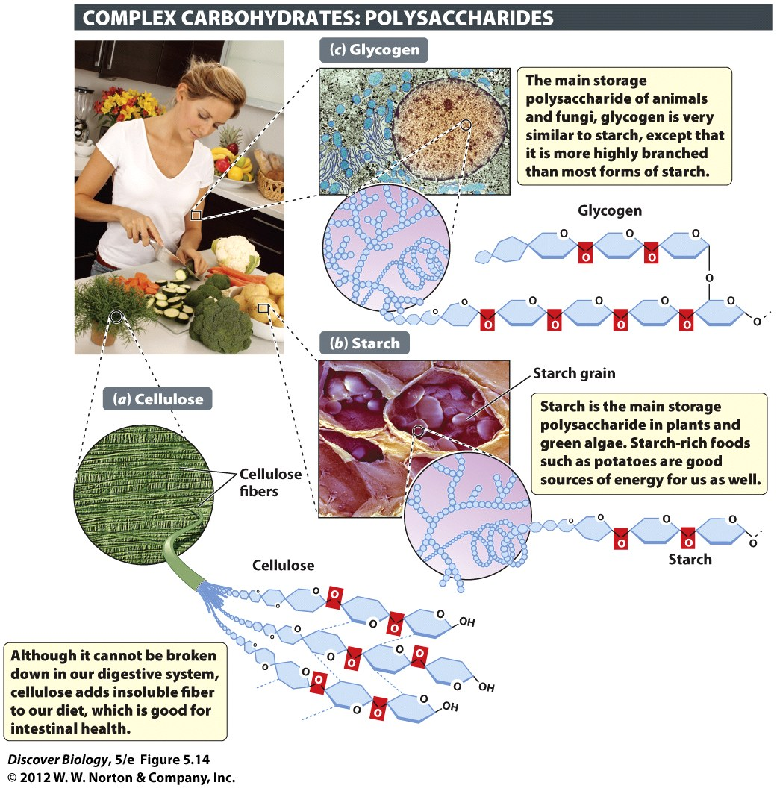
Polysaccharides
    “Many” + “sugars”
Cellulose
  Polymer of sugar
  Walls of plant cells
  Hard to digest
Starch
  Polymer of sugar
  Plant energy storage
  Easy to digest

Slide 60
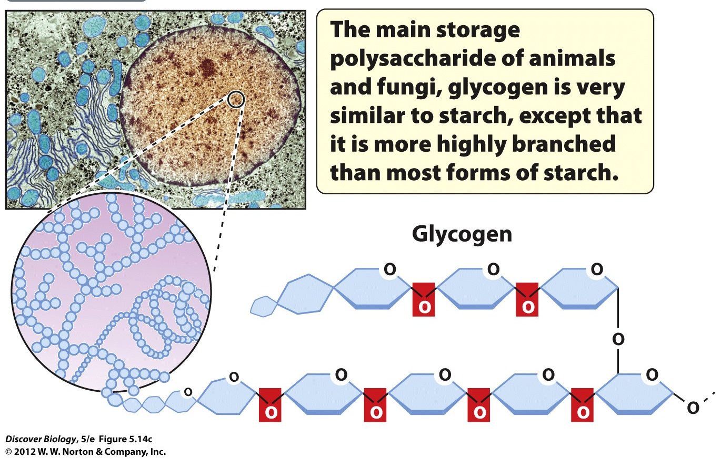
Glycogen
Energy storage in animals and fungi
Another polymer of sugars

Slide 61
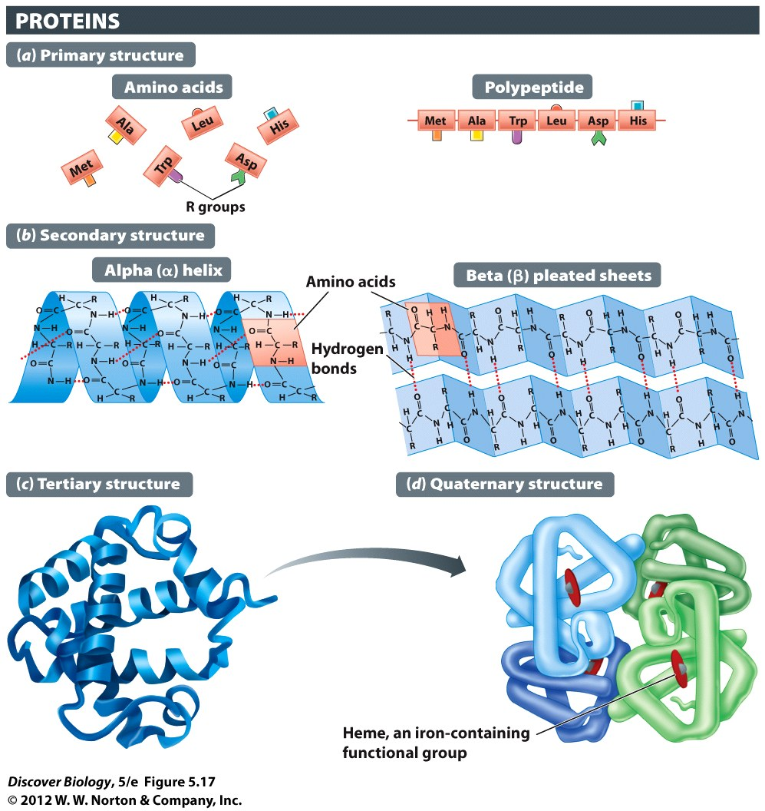
Proteins: made of Amino Acids
Peptide bond – bond between amino acids
Monomer – amino acid
Polymer – polypeptide (“primary structure”) of protein

Slide 62
Proteins: Shape matters
Primary
  Chain of amino acids
Secondary
  Spirals and folds
Tertiary
  3-D shape, 1 subunit
Quaternary
  Several subunits (parts)

Slide 63
Protein: shape = function
How a protein is shaped controls what it can do
Change the shape = stop working
“denaturing” = changing from natural shape

Slide 64
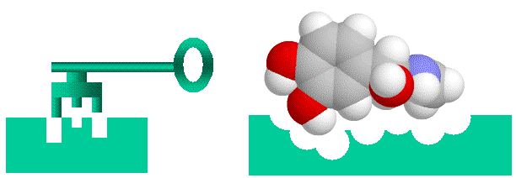
Enzymes: speed up a reaction
Make it easier for a reaction to happen
Not altered by reaction
Special shape to fit “substrate” chemical

Slide 65
Denaturing an enzyme
Changing the shape
Cannot do job anymore

Slide 66
Lipids
Fats, phospholipids, steroids
Mostly hydrogen and carbon
Fatty acid chains

Slide 67
Fatty acids
Long hydrocarbon chains
Saturated – filled with hydrogen
Unsaturated – less hydrogen

Slide 68
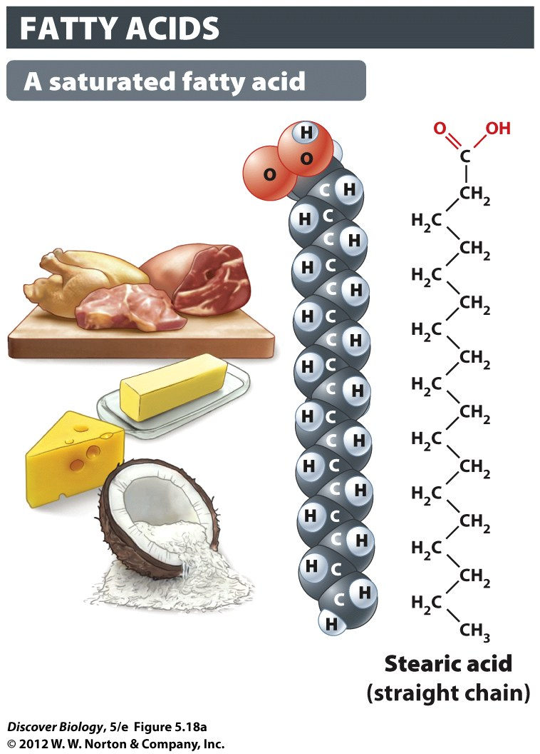
Fatty Acids:
Saturated (with H)
No double bonds
Molecules pack tightly

Slide 69
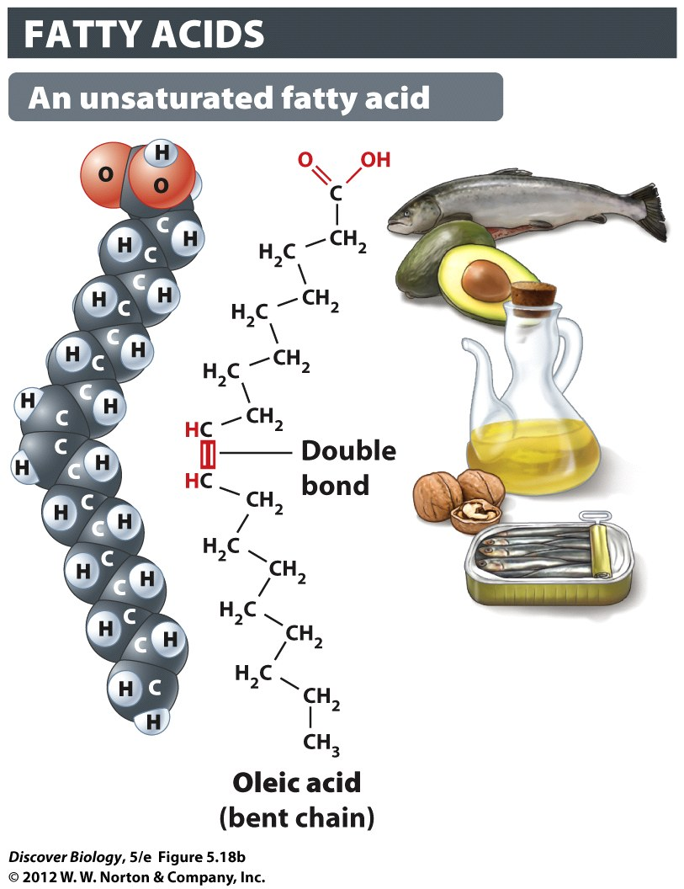
Fatty Acids:
Unsaturated
double bonds
Loosely packed

Slide 70
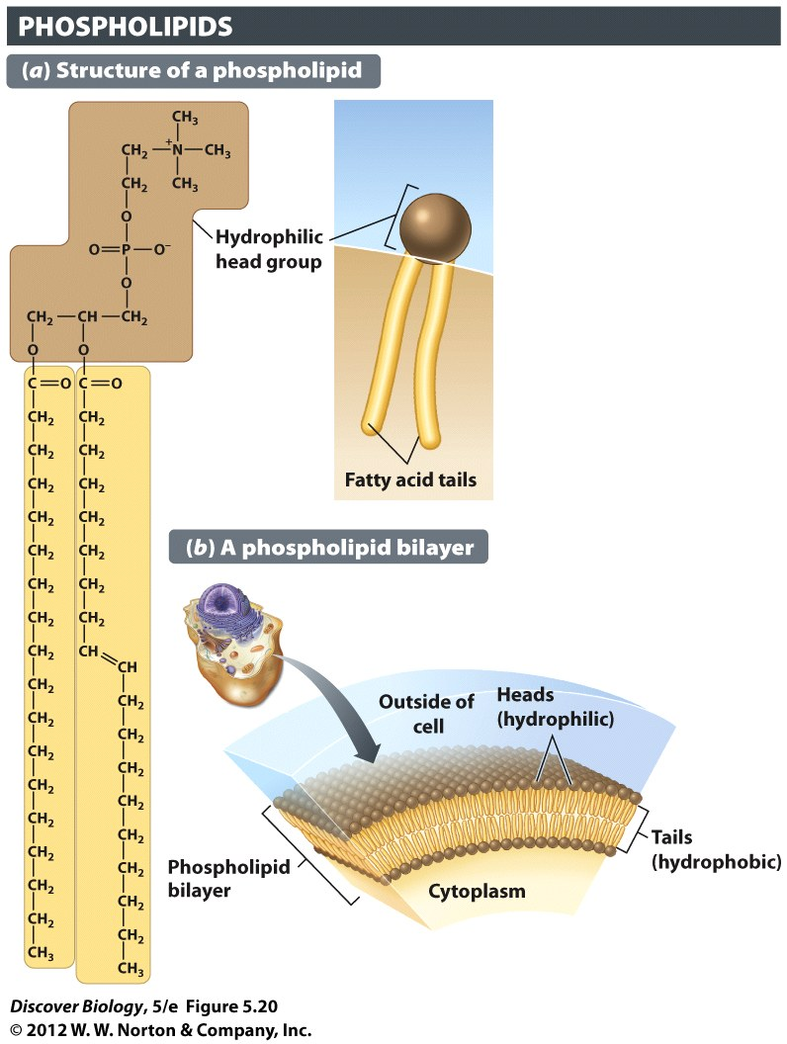
Phospholipids
Main part of cell membrane
Hydrophilic head
Hydrophobic tails

Slide 71

Phospholipids

Slide 72
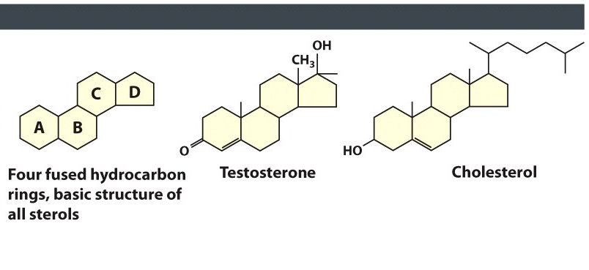
Lipids: Sterols
Used to make Steroids and Cholesterol
We need some cholesterol to make membranes

Slide 73
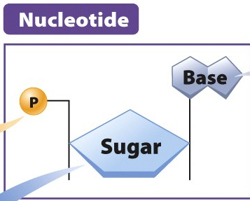
Nucleic Acids
Polymers called “DNA” or “RNA”
Monomers are “nucleotides”
Three parts in nucleotide
  Sugar
  Phosphate
  Nitrogenous base

Slide 74
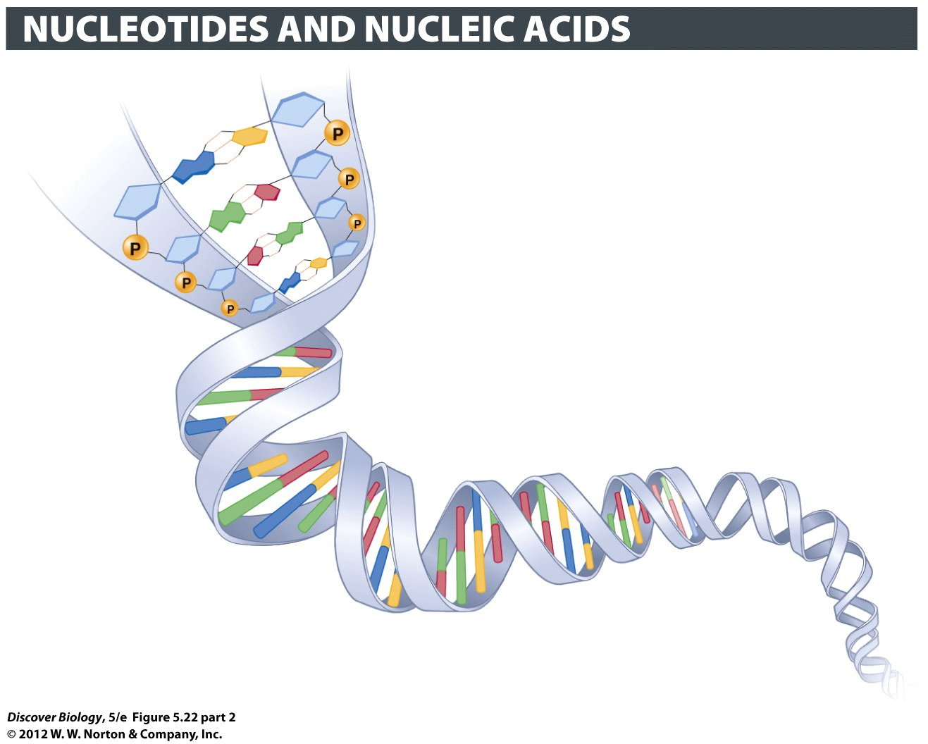
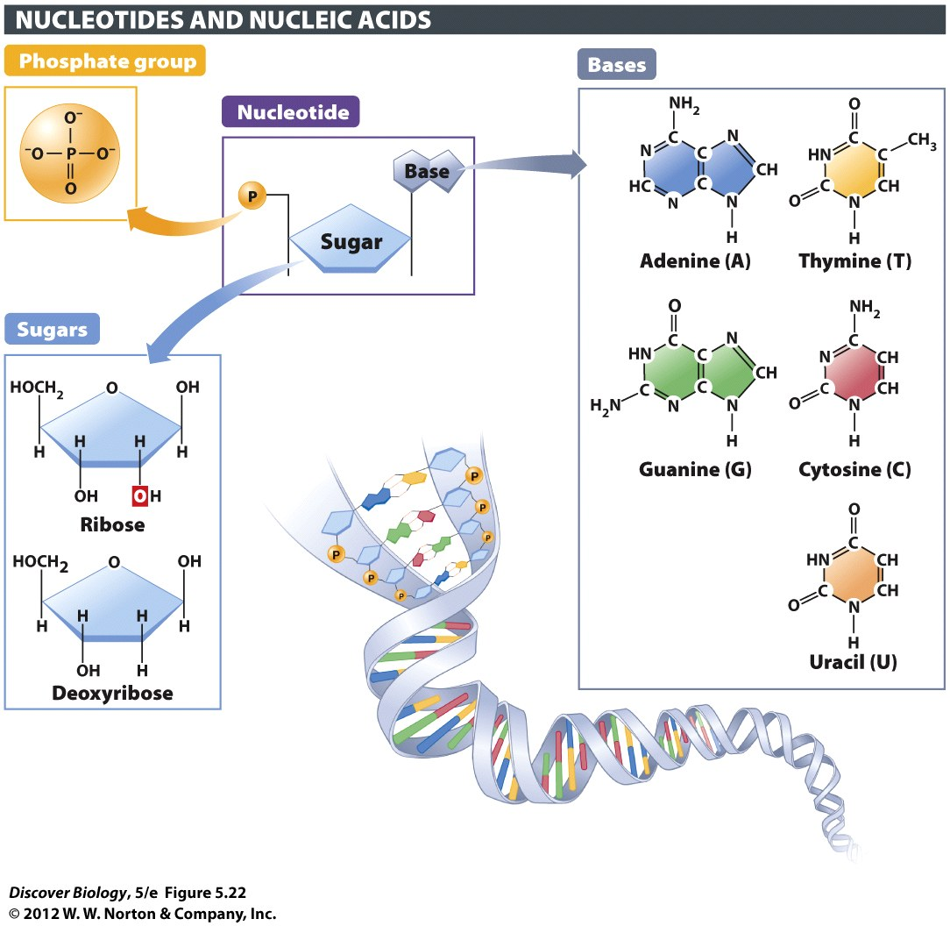
Nucleic Acids
Backbone of strand: sugar-phosphate
  RNA: sugar = Ribose
  DNA sugar = Deoxyribose

Slide 75
Nucleic Acids
Instructions to make proteins
DNA stays in the nucleus
RNA made in nucleus, leaves through nuclear pores

Slide 76
Nucleic Acids: Bases
Backbone = sugar-phosphate
Bases = information

