Slide 1

Introduction

Slide 2
biology
Bio (“life”) + logy (“study of”)
Scientific study of life (pg. 4)

Slide 3
Major themes for chapter 1
Scientific Method
Hypothesis vs. theory
Experiments, variables and controls
Case Studies
Corrolation
Statistics

Slide 4
What is Science
“Knowledge about the natural world and the evidence based process for acquiring that knowledge”
How we try to understand natural world
  What we can observe or measure the effects of
  There are things science cannot answer (pg. 4 & 13)
Goals – logical, objective, based on evidence

Slide 5
Characteristics of
Scientific Knowledge
Natural world – what we detect, observe or measure
Evidence based – experiments or observation
Peer review and independent validation
Open to evidence based challenge by anyone
    New evidence can change everything
Self correcting process

Slide 6
Scientific Method
A description of the core logic of how science works
Not a recipe of steps that all scientists use all the time
  example: like learning to waterski

Slide 7
Steps in the Scientific Method
Observation
Forming a hypothesis
Making a prediction based on hypothesis
Testing to see if the prediction is false
    Observation of test results
Reject hypothesis or plan new test for more evidence
Pg. 7

Slide 8
Scientific Method
More of a “best practices” suggestion of the way research *should* be done. Sometimes, other methods are used by scientists.
Pg. 5 –Barry Marshall, H. pylori research in 1982

Slide 9
Observations
What you see
Description, measurement or record
Need to explain: create Hypothesis (educated guess)

Slide 10
Hypothesis
“informed, logical and plausible explanation for observations of the natural world”
Educated guess that explains observations
What the rest of the world means when they say “theory”
  Scientists use the word “theory” in a VERY different way….

Slide 11
Theory
(Not what most people think it means)
“My theory is that Susan and Jim are going to start dating…”
That is an informed guess, what scientists would call a hypothesis.
It is almost the exact opposite of a scientific theory

Slide 12
Scientific Theory
an explanation of the natural world that is strongly well supported and widely accepted by scientists
    Usually scientists working independently on different things
    Support comes from repeated testing over several decades
    Far greater confidence in this explanation than in an educated guess
pg. 6

Slide 13
Characteristics of a Hypothesis
Explains prior observations
Makes “If…then”-style predictions
Something that can be tested by skeptics
CAN BE PROVEN FALSE!!!!!!
Can never be proven correct
  Can be supported by prior observations and test results
pg. 4

Slide 14
Reasoning (two types)
Inductive reasoning – use specific observations
to find a general principle
HOW TO MAKE HYPOTHESIS
Deductive Reasoning – use a general principle to
make a prediction
HOW TO MAKE A PREDICTION
(this prediction is what we will test)
Pg. 6.

Slide 15
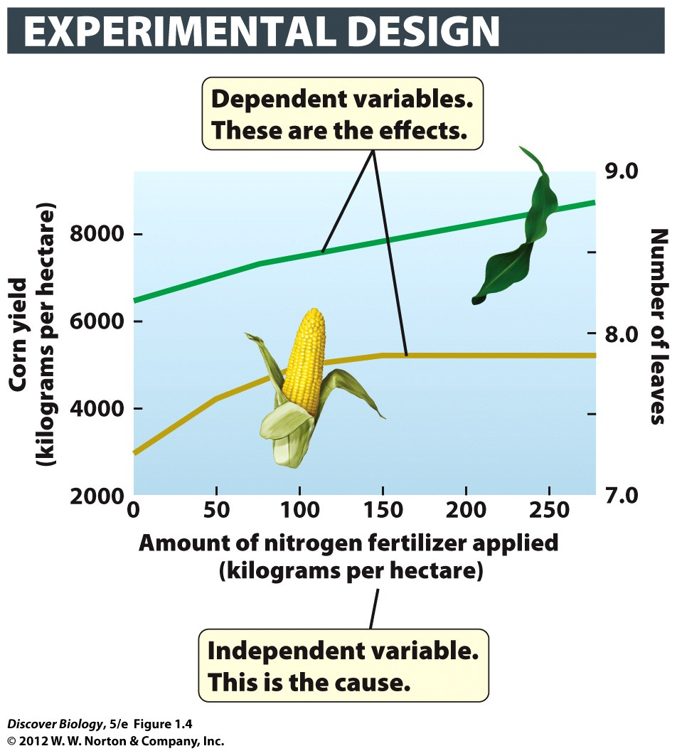
Testing a Hypothesis
“No amount of experimentation can ever prove me right; a single experiment can prove me wrong”
- Albert Einstein

Slide 16
Testing a Hypothesis
The scientist who proposes a hypothesis is the one who should test to see if it is false
Can test with observations or experiments
    Experiments are best, but some forms of science don’t have that option. Astronomers can’t blow up stars to observe the results.
Tests usually involve measuring VARIABLES (characteristics that can change)
ALTERNATIVE HYPOTHESIS (pg. 7)
      another explanation

Slide 17
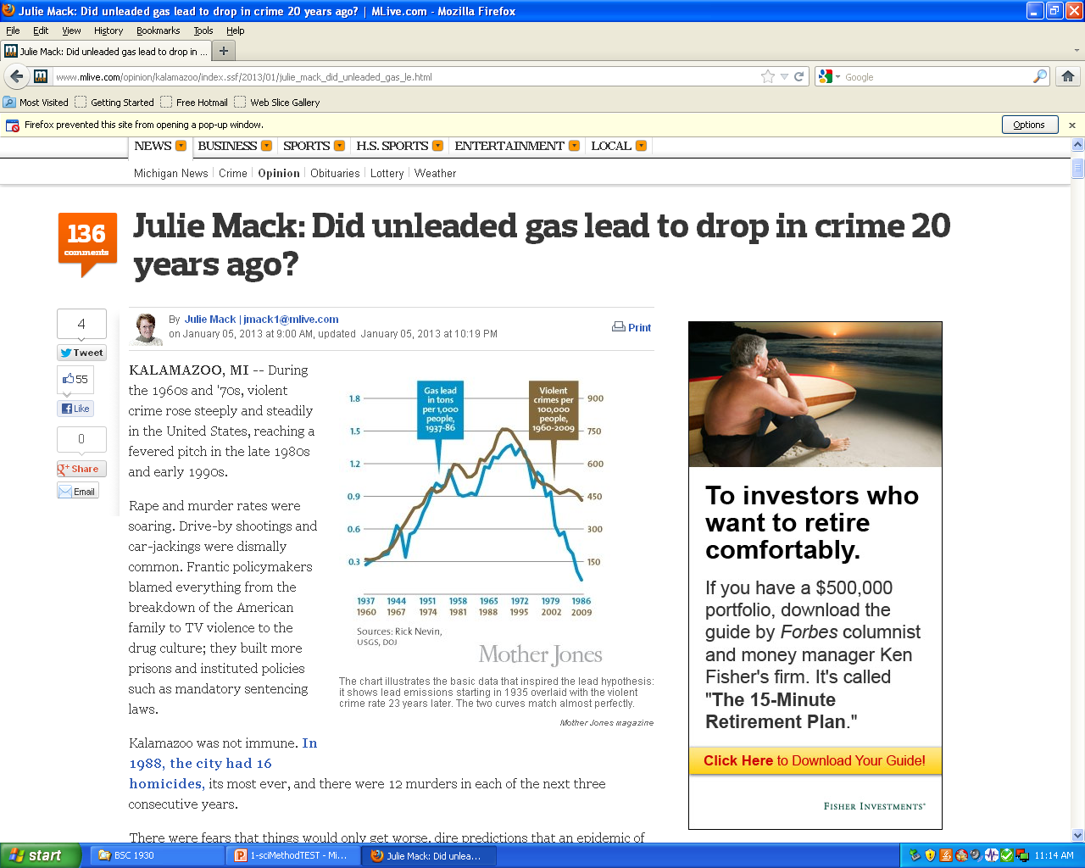
Alternate Hypothesis
Can the results be explained another way?

Slide 18
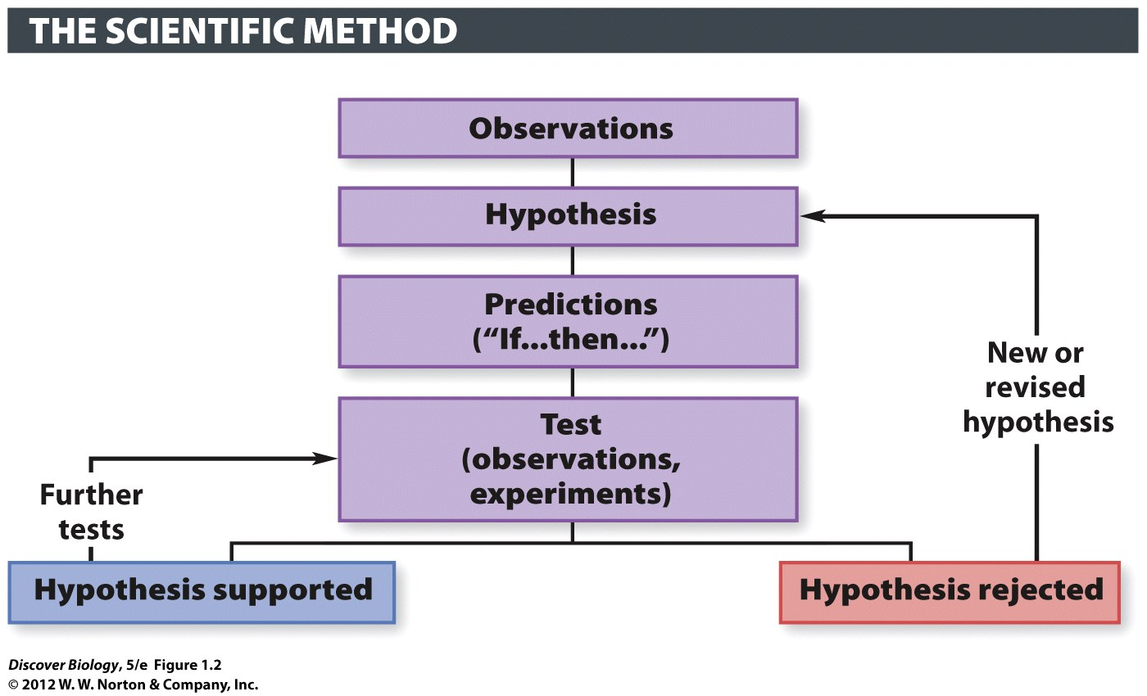
Testing: How we do science
Key - Must try to prove false what you believe is true

Slide 19
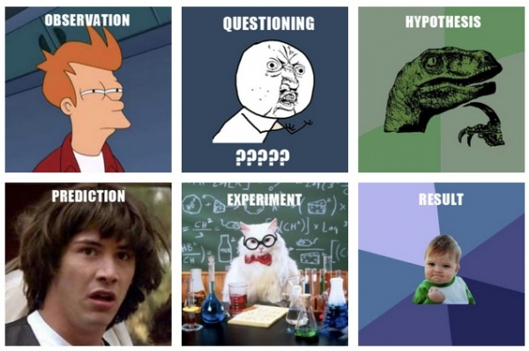
Steps in the Scientific Method

Slide 20
Experiment: best way to test
A test to see if a prediction is correct.
  Correct = support for hypothesis
  Incorrect = Was there an error (if no, find new hypothesis)
Key - Must try to prove false what you believe is true
(mice: epigenetics)
Observation: how we test if we cannot do experiment
not as good…..not certain we have proof

Slide 21
Parts of an Experiment
Control
Variables
  Dependent Variable = what we measure (results)
  Independent Variable = What
Key - Must try to prove false what you believe is true

Slide 22
Testing a Hypothesis
“No amount of experimentation can ever prove me right; a single experiment can prove me wrong”
- Albert Einstein

Slide 23
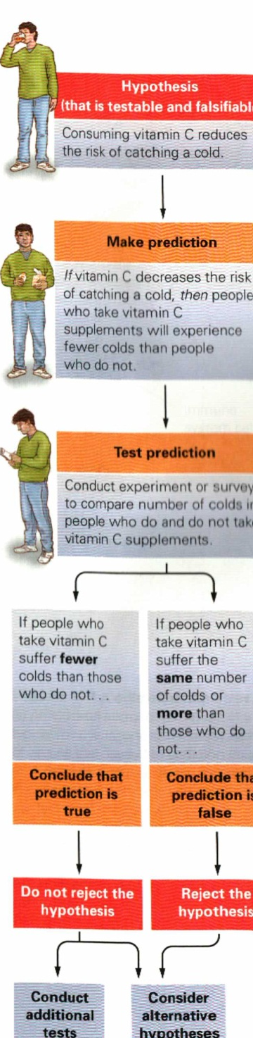
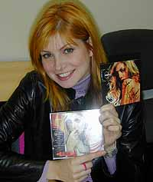
Logic behind a test
Does Vitamin C reduce the risk of catching
A cold?
The chemical,
⬅ not the pop singer
Pg. 7

Slide 24
Experiment
“a repeatable manipulation of one or more aspects of the natural world”
Modifying one variable to see what happens to another one
The thing we record for results are the “dependent variable.”
The variable we control and change as part of the experiment is the “independent variable”
pg. 8

Slide 25
Observations (as test results)
Description, measurement or record
Reproducible by others
  Detailed Description of Methods & Conditions
  Be very suspicious of claims without detailed methods – often a scam
pg. 6

Slide 26
Experimental Control
a group maintained under a standard set of conditions with no change in the independent variable
Sometimes a “placebo”

Slide 27
Testing can support a hypothesis, but cannot prove it
“No amount of experimentation can ever prove me right; a single experiment can prove me wrong”
                – Albert Einstein
Repeated tests can provide evidence that supports a hypothesis, but they cannot PROVE it.
When lots of evidence supports a hypothesis, scientists can be confident in it

Slide 28
Avoiding Bias in Experiment
Random Assignment
Blind experiment – test subject does not know
Sometimes they get a “placebo”
Double blind experiment
neither subject nor researcher
Pg. 12

Slide 29
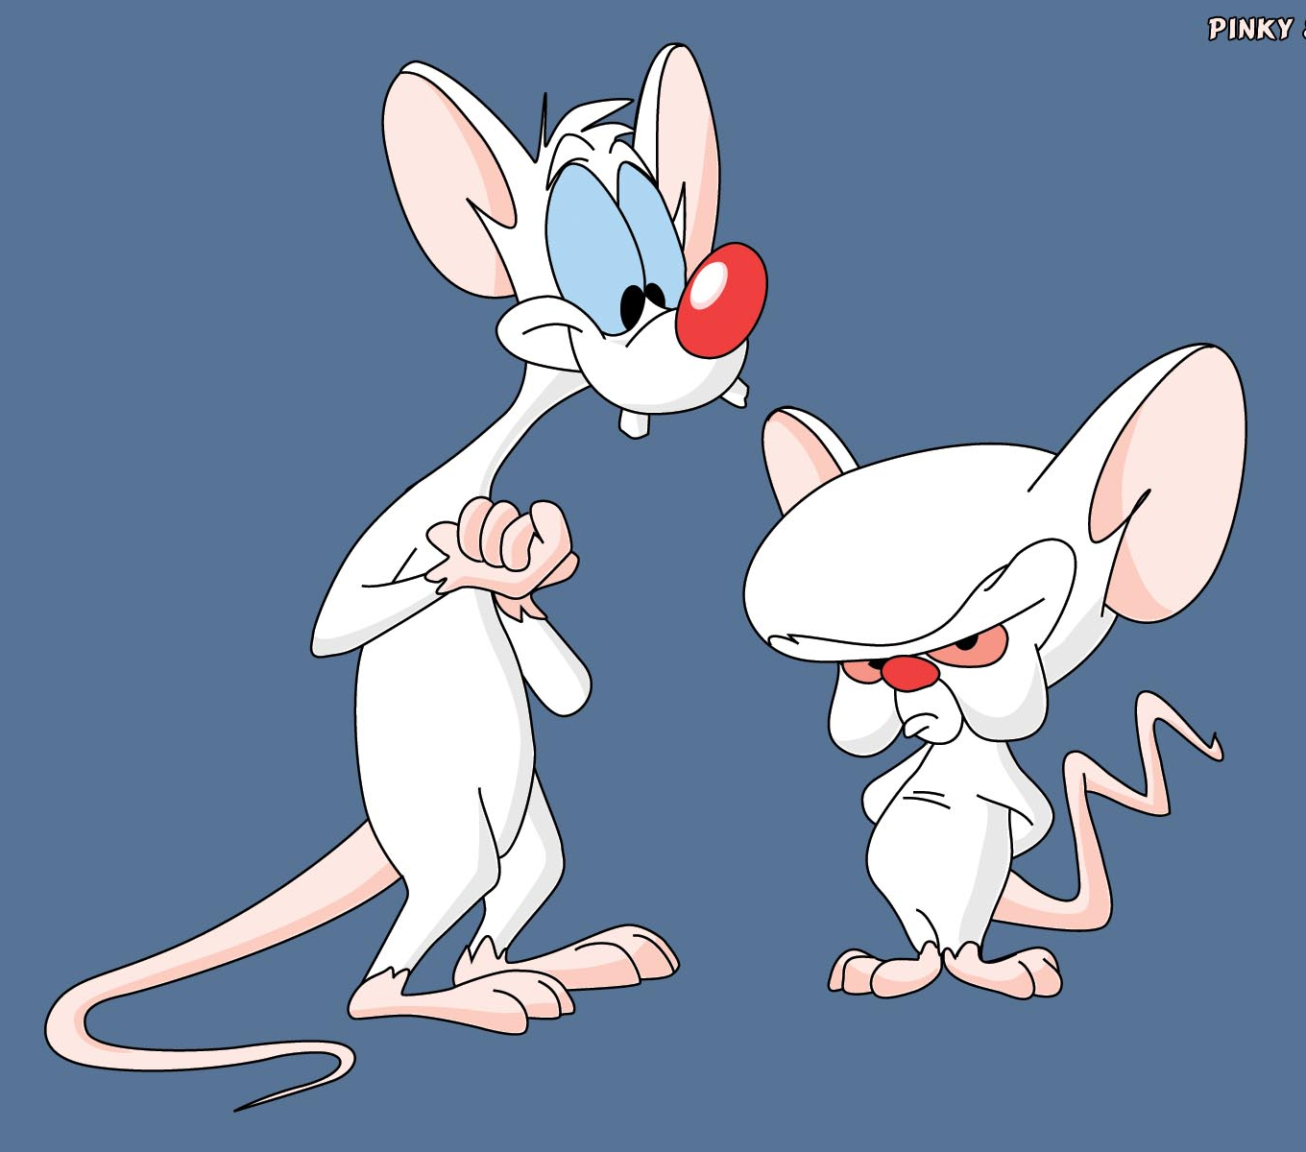
“Models”
What you use if you cannot or should not do test
white lab rat
guinea pig
Rhesus monkey
Chimp

Slide 30
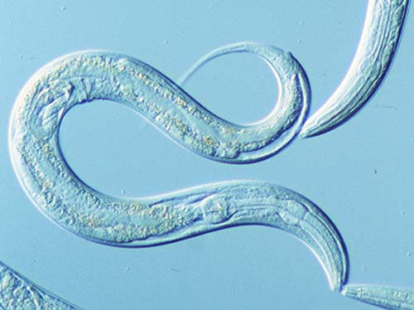
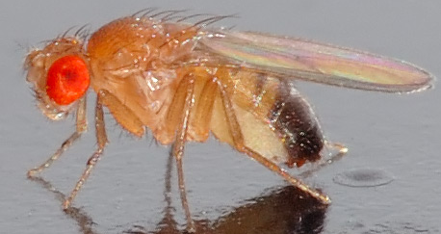
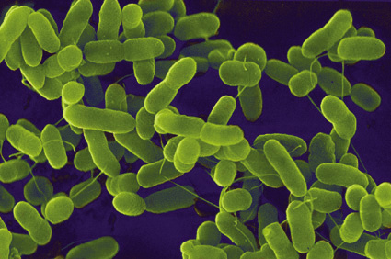
Non-mammalian “Models”
C. elegans
Drosophila
E. coli

Slide 31
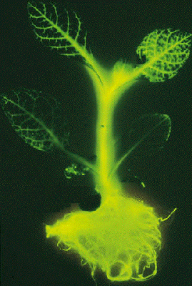
Non-Mammalian “Models”
Tobacco plant

Slide 32
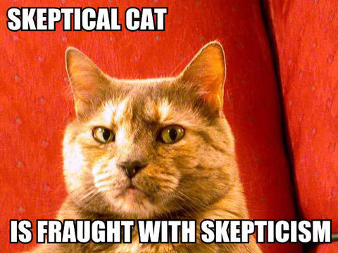
  Be very suspicious of claims without detailed methods – often a scam.
  This is true for both initial observations and results
pg. 6

Slide 33
Cold Fusion
Initial: excitement – no detailed description of how
Later: rejected by most scientists – cannot reproduce
Now: ???

Slide 34

Pastafarians
pg. 14

Slide 35
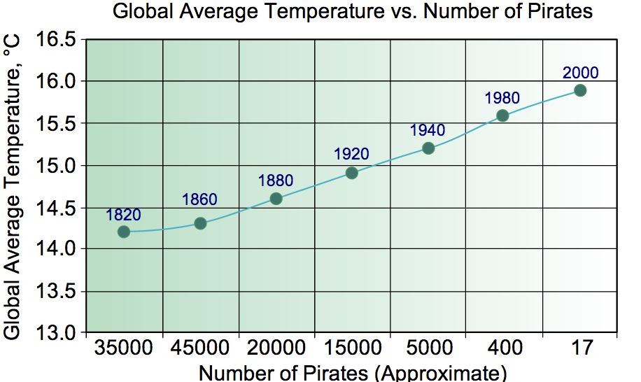
Pastafarians
pg. 14

Slide 36
Correlation
two variables are related in some way
    Example: a large value for variable occurs when there is a large value for another variable
Does not prove cause and effect!!!!!!
Correlation is often described in situations where scientists are unable to perform experiments
pg. 14

Slide 37
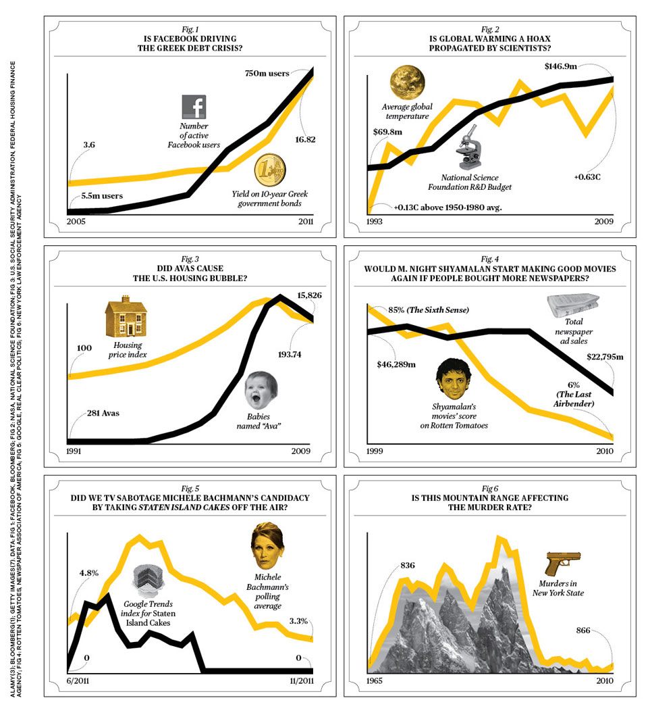

Slide 38
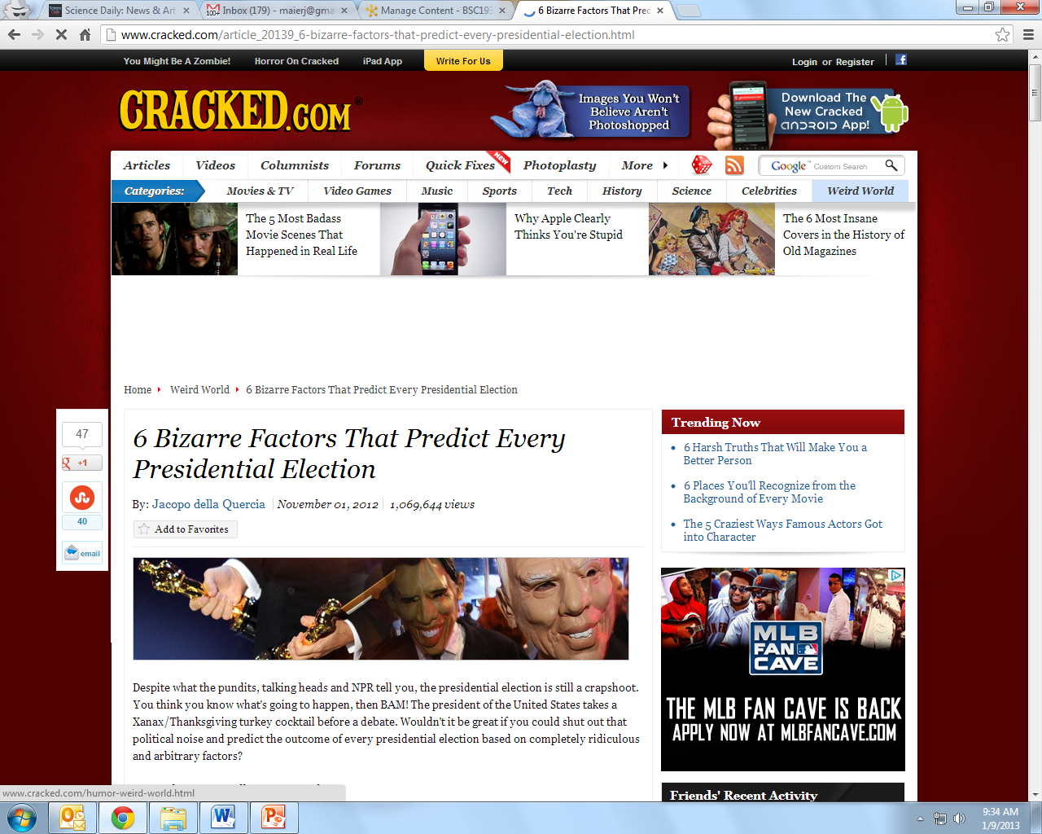
Presidential Election (redskins)

Slide 39
Why use Corrolation?
Correlation is often described in situations where scientists are unable to perform experiments
  May be unethical
  May be comparing past to present
  (can’t alter past and rerun)
All a corrolation shows is that there appears to be a relationship between the variables. The cause could be a some other variable you have not considered
pg. 14

Slide 40
Statistics (pg. 17)
using math to describe our observations
Compare with other data
Evaluate results (How much do we trust)

Slide 41
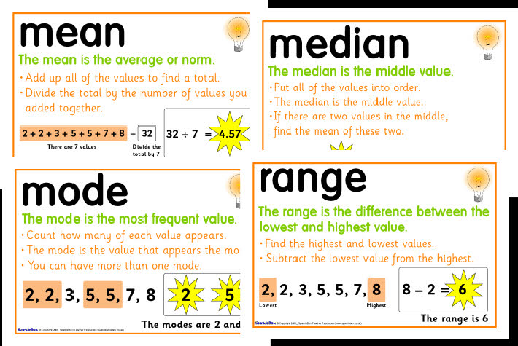
Nerd Words for Statistics

Slide 42
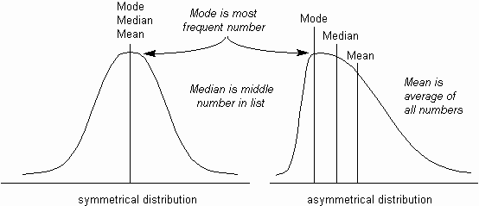
Nerd Words for Statistics
Mean = average
Median = middle value
Mode = most common

Slide 43
Nerd Words for Statistics
“Statistically Significant”
“Pay attention to this result”
It is very unlikely that the difference you see is the result of chance
We must use statistics to decide if our results can be explained away by dumb luck (random chance)
If a result is VERY VERY improbable, we are more likely to trust it .
WHY? Probably wouldn’t happen by chance

Slide 44
Nerd Words for Statistics
Sampling Error: is your test group different from control
are two test groups different
Differences in results could be from differences in groups
Probability
how likely is it that this is due to sample error
if there is a low probability of this happening by chance, the results are statistically significant

Slide 45
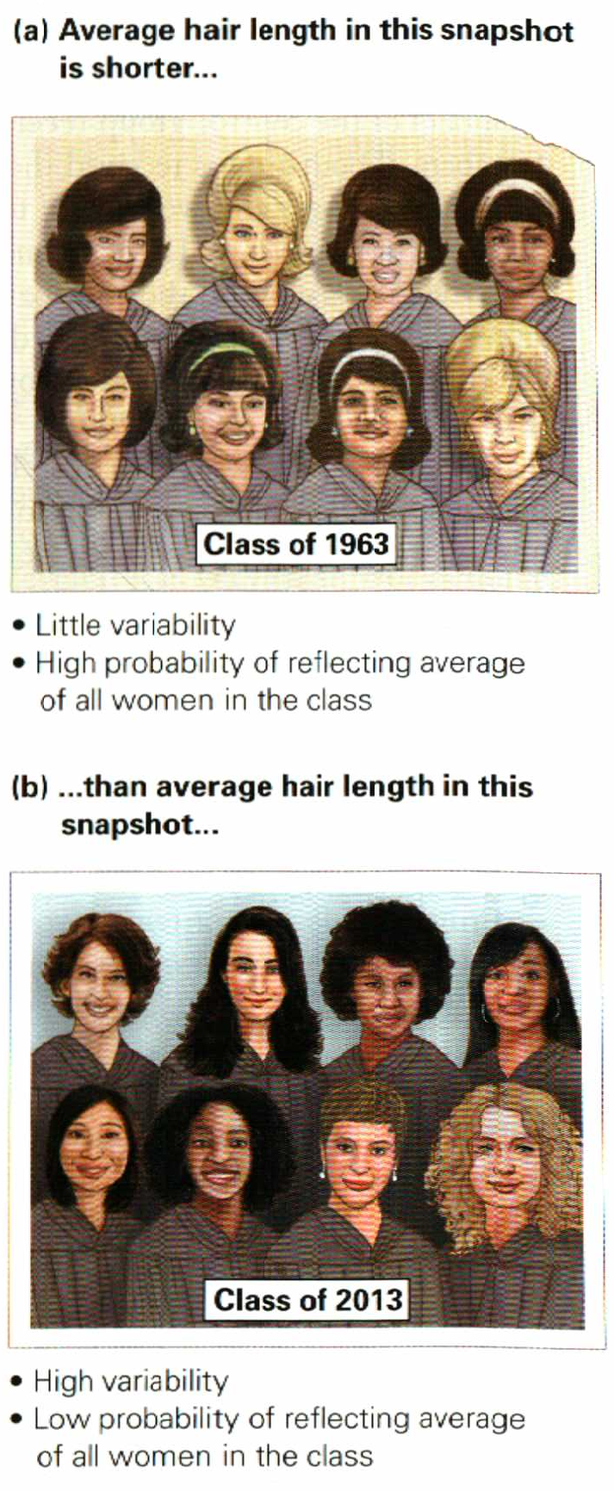
Standard Error
Standard Error – how much variability is in sample group
(how similar is sample to actual population)

Slide 46
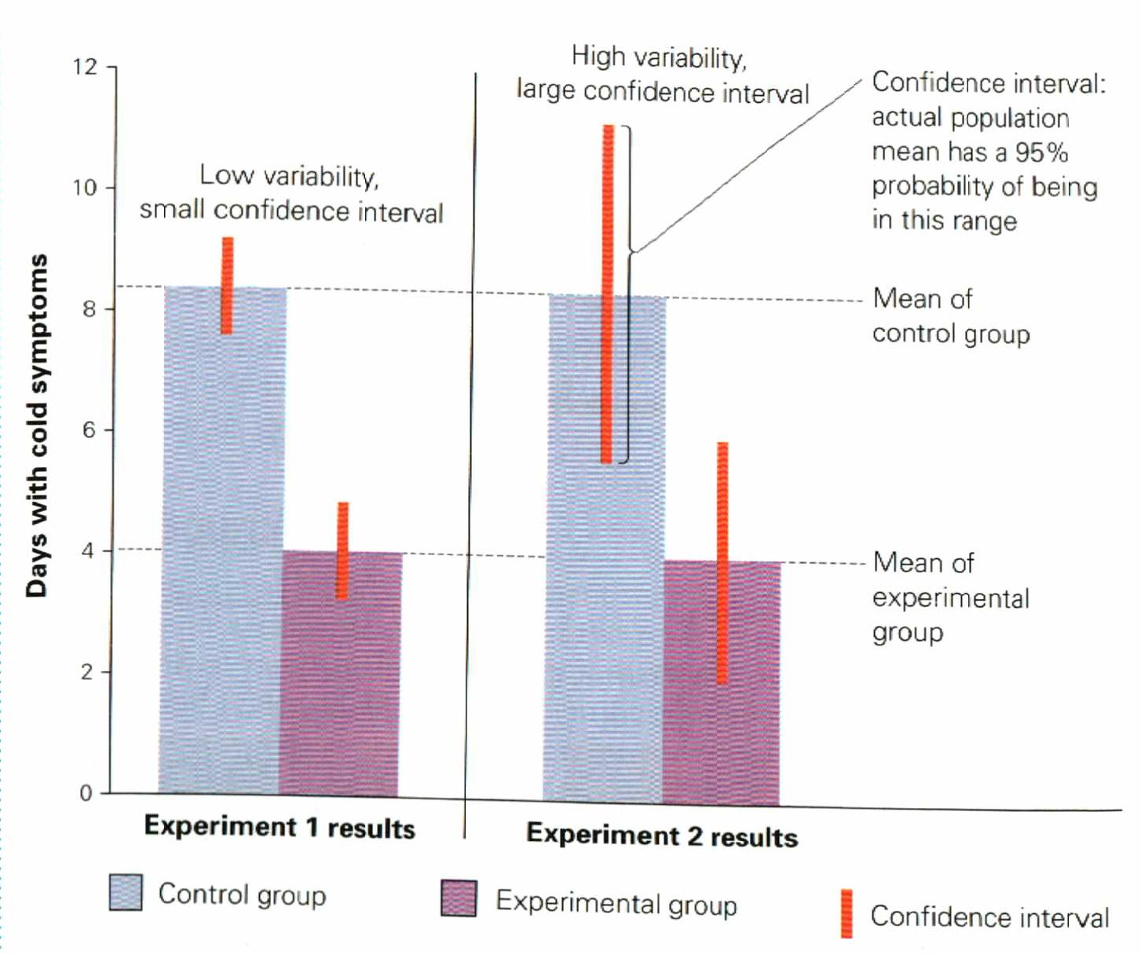
Confidence Interval
Small Confidence Interval
Means small results are
More likely to matter
Large Confidence Interval
Means low confidence
In results of test
(could be due to chance)
Pg. 19

Slide 47
Adding the variables together
Sample Average + Standard Error
highest probable value for real average
Sample Average – StandardError
Lowest probably value for real average
Pg. 18

Slide 48
Sample Size + Significance
Results are more likely to be true if:
1) You have a large difference between groups
2) You have a large sample size
“n number” = sample size
“Statistically Significant”
there’s less than a 5% chance of this result
happening at random
we believe the results were caused by test
Pg. 19

Slide 49
Other Sources of Error
Statistics cannot tell us if someone made mistakes when recording the data
Sloppy or untrained observer
Proper experimental design
  Randomized group assignment?
  Blind? Double blind?

Slide 50

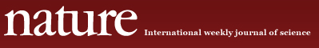
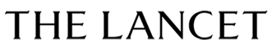
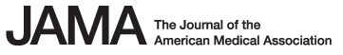

What information do you trust?
Primary Sources of information – where research is described
peer review – other scientists look at
before publishing (journals)
NEW: Online journals ➔

Slide 51

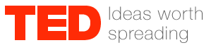



What information do you trust?
Secondary Sources
Books Web
News

