Slide 1
Not Happy with your grade?
Not understanding the material?
Remember that the TLCC has
Free Biology Tutoring
Notes:
Figure 1.1 What properties of life are demonstrated in this flower?

Slide 2
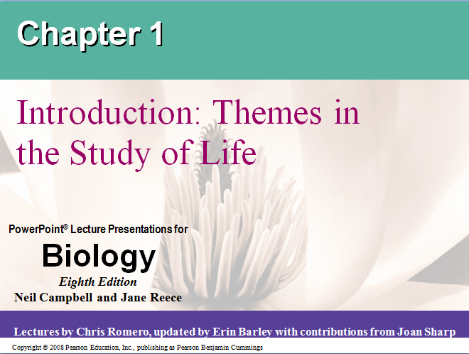
Chapter 1
Introduction: Themes in the Study of Life

Slide 3
Overview: Asking About Life
Biology = “bio” (life) + “logy” (study of)
Includes all these topics:
  How a single cell develops into an organism
  How the human mind works
  How living things interact in communities
Copyright © 2008 Pearson Education, Inc., publishing as Pearson Benjamin Cummings

Slide 4

Biology = “study of life”
So what is life?
(Good question. We don’t have a simple, one sentence definition)
Life is recognized by what living things do
Know the 6 things!!!!
Video: Seahorse Camouflage
Copyright © 2008 Pearson Education, Inc., publishing as Pearson Benjamin Cummings
Notes:
Click to add notes

Slide 5
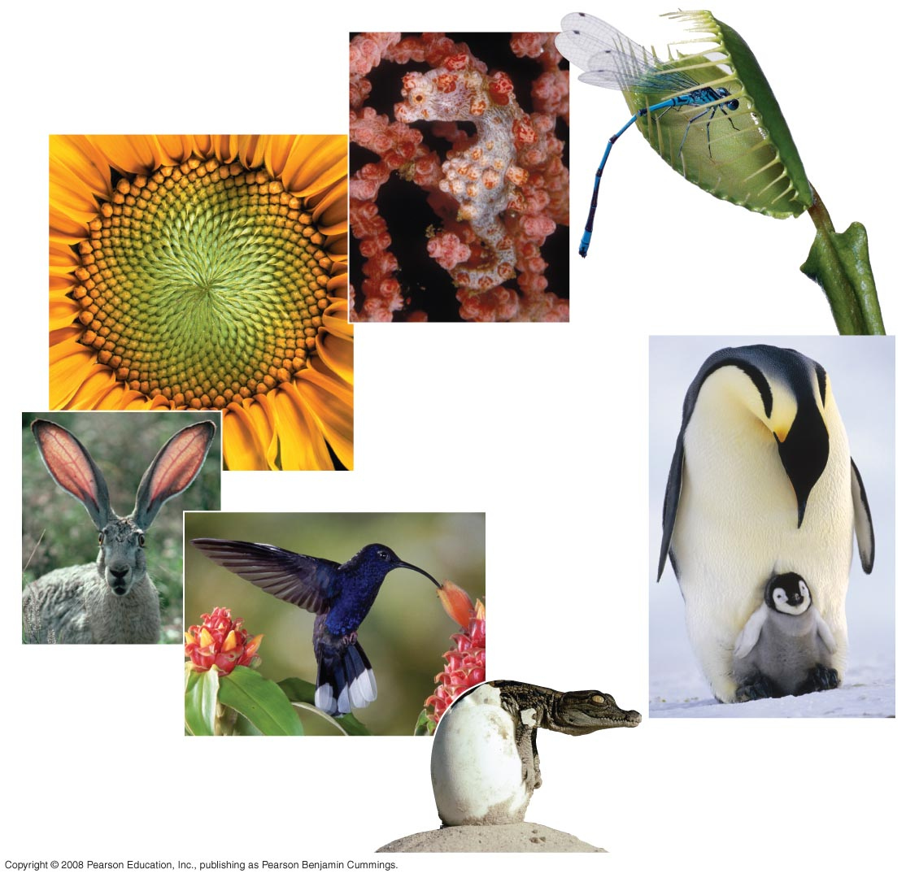
Six things that most living things do
Have levels of organization/order
Respond to their environment
Use energy
Reproduce
Grow
Evolve
(“change in a population over time”)

Slide 6

Concept 1.1: Themes connect concepts of biology
Biology: more than facts
Themes make it easy to understand and remember
Examples
    levels of organization systems & function
    Emergent properties interact with environment
    Ecosystems evolution
Copyright © 2008 Pearson Education, Inc., publishing as Pearson Benjamin Cummings

Slide 7
Theme: levels of organization & emergent properties
“biology” = study of life
  study be study of molecules in living things
  Study entire planet
The study of life can be divided into different levels of biological organization
    New properties at each level
Copyright © 2008 Pearson Education, Inc., publishing as Pearson Benjamin Cummings

Slide 8
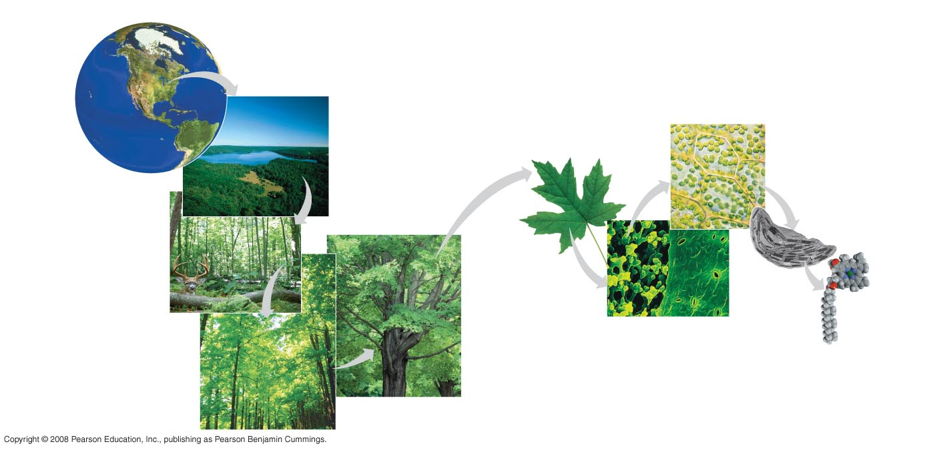
Fig. 1-4
The biosphere
Cells
Organs and organ systems
10 µm
Cell
Ecosystems
Organelles
Communities
1 µm
Atoms
Tissues
50 µm
Populations
Molecules
Organisms
Notes:
Figure 1.4 Levels of biological organization

Slide 9
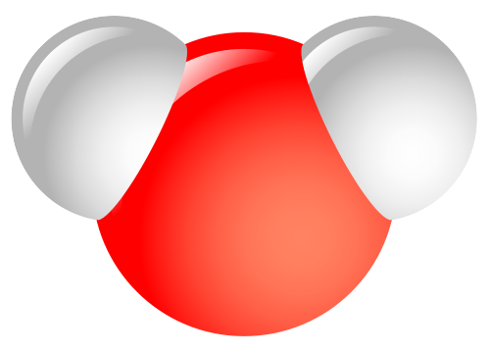
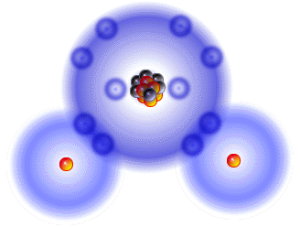
Emergent Properties: why do they exist
Emergent properties : two reasons
how parts are arranged
how they interact
Emergent properties show up in nonliving things, too: water
Copyright © 2008 Pearson Education, Inc., publishing as Pearson Benjamin Cummings

Slide 10
Reductionism: strength and weakness
Biology looks at: emergent properties
Reductionism
Understanding complex stuff by looking at parts
Good biology uses both methods
example
  Look at molecular structure of DNA
  Learn how DNA works by looking at interactions with other molecules
Copyright © 2008 Pearson Education, Inc., publishing as Pearson Benjamin Cummings

Slide 11
Systems Biology
System: a group of parts that work together
Systems biology makes models of behavior for biological systems
The systems approach poses questions such as:
  How does a drug for blood pressure affect other organs?
  How does increasing CO₂ alter the biosphere?
Copyright © 2008 Pearson Education, Inc., publishing as Pearson Benjamin Cummings

Slide 12
Theme: Organisms interact environments, exchanging matter and energy
Every organism interacts with its environment, (both living and nonliving things)
Interactions affect both both organism and their environments
  Tree takes: H2O, minerals and CO2
  Tree gives: O2, and roots help make soil
Copyright © 2008 Pearson Education, Inc., publishing as Pearson Benjamin Cummings

Slide 13
Ecosystem Dynamics
The dynamics of an ecosystem include two major processes:
  Energy flows:
  light➔producer➔consumer
  Nutrients cycle
Copyright © 2008 Pearson Education, Inc., publishing as Pearson Benjamin Cummings

Slide 14
Energy Conversion
Work requires energy
Forms of energy: light, chemical, kinetic, or thermal
The energy exchange
  Usually involves conversion of energy
Energy flows through an ecosystem, usually entering as light and exiting as heat
Copyright © 2008 Pearson Education, Inc., publishing as Pearson Benjamin Cummings

Slide 15
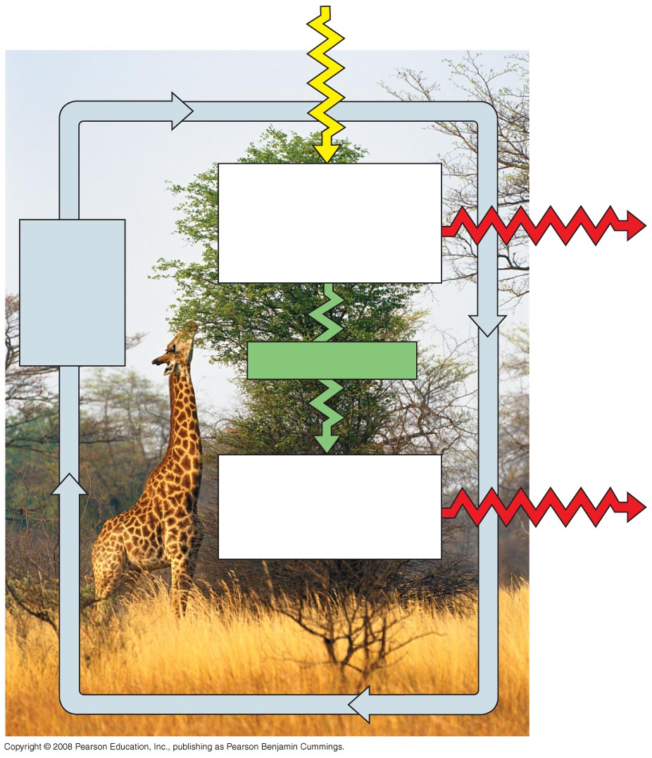
Fig. 1-5
Sunlight
Ecosystem
Producers
(plants and other photosynthetic
organisms)
Cycling
of
chemical
nutrients
Heat
Chemical energy
Consumers
(such as animals)
Heat
Notes:
Figure 1.5 Nutrient cycling and energy flow in an ecosystem

Slide 16

Theme: Structure & function are related
Structure and function of living organisms are closely related
  leaf is thin and flat
  More surface area to capture of light with chloroplasts
Copyright © 2008 Pearson Education, Inc., publishing as Pearson Benjamin Cummings

Slide 17
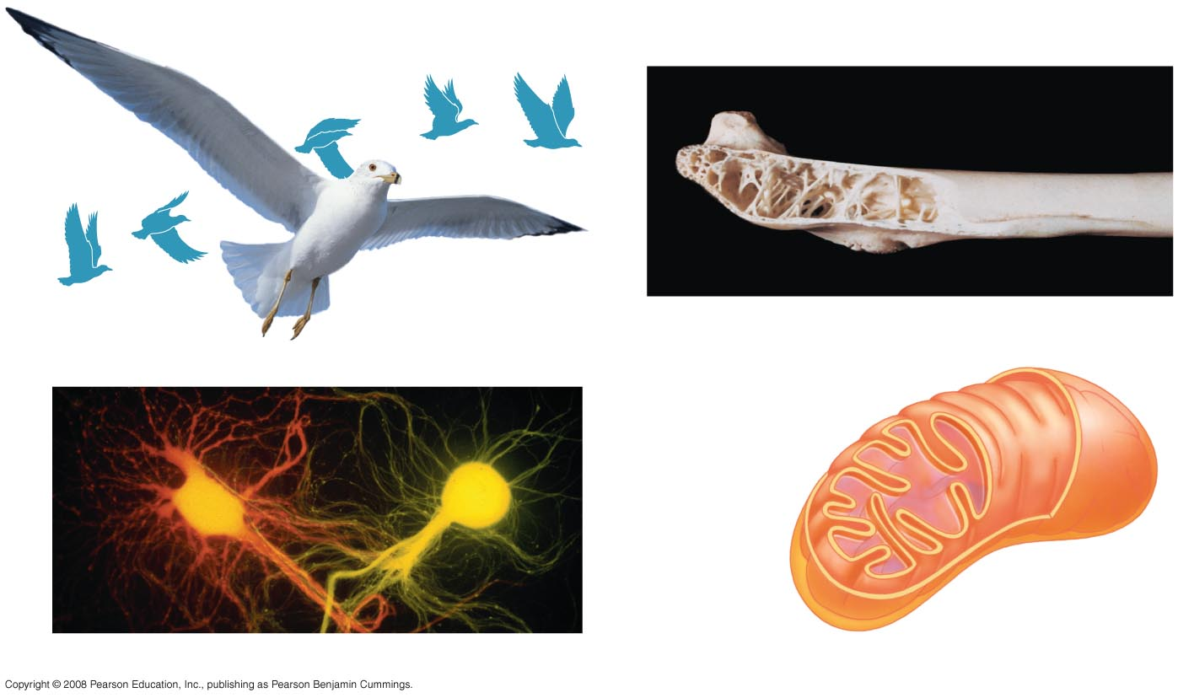
Fig. 1-6
(a) Wings
(b) Bones
Infoldings of
membrane
Mitochondrion
100 µm
0.5 µm
(c) Neurons
(d) Mitochondria
Notes:
Figure 1.6 Form fits function in a gull’s wing

Slide 18
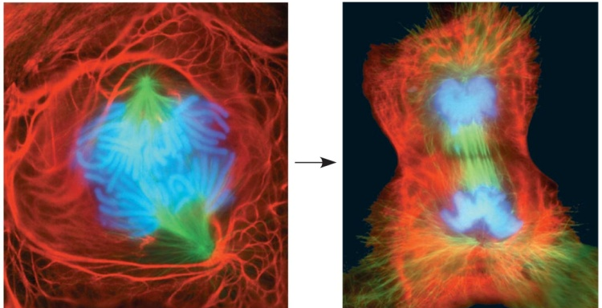
Theme: Cells are an organism’s basic units of structure and function
Smallest and simplest thing does all activities required for life
All cells:
  Are enclosed by a membrane
  Use DNA as their genetic information
The ability of cells to divide is the basis of all reproduction, growth, and repair of multicellular organisms
Copyright © 2008 Pearson Education, Inc., publishing as Pearson Benjamin Cummings

Slide 19
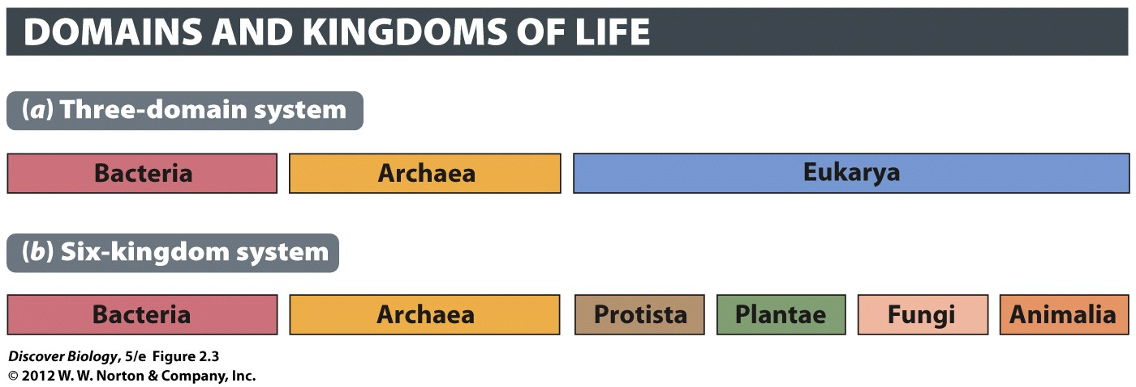
Eukaryotes = Eu(“with”) + karyo(“kernel”; i.e. nucleus)
Most stuff: plants, animals, fungi, many microbes
Prokaryotes = Pro(“before”) + karyo(“kernel”; i.e. nucleus)
very little cells without a nucelus
Terms change over time
“bacteria” ➔ “Eubacteria “ & “Archebacteria” ➔ “Bacteria” & “Archea”

Slide 20
A eukaryotic cell (“with kernel” i.e. nucleus)
  DNA stays in nucleus.
  has manyother organelles (little organs”)
plants, animals, fungi, and protists (algae and many types of larger microbes)
Copyright © 2008 Pearson Education, Inc., publishing as Pearson Benjamin Cummings

Slide 21
a prokaryotic cell:
Simple cells: no nucleus or other organelles.
DNA floats in “nuclear region”
Usually smaller.
Two kinds: Bacteria and Archea
Differences in DNA and proteins
Copyright © 2008 Pearson Education, Inc., publishing as Pearson Benjamin Cummings

Slide 22
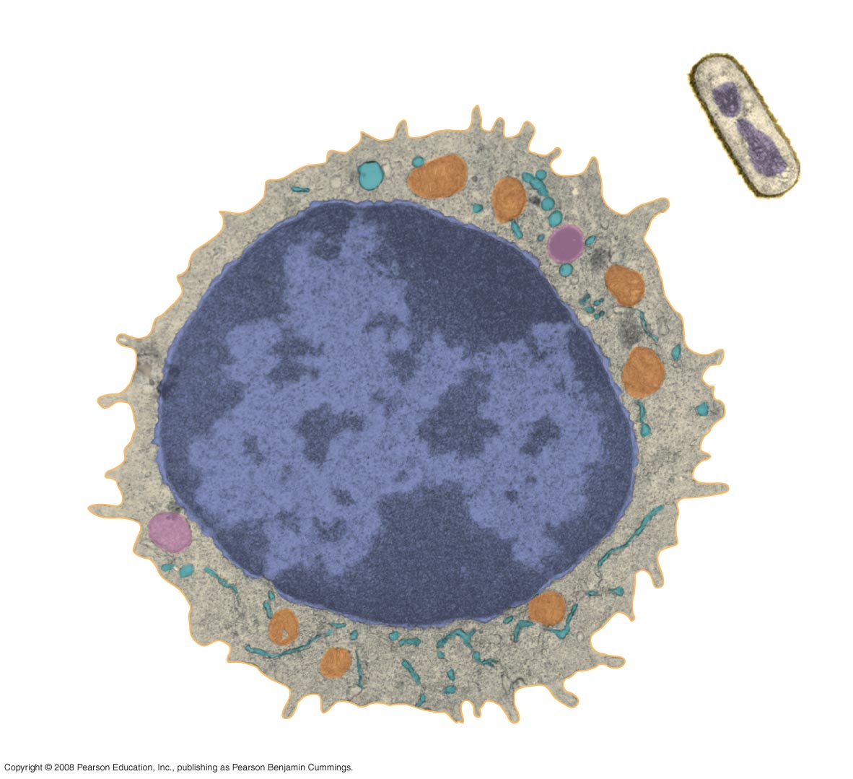
Fig. 1-8
Prokaryotic cell
Eukaryotic cell
DNA
(no nucleus)
Membrane
Membrane
Cytoplasm
Organelles
Nucleus (contains DNA)
1 µm
Notes:
Figure 1.8 Contrasting eukaryotic and prokaryotic cells in size and complexity

Slide 23
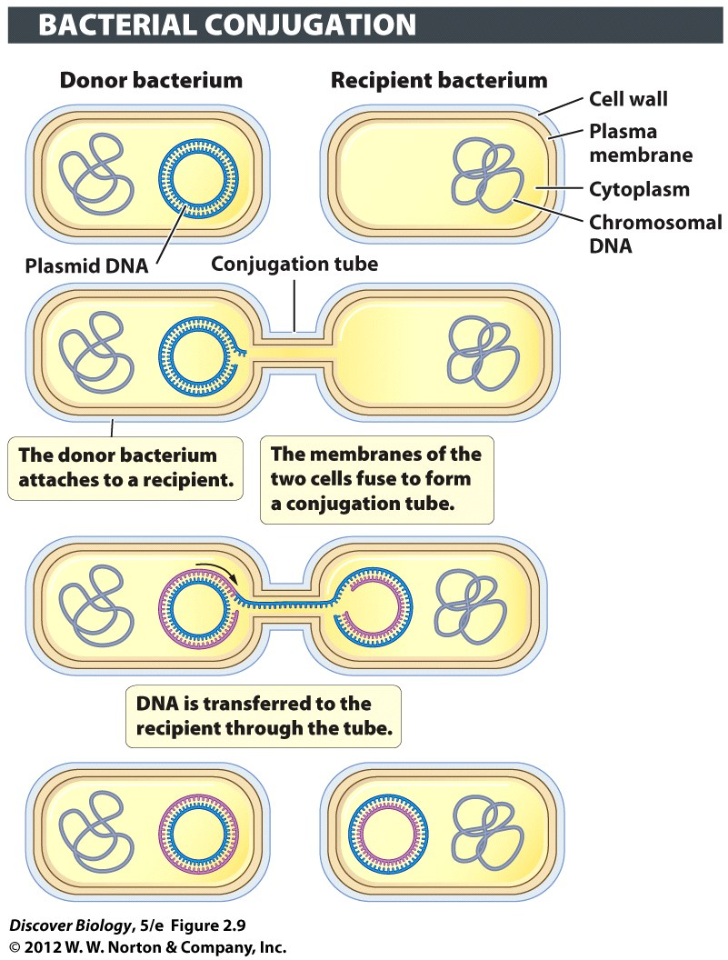
Bacteria
Small cells
Asexual reproduction
No nucleus (“prokaryote”)
bacteial chromosome
plasmid – DNA loop
NO ORGANELLES

Slide 24
Archea
Small like bacteria
No nucleus (“prokaryote”) or Organelles
Many can live in extreme conditions

Slide 25
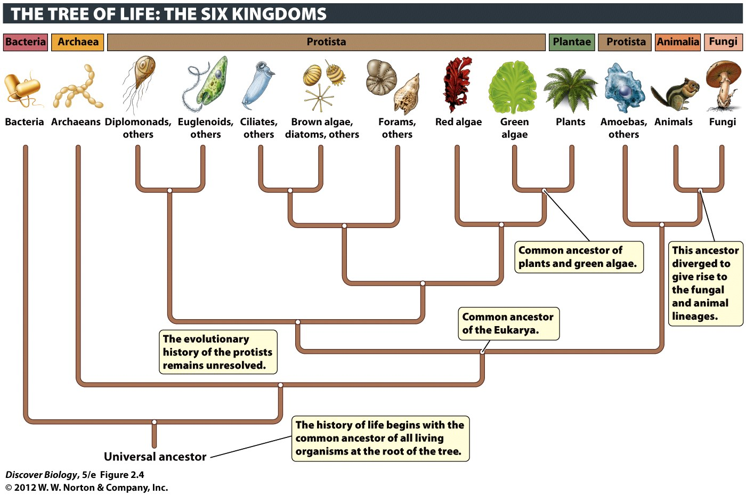
E
pg. 15

Slide 26
Eukaryotes
Animals = kingdom Animalia
Plants = kingdom Plantae
Fungi = Kingdom Fungi
Protists = Kingdom Protista
algae, amoeba, lots of microbes
(e.g. Noctiluca)

Slide 27
Eukaryotes
Have a nucleus (that’s where DNA)
Have organelles (little parts with separate jobs)
mitochondria – make energy (the power plant)
golgi aparatus – chemicals are packaged/modified
endoplasmic reticulum – manufacturing (factory)
vacuole – storage (warehouse)
Endosymbiont Origin
Will cover in detail when we study cells – lab & lecture

Slide 28
Endosymbiosis
Endosymbiosis = endo(“within”) + sym(“same”) + bio
The idea that complex cells (eukaryotes) formed when small cells started living inside big cells
evidence: double membrane, ribosomes, DNA

Slide 29
Theme: transmitting information as DNA
Chromosomes contain most of a cell’s genetic material in the form of DNA (deoxyribonucleic acid)
DNA is the substance of genes
Genes are the units of inheritance that transmit information from parents to offspring
SAME GENETIC CODE IN ALL ORGANISMS
Copyright © 2008 Pearson Education, Inc., publishing as Pearson Benjamin Cummings

Slide 30
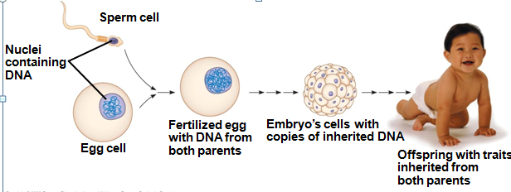
DNA Structure and Function
Each chromosome has one long DNA molecule with hundreds or thousands of genes
DNA is inherited by offspring from their parents
DNA controls the development and maintenance of organisms
Copyright © 2008 Pearson Education, Inc., publishing as Pearson Benjamin Cummings

Slide 31
Each DNA molecule is made up of two long chains arranged in a double helix
Each link of a chain is one of nucleotides
Each nucleotide is made of a sugar, phosphate and base
four kinds of chemical building blocks called nucleotides: Adenine, Cytosine, Guanine, Thymine
Copyright © 2008 Pearson Education, Inc., publishing as Pearson Benjamin Cummings

Slide 32
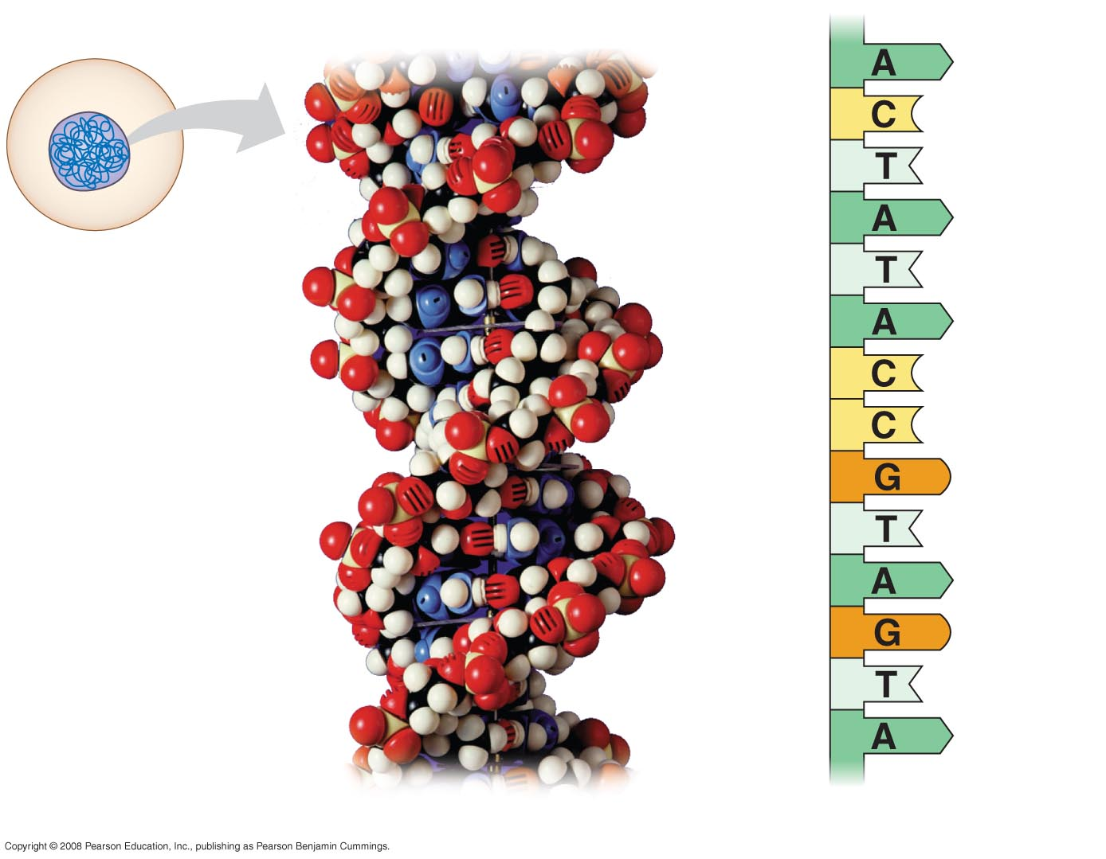
Fig. 1-10
Nucleus
DNA
Nucleotide
Cell
(a) DNA double helix
(b) Single strand of DNA
Notes:
Figure 1.10 DNA: The genetic material

Slide 33
DNA is packed into chromosomes. One chromosome contains MANY genes
Genes control protein production indirectly
DNA is transcribed into RNA then translated into a protein
An organism’s genome is its entire set of genetic instructions
Copyright © 2008 Pearson Education, Inc., publishing as Pearson Benjamin Cummings

Slide 34
Evolution: the major theme in biology
Evolution: change in the genes of a population over time
Evolution is the process of change that has transformed life on Earth
Evolution makes sense of everything we know about living organisms
Organisms living on Earth are modified descendents of common ancestors
Copyright © 2008 Pearson Education, Inc., publishing as Pearson Benjamin Cummings

Slide 35
Concept 1.2: The Core Theme: Evolution accounts for both the unity and the diversity of life
Evolution does a great job of explaining the diversity of organisms
“Nothing in biology makes sense except in the light of evolution”—Theodosius Dobzhansky
Copyright © 2008 Pearson Education, Inc., publishing as Pearson Benjamin Cummings

Slide 36
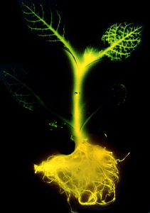
Unity in the Diversity of Life
Features that are common to many organisms:
  DNA is the universal genetic language common to all organisms
  Unity is evident in many features of cell structure
Copyright © 2008 Pearson Education, Inc., publishing as Pearson Benjamin Cummings

Slide 37
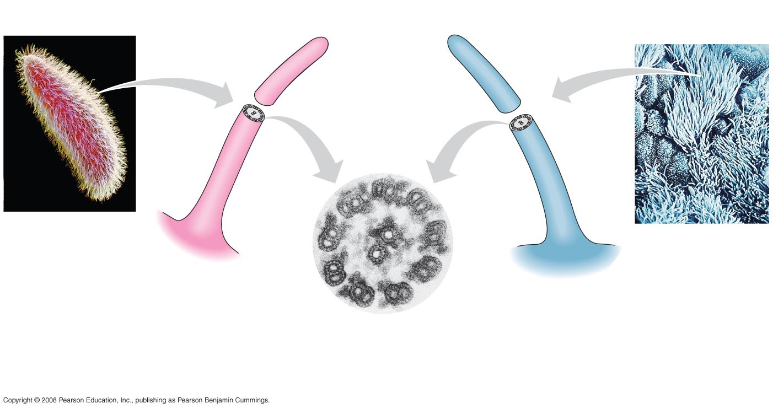
Fig. 1-16
15 µm
5 µm
Cilia of
Paramecium
Cilia of
windpipe
cells
0.1 µm
Cross section of a cilium, as viewed
with an electron microscope
Notes:
Figure 1.16 An example of unity underlying the diversity of life: the architecture of cilia in eukaryotes

Slide 38
Grouping Species: The Basic Idea
Taxonomy = naming and organizing stuff by how related we think it is
How to decide: DNA and physical traits
Biggest: Domain, Kingdom, Phylum, Class, Order, Family, Genus, Species: smallest
Copyright © 2008 Pearson Education, Inc., publishing as Pearson Benjamin Cummings

Slide 39
The Three Domains of Life
The three-domain system is currently used, and replaces the old five-kingdom system
Domain Bacteria and domain Archaea comprise the prokaryotes
Domain Eukarya anything with a nucleus
Copyright © 2008 Pearson Education, Inc., publishing as Pearson Benjamin Cummings

Slide 40
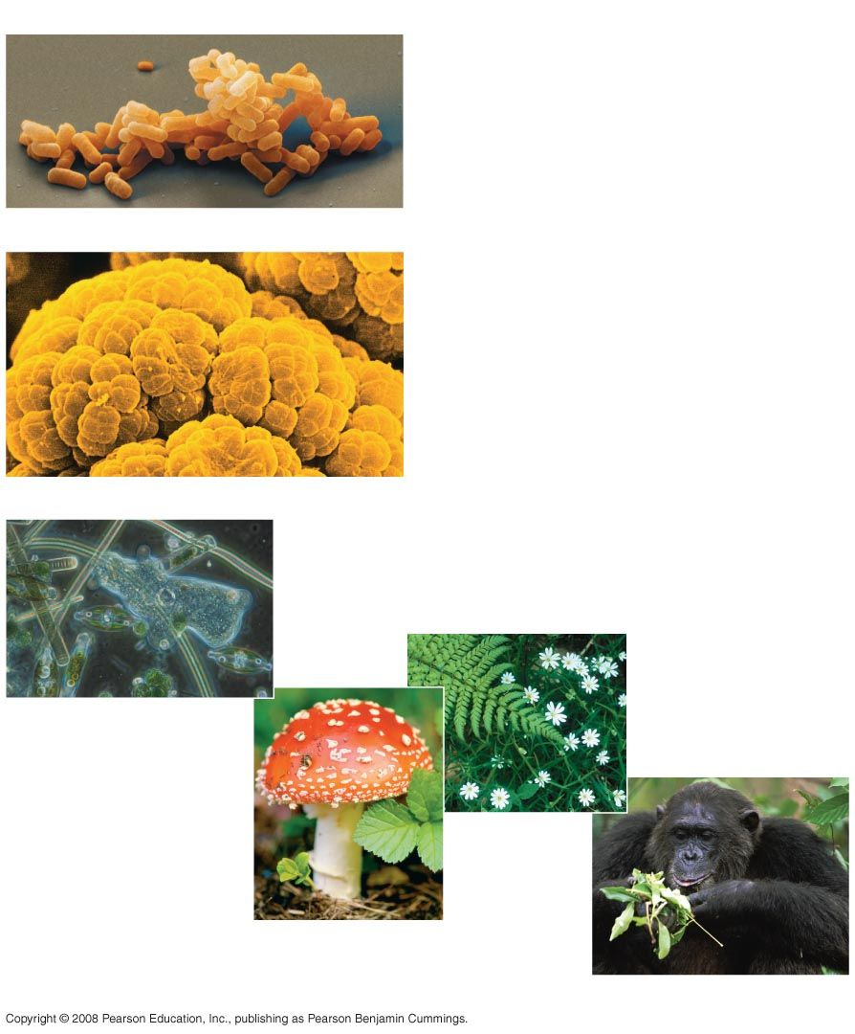
Fig. 1-15
(a) DOMAIN BACTERIA
(b) DOMAIN ARCHAEA
⬅ Extreme conditions
(c) DOMAIN EUKARYA
Protists
Kingdom
Plantae
Kingdom Fungi
Kingdom Animalia
Notes:
Figure 1.15 The three domains of life

Slide 41
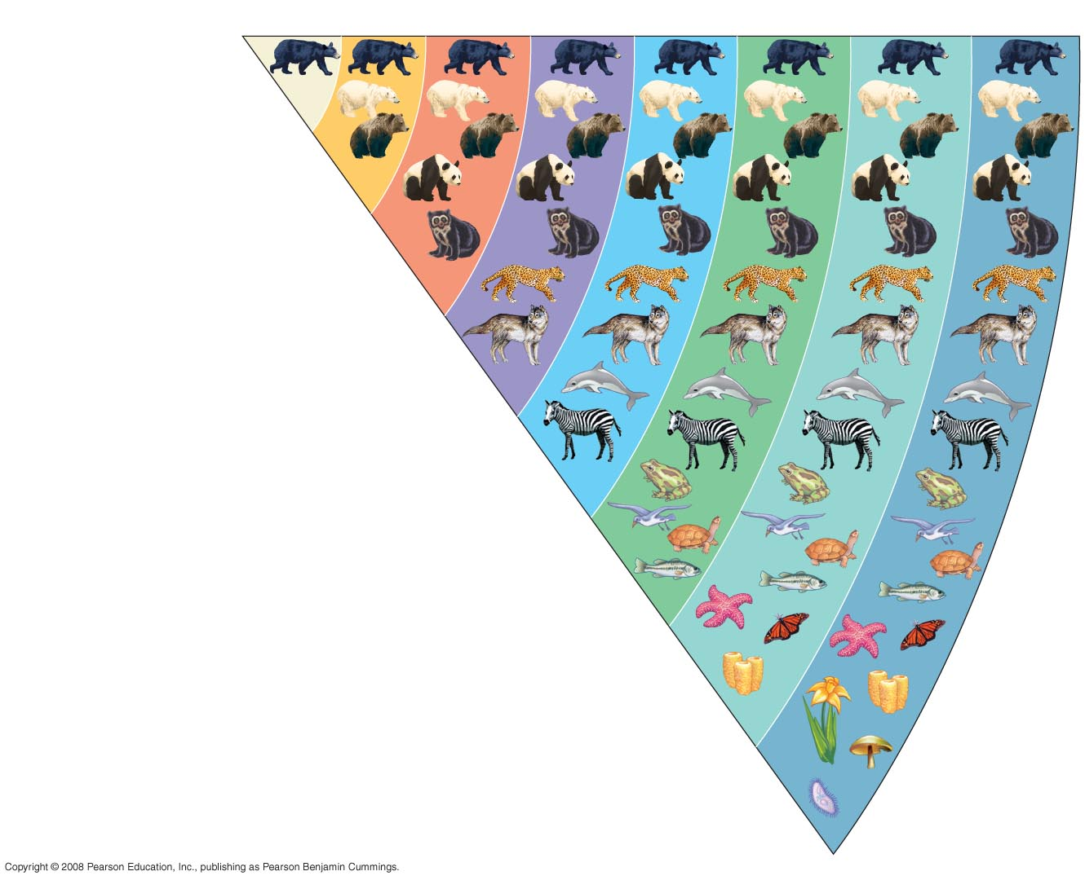
Did
King
Phillip
Come Over
For Ginger Snaps?
Fig. 1-14
Species
Genus
Family
Order
Class
Phylum
Kingdom
Domain
Ursus americanus
(American black bear)
Ursus
Ursidae
Carnivora
Mammalia
Chordata
Animalia
Eukarya
Notes:
Figure 1.14 Classifying life

Slide 42
The domain Eukarya includes three multicellular kingdoms:
  Plantae
  Fungi
  Animalia
Other eukaryotic organisms were formerly grouped into a kingdom called Protista, though these are now often grouped into many separate kingdoms
Copyright © 2008 Pearson Education, Inc., publishing as Pearson Benjamin Cummings

Slide 43
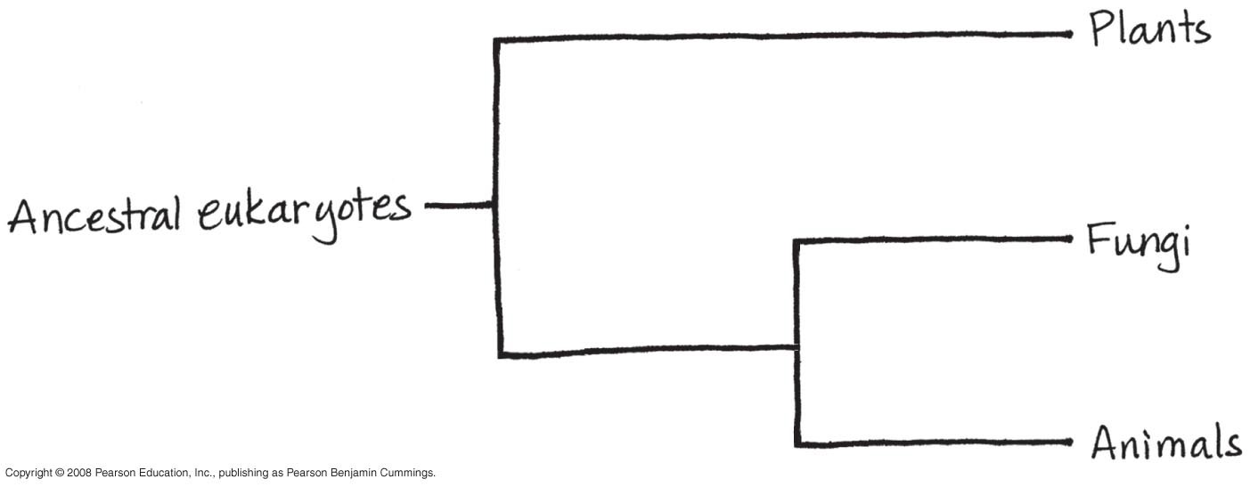
Fig. 1-UN9

Slide 45
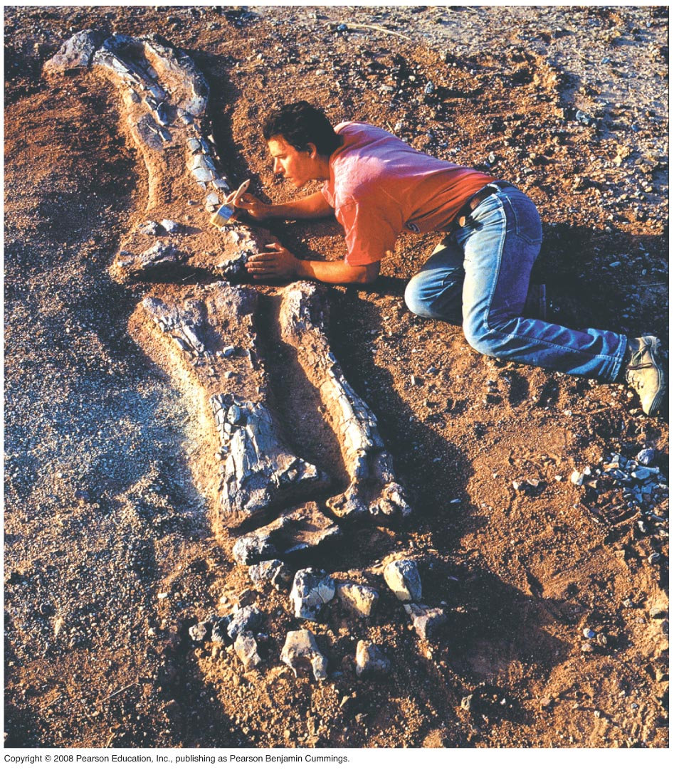
Charles Darwin and the Theory of Natural Selection
Fossils and other evidence:
The stuff alive now is different from the ones in the past
“Descent with Modification”
Copyright © 2008 Pearson Education, Inc., publishing as Pearson Benjamin Cummings

Slide 46
Charles Darwin published On the Origin of Species by Means of Natural Selection in 1859
Darwin made two main points:
  Species showed evidence of “descent with modification” from common ancestors
  Natural selection is the mechanism behind “descent with modification”
Darwin’s theory explained the duality of unity and diversity
Copyright © 2008 Pearson Education, Inc., publishing as Pearson Benjamin Cummings

Slide 47
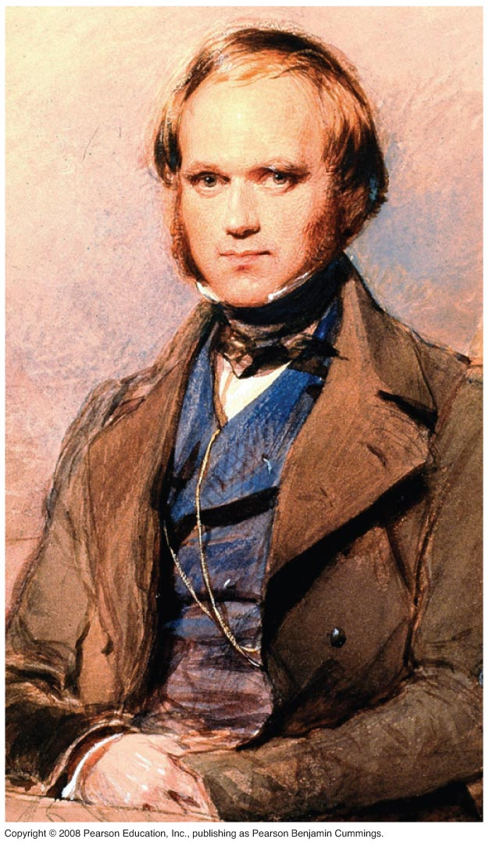

Fig. 1-18
Nature is not like t-ball:
There are winners and loosers
Notes:
Figure 1.18 Charles Darwin as a young man

Slide 48
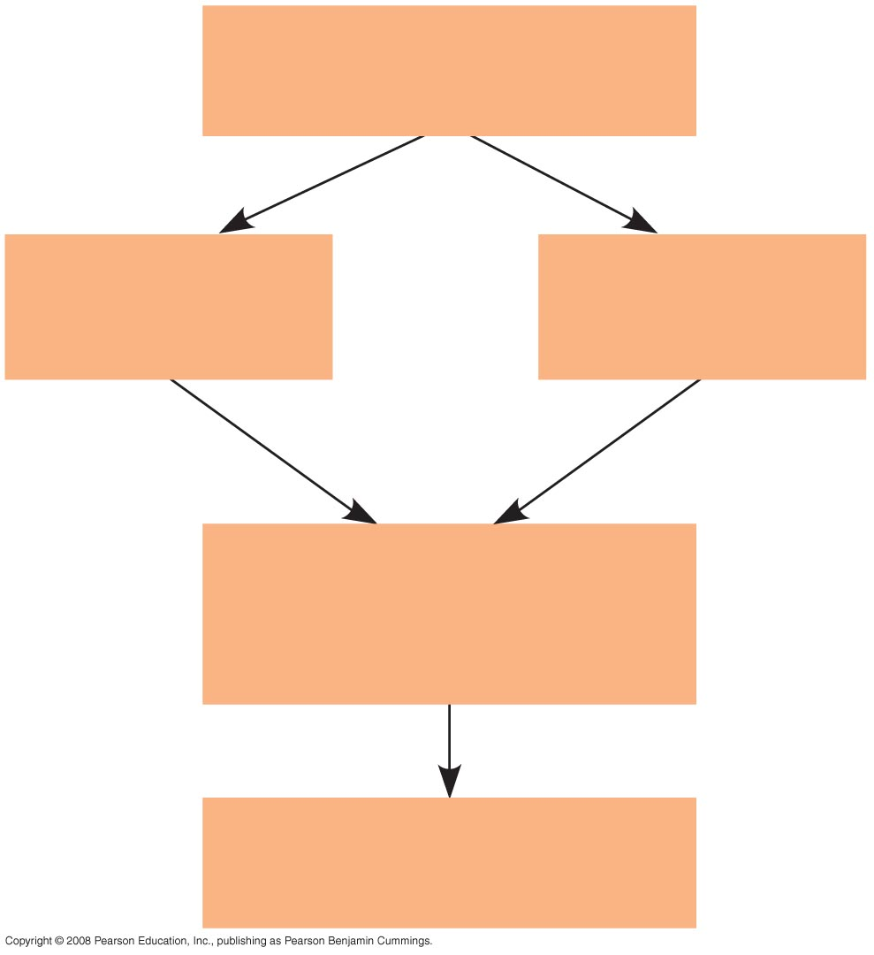
Fig. 1-UN8
Population
of organisms
Hereditary
variations
Overproduction
and competition
Environmental
factors
Differences in
reproductive success
of individuals
Evolution of adaptations
in the population

Slide 49
Darwin observed that:
  Individuals in a population have traits that vary
  Many of these traits are heritable (passed from parents to offspring)
  More offspring are produced than survive
  Competition is inevitable
  Species generally suit their environment
Copyright © 2008 Pearson Education, Inc., publishing as Pearson Benjamin Cummings

Slide 50
Darwin inferred that:
  Individuals that are best suited to their environment are more likely to survive and reproduce
  Over time, more individuals in a population will have the advantageous traits
In other words, the natural environment “selects” for beneficial traits
Copyright © 2008 Pearson Education, Inc., publishing as Pearson Benjamin Cummings

Slide 51
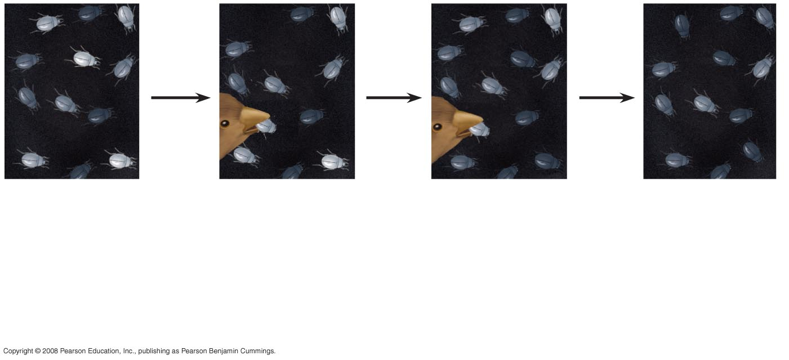
Fig. 1-20
1
Population
with varied
inherited traits.
2
Elimination
of individuals
with certain
traits.
3
Reproduction
of survivors.
4
Increasing
frequency
of traits that enhance survival and reproductive success.
Notes:
Figure 1.20 Natural selection

Slide 52
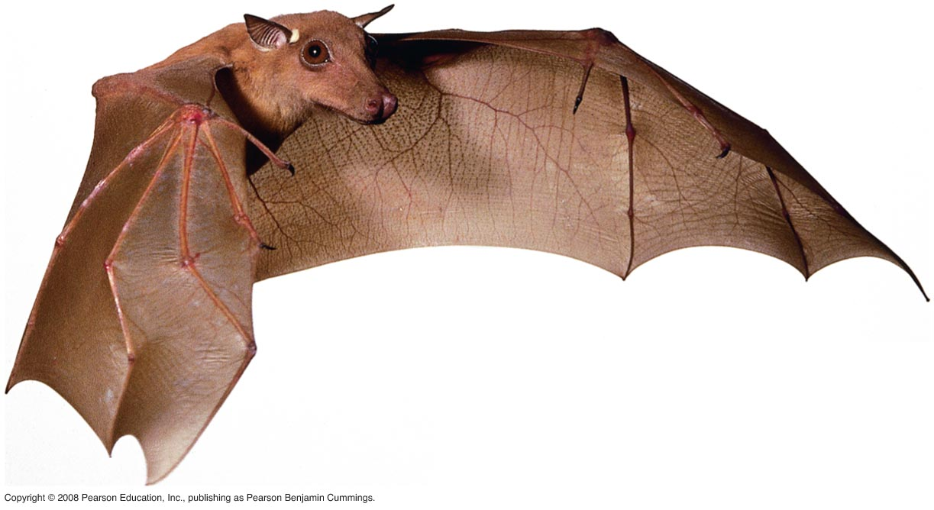

Natural selection is often evident in adaptations of organisms to their way of life and environment
Bat wings are an example of adaptation
Video: Soaring Hawk
Copyright © 2008 Pearson Education, Inc., publishing as Pearson Benjamin Cummings

Slide 53
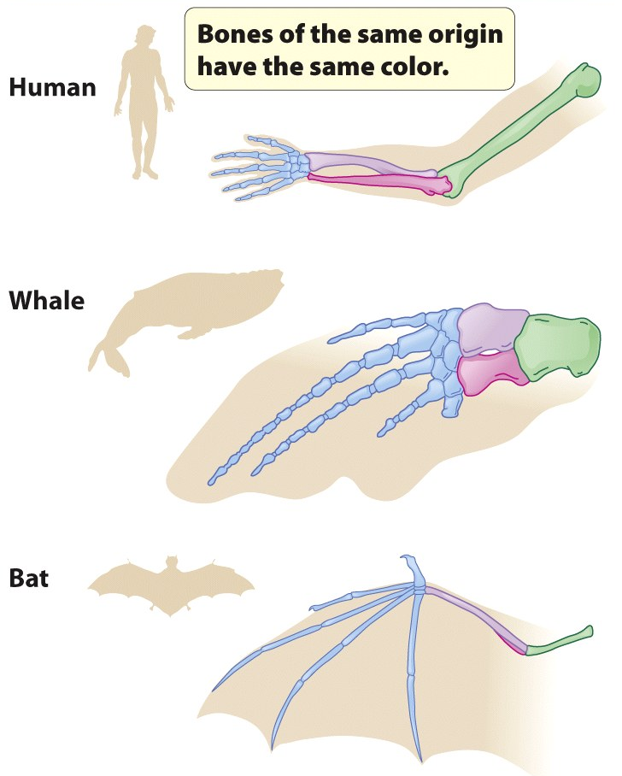
The Tree of Life
“Unity in diversity” arises from “descent with modification”
All mammals have a similar limb skeleton
Fossils provide additional evidence of anatomical unity from descent with modification
Copyright © 2008 Pearson Education, Inc., publishing as Pearson Benjamin Cummings

Slide 54
Darwin proposed that natural selection could cause an ancestral species to give rise to two or more descendent species
  For example, the finch species of the Galápagos Islands
Evolutionary relationships are often illustrated with tree-like diagrams that show ancestors and their descendents
Copyright © 2008 Pearson Education, Inc., publishing as Pearson Benjamin Cummings

Slide 55
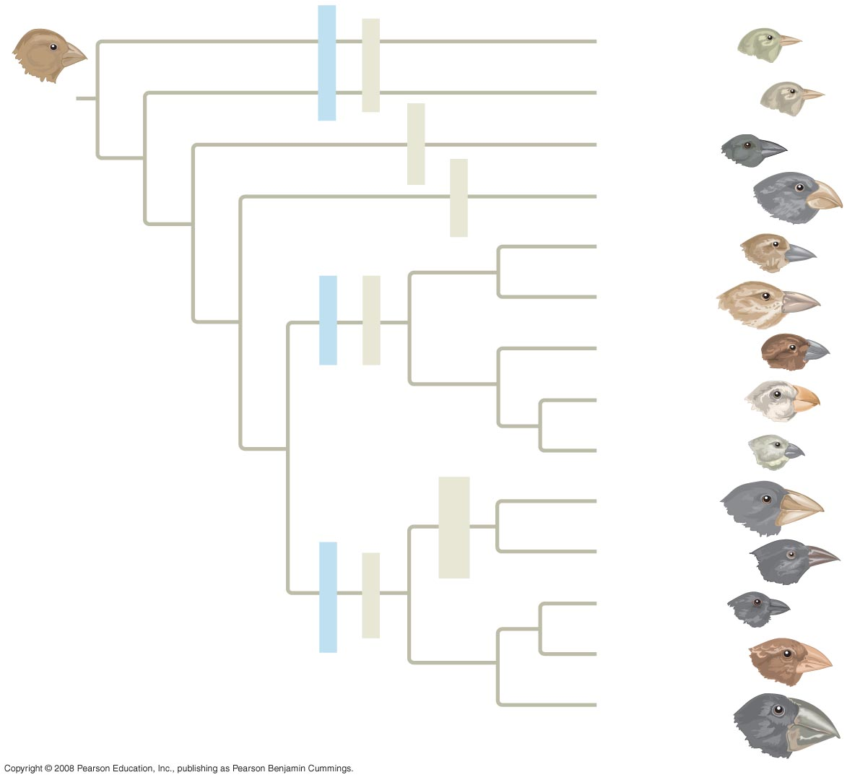
Fig. 1-22
Green warbler finch Certhidea olivacea
Warbler finches
Insect-eaters
COMMON
ANCESTOR
Gray warbler finch Certhidea fusca
Seed-eater
Sharp-beaked
ground finch Geospiza difficilis
Bud-eater
Vegetarian finch Platyspiza crassirostris
Mangrove finch Cactospiza heliobates
Woodpecker finch Cactospiza pallida
Tree finches
Insect-eaters
Medium tree finch Camarhynchus pauper
Large tree finch Camarhynchus psittacula
Small tree finch Camarhynchus parvulus
Large cactus
ground finch
Geospiza conirostris
Cactus-flower-eaters
Cactus ground finch
Geospiza scandens
Seed-eaters
Ground finches
Small ground finch
Geospiza fuliginosa
Medium ground finch
Geospiza fortis
Large ground finch
Geospiza magnirostris
Notes:
Figure 1.22 Descent with modification: adaptive radiation of finches on the Galápagos Islands

Slide 56
Video: Albatross Courtship Ritual
Video: Blue-footed Boobies Courtship Ritual
Video: Galápagos Islands Overview
Video: Galápagos Marine Iguana
Video: Galápagos Sea Lion
Video: Galápagos Tortoise
Copyright © 2008 Pearson Education, Inc., publishing as Pearson Benjamin Cummings

Slide 57
Concept 1.3: doing science - 2 methods
The word Science is derived from Latin and means “to know”
Inquiry is the search for information and explanation
There are two main types of scientific inquiry: discovery science and hypothesis-based science
Copyright © 2008 Pearson Education, Inc., publishing as Pearson Benjamin Cummings

Slide 58
Discovery Science
Discovery science describes natural structures and processes
This approach is based on observation and the analysis of data
Looking at stuff and writing down what you see
Copyright © 2008 Pearson Education, Inc., publishing as Pearson Benjamin Cummings

Slide 59
Types of Data
Data are recorded observations or items of information
Data fall into two categories
  Qualitative, or descriptions rather than measurements
  Quantitative, or recorded measurements, which are sometimes organized into tables and graphs
Copyright © 2008 Pearson Education, Inc., publishing as Pearson Benjamin Cummings

Slide 60
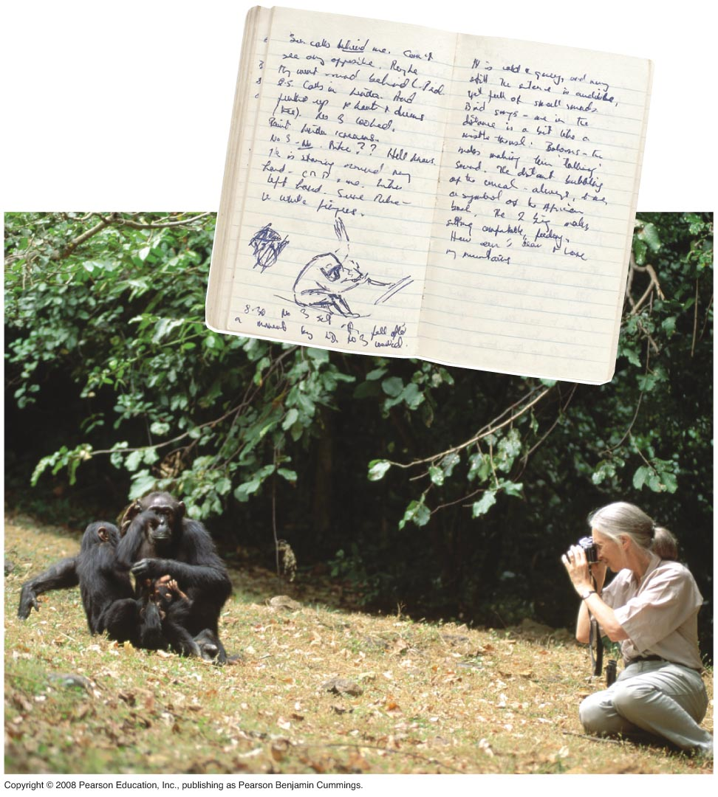
Fig. 1-23
Notes:
Figure 1.23 Jane Goodall collecting qualitative data on chimpanzee behavior

Slide 61
Induction in Discovery Science
Inductive reasoning draws conclusions through the logical process of induction
Repeat specific observations can lead to important generalizations
  For example, “the sun always rises in the east”
Copyright © 2008 Pearson Education, Inc., publishing as Pearson Benjamin Cummings

Slide 62
Hypothesis-Based Science
Observations can lead us to ask questions and propose hypothetical explanations called hypotheses
Copyright © 2008 Pearson Education, Inc., publishing as Pearson Benjamin Cummings

Slide 63
The Role of Hypotheses in Inquiry
A hypothesis is a tentative answer to a well-framed question
A scientific hypothesis leads to predictions that can be tested by observation or experimentation
Copyright © 2008 Pearson Education, Inc., publishing as Pearson Benjamin Cummings

Slide 64
For example,
  Observation: Your flashlight doesn’t work
  Question: Why doesn’t your flashlight work?
  Hypothesis 1: The batteries are dead
  Hypothesis 2: The bulb is burnt out
Both these hypotheses are testable
Copyright © 2008 Pearson Education, Inc., publishing as Pearson Benjamin Cummings

Slide 65
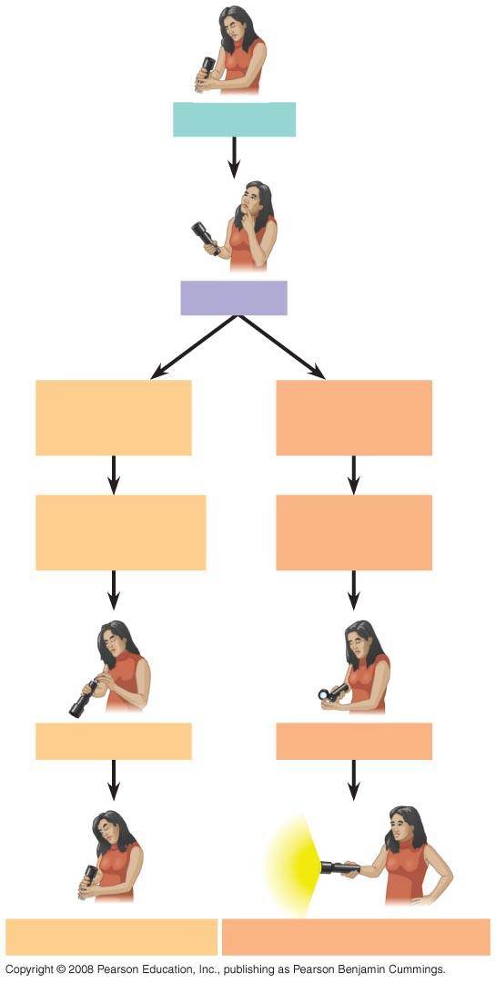
Fig. 1-24
Observations
Question
Hypothesis #1:
Dead batteries
Hypothesis #2:
Burnt-out bulb
Prediction:
Replacing batteries
will fix problem
Prediction:
Replacing bulb
will fix problem
Test prediction
Test prediction
Test falsifies hypothesis
Test does not falsify hypothesis
Notes:
Figure 1.24 A campground example of hypothesis-based inquiry

Slide 66
Deduction: The “If…Then” Logic of Hypothesis Based Science
Deductive reasoning uses general premises to make specific predictions
For example, if organisms are made of cells (premise 1), and humans are organisms (premise 2), then humans are composed of cells (deductive prediction)
Copyright © 2008 Pearson Education, Inc., publishing as Pearson Benjamin Cummings

Slide 67
Hypotheses in Scientific Inquiry
A hypothesis must be testable and falsifiable
Hypothesis-based science often makes use of two or more alternative hypotheses
Failure to falsify a hypothesis does not prove that hypothesis
  For example, you replace your flashlight bulb, and it now works; this supports the hypothesis that your bulb was burnt out, but does not prove it (perhaps the first bulb was inserted incorrectly)
Copyright © 2008 Pearson Education, Inc., publishing as Pearson Benjamin Cummings

Slide 68
The Myth of the Scientific Method
The scientific method is an idealized process of inquiry
Hypothesis-based science is based on the “textbook” scientific method but rarely follows all the ordered steps
Discovery science has made important contributions with very little dependence on the so-called scientific method
Copyright © 2008 Pearson Education, Inc., publishing as Pearson Benjamin Cummings

Slide 69
Case Study: Mimicry in Snake Populations
Many poisonous species are brightly colored, which warns potential predators
Mimics are harmless species that closely resemble poisonous species
Henry Bates hypothesized that this mimicry evolved in harmless species as an evolutionary adaptation that reduces their chances of being eaten
Copyright © 2008 Pearson Education, Inc., publishing as Pearson Benjamin Cummings

Slide 70
This hypothesis was tested with the poisonous eastern coral snake and its mimic the nonpoisonous scarlet kingsnake
Both species live in the Carolinas, but the kingsnake is also found in regions without poisonous coral snakes
If predators inherit an avoidance of the coral snake’s coloration, then the colorful kingsnake will be attacked less often in the regions where coral snakes are present
Copyright © 2008 Pearson Education, Inc., publishing as Pearson Benjamin Cummings

Slide 71
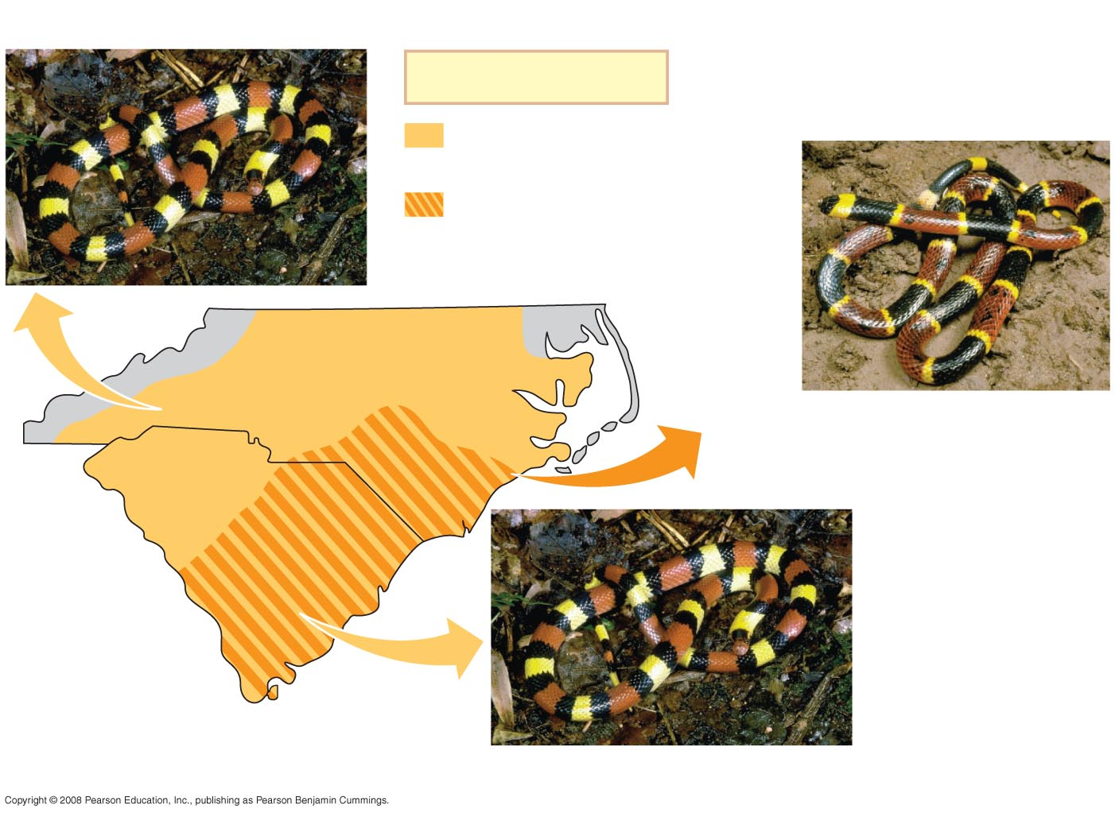
Fig. 1-25
Scarlet kingsnake (nonpoisonous)
Key
Range of scarlet
kingsnake only
Overlapping ranges of
scarlet kingsnake and
eastern coral snake
North Carolina
Eastern coral snake (poisonous)
South Carolina
Scarlet kingsnake (nonpoisonous)
Notes:
Figure 1.25 The geographic ranges of a poisonous snake and its mimic

Slide 72
Field Experiments with Artificial Snakes
To test this mimicry hypothesis, researchers made hundreds of artificial “snakes” from clay and wire:
  An experimental group resembling kingsnakes
  A control group resembling plain brown snakes
Equal numbers of both types were placed at field sites, including areas without poisonous coral snakes
Copyright © 2008 Pearson Education, Inc., publishing as Pearson Benjamin Cummings

Slide 73
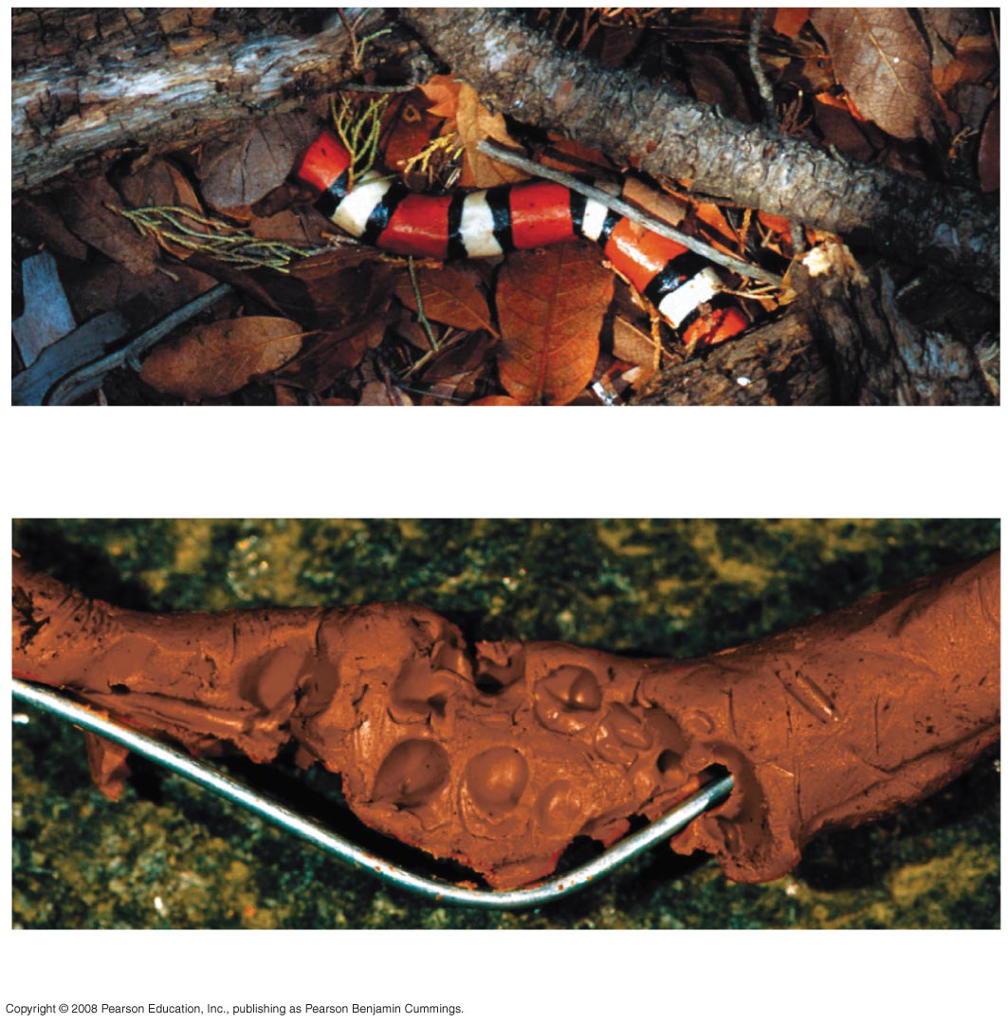
Fig. 1-26
(a) Artificial kingsnake
(b) Brown artificial snake that has been attacked
Notes:
Figure 1.26 Artificial snakes used in field experiments to test the mimicry hypothesis

Slide 74
After four weeks, the scientists retrieved the artificial snakes and counted bite or claw marks
The data fit the predictions of the mimicry hypothesis: the ringed “snakes” were attacked less frequently in the geographic region where coral snakes were found
Copyright © 2008 Pearson Education, Inc., publishing as Pearson Benjamin Cummings

Slide 75
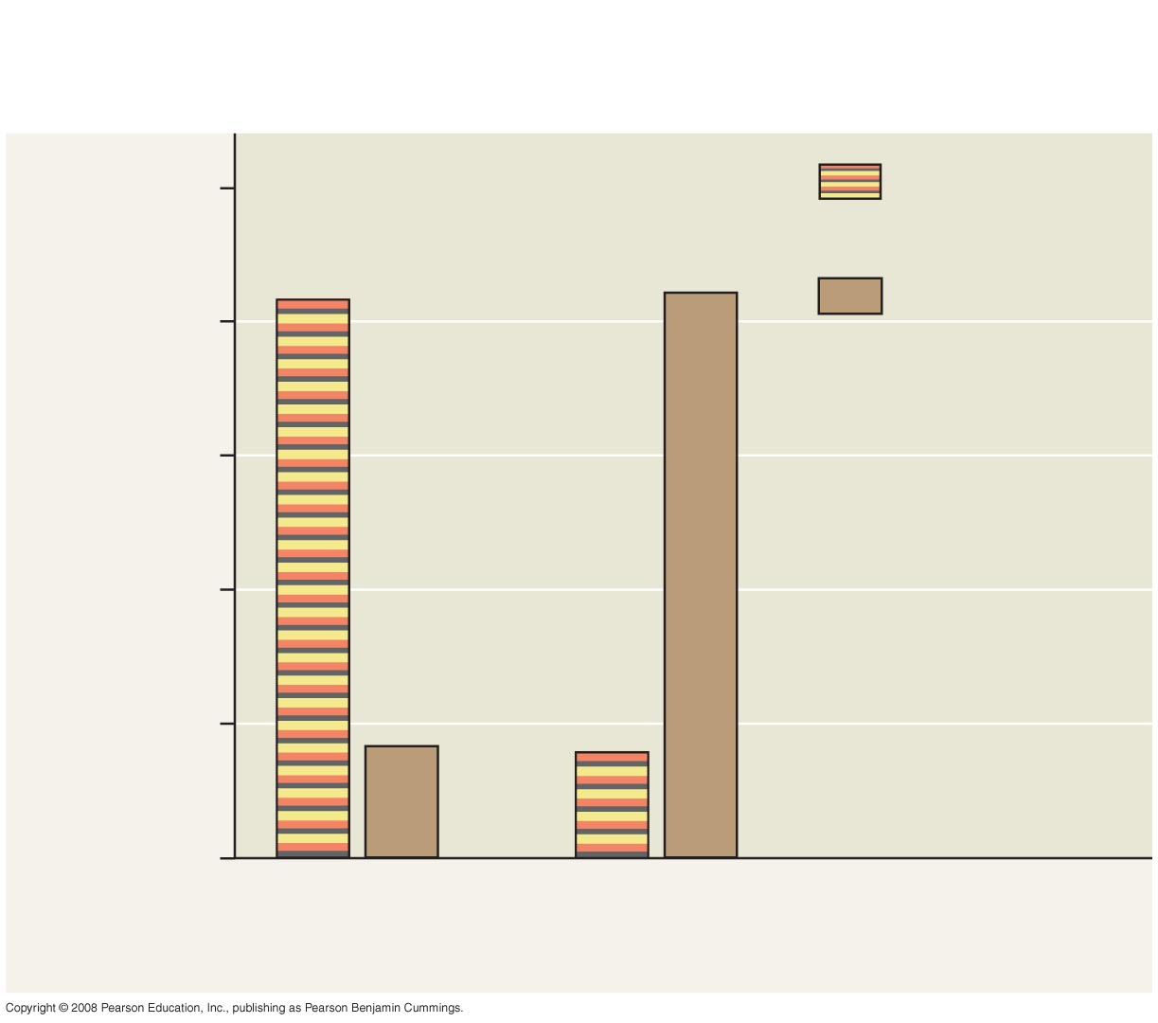
Fig. 1-27
RESULTS
100
Artificial kingsnakes
83%
84%
Brown
artificial snakes
80
60
Percent of total attacks
on artificial snakes
40
20
17%
16%
0
Coral snakes
absent
Coral snakes
present
Notes:
Figure 1.27 Does the presence of poisonous coral snakes affect predation rates on their mimics, kingsnakes?

Slide 76
Designing Controlled Experiments
A controlled experiment compares an experimental group (the artificial kingsnakes) with a control group (the artificial brown snakes)
Ideally, only the variable of interest (the color pattern of the artificial snakes) differs between the control and experimental groups
A controlled experiment means that control groups are used to cancel the effects of unwanted variables
A controlled experiment does not mean that all unwanted variables are kept constant
Copyright © 2008 Pearson Education, Inc., publishing as Pearson Benjamin Cummings

Slide 77
Limitations of Science
In science, observations and experimental results must be repeatable
Science cannot support or falsify supernatural explanations, which are outside the bounds of science
Copyright © 2008 Pearson Education, Inc., publishing as Pearson Benjamin Cummings

Slide 78
Theories in Science
In the context of science, a theory is:
  Broader in scope than a hypothesis
  General, and can lead to new testable hypotheses
  Supported by a large body of evidence in comparison to a hypothesis
  Hypothesis do NOT become theories!!!
Copyright © 2008 Pearson Education, Inc., publishing as Pearson Benjamin Cummings

Slide 79
Model Building in Science
Models are representations of natural phenomena and can take the form of:
  Diagrams
  Three-dimensional objects
  Computer programs
  Mathematical equations
Copyright © 2008 Pearson Education, Inc., publishing as Pearson Benjamin Cummings

Slide 80
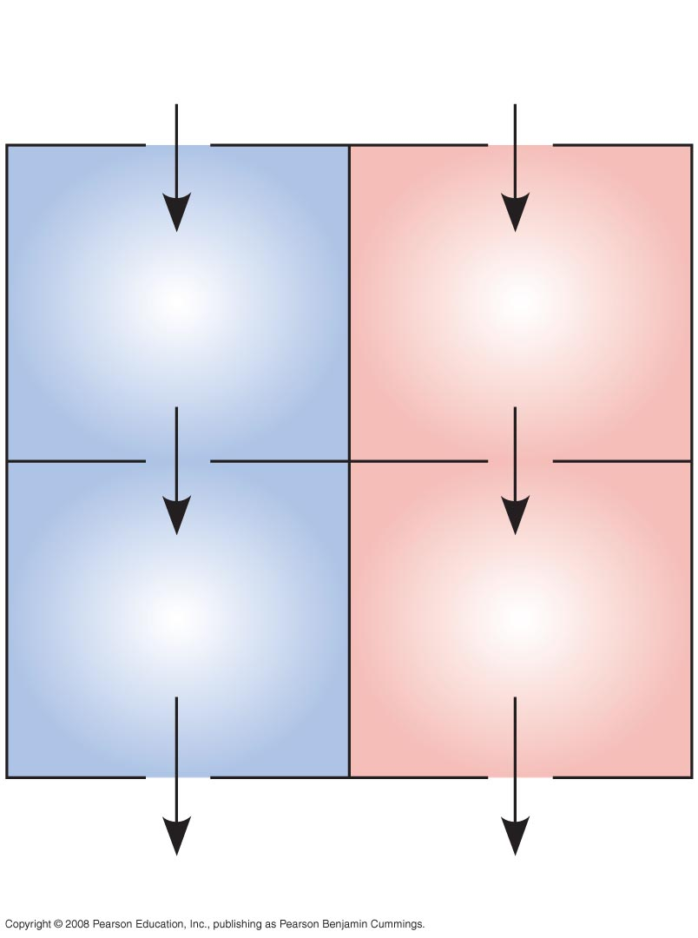
Fig. 1-28
From
body
From
lungs
Right
atrium
Left
atrium
Right
ventricle
Left
ventricle
To lungs
To body
Notes:
Figure 1.28 A model of the blood flow through the four chambers of a human heart

Slide 81
The Culture of Science
scientists usually work in teams
some team members can be graduate or undergraduate students
Scientists want to share their ideas & results
seminars, publications, and websites
Copyright © 2008 Pearson Education, Inc., publishing as Pearson Benjamin Cummings

Slide 82
Science, Technology, and Society
Science: trying to understand natural world
Technology: using information from science for a specific purpose
Science and technology are interdependent
Biology is marked by “discoveries,” while technology is marked by “inventions”
Copyright © 2008 Pearson Education, Inc., publishing as Pearson Benjamin Cummings

Slide 83
Science ⬅➔Techology
The combination of science and technology has dramatic effects on society
  For example, the discovery of DNA by James Watson and Francis Crick allowed for advances in DNA technology such as testing for hereditary diseases
Ethical issues can arise from new technology, but have as much to do with politics, economics, and cultural values as with science and technology
Copyright © 2008 Pearson Education, Inc., publishing as Pearson Benjamin Cummings

Slide 84
You should now be able to:
Briefly describe the unifying themes that characterize the biological sciences
Distinguish among the three domains of life, and the eukaryotic kingdoms
Distinguish between the following pairs of terms: discovery science and hypothesis-based science, quantitative and qualitative data, inductive and deductive reasoning, science and technology
Copyright © 2008 Pearson Education, Inc., publishing as Pearson Benjamin Cummings

Slide 85
Not Happy with your grade?
Not understanding the material?
Remember that the TLCC has
Free Biology Tutoring
Notes:
Figure 1.1 What properties of life are demonstrated in this flower?

